Slide 1

Lecture 11: React for JavaScript
05-431/631 Software Structures for User Interfaces (SSUI)
Fall, 2021

Slide 2
Logistics
Homework 3 due today
Start on Homework 4
Have more than 2 weeks – Due October 21
But don’t wait until the last minute
At least make sure you can create a React project early
Set up can be tricky
Basic React knowledge may be on the midterm
Clara will have a React session on Saturday at 1:00-3:00pm, room NSH 3001 or Zoom (link on Canvas or in your email)
Midterm is the middle of HW4: October 13, 2021
1 week from today
24 hours, take home open book
Midterm information has been posted on the course website
Midterm grade will be homeworks 1-3 and midterm
Mid-Semester Grades Due on 10/18/2021

Slide 3


What is React
https://reactjs.org/
“A JavaScript library for building user interfaces”
Created by Facebook and actively used and supported by them
Goal: be more declarative, like original html and CSS
As opposed to imperative like JavaScript
React handles updating and redrawing as data changes
Still need input handlers
New way to write html with computed parameters = JSX
Build reusable, encapsulated components
E.g., header and footer
React can also be used “native” to make Android and iOS apps

Slide 4
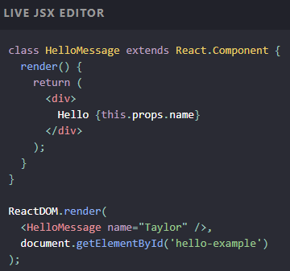
Key Concepts
JSX – yet another syntax for html
Almost like regular html, but some differences
Yet another syntax for comments: {\* comment *\}
Compute elements based on props
Computed and returned by render() methods
CSS classes called className
States – dynamic data
Note: totally different from state-transition-diagrams
Store values as JS objects
DOM updated when state’s values change

Slide 5
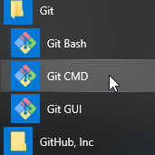
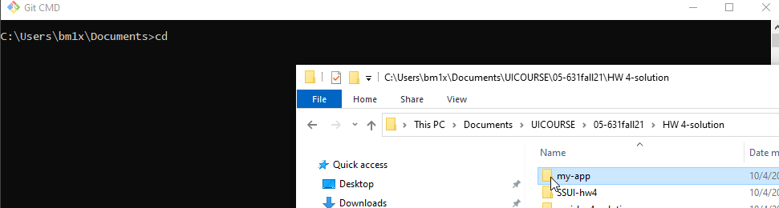
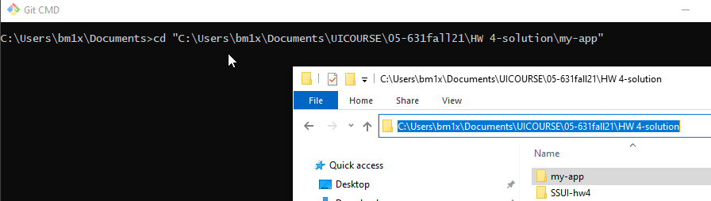
Getting Started
You probably already have Git installed, but if not: https://git-scm.com/book/en/v2/Getting-Started-Installing-Git
Download node.js and npm: https://nodejs.org/en/
I am using version 14.18.0
Now can bring up a console and type npm or npx
I am using the Git CMD console that comes with the Git download
Follow these instructions for getting started with React
https://create-react-app.dev/docs/getting-started#quick-start
cd into the code folder (expert hint: use drag-and-drop – see below)
C:\Users\bm1x\Documents> cd C:\Users\bm1x\Documents\UICOURSE\05-631fall21\HW 4-solution
C:\Users\bm1x\Documents\UICOURSE\05-631fall21\HW 4-solution> npx create-react-app my-app C:\Users\bm1x\Documents\UICOURSE\05-631fall21\HW 4-solution> cd my-app
C:\Users\bm1x\Documents\UICOURSE\05-631fall21\HW 4-solution> npm start
Will open new tab in browser running the app.
Can edit App.js and changes will be shown immediately on save
Stop with ^C in cmd window, or close tab, or close cmd window

Slide 6
Extra resources for getting started
https://reactjs.org/docs/create-a-new-react-app.html
https://docs.npmjs.com/downloading-and-installing-node-js-and-npm
W3Schools intro on how to get started with React dev: https://www.w3schools.com/react/react_getstarted.asp
Thanks to Michael Liu and Clara also for help with these slides!

Slide 7
Learning React
Can’t cover it in one lecture
You are responsible for learning React by yourself
Lots of great material out there to learn from
Lots of Stack Overflow answers that cover most problems
eCommerce websites are exactly its target application
HW4 write up includes an example app from Michael Liu that is similar to HW4: SSUI-Star-Wars
How to deploy React+Router app to Netlify from GitHub: https://dev.to/easybuoy/deploying-react-app-from-github-to-netlify-3a9j

Slide 8
JavaScript features heavily used by React
Might want to review these features!
export and import
React uses lots of files and need to control namespaces
spread and rest operator: . . .
Flatten an array or object in place
const newArray = [...oldArray, 1, 2, 3]; const newObject = {...oldObject, newProp: 'Jason'} function sortNumbers(...args) { } //args is an array of the parameters
Destructuring – assign variables using same name let {name, loc} = func(); // returns object with name: and loc: fields

Slide 9
Useful JavaScript array functions
ar1.map(fn) – returns a new array of calling fn on each element of ar1 const doubleNumArray = numbers.map(num => num * 2);
ar2.filter(fn) – returns a new array containing the elements of ar2 that when passed to fn return true const result = words.filter(word => word.length > 6);

Slide 10
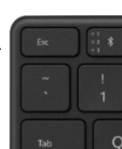
Backquote (“backtick”) operator
Called “template literals”, ref: https://developer.mozilla.org/en-US/docs/Web/JavaScript/Reference/Template_literals
Creates a string, where elements in ${} are evaluated
document.title = `You clicked ${count} times`;
Same as: "You clicked " + count + " times";
Can also include newlines: `string text line 1 string text line 2` is the same as: 'string text line 1\n' + 'string text line 2'

Slide 11
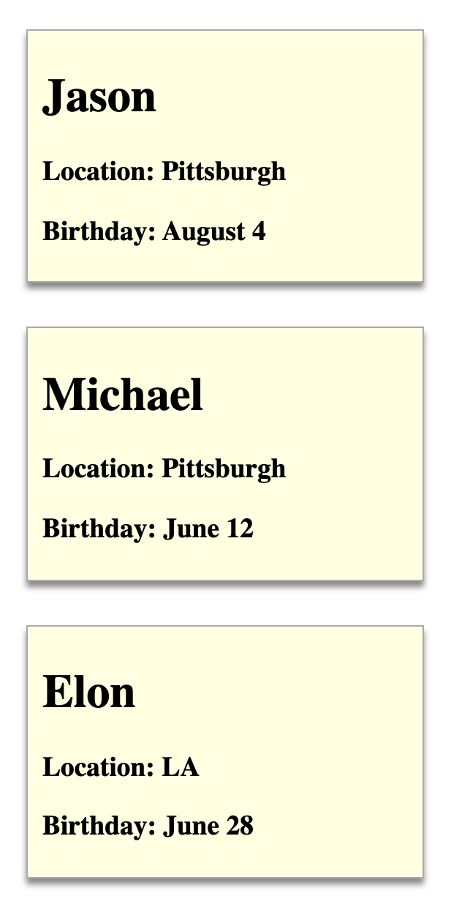
React Components
Elements of the web page
Styled with regular CSS
Defined using jsx:
Use “className” for CSS classes
const Person = (props) => {
const {name, location, birthday} = props
return (
<div className="person">
<h1>{name}</h1>
<h3>Location: {location}</h3>
<h3>Birthday: {birthday}</h3>
</div>
)
}
ReactDOM.render(<Person name={"Jason"} location={"Pittsburgh"} birthday={"August 4"}/>, document.querySelector('#p1'))
ReactDOM.render(<Person name={"Michael"} location={"Pittsburgh"} birthday={"June 12"}/>, document.querySelector('#p2'))
ReactDOM.render(<Person name={"Elon"} location={"LA"} birthday={"June 28"}/>, document.querySelector('#p3'))
<div id="p1"></div>
<div id="p2"></div>
<div id="p3"></div>
.person {
margin: 10px;
border: 1px solid #aaa;
background-color: lightyellow;
padding: 5px 10px;
width: 250px;
box-shadow: 0 4px 4px #888;
margin: 30px 20px;
}

Slide 12


React is Client Side
Compiled into pure JavaScript
But uses lots of libraries
npm to manage everything for you
https://www.npmjs.com/
Originally: Node Package Manager
Command line interface
Requires using a server on your machine
Automatically recompiles when edit code
Start with React create-react-app

Slide 13
Structure of our React apps
index.html just contains <div id="root"></div>
index.js connects the app component to it:
ReactDOM.render(
<React.StrictMode>
<App />
</React.StrictMode>,
document.getElementById('root')
);
Always need a “render” method at each level
Takes function that returns contents (App) and where to put it (‘root’)
App.js – contains the content of the app by importing all the components

Slide 14
Create components
React components: custom HTML elements that can be used to construct a web app
Create your elements
One React app typically only has ONE root component. In our case, it’s the App component.
Nest all the other components in the root (App) component => a tree of components
Can use <div> like usual <div className="App"> xxx <img src xxx /> <p> xxx </p> </div>
Each component needs to return/ render some JSX code - it defines which HTML code React should render to the DOM in the end
Instead of constructor, React classes have a render() method

Slide 15
React Router
Support multiple pages with same header/footer
react-router-dom – allows switch among different content
const app = () => {
return (
<div className="App">
<NavBar />
<div className="MainContent">
<Switch>
<Route exact path={appRoutes.home}>
<HomePage />
</Route>
<Route exact path={appRoutes.characters}>
<CharactersPage />
</Route>
<Route exact path={appRoutes.character}>
<CharacterPage />
</Route>
<Redirect to={appRoutes.home} />
</Switch>
</div>
<Footer />
</div>
);
}; export default app;
Looks like html
References regular CSS classes as “className”
Content in { } executed so computed

Slide 16
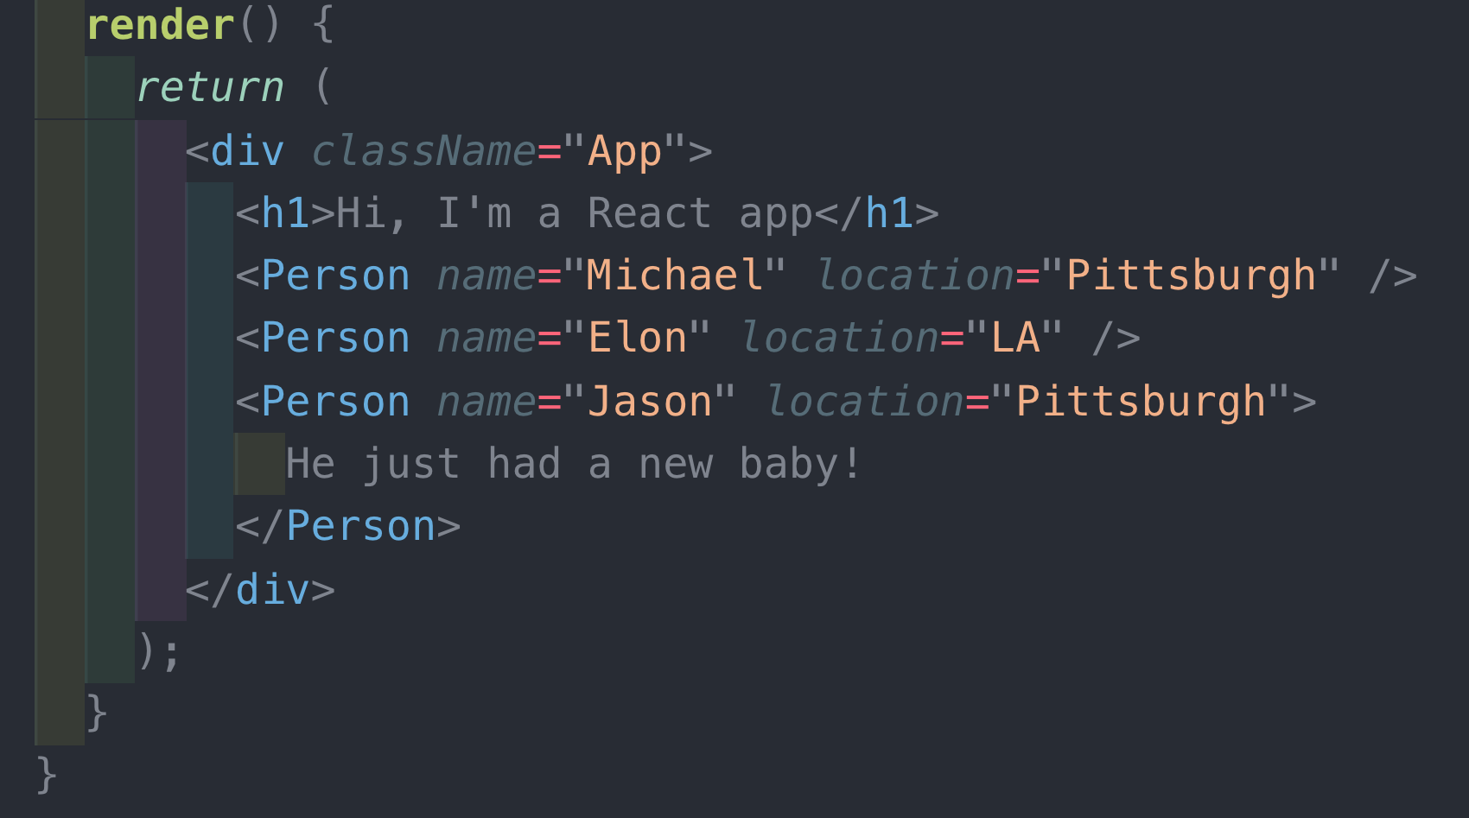
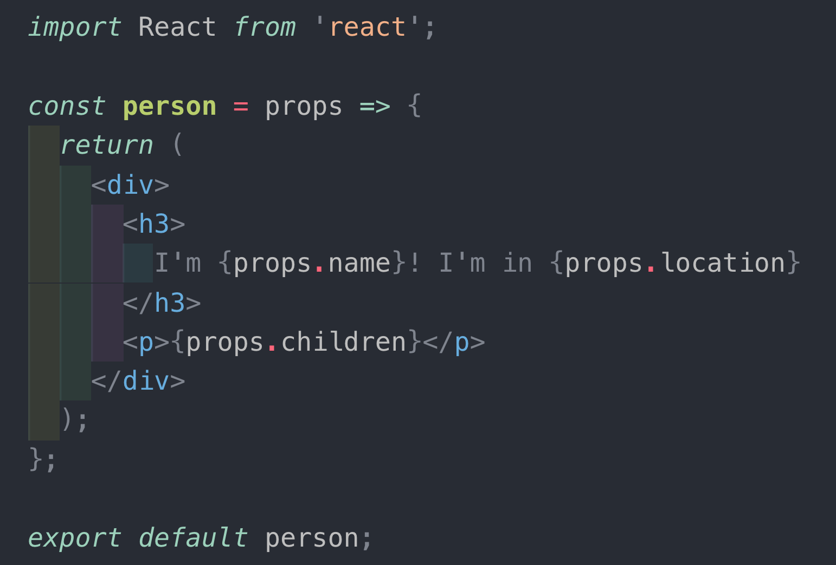
Dynamic Contents: Props and State
Props – variable that holds attributes to be used
Passed down hierarchy – parent to child

Slide 17
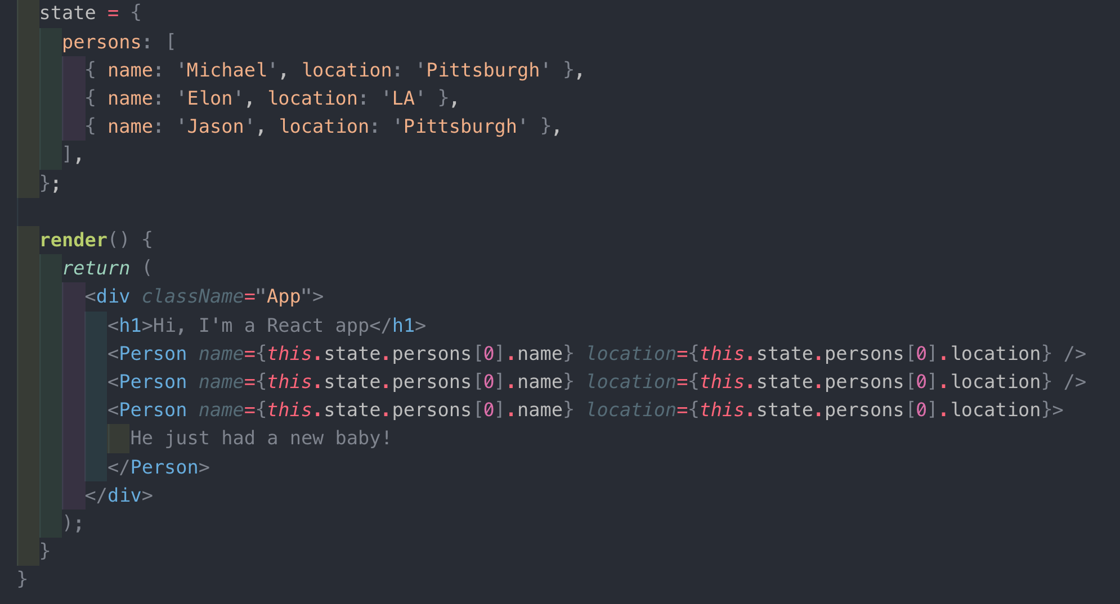
Dynamic Contents: Props and State
State: Variables that change, causing redisplay
Note: not MVC model with listener pattern
Shared variables instead
Both props and state are JavaScript objects
attribute-value pairs

Slide 18
this.setState or useState
Use this.setState to change state if using classes
Cannot update state directly
Challenging when state is data structure
Or const [count, setCount] = useState(0); if using hooks (see below)
So React knows to calculate what to redisplay
Minimize the number of states
Calculate props (attributes) based on state

Slide 19
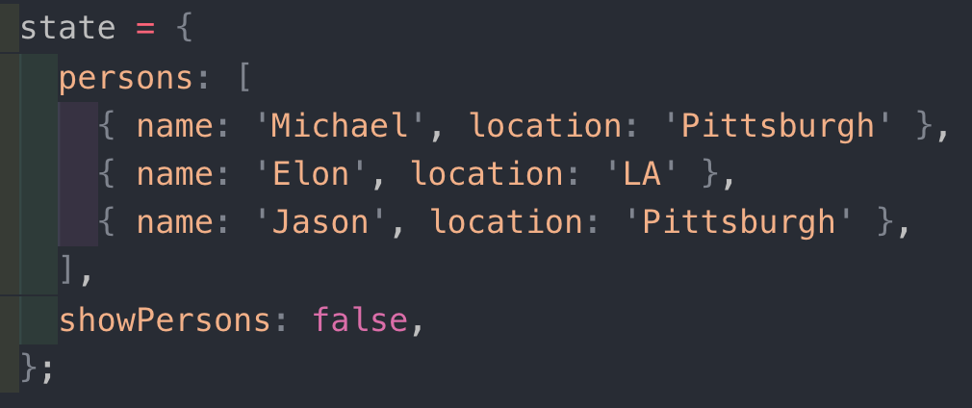
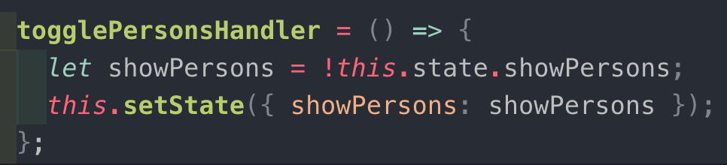
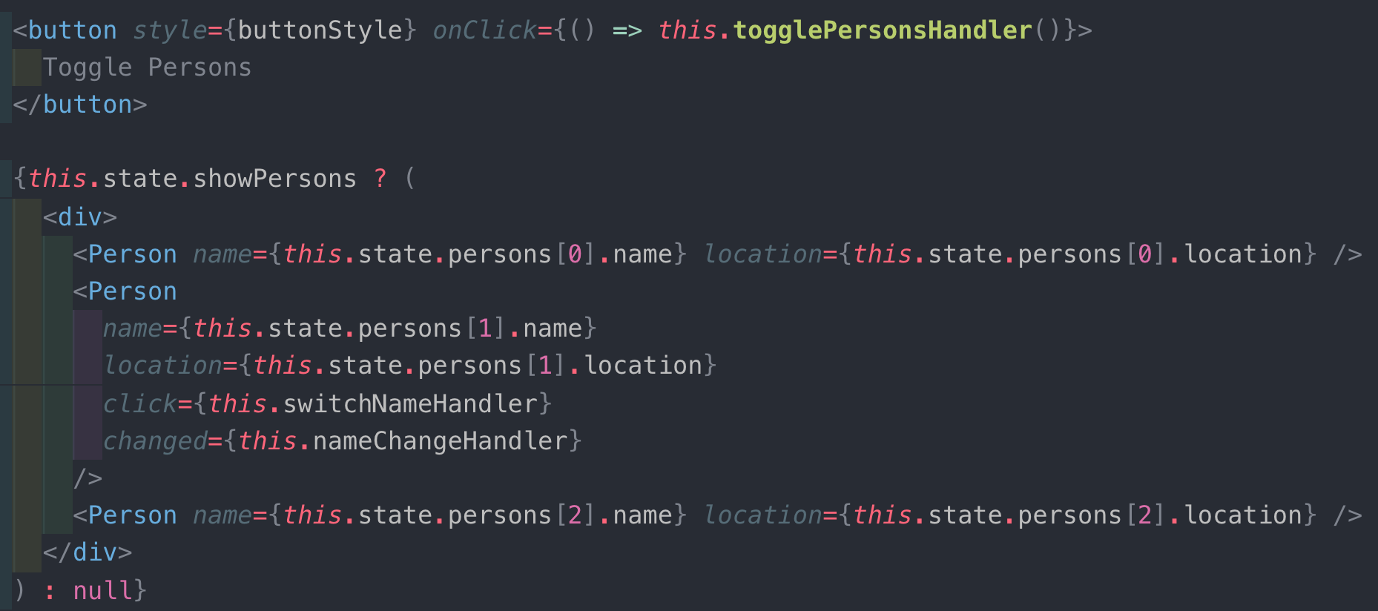
Conditional rendering
Can use ternary to compute contents, typically based on state
null causes nothing to be displayed
Can just compute contents
True means it will get rendered
Same as ternary but…
&& instead of ?
Null need not be specified

Slide 20
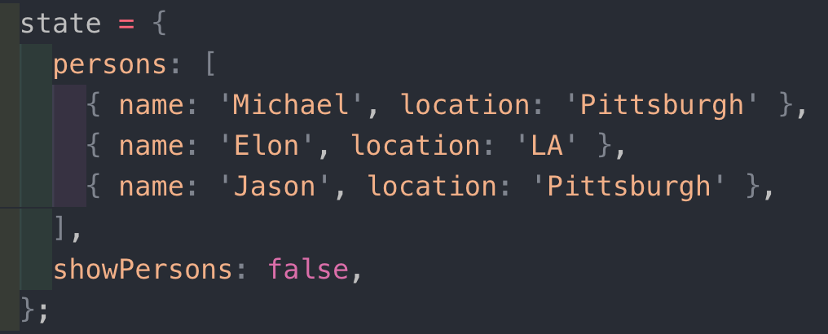
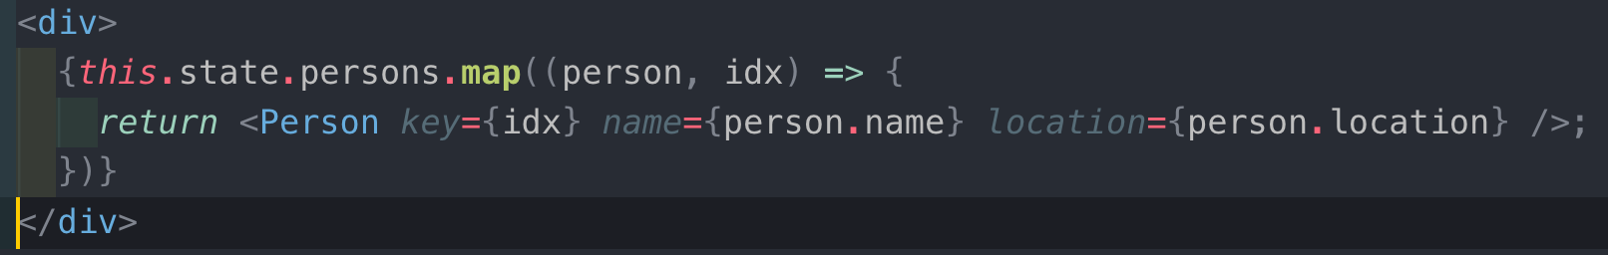
Rendering Lists
Use map() to return jsx from data list
Don’t forget the “key” attribute -- needed for efficient redisplay
Must be unique within the list
Should be “stable” wrt the element
React uses it to compute what has changed

Slide 21
React Hooks
https://reactjs.org/docs/hooks-intro.html
Added in React 16.8 released February 2019
Replaces need to define new classes
“Hooks are functions that let you “hook into” React state and lifecycle features from function components.”
Simpler way to assign and access state variables
State hook and Effects Hook
Historical note: “hooks” date at least back to the 1970s
E.g., Emacs hooks – functions you can assign that will be run just before or after some important event happens

Slide 22
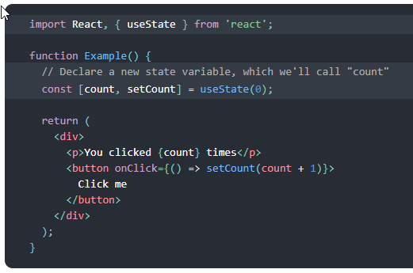
State Hook
useState is the state hook
Takes initial value of state
Returns: current value of state, and function to update it
count, setCount can be any pair of names
Values are remembered across executions

Slide 23
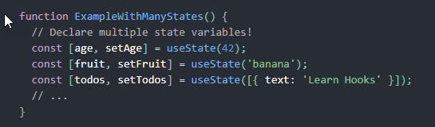
State Hook, cont.
Must be defined in top-level functions
Initial value can be a single value or object
If multiple useState() they must be in the same order everywhere
Can use any names
Be sure to put uses in {}so evaluated

Slide 24
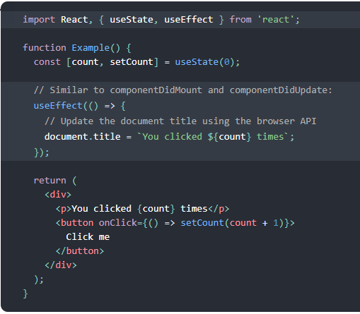
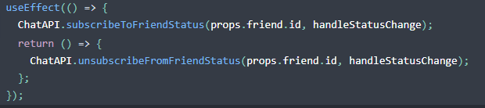
Effect Hook
Takes a function that will be called at a specific time
By default, after every render (including the first time)
Can perform side effects – updating external things
Can use state and other variables since inside the top-level function.
The function parameter can return another function to be used as cleanup
When the component “unmounts” (goes to another page)

Slide 25
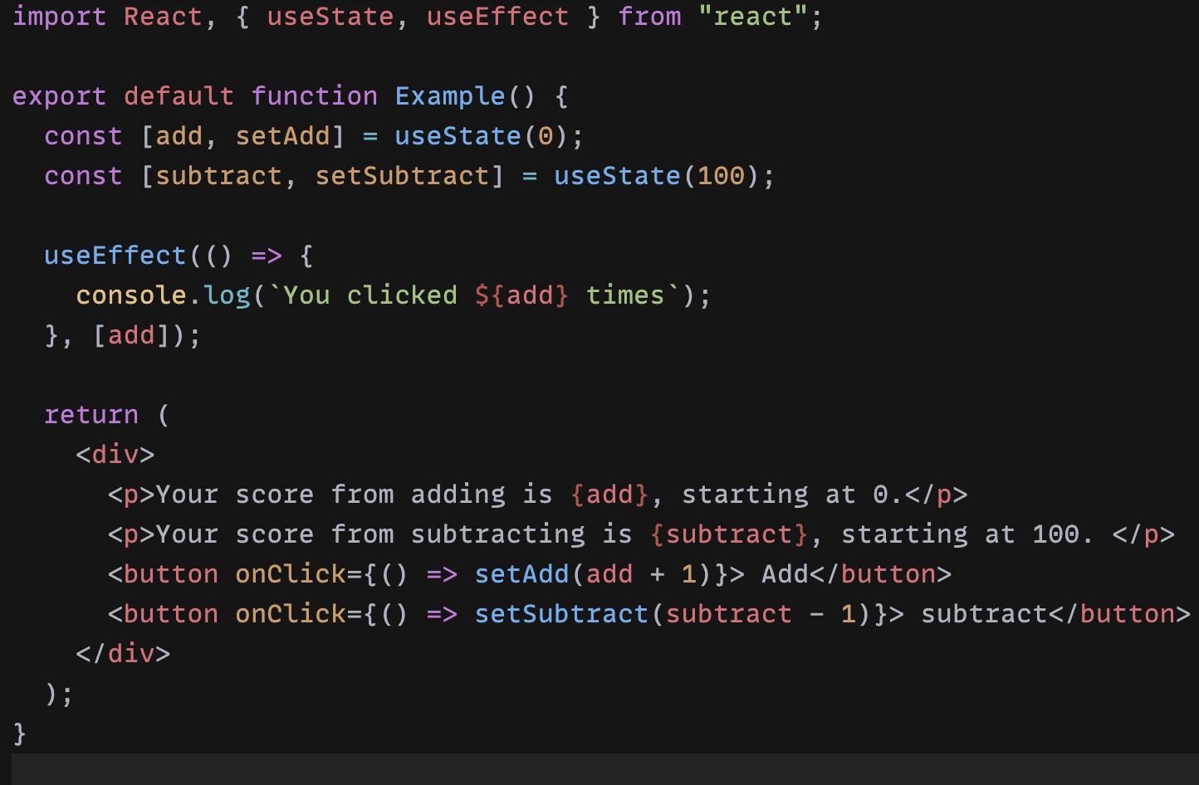
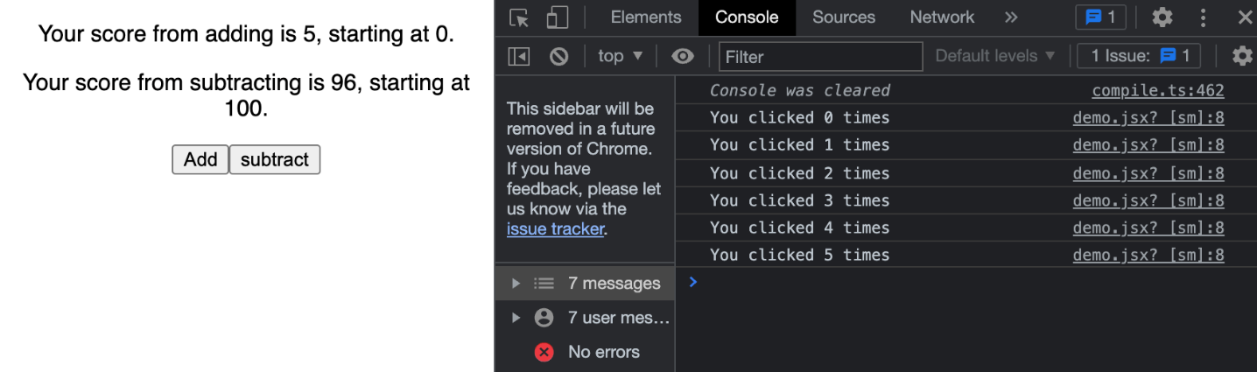
Effect Hook (another example)
useEffect() can take dependencies
Dependencies placed at in brackets at the end of function
Dependencies say that only when the specified variables change, will the app remount
Augment our current example, so that we have 2 state variables:
Only when add is updated, does it print to console

Slide 26
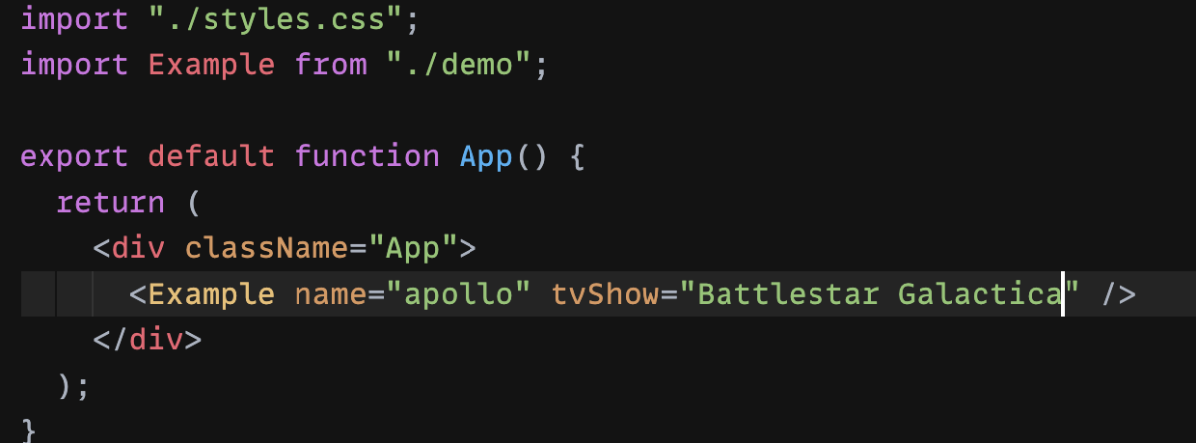
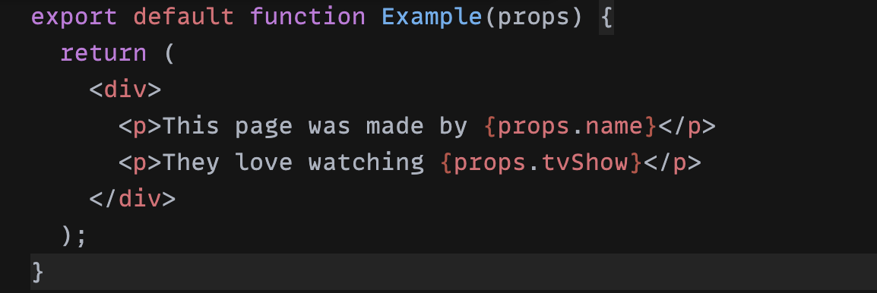
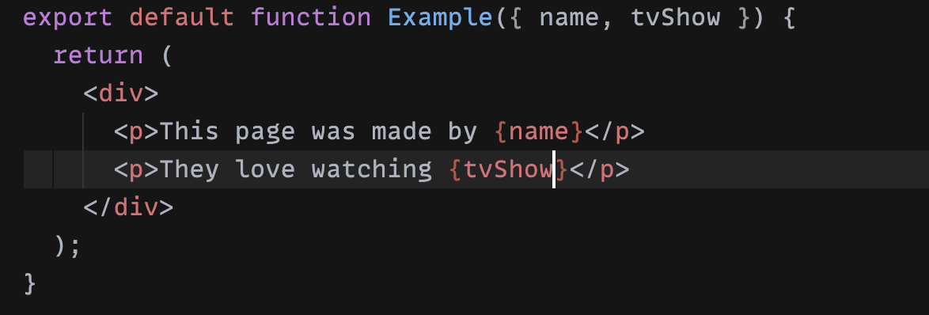
Props Hook
Props can be passed in 2 ways
Still will be passed in same way as class components [picture A]
Direct use of props (notice you no longer need “this” anymore) [picture B]
”this” is considered inherent
Object that contains parameters passed as props [picture C]
Separated by commas
A
B
C

Slide 27
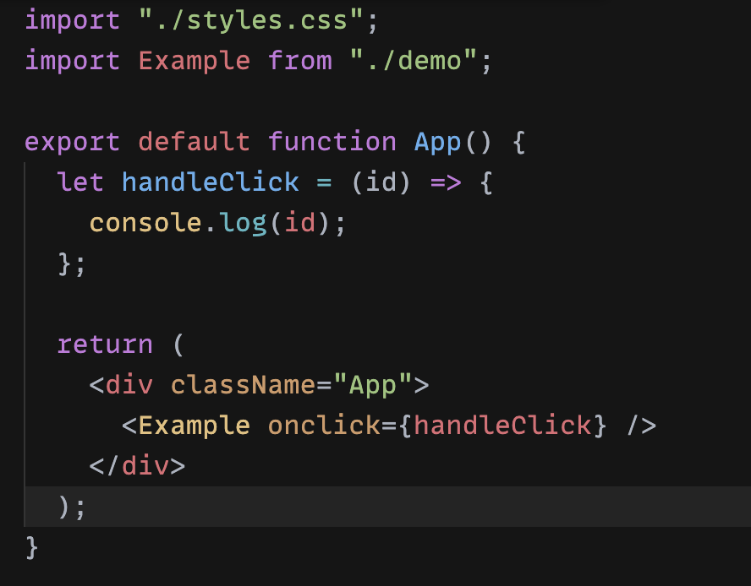
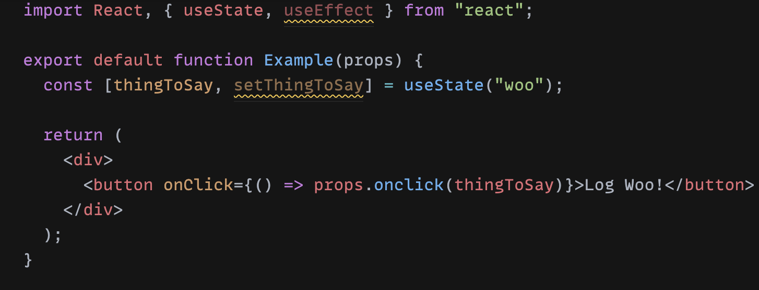
Passing function as props (in hooks)
This is the same example as the class component
Constructor not necessary
Automatic Binding (why “this” is not necessary either)
Child component does not need “this” either

Slide 28
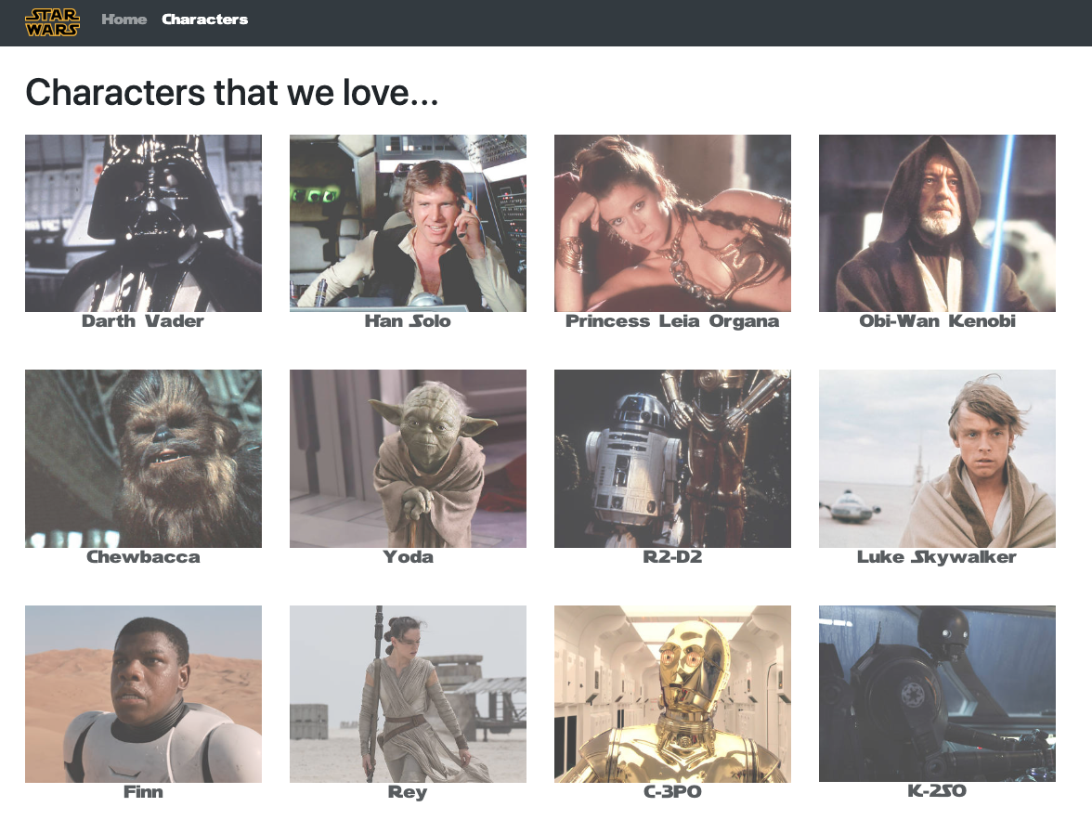
Michael Liu’s sample app
https://github.com/lxieyang/ssui-simple-react-app
https://ssui-star-wars.netlify.app/
Basic code structure
Component Reuse
Lists
Styling using Bootstrap
Routing
But doesn’t use states

