Slide 1
Lecture 10:
UI Implementation Concepts: Callbacks, Resources, Widget Hierarchies, Geometry Management
05-431/631 Software Structures for User Interfaces (SSUI)
Fall, 2021

Slide 2
Logistics
Class average on Homework 2: 93.25
  Very similar to HW 1
  Doesn’t count one very late turn-in

Slide 3
Widgets as objects
Many features of programming languages were added to support UI Toolkits
  Even Object-Oriented itself – from Smalltalk
Menus, buttons, scrollbars seem like objects
  Keep track of their own state
  Handle messages and updates
  Refresh themselves and handle input
  Redraw if change
In Unix: Motif and Tk each widget is at least one window
  Since windows already have mechanisms for mouse enter/leave, etc.
    But high overhead
  In most other toolkits, widgets are not windows
Decorative lines, labels and boxes also are "widgets“

Slide 4
Intrinsics
How the widgets are implemented
Original Mac toolbox (1984) - call GetNewMBar to create a menu, and then SetMenuBar to fill its items, followed by DrawMenuBar to actually display it
When “C” was the key language, people still wanted OO
  C++ (1982) had limitations and wasn’t available for free
  Unix Motif -- made a "fake" object system out of C, called Xt intrinsics
    Same in Andrew toolkit
  Tk -- Tcl language, and descendents
  Amulet – we created a new Prototype-instance object system, constraints, Opal graphics model, Interactors input model, command objects
Java (1996) – OO to fix some flaws in C++
  Make more reliable, also to be better for UIs
Raw html – some widgets built-in
  <input …>
  Buttons, menus, checkboxes, radio buttons, text input fields, …
JavaScript object model
  Very dynamic
  Became more like Java with introduction of Class in 2015

Slide 5
“Resources”
Starting from original Macintosh as “resource fork” – for language independence (& better memory management)
  All natural language strings and their positions in a separate file
Every parameter of widgets in Motif
  Passed as a parameter to the create routine, set afterwards, or read from a configuration file
Called "options" by Tk
Each resource has a default value defined by the class
In an X file =
appl.widget1.resource: value
appl.widget1.widget2.resource: value
*.resource: value
Many now use XML variants
  XAML language from Microsoft for .Net resources
    Extensible Application Markup Language

Slide 6
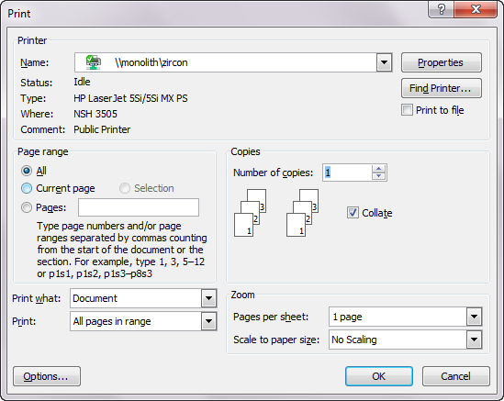
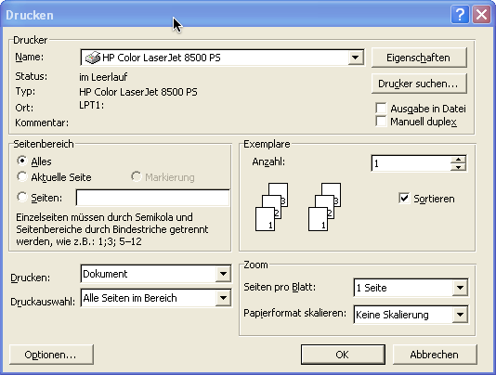
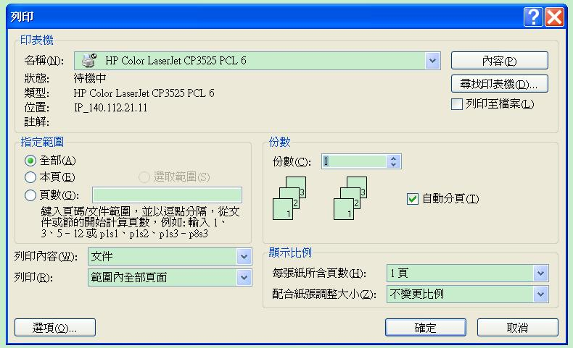
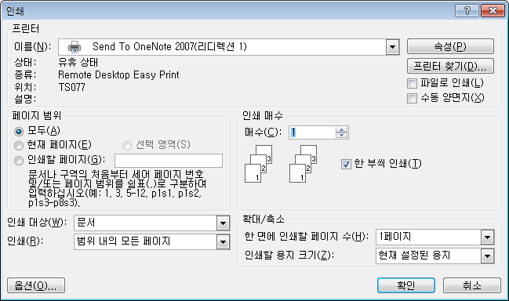
Dialog Box Layouts: Print

Slide 7
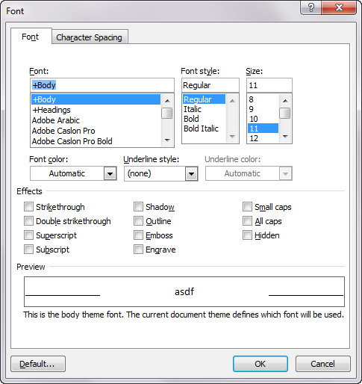
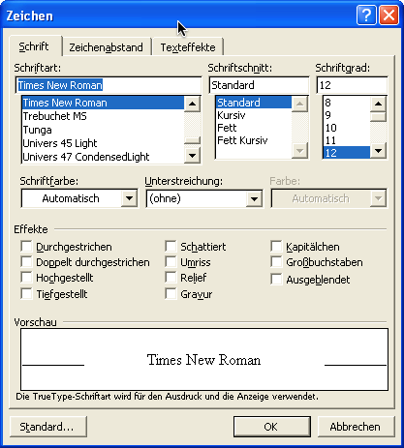
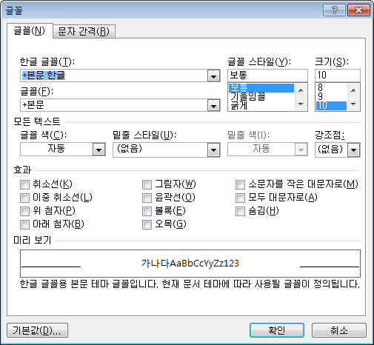
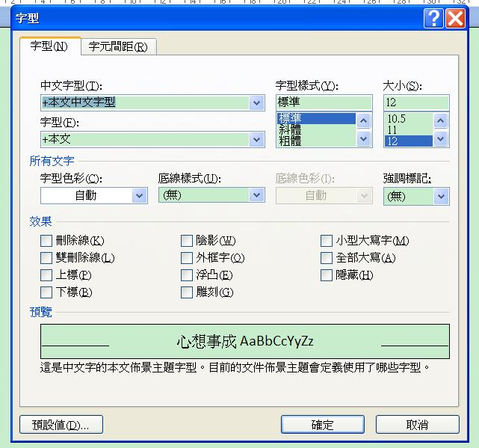
Dialog Box Layouts: Fonts

Slide 8
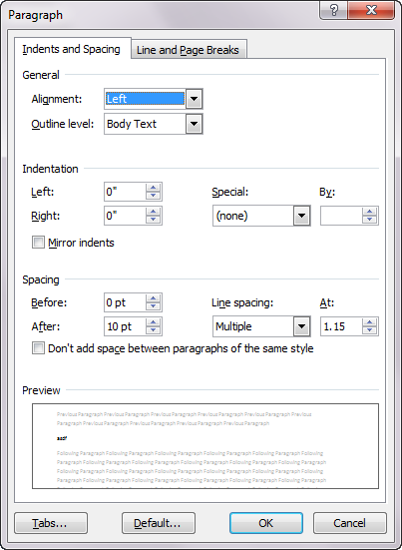
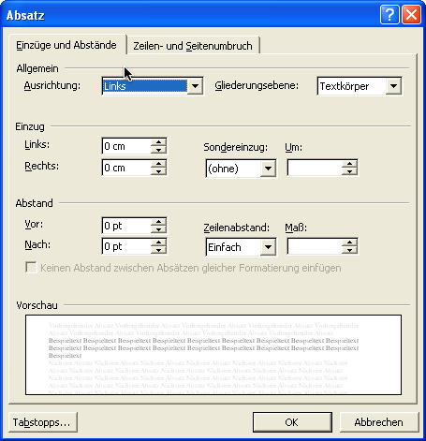
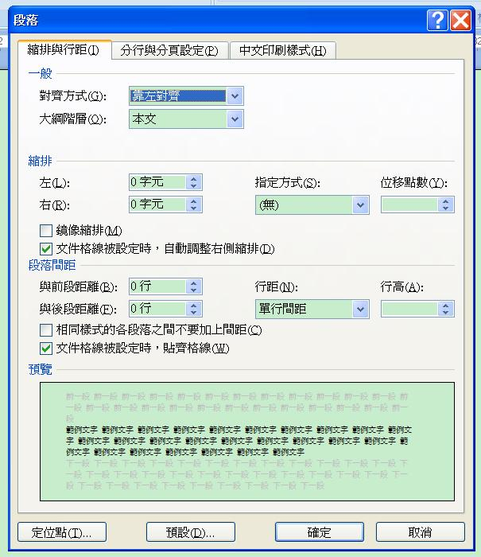
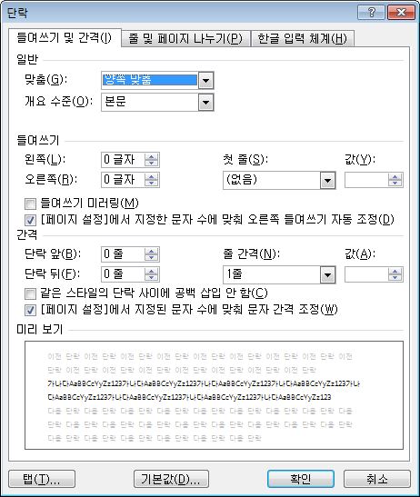
Dialog Box Layouts: Paragraph

Slide 9
Resources, cont.
Advantages
  Easier to change languages
  UI designer can do layout and wording
  Can give appropriate names to the IDs
  Easier for interactive editors to save to separate resource file
Disadvantages
  Not always a good separation
    E.g., when need whole new commands
    Right-to-left languages require code to be different
  Code is harder to write
    Have to keep looking up the IDs to use
  Code is harder to debug and understand
    Names don’t appear in the code, so hard to search for

Slide 10
Callbacks
In JavaScript – event handler functions
In Motif, associate C procedures with widgets
  Many different callbacks for the same widget
    create, start, abort, finish, destroy, ...
  Registered (set) at widget creation time, invoked at run time
  Are "resources"
  There are also "actions" which are internal to the widget and called by events
In VB, “event handlers”
  Button: click, focus-in/out, change, etc.
In tk, associate tcl script with "events" in widgets
  or the widget action if it has one
In Amulet, invoke Command Objects on "interactors" or widget finish, and call-back is the DO method.

Slide 11
HTML call-back model
Form controls (buttons, text field) have various events or “actions”
  Built-in actions like “submit”
  Attach script code to run when used
  <button type="submit" formaction "myfunction">
ReactJS – like regular JavaScript
  Has “state” variables that are shared (“reactive”)
AngularJS supports “data bindings”
  Like Amulet constraints or ConstraintJS
  Connects JavaScript variable to html element
  <p ng-bind="firstname"></p>
  Can be two-way

Slide 12
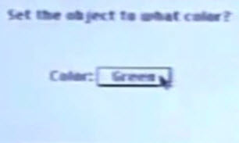
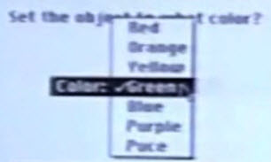
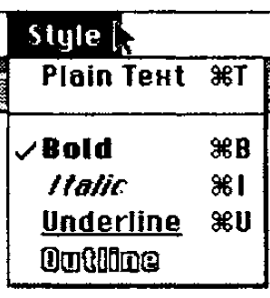
Widget Hierarchies
Inheritance to give the right methods to widgets
  Menu in option button should look and work the same as a pull-down menu
Not used in JavaScript
Functions down the parent or class hierarchy
Java swing hierarchy:
  https://docs.oracle.com/javase/10/docs/api/index.html?javax/swing/package-tree.html
  6002 interfaces, classes, subclasses; up to 8 levels deep!
  68 different classes and interfaces with the word “menu” as part of the name
    Rarely use the simple one (2 with the name “menu”)
Separate hierarchies for internal look-and-feel classes
  Visible when debugging

Slide 13
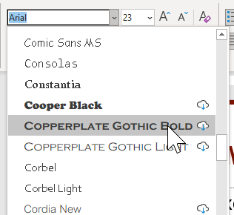
Geometry Management
Simplest – fixed values for location and size of
each widget
  Some widgets have dynamically-determined content
    E.g., fonts menu, width=widest font name
  Doesn’t work for changing languages; changing window size
Widgets don't set their own location.
  Widgets put into special group objects called "geometry managers" that perform the layout by setting the component's positions and size
Each widget negotiates with parent for more room when resize

Slide 14
JavaScript Layout
Html/CSS placements:
  Default – flows with text – next position or next line
  Also, fixed location, percent of the way across page, offset relative to previous item
CSS Layouts
  CSS framework (library), like Bootstrap
  CSS float property – move to sides
  CSS flexbox – deals with changing window size
  CSS grid – rows and columns

Slide 15

Independent Constraints
Programmer defines a set of constraints
  Mathematical relationships among the objects that compute the position, size, etc.
  E.g.: width of menu = width of its widest item
  width of ribbon = width of window – 4
  OK-Cancel buttons are centered at the bottom of the window
Idea dates back to Sketchpad research system – 1963!
Covered in depth in Lectures 16-18

Slide 16
Amulet geometry management
Combination of arbitrary constraints and containers
Group can have the Am_LAYOUT slot set with a constraint that depends on other slots
  Sets positions of parts by side effect
  Default layout routines: Horizontal and Vertical layout, for lists or tables.
Rest done by arbitrary constraints

Slide 17
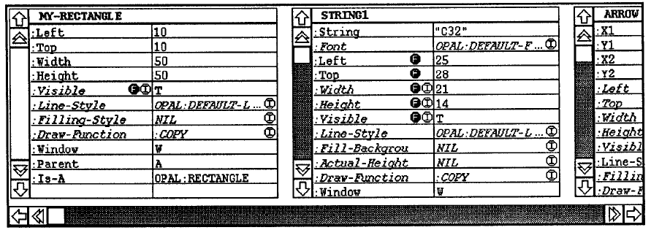
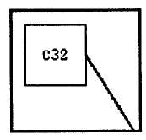
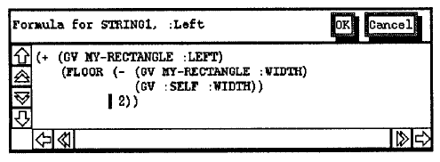
Our old research on layout: C32
Brad A. Myers. "Graphical Techniques in a Spreadsheet for Specifying User Interfaces," Proceedings SIGCHI'91: Human Factors in Computing Systems. New Orleans, LA. April 28-May 2, 1991. pp. 243-249. ACM ref. See also YouTube video or video

Slide 18
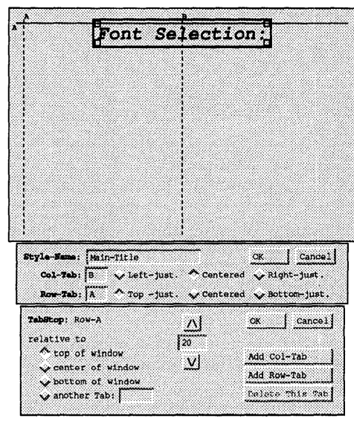
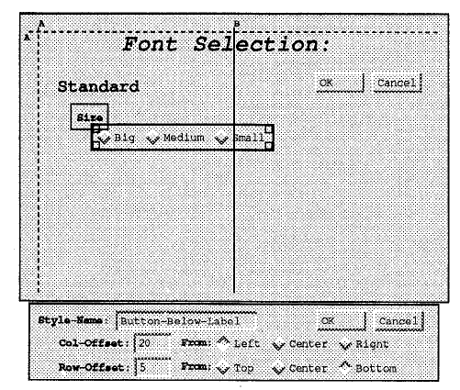
Our old research on layout: Gilt
Osamu Hashimoto and Brad A. Myers. "Graphical Styles For Building User Interfaces by Demonstration," ACM Symposium on User Interface Software and Technology: UIST'92, Monterey, CA, Nov. 16-18, 1992. pp. 117-124. pdf. See also
YouTube video. (9:01)

Slide 19
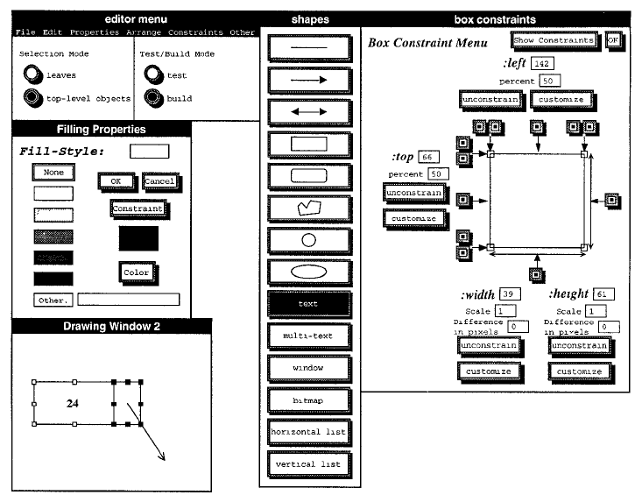
Our old research on layout: Lapidary
Brad Vander Zanden and Brad A. Myers. "Demonstrational and Constraint-Based Techniques for Pictorially Specifying Application Objects and Behaviors," ACM Transactions on Computer-Human Interaction. Vol. 2, no. 4, Dec, 1995. pp. 308-356.

Slide 20
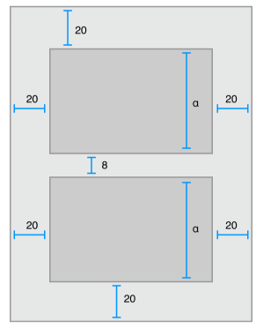
iOS
Can manually place elements of UI
“Auto Layout”
  Constraint-based layout system
  Helps with adaptive UI
Can set up constraints in the
interface builder or
programmatically
cite

Slide 21
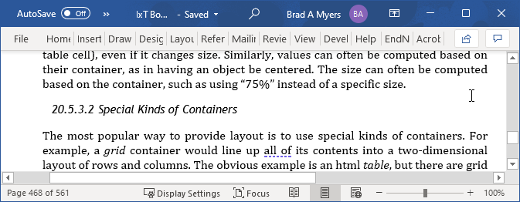
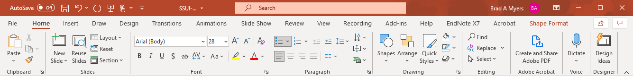
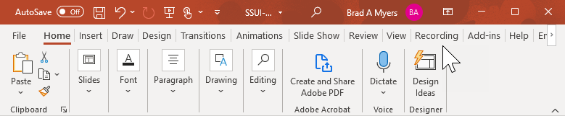
Special Containers
Put widgets in a container that will
place them appropriately
Horizontal row or vertical column
  OK for menus, but little else
Grid (table) – doesn’t cover much
Java GridBagLayout – more general but too hard to use
Doesn’t support multiple-pass calculations
  E.g., items centered in a menu depend on menu width which depends on widest item
Allowed size might be different than desired size
  E.g., Microsoft ribbon changes the widgets based on allowed size

Slide 22
TK Geometry Management
All widgets must be in a geometry manager, or else not displayed
Any widget with any geometry manager
Layout depends on
  widget specified sizes
  programmer specifications,
  size of geometry manager itself
Widgets must adjust themselves to the size given
Geometry manager requests size recursively

Slide 23
Motif Geometry Management
Motif
  RowColumn - add widgets and it lays them out
  Treats all children the same, so not for ScrollBars
Form - generic constrained layout
  Put extra resources on the children widgets
  "For details, see the Motif Reference Manual, because the complete behavior of Form is quite complicated."
  Each edge can be constrained
    at a position or offset from an edge of the Form
    at an offset from an edge of another widget
    percent of the way across the Form (edge, not center)
    a percent calculated based on the initial position
  If wrong, widgets are on top of each other

Slide 24
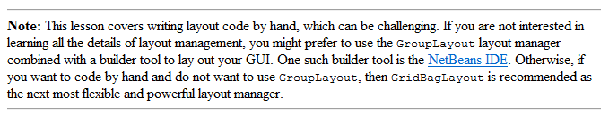
Java Widget Layout
“Using Layout Managers”
BorderLayout – layout around the edges, center gets extra space
BoxLayout – vertical or horizontal columns
CardLayout – overlapping JPanels
FlowLayout – fills row, then goes to next row
GridLayout -- components in a grid of cells. Resizes children to fill cell
GridBagLayout – “one of the most flexible — and complex — layout managers the Java platform provides…. uses a grid of rows and columns, allowing specified components to span multiple rows or columns
  Funny GridBagLayout video “Totally Gridbag” by Matt Quail (July 2004) https://www.youtube.com/watch?v=UuLaxbFKAcc (2:42)
GroupLayout – new, designed for use by IBs
SpringLayout -- also new for IBs, constraints for layouts
Funny video

Slide 25
Android
Similar to Java Swing
Layout: Different kinds of containers that lay out children
  Linear, grid, etc.
  Attach layouts to “view”s

Slide 26
Spacer model
History: TeX layout model
Typesetting system designed and mostly written by Donald Knuth starting in 1978
Boxes (of text) connected by “glue”
  \vspace also between characters, etc.
Can control the “stretchiness” of the glue

Slide 27
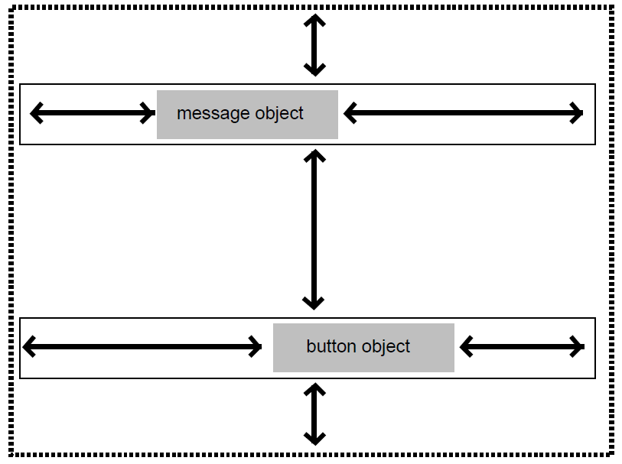
History: Interviews layout model
“Interviews” – one of the first C++ toolkits
  Linton, M.A., Vlissides, J.M., and Calder, P.R., “Composing user interfaces with InterViews.” IEEE Computer, Feb, 1989. 22(2): pp. 8-22.
Adopted the TeX boxes and glue metaphor
hbox tiles its components horizontally
  hglue
vbox tiles them vertically
  Vglue
Controls have a “natural” size
Different glues and controls
have different stretchiness

Slide 28
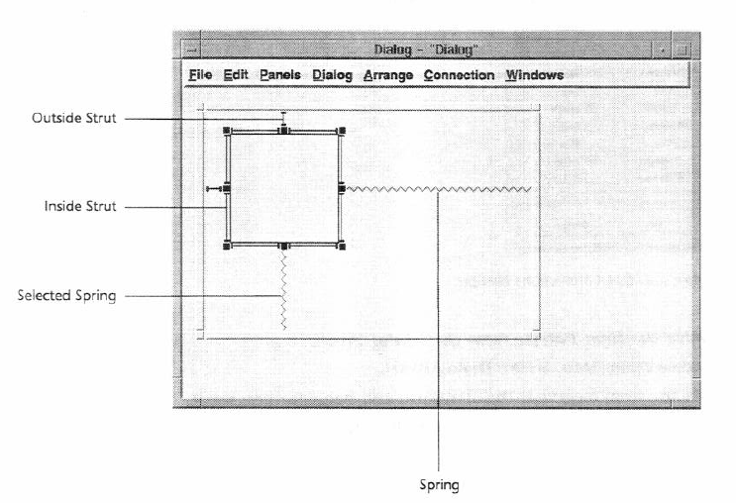
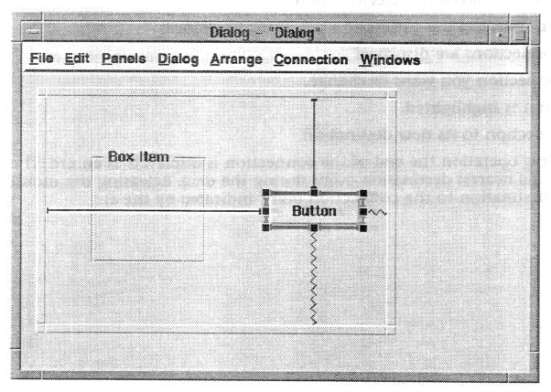
“Struts and Springs” layout
For stretchy or rigid constraints
Graphical interface layouts
NeXTStep (1989), MacOS & Galaxy (~1992)
Notes:
Also : http://doi.acm.org/10.1145/98188.98201
Interactive specification of flexible user interface displays
Scott E. Hudson & Shamim P. Mohamed

