Slide 1
Lecture 9: UI Software Patterns: State Diagrams, MVC, Lexical-Syntax-Semantics
05-431/631 Software Structures for User Interfaces (SSUI)
Fall, 2021

Slide 2
Logistics
Homework 2 grading finished and uploaded
Progress on HW 3?

Slide 3
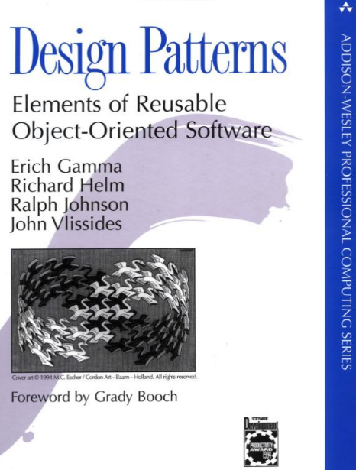
What are Design Patterns?
Wikipedia: A design pattern is the re-usable form of a solution to a design problem. The idea was introduced by the architect Christopher Alexander^{[1]} and has been adapted for various other disciplines, notably software engineering.^{[2]}
Design Patterns book (1994)
By “Gang of 4”: Erich Gamma, Richard Helm, Ralph Johnson, and John Vlissides
Patterns for object-oriented systems (originally, Java)
Now, there are LOTS more

Slide 4
Design Patterns
Generally, a way to organize code to achieve certain outcomes
Small pieces of the overall design
Both “functional” = what it does
And “non-functional” = how it does it, e.g., efficiency, reusability
Language independent
We have been using the “Listener Pattern” all along!
Also called the “Observer Pattern”
Attach an observer (call-back function) to events or other data changing
We will use the “Command” pattern for undo in Homework 5
Sometimes called “Models” but that has too many meanings!
Software Architectures – whole system design; pattern is just one piece

Slide 5
“Factory” Pattern
Instead of “normal” creation: Widget w = new Widget();
Objects must be created by another class: AbstractFactory f = AbstractFactory.getDefault(); Widget w = f.createWidget();
Used frequently in Java (>61) and .Net (>13) and SAP
Advantages?
Don’t need to allocate any memory (new not called)
Can return a different subtype from what user is aware of
Our research showed that the “factory pattern” made APIs harder to learn and use (lower “API Usability”):
When asked to design on “blank paper”, no one designed a factory
Time to develop using factories took 2.1 to 5.3 times longer compared to regular constructors (20:05 v 9:31, 7:10 v 1:20)
All subjects had difficulties getting using factories in APIs

Slide 6
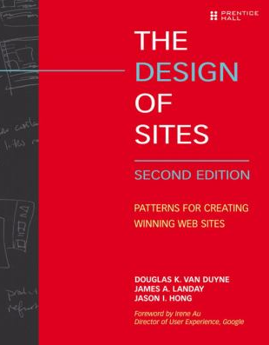
Design Patterns for UI Design
E.g.,: van Duyne, D.K., James A. Landay, and Jason I. Hong, The Design of Sites: Patterns, Principles, and Processes for Crafting a Customer-Centered Web Experience. Reading, MA: Addison-Wesley, 2002.
Mainly for UI design patterns, for UI designers, not for UI software

Slide 7
Conceptual-Semantic-Syntactic-Lexical-Pragmatic
Another way to look at the design of software
Derived from compiler theory and language work.
Mostly relevant to older, non-interactive interfaces
Pragmatic
How the physical input devices work
required "gestures" to make the input.
Ergonomics
skilled performance: "muscle memory"
press down and hold, vs. click-click

Slide 8
Conceptual-Semantic-Syntactic-Lexical-Pragmatic, cont.
Lexical
spelling and composition of tokens
“add” vs. “append” vs. “^a” vs.
Where items are placed on the display
“Key-stroke” level analysis
For input, is the design of the interaction techniques:
how mouse and keyboard combined into menu, button, string, pick, etc.

Slide 9
Conceptual-Semantic-Syntactic-Lexical-Pragmatic, cont.
Syntactic
sequence of inputs and outputs.
For input, the sequence may be represented as a grammar:
rules for combining tokens into a legal sentence
For output, includes spatial and temporal factors
Example: prefix vs. postfix
Postfix:
Prefix:
Infix:
<select obj> delete
del *
<select rectangle tool> <select where new rectangle goes>
drag-and-drop

Slide 10
Conceptual-Semantic-Syntactic-Lexical-Pragmatic, cont.
Semantic
functionality of the system; what can be expressed
What information is needed for each operation on object
What errors can occur
Semantic vs. UI is key issue in UI tools
but "semantic" is different than meaning in compilers
"Semantic Feedback“
Depends on meaning of items
Example: only appropriate places where item can be dropped highlight during drag

Slide 11
Conceptual-Semantic-Syntactic-Lexical-Pragmatic, cont.
Conceptual (definition from Foley & Van Dam text, 1st edition)
Key application concepts that must be understood by user
User model
Objects and classes of objects
Relationships among them
Operations on them
Example: text editor
objects = characters, files, paragraphs
relationships = files contain paragraphs contain chars
operations = insert, delete, etc.
Overall evaluation of CSSLP model:
+ “Separation of concerns” for input handling
+ Helps to think about syntax & lexical issues
- Not useful for output

Slide 12
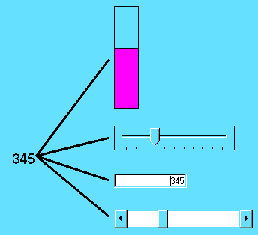
Model-View-Controller
Invented in Smalltalk, about 1980
Idea: separate out presentation (View), user input handling (Controller) and "semantics" (Model) which does the work
Fairly straightforward in principle, hard to carry through
Never adequately explained (one article, hard to find)
Goals
Program a new model, and then re-use existing views and controllers
better modularization and separation of UI from application
Multiple, different kinds of views on same model
Lots of modern variants

Slide 13
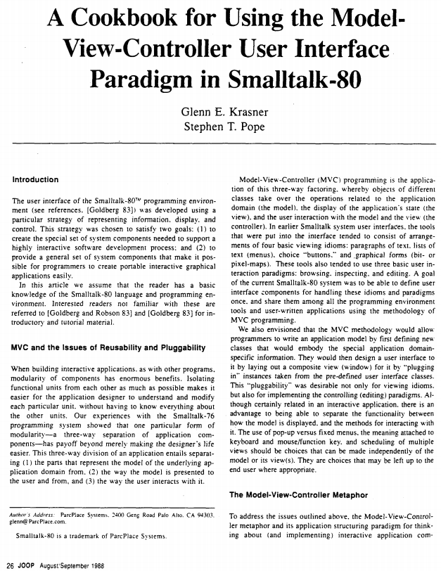
Classic MVC reference
Glenn E. Krasner and Stephen T. Pope. “A Cookbook for Using the Model-View-Controller User Interface Paradigm in Smalltalk-80,” Journal of Object Oriented Programming. Aug, 1988. vol. 1, no. 3. pp. 26-49.
Hard to find original journal
Luckily, lots of sources for pdf:
https://www.ics.uci.edu/~redmiles/ics227-SQ04/papers/KrasnerPope88.pdf
Wikipedia says invented in 1979

Slide 14
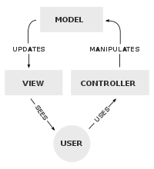
MVC
Model
“the parts that represent the model of the underlying application domain”
Simple as an integer for a counter; string for an editor
Complex as a molecular simulator
View
“the way the model is presented to the user”
Everything graphical
Layout, subviews, composites
Controller
“the way the user interacts with it”
Schedule interactions with other VCs
A menu is a controller

Slide 15
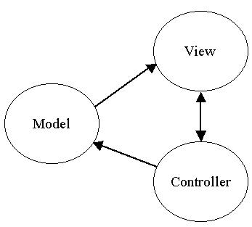
MVC

Slide 16
MVC
Views closely associated with controllers.
Each VC has one M; one M can have many VCs.
VCs know about their model explicitly, but M doesn't know about views
Changes in models broadcast to all "dependents" of a model using a standard protocol.
“Observer” pattern again
“register” the views with the model, so each is called when model changes
Like the event handlers when mouse down

Slide 17
MVC
Standard interaction cycle:
User operates input device, controller notifies model to change, model broadcasts change notification to its dependent views, views update the screen.
Views can query the model
Problems:
Views and controllers tightly coupled
What is in each part?
Complexities with views with parts, controllers with sub-controllers, models with sub-models...

Slide 18
Model-View (variant of MVC)
Since hard to separate view and controller
Primary goal: support multiple views of same data.
Simply switch views and see data differently
Put into Model "part that needs to be saved to a file"
but really need to save parts of the view

Slide 19
MVC and React / Angular / Vue
AngularJS from Google (~2009) relied on the MVC paradigm
React from Facebook (~2011) explicitly rejected MVC due to requirement of copying values around
using constraints or the observer pattern
React instead uses shared data, which it calls “states”
New design of Angular (~2016) less use of MVC
But Vue tool does use MVC

Slide 20
Note about the word “Model”
“Model” used in many ways in HCI!
User model - the way a user thinks about a system - [Don Norman]
Color model, undo model - the way that feature is presented to the user
Software models - the way that a programmer should think about the implementation
Examples: imaging model, object model (class model or prototype-instance model ), retained object model, document model, interactors model, event model, and model-view-controller (MVC) model (lectures 6 & 7)
Model of MVC - the data structure that the user interface is connected to
Model-based design – (end of lecture 8) high-level specification from which the user interface is automatically generated
Human Performance Model and Fitt’s Law Model – mathematical representations from which predictions of human performance can be calculated
Language models - representations of how words are used in a natural language (lecture 23)
3D models - computer representations of three-dimensional objects (lecture 25)
Fashion models - people who show off clothing

Slide 21
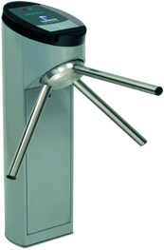
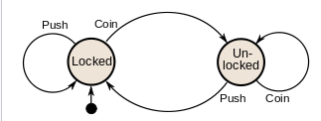
Transition Diagrams
Also called: state diagrams, finite-state machines (FSM), finite automata
Is also a kind of “model”
Set of states and set of arcs
States: mode that the system can be in
Transition: how system can change states
Can be abstracted away from UI or code
Wikipedia example:

Slide 22
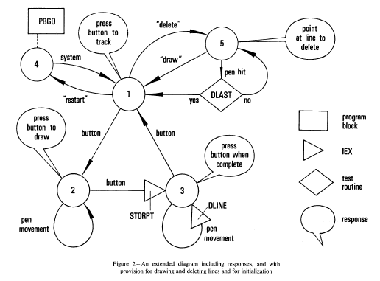
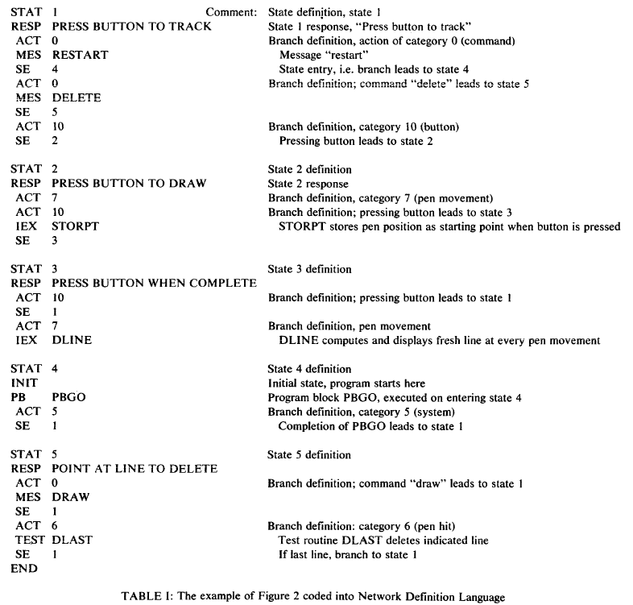
Transition Diagrams
Probably the earliest tool to help build UIs:
William Newman's "Reaction Handler" in 1968 http://doi.acm.org/10.1145/1468075.1468083

Slide 23
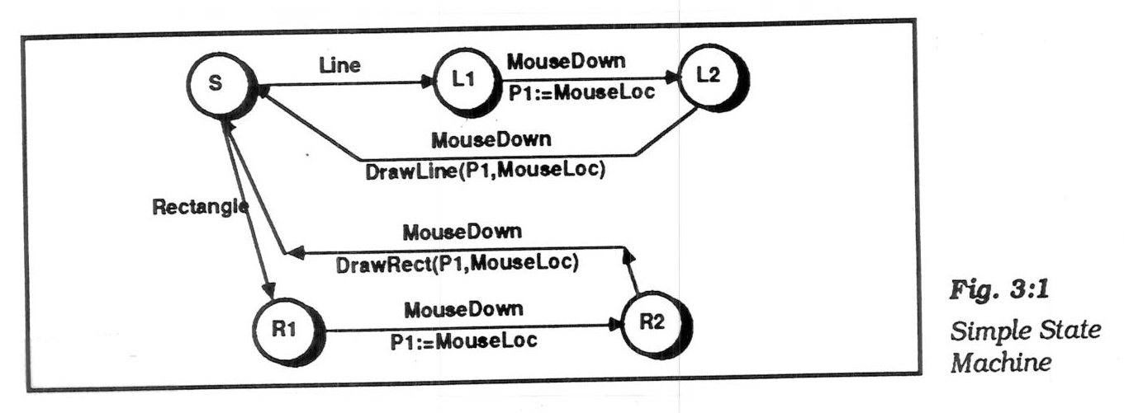
Transition Diagrams, cont.
Simplest form, arcs are user input events.
arcs can be extended by listing feedback (output) and semantic actions on the arcs
actions usually written in a conventional language (e.g., C)
picture, Olsen, p. 37 (Fig 3:1)

Slide 24
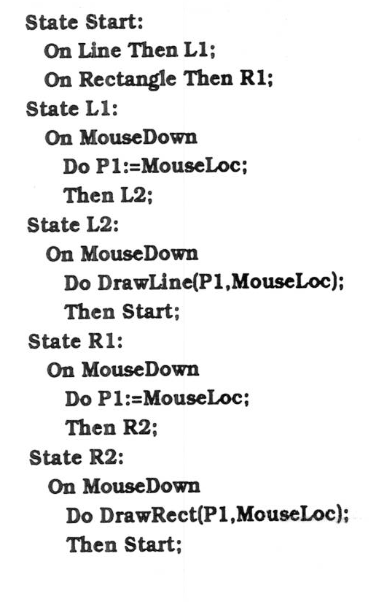
Transition Diagrams, cont.
Often, represented textually:
picture, Olsen p. 38

Slide 25
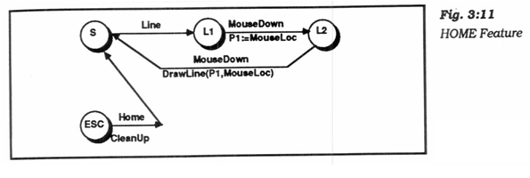
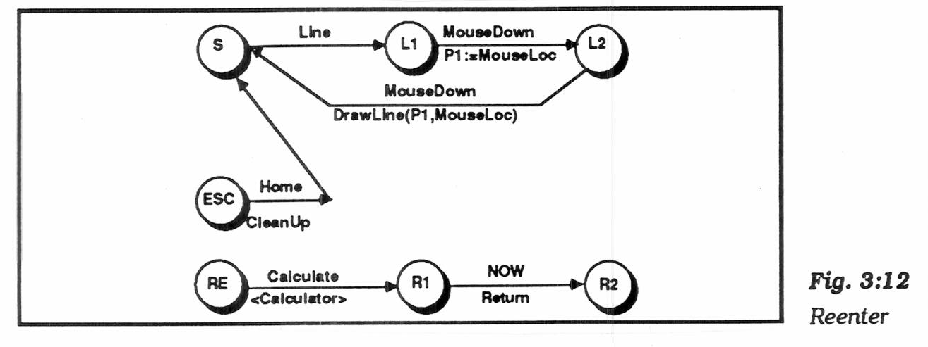
Transition Diagrams, cont.
"Pervasive states" to handle help, abort, undo, etc.
"Escape" transitions to abort (permanently leave) a dialog
picture, Olsen p. 53 (Fig 3:11)
"Re-enter" sub-dialogs for temporary excursions that return to same place. E.g., help, use calculator, etc.
picture, Olsen p. 55 (Fig 3:12)
Transitions are taken if no specific arcs from node

Slide 26
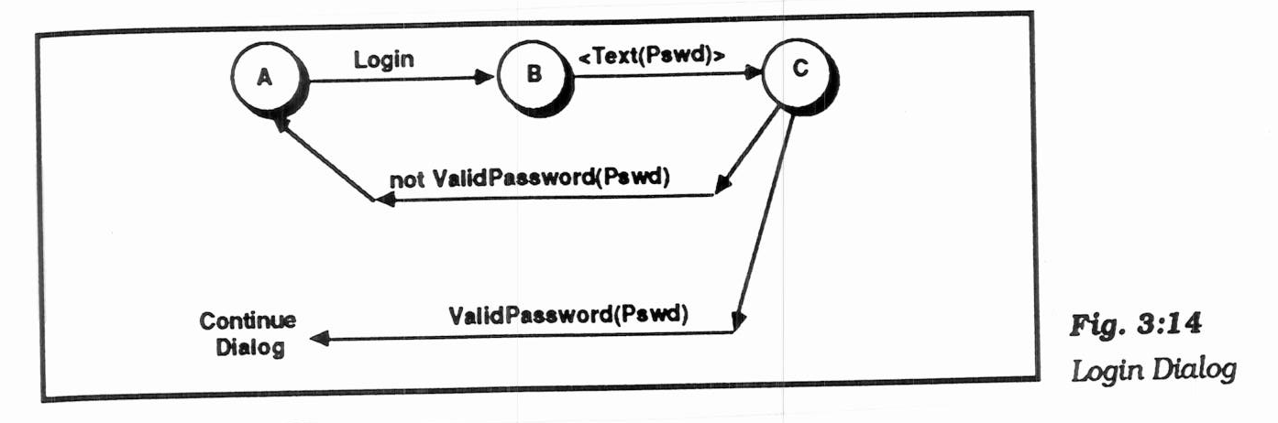
Transition Diagrams, cont.
"Augmented transition networks"
local variables
function on arcs can determine transitions
"guards" determine whether transition is legal
"conditional transitions" calculate where to go
picture, Olsen p. 57 (Fig 3:14)
upgrades the power to context-free-grammar

Slide 27
Transition Diagrams, cont.
Transition Networks, in general, used in various UIMSs:
Research: Newman's "reaction handler", Jacob's RTN, Olsen's "Interactive Pushdown Automata", Stephen Oney’s Euclase, etc.
Commercial: IDE's RAPID/USE, Virtual Prototypes's VAPS
VAPS used spreadsheet interface to the ATN

Slide 28
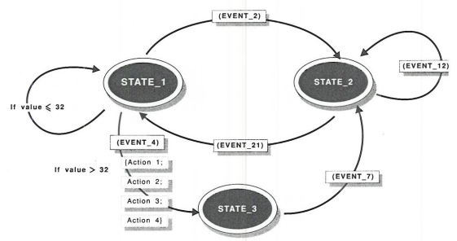
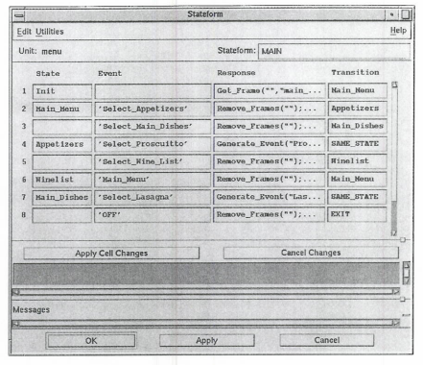
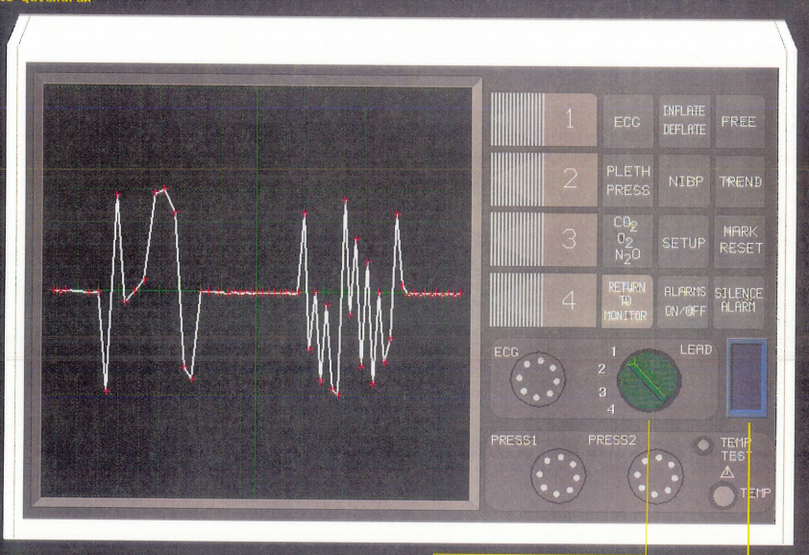
VAPS pictures
Pictures

Slide 29
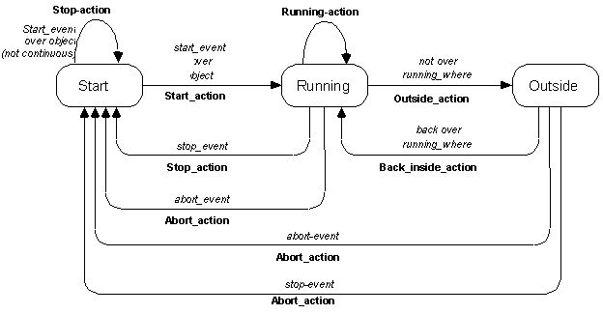
Transition Diagrams for Widget Behavior
Used internally for Garnet / Amulet “Interactors” (lecture 5)
Note: no “hover” state

Slide 30

Another example, with hover

Slide 31
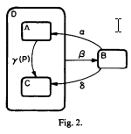
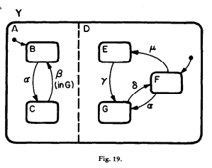
StateCharts
Invented by David Harel David Harel, “Statecharts: a visual formalism for complex systems”, Science of Computer Programming, Volume 8, Issue 3, (Elsevier) June 1987, Pages 231-274, online
Generalization of state diagrams
Reduce state explosion and other problems
Cluster (nested) states for abstractions and identical behaviors
“AND” states – system is in both A and D
E.g., watch light is always on or off, may be independent of other modes
Concurrent charts – can operate independently
Many other features
Used by Stephen Oney’s InterState

Slide 32
Transition Diagrams, evaluation
Good
Make explicit the interpretation of all events in each state
Emphasize the temporal sequence of user and system actions
Natural and easily understood if small
easy to teach, learn, and read
Appropriate for some parts of GUIs: widget behaviors, dialog box transitions, etc.
May be appropriate to model transitions around web sites

Slide 33
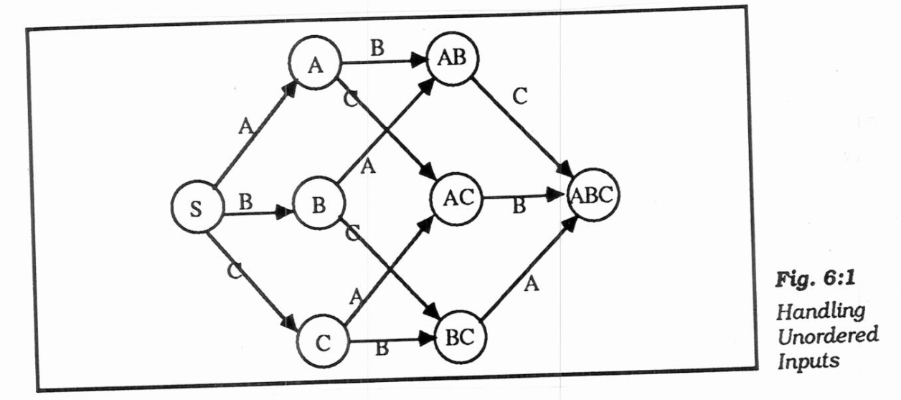
Transition Diagrams, evaluation
Bad
Does not scale: 150 commands with 3 or 4 states each
explosion of lines and states for normal interfaces: "maze of wires"
unordered inputs
picture, Olsen p. 91 (Fig 6:1)
Textual form is like GOTO-based assembly language
Communication through global variables
Doesn't handle GUI mode-free style well
What to do with un-specified input? crash, ignore input
Doesn't address output

Slide 34
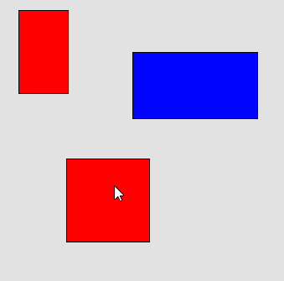
Let’s Design one for HW2
Mousedown on div
Click - select that div
Idle
Notes:
Starting configuration

Slide 35
Let’s Design one for HW2
ESC
Abort moving
Mouse move
Move object
moving
Waiting for mouse up
Mouse move
Move object
Mouse up
Mouse is down
Mouse up
Mousedown on div
Mouse move
Move object
Click - select that div
click on workarea
deselect
Idle
Move capture
Double click
click
ESC
Abort moving
Notes:
Starting configuration

Slide 36
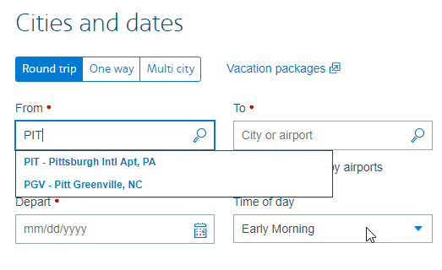
Note: Event handlers – focus vs. positional
Positional – whichever object is under the mouse handles it
Focus – specify a specific object’s to handle it
Always used for text
Used for mouse-move
Should also be used for the mouse-up or click event handler
Can be implemented by having background object have handler

