Slide 1
Lecture 6:
Input 2: Declarative input models; “Interactor” (Behavior) Objects in Garnet and Amulet
05-431/631 Software Structures for User Interfaces (SSUI)
Fall, 2021

Slide 2
Overview
Try to provide more support so input handling isn't so difficult
Make easy things simple and complex things possible
Based on the "Model-View-Controller" architecture from Smalltalk
    (Lecture 9)
True separation of graphics (view) and input handling (controller)
Also uses idea from [Foley&Wallace 1974] of identifying types of input handlers:
  move
  grow
  rotate
  text edit
  gesture
  select (pick)
  James D. Foley and Victor L. Wallace. “The Art of Natural Graphic Man-Machine Conversation,” Proceedings of the IEEE. Apr, 1974. vol. 62, no. 4. pp. 462-471.
Notes:
Stopped here

Slide 3
Innovations
Identifying primitive "Interactor" objects and correct parameterizations so most direct manipulation UIs can be constructed by re-using built-in objects.
  Better name might be “Behavior” objects
Only a few kinds of behaviors, and standard parameters
Real separation between input and output handling
Handles all input
  insides of widgets
  and for application programs
+ First successful separation of View from Controller in Smalltalk MVC
+ Integration of gestures with conventional interaction.
+ Easier to code because substantial re-use
+ Built-in support for multi-window dragging

Slide 4
General idea
Attach interactor objects to a set of graphical objects to handle their input.
Graphical objects don't handle input
  No "event methods" in objects
Instead, define invisible "Interactor" objects and attach them to graphics
Interactors can operate on multiple objects
Strategy: pick the right type of Interactor, attach to the objects to be affected, fill in necessary slots of interactor
Widgets use interactors internally
Can have multiple interactors on an object (e.g., different mouse buttons)
Interactors directly set slots of objects using a standard protocol
  constraints can be used to map those slots into behaviors:
Details of input events and event processing is hidden
Used first in Garnet, refined in Amulet.

Slide 5
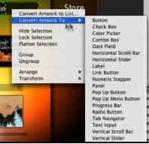
Flash Catalyst
Previous product from Adobe
  Only in CS 5.5
Also had behaviors
that can be attached
to graphics and
parameterized

Slide 6
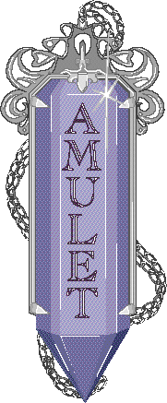
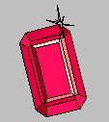
Full Documentation
Full Amulet Manual:
  http://www.cs.cmu.edu/afs/cs/project/amulet/amulet3/manual/Amulet_ManualTOC.doc.html
  Tutorial
  Interactors and Command Objects

Slide 7
Garnet, Amulet Design Overview
Invented our own object system
  Prototype-instance instead of class-instance
  Syntax: prototype.Create(“name”)
Uses obj.set ( instance-variable, value )
Uses what is now called method cascading or fluent interface
  .set and other methods return the original object, so can be chained together
  Obj.set(Am_X, 4).set(Am_Y, 6).add_part…
C++ didn’t have name spaces, so started all Amulet words with Am_ …
Full set of graphic objects and groups
  mygroup.Add_Part(myrect);

Slide 8
Types of Interactors
Am_Choice_Interactor : select one or more of a set of objects
Am_One_Shot_Interactor - single action, like Choice
Am_Move_Grow_Interactor : move or grow objects with the mouse
Am_New_Points_Interactor: to create new objects by entering points while getting feedback "rubber band" objects
Am_Text_Edit_Interactor : mouse and keyboard edit of text
Am_Gesture_Interactor: interpret freehand gestures

Slide 9
Affected Graphical Objects
Set of objects to operate on:
  To be active, Interactor must be attached to an object which is (recursively) attached to the screen
  Equivalent to visibility of graphical objects
  Unlike graphical objects which can only be added as parts of windows or groups, interactors can be added as parts of any object:
  rect.Add_Part(my_inter);
  Default: operates on the object attached to
  But also common to operate on any member of a group.
  Controlled by the Am_Start_Where_Test slot, which should contain a method

Slide 10
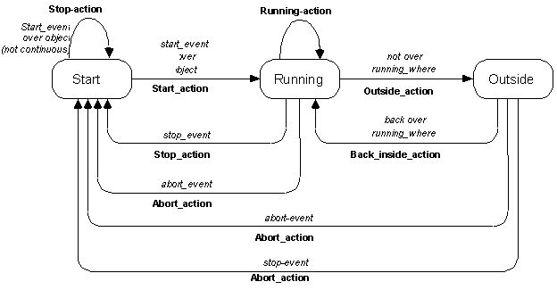
Standard Behavior
(“state diagrams” covered in lecture 9)

Slide 11
Other standard parameters
Multiple groups
  interactor can span multiple windows
start, stop and abort events
  single key, mousebutton, "any" mousebutton, modifiers, (shift, meta...), double click, click vs. drag, etc.
active?
priority levels

Slide 12
Parameters for specific types of Interactors
For buttons (Choice Interactors)
  how many objects to select: set, toggle, list-toggle
For move-grow:
  interim feedback object (while the mouse moves)
    if missing then object itself is modified
  gridding
  move or grow
  where-attach
    center, n, ne, nw, w ... , where-hit
flip if change sides
minimum size

Slide 13
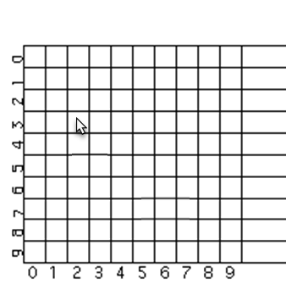
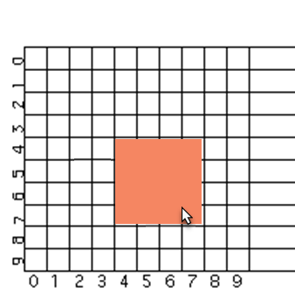
Gridding
Surprisingly complicated
  E.g., grid of 4 – where is first point?
    (X+2 mod 4)*4 = 4
  Should width be a multiple of 4 or right side?
    Width = right side at 7
    Right side = 8
Origin of grid – with window or container?

Slide 14
Flip if change sides
TEXT
BOX
IN PPT
What happens when move towards upper left?
  Pegs at minimum size?
    Most window managers do this
    Might be zero – shape disappears?
  Object flips over?
    PowerPoint does this
    Text becomes upside down and/or backwards
TEXT
BOX
IN PPT

Slide 15
Parameters for New_Point
interim feedback object (while the mouse moves)
gridding
minimum size
abort if too small
  Avoid creating tiny or invisible objects

Slide 16
Parameters for Text_Interactor
editing translation table (to map keystrokes and mouse into editing functions)

Slide 17
Parameters for Gesture_Interactor
gesture recognizer table
If missing, can use this to get freehand drawings

Slide 18
Simple Example
To make an object movable with the mouse:
Am_Object rect = Am_Rectangle.Create() .Set(Am_LEFT, 40) .Set(Am_TOP, 50) .Set(Am_FILL_STYLE, Am_Red) .Add_Part(Am_Move_Grow_Interactor.Create());

Slide 19
Choice Interactor
Three ways to get the result:
  Access the Am_INTERIM_SELECTED and Am_SELECTED slot of the object itself
    By default, sets the Am_INTERIM_SELECTED and Am_SELECTED slots of the affected objects
    Constraints that depend on these slots
  Access the Am_VALUE slot of the interactor
  Write a Am_DO_METHOD for the command object, and access the command object's Am_VALUE slot

Slide 20
Example
Am_Define_Style_Formula (line_from_selected) {
if ((bool)self.Get(Am_INTERIM_SELECTED)) return Am_Red;
else if ((bool)self.Get(Am_SELECTED)) return Am_Black;
else return Am_Blue;
}
Am_Object my_prototype = Am_Line.Create()
.Set(Am_LINE_STYLE, line_from_selected);
my_group = Am_Group.Create()
.Add_Part(Am_Choice_Interactor.Create());
Now add instances of my_prototype to my_group
Also collects a list of the selected objects in the Am_VALUE slot of the command object in the interactor

Slide 21
Advanced Feature: Priorities
If two interactors want to run, priorities used to determine which
Am_PRIORITY slot contains a number. Default = 1
When running, 100 added to it
Inspector interactors use 300.0
If multiple with same priority, runs the one attached closer to the leaf

Slide 22
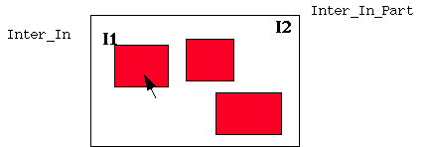
Example

Slide 23
Advanced Feature: Using Slots of Interactors
In addition to value set into Command, a number of slots are set into the Interactor itself, which might be useful.
Can get the interactor as the Owner of the command passed to the DO_METHOD
Am_START_OBJECT, Am_START_CHAR, Am_FIRST_X, Am_FIRST_Y, Am_WINDOW, Am_CURRENT_OBJECT

