Slide 1
Lecture 5: Output 1: Basic 2D Computer Graphics
05-431/631 Software Structures for User Interfaces (SSUI)
Fall, 2021

Slide 2
Logistics (9/14/2021)
Homework 1 to be graded by Thursday
Homework 2 due 1 week from today (next Tuesday)
I will have to miss class on Thursday for Yom Kippur
Jewish religious holy day
I will pre-record the lecture and you can watch it anytime
Feel free to ask questions on Piazza or email
I added a new tag (folder) to Piazza called “lecture”
I reorganized the schedule so I am covering graphics today (needed for hw 3)
Will cover important material on Thursday, but which is not part of the homework
If I don’t finish this topic (graphics) today, I will finish on next Tuesday
Readings for this lecture in cmuonly/ (see link in schedule) or on Canvas in new “Files / Special Course Readings” folder

Slide 3
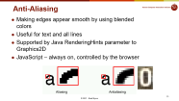
Logistics (9/21/2021)
Video online for 9/16 lecture – covers alternative designs for input and output
Today, go back and finish 2-D graphics, updated slides SSUI-05-graphics1.pptx
Grading for HW1 was finished last Wednesday, comments on Canvas
Average grade = 92 / 100 (or 94 without one very late turn-in)
Issue of specifications and communication
Homework 2 due today
Homework 3 posted today – due in 2 weeks

Slide 4
What are “Graphics”
All visual output shown to users
Includes textual output
Only 2D for now
So far, mostly html or html generated from JS
Mostly styled text and images
Also, areas of colors – mostly rectangles or rounded rectangles
Borders on regions
Now, adding in “real” graphical objects:
Other shapes – lines, circles, polygons, etc.
More properties on other graphics

Slide 5
Why talk about Graphics?
To draw application-specific graphical objects
Lines, rectangles, text
Mac, Windows, Linux, Android, iOS, web, … all have approximately the same way of describing graphics
There are some complexities that are worth looking at
There are 2 models, we (and homework 3) will cover both!

Slide 6
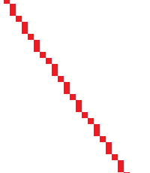

Rendering Graphics
Graphics are rendered onto the screen
Decide exactly which pixels to draw in which color
We won’t cover the low-level rendering algorithms
Do need to know what is going on, and how to control it
JavaScript provides 2 built-in ways to do graphics:
SVG – Scalable Vector Graphics = “Drawing”
Canvas = “Painting”

Slide 7
Drawing vs. Painting programs
Drawing = SVG
Painting = Canvas
Hybrid (both)

Slide 8
Drawing vs. Painting programs
Drawing
PowerPoint
MacDraw
Adobe Illustrator
Adobe InDesign
Painting
Microsoft Paint
MacPaint
Snagit Editor
Hybrid (both)
Photoshop

Slide 9
Drawing vs. Painting programs
Drawing
Graphical objects maintain their integrity after being drawn
Painting
Objects just become pixels after being drawn

Slide 10
Drawing vs. Painting programs
Drawing
Graphical objects maintain their integrity after being drawn
Shapes are reinterpreted as mathematical entities
Can move, change properties of all objects at any time
Rotation, change overlapping
Can zoom in continuously
Painting
Objects just become pixels after being drawn
Can draw arbitrary shapes
Can touch up and individually edit the pixels anywhere
Supports “flood fill” (paint can)
Lose “resolution” and see pixels when zoom in

Slide 11


Drawing vs. Painting programs
Drawing
Graphical objects maintain their integrity after being drawn
Painting
Objects just become pixels after being drawn

Slide 12
Drawing vs. Painting programs
Homework 3 – you will make a hybrid system
(Full specification still in progress)
Draw on one “layer”
Paint on another “layer”
“Layer” = collection of graphical objects that are treated separately from graphics on other layers
Super-simplified version of Photoshop or other hybrid editing programs

Slide 13


Drawing each Object
Drawing an object can be done in either model
“objectness” disappears after drawing is complete for painting programs
Completely different models!
Note: different border size, both are “3”
<svg height="100" width="100"> <circle cx="50" cy="50" r="40" stroke="black" strokewidth="3" fill="red" /> </svg>
https://www.w3schools.com/graphics/svg_circle.asp
var c = document.getElementById("myCanvas"); var ctx = c.getContext("2d"); ctx.beginPath(); ctx.lineWidth = 3; ctx.arc(50, 50, 40, 0, 2 * Math.PI); ctx.stroke(); ctx.fillStyle = "red"; ctx.fill();
https://www.w3schools.com/tags/canvas_arc.asp

Slide 14
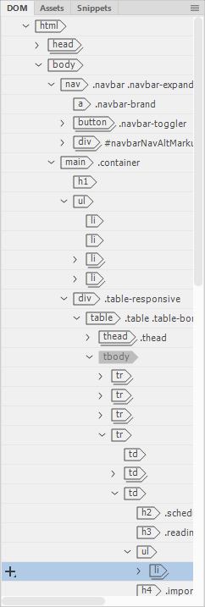
2D and covering
Objects are drawn in order, back to front
Same as a drawing program like PowerPoint
Containers – recursive
E.g., for DOM
Groups in many systems
Divs and other elements can contain others
All items in a container are above/below other containers
Group itself is usually see-through
Commands to change the order for java, SVG
Java: setComponentZOrder() on any container
SVG: remove from DOM and re-add at the desired z-order
Not canvas!

Slide 15
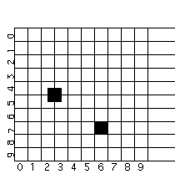
Coordinates for Drawing
Origin
Typically 0,0 in top left
Comes from text handling and raster scan
Java 2D allows customization
Different from conventional axes
Coordinates of pixels:
Center of pixel?
Corner of pixel?
Matters for lines

Slide 16
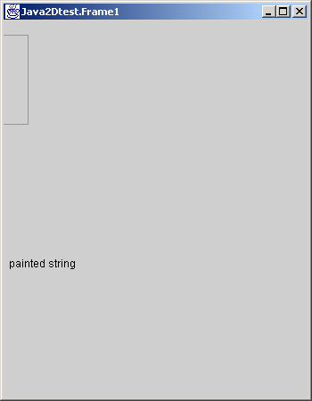
Issue: Window Coordinates
Where is 0,0 with respect to the window’s inside or outside border?
CreateWindow (10, 10, 100, 100)
Inside or outside?
Different for point vs. W/H?
What is the size of window border?
JS – just inside

Slide 17
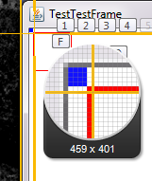
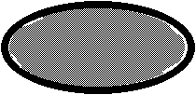
Drawing Primitives
Drawing Objects:
Graphics, graphics2D java APIs: http://docs.oracle.com/javase/8/docs/api/
Canvas / svg for JavaScript – all draw different pixels!
P1 and P2 or P1 and W/H?
void graphics.drawRect (int x, int y, int width, int height) Draws the outline of the specified rectangle. (also fillRect)
Inclusive or exclusive?
Which pixels are turned on for DrawRectangle (2,2, 8,8)?
Suppose you draw another rectangle next to it?
Suppose draw filled and outline rectangle with the same coordinates?
JavaScript SVG can control the order: https://developer.mozilla.org/en-US/docs/Web/SVG/Attribute/paint-order
What about for ellipse?
graphics.setColor(Color.red);
graphics.drawRect(4, 4, 40, 40);
graphics.setColor(Color.blue);
graphics.fillRect(0,0,4,4);

Slide 18
Primitives, 2
DrawLine has similar concerns
Thick lines often go to both sides of the coordinates
Option in JavaScript for fully inside
drawPolyline takes a sequence of points
Endpoints of each segment drawn?
Last end-point drawn?
Closed vs. open; may draw first point twice

Slide 19
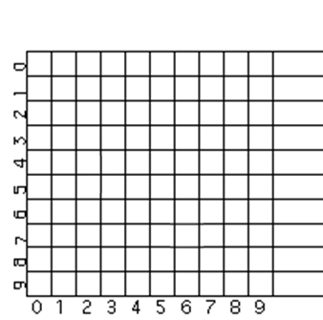
Where to draw lines?
© 2020 - Brad Myers

Slide 20
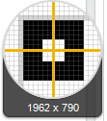
Inside or outside?
How many pixels across are painted for line width = 3, rectangle width = 7?
var c = document.getElementById("myCanvas");
var ctx = c.getContext("2d");
ctx.lineWidth = 4;
ctx.strokeRect(2, 2, 8, 8);
12

Slide 21
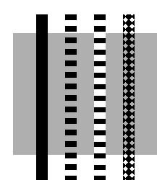
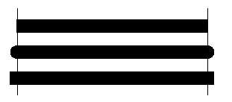
Line Properties
LineStyles
Width
Solid, dashed 111000111000111000, "double-dashed", patterned
Cap-style: butt, round, projecting (by 1/2 linewidth):

Slide 22
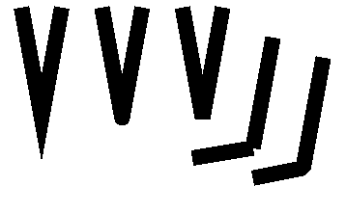

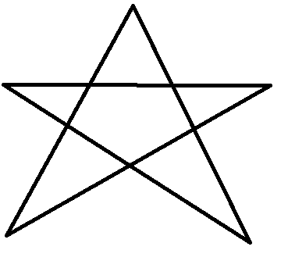
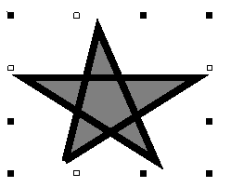
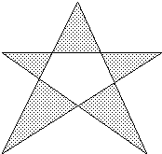
Polylines
End-caps: miter, round, bevel:
Miter = point, up to 11 degrees
JS miterLimit
Round = circle of the line width
Bevel = fill in notch with straight line
Filled, what parts?
“Winding rule”
JS: fill-rule:nonzero
“Odd parity rule”
JS: fill-rule:evenodd
Used by Java
JavaScript has both!
fill-rule:winding
fill-rule:evenodd

Slide 23

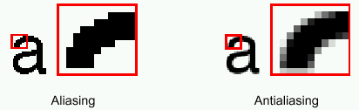
Anti-Aliasing
Making edges appear smooth by using blended colors
Useful for text and all lines
Supported by Java RenderingHints parameter to Graphics2D
JavaScript – always on, controlled by the browser

Slide 24
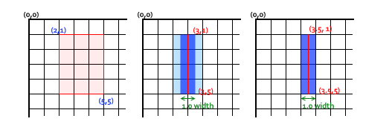
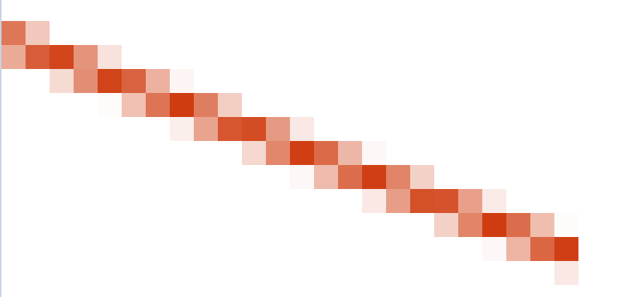
Anti-aliasing discussion
https://developer.mozilla.org/en-US/docs/Web/API/Canvas_API/Tutorial/Applying_styles_and_colors

Slide 25


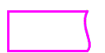
Java2D & JavaScript Canvas Path Model
Others (AWT, SVG) draw by drawing shapes (drawRect, <rect>, etc.)
Define a path first, then stroke or fill it
Also used in Macintosh, Postscript, JS
Java: g2.setStroke(dashed); g2.draw(new RoundRectangle2D.Double(x, y, rectWidth, rectHeight, 10, 10));
Can create a GeneralPath and add moveTo, lineTo’s, curveTo (etc.) to it, and then call draw.

Slide 26
JavaScript Canvas
Build up a path and then “stroke” or “fill” it
Implicit “default” path, or explicit path
Global (hidden) data structure holds the path and all parameters

Slide 27

JavaScript Canvas examples
<body>
<canvas id="myCanvas" width="100%" height="100%"></canvas>
…
<script>
var c = document.getElementById("myCanvas");
var ctx = c.getContext("2d");
ctx.strokeStyle = "red";
ctx.moveTo(10, 10);
ctx.lineTo(20, 200);
ctx.stroke();
ctx.fillStyle = "green";
ctx.fillRect(20, 20, 150, 100);
</script>
</body>

Slide 28

JavaScript Canvas
<body>
<canvas id="myCanvas" width="100%" height="100%"></canvas>
…
<script>
ctx.strokeStyle = "red";
ctx.moveTo(10, 10);
ctx.lineTo(20, 200);
ctx.stroke();
ctx.fillStyle = "green";
ctx.fillRect(20, 20, 150, 100);
ctx.moveTo(0,0);
ctx.lineWidth = 5;
ctx.strokeStyle = "blue";
ctx.lineTo(0,100);
ctx.stroke();
</script>
</body>

Slide 29
JavaScript Canvas
<body>
<canvas id="myCanvas" width="100%" height="100%"></canvas>
…
<script>
ctx.strokeStyle = "red";
ctx.moveTo(10, 10);
ctx.lineTo(20, 200);
ctx.stroke();
ctx.fillStyle = "green";
ctx.fillRect(20, 20, 150, 100);
ctx.moveTo(0,0);
ctx.lineWidth = 5;
ctx.strokeStyle = "blue";
ctx.lineTo(0,100);
ctx.stroke();
</script>
</body>
Redraws previous stroke!

Slide 30

JavaScript Canvas
<body>
<canvas id="myCanvas" width="100%" height="100%"></canvas>
…
<script>
ctx.strokeStyle = "red";
ctx.moveTo(10, 10);
ctx.lineTo(20, 200);
ctx.stroke();
ctx.beginPath();
ctx.moveTo(10, 250);
ctx.fillStyle = "green";
ctx.fillRect(20, 20, 150, 100);
ctx.moveTo(0,0);
ctx.lineWidth = 5;
ctx.strokeStyle = "blue";
ctx.lineTo(0,100);
ctx.stroke();
</script>
</body>
Need beginPath() between strokes!

Slide 31
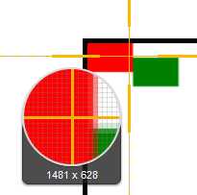
JavaScript Canvas
…
ctx.fillStyle = "red";
ctx.fillRect(0, 0, 20, 20);
ctx.fillStyle = "green";
ctx.fillRect(20, 10, 20, 20);
…
Anti-aliasing makes it hard to control which pixels are on

Slide 32
Splines
Curves defined by “cubic” equation
x(t) = a_{x}t³ + b_{x}t² + c_{x}t + d_{x} y(t) = a_{y}t³ + b_{y}t² + c_{y}t + d_{y}
Well-defined techniques from graphics (not covered here – see Foley&vanDam)
Defined to go through the “control” points curveTo(float x1, float y1, float x2, float y2, float x3, float y3) Adds a curved segment, defined by three new points, to the path by drawing a Bézier curve that intersects both the current coordinates and the coordinates (x3, y3), using the specified points (x1, y1) and (x2, y2) as Bézier control points.
Similar in SVG:
path C = curveto (reference)

Slide 33
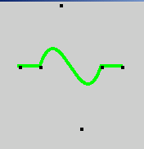
Spline Example
g2.setStroke(new BasicStroke(4.0f));
g2.setPaint(Color.green);
p.moveTo(50, 100);
p.lineTo(75, 100);
p.curveTo(100, 25, 125, 175, 150, 100);
p.lineTo(175, 100);
g2.draw(p);
g2.setPaint(Color.black);
g.fillRect(50, 100 ,4,4);
g.fillRect(75, 100 ,4,4);
g.fillRect(100, 25 ,4,4);
g.fillRect(125, 175 ,4,4);
g.fillRect(150, 100 ,4,4);
g.fillRect(175, 100 ,4,4);
Note that Bezier curves do not go through the intermediate control points

Slide 34

Color Models
RGB -- Additive color primaries
CMY -- Cyan, Magenta, Yellow
complements of red, green, blue; subtractive primaries
colors are specified that are removed from white light, instead of added to black (no light) as in RGB
YIQ -- used in color TVs in US (NTSC)
Y is luminance, what is shown on black and white TVs
I and Q encode chromaticity
Notes:
Stopped here

Slide 35
Color, cont.
HSV -- Hue, Saturation and Value (brightness) or HSL (Luminance)
user oriented, intuitive appear of artist's hint, shade, tone
simple algorithm in text to convert, but not a linear mapping
Interpolating between colors can be done using different models, with different resulting intermediate colors

Slide 36
Transparency of Color
Original model used only opaque paint
Modeled hardcopy devices this was developed for (at Xerox PARC)
Current systems now support “paint” that combines with “paint” already under it
e.g., translucent paint (“alpha” values)
Intermediate
Icons and images can select one “transparent” color
E.g, “transparent gifs”

Slide 37
Paint with transparency
Postscript model originated the “alpha blending” approach
Dominant model for hardcopy
Java2D and JS drawing models also takes this approach

Slide 38
Paint with transparency, 2
Advantages
Flexible display
Disadvantages
Slower
Less and less of an issue
But interactive response tends to be dominated by redraw time
Much harder to implement

Slide 39
Alpha Blending
Alpha is percent of this picture used
Color (float r, float g, float b, float a) Creates an sRGB color with the specified red, green, blue, and alpha values in the range (0.0 - 1.0).

Slide 40

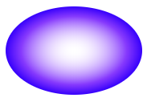
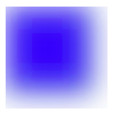
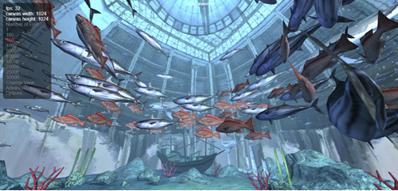
Other painting parameters
Shadows
Many kinds of gradients
Filters and blurring
3D (WebGL) …..

Slide 41
Fonts and drawing strings
Font provides description of the shape of a collection of chars
Shapes are called “glyphs”
Plus information e.g., about how to advance after drawing a glyph
And aggregate info for the whole collection

Slide 42
Fonts
Typically specified by:
A family or typeface
e.g., courier, helvetica, times roman
A size (normally in “points”)
A style
e.g., plain, italic, bold, bold & italic
other possibles (from mac): underline, outline, shadow

Slide 43
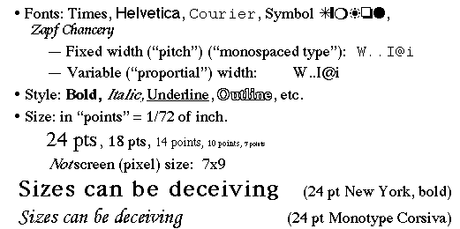
Font examples

Slide 44
Points
An odd and archaic unit of measurement
72.27 points per inch
Origin: 72 per French inch (!)
Postscript rounded to 72/inch
Most have followed
Early Macintosh: point==pixel (1/75th)

Slide 45
FontMetrics
Objects that allow you to measure characters, strings, and properties of whole fonts

Slide 46
Reference point and baseline
Each glyph has a reference point
Draw a character at x,y, reference point will end up at x,y (not top-left)
Reference point defines a “baseline”
p

Slide 47
Advance width
Each glyph has an “advance width”
Where reference point of next glyph goes along baseline
pa

Slide 48
Ascent and decent
Glyphs are drawn both above and below baseline
Distance below: “decent” of glyph
Distance above: “ascent” of glyph
p
Ascent
Decent

Slide 49
Standard ascent and decent
Font as a whole has a standard ascent and standard decent
pM
Std Ascent
Std Decent

Slide 50

Leading
Leading = space between lines of text
Pronounce “led”-ing after the lead strips that used to provide it
space between bottom of standard decent and top of standard ascent
i.e., interline spacing

Slide 51
Height
Height of character or font
ascent + decent + leading
not standard across systems: on some systems doesn’t include leading (but does in Java)
New question: is the leading above or below the text in Java?

Slide 52
Other Parameters
Kerning: overlapping of characters: VA, ff, V.
Stroke: Element of a character that would have originally been created with a single pen stroke
Em: Equal to the font's point size. So an "Em-dash" in a 18 point font is 18points wide: (option-shift-underline on Mac)
En: Half font's point size. "En-dash" is 9 points wide in 18 point font: (Mac: option-underline)
- DASHES – DASHES—DASHES

Slide 53

Types of Fonts
Bitmap fonts: look bad when scaled up. Best appearance at native resolution. Times vs.
Sometimes used for dingbats, wingdings
Postscript fonts: by Adobe, described by curves and lines so look good at any resolution, often hard to read when small
TrueType fonts: similar to Postscript: font is a program abcd
Supported by Java: java.awt.font.TRUETYPE_FONT
OpenType, etc. – web fonts are scalable

Slide 54
Encoding of Characters
Conventional ASCII
One byte per character
Various special characters in lower and upper part of fonts
Depends on OS, font, etc.
Unicode: http://www.unicode.org
16 bits per character
All the world’s languages
Java and web use Unicode

Slide 55
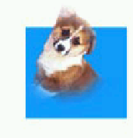


Images
Pictures created externally
“Bitmaps”, “Pixmaps”
Various encodings
bmp, pict, gif, tiff, jpeg, png, …
Issues:
Origin for when used as a cursor
Encodings for transparency
Windows cursors and gif files
Java uses alpha compositing
gif & png do support it, jpg does not

Slide 56
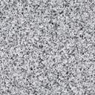

Clipping and “Stencils”
X windows, Mac, etc. can clip drawing to a set of rectangles
Must be non-overlapping
Important for refresh
Can make drawing more efficient
Java:
a single clip rectangle: setClip(int x, int y, int width, int height) Sets the current clip to the rectangle specified by the given coordinates. clipRect(int x, int y, int width, int height) Intersects the current clip with the specified rectangle.
Clip to arbitrary shape setClip(Shape clip) Sets the current clipping area to an arbitrary clip shape.
JS Canvas: ctx.clip();

Slide 57
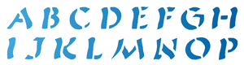

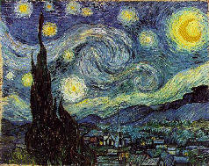


“Stencils”
Model is like the stencils used in crafts
Only see paint through the “holes”
Used for transparency, icons, other effects
Uses alpha compositing and shape clip mechanisms in Java

Slide 58


Coordinate Transformations
Supports
Translate - move
Rotate
Scale – change size (including flip = -scale)
Shear
Can modify any shape, including text
To fully understand, need matrix algebra:
Affine transformations are based on two-dimensional matrices of the following form:
a c t_{x} x
b d t_{y} y where x′ = ax + cy + t_{x} and y′ = bx + dy + t_{y}
1

Slide 59
How Parameters are Passed
How pass parameters for drawing operations?
Issue: Lots of parameters control the drawing of objects.
X drawline has at least 19
How many for Java swing?
Adds (at least): transformation matrix, antialiasing and other renderinghints, what else?

Slide 60
DrawLine Parameters
Window in which to draw
X1
Y1
X2
Y2
relative-p
line-width
draw function
background-color
foreground-color
cap style
line style (solid, dashed, double-dashed)
dash pattern
dash offset
stipple bitmap
stipple origin X
stipple origin Y
clip mask
plane mask (for drawing on specific planes)

Slide 61
How Pass Parameters?
Three basic possibilities
Pass all parameters with each operation
DrawLine(70,30,70,200, Red, ......)
- too many parameters
Not really used by any modern system

Slide 62
Passing Parameters, 2
All parameters stored in the system
Used by Macintosh, Display Postscript, etc.
Sometimes called the “pen”
Example (pseudo code):
SetColor(Red) MoveTo(70, 30) DrawTo(70, 200)
+ Fewer parameters to calls
+ Don't have to set properties don't care about
- Interrupts, multi-processing, may result in unexpected settings

Slide 63
Passing Parameters, 3
Store parameters in an object
JavaScript canvas “context”
canvas.getContext("2d");
X = “graphics context”
Windows = “device context”
corresponds to surface, but can push and pop
Java
“Graphics”, Graphics2D, Graphics3D objects
Lots of settings
Android
Has BOTH graphics object and Paint object
Parameters are in the Paint object

Slide 64
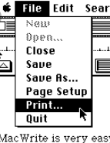
Historical reference
Early machines were all monochrome
Each pixel was black or white
Slow graphics
Tricks for highlighting and “grey”
“halftone” – every other pixel on

Slide 65
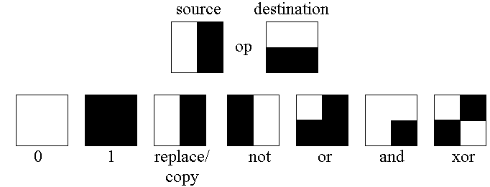

Draw Function
Replace (COPY)
XOR
And, OR, NOT, etc.
Makes it important to do the points only once
Anything XOR BLACK = inverted anything, XOR again and get original:
AND useful for making holes
Doesn’t work well in color
Java: Paint or XOR (setXORMode or setPaintMode)

Slide 66
RasterOp (BitBlt, CopyArea)
Copy an area of the screen graphics.copyArea (int x, int y, int width, int height, int dx, int dy) Copies an area of the component by a distance specified by dx and dy.
Used to have ability to combine with destination using Boolean combinations
Useful for moving, scrolling, erasing & filling rectangles, etc.
SmallTalk investigated using it for rotate, scaling, etc.
Not nearly as useful in color

Slide 67
Double Buffering
(Needed for Homework 3)
Save an extra picture offscreen
Smoother animations
Save hidden parts of windows
= “Backing store”
Use two buffers for special effects, faster refresh
“Save-under” for pop-ups
Use this for the temporary canvas for homework3
Need a way to draw interim feedback

Slide 68
Double Buffering (for a Canvas)
1. Make an off-screen copy of screen
2. Draw interim object on-screen
3. Erase by copying off-screen one to on-screen
Repeat steps 2-3 as interim object moves
(or make permanent by copying to off-screen)
1.
2.
3.
Onscreen (visible)
Offscreen (invisible)

Slide 69
Double Buffering for JavaScript Canvas
In workarea, have 3 full-size elements on top of each other
Create a temporary canvas on top of the “regular” canvas
<div id="workarea">
<canvas id="workarea-canvas" width="800" height="800"></canvas>
<canvas id="tempCanvas" width="800" height="800"></canvas>
<svg id="workarea-svg" width="800" height="800"></svg>
</div>
Remember, later one is on top – SVG is on top of Canvas, by specification
Make sure to control which one is visible
workareaCanvas.style.display = "block";
tempCanvas.style.display = "none";
Get temp’s context for drawing: let tempContext = tempCanvas.getContext("2d");
Copy contents from real (ctx) to temp canvas use: drawImage: https://www.w3schools.com/tags/canvas_drawimage.asp
tempContext.drawImage(workareaCanvas, 0, 0);
Now can draw on-screen, and easily restore old view
Onscreen (ctx)
Offscreen (tempContext)

Slide 70

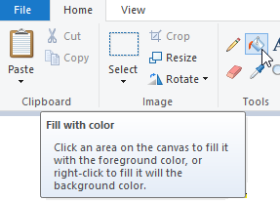
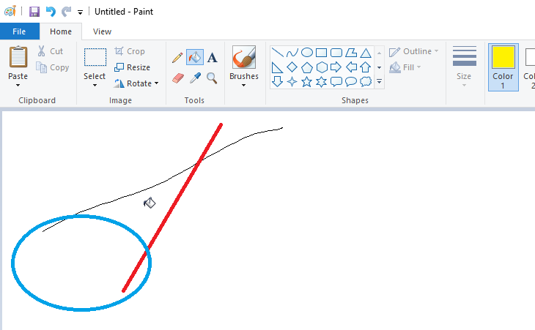
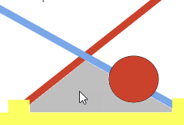

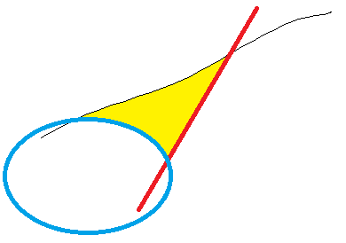
Flood Fill
You will do this for homework 3
We give you an implementation
Only available in painting programs
Issue: floodfill is SLOW, so don’t worry if it is taking a while
Added a wait cursor
Try not to click in the background! = 32 seconds!
Issue: anti-aliasing
Don’t worry about anti-aliasing for hw3

Slide 71
HW 3 hints: Modes
Similar to HW2 – need to enable and disable many handlers, and whole Canvas or SVG
Lots of global variables to keep track of the modes
Or use an enum, and think of it as a state machine
No enums in JS, but can use strings or const numbers
State machines will be covered in lecture 9
Grey out controls using styles and remove their event handlers, e.g.,
Both handler: borderColorSelection.classList.add("disabled");
Other handlers: borderColorSelection.classList.remove("disabled");
Or can put a div in front of them that is ½ transparent and also takes the events
Make svg or canvas layer appear and disappear using display
svg.style.display = "block"; // regular display
canvas.style.display = "none"; // invisible

Slide 72
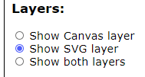
Radio buttons
Make the 3 radio buttons be mutually exclusive: use same “name” property
Handlers for each button controls modes for other controls and layers

