Slide 1
Lecture 4: Input 1: Conventional Input Models for Handling Input Events
05-431/631 Software Structures for User Interfaces (SSUI)
Fall, 2021

Slide 2
Logistics
HW 1 due today
HW 2 posted on website

Slide 3
Input Handling
Event handlers attached to UI elements
Most window managers and toolkits have used this same model
True of JavaScript as well
Quite old and has problems
Quickly gets to be complex
Don’t face it much if just use built in widgets and just “click” actions
Most important for highly interactive systems
Games, graphical editors
Or to create custom behaviors and widgets

Slide 4
Quotes
“One of the most complex aspects of Xlib programming is designing the event loop, which must take into account all of the possible events that can occur in a window.” -- Nye & O'Reilly X Toolkit Intrinsics Programming Manual, vol. 4, 1990, p. 241.
“The dispatching and handling of events is rather complicated.” -- Galaxy Reference Manual, v1.2, p. 20-5.

Slide 5
Event Records
Structures (records) composed of all information about events
Created by window manager, sent to a queue for each window
X/11 window manager from 1987 defines 33 different types of events

Slide 6
X Event Types
buttonPress
keyPress
keyRelease
buttonRelease
motionNotify
enterNotify
leaveNotify
focusIn
focusOut
keymapNotify (change keymap)
Expose
graphicsExpose (source of copy not available)
noExpose (source of copy is available)
colormapNotify
propertyNotify (some property changed)
visibilityNotify (become covered)
resizeRequest
circulateNotify (stacking order)
configureNotify (resize or move)
destroyNotify (was destroyed)
gravityNotify (moved due to gravity)
mapNotify (became visible)
createNotify
reparentNotify (in diff. window)
unmapNotify (invisible)
circulateRequest
configureRequest
mapRequest
mappingNotify (keyboard mapping)
clientMessage
selectionClear (for cut and paste)
selectionNotify
selectionRequest

Slide 7
Windows .Net Events
AutoSizeChanged
BackColorChanged
BackgroundImageChanged
BackgroundImageLayoutChanged
BindingContextChanged
CausesValidationChanged
ChangeUICues
Click
ClientSizeChanged
ContextMenuChanged
ContextMenuStripChanged
ControlAdded
ControlRemoved
CursorChanged
Disposed
DockChanged
DoubleClick
DragDrop
DragEnter
DragLeave
DragOver
EnabledChanged
Enter
FontChanged
ForeColorChanged
GiveFeedback
GotFocus
HandleCreated
HandleDestroyed
HelpRequested
ImeModeChanged
Invalidated
KeyDown
KeyPress
KeyUp
Layout
Leave
LocationChanged
LostFocus
MarginChanged
MouseCaptureChanged
MouseClick
MouseDoubleClick
MouseDown
MouseEnter
MouseHover
MouseLeave
MouseMove
MouseUp
MouseWheel
Move
PaddingChanged
Paint
ParentChanged
PreviewKeyDown
QueryAccessibilityHelp
QueryContinueDrag
RegionChanged
Resize
RightToLeftChanged
SizeChanged
StyleChanged
SystemColorsChanged
TabIndexChanged
TabStopChanged
TextChanged
Validated
Validating
VisibleChanged
Source: http://msdn.microsoft.com/en-us/library/1dk48x94.aspx

Slide 8
JavaScript DOM events
MutationEvent
OfflineAudioCompletionEvent
OverconstrainedError
PageTransitionEvent
PaymentRequestUpdateEvent
PointerEvent
PopStateEvent
ProgressEvent
RelatedEvent
RTCDataChannelEvent
RTCIdentityErrorEvent
RTCIdentityEvent
RTCPeerConnectionIceEvent
SensorEvent
StorageEvent
SVGEvent
SVGZoomEvent
TimeEvent
TouchEvent
TrackEvent
TransitionEvent
UIEvent
UserProximityEvent
WebGLContextEvent
WheelEvent
AnimationEvent
AudioProcessingEvent
BeforeInputEvent
BeforeUnloadEvent
BlobEvent
ClipboardEvent
CloseEvent
CompositionEvent
CSSFontFaceLoadEvent
CustomEvent
DeviceLightEvent
DeviceMotionEvent
DeviceOrientationEvent
DeviceProximityEvent
DOMTransactionEvent
DragEvent
EditingBeforeInputEvent
ErrorEvent
FetchEvent
FocusEvent
GamepadEvent
HashChangeEvent
IDBVersionChangeEvent
InputEvent
KeyboardEvent
MediaStreamEvent
MessageEvent
MouseEvent
Source: https://developer.mozilla.org/en-US/docs/Web/API/Event

Slide 9
Sub types of MouseEvent
onclick | The event occurs when the user clicks on an element
oncontextmenu | The event occurs when the user right-clicks on an element to open a context menu
ondblclick | The event occurs when the user double-clicks on an element
onmousedown | The event occurs when the user presses a mouse button over an element
onmouseenter | The event occurs when the pointer is moved onto an element
onmouseleave | The event occurs when the pointer is moved out of an element
onmousemove | The event occurs when the pointer is moving while it is over an element
onmouseout | The event occurs when a user moves the mouse pointer out of an element, or out of one of its children
onmouseover | The event occurs when the pointer is moved onto an element, or onto one of its children
onmouseup | The event occurs when a user releases a mouse button over an element
Source: https://www.w3schools.com/jsref/obj_mouseevent.asp

Slide 10
Mouse Event Properties
altKey | Returns whether the "ALT" key was pressed when the mouse event was triggered
button | Returns which mouse button was pressed when the mouse event was triggered
buttons | Returns which mouse buttons were pressed when the mouse event was triggered
clientX | Returns the horizontal coordinate of the mouse pointer, relative to the current window, when the mouse event was triggered
clientY | Returns the vertical coordinate of the mouse pointer, relative to the current window, when the mouse event was triggered
ctrlKey | Returns whether the "CTRL" key was pressed when the mouse event was triggered
getModifierState() | Returns true if the specified key is activated
metaKey | Returns whether the "META" key was pressed when an event was triggered
movementX | Returns the horizontal coordinate of the mouse pointer relative to the position of the last mousemove event
movementY | Returns the vertical coordinate of the mouse pointer relative to the position of the last mousemove event
offsetX | Returns the horizontal coordinate of the mouse pointer relative to the position of the edge of the target element
offsetY | Returns the vertical coordinate of the mouse pointer relative to the position of the edge of the target element
pageX | Returns the horizontal coordinate of the mouse pointer, relative to the document, when the mouse event was triggered
pageY | Returns the vertical coordinate of the mouse pointer, relative to the document, when the mouse event was triggered
region
relatedTarget | Returns the element related to the element that triggered the mouse event
screenX | Returns the horizontal coordinate of the mouse pointer, relative to the screen, when an event was triggered
screenY | Returns the vertical coordinate of the mouse pointer, relative to the screen, when an event was triggered
shiftKey | Returns whether the "SHIFT" key was pressed when an event was triggered
which | Returns which mouse button was pressed when the mouse event was triggered
Source: https://www.w3schools.com/jsref/obj_mouseevent.asp

Slide 11
Sub Types of Touch Event
ontouchcancel | The event occurs when the touch is interrupted
ontouchend | The event occurs when a finger is removed from a touch screen
ontouchmove | The event occurs when a finger is dragged across the screen
ontouchstart | The event occurs when a finger is placed on a touch screen

Slide 12
Touch Event Properties
Some touch devices also have keyboard keys
altKey | Returns whether the "ALT" key was pressed when the touch event was triggered
changedTouches | Returns a list of all the touch objects whose state changed between the previous touch and this touch
ctrlKey | Returns whether the "CTRL" key was pressed when the touch event was triggered
metaKey | Returns whether the "meta" key was pressed when the touch event was triggered
shiftKey | Returns whether the "SHIFT" key was pressed when the touch event was triggered
targetTouches | Returns a list of all the touch objects that are in contact with the surface and where the touchstart event occured on the same target element as the current target element
touches | Returns a list of all the touch objects that are currently in contact with the surface

Slide 13
Inherited Properties for both (from Event)
bubbles | Returns whether or not a specific event is a bubbling event
cancelBubble | Sets or returns whether the event should propagate up the hierarchy or not
cancelable | Returns whether or not an event can have its default action prevented
composed | Returns whether the event is composed or not
createEvent() | Creates a new event
composedPath() | Returns the event's path
currentTarget | Returns the element whose event listeners triggered the event
defaultPrevented | Returns whether or not the preventDefault() method was called for the event
eventPhase | Returns which phase of the event flow is currently being evaluated
isTrusted | Returns whether or not an event is trusted
preventDefault() | Cancels the event if it is cancelable, meaning that the default action that belongs to the event will not occur
stopImmediate-Propagation() | Prevents other listeners of the same event from being called
stopPropagation() | Prevents further propagation of an event during event flow
target | Returns the element that triggered the event
timeStamp | Returns the time (in milliseconds relative to the epoch) at which the event was created
type | Returns the name of the event

Slide 14
Examples: Mouse
document.addEventListener(
"click", // or "dblclick"
(event) => {
event.target // what clicked on
event.clientX // x location of the click
event.clientY // y location of the click }
);
Or might attach to a particular target object:
const workarea = document.querySelector("#workarea");
workarea.addEventListener("click", () => {console.log("click on workarea");}
);

Slide 15
Examples: touch
document.addEventListener(
"touchstart",
(event) => {
if (event.touches.length === 1) { // first finger
…
} else if (event.touches.length === 2) { //second finger
…
}
});

Slide 16
What events are generated?
When double click with the mouse?
See https://www.cs.cmu.edu/~bam/uicourse/05631fall2021/HW2/input-test/

Slide 17
What events are generated?
When double click with the mouse?
Answer:
mousedown
mouseup
click -- e.detail has click count = 1
mousedown
mouseup
click
dbclick -- e.detail has click count = 1
Can keep clicking and click count will go up, but no named events (no “tripleclick”)

Slide 18
What about for touch events?
Important: no touch “click” equivalent in JavaScript
But wants to have code that works across regular and touch devices
So touches also (sometimes) generate mouse events
Generates touchstart, touchend, mouseover, mousemove, mousedown, mouseup, click, [dblclick]
But only up to 2 clicks (no 3 click)
See https://www.cs.cmu.edu/~bam/uicourse/05631fall2021/HW2/input-test/index.html

Slide 19
What does “click” mean?

Slide 20
What does “click” mean?
In most systems, must be short time, and not move before release

Slide 21
What does “click” mean?
In JavaScript, for mouse, does not depend on movement or time
Can press mouse button and hold for arbitrary amount of time
Can press and move, as long as stay over same object
But dblclick does depend on time
But on iPhone, touch-ing only generates click if short and don’t move
Can feel the “long-press” timeout – phone vibrates

Slide 22
Implications for the UI
What does all this mean for what you can have click, double click, and triple click do?

Slide 23
Implications for the UI
What does all this mean for what you can have click, double click, and triple click do?
Click behavior always happens before double click behavior
Otherwise would need a timeout to wait and see if the double click happens
Single click => select, double click => open
Selecting text with 1,2,3 clicks in Chrome, PowerPoint or Word

Slide 24
Strategies for Multiple Behaviors
Different things happen on mouse down depending on:
Mode
What press down on
What do next (release, move, …)
E.g., press-move vs. click
How control this? Two main strategies
1) put event handlers on the objects only when relevant, and remove them when not, dynamically
E.g., put a click handler on each target when waiting for click, remove it when not.
2) put event handlers globally, e.g., on document, and control behavior with global variable(s)

Slide 25
Select vs. Move
Why doesn’t this work: target.addEventListener(
"mousedown",
(event) => { … } ); target.addEventListener( "mousemove",
(event) => { … } );
Need to have move handler on the background, not on the target
workarea

Slide 26
Click vs. Move Differentiation
If need to differentiate single click from double (or two fingers down), then do need a timeout
setTimeout(function, milliseconds, param1, param2, ...)
Parameters sent to the function
Function might remove the double-click handler, and perform the single click function
Alternatively, may be sufficient to perform action on mouseup (or touchstop) if no extra mousedown or mousemove (or touchdown, touchmove)

Slide 27
Coordinating multiple behaviors
For button like behavior, can have one onclick handler per button
But if doing graphics in JavaScript, seems better to have fewer, more global event handlers, like on the document
Then use event.target to find where actually happened
Control modes with one (or a few) global variables
Want enum (but not in JS), can use strings: “idle”, “pressdown”, moving”, “doubleclickmoving”, “aborting”, …

Slide 28
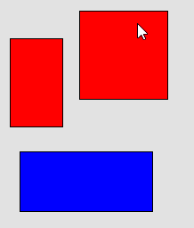
Hints for Homework 2
Will need a lot of global variables to keep track of the state and modes:
selected_object, object_being_dragged_around, double_click_mode, object_being_resized, touch_count, touch_point_delta, orig_size_position, etc.
Will need a lot of different kinds of event handlers attached to different kinds of objects – targets and background
Each handler will need lots of if statements, depending on the global variables

Slide 29
Propagation
Events sent to the lowest level DOM element containing the pointer
If event not consumed by a handler, then sent to the container element, etc.
Handlers say whether they handled (consumed) the event or not
JavaScript: event.stopPropagation();
See 3 and more clicks in input-test
Android: onXXXX() handlers return Booleans

Slide 30
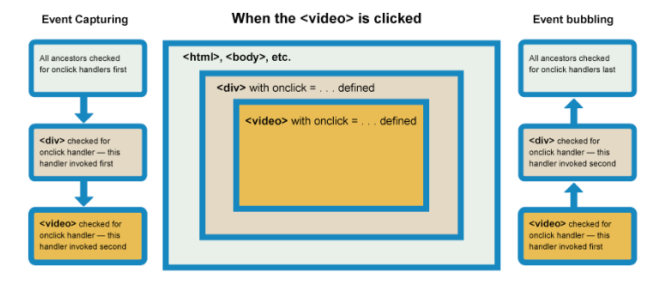
JavaScript Propagation
JavaScript for the web goes both down and then up the container tree, due to combining the way that IE and Mozilla did it, and handlers can pick which one they want.
“Capturing” vs. “bubbling”
Default = bubbling, but runs all, unless call stopPropagation()
https://developer.mozilla.org/en-US/docs/Learn/JavaScript/Building_blocks/Events#Event_bubbling_and_capture

Slide 31
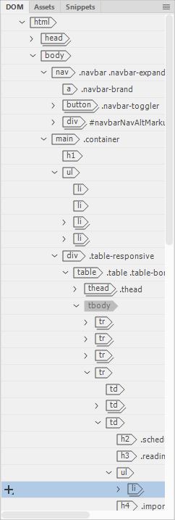
JavaScript Propagation
Third parameter to addEventListener is whether down (Capturing) or up (bubbling)
Default = false = up (“bubble”);
true – handled on the way down
Can have multiple handlers, both up and down!
See special divs in input-test: https://www.cs.cmu.edu/~bam/uicourse/05631fall2021/HW2/input-test/
Capturing useful in rare situations
Often with stopPropagation()
E.g., only scroll container; touches ignore internal objects, etc.

Slide 32

Issue: Covering
Which objects get an event when overlapping
“Z” order vs. containment
What about when top object doesn’t want event?
Can’t necessarily use obj.contains(eventX, eventY)
Input mechanism must know about graphical objects
Handled automatically by DOM
Bounding box vs. on object
Complexities: http://developer.apple.com/library/ios/#documentation/EventHandling/Conceptual/EventHandlingiPhoneOS/event_delivery_responder_chain/event_delivery_responder_chain.html#//apple_ref/doc/uid/TP40009541-CH4-SW2

Slide 33
Text Events - Which Window?

Slide 34
Text Events - Which Window?
Called “focus”
Old name: “active” window
My old name: “Listener” window
Click to Type
Move to Type
Affects what kinds of interactions are possible
Mac single menubar not possible with move-to-type
Note difference with “mouse” events focus vs. scroll events focus!
Windows and Mac
Also which text input widget has the focus
So also relevant to smartphones

Slide 35
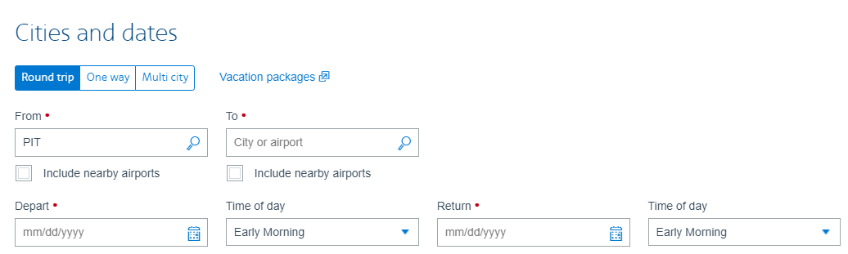
Multiple Text Fields
https://www.aa.com/booking/find-flights
<form>
Field 1 (first tab selection):
<input type="text" name="field1" tabindex=1 /><br />
Field 2 (third tab selection):
<input type="text" name="field2" tabindex=3 /><br />
Field 3 (second tab selection):
<input type="text" name="field3" tabindex=2 /><br />
</form>
ref
Click or tab to select which field
Tab order includes all kinds of input
Especially important for accessibility
Default = DOM order
Control with tabindex property in html

Slide 36
JavaScript: Assign Focus manually
Need to do the following
// enable getting the keyboard focus
// https://stackoverflow.com/questions/18928116/javascript-keydown-event-listener-is-not-working
workspace.setAttribute("tabindex", -1);
// give it the keyboard focus to start
// https://stackoverflow.com/questions/6754275/set-keyboard-focus-to-a-div/6809236
workspace.focus();
// now can listen for keyboard events
workspace.addEventListener("keydown", (event) => { console.log("key=" + event.code);
if (event.code == "Escape") {
console.log("abort"); … do abort stuff }
});

Slide 37
Gestural “Events”
Many libraries add gestural events
swipe, multi-touch pinch and rotate recognizers
Long press on Android or iPhone
Come in as if they were regular events
So lower-level code doesn’t need to distinguish
Android has separate “gesture” classes
iOS: Gesture Recognizers

Slide 38
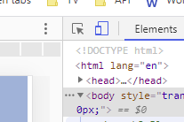
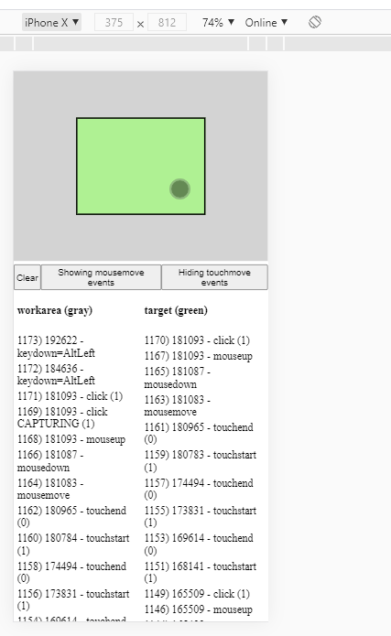
Note: Debugging Touch on Chrome
Can go into mouse/tablet mode
Pick device size
Mouse actions pretend to be touch
Just 1 finger

Slide 39
Debugging events on phones
See instructions on homework 2 for debugging Chrome on Android and iOS
Note: not Safari browser on iOS
Can use console() output to debug and see what’s happening
Thanks Clara!

Slide 40
Event Handling in Other Systems
Other systems need additional kinds of events
E.g., window manipulations – iconify, delete, etc.
Keyboard keys down and up
For when refresh needed
Not needed in JavaScript

Slide 41
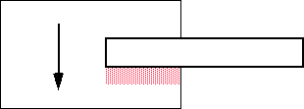
Issue: Scrolling Refresh in X/11
Race condition when copy from an area that might be covered
X/11 provides graphicsExpose and noExpose events

Slide 42
Other Architectures
Old (e.g., Windows SDK): giant switch statement per window
Branch for each event
But not dependent on mode, which object, etc.
Global event handlers for each type of event
No matter where that event happens in the window
E.g., per Activity in Android
Specific event handlers per object
Java Swing: button1.addActionListener(this);
Android: View event listeners (since widgets are views)
JavaScript: obj1.addEventListener ( )
Lots of issues with multiple threading

Slide 43
Translation Tables
Not available in JavaScript – native window systems
So particular mouse key or keyboard key not hard-wired into application.
Allows user customization and easier changes
Supported in Motif by the resources mechanism
e.g. Shift<Btn1Down>: doit() can be put in .Xdefaults, and then application deals with doit, and user can change bindings.
Keyboard translation is 2 step process in X:
Hardware "keycodes" numbers mapped to "keysyms"
"Keysyms" translated to events
For double-clicking, Motif does translation, but not Xlib
For non-widgets, have to do it yourself
Always also get the single click events
Java – no built-in double click support
Does have click vs. drag
Browser / OS level for JavaScript
E.g., can swap left/right mouse buttons for left-handed people

