Slide 1
05-431 / 05-631
Software Structures for User Interfaces (SSUI)
Brad Myers
Human Computer Interaction Institute
Fall, 2021

Slide 2
Course:
Course web page:
  Temporarily: http://www.uicourse.org/
  http://www.cs.cmu.edu/~bam/uicourse/05631fall2021
Schedule / Syllabus:
  http://www.cs.cmu.edu/~bam/uicourse/05631fall2021/schedule.html
Tuesday / Thursday, 3:05PM - 4:25PM
Completely redesigned last year – you are the second class

Slide 3
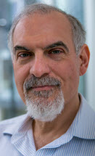

Instructor
Brad Myers
  Human Computer Interaction Institute
  Office: Newell-Simon Hall (NSH) 3513
  Office Phone: 412-268-5150
  E-mail: bam@cs.cmu.edu
  http://www.cs.cmu.edu/~bam
TA: Clara Cook
  MHCI
  https://claracook.web.app/
  Email: clarac@andrew.cmu.edu

Slide 4
Office Hours
Homeworks are due on Tuesdays and Thursdays before class
  See: https://www.cs.cmu.edu/~bam/uicourse/05631fall2021/homeworks.html
Tentative:
  Clara’s office hour: Mondays at 1:30-2:30
  My office hour: Wednesdays at 3:30-4:30
Or post questions on Piazza – will usually answer right away

Slide 5

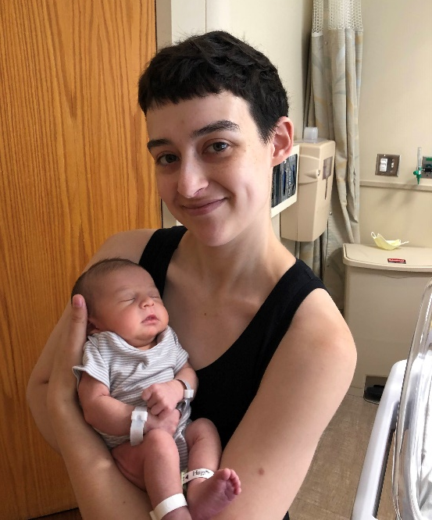
Acknowledgements
Thanks to PhD student Michael Liu and
Mary Beth Kery for consultations on content, homeworks and web page design
Michael wrote most of the reference implementations for the homeworks
  Continues to consult on design
Corey Emery – TA last year
  Helped develop most of the homeworks
Also discussions with Profs. Scott Hudson, Jen Mankoff, and many others

Slide 6
Other HCI Courses
We will not cover UI design
  Homeworks specify the designs
  You need to do software design and implementation to match the spec.
We will not cover UX / HCI Methods
  Not how to evaluate a user interface, needs analysis, or iterative prototyping
Not redundant with any other HCI course
Other courses that provide an overview of HCI or teach methods:
  05-391/891 Designing Human Centered Software (DHCS) – best overview
  05-410/610 User-Centered Research and Evaluation (UCRE) – UX methods
  05-430/630 Programming Usable Interfaces (PUI) – iterative prototyping
    Prof. Alex Ion from PUI says our 1st homework is most of the programming in PUI
  05-863 Introduction to Human Computer Interaction for Technology Executives

Slide 7
Course History
05-431/631 Software Structures for User Interfaces (SSUI)
  also Software Architectures for UIs (SAUI)
  One of the first HCII courses
  I taught it in 2001
  Focused on Java programming
430/630 PUI added later, with prototyping/iterative design
Fewer CS students in MHCI/BHCI programs
All students wanted PUI content
“SSUI" then became a lab in PUI – now just called “Advanced Lab”
Fall’2020 – started over since SSUI needed for new HCI Major
  Purely virtual
This is the second time taught – 1st time in-person

Slide 8
Readings
Schedule & readings:
  https://www.cs.cmu.edu/~bam/uicourse/05631fall2021/schedule.html
  Will link to the slides for each lecture
  Course schedule is tentative
  Note required readings – only a few that aren’t part of homeworks
  Lots of “Recommended” and “Optional”
    Recommended - Good background on that topic; what you should know
    Optional – other interesting or historically important readings
  CMU-only and ACM DL, use CMU network or VPN

Slide 9
Homeworks
Homeworks
  https://www.cs.cmu.edu/~bam/uicourse/05631fall2021/homeworks.html
Take Home Midterm
  Was popular last year, so doing it again
  No Final
See homework policies
    Due before class on the scheduled date, homeworks can be turned in late for a penalty, homeworks are individual, no cheating, turn in on Canvas.
Schedule + Homeworks = Syllabus
Questions using Piazza: piazza.com/cmu/fall2021/05431631/home
Turn-in using Github
  Has everyone used Github?

Slide 10
Final Project
https://www.cs.cmu.edu/~bam/uicourse/05631fall2021/FinalProject/index.html
Create your own
Can be a reimplementation or novel & publishable
Will be in groups
Start 11/9/2021 – will have about 1 month
Lots of topic ideas on the final projects page
Last year, many groups used a natural language toolkit to build a multi-modal UI

Slide 11
What is this class about?
“Software Structures for User Interfaces”
“User Interfaces” (UI)
  The part of an application or device that a person sees or interacts with
  Everything the user can see, the look-and-feel, all behaviors, speed of interaction, etc.
“Software Structures”
  How the UI is implemented = “Front end programming”
  Software patterns / architectures across many platforms
    Not just what is popular today
  Complexities unique to UIs

Slide 12
What Will This Class Cover?
Key principles & structures for implementing UIs
Most have stood the “test of time”
  Some invented in the 1980s and still used today
Key tradeoffs and design decisions for the implementations
Will continue to be useful with the next library & language

Slide 13
But what specifically?
}
(See the schedule and homework list)
HTML, CSS, JavaScript, React
  Their models, principles, hierarchies, intersections and differences
  (But you need to learn the details on your own)
Input handling
  Click, double-click, drag, touch, multiple fingers, other sensors
2D output
  Canvas vs. retained object model, details of 2D graphics, refresh
Implementing Undo
Connecting to a backend, using web services, cloud database
Other Implementation details: resources, geometry management
Constraints and data bindings
Model-view-controller and other architectures
Interactive UI builders & prototypers
Implementing for accessibility
Specialized UI tools: visualization, 3D, AR/VR, conversational UIs, UbiComp, animation
homeworks

Slide 14
People’s Backgrounds
Based on your survey answers from the Google Form
Questions mostly matched what we will cover

Slide 15
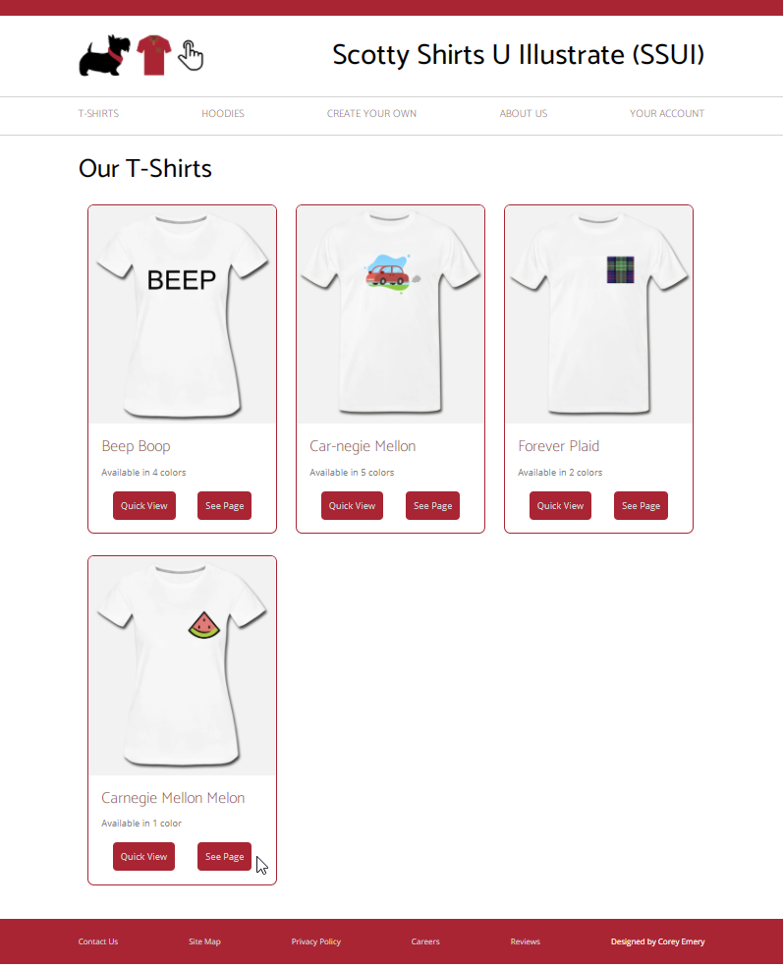
Homework 1
Assigned today, due 9/9/2021 at 3:05pm ET (next Thursday)
https://www.cs.cmu.edu/~bam/uicourse/05631fall2021/HW1/
Build a dynamic website to sell T-shirts
  Dynamic = some parts of pages created using your JavaScript code
Detailed specification (no UI design needed)
Only needs to run on Chrome on regular size screens
  Not “responsive”

Slide 16
Idea: Special Lab session by
Clara (TA) on html/css/JS?
Would it be useful to have a special lab sessions by Clara (TA) on html/css/JS?
If so, when?
One later about React?
Any other homework topics?

Slide 17
Why is This Important?
Virtually all UIs are created using such Tools
Previous research has influenced today’s tools
  Enormous impact!
New tools are created all the time
  E.g., Flutter for Dart language and mobile
  Some are easier to use than others!
Principles and architectures for good designs
  Avoid “reinventing the wheel”
  What are the “best practices” for these tools
Modern UIs and Tools for web, phones, wearables, Smart TVs, etc. all use similar designs
  Speech and conversational interfaces are different
Research topic in ACM UIST, CHI
  Also ICSE, SPLASH, PLATEAU, CHASE, many others

Slide 18
Why are User Interfaces Difficult to Design?

Slide 19
Why Hard to Design UIs?
“It is easy to make things hard. It is hard to make things easy.”
No silver bullet
Seems easy, common sense, but seldom done right
  Once done right, however, seems “obvious”
User Interface design is a creative process
Designers have difficulty thinking like users
  Often need to understand task domain
  Can’t “unlearn” something

Slide 20
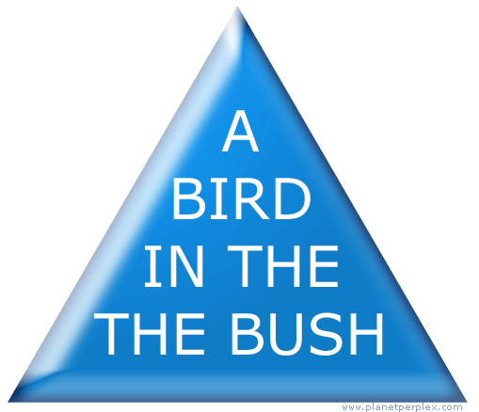
Can’t Unlearn Something

Slide 21
Why Difficult, 2
Specifications are always wrong:
  "Only slightly more than 30% of the code developed in application software development ever gets used as intended by end-users. The reason for this statistic may be a result of developers not understanding what their users need."
    -- Hugh Beyer and Karen Holtzblatt,
    "Contextual Design: A Customer-Centric
    Approach to Systems Design,“
    ACM Interactions, Sep+Oct, 1997, iv.5, p. 62.
  Need for prototyping and iteration

Slide 22
Why Difficult, 3
Tasks and domains are complex
  Word 1 (100 commands) vs. Word 2013 (>2000)
  MacDraw 1 vs. Illustrator
  BMW iDrive adjusts over 700 functions
Adding graphics can make worse
  Pretty ≠ Easy to use
Can’t necessarily just copy other designs
  Legal issues
All design/development involves tradeoffs
  Add Features
  Test/Fix Bugs
  Test/Fix usability
  Time-to-market

Slide 23
Why are User Interfaces Difficult to Implement?

Slide 24
What are the most difficult kinds of programs, in general?
What properties make a task difficult to program?

Slide 25
What are the most difficult kinds of programs, in general?
What properties make a task difficult to program?
GUI programming has most of them!

Slide 26
Why Are User Interfaces Hard to Implement?
They are hard to design, requiring iterative implementation
  Not the waterfall model: specify, design, implement, test, deliver
They are reactive and are programmed from the "inside-out"
  Event based programming
  More difficult to modularize

Slide 27
Why Hard to Implement? cont.
They generally require multi-processing
  To deal with user typing; aborts
  Window refresh
  Window system as a different process
  Multiple input devices
There are real-time requirements for handling input events
  Output 60 times a second
  Keep up with mouse tracking
  Video, sound, multi-media

Slide 28
Why Hard to Implement? cont.
Need for robustness
  No crashing, on any input
  Need for security, e.g., protect from SQL injection attacks
  Helpful error messages and recover gracefully
  Aborts
  Undo
Lower testability
  No unit tests for user inputs
  Few tools for regression testing
Difficulty of Modularization
  Much code goes into event handlers

Slide 29
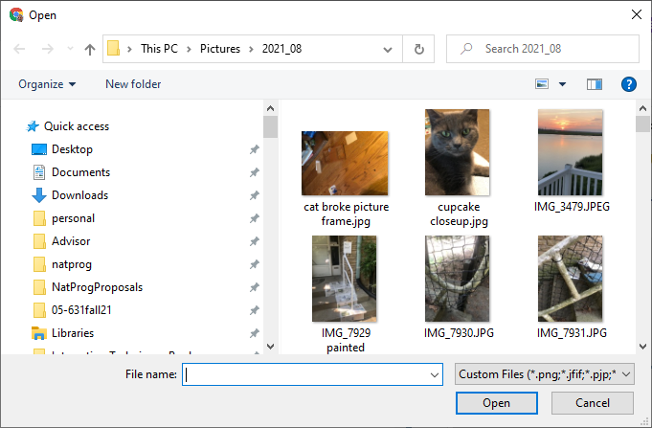
Examples
Difference between displaying “hello” and displaying a blue rectangle
  Easier with html/JavaScript!
Difficulty to read a file name
  Reading a text string from the console - const input = prompt();
  Configuring and handling built-in file dialog
    <input type="file"
    id="mypic" name="mypic"
    accept="image/png, image/jpeg">
  Creating a new file dialog

Slide 30
Goal: Gentle Slope Systems
High
Ceiling
Web Development
Java
Machine Learning
pandas
Server-side APIs
Visual Basic
numpy API
Client-side APIs
Swing
matplotlib.pyplot API
Difficulty
of
Use
csv loader
C or C# Programming
scikit-lean API
JavaScript
Machine Learning techniques
Python
CSS & HTML
Goal
Low
Threshold
Email
Filters
editor
Basic
Program Complexity and Sophistication

