Slide 1
Lecture 27: Animation in Toolkits
05-431/631 Software Structures for User Interfaces (SSUI)
Fall, 2020

Slide 2
Logistics
One more regular lecture!
Added topic, based on survey: “Toolkits for 3D Programming and the UIs of Games”
Project presentations next Thursday!
Will assign random order except for Viz wants to be first, Remote HQ requested to be 2nd – anyone else have constraints?
Everyone please attend!
Project code deliverables – invite Corey and me to github repository (even if reusing one of yours from the homeworks)

Slide 3
Animation
Definition
Objects change a visual property on their own
Doesn’t count if just following the mouse
Animation is now available everywhere
Perceptual advantages
Now have plenty of spare horsepower
Mainstream in UIs since Win ’98
Built into CSS and other toolkits by default now

Slide 4
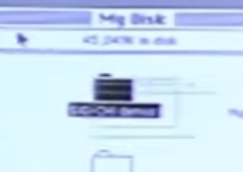
Classic Animation in Toolkits
Original Macintosh (1984)
Selected menu item: https://youtu.be/9qtd8Hc90Hw?t=1350
“Marching ants” to show selection in paint programs: “lasso tool”: https://youtu.be/9qtd8Hc90Hw?t=5580
Show icon <-> window transformation: https://youtu.be/9qtd8Hc90Hw?t=6088
Silly buttons on SGI machines: https://youtu.be/9qtd8Hc90Hw?t=2143

Slide 5
Why Animation?
Gives a feeling of reality and liveness
“animation” = “bring to life”
make inanimate object animate
Provides visual continuity (and other effects) enhancing perception
particularly perception of change
hard to follow things that just flash into & out of existence
real world doesn’t act this way

Slide 6

Why Animation, cont.
Can also be used to direct attention
movement draws attention
strong evolutionary reasons
therein lies a danger
overuse tends to demand too much attention
e.g., the dreaded paper clip
Used sparingly and understandingly, animation can enhance the interface

Slide 7
Three principles from traditional animation
Not mutually exclusive
Solidity
Make objects appear to be solid
Momentum, friction
Exaggeration
Exaggerate certain physical actions to enhance perception
Reinforcement
Effects to drive home feeling of reality

Slide 8
Specific techniques employing these principles
Good related paper: John Lasseter, “Principles of traditional animation applied to 3D computer animation”, Proceedings of SIGGRAPH ‘87, pp. 35 - 44
Solidity
want objects to appear solid and appear to have mass

Slide 9
Specific techniques employing these principles
Solidity
No teleportation
Objects must come from somewhere
not just “pop into existence”
Nothing in the real world does this (things with mass can’t do this)

Slide 10

Specific techniques employing these principles
Solidity
Motion blur
if objects move more than their own length (some say 1/2 length) in one frame, motion blur should be used
matches real world perception
makes movement look smoother
doesn’t need to be realistic
Related to anti-aliasing but for movement

Slide 11
Specific techniques employing these principles
Solidity
Squash and stretch
Cartoon objects are typically designed to look “squishy”
When they stop, hit something, land, they tend to squash
Like water balloon
Compress in direction of travel

Slide 12
Specific techniques employing these principles
Solidity
Squash and stretch
Also stretch when they accelerate
opposite direction
Basically an approximation of inertia + conservation of volume (area)

Slide 13
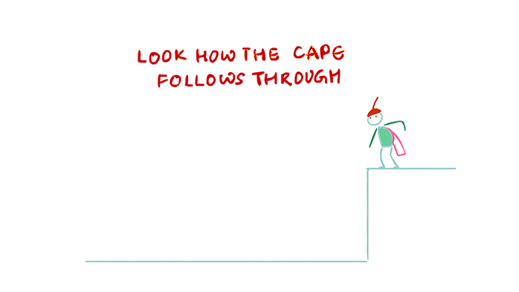
Specific techniques employing these principles
Solidity
Squash and stretch
Although squash and stretch makes things look “squishy” they contribute to solidity because they show mass
(This is tends to be exaggerated)
Follow through (& secondary action)
Objects don’t just stop, they continue parts of the motion
E.g., clothes keep moving, body parts keep moving
Reinforces that object has mass via inertia
Also tends to be exaggerated
credit: http://www.dsource.in/course/principles-animation/follow-through-and-overlapping-action

Slide 14
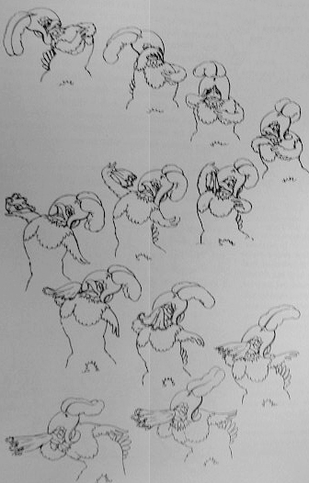
Follow Through
Notice feather lags behind character
Also squash and stretch here
From: Thomas & Johnston “The Illusion of Life: Disney Animation”, Hyperion, 1981

Slide 15
Specific techniques employing these principles
Exaggeration
Cartoon animation tends to do this in a number of ways
Paradoxically increases realism (liveness) by being less literal
What is really going on is tweaking the perceptual system at just the right points

Slide 16

Specific techniques employing these principles
Exaggeration
Anticipation
Small counter movement just prior to the main movement
This sets our attention on the object where the action is (or will be)
Squash & stretch
Follow through
Credit: https://iwanttobeananimator.wordpress.com/2017/07/27/lesson-8-anticipation/

Slide 17
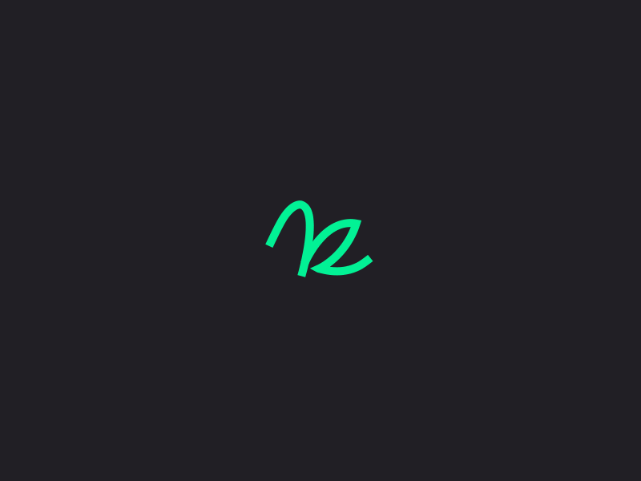
Specific techniques employing these principles
Reinforcement
Slow-in / Slow-out
Movement between two points starts slow, is fast in the middle, and ends slow
Two effects here
objects with mass must accelerate
interesting parts typically at ends
tweaking perception
Source: https://graphicdesign.stackexchange.com/questions/86578/how-can-i-make-a-smooth-gif-like-this

Slide 18
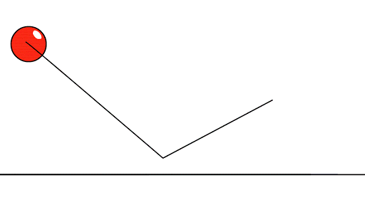
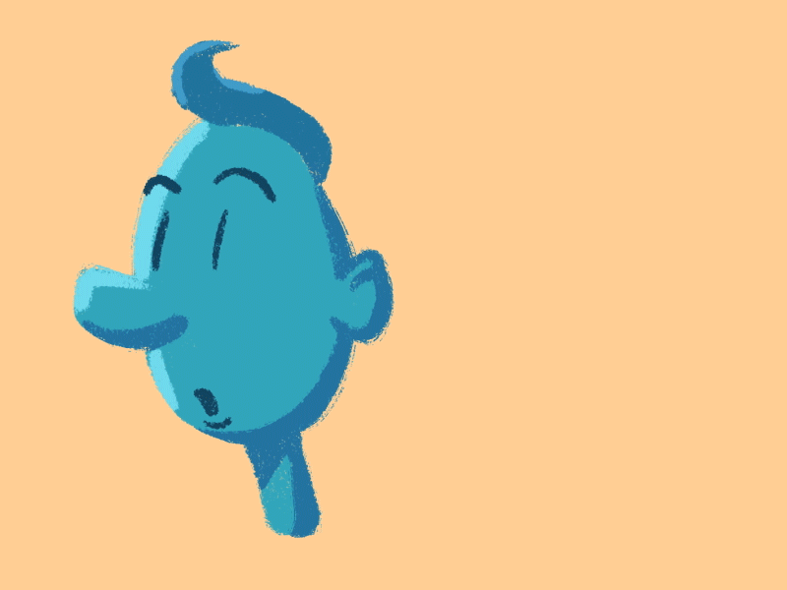
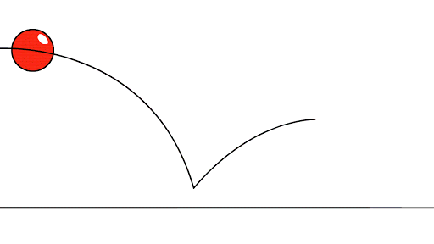
Specific techniques employing these principles
Reinforcement
Movement in arcs
Objects move in gently curving paths, not straight lines
Movements by animate objects are in arcs (due to mechanics of joints)
Most movements in gravity also in arcs
Source: https://www.pinterest.com/pin/499477414914079446/
Source: http://dsource.in/course/principles-animation/arcs

Slide 19
Recap
Appearance of mass
Solidity & conservation of volume
Several ways to show inertia
Tweak perception
Direct attention to things that count
Time on conceptually important parts
Caricature of reality

Slide 20
Reminder
Animation can bring otherwise boring things to life, but…
Its not a uniformly good thing
Demands a lot of attention
Can take time
Needs to be used wisely (and probably sparingly)

Slide 21
Making animation happen in a toolkit
Model in Amulet
High to middle level model
Robust to timing issues
Primary abstraction: animation as constraints
Just set slot value
Animation interpolates between new and old values
Special animations for visibility
True -> false, stays true until animation ends
Fly off, shrink, fade out, explode, etc.

Slide 22
Animation Constraints
Can be attached to any slot of an object
If slot is set, animation constraint
Removes the new value
Restores the old value
Sets slot with a series of values interpolated between the old and new values
Works on any type of slot
Position, color, line-style, visibility, point-list, etc.

Slide 23
Animation Constraints
Easy to attach animation constraints to slots
Instances will also have animations
Parameters
Fixed time or fixed speed
Commands to be executed when animation complete
New values interrupt or are queued
Anticipation and follow-through
Demo

Slide 24
Code for Animation Constraints
animator = Am_Animation.Create();
Rectangle_Prototype .Set(Am_LEFT, Am_Animate_With(animator)) .Set(Am_TOP, Am_Animate_With(animator));

Slide 25
Animating Bullet’s Position
Bullet = Am_Rectangle.Create() .Set(Am_TOP, 500) //start at bottom of window .Set(Am_TOP, Am_Animate_With( Am_Animator.Create() .Set(Am_VELOCITY, 300) .Set(Am_COMMAND, erase_bullet)));
Am_Object a_bullet = Bullet.Create(); a_bullet.Set(Am_TOP, -16);

Slide 26
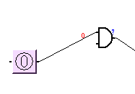
Command can propagate the value
Am_Object anim_proto = Am_Interpolator.Create() .Add_Part(Am_COMMAND, propagate_value_command);
moving_text_proto = Am_Text.Create() .Set(Am_LEFT, Am_Animate_With (anim_proto)) .Set(Am_TOP, Am_Animate_With (anim_proto));

Slide 27
Interrupting the Animation
50
100
0
New value Set
200
Not Interrupting
50
100
0
New value Set
200

Slide 28
Types of Animations
Can animate any type of slot, not just position
Colors
Through RGB or HSV color spaces
Point-lists of a polygon
List-of-values
Any type of list
Often used for pictures
Toggling between two values for blinking
Continuous animations
Cycle or Bounce commands

Slide 29
Cartoon Animations
Am_Circle.Create ("Wiggler") .Set (Am_TOP, Am_From_Sibling (MOVER, Am_TOP)) .Set (Am_TOP, Am_Animate_With ( Am_Exaggerated_Interpolator.Create () .Set(Am_WIGGLE_AMOUNT, 4)));

Slide 30
Color Change
color_change_rect = Am_Rectangle.Create () .Set (Am_FILL_STYLE, fetch_color) .Set (Am_FILL_STYLE, Am_Animate_With ( Am_Style_Interpolator.Create ()));
RGB
HSV

Slide 31



Point-List Animation
polygon = Am_Polygon.Create ("Polygon") .Set(Am_POINT_LIST, triangle_point_list) .Set(Am_POINT_LIST, Am_Animate_With ( Am_Point_List_Interpolator.Create());

Slide 32




Animation Through a List
walking_eye = Am_Bitmap.Create () .Set(Am_IMAGE, Am_Animate_With ( Am_List_Interpolator.Create () .Set(Am_LIST_PATH, list_of_pictures) .Set(Am_COMMAND, Am_Animation_Wrap_Command.Create())));

Slide 33
Animations for Visibility
Different “special effects” for when become visible and invisible
Sets other slots of objects using side-effects
Fade out using half-toning
Shrinking
Flying offscreen
Exploding

Slide 34
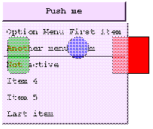
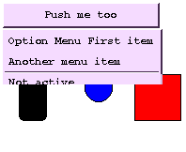
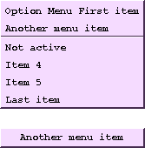
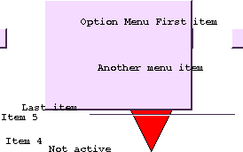
Animation of Visibility
Fade
Shrink
Fly Away
Explode

Slide 35
Other Parameters
Pacing function
Control timing
Set duration or speed
Also, slow-in-and-slow-out
Path function
How values are interpolated

Slide 36
Implementation
Animation constraint is an Amulet object with four methods:
Start
Timer — called at regular intervals
Stop
Abort — called when interrupted with a new value
These methods are in animator objects
Not in graphical objects
Usually no need to write new animators

Slide 37
Other features
Undoing Animations
Command objects are queued for Undo
Regular Undo will trigger animations
Commands in animations can be queued for undo
Debugging Animations
Interactive Inspector can:
Break when slot set
Pause, single-step and resume animations
Trace animations

Slide 38
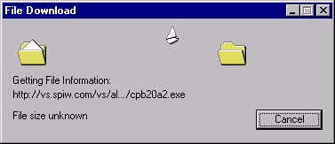
Other Uses of Animations
Progress bars and file transfer dialogs in Windows
iPhone animations
Animation in an out of apps
Screen changes – pages sweep across
Bounce at end of scroll

Slide 39
Uses of Animations
Games
Scroll bar arrows auto-repeat at constant speed
Visualizations
Making operations clearer
Undo, Align, Delete, etc.
Multi-user applications
Any time the user might not be able to see the results

Slide 40
CSS Transitions
CSS Transitions cause a property to change over time
Numeric properties interpolated: CSS: div { width: 100px; height: 100px; background: red; transition: width 2s; }
div:hover { width: 300px; }
transition-timing-function: defaults to ease = slow-in-slow-out
Other options: linear, cubic-bezier(n,n,n,n), etc.
Also colors (full list)
Can fade out element by transitioning opacity goes from 1..0

Slide 41
CSS Animations
Provide keyframes for values to go between @keyframes example { 0% {background-color:red; left:0px; top:0px;} 25% {background-color:yellow; left:200px; top:0px;} 50% {background-color:blue; left:200px; top:200px;} 75% {background-color:green; left:0px; top:200px;} 100% {background-color:red; left:0px; top:0px;} } /* The element to apply the animation to */ div { width: 100px; height: 100px; position: relative; background-color: red; animation-name: example; animation-duration: 4s; }
Can also control timing, iteration count, repeat direction (forwards/backwards), and many other properties

