Slide 1
Lecture 20:
Interactive Tools: Prototypers (HyperCard, Director, Visual Basic, Balsamiq), Interface Builders, and Sketching Tools
05-431/631 Software Structures for User Interfaces (SSUI)
Fall, 2020

Slide 2
Logistics
2 people late for HW5 – please finish soon!
HW6 due next Thursday, 11/12/2020, then start on projects right away!
Start thinking about final project ideas
  Lots of ideas here: https://www.cs.cmu.edu/~bam/uicourse/05631fall2020/FinalProject/index.html
  Enter proposals into Piazza before next Wed, 11/11/2020 at 8:00pm (in parallel with working on HW6)
  Try to form groups around the projects on Piazza
  We will finalize groups on Thursday, 11/12 in class, so you can get started right away (before Thanksgiving break)

Slide 3
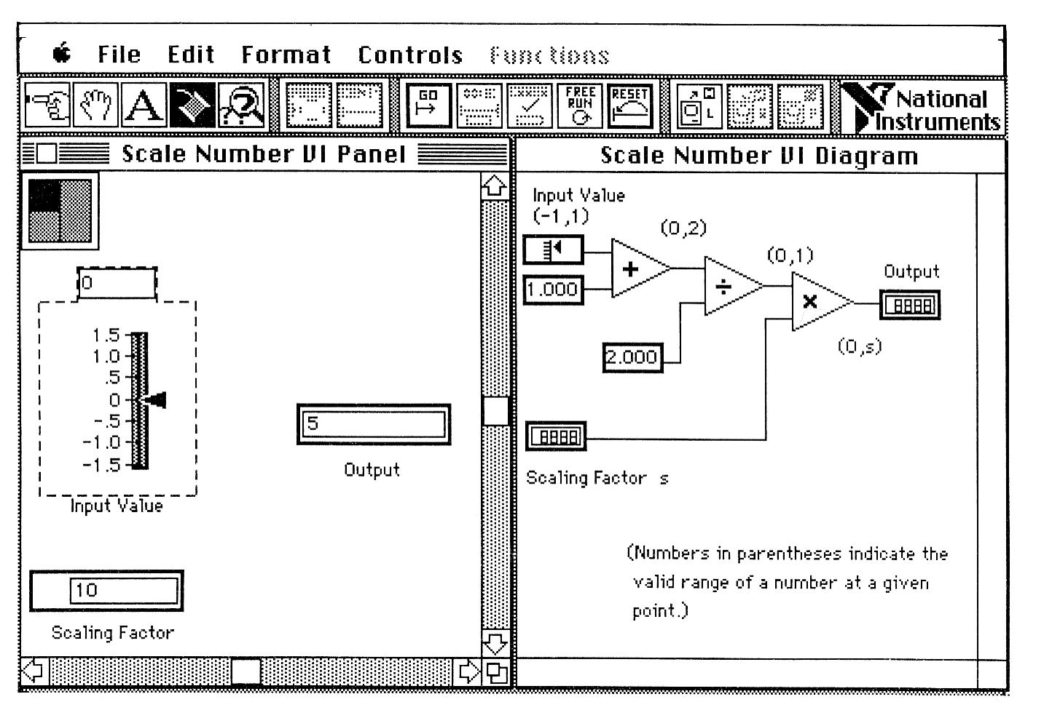
Definition
Tools that use graphical techniques to specify UI
Usually focus on graphical parts of UI
Not same as “visual” or “graphical programming”

Slide 4
Prototyping Tools
Just show what looks like
  Storyboard of screens
“Click-through prototypes”
Note: differentiate from term "rapid prototyping“
Some support for behavior: typically changing screens
Like a movie of the interaction
Goal: see some of interface very quickly (hours)
Often no possibility of migrating to real application
May not use "real" widgets
"Low Fidelity" Techniques

Slide 5
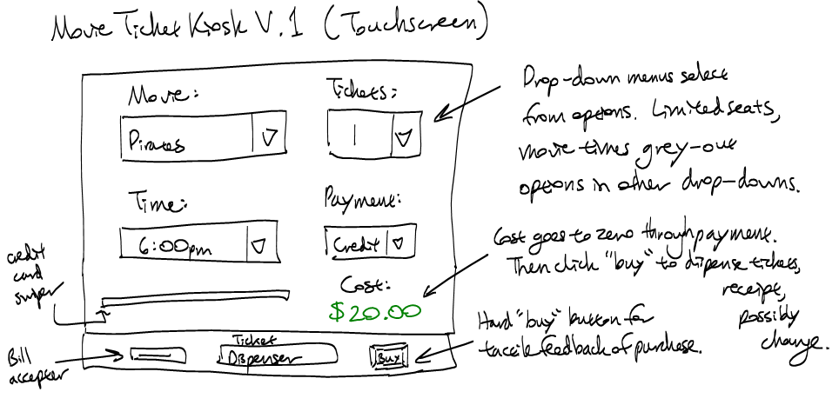
Low Fidelity Prototyping
Just use paper and/or overheads
  No tools
  Experimenter "plays computer"
  Ask the user "what would you
  do now“
  Experimenter shows the
  computer's expected response
  Very cheap and easy and
  gets surprisingly good results
  Find out if users understand organization, how to find desired operations, if understand menu names, etc.
  Easy to change between sessions
Can make a movie of the paper using a regular video camera
  To demonstrate/explain the interface

Slide 6
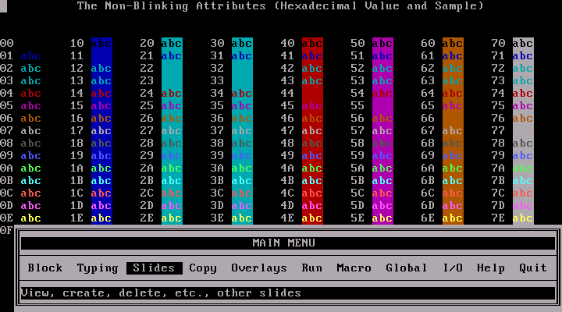
Early Prototypers
For Character Screens
  24x80 DOS, often no mouse (like terminal / console)
  Especially for forms-based applications
  Examples: Dan Bricklin’s Demo-It (Windows v2.0 ~1987), Protoscreens for PCs from Bailey&Bailey (~1990)
  Specify characters for each position of screen, or a "character graphics"
  Can specify fields that are editable text
  Can specify that clicking
  on an area cause
  changing to a new screen.
  Also menus

Slide 7
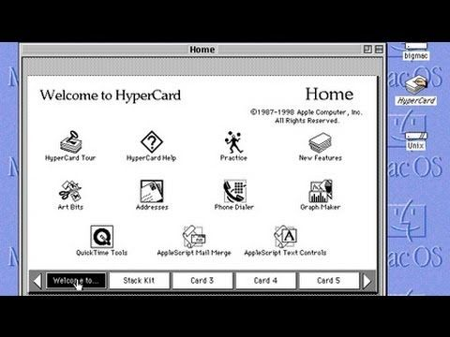
Card Programs as Prototypers
Card Programs
  Examples:
    HyperCard and SuperCard for Mac
    OWL's GUIDE for PCs (gone?)
    Toolbook (formerly from Asymetrix then Click2Learn, then SumTotal Systems, Inc. http://www.toolbook.com)
  Sequence of cards
  Click-through prototypes
  Paint program
  (not "draw")
  Draw pictures on each
  card
  May be multiple layers

Slide 8
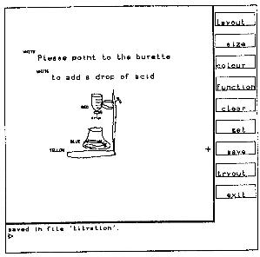
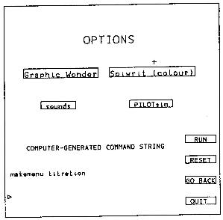
Early Research Card Systems
Menulay
  Buxton, Siggraph’83 pp. 31-38
    http://www.billbuxton.com/menulay.pdf
    http://www.youtube.com/watch?v=Kt0oAg0haU0
  vector screens, widgets, sounds, text,
  output C code and tables
  All actions (including transitions)
  required C
  programming

Slide 9
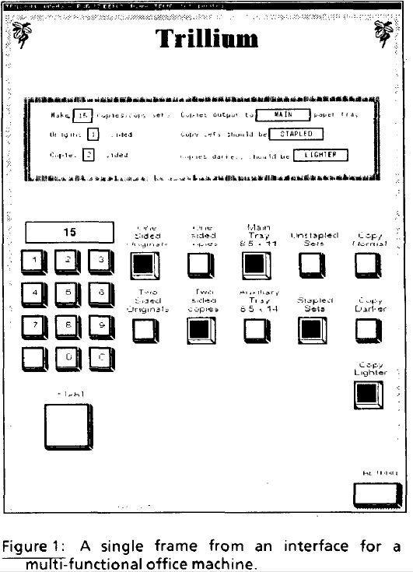
Early Research Card Systems, cont.
Trillium
  Henderson, CHI’86
  http://doi.acm.org/10.1145/22339.22375
  Xerox copier interfaces
  interpreted Lisp
  Transitions defined using the
  interface

Slide 10
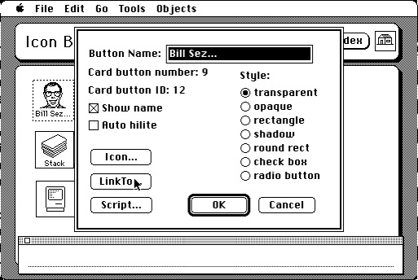
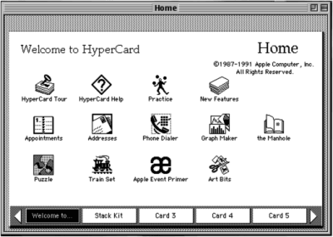
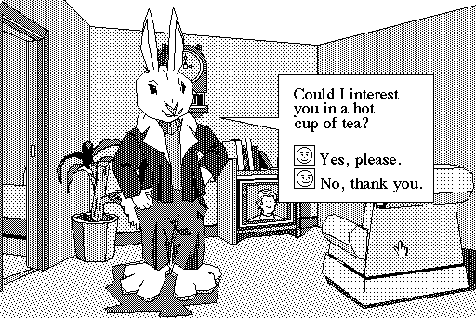
HyperCard
1987 – 2004

Slide 11
HyperCard, details
  Buttons can transition to another card
    Fancy transitions
  Single window
  Buttons can start running a script ("HyperTalk")
    Script can move objects, change cards, animate, compute, etc.
    Code management: who changes what; finding the script
    Not good for dynamically created graphics
  Complete control of individual pixels
    Graphic designers have complete control
    Design new widgets
  Can be "real" application if sufficient power/speed
    Used for original Myst game, etc.
  See also Lecture 19 on EUP

Slide 12
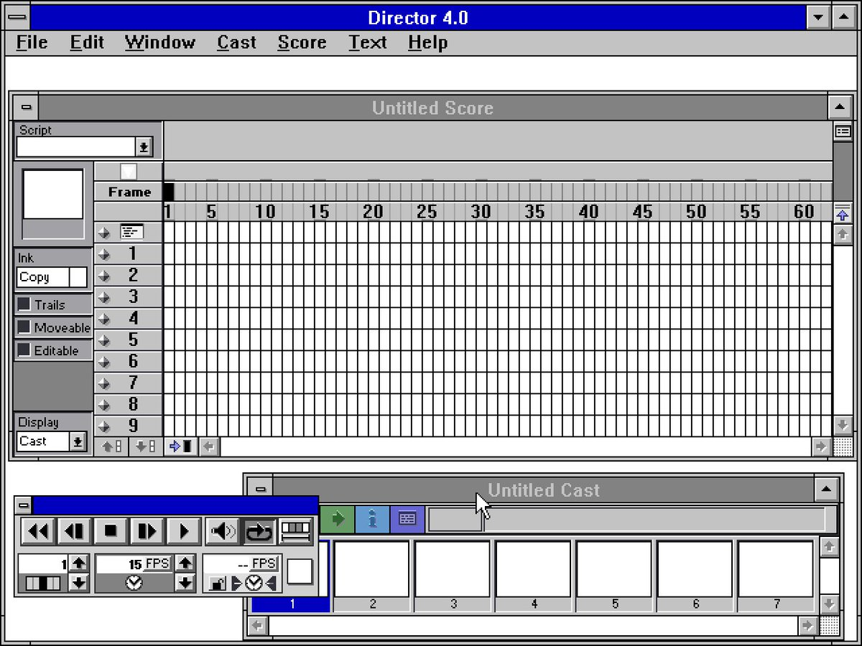
Animation Programs
Example: MacroMedia’s Director (1987) – now Adobe
  Replaced (pretty much) by Adobe Flash, now html
  Discontinued January 27, 2017
Also control individual pixels
Individual paintings can be specified as animation element
  E.g., characters
  Each can be instantiated,
  moved, etc.
Good control over timing,
synchronization
Scripting language
  Can program that when a
  mouse button is clicked in an
  area, start an animation or
  transition
  Scripting language even more
  primitive than HyperTalk
Good for "Future Scenarios“
when want good fidelity with
real look
Not for final (real) interface
unless Multi-media

Slide 13
Interface Builders
Also called Interface Development Tools (IDTs) or GUI Builders or “resource editors”
Lay out widgets to make dialog boxes, menus.
Have a palette or menu of kinds of widgets
Select widget, place with mouse in a window
Set some properties
Design menus, palettes, dialog boxes, controls
Put in “graphics” pane for main application window
Easy to use, but limited
Connect call-backs with each widget
Generates C code directly or intermediate language
Sometimes connected to an interpreter so can execute call-backs.
  If not, some call-backs can be simulated, e.g. transition to another window; pop-up error

Slide 14
Interface Builders, cont.
Layout mechanisms
  See lectures 8 (Geometry Management) and 16 (Constraints)
  usually a complication
    X's row and columns stuff
    Galaxy's struts and springs
    Java’s Layout Managers
“Resources”
  store information in special files rather than in source code
  positions, colors, text labels, etc.
  allow for easier modification for users, internationalization, etc.
IBs Usually don't support:
  Error checking of values, e.g. for text input fields
  Graying of widgets depending on values and other widgets
  Default values of widgets
  Dynamic changing of widgets (e.g., add more items)
  Dynamic changing layers (groups) of widgets (visibility) depending on values and other widgets
  Any dynamically created graphical objects.

Slide 15
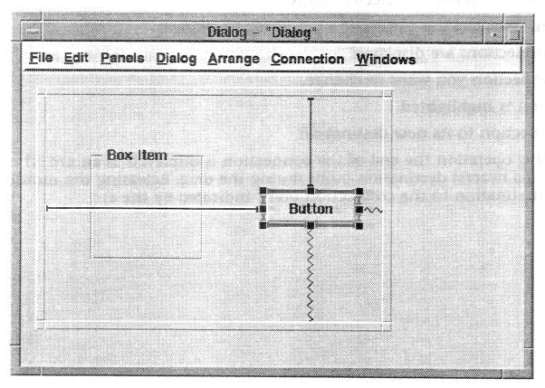
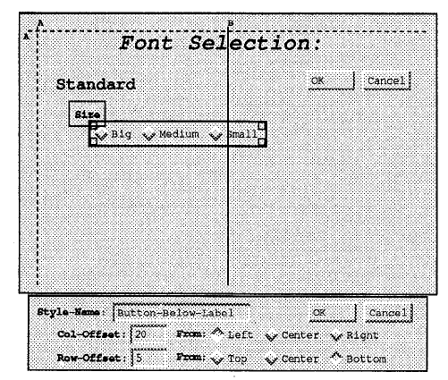
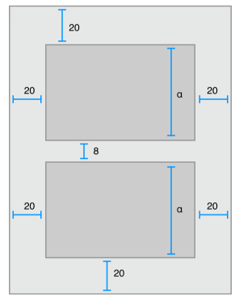
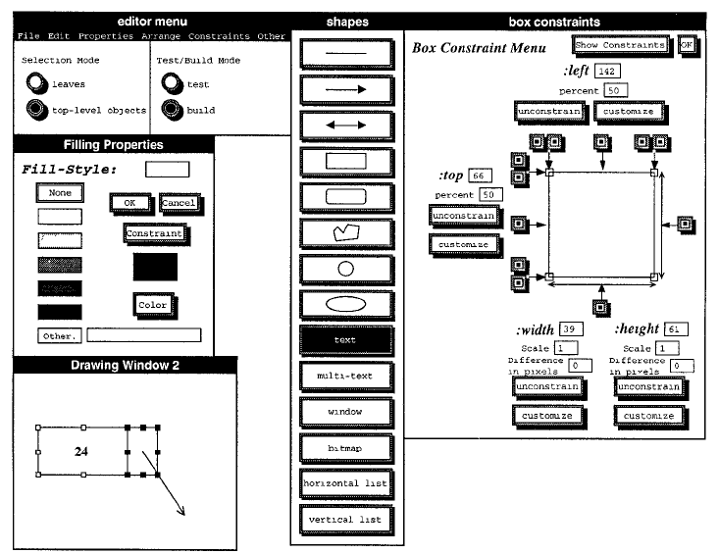
Examples from previous lectures
Struts and springs
Gilt’s graphical tabs
iOS Auto Layout
Lapidary constraints

Slide 16
Interface Builders, cont.
Examples:
  See “Card” systems, e.g., Menulay (1983-research system)
  NeXT Interface Builder (NeXT) - 1988 popularized the name
    By Jean-Marie Hullot who had an IB in Lisp at INRIA in France
  Visual Basic
  Resource editors in programming environments
Used to be lots of IB products
  Used to be many commercial tools are in this category; over 100
    See my old list (1997): http://www.cs.cmu.edu/~bam/toolnames.html
  Most went out of business
  Microsoft, MetroWorks, etc. include “resource editors” for “free”

Slide 17
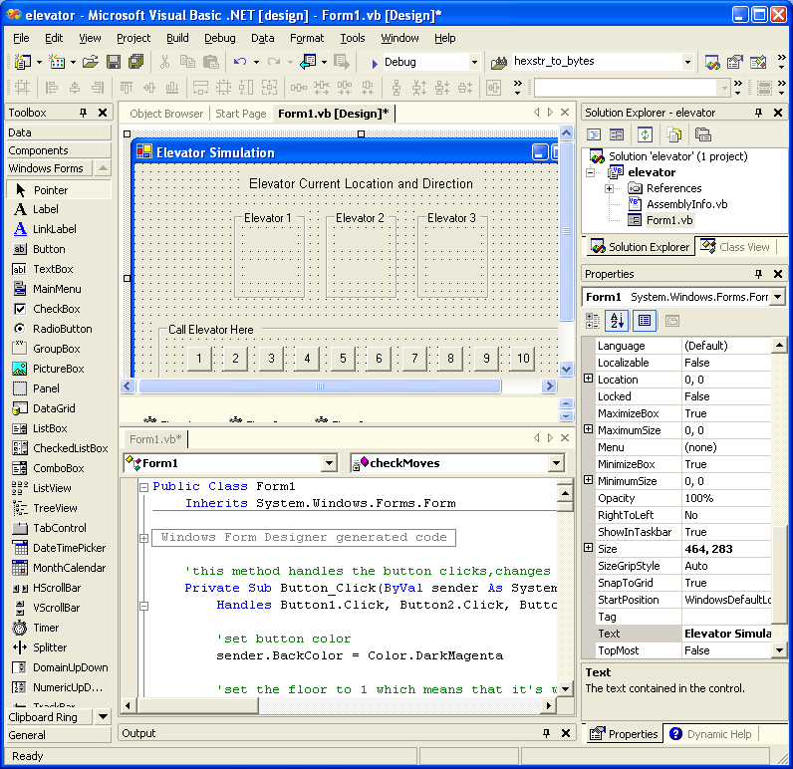
VB
Screen

Slide 18
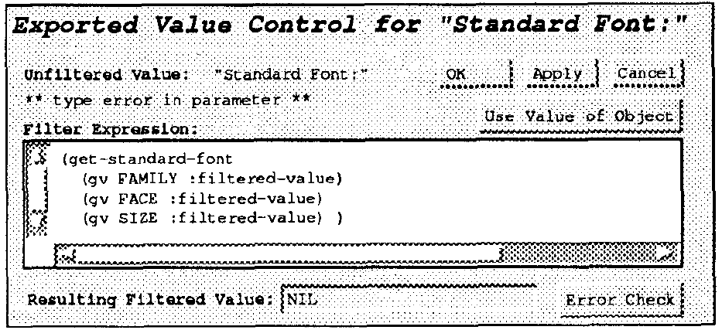
Some Research in IB
Garnet’s GILT interface builder:
  Eliminating Call-backs (UIST’91)
    http://doi.acm.org/10.1145/120782.120805 or
    video (5min) or video of both (9 min)
    Handles error checking, data transformations, connections of widgets to each other

Slide 19
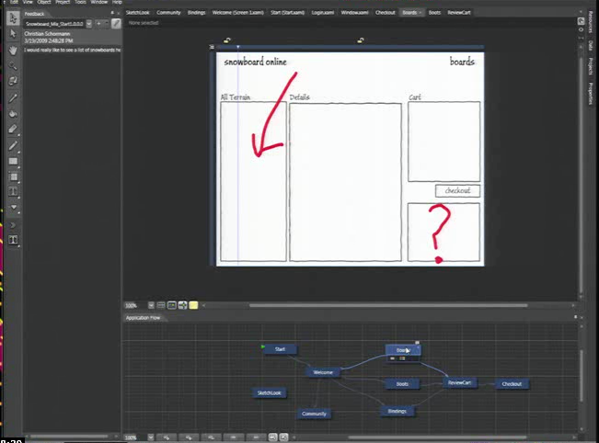
Microsoft’s Expression Blend
Microsoft Silverlight Blend’s SketchFlow
  http://channel9.msdn.com/Events/MIX/MIX09/C01F (1 hour video)
2006-2012
Behaviors, etc.
as well
Landay says this
has “sketching”
(see 3/19/09 blog)
Now discontinued
  Some features
  put into Visual
  Studio

Slide 20
Commercial Prototypers
Search for “Prototyping tools” or “Wireframing Tools”
Here is a list:
  https://medium.theuxblog.com/11-best-prototyping-tools-for-ui-ux-designers-how-to-choose-the-right-one-c5dc69720c47

Slide 21
Examples:
Axure (downloaded)
Sketch (Mac only)
Adobe XD
  New, free and seems powerful
On-line tools
  InVision
  Figma – good collaboration features (also downloadable)
  Balsamiq (http://www.balsamiq.com/)
  Just in Mind
  Protopie https://www.protopie.io/
  ….many others!

Slide 22
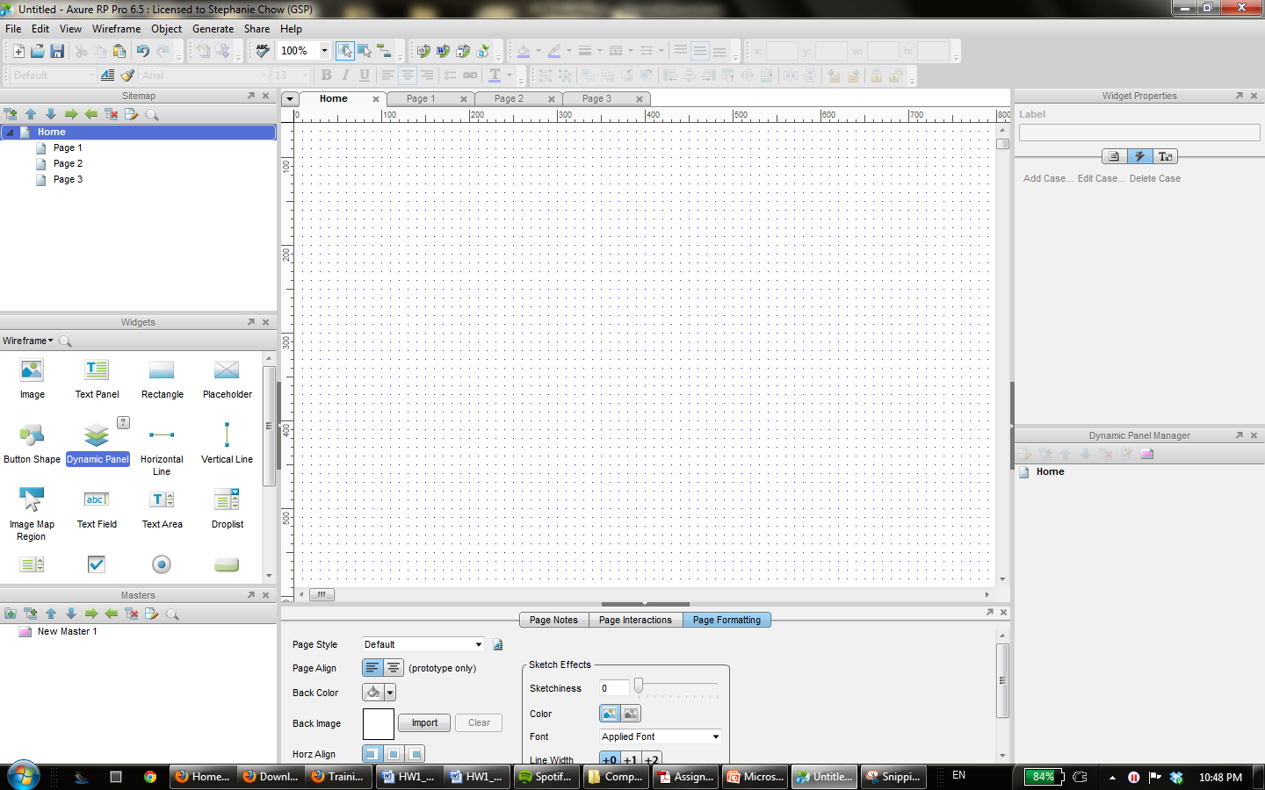
Axure
Drag and drop widgets onto your page

Slide 23
Research in Informal Tools
Sketching tools
Use before interface builders
Designed to help support the ideation phase
Menulay (saw earlier)
James Landay’s SILK tool
  Infer formal widgets and widget groupings from sketches
  Convert to real widgets
  Sketch storyboards for transitions

Slide 24
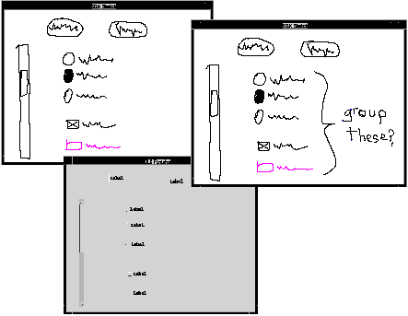
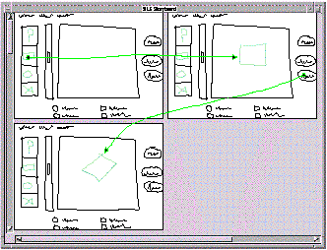
Research in Informal Tools
Main paper: http://doi.acm.org/10.1145/223904.223910
Video from CHI’96 (8:22 min)

Slide 25
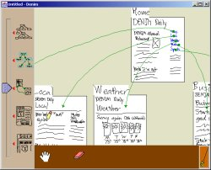
Landay’s later tool: Denim
Denim and its video

