Slide 1

Lecture 11:
React for JavaScript
05-431/631 Software Structures for User Interfaces (SSUI)
Fall, 2020

Slide 2
Logistics
Homework 3 due today
Start on Homework 4
  Changed deadline so you have 2 full weeks – Due October 20
    But don’t wait until the last minute
    That will be the start of the take-home midterm as well
      Midterm grade will be homeworks 1-4 and midterm
  All the other deadlines moved back 1 lecture period as well
At least make sure you can create a React project early
  Set up can be tricky

Slide 3


What is React
https://reactjs.org/
“A JavaScript library for building user interfaces”
Created by Facebook and actively used
and supported by them
Goal: be more declarative, like original html and CSS
  As opposed to imperative like JavaScript
  React handles updating and redrawing as data changes
    Still need input handlers
  New way to write html with computed parameters = JSX
Build reusable, encapsulated components
  E.g., header and footer
React can also be used “native” to make Android and iOS apps

Slide 4
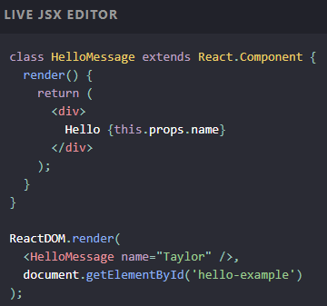
Key Concepts
JSX – yet another syntax
for html
  Almost like regular html, but
  some differences
    Yet another syntax for
    comments: {\* comment *\}
  Compute elements based on props
  Computed and returned by render() methods
States – dynamic data
  Note: totally different from state-transition-diagrams
  Store values as JS objects
  DOM updated when state’s values change

Slide 5
Learning React
Can’t cover it in one lecture
  You are responsible for learning React by yourself
Lots of great material out there to learn from
Lots of Stack Overflow answers that cover most problems
eCommerce websites are exactly its target application
HW4 write up includes an example app from Michael Liu that is similar to HW4: SSUI-Star-Wars
How to deploy React+Router app to Netlify from GitHub: https://dev.to/easybuoy/deploying-react-app-from-github-to-netlify-3a9j
Thanks to Michael also for the rest of these slides!

Slide 6
JavaScript features heavily used by React
Might want to review these features!
export and import
  React uses lots of files and need to control namespaces
spread and rest operator: . . .
  Flatten an array or object in place
  const newArray = [...oldArray, 1, 2, 3];
  const newObject = {...oldObject, newProp: ‘Jason’}
  function sortNumbers(...args) { } //args is an array of the parameters
Destructuring – assign variables using same name
let {name, loc} = func(); // returns object with name: and loc: fields

Slide 7
Useful JavaScript array functions
ar1.map(fn) – returns a new array of calling fn on each element of ar1
const doubleNumArray = numbers.map(num => num * 2);
ar2.filter(fn) – returns a new array containing the elements of ar2 that when passed to fn return true
const result = words.filter(word => word.length > 6);

Slide 8
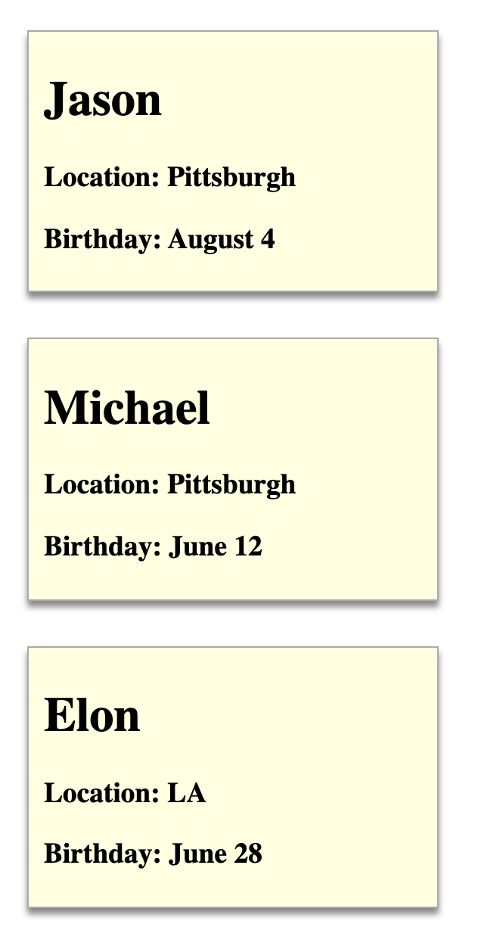
React Components
Elements of the web page
Styled with regular CSS
Defined using jsx:
Use “className” for CSS classes
const Person = (props) => {
const {name, location, birthday} = props
return (
<div className="person">
<h1>{name}</h1>
<h3>Location: {location}</h3>
<h3>Birthday: {birthday}</h3>
</div>
)
}
ReactDOM.render(<Person name={"Jason"} location={"Pittsburgh"} birthday={"August 4"}/>, document.querySelector('#p1'))
ReactDOM.render(<Person name={"Michael"} location={"Pittsburgh"} birthday={"June 12"}/>, document.querySelector('#p2'))
ReactDOM.render(<Person name={"Elon"} location={"LA"} birthday={"June 28"}/>, document.querySelector('#p3'))
<div id="p1"></div>
<div id="p2"></div>
<div id="p3"></div>
.person {
margin: 10px;
border: 1px solid #aaa;
background-color: lightyellow;
padding: 5px 10px;
width: 250px;
box-shadow: 0 4px 4px #888;
margin: 30px 20px;
}

Slide 9


React is Client Side
Compiled into pure JavaScript
But uses lots of libraries
npm to manage everything for you
  https://www.npmjs.com/
  Originally: Node Package Manager
  Command line interface
  Requires using a server on your machine
    Automatically recompiles when edit code
Start with React create-react-app

Slide 10
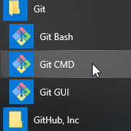
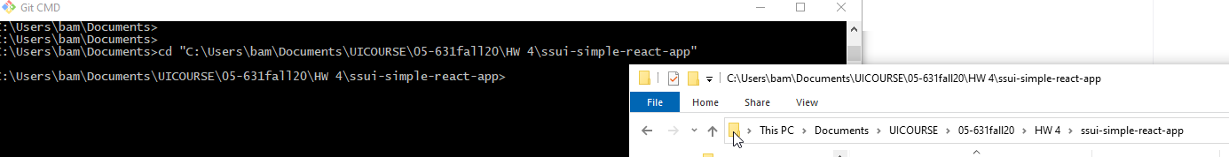
Starting and Running
Download git, github desktop, node.js, npm
  https://www.npmjs.com/get-npm
Start a console (Mac) or cmd (PC) window
  E.g., Git CMD or Git Bash
cd to folder (can drag-and-drop)
Run npm install
Run npm start
  Will open localhost:3000 in browser
To stop, close cmd window or type ^C
For almost all errors, delete and start over
If edit code in that folder, when save, page will reload automatically

Slide 11
Structure of our React apps
index.html just contains <div id="root"></div>
index.js connects the app component to it:
const app = (
<Router>
<ScrollToTop>
<App />
</ScrollToTop>
</Router>
);
ReactDOM.render(app, document.getElementById("root"));
Always need a “render” method at each level
app.js – contains the content of the app by importing all the components

Slide 12
Create components
React components: custom HTML elements that can be used to construct a web app
  Create your elements as:
  class myElement extends Component { … }
One React app typically only has ONE root component. In our case, it’s the App component.
Nest all the other components in the root (App) component. => a tree of components
Each component needs to return/ render some JSX code - it defines which HTML code React should render to the DOM in the end
  Instead of constructor, React classes have a render() method

Slide 13
React Router
Support multiple pages with same header/footer
  react-router-dom – allows switch among different content
  const app = () => {
return (
<div className="App">
<NavBar />
<div className="MainContent">
<Switch>
<Route exact path={appRoutes.home}>
<HomePage />
</Route>
<Route exact path={appRoutes.characters}>
<CharactersPage />
</Route>
<Route exact path={appRoutes.character}>
<CharacterPage />
</Route>
<Redirect to={appRoutes.home} />
</Switch>
</div>
<Footer />
</div>
);
};
export default app;
Looks like html
References regular CSS classes as “className”
Content in { } executed so computed

Slide 14
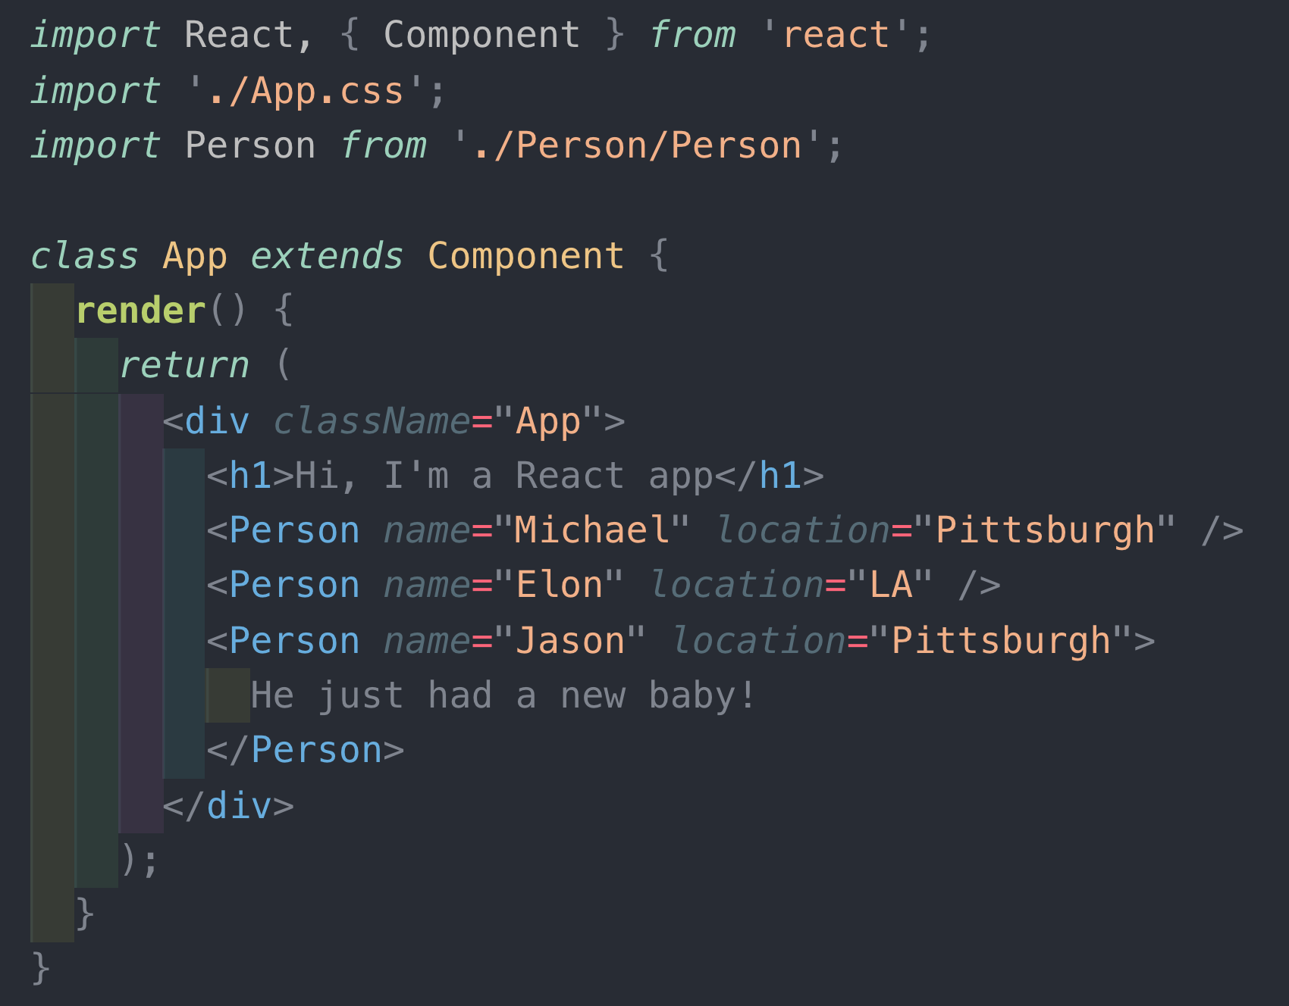
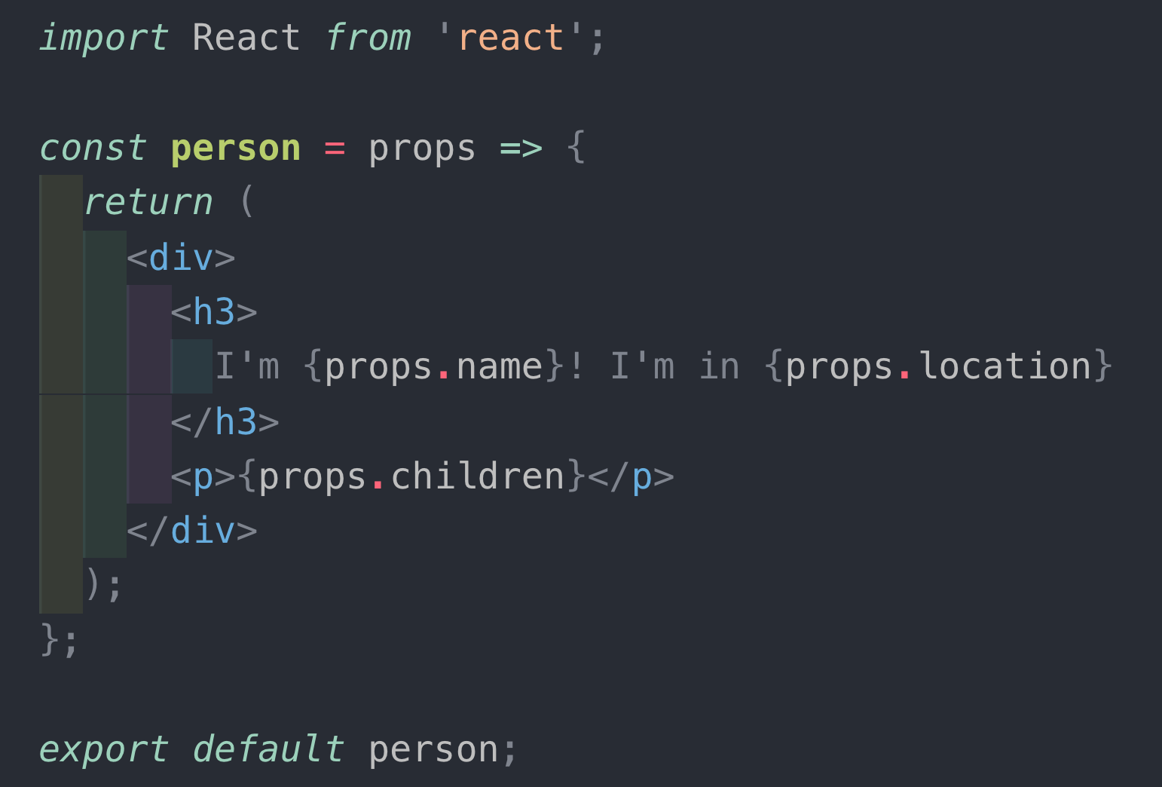
Dynamic Contents:
Props and State
Props – variable that holds attributes to be used
Passed down hierarchy – parent to child

Slide 15
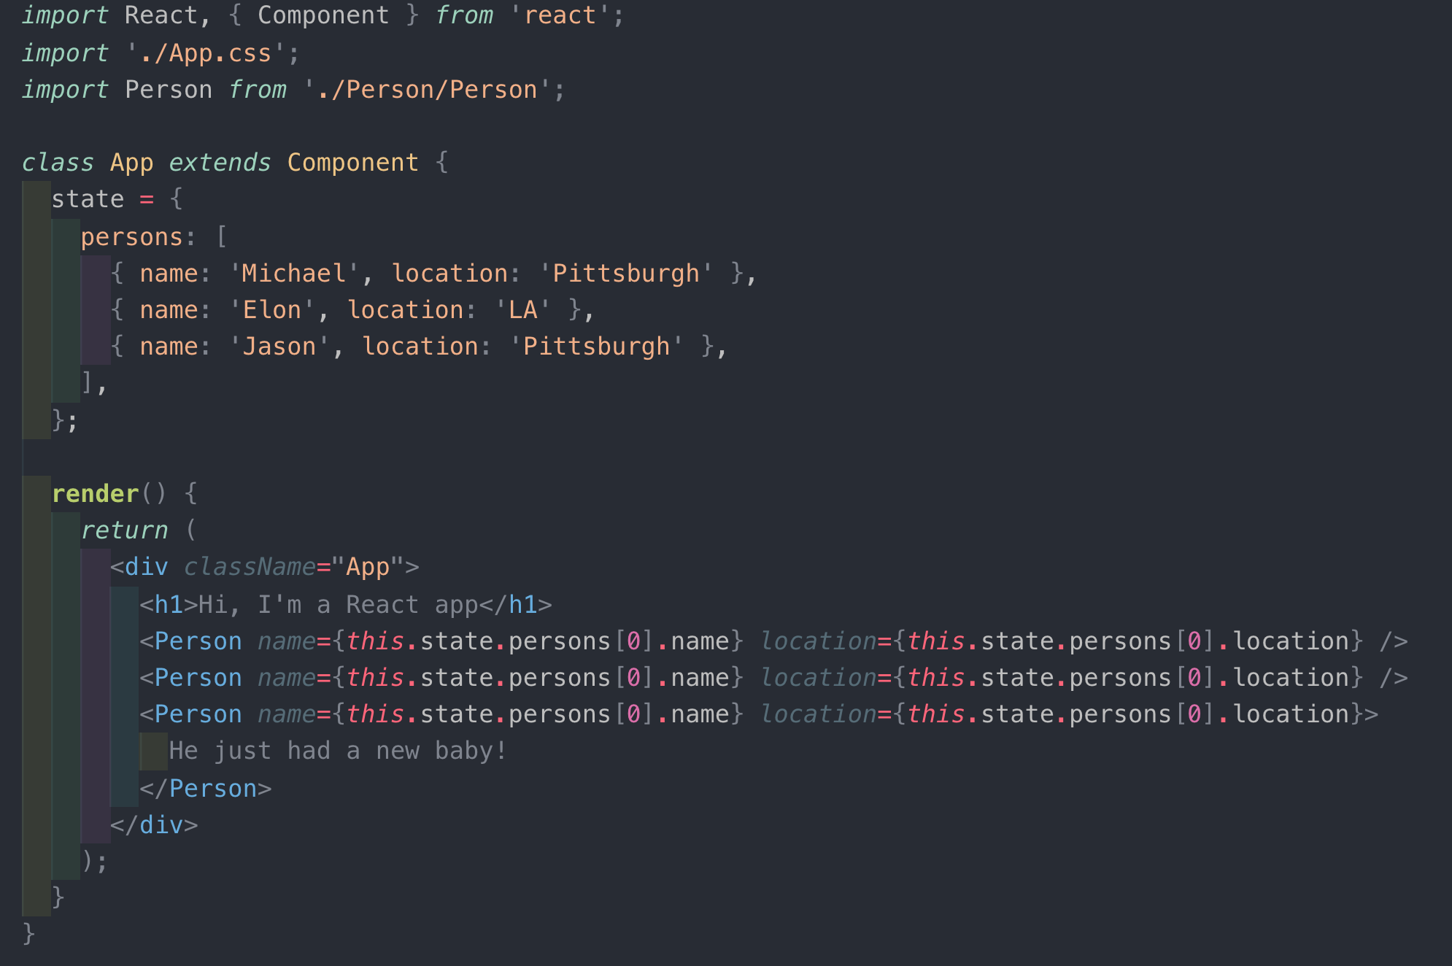
Dynamic Contents:
Props and State
State: Variables that change, causing redisplay
  Note: not MVC model with listener pattern
  Shared variables instead
Both props and
state are
JavaScript
objects
  attribute-value
  pairs)

Slide 16
this.setState
Use this.setState to change state, so React knows to calculate what to redisplay
Minimize the number of states
Calculate props (attributes) based on state

Slide 17
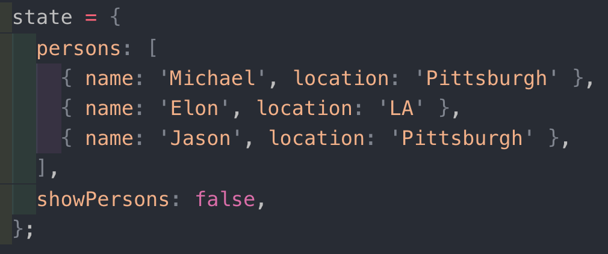
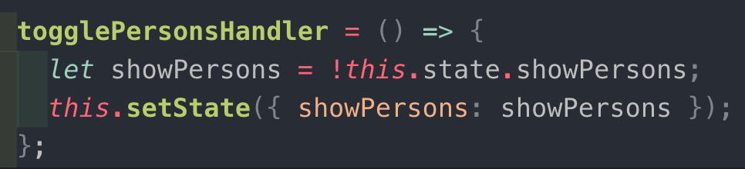
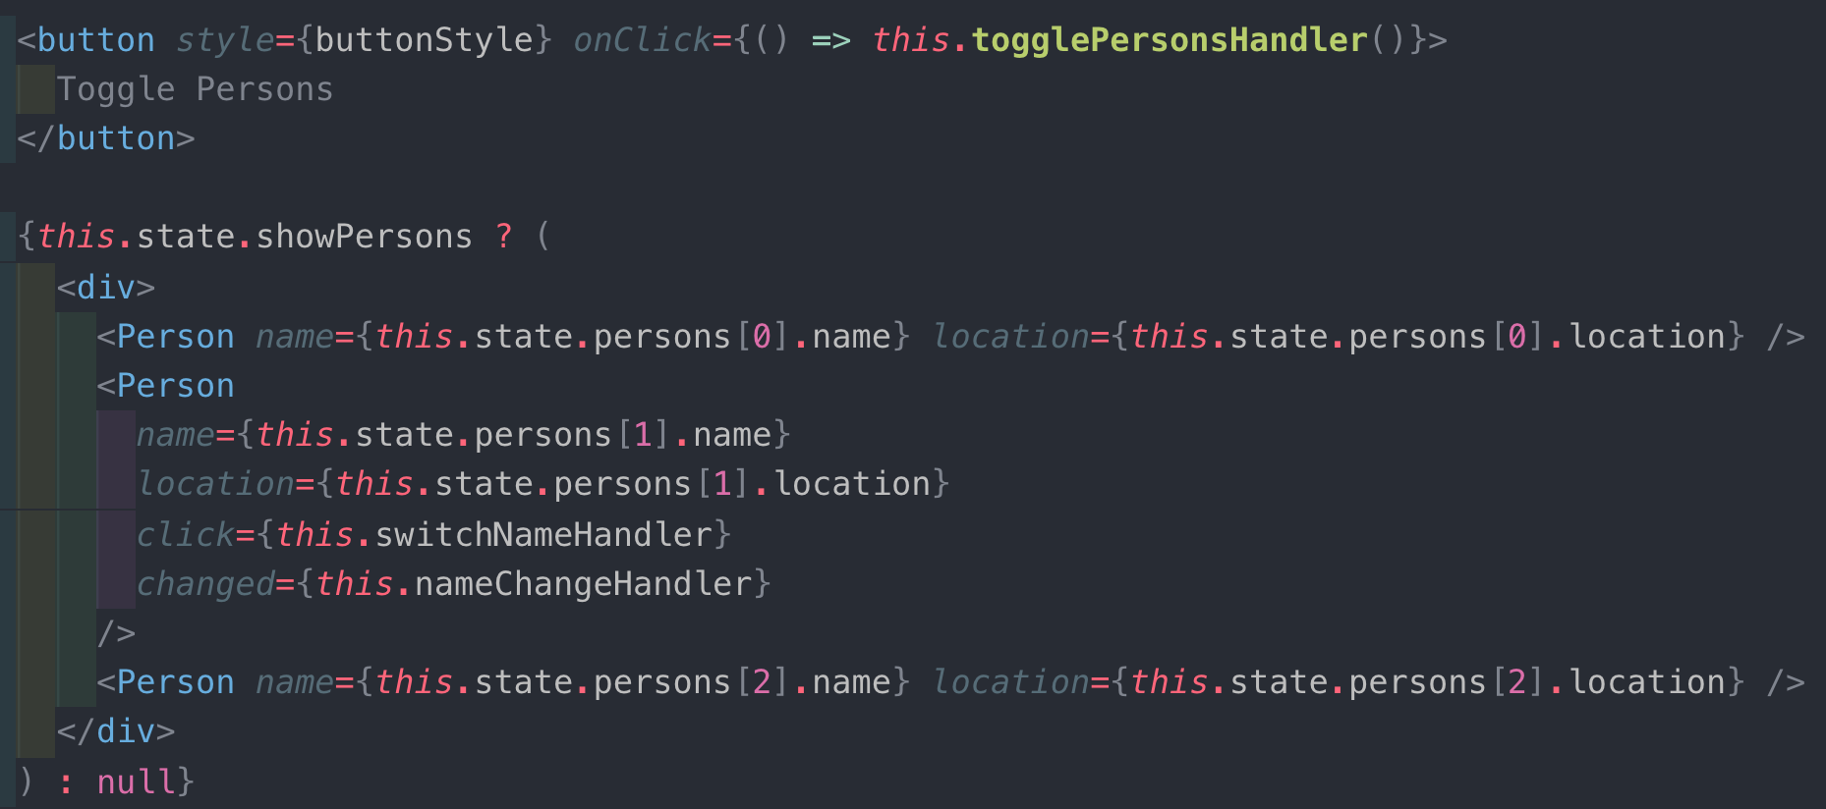
Conditional rendering
Can use ternary to
compute contents, typically
based on state
  null causes nothing to be
  displayed

Slide 18
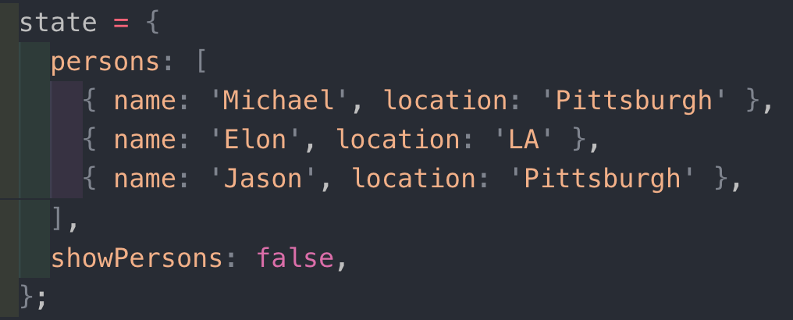
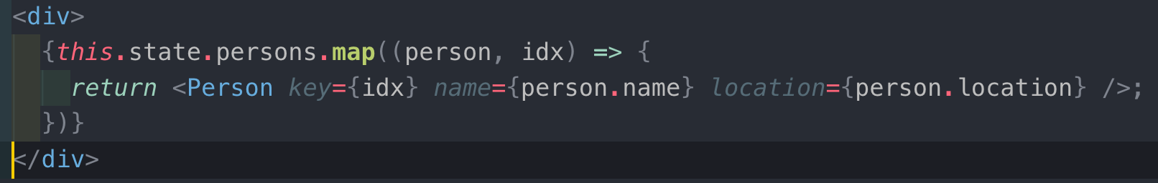
Rendering Lists
Use map() to return jsx from data list
Don’t forget the “key” attribute -- needed for efficient redisplay
  Must be unique within the list
  Should be “stable” wrt the element
  React uses it to compute what has changed

Slide 19
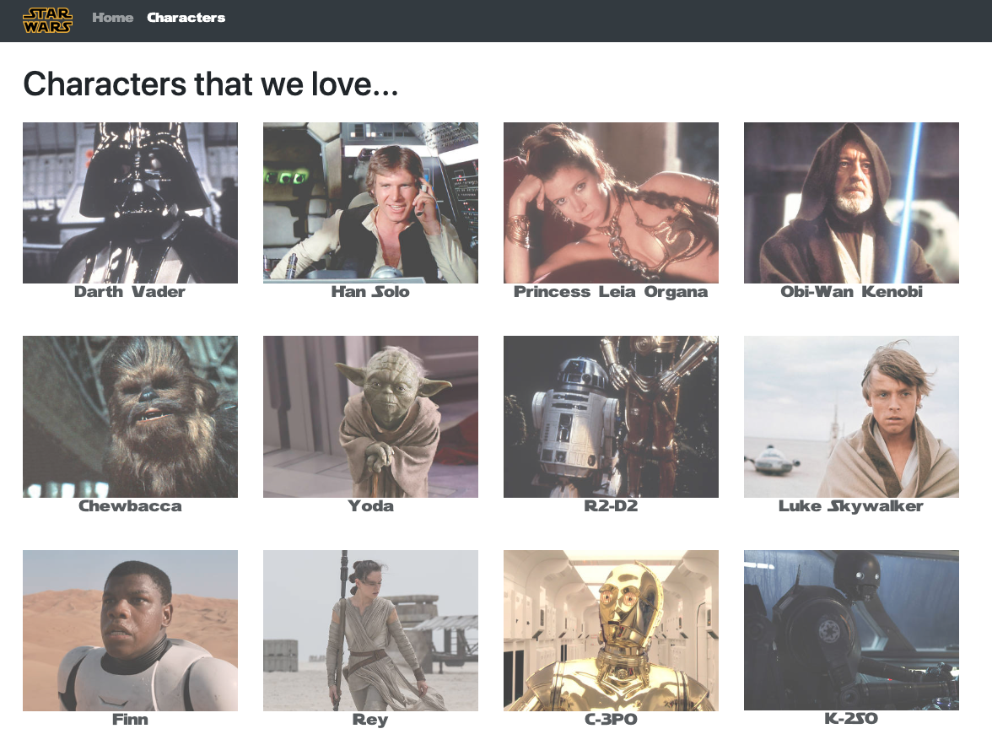
Michael’s sample app
https://github.com/lxieyang/ssui-simple-react-app
https://ssui-star-wars.netlify.app/
Basic code structure
Component Reuse
Lists
Styling using Bootstrap
Routing
Not setState()

