Slide 1
Lecture 10: What is "User Interface Software", Overview of UI Software and Tools
05-431/631 Software Structures for User Interfaces (SSUI)
Fall, 2020

Slide 2
Logistics
Homework 2 almost graded
Will be released later today
Great job! Average = 91.7
Please take recommendations into account
Note: please fix typos in homework 1 screens!
How is Homework 3 going?

Slide 3
What does UI Software encompass?
“User Interface Software”
All the software that implements the user interface
“User Interface” = The part of an application that a person (user) can see or interact with (look + feel)
Often distinguished from the “functionality” (back-end) implementation
Some ambiguity if a tool is specifically for “UI” part
User Interface Software Tools
Ways to help programmers create user interface software
Tools used by UI Designers and UI Builders

Slide 4
Names
Tools = UI Frameworks, Toolkits, Development Kits = SDK, Libraries
UI APIs = Application Programming Interfaces (APIs)
Old names = User Interface Management Systems (UIMS), User Interface Development Environments (UIDE)
Micro-Service Architecture for web UIs
Also interactive tools: Resource Editors, Interface Builders, Prototypers, UI Builders

Slide 5
Examples of UI Software Tools
We created a list in 2017 = https://docs.google.com/document/d/1qeBkQaoIBmwK9Z7LmWP4L_4GKgddzNn7YmvSQuPukGo
Over 100!
Lots of new ones that should be added
APIs for UI development:
JavaScript/Web: ReactJS, Vue, AngularJS
Apple Cocoa, Carbon
Microsoft Foundation Classes, .Net, wx-Python
Java AWT, Swing, Android UI classes
Interactive tools
Visual Basic .Net
Adobe Flash, Adobe Catalyst
Prototypers like Axure, Balsamiq, Adobe XD
Research systems:
Garnet
Amulet
ConstraintJS
InterState

Slide 6
Why is This Important?
Virtually all UIs are created using such Tools
Previous research has influenced today’s tools
Enormous impact!
New tools are created all the time
E.g., Flutter for Dart language and mobile
Some are easier to use than others!
Principles and architectures for good designs
Avoid “reinventing the wheel”
What are the “best practices” for these tools
Modern UIs and Tools for web, phones, wearables, Smart TVs, etc. all use similar designs
Speech and conversational interfaces are different
Research topic in ACM UIST, CHI
Also ICSE, SPLASH, PLATEAU, CHASE, many others

Slide 7
Analogy with OS or Compilers
In CS curriculums, often teach Operating Systems, Compilers, Networking
Even though most people will just use these
Useful to know the key principles
Lasts longer than the specifics of one current tool
Some people will need to know how to build the next generation of tools
The algorithms, architectures, design patterns, and principles are useful in other situations as well

Slide 8
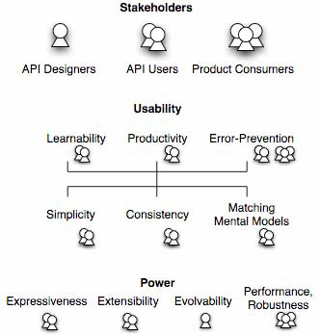
Stakeholders
Many groups of people
Need unambiguous names
Too many “users”
Tool Designers
Tool Users (are programmers)
Users of products created with the tools = consumers or end-users
Source: Jeffrey Stylos and Brad Myers, "Mapping the Space of API Design Decisions," 2007 IEEE Symposium on Visual Languages and Human-Centric Computing, VL/HCC'07. Sept 23-27, 2007, Coeur d'Alene, Idaho. pp. 50-57. pdf

Slide 9
Who Are Developers?
Programming tools are not just used by highly-trained professional programmers
End-User Programmers = People whose primary job is not programming
In 2012 in USA at work: — [Scaffidi, Shaw and Myers 2005]
3 million professional programmers
6 million scientists & engineers
13 million will describe themselves as programmers
55 million will use spreadsheets or databases at work
90 million computer users at work in US
All these may be the tool users!

Slide 10


UI Runtime Pipeline
Hardware Sensor
Device Driver
OS
Toolkit
input
Syntactic feedback /
View/controller
Application Code
output
Screen Driver
Device Driver
OS
Drawing Package
Toolkit

Slide 11
UI Runtime Pipeline w/ Browser
Browser
Html / canvas spec
Hardware Sensor
Device Driver
OS
Toolkit
Toolkits
input
Application Code
output
Toolkits
Screen Driver
Device Driver
OS
Drawing Package
Toolkit
Html / canvas spec

Slide 12
UI Tools stack
Interactive Tools (Builders, Prototypers)
Framework (Architecture, Objects)
Toolkit (library, programming interface)
OS / Windows Interface (Input and Output)
Device Drivers & Hardware
}
Optional

Slide 13
From the bottom: Windows & OS
Window System + Operating System
Microsoft Windows, MacOS, Android, iOS, etc.
Unix & older OS’s separated OS, Windows
SunOS: X Windows or NeWS or SunTools
Low level input events – keycodes, mouse position, values from accelerometers
Low level graphics primitives
Draw Circle, Draw Line, set pixel color
Clipped to window boundaries

Slide 14
Toolkits
(Specific meaning, one part of the tool set)
A library of procedures
Only a programming interface
Provides higher-level “widgets”
Also called “controls”
Scroll bars, buttons, text input fields
Examples:
Html, canvas, svg
Java Swing, SWT, AWT
Win32, Macintosh “toolbox”

Slide 15
Frameworks
Higher-level programming architecture
Generally all-encompassing – controls all of the way apps are built
Supports common design patterns
Listener pattern, data bindings, etc.
Significantly affects design of applications
Often object-oriented
“Foundation Classes”
Often cross-platform (iOS + Android)
React native, Flutter, Microsoft’s Xamarin, Titanium, …
Electron (https://electronjs.org/): cross-platform toolkit for desktop apps
Sometimes hard to distinguish from “toolkits”
(So we usually won’t!)
Other Examples:
Historical: Apple MacApp, my Amulet
Current: Unity, AngularJS

Slide 16
Interactive Tools
Not a programming interface
Supports designers who might not be programmers
Select widgets and place them
Layout, possibly with constraints
Specify properties of widgets
Prototypes or real code
For real code, often built into IDEs
Examples:
Adobe Dreamweaver for web pages
Prototypers: Balsamiq, Axure, etc.
Resource editors & builders: Eclipse, Xcode IB, Android studio, Microsoft Visual Basic IDE

Slide 17
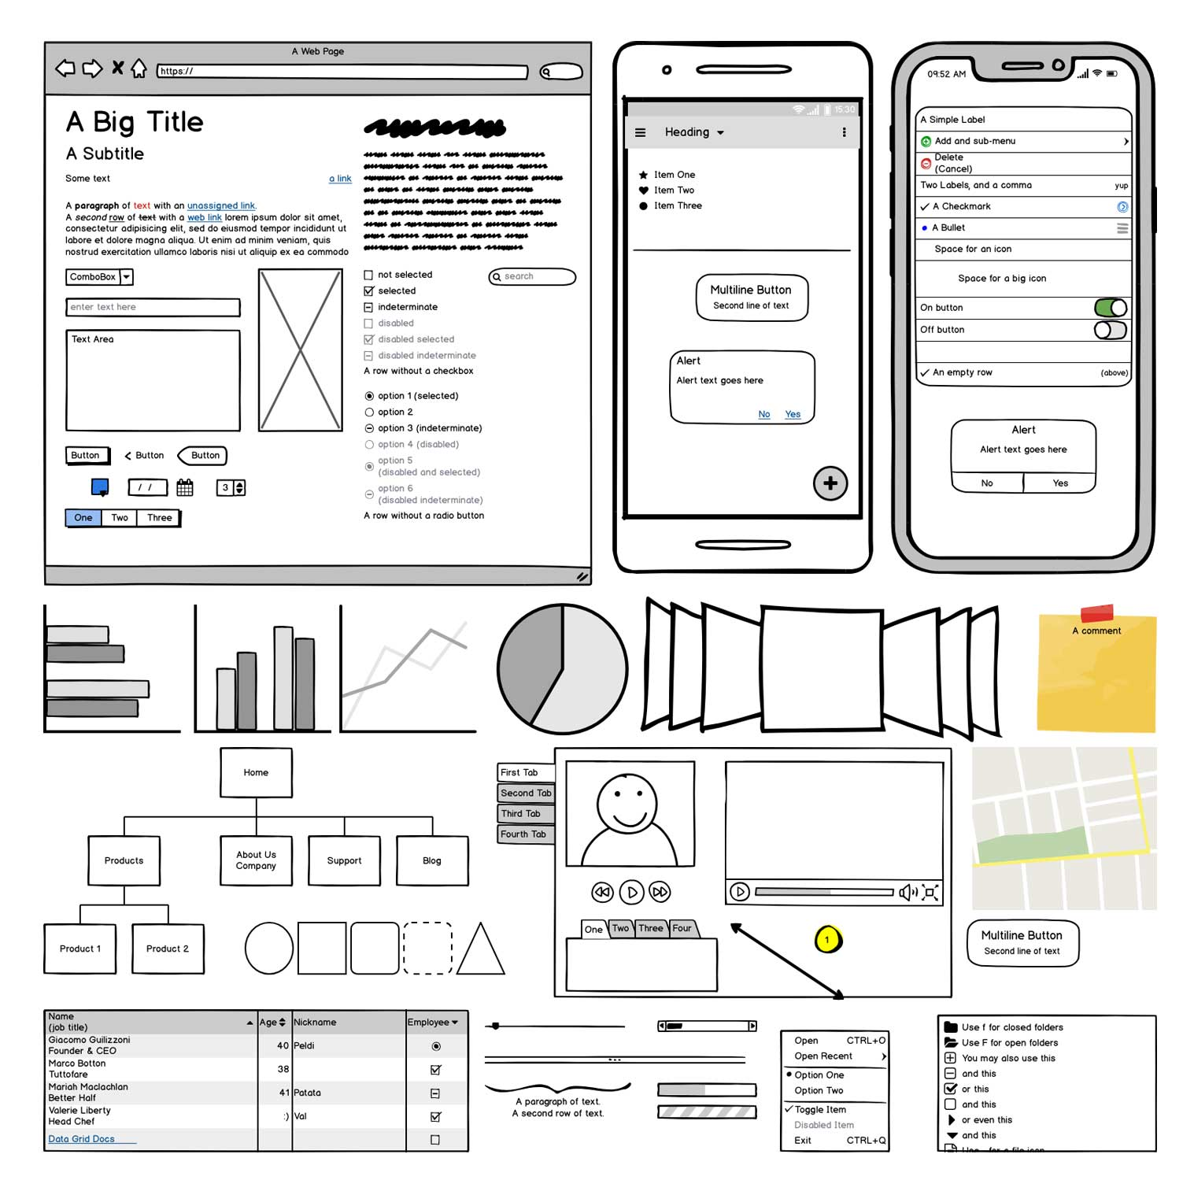
Balsamiq
https://balsamiq.com/wireframes/

Slide 18
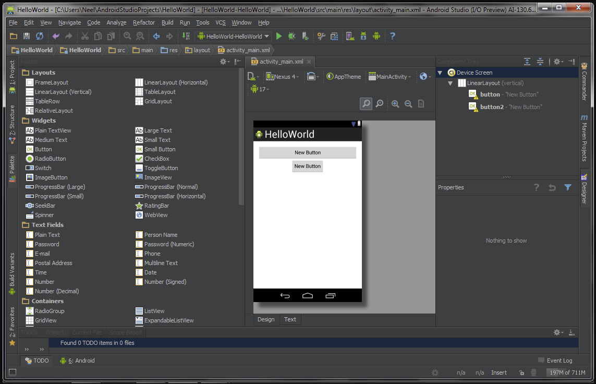
Android Studio Builder
https://stacktips.com/tutorials/android/android-studio-features/attachment/android-studio-viewing-layout_builder

