Slide 1
Lecture 9:
UI Software Patterns:
State Diagrams, MVC,
Lexical-Syntax-Semantics
05-431/631 Software Structures for User Interfaces (SSUI)
Fall, 2020

Slide 2

Logistics
Homework 2 grading will be delayed
Corey was sick

Slide 3
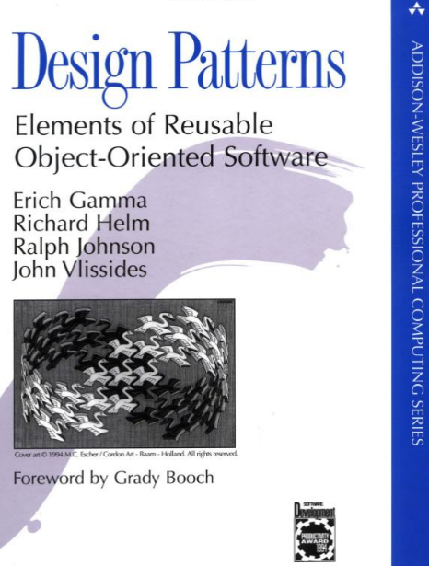
What are Design Patterns?
Wikipedia: A design pattern is the re-usable form of a solution to a design problem. The idea was introduced by the architect Christopher Alexander^{[1]} and has been adapted for various other disciplines, notably software engineering.^{[2]}
Design Patterns book (1994)
  By “Gang of 4”: Erich Gamma, Richard
  Helm, Ralph Johnson, and John Vlissides
  Patterns for object-oriented systems
Now, there are LOTS more

Slide 4
Design Patterns
Generally, a way to organize code to achieve certain outcomes
  Small pieces of the overall design
  Both “functional” = what it does
  And “non-functional” = how it does it, e.g., efficiency, reusability
  Language independent
We have been using the “Listener Pattern” all along!
  Also called the “Observer Pattern”
  Attach an observer (call-back function) to events or other data changing
We will use the “Command” pattern for undo in Homework 5
Sometimes called “Models” but that has too many meanings!
Software Architectures – whole system design; pattern is just one piece

Slide 5
“Factory” Pattern
Instead of “normal” creation: Widget w = new Widget();
Objects must be created by another class:
AbstractFactory f = AbstractFactory.getDefault();
Widget w = f.createWidget();
Used frequently in Java (>61) and .Net (>13) and SAP
Advantages?
  Don’t need to allocate any memory (new not called)
  Can return a different subtype from what user is aware of
Our research showed that the “factory pattern” made APIs harder to learn and use (lower “API Usability”):
  When asked to design on “blank paper”, no one designed a factory
  Time to develop using factories took 2.1 to 5.3 times longer compared to regular constructors (20:05 v 9:31, 7:10 v 1:20)
  All subjects had difficulties getting using factories in APIs

Slide 6
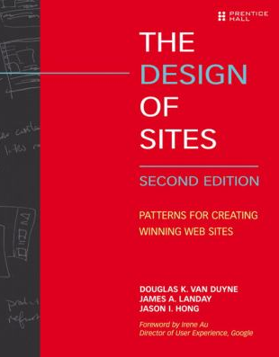
Design Patterns for UI Design
E.g.,:
van Duyne, D.K., James A. Landay, and Jason I. Hong, The Design of Sites: Patterns, Principles, and Processes for Crafting a Customer-Centered Web Experience. Reading, MA: Addison-Wesley, 2002.
Mainly for UI design patterns,
for UI designers, not for UI
software

Slide 7
Conceptual-Semantic-Syntactic-Lexical-Pragmatic
Another way to look at the design of software
Derived from compiler theory and language work.
Mostly relevant to older, non-interactive interfaces
Pragmatic
  How the physical input devices work
  required "gestures" to make the input.
  Ergonomics
  skilled performance: "muscle memory"
  press down and hold, vs. click-click

Slide 8
Conceptual-Semantic-Syntactic-Lexical-Pragmatic, cont.
Lexical
  spelling and composition of tokens
    “add” vs. “append” vs. “^a” vs.
  Where items are placed on the display
  “Key-stroke” level analysis
  For input, is the design of the interaction techniques:
    how mouse and keyboard combined into menu, button, string, pick, etc.

Slide 9
Conceptual-Semantic-Syntactic-Lexical-Pragmatic, cont.
Syntactic
  sequence of inputs and outputs.
  For input, the sequence may be represented as a grammar:
    rules for combining tokens into a legal sentence
  For output, includes spatial and temporal factors
  Example: prefix vs. postfix

Slide 10
Conceptual-Semantic-Syntactic-Lexical-Pragmatic, cont.
Semantic
  functionality of the system; what can be expressed
  What information is needed for each operation on object
  What errors can occur
  Semantic vs. UI is key issue in UI tools
    but "semantic" is different than meaning in compilers
  "Semantic Feedback“
    Depends on meaning of items
    Example: only appropriate places where item can be dropped highlight during drag

Slide 11
Conceptual-Semantic-Syntactic-Lexical-Pragmatic, cont.
Conceptual (definition from Foley & Van Dam text, 1st edition)
  Key application concepts that must be understood by user
  User model
    Objects and classes of objects
    Relationships among them
    Operations on them
      Example: text editor
        objects = characters, files, paragraphs
        relationships = files contain paragraphs contain chars
        operations = insert, delete, etc.

Slide 12
Model-View-Controller
Invented in Smalltalk, about 1980
Idea: separate out presentation (View), user input handling (Controller) and "semantics" (Model) which does the work
Fairly straightforward in principal, hard to carry through
Never adequately explained (one article, hard to find)
Goals
  program a new model, and then re-use existing views and controllers
  multiple, different kinds of views on same model
Lots of modern variants

Slide 13
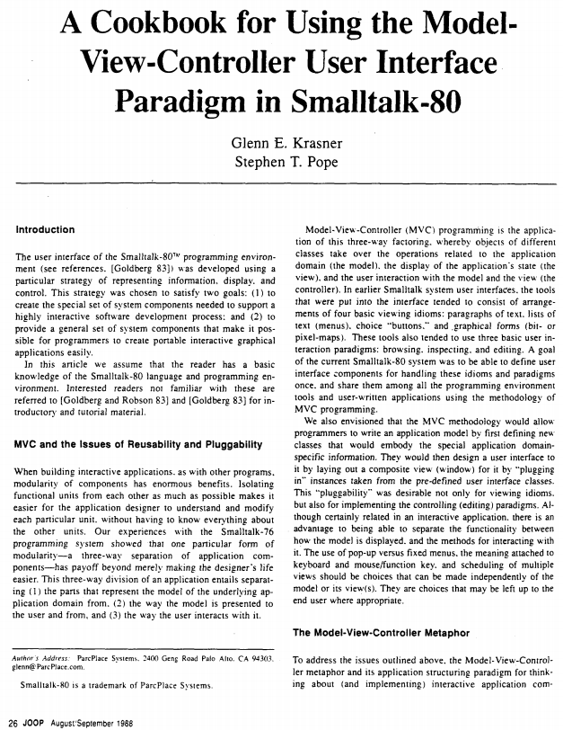
Classic MVC reference
Glenn E. Krasner and Stephen T. Pope. “A Cookbook for Using the Model-View-Controller User Interface Paradigm in Smalltalk-80,” Journal of Object Oriented Programming. Aug, 1988. vol. 1, no. 3. pp. 26-49.
Hard to find original journal
Luckily, lots of sources for pdf:
https://www.ics.uci.edu/~redmiles/ics227-SQ04/papers/KrasnerPope88.pdf
Wikipedia says invented in 1979

Slide 14
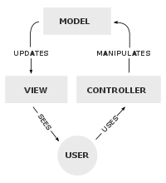
MVC
Model
  “the parts that represent the model of
  the underlying application domain”
  Simple as an integer for a counter; string
  for an editor
  Complex as a molecular simulator
View
  “the way the model is presented to the
  user”
  Everything graphical
  Layout, subviews, composites
Controller
  “the way the user interacts with it”
  Schedule interactions with other VCs
  A menu is a controller

Slide 15
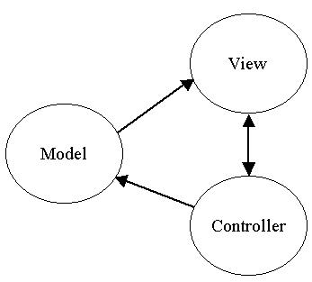
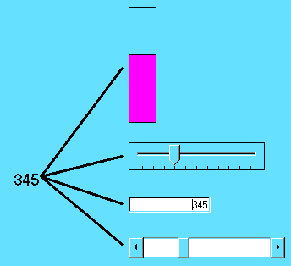
MVC

Slide 16
MVC
Views closely associated with controllers.
Each VC has one M; one M can have many VCs.
  VCs know about their model explicitly, but M doesn't know about views
  Changes in models broadcast to all "dependents" of a model using a standard protocol.
  “Observer” pattern again
    “register” the views with the model, so each is called when model changes
      Like the event handlers when mouse down

Slide 17
MVC
Standard interaction cycle:
  User operates input device, controller notifies model to change, model broadcasts change notification to its dependent views, views update the screen.
  Views can query the model
Problems:
  Views and controllers tightly coupled
  What is in each part?
  Complexities with views with parts, controllers with sub-controllers, models with sub-models...

Slide 18
Model-View (variant of MVC)
Since hard to separate view and controller
Primary goal: support multiple views of same data.
  Simply switch views and see data differently
Put into Model "part that needs to be saved to a file"
  but really need to save parts of the view

Slide 19
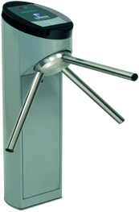
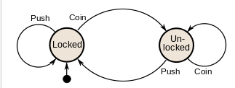
Transition Diagrams
Also called: state diagrams, finite-state machines (FSM), finite automata
Set of states and set of arcs
States: mode that the system can be in
Transition: how system can change states
Can be abstracted away from UI or code
Wikipedia example:

Slide 20
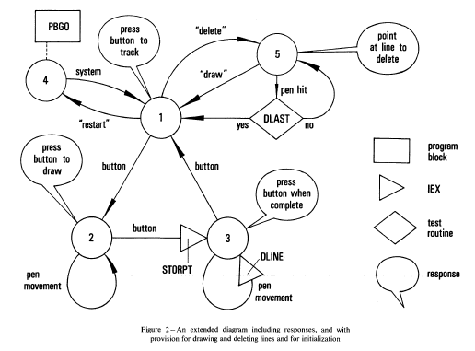
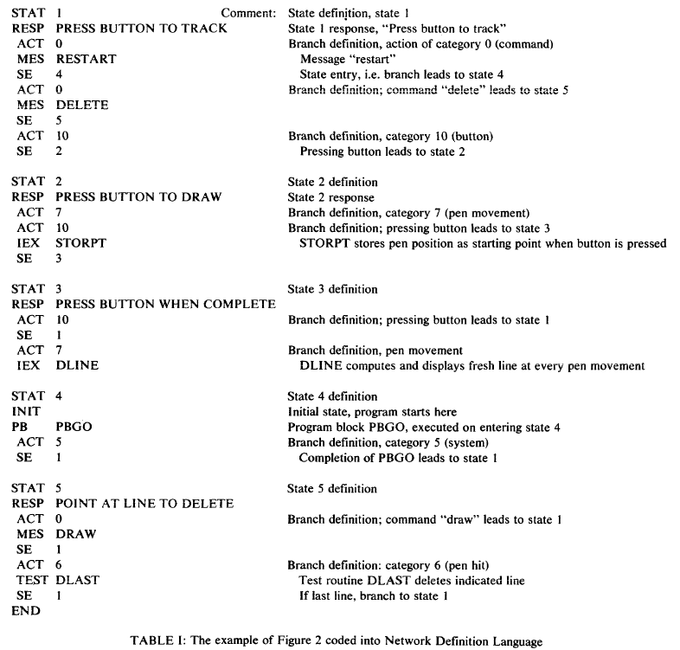
Transition Diagrams
Probably the earliest tool to help build UIs:
  William Newman's "Reaction Handler" in 1968 http://doi.acm.org/10.1145/1468075.1468083

Slide 21
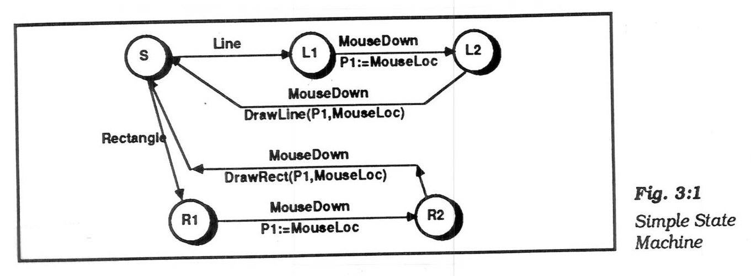
Transition Diagrams, cont.
Simplest form, arcs are user input events.
  arcs can be extended by listing feedback (output) and semantic actions on the arcs
  actions usually written in a conventional language (e.g. C)
  picture, Olsen, p. 37 (Fig 3:1)

Slide 22
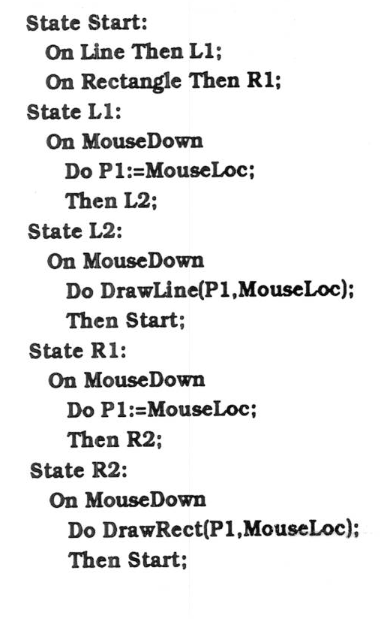
Transition Diagrams, cont.
Often, represented textually:
  picture, Olsen p. 38

Slide 23
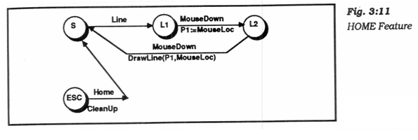
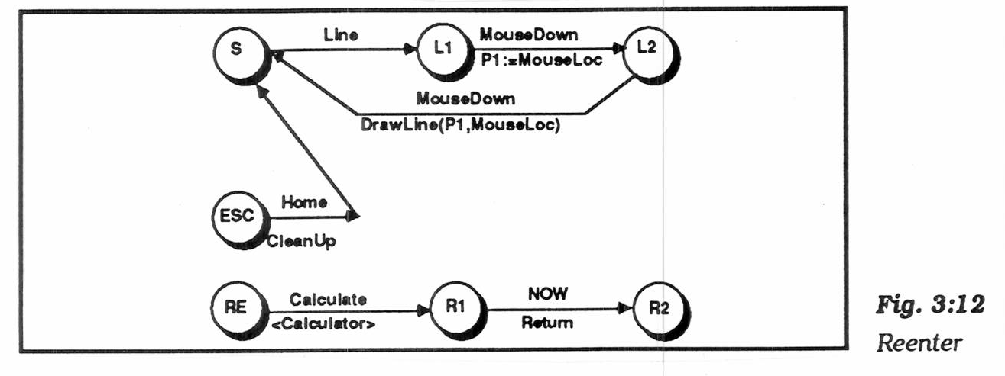
Transition Diagrams, cont.
"Pervasive states" to handle help, abort, undo, etc.
  "Escape" transitions to abort (permanently leave) a dialog
    picture, Olsen p. 53 (Fig 3:11)
  "Re-enter" sub-dialogs for temporary excursions that return to same place. E.g., help, use calculator, etc.
    picture, Olsen p. 55 (Fig 3:12)
  Transitions are taken if no specific arcs from node

Slide 24
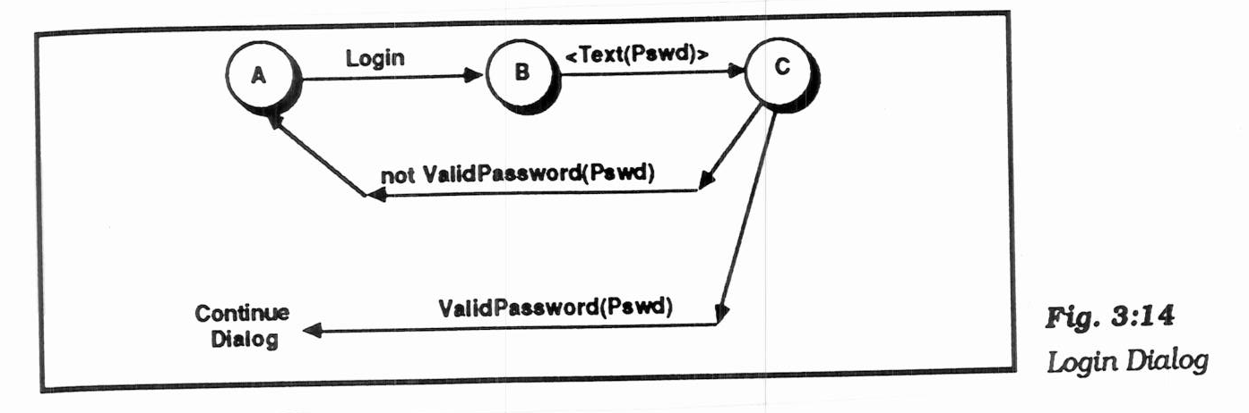
Transition Diagrams, cont.
"Augmented transition networks"
  local variables
  function on arcs can determine transitions
  "guards" determine whether transition is legal
  "conditional transitions" calculate where to go
    picture, Olsen p. 57 (Fig 3:14)
  upgrades the power to context-free-grammar

Slide 25
Transition Diagrams, cont.
Transition Networks, in general, used in various UIMSs:
  Research: Newman's "reaction handler", Jacob's RTN, Olsen's "Interactive Pushdown Automata", Stephen Oney’s Euclase, etc.
  Commercial: IDE's RAPID/USE,
  Virtual Prototypes's VAPS
  VAPS used spreadsheet interface to the ATN

Slide 26
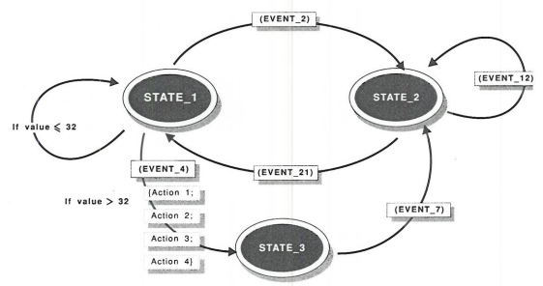
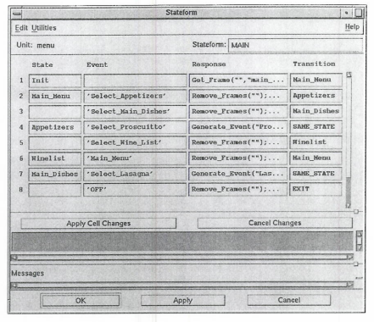
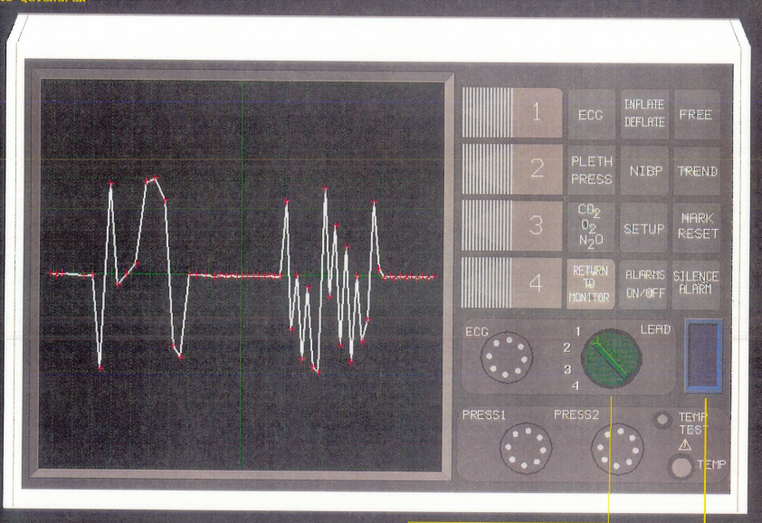
VAPS pictures
Pictures

Slide 27
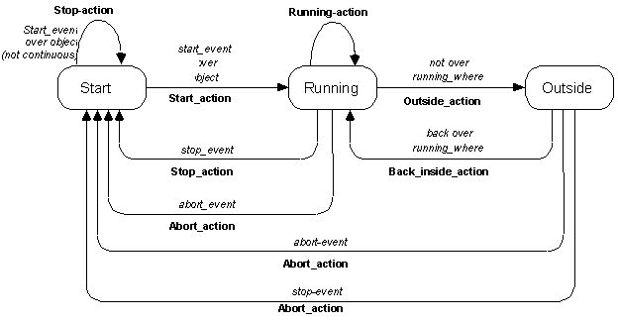
Transition Diagrams for Widget Behavior
Used internally for Garnet / Amulet “Interactors” (lecture 5)
  Note: no “hover” state

Slide 28
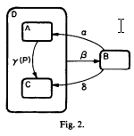
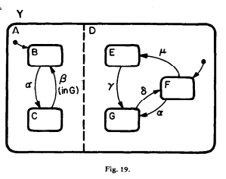
StateCharts
Invented by David Harel
David Harel, “Statecharts: a visual formalism for complex systems”, Science of Computer Programming, Volume 8, Issue 3, (Elsevier) June 1987, Pages 231-274, online
Generalization of state diagrams
  Reduce state explosion and other problems
Cluster (nested) states for abstractions and identical behaviors
“AND” states – system is in both A and D
  E.g., watch light is always on or off, may be
  independent of other modes
Concurrent charts – can operate
independently
Many other features
Used by Stephen Oney’s InterState

Slide 29
Transition Diagrams, evaluation
Good
  Make explicit the interpretation of all events in each state
  Emphasize the temporal sequence of user and system actions
  Natural and easily understood if small
    easy to teach, learn, and read
  Appropriate for some parts of GUIs: widget behaviors, dialog box transitions, etc.
  May be appropriate to model transitions around web sites

Slide 30
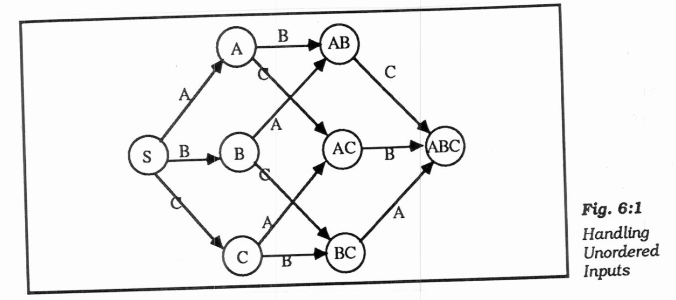
Transition Diagrams, evaluation
Bad
  Does not scale:
  150 commands with
  3 or 4 states each
    explosion of lines and
    states for normal interfaces: "maze of wires"
  unordered inputs
    picture, Olsen p. 91 (Fig 6:1)
  Textual form is like GOTO-based assembly language
  Communication through global variables
  Doesn't handle GUI mode-free style well
  What to do with un-specified input? crash, ignore input
  Doesn't address output

Slide 31
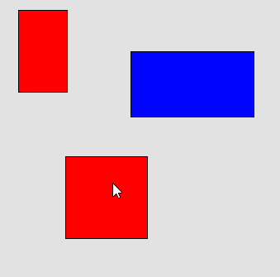
Let’s Design one for HW2
Mousedown
on div
Click -
select that div
Idle
Notes:
Starting configuration

Slide 32
Let’s Design one for HW2
First move event
moving
Div moves
Mouse-
down
Move event
Move div
Mousedown
on div
Mouse up anywhere
Move finished
Click -
select that div
Idle
ESC key
Aborting – restore to original place
click
on workarea
deselect
Dblclick on div
Dbl
moving
Click anywhere
Move finished
ESC key
Aborting – restore to original place
Move event
Move div
Notes:
Created in-class; should be cleaned up!

Slide 33
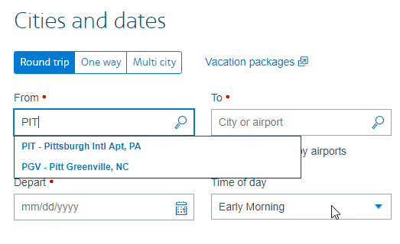
Note: Event handlers – focus vs. positional
Positional – whichever object is
under the mouse handles it
Focus – specify a specific object’s to handle it
  Always used for text
  Used for mouse-move
  Should also be used
  for the mouse-up or
  click event handler
  Can be implemented
  by having background
  object have handler

