Slide 1
Lecture 7: Output 2: Basic 2D Computer Graphics
05-431/631 Software Structures for User Interfaces (SSUI)
Fall, 2020

Slide 2
Logistics
Homework 2 due today
Thanks for using Piazza – lots of great questions and information
Start on Homework 3
A little harder so you have 2 weeks
Please don’t wait until last minute!
Please fill out anonymous status survey: https://www.surveymonkey.com/r/SSUI3weeks
How is the class going?

Slide 3
DOM is an Example of: Structured Graphics
Saves a list of all the graphical objects
Edit the screen by editing the saved list
Also called "display list" or "retained object model"
Provided by many toolkits and graphics packages early vector displays
CORE (~1977), GKS (1985), PHIGS (1988)
Optional in InterViews, CLIM, etc.
Required in Amulet, Garnet, Rendezvous, etc.
Also SVG that is part of DOM

Slide 4
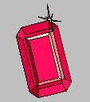

Aside: Garnet and Amulet
Garnet: (link)
1987 to 1994
Common Lisp and X11 or Macintosh
Generating an Amalgam of Real-time, Novel Editors and Toolkits
Amulet:
1994 to 1997
C++ and X11, Windows or Macintosh
Automatic Manufacture of Usable and Learnable Editors and Toolkits
Novel object, graphics, constraint, input, output, undo, command, and animation models
Were widely used for a while

Slide 5
Amulet and Garnet Papers and Videos
Brad A. Myers, Dario A. Giuse, Roger B. Dannenberg, Brad Vander Zanden, David S. Kosbie, Ed Pervin, Andrew Mickish, and Philippe Marchal. "Garnet: Comprehensive Support for Graphical, Highly-Interactive User Interfaces," IEEE Computer. vol. 23, no. 11. November, 1990. pp. 71-85. Translated into Japanese and reprinted in Nikkei Electronics, No. 522, March 18, 1991, pp. 187-205. Also reprinted in: R.Baecker, J.Grudin, W.Buxton, and S. Greenberg, eds. Readings in Human-Computer Interaction: Toward the Year 2000. Second Edition. San Francisco: Morgan Kaufmann Publishers, Inc., 1995. pp. 357-372. pdf. See also YouTube video or OpenVideo.
Brad A. Myers, Richard G. McDaniel, Robert C. Miller, Alan Ferrency, Andrew Faulring, Bruce D. Kyle, Andrew Mickish, Alex Klimovitski, and Patrick Doane. "The Amulet Environment: New Models for Effective User Interface Software Development", IEEE Transactions on Software Engineering, Vol. 23, no. 6. June, 1997. pp. 347-365. IEEE pdf or tech report or abstract only. See also YouTube video or OpenVideo

Slide 6
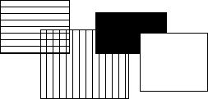
Structured Graphics, cont.
Advantages:
Simpler to program with: don't call "draw" and "erase"
Just add and remove objects
Automatic refresh of windows when uncovered, etc.
Automatic redisplay of objects when change and also of other overlapping objects
Before
After

Slide 7
Structured Graphics Can Support
Ability to support:
high-level behaviors like move, grow, cut/copy/paste, etc.
high-level widgets like selection handles
constraints among objects
automatic layout
grouping: "Groups" in Garnet
automatic printing
external scripting, ...
accessibility

Slide 8
Structured Graphics Disadvantages
Disadvantages:
Significant space penalties
objects take up to 1000 bytes each
imagine a scene with 40,000 dots (200x200 fat bits)
Time penalties
Redisplay doesn't take advantage of special properties of data:
regularity
non-overlapping

Slide 9
Basic Idea: Graphical objects retained in a hierarchy
Primitives: text, rectangles, circles, …
Groups
Also called “aggregates”, “collections”, …
In HTML: <div>, <ux>, …
SVG: “Group”
The size of a group includes all of its “children” objects.
Also called “components”
Bounding box of group
Group is “parent”, elements are “children”
Foo

Slide 10
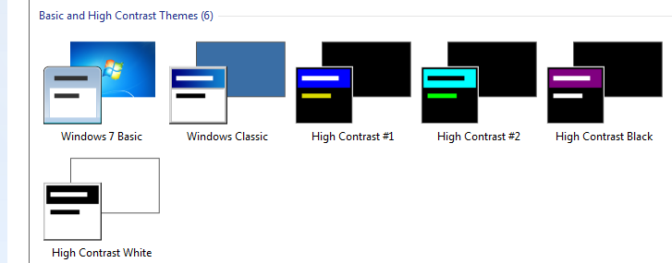
Design Issues: Hierarchies & Inheritance
How many hierarchies for OO graphics systems?
Inheritance (class-instance or prototype-instance)
Components / Groups
Style hierarchies, like from CSS classes or Windows themes
Where do properties come from?
Color, size, shape
From aggregate or inheritance hierarchy?
Issue: changing type of object – rectangle → polygon
Windows widget properties
Size, color scheme, transparency, …

Slide 11
Redisplay Algorithms
Redisplay everything each time
Most appropriate for small numbers of objects, and if drawing is really quick compared to computation
Used on the Macintosh and many others
Used by Amulet
I don’t know what browsers do

Slide 12
Redisplay only the affected areas of the screen
Requires computing what areas are affected
Garnet:
keep track of objects that change any "interesting" slot
compute the bounding box of all these changed objects in their old and new locations
assert this as the clipping region (must not self-intersect; Garnet uses 2 regions)
erase the area
go through objects from top-to-bottom, back to front draw those which overlap the bounding box
goes through all top level aggregates, and any children of the aggregates that intersect (recursively)
Other techniques: quad trees

Slide 13
Overview of Redisplay Algorithm
Foo
Simplest algorithm: draw all objects from back to front
More sophisticated: Can clip to boundary of changed objects
1st pass – collect all the objects which have changed
Combine into one or more clipping rectangles
2nd pass – go through all objects from back to front and redraw them
Will be clipped to affected regions
Optimization – only do components if group intersects changed area

Slide 14
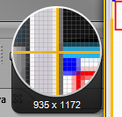
Issue: Anti-Aliasing and special effects
Drop shadows, highlights, other special effects
Can draw outside of the normal display area
Have to be more careful in computing bounding boxes
MacOS & iOS & Web use anti-aliasing by default and seem to redraw lots of windows

Slide 15
Object-Oriented Techniques
Motivation
Became popular along with GUIs, Direct Manipulation
Icons, graphics seem like objects:
have internal state, persistance
OO was originally developed (SmallTalk) and became popular (C++) mostly due to GUIs.
C++ became popular with Windows programming

Slide 16
Object Oriented
As a UI technique:
Same as GUI, Direct Manipulation = icons, graphical objects, widgets
Here, as a programming paradigm (often in a language)
A form of "data abstraction"
"Classes" describe the basic structure of the data
Also, the methods that can be called
Usually no direct access to the data, only the methods

Slide 17
OO
Create "instances" of the classes
local copy of data
may also be class data -- all instances share the same value
shares all methods
"Inheritance": create a new class "like" the superclass
by default has all the same methods and data
can add new data and methods and re-program inherited methods
Example: graphical_object.draw ... circle.draw

Slide 18
OO
New style of programming; thinking about the problem
Many books about how to do it right.
OO design; getting the classes and protocols right
So subclasses don't have extra, wasted data space
Methods make sense to all sub-classes
So external classes don't need to know inside description.
Also OO databases, etc.
Implementation:
object in memory, starts with pointer to table of methods, etc.
lots of tricks and extra declarations in C++, Java etc. to avoid overhead of lookups at run-time ("virtual", "pure virtual")

Slide 19
Multiple inheritance
Class has multiple parent classes
Combine all the methods and data of all
Special rules for when conflict (same method, same name of data with different types, etc.)
Example: circle inherits from graphical-object and moveable-object
Complex so often not used even when available
“Diamond problem”
Amulet uses constraints to provide flexible copying of values instead
Java, etc. use “interfaces”
No inheritance of implementations, but ability to have arbitrary “mix-ins”
No confusion about which superclass to inherit from

Slide 20
Prototype-Instance model
Instead of the class-instance model
All objects are instances
Can use any object as a prototype for other objects
Inherits all slots it doesn't override (= instance variables, member variables, fields, attributes).
Methods are just a value in a slot
Dynamic changing of methods
Easy to implement using structures.
Usually, changing prototype data also changes all instances that do not override it.
Now used by JavaScript
Older uses: ActionScript (Flash), SELF, NewtonScript,

Slide 21
Prototype-Instance model
Adding and removing of slots dynamically to any instance
Simpler model, easy to implement
More dynamic
But much less efficient
Can't usually compile slot accesses into structure access; may need a search
No type checking on slots
Methods looked up at run-time
Space for names of slots, extra pointers, etc.

Slide 22
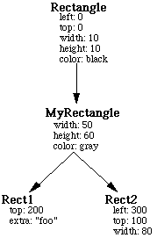
Prototype-Instance model
Available, but not frequently used in JavaScript

Slide 23
JavaScript class and superclass, and dynamic setting
class x extends y { constructor (a,b) { //class constructor super(a); // call constructor of y (required) this.b = b; //other set up stuff } doSomething(a) { //overrides this method super(a); // call y’s version of doSomething // local stuff }
Dynamic creating of new field:
let myx = new x(4, 5);
myx.newthing = 6; //creates and sets a new field in myx
…
let p = myx.newthing + 12; //somewhere else can use it

