Slide 1
Lecture 5: Input 2: Declarative input models; “Interactor” (Behavior) Objects in Garnet and Amulet
05-431/631 Software Structures for User Interfaces (SSUI)
Fall, 2020

Slide 2
Logistics
Quiz on Canvas
https://canvas.cmu.edu/courses/19124/quizzes/44387
Don’t use the js-touch-click tool – figure it out based on what you know.

Slide 3
Overview
Try to provide more support so input handling isn't so difficult
Make easy things simple and complex things possible
Based on the "Model-View-Controller" architecture from Smalltalk
(Lecture 9)
True separation of graphics (view) and input handling (controller)
Also uses idea from [Foley&Wallace 1974] of identifying types of input handlers:
move
grow
rotate
text edit
gesture
select (pick)
James D. Foley and Victor L. Wallace. “The Art of Natural Graphic Man-Machine Conversation,” Proceedings of the IEEE. Apr, 1974. vol. 62, no. 4. pp. 462-471.
Notes:
Stopped here

Slide 4
Innovations
Identifying primitive "Interactor" objects and correct parameterizations so most direct manipulation UIs can be constructed by re-using built-in objects.
Better name might be “Behavior” objects
Only a few kinds of behaviors, and standard parameters
Real separation between input and output handling
Handles all input
insides of widgets
and for application programs
+ First successful separation of View from Controller in Smalltalk MVC
+ Integration of gestures with conventional interaction.
+ Easier to code because substantial re-use
+ Built-in support for multi-window dragging

Slide 5
General idea
Attach interactor objects to a set of graphical objects to handle their input.
Graphical objects don't handle input
No "event methods" in objects
Instead, define invisible "Interactor" objects and attach them to graphics
Interactors can operate on multiple objects
Strategy: pick the right type of Interactor, attach to the objects to be affected, fill in necessary slots of interactor
Widgets use interactors internally
Can have multiple interactors on an object (e.g., different mouse buttons)
Interactors directly set slots of objects using a standard protocol
constraints can be used to map those slots into behaviors:
Details of input events and event processing is hidden
Used first in Garnet, refined in Amulet.

Slide 6
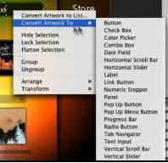
Flash Catalyst
Previous product from Adobe
Only in CS 5.5
Also had behaviors that can be attached to graphics and parameterized

Slide 7

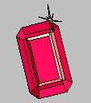
Full Documentation
Full Amulet Manual:
http://www.cs.cmu.edu/afs/cs/project/amulet/amulet3/manual/Amulet_ManualTOC.doc.html
Tutorial
Interactors and Command Objects

Slide 8
Garnet, Amulet Design Overview
Invented our own object system
Prototype-instance instead of class-instance
Syntax: prototype.Create(“name”)
Uses obj.set ( instance-variable, value )
Uses what is now called method cascading or fluent interface
.set and other methods return the original object, so can be chained together
Obj.set(Am_X, 4).set(Am_Y, 6).add_part…
C++ didn’t have name spaces, so started all Amulet words with Am_ …
Full set of graphic objects and groups
mygroup.Add_Part(myrect);

Slide 9
Types of Interactors
Am_Choice_Interactor : select one or more of a set of objects
Am_One_Shot_Interactor - single action, like Choice
Am_Move_Grow_Interactor : move or grow objects with the mouse
Am_New_Points_Interactor: to create new objects by entering points while getting feedback "rubber band" objects
Am_Text_Edit_Interactor : mouse and keyboard edit of text
Am_Gesture_Interactor: interpret freehand gestures

Slide 10
Affected Graphical Objects
Set of objects to operate on:
To be active, Interactor must be attached to an object which is (recursively) attached to the screen
Equivalent to visibility of graphical objects
Unlike graphical objects which can only be added as parts of windows or groups, interactors can be added as parts of any object: rect.Add_Part(my_inter);
Default: operates on the object attached to
But also common to operate on any member of a group.
Controlled by the Am_Start_Where_Test slot, which should contain a method

Slide 11
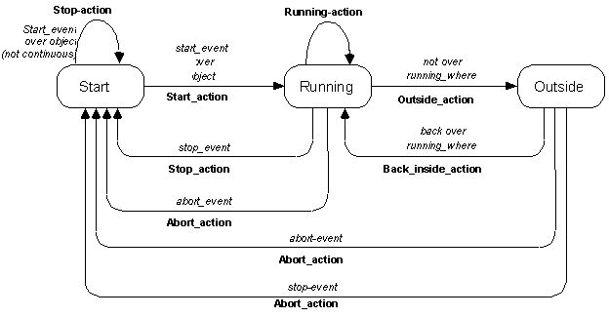
Standard Behavior
(“state diagrams” covered in lecture 9)

Slide 12
Other standard parameters
Multiple groups
interactor can span multiple windows
start, stop and abort events
single key, mousebutton, "any" mousebutton, modifiers, (shift, meta...), double click, click vs. drag, etc.
active?
priority levels

Slide 13
Parameters for specific types of Interactors
For buttons (Choice Interactors)
how many objects to select: set, toggle, list-toggle
For move-grow:
interim feedback object (while the mouse moves)
if missing then object itself is modified
gridding
move or grow
where-attach
center, n, ne, nw, w ... , where-hit
flip if change sides
minimum size

Slide 14
Parameters for New_Point
interim feedback object (while the mouse moves)
gridding
minimum size
abort if too small

Slide 15
Parameters for Text_Interactor
editing translation table (to map keystrokes and mouse into editing functions)

Slide 16
Parameters for Gesture_Interactor
gesture recognizer table
If missing, can use this to get freehand drawings

Slide 17
Simple Example
To make an object movable with the mouse:
Am_Object rect = Am_Rectangle.Create() .Set(Am_LEFT, 40) .Set(Am_TOP, 50) .Set(Am_FILL_STYLE, Am_Red) .Add_Part(Am_Move_Grow_Interactor.Create());

Slide 18
Choice Interactor
Three ways to get the result:
Access the Am_INTERIM_SELECTED and Am_SELECTED slot of the object itself
By default, sets the Am_INTERIM_SELECTED and Am_SELECTED slots of the affected objects
Constraints that depend on these slots
Access the Am_VALUE slot of the interactor
Write a Am_DO_METHOD for the command object, and access the command object's Am_VALUE slot

Slide 19
Example
Am_Define_Style_Formula (line_from_selected) { if ((bool)self.Get(Am_INTERIM_SELECTED)) return Am_Red; else if ((bool)self.Get(Am_SELECTED)) return Am_Black; else return Am_Blue; } Am_Object my_prototype = Am_Line.Create() .Set(Am_LINE_STYLE, line_from_selected); my_group = Am_Group.Create() .Add_Part(Am_Choice_Interactor.Create());
Now add instances of my_prototype to my_group
Also collects a list of the selected objects in the Am_VALUE slot of the command object in the interactor

Slide 20
Advanced Feature: Priorities
If two interactors want to run, priorities used to determine which
Am_PRIORITY slot contains a number. Default = 1
When running, 100 added to it
Inspector interactors use 300.0
If multiple with same priority, runs the one attached closer to the leaf

Slide 21
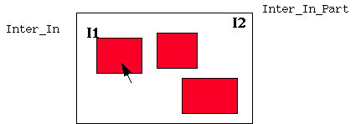
Example

Slide 22
Advanced Feature: Using Slots of Interactors
In addition to value set into Command, a number of slots are set into the Interactor itself, which might be useful.
Can get the interactor as the Owner of the command passed to the DO_METHOD
Am_START_OBJECT, Am_START_CHAR, Am_FIRST_X, Am_FIRST_Y, Am_WINDOW, Am_CURRENT_OBJECT

