Slide 1
Lecture 23: Tools and Models for Using and Implementing Interaction Techniques (chapter 20)
Brad Myers
05-440/05-640: Interaction Techniques
Spring, 2025

Slide 2
Logistics
Interim reports due today
Quick survey about when you are available – do Quiz 6 now
https://canvas.cmu.edu/courses/45597/quizzes/142545
Presentation schedule next week on the class schedule
Please practice so correct length!
Meetings with groups will start soon

Slide 3
User Interface Software
How to implement the user interface portion
Including how to implement widgets & other interaction techniques
Various ways have been proposed over time
Different layers
HCII courses about UI software:
PUI
SSUI

Slide 4
Why are UIs hard to Implement?
They are hard to design, requiring iterative implementation
They are reactive and must be programmed from the “inside-out”
They generally require multiprocessing
There are real-time requirements for handling input events
The software must be especially robust while supporting aborting and undoing of most actions
It is difficult to test user interface software
The tools to help with user interfaces can be extremely complex
Programmers report an added difficulty in modularizing user interface software.
UIs often require implementing in multiple languages: JavaScript, html, CSS, JSON, SQL, etc.
Significant churn in tools, especially for web:
Java, Flash, Ruby on Rails, PHP, ASP, JSP, CoffeeScript, jQuery, ReactJS, …

Slide 5
Many UI Software Layers
Interactive GUI Tools | Interactive Prototyping Tools |  | Automatic Tools
UI Framework (optional)
UI Toolkit
Input Model |  | Imaging Model
Operating System

Slide 6
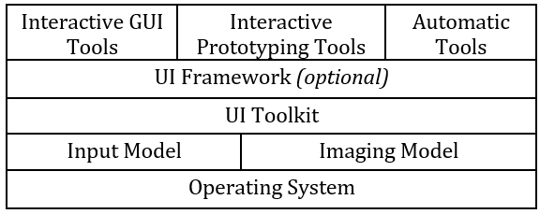
Operating System
Examples: Microsoft Windows, Macintosh OS, iOS, Android, Linux
In the “old days”, custom “operating systems” for Smalltalk, Bravo editor, Xerox Star, etc.
Handles low-level “device drivers” that take hardware inputs from keyboard, mouse, microphone, USB, etc.
Also screen drivers to allow output to screen, sounds, etc.
Also, other services, like file system, networking, etc.
Browser is the “OS” for web
Libraries in Java, JavaScript, Adobe Flash ActionScript, etc. that provide “wrappers” to provide this same functionality

Slide 7
Input Model
How user events such as the keyboard and mouse are made available to the code
Event Model
Most common approach
Event handlers for mouse buttons, mouse movement, keys, buttons, etc.
Lots of other things come in as “events”
Gestures (flick), sensors, voice input, etc.

Slide 8
Imaging Model
How the graphics and text are drawn on the screen
E.g., DrawRectangle, DrawEllipse, DrawLine, DrawText, DrawImage, etc.
Painting (Canvas) vs. drawing (SVG)
Can have lots of parameters

Slide 9
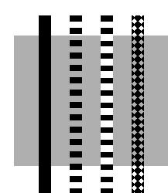
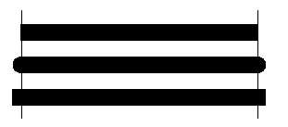
Line Properties
LineStyles
Width (lineWidth)
Solid, dashed 111000111000111000, "double-dashed", patterned (lineDashOffset)
Cap-style (lineCap): butt, round, projecting (by 1/2 linewidth):

Slide 10
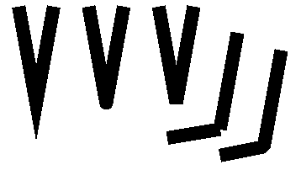

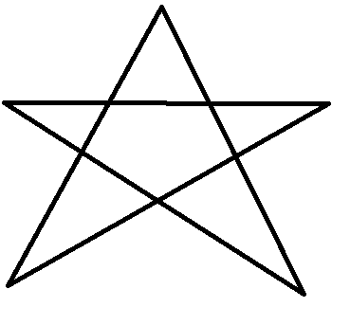
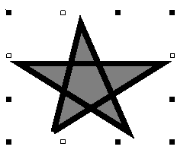
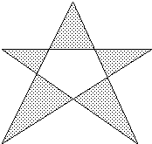
Polylines
End-caps: miter, round, bevel:
Miter = point, up to 11 degrees (miterLimit)
Round = circle of the line width
Bevel = fill in notch with straight line
Filled, what parts?
“Winding rule”
JS: fill-rule:nonzero
“Odd parity rule”
JS: fill-rule:evenodd
Used by Java
JavaScript has both!
fill-rule:winding
fill-rule:evenodd

Slide 11
DrawLine Parameters
Window (Canvas) in which to draw
X1
Y1
X2
Y2
relative-p
line-width
draw function
background-color
foreground-color
cap style
line style (solid, dashed, double-dashed)
dash pattern
dash offset
stipple bitmap
stipple origin X
stipple origin Y
clip mask
plane mask (for drawing on specific planes)
Other graphics, like Text, have even more parameters!

Slide 12
Toolkits
A library of interaction techniques (widgets) that can be called by application programs
Toolkits used only by programmers, only procedural interface
Examples:
Macintosh Toolbox
Windows Toolkit
xtk for X (Motif and OpenLook)
Java Swing and awt and swt
html for output, with input controls for input
JavaScript jQuery, AngularJS, D3, & many others
Research: Garnet & Amulet, etc.

Slide 13
Toolkits
Macintosh and all modern PC, Mac and phone toolkits provide a particular look and feel
Provides consistency across all applications on a platform
X Window system (1988) & web don’t
“Instead of mandating a particular user interface, the base window system should support a wide range of interfaces. To achieve this, the system must provide hooks (mechanism) rather than religion (policy).” [Scheifler 1986, p. 83]
Developers can create their own look and feels, or chose from various collections

Slide 14
UI Frameworks
Makes it easier to write the code for interactive applications, typically by providing a collection of mid-level object-oriented classes
Dates back to MacApp in 1986
Found that the original Macintosh toolkit was too hard to use
Examples:
High level parts of programming for PC, Mac, iOS, etc.
ReactJS, Angular, and Vue

Slide 15
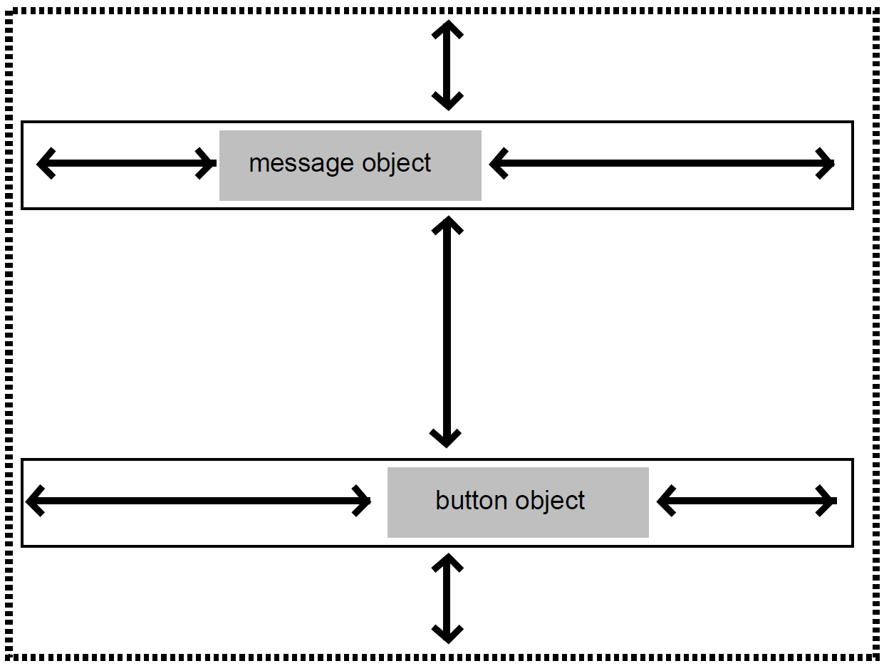
Important aspects of Toolkits & Frameworks
Geometry Management – where the widgets go, and how big they are
Specific fixed places: (30,40, 120,60)
Need more flexibility for dynamic and adaptive layouts (“responsive design”)
Can be based on their containers (like in html)
Constraint-based layouts (e.g., at the right side of the window – “align right”)
“Layout Managers” – but hard to control (e.g., Java’s GridBag layout funny video)
“Springs and struts” (or “boxes” and “glue”) metaphors

Slide 16
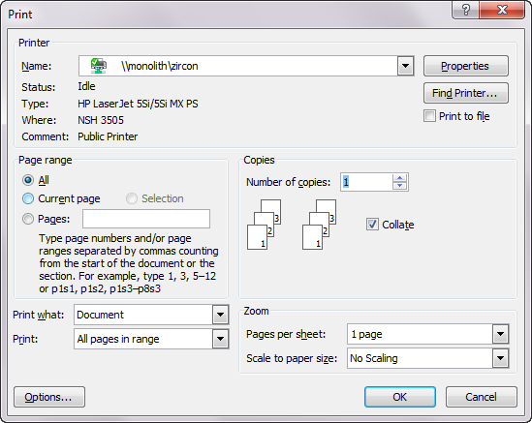
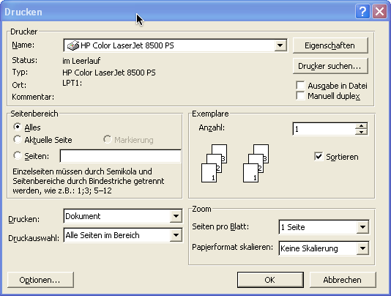
Important aspects, cont.
Resource Files
Deal with internationalization and separation of concerns
List the words and positions in a file and refer to them by “IDs”
Professional designer, tech writer or translator can then provide actual contents
Dates back to original Macintosh = “resource fork”

Slide 17
Toolkits & Frameworks Success
Help maintain consistency among UIs
Key insight of Macintosh toolbox (1984)
Not just that the Macintosh UI guidelines required consistent look and feel
Path of least resistance translates into getting programmers to do the right thing
Successful partially because address common, low-level features for all UIs
Address the useful & important aspects of UIs

Slide 18
Graphical Interactive Tools layer
Use a mouse to drag-and-drop parts of the user interface
Create or use widgets
Examples: Menulay (1983), Trillium (1986), Jean-Marie Hullot from INRIA to NeXT
Two categories:
“Interactive GUI Tools”
“Interactive Prototyping Tools”
Advantages:
Graphical parts done in an appropriate, graphical way
Address the useful & important aspects of UIs
Accessible to non-programmers
Low threshold

Slide 19
Interface Builders
Also called Interface Development Tools (IDTs) or GUI Builders or “resource editors” or Form Editors
Use real widgets
Lay out widgets to make dialog boxes, menus.
Have a palette or menu of kinds of widgets
Select widget, place with mouse in a window
Set some properties
Design menus, palettes, dialog boxes, controls
Put in “graphics” pane for main application window
Easy to use, but limited
Connect call-backs with each widget

Slide 20
Interface Builders, cont.
Layout mechanisms
Connects to the various forms of geometry management
“Resources”
Connects to the resource file
IBs Usually don't support:
Error checking of values, e.g., for text input fields
Graying of widgets depending on values and other widgets
Default values of widgets
Dynamic changing of widgets (e.g., add more items)
Dynamic changing layers (groups) of widgets (visibility) depending on values and other widgets
Any dynamically created graphical objects.

Slide 21
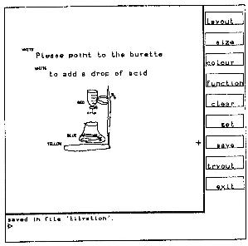
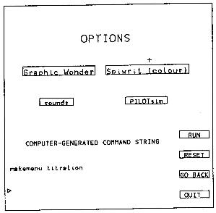
Early Research IB
Menulay (1983)
W. Buxton, M.R. Lamb, D. Sherman and K.C. Smith. “Towards a Comprehensive User Interface Management System,” Computer Graphics, Proc. SIGGRAPH'83. Jul, 1983. pp. 35-42.
http://www.billbuxton.com/menulay.pdf
http://www.youtube.com/watch?v=Kt0oAg0haU0
Vector screens, widgets, sounds, text, output C code and tables
All actions (including transitions) required C programming
NeXT Interface Builder (NeXT) - 1988 popularized the name
By Jean-Marie Hullot who had an IB in Lisp at INRIA in France
Visual Basic
Resource editors in programming environments

Slide 22
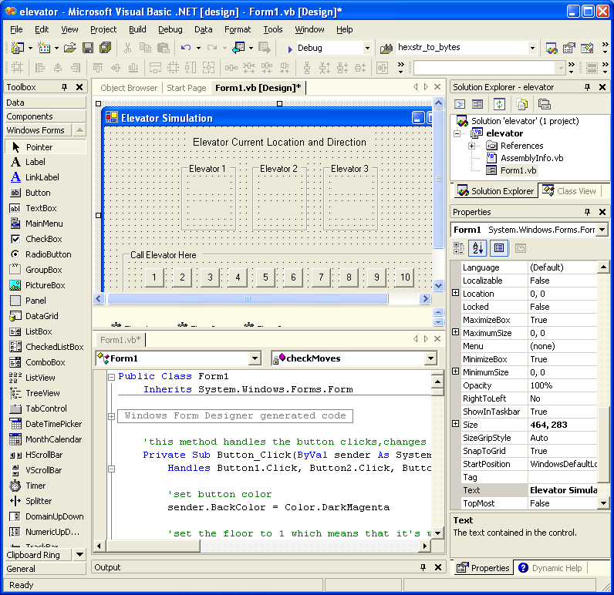
VB Screen

Slide 23
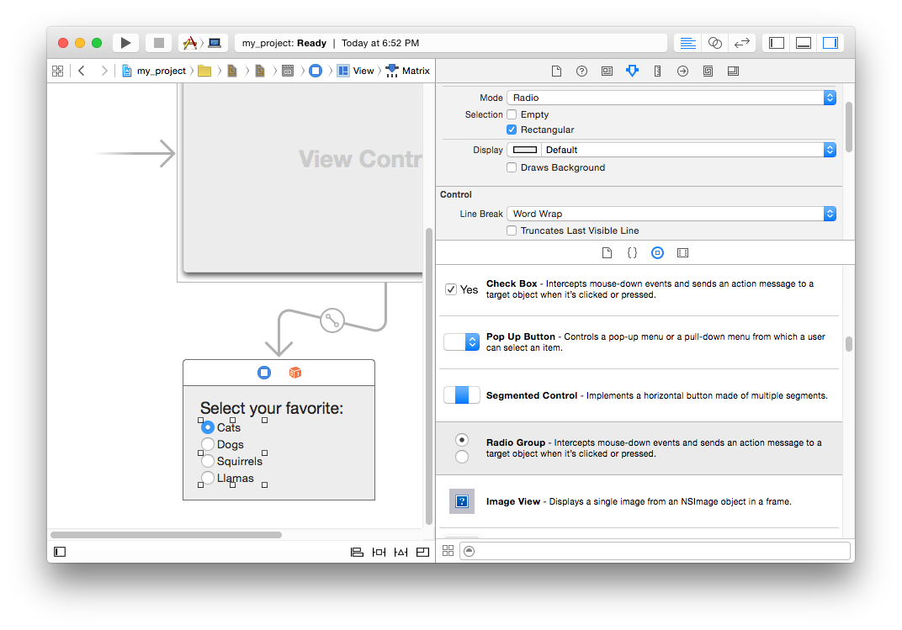
Xcode screen

Slide 24
Research: Peridot (1986-88)
Myers B. "Creating User Interfaces Using Programming-by-Example, Visual Programming, and Constraints," ACM Transactions on Programming Languages and Systems. vol. 12, no. 2, April, 1990. pp. 143-177. (Peridot)
Myers B., Creating User Interfaces by Demonstration, Academic Press, San Diego, 1988.
Myers B., "Creating Interaction Techniques by Demonstration," IEEE Computer Graphics and Applications, Vol. 7, No. 9, IEEE, September 1987, pp. 51 - 60.
First demonstrational tool, and it used by-example techniques to allow the creation of new widgets.
From the drawings, it infers:
Graphical constraints among the objects, such as that the boxes should be the same size as the text.
control structures such as iteration over all the items in a menu
how the mouse affects the graphics, such as that the check mark should follow the mouse.
feedback: question and answer
video (8 min) YouTube or CMU copy

Slide 25
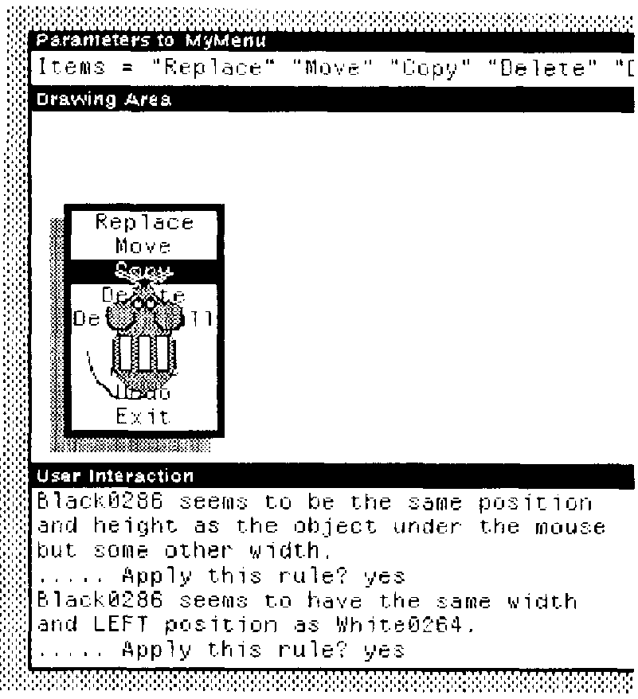
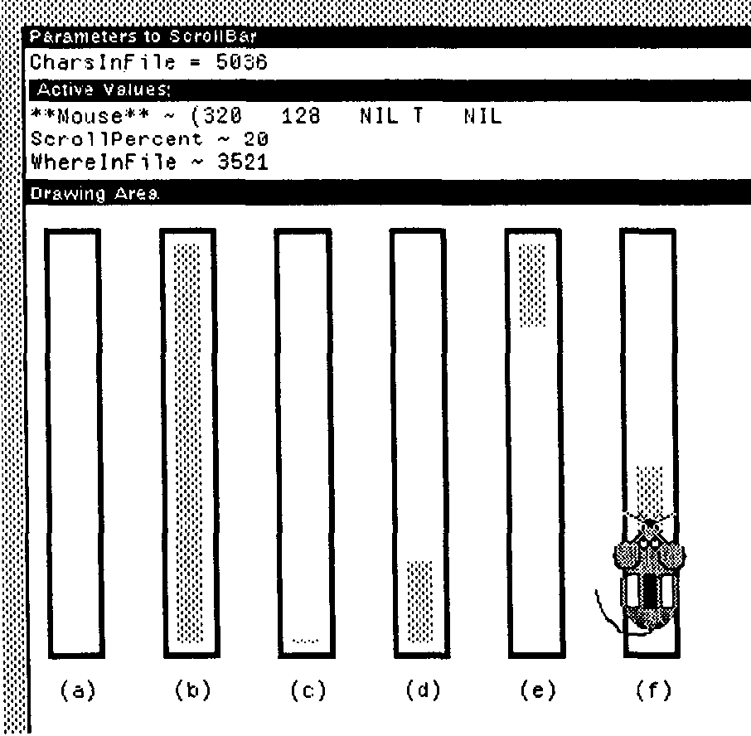
Peridot Pictures

Slide 26
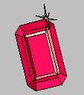

Research: Garnet / Amulet
My research projects to investigate better ways to build user interfaces
Create and use widgets
Garnet (1987-1994) in Lisp
Generating an Amalgam of Real-time, Novel Editors and Toolkits
Garnet video (9:30, 1993) (local copy)
Amulet (1994-1997) in C++
Automatic Manufacture of Usable and Learnable Editors and Toolkits
Amulet video (8:28, 1996)
Same architecture
Low and high-level tools

Slide 27

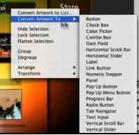
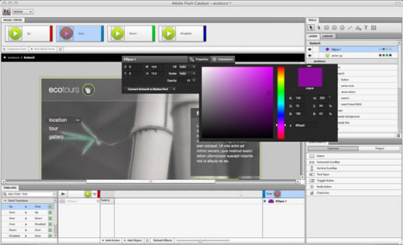
Flash Catalyst
Adobe Catalyst (formerly Thermo)
Part of CS5.5, discontinued in CS 6.0
Associate behaviors with the objects
Like my Garnet Lapidary

Slide 28
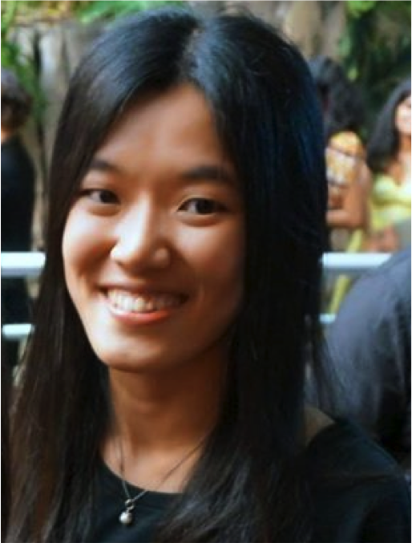
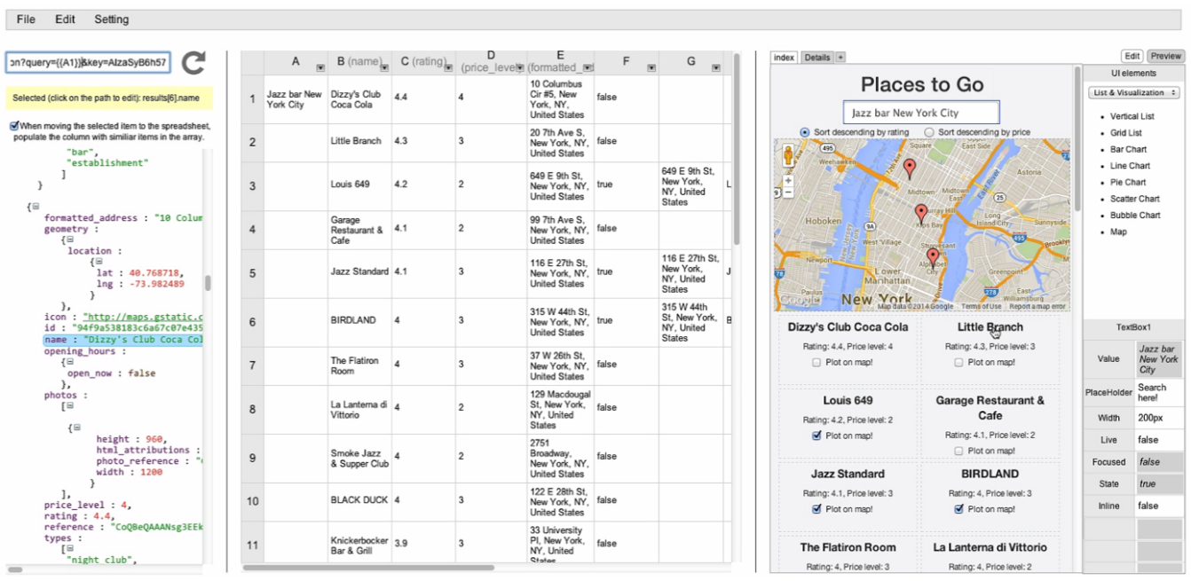
Another research example: Gneiss
PhD work of Kerry Chang, 2016
Allow web services to be utilized with a spreadsheet, to do data analysis & create web applications
Aimed at “end-user programmers” (EUP)
Video (5:00)

Slide 29
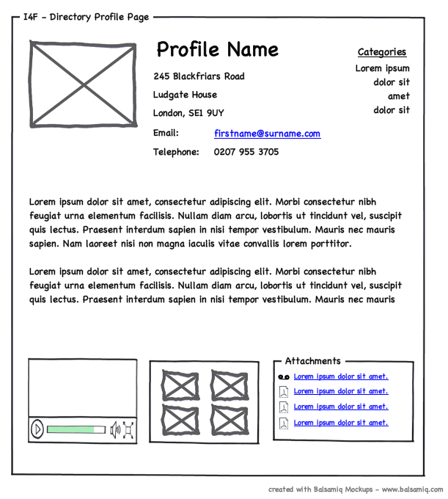
Prototyping Tools
Just show what looks like
Storyboard of screens
“Click-through prototypes”
Some support for behavior: typically changing screens
Goal: see some of interface very quickly (hours)
Often no possibility of migrating to real application
May not use "real" widgets
"Low Fidelity" Techniques
“Wireframes”

Slide 30
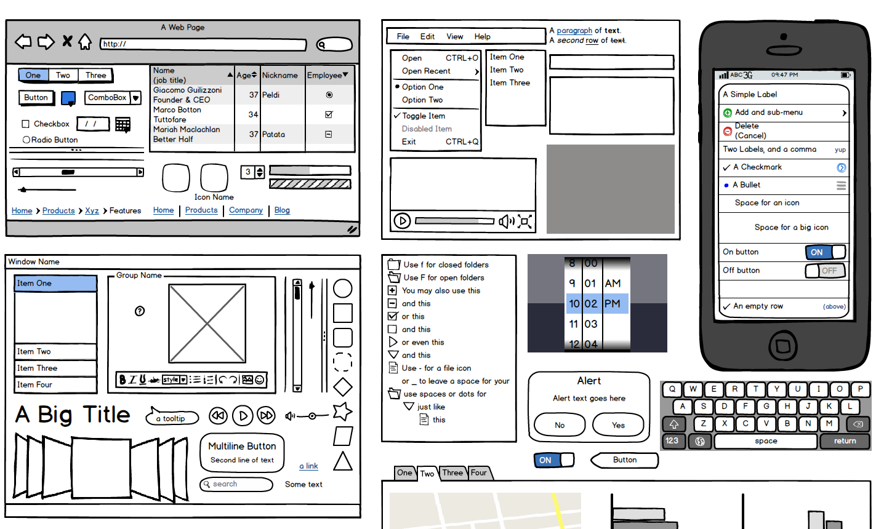
Prototyping tools
Long history
Dan Bricklin’s “Demo” for DOS screens (1985)
See Dan’s guest lecture from 2019 (link)
HyperCard (1987)
See Bill Atkinson’s guest lecture from 2019 (link)
Modern examples:
Figma
Adobe XD
Balsamiq
Axure
InVision
Sketch
…

Slide 31
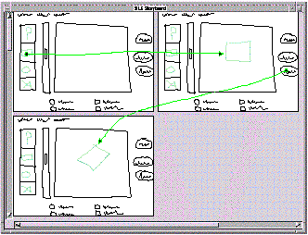
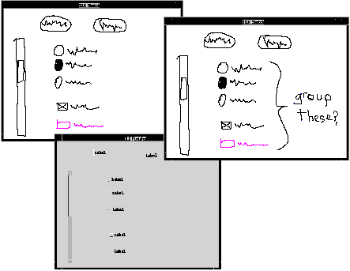
Research on Prototyping
James Landay’s PhD research (1985) on SILK
Main paper: http://doi.acm.org/10.1145/223904.223910
Video from CHI’96 (8:22 min)
Draw sketchy prototypes
Storyboards with click-through
Transform into “real” UI

Slide 32
Automatic Creation from Specification
High level “model”, often from a programmer
AI system creates a UI from that
Rule driving or Machine Learning (ML) approaches
Can adapt to different form factors and abilities
Note: Gregg Vanderheiden’s vision
Not very successful
Often the spec is bigger than the code would be

Slide 33
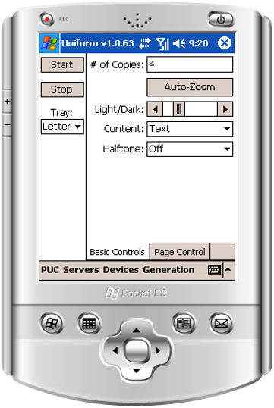
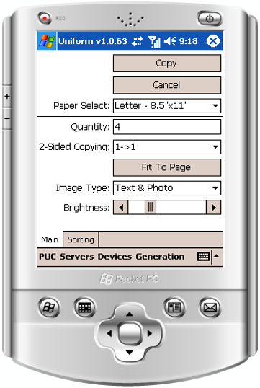
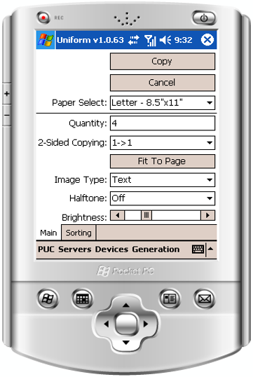
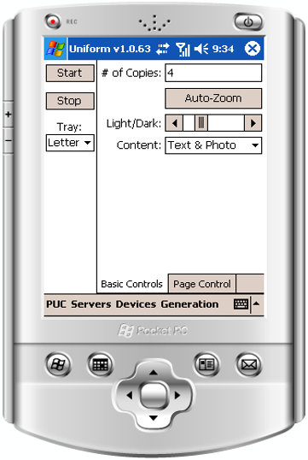
Research on Automatic Creation
Jeff Nichol’s PhD research
Personal Universal Controller (PUC)
Personally consistent
Better than original device’s

Slide 34
Design Exercise
Lecture 23:Tools and Models for Using and Implementing Interaction Techniques (chapter 20 of textbook)
Scenario:
You and a few friends recently quit your jobs at Figma to pursue a startup that will rival Figma
Not only do you want to create a better version of Figma, but you also want to go beyond what it can currently do
Right now, Figma is used for prototyping apps and showing transitions between different features. However, there is no way to prototype interaction features (such as scrolling, typing, etc.)
Prompt:
With the Figma framework already handy, your startup aims to implement a tool that can create actual parts of the interface
Specifically, users can scroll, type, etc. through the prototype interfaces
These interaction techniques will behave similarly to how they are implemented with code
From this, we want you to develop the new tool with Figma’s current toolkit and framework in mind
This tool can look like a new widget that follows a Figma’s design system
To Do:
Generate Ideas and Discuss Pros / Cons of your new tool
Write down your design decisions and reasons
Create a sketch (draw a picture) of how users will be interacting with this tool / widget and the important states you want to highlight
Discuss the limitations, trade offs, and considerations of the design
Evaluate the learnability of this feature
Logistics
Groups of 3 or 4
Pen and paper
Be sure to clearly write the group member names - including Andrew IDs
Select a person in the group with good handwriting to be the scribe

