Slide 1
Lecture 19:
Various Undo Models, Interaction Histories, and Macro Recording
(chapter 15)
05-440/05-640: Interaction Techniques
Spring, 2025

Slide 2
Logistics
Project proposal (2 pages) due Monday
  Janelle and Brad will try to turn them around by Wednesday
Brad Myers will be away next week
  Two guest lectures, both in-person!
  Please attend and be on time

Slide 3


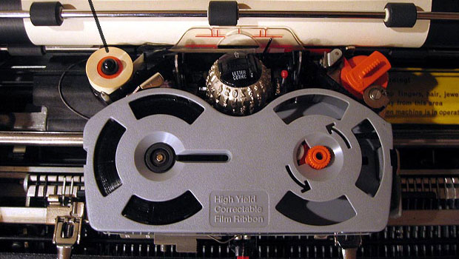
Early Undo
Invented 1951 by
Bette Nesmith Graham
IBM Correcting
Selectric II
1973
Notes:
Eraser on pencil from 1850s

Slide 4
Definitions
Undo is reversing a previous operation so that it no longer is in effect
  Usually ^Z
  For web apps, sometimes the Back button in a browser
Undo Model – what kind of undo is supported
  Single level; multi-level – script or inverse; selective
Cancel is stopping an operation while it is in progress
Redo – undo the undo (or same as Repeat)
Repeat – do the previous operations again on new selection
Selective Undo – the user can select which operation(s) in the past to undo

Slide 5
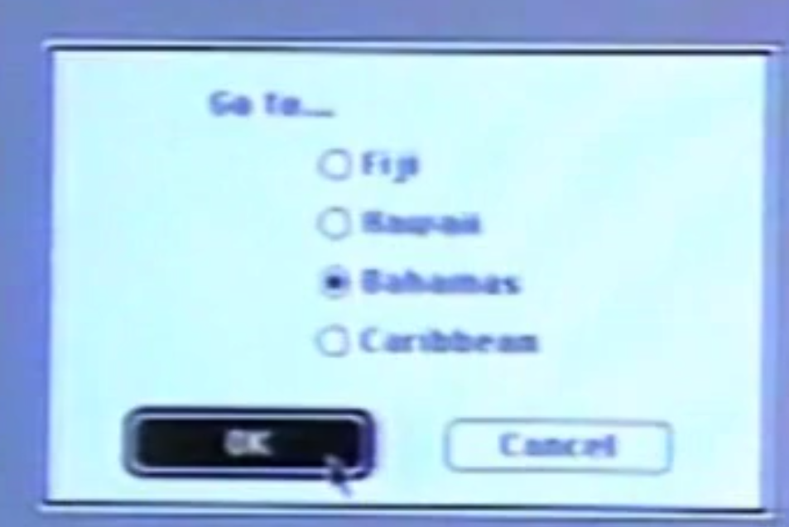
Cancel or Abort
Often ESC key or the “Cancel” button in a dialog box
  Macintosh Command-Period (Cmd-dot)
= Abort
^C in command lines, cmd, Macintosh terminal,
console, etc.
  Inconsistent with Cmd-C on Mac
Windows Control-Alt-Delete
  Serious abort on Windows
Macintosh Command-Option-ESC
  “Force Quit”
iPhone “home” button
  But now leaves the app running in the background
  Swipe up and hold, then swipe up or “X” to really abort the app

Slide 6
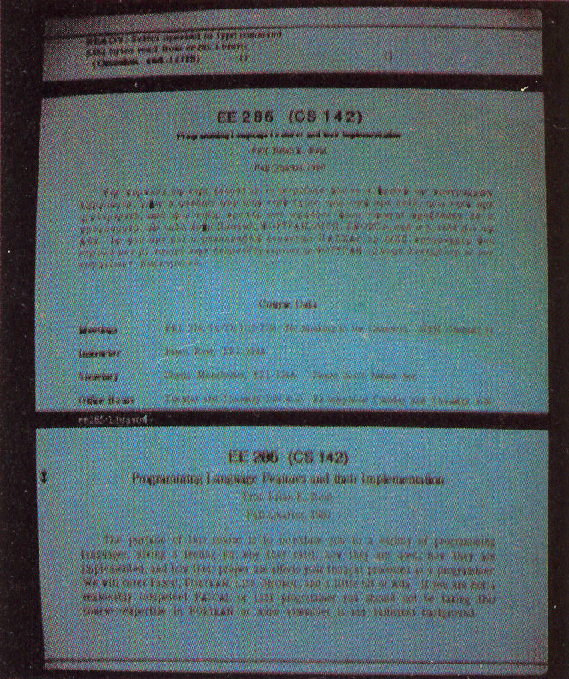
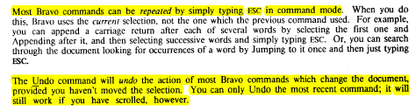
Computer Undo
Originally, single previous action could be undone
  Single Level Undo Model
Various systems in the 1960s
  Andy van Dam claims FRESS in 1966 was first; was multi-level
Bravo: 1974
  Butler Lampson, Charles Simonyi and colleagues in
  Simonyi went to Microsoft and created Microsoft Word
  First WYSIWYG text editing
  Single level undo for most commands
  Undo again would “undo the undo” = “redo”
  Some commands could not be undone
  Could not undo if “moved the selection”
  Could repeat the previous command
  with ESC, using the current selection
    Uses the same arguments as previous time
    Example: “insert abc” multiple times
history-computer.com/Library/AltoUsersHandbook.pdf‎

Slide 7
Shortcuts - ^Z
NY Times (quoted by Wikipedia) says shortcut ^Z was selected “by programmers at the research center Xerox PARC”
  http://www.nytimes.com/2009/09/20/magazine/20FOB-onlanguage-t.html?_r=0
  Larry Tesler says that is incorrect
Redo shortcut
  ^Y in Windows
  ^-SHIFT-Z in some other systems

Slide 8
Larry Tesler’s email
Warren Teitelman's Interlisp Shell (1960's) had perhaps the first generalized Undo command. But it only undid top-level shell commands, not side effects that they had caused. As I recall, as in Photoshop, you could undo a specific command in the history without undoing those in between.
…
The 1975 Gypsy manual describes cut, copy and paste but not undo. I do not know why we didn't document--or maybe didn't implement--Undo since it was already in Bravo. But when Dan Ingalls implemented the Smalltalk-76 edit menu shortly afterward (late 1975?), it had cut, copy, paste and undo.
The NYT article was mistaken (and contained no citations to Xerox publications). The Lisa was the first system to assign XCVZ to cut, copy, paste and undo (shifted with the "apple" key). I chose them myself. X was a standard symbol of deletion. C was the first letter of Copy. V was an upside down caret and apparently meant Insert in at least one earlier editor.
Z was next to X, C and V on the U.S. QWERTY keyboard. But its shape also symbolized the "Do-Undo-Redo" triad: top rightward stroke = step forward; middle leftward stroke = step back; bottom rightward stroke = step forward again.
So X, C and even V were not novel. But I know of no use of Z to mean Undo before the Lisa.
When Z undid only the most recent command, another Z redid it. Y was used in Bravo (bare Y) and Microsoft Office (ctrl-Y) to mean Redo. In both of those editors, Y redid the last command, even if that command hadn't been undone first. Example:
Select paragraph 1
Indent by 6 [a multi-step dialog-based command]
Select paragraph 4
Redo [i.e., Indent the current selection by 6, too]
When undo became multi-level, the Mac and Microsoft (including Word for Mac) diverged as you said.
Larry

Slide 9
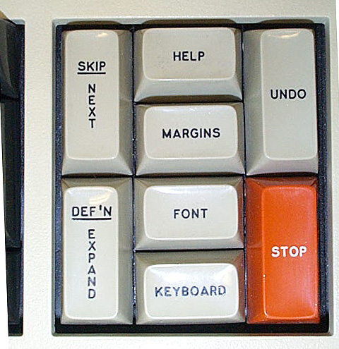
Xerox Star Undo
Probably single level Undo
Used keyboard keys
“Stop” for cancel

Slide 10
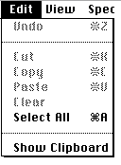
Original Macintosh
First system to require Undo everywhere
Single-level undo originally
“Multi-level undo commands were introduced in the 1980s”
  -- Wikipedia
  But I don’t know exactly which version of Mac OS

Slide 11
Single Level Undo
create
green rect
resize
rect
make
blue
rotate
rect
Just toggles the latest item on the list
A
B
C
D
undo
A
B
C
D
undo
A
B
C
D

Slide 12
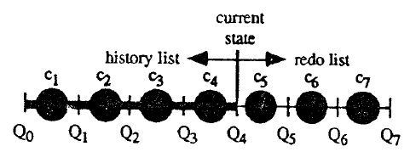
Linear Undo
create
green rect
resize
rect
make
blue
rotate
rect
Also “multi-level” undo
Keep a list of all operations
Undo (^Z) goes backwards, repeatedly
Redo (^-Shift Z or ^Y) goes forwards after an undo
  Undo the undo
New operations remove anything undone – it is lost forever
1)
2)
3)
4)
5)
A
B
C
D
undo
A
B
C
X
D
undo
undo
A
B
X
X
C
D
undo
A
B
C
X
D
redo
undo
A
B
C
X
X
D
redo
E
add
shadow

Slide 13
Repeat
create
green rect
resize
rect
make
blue
rotate
rect
Does the previous operation again on the current selection
E.g., rotate something else by the same amount
  Really useful
Goes on the undo stack just like normal operations
Typically, uses same shortcut key as Redo
  But might want to repeat the previous command after an undo
  Office changes icon
Repeat is often not available
A
B
C
D
repeat
A
B
C
D
E
create
green rect
resize
rect
make
blue
rotate
rect
A
B
C
D
undo
A
B
C
D
Repeat
make blue
E

Slide 14
Complications: Operations not put on Undo Stack
Scrolling
  But jumping to last spot might be undoable with Control-leftarrow
  Might be useful to have a “go back” for scrolling too
  See research later
Changing the selection
  not undoable, doesn’t change undo stack
  My Topaz system made this available for undo – see later
Changing the value of controls, if doesn’t affect any objects
  Changing the color of the next-drawn object
Copy (as in Cut-Copy-Paste)
  Clipboard changes are not affected by undo
    Lots of clever strategies take advantage of this
    Also, not possible since clipboard is global and undo is per-application
Saving to file is not undoable
  Old: blocks off all previous operations
  Current: not put on undo stack so can undo past saves

Slide 15
Complications: operations that are collected
Multiple operations typed grouped into one undo
  Typing characters into an editor – various things break up the unit of undo
  Similarly, multiple backspaces
  Find-and-replace-all
Used of arrow keys to “nudge” graphics often grouped into 1 operation
  Find-and-replace multiple
Or, one operation causes multiple entries on undo stack:
aaa. teh_ → aaa. The_ (auto-correct & auto-capitalize & space)

Slide 16
Complications – Per Window or Across Windows?
Separate applications (e.g., Excel and PowerPoint) always have independent undo stacks
But what about Undo in separate windows of the same application?

Slide 17
Complications – Per Window or Across Windows?
Separate applications (e.g., Excel and PowerPoint) always have independent undo stacks
But what about Undo in separate windows of the same application?
  Excel does all windows together!
  PowerPoint and Word do each window separately!

Slide 18

Undo in Various Platforms
Early PDAs have similar undo to regular computers
  iPhone – shake for a few kinds
  Android – “back” button, but mostly used for cancel
  Missing for most web and phone app operations
See details for how Linear Undo works in PowerPoint
  Good reference for expected behaviors
  Note how selection changes as a result of undo
Many programs have “unusual” designs for undo
  Outlook – single level; undo delete – but not selected (so hard to find)
  Emacs editor – weird “switch directions” undo – forward/backwards
  PhotoShop – 2 or 3 different undo mechanisms

Slide 19
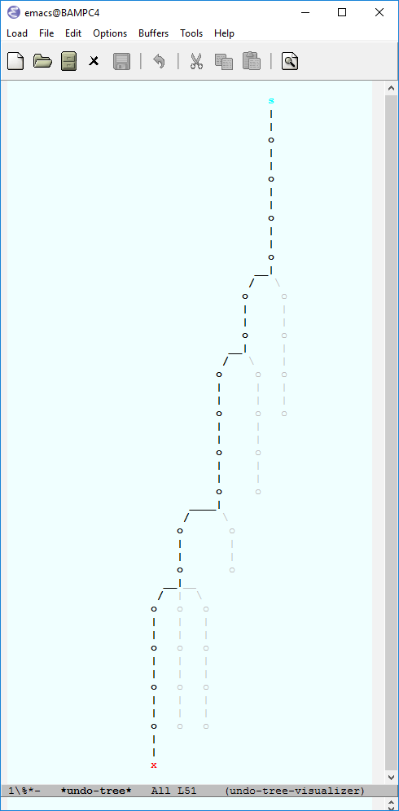
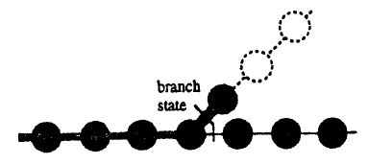
Hierarchical or Tree-Based Undo
create
green rect
resize
rect
make
blue
rotate
rect
A
B
C
D
Keep the entire history of all edits
User can return to any previous state of the system
  In theory, but navigation is difficult
Emacs:
  Cubitt, T. “Undo-Tree package”: undo-tree.el
  version 0.6.4, http://www.dr-qubit.org/emacs.php
  Visualizes as a tall tree with unlabeled nodes
1)
2)
3)
4)
5)
undo
X
A
B
C
D
undo
undo
X
X
A
B
C
D
undo
X
A
B
C
D
redo
undo
A
B
C
D
add
shadow
redo
E

Slide 20
Selective Undo
Selective Undo – let the user select which operation(s) to undo
  While leaving later operations intact
Two main models:
  Script model
  Inverse model
undo
X
A
B
C
D

Slide 21
Selective Undo Models: Script
“Script” model – pretend the operation never happened
  Can undo all operations to that point, remove the command, then redo all the subsequent commands
    “Rewrite history”
  But what if it was a “create” and later operations were “change color”?
    Not allowed to selectively undo the create?
    Or later operations are ignored?
create
green rect
resize
rect
make
blue
rotate
rect
1)
2a)
2b)
1x)
A
B
C
D
X
A
B
C
D
undo
X
?
A
B
C
D
create
green rect
resize
rect
make
blue
make
red
X
?
A
B
C
D
undo

Slide 22
Selective Undo Models: Script, cont.
Many other examples of intertwined operations
  Not always clear what the user would want
Can also support “insert” operation into history
  Undo back to that point, do the new operation, then redo all subsequent operations
  Also can be unclear what it means in many situations
    If create an object, do future operations include it?

Slide 23

Direct Selective Undo or Inverse Model
Gina:
Thomas Berlage. “A Selective Undo Mechanism for Graphical User Interfaces Based on Command Objects,” ACM Transactions on Computer Human Interaction. Sep. 1994. vol. 1, no. 3. pp. 269-294.
Perform inverse of selected operation
Put at end of undo stack
Almost anything can be undone
Meaning determined by what is “useful” and appropriate
create
green rect
resize
rect
make
blue
rotate
rect
1)
2a)
2b)
1x)
A
B
C
D
undo make
blue = green
undo
A
B
C
D
C’
undo create
= delete
undo
A
B
C
D
A’
create
green rect
resize
rect
make
blue
make
red
undo make
blue = green
undo
A
B
C
D’
C’

Slide 24
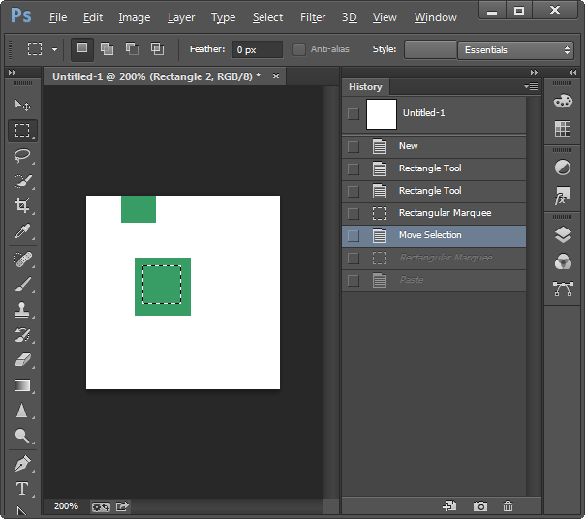
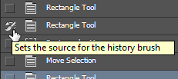
Adobe PhotoShop
History pane displays previous operations
^Z – one-level undo that toggles undo/redo – until V2019
Also Shift-^Z, Alt-^Z - linear undo forwards and backwards
  Redo list erased on new operations
“History brush”
  Select point in past and brush area – returns to
  the way it was in the past
  Can’t “skip” operations
  Is selective by region, but not by time

Slide 25

Timeline view in Fusion 360
Fusion 360 (a CAD software) from AutoDesk
  https://www.autodesk.com/products/fusion-360/blog/master-the-timeline-browser-preferences/
Provides graphical timeline for undo
Complete collection of every change made to your design
  Selective undo (“suppress”) also affects later operations that depend on it

Slide 26
Multi-User Undo
Required for Google Docs
  Let’s try: https://tinyurl.com/SSUIUndo
If multiple users have overlapping selection regions and one user does Undo – what should be done?
  Undo the globally last operation
  Undo that user’s last operation
  Undo the last operation in the region of the user’s cursor
Google Doc is somewhat random
Old research on correct ways to handle this
  Summary: it’s complicated for text, easier for graphics

Slide 27
Research on Undo
Not a popular topic, but there are some issues worth exploring

Slide 28
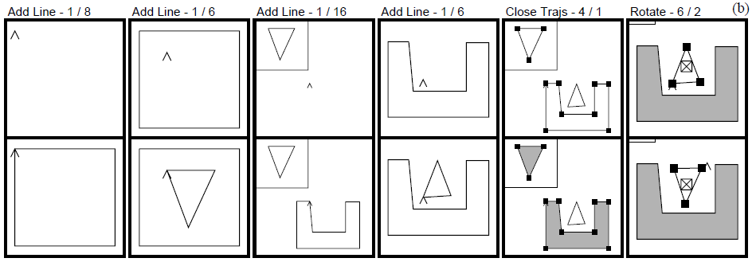
Kurlander’s Graphics Histories
Kurlander, D. and Feiner, S. Editable Graphical Histories. Proc. 1988 IEEE Workshop on Visual Languages. (Pittsburgh, Oct. 10-12, 1988). 127-134. http://ieeexplore.ieee.org/stamp/stamp.jsp?tp=&arnumber=18020&isnumber=662
Video (2:42)
Before and after scenes for each operation
Can undo back to any point
  Can then change things and redo the operations afterwards
  Basically, the “script” model of undo/redo

Slide 29

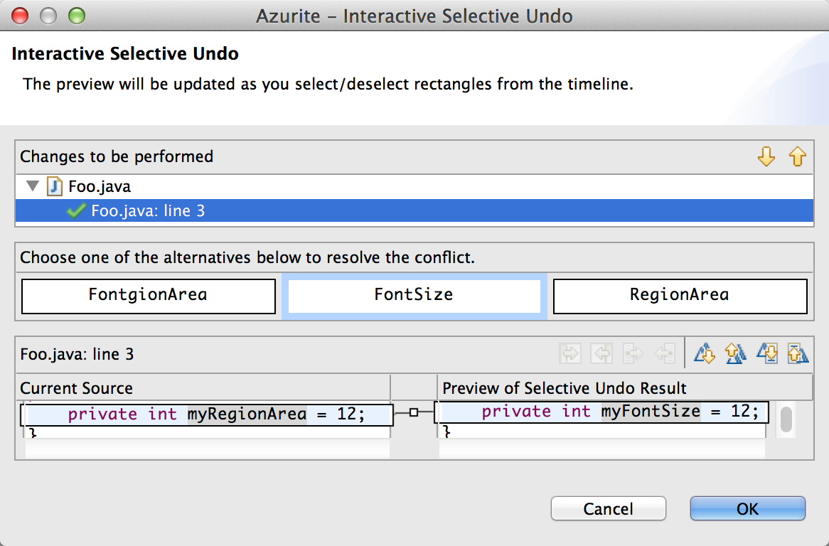
Research: YoungSeok Yoon’s
Selective Undo in Code
YoungSeok Yoon, Sebon Koo and Brad A. Myers, "Visualization of Fine-Grained Code Change
History", 2013 IEEE Symposium on Visual Languages and Human-Centric Computing (VL/HCC'13),
San Jose, CA, September 15–19, 2013. pp. 119-126. local pdf.
Called “Azurite”
  Adding Zest to Undoing and Restoring Improves Textual Exploration
Plugin for Eclipse for Java
Difficulty – region conflicts
  Same area of code modified by multiple operations
  Later ones not being undone
    FontSize
    RectangleSize
    RegionArea
  Detects and asks user
Allows multiple commands to be selectively undone
  No region conflicts if undo all the commands for one region

Slide 30
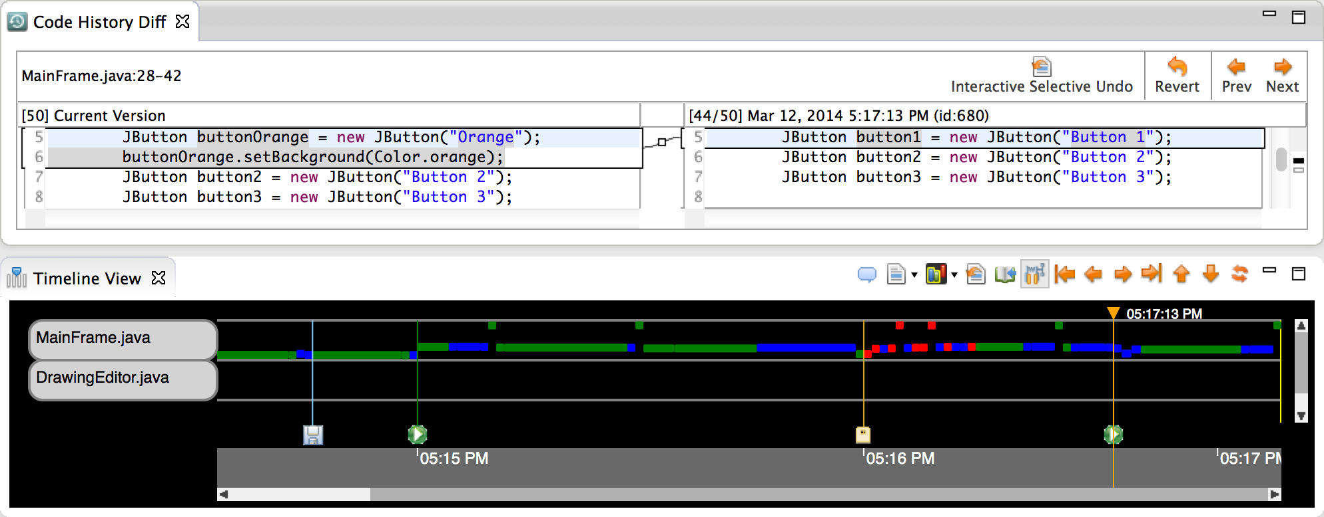
Azurite, cont.
How find and select what to undo?
Timeline visualization of history
Select area of code and explore its history interactively
Or search backwards through time video 3:37

Slide 31
Selective Undo by Region
Selective Undo by Region
  Regular linear undo but only for operations in the region
  Avoids the ambiguities
  Available in PhotoShop
    History Brush or by Layers
  Avoids conflicts if objects completely in or out of the region
  Azurite – region = code selections

Slide 32


Region Conflicts: Flood Fill
Can still have region conflicts
  Actions at same place will do different things
Draw some lines
Paint-bucket (flood fill) the area in between
Undo one of the lines in step 1
→ Paints entire background

Slide 33
Direct Selective Undo Implementation
Implementing direct selective undo not much harder than regular undo:
  Semantics is based on what the user would want
  Undo the operation in a new context means to set the object back to its previous value
  Selective Undo is enabled if object is still available
  E.g., Undo of create is delete
Redo the operation means to set the value of the object again;
  redo of create = a new object
Repeat = redo on new object

Slide 34
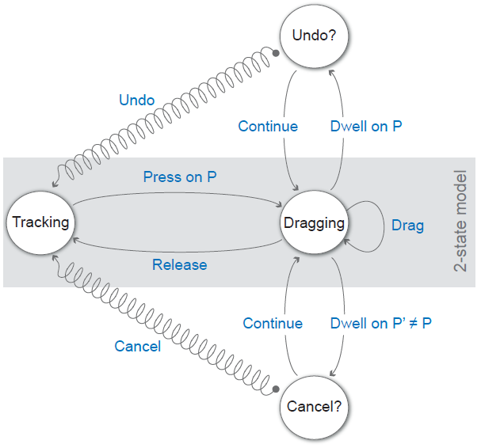
Research: Dwell-and-spring (2012)
Caroline Appert, Olivier Chapuis, and Emmanuel Pietriga. 2012. Dwell-and-spring: undo for direct manipulation. In Proceedings of the SIGCHI Conference on Human Factors in Computing Systems (CHI '12). ACM, pp.1957-1966. http://doi.acm.org/10.1145/2207676.2208339 (with video)
Provide a way to cancel and undo direct manipulation of window rearranging, and scrolling
If dwell (wait with mouse down) then pops up display of a spring
If enter spring, then can undo the operation
Works selectively on each operation
local video (4:27)

Slide 35

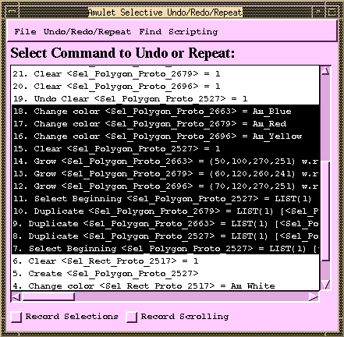
Scripting = “Topaz”
Brad A. Myers. "Scripting Graphical Applications by Demonstration," Proceedings
CHI'98: Human Factors in Computing Systems. Los Angeles, CA, April 18-23, 1998.
pp. 534-541. ACM DL, or local pdf, and YouTube video or local video (3:09).
(Topaz)
Select set of commands and specify that in a program
Uses selective repeat
Can parameterize actions
Moving which object selected is recorded
  Forwards, backwards, left, right, up, down, in, out
  Search for object of a particular type or value
Little or no change to application if it supports Selective Repeat

Slide 36
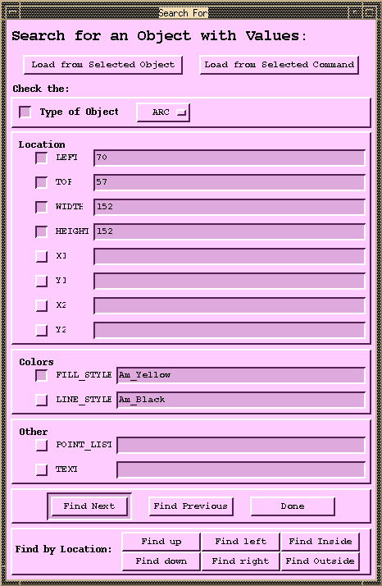
Pictures for Scripting: Object Search

Slide 37
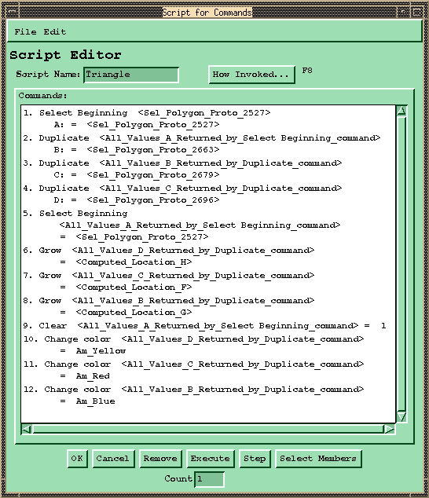
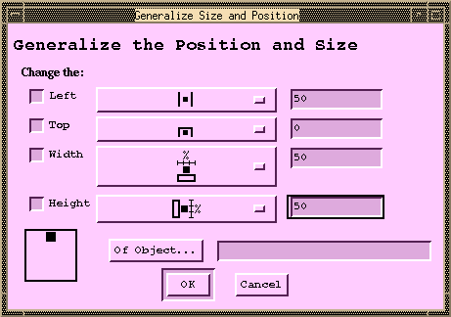
Pictures for Scripting: Generalize Position / Size

Slide 38
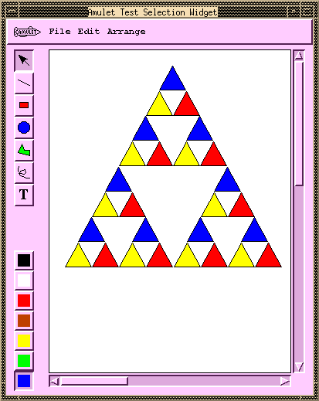
Pictures for Scripting: Result

Slide 39


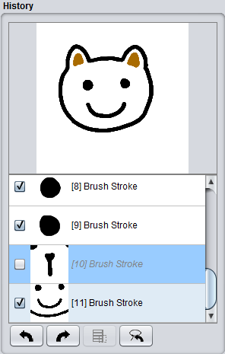
Aquamarine
Brad A. Myers, Ashley Lai, Tam Minh Le, YoungSeok Yoon, Andrew Faulring, Joel Brandt, "Selective Undo Support for Painting Applications", Proceedings CHI'2015: Human Factors in Computing Systems, Seoul, Korea, April 18-23, 2015. pp. 4227-4236. http://dl.acm.org/citation.cfm?doid=2702123.2702543
Allowing Quick Undoing of Any Marks And Repairs to Improve Novel Editing
Selective undo of past operations in a paint program using the script model
  Can’t use inverse model in paint because can’t change affected pixels in current context
  No dependencies among objects as there are in a drawing program
  Issue: spatial dependencies:
    Copy and paste
    Flood fill (paint bucket)
Short Video: 0:30
Video: 4:35

Slide 40
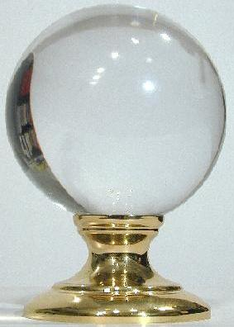
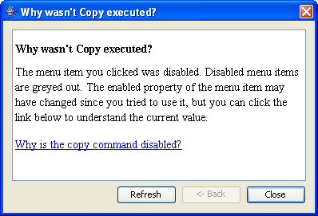
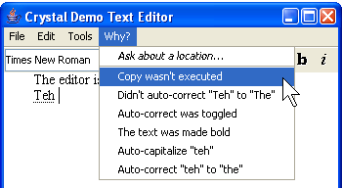
Using Undo History for “Why” Help
Crystal: Clarifications Regarding Your Software using a
Toolkit, Architecture and Language
Brad Myers, David A. Weitzman, A.J. Ko, and Duen Horng Chau, "Answering
Why and Why Not Questions in User Interfaces," Proceedings CHI'2006:
Human Factors in Computing Systems. Montreal, Canada, April 22-27, 2006.
pp. 397-406. pdf. See also YouTube or local video
Help answer why things happen in regular desktop applications
Lots of complexity in powerful features that people generally like
Ask “Why” about what recently happened

Slide 41
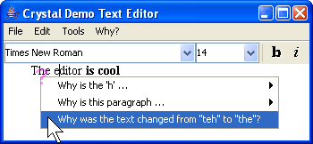
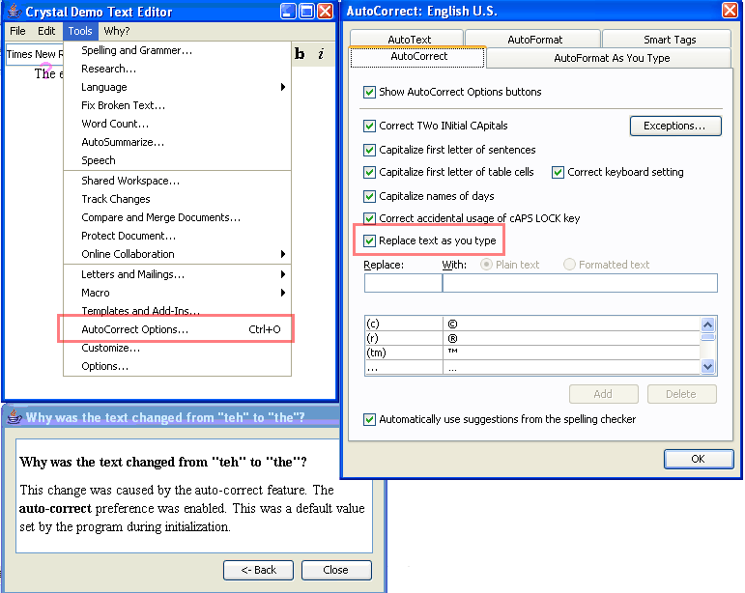
Crystal
Or, ask Why about a location by clicking on objects, or whitespace
Also can explain complexities like
style inheritance, etc.

