Slide 1
Lecture 7: Creating, Selecting and Manipulating Objects (chapter 10 of textbook)
Brad Myers
05-440/640: Interaction Techniques
Spring, 2025

Slide 2
Logistics
Homework 1
24 on-time
7 late
5 still missing
Reminder, can only be 1 week late (see the late policy)
Homework 2 due Mon, Feb. 17, 2025 at 2:00pm ET
Confirmed 3rd guest speaker: David Lindlbauer on "Intelligent Interaction Techniques for Extended Reality"

Slide 3

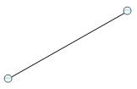
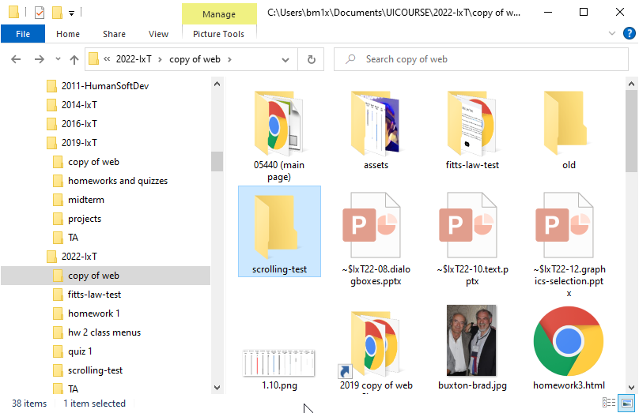
Overview of Topic
Creating, Selecting, Modifying computerized things that are not text
(Text covered in lectures 10-11)
Graphics in an editor like PowerPoint
Pixels in a Painting program
Files listed in a hierarchy view
Files listed as icons
Spreadsheets
….
“Objects” – 2D
Anything displayed: graphics, icons, text in list, etc.
(3D in lecture 13)
Focus on interactions (so not just visualizations)

Slide 4
Syntax of Operations
Prefix: Operation first, then parameters
All command lines are like this
GUIs: _____
Postfix: Parameter first, then operation
Select object, then hit <delete>
Infix: operator in the middle
4+5
GUIs: _____

Slide 5
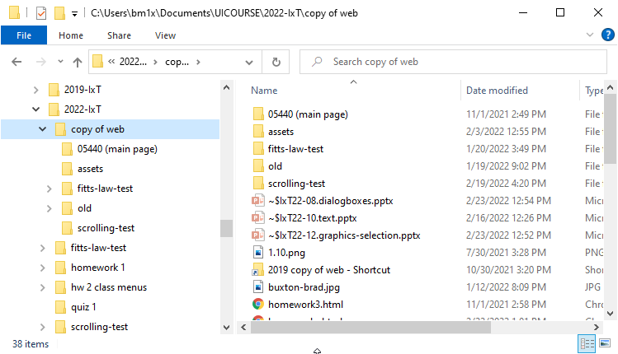
Object order and Grouping
2½ D display order
Covering, “Bring to Front”
Grouping – must be contiguous in display order
Also for folders and their contents
Types of objects – don’t change

Slide 6

Creating new Objects
Usually infix – what kind of object, create, then where
“Tool” metaphor – pick up a create-rectangle tool, and then can use it
Usually resets to selection mode after 1 create
Sometimes can double-click or explicitly peg the current mode
Same for painting, but then “objectness” disappears

Slide 7
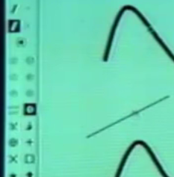


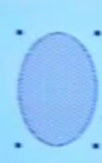
Graphical Selection
Draw, 1975
Go into “selection” mode
Click on object to select it
Rectangular area to select multiple – objects must be totally enclosed
Star, 1981
Click left to select, right to add to selected set
Rubber band select with right mouse button
Lisa and Macintosh, 1982
Click for single object
Click in background for no selection
“Selection handles”
Often show through covering objects
Drag through to select multiple (fully within)
Shift click or shift-drag to toggle in selected set
Reverse video or handles
Lasso tool for bitmap selection – animated
Note: not drag-through select if start on an object, moves object instead

Slide 8
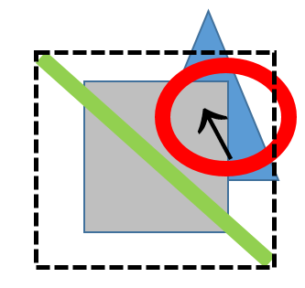
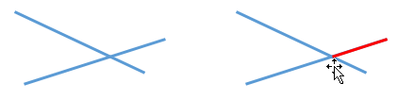
Graphical Selection, cont.
Clicking “on” an object
Selecting objects while still inside a group
Emergent “objects”
Selecting multiple using bounding box
Entirely inside or just intersect
Hello
Hello

Slide 9
Graphical Editing
See Bill Atkinson lecture 2019 - moded
Generally, the “tool” metaphor
Deleting is postfix
Selected object, delete
Resize, move are generally infix
This object, move, to here
“Rubber band” feedback to show where will go
Invented by Sketchpad
Note only 1 side (not like “real” rubber band) – Buxton

Slide 10
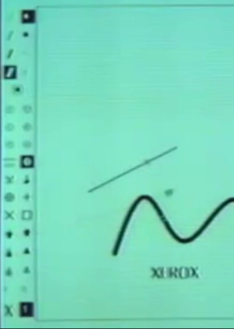
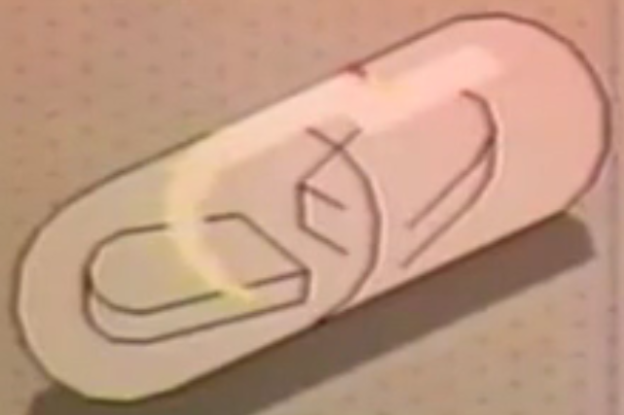
Graphical Editing
Draw, 1975,
Infix – selected object, type of transformation, where goes
Uses a “transformation vector” or full “affine transformation”
Star, 1981
Infix – selected object, “move”, click for where
Stretch, can drag out how much to stretch
Magnify – same proportions
Lisa/Macintosh, 1983
Postfix
Handles can be pressed and dragged to resize
Anywhere in object to move
Gargoyle (Xerox PARC), 1982
Caret & anchor points
Silicon Graphics icon editor, 1989
Objects can “snap” to grid, and other objects, including along an edge

Slide 11
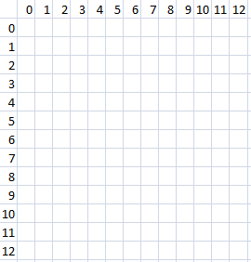
Parameters to object manipulation
Measurements in pixels, inches, points (¹/₇₂in)
When moving/growing an object
Lines change differently than rectangular objects
Object itself changes, or “interim feedback”?
Gridding, snapping to other objects
Issues with gridding: origin with window/drawing?
Based on object or mouse?
Width = inside or outside?
If hold down shift key while resizing
Minimum size?
Disappears if 0 size?
Flip if change sides?
Abort after started? Undo?
Test text

Slide 12
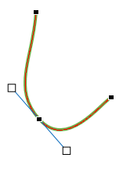

Full-Featured Drawing tools
Many ways to select and draw objects
Paint (Photoshop) vs. Object (Illustrator, CAD/CAM)
Many mechanisms in Illustrator, etc.
Many more issues for complex shapes
“Nudging” objects using arrow keys
Polygons
Curves (“splines”)
Origin for patterns

Slide 13
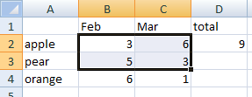
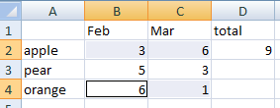
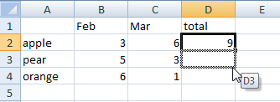
Selections in Spreadsheets
Selections in spreadsheets have always differed somewhat from other applications
Click on cell, drag to select multiple
Shift click to extend
Control click (and drag) for multiple selection regions
Always operates on rectangles
Selection handle to smart-fill values and formulas
“Fill handle”
Guest lecture by Dan Bricklin (2019)

Slide 14
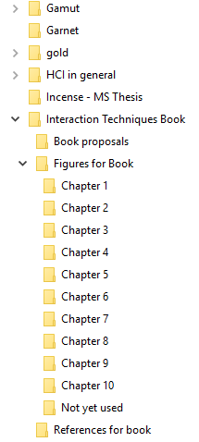
Selections in Linear and Hierarchical Lists
Lists and hierarchies operate differently as well
E.g., Windows “Explorer”, Macintosh “finder”, etc.
“Hierarchical view”, “Outline view”, “Tree view”
Click to select one
Click and drag usually moves selected object (no drag-through select)
Shift click extends (or shortens) selection to new click point
Control click toggles item in selection set
May be able to select a region using a box, if start not on an object

Slide 15
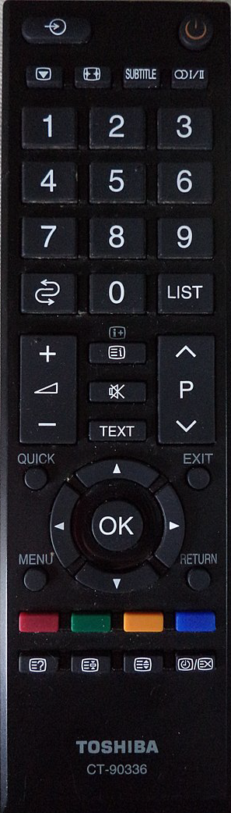

Selections in Consumer Electronics
Often just menus, covered already
Electronic programming guides (EPG) for TV schedules
Different size blocks for selection
What happens with navigate up and down?

Slide 16
Designing a syntax
Which order to select when designing a new behavior?
E.g., selection first or tool first?
Might decide based on which is most difficult to get right
Selection first if tricky to click on correct thing
E.g., select eraser, then have to carefully click on correct thing
Vs. working on the selection until correct, then easily hitting “delete”

Slide 17
Research on Graphical Objects
Brad A. Myers. (1998) "Scripting Graphical Applications by Demonstration," Proceedings CHI'98. pp. 534-541. ACM DL, or local pdf, and video or YouTube (3:09). (Topaz)
Search for graphical objects by location or property
Move selection from object to object
Write reusable scripts of object manipulation
video (3:08)

Slide 18
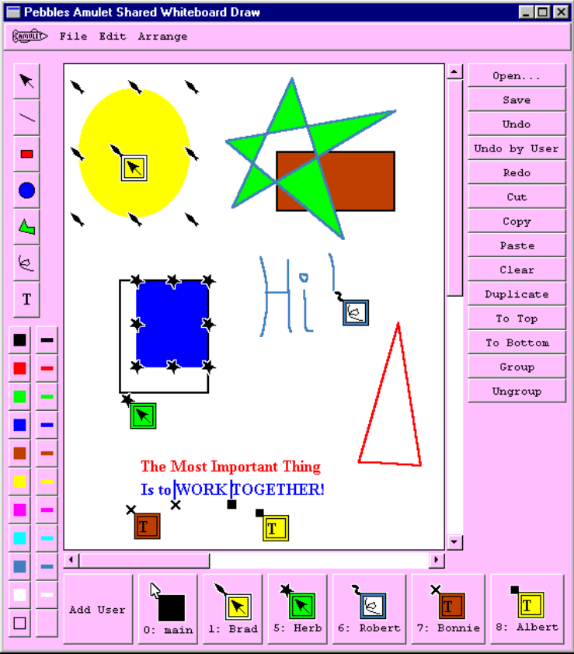
Research on Graphical Objects
Multi-user editing
PebblesDraw: shared screen
Brad A. Myers, Herb Stiel and Robert Gargiulo. “Collaboration Using Multiple PDAs Connected to a PC,” Proceedings CSCW'98: ACM Conference on Computer-Supported Cooperative Work. Seattle, WA, November 14-18, 1998a. pp. 285-294. http://www.cs.cmu.edu/~pebbles
Google Drawings
Separate screens

Slide 19
In-class, on-paper Design Exercise!
Background:
Selection works differently in graphical objects & icons vs. lists vs. spreadsheets
Shift click and control click do different things
Presentation of selected looks very different (handles vs. highlighting)
Drag works differently as well - drag and drop vs. move object vs. extend selection
Scenario:
Imagine you are creating something new, let's call it bubbles, which can be independent or in a list or a table (spreadsheet), and you want to have consistent way to select and edit, across different presentations and on different platforms (phone and laptop)
You get to decide what “bubbles” are and how they look and behave.
Prompt
Design a way to select and modify (e.g., move or grow) bubbles
Be sure to consider how to select multiple objects, what the selection looks like, and what shift-click, control-click, long-press or right mouse button, drag, etc. all do.
You may want to specify the graphical properties of bubbles as well (color, line style, shape, etc.) and the feedback for selecting objects
Consider the “Considerations for Selecting and Creating Objects” in section 10.15 of the textbook.
To Do:
Generate Ideas and Discuss Pros / Cons of your ways to select and modify bubbles
Write down your design decisions and reasons
Create a sketch (draw a picture) of what bubbles look like normally, and when selected, and while being modified
Discuss and/or draw how selecting looks when bubbles are alone, in a list, in a table, and when on a phone or a laptop
Discuss the limitations and tradeoffs of the design
Logistics
Groups of 3 or 4
Pen and paper
Be sure to clearly write the group member names - including Andrew IDs
Select a person in the group with good handwriting to be the scribe

