Slide 1
Lecture 4:
History of Handhelds (PDAs to Smartphones & Tablets) and their Interaction Techniques
Brad Myers
05-440/05-640: Interaction Techniques
Spring, 2016

Slide 2
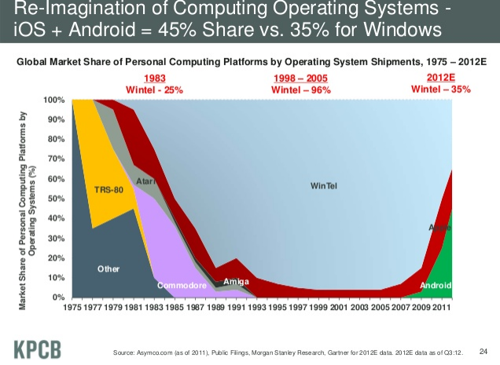
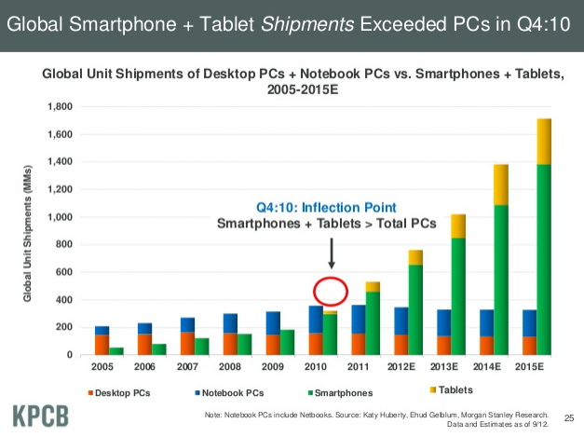
“Computers”
(cite,
slide 24, 25)

Slide 3
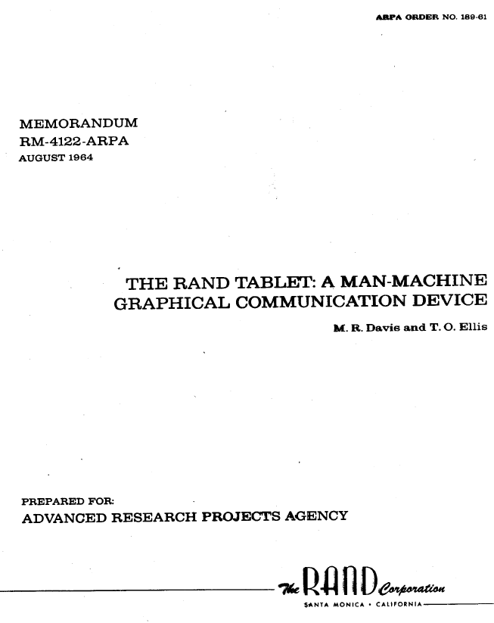
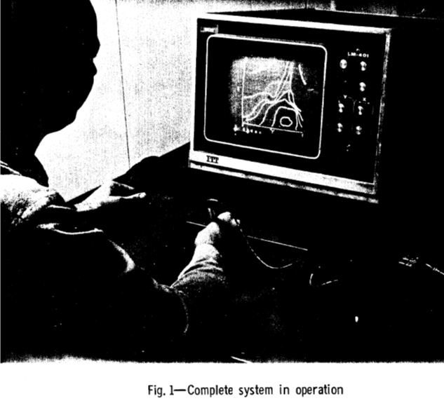
Early Handwriting Input
Handwriting recognition has been an active research
topic since 1960’s:
  Rand Tablet: 1964: http://www.rand.org/content/dam/rand/pubs/research_memoranda/2005/RM4122.pdf
Used term: “pen-computing”
Early: hand printing
Lots of work on handwriting and gestures
  E.g., W. Buxton, E. Fiume, R. Hill, A. Lee, C. Woo, “Continuous hand-gesture driven input,” Graphics Interface '83 (1983), pp. 191–195

Slide 4
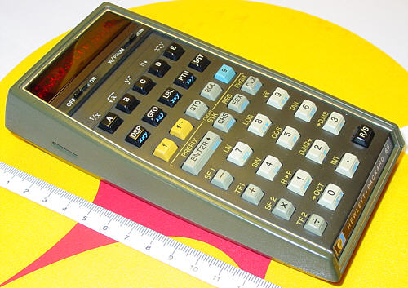
Programmable Calculators
The first programmable pocket calculator was the HP-65, in 1974 – Wikipedia
First graphing calculator was the Casio FX-7000G released in 1985
Continued to improve and get cheaper through 80’s and 90’s
  HP and TI
HP used reverse polish
notation (RPN) = postfix
  No need for parentheses:
  4 5 + 6 * instead of (4+5)*6

Slide 5
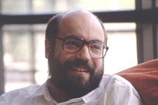
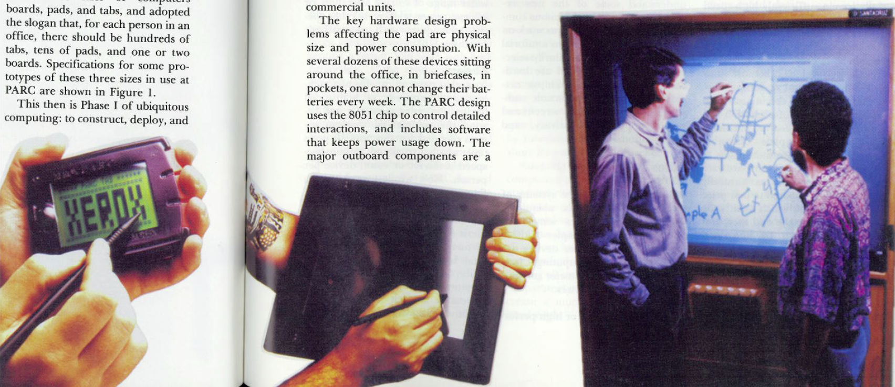
“Ubiquitous Computing”
Term coined by Mark Weiser
at Xerox PARC, 1988
  Mark Weiser. “The Computer for the 21st
  Century”, Scientific American, 94-104, Sep 1991.
  Mark Weiser. “Some Computer Science Issues in Ubiquitous Computing,” CACM. July, 1993. 36(7). pp. 74-83.
  (Died at 46 in 1999 of cancer)
“I called these three sizes of computers boards, pads, and tabs, and adopted the slogan that, for each person in an office, there should be hundreds of tabs, tens of pads, and one or two boards.” [p. 76]
http://en.wikipedia.org/wiki/File:Mark_weiser.jpg

Slide 6
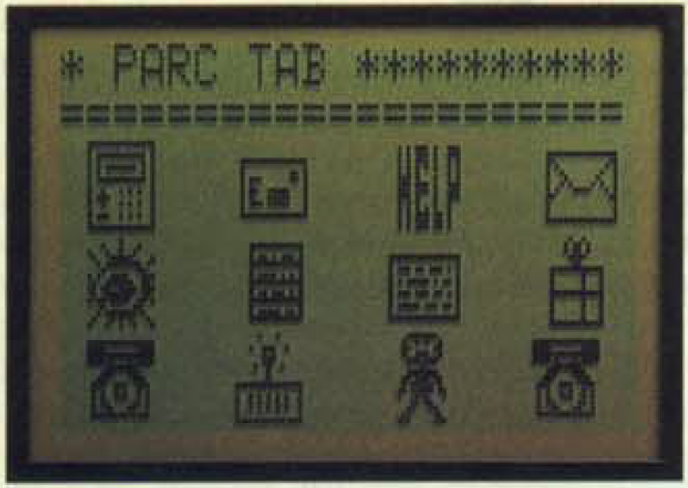
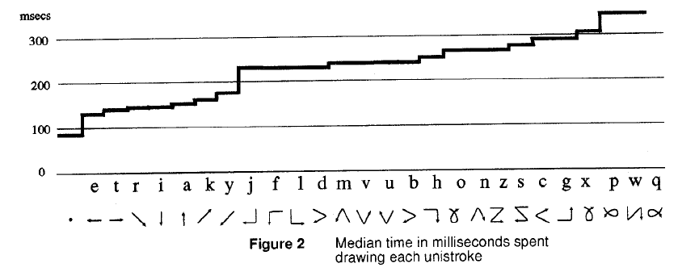
PARC Tab
~1989
Low speed wireless network using IR
Touch-sensitive screen
Quick writing – unistrokes, write on top of each other
  David Goldberg and Cate Richardson. “Touch Typing with a Stylus,” Human Factors in Computing Systems, Proceedings INTERCHI'93. Amsterdam, Netherlands, Apr, 1993. pp. 80-87.

Slide 7
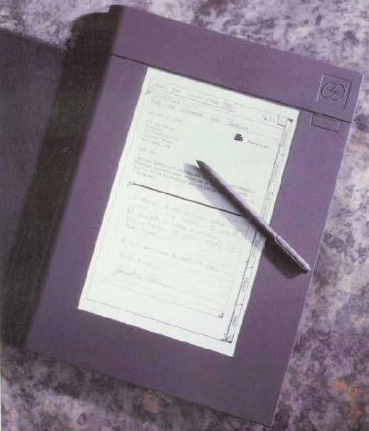
Go Corp’s “PenPoint” OS
Founded 1987, released in 1991
  One of the founders was Robert Carr from Xerox PARC; Alto designer
Hardware by NCR, IBM and EO
Styled to look like a tabbed notebook
Conventional tapping on menus
Lots of gestures for editing,
page turning, etc.
  Flick to scroll and turn pages, circle, insert
  space, cross-out, insert word, get help, …
  Press and hold to start moving or selecting
Hand printing for text entry
Hyperlinks
Instant on-off

Slide 8
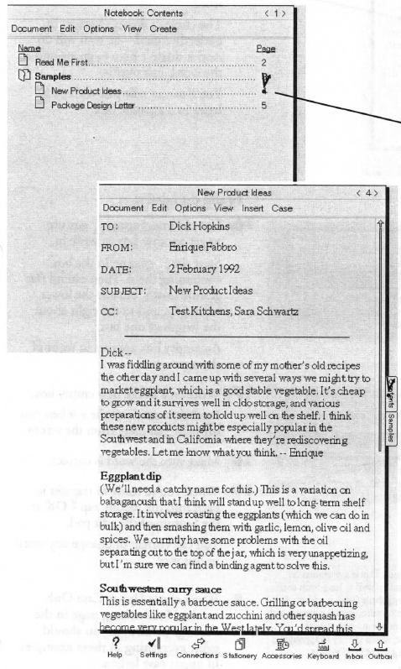
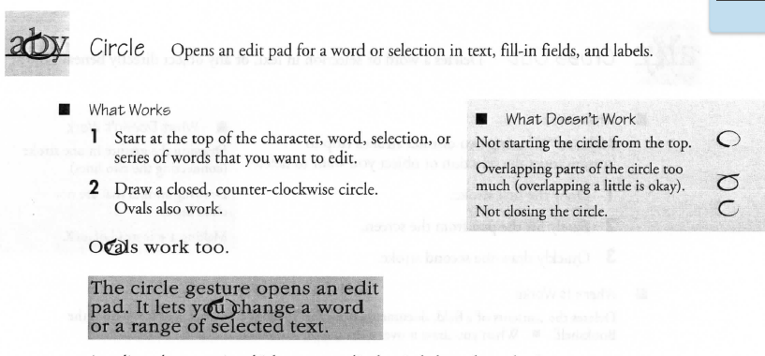
PenPoint
User’s guide
  http://research.microsoft.com/en-us/um/people/bibuxton/buxtoncollection/a/pdf/
  Go%20PenPoint%20Getting%20Started.pdf
Pictures: http://www.digibarn.com/collections/systems/go/index.html
Video:
  http://www.youtube.com/watch?v=x0XE08BjQDQ

Slide 9
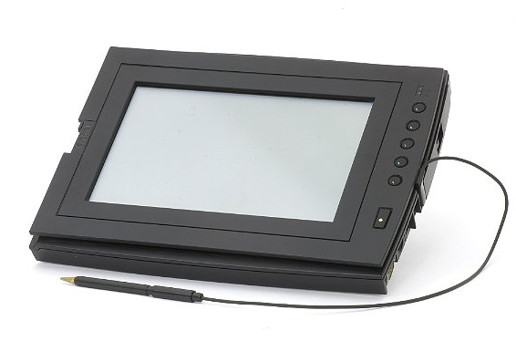
GRiDPad
Jeff Hawkins
1989
http://www.computerhistory.org/revolution/mobile-computing/18/319/1727
under 5 lbs
386SL 20MHz processor with a 80387SX coprocessor with 20MB RAM and 40, 60, 80 or 120MB hard drive. It had a 10" diagonal backlit VGA display with 32 gray scales. There was a built in PCMCIA card slot, an internal fax/modem card, a floppy drive
port and a standard keyboard
port. Operating time was about
3 hours on NiCad battery pack.
http://www.digibarn.com/collections/systems/gridpad/index.html

Slide 10
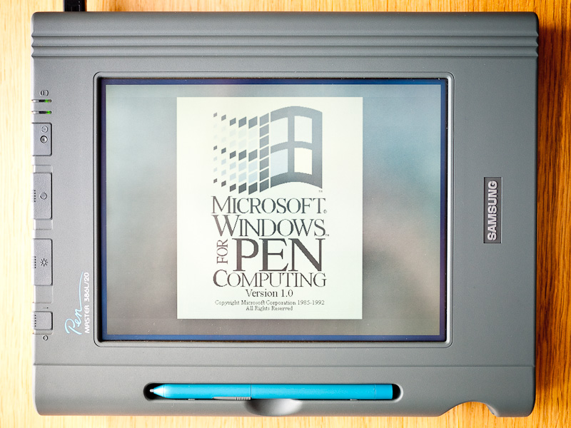
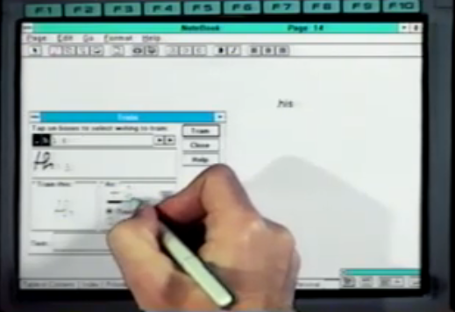
Microsoft Pen Windows
From: 1991
Version of Windows 3.1 for pen computing
Added handwriting recognition
Versions for Windows NT, Windows 95, etc.
Images: http://retrocosm.net/2012/01/, http://www.betaarchive.com/imageupload/1298947809.or.94950.png

Slide 11
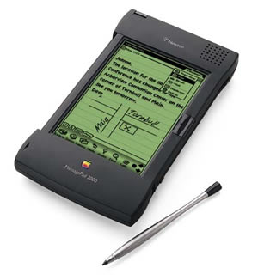
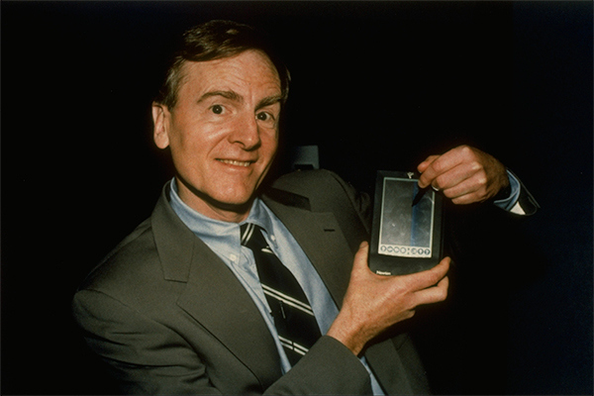
Apple Newton
Started 1987, released 1993
Newton “MessagePad”
Coined term “Personal Digital
Assistant (PDA)
Was on sale for 6 years
Fairly large & heavy
Interesting OS using an interpreted programming language: NewtonScript
  “Prototype-Instance” OO model like JavaScript
John Sculley III

Slide 12
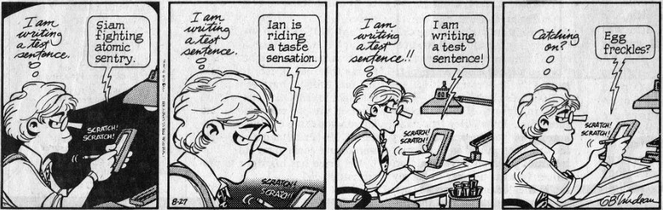
Apple Newton
Key issue: handwriting recognition was main input technique
http://www.computerhistory.org/revolution/mobile-computing/18/319/1714
Often not successful
  Famously panned for an entire week by Doonesbury (August 1993)

Slide 13
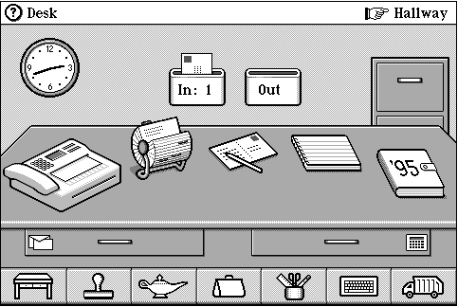
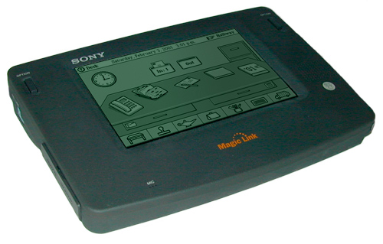
General Magic’s “Magic Cap” OS
1994
Ran on Sony MagicLink hardware
Object-oriented OS for PDAs
3D Room metaphor
Special AT&T wireless network (very slow)
Pictures: http://en.wikipedia.org/wiki/File:Magic_Cap_OS.gif
http://en.wikipedia.org/wiki/File:SonyMagicLink.jpg

Slide 14
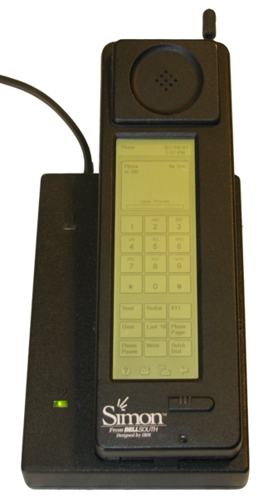
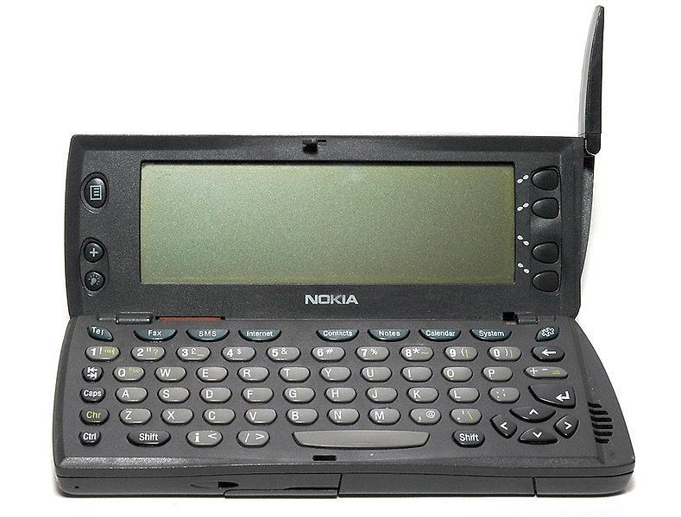
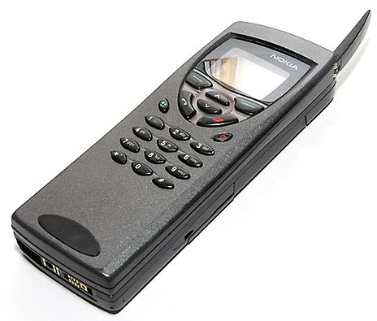
Early phone + PDAs
IBM Simon
  Shipped in 1994 by BellSouth
Nokia 9110 Communicator
  1996
  Added full physical keyboard
Typical PDA features:
  Address book, calendar
Slow processor
and network

Slide 15
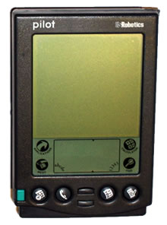
Palm
Founded by Jeff Hawkins who did GridPad
US Robotics (1995), 3Com (1997),
Handspring (1998), Palm (2000), HP (2010)
First released version: 1996 = “Pilot”
  Name changed due to lawsuit
They did lots of user testing with prototypes created using HyperCard
Graffiti for data entry

Slide 16
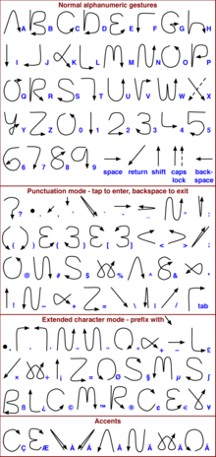
Palm Graffiti
Jeff Hawkins had seen Xerox
QuickWriting
  Lawsuit
Designed to be easier to learn
  Still required practice
Unistroke except for “X”
Two sides – numbers look the same as some letters

Slide 17
Palm’s design Principles
“Designing the Palm Pilot: A conversation with Rob Haitani”, by Eric Bergman and Rob Haitani, chapter 4 in Information Appliances and Beyond, Eric Bergman, ed. (2000)
Fast access to key features on small screens ->
  Only a few commands used a lot
  Leave commands off main screen, even if not symmetric
    new vs. delete
    (think stapler and stapler remover)
  Note that violates consistency
  Tap and then type in schedule and to-do
  Only four buttons – which ones?
  Vs. Windows CE -> if know PC, this is familiar
    But usage models are different
      PC: infrequent long usage
      Palm: frequent short bursts of usage

Slide 18
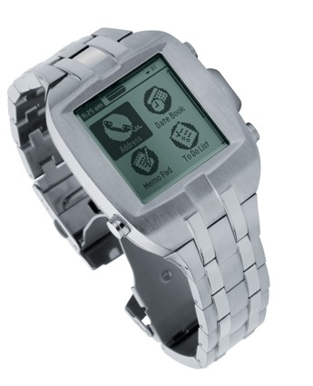
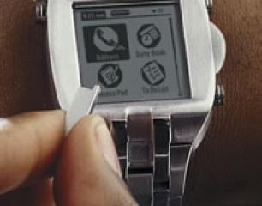
Palm Watch
Fossil,
  Announced 2002, shipped 2003-5
160 x 160 illuminated screen
with a stylus integrated into the band, 8MB internal memory, rechargeable battery and
standard Palm platform features
$250
Heavy, short battery life, tiny stylus

Slide 19
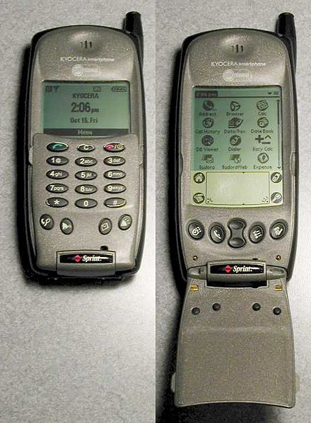
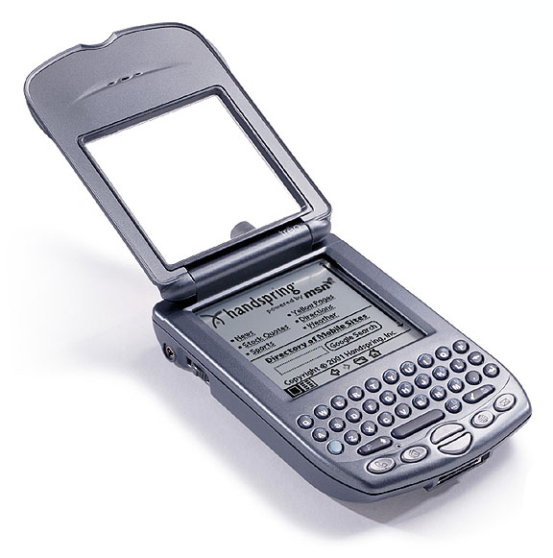
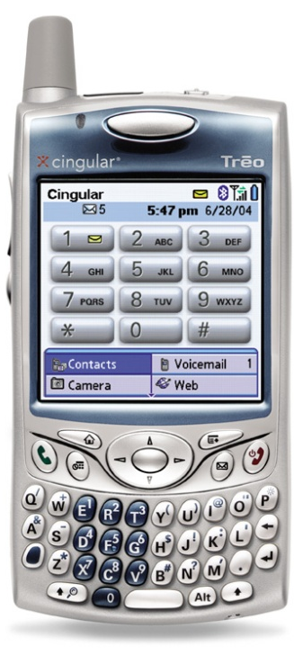
Palm Phones
Kyocera QCP-6035 about 2001
  Physical phone buttons, or regular
  Palm
  Low-speed internet
Handspring (then Palm) Treo
  Blackberry-like keyboard
  replaces Graffiti
  Starting 2002

Slide 20
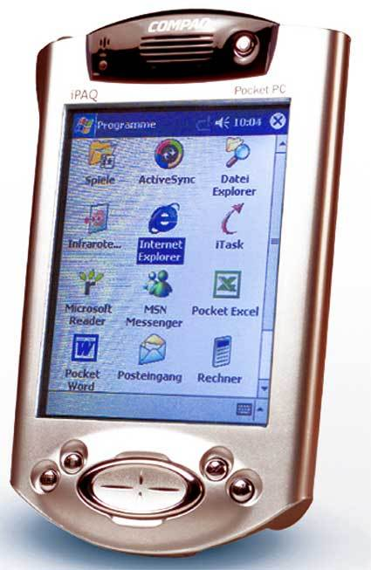
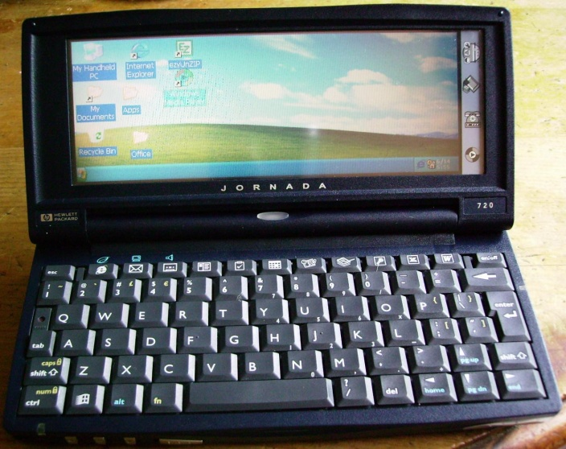
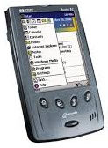
Windows CE
CE 1.0 released in 1996 (same year as 1st PalmPilot)
Many names: Windows Compact Edition (WinCE), Windows Palm PC, Windows Pocket PC (PPC), Windows Handheld PC (HPC), Windows Mobile, now WindowsPhone
HPC for landscape devices with a keyboard, PPC for portrait
Similarities to Windows, but different OS
  Instant on
  Different UI interactions
Compaq iPaq became very popular (2000)

Slide 21
Studies for Original Windows CE
“The Interaction Design of Microsoft Windows CE”, by Sarah Zuberec, chapter 5 in Information Appliances and Beyond, Eric Bergman, ed. (2000)
Studies: minimum target: stylus = 5.04mm², finger = 9.04mm²
Drag between down and up for “tap” = 2mm
Many usage scenarios
User tests identified Tahoma 10 bold as best system font, but couldn’t be used because not enough content fit in the dialogs
  So used Tahoma 9
Novice users did better with keyboard, but experts preferred character recognizer
Problem with initial designs: too many taps
  Achieved “walk up and use” but too slow for experts
Double tap with stylus difficult and unnatural
  “Consistency worked against learning and use.”

Slide 22
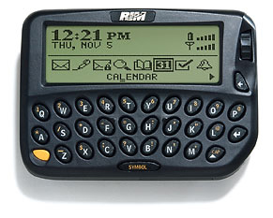
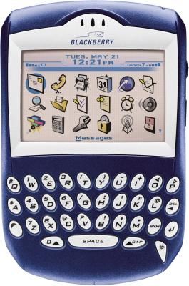
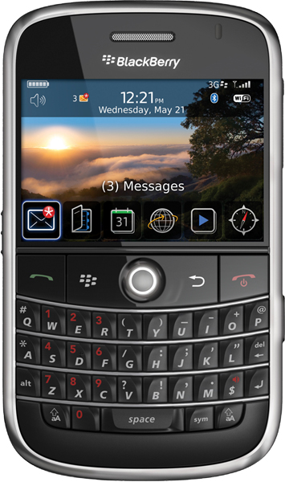
RIM Blackberry
Starting 1999
Research in Motion (RIM)
Blackberry 850
  Email & pager
  Originally, proprietary network
Key features:
  Two-thumb keyboard
  Roller dial (“scroll wheel”) for navigation
    Moved to side of device
  Eventually, became 2D navigation
Later, regular phone networks
Awkward attempts at full-screen touchscreen
  Attempted to be backwards
  compatible with old applications
Insufficient 3rd party applications
  Late to have good APIs

Slide 23
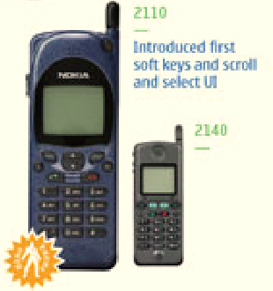
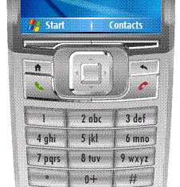
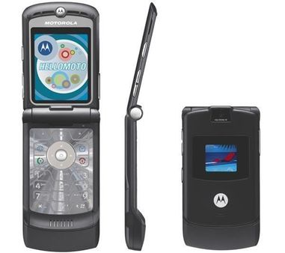
Early wireless phone UIs
1993 – first Nokia soft keys & scrolling
Standardized on 2 or 4 directions,
2 action keys
Motorola Razr – 2004
  Thinner is better
Text entry by multi-tap or T9
  Note: not touch screens
WAP – starting 1997
  Wireless Application Protocol
  Bring web-like access to these
  devices
  Terrible usability
    Nielsen study

Slide 24
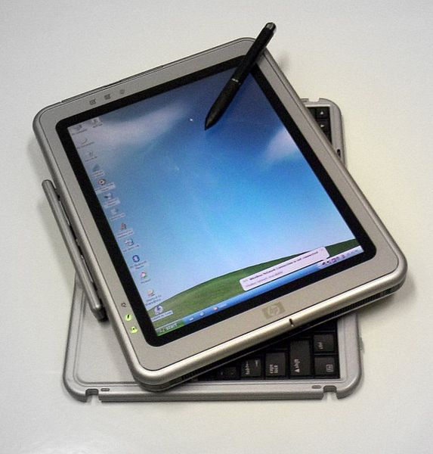
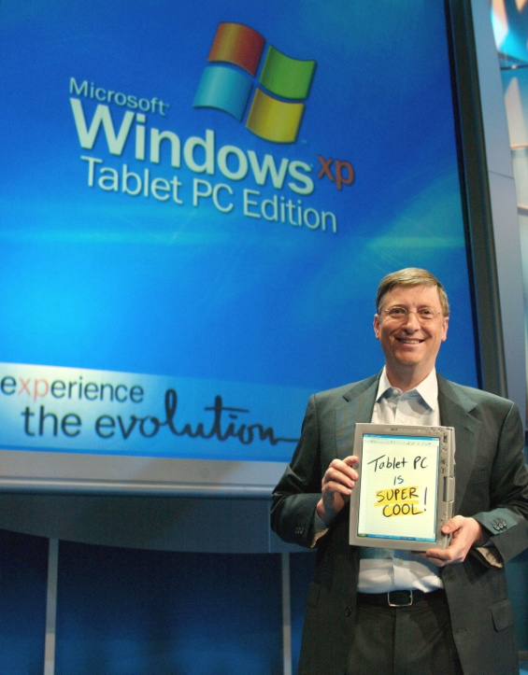
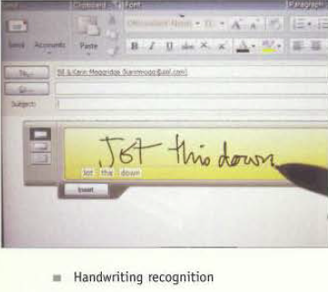
Windows TabletPC
2001 spec (Windows XP), first devices in 2002
Bill Gates said it would be big (2002)
Handwriting recognition was much better, but still not sufficiently accurate
Windows UI not
changed for pen
  Lower accuracy than mouse
Quite poor UIs for
correction

Slide 25
2G, 3G, 4G, GSM, CDMA, etc.
1G = analog, 1980s
2G = GSM digital data, 1992, CDMA version followed
  About 40 kbit/s
3G = about 2001
  200 kbit/s
4G = about 2008
  100 Mbit/s, up to 1 Gbit/s

Slide 26
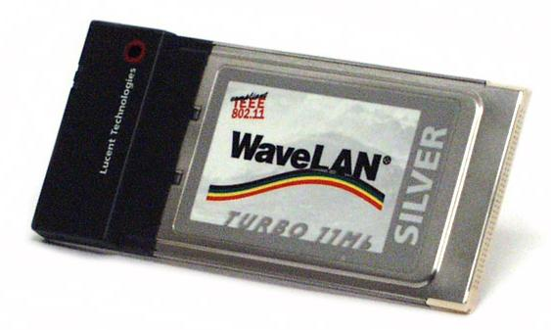


Wifi and BlueTooth
Wifi – from 1988
  Officially IEEE 802.11
    Whole family: 802.11a, b, g, n …
  Originally called “WaveLan”
  CMU was first fully wireless campus starting in 1997 = “wireless Andrew”
  “Wifi” trademark in 1999
BlueTooth started by Ericsson in 1994
  Standardized as IEEE 802.15 in 2002 and 2005
  Name from 1997
  Named for Danish tenth-century king
  Short range, exactly 2 devices
  Original use: phone to earpiece
  Now, mice, keyboards, etc.

Slide 27
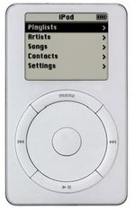
iPod
2001
Apple iPod lauded for design and user interface
Unique dial interaction technique
  Enabled easy access to thousands of songs
  Highly tuned speed ratio
iTunes → entire service design
5 GB hard drive that put “1,000 songs in your pocket.”

Slide 28
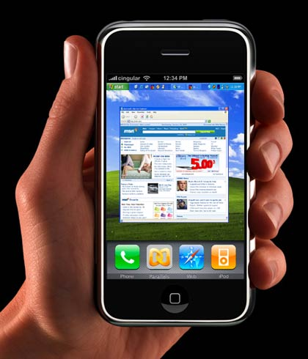
iPhone
Starting 2007
Went against the conventional wisdom in many aspects
  --- what? ---
Some unique interaction
techniques
  --- what? ---

Slide 29
iPhone
Starting 2007
Went against the conventional wisdom in many aspects
  No blackberry-style keyboard
  Capacitive screen (multi-touch)
  No stylus
  Only one button – focus on
  easy to use
Some unique interaction
techniques
  Scroll bounce, swipe login, …

Slide 30

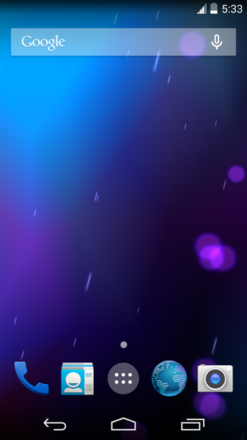
Android
Unveiled 2007, first phone in 2008
Google offers it free to phone
manufacturers
Open source
Based on Linux and Java
About 700,000 different device types
Hundreds of screen sizes

Slide 31
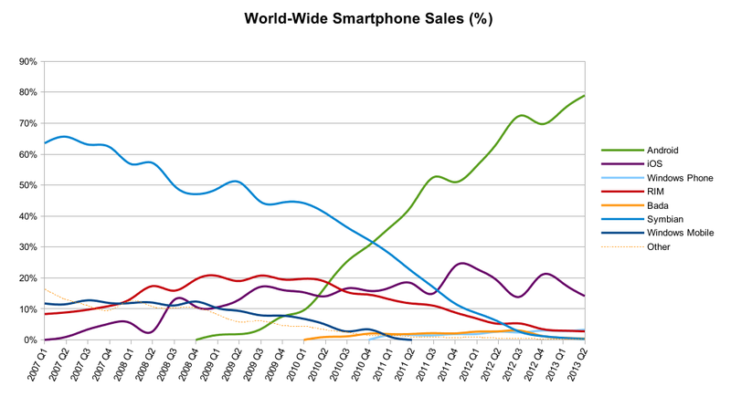
Phone MarketShare
http://en.wikipedia.org/wiki/File:World_Wide_Smartphone_Sales_Share.png

Slide 32
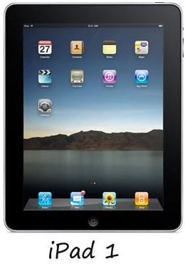
iPad
2010
Very different from TabletPC
  Media machine
  Little text entry facilities
  Interactions same as a Phone,
  instead of mimicking a PC
  Focuses on ease of use

Slide 33
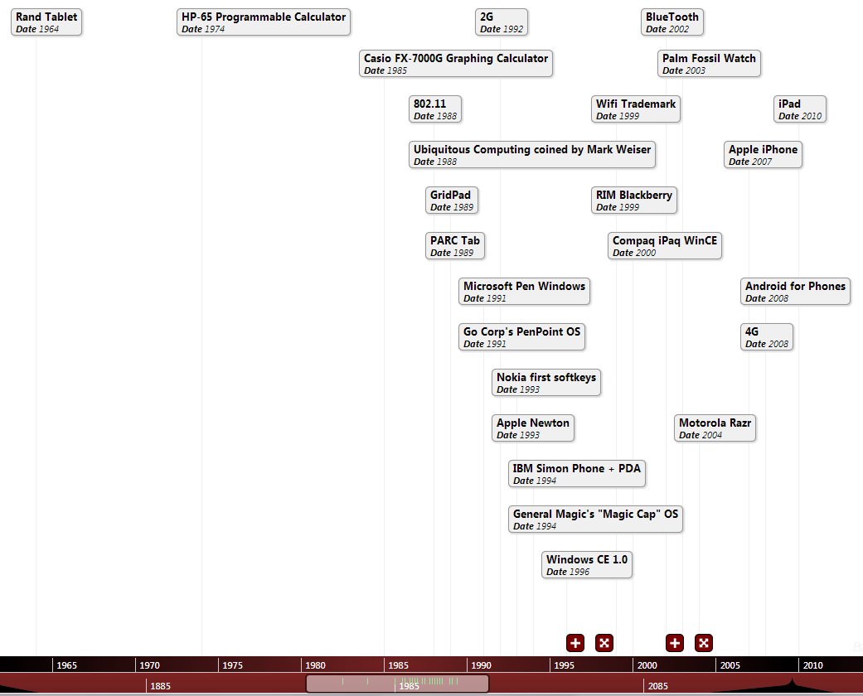
Timeline
http://whenintime.com/tl/bradamyers/Handhelds/

Slide 34
Many other devices not covered
Personal organizers
  Casio, Sharp, etc.
Book readers (Amazon Kindle, etc.)
Custom devices for vertical markets
  Warehouses, doctors, etc.

