Slide 1
The Power of Interoperability: Why Objects Are Inevitable
Onward! Essay, 2013
http://www.cs.cmu.edu/~aldrich/papers/objects-essay.pdf
Comments on this work are welcome. Please send them to aldrich at cmu dot edu
Jonathan Aldrich
Institute for Software Research
School of Computer Science
Carnegie Mellon University
Copyright © 2013 by Jonathan Aldrich. This work is made available under the terms of the Creative Commons Attribution-ShareAlike 3.0 license:
http://creativecommons.org/licenses/by-sa/3.0/

Slide 2
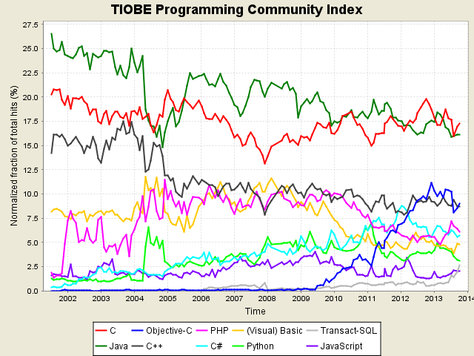
Object-Oriented Programming is Widespread
6-8 of top 10 PLs are OO – TIOBE

Slide 3
Object-Oriented Programming is Influential
Major conferences: OOPSLA, ECOOP
Turing awards for Dahl and Nygaard, and Kay
Other measures of popularity
Langpop.com: 6-8 of most popular languages
SourceForge: Java, C++ most popular
GitHub: JavaScript, Ruby most popular
Significant use of OO design even in procedural languages
Examples: GTK+, Linux kernel, etc.
Why this success?

Slide 4
OOP Has Been Criticized
“I find OOP technically unsound… philosophically unsound… [and] methodologically wrong.”
- Alexander Stepanov, developer of the C++ STL

Slide 5
Why has OOP been successful?

Slide 6
Why has OOP been successful?
“…it was hyped [and] it created a new software industry.”
- Joe Armstrong, designer of Erlang
Marketing/adoption played a role in the ascent of OOP.
But were there also genuine advantages of OOP?

Slide 7

Why has OOP been successful?
“the object-oriented paradigm...is consistent with the natural way of human thinking”
- [Schwill, 1994]
OOP may have psychological benefits.
But is there a technical characteristic of OOP that is critical for modern software?

Slide 8
What kind of technical characteristic?
Talk Outline
A technical characteristic unique to objects
Addressed in Cook’s 2009 Onward! Essay
That has a big impact
Our focus: why that characteristic matters
I.e. how it affects in-the-large software development

Slide 9


What Makes OOP Unique?
Candidates: key features of OOP
Encapsulation?
Abstract data types (ADTs) also provide encapsulation
Inheritance?
Neither universal nor unique in OOPLs
Worth studying, but not our focus
Polymorphism/Dynamic dispatch?
Every OOPL has dynamic dispatch
Distinguishes objects from ADTs
animal.speak()
“meow”
“woof”

Slide 10
Dynamic Dispatch as Central to OOP
Significant grounding in the OO literature
Cook’s 2009 Onward! essay
Object: “value exporting a procedural interface to data or behavior”
Objects are self-knowing (autognostic), carrying their own behavior
Equivalent to Reynolds’ [1975] procedural data structures
Historical language designs
“the big idea [of Smalltalk] is messaging” [Kay, 1998 email]
Design guidance
“favor object composition over class inheritance” [Gamma et al. ’94]
“black-box relationships [based on dispatch, not inheritance] are an ideal towards which a system should evolve” [Johnson & Foote, 1988]

Slide 11
Objects vs. ADTs
Two Object-Oriented Sets
interface IntSet {
bool contains(int element)
bool isSubsetOf(IntSet otherSet)
}
class IntSet1 implements IntSet {…}
class IntSet2 implements IntSet {…}
// in main()
IntSet s1 = new IntSet1(...);
IntSet s2 = new IntSet2(...);
bool x = s1.isSubsetOf(s2);
Interface is a set of messages
All communication is message-based; isSubsetOf() implemented by calling contains() on otherSet
⊆
= true
{1}
{1,2}
⊆
= true
{1}
{1,2}
⊆
= true
{1}
{1,2}
Set Objects
Different implementations interoperate freely

Slide 12
Objects vs. ADTs
Two Set ADTs
final class IntSetA {
bool contains(int element) { ... }
bool isSubsetOf(IntSetA other) { ... }
}
final class IntSetB {
bool contains(int element) { ... }
bool isSubsetOf(IntSetB other) { ... }
}
// in main()
IntSet sA = new IntSetA(...);
IntSet sB = new IntSetB(...);
bool x = sA.isSubsetOf(sB); // ERROR!
Interface is a set of operations over a fixed but hidden type (IntSetA)
isSubsetOf() is a binary method that only works with other instances of IntSetA. Good for performance.
⊆
= true
{1}
{1,2}
⊆
= true
{1}
{1,2}
X
⊆
{1}
{1,2}
Set ADTs
Different ADT implementations cannot interoperate

Slide 13
Does Interoperability Matter?
For data structures such as Set, maybe not
Maybe optimization benefits of ADTs dominate interoperability
“Although a program development support system must store many implementations of a type..., allowing multiple implementations within a single program seems less important.”
- A History of CLU [Liskov, 1993]
But are data structures what OOP is really about?

Slide 14
Are Objects “Procedural Data Structures?”
An object is “...a value exporting a procedural interface to data or behavior.” [Cook, 2009]
“a program execution is regarded as a physical model, simulating the behavior of either a real or imaginary part of the world” [Madsen, Møller-Pedersen, Nygaard (and implicitly Dahl), 1993]
“The last thing you wanted any programmer to do is mess with internal state even if presented figuratively. Instead, the objects should be presented as sites of higher level behaviors more appropriate for use as dynamic components.” [Kay, 1993]

Slide 15
Service Abstraction
Objects can implement data structures
Useful, but not their primary purpose
Not a unique benefit of objects
Kay [1993] writes of the “objects as server metaphor” in which every “object would be a server offering services” that are accessed via messages to the object.
A better term is service abstraction
Definition: a value exporting a procedural interface to behavior
Identical to procedural data abstraction, but focused on behavior
Captures the characteristic of objects in which we are interested

Slide 16
Service Abstraction provides Interoperability
Let’s assume service abstraction is the core of OO
What are the benefits of service abstraction?
Reynolds/Cook: procedural data abstraction provides interoperability
But so do functions, type classes, generic programming, etc.
What makes service abstraction unique?

Slide 17
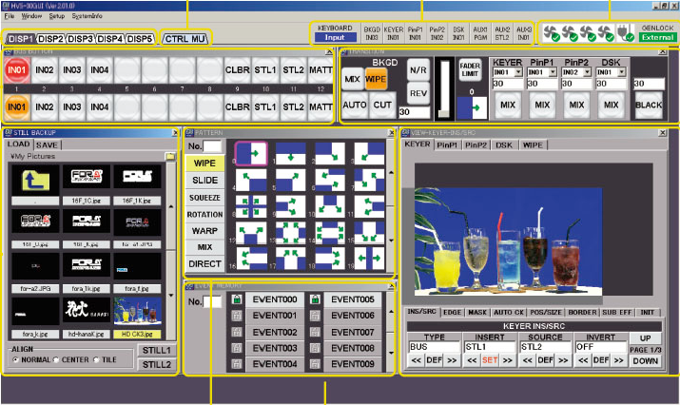
Interoperability of Widgets
Consider a Widget-based GUI
Concept notably developed in Smalltalk
interface Widget {
Dimension getSize();
Dimension getPreferredSize();
void setSize(Dimension size);
void paint(Display display);
… /* more here */ } // based on ConstrainedVisual from Apache Pivot UI framework
Nontrivial abstraction – not just paint()
A single first-class function is not enough
Source: http://www.for-a.com/products/hvs300hs/hvs300hs.html

Slide 18
Interoperability of Composite Widgets
Consider a Composite GUI
Concept notably developed in Smalltalk
class CompositeWidget implements Widget {
Dimension getSize();
Dimension getPreferredSize();
void setSize(Dimension size);
void paint(Display display);
void add(Widget widget)
… /* more here */ } // based on Container from Apache Pivot UI framework
Nontrivial abstraction – not just paint()
A single first-class function is not enough
Composite needs to store diverse subcomponents in a list
Can’t do this with type classes, generic programming
Composite needs to invoke paint() uniformly on all subcomponents
Also breaks type classes, generic programming
Source: http://www.for-a.com/products/hvs300hs/hvs300hs.html

Slide 19
Design Leverage of Service Abstractions
The ability to define nontrivial abstractions that are modularly extensible, where instances of those extensions can interoperate in a first-class way.
Nontrivial abstractions
An interface that provides at least two essential services
Modular extensibility
New implementations not anticipated when the abstraction was designed can be provided without changing the original abstraction
First-class Interoperability
Interoperability of binary methods
Such as adding a subcomponent to a composite
First-class manipulation of different implementations
Such as putting subcomponents in a list
Uniform treatment of different implementations
Such as invoking paint() on all subcomponents

Slide 20
Talk Outline
A technical characteristic unique to objects
Objects, for our purposes, are service abstractions that provide dispatch
Service abstractions uniquely provide first-class interoperability
That has a big impact
Well, first-class interoperability is nice for GUIs
Does this affect in-the-large software development more broadly?

Slide 21
Large-Scale Development Impact
How might service abstractions impact in-the-large software development?
Some hints
We are likely looking for an approach to design
We already know service abstractions are useful for GUIs
Anecdotally, one can argue that GUIs drove OO
Smalltalk, MacApp, Microsoft Foundation Classes, Java Applets, …
What are these GUI designs an instance of?
A likely candidate: software frameworks [Johnson, 1997]

Slide 22
Software Frameworks
A framework is “the skeleton of an application that can be customized by an application developer” [Johnson, 1997]
Frameworks uniquely provide architectural reuse
Reuse of “the edifice that ties components together” [Johnson and Foote, 1988]
Johnson [1997] argues can reduce development effort by 10x
As a result, frameworks are ubiquitous
GUIs: Swing, SWT, .NET, GTK+
Web: Rails, Django, .NET, Servlets, EJB
Mobile: Android, Cocoa
Big data: MapReduce, Hadoop

Slide 23
Frameworks need Service Abstraction
Frameworks define abstractions that extensions implement
The developer “supplies [the framework] with a set of components that provide the application specific behavior” [Johnson and Foote, 1988]
Sometimes the application-specific behavior is just a function
More often, as we will see, these abstractions are nontrivial
Frameworks require modular extensibility
Applications extend the framework without modifying its code
Frameworks are typically distributed as binaries or bytecode
cf. Meyer’s [1988] open-closed principle
Framework developers cannot anticipate the details of extensions
Though they do plan for certain kinds of extensions
Frameworks require first-class interoperability
Plugins often must interoperate with each other
Frameworks must dynamically and uniformly manage diverse plugins
We have already seen this for GUI widgets – let’s look at other examples

Slide 24

Web Frameworks: Java Servlets
interface Servlet {
void service(Request req, Response res);
void init(ServletConfig config);
void destroy();
String getServletInfo();
ServletConfig getServletConfig();
}
Nontrivial abstraction
Lifecycle methods for resource management
Configuration controls
Modular extensibility
Intent is to add new Servlets
First-class interoperability required
Web server has a list of diverse Servlet implementations
Dispatch is required to allow different Servlets to provide their own behavior

Slide 25

Operating Systems: Linux
Linux is an OO framework!
In terms of design—not implemented in an OO language
File systems as service abstractions
Interface is a struct of function pointers
Allows file systems to interoperate
E.g. symbolic links between file systems
Not just file systems
Many core OS abstractions are extensible
~100 Service abstractions in the kernel
fat
ntfs
ext2

Slide 26
Operating Systems: Linux
Linux is an OO framework!
In terms of design—not implemented in an OO language
File systems as service abstractions
Interface is a struct of function pointers
Allows file systems to interoperate
E.g. symbolic links between file systems
Not just file systems
Many core OS abstractions are extensible
~100 Service abstractions in the kernel
fat
ntfs
ext2
People often miss this, or even deny it, but there are many examples of object-oriented programming in the kernel. Although the kernel devel-opers may shun C++ and other explicitly object-oriented languages, thinking in terms of objects is often useful. The VFS [Virtual File System] is a good example of how to do clean and efficient OOP in C, which is a language that lacks any OOP constructs. - Robert Love, Linux Kernel Development (2nd Edition)

Slide 27
Objection: If I want objects, I can build them!
Works nicely in a dynamically-typed setting with macros
Exhibit A: PLT Scheme / Racket
Works poorly in a statically typed language
Certainly possible [Kiselyov and Lämmel, 2005]
Painful in C, Standard ML, Haskell, etc.
No built-in type gives you exactly what you want
Annoying object packing/unpacking is necessary
Feels like an encoding, rather than a natural expression of ideas
Typed Racket works because of special OO types
Programmers do it when really necessary
cf. GTK+ GUI framework, Microsoft COM, Linux drivers, etc.
My take: people only do this if OO languages are excluded a priori

Slide 28
Software Ecosystems
A software ecosystem is a “set of software solutions that enable, support, and automate the activities...[of] actors in the associated social or business ecosystem” [Bosch, 2009]
Examples: iOS, Android, Windows, Microsoft Office, Eclipse, Amazon Marketplace, …
Ecosystems have enormous economic impact
Driven by network effects [Katz and Shapiro, 1985]
Top 5 tech firms control or dominate an ecosystem
Apple, Microsft, IBM, Samsung, Google
Ecosystems require first-class interoperability
Critical to achieving benefit from network effects
“the architecture provides a formalization of the rules of interoperability and hence teams can, to a large extent, operate independently” [Bosch, 2009]

Slide 29



Mobile Devices: Android
class ContentProvider {
abstract Cursor query(Uri uri, ...);
abstract int insert(Uri uri, ContentValues vals);
abstract Uri update(Uri uri, ContentValues vals, ...);
abstract int delete(Uri uri, ...);
... // other methods not shown
}
Network effects (apps) give Android value
Apps build on each other
Example: contact managers
Smartr Contacts is a drop-in replacement for the default contact manager
Phone, email apps can use Smartr Contacts without preplanning
Enabled by service abstraction interfaces
Android keeps a list of heterogeneous ContentProvider implementations

Slide 30
Conclusions
The essence of objects is dispatch, or service abstraction
Dispatch uniquely provides first-class interoperability
First-class interoperability is critical to frameworks and ecosystems
Frameworks and ecosystems are economically critical to the software industry

Slide 31
Hypotheses
Adding first-class modules to languages without objects will promote framework-like designs
Fully parametric module systems will be more practical with OO types than with ADT types

Slide 32
Future Work
Empirical validation for the benefits of interoperability
Exploration of other possible benefits of OO
Psychology
Inheritance

Slide 33
Conclusions
The essence of objects is dispatch, or service abstraction
Dispatch uniquely provides first-class interoperability
First-class interoperability is critical to frameworks and ecosystems
Frameworks and ecosystems are economically critical to the software industry

