Slide 1
Chapter 14: Scripting
Section 14.1: What is a Scripting Language?
Programming Language Pragmatics, Fifth Edition
Michael L. Scott and Jonathan Aldrich
Copyright © 2025 by Elsevier. Slides written by Jonathan Aldrich and Michael L. Scott.

Slide 2
What is a scripting language?
Scripts are programs that coordinate other programs
  “Scripting languages assume that a collection of useful
  components already exist in other languages. They are intended
  not for writing applications from scratch but rather for combining components.” – John Ousterhout, creator of Tcl
Conventional languages focus on efficiency, maintainability, and static error detection
  Hardware-focused types, powerful modularity facilities
  Great for systems code, but writing coordination code is hard
Scripting languages stress flexibility, rapid development, local customization, and dynamic checking
  Types capture high-level concepts like tables, patterns, lists, and files
  Succinct, interactive, few static declarations, “batteries included”

Slide 3
Applications of scripting languages
Gluing existing components together to build a larger
system
  Example (graphic art): download camera photos,
  convert format, rotate pictures, create thumbnails,
  create index, back up photos
Dynamic content generation
  Example (web page): authenticate, read from database, manipulate images, read and customize HTML
System extension and customization
  Example (gaming): program a librarian non-player character (NPC) to respond to someone talking in the library by asking them to be quiet

Slide 4
History of scripting languages
Two sets of ancestors
  Command interpreters or “shells” of traditional batch and “terminal”
  (command-line) computing
    IBM’s JCL (1965), MS-DOS command interpreter, Unix sh and csh
  Tools for text processing and report generation
    IBM’s RPG (1959), and Unix’s sed and awk.
Timeline
  1979: Rexx, IBM’s “Restructured Extended Executor”
  1987: Larry Wall develops Perl to make report processing easier
  1987: Dan Winkler creates HyperTalk; predecessor of AppleScript (1993)
  1991: Guido van Rossum creates Python, a scripting language to appeal to C/Unix hackers
  1995: Rasmus Lerdof adapts a set of Perl shell scripts for maintaining his Personal Home Page to the PHP language; becomes dominant for server-side web scripts
  1995: Brendan Eich develops JavaScript for scripting dynamic web pages
Notes:
JCL = Job Control Language
RPG = Report Program Generator

Slide 5

Programming language people: Guido van Rossum
Guido van Rossum (1956–)
Distinguished Engineer,
Microsoft
Created the Python programming language in 1991. “Benevolent dictator for life” of the language until he stepped down in 2018, when the Python Steering Council took over.
Image by Kushal Das
CC BY-SA 4.0
Notes:
Image source: https://commons.wikimedia.org/w/index.php?curid=159704700

Slide 6
Characteristics of scripting languages
Both batch and interactive use
Economy of expression
Lack of declarations; simple scoping rules
Flexible dynamic typing
Easy access to system facilities and other programs
Sophisticated pattern matching and string manipulation
High level data types (e.g. tables)

Slide 7
Check your understanding: scripting languages
What are 3 common applications of scripting languages?

Slide 8
Check your understanding: scripting languages
What are 3 common applications of scripting languages?
Answer:
  Gluing existing components together to build a larger system
  Dynamic content generation
  System extension and customization

Slide 9
Section 14.2 part 1: Shells
Programming Language Pragmatics, Fifth Edition
Michael L. Scott and Jonathan Aldrich

Slide 10
Shell (Command) languages
Origin in a deck of punch cards
  A control card might test a program’s exit code and decide what
  to do next
  Linear sequence of control cards limited expressiveness (e.g. no iteration)
Most common today are variants of sh
  Originally designed by Ken Thompson for Unix in 1973
  Enhanced with variables and control flow by Stephen Bourne
Bill Joy’s csh adapted sh to C-like syntax
  Popularized for that & command-line editing and completion in successor tcsh
David Korn incorporated similar mechanisms into ksh
  Open source version is bash (“Bourne-again shell”)
  Better than tcsh for complex scripting tasks,¹ compatible with legacy sh scripts
  We focus on bash, most common today (despite zsh alternative)
  ¹Why bash > tcsh for scripts: http://www.faqs.org/faqs/unix-faq/shell/csh-whynot/

Slide 11
Filename and variable expansion (“globbing”)
ls *.pdf # ls fig1.pdf fig2.pdf fig3.pdf
fig[0-9].pdf # other regular expressions
fig3.{eps,pdf}
for fig in *.eps # expansion with looping
do
ps2pdf $fig
done
cp $foo ${foo}_backup # variable interpolation

Slide 12
Tests, queries, and conditions
for fig in *.eps
do
target=${fig%.eps}.pdf # variable assignment
# removes .eps from $fig
if [ $fig –nt $target ] # “newer than” test
then
ps2pdf $fig
fi
done

Slide 13
Pipes and redirection
for fig in *; do echo ${fig%.*}; done | sort –u | wc -l
  echo prints arguments
  sort -u sorts the file names & removes duplicates (-u for unique)
  wc –l counts lines
for fig in *; do echo ${fig%.*}; done | sort –u > all_figs
  > all_figs redirects output to a file
  >> all_figs would append to a file
  < all_figs redirects the input from a file
ps2pdf my_fig.eps 1>&2
  1 is stdout, 2 is stderr; this redirects stdout to stderr

Slide 14
Quoting and expansion
for fig in *.eps
do
ps2pdf "$fig"
done
  If $fig has a space in it, quotes prevent expansion to 2 arguments
  Using single quotes also prevents filename/variable expansion
for fig in $(cat my_figs); do ps2pdf $fig.eps; done
  Evaluates parenthesized expression in subshell, expands output
  Can also use backward quotes (`cat my_figs`)
{ date; ls; } >> file_list
  Braces treat a list as a unit; here we redirect the output of a sequence of commands

Slide 15
Check your understanding: quoting
What is the difference between:
  single quoting ''
  double quoting ""
  back quotes ``

Slide 16
Check your understanding: quoting
What is the difference between:
  single quoting ''
  double quoting ""
  back quotes ``
Answer
  single quotes prevent variable expansion
  double quotes prevent spaces from separating arguments
  back quotes evaluate the inner part in a subshell and expand the output

Slide 17
Section 14.2 part 2:
Other problem domains for scripting
Programming Language Pragmatics, Fifth Edition
Michael L. Scott and Jonathan Aldrich

Slide 18
Text processing and report generation
A second set of languages are designed for repetitive text manipulation tasks
These tasks combine primitive text operations
  search
  substitution, insertion, deletion
  matching brackets
  forward/backward motion through a file

Slide 19
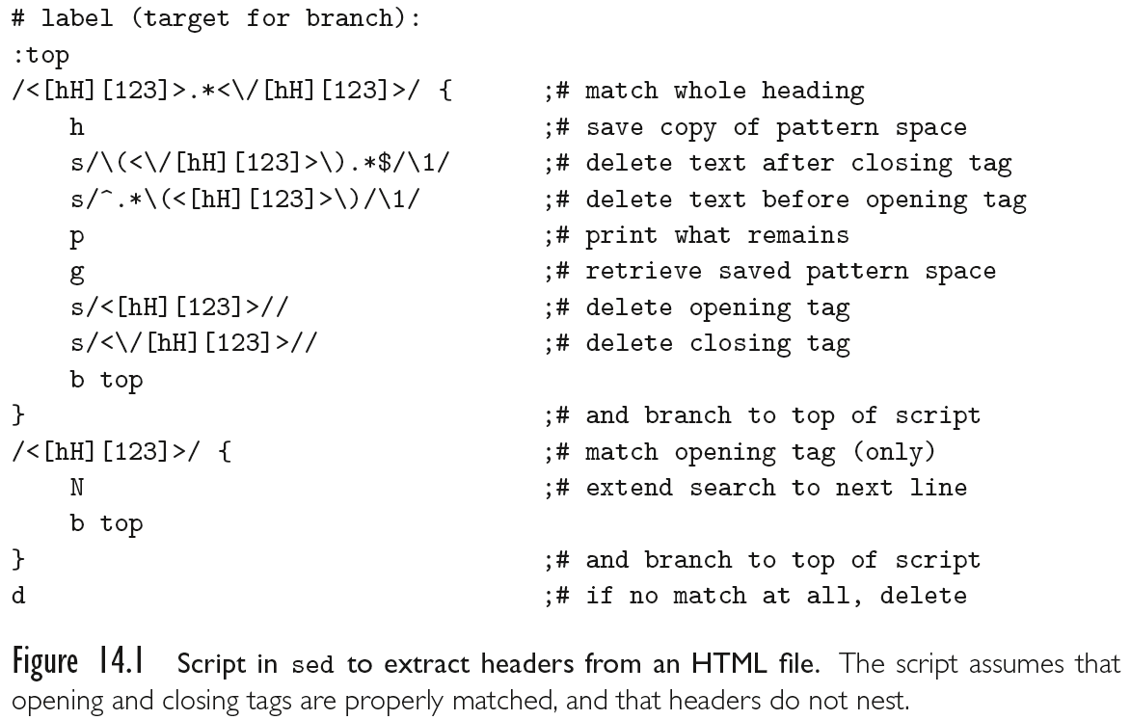
A sed script for extracting headers from a web page
Notes:
sed = “stream editor”
one-line commands
no variables

Slide 20
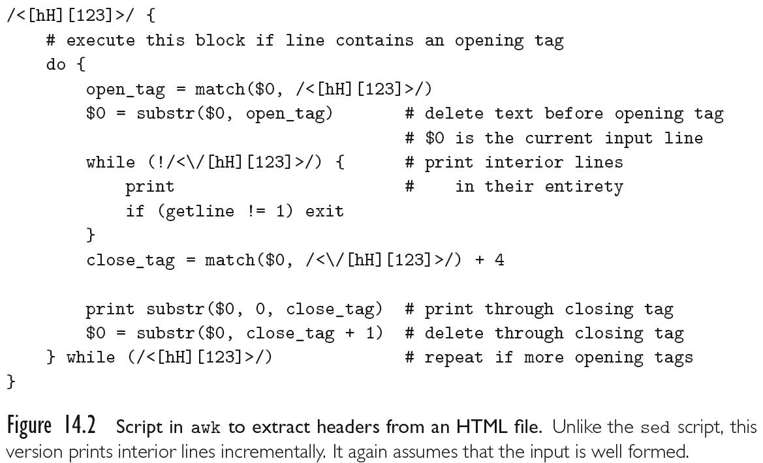
The same program in awk
Notes:
awk = Alfred Aho, Peter Weinberger, and Brian Kernighan
by default one line at a time like sed, but can break out of this mode
C-like syntax, commands as words
support for variables

Slide 21
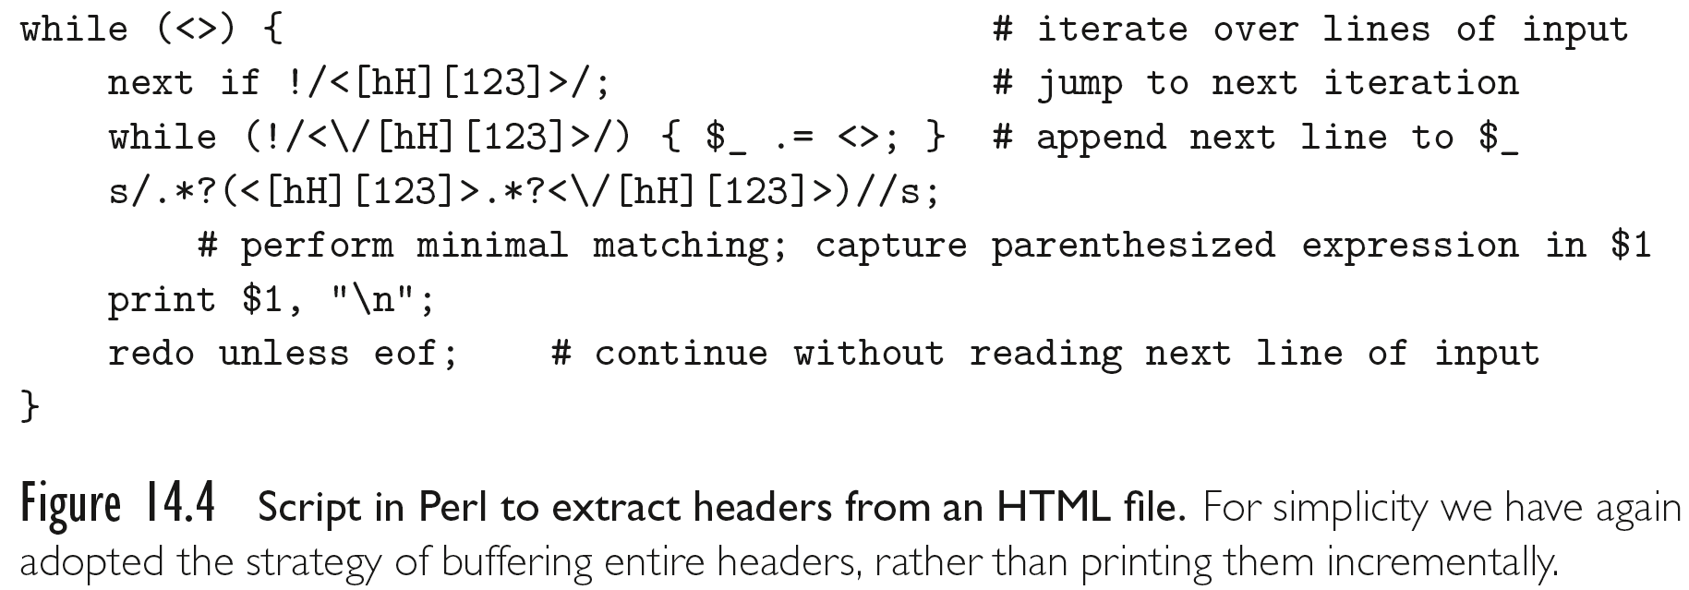
perl makes this script considerably shorter
Perl: originally meant to combine sed, awk, and sh

Slide 22
Mathematics, statistics, and scientific computing
Origins: APL
  Emphasis: concise, elegant expression of mathematical
  algorithms
  Most features of a scripting language, except system facilities and strings
Modern DSLs for mathematics: Maple, Mathematica, Matlab
  Support numerical methods, symbolic mathematics, data visualization, mathematical modeling
Statistics: R
  multidimensional array and list types, array slice operations, user-defined infix operators, call-by-need parameters, and first-class functions
Scientific computing: Julia
  Many scripting features, but design for high performance computing
  Dynamic types, JIT compilation, generics, dynamic dispatch, extensive libraries

Slide 23
Data science and machine learning
Python is dominant in this domain
Jupyter notebooks ubiquitous in data science
  A sequence of cells containing live python code and narrative markdown
  Cells may read files and produce tables or plots
Python libraries for machine learning (“batteries included”)
  NumPy – numerical array computing
  Pandas – DataFrames for data manipulation, cleaning, and analysis
  Matplotlib – data visualization
  SciPy – scientific computing
  TensorFlow and PyTorch – deep learning
These are all high-performance libraries with core algorithms written in C; Python is the “glue”

Slide 24
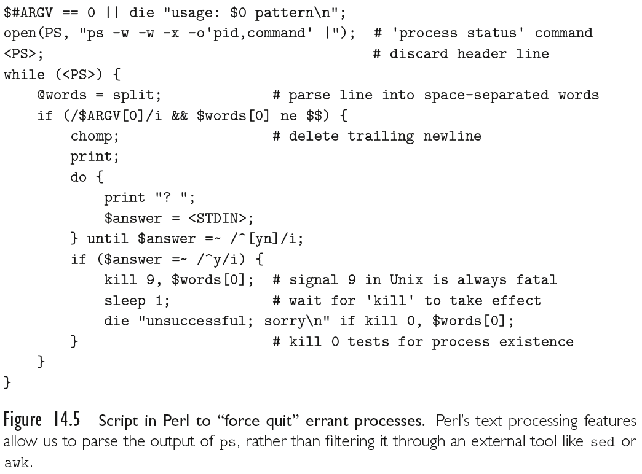
“Glue languages” and general purpose scripting

Slide 25
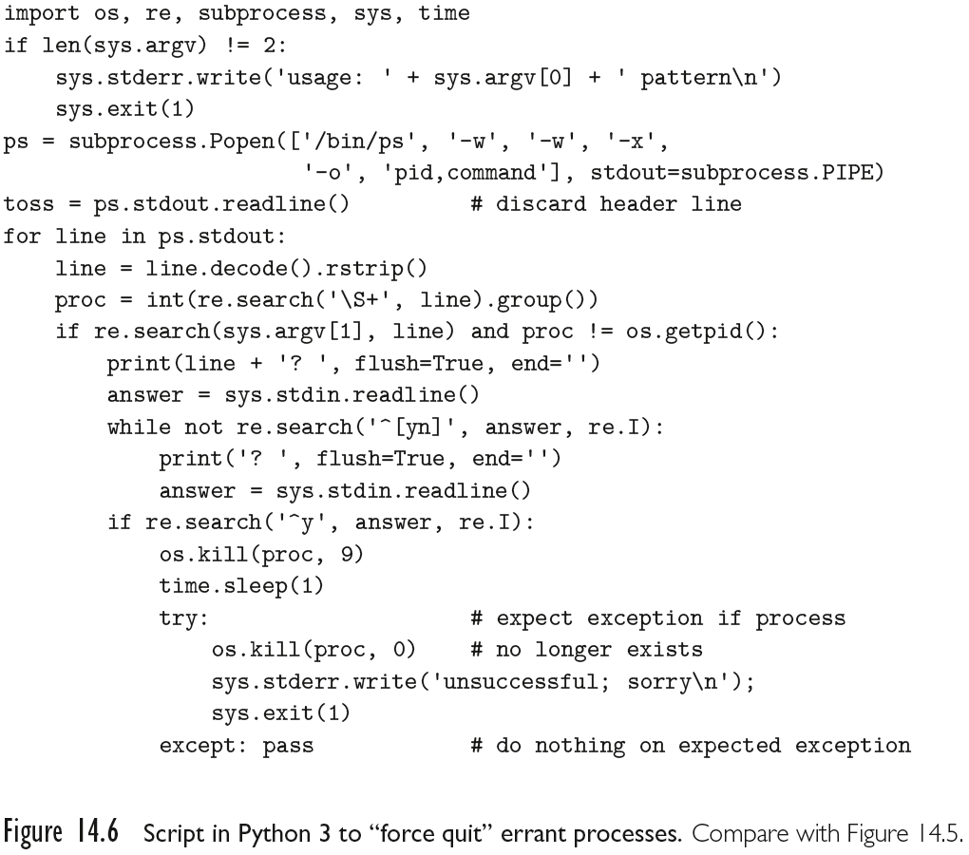
“Glue languages” and general purpose scripting

Slide 26
Extension languages
Most applications accept some sort of commands
  these commands are entered textually or triggered by user interface events
  such as mouse clicks, menu selections, and keystrokes
  Commands in a graphical drawing program might save or load a drawing; select, insert, delete, or modify its parts; choose a line style, weight, or color; zoom or rotate the display; or modify user preferences.
An extension language serves to increase the usefulness of an application by allowing the user to create new commands, generally using the existing commands as primitives.
Extension languages are increasingly seen as an essential feature of sophisticated tools
  Adobe’s graphics suite (Illustrator, Photoshop, InDesign, etc.) can be extended (scripted) using JavaScript, Visual Basic (on Windows), or AppleScript
  AOLserver, an open-source web server from America On-Line, can be scripted using Tcl. Disney and Industrial Light and Magic use Python to extend their internal (proprietary) tools

Slide 27
Extension languages
To admit extension, a tool must
  incorporate, or communicate with, an interpreter for a scripting
  language
  provide hooks that allow scripts to call the tool’s existing commands
  allow the user to tie newly defined commands to user interface events
With care, these mechanisms can be made independent of any particular scripting language
One of the oldest existing extension mechanisms is that of the emacs text editor, used to write the textbook
  An enormous number of extension packages have been created for emacs; many of them are installed by default in the standard distribution.
  The extension language for emacs is a dialect of Lisp called Emacs Lisp.
  An example script appears in Figure 14.8
    It assumes that the user has used the standard marking mechanism to select a region of text

Slide 28
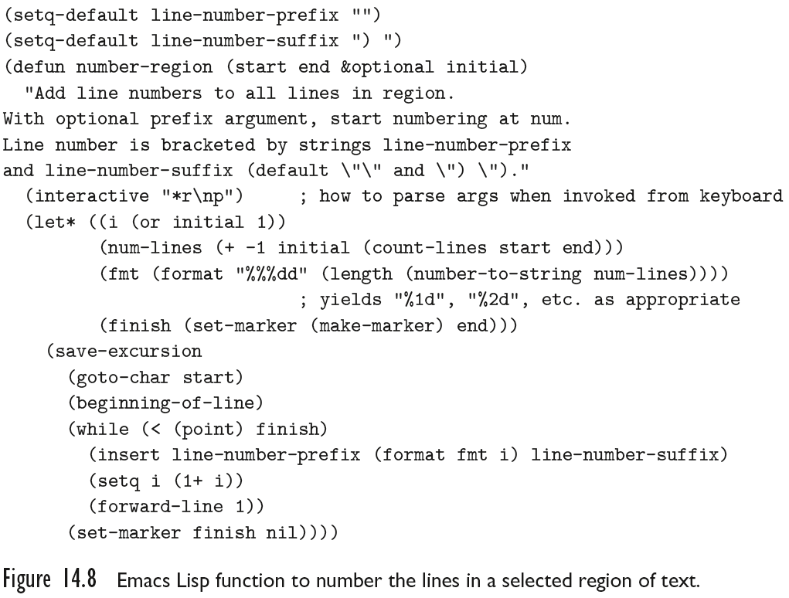
emacs extension to add line numbers

Slide 29
Check your understanding: scripting languages
Describe a unique feature of one of the languages
described here and how it helps with scripting
applications

Slide 30
Check your understanding: scripting languages
Describe a unique feature of one of the languages
described here and how it helps with scripting
applications
Sample answers
  Convenient syntax for pattern matching makes text processing tasks easy
  Perl’s implicit $_ argument avoids boilerplate
  Built-in functions and libraries make it easy to start, kill, and manipulate processes

Slide 31
Section 14.3: Scripting the web
Programming Language Pragmatics, Fifth Edition
Michael L. Scott and Jonathan Aldrich

Slide 32
Web scripts provide dynamism in web pages
Much of the content on the www is static web pages
However, many web pages contain content that is
dynamically generated to respond to the user’s query
Server-side scripts compute web pages from private server data
  Provider has complete control over content
  Examples: search engines, retail sites, anything with user accounts
Client-side scripts modify web pages on the client side
  Don’t need proprietary information
  More efficient to execute on the client
  Examples: interactive animation, error-checking of forms, calculations

Slide 33
CGI Scripts
The original mechanism for server-side web scripting is
the Common Gateway Interface (CGI)
A CGI script is an executable program residing in a special directory known to the web server program
When a client requests the URI corresponding to such a program, the server executes the program and sends its output back to the client
  this output needs to be something that the browser will understand: typically HTML.
CGI scripts may be written in any language available
  Perl is particularly popular:
    its string-handling and “glue” mechanisms are suited to generating HTML
    it was already widely available during the early years of the web

Slide 34
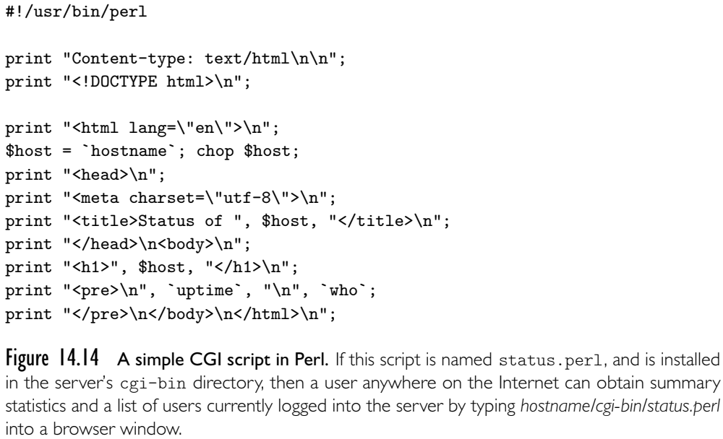
Example CGI script

Slide 35
Embedded server-side scripts
Though widely used, CGI scripts have several
disadvantages:
  The web server must launch each script as a separate program,
  with potentially significant overhead
    However, CGI scripts compiled to native code can be very fast once running
  Scripts must generally be installed in a trusted directory by trusted system administrators
    for security reasons, they cannot reside in arbitrary locations as ordinary pages do
  The name of the script appears in the URI, typically prefixed with the name of the trusted directory, so static and dynamic pages look different to end users
  Each script must generate not only dynamic content, but also the HTML tags that are needed to format and display it
    This extra “boilerplate” makes scripts more difficult to write
Most web servers now provide a “module loading” mechanism that provides interpreters for one or more scripting languages

Slide 36
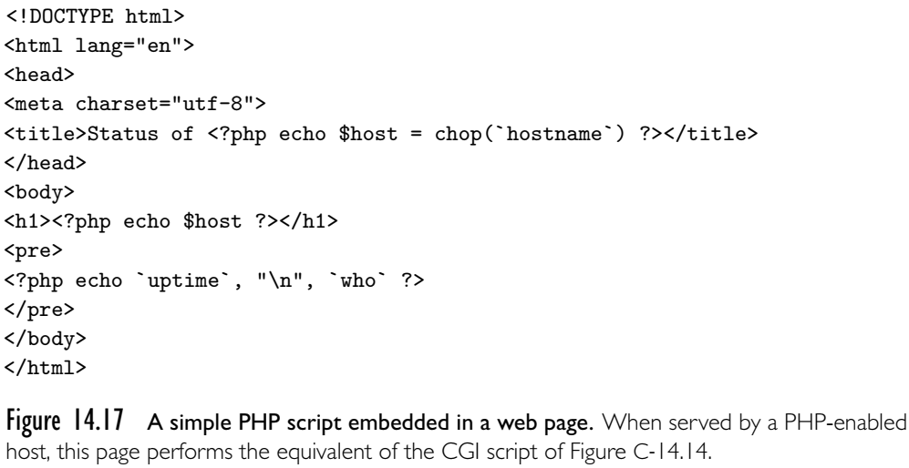
Example embedded PHP script

Slide 37
Client-side scripts
Embedded server-side scripts are generally faster than CGI
scripts, at least when startup cost predominates
  Internet communication is still too slow for interactive pages
Because they run on the web designer’s site, CGI scripts and, to a lesser extent, embeddable server-side scripts can be written in many different languages
  all the client ever sees is standard HTML.
Client-side scripts, by contrast, require an interpreter on the client’s machine
  there is a powerful incentive for convergence in client-side scripting languages: most designers want their pages to be viewable by as wide an audience as possible
Pages intended for the general public almost always use JavaScript for interactive features.

Slide 38
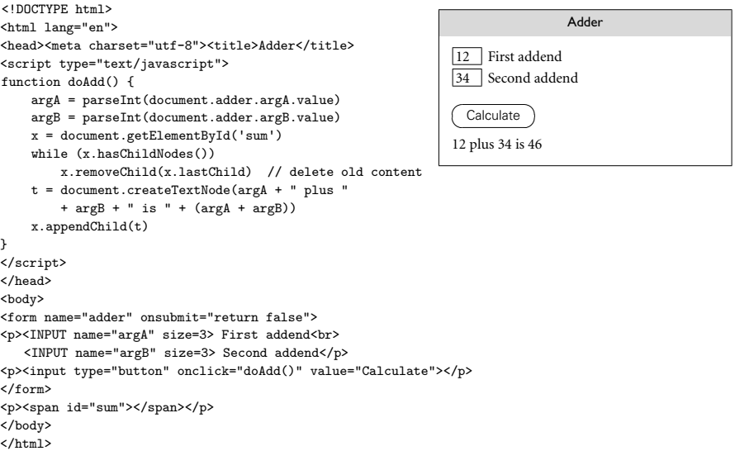
Example web page with JavaScript

Slide 39
Check your understanding: web scripting
Explain the key difference between server-side and
client-side web scripting. What language(s) are
commonly used for each?

Slide 40
Check your understanding: web scripting
Explain the key difference between server-side and
client-side web scripting. What language(s) are
commonly used for each?
Answer:
  Server-side vs. client-side refers to where the script runs
  Server-side scripts are often in Perl or PHP.
  Client-side scripts are almost universally written in JavaScript

Slide 41
Section 14.4 part 1: Declarations and data types in scripting languages
Programming Language Pragmatics, Fifth Edition
Michael L. Scott and Jonathan Aldrich

Slide 42
Variable declarations in scripting languages
Most scripting languages (Scheme is the obvious
exception) do not require variables to be declared
  Perl and JavaScript permit optional declarations
  - a kind of compiler-checked documentation
  Perl can be run in a mode (use strict ’vars’) that requires declarations
A convention determines the scope of a variable
  JavaScript & Perl: variables are global unless locally declared (let x = …)
  Python: variables are local to the scope where they are written
    Can be read in a nested scope
    Can write to a global by importing: global x
  Ruby: foo is local, $foo is global, while @foo is an instance variable and @@foo is a class variable

Slide 43
Nesting and scoping conventions vary
Scheme, Python, and JavaScript provide the classic
combination of nested subroutines and static (lexical)
scope
Tcl allows subroutines to nest, but uses dynamic scope
Named subroutines (methods) do not nest in PHP or Ruby
  Perl and Ruby join Scheme, Python, JavaScript, in providing first class anonymous local subroutines
Nested blocks are statically scoped in Perl
  In Ruby they are part of the named scope in which they appear
Scheme, Perl, Python, and JavaScript provide for variables captured in closures
PHP, JavaScript, and the major glue languages (Perl, Tcl, Python, Ruby) all have sophisticated namespace mechanisms
  information hiding, selective import of names from separate modules

Slide 44
Data types in scripting languages
As we have seen, scripting languages don’t generally
require (or even permit) the declaration of types for
variables
Most perform extensive run-time checks to make sure that values are never used in inappropriate ways
Perl, Rexx, and Tcl are weakly typed
  They assume programmers should check for errors they care about
  In the absence of such checks, they try to do something reasonable
  $a[3] = "1";
  print $a[3] + $a[4], "\n"
Other languages (e.g., Scheme, Python, and Ruby) are relatively strict about this checking
  a = []
  a[3] = "1"
  print Integer(a[3]) + Integer(a[4]), "\n"

Slide 45
Numeric types in scripting languages
Numeric types are “just numbers”
JavaScript & Lua approach: everything is a double
Perl, Scheme, Python provide multiple types
  integers, doubles, complex (Python, Scheme), rationals (just Scheme)
  All support bignums: arbitrary precision integers
  Operations convert to a common type that can represent the result
    Adding an integer and a double results in a double
    Overflowing a 32-bit integer results in a bignum
    Dividing two integers in Scheme results in a rational number if the remainder is nonzero

Slide 46
Composite types in scripting languages
Arrays and maps (“hashes”) are universal. In Ruby:
  colors = ["red", "green", "blue"]
  complements = {"red" => "cyan",
  "green" => "magenta",
  "blue" => “yellow"}
  print colors[2], complements["blue"]
PHP and JavaScript eliminate the distinction between arrays and hashes – arrays are just hashes with numeric keys
JavaScript unifies objects with hashes, too
  obj.attr is the same as obj["attr"]

Slide 47
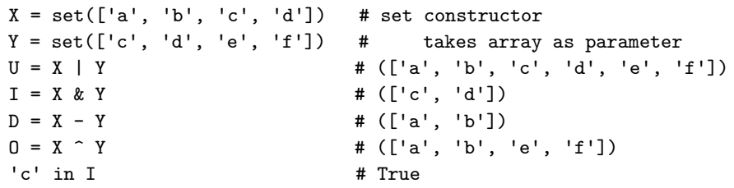
Composite types in scripting languages
Python adds immutable tuples
  crimson = (0xdc, 0x14, 0x3c) # R,G,B components
  Cheaper to access than arrays
  Multiway assignment is just assignment of tuples
  a, b = b, a
and sets

Slide 48
Check your understanding: numeric types in scripting
How does JavaScript avoid problems with integer
overflow? What about Python?

Slide 49
Check your understanding: numeric types in scripting
How does JavaScript avoid problems with integer
overflow? What about Python?
Answer: All numbers are represented as double-precision floating point in JavaScript, so integer overflow does not occur (and floating point numbers go up to approximately 10³⁰⁸).
In Python, when integer overflow occurs, the resulting value is represented as a bignum (arbitrary-precision integer) instead.

Slide 50
Section 14.4 part 2: Regular expressions in scripting languages
Programming Language Pragmatics, Fifth Edition
Michael L. Scott and Jonathan Aldrich

Slide 51
String and pattern manipulation
Regular expressions are present in many scripting
languages and related tools. Many employ extended
versions of the notation
  In prior slides, we’ve seen examples in bash, sed, awk, Perl, and Python
  Many readers are familiar with grep, the stand-alone Unix pattern-matching tool
Two main groups
  The first group includes awk, egrep (the most widely used of several different versions of grep), the regex routines of the C standard library, and older versions of Tcl
    These implement REs as defined in the POSIX standard
  Languages in the second group follow the lead of Perl, which provides a large set of extensions, sometimes referred to as “advanced REs”

Slide 52
POSIX regular expressions
Regular expressions support concatenation, alternation,
and Kleene closure, with parentheses for grouping:
  /ab(cd|ef)g*/ matches abcd, abcdg, abefg, abefgg, abcdggg, etc.
Other quantifiers are supported, too:
  ? for zero or one repetitions, + for one or more repetitions
  {n} means exactly n repetitions, {n,} at least n, {n,m} between n and m
Zero-length assertions ^ and $ match only at the beginning and end
Character classes: [aeiou] means a|e|i|o|u,
[0-9a-fA-F] matches hex digits,
[^a-z] matches any non-lowercase character,
[:space:] matches whitespace
Backslash is an escape: \? matches ?, \\ matches \

Slide 53
Advanced regular expressions: testing
Perl created extensions of POSIX regular expressions
  Now adopted by PHP, Python, Ruby, JavaScript, Emacs Lisp,
  Java, and C#
Testing operators
  The =~ operator tests for matching
  $foo = "albatross";
  if ($foo =~ /ba.*s+/) ... # true
  A regular expression by itself tests against $_
  $_ = "albatross";
  if (/ba.*s+/) ... # true
  The !~ operator returns true when a pattern does not match
  if ("albatross" !~ /^ba.*s+/) ... # true

Slide 54
Advanced REs: substitutions & modifiers
The s/// operator replaces what lies between the first
and second slashes with whatever lies between the
second and third
  The syntax is inherited from sed
  $foo = "albatross";
  $foo =~ s/lbat/c/; # $foo now contains "across"
Matches and substitutions can be modified with characters after the closing delimiter
  i makes the match case-insensitive
  $foo = “Albatross";
  if ($foo =~ /^al/i) ... # true
  g on a substitution replaces all occurrences
  $foo = "albatross";
  $foo =~ s/[aeiou]/-/g; # $foo now contains "-lb-tr-ss"

Slide 55
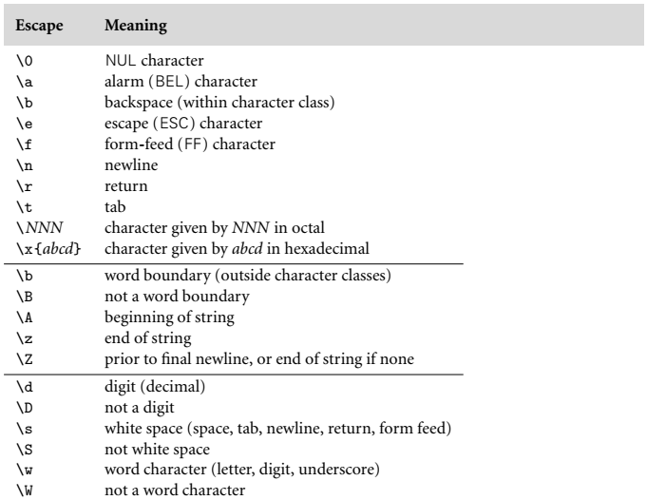
Advanced REs: escapes
Figure 14.11 from the textbook. Sequences at the top of the table represent individual characters; sequences in the middle are zero-width assertions; sequences at the bottom are built-in character classes. These are only examples: Perl assigns a meaning to almost every backslash-character sequence

Slide 56
Advanced REs: greedy and minimal matches
By default Perl’s RE matching strategy is greedy
  “Left-most longest” – the match starts at the earliest possible
  position within the string, then extends as far as possible
  If we match the pattern /(bc)+/ to the string abcbcbcde, the greedy match will be abcbcbcde
We can append a ? to + or * to get a minimal match
  Still starts at the earliest possible position
  Matches the shortest possible character sequence that allows the overall match to succeed
  For the pattern /(bc)+?/ the minimal match would be abcbcbcde

Slide 57
Advanced REs: variable interpolation and capture
Variable interpolation: Perl variables starting with $
are expanded into patterns
  $prefix = ...
  $suffix = ...
  if ($foo =~ /^$prefix.*$suffix$/) ...
Any parenthesized fragment of an RE captures the text it matches
  The following command changes $line to remove all characters before the opening header tag. \1 indicates the tag matched by the parentheses
  $line =~ s/^.*(<[hH][123]>)/\1/;
  We can access captured groups after a RE with $1, $2, etc.
  print "Opening tag: ", $1, "\n";

Slide 58
Check your understanding: Perl regular expressions
Explain the difference between greedy and minimal
matches

Slide 59
Check your understanding: Perl regular expressions
Explain the difference between greedy and minimal
matches
Answer: A greedy match, also called left-most longest, starts as early as possible in the string and continues for as long as possible. A minimal match corresponds to left-most shortest; it starts as early as possible in the string but matches the shortest sequence of characters that allows the overall match to succeed.

Slide 60
Section 14.4 part 3: Support for objects in scripting languages
Programming Language Pragmatics, Fifth Edition
Michael L. Scott and Jonathan Aldrich

Slide 61
OO features of scripting languages
Early scripting languages were not OO (e.g. Perl,
the Unix shell)
More recent scripting languages mostly embrace it
  Objects naturally represent resources that scripts need to manipulate
  Need to script things that already have OO interfaces (e.g. VBA)
  Following PL trends – programmers expect & understand OO
Perl 5 has features that allow one to program in an
object-oriented style
PHP and JavaScript have cleaner, more conventional-looking object-oriented features
  both allow the programmer to use a more traditional imperative style
Python and Ruby are explicitly and uniformly object-oriented

Slide 62
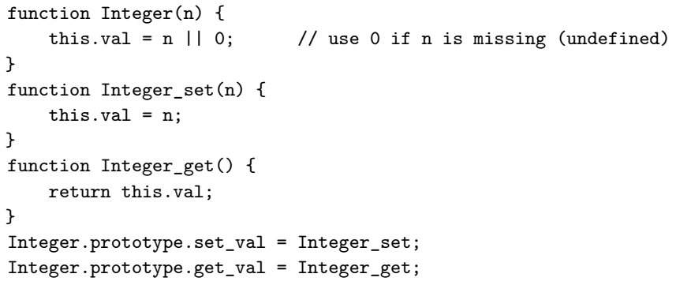
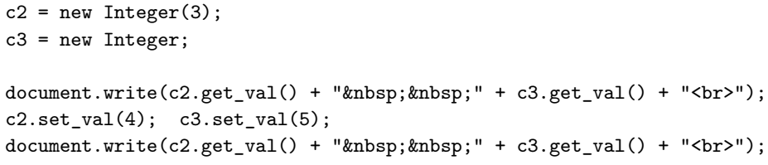
JavaScript is an object-based language
Integer
prototype
Integer.prototype
Integer_get
get_val
set_val
c2
prototype
val = 3
Integer_set
c3
prototype
val = 0
Prints
0
5

Slide 63
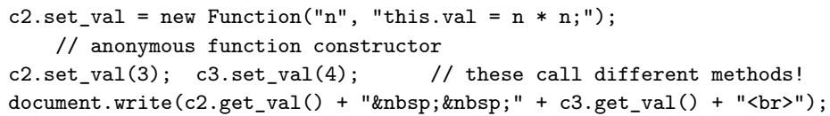
We can override methods per-object
Integer
prototype
Integer.prototype
Integer_get
get_val
set_val
c2
prototype
val = 3
Integer_set
set_val
c2.set_val
c3
prototype
val = 0
Prints
9 4

Slide 64
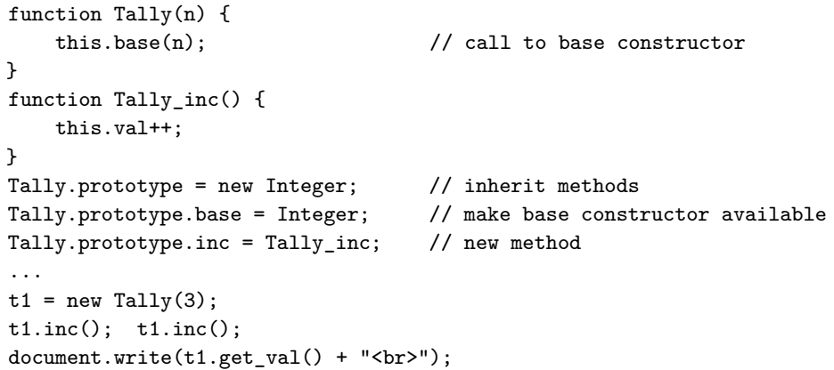
Prototypes support inheritance
Integer_get
Integer
Integer.prototype
Integer_set
prototype
get_val
set_val
Tally
prototype
Tally.prototype
Tally_inc
Prints
5
t1
prototype
prototype
val = 3
base
inc

Slide 65
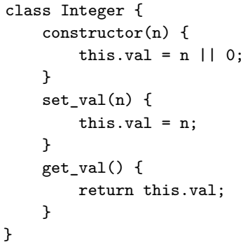
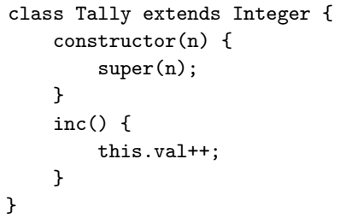
Classes in JavaScript
Classes were added in 2015 as part of ECMAScript 6
Under the hood, classes are implemented with the prototype mechanism described above!

Slide 66
TypeScript adds optional types to JavaScript
JavaScript is now used for more than scripting web pages
  E.g. desktop and mobile apps, server code based on node.js
  Motivated the addition of classes, namespaces, etc. to JavaScript
  Static typing is also very helpful for writing applications at scale!
TypeScript adds optional typing annotations to JavaScript
  An example of gradual typing – can seamlessly mix statically typed and dynamically typed code
  TypeScript reports errors when types are inconsistent, but never when they are missing

Slide 67
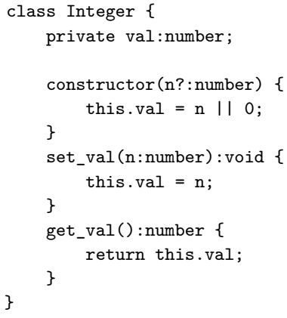
Classes in TypeScript
TypeScript supports typical types
  number represents JavaScript’s double-precision floating points
It also provides features useful for gradual typing
  Optional arguments and fields with ?
  Literal types (denote a specific value)
  Structural union types
  Conditional types (“if” in the type system)

Slide 68
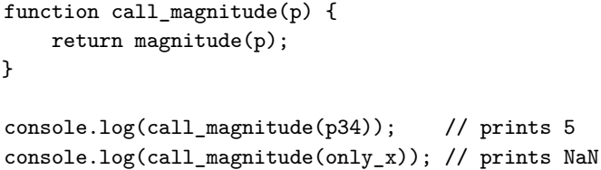
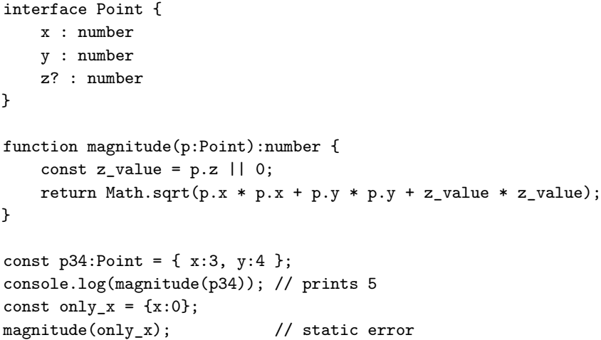
Mixing statically and dynamically typed code

Slide 69
Objects in Python
Python is uniformly object-oriented
  Even integers act like objects – you can call methods on them
Constructors are called __init__ and cannot be overloaded
The receiver parameter is explicit; by convention, it is called self
  Self-calls within a method must name the object explicitly: self.print() not print()
Objects are created with my_object = My_class(args)
Fields are created with assignment:
  my_object.new_field = value
New methods can be added to a class at any time:
  def my_func(self): ...
  my_class.new_method = my_func

Slide 70
Check your understanding: Objects in JavaScript
What are prototypes in JavaScript? What purpose do
they serve?

Slide 71
Check your understanding: Objects in JavaScript
What are prototypes in JavaScript? What purpose do
they serve?
Answer: JavaScript prototypes are objects that encapsulate a set of methods that are inherited by other objects. They provide code reuse, similar to the role of class inheritance in other languages.

Slide 72
Scripting languages
Scripts are programs that coordinate other programs
Application areas
  Gluing existing components together to build a larger system
  Dynamic content generation
  System extension and customization
Emphasize flexibility, rapid development, local customization, and dynamic checking

