Slide 1
Perceptions of Behavioral Advertising among CMU Community
Ashwini Rao
April 21, 2014

Slide 2
Outline
Background regarding behavioral advertising
Details of campus survey
Discuss results from the survey

Slide 3
Behavioral advertising:
show personalized advertisements based on user behavior, not just site content

Slide 4
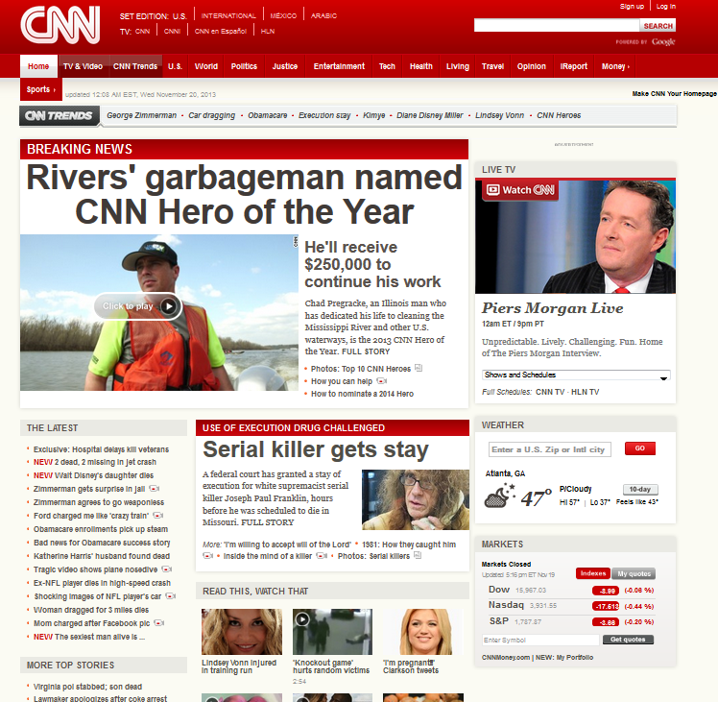
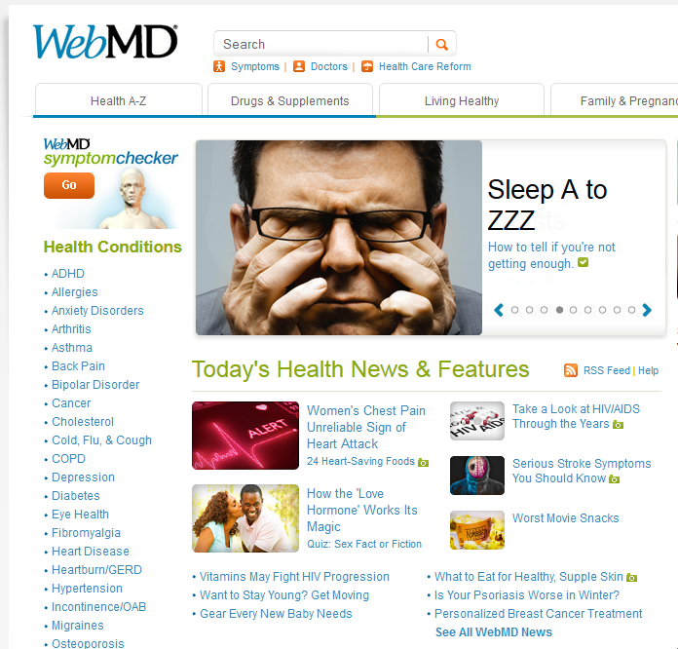
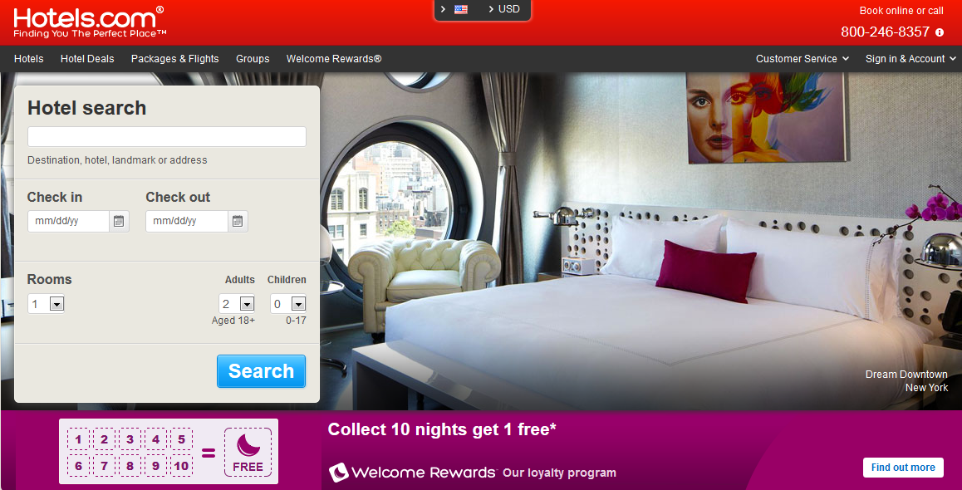
Behavioral ad example
1. Watch video on 2014 Winter Olympics
3. See ad for discount airfare
2. Research cheap hotels

Slide 5
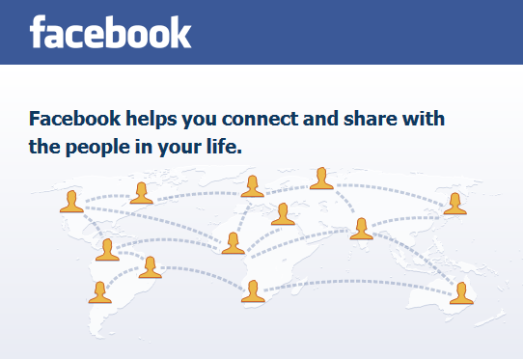
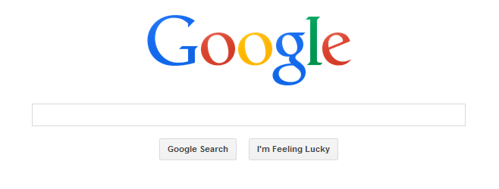
Advantages of Behavioral Ads
Supports free Internet services
  E.g. search, social networking
Effective in increasing ad revenues
Notes:
E.g. Yan et al. report average 670% increase in click-through rate of ads

Slide 6
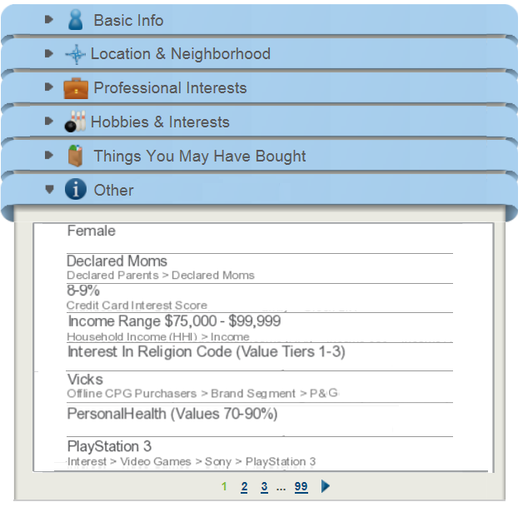
What’s the catch?
Based on actual user profiles from prior user study, 2013 (n=6)
Notes:
Data about users is collected to create individual profiles, which leads to many user concerns.

Slide 7
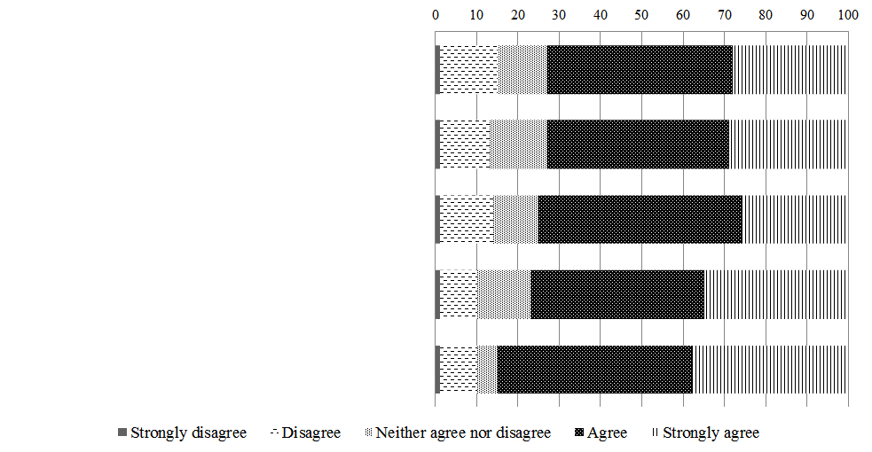
User concerns
Contains sensitive data
Amount of data
Data from multiple sources
Level of detail
How data may be used
Survey on Amazon Mechanical Turk, 2014 (n=100)
Notes:
At least 70% agreed or strongly agreed with each of the above concerns.

Slide 8
Perceptions among CMU Community
What does CMU community think of behavioral advertising?
  Awareness and opinions
Survey as part of Data Privacy Day
  Conducted on Jan 27, 2014
  Recruited participants (n=161) at University Center

Slide 9
Survey Design
Asked six questions to test awareness
  4 true, 2 false questions
  Rate on a 5-point scale of strongly disagree to strongly agree
Collected opinions about a sample profile
  Concern, comfort
Notes:
What types of data are being used for behavioral advertising?
Are there protections that restrict the use of certain data for advertising?

Slide 10
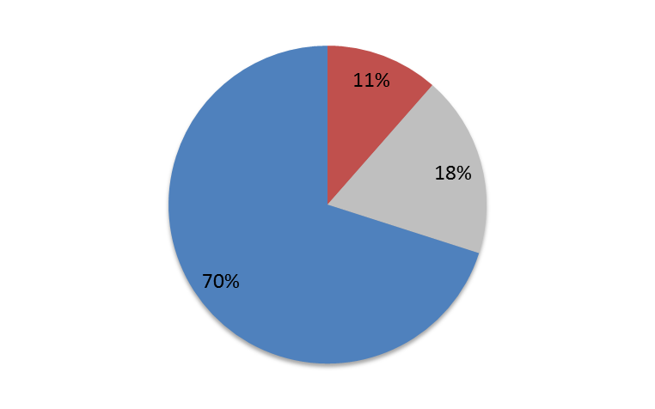
“Marketing firms routinely use data collected about consumers to assign them personality types such as “leader vs. follower” or “introvert vs. extrovert.”
(TRUE)
70%
agree
29%
other

Slide 11
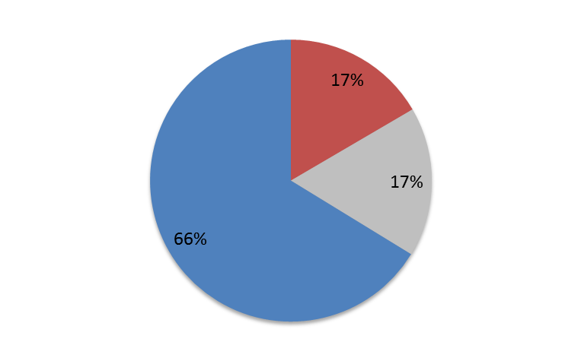
“Readily available information about the websites you visit and videos you watch is routinely used by marketing companies to determine your propensity to gamble in casinos or play on the stock market.”
(TRUE)
66%
agree
34%
other

Slide 12
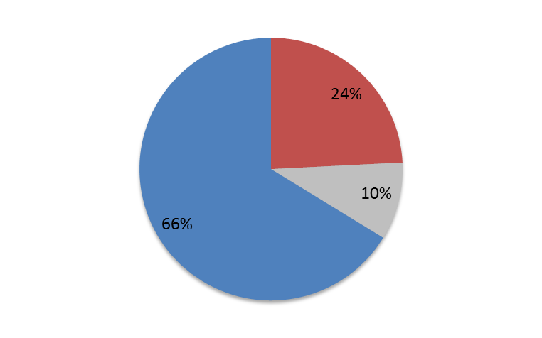
“Email providers may use the content of emails that you send and receive to determine what advertisements to show you.”
(TRUE)
66%
agree
34%
other

Slide 13
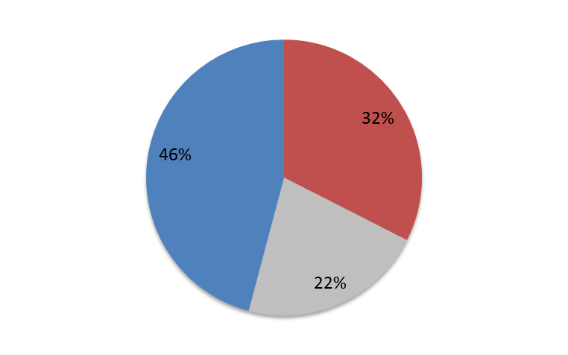
“Data about individuals’ religious and moral beliefs is readily available for anyone willing to purchase it.”
(TRUE)
46%
agree
54%
other

Slide 14
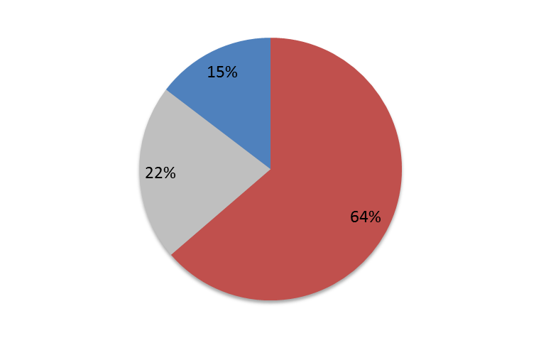
“Advertisers routinely collect credit card numbers stored on your computer.”
(FALSE)
36%
other
64%
disagree

Slide 15
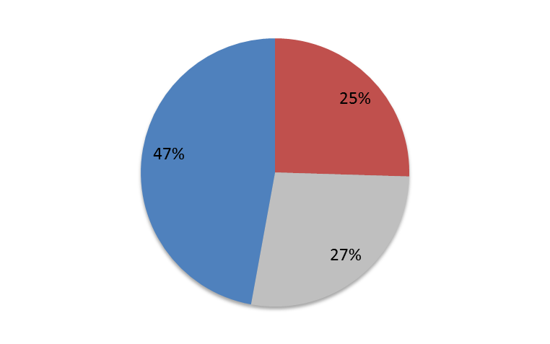
“US law prohibits advertising companies from collecting and selling information about which prescription drugs you use.”
(FALSE)
75%
other
25%
disagree

Slide 16
Sample profile

Slide 17
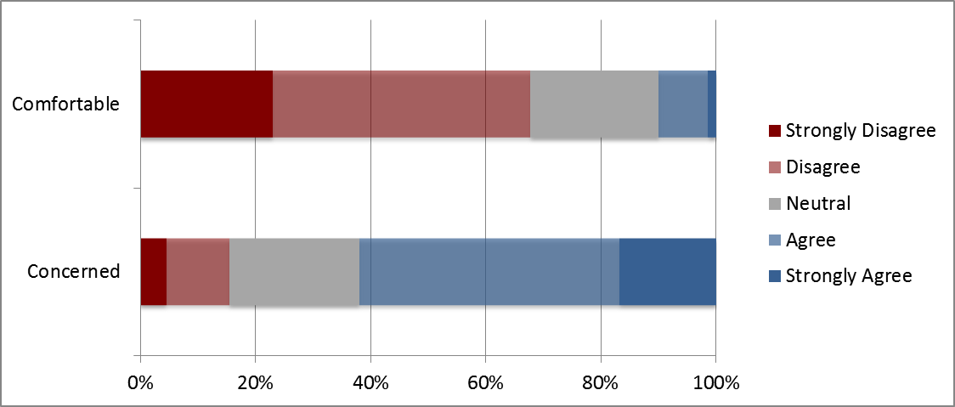
Opinion on Sample Profile
10% comfortable
62% concerned

Slide 18
CMU vs. other population
Misconceptions about protected data
  Awareness generally higher compared to others
Majority concerned
  Concern slightly lower compared to others
  Concerned more about religious than income and credit data

Slide 19
Questions?

Slide 20
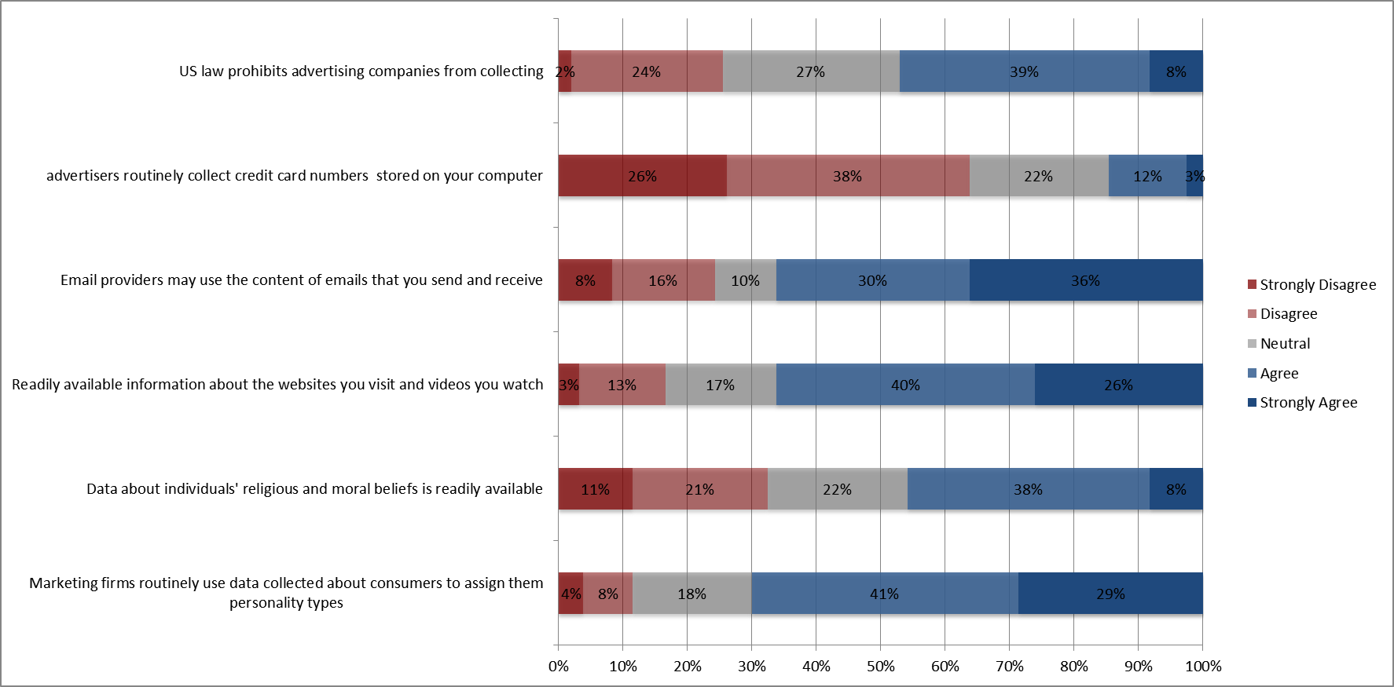

Slide 21
