Slide 1
PETE & C
Ananda Gunawardena
CMU
February 08, 2009

Slide 2
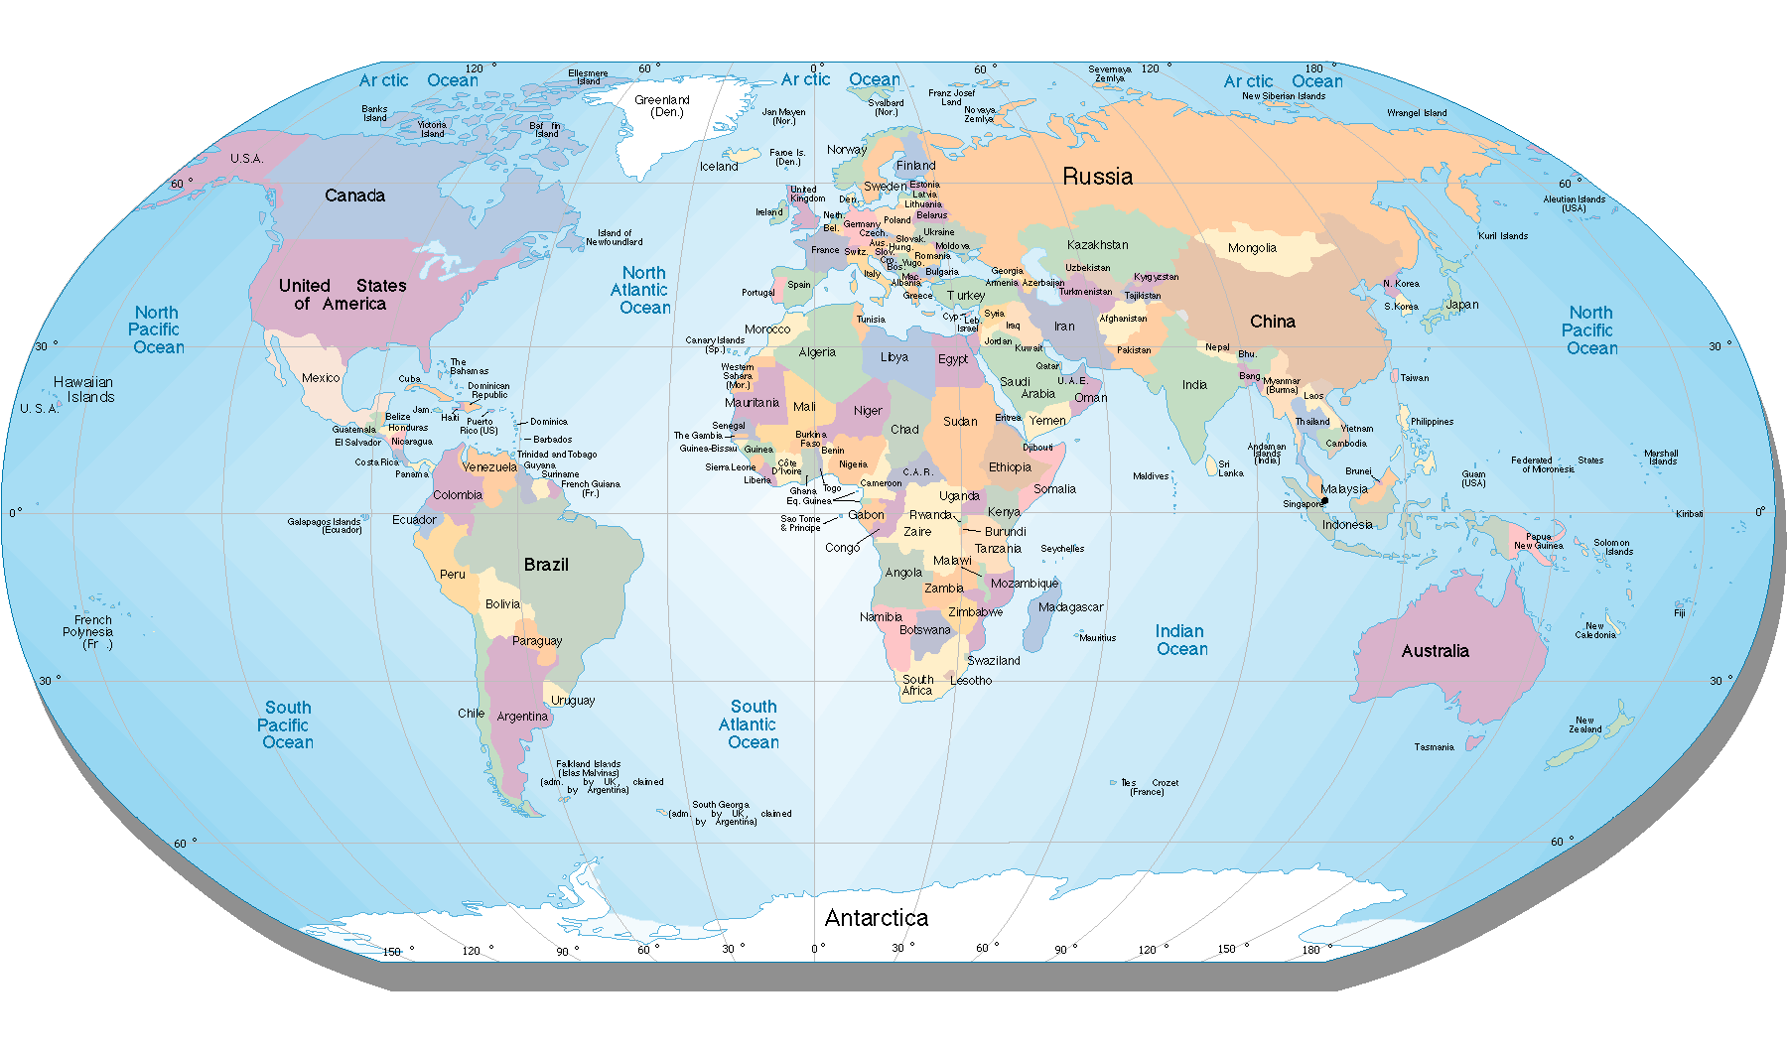
Countries of the world

Slide 3
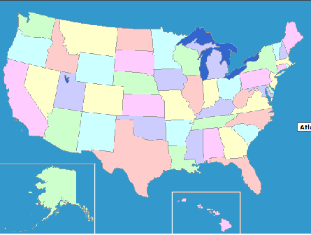
Name the States

Slide 4
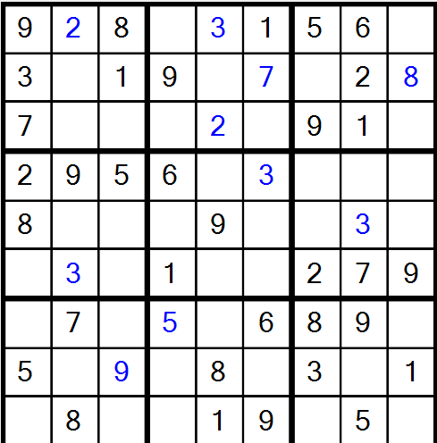
Solve the Sudoku Board

Slide 5
Solve the problem
Three hats and one coat cost $66
One hat and three coats cost $ 42
How much is a hat? How much is a coat?

Slide 6
Name the President/Prime Minister
USA
England
Japan
China
Germany
Sri Lanka

Slide 7
Name the new Cabinet
Secretary of Energy
Secretary of Health
Secretary of Education
Secretary of Labor
Secretary of veterans affairs
Secretary of State
Secretary of Treasury

Slide 8
Yes / No
The US economy will recover in 2009

Slide 9
Choose the answer
The largest prime number less than 100 is
99
97
93
91

