Slide 1







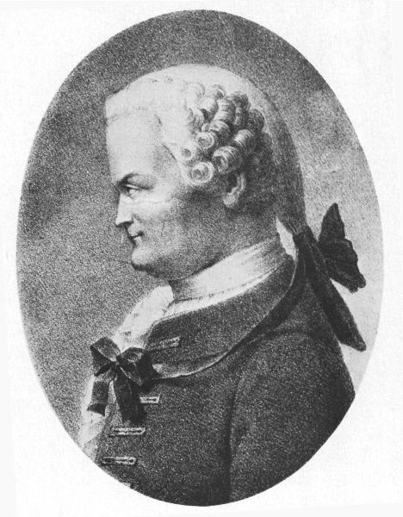

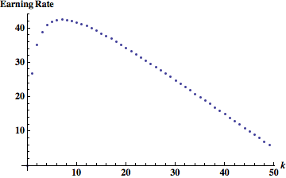





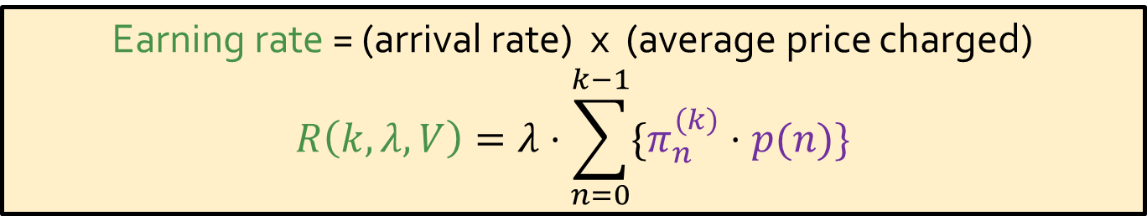


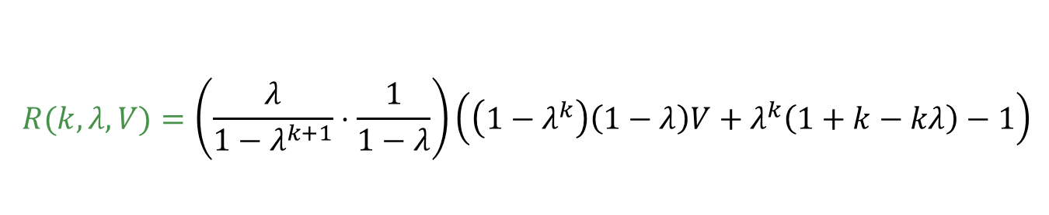













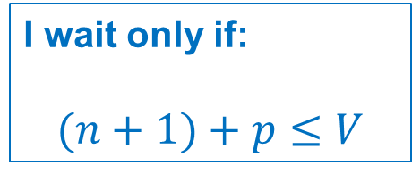


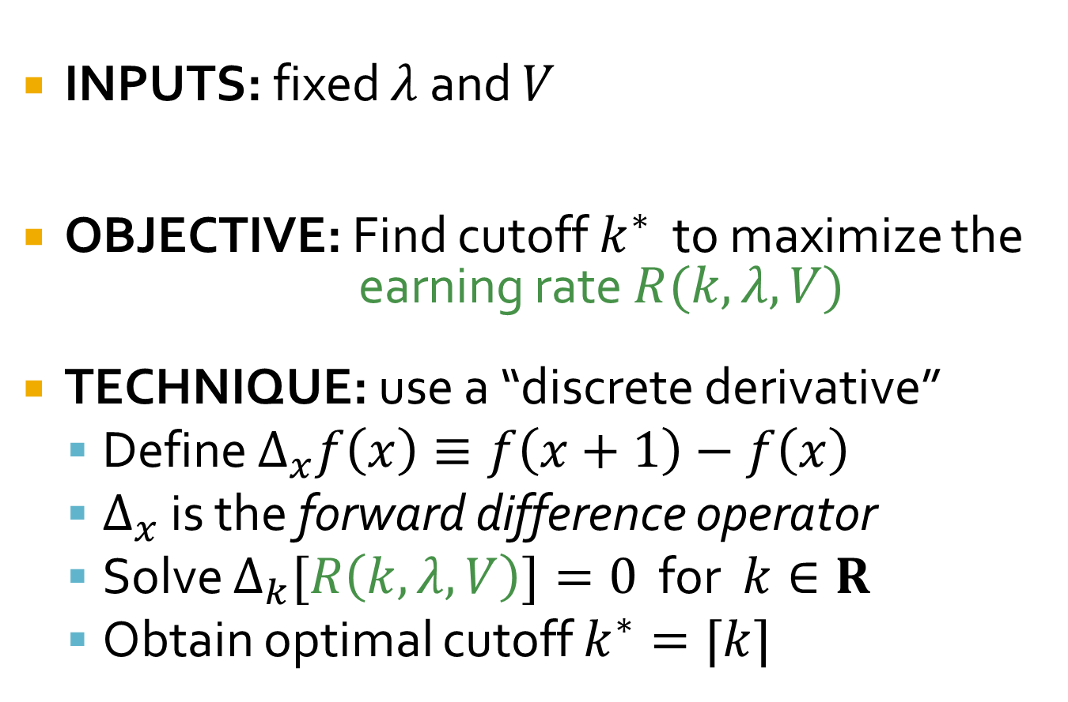
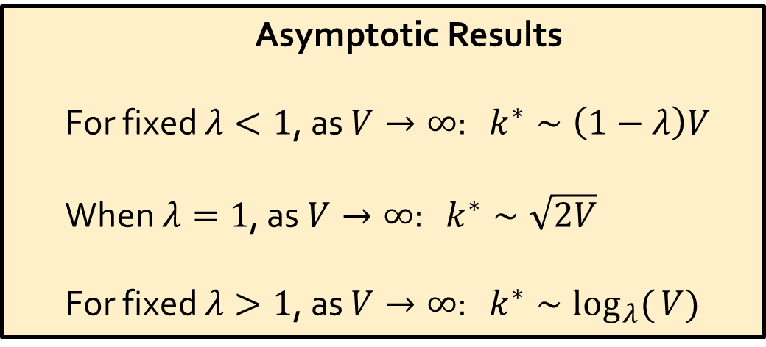





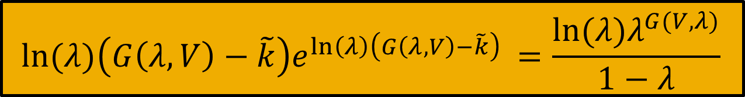






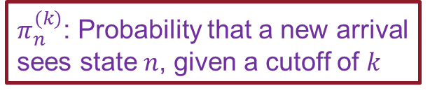
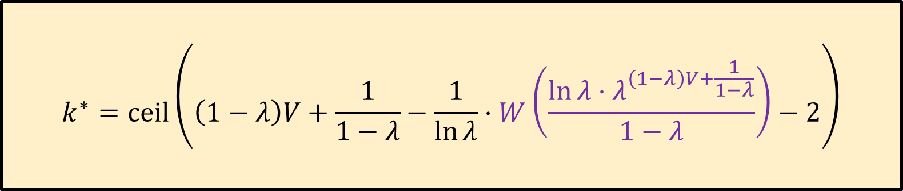


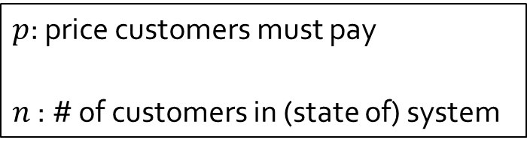


The Profit Maximizing Cutoff in Observable Queues with State Dependent Pricing
Christian Borgs (MSR-NE) Jennifer T. Chayes (MSR-NE) Sherwin Doroudi (CMU-Tepper) Mor Harchol-Balter (CMU-CS) Kuang Xu (MIT-LIDS)
Support provided by Microsoft Computational Thinking grant
1. Background & Motivation
4. Problem Statement & Approach
CHARGE ENTRY PRICE
INPUTS: fixed $λ$ and $V$
OBJECTIVE: Find cutoff $k^{∗}$ to maximize the
earning rate $R(k,λ, V)$
TECHNIQUE: use a “discrete derivative”
  Define $Δ_{x}f\left(x\right)≡f\left(x+1\right)−f\left(x\right)$
  $Δ_{x}$ is the forward difference operator
  Solve $Δ_{k}[R\left(k,λ,V\right)]=0$ for $k∈R$
  Obtain optimal cutoff $k^{∗}=⌈k⌉$
DELAY
SENSITIVE
CUSTOMERS
Hmm…
should
I join?
OBSERVABLE QUEUE
w/ LIMITED
BUDGET
CLOUD COMPUTING SERVICE
GOAL: Choose prices and admissions
policy to maximize profits
2. The Queueing Model
5. The Analysis
$M/M/1$ queue
All customers are identical with parameters:
Solve: $R\left(k+1,λ,V\right)−R\left(k,λ,V\right)=0$
Define: $\tilde{k}≡k+2$ and $G\left(λ,V\right)≡\left(1−λ\right)V+\frac{1}{1−λ}$
Question: How do we solve this for $\tilde{k}$?
Now solve: ${xe}^{x}=C$ for $x$
Answer: Lambert $W$ (product log) function
$$W\left(x\right)e^{W(x)}=x W\left(xe^{x}\right)=x$$
$$λ→$$
Call this
constant $C$
$$μ$$
WLOG
$$=1$$
$$ln⁡(λ)\left(G\left(λ,V\right)−\tilde{k}\right)e^{\ln\left(λ\right)\left(G\left(λ,V\right)−\tilde{k}\right) }=\frac{{ln⁡(λ)λ}^{G(V,λ)}}{1−λ}$$
$$V v$$
$$=1$$
Call both of
these $x$
Value for receiving service
Waiting cost per unit time
I wait only if:
$$(n+1)+p≤V$$
$p$: price customers must pay
$n$ : # of customers in (state of) system
Or equivalently
⬄
3. How to Price?
6. Conclusions
Charge as much as customers are willing to pay in each state: $p\left(n\right)= V−(n+1)$
$$k^{∗}=ceil\left(\left(1−λ\right)V+\frac{1}{1−λ}−\frac{1}{\ln{λ}}⋅W\left(\frac{\ln{λ}⋅λ^{\left(1−λ\right)V+\frac{1}{1−λ}}}{1−λ}\right)−2\right)$$
$$λ$$
$$1$$
$$λ$$
$$1$$
$$λ$$
$$1$$
$$λ$$
$$1$$
Cutoff at $k$
$$0$$
$$1$$
$$k−1$$
$$k$$
$$λ$$
$$1$$
$$V−1$
$$V−2$
$$V−k−2$
$$V−k−1$
So what can the closed form do for us?
But… we use an explicit early cutoff at state $k$.
Why?
Asymptotic Results
For fixed $λ<1$, as $V→∞$: $k^{∗}∼\left(1−λ\right)V$
When $λ=1$, as $V→∞$: $k^{∗}∼\sqrt{2V}$
For fixed $λ>1$, as $V→∞$: $k^{∗}∼\log_{λ}({V)}$
Answer: Cutoff ➔ shorter queue ➔ high prices more often
So how much do we make?
$$λ$$
$$1$$
$$λ$$
$$1$$
$$λ$$
$$1$$
$$λ$$
$$1$$
Probability:
$π_{0}^{(k)}$ $π_{1}^{(k)}$ $π_{k−1}^{(k)}$
Yes!
Price charged:
$$0$$
$$1$$
$$k−1$$
$$k$$
Is the cutoff of practical use?
$$V−1$
$$V−2$
$$V−k−2$
When $λ>1$: high cutoff ➔ huge losses!
Earning rate = (arrival rate) x (average price charged)
$$R\left(k,λ,V\right)=λ⋅\sum_{n=0}^{k−1}{\{π_{n}^{(k)}⋅p(n)\}}$$
$$k^{∗}=7$$
$$λ=1.2$$
$$V=50$$
$π_{n}^{(k)}$: Probability that a new arrival sees state $n$, given a cutoff of $k$
$$p\left(n\right)=V−(n+1)$$
Earning Rate
$$R(k,λ,V)=\left(\frac{λ}{1−λ^{k+1}}⋅\frac{1}{1−λ}\right)\left(\left(1−λ^{k}\right)\left(1−λ\right)V+λ^{k}\left(1+k−kλ\right)−1\right)$$
$$k$$

