Slide 1
Parallelism and the Memory Hierarchy Todd C. Mowry & Dave Eckhardt
Brief History of Parallel Processing
Impact of Parallelism on Memory Protection
Cache Coherence

Slide 2
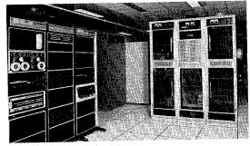

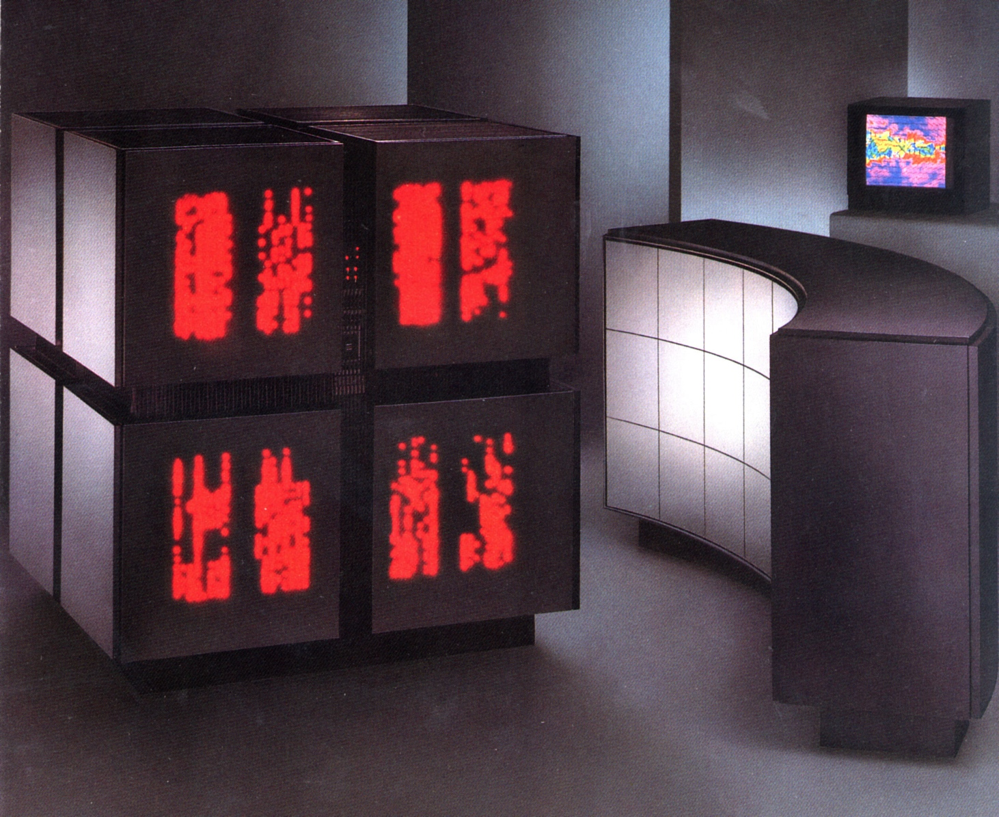
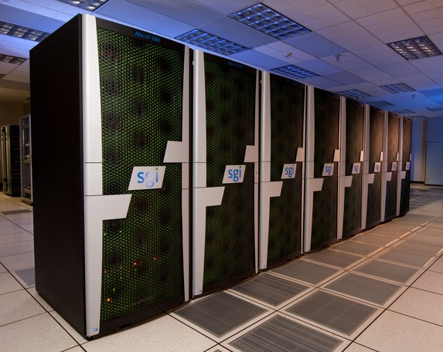
A Brief History of Parallel Processing
Initial Focus (starting in 1970’s): “Supercomputers” for Scientific Computing
C.mmp at CMU (1971)
16 PDP-11 processors
Cray XMP (circa 1984)
4 vector processors
Thinking Machines CM-2 (circa 1987)
65,536 1-bit processors +
2048 floating-point co-processors
Blacklight at the Pittsburgh Supercomputer Center
SGI UV 1000cc-NUMA (today)
4096 processor cores

Slide 3
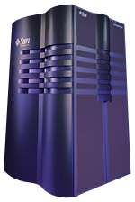
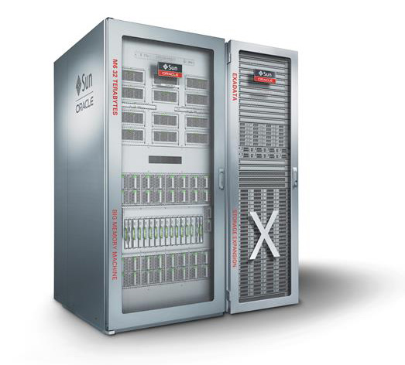
A Brief History of Parallel Processing
Initial Focus (starting in 1970’s): “Supercomputers” for Scientific Computing
Another Driving Application (starting in early 90’s): Databases
Sun Enterprise 10000 (circa 1997)
64 UltraSPARC-II processors
Oracle SuperCluster M6-32 (today)
32 SPARC M2 processors

Slide 4
A Brief History of Parallel Processing
Initial Focus (starting in 1970’s): “Supercomputers” for Scientific Computing
Another Driving Application (starting in early 90’s): Databases
Inflection point in 2004: Intel hits the Power Density Wall
Pat Gelsinger, ISSCC 2001

Slide 5
Impact of the Power Density Wall
The real “Moore’s Law” continues
i.e. # of transistors per chip continues to increase exponentially
But thermal limitations prevent us from scaling up clock rates
otherwise the chips would start to melt, given practical heat sink technology
How can we deliver more performance to individual applications?
increasing numbers of cores per chip
Caveat:
in order for a given application to run faster, it must exploit parallelism

Slide 6
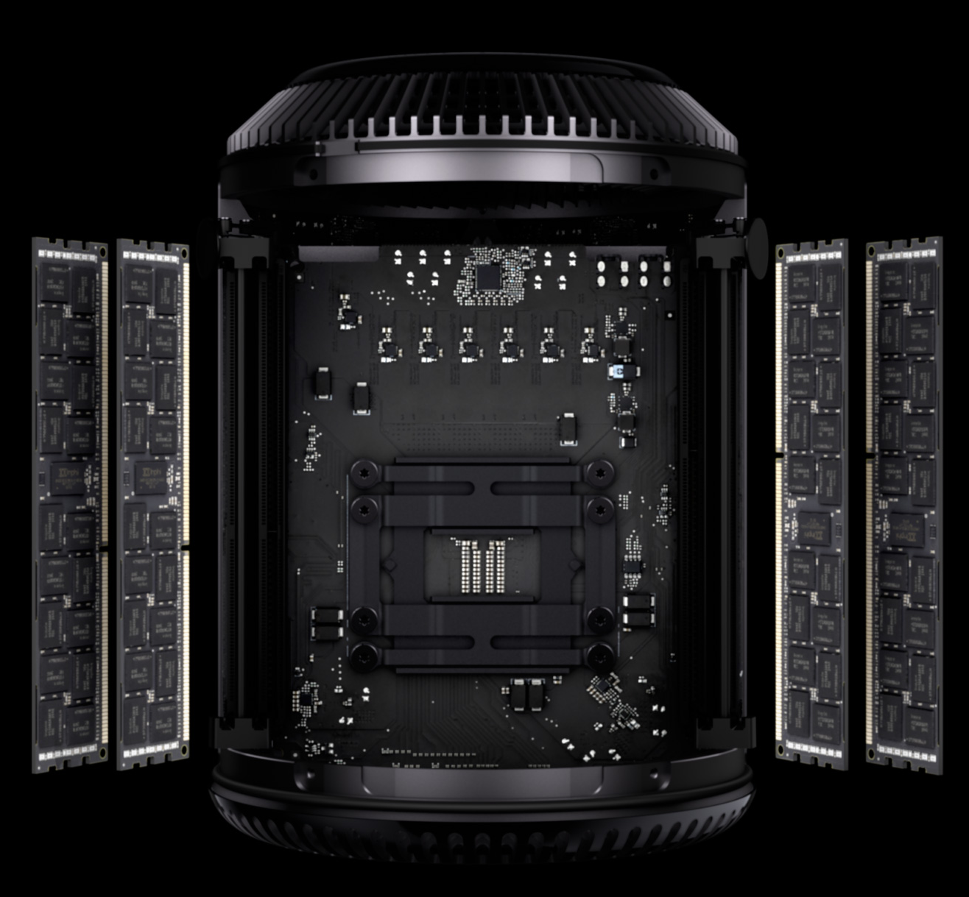




Parallel Machines Today
Examples from Apple’s product line:
iPad Air 2
3 A8X cores
iPhone 6
2 A8 cores
Mac Pro
12 Intel Xeon E5 cores
iMac
4 Intel Core i5 cores
MacBook Pro Retina 15”
4 Intel Core i7 cores
(Images from apple.com)

Slide 7
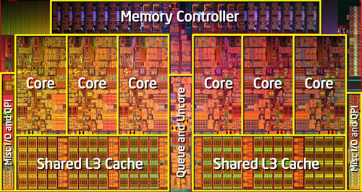
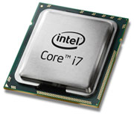
Example “Multicore” Processor: Intel Core i7
Intel Core i7-980X (6 cores)
Cores: six 3.33 GHz Nahelem processors (with 2-way “Hyper-Threading”)
Caches: 64KB L1 (private), 256KB L2 (private), 12MB L3 (shared)

Slide 8
Impact of Parallel Processing on the Kernel (vs. Other Layers)
System Layers
Kernel itself becomes a parallel program
avoid bottlenecks when accessing data structures
lock contention, communication, load balancing, etc.
use all of the standard parallel programming tricks
Thread scheduling gets more complicated
parallel programmers usually assume:
all threads running simultaneously
load balancing, avoiding synchronization problems
threads don’t move between processors
for optimizing communication and cache locality
Primitives for naming, communicating, and coordinating need to be fast
Shared Address Space: virtual memory management across threads
Message Passing: low-latency send/receive primitives
Programmer
Programming Language
Compiler
User-Level Run-Time SW
Kernel
Hardware

Slide 9
Case Study: Protection
One important role of the OS:
provide protection so that buggy processes don’t corrupt other processes
Shared Address Space:
access permissions for virtual memory pages
e.g., set pages to read-only during copy-on-write optimization
Message Passing:
ensure that target thread of send() message is a valid recipient

Slide 10
How Do We Propagate Changes to Access Permissions?
What if parallel machines (and VM management) simply looked like this:
(assume that this is a parallel program, deliberately sharing pages)
Updates to the page tables (in shared memory) could be read by other threads
But this would be a very slow machine!
Why?
…
CPU 0
CPU 1
CPU 2
CPU N
(No caches or TLBs.)
Set Read-Only
Memory
Page Table
Read-Write
Read-Only
f029
Read-Only
f835

Slide 11
VM Management in a Multicore Processor
TLB 0
TLB 1
TLB 2
TLB N
…
CPU 0
CPU 1
CPU 2
CPU N
L1 $
L1 $
L1 $
L1 $
L2 $
L2 $
L2 $
L2 $
Set Read-Only
L3 Cache
Memory
Page Table
Read-Write
Read-Only
f029
Read-Only
f835
“TLB Shootdown”:
relevant entries in the TLBs of other processor cores need to be flushed

Slide 12


TLB Shootdown (Example Design)
TLB 0
TLB 1
TLB 2
TLB N
…
CPU 0
CPU 1
CPU 2
CPU N
Lock PTE
Page Table
Read-Write
0 1 2 N
Read-Only
f029
Read-Only
f835
Initiating core triggers OS to lock the corresponding Page Table Entry (PTE)
OS generates a list of cores that may be using this PTE (erring conservatively)
Initiating core sends an Inter-Processor Interrupt (IPI) to those other cores
requesting that they invalidate their corresponding TLB entries
Initiating core invalidates local TLB entry; waits for acknowledgements
Other cores receive interrupts, execute interrupt handler which invalidates TLBs
send an acknowledgement back to the initiating core
Once initiating core receives all acknowledgements, it unlocks the PTE

Slide 13
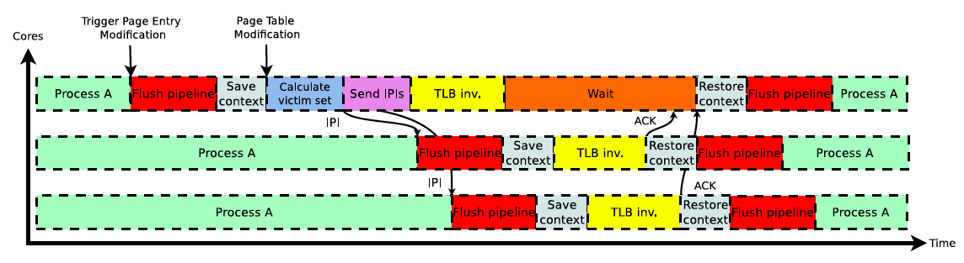
TLB Shootdown Timeline
Image from: Villavieja et al, “DiDi: Mitigating the Performance Impact of TLB Shootdowns Using a Shared TLB Directory.” In Proceedings of PACT 2011.

Slide 14
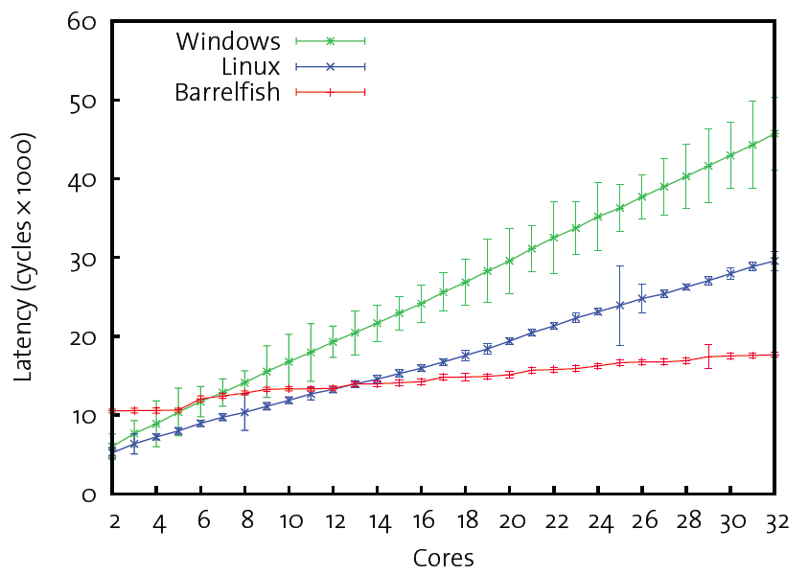
Performance of TLB Shootdown
Image from: Baumann et al,“The Multikernel: a New OS Architecture for Scalable Multicore Systems.” In Proceedings of SOSP ‘09.
Expensive operation
e.g., over 10,000 cycles on 8 or more cores
Gets more expensive with increasing numbers of cores

Slide 15
Now Let’s Consider Consistency Issues with the Caches
TLB 0
TLB 1
TLB 2
TLB N
…
CPU 0
CPU 1
CPU 2
CPU N
L1 $
L1 $
L1 $
L1 $
L2 $
L2 $
L2 $
L2 $
L3 Cache
Memory

Slide 16
Caches in a Single-Processor Machine (Review from 213)
Ideally, memory would be arbitrarily fast, large, and cheap
unfortunately, you can’t have all three (e.g., fast → small, large → slow)
cache hierarchies are a hybrid approach
if all goes well, they will behave as though they are both fast and large
Cache hierarchies work due to locality
temporal locality → even relatively small caches may have high hit rates
spatial locality → move data in blocks (e.g., 64 bytes)
Locating the data:
Main memory: directly (geographically) addressed
we know exactly where to look:
at the unique location corresponding to the address
Cache: may or may not be somewhere in the cache
need tags to identify the data
may need to check multiple locations, depending on the degree of associativity

Slide 17
Cache Read
Locate set
Check if any line in set has matching tag
Yes + line valid: hit
Locate data starting at offset
E = 2e lines per set
Address of word:
t bits
s bits
b bits
S = 2^{s} sets
tag
set
index
block
offset
data begins at this offset
v
tag
0
1
2
B-1
valid bit
B = 2^{b} bytes per cache block (the data)

Slide 18
Intel Quad Core i7 Cache Hierarchy
Processor package
Core 0
Core 3
Regs
Regs
L1 I-cache and D-cache:
32 KB, 8-way,
Access: 4 cycles
L2 unified cache:
256 KB, 8-way,
Access: 11 cycles
L3 unified cache:
8 MB, 16-way,
Access: 30-40 cycles
Block size: 64 bytes for all caches.
L1
D-cache
L1
I-cache
L1
D-cache
L1
I-cache
…
L2 unified cache
L2 unified cache
L3 unified cache
(shared by all cores)
Main memory

Slide 19
Simple Multicore Example: Core 0 Loads X
load r1 ← X
(r1 = 17)
Core 0
Core 3
L1-D
L1-D
(1) Miss
X
17
…
L2
L2
X
17
(2) Miss
L3
X
17
(3) Miss
Main memory
X: 17
(4) Retrieve from memory, fill caches

Slide 20
Example Continued: Core 3 Also Does a Load of X
load r2 ← X
(r2 = 17)
Core 0
Core 3
Example of constructive sharing:
Core 3 benefited from Core 0 bringing X into the L3 cache
L1-D
L1-D
X
17
(1) Miss
X
17
…
L2
L2
X
17
(2) Miss
X
17
Fairly straightforward with only loads. But what happens when stores occur?
L3
X
17
(3) Hit! (fill L2 & L1)
Main memory
X: 17

Slide 21
Review: How Are Stores Handled in Uniprocessor Caches?
store 5 → X
L1-D
X
17
17 → 5
L2
X
17
What happens here?
L3
We need to make sure we don’t have a consistency problem
X
17
Main memory
X: 17

Slide 22
Options for Handling Stores in Uniprocessor Caches
Option 1: Write-Through Caches
→ propagate “immediately”
store 5 → X
L1-D
What are the advantages and disadvantages
of this approach?
X
17
17 → 5
(1)
L2
X
17
17 → 5
(2)
L3
X
17 → 5
17
(3)
Main memory
17 → 5
X: 17

Slide 23
Options for Handling Stores in Uniprocessor Caches
Option 1: Write-Through Caches
Option 2: Write-Back Caches
propagate immediately
defer propagation until eviction
keep track of dirty status in tags
store 5 → X
(Analogous to
PTE dirty bit.)
L1-D
L1-D
X
17
17 → 5
X
17
17 → 5
Dirty
Upon eviction,
if data is dirty, write it back.
Write-back is more commonly used in practice (due to bandwidth limitations)
L2
L2
X
17
X
17
17 → 5
L3
L3
X
17 → 5
X
17
17
Main memory
Main memory
17 → 5
X: 17
X: 17

Slide 24
Resuming Multicore Example
1. store 5 → X
2. load r2 ← X
(r2 = 17) Hmm…
Core 0
Core 3
L1-D
L1-D
What is supposed to happen in this case?
Is it incorrect behavior for r2 to equal 17?
if not, when would it be?
(Note: core-to-core communication often takes tens of cycles.)
X
17
Hit!
17 → 5
Dirty
…
X
17
L2
L2
X
17
X
17
L3
X
17
Main memory
X: 17

Slide 25
What is Correct Behavior for a Parallel Memory Hierarchy?
Note: side-effects of writes are only observable when reads occur
so we will focus on the values returned by reads
Intuitive answer:
reading a location should return the latest value written (by any thread)
Hmm… what does “latest” mean exactly?
within a thread, it can be defined by program order
but what about across threads?
the most recent write in physical time?
hopefully not, because there is no way that the hardware can pull that off
e.g., if it takes >10 cycles to communicate between processors, there is no way that processor 0 can know what processor 1 did 2 clock ticks ago
most recent based upon something else?
Hmm…

Slide 26
Refining Our Intuition
Thread 0
Thread 1
Thread 2
// write evens to X
for (i=0; i<N; i+=2) {
X = i;
…
}
// write odds to X
for (j=1; j<N; j+=2) {
X = j;
…
}
…
A = X;
…
B = X;
…
C = X;
…
(Assume: X=0 initially, and these are the only writes to X.)
What would be some clearly illegal combinations of (A,B,C)?
How about:
What can we generalize from this?
writes from any particular thread must be consistent with program order
in this example, observed even numbers must be increasing (ditto for odds)
across threads: writes must be consistent with a valid interleaving of threads
not physical time! (programmer cannot rely upon that)
(4,8,1)?
(9,12,3)?
(7,19,31)?

Slide 27
Visualizing Our Intuition
Thread 0
Thread 1
Thread 2
// write evens to X
for (i=0; i<N; i+=2) {
X = i;
…
}
// write odds to X
for (j=1; j<N; j+=2) {
X = j;
…
}
…
A = X;
…
B = X;
…
C = X;
…
CPU 0
CPU 1
CPU 2
Single port to memory
Memory
Each thread proceeds in program order
Memory accesses interleaved (one at a time) to a single-ported memory
rate of progress of each thread is unpredictable

Slide 28
Correctness Revisited
Thread 0
Thread 1
Thread 2
// write evens to X
for (i=0; i<N; i+=2) {
X = i;
…
}
// write odds to X
for (j=1; j<N; j+=2) {
X = j;
…
}
…
A = X;
…
B = X;
…
C = X;
…
CPU 0
CPU 1
CPU 2
Single port to memory
Memory
Recall: “reading a location should return the latest value written (by any thread)”
“latest” means consistent with some interleaving that matches this model
this is a hypothetical interleaving; the machine didn’t necessary do this!

Slide 29
Two Parts to Memory Hierarchy Correctness
“Cache Coherence”
do all loads and stores to a given cache block behave correctly?
i.e. are they consistent with our interleaving intuition?
important: separate cache blocks have independent, unrelated interleavings!
“Memory Consistency Model”
do all loads and stores, even to separate cache blocks, behave correctly?
builds on top of cache coherence
especially important for synchronization, causality assumptions, etc.

Slide 30
Cache Coherence (Easy Case)
One easy case: a physically shared cache
Intel Core i7
Core 0
Core 3
L1-D
L1-D
…
L2
L2
L3
X
17
L3 cache is physically shared by on-chip cores

Slide 31
Cache Coherence (Easy Case)
One easy case: a physically shared cache
Thread 0
Thread 1
2-way Hyperthreading
Intel Core i7
Core 0
L1-D
…
L2
L1 cache (plus L2, L3) is physically shared by Thread 0 and Thread 1

Slide 32
Cache Coherence: Beyond the Easy Case
How do we implement L1 & L2 cache coherence between the cores?
Common approaches: update or invalidate protocols
store 5 → X
Core 0
Core 3
L1-D
L1-D
X
17
???
X
17
L2
…
L2
X
17
X
17
L3
X
17

Slide 33
One Approach: Update Protocol
Basic idea: upon a write, propagate new value to shared copies in peer caches
store 5 → X
Core 0
Core 3
L1-D
L1-D
X
17
17 → 5
X
17
X = 5
17 → 5
update
L2
…
L2
X
17 → 5
17
X
17
17 → 5
L3
X
17
17 → 5

Slide 34
Another Approach: Invalidate Protocol
Basic idea: to perform a write, first delete any shared copies in peer caches
store 5 → X
Core 0
Core 3
L1-D
L1-D
X
17
17 → 5
X
X
17
Delete X
17
Invalid
invalidate
L2
…
L2
X
17 → 5
17
X
X
17
17
Invalid
L3
X
17
17 → 5

Slide 35
Update vs. Invalidate
When is one approach better than the other?
(hint: the answer depends upon program behavior)
Key question:
Is a block written by one processor read by others before it is rewritten?
if so, then update may win:
readers that already had copies will not suffer cache misses
if not, then invalidate wins:
avoids useless updates (including to dead copies)
Which one is used in practice?
invalidate (due to hardware complexities of update)
although some machines have supported both (configurable per-page by the OS)

Slide 36

How Invalidation-Based Cache Coherence Works (Short Version)
Cache tags contain additional coherence state (“MESI” example below):
Invalid:
nothing here (often as the result of receiving an invalidation message)
Shared (Clean):
matches the value in memory; other processors may have shared copies also
I can read this, but cannot write it until I get an exclusive/modified copy
Exclusive (Clean):
matches the value in memory; I have the only copy
I can read or write this (a write causes a transition to the Modified state)
Modified (aka Dirty):
has been modified, and does not match memory; I have the only copy
I can read or write this; I must supply the block if another processor wants to read
The hardware keeps track of this automatically
using either broadcast (if interconnect is a bus) or a directory of sharers
(Not “Messi”)

Slide 37
Performance Impact of Invalidation-Based Cache Coherence
Invalidations result in a new source of cache misses!
Recall that uniprocessor cache misses can be categorized as:
(i) cold/compulsory misses, (ii) capacity misses, (iii) conflict misses
Due to the sharing of data, parallel machines also have misses due to:
(iv) true sharing misses
e.g., Core A reads X → Core B writes X → Core A reads X again (cache miss)
nothing surprising here; this is true communication
(v) false sharing misses
e.g., Core A reads X → Core B writes Y → Core A reads X again (cache miss)
What???
where X and Y unfortunately fell within the same cache block

Slide 38
Beware of False Sharing!
Thread 0
Thread 1
while (TRUE) {
X += …
…
}
X
…
Y
…
while (TRUE) {
Y += …
…
}
1 block
Core 0
invalidations,
cache misses
Core 1
L1-D
L1-D
X
…
Y
…
X
…
Y
…
It can result in a devastating ping-pong effect with a very high miss rate
plus wasted communication bandwidth
Pay attention to data layout:
the threads above appear to be working independently, but they are not

Slide 39
How False Sharing Might Occur in the OS
Operating systems contain lots of counters (to count various types of events)
many of these counters are frequently updated, but infrequently read
Simplest implementation: a centralized counter
Perfectly reasonable on a sequential machine.
But it performs very poorly on a parallel machine. Why?
each update of get_tid_ctr invalidates it from other processor’s caches
// Number of calls to get_tid
int gettid_ctr = 0;
int gettid(void) {
atomic_add(&gettid_ctr,1);
return (running->tid);
}
int get_gettid_events(void) {
return (gettid_ctr);
}

Slide 40
“Improved” Implementation: An Array of Counters
Each processor updates its own counter
To read the overall count, sum up the counter array
Eliminates lock contention, but may still perform very poorly. Why?
False sharing!
int gettid_ctr[NUM_CPUs]= {0};
int gettid(void) {
// exact coherence not required
gettid_ctr[running->CPU]++;
return (running->tid);
}
int get_gettid_events(void) {
int cpu, total = 0;
for (cpu = 0; CPU < NUM_CPUs; cpu++)
total += gettid_ctr[cpu];
return (total);
}
No longer need a
lock around this.

Slide 41
Faster Implementation: Padded Array of Counters
Put each private counter in its own cache block.
(any downsides to this?)
Even better:
replace PADDING
with other useful
per-CPU counters.
struct {
int get_tid_ctr;
int PADDING[INTS_PER_CACHE_BLOCK-1];
} ctr_array[NUM_CPUs];
int get_tid(void) {
ctr_array[running->CPU].get_tid_ctr++;
return (running->tid);
}
int get_tid_count(void) {
int cpu, total = 0;
for (cpu = 0; CPU < NUM_CPUs; cpu++)
total += ctr_array[cpu].get_tid_ctr;
return (total);
}

Slide 42
Parallel Counter Implementation Summary
Centralized:
Simple Array:
…
…
CPU 0
CPU 1
CPU 2
CPU 3
CPU 0
CPU 1
CPU 2
CPU 3
Mutex
contention?
…
False
sharing?
Cache Block
Padded Array:
Clustered Array:
…
…
CPU 0
CPU 1
CPU 2
CPU 3
CPU 0
CPU 1
CPU 2
CPU 3
…
…
Cache Block
Cache Block
Cache Block
Cache Block
Cache Block
Cache Block
Wasted space?
(If there are multiple counters to pack together.)

Slide 43
True Sharing Can Benefit from Spatial Locality
Thread 0
Thread 1
X = …
Y = …
…
…
X
…
Y
…
…
…
r1 = X;
r2 = Y;
1 block
Cache Miss
Cache Hit!
Core 0
Core 1
both X and Y
sent in 1 miss
L1-D
L1-D
X
…
Y
…
X
…
Y
…
With true sharing, spatial locality can result in a prefetching benefit
Hence data layout can help or harm sharing-related misses in parallel software

Slide 44
Options for Building Even Larger Shared Address Machines
Symmetric Multiprocessor (SMP):
…
CPU 0
CPU 1
CPU N
Interconnection Network
…
Memory 0
Memory 1
Memory N
Non-Uniform Memory Access (NUMA):
…
CPU 0
Memory 0
CPU 1
Memory 1
CPU N
Memory N
Interconnection Network
Tradeoffs?
NUMA is more commonly used at large scales (e.g., Blacklight at the PSC)

Slide 45
Summary
Case study: memory protection on a parallel machine
TLB shootdown
involves Inter-Processor Interrupts to flush TLBs
Part 1 of Memory Correctness: Cache Coherence
reading “latest” value does not correspond to physical time!
corresponds to latest in hypothetical interleaving of accesses
new sources of cache misses due to invalidations:
true sharing misses
false sharing misses
Looking ahead: Part 2 of Memory Correctness, plus Scheduling Revisited

Slide 46
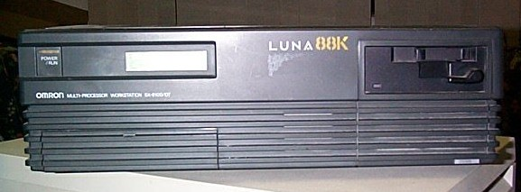
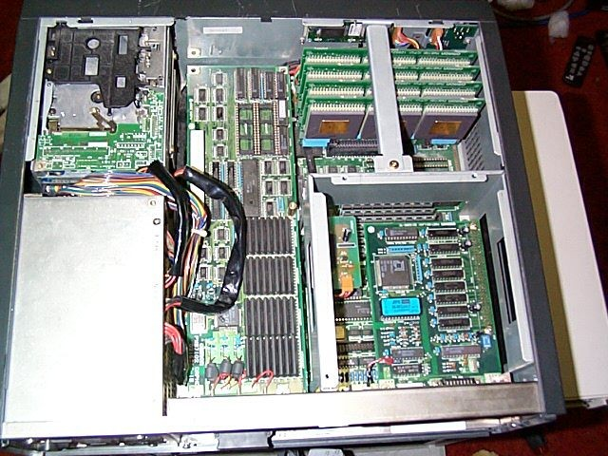
Omron Luna88k Workstation
Jan 1 00:28:40 luna88k vmunix: CPU0 is attached
Jan 1 00:28:40 luna88k vmunix: CPU1 is attached
Jan 1 00:28:40 luna88k vmunix: CPU2 is attached
Jan 1 00:28:40 luna88k vmunix: CPU3 is attached
Jan 1 00:28:40 luna88k vmunix: LUNA boot: memory from 0x14a000 to 0x2000000
Jan 1 00:28:40 luna88k vmunix: Kernel virtual space from 0x00000000 to 0x79ec000.
Jan 1 00:28:40 luna88k vmunix: OMRON LUNA-88K Mach 2.5 Vers 1.12 Thu Feb 28 09:32 1991 (GENERIC)
Jan 1 00:28:40 luna88k vmunix: physical memory = 32.00 megabytes.
Jan 1 00:28:40 luna88k vmunix: available memory = 26.04 megabytes.
Jan 1 00:28:40 luna88k vmunix: using 819 buffers containing 3.19 megabytes of memory
Jan 1 00:28:40 luna88k vmunix: CPU0 is configured as the master and started.
From circa 1991: ran a parallel Mach kernel (on the desks of lucky CMU CS Ph.D. students) four years before the Pentium/Windows 95 era began.

