Slide 1
15-213/513 and 14-513 Midterm
Review Session
Your TAs
Thursday, October 8th

Slide 2
Midterm Exam Logistics
Tuesday, October 20, 12:30-1:50PM
Location
  GHC 4401 (CSD)
  CIC 1201 (INI)
Physical Cheat Sheets - 1 page, double-sided
  No previous exam questions
  You should put your andrew ID on your cheat sheet, and you will be submitting this with your exam
Bring your IDs and a blue/black pen to the exam!

Slide 3
Overview of Exam Topics
Low-level C (structs, alignment)
Bits, Bytes, Ints (datalab)
Assembly (bomblab)
Stacks, Memory Layout (attacklab)
Linking
Caches (cachelab)
Virtual Memory

Slide 4
Structs/Alignment

Slide 5
Alignment Rules
Primitive Types
  char: 1-byte aligned
  short: 2-byte aligned
  int: 4-byte aligned
  long/pointer-type: 8-byte aligned
Structs: alignment of largest element in struct.
Arrays: alignment of base type.

Slide 6
Problem Solving Strategies
Place elements in the struct top-to-bottom, ensuring alignment for each.
Figure out any nested structs first.
Draw out a diagram with N rows and 8 columns!

Slide 7
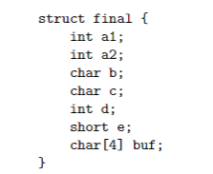
Example: Struct
How would the following struct be represented in memory?

Slide 8
Example: Struct
a1,a2 are ints - 4 bytes each
a1 | a1 | a1 | a1 | a2 | a2 | a2 | a2

Slide 9
Example: Struct
b,c are 1 btye each and have no alignment requirements
a1 | a1 | a1 | a1 | a2 | a2 | a2 | a2
b | c

Slide 10
Example: Struct
d is 4 bytes and must be 4 byte aligned. What is our current alignment status?
8+1+1 = 10 => Need padding!
a1 | a1 | a1 | a1 | a2 | a2 | a2 | a2
b | c | - | - | d | d | d | d

Slide 11
Example: Struct
e is 2 bytes and must be 2 byte aligned. What is our current alignment status?
10+1+1+4 = 16 => Already satisfied!
a1 | a1 | a1 | a1 | a2 | a2 | a2 | a2
b | c | - | - | d | d | d | d
e | e

Slide 12
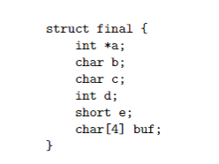
Example: Struct
Now we have a constant length array - what is the alignment policy?
Takes alignment of primitive type!
a1 | a1 | a1 | a1 | a2 | a2 | a2 | a2
b | c | - | - | d | d | d | d
e | e | buf | buf | buf | buf | - | -

Slide 13

Example: Nested Struct
How would the following struct (final_nested) be represented in memory?

Slide 14
Example: Nested Struct
Remember: Structs take the highest alignment requirement of its fields!
What is the alignment of struct final?
Alignment of struct final is 4
  int is the largest type
x | x | x | x | a1 | a1 | a1 | a1
a2 | a2 | a2 | a2 | b | c | - | -
d | d | d | d | e | e | buf | buf
buf | buf

Slide 15
Example: Nested Struct
Finally, we have a long, which has alignment of 8 bytes
  arrays are aligned to the element type
x | x | x | x | a1 | a1 | a1 | a1
a2 | a2 | a2 | a2 | b | c | - | -
d | d | d | d | e | e | buf | buf
buf | buf | - | - | - | - | - | -
y | y | y | y | y | y | y | y

Slide 16
Minimizing Struct Size
How to minimize padding/struct length with element ordering?
Order elements from largest to smallest!
https://nirpechuk.github.io/structs/

Slide 17
Assembly

Slide 18
Assembly
Typical questions asked
  Given a function, look at assembly to fill in missing portions
  Given assembly of a function, intuit the behavior of the program
  (More rare) Compare different chunks of assembly, which one implements the function given?
Important things to remember/put on your cheat sheet:
  Memory Access formula: D(Rb,Ri,S)
  Distinguish between mov/lea instructions
  Callee/Caller save regs
  Condition codes and corresponding eflags

Slide 19
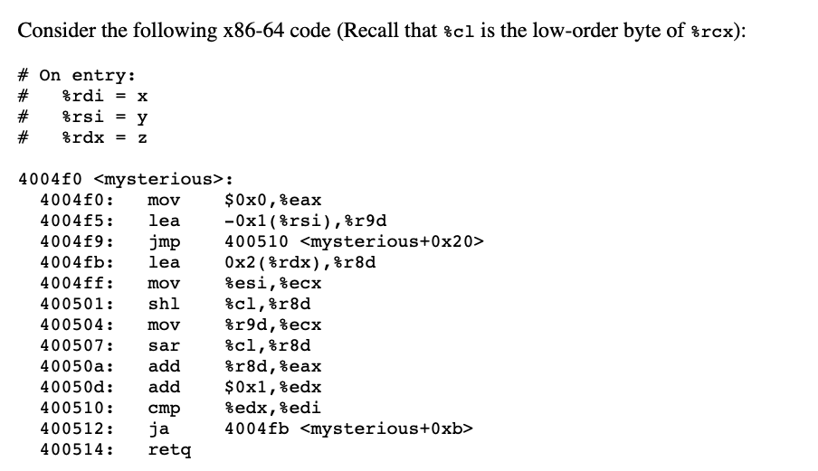
Assembly
Katherine TODO: pick one

Slide 20
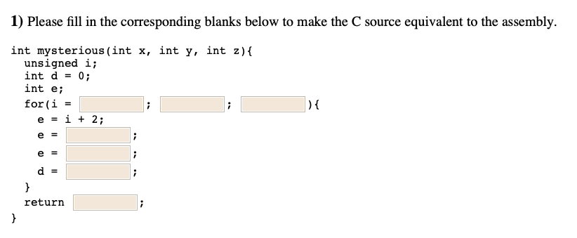
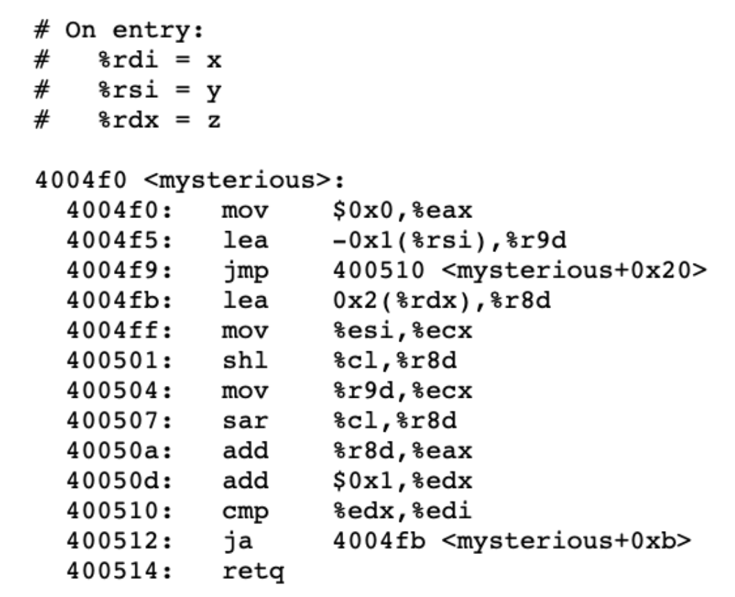
Assembly
z

Slide 21
Assembly
z
e = %r8d

Slide 22
Assembly
z
We know that e = %r8d...

Slide 23

Assembly
z
e << y
Where did %cl come from?

Slide 24
Assembly
z
e << y
Again, e = %r8d...

Slide 25
Assembly
z
e << y
e >> (y - 1)

Slide 26
Assembly
z
e << y
e >> (y - 1)
What’s left?

Slide 27
Assembly
z
e << y
e >> (y - 1)
e + d

Slide 28
Assembly
z
i++
e << y
e >> (y - 1)
e + d
Loop end: add 1, compare, iterate

Slide 29
Assembly
z
x > i
i++
e << y
e >> (y - 1)
e + d
cmp %edx, %edi => (edi - edx > 0), same as x > i

Slide 30
Assembly
z
x > i
i++
e << y
e >> (y - 1)
e + d

Slide 31
Assembly
z
x > i
i++
e << y
e >> (y - 1)
e + d
d

Slide 32
Assembly
z
x > i
i++
e << y
e >> (y - 1)
e + d
d

Slide 33
Assembly
Wrap-Up
  Put assembly commands on your cheat sheet!
  Put register bit-widths on your cheat sheet!
Make sure you understand the practice exam question and how each phase of bomblab works

Slide 34
Memory Layout - Arrays

Slide 35

Arrays
IMPORTANT POINTS + TIPS:
Remember your indexing rules! They’ll take you 95% of the way there.
Be careful about addressing (&) vs. dereferencing (*)
You may be asked to look at assembly!

Slide 36
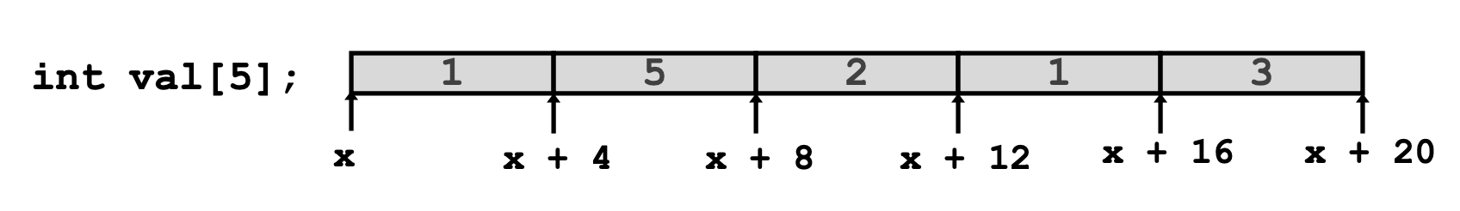
Arrays
Good toy examples:
A can be used as the pointer to the first array element: A[0]
Type Value
val
val[2]
*(val + 2)
&val[2]
val + 2
val + i

Slide 37
Arrays
Good toy examples:
A can be used as the pointer to the first array element: A[0]
Type Value
val int * x
val[2]
*(val + 2)
&val[2]
val + 2
val + i

Slide 38
Arrays
Good toy examples:
A can be used as the pointer to the first array element: A[0]
Type Value
val int * x
val[2] int 2
*(val + 2)
&val[2]
val + 2
val + i

Slide 39
Arrays
Good toy examples:
A can be used as the pointer to the first array element: A[0]
Type Value
val int * x
val[2] int 2
*(val + 2) int 2
&val[2]
val + 2
val + i

Slide 40
Arrays
Good toy examples:
A can be used as the pointer to the first array element: A[0]
Type Value
val int * x
val[2] int 2
*(val + 2) int 2
&val[2] int * x + 8
val + 2
val + i

Slide 41
Arrays
Good toy examples:
A can be used as the pointer to the first array element: A[0]
Type Value
val int * x
val[2] int 2
*(val + 2) int 2
&val[2] int * x + 8
val + 2 int * x + 8
val + i

Slide 42
Arrays
Good toy examples:
A can be used as the pointer to the first array element: A[0]
Type Value
val int * x
val[2] int 2
*(val + 2) int 2
&val[2] int * x + 8
val + 2 int * x + 8
val + i int * x + (4 * i)

Slide 43
Arrays
Good toy examples:
A can be used as the pointer to the first array element: A[0]
Type Value
val int * x
val[2] int 2
*(val + 2) int 2
&val[2] int * x + 8
val + 2 int * x + 8
val + i int * x + (4 * i)
Accessing methods:
val[index]
*(val + index)

Slide 44
Arrays
Good toy examples:
A can be used as the pointer to the first array element: A[0]
Accessing methods:
val[index]
*(val + index)
Type Value
val int * x
val[2] int 2
*(val + 2) int 2
&val[2] int * x + 8
val + 2 int * x + 8
val + i int * x + (4 * i)
Addressing methods:
&val[index]
val + index

Slide 45
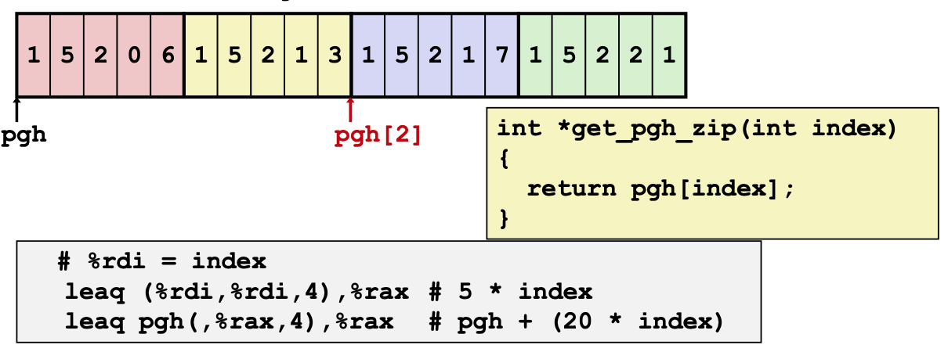
Arrays
Sample assembly-type questions

Slide 46
Caches

Slide 47
Caches - Quick Review
Direct Mapped vs. N-way associative vs. fully associative
  What do these mean and how might they have an advantage over the other?
Eviction Policy
  The main one we covered was LRU (least recently used)

Slide 48
Cache
Suppose you have a 2-way associative cache with 4 sets and 64 byte blocks.
What would the address decomposition look like?
… 0 0 0 0 0 0 0 0 0 0 0 0

Slide 49
Cache
Suppose you have a 2-way associative cache with 4 sets and 64 byte blocks.
What would the address decomposition look like?
  4 sets = 2^2 sets => 2 set bits
  64 byte blocks => 2^6 byte blocks => 6 block offset bits
  Remainder is tag!
… 0 0 0 0 0 0 0 0 0 0 0 0

Slide 50
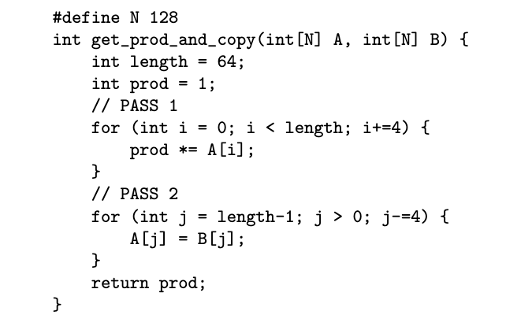
Cache
Suppose you have a 2-way associative cache with 4 sets and 64 byte blocks. Assume A and B are cache-aligned.
  What is the miss rate of pass 1 and pass 2?

Slide 51
Cache - Pass 1
We have 64 byte blocks, indicating a cache line holds 16 ints
We iterate through 64 elements with stride 4
  16 iterations total
How many iterations access the same cache line?
  4 iterations covers 16 elements = one block

Slide 52
Cache - Pass 1
Then what is our miss rate?
4 iterations cover one cache line, meaning the first is a cold miss, then the next 3 are hits!
This pattern repeats across all batches of iterations, giving us a miss rate of 1/4

Slide 53
Cache - Pass 2
Once again we iterate through 64 elements with stride 4
  16 iterations total
Remember our cache does not reset before pass 1 and pass 2. What is the state of our cache before pass 2?

Slide 54
Cache 2 - Pass 2
We had 4 cache line accesses from the 4 batches of iterations from pass 1. Remember each set has 2 lines and we have 4 sets.
Set 0
A[0-15]
-
Set 1
A[16-31]
-
Set 2
A[32-47]
-
Set 3
A[48-63]
-
Do we need to evict from the cache during pass 2?

Slide 55
Cache 2 - Pass 2
No, we do not need to evict!
  We access 4 memory blocks of B in pass 2, and since there are 2 lines per set, we do not need to evict
Set 0
A[0-15]
B[0-15]
Set 1
A[16-31]
B[16-31]
Set 2
A[32-47]
B[32-47]
Set 3
A[48-63]
B[48-63]
Yay! Our cache was the same size as our working set.

Slide 56
Cache 2 - Pass 2
Now what is our miss rate?
Per batch of iterations, we have 4 hits to A, 1 cold miss to B, and 3 following hits to B.
This yields a miss rate of 1/8

Slide 57
Virtual Memory

Slide 58
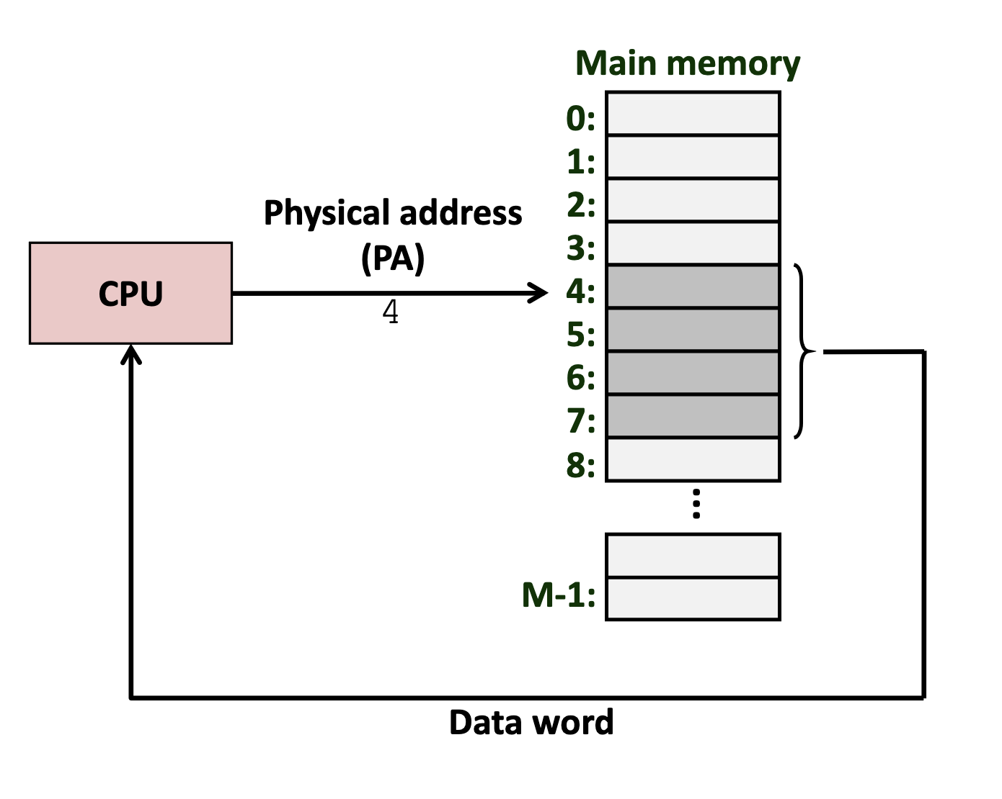
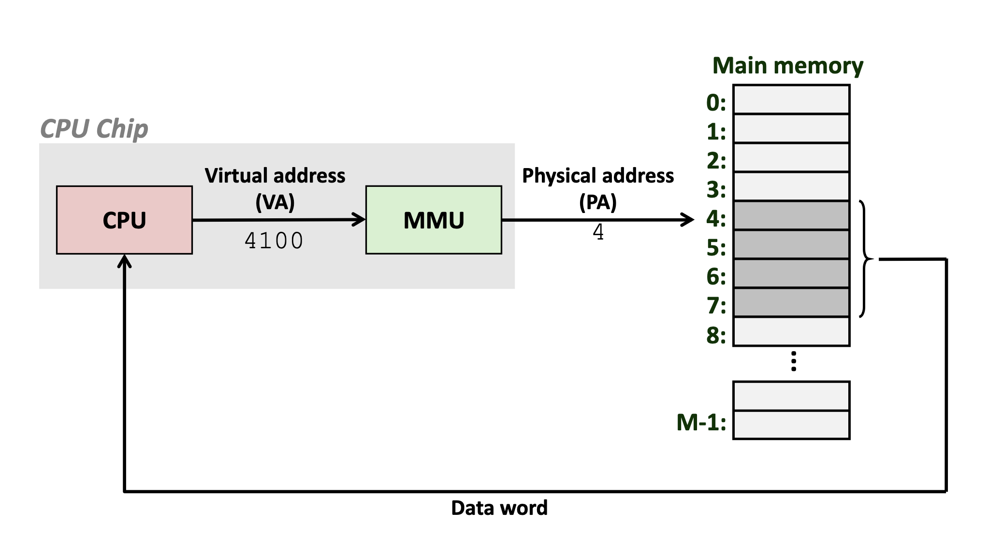
Virtual Memory - Review
Physical Addressing
Virtual Addressing
Memory address refers to an exact location in memory—only used in simple systems
Memory address refers to a process-specific address, mapped to physical memory via the hardware memory management unit.
One of the Great Ideas Of Computer Science™
Notes:
Quick review from lecture, don’t spend too much time on this

Slide 59
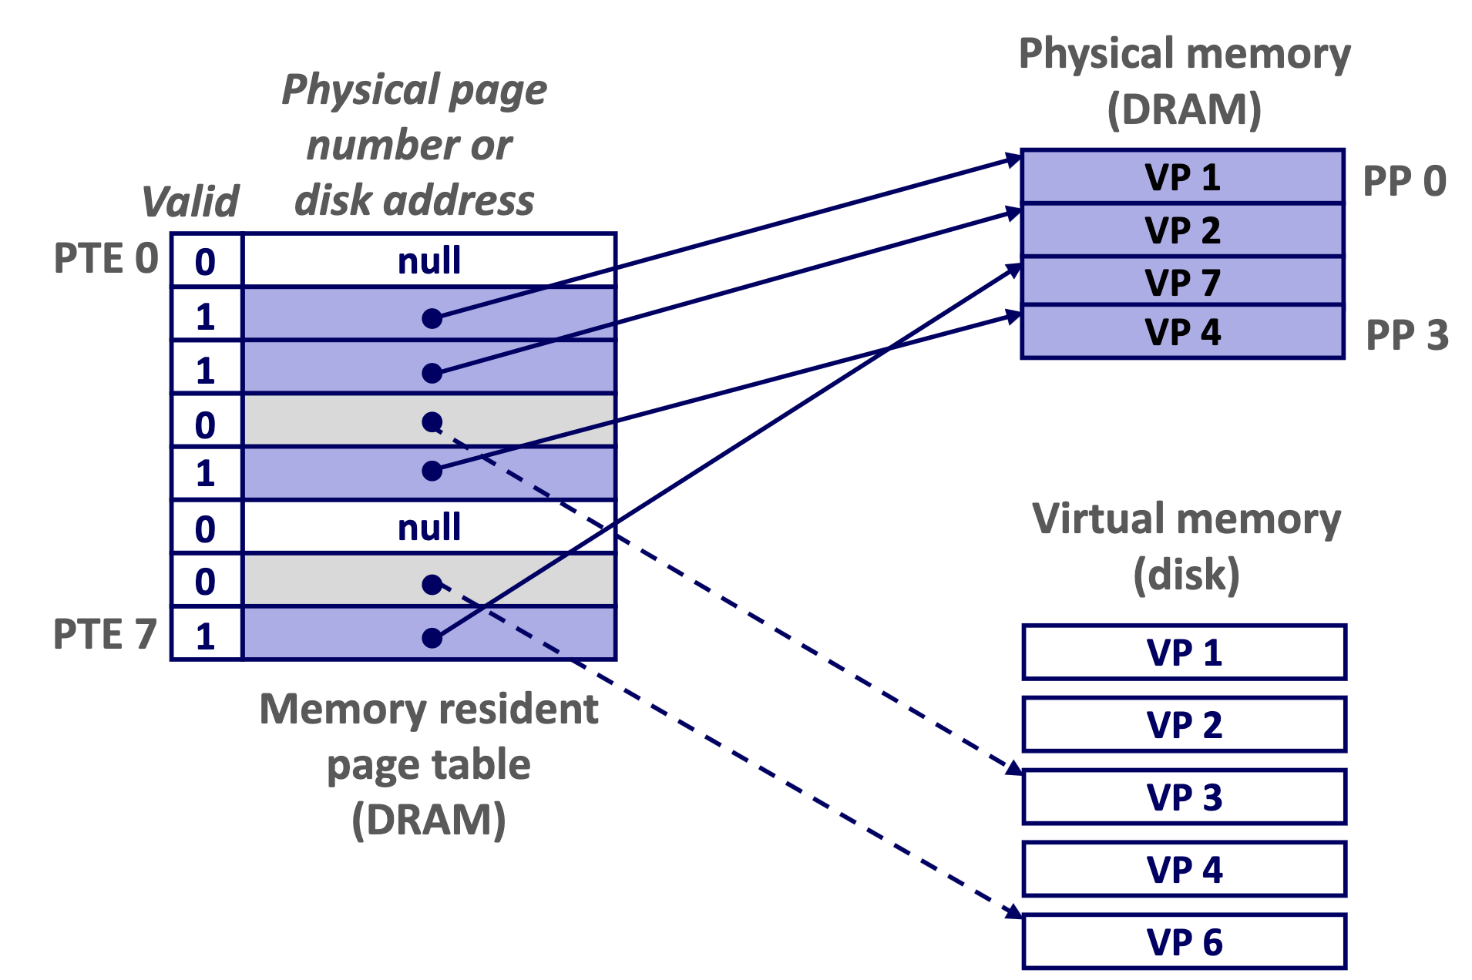
Virtual Memory - Page Table
Virtual addresses are mapped to physical addresses in the page table. Each entry is called a page table entry.
A page fault raises an exception, which causes the OS to fetch the page from disk and evict a page from DRAM.

Slide 60
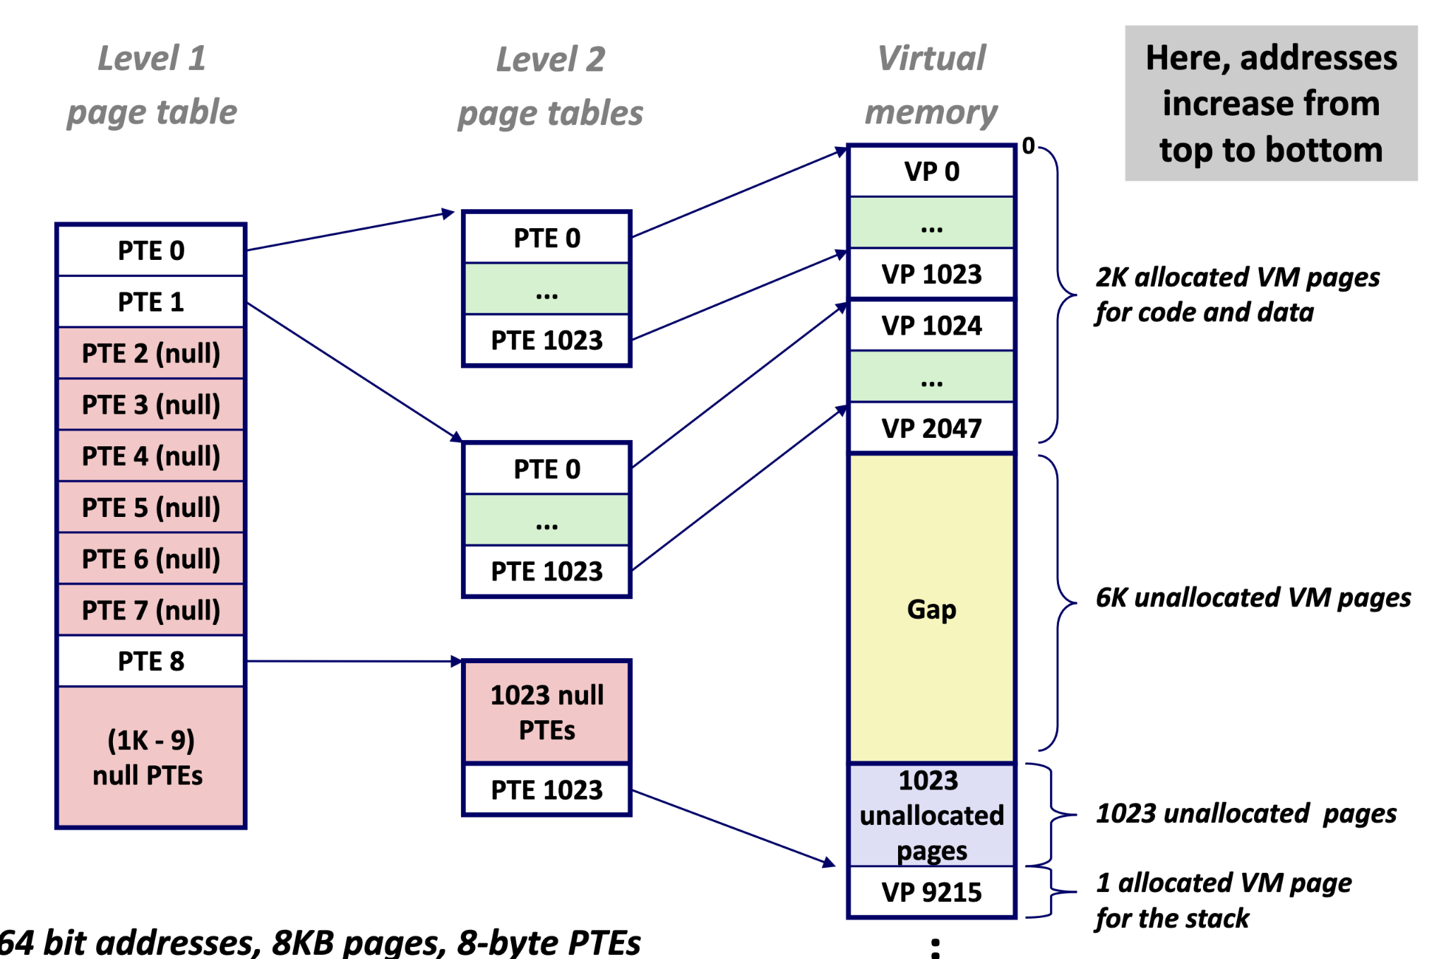
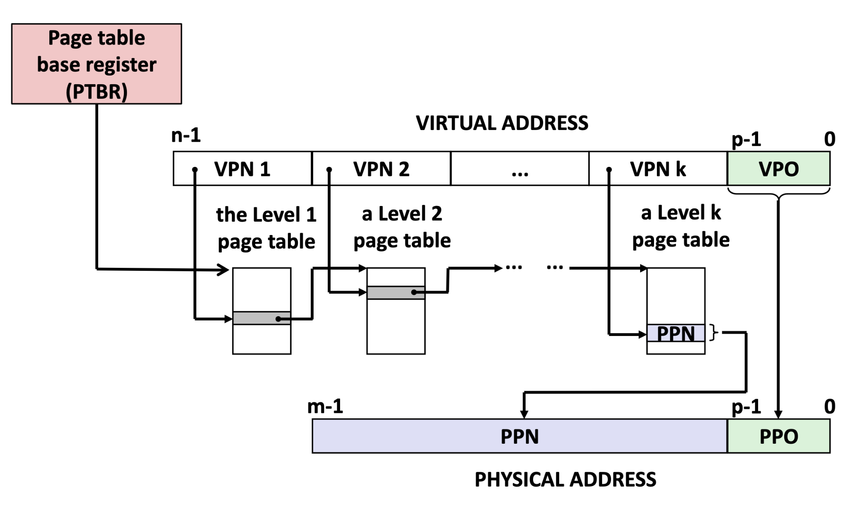
Virtual Memory - Multi-Level Page Tables
The size of a page table quickly gets out of control when we have to address large addresses space.
The solution is to nest page tables. The VPO/PPO acts as the pseudo-”block offset”

Slide 61
Example - Multi-Level Page Table
Consider a system with 32 bit virtual address space and a 24 bit physical address space. Page Size is 4KB. Assume the size of entries in the Page Table is 4 bytes.
Question of interest : How would we map the virtual address space? Is a single-level page table enough? Do we need more levels? Let’s dive into it….

Slide 62
Example (Address Decomp.)
Setup: 32 bit VA, 24 bit PA, Page Size = 4KB, PTE Size = 4 bytes
Question 1: How many bits in the virtual/physical address for page offset?
VPO = PPO = log₂(page size) = 12 bits
20 bits | 12 bits
to be discussed in later slides | offset (VPO = PPO)

Slide 63
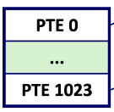
Example (PTEs in Pages)
Setup: 32 bit VA, 24 bit PA, Page Size = 4KB, PTE Size = 4 bytes
Question 2: How many PTEs (page table entries) fit inside a single page?
# of PTEs in a page = size of a page / size of a PTE
  4KB/4B = 2^12/2^2 = 2^10 = 1024

Slide 64
Example (Mapping PTEs to VA)
Setup: 32 bit VA, 24 bit PA, Page Size = 4KB, PTE Size = 4 bytes
Question 3: How many PTEs are required to map the entire VA space?
# of PTEs for VA space = size of VA space/size of a page
  2^32/2^12 = 2^20 PTEs

Slide 65
Example (Multi-Level Storage)
Setup: 32 bit VA, 24 bit PA, Page Size = 4KB, PTE Size = 4 bytes
So far, we’ve discussed preliminary values that tell us how to map onto the entire VA space.
  General/“Single-Level” Ideas
Now let’s talk about how we can extend this to a multi-level page table

Slide 66
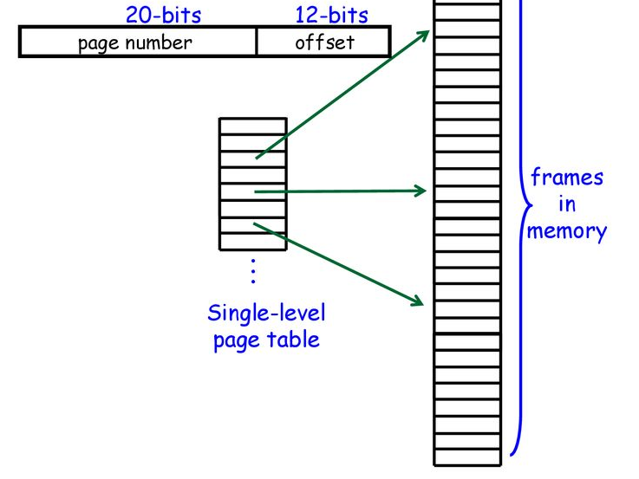
Example (Multi-Level Storage)
Setup: 32 bit VA, 24 bit PA, Page Size = 4KB, PTE Size = 4 bytes
Question 4: How many pages do we need to cover the single level page table?
# of pages for Single Level = # of PTEs to map VA space/# of PTEs in a page
  2^20/2^10 = 2^10 pages

Slide 67
Example (Multi-Level Storage)
Setup: 32 bit VA, 24 bit PA, Page Size = 4KB, PTE Size = 4 bytes
Question 5: How many pages do we need to represent the outer level page table?
# of pages for Outer Level = # of pages for Single Level / # PTEs in a page
  2^10/2^10 = 1 page

Slide 68
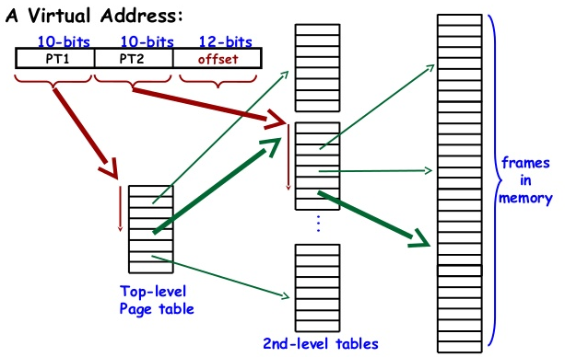
Example (Multi-Level Storage)
This is what our final multi-level page table would look like

Slide 69
Example (Multi-Level Storage)
Great, now we’ve setup a 2-level page table, let’s talk about the benefits we get.
Without the outer level, we would have to store the entirety of the single-level page table.
  Oops that’s (2^20 PTEs x 4 bytes) = 2^22 bytes = 4096 KB
  Can also think of as (2^10 Pages x 4 KB)

Slide 70
Example (Multi-Level Storage)
Now we have two-levels. Suppose we have a single memory access (assuming the page table was empty at first). How many pages would be required?
Entire outer level (there is only one page)
1 PTE needed from outer level => 1 page in inner level
Total 2 pages! We saved a huge chunk of space.
  2 pages = 8 KB <<<<<<< 4096 KB

Slide 71

GOOD LUCK!!
[Requin is studying with you guys too :)]

Slide 72
Q/A

Slide 73
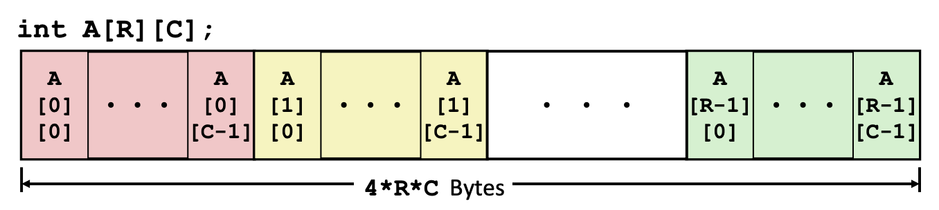
Arrays
Nested indexing rules
Declared: T A[R][C]
Contiguous chunk of space (think of multiple arrays lined up next to each other)

Slide 74
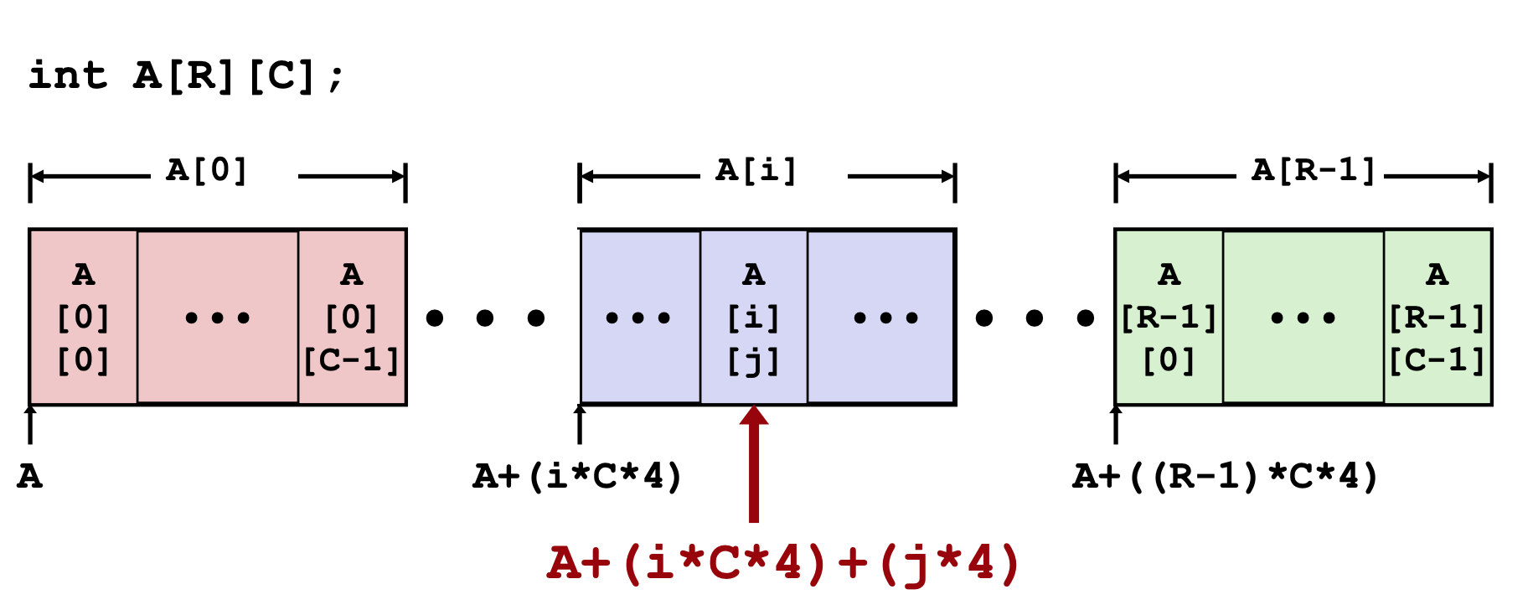
Arrays
Nested indexing rules:
Arranged in ROW-MAJOR ORDER - think of row vectors
A[i] is an array of C elements (“columns”) of type T

Slide 75
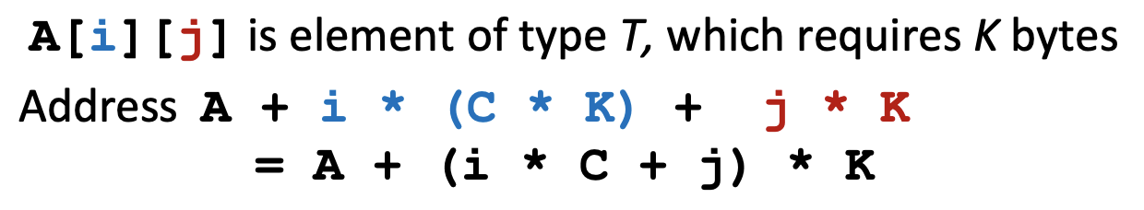
Arrays
Nested indexing rules:

Slide 76
Arrays
Consider accessing elements of A….
Compiles Bad Deref? Size (bytes)
int A1[3][5]
int *A2[3][5]
int (*A3)[3][5]
int *(A4[3][5])
int (*A5[3])[5]

Slide 77
Arrays
Consider accessing elements of A….
Compiles Bad Deref? Size (bytes)
int A1[3][5] Y N 3*5*(4) = 60
int *A2[3][5]
int (*A3)[3][5]
int *(A4[3][5])
int (*A5[3])[5]

Slide 78
Arrays
Consider accessing elements of A….
Compiles Bad Deref? Size (bytes)
int A1[3][5] Y N 3*5*(4) = 60
int *A2[3][5] Y N 3*5*(8) = 120
int (*A3)[3][5]
int *(A4[3][5])
int (*A5[3])[5]

Slide 79
Arrays
Consider accessing elements of A….
Compiles Bad Deref? Size (bytes)
int A1[3][5] Y N 3*5*(4) = 60
int *A2[3][5] Y N 3*5*(8) = 120
int (*A3)[3][5] Y N 1*8 = 8
int *(A4[3][5])
int (*A5[3])[5]

Slide 80
Arrays
Consider accessing elements of A….
Compiles Bad Deref? Size (bytes)
int A1[3][5] Y N 3*5*(4) = 60
int *A2[3][5] Y N 3*5*(8) = 120
int (*A3)[3][5] Y N 1*8 = 8
int *(A4[3][5]) Y N 3*5*(8) = 120
int (*A5[3])[5]

Slide 81
Arrays
Consider accessing elements of A….
Compiles Bad Deref? Size (bytes)
int A1[3][5] Y N 3*5*(4) = 60
int *A2[3][5] Y N 3*5*(8) = 120
int (*A3)[3][5] Y N 1*8 = 8
int *(A4[3][5]) Y N 3*5*(8) = 120
int (*A5[3])[5] Y N 3*8 = 24

Slide 82
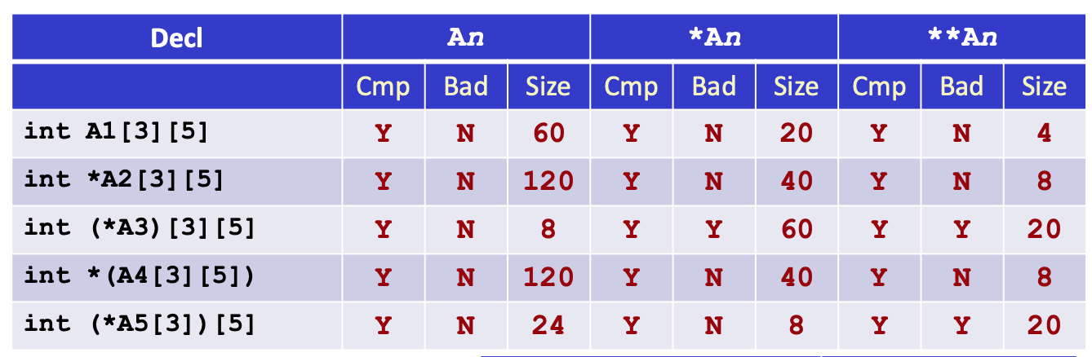
Arrays
ex., A3: pointer to a 3x5 int array
*A3: BAD, 3x5 int array (3 * 5 elements * each 4 bytes = 60)
**A3: BAD, but means stepping inside one of 3 “rows” c

Slide 83
Arrays
ex., A5: array of 3 (int *) pointers
*A5: 1 (int *) pointer, points to an array of 5 ints
**A5: BAD, means accessing 5 individual ints of the pointer
(stepping inside “row”)

Slide 84
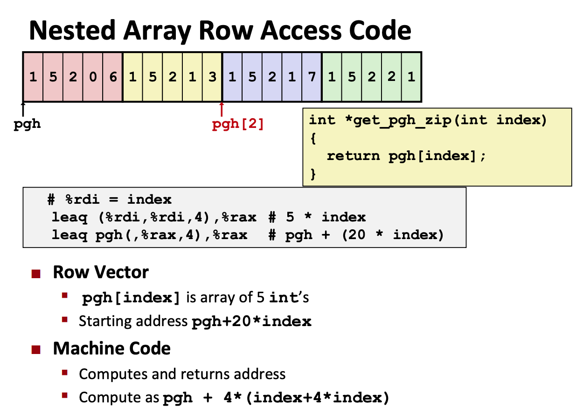
Arrays

Slide 85
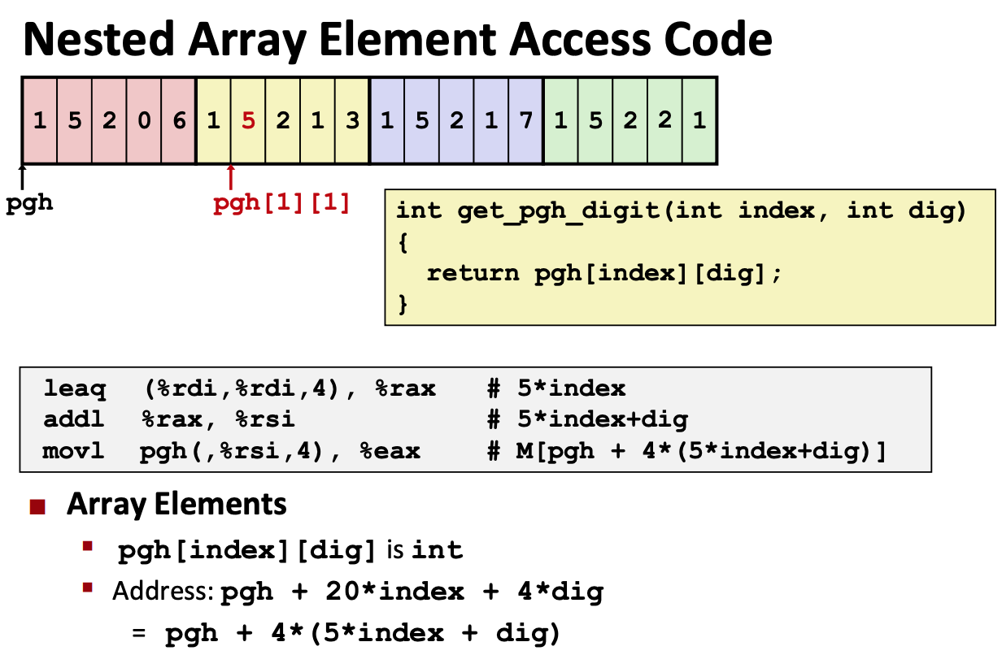
Arrays

