Slide 1

14-513
18-613

Slide 2
Linking 18-213/18-613: Introduction to Computer Systems 16th Lecture, March 13, 2025

Slide 3
Today
Linking
Motivation CSAPP 7.1
What it does CSAPP 7.2-7.4
How it works CSAPP 7.5-7.9
Shared libraries and dynamic linking CSAPP 7.10-7.12
Case study: Library interpositioning CSAPP 7.13
Understanding linking can help you avoid nasty errors and make you a better programmer.

Slide 4
Example C Program
int sum(int *a, int n);
int array[2] = {1, 2};
int main(int argc, char** argv)
{
int val = sum(array, 2);
return val;
}
int sum(int *a, int n)
{
int i, s = 0;
for (i = 0; i < n; i++) {
s += a[i];
}
return s;
}
main.c
sum.c

Slide 5
Linking
Programs are translated and linked using a compiler driver:
linux> gcc -Og -o prog main.c sum.c
linux> ./prog
main.c
sum.c
Source files
Translators
(cpp, cc1, as)
Translators
(cpp, cc1, as)
main.o
sum.o
Separately compiled
relocatable object files
Linker (ld)
Fully linked executable object file
(contains code and data for all functions
defined in main.c and sum.c)
prog

Slide 6
Why Linkers?
Reason 1: Modularity
Program can be written as a collection of smaller source files, rather than one monolithic mass.
Can build libraries of common functions (more on this later)
e.g., Math library, standard C library

Slide 7
Why Linkers? (cont)
Reason 2: Efficiency
Time: Separate compilation
Change one source file, compile, and then relink.
No need to recompile other source files.
Can compile multiple files concurrently.
Space: Libraries
Common functions can be aggregated into a single file...
Option 1: Static Linking
Executable files and running memory images contain only the library code they actually use
Option 2: Dynamic linking
Executable files contain no library code
During execution, single copy of library code can be shared across all executing processes

Slide 8
What Do Linkers Do?
Step 1: Symbol resolution
Programs define and reference symbols (global variables and functions):
void swap() {…} /* define symbol swap */
swap(); /* reference symbol swap */
int *xp = &x; /* define symbol xp, reference x */
Symbol definitions are stored in object file (by assembler) in symbol table.
Symbol table is an array of entries
Each entry includes name, size, and location of symbol.
During symbol resolution step, the linker associates each symbol reference with exactly one symbol definition.

Slide 9
Symbols in Example C Program
Definitions
int sum(int *a, int n);
int array[2] = {1, 2};
int main(int argc, char** argv)
{
int val = sum(array, 2);
return val;
}
int sum(int *a, int n)
{
int i, s = 0;
for (i = 0; i < n; i++) {
s += a[i];
}
return s;
}
main.c
sum.c
Reference
Notes:
Try:
objdump –t main.o
objdump –t sum.o

Slide 10
What Do Linkers Do? (cont’d)
Step 2: Relocation
Merges separate code and data sections into single sections
Relocates symbols from their relative locations in the .o files to their final absolute memory locations in the executable.
Updates all references to these symbols to reflect their new positions.
Let’s look at these two steps in more detail….

Slide 11
Three Kinds of Object Files (Modules)
Relocatable object file (.o file)
Contains code and data in a form that can be combined with other relocatable object files to form executable object file.
Each .o file is produced from exactly one source (.c) file
Executable object file (a.out file)
Contains code and data in a form that can be copied directly into memory and then executed.
Shared object file (.so file)
Special type of relocatable object file that can be loaded into memory and linked dynamically, at either load time or run-time.
Called Dynamic Link Libraries (DLLs) by Windows

Slide 12
Executable and Linkable Format (ELF)
Standard binary format for object files
One unified format for
Relocatable object files (.o),
Executable object files (a.out)
Shared object files (.so)
Generic name: ELF binaries

Slide 13
ELF Object File Format
Elf header
Word size, byte ordering, file type (.o, exec, .so), machine type, etc.
Segment header table
Page size, virtual address memory segments (sections), segment sizes.
.text section
Code
.rodata section
Read only data: jump tables, string constants, ...
.data section
Initialized global variables
.bss section
Uninitialized global variables
“Block Started by Symbol”, “Better Save Space”
Has section header but occupies no space
0
ELF header
Segment header table
(required for executables)
.text section
.rodata section
.data section
.bss section
.symtab section
.rel.txt section
.rel.data section
.debug section
Section header table

Slide 14
ELF Object File Format (cont.)
.symtab section
Symbol table
Procedure and static variable names
Section names and locations
.rel.text section
Relocation info for .text section
Addresses of instructions that will need to be modified in the executable
Instructions for modifying
.rel.data section
Relocation info for .data section
Addresses of pointer data that will need to be modified in the merged executable
.debug section
Info for symbolic debugging (gcc -g)
Section header table
Offsets and sizes of each section
0
ELF header
Segment header table
(required for executables)
.text section
.rodata section
.data section
.bss section
.symtab section
.rel.text section
.rel.data section
.debug section
Section header table

Slide 15
Linker Symbols
Global symbols
Symbols defined by module m that can be referenced by other modules.
e.g., non-static C functions and non-static global variables.
External symbols
Global symbols that are referenced by module m but defined by some other module.
Local symbols
Symbols that are defined and referenced exclusively by module m.
e.g, C functions and global variables defined with the static attribute.
Local linker symbols are not local program variables

Slide 16
Step 1: Symbol Resolution
Referencing
a global…
…that’s defined here
int sum(int *a, int n);
int array[2] = {1, 2};
int main(int argc,char **argv)
{
int val = sum(array, 2);
return val;
}
int sum(int *a, int n)
{
int i, s = 0;
for (i = 0; i < n; i++) {
s += a[i];
}
return s;
}
main.c
sum.c
Defining
a global
Referencing
a global…
Linker knows
nothing of i or s
Linker knows
nothing of val
…that’s defined here

Slide 17
Symbol Identification
Which of the following names will be in the symbol table of symbols.o?
Names:
incr
foo
a
argc
argv
b
main
printf
Others?
symbols.c:
incr
foo
a
argc
argv
b
main
printf
"%d\n"
int incr = 1;
static int foo(int a) {
int b = a + incr;
return b;
}
int main(int argc,
char* argv[]) {
printf("%d\n", foo(5));
return 0;
}
Can find this with readelf:
linux> readelf –s symbols.o
Notes:
Answer:
incr, foo, main, printf
Can actually make a case for “%d\n”: it’s a global constant string (in read only section) so it will have a name

Slide 18
Local Symbols
Local non-static C variables vs. local static C variables
Local non-static C variables: stored on the stack
Local static C variables: stored in either .bss or .data
static int x = 15;
int f() {
static int x = 17;
return x++;
}
int g() {
static int x = 19;
return x += 14;
}
int h() {
return x += 27;
}
Compiler allocates space in .data for each definition of x
Creates local symbols in the symbol table with unique names, e.g., x, x.1721 and x.1724.
static-local.c
Notes:
Try:
objdump –t static-local.o
objdump –rd static-local.o

Slide 19
How Linker Resolves Duplicate Symbol Definitions
Program symbols are either strong or weak
Strong: procedures and initialized globals
Weak: uninitialized globals
Or ones declared with specifier extern
p1.c
p2.c
strong
int foo=5;
p1() {
}
int foo;
p2() {
}
weak
strong
strong

Slide 20
Linker’s Symbol Rules
Rule 1: Multiple strong symbols are not allowed
Each item can be defined only once
Otherwise: Linker error
Rule 2: Given a strong symbol and multiple weak symbols, choose the strong symbol
References to the weak symbol resolve to the strong symbol
Rule 3: If there are multiple weak symbols, pick an arbitrary one
Can override this with gcc –fno-common
Puzzles on the next slide
Notes:
If you are not aware of these rules, you can run into very nasty, difficult problems.

Slide 21
Linker Puzzles
int x;
p1() {}
p1() {}
Link time error: two strong symbols (p1)
int x;
p1() {}
int x;
p2() {}
References to x will refer to the same
uninitialized int. Is this what you really want?
int x;
int y;
p1() {}
double x;
p2() {}
Writes to x in p2 might overwrite y!
Evil!
int x=7;
int y=5;
p1() {}
double x;
p2() {}
Writes to x in p2 might overwrite y!
Nasty!
int x=7;
p1() {}
int x;
p2() {}
References to x will refer to the same initialized
variable.
Important: Linker does not do type checking.

Slide 22

Type Mismatch Example
long int x; /* Weak symbol */
int main(int argc,
char *argv[]) {
printf("%ld\n", x);
return 0;
}
/* Global strong symbol */
double x = 3.14;
/* Global strong symbol */
double x = 3.14;
mismatch-main.c
mismatch-variable.c
Compiles without any errors or warnings
What gets printed?
Notes:
Try:
objdump –t mismatch-main.o
objdump –t mismatch-variable.o

Slide 23
Global Variables
Avoid if you can
Otherwise
Use static if you can (why?)
Initialize if you define a global variable
Use extern if you reference an external global variable
Treated as weak symbol
But also causes linker error if not defined in some file

Slide 24
Use of extern in .h Files
c1.c
global.h
#include "global.h"
int f() {
return g+1;
}
extern int g;
int f();
c2.c
#include <stdio.h>
#include "global.h”
int g = 0;
int main(int argc, char argv[]) {
int t = f();
printf("Calling f yields %d\n", t);
return 0;
}

Slide 25
Use of .h Files (#2)
global.h
c1.c
extern int g;
static int init = 0;
#ifdef INITIALIZE
int g = 23;
static int init = 1;
#else
extern int g;
static int init = 0;
#endif
#include "global.h"
int f() {
return g+1;
}
c2.c
#define INITIALIZE
#include <stdio.h>
#include "global.h"
int main(int argc, char** argv) {
if (init)
// do something, e.g., g=31;
int t = f();
printf("Calling f yields %d\n", t);
return 0;
}
int g = 23;
static int init = 1;

Slide 26
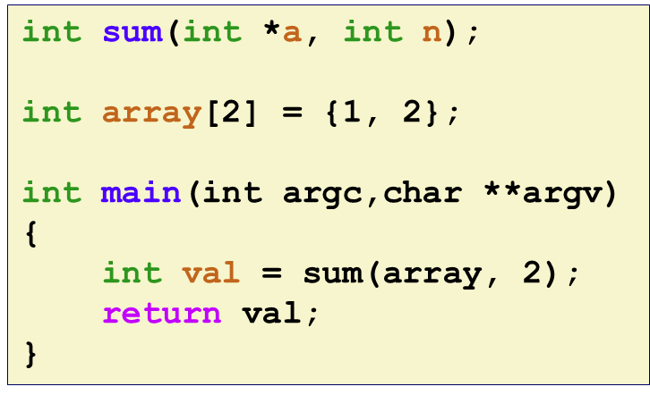
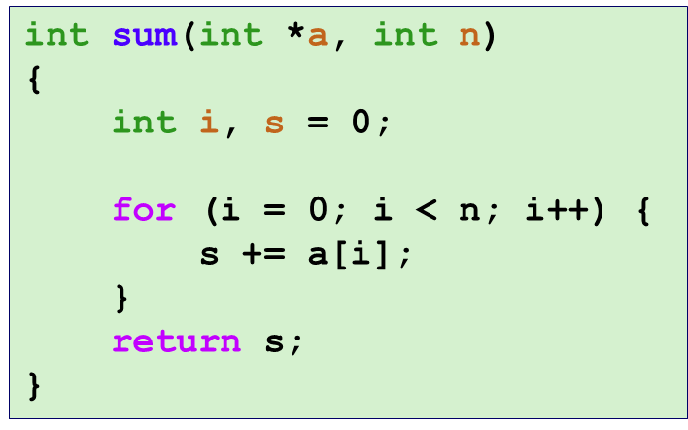
Step 2: Relocation
Relocatable Object Files
Executable Object File
System code
.text
0
Headers
System data
.data
System code
main()
.text
main.o
sum()
main()
.text
.data
More system code
int array[2]={1,2}
System data
.data
sum.o
sum()
int array[2]={1,2}
.text
.symtab
.debug
Notes:
System code including code that runs before and after main. Sets up argc/v and takes the return value
objdump –t prog
generates LOTS of stuff

Slide 27
Relocation Entries
int array[2] = {1, 2};
int main(int argc, char** argv)
{
int val = sum(array, 2);
return val;
}
main.c
0000000000000000 <main>:
0: 48 83 ec 08 sub $0x8,%rsp
4: be 02 00 00 00 mov $0x2,%esi
9: bf 00 00 00 00 mov $0x0,%edi # %edi = &array
a: R_X86_64_32 array # Relocation entry
e: e8 00 00 00 00 callq 13 <main+0x13> # sum()
f: R_X86_64_PC32 sum-0x4 # Relocation entry
13: 48 83 c4 08 add $0x8,%rsp
17: c3 retq
main.o
Source: objdump –r –d main.o
Notes:
What are the globals? Where are they (address / section)? … Then click.
PC32, PC relative to next RIP – 0x4 for the offset

Slide 28
Relocated .text section
00000000004004d0 <main>:
4004d0: 48 83 ec 08 sub $0x8,%rsp
4004d4: be 02 00 00 00 mov $0x2,%esi
4004d9: bf 18 10 60 00 mov $0x601018,%edi # %edi = &array
4004de: e8 05 00 00 00 callq 4004e8 <sum> # sum()
4004e3: 48 83 c4 08 add $0x8,%rsp
4004e7: c3 retq
00000000004004e8 <sum>:
4004e8: b8 00 00 00 00 mov $0x0,%eax
4004ed: ba 00 00 00 00 mov $0x0,%edx
4004f2: eb 09 jmp 4004fd <sum+0x15>
4004f4: 48 63 ca movslq %edx,%rcx
4004f7: 03 04 8f add (%rdi,%rcx,4),%eax
4004fa: 83 c2 01 add $0x1,%edx
4004fd: 39 f2 cmp %esi,%edx
4004ff: 7c f3 jl 4004f4 <sum+0xc>
400501: f3 c3 repz retq
callq instruction uses PC-relative addressing for sum():
0x4004e8 = 0x4004e3 + 0x5
Source: objdump -d prog

Slide 29
Loading Executable Object Files
Memory
invisible to user code
Executable Object File
Kernel virtual memory
0
ELF header
User stack
(created at runtime)
Program header table
(required for executables)
%rsp
(stack
pointer)
.init section
.text section
Memory-mapped region for
shared libraries
.rodata section
.data section
.bss section
brk
.symtab
Run-time heap
(created by malloc)
.debug
Read/write data segment
(.data, .bss)
Loaded
from
the
executable
file
.line
.strtab
Read-only code segment
(.init, .text, .rodata)
Section header table
(required for relocatables)
0x400000
Unused
0
Notes:
…
Large heap in the high addresses (mmap)
.line section holds machine code->C line number mapping (only present when compile with –g}
.strtab section holds a string table for symbols and section names

Slide 30
Quiz Time!
Canvas Quiz: Day 16 – Linking

Slide 31
Today
Linking
Motivation
What it does
How it works
Shared libraries and dynamic linking
Case study: Library interpositioning

Slide 32
Commonly Used Libraries
libc.a (the C standard library)
4.6 MB archive of 1496 object files.
I/O, memory allocation, signal handling, string handling, data and time, random numbers, integer math
libm.a (the C math library)
2 MB archive of 444 object files.
floating point math (sin, cos, tan, log, exp, sqrt, …)
% ar –t /usr/lib/libc.a | sort
…
fork.o
…
fprintf.o
fpu_control.o
fputc.o
freopen.o
fscanf.o
fseek.o
fstab.o
…
% ar –t /usr/lib/libm.a | sort
…
e_acos.o
e_acosf.o
e_acosh.o
e_acoshf.o
e_acoshl.o
e_acosl.o
e_asin.o
e_asinf.o
e_asinl.o
…
Notes:
The convention is that libraries are always prefixed with “lib”
$(CC) $(CFLAGS) -o csim csim.c cachelab.c -lm

Slide 33
Libraries: Packaging a Set of Functions
How to package functions commonly used by programmers?
Math, I/O, memory management, string manipulation, etc.
Awkward, given the linker framework so far:
Option 1: Put all functions into a single source file
Programmers link big object file into their programs
Space and time inefficient
Option 2: Put each function in a separate source file
Programmers explicitly link appropriate binaries into their programs
More efficient, but burdensome on the programmer

Slide 34
Old-Fashioned Solution: Static Libraries
Static libraries (.a archive files)
Concatenate related relocatable object files into a single file with an index (called an archive).
Enhance linker so that it tries to resolve unresolved external references by looking for the symbols in one or more archives.
If an archive member file resolves reference, link it into the executable.

Slide 35
Creating Static Libraries
atoi.c
printf.c
random.c
Translator
Translator
...
Translator
atoi.o
printf.o
random.o
Archiver (ar)
unix> ar rs libc.a \
atoi.o printf.o … random.o
libc.a
C standard library
Archiver allows incremental updates
Recompile function that changes and replace .o file in archive.

Slide 36
Linking with Static Libraries
libvector.a
void addvec(int *x, int *y,
int *z, int n) {
int i;
for (i = 0; i < n; i++)
z[i] = x[i] + y[i];
}
#include <stdio.h>
#include "vector.h"
int x[2] = {1, 2};
int y[2] = {3, 4};
int z[2];
int main(int argc, char** argv)
{
addvec(x, y, z, 2);
printf("z = [%d %d]\n”,
z[0], z[1]);
return 0;
}
addvec.c
void multvec(int *x, int *y,
int *z, int n)
{
int i;
for (i = 0; i < n; i++)
z[i] = x[i] * y[i];
}
main2.c
multvec.c

Slide 37
Linking with Static Libraries
addvec.o
multvec.o
main2.c
vector.h
Archiver
(ar)
Translators
(cpp, cc1, as)
libvector.a
libc.a
Static libraries
Relocatable
object files
main2.o
addvec.o
printf.o and any other
modules called by printf.o
Linker (ld)
unix> gcc –static –o prog2c \
main2.o -L. -lvector
Fully linked
executable object file
(861,232 bytes)
prog2c
“c” for “compile-time”
Notes:
Try:
objdump –t main2.o
objdump –rd main2.o
objdump –t libvector.a
objdump –rd libvector.a

Slide 38
Using Static Libraries
Linker’s algorithm for resolving external references:
Scan .o files and .a files in the command line order.
During the scan, keep a list of the current unresolved references.
As each new .o or .a file, obj, is encountered, try to resolve each unresolved reference in the list against the symbols defined in obj.
If any entries in the unresolved list at end of scan, then error.
Problem:
Command line order matters!
Moral: put libraries at the end of the command line.
unix> gcc -static -o prog2c -L. -lvector main2.o
main2.o: In function `main':
main2.c:(.text+0x19): undefined reference to `addvec'
collect2: error: ld returned 1 exit status

Slide 39
Modern Solution: Shared Libraries
Static libraries have the following disadvantages:
Duplication in the stored executables (every function needs libc)
Duplication in the running executables
Minor bug fixes of system libraries require each application to explicitly relink
Rebuild everything with glibc?
https://security.googleblog.com/2016/02/cve-2015-7547-glibc-getaddrinfo-stack.html
Modern solution: shared libraries
Object files that contain code and data that are loaded and linked into an application dynamically, at either load-time or run-time
Also called: dynamic link libraries, DLLs, .so files

Slide 40
Shared Libraries (cont.)
Dynamic linking can occur when executable is first loaded and run (load-time linking)
Common case for Linux, handled automatically by the dynamic linker (ld-linux.so)
Standard C library (libc.so) usually dynamically linked
Dynamic linking can also occur after program has begun (run-time linking)
In Linux, this is done by calls to the dlopen() interface
Distributing software
High-performance web servers
Runtime library interpositioning
Shared library routines can be shared by multiple processes
Using the virtual-to-physical memory mapping

Slide 41
What dynamic libraries are required?
.interp section
Specifies the dynamic linker to use (i.e., ld-linux.so)
.dynamic section
Specifies the names, etc of the dynamic libraries to use
Follow an example of prog
(NEEDED) Shared library: [libm.so.6]
Where are the libraries found?
Use “ldd” to find out:
unix> ldd prog
linux-vdso.so.1 => (0x00007ffcf2998000)
libc.so.6 => /lib/x86_64-linux-gnu/libc.so.6 (0x00007f99ad927000)
/lib64/ld-linux-x86-64.so.2 (0x00007f99adcef000)

Slide 42
Dynamic Library Example
addvec.c
multvec.c
unix> gcc –Og –c addvec.c multvec.c -fpic
Translator
Translator
addvec.o
multvec.o
unix> gcc -shared -o libvector.so \
addvec.o multvec.o
Loader (ld)
libvector.so
Dynamic vector library

Slide 43
Dynamic Linking at Load-time
main2.c
vector.h
unix> gcc -shared -o libvector.so \
addvec.c multvec.c -fpic
Translators
(cpp, cc1, as)
libc.so
libvector.so
Relocatable
object file
main2.o
Relocation and symbol table info
Linker (ld)
unix> gcc –o prog2l \
main2.o ./libvector.so
Partially linked
executable object file
(8488 bytes)
prog2l
Loader (execve)
libc.so
libvector.so
Code and data
Fully linked
executable
in memory
Dynamic linker (ld-linux.so)
Notes:
Partially linked still has relocatable entries
Loader (i.e., the execve syscall, which we will cover later)
Try:
ldd prog2l
objdump –t libvector.so
objdump –rd libvector.so

Slide 44
Dynamic Linking: Global Offset Table(GOT)
Data segment
Global offset table (GOT)
GOT[0]: …
GOT[1]: …
GOT[2]: …
GOT[3]: &addcnt
Fixed distance of 0x2008b9 bytes at run time between GOT[3] and addl instruction.
Code segment
addvec:
mov 0x2008b9(%rip),%rax # %rax=*GOT[3]=&addcnt
addl $0x1,(%rax) # addcnt++
The GOT is an array of pointers, with one entry per dynamically linked function (and then a few)
The dynamic linker populates this table as it links each such function at runtime
Calls to dynamically linked functions are made using indirection via the corresponding entry in the GOT

Slide 45
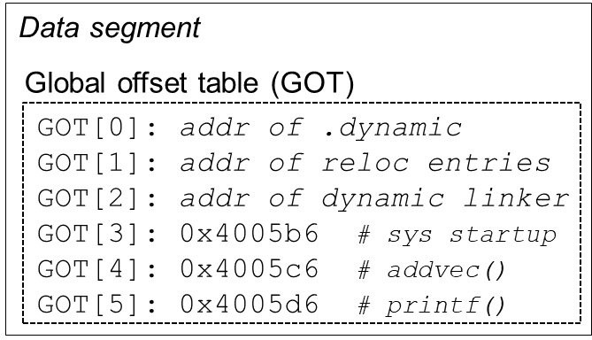
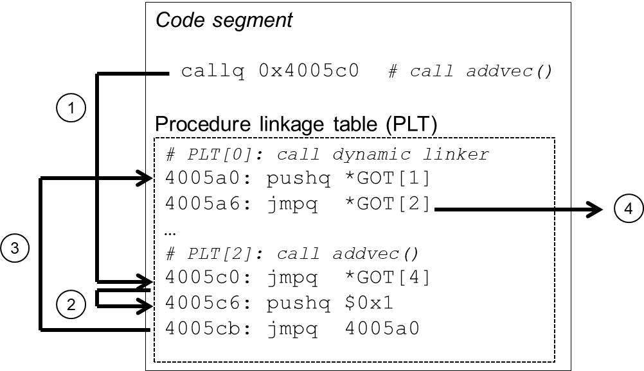
Dynamic Linking: Procedure Linkage Table (PLT): Initial
Initially, all entries in the GOT point right back to the next instruction in the PLT
This instruction, and the one that follows it, call the dynamic linker, which in turn maps in the function and adjusts the GOT to point to it
Notes:
0x1 is an ID for addvec. Step 4: dynamic linker uses the two stack entries to determine the runtime location of addvec, overwrites GOT[4} with this address, and passes control to addvec.

Slide 46
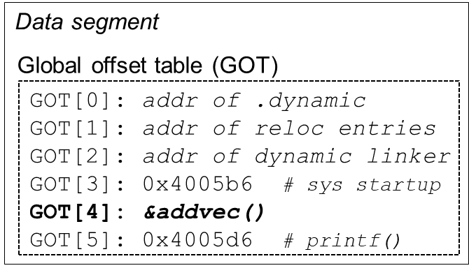
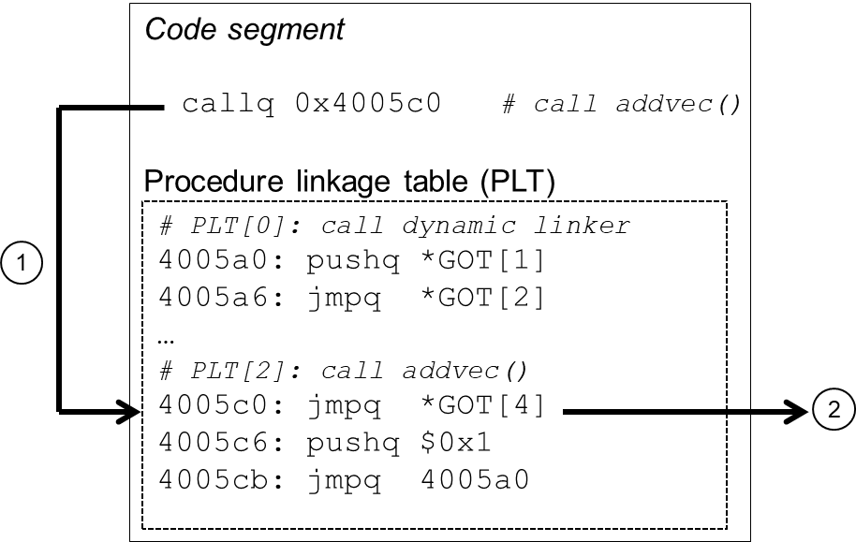
Dynamic Linking: Procedure Linkage Table (PLT): Steady State
Once the dynamic linker is done, the GOT contains the address of the function
The dynamic linker calls the newly linked function
Subsequent calls will succeed without the intervention of the dynamic linker.

Slide 47
Dynamic Linking API for Run-time Linking
#include <stdio.h>
#include <stdlib.h>
#include <dlfcn.h>
int x[2] = {1, 2};
int y[2] = {3, 4};
int z[2];
int main(int argc, char** argv)
{
void *handle;
void (*addvec)(int *, int *, int *, int);
char *error;
/* Dynamically load the shared library that contains addvec() */
handle = dlopen("./libvector.so", RTLD_LAZY);
if (!handle) {
fprintf(stderr, "%s\n", dlerror());
exit(1);
}
. . .
dll.c
Notes:
…
RTLD_LAZY – don’t resolve references until requested

Slide 48
Dynamic Linking API (cont’d)
...
/* Get a pointer to the addvec() function we just loaded */
addvec = dlsym(handle, "addvec");
if ((error = dlerror()) != NULL) {
fprintf(stderr, "%s\n", error);
exit(1);
}
/* Now we can call addvec() just like any other function */
addvec(x, y, z, 2);
printf("z = [%d %d]\n", z[0], z[1]);
/* Unload the shared library */
if (dlclose(handle) < 0) {
fprintf(stderr, "%s\n", dlerror());
exit(1);
}
return 0;
}
dll.c

Slide 49
Dynamic Linking API
dll.c
vector.h
unix> gcc -shared -o libvector.so \
addvec.c multvec.c -fpic
Translators
(cpp, cc1, as)
libc.so
libvector.so
Relocatable
object file
dll.o
Relocation and symbol table info
Linker (ld)
unix> gcc -rdynamic –o prog2r \
dll.o -ldl
prog2r
Partially linked
executable object file
(8784 bytes)
libc.so
Loader (execve)
Code and data
Fully linked
executable
in memory
Dynamic linker (ld-linux.so)
Call to dynamic linker via dlopen
Notes:
Linker has no information about vector library
Try:
ldd prog2r

Slide 50
Linking Summary
Linking is a technique that allows programs to be constructed from multiple object files
Linking can happen at different times in a program’s lifetime:
Compile time (when a program is compiled)
Load time (when a program is loaded into memory)
Run time (while a program is executing)
Understanding linking can help you avoid nasty errors and make you a better programmer

Slide 51
Today
Linking
Motivation
What it does
How it works
Shared libraries and dynamic linking
Case study: Library interpositioning

Slide 52
Case Study: Library Interpositioning
Documented in Section 7.13 of book
Library interpositioning: powerful linking technique that allows programmers to intercept calls to arbitrary functions
Interpositioning can occur at:
Compile time: When the source code is compiled
Link time: When the relocatable object files are statically linked to form an executable object file
Load/run time: When an executable object file is loaded into memory, dynamically linked, and then executed.

Slide 53
Some Interpositioning Applications
Security
Confinement (sandboxing)
Behind the scenes encryption
Debugging
In 2014, two Facebook engineers debugged a treacherous 1-year old bug in their iPhone app using interpositioning
Code in the SPDY networking stack was writing to the wrong location
Solved by intercepting calls to Posix write functions (write, writev, pwrite)
Source: Facebook engineering blog post at:
https://code.facebook.com/posts/313033472212144/debugging-file-corruption-on-ios/

Slide 54
Some Interpositioning Applications
Monitoring and Profiling
Count number of calls to functions
Characterize call sites and arguments to functions
Malloc tracing
Detecting memory leaks
Generating address traces (used to create malloc lab traces)
Error Checking
C Programming Lab used customized versions of malloc/free to do careful error checking
Other labs (malloc, shell, proxy) also use interpositioning to enhance checking capabilities

Slide 55
Example program
#include <stdio.h>
#include <malloc.h>
#include <stdlib.h>
int main(int argc,
char *argv[])
{
int i;
for (i = 1; i < argc; i++) {
void *p =
malloc(atoi(argv[i]));
free(p);
}
return(0);
}
Goal: trace the addresses and sizes of the allocated and freed blocks, without breaking the program, and without modifying the source code.
Three solutions: interpose on the library malloc and free functions at compile time, link time, and load/run time.
int.c
Notes:
int for interpositioning
Putting malloc.h in angle brackets is important. Also, calling it malloc.h

Slide 56
Compile-time Interpositioning
#ifdef COMPILETIME
#include <stdio.h>
#include <malloc.h>
/* malloc wrapper function */
void *mymalloc(size_t size)
{
void *ptr = malloc(size);
printf("malloc(%d)=%p\n", (int)size, ptr);
return ptr;
}
/* free wrapper function */
void myfree(void *ptr)
{
free(ptr);
printf("free(%p)\n", ptr);
}
#endif
mymalloc.c
Notes:
Here are the wrapper functions.
Now, we want the application to call the wrappers, rather than the library functions

Slide 57
Compile-time Interpositioning
#define malloc(size) mymalloc(size)
#define free(ptr) myfree(ptr)
void *mymalloc(size_t size);
void myfree(void *ptr);
malloc.h
linux> make intc
gcc -Wall -DCOMPILETIME -c mymalloc.c
gcc -Wall -I. -o intc int.c mymalloc.o
linux> make runc
./intc 10 100 1000
malloc(10)=0x1ba7010
free(0x1ba7010)
malloc(100)=0x1ba7030
free(0x1ba7030)
malloc(1000)=0x1ba70a0
free(0x1ba70a0)
linux>
Search for <malloc.h> leads to
/usr/include/malloc.h
Search for <malloc.h> leads to
Notes:
Compile-time flags are important
mymalloc.c will use library version of malloc.h
int.c will use custom version, which redefines malloc/free to by mymalloc/myfree
Try disassembling main when gdb intc
Run intc multiple times and see how heap gets randomized as a security precaution

Slide 58
Link-time Interpositioning
#ifdef LINKTIME
#include <stdio.h>
void *__real_malloc(size_t size);
void __real_free(void *ptr);
/* malloc wrapper function */
void *__wrap_malloc(size_t size)
{
void *ptr = __real_malloc(size); /* Call libc malloc */
printf("malloc(%d) = %p\n", (int)size, ptr);
return ptr;
}
/* free wrapper function */
void __wrap_free(void *ptr)
{
__real_free(ptr); /* Call libc free */
printf("free(%p)\n", ptr);
}
#endif
mymalloc.c

Slide 59
Link-time Interpositioning
linux> make intl
gcc -Wall -DLINKTIME -c mymalloc.c
gcc -Wall -c int.c
gcc -Wall -Wl,--wrap,malloc -Wl,--wrap,free -o intl \
int.o mymalloc.o
linux> make runl
./intl 10 100 1000
malloc(10) = 0x91a010
free(0x91a010)
. . .
Search for <malloc.h> leads to
/usr/include/malloc.h
The “-Wl” flag passes argument to linker, replacing each comma with a space.
The “--wrap,malloc ” arg instructs linker to resolve references in a special way:
Refs to malloc should be resolved as __wrap_malloc
Refs to __real_malloc should be resolved as malloc
Notes:
Both mymalloc.c & int.c will get library version of malloc.h
But, interpositioning trick causes nonstandard symbol resolution
Try disassembling main from within gdb

Slide 60
Load/Run-time Interpositioning
#ifdef RUNTIME
#define _GNU_SOURCE
#include <stdio.h>
#include <stdlib.h>
#include <dlfcn.h>
/* malloc wrapper function */
void *malloc(size_t size)
{
void *(*mallocp)(size_t size);
char *error;
mallocp = dlsym(RTLD_NEXT, "malloc"); /* Get addr of libc malloc */
if ((error = dlerror()) != NULL) {
fputs(error, stderr);
exit(1);
}
char *ptr = mallocp(size); /* Call libc malloc */
printf("malloc(%d) = %p\n", (int)size, ptr);
return ptr;
}
Observe that DON’T have
#include <malloc.h>
mymalloc.c
Notes:
This code includes <stdlib.h>, which defines malloc & free

Slide 61
Load/Run-time Interpositioning
/* free wrapper function */
void free(void *ptr)
{
void (*freep)(void *) = NULL;
char *error;
if (!ptr)
return;
freep = dlsym(RTLD_NEXT, "free"); /* Get address of libc free */
if ((error = dlerror()) != NULL) {
fputs(error, stderr);
exit(1);
}
freep(ptr); /* Call libc free */
printf("free(%p)\n", ptr);
}
#endif
mymalloc.c
Notes:
D

Slide 62
Load/Run-time Interpositioning
linux> make intr
gcc -Wall -DRUNTIME -shared -fpic -o mymalloc.so mymalloc.c -ldl
gcc -Wall -o intr int.c
linux> make runr
(LD_PRELOAD="./mymalloc.so" ./intr 10 100 1000)
malloc(10) = 0x91a010
free(0x91a010)
. . .
linux>
Search for <malloc.h> leads to
/usr/include/malloc.h
The LD_PRELOAD environment variable tells the dynamic linker to resolve unresolved refs (e.g., to malloc)by looking in mymalloc.so first.
Type into (some) shells as:
env LD_PRELOAD=./mymalloc.so ./intr
Notes:
Disassemble main from within intr.
See that will have to call dynamic linker to find it.

Slide 63
Interpositioning Recap
Compile Time
Apparent calls to malloc/free get macro-expanded into calls to mymalloc/myfree
Simple approach. Must have access to source & recompile
Link Time
Use linker trick to have special name resolutions
malloc → __wrap_malloc
__real_malloc → malloc
Load/Run Time
Implement custom version of malloc/free that use dynamic linking to load library malloc/free under different names
Can use with ANY dynamically linked binary
env LD_PRELOAD=./mymalloc.so gcc –c int.c)
Notes:
Fun to trace other programs, including gcc.
Need to
setenv LD_PRELOAD
to turn off feature.

Slide 64
Linking Recap
Usually: Just happens, no big deal
Sometimes: Strange errors
Bad symbol resolution
Ordering dependence of linked .o, .a, and .so files
For power users:
Interpositioning to trace programs with & without source

