Slide 1
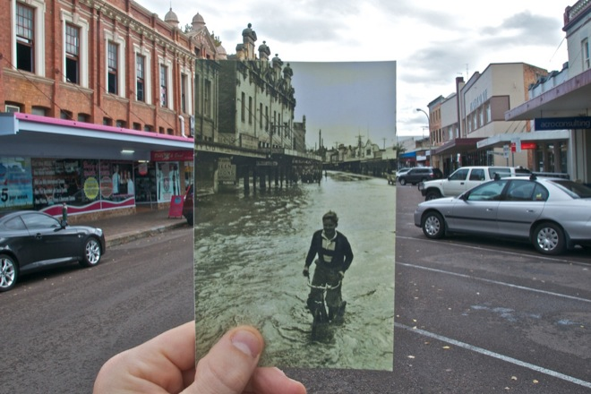
Image homographies
16-385 Computer Vision
Spring 2019, Lecture 8
http://www.cs.cmu.edu/~16385/

Slide 2
Course announcements
Homework 2 was posted last Wednesday.
- Due on February 27th at midnight.
- Start early cause it is much larger and more difficult than homework 1.
Homework schedule has been adjusted on course website.
- We need to discuss HW4 and HW7.
- Do you prefer if HW schedule is shifted back to Fridays?

Slide 3
Overview of today’s lecture
Leftover from last time: Computing linear transformations.
Motivation: panoramas.
Back to warping: image homographies.
Computing with homographies.
The direct linear transform (DLT).
Random Sample Consensus (RANSAC).

Slide 4
Slide credits
Most of these slides were adapted from:
Kris Kitani (15-463, Fall 2016).
Noah Snavely (Cornell).

Slide 5
Motivation for image alignment: panoramas.

Slide 6
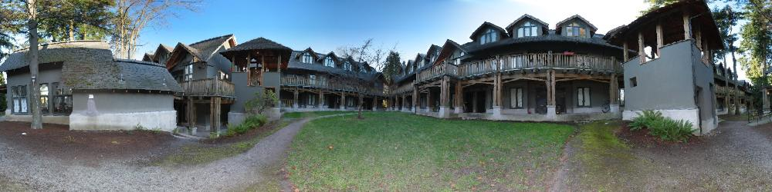
How do you create a panorama?
Panorama: an image of (near) 360º field of view.

Slide 7
How do you create a panorama?
Panorama: an image of (near) 360º field of view.
Use a very wide-angle lens.

Slide 8
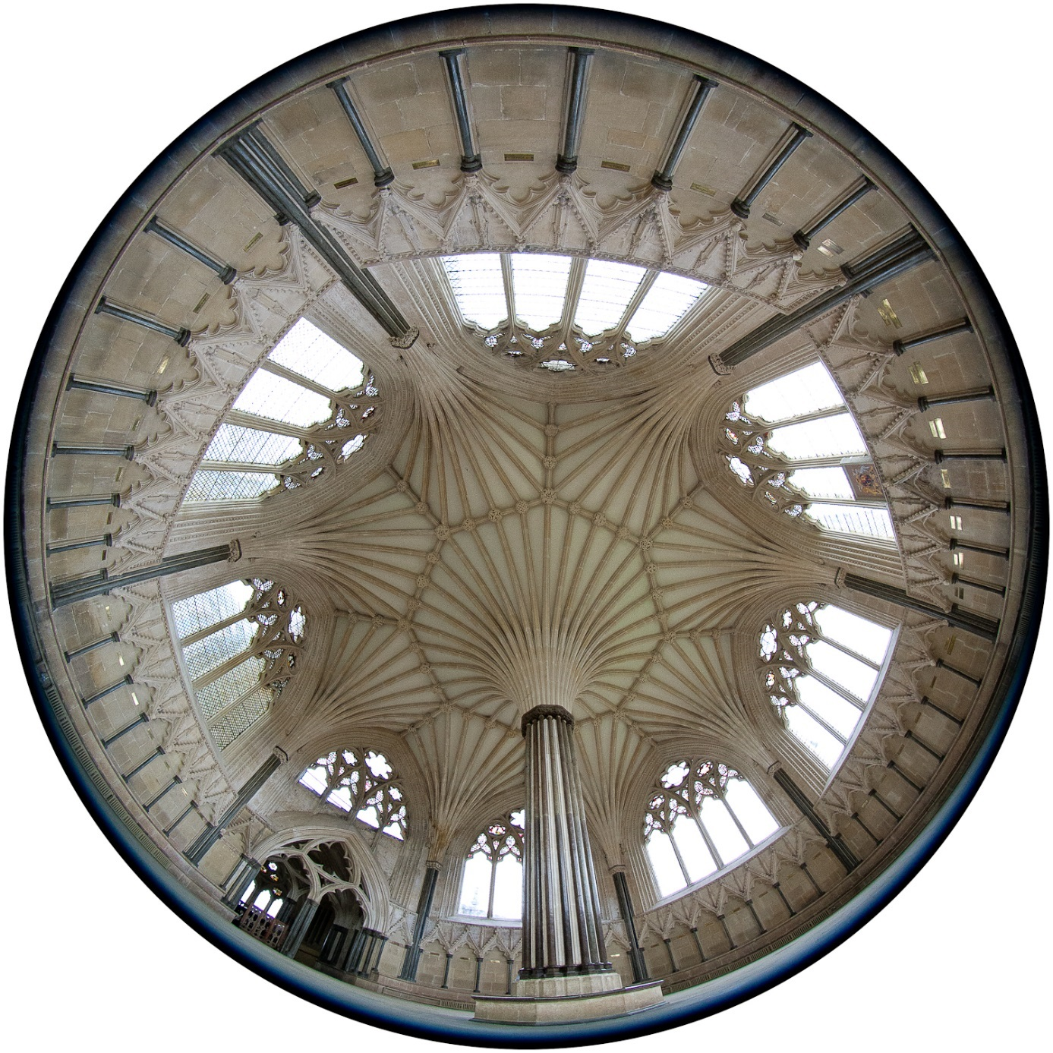
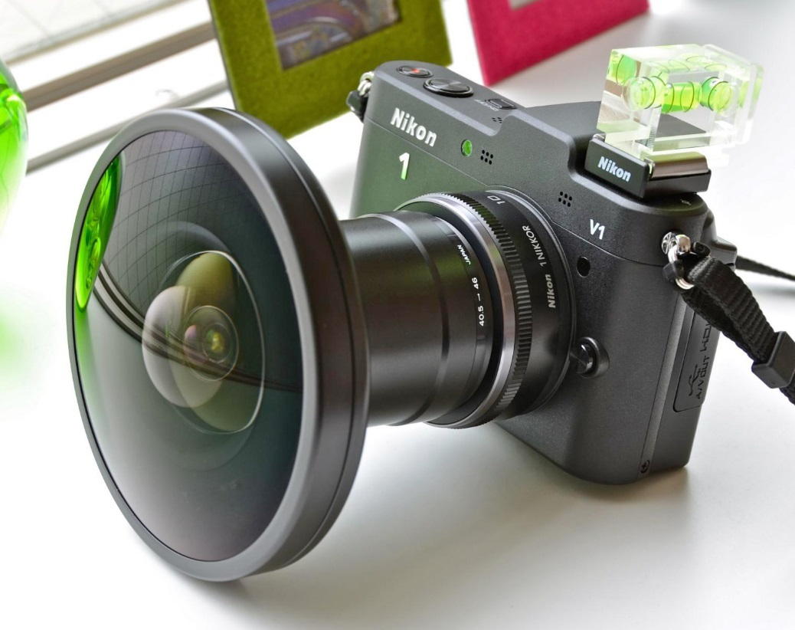
Wide-angle lenses
Fish-eye lens: can produce (near) hemispherical field of view.
What are the pros and cons of this?

Slide 9
How do you create a panorama?
Panorama: an image of (near) 360º field of view.
Use a very wide-angle lens.
Pros: Everything is done optically, single capture.
Cons: Lens is super expensive and bulky, lots of distortion (can be dealt-with in post).
Any alternative to this?

Slide 10
How do you create a panorama?
Panorama: an image of (near) 360º field of view.
Use a very wide-angle lens.
Pros: Everything is done optically, single capture.
Cons: Lens is super expensive and bulky, lots of distortion (can be dealt-with in post).
Capture multiple images and combine them.

Slide 11
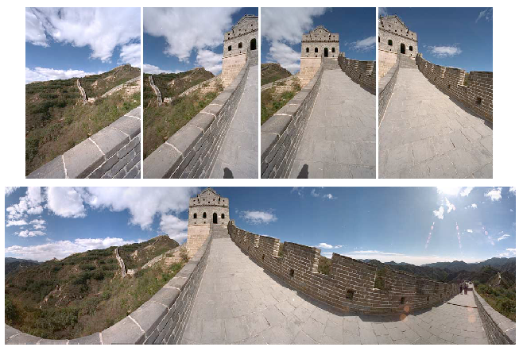
Panoramas from image stitching
Capture multiple images from different viewpoints.
Stitch them together into a virtual wide-angle image.

Slide 12
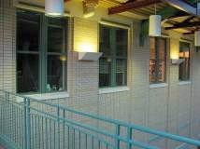
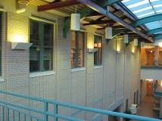
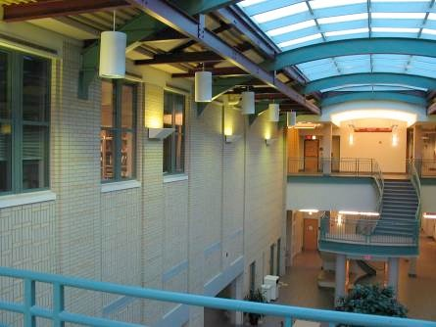
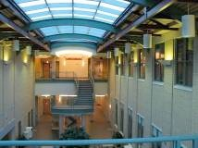
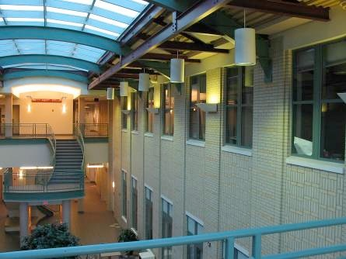
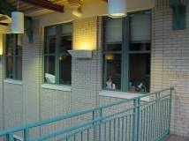
How do we stitch images from different viewpoints?
Will standard stitching work?
Translate one image relative to another.
(Optionally) find an optimal seam.

Slide 13
How do we stitch images from different viewpoints?
Will standard stitching work?
Translate one image relative to another.
(Optionally) find an optimal seam.
left on top
right on top
Translation-only stitching is not enough to mosaic these images.

Slide 14
How do we stitch images from different viewpoints?
What else can we try?

Slide 15
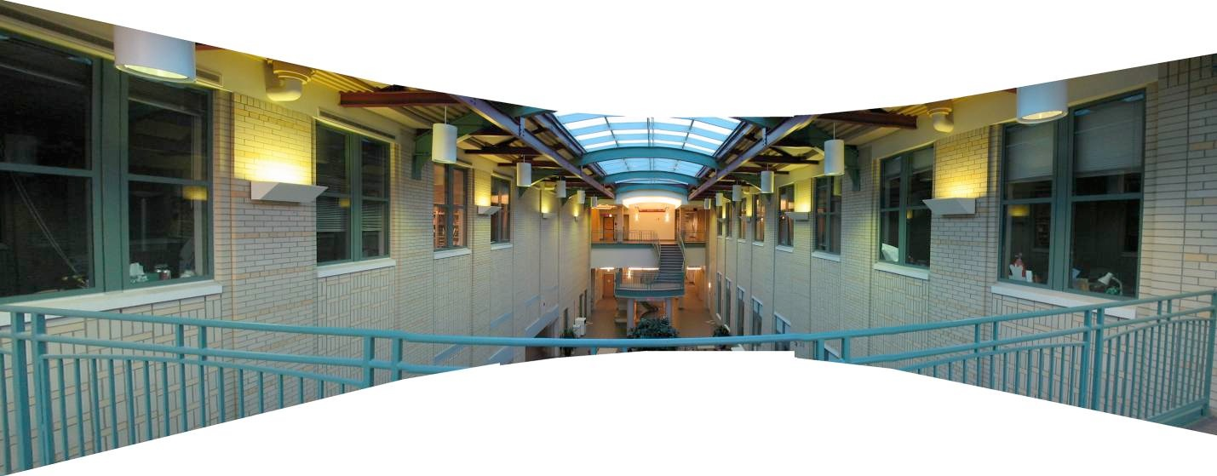
How do we stitch images from different viewpoints?
Use image homographies.

Slide 16
Back to warping: image homographies

Slide 17
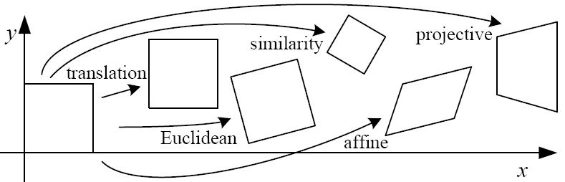
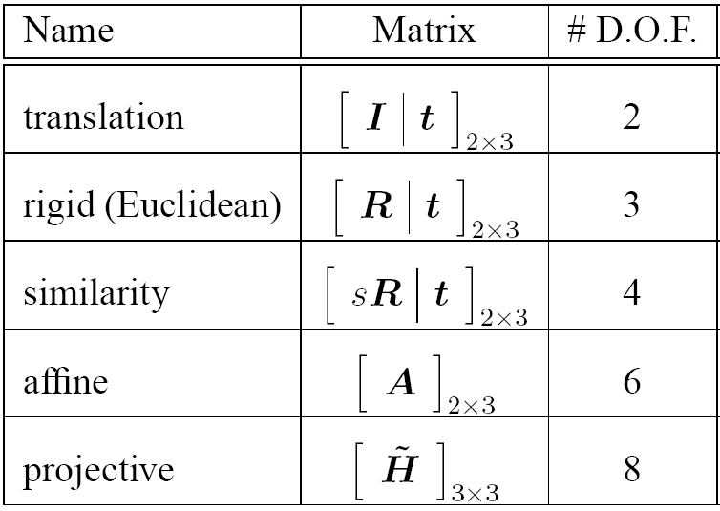
Classification of 2D transformations

Slide 18
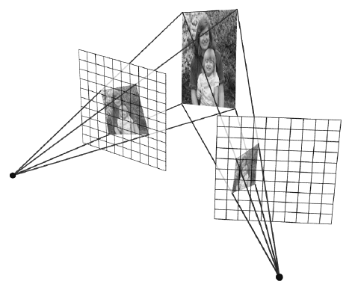
Classification of 2D transformations
PP3
PP1
Which kind transformation is needed to warp projective plane 1 into projective plane 2?
PP2

Slide 19
Classification of 2D transformations
PP3
PP1
Which kind transformation is needed to warp projective plane 1 into projective plane 2?
PP2
A projective transformation (a.k.a. a homography).

Slide 20
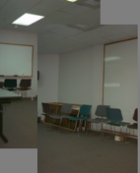
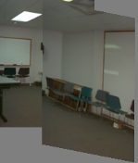
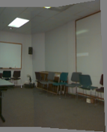
Warping with different transformations
translation
affine
pProjective (homography)

Slide 21
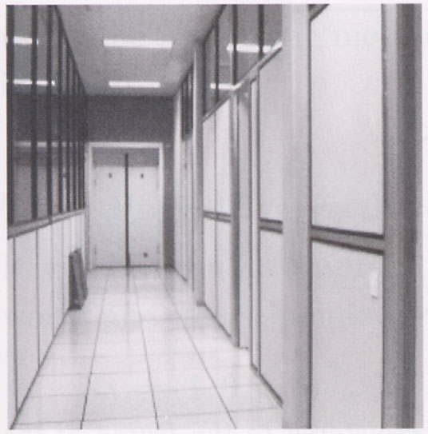
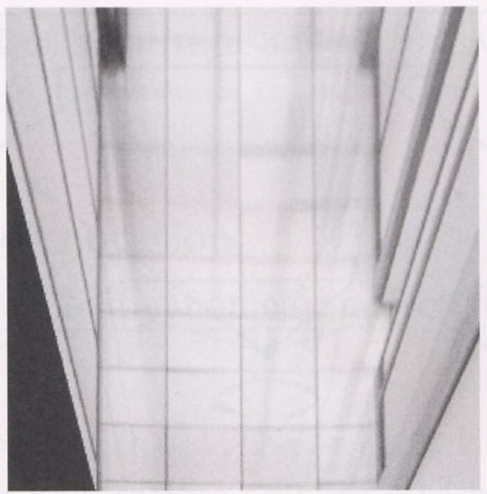
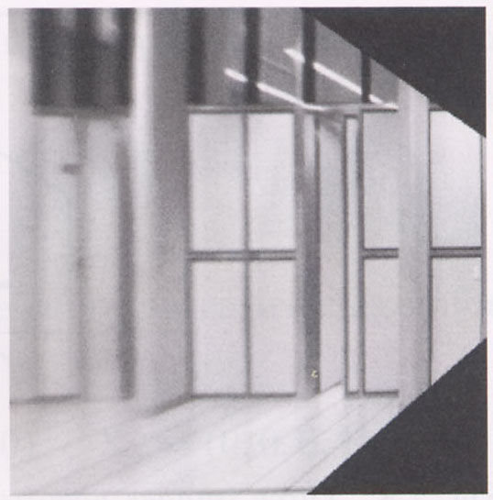
View warping
original view
synthetic top view
synthetic side view
What are these black areas near the boundaries?

Slide 22
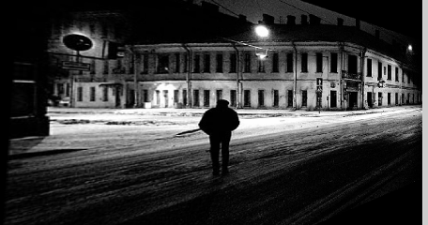
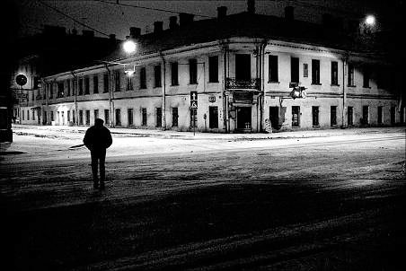
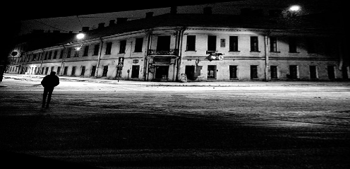
Virtual camera rotations
synthetic rotations
original view

Slide 23
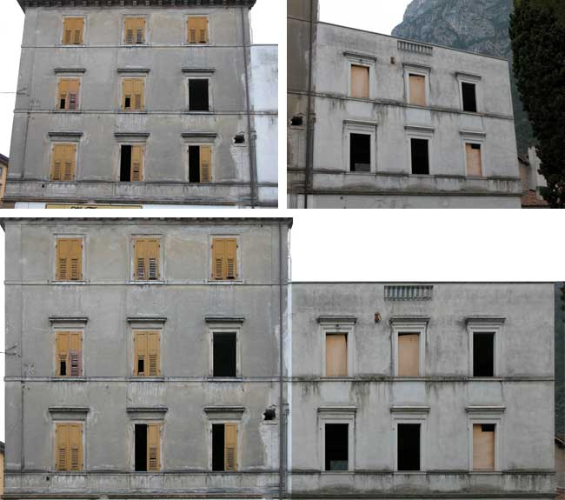
Image rectification
two original images
rectified and stitched

Slide 24
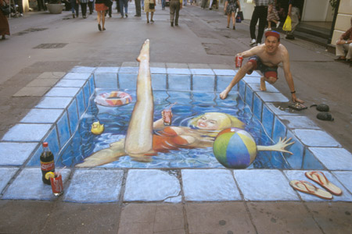
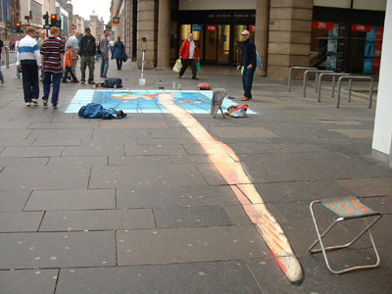
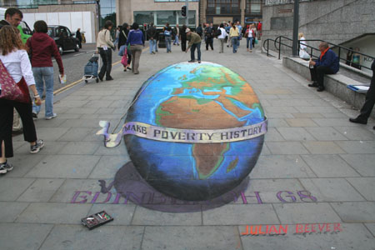
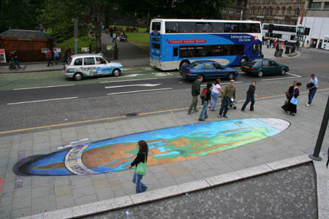
Street art

Slide 25
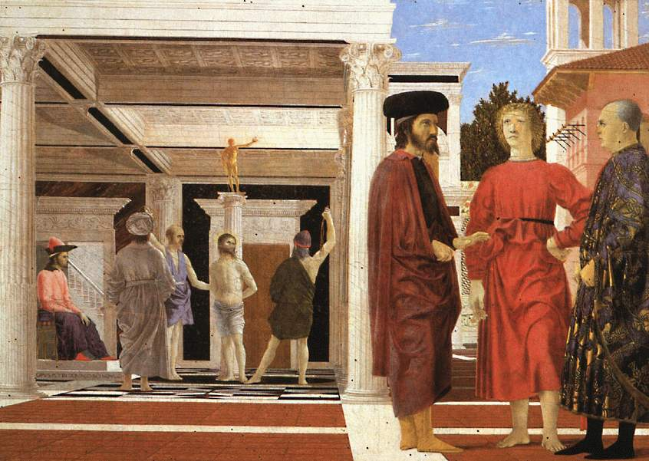

Understanding geometric patterns
What is the pattern on the floor?
magnified view of floor

Slide 26

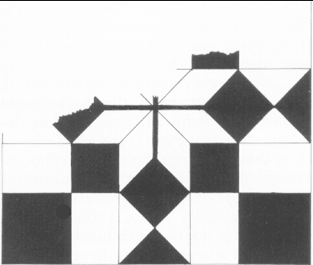
Understanding geometric patterns
What is the pattern on the floor?
Homography
reconstruction from rectified view
magnified view of floor
rectified view

Slide 27
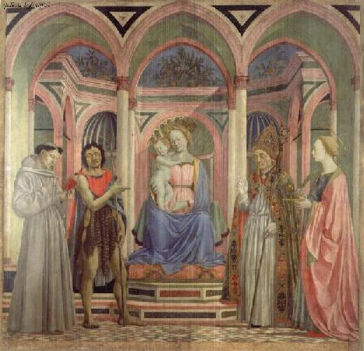
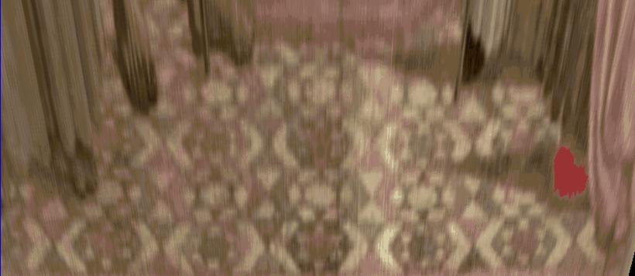
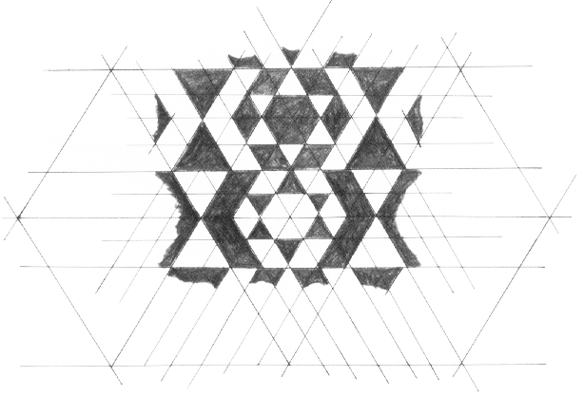
Understanding geometric patterns
Very popular in renaissance drawings (when perspective was discovered)
rectified view of floor
reconstruction

Slide 28
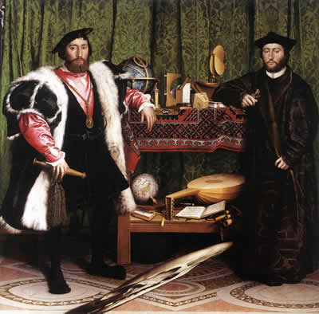
A weird drawing
Holbein, “The Ambassadors”

Slide 29
A weird drawing
Holbein, “The Ambassadors”
What’s this???

Slide 30
A weird drawing
Holbein, “The Ambassadors”
rectified view
skull under anamorphic perspective

Slide 31
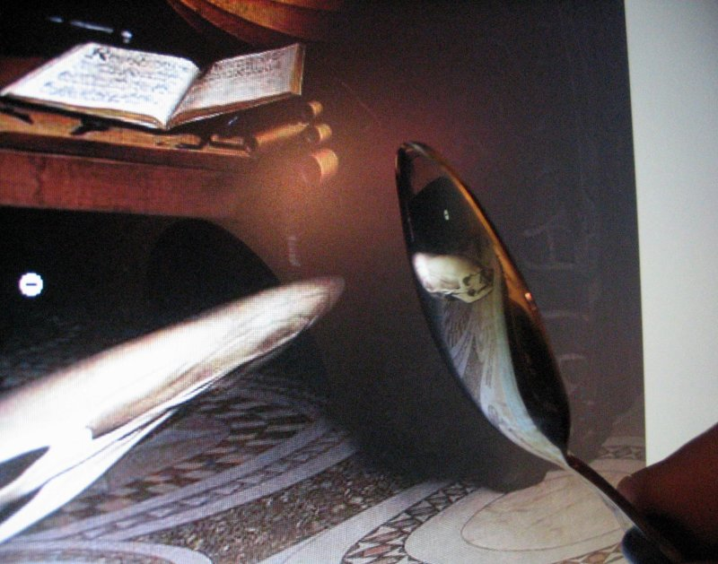
A weird drawing
Holbein, “The Ambassadors”
DIY: use a polished spoon to see the skull

Slide 32
Panoramas from image stitching
Capture multiple images from different viewpoints.
Stitch them together into a virtual wide-angle image.

Slide 33
When can we use homographies?

Slide 34
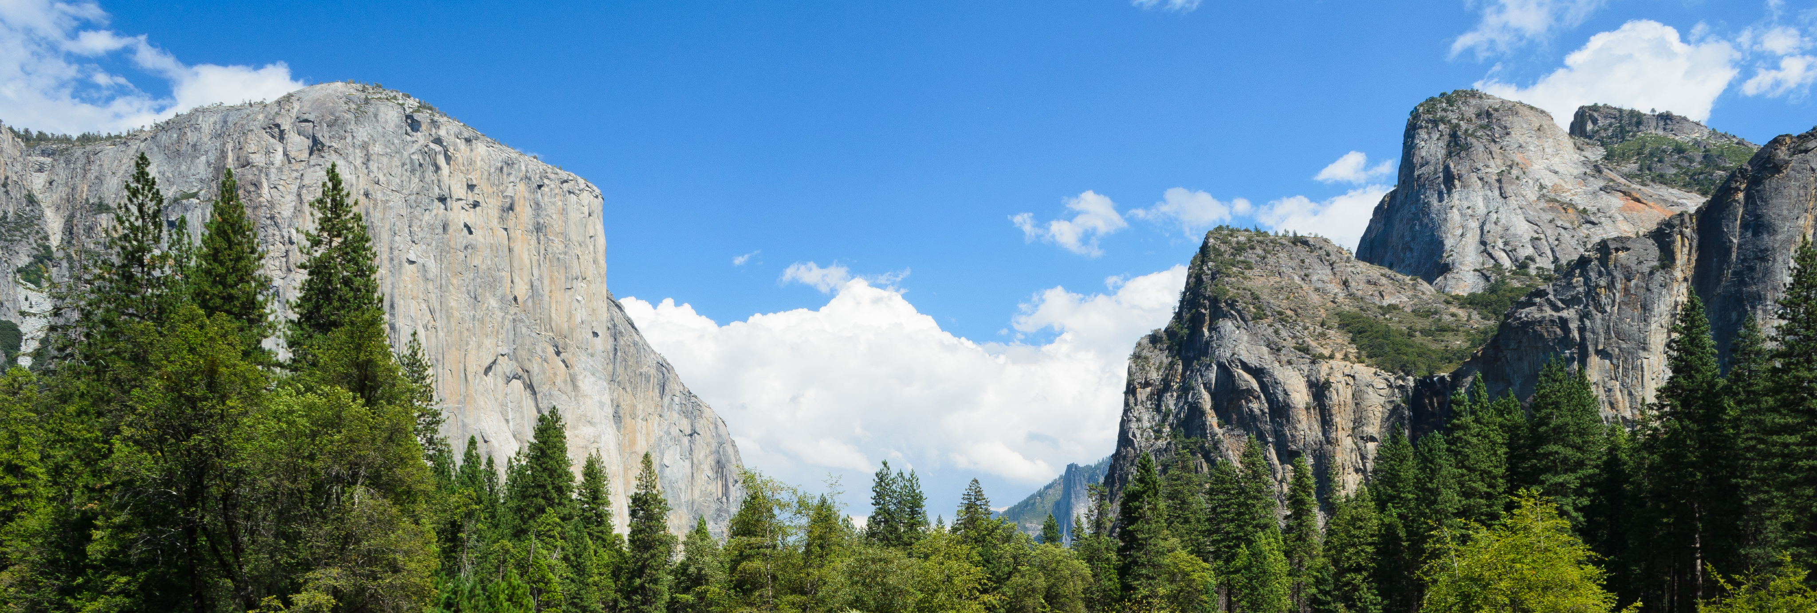
We can use homographies when…
… the scene is planar; or
… the scene is very far or has small (relative) depth variation → scene is approximately planar

Slide 35
We can use homographies when…
… the scene is captured under camera rotation only (no translation or pose change)
More on why this is the case in a later lecture.

Slide 36
Computing with homographies

Slide 37
Classification of 2D transformations
PP3
PP1
Which kind transformation is needed to warp projective plane 1 into projective plane 2?
PP2
A projective transformation (a.k.a. a homography).

Slide 38

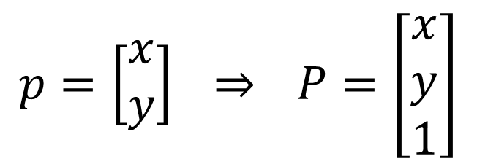
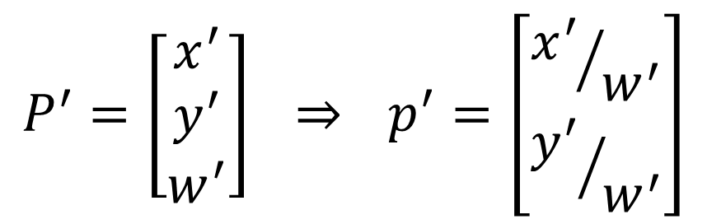
Applying a homography
$$p=\left[\begin{matrix}x \\ y\end{matrix}\right] \underset{⇒}{} P=\left[\begin{matrix}x \\ y \\ 1\end{matrix}\right]$$
Convert to homogeneous coordinates:
What is the size of the homography matrix?
Multiply by the homography matrix:
$$P^{′}=H⋅P$$
$$P^{′}=\left[\begin{matrix}x^{′} \\ y^{′} \\ w^{′}\end{matrix}\right] \underset{⇒}{} p^{′}=\left[\begin{matrix}{x^{′}}/{w^{′}} \\ {y^{′}}/{w^{′}}\end{matrix}\right]$$
Convert back to heterogeneous coordinates:

Slide 39
Applying a homography
$$p=\left[\begin{matrix}x \\ y\end{matrix}\right] \underset{⇒}{} P=\left[\begin{matrix}x \\ y \\ 1\end{matrix}\right]$$
Convert to homogeneous coordinates:
What is the size of the homography matrix?
Answer: 3 x 3
Multiply by the homography matrix:
$$P^{′}=H⋅P$$
How many degrees of freedom does the homography matrix have?
$$P^{′}=\left[\begin{matrix}x^{′} \\ y^{′} \\ w^{′}\end{matrix}\right] \underset{⇒}{} p^{′}=\left[\begin{matrix}{x^{′}}/{w^{′}} \\ {y^{′}}/{w^{′}}\end{matrix}\right]$$
Convert back to heterogeneous coordinates:

Slide 40
Applying a homography
$$p=\left[\begin{matrix}x \\ y\end{matrix}\right] \underset{⇒}{} P=\left[\begin{matrix}x \\ y \\ 1\end{matrix}\right]$$
Convert to homogeneous coordinates:
What is the size of the homography matrix?
Answer: 3 x 3
Multiply by the homography matrix:
$$P^{′}=H⋅P$$
How many degrees of freedom does the homography matrix have?
Answer: 8
$$P^{′}=\left[\begin{matrix}x^{′} \\ y^{′} \\ w^{′}\end{matrix}\right] \underset{⇒}{} p^{′}=\left[\begin{matrix}{x^{′}}/{w^{′}} \\ {y^{′}}/{w^{′}}\end{matrix}\right]$$
Convert back to heterogeneous coordinates:

Slide 41
Applying a homography
What is the size of the homography matrix?
Answer: 3 x 3
$$P^{′}=H⋅P$$
How many degrees of freedom does the homography matrix have?
Answer: 8
How do we compute the homography matrix?

Slide 42
The direct linear transform (DLT)

Slide 43











Create point correspondences
Given a set of matched feature points
$$\left\{p_{i},p_{i}^{′}\right\}$$
find the best estimate of
$$H$$
such that
$$P^{′}=H⋅P$$
$$p_{1}$$
$$p_{1}^{′}$$
$$p_{2}^{′}$$
$$p_{2}$$
$$p_{4}$$
$$p_{3}$$
$$p_{4}^{′}$$
$$p_{3}^{′}$$
original image
target image
How many correspondences do we need?

Slide 44
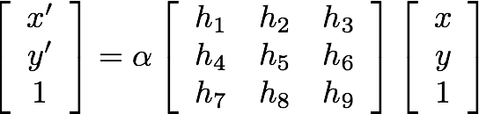

Determining the homography matrix
Write out linear equation for each correspondence:
$$P^{′}=H⋅P$$
or

Slide 45
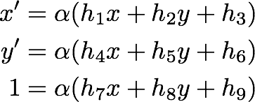
Determining the homography matrix
Write out linear equation for each correspondence:
$$P^{′}=H⋅P$$
or
Expand matrix multiplication:

Slide 46

Determining the homography matrix
Write out linear equation for each correspondence:
$$P^{′}=H⋅P$$
or
Expand matrix multiplication:
Divide out unknown scale factor:
How do you rearrange terms to make it a linear system?

Slide 47


Just rearrange the terms

Slide 48


Determining the homography matrix
Re-arrange terms:
Re-write in matrix form:
How many equations from one point correspondence?

Slide 49



Determining the homography matrix
Stack together constraints from multiple point correspondences:
Homogeneous linear least squares problem

Slide 50
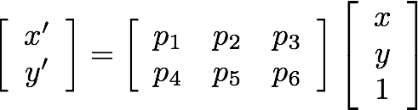



Reminder: Determining unknown transformations
Why can we drop the last line?
Affine transformation:
Vectorize transformation parameters:
Stack equations from point correspondences:
Notation in system form:

Slide 51
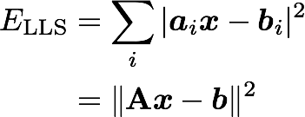


Reminder: Determining unknown transformations
Convert the system to a linear least-squares problem:
In Matlab:
x = A \ b
Expand the error:
Minimize the error:
Set derivative to 0
Note: You almost never want to compute the inverse of a matrix.
Solve for x

Slide 52
Determining the homography matrix
Stack together constraints from multiple point correspondences:
Homogeneous linear least squares problem
How do we solve this?

Slide 53
Determining the homography matrix
Stack together constraints from multiple point correspondences:
Homogeneous linear least squares problem
Solve with SVD

Slide 54

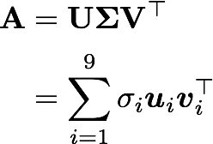
Singular Value Decomposition
ortho-normal
diagonal
ortho-normal
unit norm constraint
n x m
n x n
n x m
m x m
n x 1
1 x m
Each column of V represents a solution for
where the singular value represents the reprojection error

Slide 55



Solving for H using DLT
Given
solve for H such that
1. For each correspondence, create 2x9 matrix
2. Concatenate into single 2n x 9 matrix
3. Compute SVD of
4. Store singular vector of the smallest singular value
5. Reshape to get

Slide 56
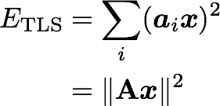




General form of total least squares
(Warning: change of notation. x is a vector of parameters!)
(matrix form)
constraint
(Rayleigh quotient)
minimize
minimize
subject to
Solution is the eigenvector
corresponding to smallest eigenvalue of
Solution is the column of V
corresponding to smallest singular value
(equivalent)

Slide 57
Linear least squares estimation only works when the transform function is linear! (duh)
Also doesn’t deal well with outliers.

Slide 58








Create point correspondences
$$p_{1}$$
$$p_{1}^{′}$$
$$p_{2}^{′}$$
$$p_{2}$$
$$p_{4}$$
$$p_{3}$$
$$p_{4}^{′}$$
$$p_{3}^{′}$$
original image
target image
How do we automate this step?

Slide 59
The image correspondence pipeline
Feature point detection
  Detect corners using the Harris corner detector.
Feature point description
  Describe features using the Multi-scale oriented patch descriptor.
Feature matching

Slide 60
The image correspondence pipeline
Feature point detection
  Detect corners using the Harris corner detector.
Feature point description
  Describe features using the Multi-scale oriented patch descriptor.
Feature matching

Slide 61
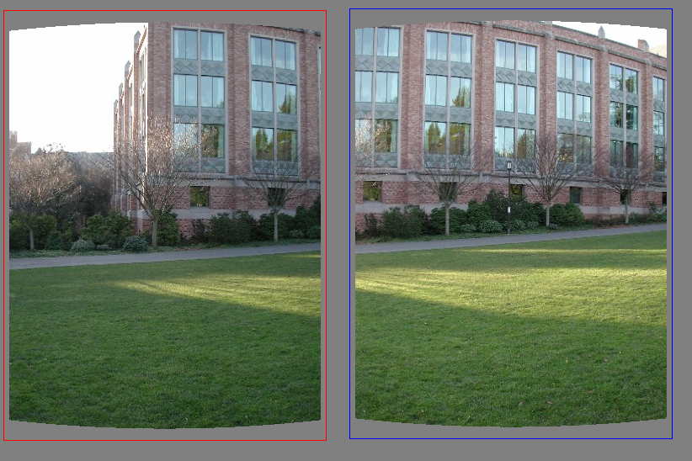
bad correspondence
good correspondence

Slide 62
Random Sample Consensus (RANSAC)

Slide 63
Fitting lines
(with outliers)
Algorithm:
Sample (randomly) the number of points required to fit the model
Solve for model parameters using samples
Score by the fraction of inliers within a preset threshold of the model
Repeat 1-3 until the best model is found with high confidence
Notes:
Let me give you an intuition of what is going on. Suppose we have the standard line fitting problem in presence of outliers.
We can formulate this problem as follows: want to find the best partition of points in inlier set and outlier set such that…
The objective consists of adjusting the parameters of a model function so as to best fit a data set.
"best" is defined by a function f that needs to be minimized.
Such that the best parameter of fitting the line give rise to a residual error lower that delta
as when the sum, S, of squared residuals

Slide 64
Fitting lines
(with outliers)
Algorithm:
Sample (randomly) the number of points required to fit the model
Solve for model parameters using samples
Score by the fraction of inliers within a preset threshold of the model
Repeat 1-3 until the best model is found with high confidence
Notes:
Let me give you an intuition of what is going on. Suppose we have the standard line fitting problem in presence of outliers.
We can formulate this problem as follows: want to find the best partition of points in inlier set and outlier set such that…
The objective consists of adjusting the parameters of a model function so as to best fit a data set.
"best" is defined by a function f that needs to be minimized.
Such that the best parameter of fitting the line give rise to a residual error lower that delta
as when the sum, S, of squared residuals

Slide 65
Fitting lines
(with outliers)
Algorithm:
Sample (randomly) the number of points required to fit the model
Solve for model parameters using samples
Score by the fraction of inliers within a preset threshold of the model
Repeat 1-3 until the best model is found with high confidence
Notes:
Let me give you an intuition of what is going on. Suppose we have the standard line fitting problem in presence of outliers.
We can formulate this problem as follows: want to find the best partition of points in inlier set and outlier set such that…
The objective consists of adjusting the parameters of a model function so as to best fit a data set.
"best" is defined by a function f that needs to be minimized.
Such that the best parameter of fitting the line give rise to a residual error lower that delta
as when the sum, S, of squared residuals

Slide 66


Fitting lines
(with outliers)
Algorithm:
Sample (randomly) the number of points required to fit the model
Solve for model parameters using samples
Score by the fraction of inliers within a preset threshold of the model
Repeat 1-3 until the best model is found with high confidence
Notes:
Let me give you an intuition of what is going on. Suppose we have the standard line fitting problem in presence of outliers.
We can formulate this problem as follows: want to find the best partition of points in inlier set and outlier set such that…
The objective consists of adjusting the parameters of a model function so as to best fit a data set.
"best" is defined by a function f that needs to be minimized.
Such that the best parameter of fitting the line give rise to a residual error lower that delta
as when the sum, S, of squared residuals

Slide 67

Fitting lines
(with outliers)
Algorithm:
Sample (randomly) the number of points required to fit the model
Solve for model parameters using samples
Score by the fraction of inliers within a preset threshold of the model
Repeat 1-3 until the best model is found with high confidence
Notes:
Let me give you an intuition of what is going on. Suppose we have the standard line fitting problem in presence of outliers.
We can formulate this problem as follows: want to find the best partition of points in inlier set and outlier set such that…
The objective consists of adjusting the parameters of a model function so as to best fit a data set.
"best" is defined by a function f that needs to be minimized.
Such that the best parameter of fitting the line give rise to a residual error lower that delta
as when the sum, S, of squared residuals

Slide 68
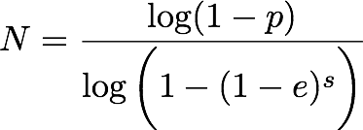
How to choose parameters?
Number of samples N
  Choose N so that, with probability p, at least one random sample is free from outliers (e.g. p=0.99) (outlier ratio: e )
Number of sampled points s
  Minimum number needed to fit the model
Distance threshold δ
  Choose δ so that a good point with noise is likely (e.g., prob=0.95) within threshold
  Zero-mean Gaussian noise with std. dev. σ: t²=3.84σ²
 | proportion of outliers e
s | 5% | 10% | 20% | 25% | 30% | 40% | 50%
2 | 2 | 3 | 5 | 6 | 7 | 11 | 17
3 | 3 | 4 | 7 | 9 | 11 | 19 | 35
4 | 3 | 5 | 9 | 13 | 17 | 34 | 72
5 | 4 | 6 | 12 | 17 | 26 | 57 | 146
6 | 4 | 7 | 16 | 24 | 37 | 97 | 293
7 | 4 | 8 | 20 | 33 | 54 | 163 | 588
8 | 5 | 9 | 26 | 44 | 78 | 272 | 1177

Slide 69
Given two images…
find matching features (e.g., SIFT) and a translation transform

Slide 70
Matched points will usually contain bad correspondences
bad correspondence
good correspondence
how should we estimate the transform?

Slide 71
LLS will find the ‘average’ transform
‘average’ transform
solution is corrupted by bad correspondences

Slide 72
Use RANSAC
How many correspondences to compute translation transform?

Slide 73
Need only one correspondence, to find translation model

Slide 74
Pick one correspondence, count inliers
one
correspondence

Slide 75
Pick one correspondence, count inliers
2 inliers

Slide 76
Pick one correspondence, count inliers
one
correspondence

Slide 77
Pick one correspondence, count inliers
5 inliers

Slide 78
Pick one correspondence, count inliers
5 inliers
Pick the model with the highest number of inliers!

Slide 79
Estimating homography using RANSAC
RANSAC loop
  Get four point correspondences (randomly)
  Compute H (DLT)
  Count inliers
  Keep if largest number of inliers
Recompute H using all inliers

Slide 80
Estimating homography using RANSAC
RANSAC loop
  Get four point correspondences (randomly)
  Compute H using DLT
  Count inliers
  Keep if largest number of inliers
Recompute H using all inliers

Slide 81
Estimating homography using RANSAC
RANSAC loop
  Get four point correspondences (randomly)
  Compute H using DLT
  Count inliers
  Keep if largest number of inliers
Recompute H using all inliers

Slide 82
Estimating homography using RANSAC
RANSAC loop
  Get four point correspondences (randomly)
  Compute H using DLT
  Count inliers
  Keep H if largest number of inliers
Recompute H using all inliers

Slide 83

Estimating homography using RANSAC
RANSAC loop
  Get four point correspondences (randomly)
  Compute H using DLT
  Count inliers
  Keep H if largest number of inliers
Recompute H using all inliers

Slide 84
Useful for…

Slide 86
The image correspondence pipeline
Feature point detection
  Detect corners using the Harris corner detector.
Feature point description
  Describe features using the Multi-scale oriented patch descriptor.
Feature matching and homography estimation
  Do both simultaneously using RANSAC.

Slide 87
References
Basic reading:
Szeliski textbook, Sections 6.1.
Additional reading:
Hartley and Zisserman, “Multiple View Geometry,” Cambridge University Press 2003.
as usual when it comes to geometry and vision, this book is the best reference; Sections 2 and 4 in particular discuss everything about homography estimation

