Slide 1

2D transformations (a.k.a. warping)
16-385 Computer Vision
Spring 2019, Lecture 7
http://www.cs.cmu.edu/~16385/

Slide 2
Course announcements
Homework 2 is posted on the course website.
- It is due on February 27th at 23:59 pm.
- Start early because it is much larger and more difficult than homework 1.
- Note the updated deadline – homeworks are now back in sync with lectures, but homework 4 will be turned into a single-week homework.

Slide 3
Overview of today’s lecture
Reminder: image transformations.
2D transformations.
Projective geometry 101.
Transformations in projective geometry.
Classification of 2D transformations.
Determining unknown 2D transformations.
Determining unknown image warps.

Slide 4
Slide credits
Most of these slides were adapted from:
Kris Kitani (16-385, Spring 2017).

Slide 5
Reminder: image transformations

Slide 6

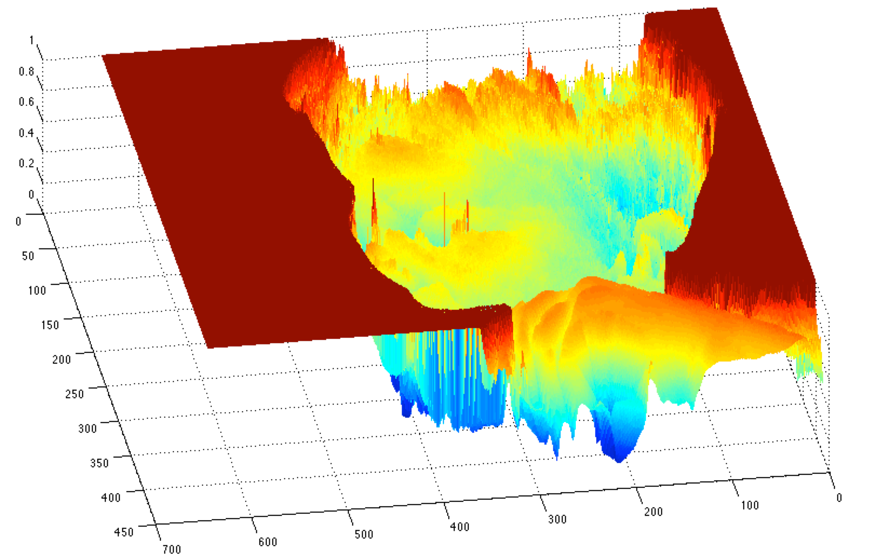


What is an image?
A (grayscale) image is a 2D function.
grayscale image
What is the range of the image function f?
domain

Slide 7

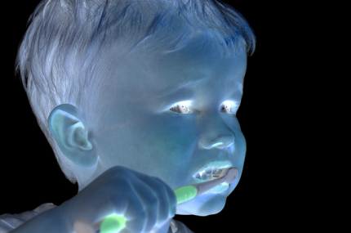
What types of image transformations can we do?
Filtering
Warping
changes pixel values
changes pixel locations

Slide 8


What types of image transformations can we do?
Filtering
Warping
changes range of image function
changes domain of image function

Slide 9
Warping example: feature matching

Slide 10
Warping example: feature matching

Slide 11
Warping example: feature matching
object recognition
3D reconstruction
augmented reality
image stitching
How do you compute the transformation?

Slide 12


Warping example: feature matching
Given a set of matched feature points:
point in one image
point in the other image
and a transformation:
transformation
function
parameters
find the best estimate of the parameters
What kind of transformation functions are there?

Slide 13
2D transformations

Slide 14
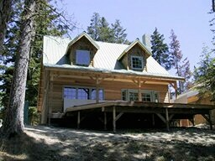
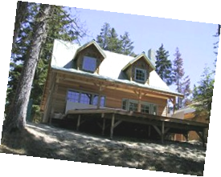
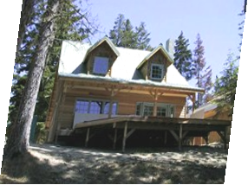
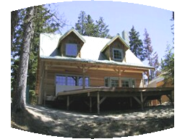
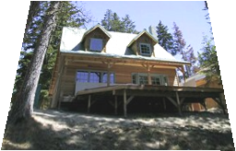
2D transformations
translation
rotation
aspect
affine
perspective
cylindrical

Slide 15


2D planar transformations

Slide 16

How would you implement scaling?
Scale
Each component multiplied by a scalar
Uniform scaling - same scalar for each component

Slide 17
What’s the effect of using different scale factors?
Scale
Each component multiplied by a scalar
Uniform scaling - same scalar for each component

Slide 18

matrix representation of scaling:
Scale
scaling matrix S
Each component multiplied by a scalar
Uniform scaling - same scalar for each component

Slide 19
How would you implement shearing?
Shear

Slide 20


Shear
or in matrix form:

Slide 21

How would you implement rotation?
rotation around the origin

Slide 22

rotation around the origin

Slide 23



Polar coordinates…
x = r cos (φ)
y = r sin (φ)
x’ = r cos (φ + θ)
y’ = r sin (φ + θ)
Trigonometric Identity…
x’ = r cos(φ) cos(θ) – r sin(φ) sin(θ)
y’ = r sin(φ) cos(θ) + r cos(φ) sin(θ)
Substitute…
x’ = x cos(θ) - y sin(θ)
y’ = x sin(θ) + y cos(θ)
$$r$$
rotation around the origin
$$r$$
$$φ$$

Slide 24

or in matrix form:
rotation around the origin

Slide 25
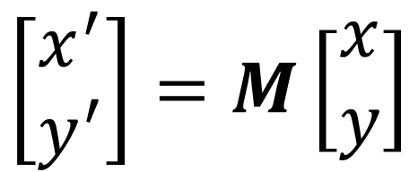
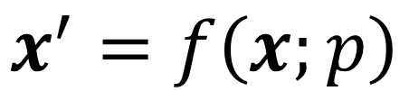


2D planar and linear transformations
$$x^{′}=f\left(x;p\right)$$
$$\left[\begin{matrix}x^{′} \\ y^{′}\end{matrix}\right]=M\left[\begin{matrix}x \\ y\end{matrix}\right]$$
parameters
$$p$$
point
$$x$$

Slide 26






2D planar and linear transformations
Scale
Flip across y
Rotate
Flip across origin
Shear
Identity

Slide 27
2D translation
How would you implement translation?

Slide 28


2D translation
What about matrix representation?

Slide 29
2D translation
What about matrix representation?
Not possible.

Slide 30
Projective geometry 101

Slide 31
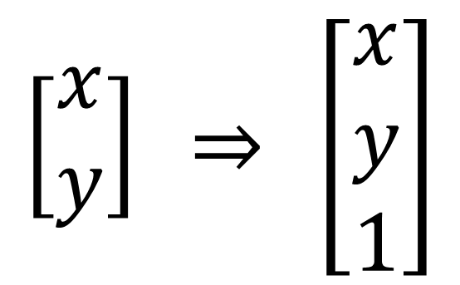
Homogeneous coordinates
heterogeneous coordinates
homogeneous coordinates
$$\left[\begin{matrix}x \\ y\end{matrix}\right] \underset{⇒}{} \left[\begin{matrix}x \\ y \\ 1\end{matrix}\right]$$
add a 1 here
Represent 2D point with a 3D vector

Slide 32
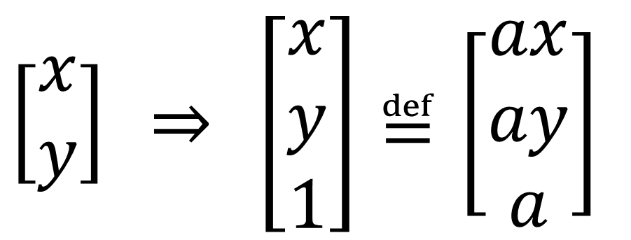
Homogeneous coordinates
heterogeneous coordinates
homogeneous coordinates
$$\left[\begin{matrix}x \\ y\end{matrix}\right] \underset{⇒}{} \left[\begin{matrix}x \\ y \\ 1\end{matrix}\right]≝\left[\begin{matrix}ax \\ ay \\ a\end{matrix}\right]$$
Represent 2D point with a 3D vector
3D vectors are only defined up to scale

Slide 33
2D translation
What about matrix representation using homogeneous coordinates?

Slide 34
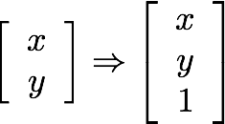
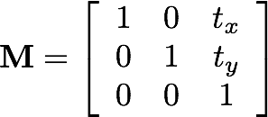
2D translation
What about matrix representation using heterogeneous coordinates?

Slide 35
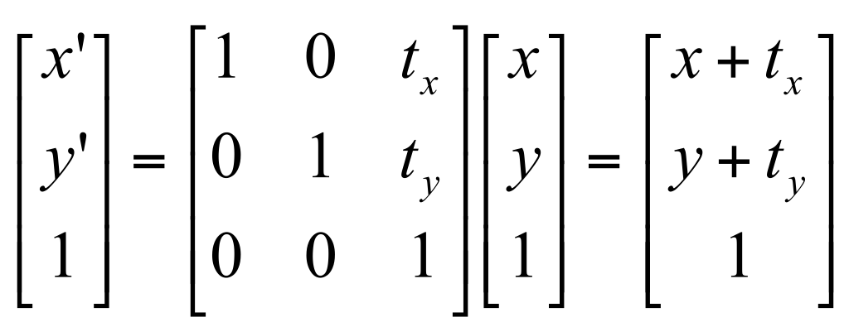

2D translation using homogeneous coordinates

Slide 36

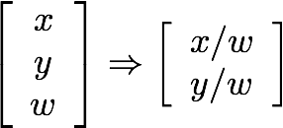

Homogeneous coordinates
Conversion:
heterogeneous → homogeneous
homogeneous → heterogeneous
scale invariance
Special points:
point at infinity
undefined

Slide 37
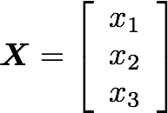
Projective geometry
image plane
image point in pixel coordinates
X is a projection of a point P on the image plane
image point in homogeneous coordinates
What does scaling X correspond to?

Slide 38
Transformations in projective geometry

Slide 39
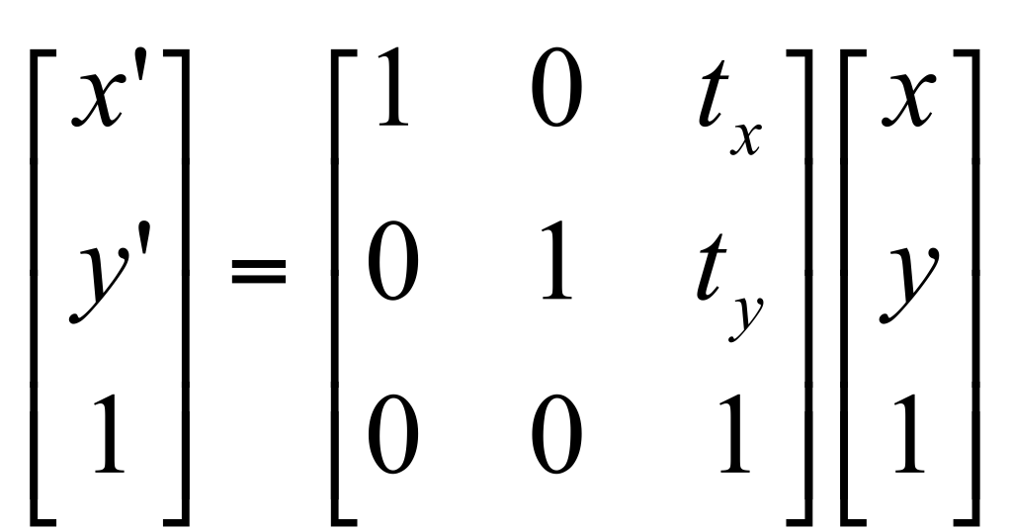
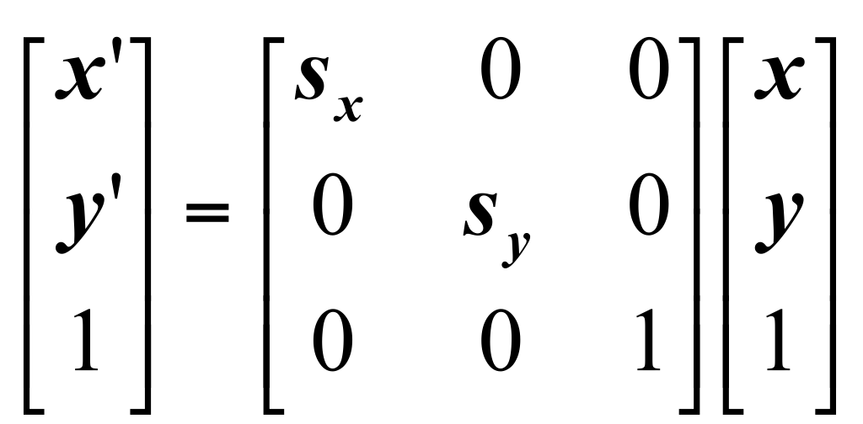
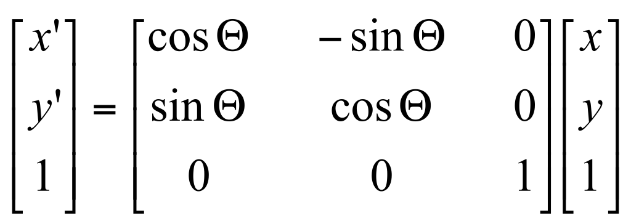
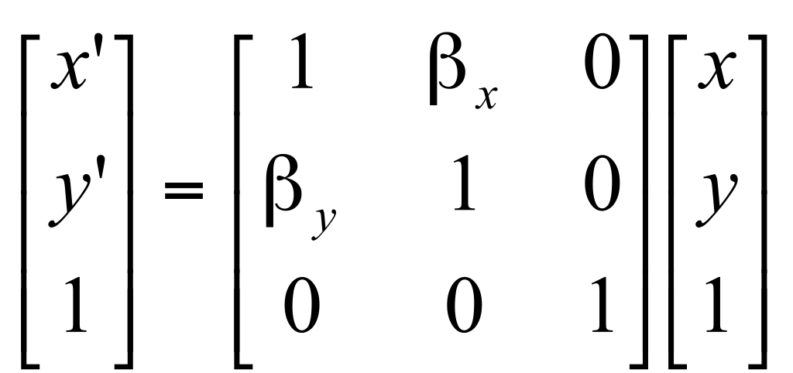
2D transformations in heterogeneous coordinates
Re-write these transformations as 3x3 matrices:
?
translation
scaling
?
?
rotation
shearing

Slide 40
2D transformations in heterogeneous coordinates
Re-write these transformations as 3x3 matrices:
translation
scaling
?
?
rotation
shearing

Slide 41
2D transformations in heterogeneous coordinates
Re-write these transformations as 3x3 matrices:
translation
scaling
?
rotation
shearing

Slide 42
2D transformations in heterogeneous coordinates
Re-write these transformations as 3x3 matrices:
translation
scaling
rotation
shearing

Slide 43
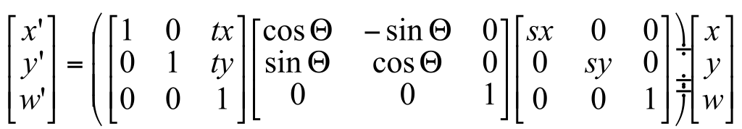
Matrix composition
Transformations can be combined by matrix multiplication:
p’ = ? ? ? p

Slide 44
Matrix composition
Transformations can be combined by matrix multiplication:
p’ = translation(t_{x},t_{y}) rotation(θ) scale(s,s) p
Does the multiplication order matter?

Slide 45
Classification of 2D transformations

Slide 46
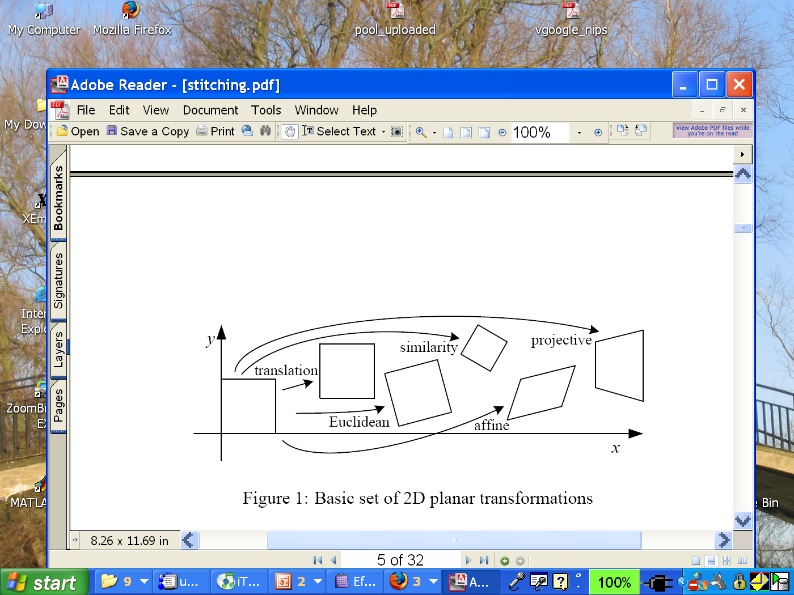
Classification of 2D transformations

Slide 47
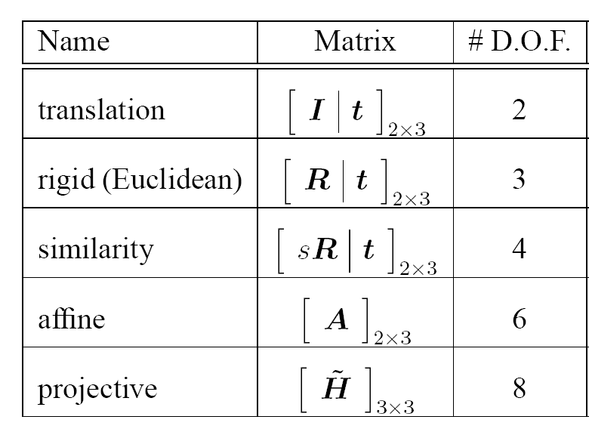
Classification of 2D transformations
?
?
?
?
?

Slide 48
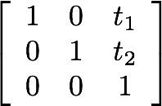
Classification of 2D transformations
Translation:
How many degrees of freedom?

Slide 49
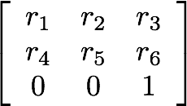
Classification of 2D transformations
Euclidean (rigid):
rotation + translation
Are there any values that are related?

Slide 50
Classification of 2D transformations
Euclidean (rigid):
rotation + translation
How many degrees of freedom?

Slide 51
Classification of 2D transformations
which other matrix values will change if this increases?
Euclidean (rigid):
rotation + translation

Slide 52
Classification of 2D transformations
what will happen to the image if this increases?
Euclidean (rigid):
rotation + translation

Slide 53
Classification of 2D transformations
what will happen to the image if this increases?
Euclidean (rigid):
rotation + translation

Slide 54
Classification of 2D transformations
Similarity:
uniform scaling + rotation
+ translation
Are there any values that are related?

Slide 55
Classification of 2D transformations
multiply these four by scale s
Similarity:
uniform scaling + rotation
+ translation
How many degrees of freedom?

Slide 56
Classification of 2D transformations
what will happen to the image if this increases?
Similarity:
uniform scaling + rotation
+ translation

Slide 57
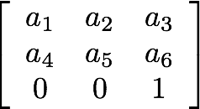
Classification of 2D transformations
Affine transform:
uniform scaling + shearing
+ rotation + translation
Are there any values that are related?

Slide 58
Classification of 2D transformations
Affine transform:
uniform scaling + shearing
+ rotation + translation
Are there any values that are related?
similarity
shear

Slide 59
Classification of 2D transformations
Affine transform:
uniform scaling + shearing
+ rotation + translation
How many degrees of freedom?
similarity
shear

Slide 60
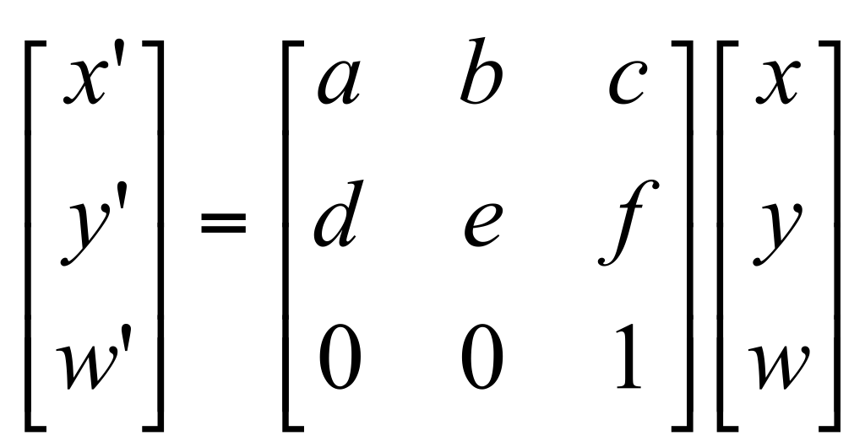
Affine transformations
Affine transformations are combinations of
arbitrary (4-DOF) linear transformations; and
translations
Properties of affine transformations:
origin does not necessarily map to origin
lines map to lines
parallel lines map to parallel lines
ratios are preserved
compositions of affine transforms are also affine transforms
Does the last coordinate w ever change?

Slide 61
Affine transformations
Affine transformations are combinations of
arbitrary (4-DOF) linear transformations; and
translations
Properties of affine transformations:
origin does not necessarily map to origin
lines map to lines
parallel lines map to parallel lines
ratios are preserved
compositions of affine transforms are also affine transforms
Nope! But what does that mean?

Slide 62
How to interpret affine transformations here?
image plane
image point in pixel coordinates
X is a projection of a point P on the image plane
image point in heterogeneous coordinates

Slide 63
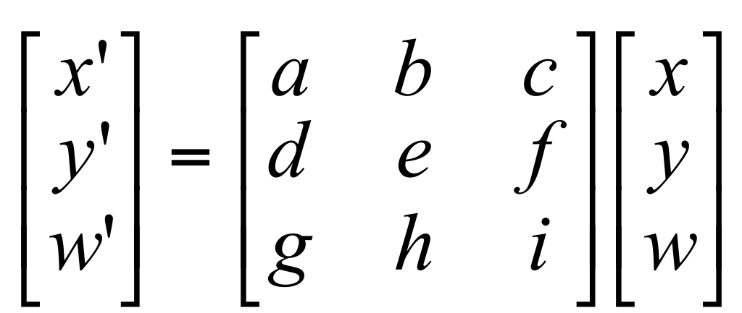
Projective transformations
Projective transformations are combinations of
affine transformations; and
projective wraps
Properties of projective transformations:
origin does not necessarily map to origin
lines map to lines
parallel lines do not necessarily map to parallel lines
ratios are not necessarily preserved
compositions of projective transforms are also projective transforms
How many degrees of freedom?

Slide 64
Projective transformations
Projective transformations are combinations of
affine transformations; and
projective wraps
Properties of projective transformations:
origin does not necessarily map to origin
lines map to lines
parallel lines do not necessarily map to parallel lines
ratios are not necessarily preserved
compositions of projective transforms are also projective transforms
8 DOF: vectors (and therefore matrices) are defined up to scale)

Slide 65
How to interpret projective transformations here?
image plane
image point in pixel coordinates
X is a projection of a point P on the image plane
image point in heterogeneous coordinates

Slide 66
Determining unknown 2D transformations

Slide 67
Determining unknown transformations
Suppose we have two triangles: ABC and DEF.
B
E
D
C
A
F

Slide 68
Determining unknown transformations
Suppose we have two triangles: ABC and DEF.
What type of transformation will map A to D, B to E, and C to F?
B
E
D
C
A
F

Slide 69
Determining unknown transformations
Suppose we have two triangles: ABC and DEF.
What type of transformation will map A to D, B to E, and C to F?
How do we determine the unknown parameters?
B
E
D
C
A
F
Affine transform:
uniform scaling + shearing
+ rotation + translation
How many degrees of freedom do we have?

Slide 70
Determining unknown transformations
Suppose we have two triangles: ABC and DEF.
What type of transformation will map A to D, B to E, and C to F?
How do we determine the unknown parameters?
B
E
D
C
A
F
unknowns
One point correspondence gives how many equations?
How many point correspondences do we need?
point correspondences

Slide 71
Determining unknown transformations
Suppose we have two triangles: ABC and DEF.
What type of transformation will map A to D, B to E, and C to F?
How do we determine the unknown parameters?
B
E
D
C
A
F
unknowns
How do we solve this for M?
point correspondences

Slide 72






Least Squares Error

Slide 73


Least Squares Error
What is this?
What is this?
What is this?

Slide 74



Least Squares Error
Euclidean (L2) norm
Euclidean (L2) norm
squared!
predicted
location
measured location

Slide 75
Least Squares Error
Residual (projection error)

Slide 76
Least Squares Error
What is the free variable?
What do we want to optimize?

Slide 77

Find parameters that minimize squared error

Slide 78
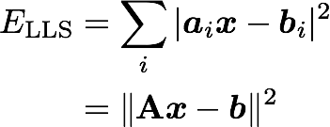
General form of linear least squares
(Warning: change of notation. x is a vector of parameters!)
(matrix form)

Slide 79
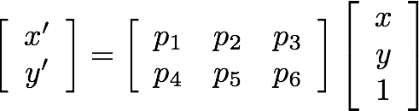



Determining unknown transformations
Why can we drop the last line?
Affine transformation:
Vectorize transformation parameters:
Stack equations from point correspondences:
Notation in system form:

Slide 80
General form of linear least squares
(Warning: change of notation. x is a vector of parameters!)
(matrix form)
This function is quadratic.
How do you find the root of a quadratic?

Slide 81


Solving the linear system
Convert the system to a linear least-squares problem:
In Matlab:
x = A \ b
Expand the error:
Minimize the error:
Set derivative to 0
Note: You almost never want to compute the inverse of a matrix.
Solve for x

Slide 82
Linear least squares estimation only works when the transform function is ?

Slide 83
Linear least squares estimation only works when the transform function is linear! (duh)
Also doesn’t deal well with outliers

Slide 84
Determining unknown image warps

Slide 85
Determining unknown image warps
Suppose we have two images.
How do we compute the transform that takes one to the other?
T(x, y)
y
y’
x
x’
f(x, y)
g(x’, y’)

Slide 86
Forward warping
Suppose we have two images.
How do we compute the transform that takes one to the other?
T(x, y)
y
y’
x
x’
f(x, y)
g(x’, y’)
later lecture
Form enough pixel-to-pixel correspondences between two images
Solve for linear transform parameters as before
Send intensities f(x,y) in first image to their corresponding location in the second image

Slide 87
Forward warping
Suppose we have two images.
How do we compute the transform that takes one to the other?
T(x, y)
y
y’
x
x’
f(x, y)
g(x’, y’)
what is the problem with this?
Form enough pixel-to-pixel correspondences between two images
Solve for linear transform parameters as before
Send intensities f(x,y) in first image to their corresponding location in the second image

Slide 88
Forward warping
Pixels may end up between two points
How do we determine the intensity of each point?
f(x,y)
g(x’,y’)
T(x,y)
y
y’
x
x’

Slide 89
Forward warping
Pixels may end up between two points
How do we determine the intensity of each point?
We distribute color among neighboring pixels (x’,y’) (“splatting”)
f(x,y)
g(x’,y’)
T(x,y)
y
y’
x
x’
What if a pixel (x’,y’) receives intensity from more than one pixels (x,y)?

Slide 90
Forward warping
Pixels may end up between two points
How do we determine the intensity of each point?
We distribute color among neighboring pixels (x’,y’) (“splatting”)
f(x,y)
g(x’,y’)
T(x,y)
y
y’
x
x’
What if a pixel (x’,y’) receives intensity from more than one pixels (x,y)?
We average their intensity contributions.

Slide 91
Inverse warping
Suppose we have two images.
How do we compute the transform that takes one to the other?
T⁻¹(x, y)
y
y’
x
x’
f(x, y)
g(x’, y’)
what is the problem with this?
Form enough pixel-to-pixel correspondences between two images
Solve for linear transform parameters as before, then compute its inverse
Get intensities g(x',y') in in the second image from point (x,y) = T⁻¹(x’,y’) in first image

Slide 92
Inverse warping
Pixel may come from between two points
How do we determine its intensity?
f(x,y)
g(x’,y’)
T⁻¹(x,y)
y
y’
x
x’

Slide 93
Inverse warping
Pixel may come from between two points
How do we determine its intensity?
Use interpolation
f(x,y)
g(x’,y’)
T⁻¹(x,y)
y
y’
x
x’

Slide 94
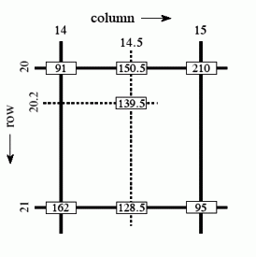

Bilinear interpolation
Grayscale example
In Matlab:
call interp2
Interpolate to find R2
Interpolate to find R1
Interpolate to find P
In matrix form (with adjusted coordinates)

Slide 95
Forward vs inverse warping
Suppose we have two images.
How do we compute the transform that takes one to the other?
T(x, y)
T⁻¹(x, y)
y
y’
x
x’
f(x, y)
g(x’, y’)
Pros and cons of each?

Slide 96
Forward vs inverse warping
Suppose we have two images.
How do we compute the transform that takes one to the other?
T(x, y)
T⁻¹(x, y)
y
y’
x
x’
f(x, y)
g(x’, y’)
Inverse warping eliminates holes in target image
Forward warping does not require existence of inverse transform

Slide 97
References
Basic reading:
Szeliski textbook, Section 3.6.
Additional reading:
Hartley and Zisserman, “Multiple View Geometry in Computer Vision,” Cambridge University Press 2004.
a comprehensive treatment of all aspects of projective geometry relating to computer vision, and also a very useful reference for the second part of the class.
Richter-Gebert, “Perspectives on projective geometry,” Springer 2011.
a beautiful, thorough, and very accessible mathematics textbook on projective geometry (available online for free from CMU’s library).

