Slide 1
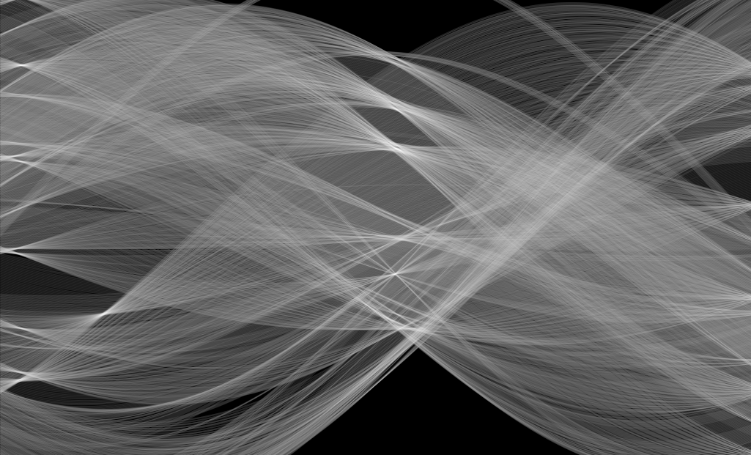
Hough transform
16-385 Computer Vision
Spring 2019, Lecture 4
http://www.cs.cmu.edu/~16385/

Slide 2
Course announcements
Homework 1 is now due on Monday February 11th!
- Any questions about the homework?
- How many of you have looked at/started/finished homework 1?
Some changes to office hours for this week only:
- Tuesday’s office hours will be 5:30-7:30 pm and will be covered by Yannis.
- Friday’s 3-5 pm office hours will be covered by Anshuman.
- There will be an extra set of office hours this week to make up for the change.

Slide 3
Overview of today’s lecture
Leftover from Lecture 3:
Frequency-domain filtering.
Revisiting sampling.
New in lecture 4:
Finding boundaries.
Line fitting.
Line parameterizations.
Hough transform.
Hough circles.
Some applications.

Slide 4
Slide credits
Most of these slides were adapted from:
Kris Kitani (15-463, Fall 2016).
Some slides were inspired or taken from:
Fredo Durand (MIT).
James Hays (Georgia Tech).

Slide 5
Finding boundaries

Slide 6
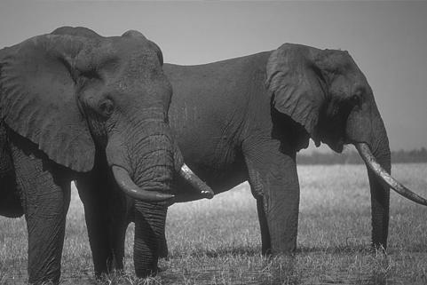
Where are the object boundaries?

Slide 7
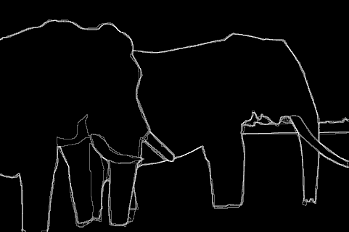
Human annotated boundaries

Slide 8
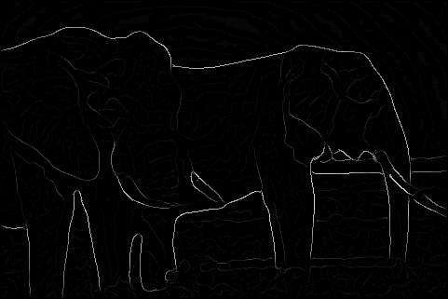
edge detection

Slide 9
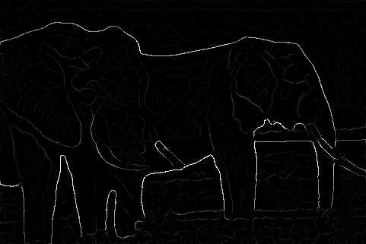
Multi-scale edge detection

Slide 10
Edge strength does not necessarily
correspond to our perception of boundaries

Slide 11
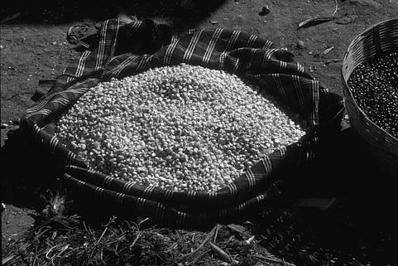
Where are the object boundaries?

Slide 12
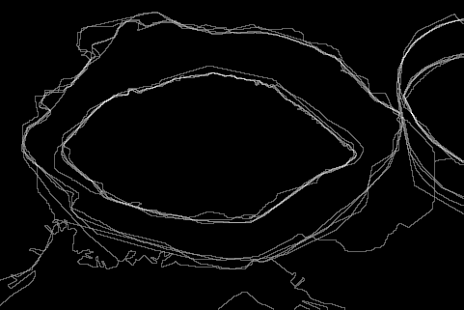
Human annotated boundaries

Slide 13
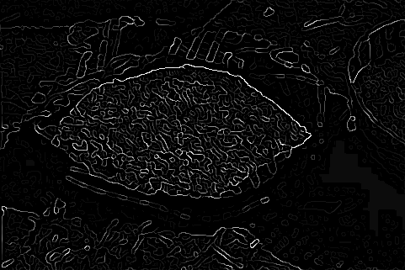
edge detection

Slide 14
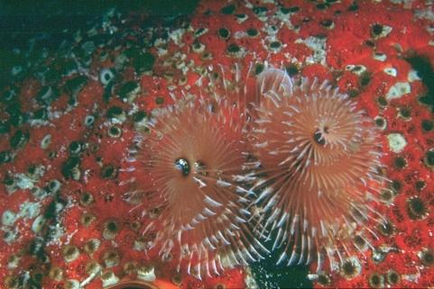
Defining boundaries are hard for us too

Slide 15
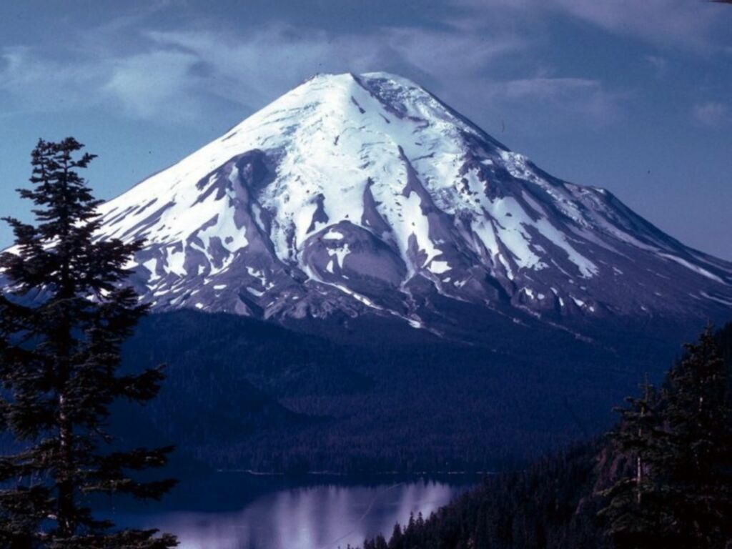
Where is the boundary of the mountain top?

Slide 16
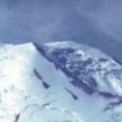
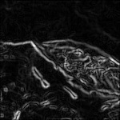
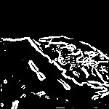
Lines are hard to find
Original image
Edge detection
Thresholding
Noisy edge image
Incomplete boundaries

Slide 17
Applications
Autonomous Vehicles
(lane line detection)
tissue engineering
(blood vessel counting)
behavioral genetics
(earthworm contours)
Autonomous Vehicles
(semantic scene segmentation)
Computational Photography
(image inpainting)

Slide 18


Slide 19
Line fitting

Slide 20
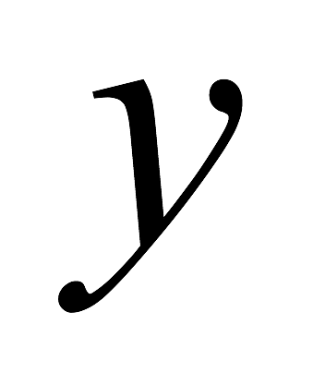
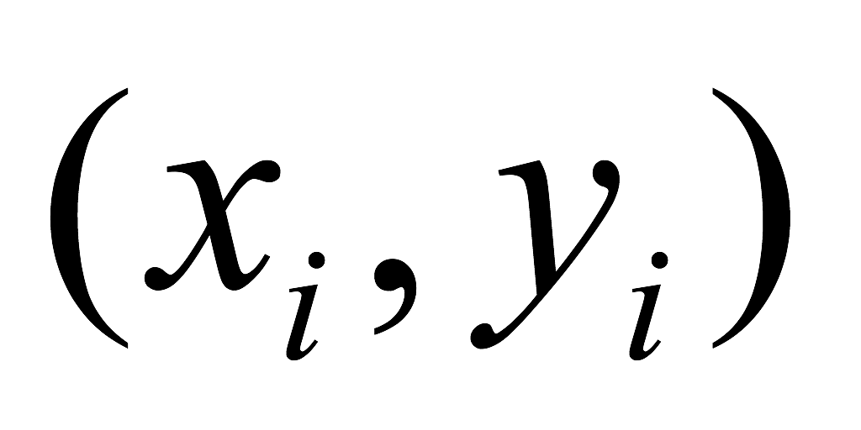
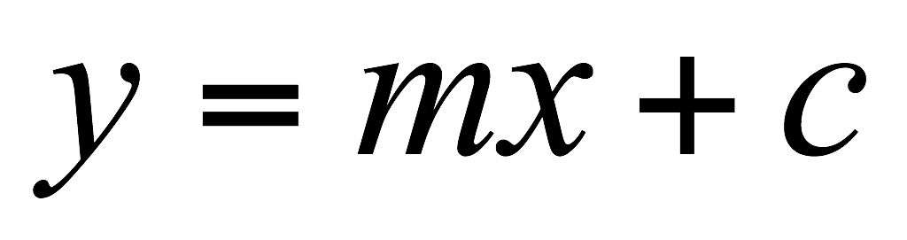
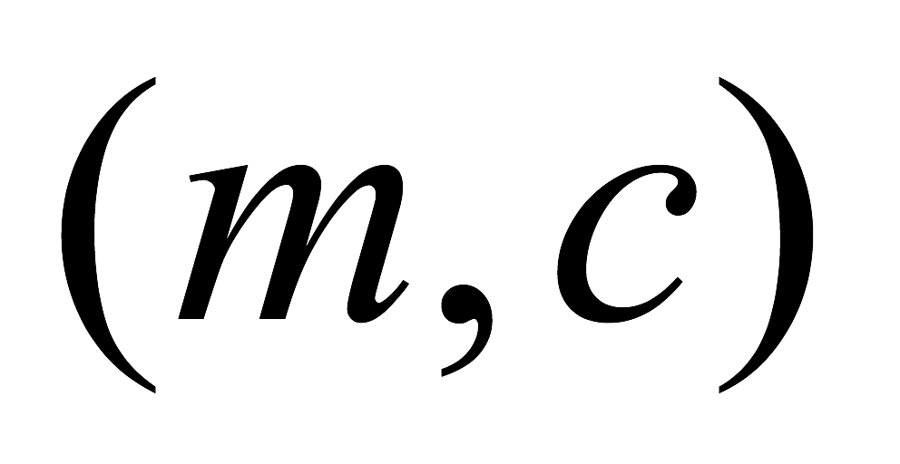
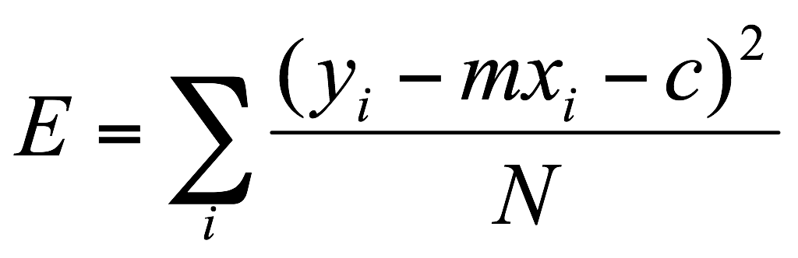
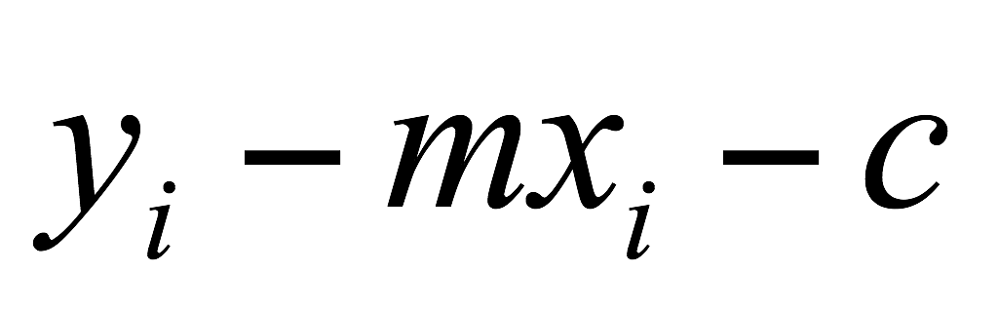
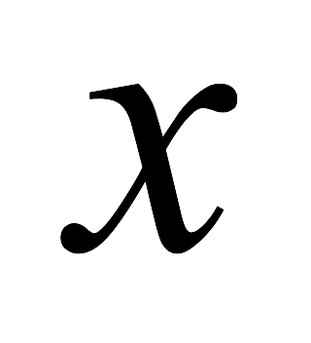
Line fitting
Given: Many pairs
Find: Parameters
Minimize: Average square distance:
Using:
Note:

Slide 21
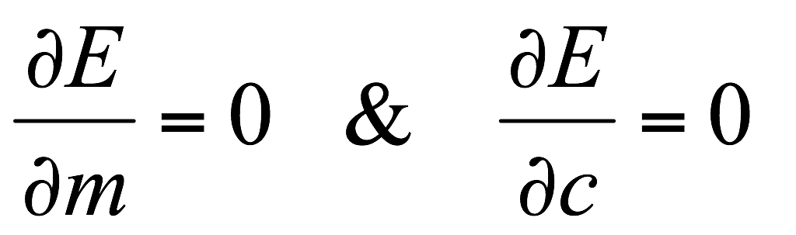
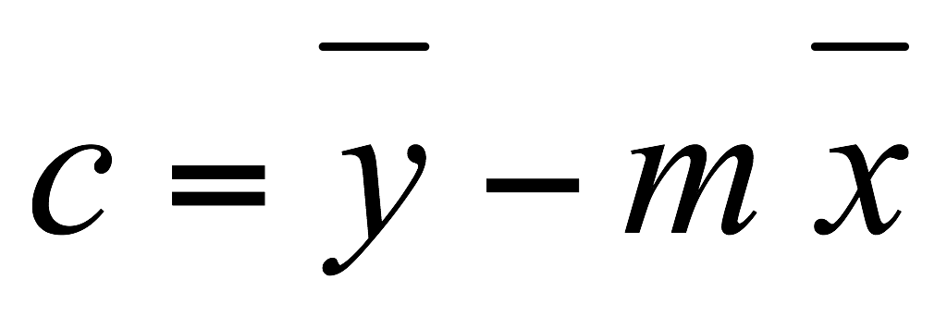
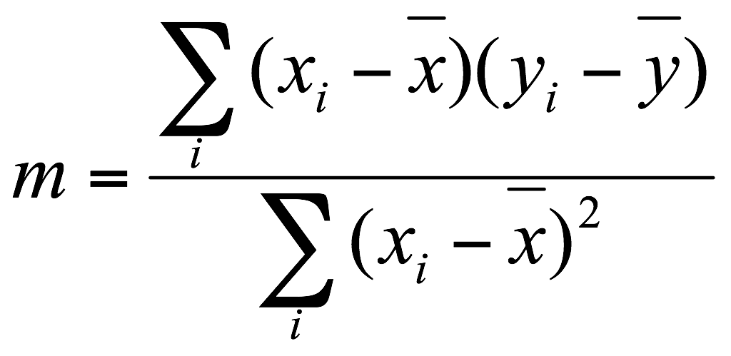
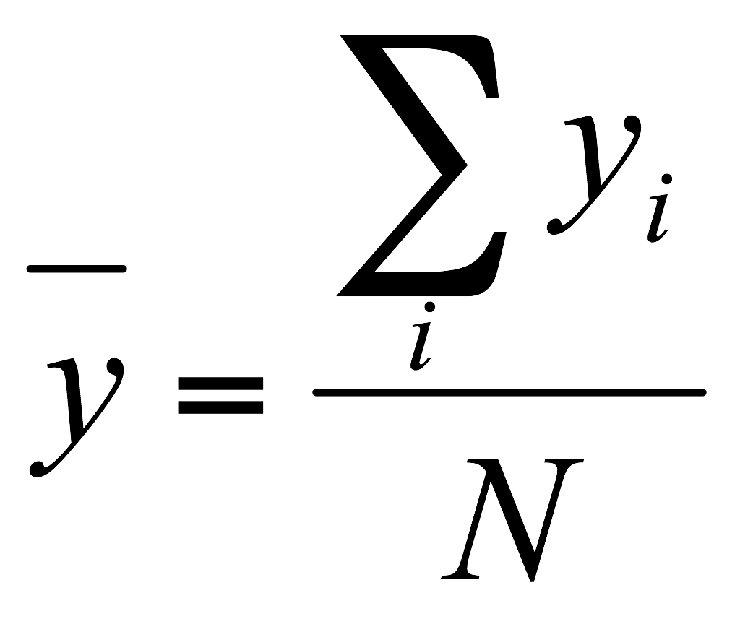
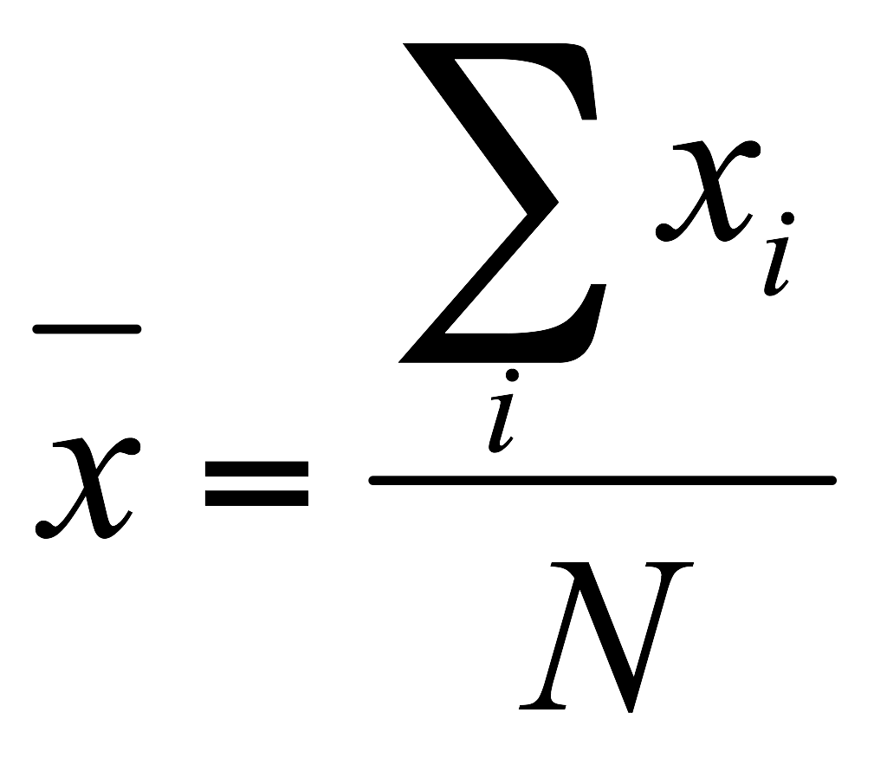
Line fitting
Given: Many pairs
Find: Parameters
Minimize: Average square distance:
Using:
Note:
What are some problems with the approach?

Slide 22
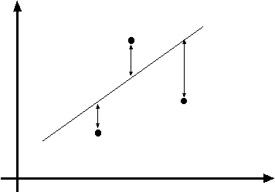
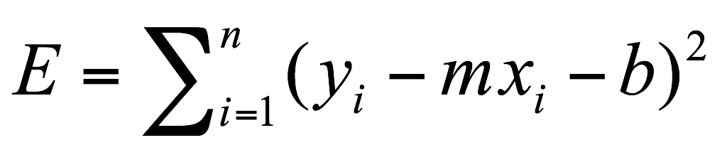
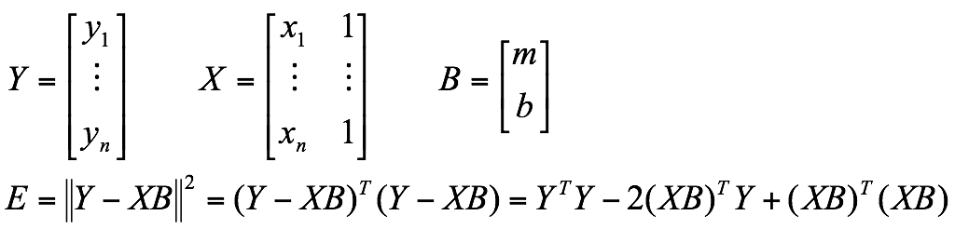
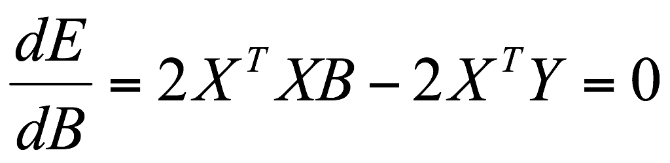
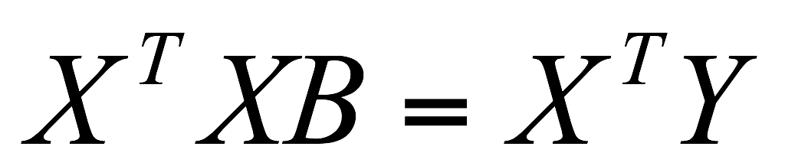
Data: (x₁, y₁), …, (x_{n}, y_{n})
Line equation: y_{i} = m x_{i} + b
(x_{i}, y_{i})
Find (m, b) to minimize
Normal equations: least squares solution to XB=Y

Slide 23
Line fitting
Given: Many pairs
Find: Parameters
Minimize: Average square distance:
Using:
Note:
How can we solve this minimization?

Slide 24
Problems with parameterizations
Where is the line that minimizes E?

Slide 25

Problems with parameterizations
Where is the line that minimizes E?
Huge E!

Slide 26

Problems with parameterizations
Where is the line that minimizes E?
Line that minimizes E!!

Slide 27
Problems with parameterizations
Where is the line that minimizes E?
Line that minimizes E!!
(Error E must be formulated carefully!)
How can we deal with this?

Slide 28
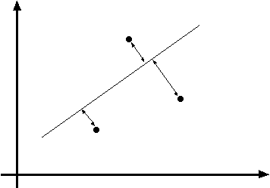
Line fitting is easily setup as a maximum likelihood problem
… but choice of model is important
What optimization are we solving here?

Slide 29
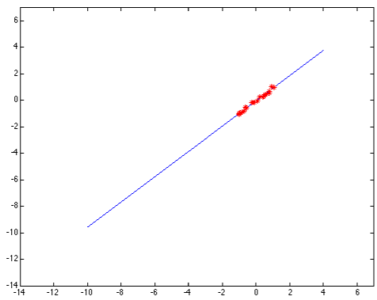
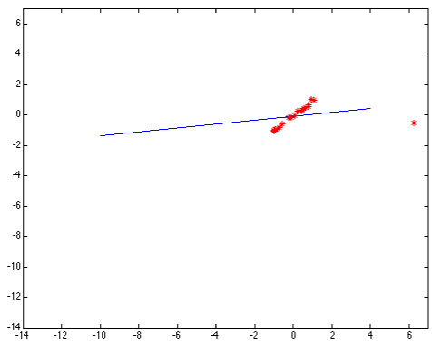
Problems with noise
Least-squares error fit
Squared error heavily penalizes outliers

Slide 30
Model fitting is difficult because…
Extraneous data: clutter or multiple models
  We do not know what is part of the model?
  Can we pull out models with a few parts from much larger amounts of background clutter?
Missing data: only some parts of model are present
Noise
Cost:
  It is not feasible to check all combinations of features by fitting a model to each possible subset
So what can we do?

Slide 31
Line parameterizations

Slide 32



Slope intercept form
slope
y-intercept
What are m and b?

Slide 33
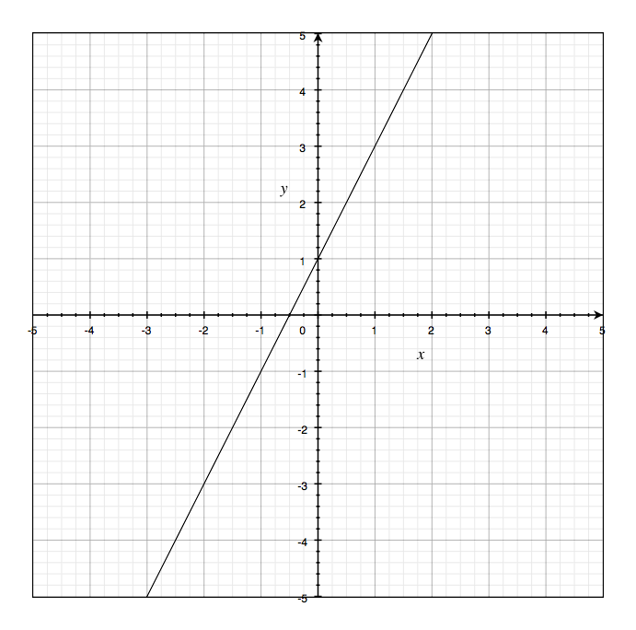

Slope intercept form
slope
y-intercept

Slide 34

Double intercept form
x-intercept
y-intercept
What are x and y?

Slide 35
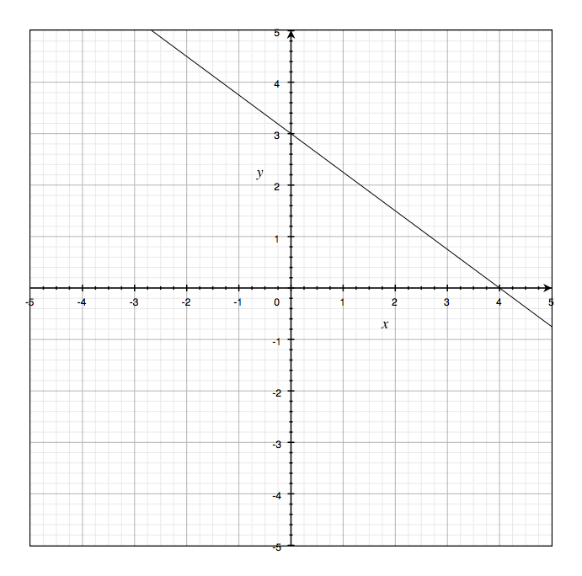

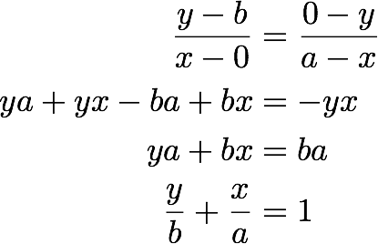


Double intercept form
x-intercept
y-intercept
Derivation:
(Similar slope)

Slide 36

Normal Form
What are rho and theta?

Slide 37
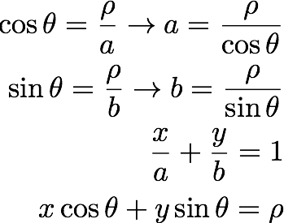
Normal Form
Derivation:
plug into:

Slide 38
Hough transform

Slide 39
Hough transform
Generic framework for detecting a parametric model
Edges don’t have to be connected
Lines can be occluded
Key idea: edges vote for the possible models

Slide 40
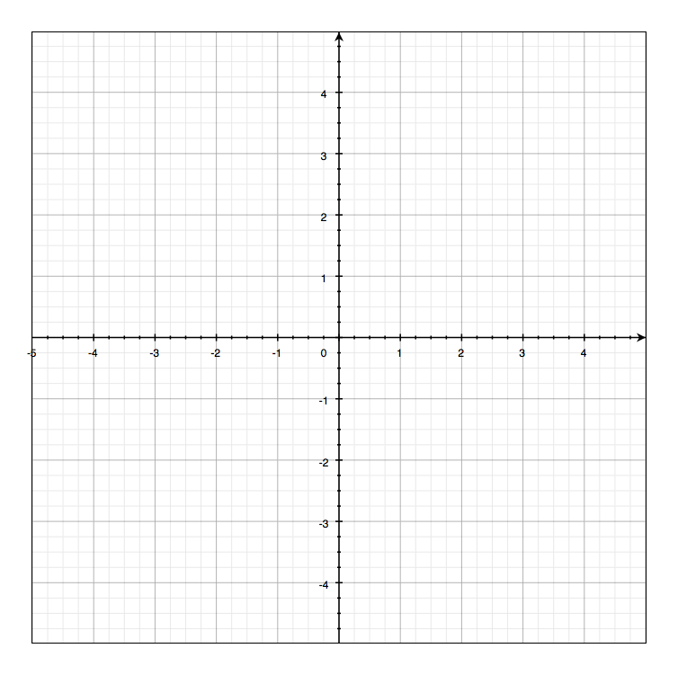
Image and parameter space
variables
parameters
Image space

Slide 41


Image and parameter space
variables
variables
parameters
parameters
a line becomes a point
Image space
Parameter space

Slide 42
Image and parameter space
variables
parameters
What would a point in image space become in parameter space?
Image space

Slide 43
Image and parameter space
variables
variables
parameters
parameters
a point becomes a line
Image space
Parameter space

Slide 44

Image and parameter space
variables
variables
parameters
parameters
two points become
?
Image space
Parameter space

Slide 45
Image and parameter space
variables
variables
parameters
parameters
two points become
?
Image space
Parameter space

Slide 46

Image and parameter space
variables
variables
parameters
parameters
three points become
?
Image space
Parameter space

Slide 47
Image and parameter space
variables
variables
parameters
parameters
three points become
?
Image space
Parameter space

Slide 48

Image and parameter space
variables
variables
parameters
parameters
four points become
?
Image space
Parameter space

Slide 49
Image and parameter space
variables
variables
parameters
parameters
four points become
?
Image space
Parameter space

Slide 50
How would you find the best fitting line?
Image space
Parameter space
Is this method robust to measurement noise?
Is this method robust to outliers?

Slide 51
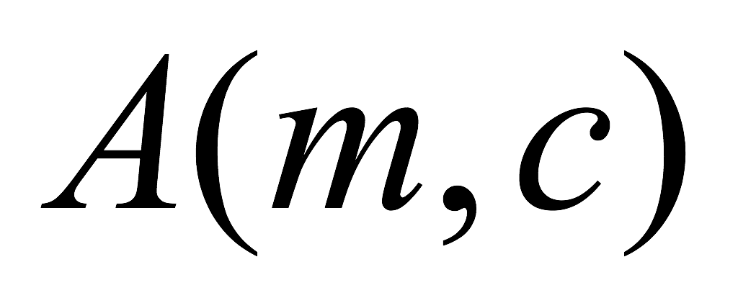
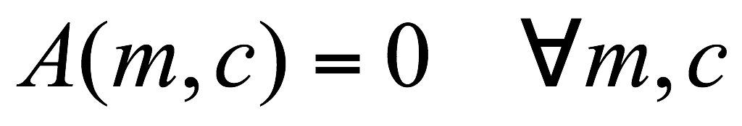
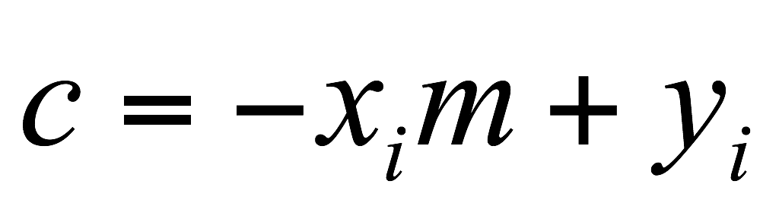
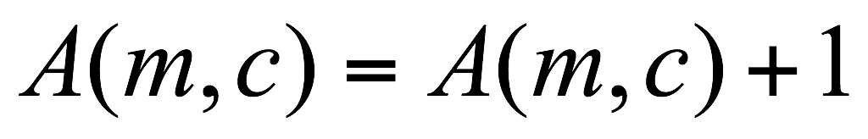
Line Detection by Hough Transform
Algorithm:
Quantize Parameter Space
Create Accumulator Array
Set
For each image edge
For each element in
If lies on the line:
Increment
Find local maxima in
Parameter Space
 | 1 |  |  |  |  |  | 1
 |  | 1 |  |  |  | 1
 |  |  | 1 |  | 1
 |  |  |  | 2
 |  |  | 1 |  | 1
 |  | 1 |  |  |  | 1
 | 1 |  |  |  |  |  | 1

Slide 52
Problems with parameterization
How big does the accumulator need to be for the parameterization ?
 | 1 |  |  |  |  |  | 1
 |  | 1 |  |  |  | 1
 |  |  | 1 |  | 1
 |  |  |  | 2
 |  |  | 1 |  | 1
 |  | 1 |  |  |  | 1
 | 1 |  |  |  |  |  | 1

Slide 53
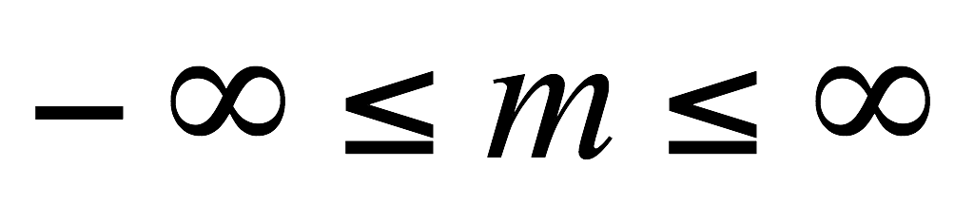
Problems with parameterization
How big does the accumulator need to be for the parameterization ?
 | 1 |  |  |  |  |  | 1
 |  | 1 |  |  |  | 1
 |  |  | 1 |  | 1
 |  |  |  | 2
 |  |  | 1 |  | 1
 |  | 1 |  |  |  | 1
 | 1 |  |  |  |  |  | 1
The space of m is huge!
The space of c is huge!

Slide 54
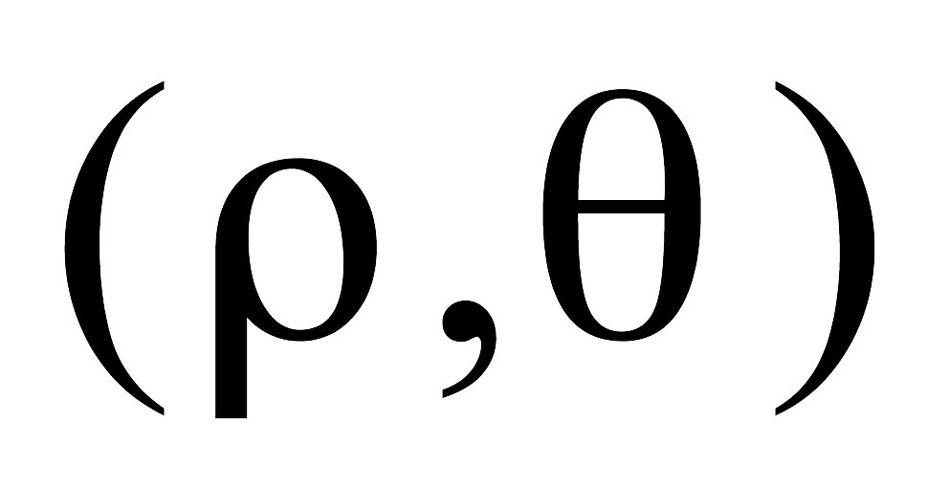

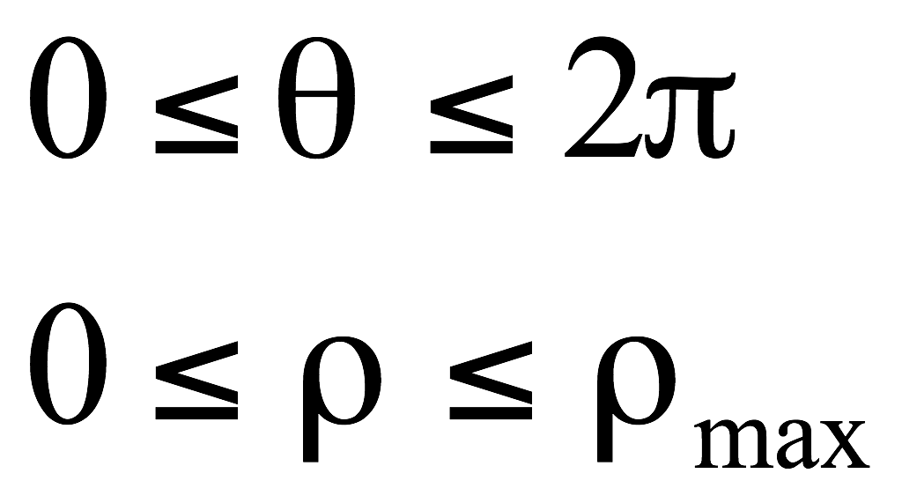
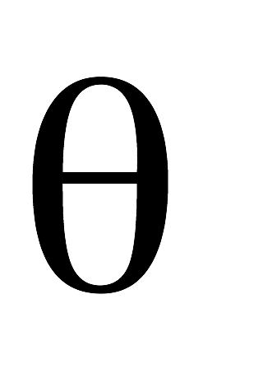
Better Parameterization
Use normal form:
Given points find
Image Space
Hough Space Sinusoid
?
(Finite Accumulator Array Size)
Hough Space

Slide 55
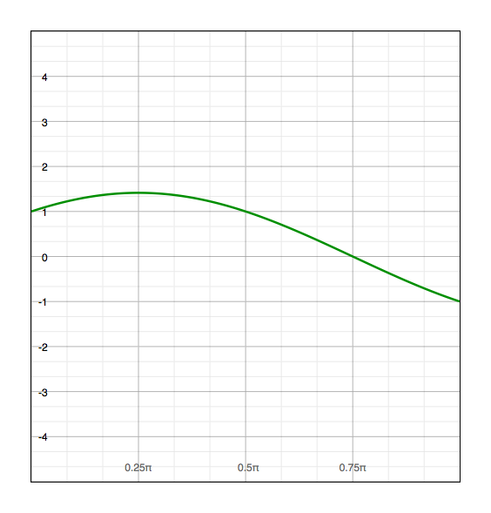
Image and parameter space
variables
parameters
parameters
variables
a point becomes?
Image space
Parameter space

Slide 56
Image and parameter space
variables
parameters
parameters
variables
a point becomes a wave
Image space
Parameter space

Slide 57
Image and parameter space
variables
parameters
a line
becomes?
Image space
Parameter space

Slide 58
Image and parameter space
variables
parameters
a line
becomes a point
Image space
Parameter space

Slide 59
Image and parameter space
variables
parameters
a line
becomes?
Image space
Parameter space

Slide 60
Image and parameter space
variables
parameters
a line
becomes a point
Image space
Parameter space

Slide 61
Image and parameter space
variables
parameters
a line
becomes a point
Image space
Parameter space

Slide 62
Image and parameter space
variables
parameters
a line
becomes a point
Image space
Parameter space

Slide 63
Image and parameter space
variables
parameters
a line
becomes a point
Image space
Parameter space

Slide 64
Image and parameter space
variables
parameters
a line
becomes a point
Image space
Parameter space

Slide 65

Image and parameter space
variables
parameters
Wait …why is rho negative?
a line
becomes a point
Image space
Parameter space

Slide 66
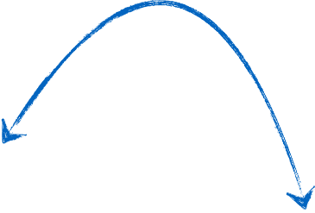
Image and parameter space
variables
parameters
same line through the point
a line
becomes a point
Image space
Parameter space

Slide 67


There are two ways to write the same line:
Positive rho version:
Negative rho version:
Recall:

Slide 68
Image and parameter space
variables
parameters
same line through the point
a line
becomes a point
Image space
Parameter space

Slide 69
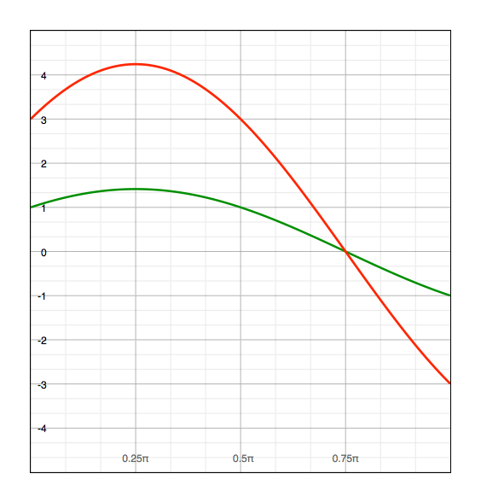
Image and parameter space
variables
parameters
two points become
?
Image space
Parameter space

Slide 70
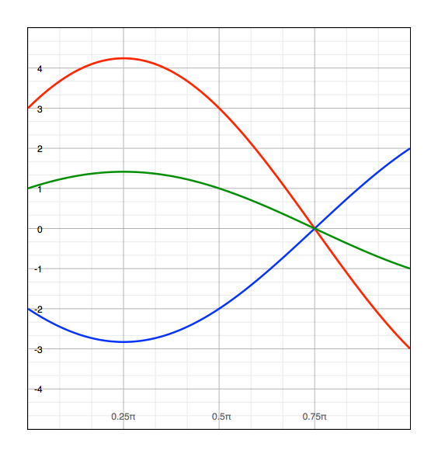
Image and parameter space
variables
parameters
three points become
?
Image space
Parameter space

Slide 71

Image and parameter space
variables
parameters
four points become
?
Image space
Parameter space

Slide 72

Implementation
Initialize accumulator H to all zeros
For each edge point (x,y) in the image
For θ = 0 to 180
ρ = x cos θ + y sin θ
H(θ, ρ) = H(θ, ρ) + 1
end
end
Find the value(s) of (θ, ρ) where H(θ, ρ) is a local maximum
The detected line in the image is given by
ρ = x cos θ + y sin θ
NOTE: Watch your coordinates. Image origin is top left!

Slide 73


Image space
Votes
Notes:
Figure 15.1, top half. Note that most points in the vote array are very dark, because they
get only one vote.

Slide 74



Basic shapes
(in parameter space)
can you guess the shape?

Slide 75
Basic shapes
(in parameter space)
line

Slide 76
Basic shapes
(in parameter space)
line
rectangle

Slide 77
Basic shapes
(in parameter space)
line
rectangle
circle

Slide 78


Basic Shapes

Slide 79

More complex image

Slide 80

In practice, measurements are noisy…
Image space
Votes
Notes:
This is 15.1 lower half

Slide 81

Too much noise …
Image space
Votes
Notes:
15.2; main point is that lots of noise can lead to large peaks in the array

Slide 82
Effects of noise level
Number of votes for a line of 20 points with increasing noise
More noise, fewer votes (in the right bin)

Slide 83
Effect of noise points
More noise, more votes (in the wrong bin)

Slide 84




Real-world example
Original
Edges
parameter space
Hough Lines

Slide 85
Hough Circles

Slide 86

Let’s assume radius known
parameters
parameters
variables
variables
What is the dimension of the parameter space?

Slide 87


parameters
parameters
variables
variables
Image space
Parameter space
What does a point in image space correspond to in parameter space?

Slide 88

parameters
parameters
variables
variables

Slide 89
parameters
parameters
variables
variables

Slide 90
parameters
parameters
variables
variables

Slide 91
parameters
parameters
variables
variables

Slide 92
What if radius is unknown?
parameters
parameters
variables
variables

Slide 93

What if radius is unknown?
parameters
parameters
variables
variables
If radius is not known: 3D Hough Space!
Use Accumulator array
Surface shape in Hough space is complicated

Slide 94



Using Gradient Information
Gradient information can save lot of computation:
Edge Location
Edge Direction
Assume radius is known:
Need to increment only one point in accumulator!

Slide 95



parameters
parameters
variables
variables

Slide 96
parameters
parameters
variables
variables

Slide 97



Slide 98

Pennie Hough detector
Quarter Hough detector

Slide 99
Pennie Hough detector
Quarter Hough detector

Slide 100
The Hough transform …
Deals with occlusion well?
Detects multiple instances?
Robust to noise?
Good computational complexity?
Easy to set parameters?

Slide 101
Can you use Hough Transforms for other objects,
beyond lines and circles?
Do you have to use edge detectors to vote in Hough Space?

Slide 102
Application of
Hough transforms

Slide 103



Detecting shape features
F. Jurie and C. Schmid, Scale-invariant shape features for recognition of object categories, CVPR 2004

Slide 104

Original images
Laplacian circles
Hough-like circles
Which feature detector is more consistent?

Slide 105

Robustness to scale and clutter

Slide 106


Object detection
Index displacements by “visual codeword”
visual codeword with
displacement vectors
training image
B. Leibe, A. Leonardis, and B. Schiele, Combined Object Categorization and Segmentation with an Implicit Shape Model,
ECCV Workshop on Statistical Learning in Computer Vision 2004

Slide 107


Slide 108
References
Basic reading:
Szeliski textbook, Sections 4.2, 4.3.

