Slide 1
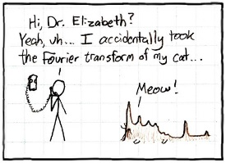
Image pyramids and frequency domain
16-385 Computer Vision
Spring 2019, Lecture 3
http://www.cs.cmu.edu/~16385/

Slide 2
Course announcements
Homework 1 will be posted tonight.
- Homework 1 is due on February 6th at midnight.
Office hours for the rest of the semester:
Monday, 5-7 pm, NSH 1109, Sharvani
Tuesday, 5-7 pm, NSH 4119, Anshuman
Wednesday 4-6 pm, NSH 4119, Neeraj
Thursday 4-6 pm, NSH 4119, Abhay
Friday 3-5 pm, Smith Hall graphics lounge, Yannis
Friday 5-7 pm, Smith Hall graphics lounge, Bruce

Slide 3
Overview of today’s lecture
Image downsampling.
Aliasing.
Gaussian image pyramid.
Laplacian image pyramid.
Fourier series.
Frequency domain.
Fourier transform.
Frequency-domain filtering.
Revisiting sampling.

Slide 4
Slide credits
Most of these slides were adapted directly from:
Kris Kitani (15-463, Fall 2016).
Some slides were inspired or taken from:
Fredo Durand (MIT).
Bernd Girod (Stanford University).
James Hays (Georgia Tech).
Steve Marschner (Cornell University).
Steve Seitz (University of Washington).

Slide 5
Image downsampling

Slide 6
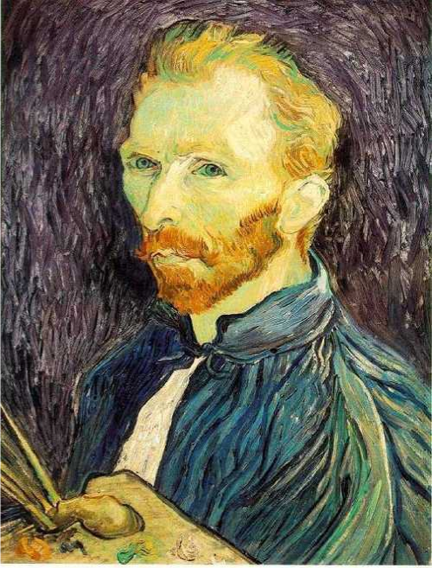
This image is too big to fit on the screen.
How would you reduce it to half its size?

Slide 7
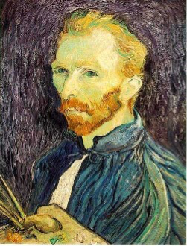
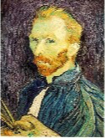

Naïve image downsampling
Throw away half the rows and columns
delete even rows
delete even columns
delete even rows
delete even columns
1/8
1/4
1/2
What is the problem with this approach?

Slide 8
Naïve image downsampling
1/2
1/4 (2x zoom)
1/8 (4x zoom)
What is the 1/8 image so pixelated (and do you know what this effect is called)?

Slide 9
Aliasing

Slide 10
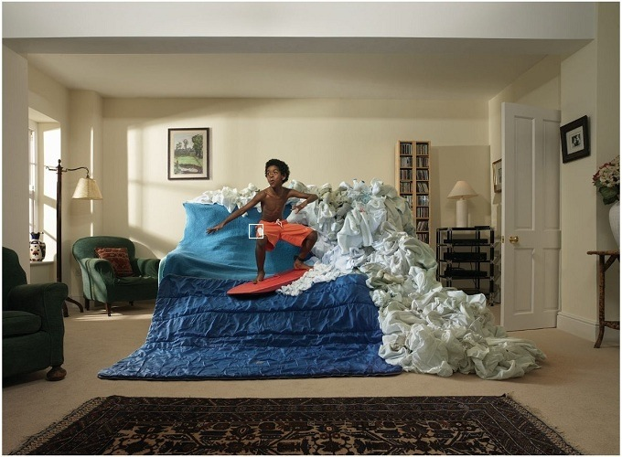

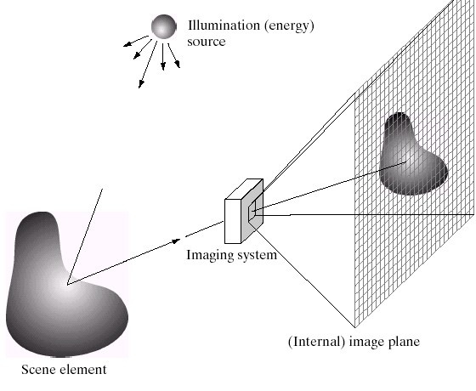
Reminder
Images are a discrete, or sampled, representation of a continuous world

Slide 11
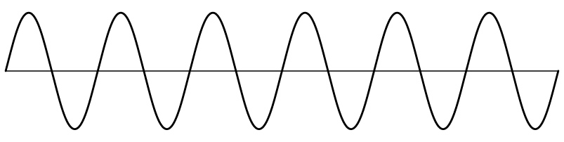
Sampling
Very simple example: a sine wave
How would you discretize this signal?

Slide 12
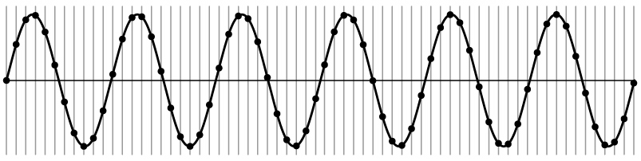
Sampling
Very simple example: a sine wave

Slide 13
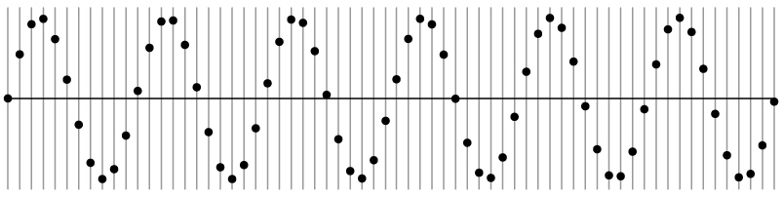
Sampling
Very simple example: a sine wave
How many samples should I take?
Can I take as many samples as I want?

Slide 14
Sampling
Very simple example: a sine wave
How many samples should I take?
Can I take as few samples as I want?

Slide 15
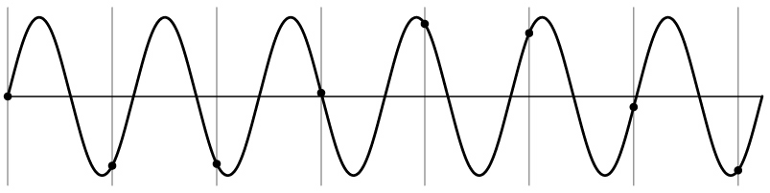
Undersampling
Very simple example: a sine wave
Unsurprising effect: information is lost.

Slide 16
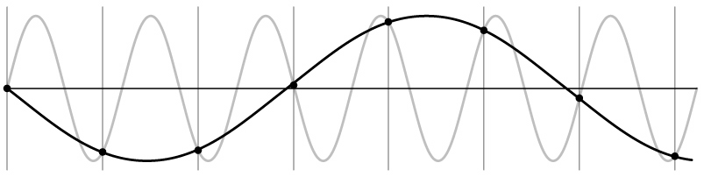
Undersampling
Very simple example: a sine wave
Unsurprising effect: information is lost.
Surprising effect: can confuse the signal with one of lower frequency.

Slide 17
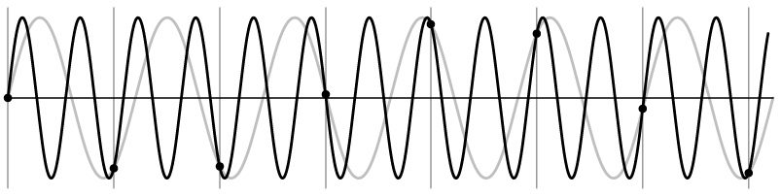
Undersampling
Very simple example: a sine wave
Unsurprising effect: information is lost.
Surprising effect: can confuse the signal with one of lower frequency.
Note: we could always confuse the signal with one of higher frequency.

Slide 18
Aliasing
Fancy term for: Undersampling can disguise a signal as one of a lower frequency
Unsurprising effect: information is lost.
Surprising effect: can confuse the signal with one of lower frequency.
Note: we could always confuse the signal with one of higher frequency.

Slide 19
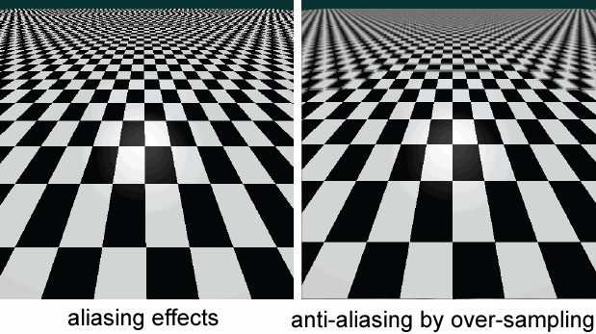
Aliasing in textures

Slide 20
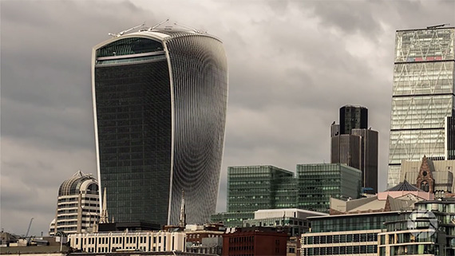
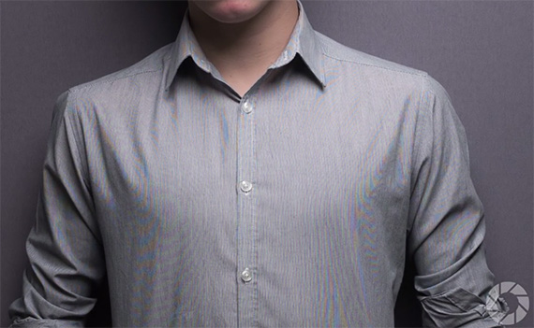
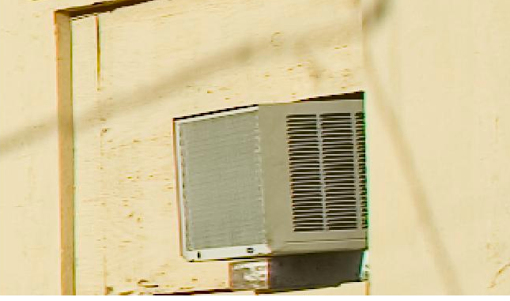
Aliasing in photographs
This is also known as “moire”

Slide 21
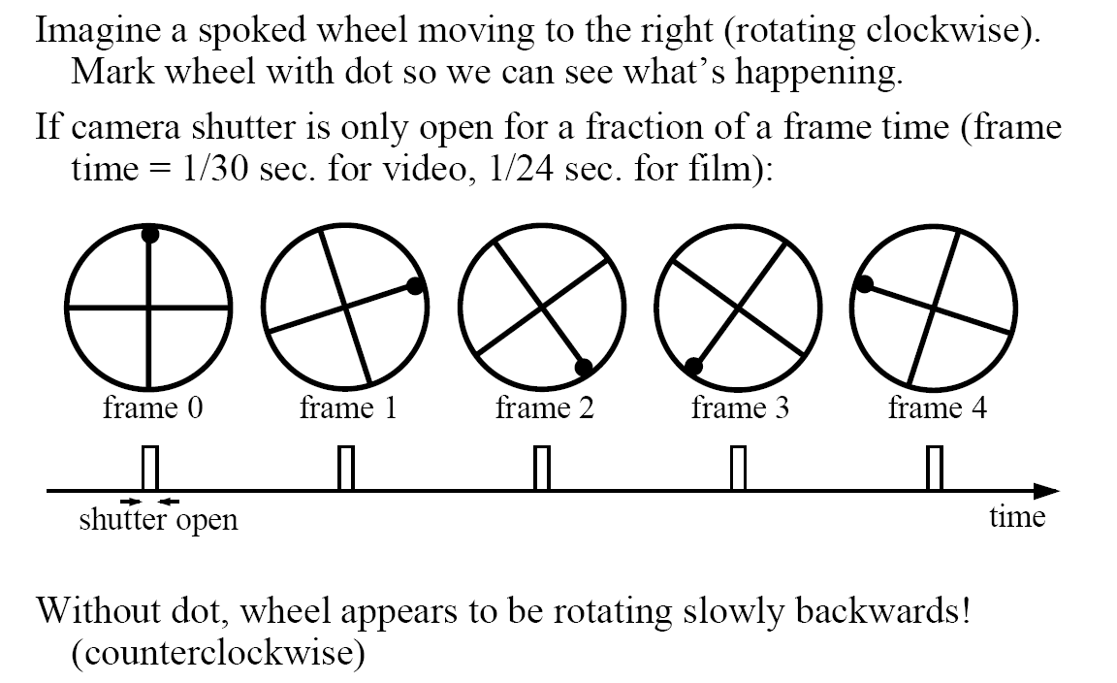
Temporal aliasing

Slide 22
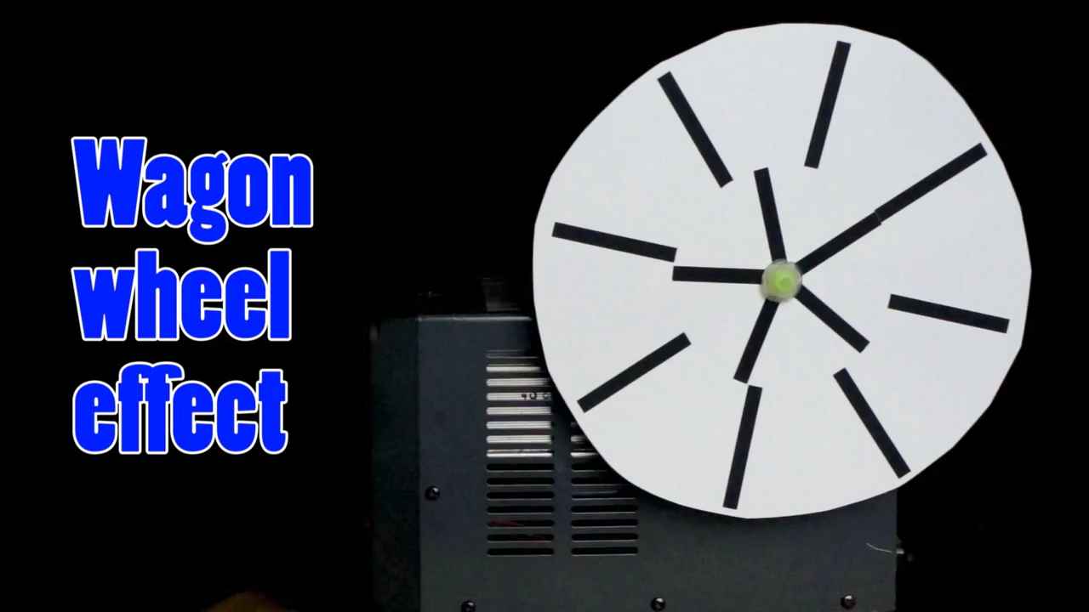
Temporal aliasing

Slide 23
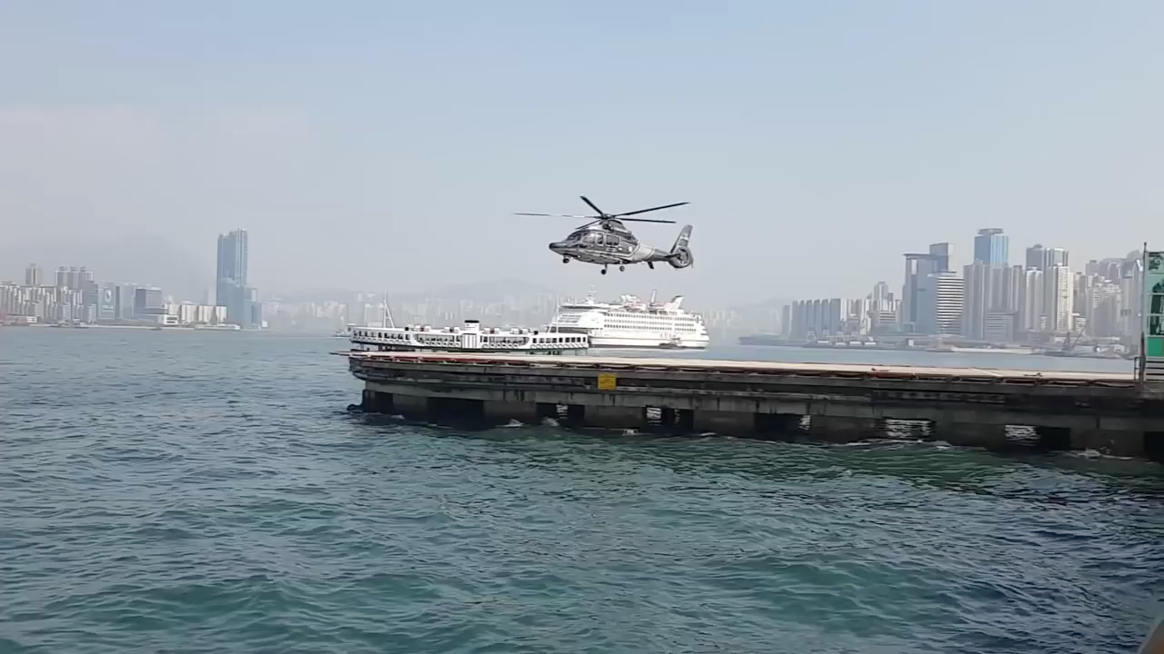
Temporal aliasing

Slide 24
Anti-aliasing
How would you deal with aliasing?

Slide 25
Anti-aliasing
How would you deal with aliasing?
Approach 1: Oversample the signal

Slide 26
Anti-aliasing in textures
aliasing artifacts
anti-aliasing by oversampling

Slide 27
Anti-aliasing
How would you deal with aliasing?
Approach 1: Oversample the signal
Approach 2: Smooth the signal
  Remove some of the detail effects that cause aliasing.
  Lose information, but better than aliasing artifacts.
How would you smooth a signal?

Slide 28

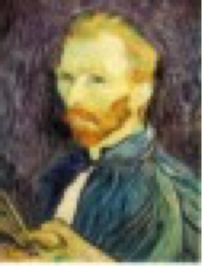
Better image downsampling
Apply a smoothing filter first, then throw away half the rows and columns
Gaussian filter
delete even rows
delete even columns
Gaussian filter
delete even rows
delete even columns
1/8
1/4
1/2

Slide 29
Better image downsampling
1/2
1/4 (2x zoom)
1/8 (4x zoom)

Slide 30
Naïve image downsampling
1/2
1/4 (2x zoom)
1/8 (4x zoom)

Slide 31
Anti-aliasing
Question 1: How much smoothing do I need to do to avoid aliasing?
Question 2: How many samples do I need to take to avoid aliasing?
Answer to both: Enough to reach the Nyquist limit.
We’ll see what this means soon.

Slide 32
Gaussian image pyramid

Slide 33
Gaussian image pyramid
The name of this sequence of subsampled images

Slide 34
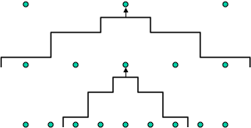
Constructing a Gaussian pyramid
Algorithm
sample
repeat:
filter
filter
sample
subsample
filter
until min resolution reached
sample
Question: How much bigger than the original image is the whole pyramid?

Slide 35
Constructing a Gaussian pyramid
Algorithm
sample
repeat:
filter
filter
sample
subsample
filter
until min resolution reached
sample
Question: How much bigger than the original image is the whole pyramid?
Answer: Just 4/3 times the size of the original image! (How did I come up with this number?)

Slide 36
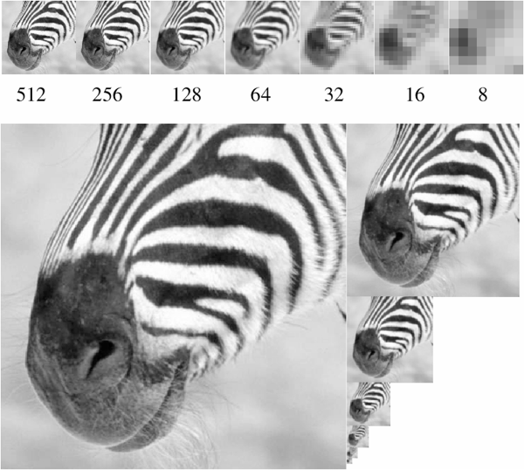
Some properties of the Gaussian pyramid
What happens to the details of the image?

Slide 37
Some properties of the Gaussian pyramid
What happens to the details of the image?
They get smoothed out as we move to higher levels.
What is preserved at the higher levels?

Slide 38
Some properties of the Gaussian pyramid
What happens to the details of the image?
They get smoothed out as we move to higher levels.
What is preserved at the higher levels?
Mostly large uniform regions in the original image.
How would you reconstruct the original image from the image at the upper level?

Slide 39
Some properties of the Gaussian pyramid
What happens to the details of the image?
They get smoothed out as we move to higher levels.
What is preserved at the higher levels?
Mostly large uniform regions in the original image.
How would you reconstruct the original image from the image at the upper level?
That’s not possible.

Slide 40
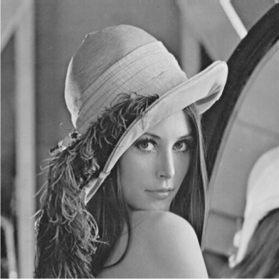
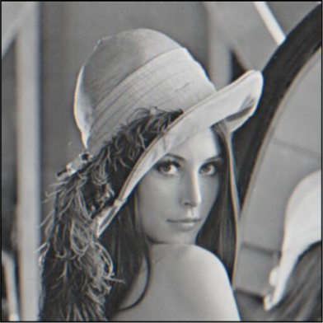
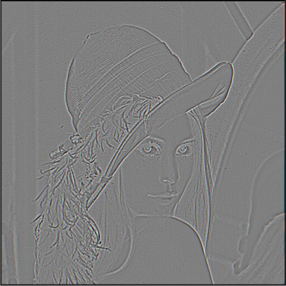
Blurring is lossy
-
=
level 0
level 1 (before downsampling)
residual
What does the residual look like?

Slide 41
Blurring is lossy
-
=
level 0
level 1 (before downsampling)
residual
Can we make a pyramid that is lossless?

Slide 42
Laplacian image pyramid

Slide 43
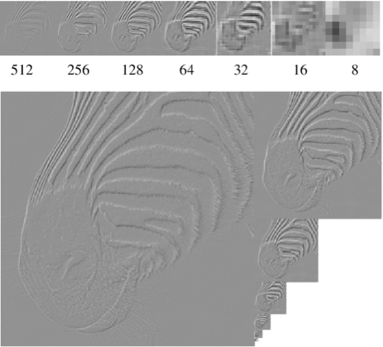
Laplacian image pyramid
At each level, retain the residuals instead of the blurred images themselves.
Can we reconstruct the original image using the pyramid?

Slide 44
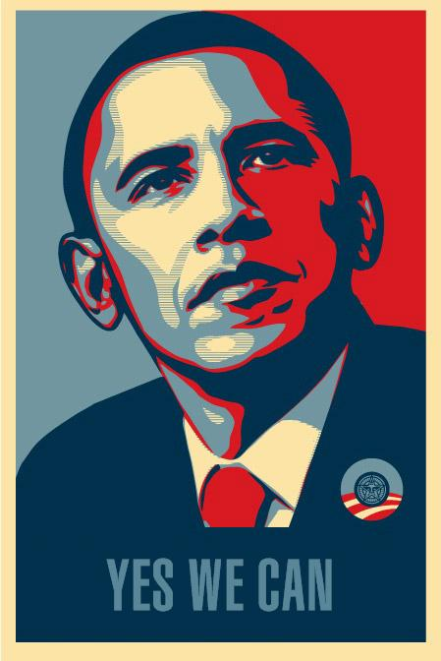
Laplacian image pyramid
At each level, retain the residuals instead of the blurred images themselves.
Can we reconstruct the original image using the pyramid?
Yes we can!
What do we need to store to be able to reconstruct the original image?

Slide 45
Let’s start by looking at just one level
=
+
level 0
level 1 (upsampled)
residual
Does this mean we need to store both residuals and the blurred copies of the original?

Slide 46
Constructing a Laplacian pyramid
Algorithm
repeat:
filter
compute residual
subsample
until min resolution reached

Slide 47
Constructing a Laplacian pyramid
What is this part?
Algorithm
repeat:
filter
compute residual
subsample
until min resolution reached

Slide 48
Constructing a Laplacian pyramid
It’s a Gaussian pyramid.
Algorithm
repeat:
filter
compute residual
subsample
until min resolution reached

Slide 49
What do we need to construct the original image?

Slide 50
What do we need to construct the original image?
(1) residuals

Slide 51
What do we need to construct the original image?
(2) smallest image
(1) residuals

Slide 52
Reconstructing the original image
Algorithm
repeat:
upsample
sum with residual
until orig resolution reached

Slide 53




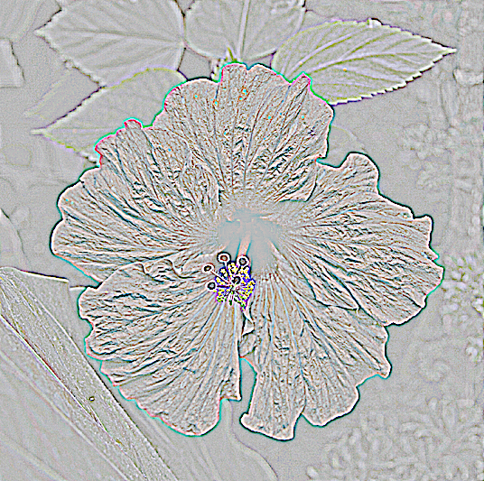
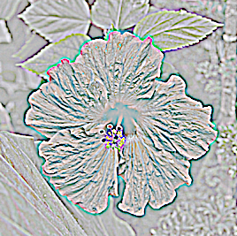
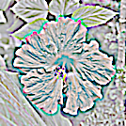
Gaussian vs Laplacian Pyramid
Shown in opposite order for space.
Which one takes
more space to store?

Slide 54
Why is it called a Laplacian pyramid?

Slide 55
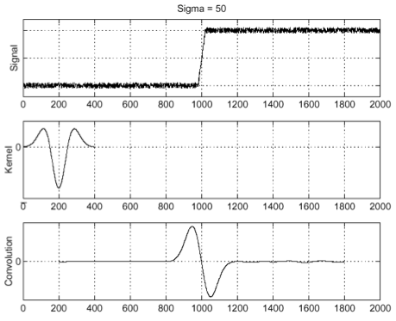
Reminder: Laplacian of Gaussian (LoG) filter
As with derivative, we can combine Laplace filtering with Gaussian filtering
input
Laplacian of Gaussian
output
“zero crossings” at edges

Slide 56
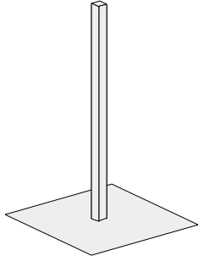
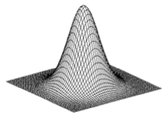
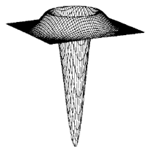
Why is it called a Laplacian pyramid?
-
=
-
unit
Gaussian
Laplacian
Difference of Gaussians approximates the Laplacian

Slide 57
Why Reagan?

Slide 58
Why Reagan?
Ronald Reagan was President when the Laplacian pyramid was invented
The Laplacian Pyramid as a Compact Image Code (1983)
Peter J. Burt , Edward H. Adelson

Slide 59
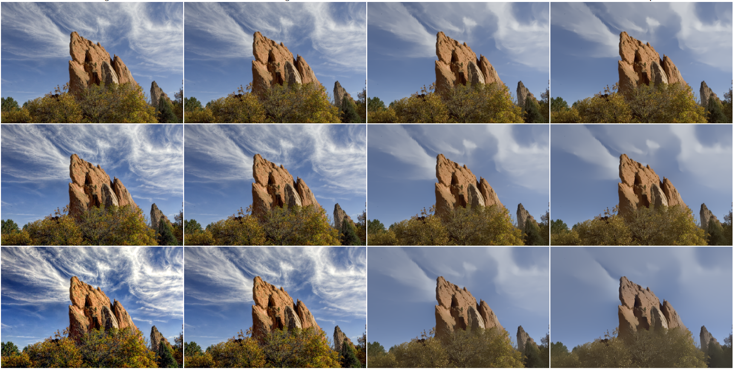
Still used extensively

Slide 60
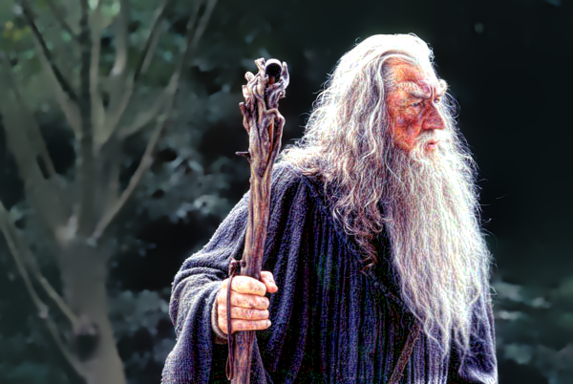
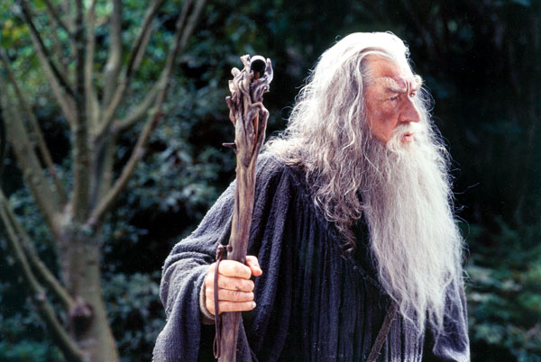

Still used extensively
input image
foreground details enhanced, background details reduced
user-provided mask

Slide 61




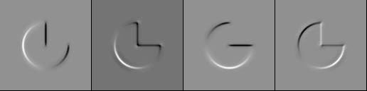
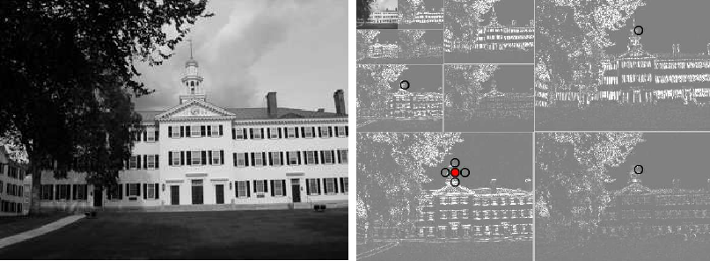
Other types of pyramids
Steerable pyramid: At each level keep multiple versions, one for each direction.
Wavelets: Huge area in image processing (see 18-793).

Slide 62
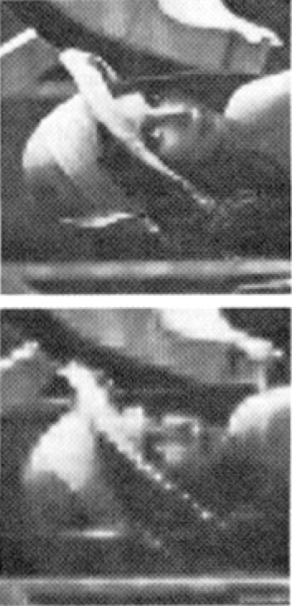
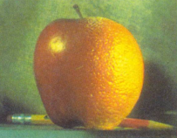
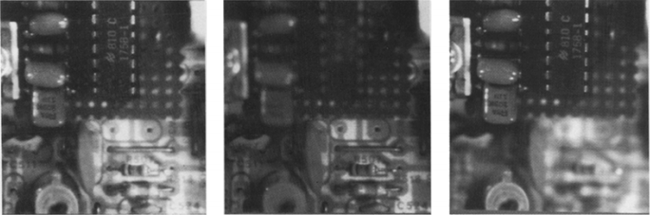
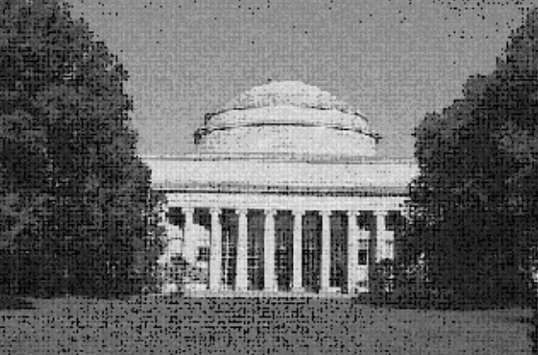
What are image pyramids used for?
image compression
multi-scale
texture mapping
image blending
focal stack compositing
denoising
multi-scale detection
multi-scale registration

Slide 63
Some history

Slide 64
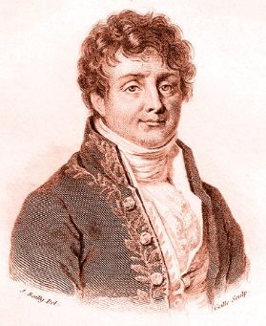
Who is this guy?

Slide 65
What is he famous for?
Jean Baptiste Joseph Fourier
(1768-1830)

Slide 66
What is he famous for?
The Fourier series claim (1807):
‘Any univariate function can be rewritten as a weighted sum of sines and cosines of different frequencies.’
… and apparently also for the discovery of the greenhouse effect
Jean Baptiste Joseph Fourier
(1768-1830)

Slide 67
Is this claim true?
The Fourier series claim (1807):
‘Any univariate function can be rewritten as a weighted sum of sines and cosines of different frequencies.’
Jean Baptiste Joseph Fourier
(1768-1830)

Slide 68
Is this claim true?
The Fourier series claim (1807):
‘Any univariate function can be rewritten as a weighted sum of sines and cosines of different frequencies.’
Well, almost.
The theorem requires additional conditions.
Close enough to be named after him.
Very surprising result at the time.
Jean Baptiste Joseph Fourier
(1768-1830)

Slide 69
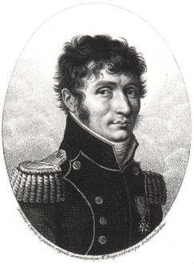
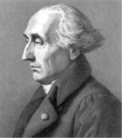
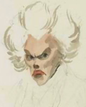
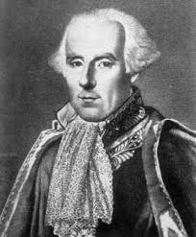
Is this claim true?
The Fourier series claim (1807):
‘Any univariate function can be rewritten as a weighted sum of sines and cosines of different frequencies.’
Well, almost.
The theorem requires additional conditions.
Close enough to be named after him.
Very surprising result at the time.
The committee examining his paper had expressed skepticism, in part due to not so rigorous proofs
Jean Baptiste Joseph Fourier
(1768-1830)
Malus
Lagrange
Legendre
Laplace

Slide 70
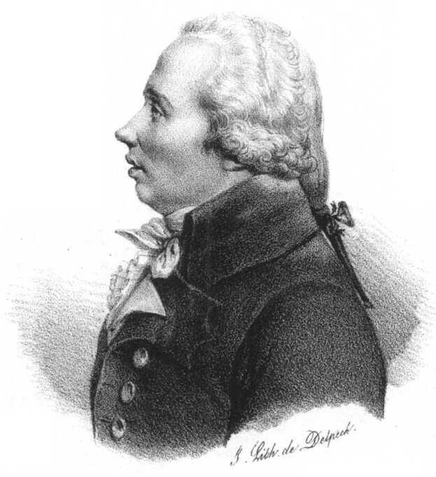
Amusing aside
Only known portrait of Adrien-Marie Legendre
1820 watercolor caricatures of French mathematicians Adrien-Marie Legendre (left) and Joseph Fourier (right) by French artist Julien-Leopold Boilly
For two hundred years, people were misidentifying this portrait as him
Louis Legendre
(same last name, different person)

Slide 71
Fourier series

Slide 72

Basic building block
Fourier’s claim: Add enough of these to get any periodic signal you want!

Slide 73
Basic building block
amplitude
phase
sinusoid
variable
angular
frequency
Fourier’s claim: Add enough of these to get any periodic signal you want!

Slide 74
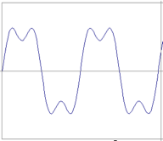
Examples
How would you generate this function?
=
?
+
?

Slide 75


Examples
How would you generate this function?
=
?
+
?

Slide 76



Examples
How would you generate this function?
=
?
+
?

Slide 77

Examples
How would you generate this function?
=
?
+
?
square wave

Slide 78
Examples
How would you generate this function?
≈
?
+
?
square wave
=

Slide 79


Examples
How would you generate this function?
≈
?
+
?
square wave
=

Slide 80


Examples
How would you generate this function?
≈
?
+
?
square wave
=

Slide 81


Examples
How would you generate this function?
≈
?
+
?
square wave
=

Slide 82


Examples
How would you generate this function?
≈
?
+
?
square wave
=
How would you express this mathematically?

Slide 83

Examples
=
square wave
infinite sum of sine waves
How would could you visualize this in the frequency domain?

Slide 84

Examples
=
square wave
infinite sum of sine waves
magnitude
frequency

Slide 85
Frequency domain

Slide 86
Visualizing the frequency spectrum
amplitude
frequency

Slide 87

Visualizing the frequency spectrum
Recall the temporal domain visualization
amplitude
=
+
frequency

Slide 88

Visualizing the frequency spectrum
Recall the temporal domain visualization
amplitude
=
+
How do we plot ...
frequency

Slide 89
Visualizing the frequency spectrum
Recall the temporal domain visualization
amplitude
=
+
frequency

Slide 90
Visualizing the frequency spectrum
Recall the temporal domain visualization
amplitude
=
+
frequency

Slide 91
Visualizing the frequency spectrum
Recall the temporal domain visualization
amplitude
=
+
not visualizing the symmetric negative part
frequency
Need to understand this to understand the 2D version!
What is at zero frequency?

Slide 92
Visualizing the frequency spectrum
Recall the temporal domain visualization
amplitude
=
+
not visualizing the symmetric negative part
frequency
signal average (zero for a sine wave with no offset)
Need to understand this to understand the 2D version!

Slide 93

Examples
Spatial domain visualization
Frequency domain visualization
1D
?
2D

Slide 94


Examples
Spatial domain visualization
Frequency domain visualization
1D
2D
What do the three dots correspond to?

Slide 95
Examples
Spatial domain visualization
Frequency domain visualization
?

Slide 96
Examples
Spatial domain visualization
Frequency domain visualization

Slide 97
Examples
How would you generate this image with sine waves?

Slide 98
Examples
How would you generate this image with sine waves?
Has both an x and y components

Slide 99
Examples
+
=
?

Slide 100
Examples
+
=
?

Slide 101
Examples
+
=

Slide 102
Basic building block
amplitude
phase
sinusoid
variable
What about non-periodic signals?
angular
frequency
Fourier’s claim: Add enough of these to get any periodic signal you want!

Slide 103
Fourier transform

Slide 104

Recalling some basics
Complex numbers have two parts:
rectangular coordinates
what‘s this?
what‘s this?

Slide 105
Recalling some basics
Complex numbers have two parts:
rectangular coordinates
real
imaginary

Slide 106

Recalling some basics
Complex numbers have two parts:
rectangular coordinates
real
imaginary
Alternative reparameterization:
polar transform
polar coordinates
how do we compute these?

Slide 107


Recalling some basics
Complex numbers have two parts:
rectangular coordinates
real
imaginary
Alternative reparameterization:
polar transform
polar coordinates
polar transform

Slide 108
Recalling some basics
Complex numbers have two parts:
rectangular coordinates
real
imaginary
Alternative reparameterization:
polar transform
polar coordinates
How do you write these in exponential form?
polar transform

Slide 109

Recalling some basics
Complex numbers have two parts:
rectangular coordinates
real
imaginary
Alternative reparameterization:
polar coordinates
exponential form
or equivalently
polar transform
how did we get this?

Slide 110

Recalling some basics
Complex numbers have two parts:
rectangular coordinates
real
imaginary
Alternative reparameterization:
polar coordinates
exponential form
or equivalently
polar transform
Euler’s formula
This will help us understand the Fourier transform equations

Slide 111





Fourier transform
Fourier transform
inverse Fourier transform
continuous
discrete
Where is the connection to the ‘summation of sine waves’ idea?

Slide 112
Fourier transform
Fourier transform
inverse Fourier transform
continuous
discrete
Where is the connection to the ‘summation of sine waves’ idea?

Slide 113

Fourier transform
Where is the connection to the ‘summation of sine waves’ idea?
Euler’s formula
sum over frequencies
scaling parameter
wave components

Slide 114

Fourier transform pairs
spatial domain
frequency domain
Note the symmetry: duality property of Fourier transform

Slide 115
Computing the discrete Fourier transform (DFT)

Slide 116



Computing the discrete Fourier transform (DFT)
is just a matrix multiplication:
In practice this is implemented using the fast Fourier transform (FFT) algorithm.

Slide 117






Fourier transforms of natural images
original
amplitude
phase

Slide 118


Fourier transforms of natural images
Image phase matters!
cheetah phase with zebra amplitude
zebra phase with cheetah amplitude

Slide 119
Frequency-domain filtering

Slide 120
Why do we care about all this?

Slide 121



The convolution theorem
The Fourier transform of the convolution of two functions is the product of their Fourier transforms:
The inverse Fourier transform of the product of two Fourier transforms is the convolution of the two inverse Fourier transforms:
Convolution in spatial domain is equivalent to multiplication in frequency domain!

Slide 122
What do we use convolution for?

Slide 123
Convolution for 1D continuous signals
Definition of linear shift-invariant filtering as convolution:
filtered signal
filter
input signal
Using the convolution theorem, we can interpret and implement all types of linear shift-invariant filtering as multiplication in frequency domain.
Why implement convolution in frequency domain?

Slide 124
Frequency-domain filtering in Matlab
Filtering with fft:
im = double(imread(‘…'))/255;
im = rgb2gray(im); % “im” should be a gray-scale floating point image
[imh, imw] = size(im);
hs = 50; % filter half-size
fil = fspecial('gaussian', hs*2+1, 10);
fftsize = 1024; % should be order of 2 (for speed) and include padding
im_fft = fft2(im, fftsize, fftsize); % 1) fft im with padding
fil_fft = fft2(fil, fftsize, fftsize); % 2) fft fil, pad to same size as image
im_fil_fft = im_fft .* fil_fft; % 3) multiply fft images
im_fil = ifft2(im_fil_fft); % 4) inverse fft2
im_fil = im_fil(1+hs:size(im,1)+hs, 1+hs:size(im, 2)+hs); % 5) remove padding
Displaying with fft:
figure(1), imagesc(log(abs(fftshift(im_fft)))), axis image, colormap jet

Slide 125








Spatial domain filtering
=
filter kernel
Fourier transform
inverse Fourier transform
=
Frequency domain filtering

Slide 126


Revisiting blurring
Why does the Gaussian give a nice smooth image, but the square filter give edgy artifacts?
Gaussian filter
Box filter

Slide 127


Gaussian blur

Slide 128

Box blur

Slide 129



More filtering examples
?
filters shown in frequency-domain
?

Slide 130
More filtering examples
low-pass
filters shown in frequency-domain
band-pass

Slide 131

More filtering examples
high-pass
?

Slide 132
More filtering examples
high-pass

Slide 133
More filtering examples
original image
low-pass filter
?
frequency magnitude

Slide 134
More filtering examples
original image
low-pass filter
frequency magnitude

Slide 135
More filtering examples
original image
high-pass filter
?
frequency magnitude

Slide 136
More filtering examples
original image
high-pass filter
frequency magnitude

Slide 137
More filtering examples
original image
band-pass filter
frequency magnitude

Slide 138
More filtering examples
original image
band-pass filter
frequency magnitude

Slide 139
More filtering examples
original image
band-pass filter
frequency magnitude

Slide 140
More filtering examples
original image
band-pass filter
frequency magnitude

Slide 141
Revisiting sampling

Slide 142

The Nyquist-Shannon sampling theorem
A continuous signal can be perfectly reconstructed from its discrete version using linear interpolation, if sampling occurred with frequency:
This is called the Nyquist frequency
Equivalent reformulation: When downsampling, aliasing does not occur if samples are taken at the Nyquist frequency or higher.

Slide 143
Gaussian pyramid
How does the Nyquist-Shannon theorem relate to the Gaussian pyramid?

Slide 144
Gaussian pyramid
How does the Nyquist-Shannon theorem relate to the Gaussian pyramid?
Gaussian blurring is low-pass filtering.
By blurring we try to sufficiently decrease the Nyquist frequency to avoid aliasing.
How large should the Gauss blur we use be?

Slide 145

Frequency-domain filtering in human vision
Gala Contemplating the Mediterranean Sea Which at Twenty Meters Becomes the Portrait of Abraham Lincoln
(Homage to Rothko)
Salvador Dali, 1976

Slide 146

Frequency-domain filtering in human vision
Low-pass filtered version

Slide 147

Frequency-domain filtering in human vision
High-pass filtered version

Slide 148

Variable frequency sensitivity
Experiment: Where do you see the stripes?
contrast
frequency

Slide 149

Variable frequency sensitivity
Campbell-Robson contrast sensitivity curve
Early processing in humans filters for various orientations and scales of frequency
Perceptual cues in the mid frequencies dominate perception
contrast
Our eyes are sensitive to mid-range frequencies
frequency

Slide 150
References
Basic reading:
Szeliski textbook, Sections 3.4, 3.5
Additional reading:
Burt and Adelson, “The Laplacian Pyramid as a Compact Image Code,” IEEE ToC 1983.
The original Laplacian pyramid paper.
Hubel and Wiesel, “Receptive fields, binocular interaction and functional architecture in the cat's visual cortex,” The Journal of Physiology 1962
A foundational paper describing information processing in the visual system, including the different types of filtering it performs; Hubel and Wiesel won the Nobel Prize in Medicine in 1981 for the discoveries described in this paper.

