Slide 1
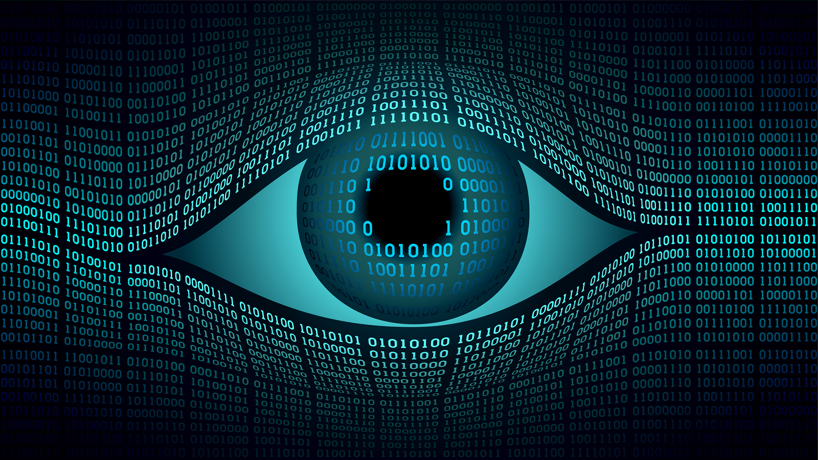
Wrap-up
16-385 Computer Vision
Spring 2019, Lecture 26
http://www.cs.cmu.edu/~16385/

Slide 2
Course announcements
Homework 7 is due on Sunday 5th.
- You can use any of your remaining late days.
- Any questions about homework 7?
- How many of you have looked at/started/finished the homework?
Office hours this week:
- Yannis will have additional office hours on Thursday, 6 – 8 pm.
- On Friday, Bruce and Yannis will switch office hours.

Slide 3
Class evaluation*s* – please take them!
CMU’s Faculty Course Evaluations (FCE): https://cmu.smartevals.com/
16-385 end-of-semester survey: Will be posted on Piazza.
Please take both, super helpful for developing future offerings of the class.
Thanks in advance!

Slide 4
Course overview
Lectures 1 – 7
See also 18-793: Image and Video Processing
Image processing.
Geometry-based vision.
Physics-based vision.
Semantic vision.
Dealing with motion.
Lectures 7 – 12
See also 16-822: Geometry-based Methods in Vision
Lectures 13 – 16
See also 16-823: Physics-based Methods in Vision
See also 15-462: Computer Graphics
See also 15-463: Computational Photography
Lectures 17 – 20
See also 16-824: Vision Learning and Recognition
See also 10-703: Deep Reinforcement Learning
Lectures 21 – 24
See also 16-831: Statistical Techniques in Robotics
See also 16-833: Robot Localization and Mapping

Slide 5
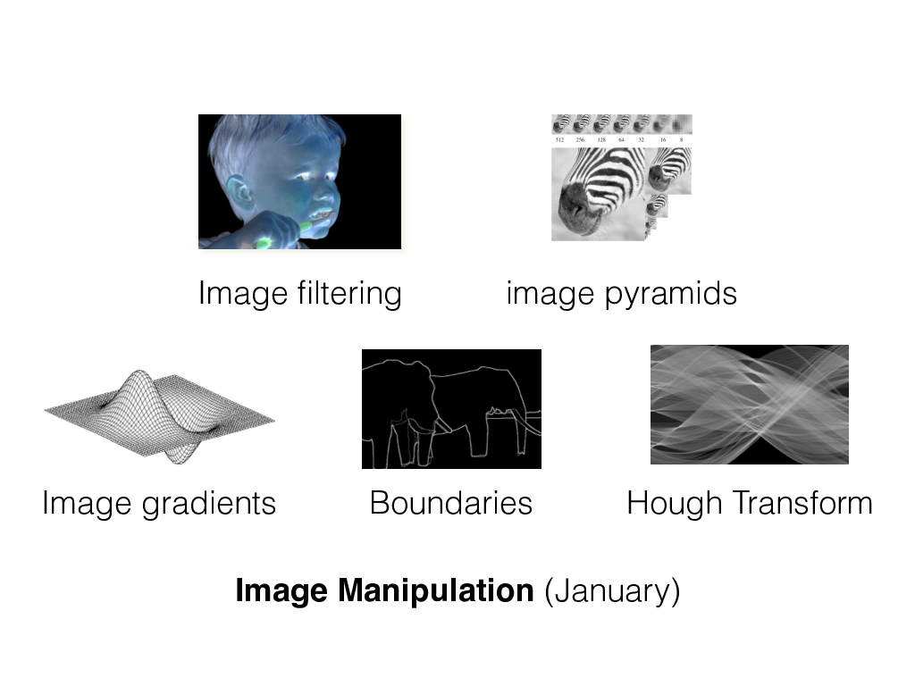
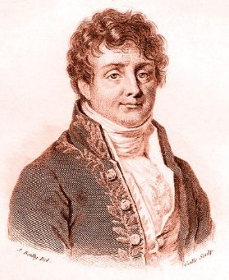
Image processing
Fourier filtering

Slide 6
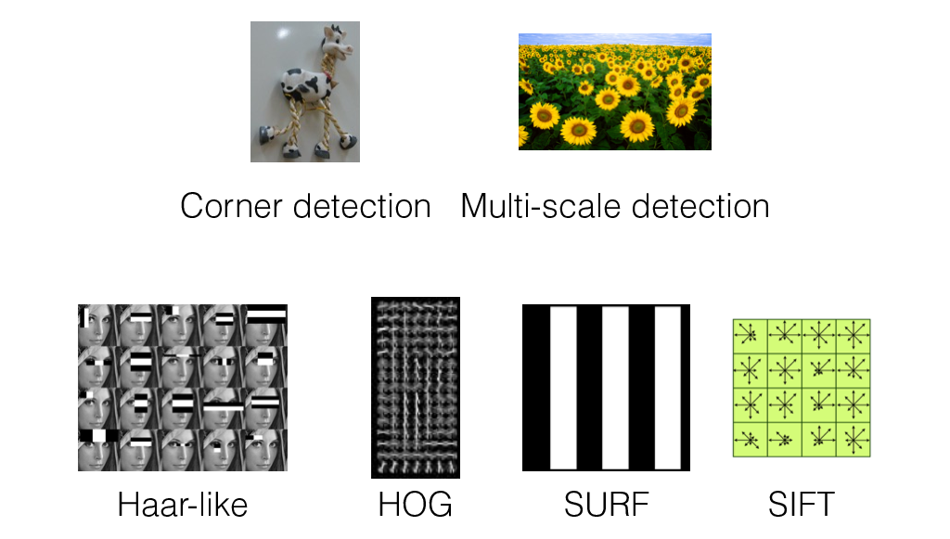
Image features

Slide 7
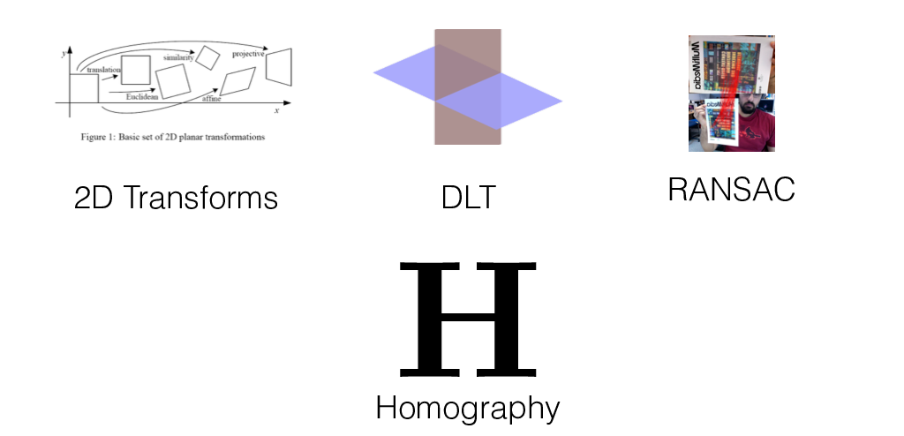
2D alignment

Slide 8
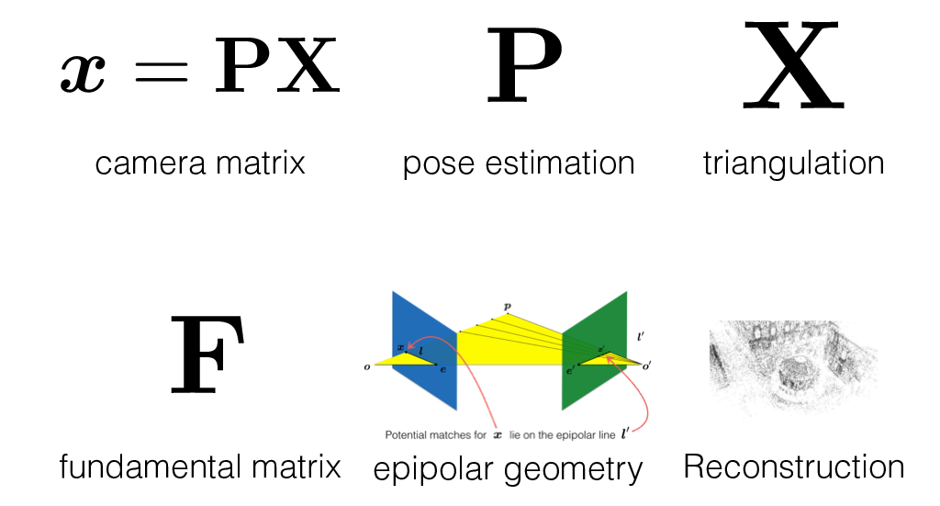
Camera and multi-view geometry

Slide 9
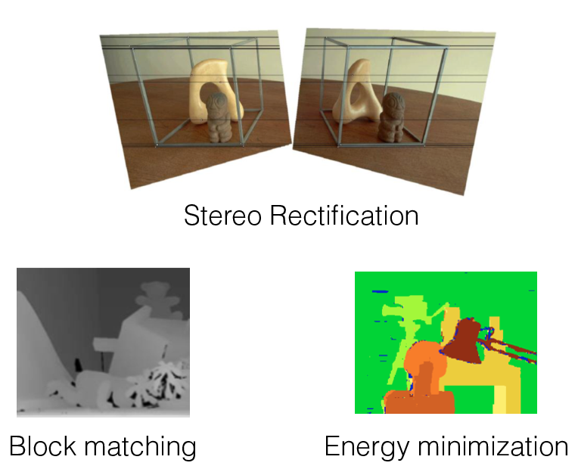
Stereo

Slide 10
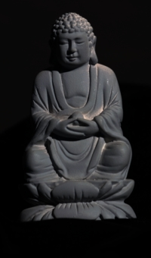

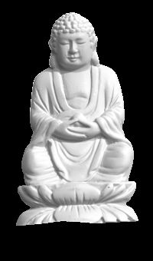

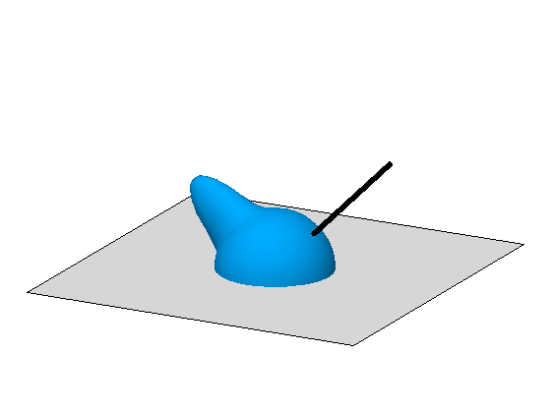

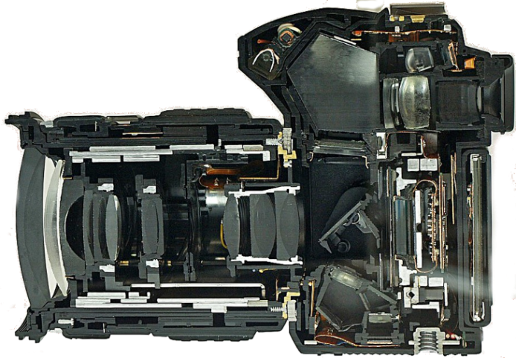
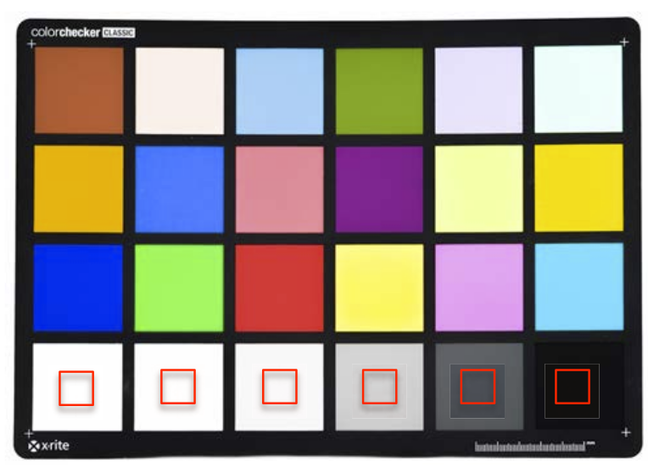
Image formation and physics
illumination
reflectance
shape
Radiometry and image formation
Photometric stereo
Image processing pipeline
Radiometric and color calibration

Slide 11
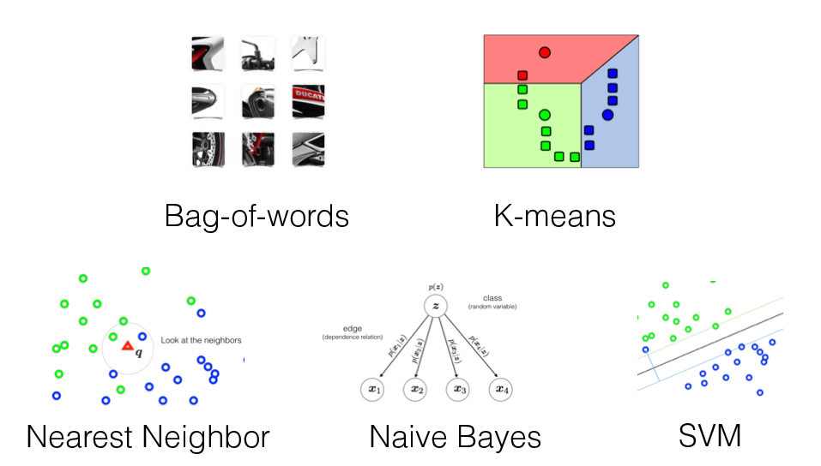
Object recognition

Slide 12
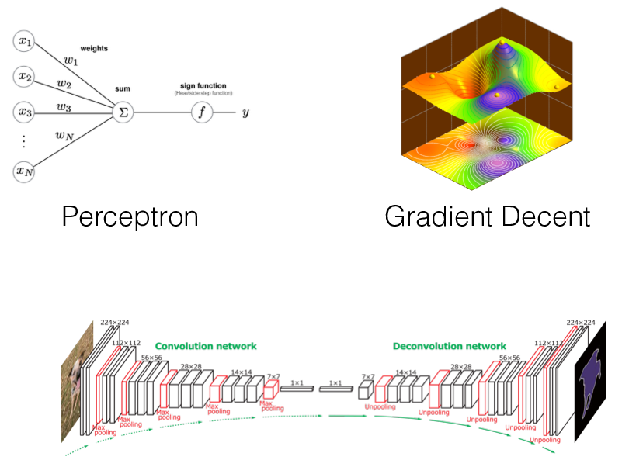
Neural networks
Convolutional Neural Networks

Slide 13
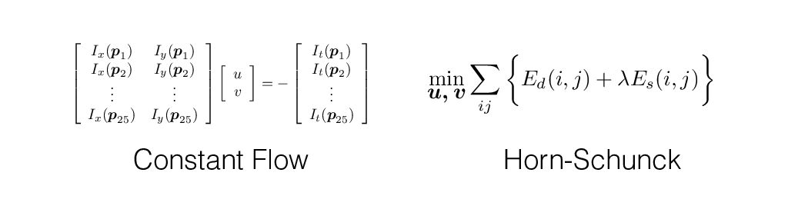
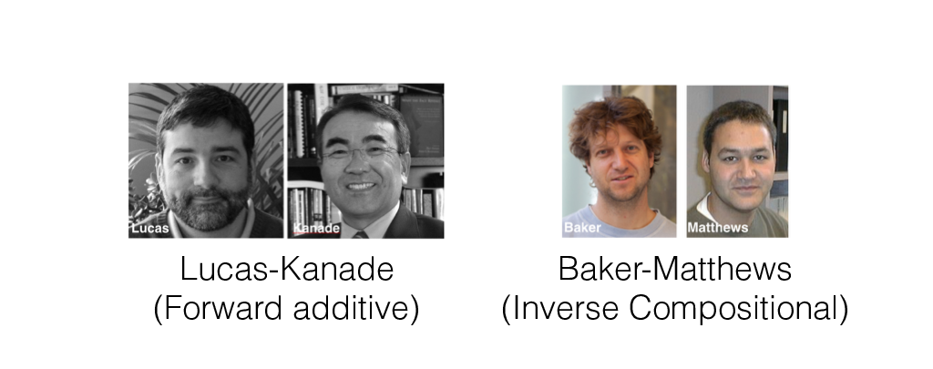
Optical flow and alignment

Slide 14
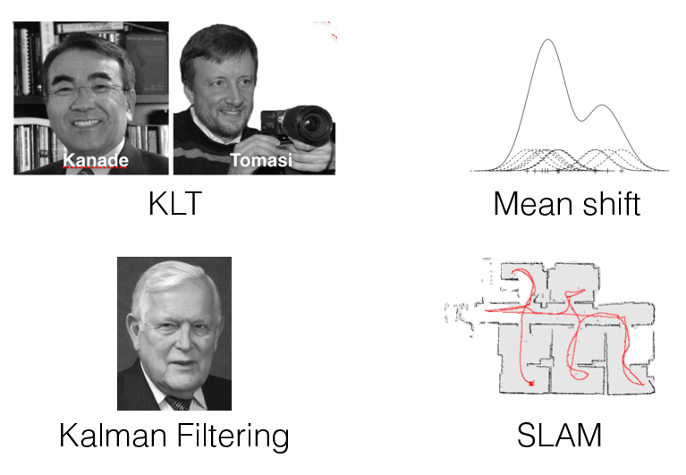
Tracking in videos

Slide 15
Things you should know how to do
Detect lines (circles, shapes) in an image.
Perform automatic image warping and basic AR.
Reconstruct 3D scene structure from two images.
Do photometric stereo and render simple images.
Recognize objects using a bag-of-words model.
Recognize objects using deep CNNs.
Track objects in video.

Slide 16
Questions?

Slide 17
Do you plan on taking any other vision courses?

Slide 18
Which part of the class did you like the most?

Slide 19
Which part of the class did you like the least?

Slide 20
Any topics you wanted to learn more about?

Slide 21
Any topics you wanted to learn less about?

Slide 22
Would the class work better if we did learning first?

Slide 23
Which was your favorite homework?

Slide 24
Which was your least favorite homework?

Slide 25
How does homework difficulty compare to other classes?

Slide 26
Would it be better if homeworks were in Python?

