Slide 1
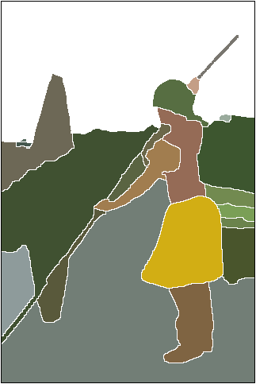
Segmentation
16-385 Computer Vision
Spring 2019, Lecture 25
http://www.cs.cmu.edu/~16385/

Slide 2
Overview of today’s lecture
Finish temporal models.
Normalized cuts.
Boundaries.
Clustering for segmentation.

Slide 3
Slide credits
Most of these slides were adapted from:
Srinivasa Narasimhan (16-385, Spring 2015).
James Hays (Brown University).

Slide 4
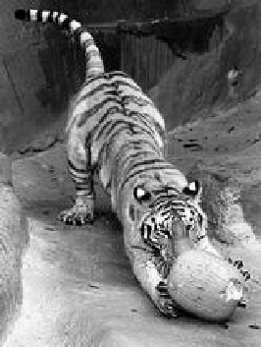
Image segmentation by pairwise similarities
Image = { pixels }
Segmentation = partition of image into segments
Similarity between pixels i and j
S_{ij} = S_{ji} ≥ 0
S_{ij}
Objective: “similar pixels, with large value of S_{ij}, should be in the same segment, dissimilar pixels should be in different segments”

Slide 5


Relational Graphs
G=(V, E, S)
  V: each node denotes a pixel
  E: each edge denotes a pixel-pixel relationship
  S: each edge weight measures pairwise similarity
Segmentation = node partitioning
  break V into disjoint sets V₁ , V₂

Slide 6
Weighted graph partitioning
i
Pixels i I = vertices of graph G
Edges ij = pixel pairs with S_{ij} > 0
Similarity matrix S = [ S_{ij} ]
d_{i} = Σ_{j Є G} S_{ij} degree of I
deg A = Σ_{i Є A} d_{i} degree of A G
Assoc(A,B) = Σ_{i Є A} Σ_{j Є B} S_{ij}
S_{ij}
j
i
A
A
B

Slide 7
Cuts in a Graph
(edge) cut = set of edges whose removal makes a graph disconnected
weight of a cut: cut( A, B ) = Σ_{i Є A,} Σ_{j Є B} S_{ij} =Assoc(A,B)
the normalized cut
Normalized Cut criteria: minimum cut(A,Ā)
NCut( A,B ) = cut(A, B)( + )
1
deg A
1
deg B

Slide 8
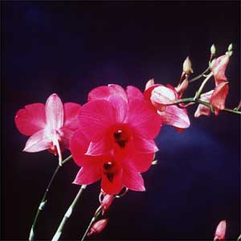
Grouping with Spectral Graph Partitioning
SGP: data structure = a weighted graph, weights describing data affinity
Segmentation is to find a node partitioning of a relational graph, with minimum total cut-off affinity.
Discriminative models are used to evaluate the weights between nodes.
The solution sought is the cuts of the minimum energy.

NP-Hard!

Slide 9
Matrix representation of the graph problem:
0.1
5
4
1
6
2
3
4
2
3
9
7
5
2
1
2
1
7
1
8
2
2
0.1
affinity matrix

Slide 10
Eigenvector approach to segmentation
Represent a connected component (or cluster C)
By a weight vector w such that (indicator vector):
w^{t}Mw is the association of C because:
If C is a good cluster, then the average association between features
In C should be large. Therefore, we want:
w^{t}Mw is large
Suggests algorithm:
    Build matrix M
    Find w such that w^{t}Mw is maximum.
Problem: w is a binary vector

Slide 11
Replace binary vector with continuous weight vector. Interpretation:
      w_{i} large if i belongs to C.
Problem becomes:
  Find w such that w^{t}Mw is maximum
  Construct the corresponding component C by:
  i belongs to C if w_{i} is large.
Problem with scale:
The relative values of the w_{i}’s are important, the total magnitude of w is not.
Normalization:

Slide 12
Replace binary vector with continuous weight vector. Interpretation:
      w_{i} large if i belongs to C.
Problem becomes:
  Find w such that w^{t}Mw is maximum
  Construct the corresponding component C by:
  i belongs to C if w_{i} is large.
Problem with scale:
The relative values of the w_{i}’s are important, the total magnitude of w is not.
Normalization:
Rayleigh’s ratio theorem:
Given a symmetric matrix M, the maximum of the ratio
is obtained for the eigenvector w_{max} corresponding to the largest eigenvalue λ_{max} of M.

Slide 13
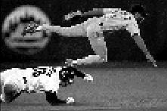







Brightness Image Segmentation

Slide 14
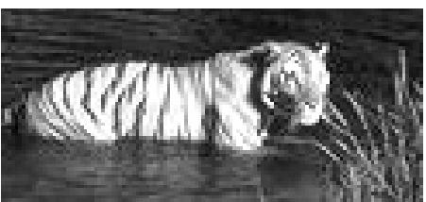
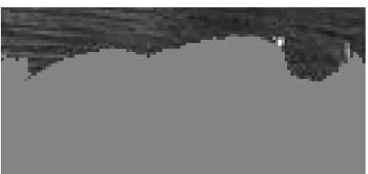
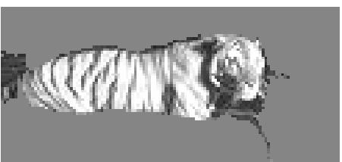
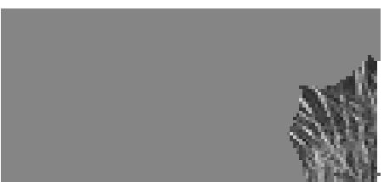
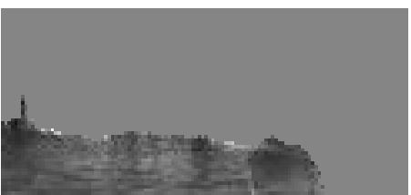
Brightness Image Segmentation

Slide 15
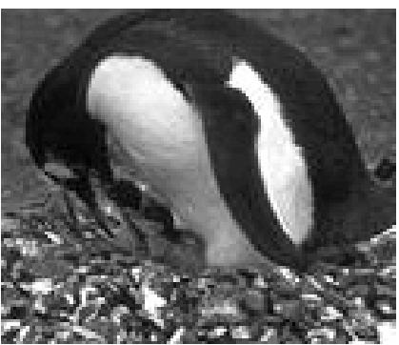
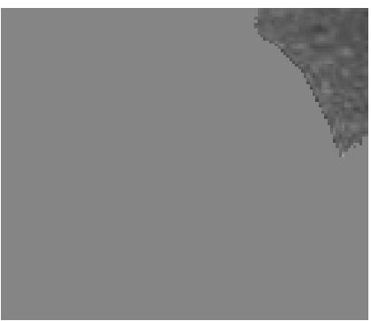
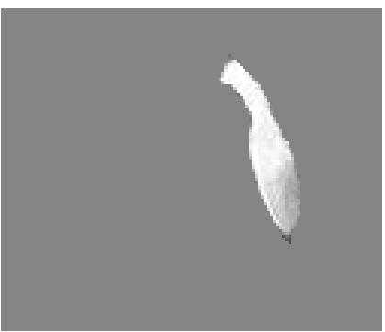
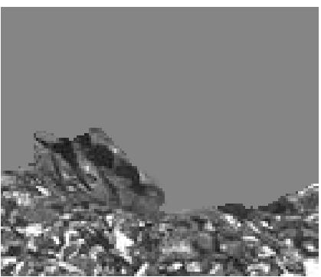
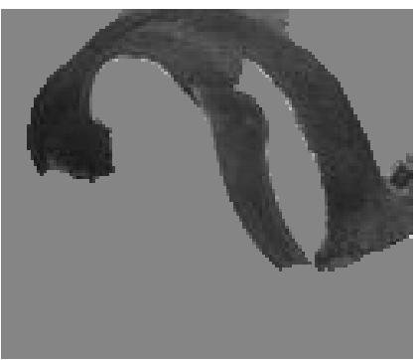
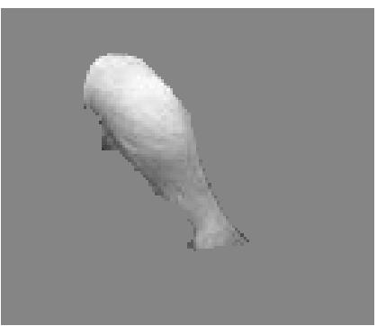
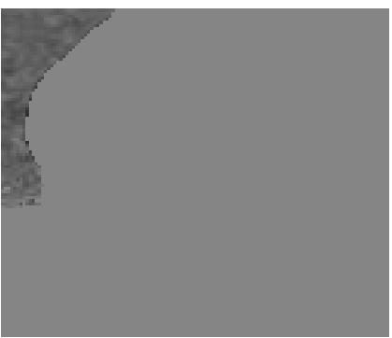

Slide 16
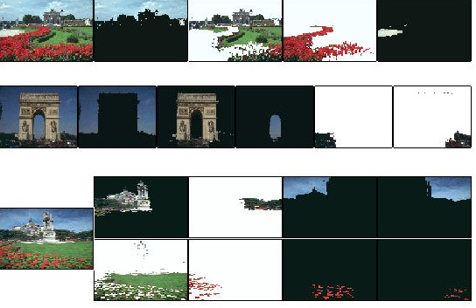
Results on color segmentation

Slide 17
Segmentation from boundaries

Slide 18
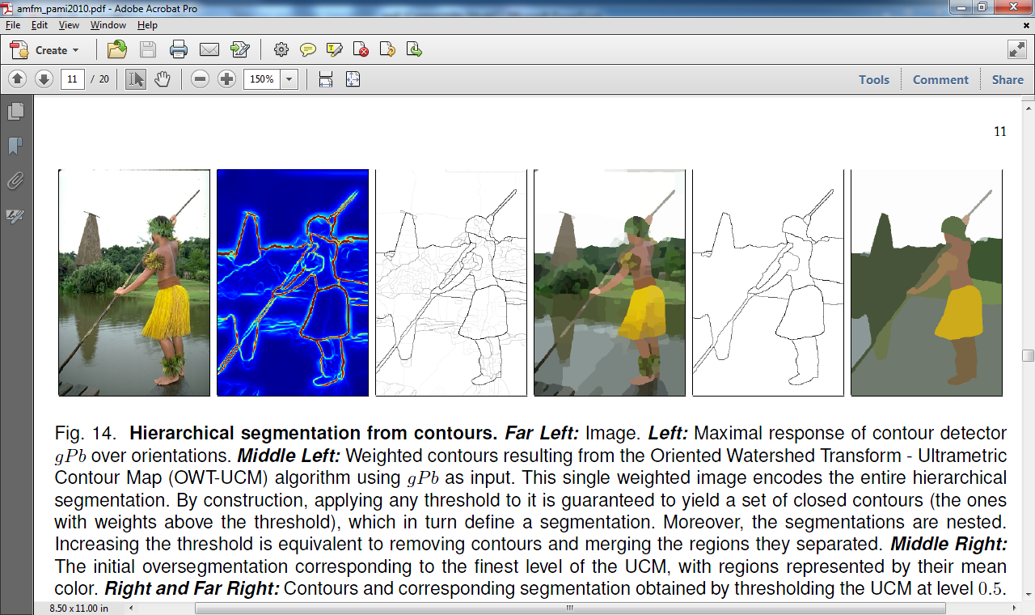
Prob. of boundary
Intuition:
Duality between regions and boundaries
Maybe “easier” to estimate boundaries first
Then use the boundaries to generate segmentations at different levels of granularity
Fine resolution
Coarse resolution
All examples from: P. Arbelaez, M. Maire, C. Fowlkes and J. Malik. Contour Detection and Hierarchical Image Segmentation. IEEE TPAMI, Vol. 33, No. 5, pp. 898-916, May 2011.
Complete package: http://www.eecs.berkeley.edu/Research/Projects/CS/vision/grouping/resources.html

Slide 19
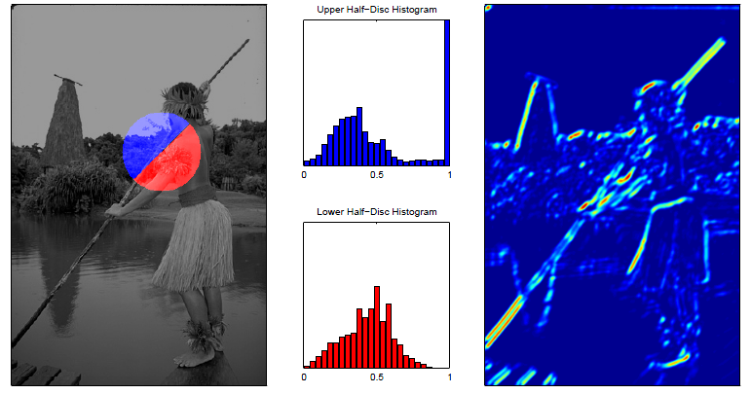
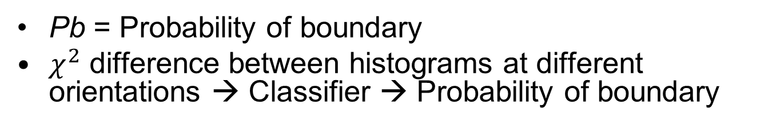
Finding boundaries
Pb

Slide 20
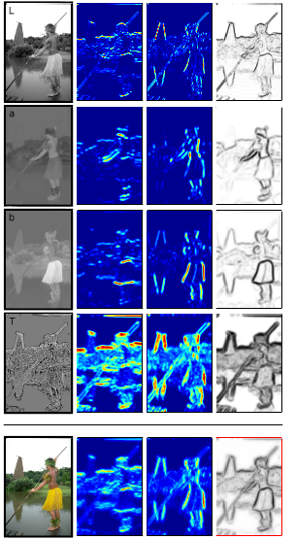
Brightness
Color 1
Combining multiple cues
Color 2
Texton

Slide 22
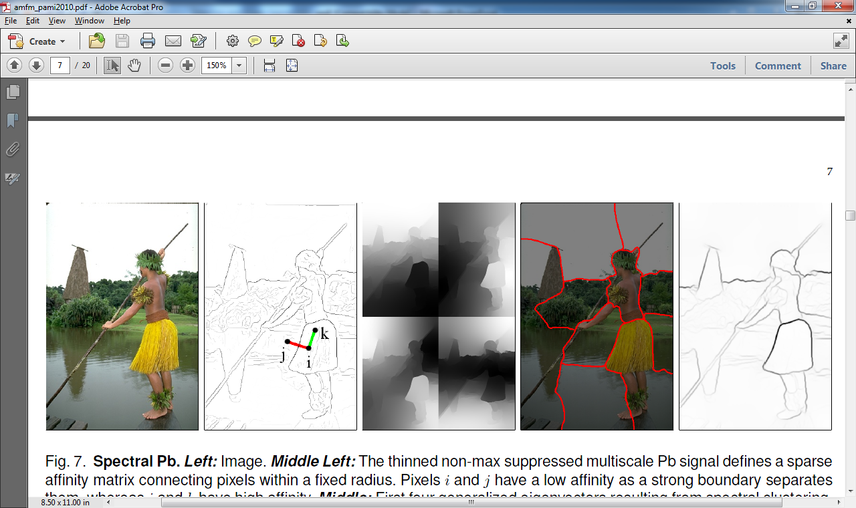
gPb (global Pb)
Idea: We could use the Pb contours to generate an affinity matrix and then use Ncuts
j and i have lower affinity because they cross higher Pb values

Slide 23
gPb (global Pb)
Not good: generate segmentation from the eigenvectors
Good: Combine the gradients of the eigenvectors!!

Slide 24
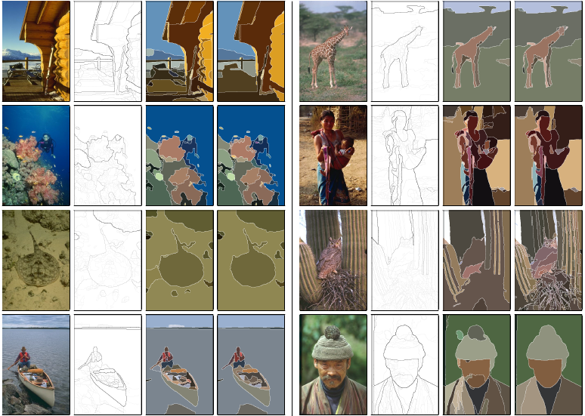
Final step: Convert closed boundary (UCM = Ultrametric Contour Map)
Different thresholds on contours yield segmentations at different levels of granularity
Guaranteed to produce a hierarchical segmentation

Slide 25
Prob. of boundary
Intuition:
Duality between regions and boundaries
Maybe “easier” to estimate boundaries first
Then use the boundaries to generate segmentations at different levels of granularity
Fine resolution
Coarse resolution
Complete package: http://www.eecs.berkeley.edu/Research/Projects/CS/vision/grouping/resources.html

Slide 26
Clustering: group together similar points and represent them with a single token
Key Challenges:
1) What makes two points/images/patches similar?
2) How do we compute an overall grouping from pairwise similarities?

Slide 27
Why do we cluster?
Summarizing data
  Look at large amounts of data
  Patch-based compression or denoising
  Represent a large continuous vector with the cluster number
Counting
  Histograms of texture, color, SIFT vectors
Segmentation
  Separate the image into different regions
Prediction
  Images in the same cluster may have the same labels

Slide 28
How do we cluster?
K-means
  Iteratively re-assign points to the nearest cluster center
Agglomerative clustering
  Start with each point as its own cluster and iteratively merge the closest clusters
Mean-shift clustering
  Estimate modes of pdf

Slide 29
K-means clustering

Slide 30
1. Select initial centroids at random

Slide 31
1. Select initial centroids at random
2. Assign each object to the cluster with the nearest centroid.

Slide 32
1. Select initial centroids at random
2. Assign each object to the cluster with the nearest centroid.
3. Compute each centroid as the mean of the objects assigned to it (go to 2)

Slide 33
1. Select initial centroids at random
2. Assign each object to the cluster with the nearest centroid.
3. Compute each centroid as the mean of the objects assigned to it (go to 2)
2. Assign each object to the cluster with the nearest centroid.

Slide 34
1. Select initial centroids at random
2. Assign each object to the cluster with the nearest centroid.
3. Compute each centroid as the mean of the objects assigned to it (go to 2)
2. Assign each object to the cluster with the nearest centroid.
Repeat previous 2 steps until no change

Slide 35
K-means Clustering
Given k:
Select initial centroids at random.
Assign each object to the cluster with the nearest centroid.
Compute each centroid as the mean of the objects assigned to it.
Repeat previous 2 steps until no change.

Slide 36
K-means: design choices
Initialization
  Randomly select K points as initial cluster center
  Or greedily choose K points to minimize residual
Distance measures
  Traditionally Euclidean, could be others
Optimization
  Will converge to a local minimum
  May want to perform multiple restarts

Slide 37
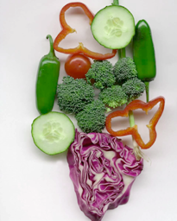
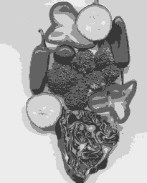
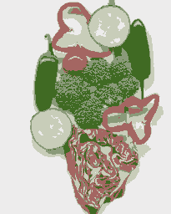
K-means clustering using intensity or color
Image
Clusters on intensity
Clusters on color
Notes:
I gave each pixel the mean intensity or mean color of its cluster --- this is basically just vector quantizing the image intensities/colors. Notice that there is no requirement that clusters be spatially localized and they’re not.

Slide 38
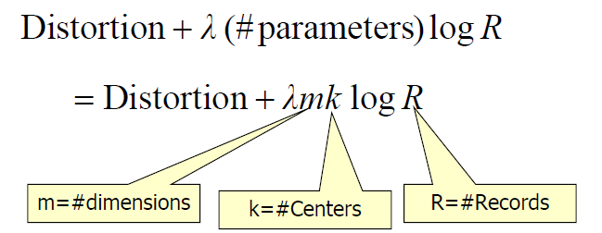
How to choose the number of clusters?
Minimum Description Length (MDL) principal for model comparison
Minimize Schwarz Criterion
  also called Bayes Information Criteria (BIC)

Slide 39
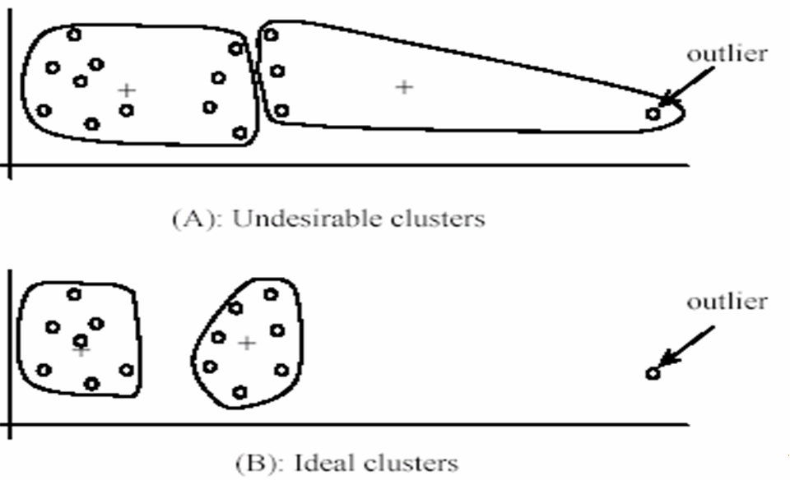
K-Means pros and cons
Pros
  Finds cluster centers that minimize conditional variance (good representation of data)
  Simple and fast*
  Easy to implement
Cons
  Need to choose K
  Sensitive to outliers
  Prone to local minima
  All clusters have the same parameters (e.g., distance measure is non-adaptive)
  *Can be slow: each iteration is O(KNd) for N d-dimensional points
Usage
  Rarely used for pixel segmentation

Slide 40
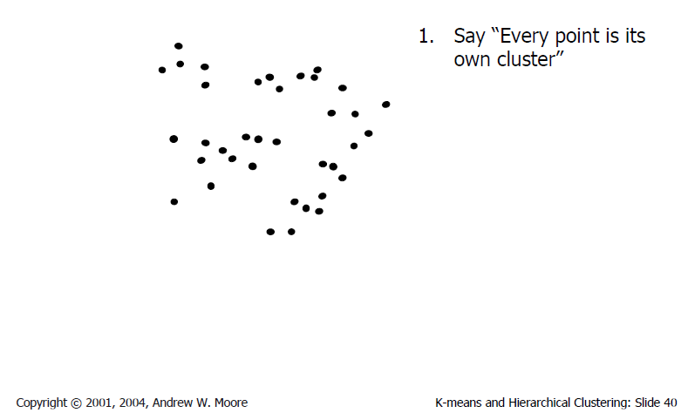
Agglomerative clustering

Slide 41
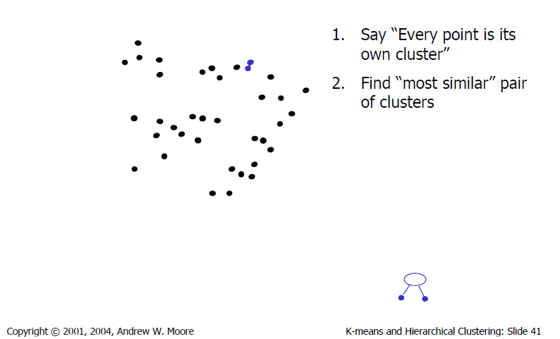
Agglomerative clustering

Slide 42
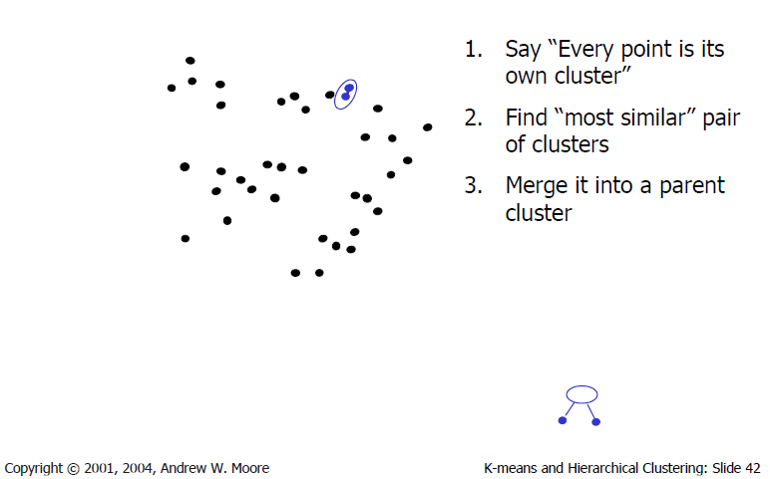
Agglomerative clustering

Slide 43
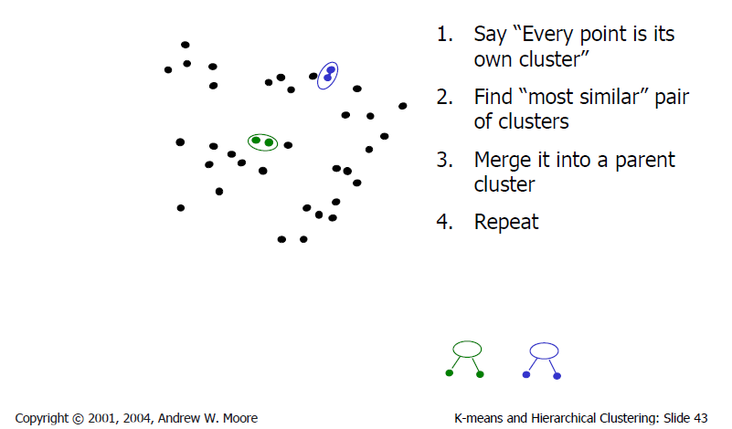
Agglomerative clustering

Slide 44
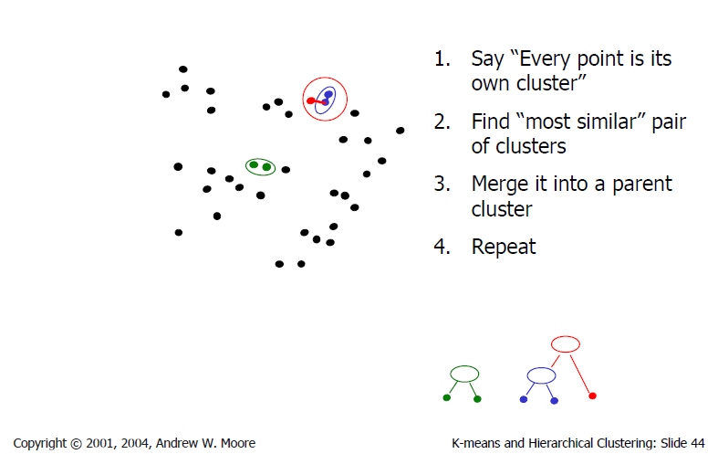
Agglomerative clustering

Slide 45
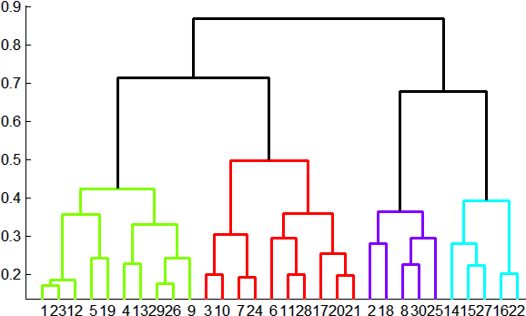
Agglomerative clustering
How to define cluster similarity?
Average distance between points, maximum distance, minimum distance
Distance between means or medoids
How many clusters?
Clustering creates a dendrogram (a tree)
Threshold based on max number of clusters or based on distance between merges
distance

Slide 46
Conclusions: Agglomerative Clustering
Good
Simple to implement, widespread application
Clusters have adaptive shapes
Provides a hierarchy of clusters
Bad
May have imbalanced clusters
Still have to choose number of clusters or threshold
Need to use an “ultrametric” to get a meaningful hierarchy

Slide 47
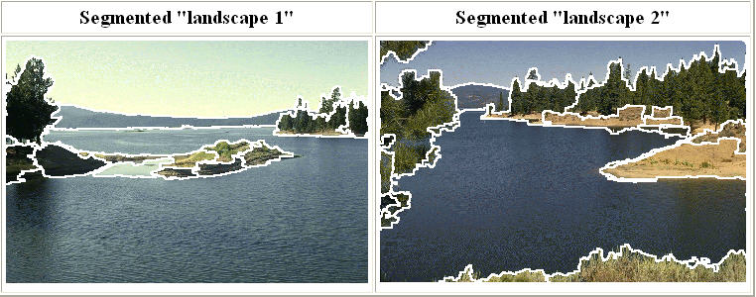
Mean shift segmentation
D. Comaniciu and P. Meer, Mean Shift: A Robust Approach toward Feature Space Analysis, PAMI 2002.
Versatile technique for clustering-based segmentation

Slide 48
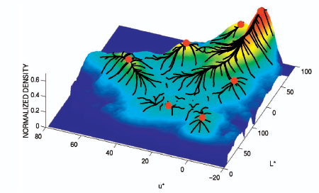
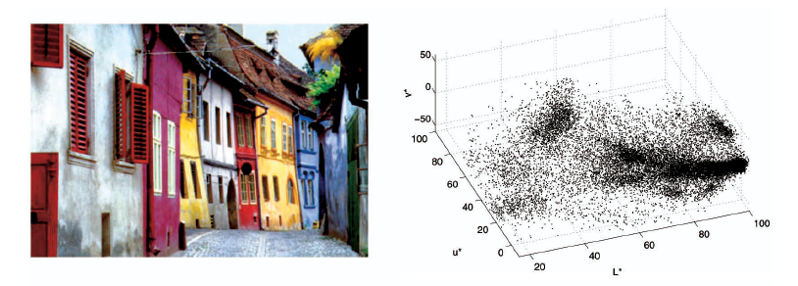
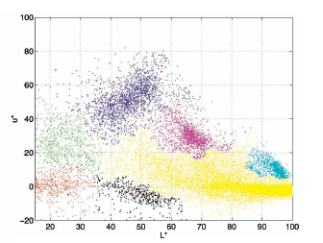
Mean shift algorithm
Try to find modes of this non-parametric density

Slide 49
Mean Shift Algorithm
A ‘mode seeking’ algorithm
Fukunaga & Hostetler (1975)

Slide 50
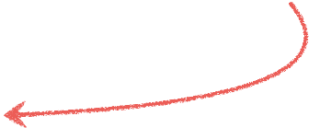
Mean Shift Algorithm
A ‘mode seeking’ algorithm
Fukunaga & Hostetler (1975)
Find the region of highest density

Slide 51

Mean Shift Algorithm
A ‘mode seeking’ algorithm
Fukunaga & Hostetler (1975)
Pick a point

Slide 52
Mean Shift Algorithm
A ‘mode seeking’ algorithm
Fukunaga & Hostetler (1975)
Draw a window

Slide 53
Mean Shift Algorithm
A ‘mode seeking’ algorithm
Fukunaga & Hostetler (1975)
Compute the (weighted) mean

Slide 54
Mean Shift Algorithm
A ‘mode seeking’ algorithm
Fukunaga & Hostetler (1975)
Shift the window

Slide 55
Mean Shift Algorithm
A ‘mode seeking’ algorithm
Fukunaga & Hostetler (1975)
Compute the mean

Slide 56
Mean Shift Algorithm
A ‘mode seeking’ algorithm
Fukunaga & Hostetler (1975)
Shift the window

Slide 57
Mean Shift Algorithm
A ‘mode seeking’ algorithm
Fukunaga & Hostetler (1975)
Compute the mean

Slide 58
Mean Shift Algorithm
A ‘mode seeking’ algorithm
Fukunaga & Hostetler (1975)
Shift the window

Slide 59
Mean Shift Algorithm
A ‘mode seeking’ algorithm
Fukunaga & Hostetler (1975)
Compute the mean

Slide 60
Mean Shift Algorithm
A ‘mode seeking’ algorithm
Fukunaga & Hostetler (1975)
Shift the window

Slide 61
Mean Shift Algorithm
A ‘mode seeking’ algorithm
Fukunaga & Hostetler (1975)
Compute the mean

Slide 62
Mean Shift Algorithm
A ‘mode seeking’ algorithm
Fukunaga & Hostetler (1975)
Shift the window

Slide 63
Mean Shift Algorithm
A ‘mode seeking’ algorithm
Fukunaga & Hostetler (1975)
Compute the mean

Slide 64
Mean Shift Algorithm
A ‘mode seeking’ algorithm
Fukunaga & Hostetler (1975)
Shift the window

Slide 65
Mean Shift Algorithm
A ‘mode seeking’ algorithm
Fukunaga & Hostetler (1975)
Compute the mean

Slide 66
Mean Shift Algorithm
A ‘mode seeking’ algorithm
Fukunaga & Hostetler (1975)
Shift the window

Slide 67
Mean Shift Algorithm
A ‘mode seeking’ algorithm
Fukunaga & Hostetler (1975)
Compute the mean

Slide 68
Mean Shift Algorithm
A ‘mode seeking’ algorithm
Fukunaga & Hostetler (1975)
Shift the window
To understand the theory behind this we need to understand…

Slide 69
Real Modality Analysis

Slide 70
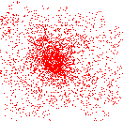
Attraction basin
Attraction basin: the region for which all trajectories lead to the same mode
Cluster: all data points in the attraction basin of a mode
Slide by Y. Ukrainitz & B. Sarel

Slide 71
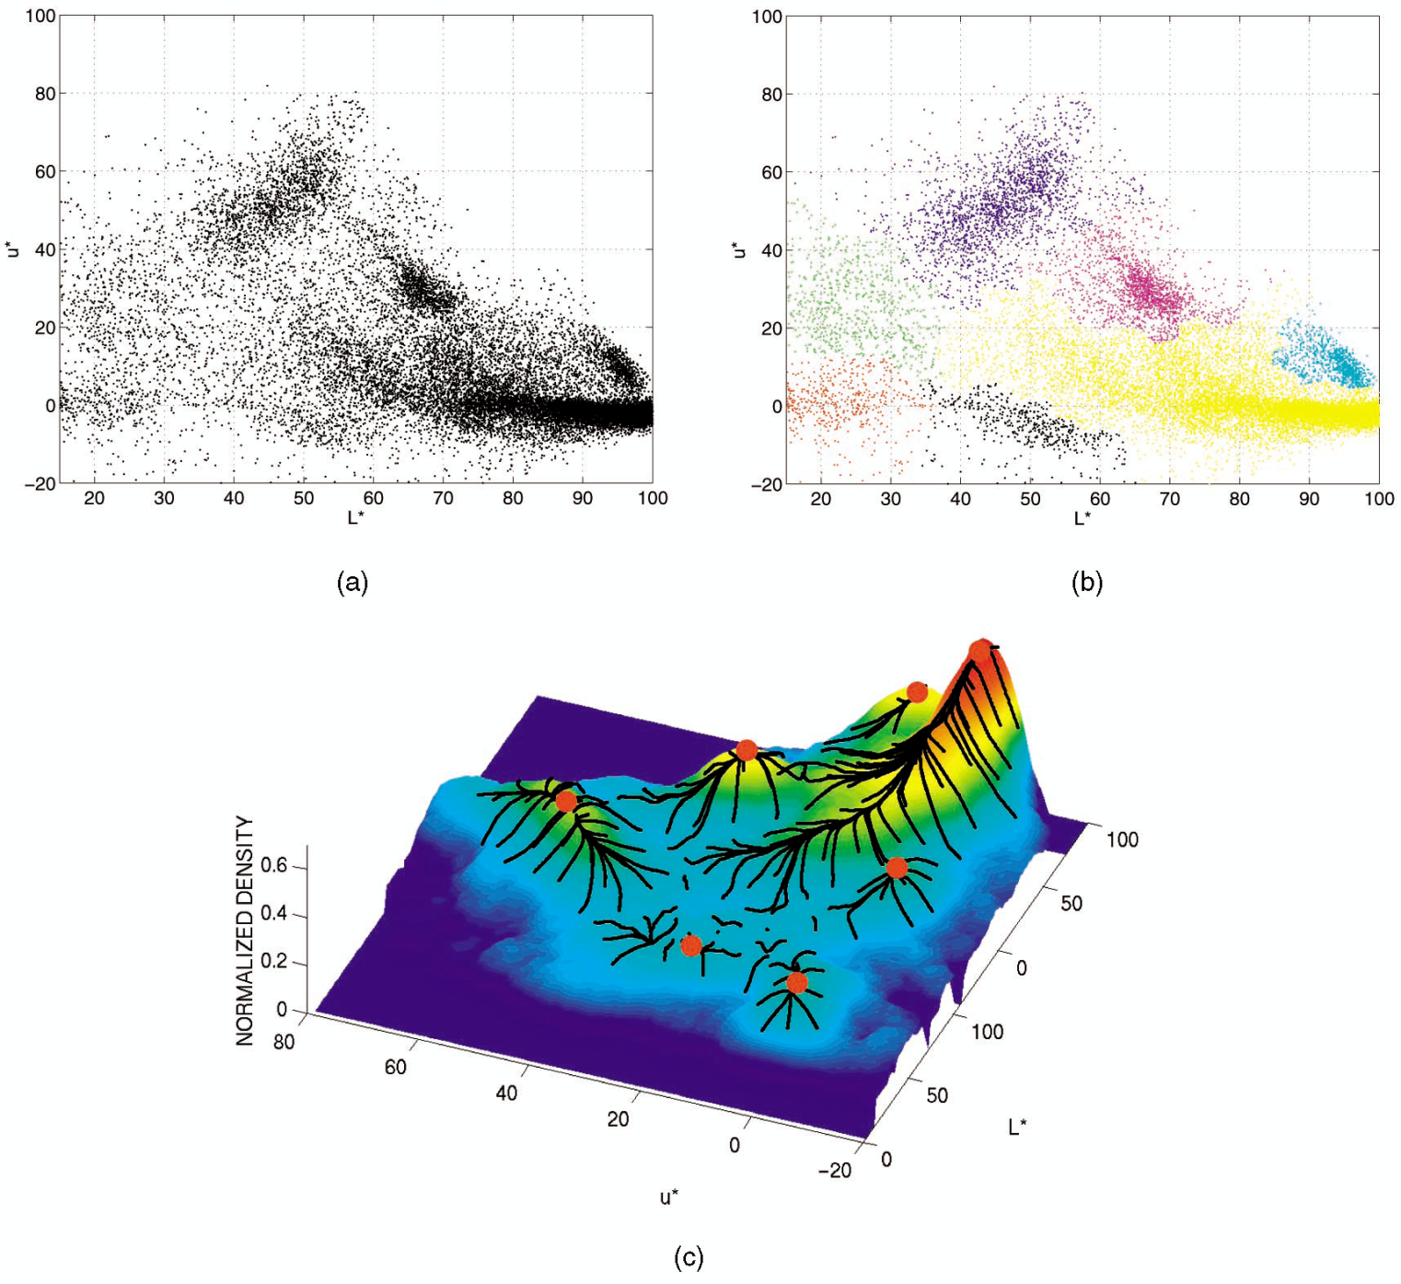
Attraction basin

Slide 72
Mean shift clustering
The mean shift algorithm seeks modes of the given set of points
  Choose kernel and bandwidth
  For each point:
    Center a window on that point
    Compute the mean of the data in the search window
    Center the search window at the new mean location
    Repeat (b,c) until convergence
  Assign points that lead to nearby modes to the same cluster

Slide 73

Segmentation by Mean Shift
Compute features for each pixel (color, gradients, texture, etc)
Set kernel size for features K_{f} and position K_{s}
Initialize windows at individual pixel locations
Perform mean shift for each window until convergence
Merge windows that are within width of K_{f} and K_{s}

Slide 74
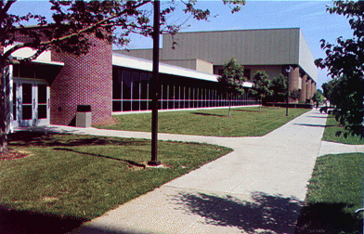
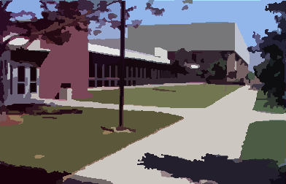
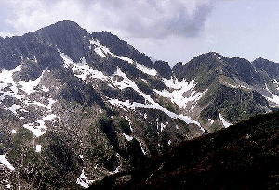
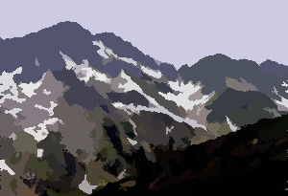
Mean shift segmentation results
http://www.caip.rutgers.edu/~comanici/MSPAMI/msPamiResults.html

Slide 75
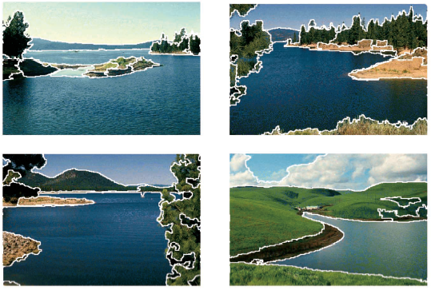
http://www.caip.rutgers.edu/~comanici/MSPAMI/msPamiResults.html

Slide 76
Mean-shift: other issues
Speedups
  Binned estimation
  Fast search of neighbors
  Update each window in each iteration (faster convergence)
Other tricks
  Use kNN to determine window sizes adaptively
Lots of theoretical support
  D. Comaniciu and P. Meer, Mean Shift: A Robust Approach toward Feature Space Analysis, PAMI 2002.

Slide 77
References
Basic reading:
Szeliski, Sections 5.2, 5.3, 5.4, 5.5.
Notes:
Ch

