Slide 1
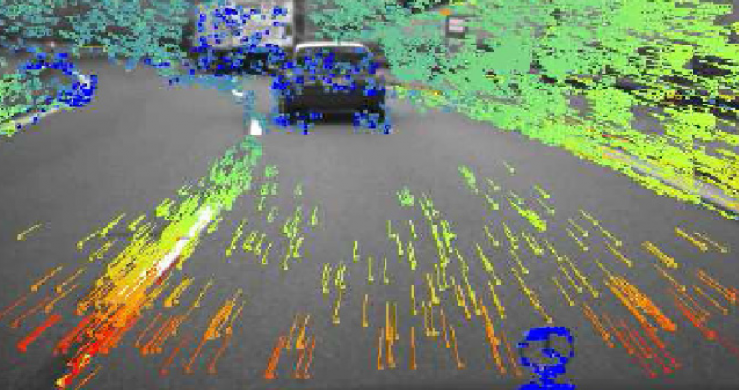
Optical flow
16-385 Computer Vision
Spring 2019, Lecture 21
http://www.cs.cmu.edu/~16385/

Slide 2
Course announcements
Homework 6 has been posted and is due on April 24th.
- Any questions about the homework?
- How many of you have looked at/started/finished homework 6?
Wednesday’s office hours will be covered by Yannis at the graphics lounge.

Slide 3
Overview of today’s lecture
Quick intro to vision for video.
Optical flow.
Constant flow.
Horn-Schunck flow.

Slide 4
Slide credits
Most of these slides were adapted from:
Kris Kitani (16-385, Spring 2017).

Slide 5
Course overview
Lectures 1 – 7
See also 18-793: Image and Video Processing
Image processing.
Geometry-based vision.
Physics-based vision.
Semantic vision.
Dealing with motion.
Lectures 7 – 12
See also 16-822: Geometry-based Methods in Vision
Lectures 13 – 16
See also 16-823: Physics-based Methods in Vision
See also 15-463: Computational Photography
Lectures 17 – 21
See also 16-824: Vision Learning and Recognition
We are starting this part now

Slide 6
Computer vision for video

Slide 7
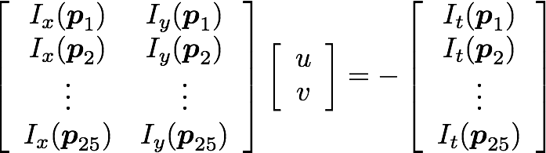
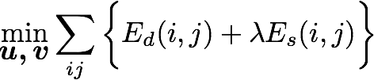
Constant Flow
Horn-Schunck
Optical Flow

Slide 8
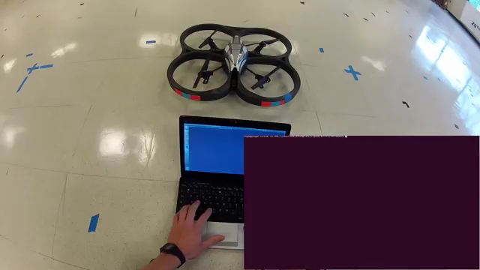
Optical flow used for feature tracking on a drone

Slide 9
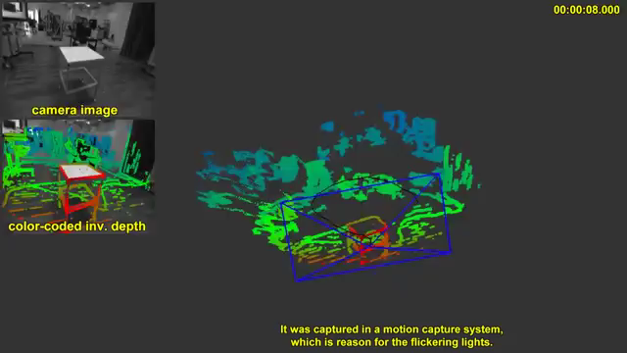
optical flow used for motion estimation in visual odometry

Slide 10

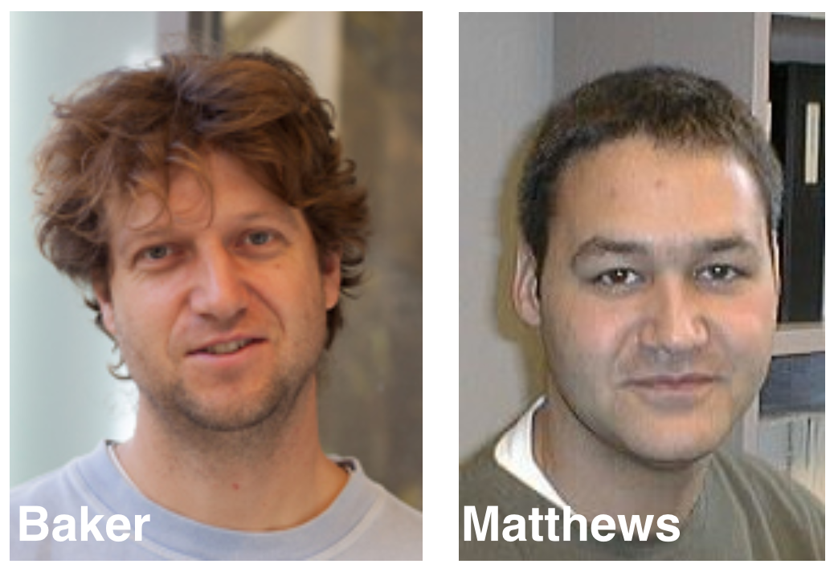
Lucas-Kanade
(Forward additive)
Baker-Matthews
(Inverse Compositional)
Image Alignment

Slide 11
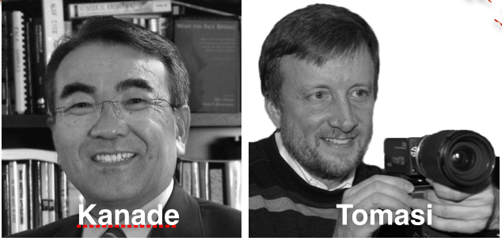
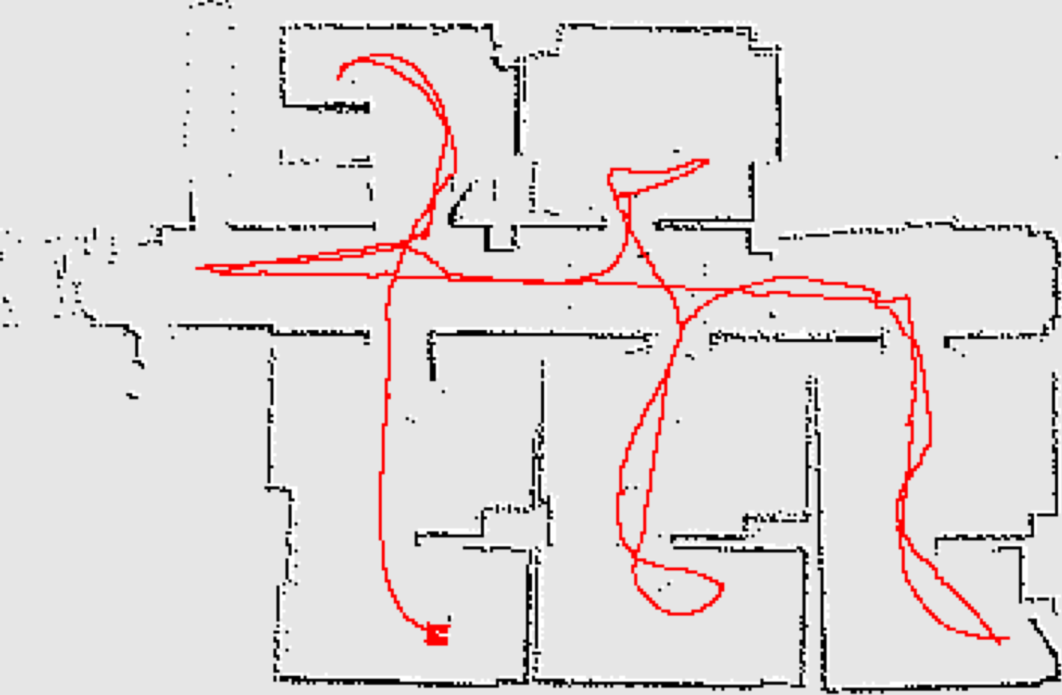
KLT
Mean shift
Kalman Filtering
SLAM
Tracking in Video

Slide 12
Optical flow

Slide 13
Optical Flow
Problem Definition
Given two consecutive image frames, estimate the motion of each pixel
Assumptions
Brightness constancy
Small motion

Slide 14




Optical Flow
(Problem definition)
Estimate the motion (flow) between these two consecutive images
How is this different from estimating a 2D transform?

Slide 15
Key Assumptions
(unique to optical flow)
Color Constancy
(Brightness constancy for intensity images)
Implication: allows for pixel to pixel comparison
(not image features)
Small Motion
(pixels only move a little bit)
Implication: linearization of the brightness constancy constraint

Slide 16
Approach
Look for nearby pixels with the same color
(small motion)
(color constancy)

Slide 17




Brightness constancy
Assumption 1
Scene point moving through image sequence

Slide 18



Brightness constancy
Assumption 1
Scene point moving through image sequence

Slide 19
Brightness constancy
Assumption 1
Scene point moving through image sequence
Assumption:Brightness of the point will remain the same

Slide 20

Brightness constancy
Assumption 1
Scene point moving through image sequence
Assumption:Brightness of the point will remain the same
constant

Slide 21

Small motion
Assumption 2

Slide 22


Small motion
Assumption 2

Slide 23


Small motion
Assumption 2
Optical flow (velocities):
Displacement:

Slide 24
Small motion
Assumption 2
Optical flow (velocities):
Displacement:
For a really small space-time step…
… the brightness between two consecutive image frames is the same

Slide 25

These assumptions yield the …
Brightness Constancy Equation
total derivative
partial derivative
Equation is not obvious. Where does this come from?

Slide 26
For small space-time step, brightness of a point is the same

Slide 27
For small space-time step, brightness of a point is the same
Insight:
If the time step is really small,
we can linearize the intensity function

Slide 28
Multivariable Taylor Series Expansion
(First order approximation, two variables)

Slide 29

Multivariable Taylor Series Expansion
(First order approximation, two variables)
assuming small motion

Slide 30
Multivariable Taylor Series Expansion
(First order approximation, two variables)
partial derivative
assuming small motion
fixed point
cancel terms

Slide 31

Multivariable Taylor Series Expansion
(First order approximation, two variables)
assuming small motion
cancel terms

Slide 32
Multivariable Taylor Series Expansion
(First order approximation, two variables)
assuming small motion
divide by
take limit

Slide 33

Multivariable Taylor Series Expansion
(First order approximation, two variables)
assuming small motion
divide by
take limit

Slide 34
Multivariable Taylor Series Expansion
(First order approximation, two variables)
assuming small motion
divide by
take limit
Brightness Constancy Equation

Slide 35


Brightness Constancy Equation
shorthand notation
(x-flow)
(y-flow)
vector form
(1 x 2)
(2 x 1)

Slide 36
(putting the math aside for a second…)
What do the term of the
brightness constancy equation represent?

Slide 37
(putting the math aside for a second…)
What do the term of the
brightness constancy equation represent?
Image gradients
(at a point p)

Slide 38
(putting the math aside for a second…)
What do the term of the
brightness constancy equation represent?
flow velocities
Image gradients
(at a point p)

Slide 39
(putting the math aside for a second…)
What do the term of the
brightness constancy equation represent?
flow velocities
Image gradients
(at a point p)
temporal gradient
How do you compute these terms?

Slide 40


How do you compute …
spatial derivative

Slide 41
How do you compute …
spatial derivative
Forward difference
Sobel filter
Scharr filter
…

Slide 42

How do you compute …
spatial derivative
temporal derivative
Forward difference
Sobel filter
Scharr filter
…

Slide 43
How do you compute …
spatial derivative
temporal derivative
Forward difference
Sobel filter
Scharr filter
…
frame differencing

Slide 44
Frame differencing
1 | 1 | 1 | 1 | 1
1 | 1 | 1 | 1 | 1
1 | 10 | 10 | 10 | 10
1 | 10 | 10 | 10 | 10
1 | 10 | 10 | 10 | 10
1 | 10 | 10 | 10 | 10
1 | 1 | 1 | 1 | 1
1 | 1 | 1 | 1 | 1
1 | 1 | 1 | 1 | 1
1 | 1 | 10 | 10 | 10
1 | 1 | 10 | 10 | 10
1 | 1 | 10 | 10 | 10
0 | 0 | 0 | 0 | 0
0 | 0 | 0 | 0 | 0
0 | 9 | 9 | 9 | 9
0 | 9 | 0 | 0 | 0
0 | 9 | 0 | 0 | 0
0 | 9 | 0 | 0 | 0
-
=
(example of a forward difference)

Slide 45
Example:
x
x
1 | 1 | 1 | 1 | 1
1 | 1 | 1 | 1 | 1
1 | 10 | 10 | 10 | 10
1 | 10 | 10 | 10 | 10
1 | 10 | 10 | 10 | 10
1 | 10 | 10 | 10 | 10
1 | 1 | 1 | 1 | 1
1 | 1 | 1 | 1 | 1
1 | 1 | 1 | 1 | 1
1 | 1 | 10 | 10 | 10
1 | 1 | 10 | 10 | 10
1 | 1 | 10 | 10 | 10
3 x 3 patch
y
y
x
x
x
- | 0 | 0 | 0 | -
- | 0 | 0 | 0 | -
- | 9 | 0 | 0 | -
- | 9 | 0 | 0 | -
- | 9 | 0 | 0 | -
- | 9 | 0 | 0 | -
- | - | - | - | -
0 | 0 | 0 | 0 | 0
0 | 9 | 9 | 9 | 9
- | 0 | 0 | 0 | 0
0 | 0 | 0 | 0 | 0
- | - | - | - | -
0 | 0 | 0 | 0 | 0
0 | 0 | 0 | 0 | 0
0 | 9 | 9 | 9 | 9
0 | 9 | 0 | 0 | 0
0 | 9 | 0 | 0 | 0
0 | 9 | 0 | 0 | 0
y
y
y
-1
0
1
-1 0 1

Slide 46


How do you compute …
spatial derivative
optical flow
temporal derivative
Forward difference
Sobel filter
Scharr filter
…
How do you compute this?
frame differencing

Slide 47
How do you compute …
spatial derivative
optical flow
temporal derivative
Forward difference
Sobel filter
Scharr filter
…
We need to solve for this!
(this is the unknown in the optical flow problem)
frame differencing

Slide 48
How do you compute …
spatial derivative
optical flow
temporal derivative
Forward difference
Sobel filter
Scharr filter
…
frame differencing
Solution lies on a line
Cannot be found uniquely with a single constraint

Slide 49


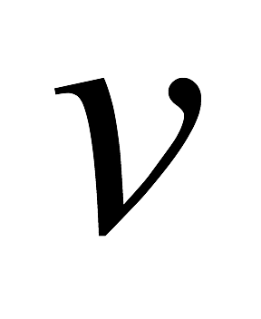
Solution lies on a straight line
many combinations of u and v will satisfy the equality
The solution cannot be determined uniquely with a single constraint (a single pixel)

Slide 50

spatial derivative
optical flow
temporal derivative
How can we use the brightness constancy equation to
estimate the optical flow?

Slide 51







unknown
known
We need at least ____ equations to solve for 2 unknowns.

Slide 52
unknown
known
Where do we get more equations (constraints)?

Slide 53
Horn-Schunck
Optical Flow (1981)
Lucas-Kanade
Optical Flow (1981)
brightness constancy
method of differences
small motion
‘smooth’ flow
(flow can vary from pixel to pixel)
‘constant’ flow
(flow is constant for all pixels)
global method
(dense)
local method
(sparse)

Slide 54
Constant flow

Slide 55
Where do we get more equations (constraints)?
Assume that the surrounding patch (say 5x5) has ‘constant flow’

Slide 56
Assumptions:
Flow is locally smooth
Neighboring pixels have same displacement
Using a 5 x 5 image patch, gives us 25 equations
\left[
\begin{array}{c c}
I_x(\vec{p}_1) & I_y(\vec{p}_1) \\
I_x(\vec{p}_2) & I_y(\vec{p}_2) \\
\vdots & \vdots \\
I_x(\vec{p}_{25}) & I_y(\vec{p}_{25})
\end{array}
\right]
\left[
\begin{array}{c}
u\\
v
\end{array}
\right]
=
-
\left[
\begin{array}{c}
I_t(\vec{p}_1)\\
I_t(\vec{p}_2)\\
\vdots\\
I_t(\vec{p}_{25})
\end{array}
\right]

Slide 57
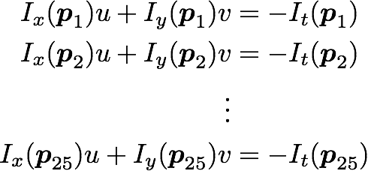
Assumptions:
Flow is locally smooth
Neighboring pixels have same displacement
Using a 5 x 5 image patch, gives us 25 equations
\left[
\begin{array}{c c}
I_x(\vec{p}_1) & I_y(\vec{p}_1) \\
I_x(\vec{p}_2) & I_y(\vec{p}_2) \\
\vdots & \vdots \\
I_x(\vec{p}_{25}) & I_y(\vec{p}_{25})
\end{array}
\right]
\left[
\begin{array}{c}
u\\
v
\end{array}
\right]
=
-
\left[
\begin{array}{c}
I_t(\vec{p}_1)\\
I_t(\vec{p}_2)\\
\vdots\\
I_t(\vec{p}_{25})
\end{array}
\right]

Slide 58
Assumptions:
Flow is locally smooth
Neighboring pixels have same displacement
Using a 5 x 5 image patch, gives us 25 equations
Matrix form
\left[
\begin{array}{c c}
I_x(\vec{p}_1) & I_y(\vec{p}_1) \\
I_x(\vec{p}_2) & I_y(\vec{p}_2) \\
\vdots & \vdots \\
I_x(\vec{p}_{25}) & I_y(\vec{p}_{25})
\end{array}
\right]
\left[
\begin{array}{c}
u\\
v
\end{array}
\right]
=
-
\left[
\begin{array}{c}
I_t(\vec{p}_1)\\
I_t(\vec{p}_2)\\
\vdots\\
I_t(\vec{p}_{25})
\end{array}
\right]

Slide 59
Assumptions:
Flow is locally smooth
Neighboring pixels have same displacement
Using a 5 x 5 image patch, gives us 25 equations
How many equations? How many unknowns? How do we solve this?
\left[
\begin{array}{c c}
I_x(\vec{p}_1) & I_y(\vec{p}_1) \\
I_x(\vec{p}_2) & I_y(\vec{p}_2) \\
\vdots & \vdots \\
I_x(\vec{p}_{25}) & I_y(\vec{p}_{25})
\end{array}
\right]
\left[
\begin{array}{c}
u\\
v
\end{array}
\right]
=
-
\left[
\begin{array}{c}
I_t(\vec{p}_1)\\
I_t(\vec{p}_2)\\
\vdots\\
I_t(\vec{p}_{25})
\end{array}
\right]

Slide 60


Least squares approximation
is equivalent to solving
\left[
\begin{array}{c c}
\sum \limits_{p \in P} I_x I_x
&
\sum \limits_{p \in P} I_x I_y
\\
\sum \limits_{p \in P} I_y I_x
&\sum \limits_{p \in P} I_y I_y
\end{array}
\right]
%
\left[
\begin{array}{c}
u\\v
\end{array}
\right]
= -
\left[
\begin{array}{c}
\sum \limits_{p \in P} I_x I_t
\\
\sum \limits_{p \in P} I_y I_t
\end{array}
\right]

Slide 61


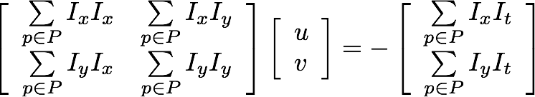

Least squares approximation
is equivalent to solving
To obtain the least squares solution solve:
where the summation is over each pixel p in patch P
\left[
\begin{array}{c c}
\sum \limits_{p \in P} I_x I_x
&
\sum \limits_{p \in P} I_x I_y
\\
\sum \limits_{p \in P} I_y I_x
&\sum \limits_{p \in P} I_y I_y
\end{array}
\right]
%
\left[
\begin{array}{c}
u\\v
\end{array}
\right]
= -
\left[
\begin{array}{c}
\sum \limits_{p \in P} I_x I_t
\\
\sum \limits_{p \in P} I_y I_t
\end{array}
\right]

Slide 62
Least squares approximation
is equivalent to solving
To obtain the least squares solution solve:
where the summation is over each pixel p in patch P
Sometimes called ‘Lucas-Kanade Optical Flow’
(can be interpreted to be a special case of the LK method with a translational warp model)
\left[
\begin{array}{c c}
\sum \limits_{p \in P} I_x I_x
&
\sum \limits_{p \in P} I_x I_y
\\
\sum \limits_{p \in P} I_y I_x
&\sum \limits_{p \in P} I_y I_y
\end{array}
\right]
%
\left[
\begin{array}{c}
u\\v
\end{array}
\right]
= -
\left[
\begin{array}{c}
\sum \limits_{p \in P} I_x I_t
\\
\sum \limits_{p \in P} I_y I_t
\end{array}
\right]

Slide 63
When is this solvable?
A^{T}A should be invertible
A^{T}A should not be too small
λ₁ and λ₂ should not be too small
A^{T}A should be well conditioned
λ₁/λ₂ should not be too large (λ₁=larger eigenvalue)

Slide 64
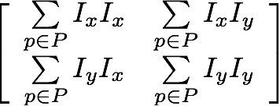
Where have you seen this before?
=
\left[
\begin{array}{c c}
\sum \limits_{p \in P} I_x I_x
&
\sum \limits_{p \in P} I_x I_y
\\
\sum \limits_{p \in P} I_y I_x
&\sum \limits_{p \in P} I_y I_y
\end{array}
\right]

Slide 65
Where have you seen this before?
Harris Corner Detector!
\left[
\begin{array}{c c}
\sum \limits_{p \in P} I_x I_x
&
\sum \limits_{p \in P} I_x I_y
\\
\sum \limits_{p \in P} I_y I_x
&\sum \limits_{p \in P} I_y I_y
\end{array}
\right]

Slide 66
Implications
Corners are when λ1, λ2 are big; this is also when Lucas-Kanade optical flow works best
Corners are regions with two different directions of gradient (at least)
Corners are good places to compute flow!
What happens when you have no ‘corners’?

Slide 67
You want to compute optical flow.
What happens if the image patch contains only a line?

Slide 68


Barber’s pole illusion

Slide 69

Barber’s pole illusion

Slide 70

Barber’s pole illusion

Slide 71
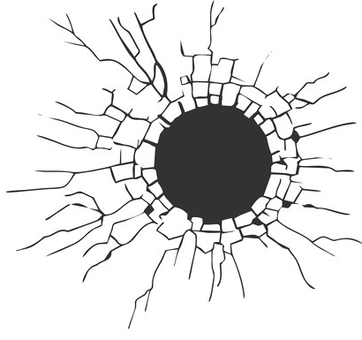



Aperture Problem
small visible image patch
In which direction is the line moving?

Slide 72
Aperture Problem
small visible image patch
In which direction is the line moving?

Slide 73
Aperture Problem

Slide 74
Aperture Problem

Slide 75
Aperture Problem

Slide 76
Aperture Problem

Slide 77

Want patches with different gradients to the avoid aperture problem

Slide 78
Want patches with different gradients to the avoid aperture problem

Slide 79


H(x,y) = y
I(x,y)
1 | 1 | 1 | 1
2 | 2 | 2 | 2
3 | 3 | 3 | 3
4 | 4 | 4 | 4
5 | 5 | 5 | 5
x
- | - | - | -
- | 1 | 1 | 1
- | 2 | 2 | 2
- | 3 | 3 | 3
- | 4 | 4 | 4
x
optical flow: (1,1)
y
y
Compute gradients
Solution:
We recover the v of the optical flow but not the u.
This is the aperture problem.

Slide 80
Horn-Schunck optical flow

Slide 81
Horn-Schunck
Optical Flow (1981)
Lucas-Kanade
Optical Flow (1981)
brightness constancy
method of differences
small motion
‘smooth’ flow
(flow can vary from pixel to pixel)
‘constant’ flow
(flow is constant for all pixels)
global method
(dense)
local method
(sparse)

Slide 82
Smoothness
most objects in the world are rigid or deform elastically
moving together coherently
we expect optical flow fields to be smooth

Slide 83
Key idea
(of Horn-Schunck optical flow)
Enforce
brightness constancy
Enforce
smooth flow field
to compute optical flow

Slide 84
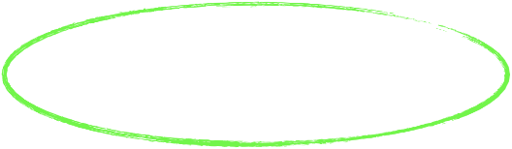
Key idea
(of Horn-Schunck optical flow)
Enforce
brightness constancy
Enforce
smooth flow field
to compute optical flow

Slide 85

Enforce brightness constancy
For every pixel,

Slide 86


Enforce brightness constancy
For every pixel,
lazy notation for

Slide 87





displacement of object
Find the optical flow such that it satisfies:
+
=
changes these
changes these

Slide 88

Key idea
(of Horn-Schunck optical flow)
Enforce
brightness constancy
Enforce
smooth flow field
to compute optical flow

Slide 89
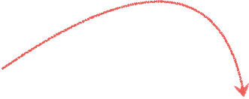

Enforce smooth flow field
u-component of flow

Slide 90

Which flow field optimizes the objective?
?

Slide 91
Which flow field optimizes the objective?
big
small

Slide 92
Key idea
(of Horn-Schunck optical flow)
Enforce
brightness constancy
Enforce
smooth flow field
to compute optical flow
bringing it all together…

Slide 93
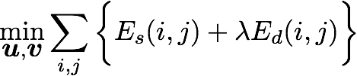

Horn-Schunck optical flow
smoothness
brightness constancy
weight

Slide 94









HS optical flow objective function
Brightness constancy
Smoothness
why not all four neighbors?

Slide 95
How do we solve this minimization problem?

Slide 96
How do we solve this minimization problem?
Compute partial derivative, derive update equations
(gradient decent!)

Slide 97
Compute the partial derivatives of this huge sum!
smoothness term
brightness constancy

Slide 98

Compute the partial derivatives of this huge sum!
it’s not so bad…
how many u terms depend on k and l?

Slide 99
Compute the partial derivatives of this huge sum!
it’s not so bad…
how many u terms depend on k and l?
FOUR from smoothness
ONE from brightness constancy

Slide 100
Compute the partial derivatives of this huge sum!
it’s not so bad…
how many u terms depend on k and l?
FOUR from smoothness
ONE from brightness constancy

Slide 101


Compute the partial derivatives of this huge sum!
(variable will appear four times in sum)

Slide 102


Compute the partial derivatives of this huge sum!
(variable will appear four times in sum)
short hand for local average

Slide 103
Where are the extrema of E?

Slide 104
Where are the extrema of E?
(set derivatives to zero and solve for unknowns u and v)

Slide 105
Where are the extrema of E?
(set derivatives to zero and solve for unknowns u and v)
this is a linear system
how do you solve this?

Slide 106
ok, take a step back, why are we doing all this math?

Slide 107
We are solving for the optical flow (u,v) given two constraints
smoothness
brightness constancy
We need the math to minimize this
(back to the math)

Slide 108
Partial derivatives of Horn-Schunck objective function E:
Where are the extrema of E?
(set derivatives to zero and solve for unknowns u and v)
how do you solve this?

Slide 109

Recall

Slide 110
Recall
Same as the linear system:
(det A)
(det A)

Slide 111


Rearrange to get update equations:
new value
old
average
Notes:
\hat{u}_{kl} = \bar{u}_{kl} -
\frac
{I_x \bar{u}_{kl} + I_y \bar{v}_{kl} + I_t}
{\lambda^{-1} + I_x^2 + I_y^2}
I_x
\hat{v}_{kl} = \bar{v}_{kl} -
\frac
{I_x \bar{u}_{kl} + I_y \bar{v}_{kl} + I_t}
{\lambda^{-1} + I_x^2 + I_y^2}
I_y

Slide 112
Recall:
When lambda is small (lambda inverse is big)…
new value
old
average
Notes:
\hat{u}_{kl} = \bar{u}_{kl} -
\frac
{I_x \bar{u}_{kl} + I_y \bar{v}_{kl} + I_t}
{\lambda^{-1} + I_x^2 + I_y^2}
I_x
\hat{v}_{kl} = \bar{v}_{kl} -
\frac
{I_x \bar{u}_{kl} + I_y \bar{v}_{kl} + I_t}
{\lambda^{-1} + I_x^2 + I_y^2}
I_y

Slide 113
Recall:
When lambda is small (lambda inverse is big)…
goes to zero
new value
old
average
goes to zero
Notes:
\hat{u}_{kl} = \bar{u}_{kl} -
\frac
{I_x \bar{u}_{kl} + I_y \bar{v}_{kl} + I_t}
{\lambda^{-1} + I_x^2 + I_y^2}
I_x
\hat{v}_{kl} = \bar{v}_{kl} -
\frac
{I_x \bar{u}_{kl} + I_y \bar{v}_{kl} + I_t}
{\lambda^{-1} + I_x^2 + I_y^2}
I_y

Slide 114

Recall:
When lambda is small (lambda inverse is big)…
goes to zero
new value
old
average
goes to zero
…we only care about smoothness.
Notes:
\hat{u}_{kl} = \bar{u}_{kl} -
\frac
{I_x \bar{u}_{kl} + I_y \bar{v}_{kl} + I_t}
{\lambda^{-1} + I_x^2 + I_y^2}
I_x
\hat{v}_{kl} = \bar{v}_{kl} -
\frac
{I_x \bar{u}_{kl} + I_y \bar{v}_{kl} + I_t}
{\lambda^{-1} + I_x^2 + I_y^2}
I_y

Slide 115
ok, take a step back, why did we do all this math?

Slide 116
We are solving for the optical flow (u,v) given two constraints
smoothness
brightness constancy
We needed the math to minimize this
(now to the algorithm)

Slide 117

Horn-Schunck
Optical Flow Algorithm
Precompute image gradients
Precompute temporal gradients
Initialize flow field
While not converged
Compute flow field updates for each pixel:
Just 8 lines of code!

Slide 118
References
Basic reading:
Szeliski, Section 8.4.
Notes:
Ch

