Slide 1
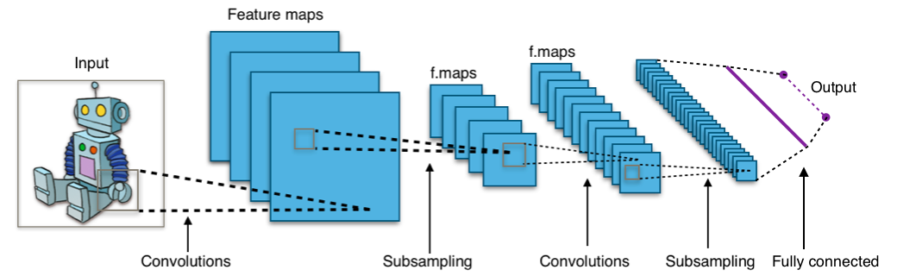
Convolutional neural networks
16-385 Computer Vision
Spring 2019, Lecture 20
http://www.cs.cmu.edu/~16385/

Slide 2
Course announcements
Homework 5 is due tonight.
- Any questions about the homework?
- How many of you have looked at/started/finished homework 5?
Homework 6 will be posted tonight and will be due April 24th.

Slide 3
Overview of today’s lecture
Some notes on optimization.
Convolutional neural networks.
Training ConvNets.

Slide 4
Slide credits
Most of these slides were adapted from:
Noah Snavely (Cornell University).
Fei-Fei Li (Stanford University).
Andrej Karpathy (Stanford University).

Slide 5
Some notes on optimization

Slide 6
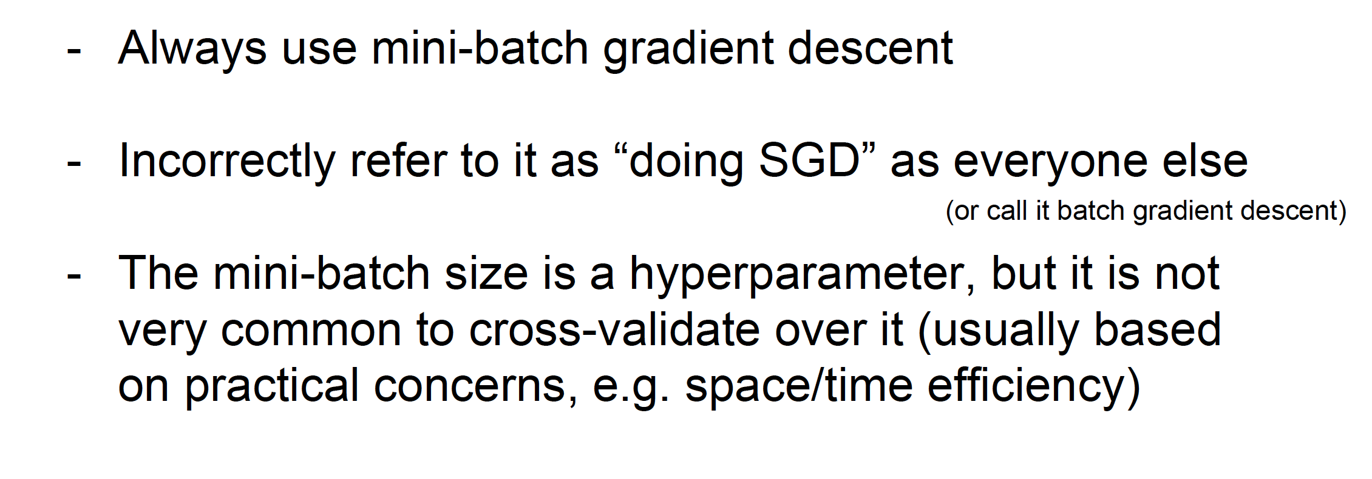
Summary

Slide 7
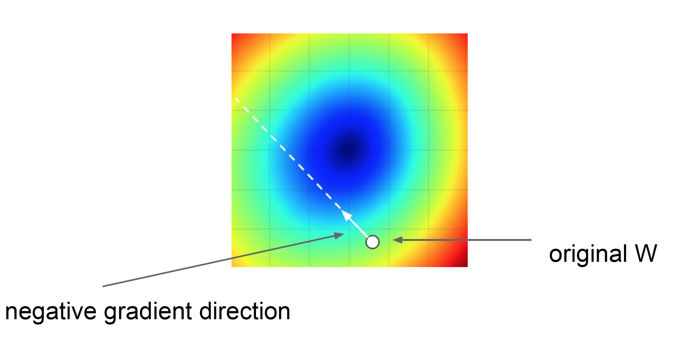

Learning rates
Step size: learning rate
Too big: will miss the minimum
Too small: slow convergence
-

Slide 8
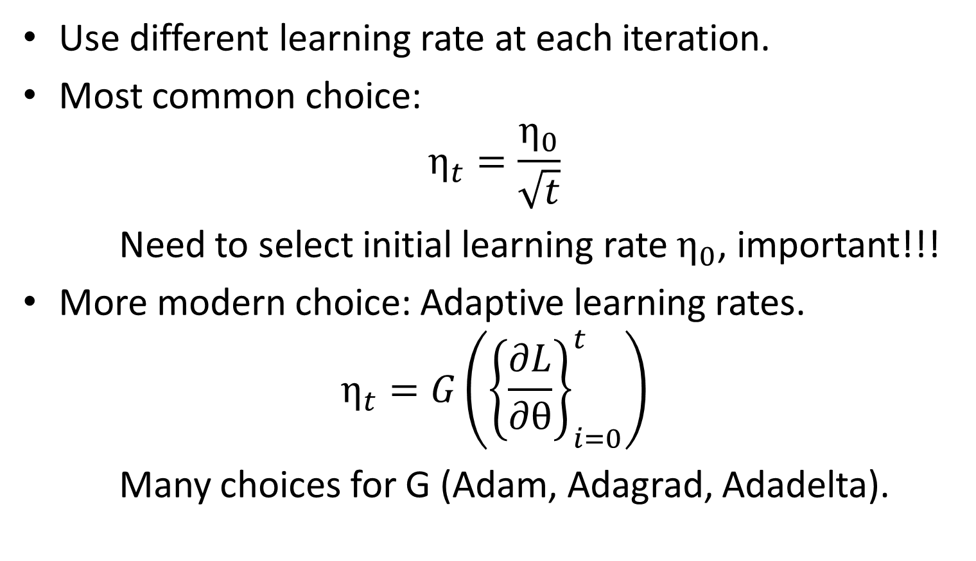
Learning rate scheduling
Use different learning rate at each iteration.
Most common choice:
$$η_{t}=\frac{η_{0}}{\sqrt{t}}$$
Need to select initial learning rate $η_{0}$, important!!!
More modern choice: Adaptive learning rates.
$$η_{t}=G\left({\left\{\frac{∂L}{∂θ}\right\}}_{i=0}^{t}\right)$$
Many choices for G (Adam, Adagrad, Adadelta).

Slide 9
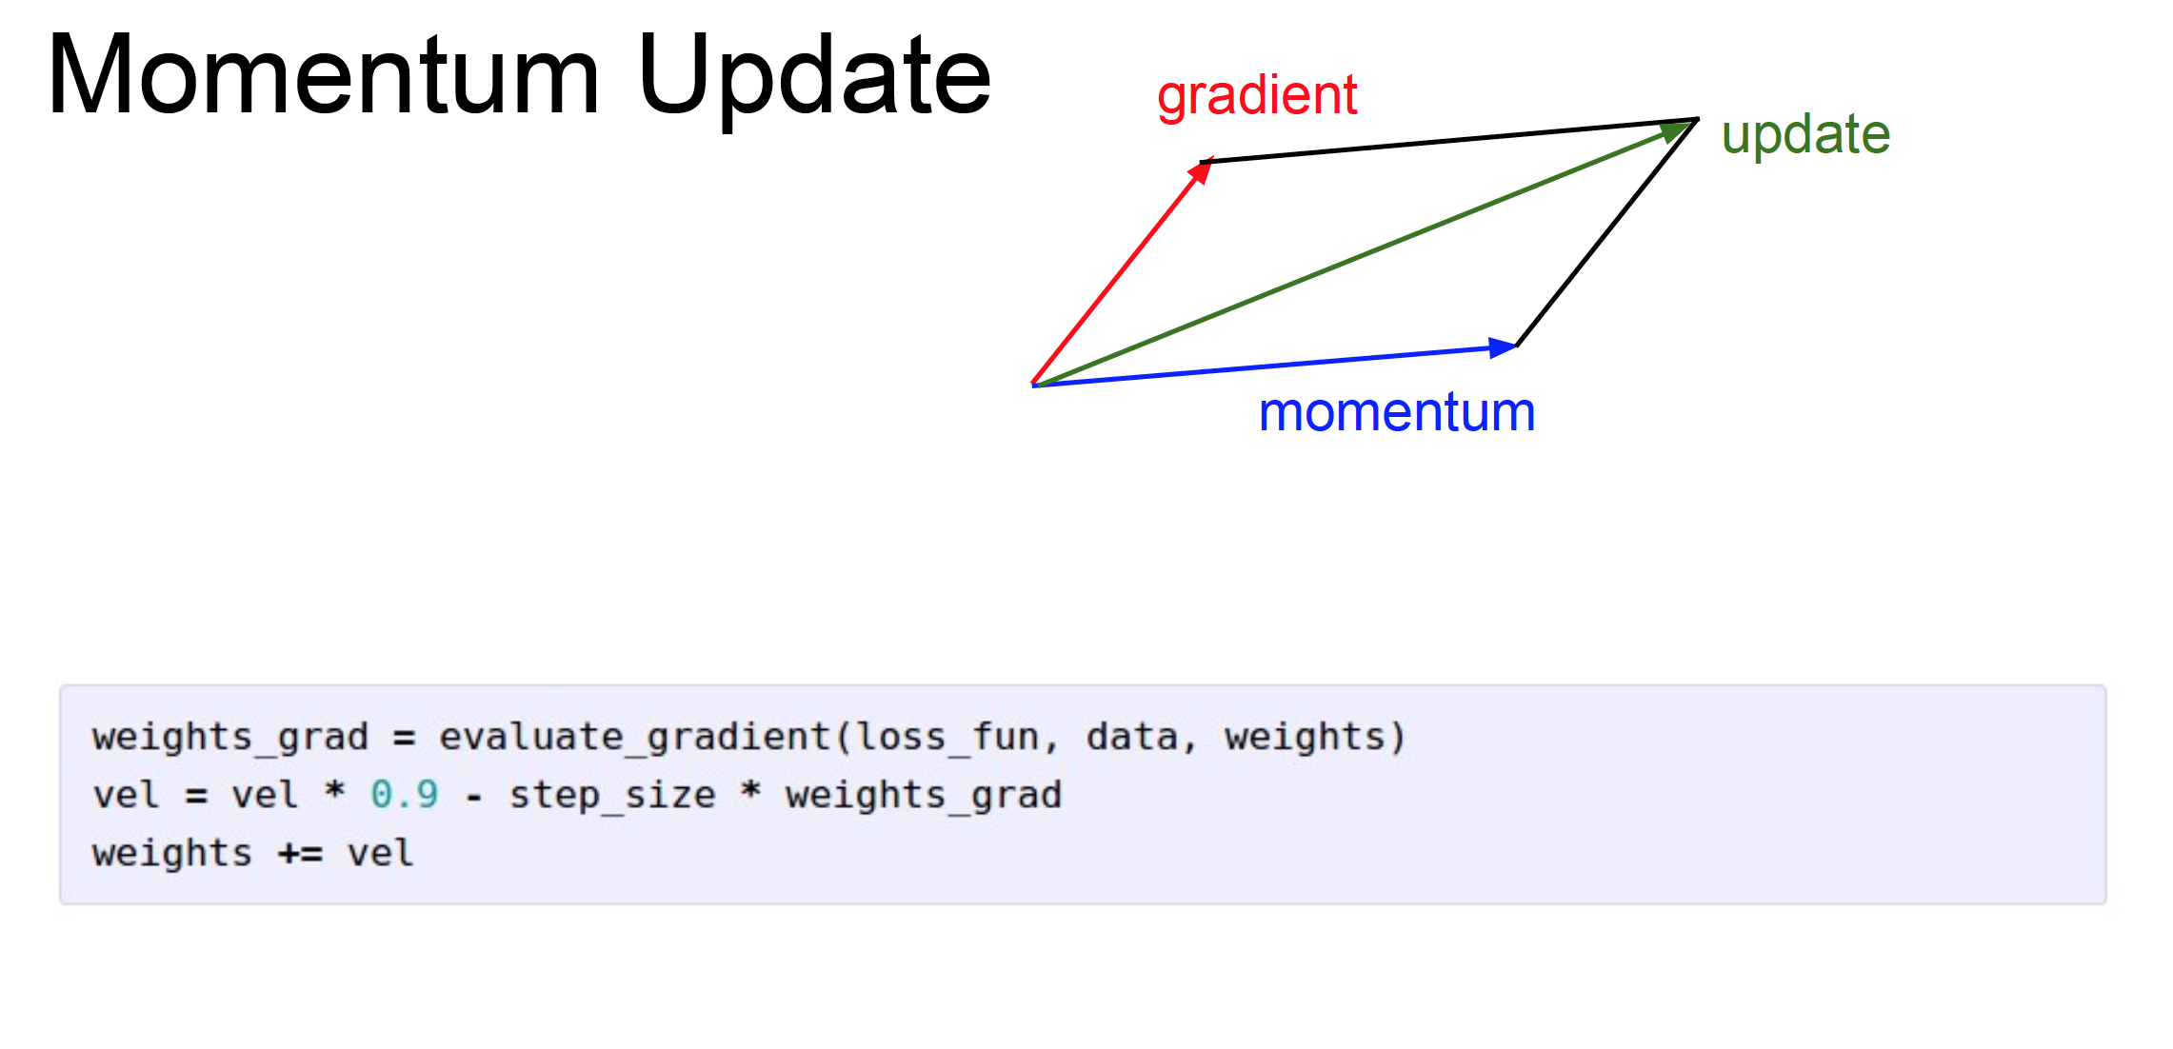
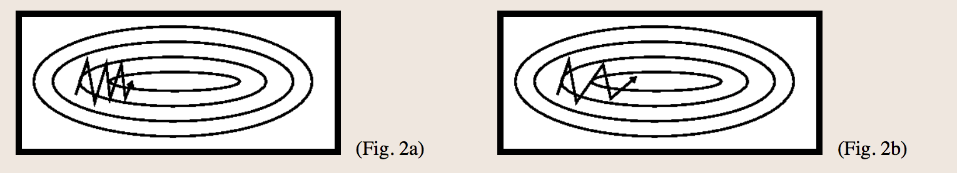
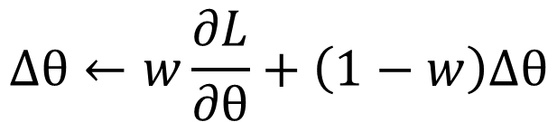
-
$$Δθ←w\frac{∂L}{∂θ}+\left(1−w\right)Δθ$$
Take direction history into account!

Slide 10
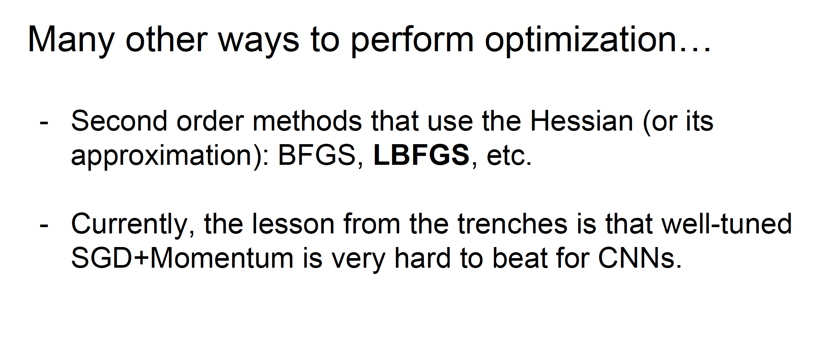
No consensus on Adam etc.: Seem to give faster performance to worse local minima.
Notes:
Limited memory Broyden–Fletcher–Goldfarb–Shanno

Slide 11

Derivatives
Given f(x), where x is vector of inputs
  Compute gradient of f at x:
  How do we do differentiation?

Slide 12
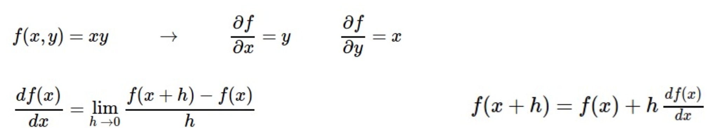
Numerical differentiation
  Numerical differentiation is:
Notes:
What does the derivative say? A step in direction of gradient of size h

Slide 13
Numerical differentiation
  Numerical differentiation is:
  Approximate.
  Slow.
  Numerically unstable.
  Easy to write.
Notes:
What does the derivative say? A step in direction of gradient of size h

Slide 14
Symbolic differentiation
Notes:
What does the derivative say? A step in direction of gradient of size h

Slide 15
Symbolic differentiation
What Mathematica does: Automatically derive analytical expressions for derivative.
Notes:
What does the derivative say? A step in direction of gradient of size h

Slide 16
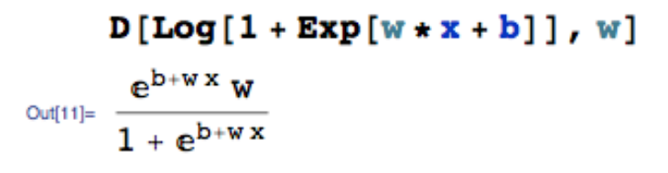
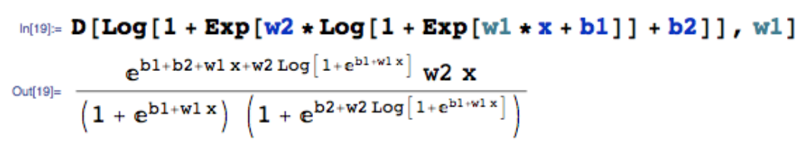
Symbolic differentiation
What Mathematica does: Automatically derive analytical expressions for derivative.
Often results in very redundant (and expensive to evaluate) expressions.
Often intractable.
Notes:
What does the derivative say? A step in direction of gradient of size h

Slide 17
Automatic differentiation (autodiff)
Notes:
What does the derivative say? A step in direction of gradient of size h

Slide 18
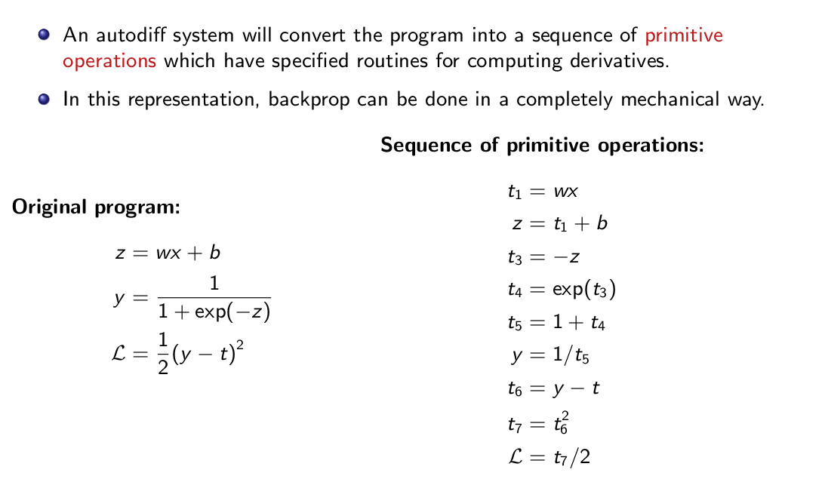
Automatic differentiation (autodiff)
Notes:
What does the derivative say? A step in direction of gradient of size h

Slide 19
In summary
Numerical gradient: easy to implement, bad to use.
Symbolic gradient: sometimes useful, often intractable.
Automatic gradient: exact, fast, error-prone.
In practice: Use symbolic gradient for small/trivial programs. Almost always use analytic gradient, but check correctness of implementation with numerical gradient.
This is called a gradient check.
Notes:
What does the derivative say? A step in direction of gradient of size h

Slide 20
Convolutional Neural Networks

Slide 21

Aside: “CNN” vs “ConvNet”
Note:
•
There are many papers that use either phrase, but
•
“ConvNet” is the preferred term, since “CNN” clashes with other things called CNN

Slide 22

Motivation

Slide 23

Products

Slide 24
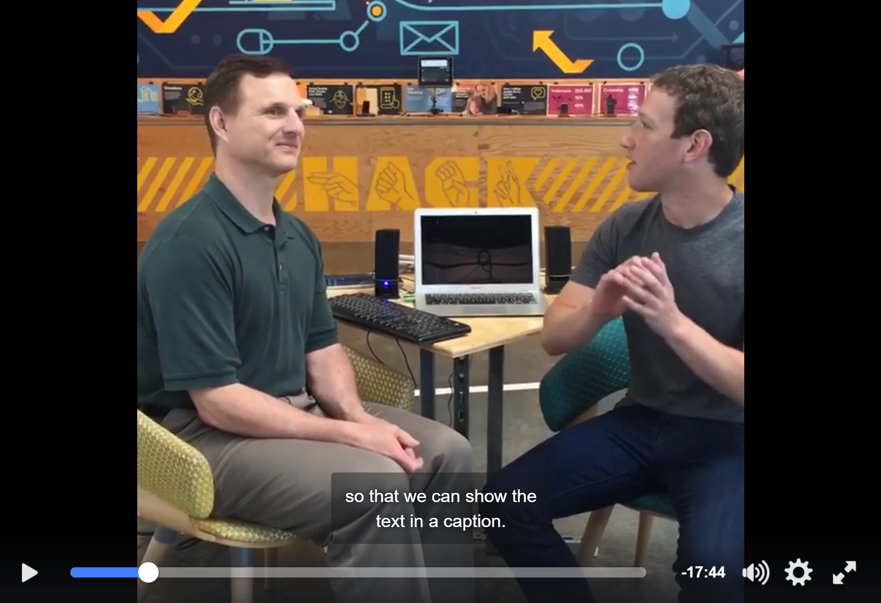
Helping the Blind
https://www.facebook.com/zuck/videos/10102801434799001/

Slide 25
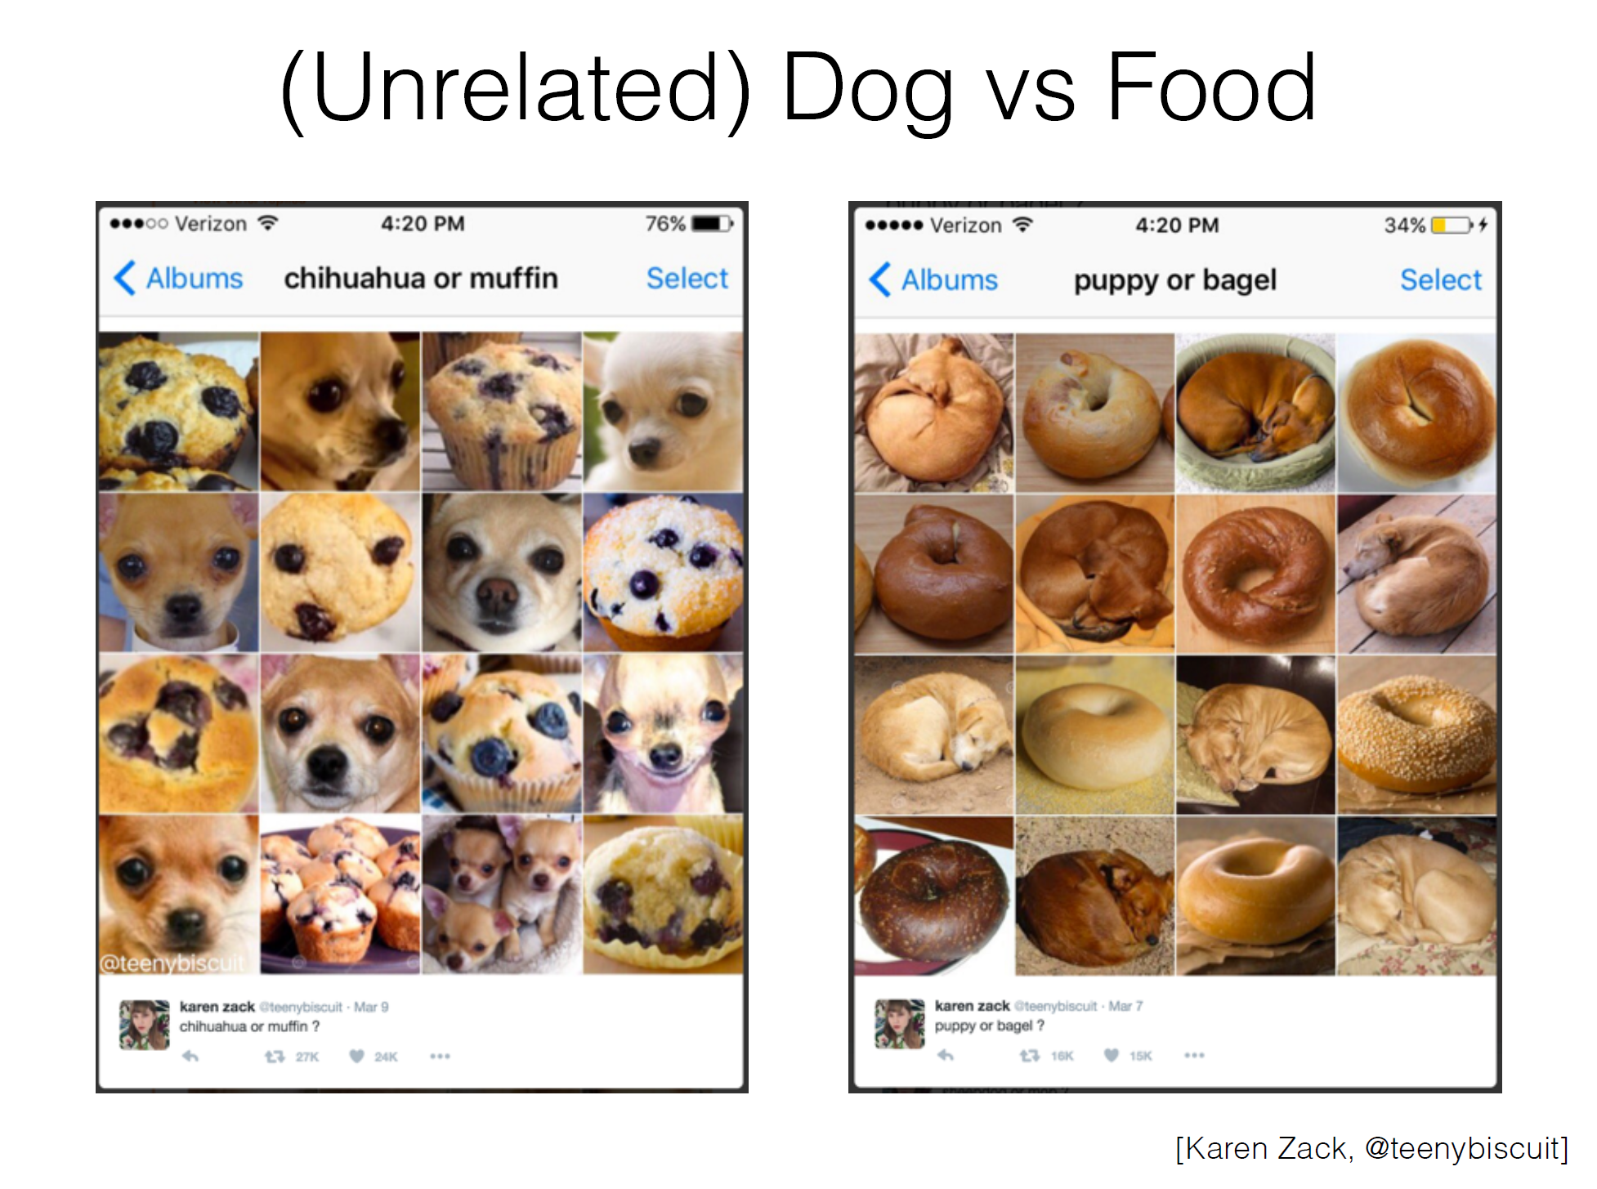

Slide 26
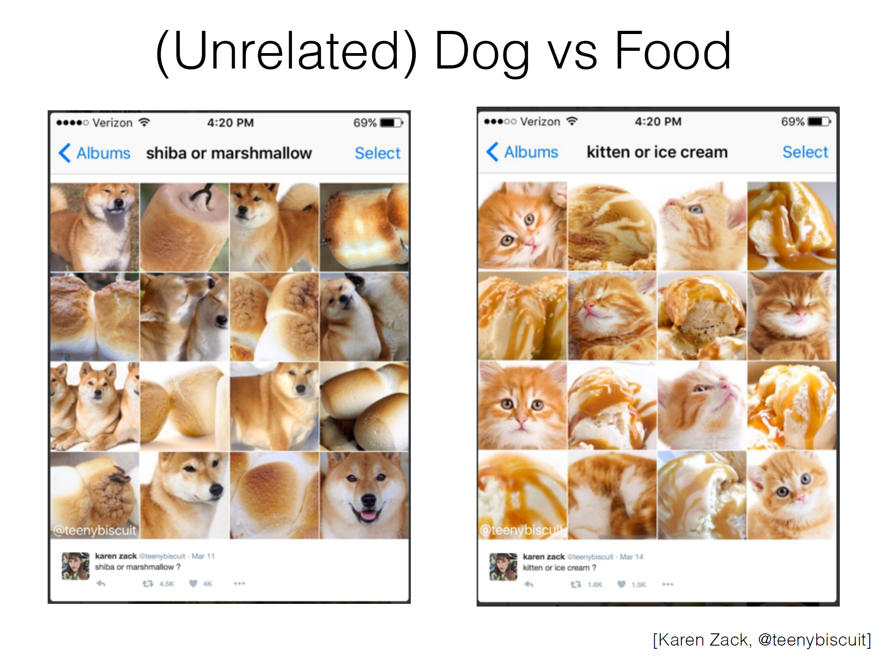

Slide 27
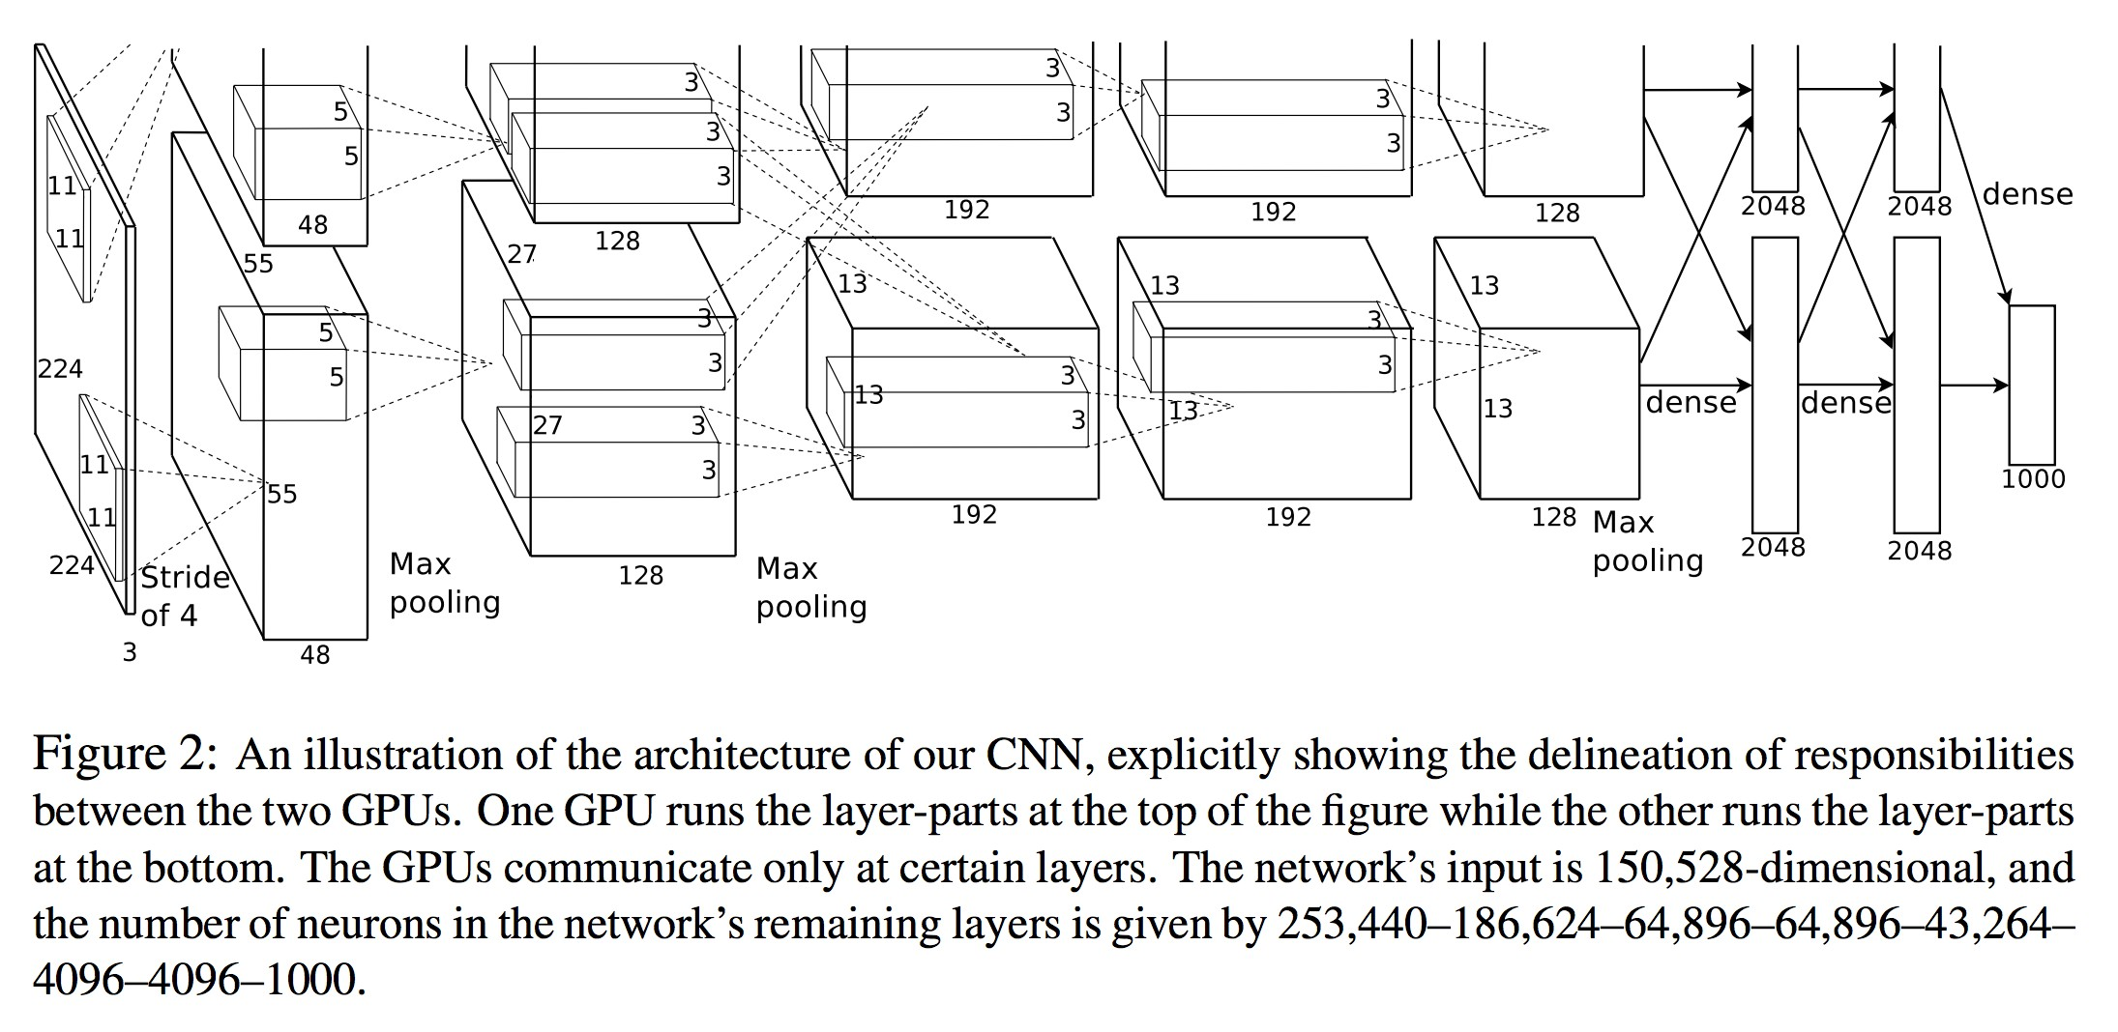
CNNs in 2012: “SuperVision” (aka “AlexNet”)
“AlexNet” — Won the ILSVRC2012 Challenge
Major breakthrough: 15.3% Top-5 error on ILSVRC2012 (Next best: 25.7%)
[Krizhevsky, Sutskever, Hinton. NIPS 2012]

Slide 28
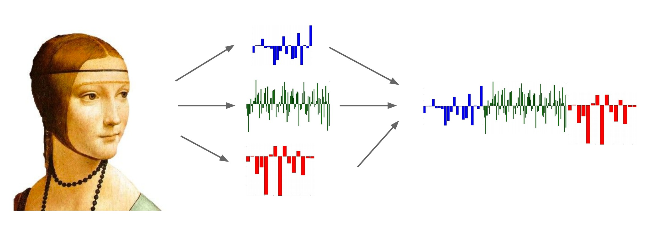
Recap: Before Deep Learning
SVM
Ans
Input Pixels
Extract Features
Concatenate into a vector x
Linear Classifier
Figure: Karpathy 2016

Slide 29

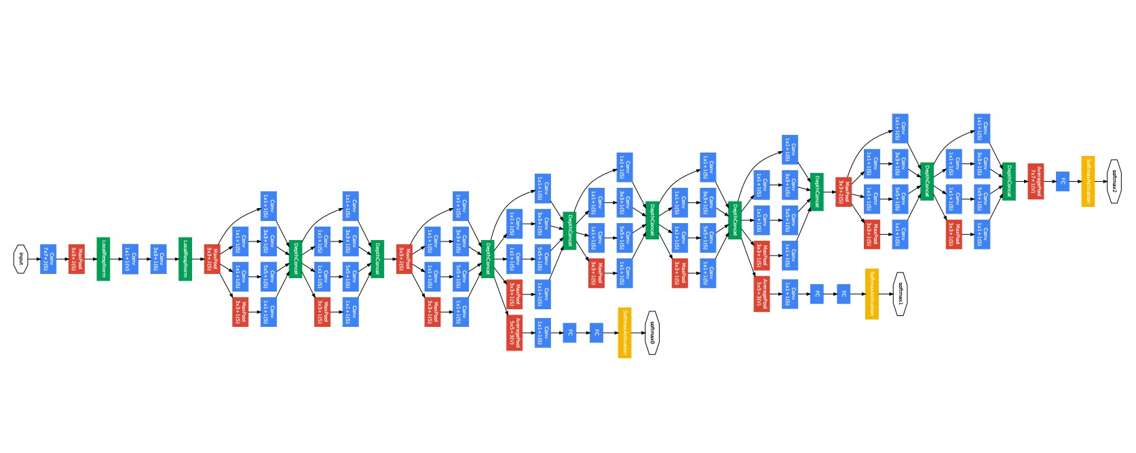
The last layer of (most) CNNs are linear classifiers
This piece is just a linear classifier
Ans
(GoogLeNet)
Input Pixels
Perform everything with a big neural network, trained end-to-end
Key: perform enough processing so that by the time you get to the end of the network, the classes are linearly separable

Slide 30
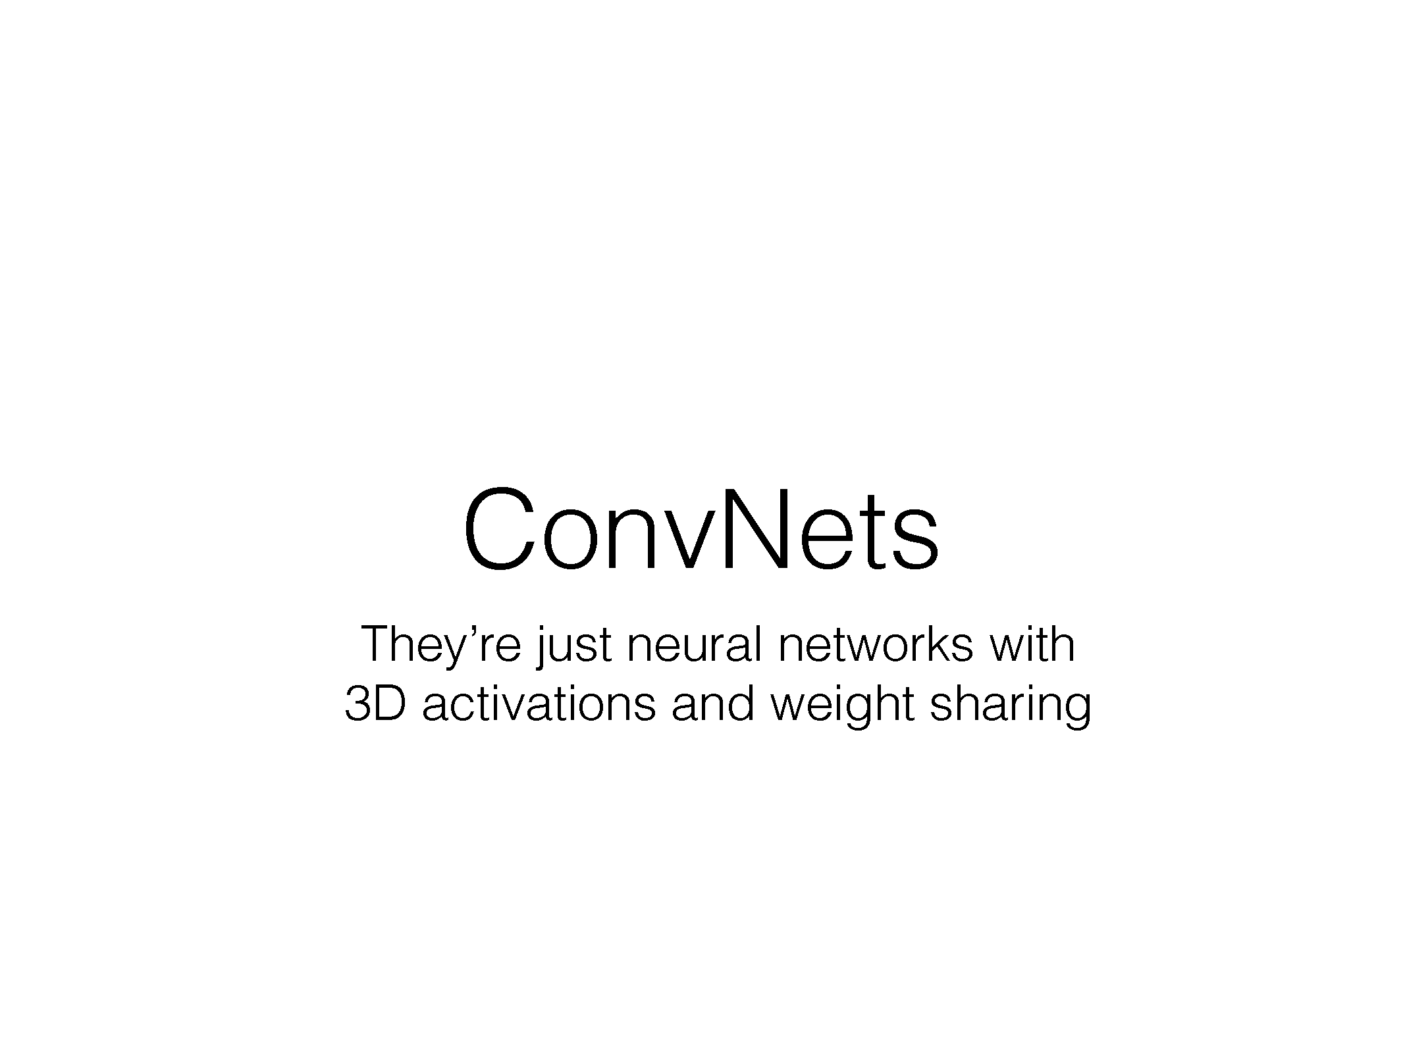

Slide 31
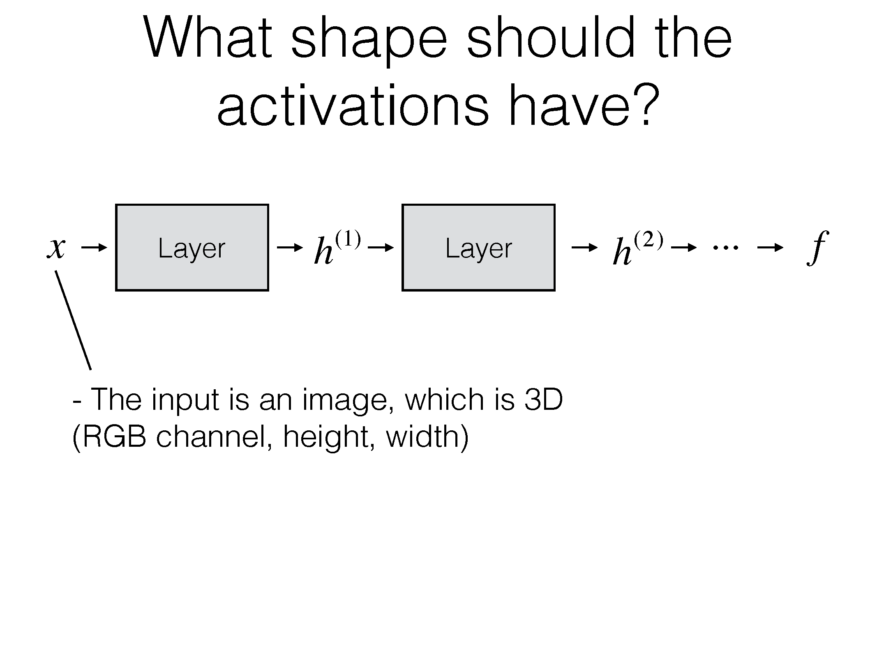

Slide 32
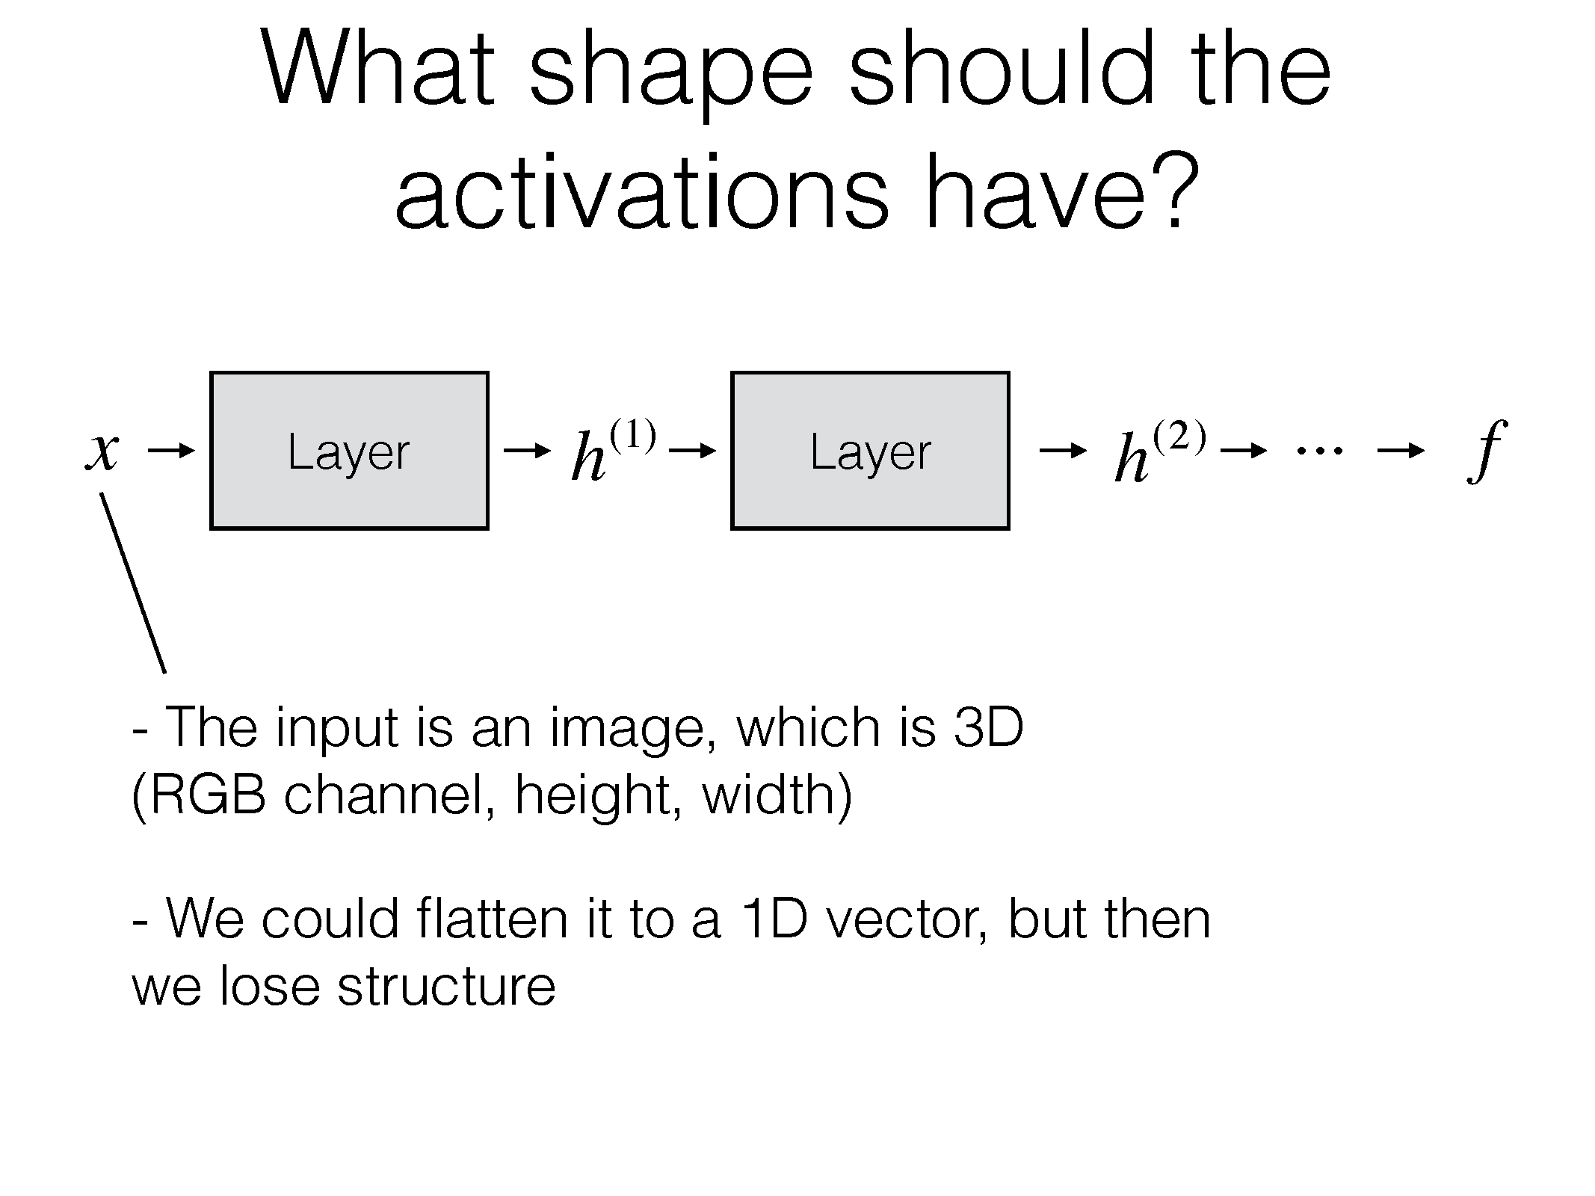

Slide 33
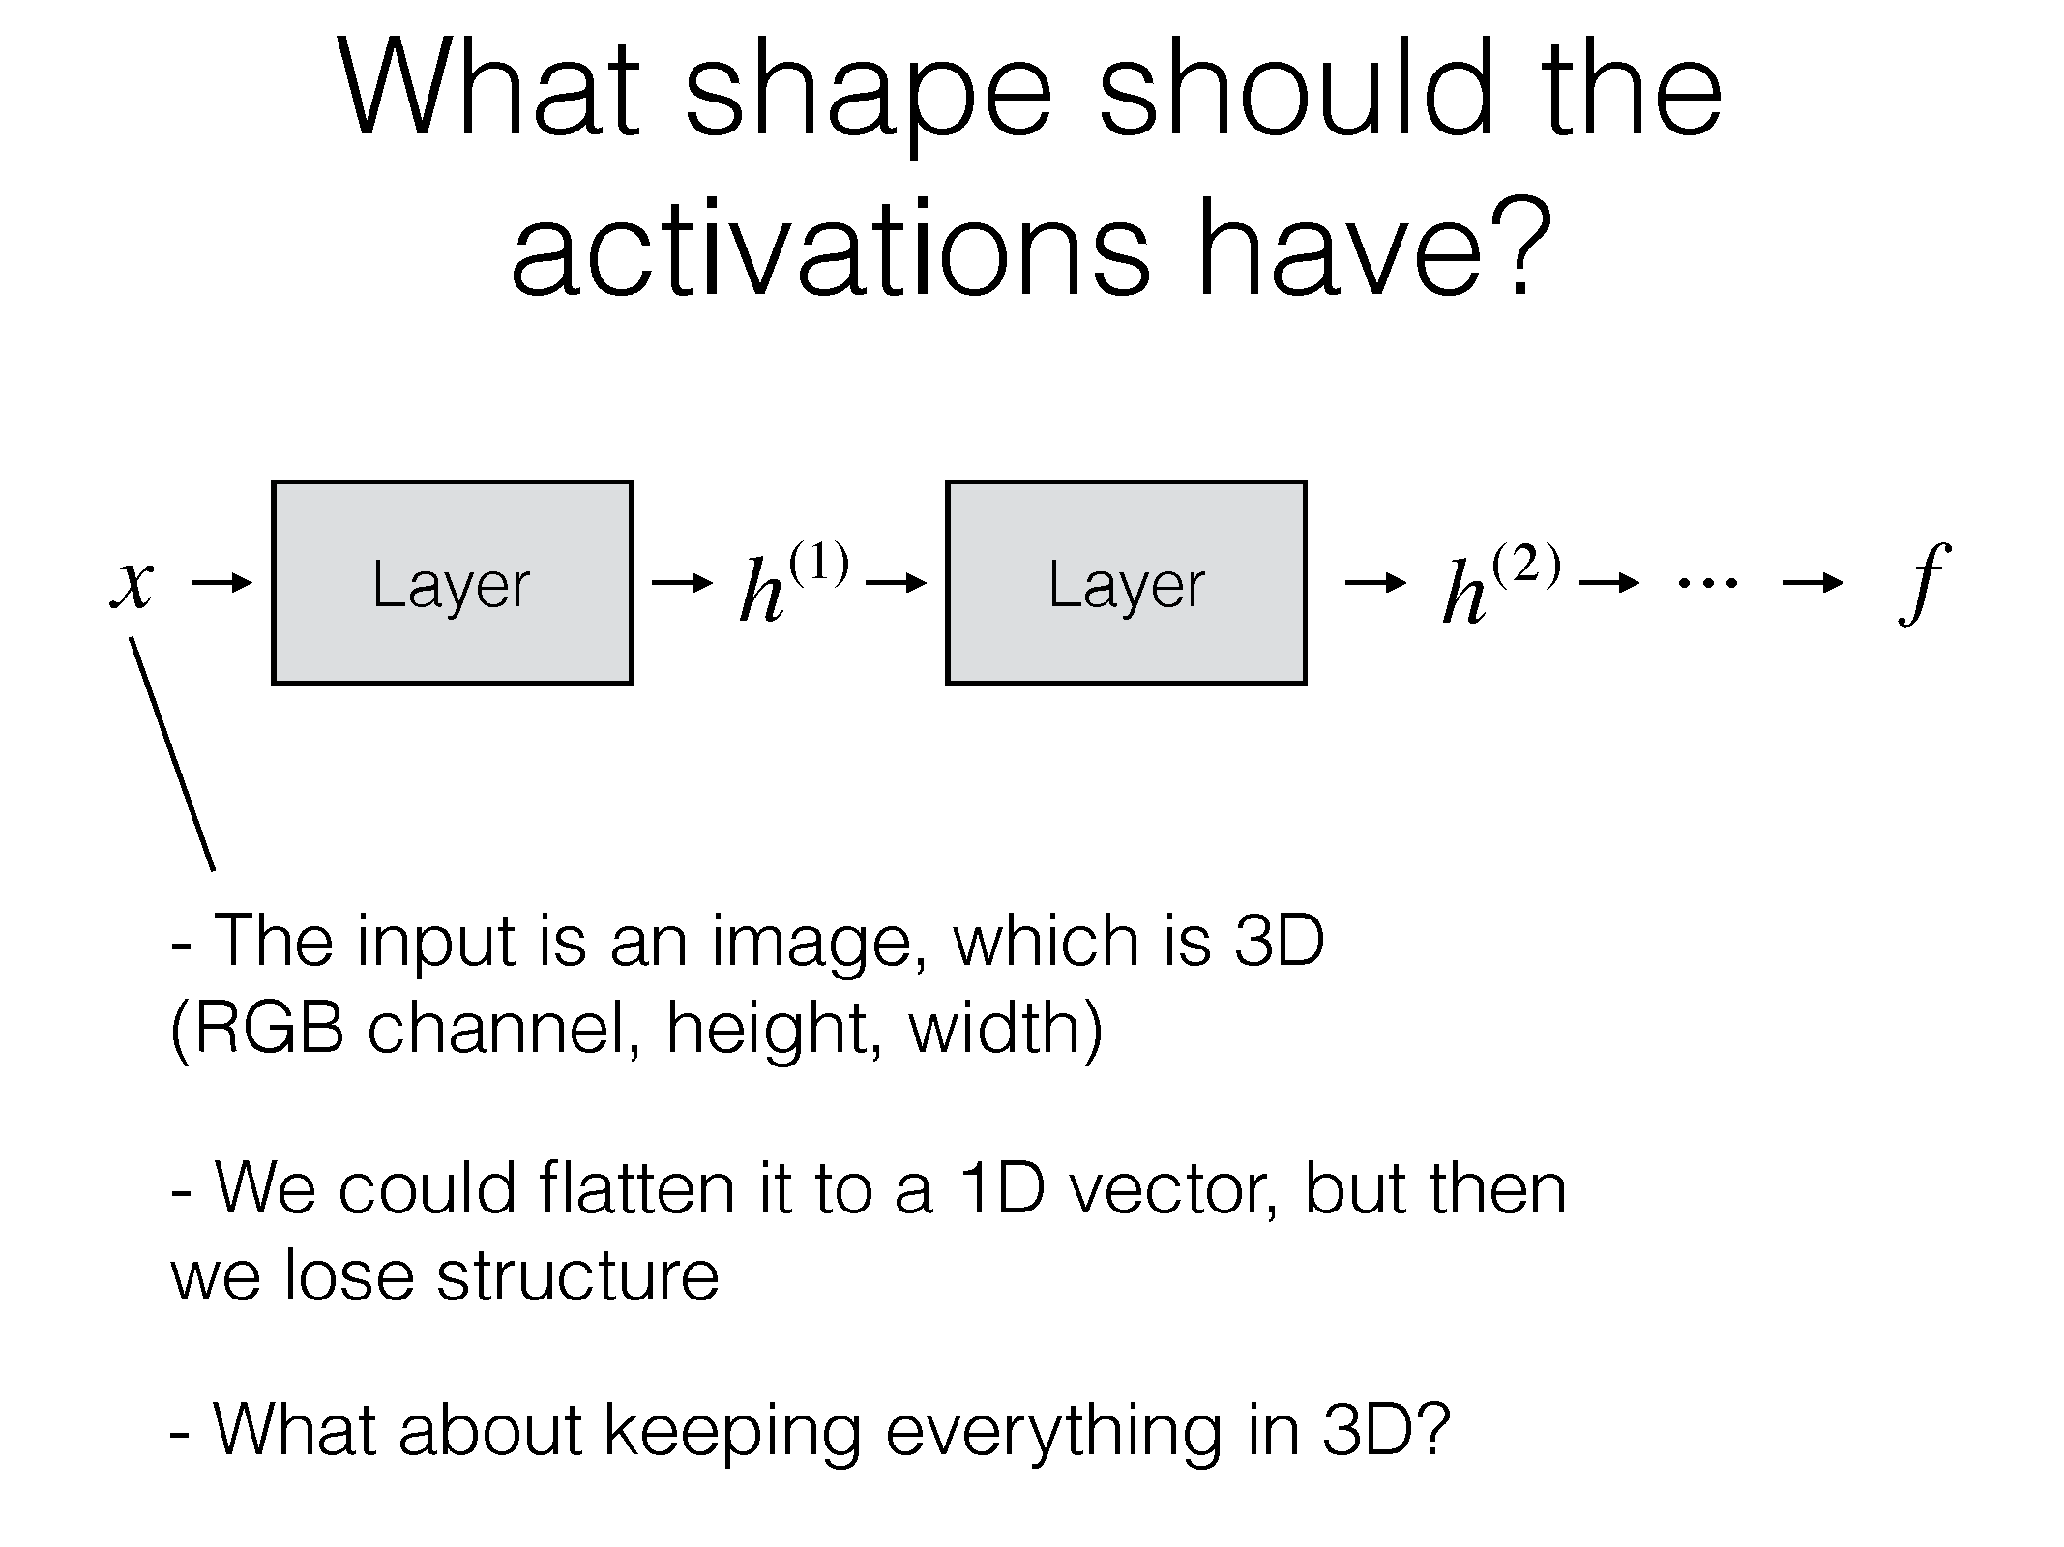

Slide 34
ConvNets
They’re just neural networks with 3D activations and weight sharing

Slide 35
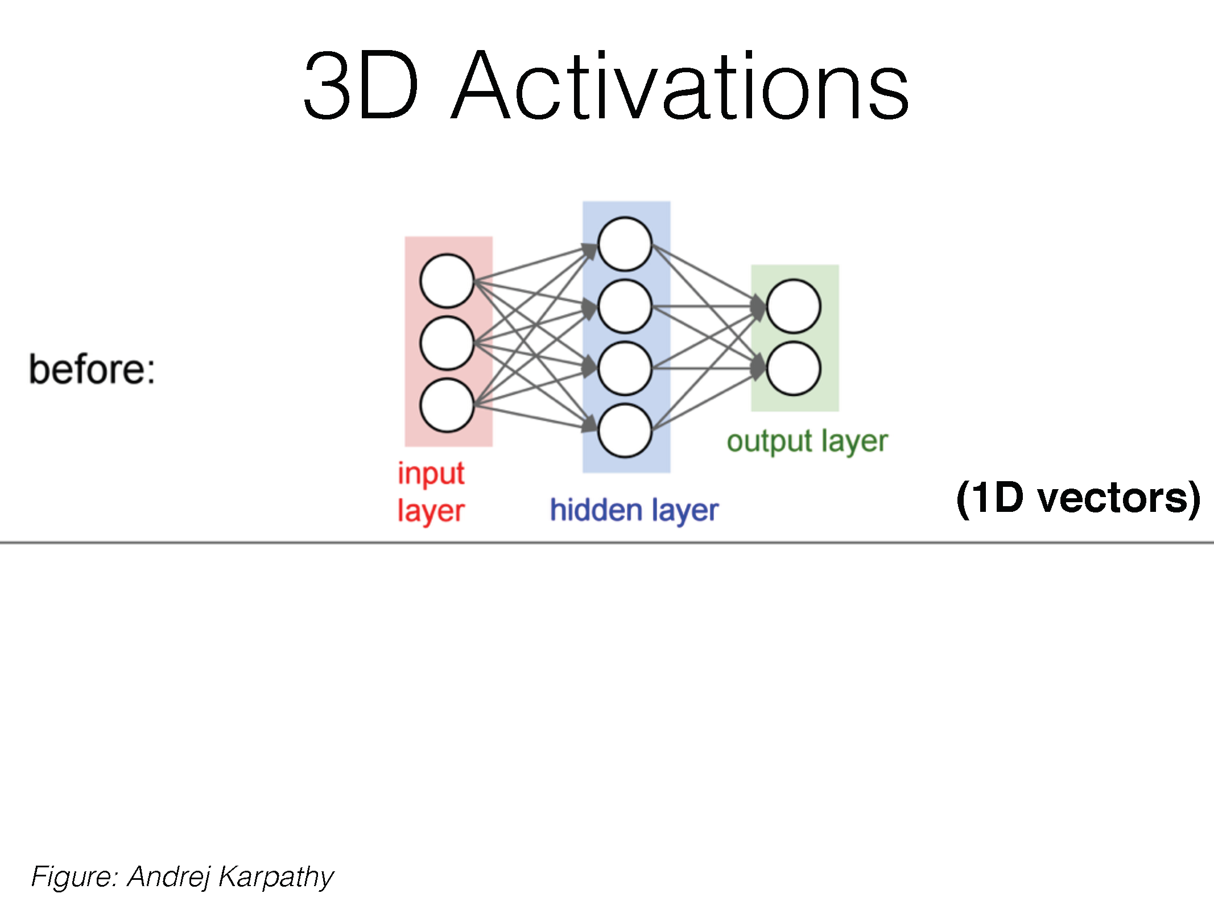

Slide 36
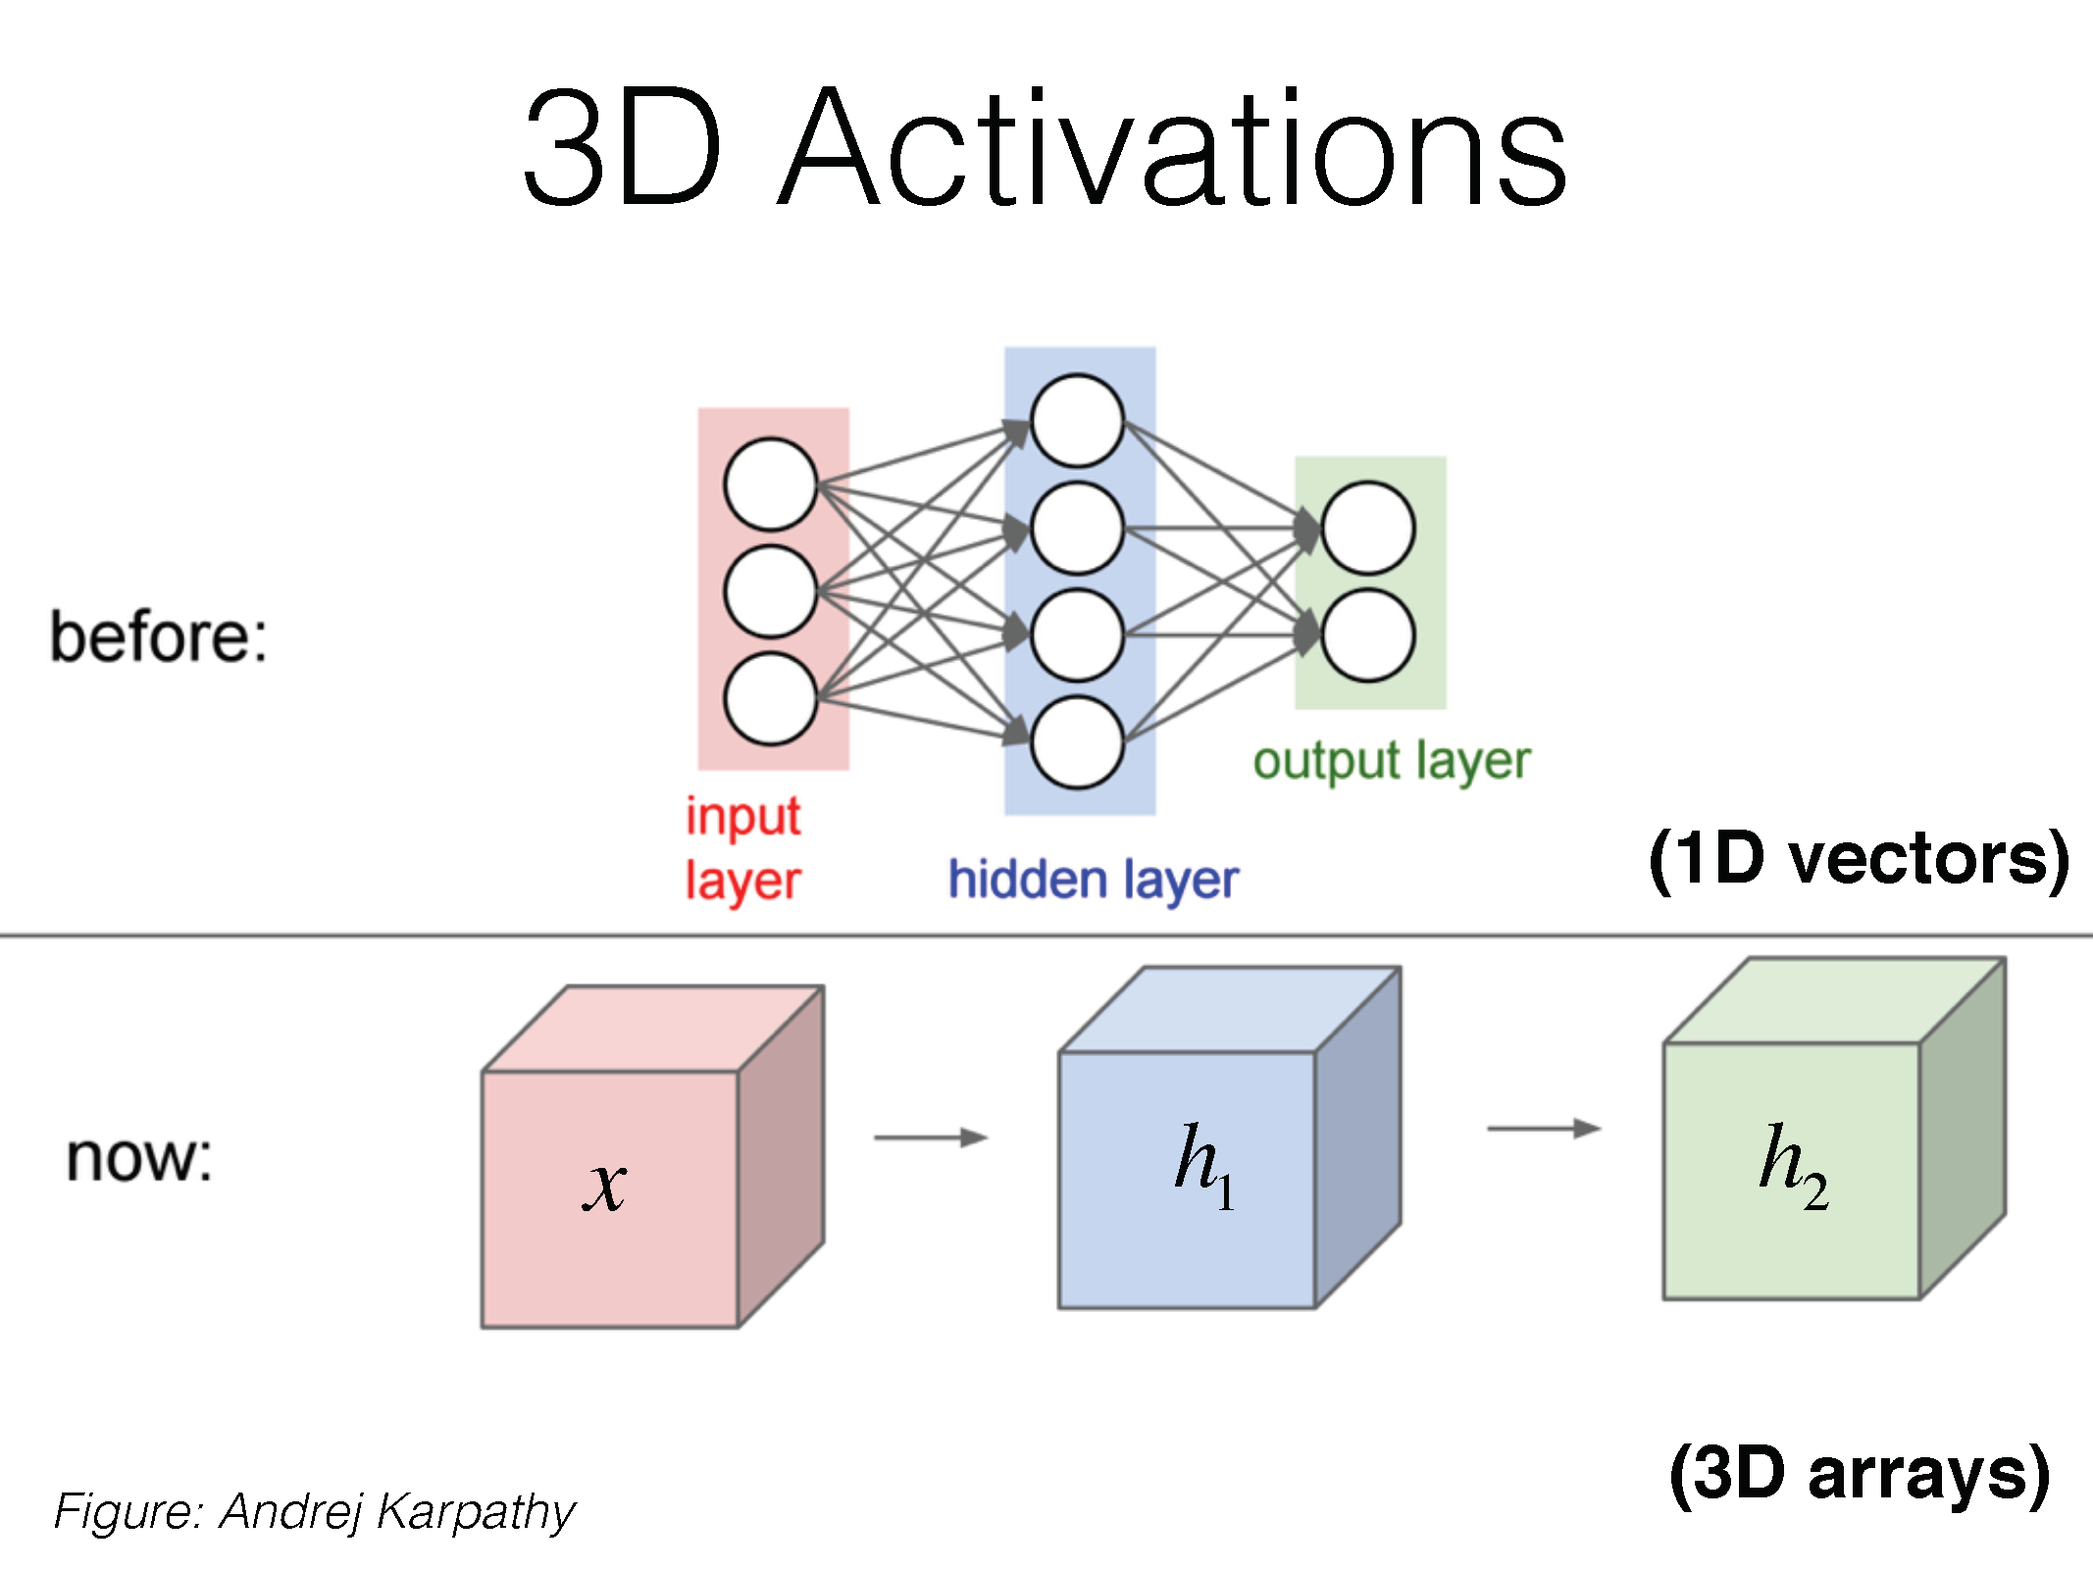

Slide 37
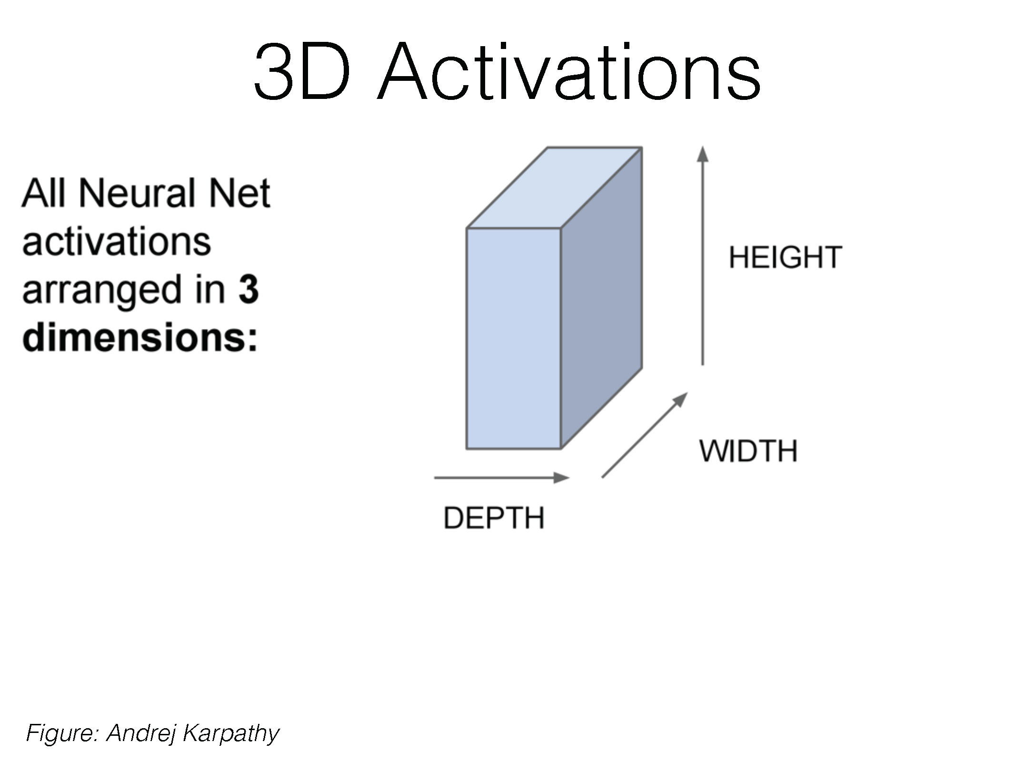

Slide 38
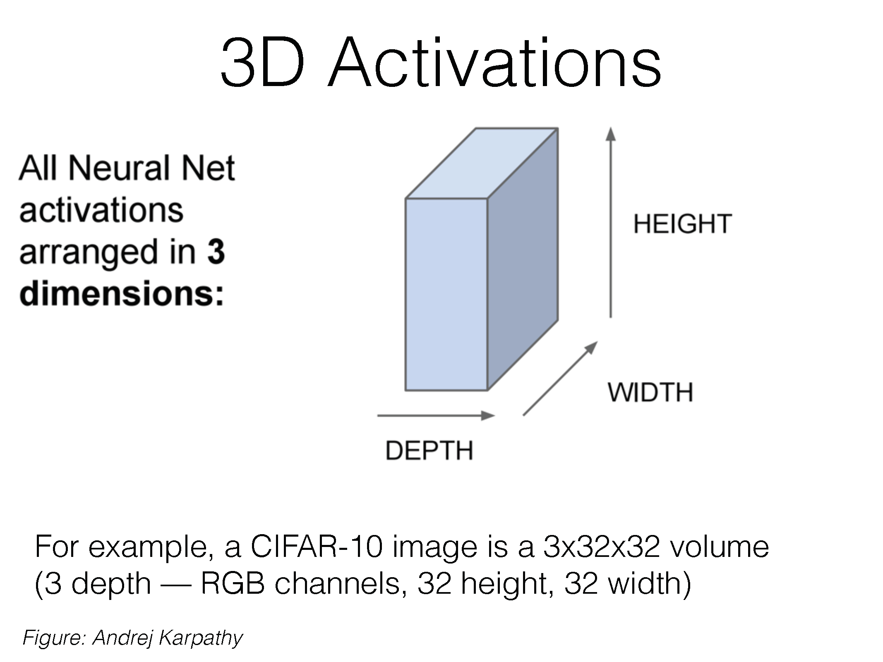

Slide 39
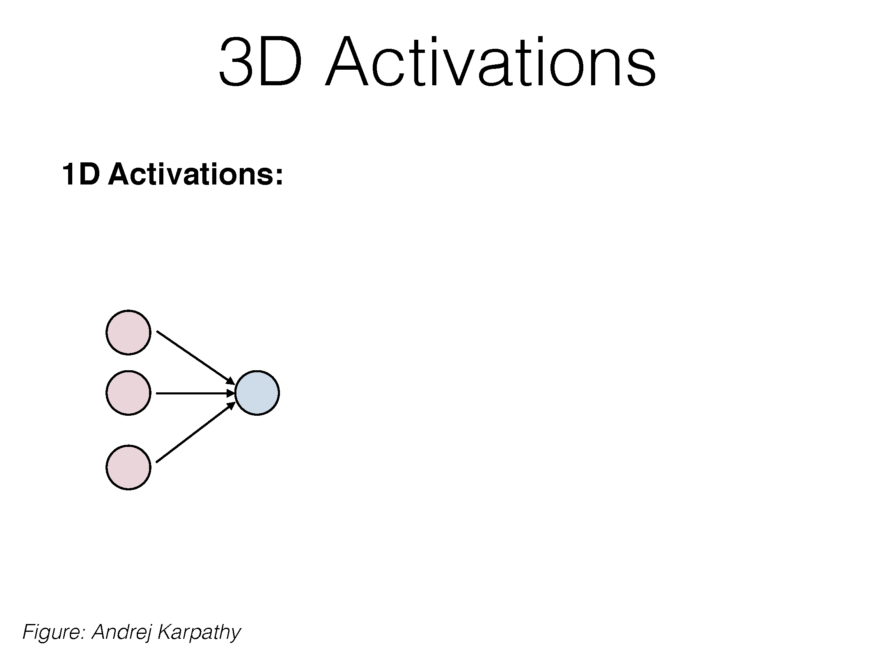

Slide 40
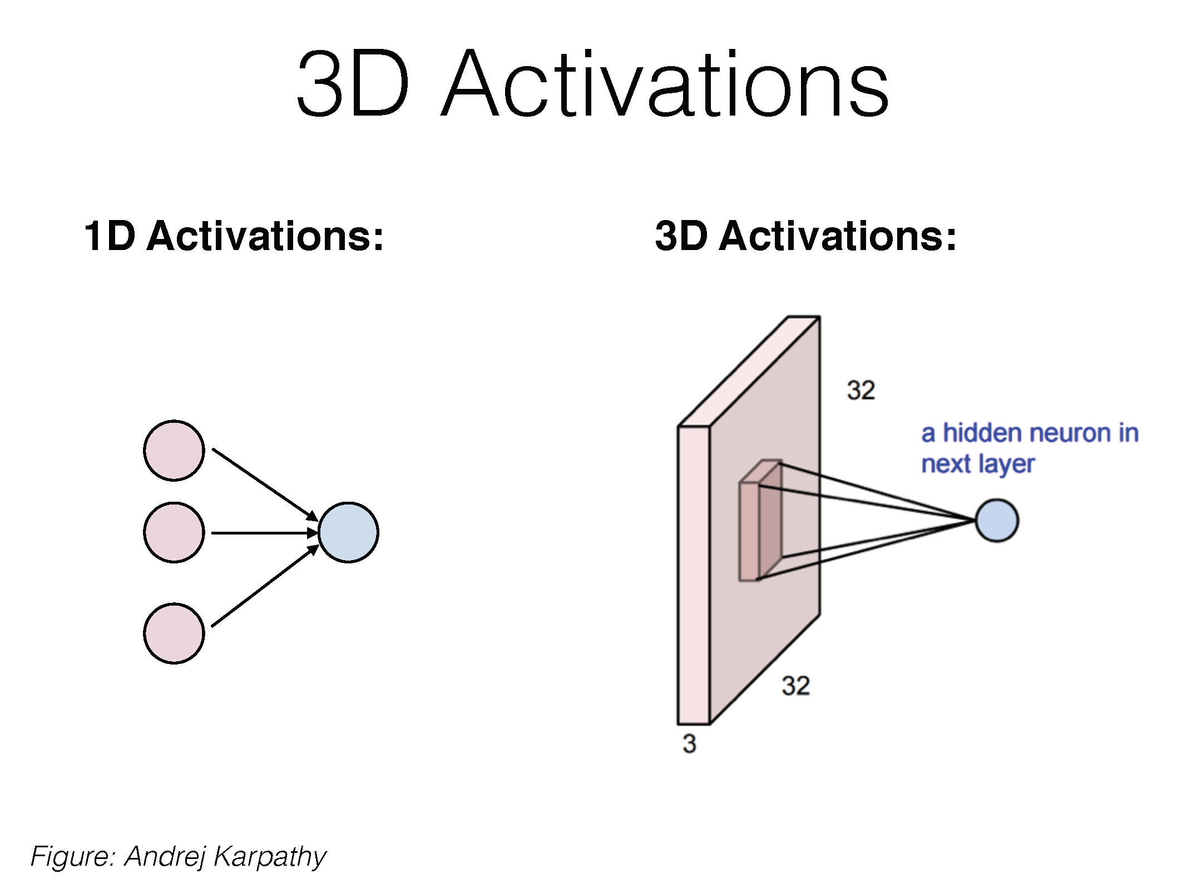

Slide 41
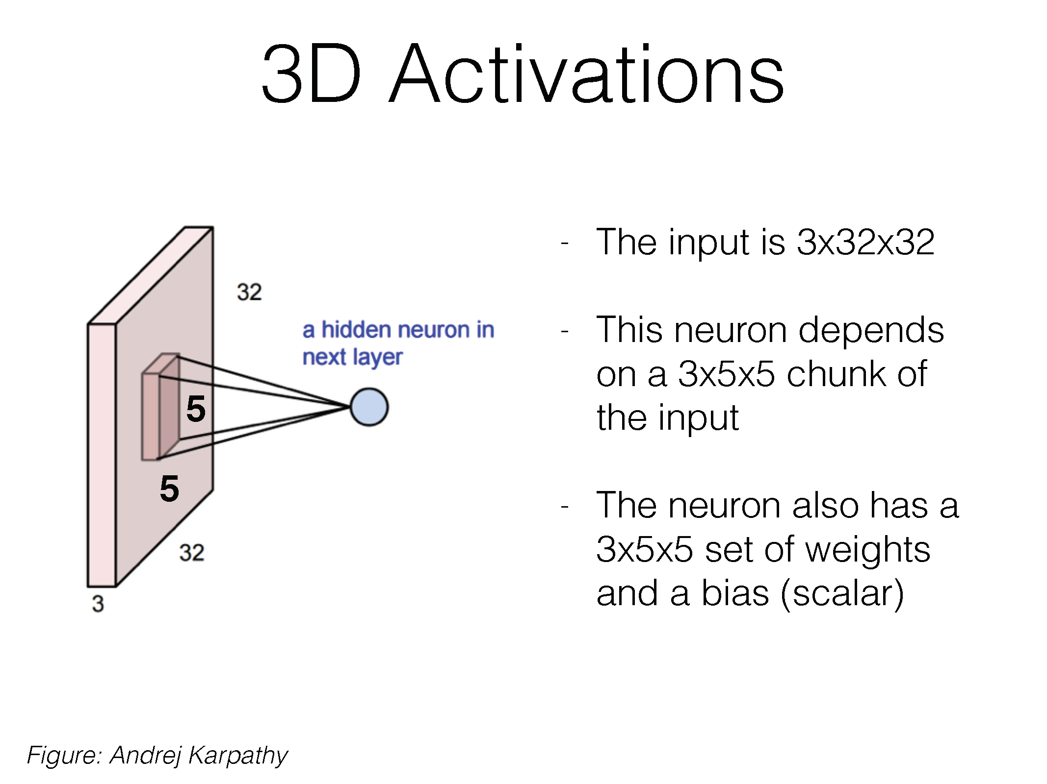

Slide 42
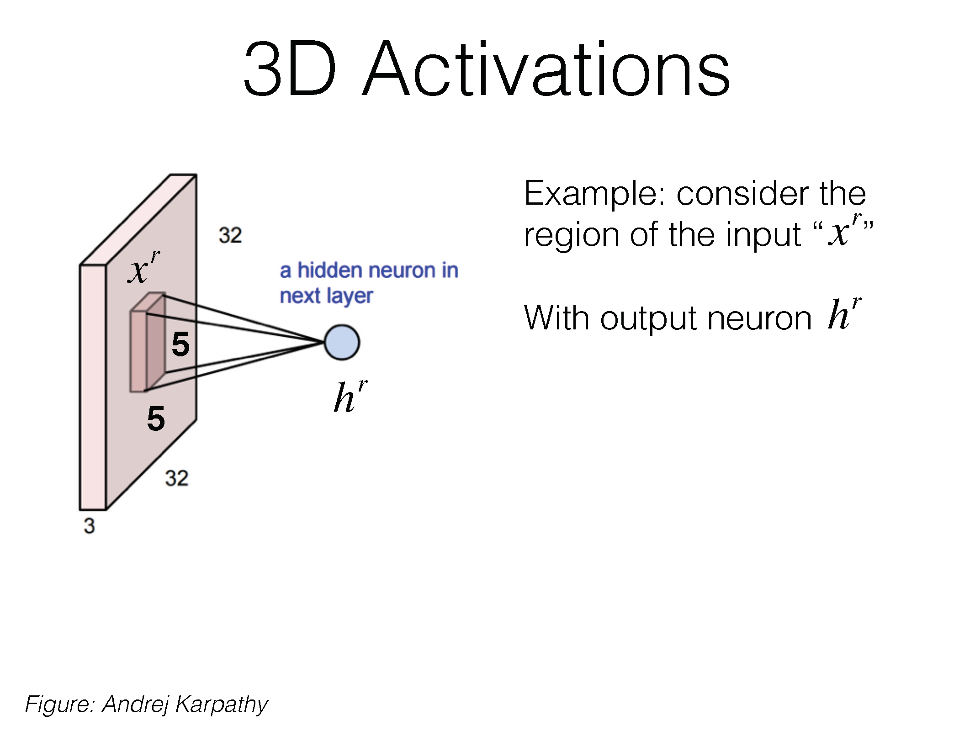

Slide 43
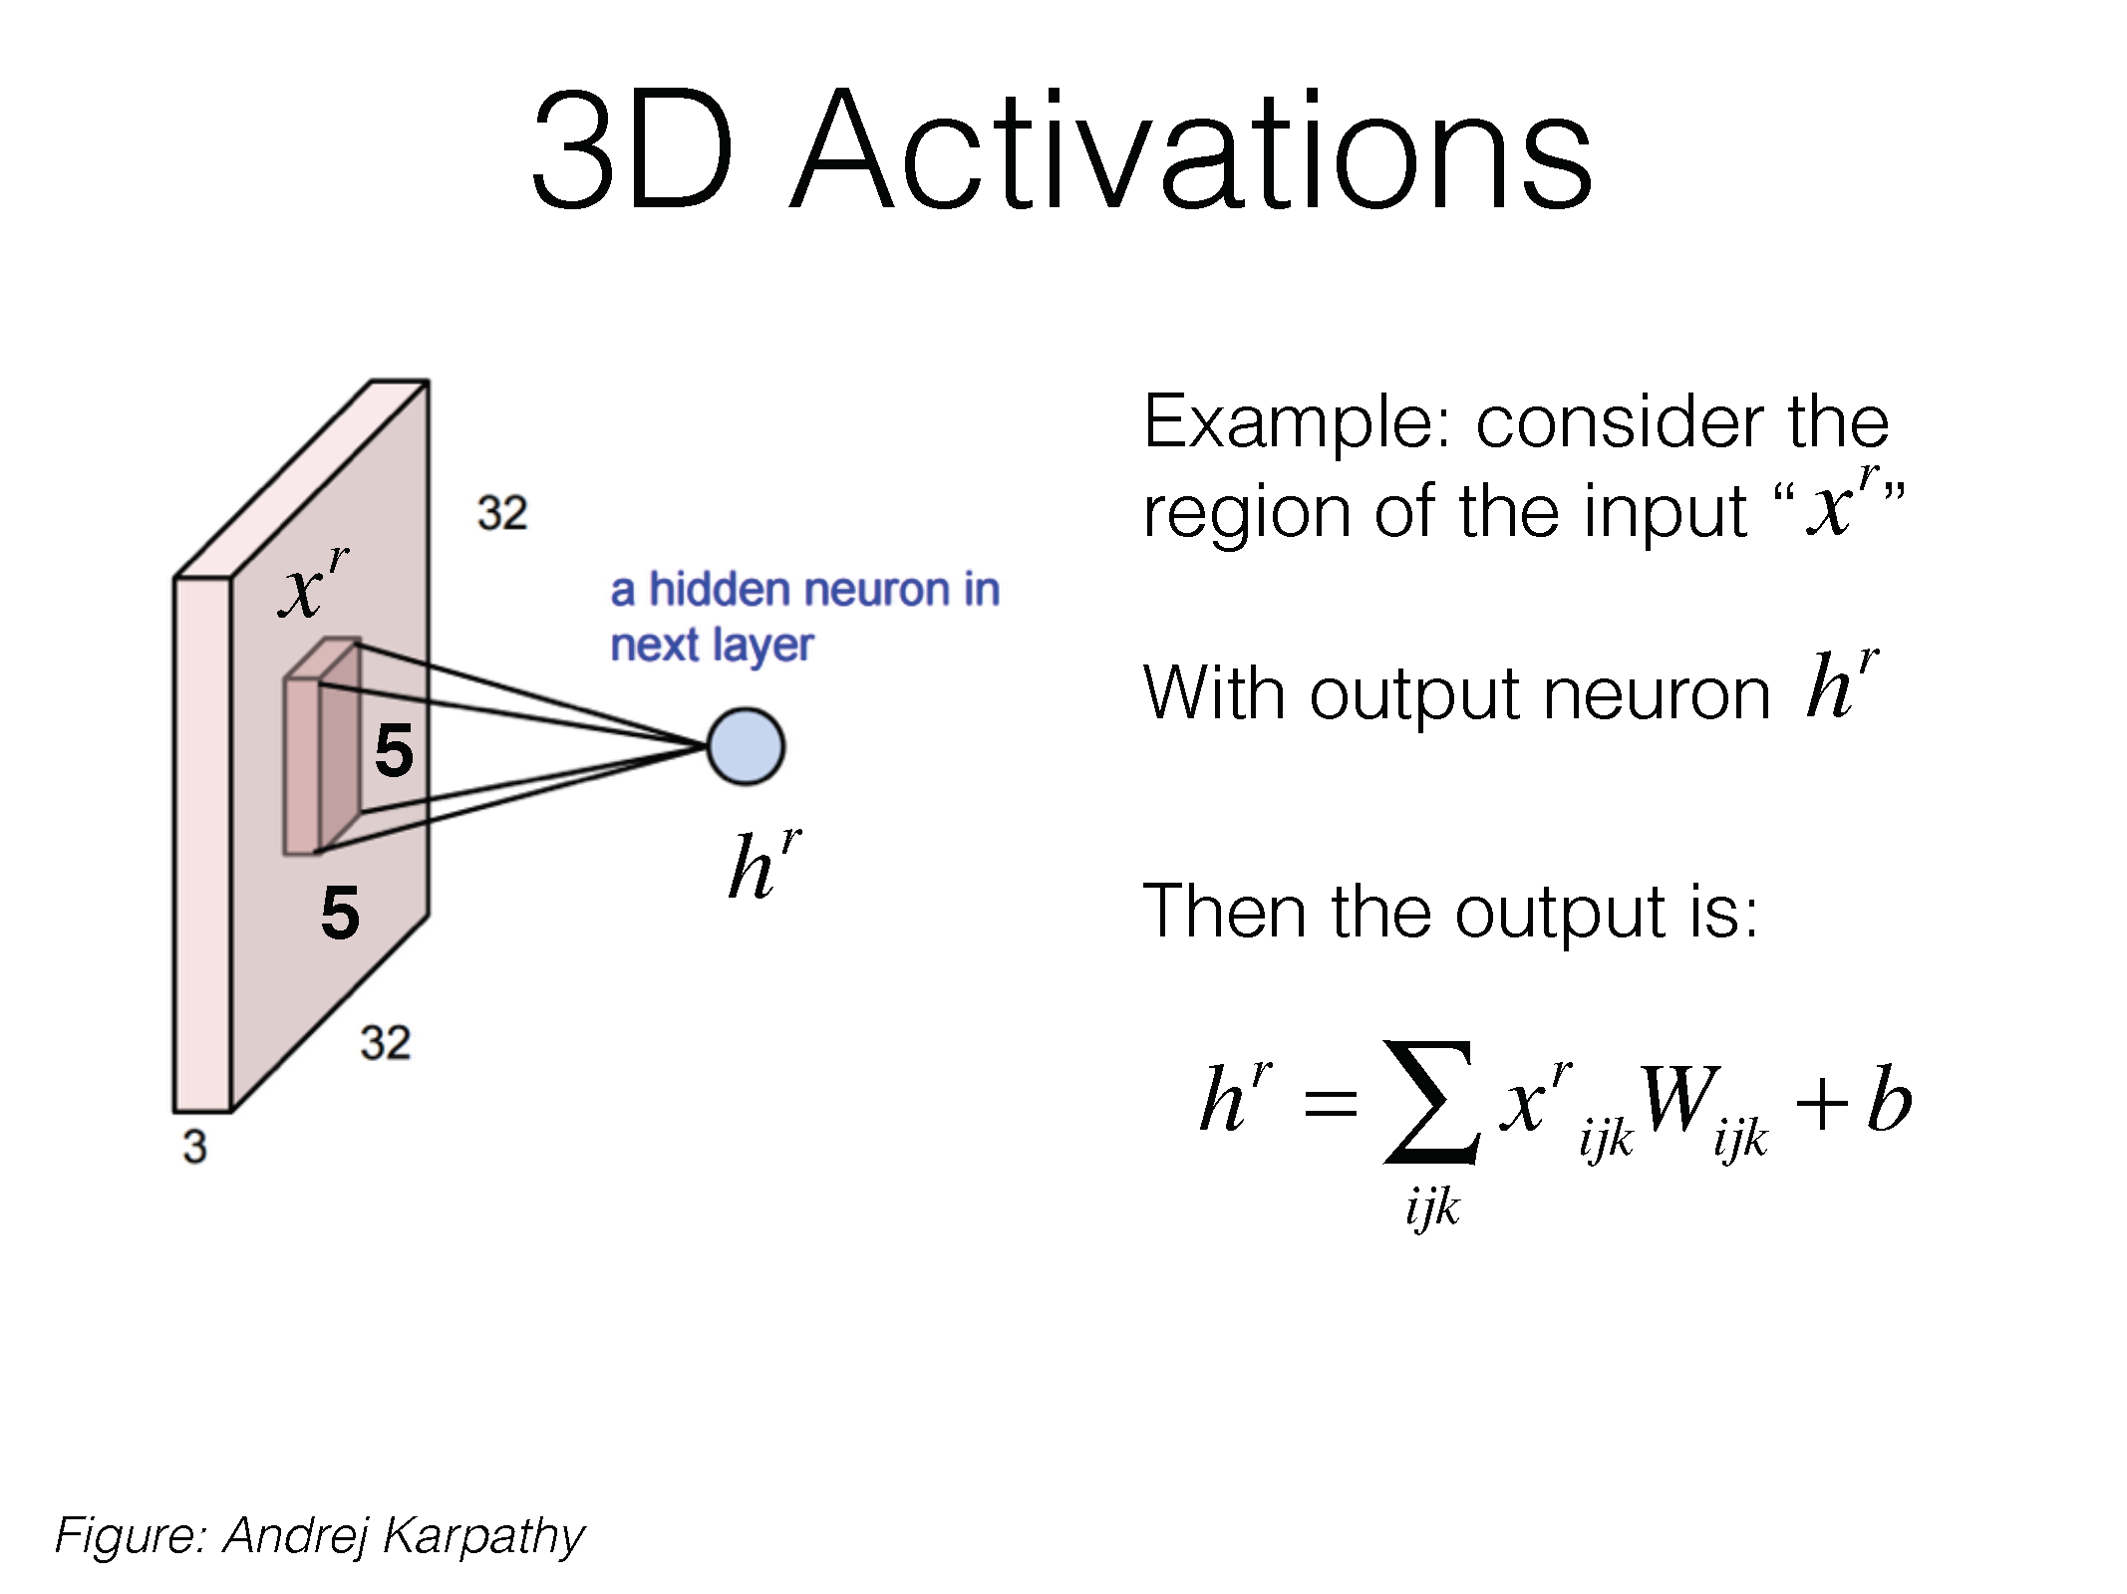

Slide 44
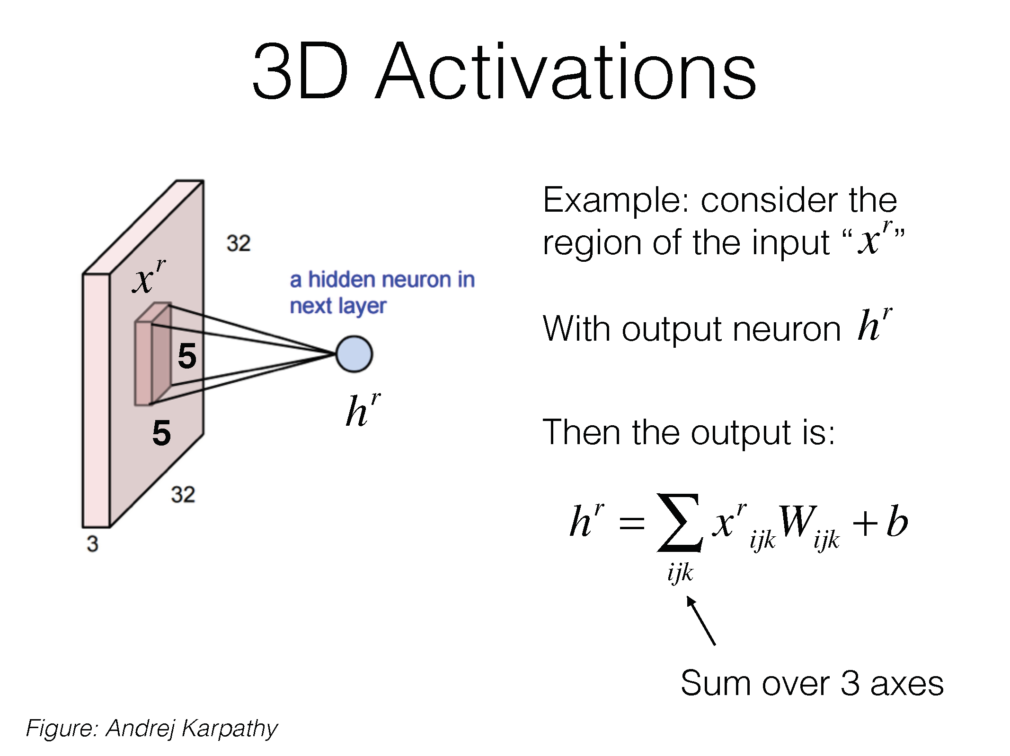

Slide 45
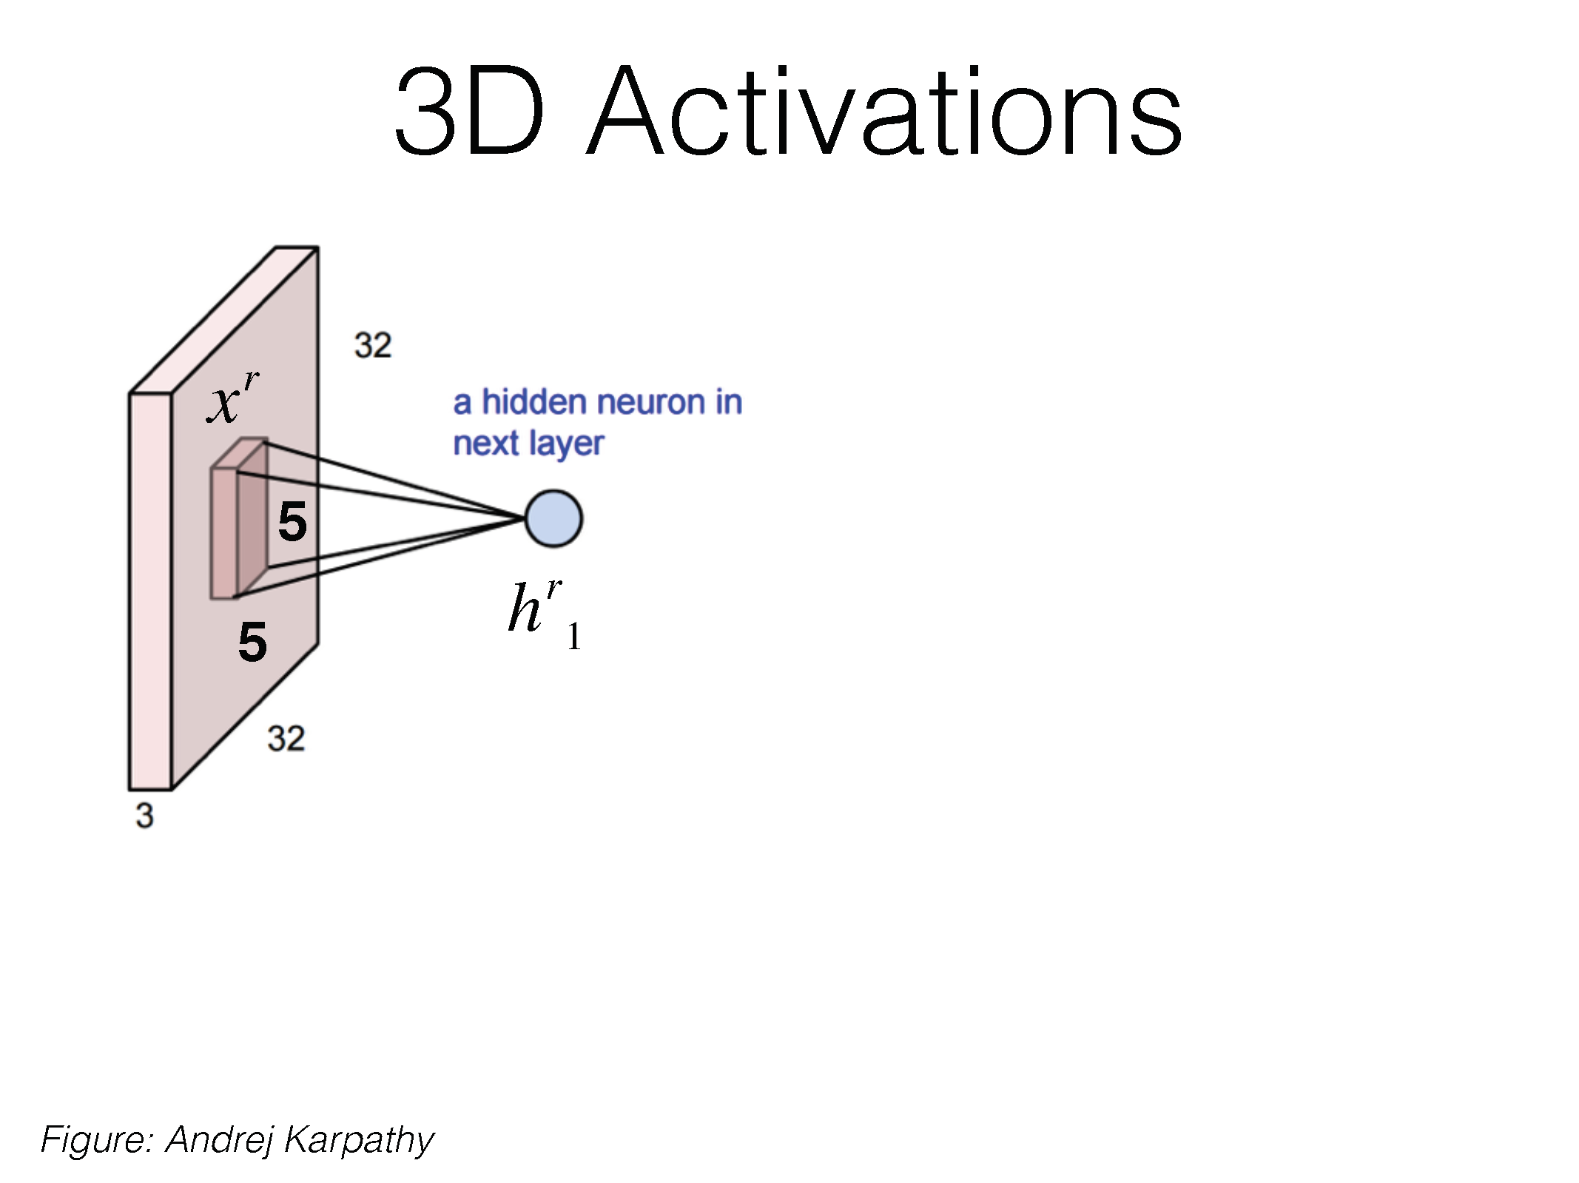

Slide 46


Slide 47
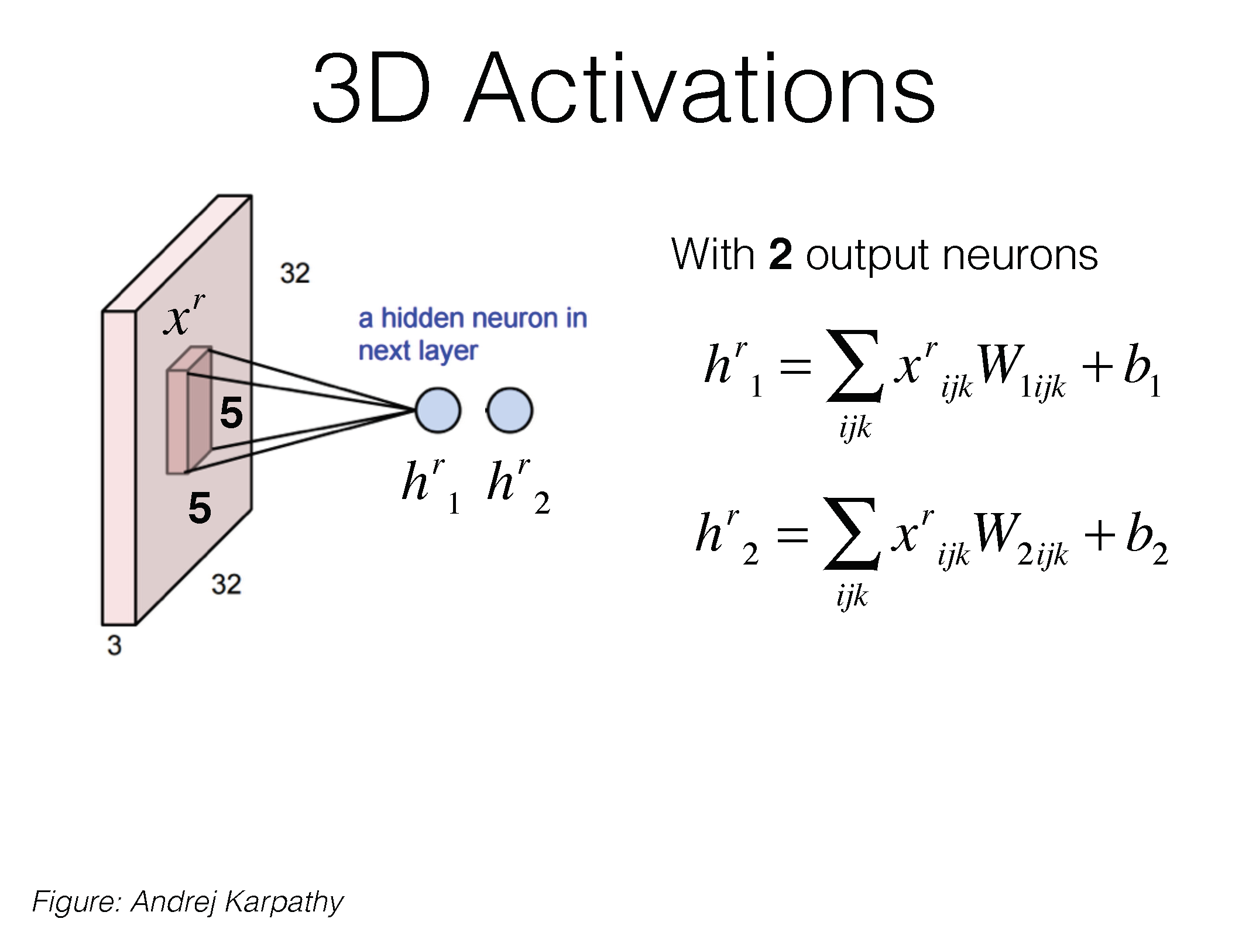

Slide 48
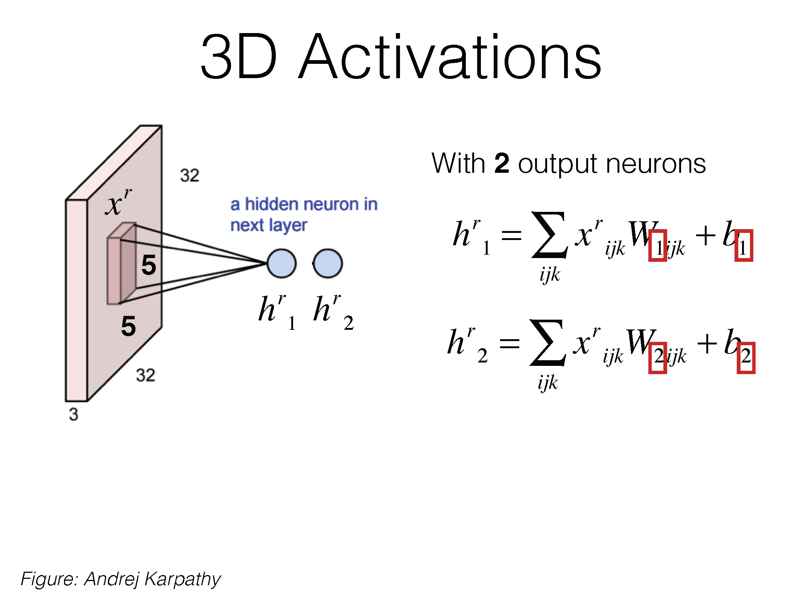

Slide 49
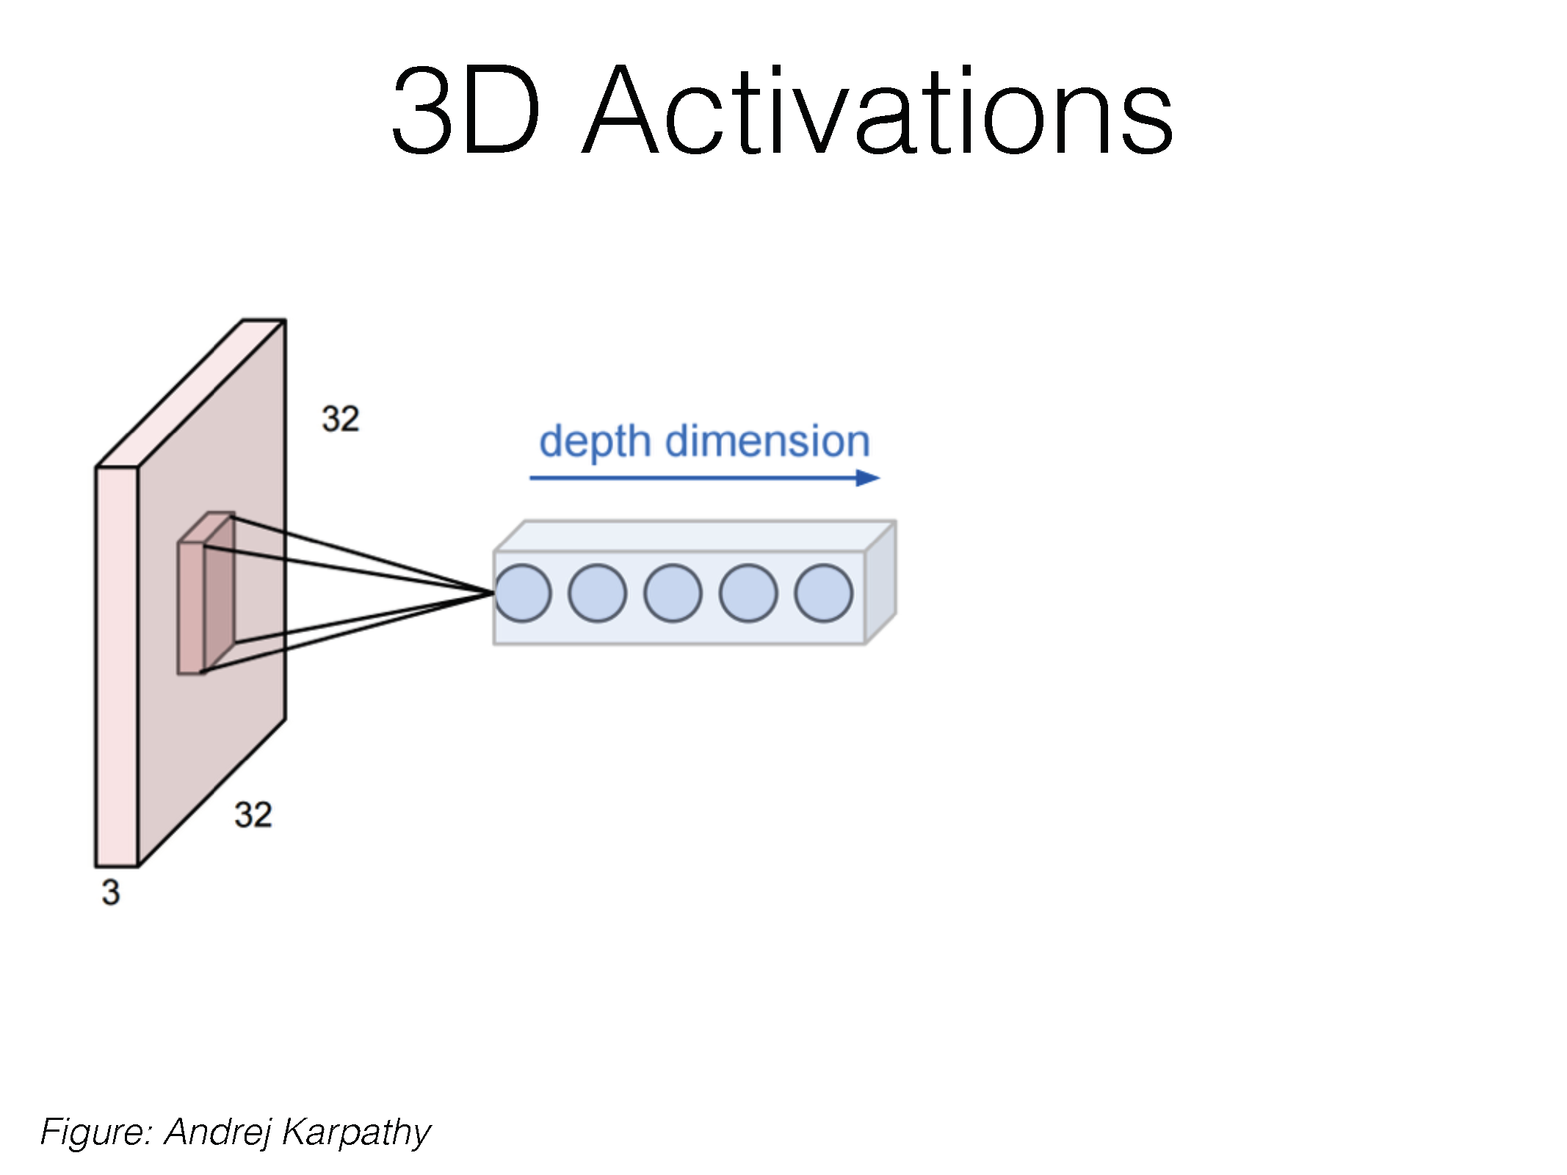

Slide 50
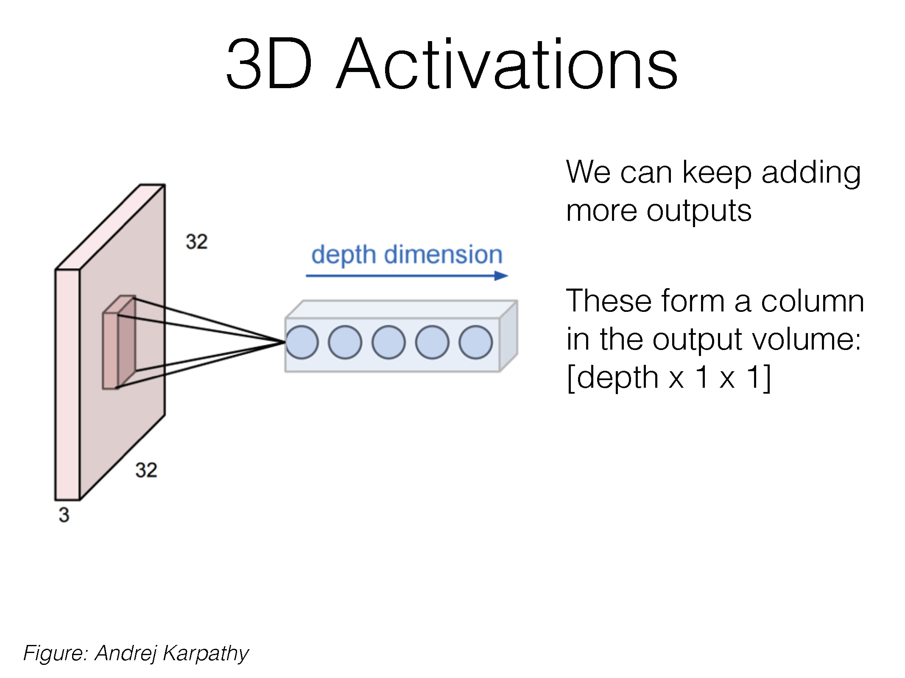

Slide 51
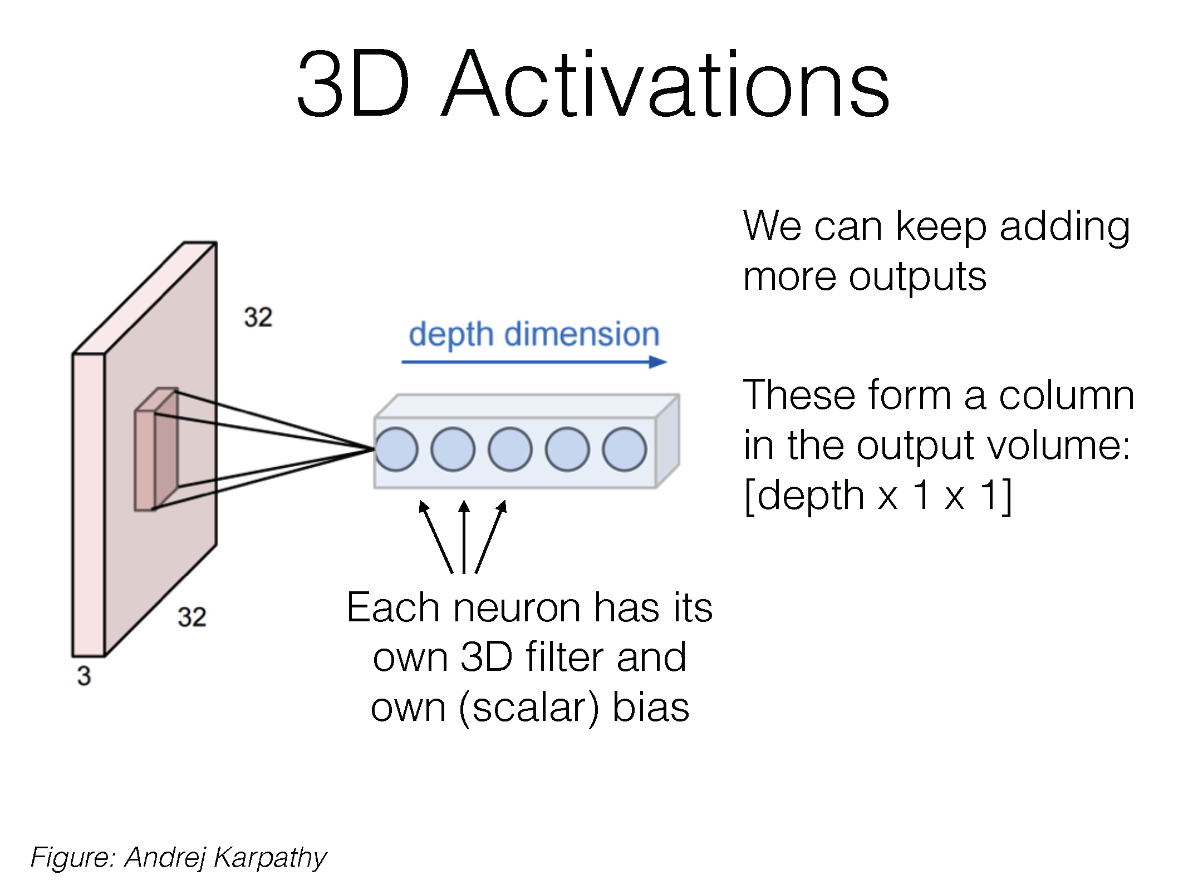

Slide 52
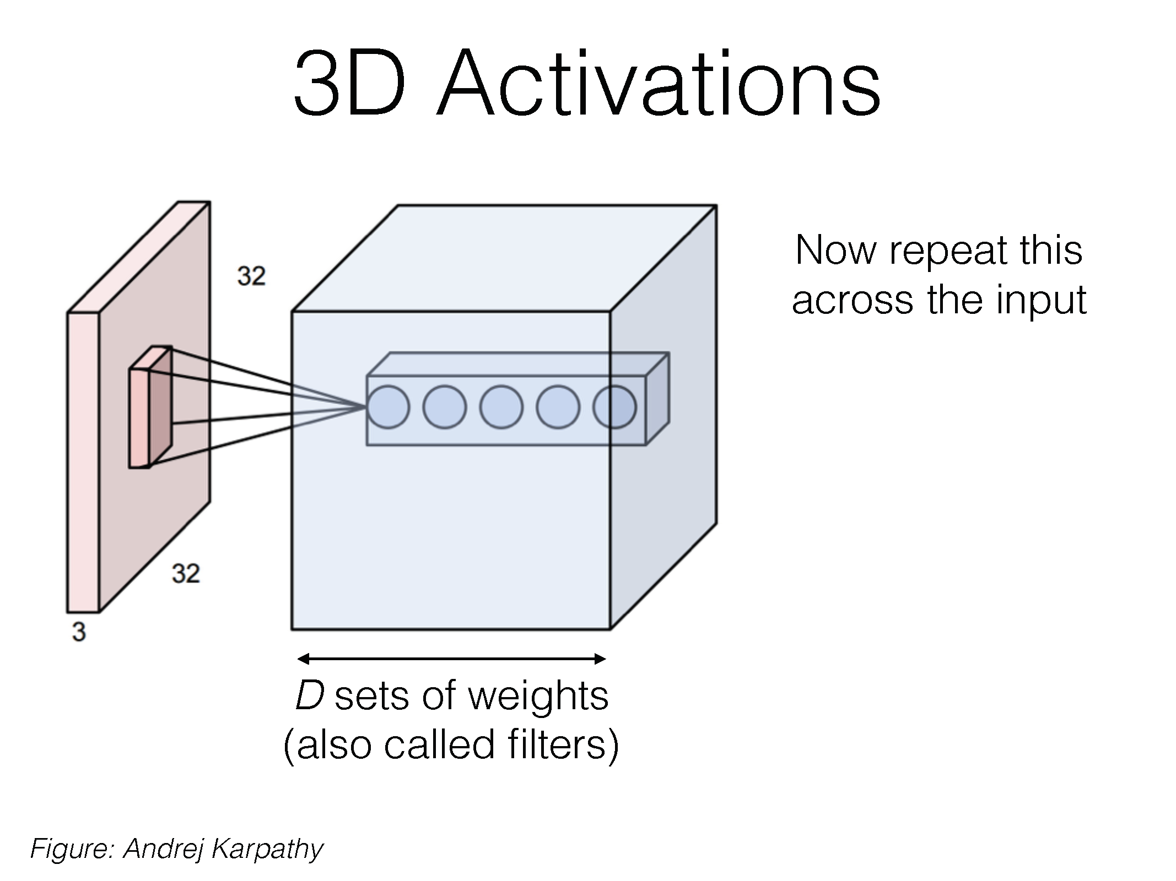

Slide 53
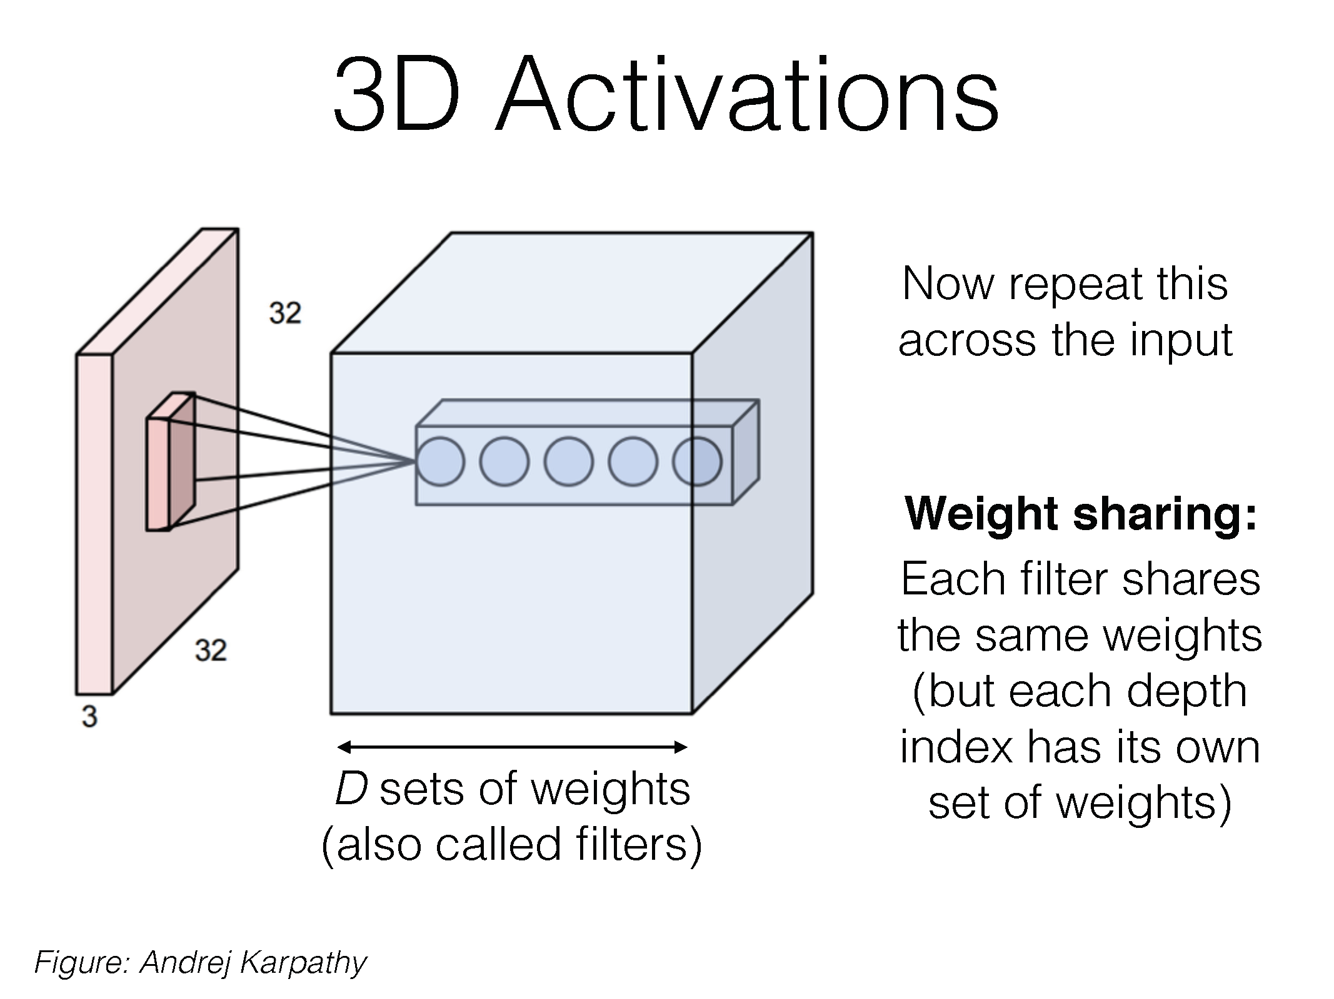

Slide 54
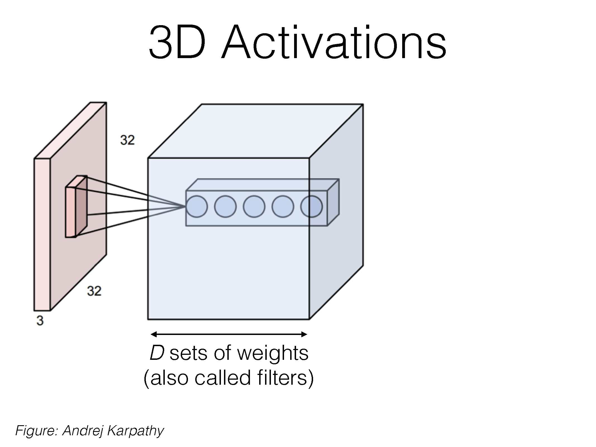

Slide 55
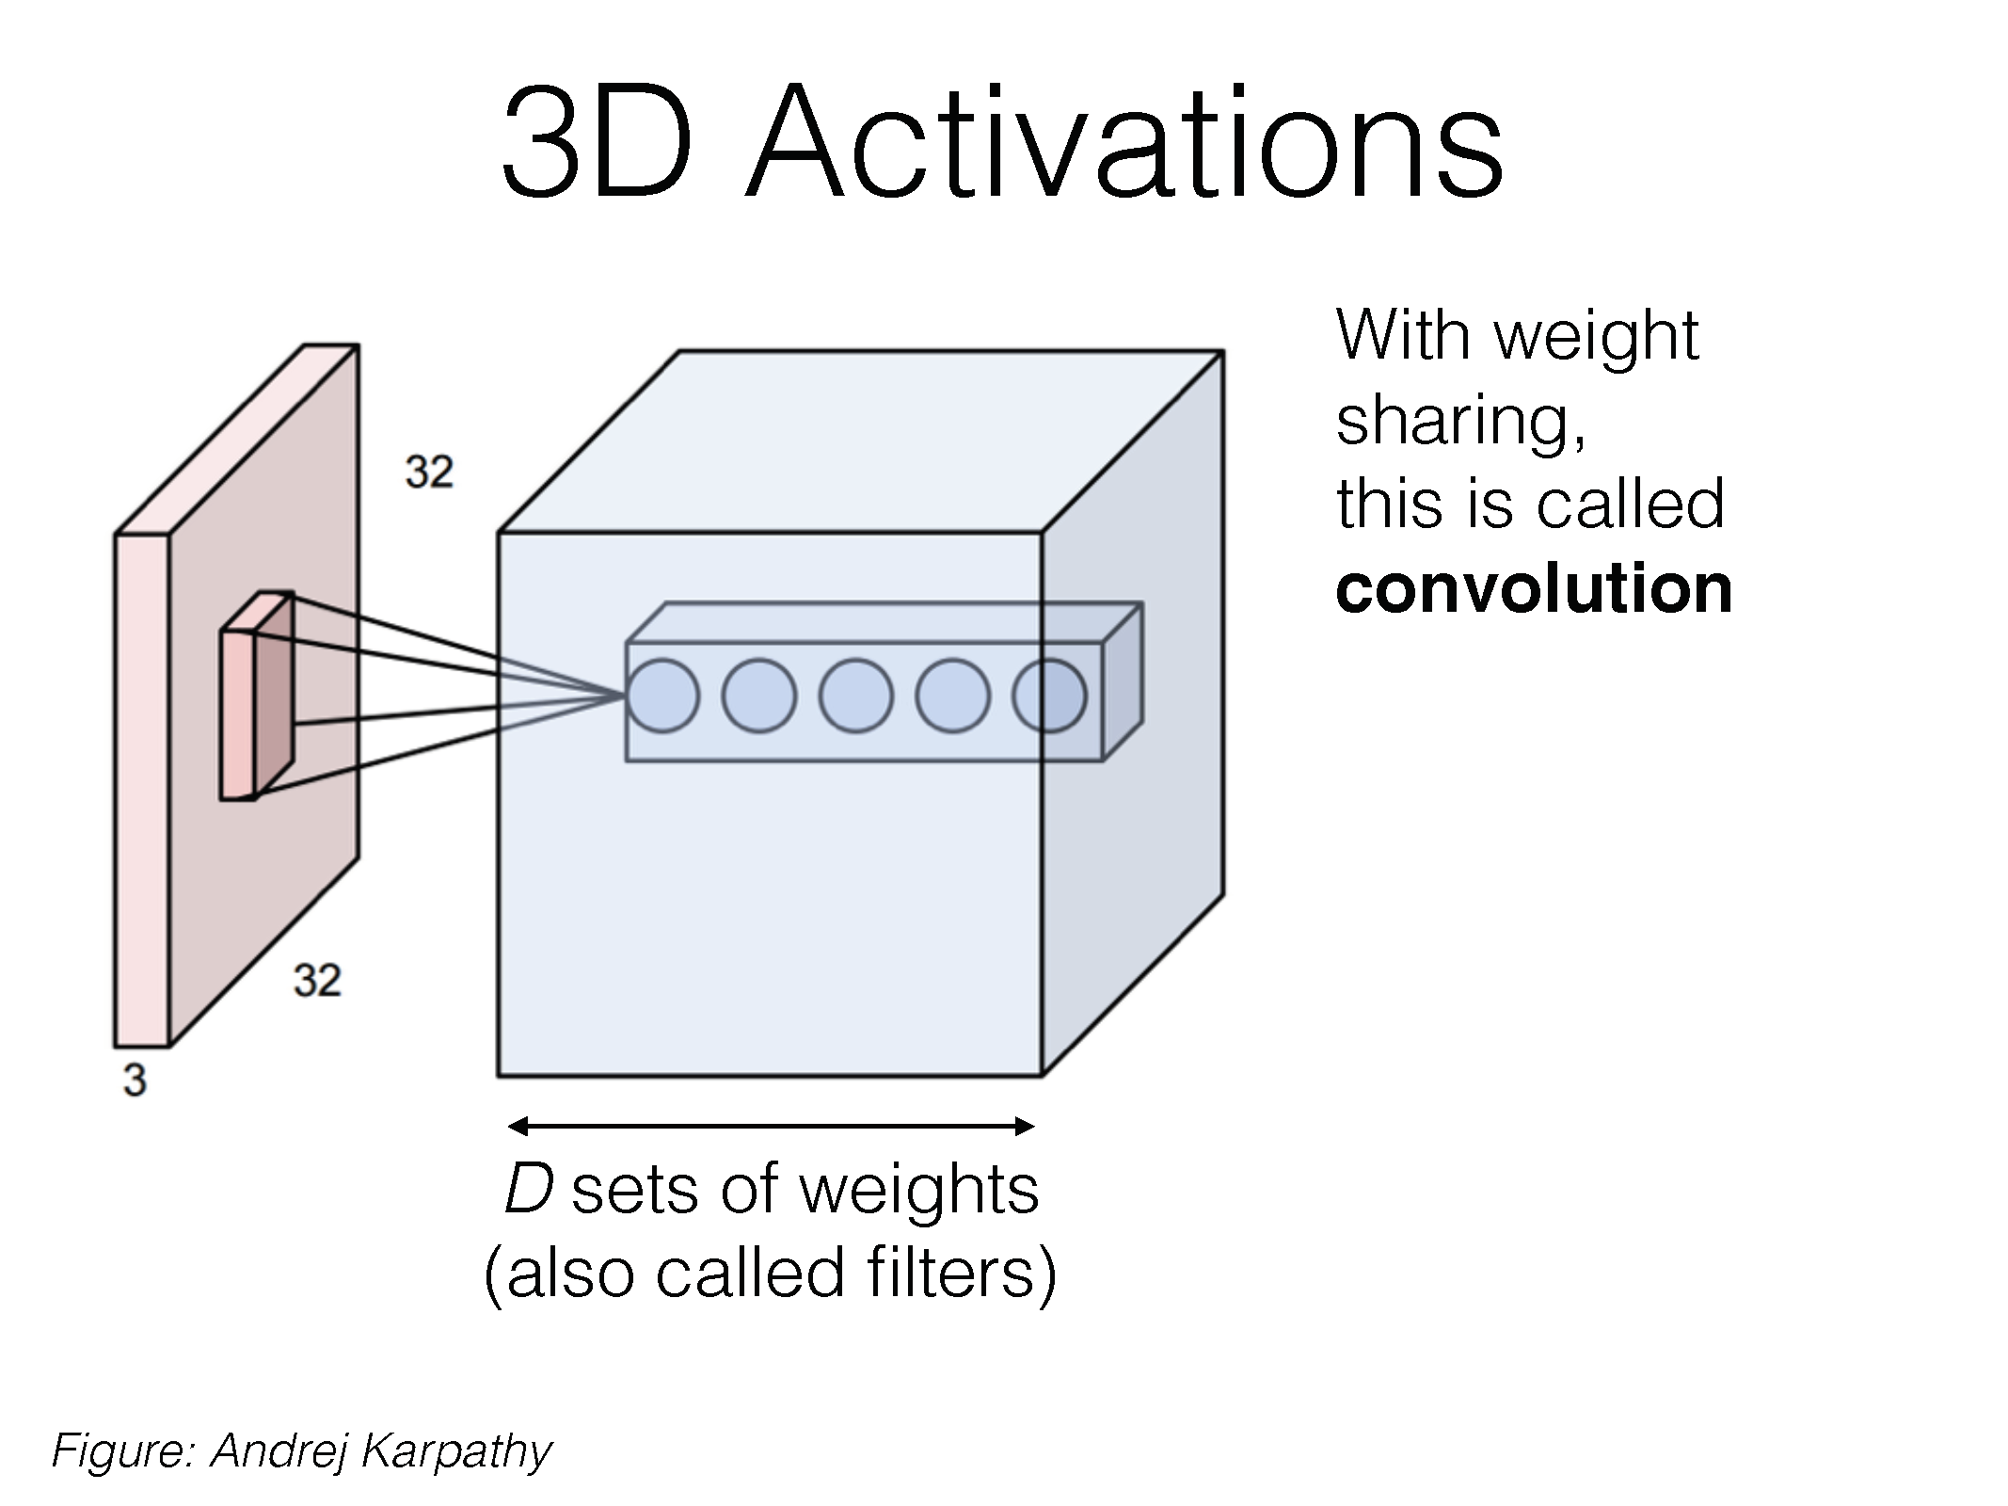

Slide 56
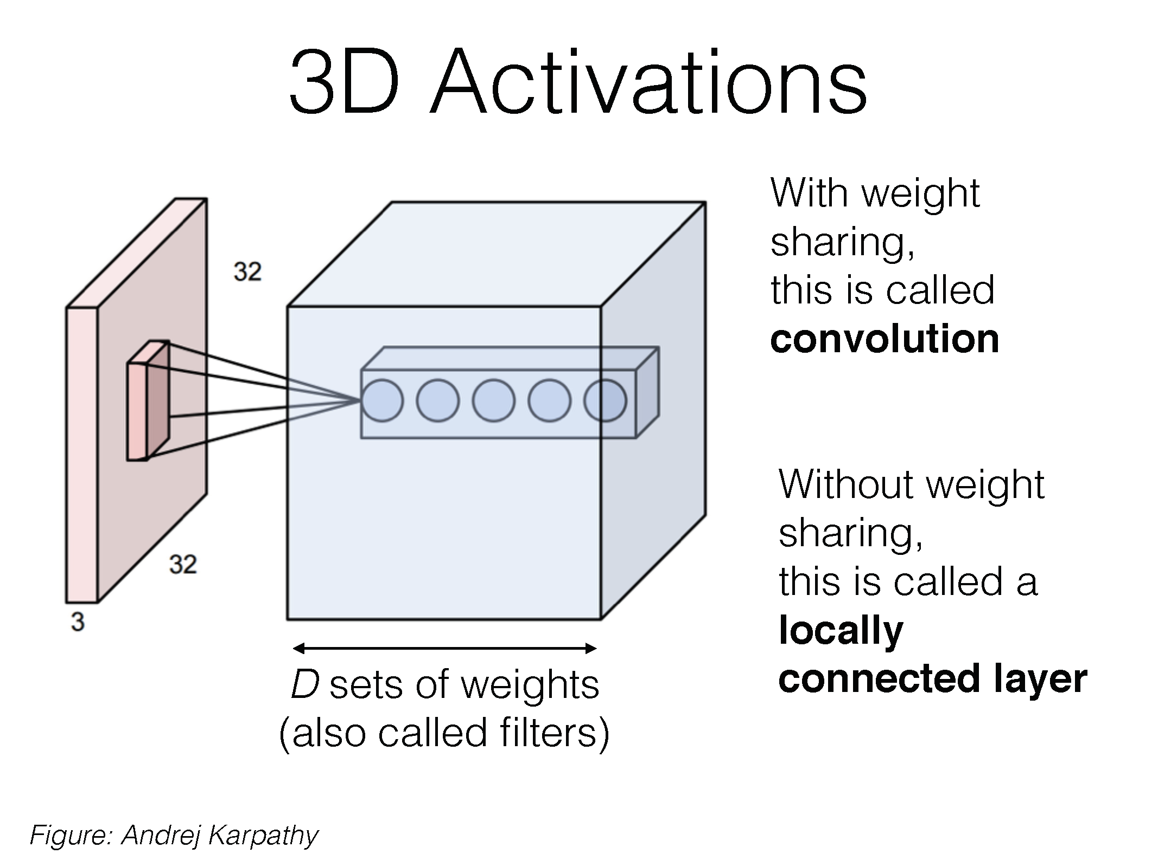

Slide 57
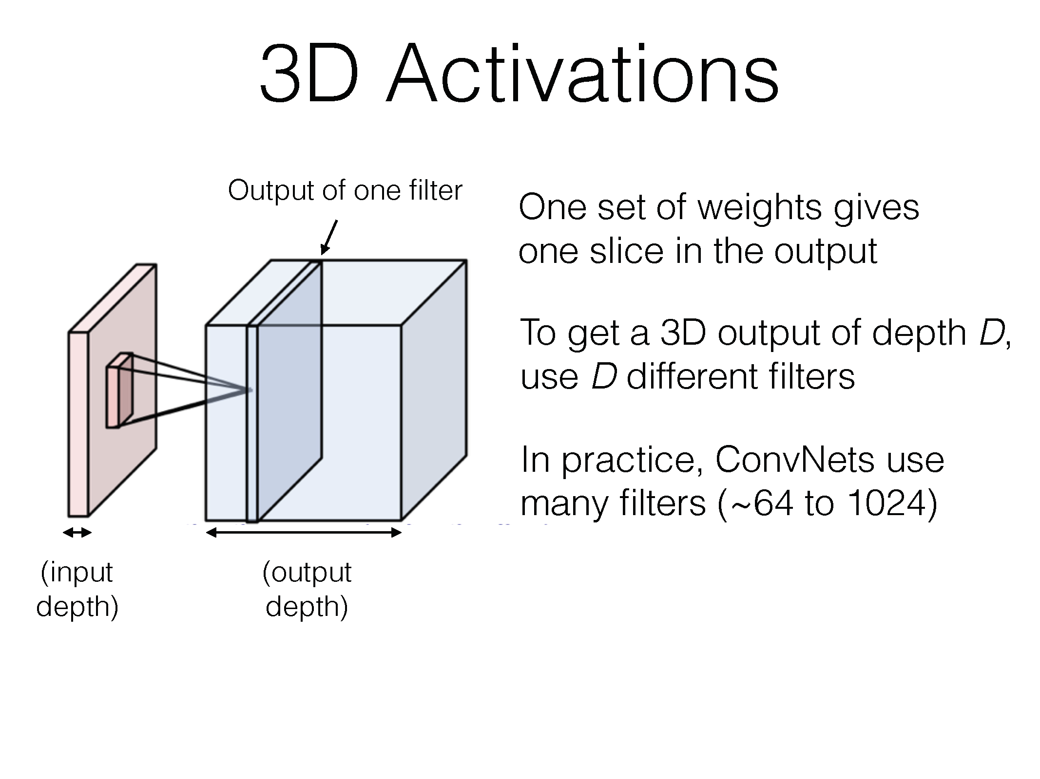

Slide 58
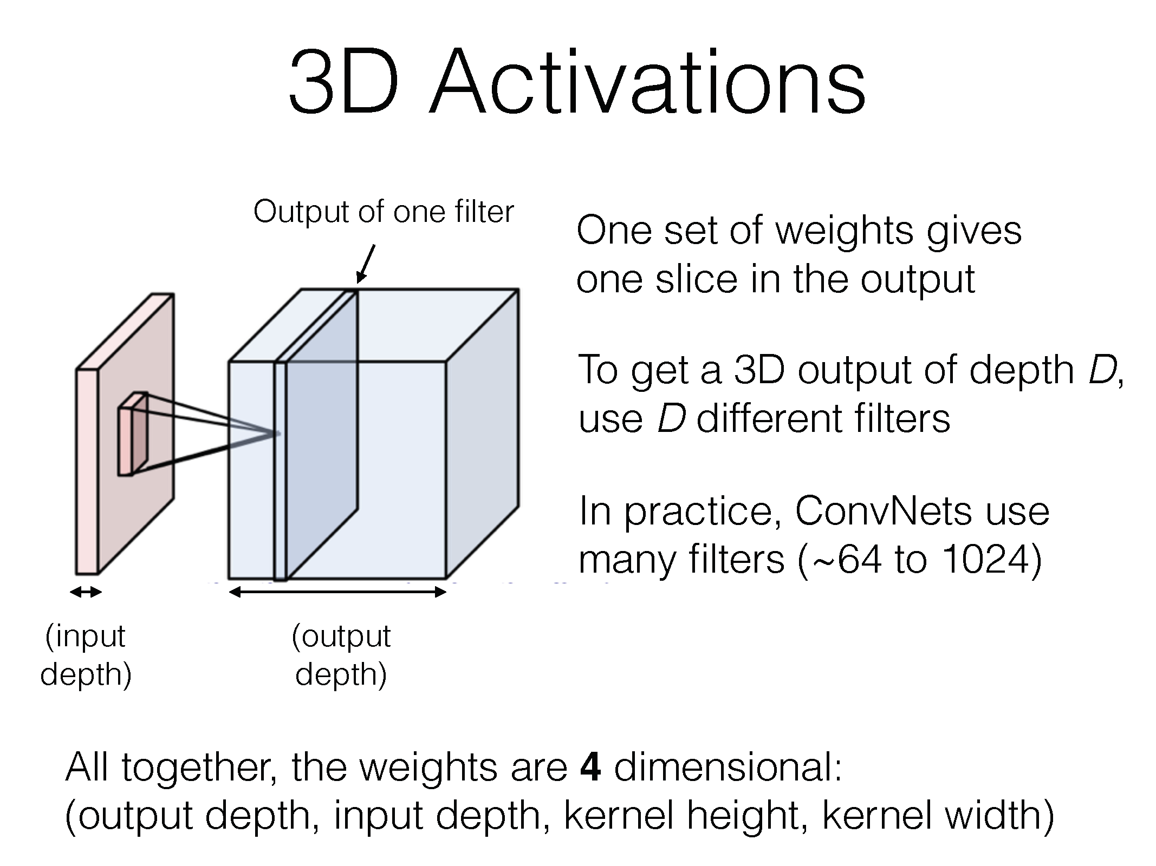

Slide 59
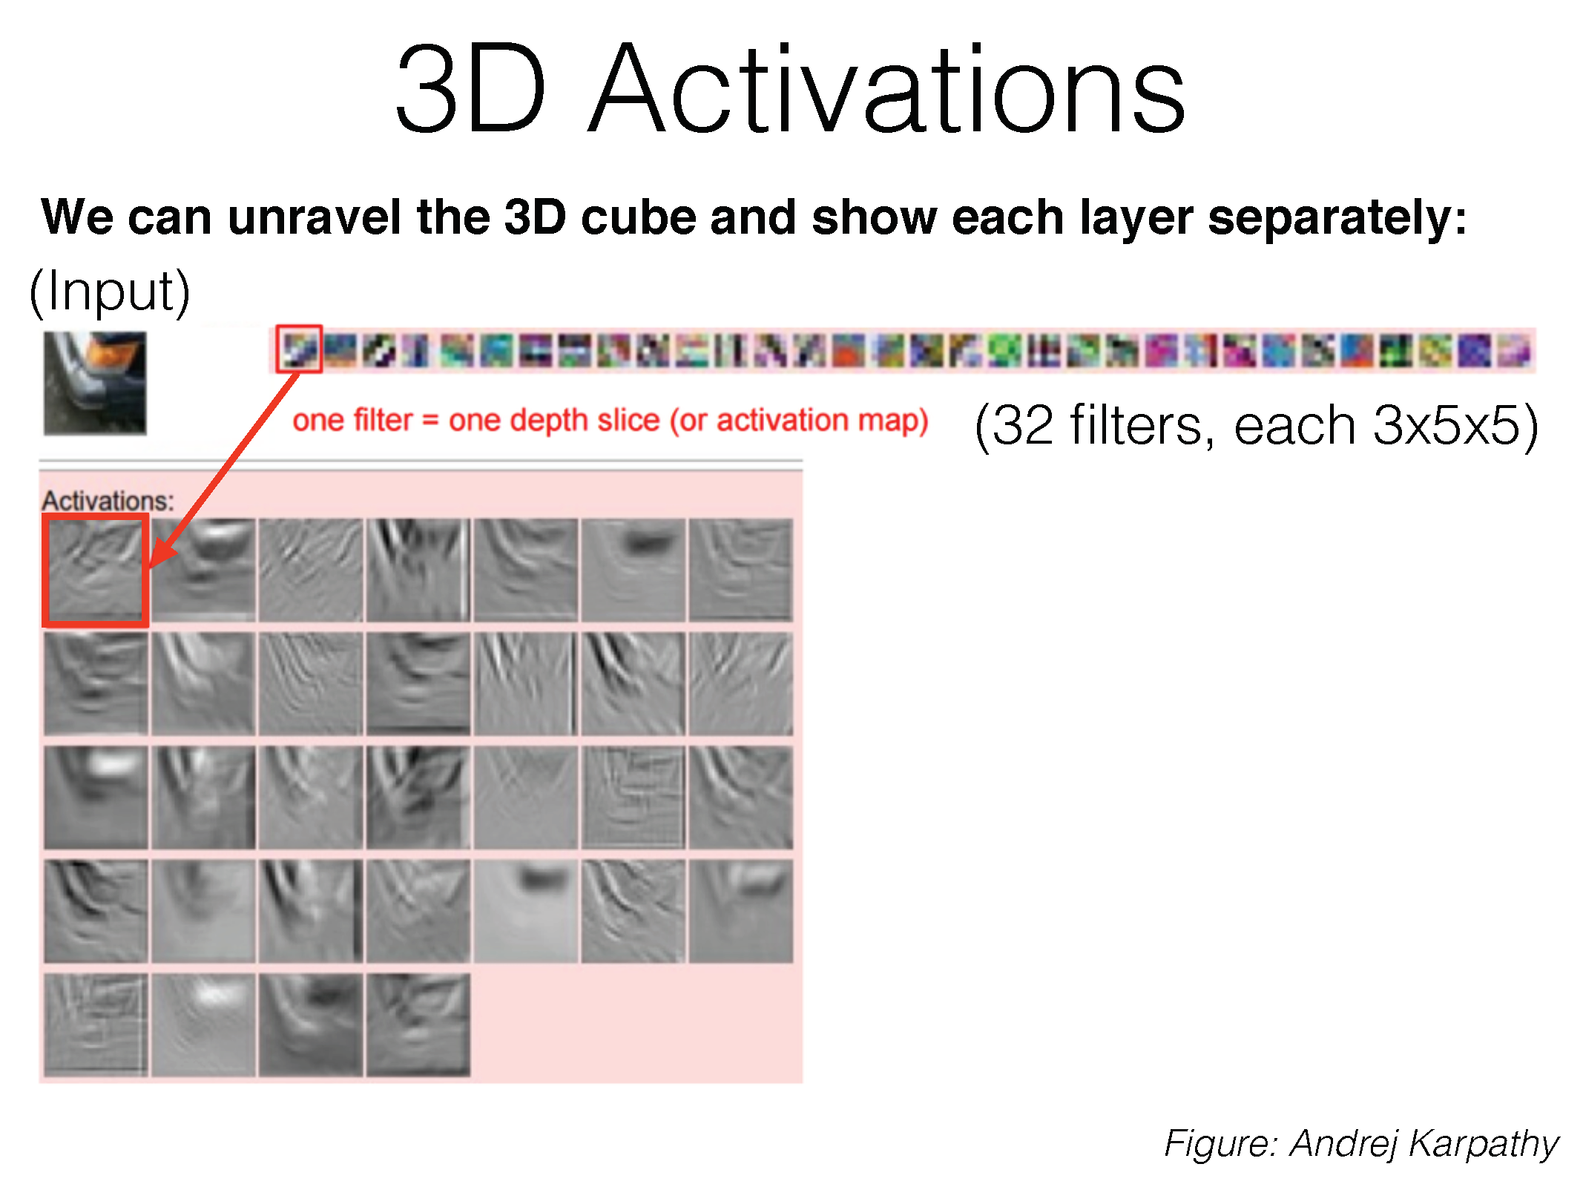

Slide 60
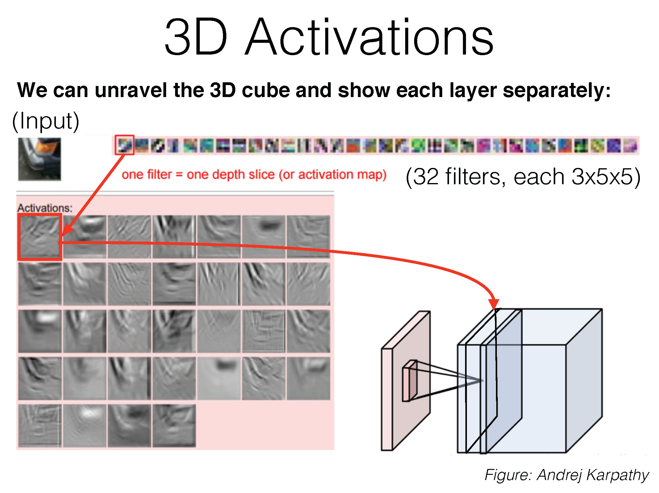

Slide 61
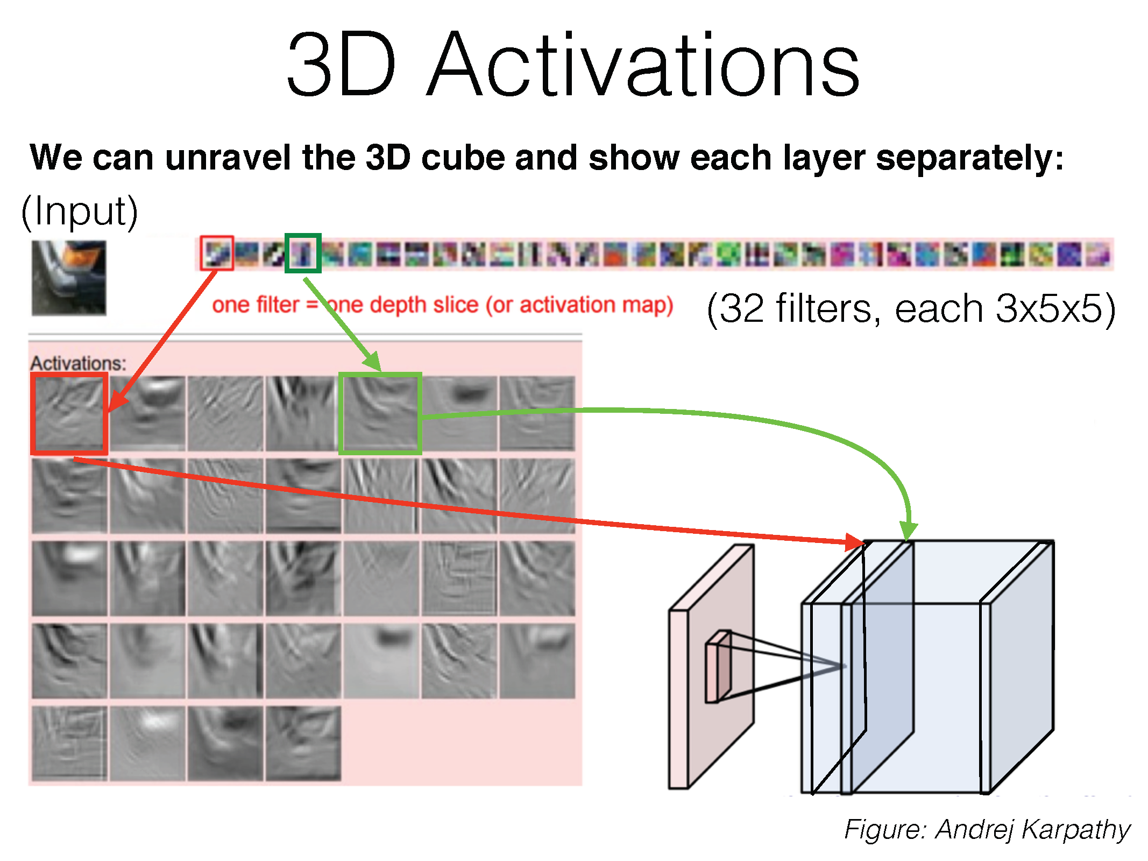

Slide 62
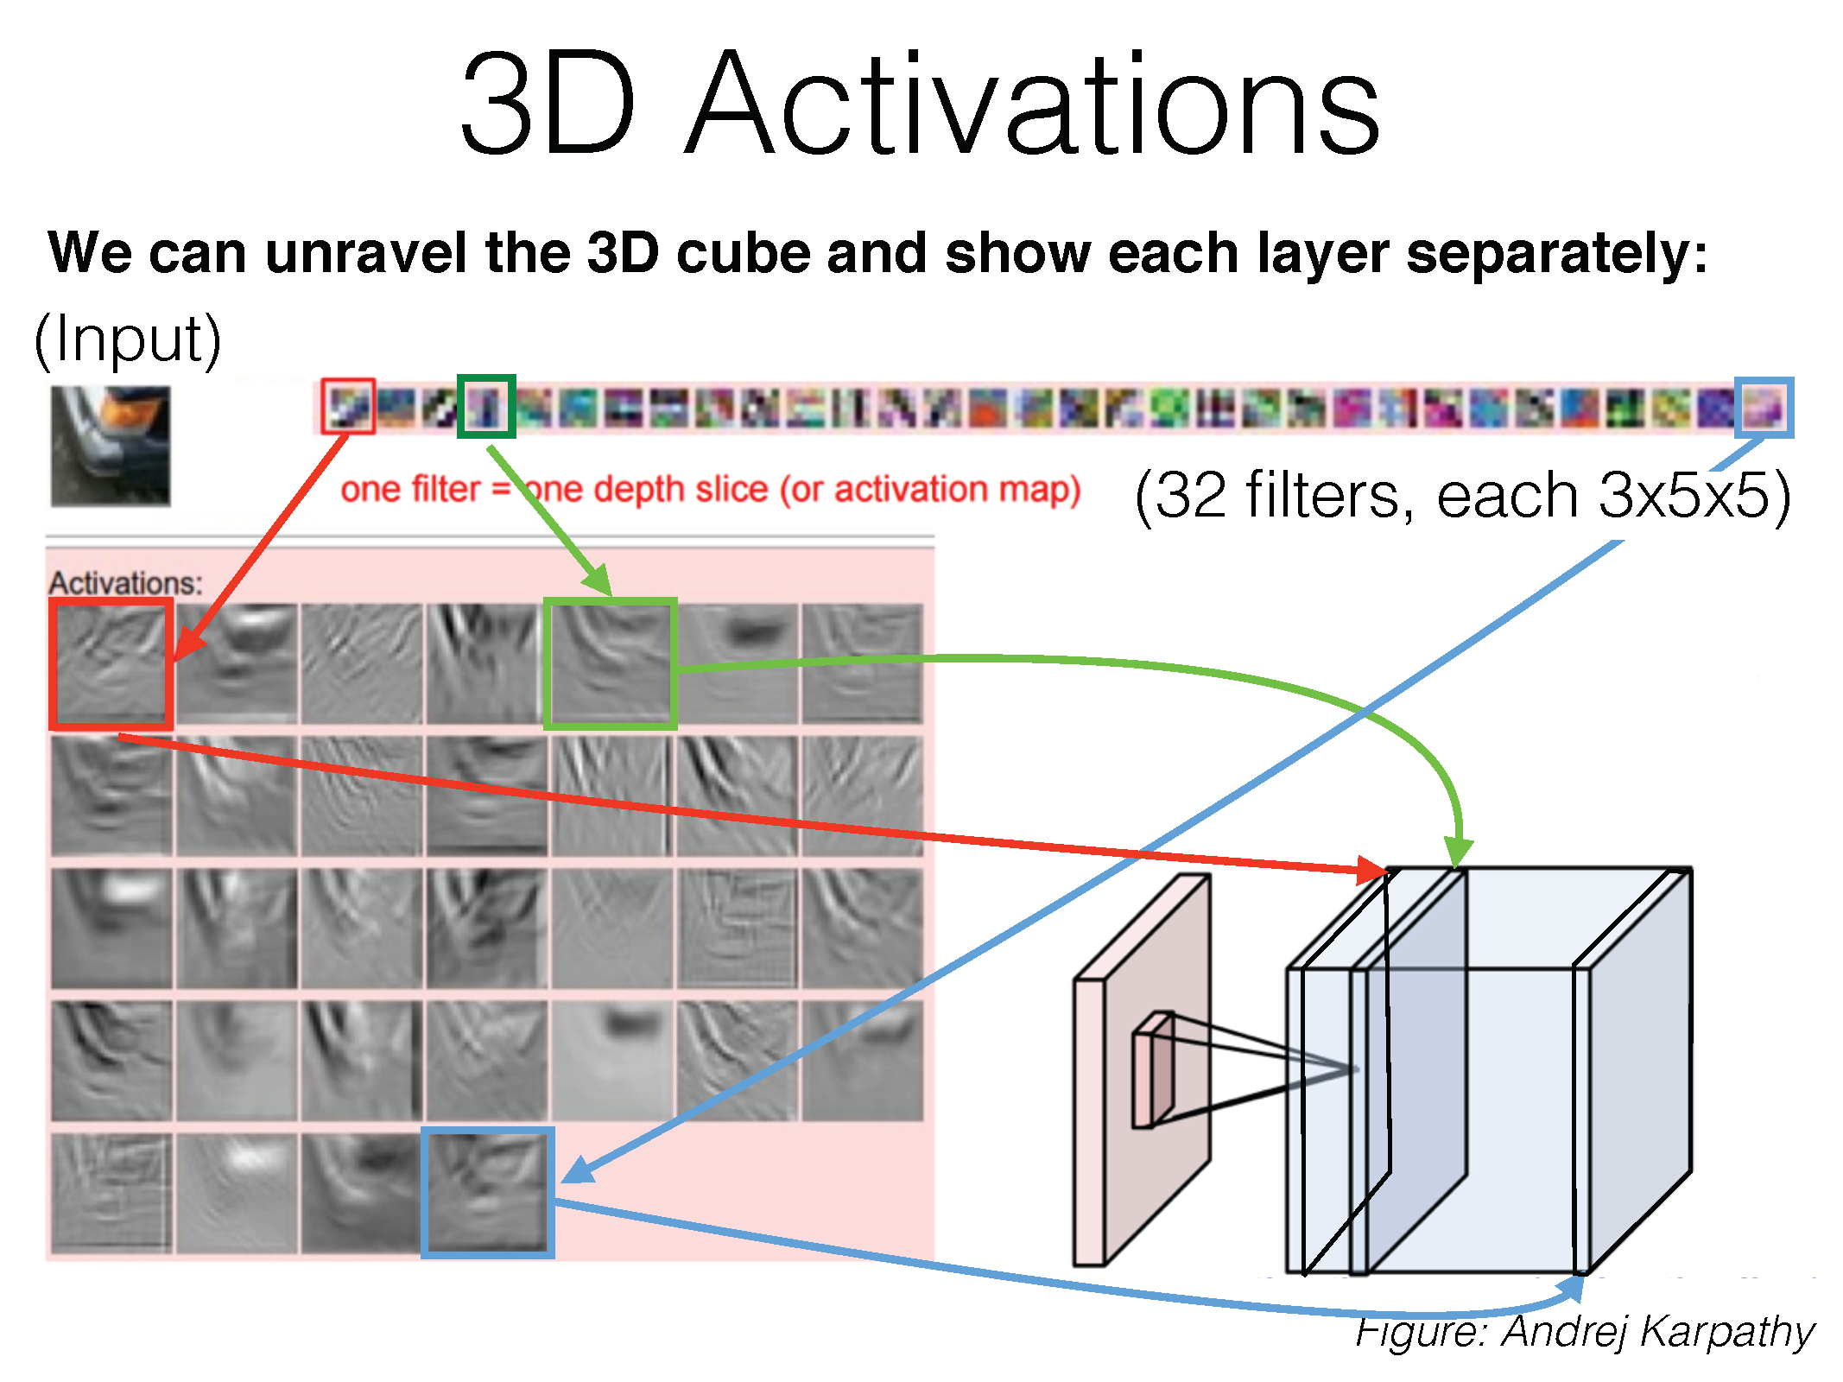

Slide 63
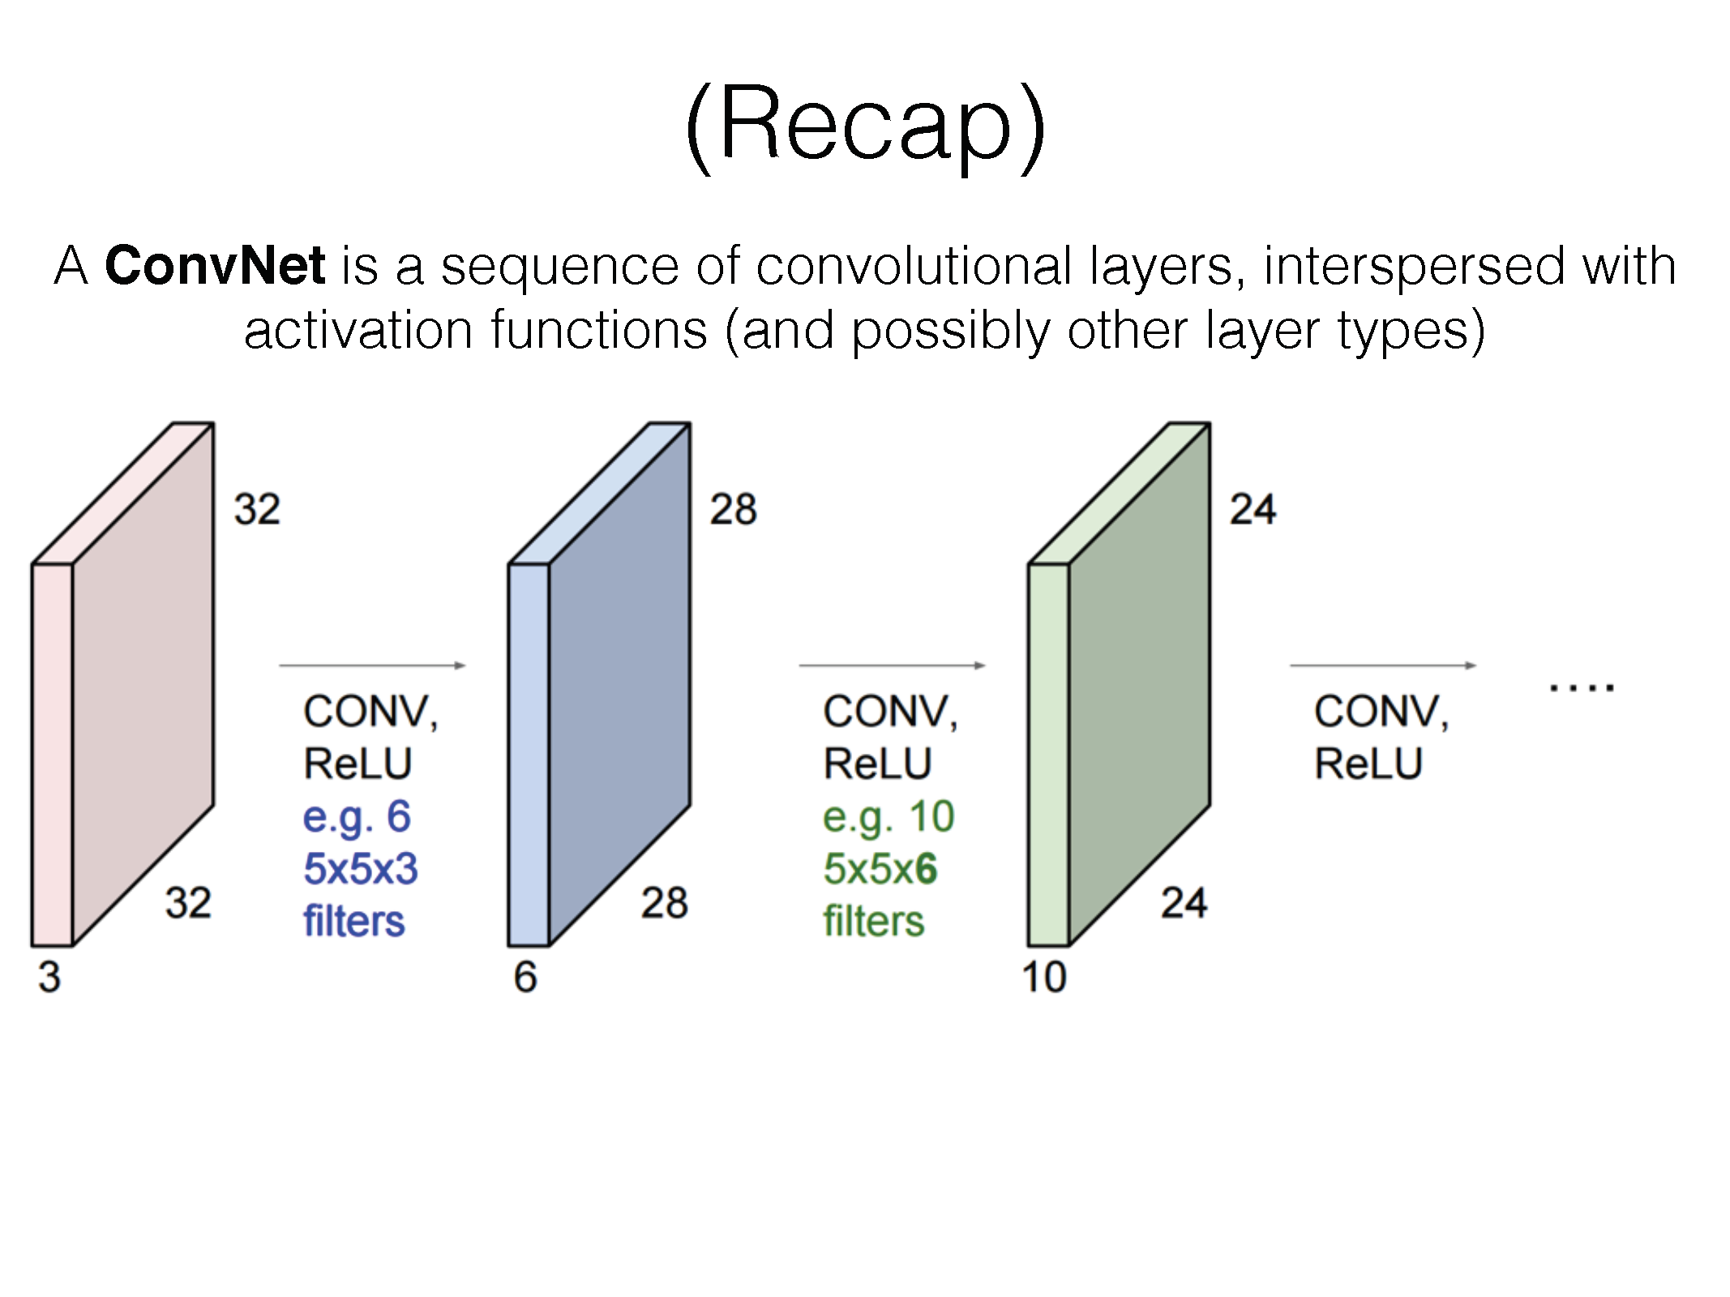

Slide 64


Slide 65


Slide 66


Slide 67


Slide 68


Slide 69


Slide 70


Slide 71
Demos
http://cs231n.stanford.edu/
http://cs.stanford.edu/people/karpathy/convnetjs/demo/mnist.html

Slide 72


Slide 73


Slide 74


Slide 75


Slide 76


Slide 77


Slide 78


Slide 79


Slide 80


Slide 81


Slide 82


Slide 83


Slide 84


Slide 85


Slide 86


Slide 87


Slide 88


Slide 89


Slide 90


Slide 91


Slide 92


Slide 93


Slide 94


Slide 95


Slide 96


Slide 97


Slide 98
Training ConvNets

Slide 99


Slide 100


Slide 101


Slide 102


Slide 103


Slide 104


Slide 105


Slide 106


Slide 107


Slide 108


Slide 109


Slide 110


Slide 111


Slide 112


Slide 113


Slide 114


Slide 115


Slide 116


Slide 117


Slide 118


Slide 119


Slide 120


Slide 121


Slide 122


Slide 123


Slide 124


Slide 125


Slide 126


Slide 127


Slide 128


Slide 129


Slide 130


Slide 131


Slide 132


Slide 133


Slide 134


Slide 135


Slide 136


Slide 137


Slide 138


Slide 139
References
Basic reading: No standard textbooks yet! Some good resources:
  https://sites.google.com/site/deeplearningsummerschool/
  http://www.deeplearningbook.org/
  http://www.cs.toronto.edu/~hinton/absps/NatureDeepReview.pdf
Notes:
Ch

