Slide 1
Image classification
16-385 Computer Vision
Spring 2019, Lecture 18
http://www.cs.cmu.edu/~16385/

Slide 2
Course announcements
Homework 5 is available online.
- Any questions about the homework?
- How many of you have looked at/started/finished homework 5?
Extra late day awarded to everyone.
- You can use this for any homework you want, including retroactively for older homeworks.
No lecture on Wednesday.
Extra office hours by Yannis on Friday, 1-3 pm.
- This are in addition to the usual office hours between 3-5 pm.
- These will take place in the graphics lounge and/or Smith 225.
How many of you went to Angela Dai’s talk?
Vote on Piazza for your favorite faculty candidates!

Slide 3
Overview of today’s lecture
Bag-of-words.
K-means clustering.
Classification.
K nearest neighbors.
Naïve Bayes.
Support vector machine.

Slide 4
Slide credits
Most of these slides were adapted from:
Kris Kitani (16-385, Spring 2017).
Noah Snavely (Cornell University).
Fei-Fei Li (Stanford University).

Slide 5
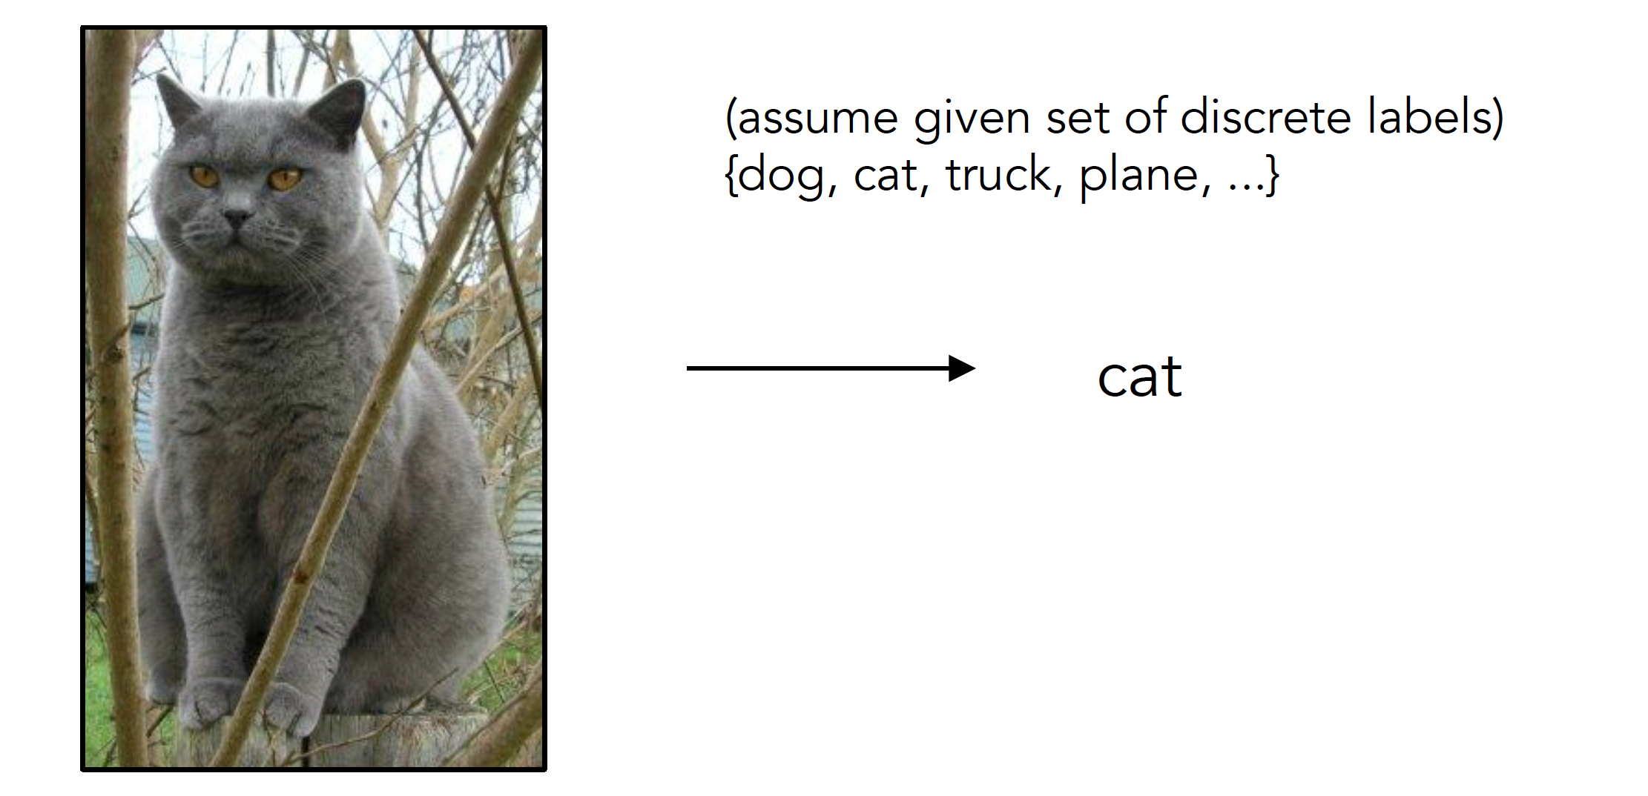
Image Classification

Slide 6
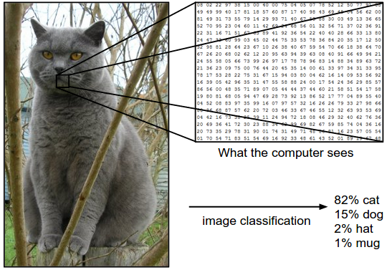
Image Classification: Problem

Slide 7
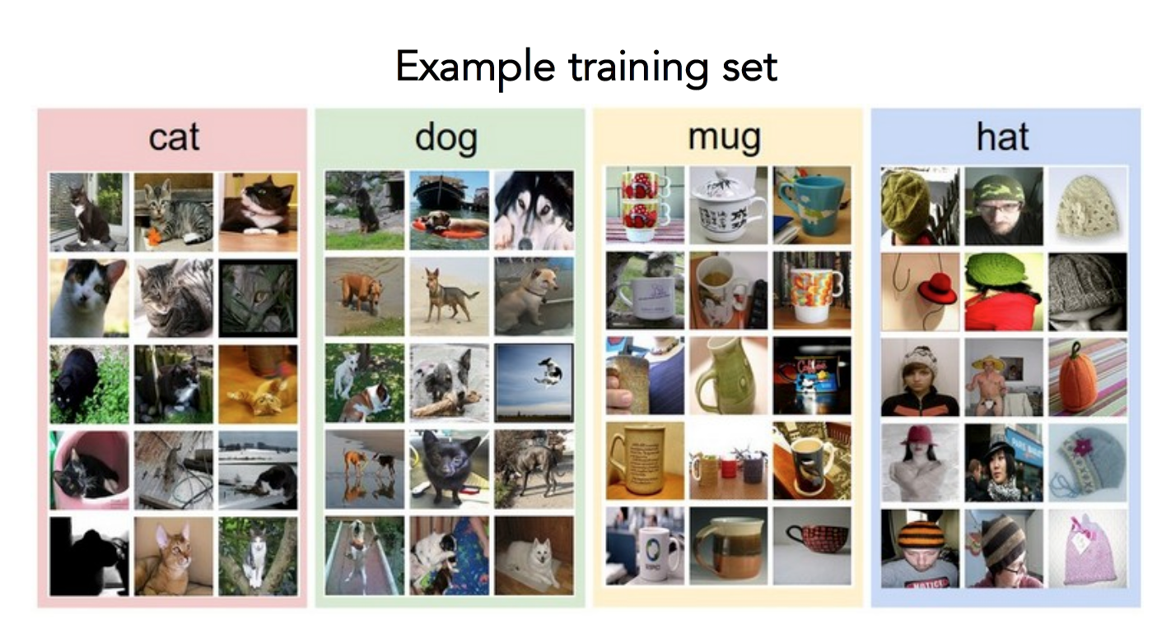
Data-driven approach
Collect a database of images with labels
Use ML to train an image classifier
Evaluate the classifier on test images

Slide 8
Bag of words

Slide 9
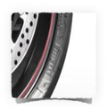
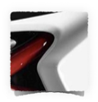
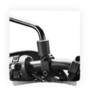
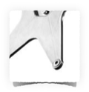
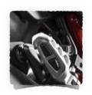
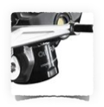
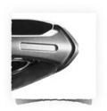
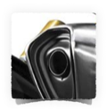

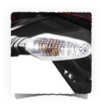
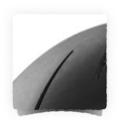
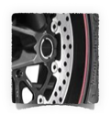
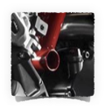
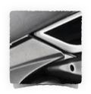
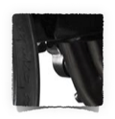
What object do these parts belong to?

Slide 10

Some local feature are very informative
An object as
a collection of local features
(bag-of-features)
deals well with occlusion
scale invariant
rotation invariant

Slide 11
(not so) crazy assumption
spatial information of local features
can be ignored for object recognition (i.e., verification)

Slide 12
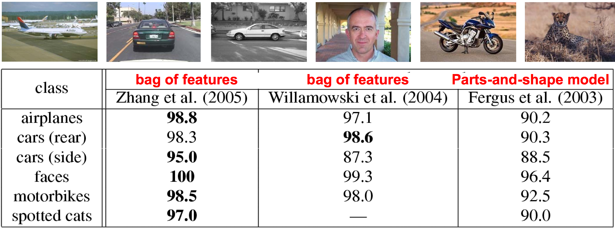
CalTech6 dataset
Works pretty well for image-level classification
Csurka et al. (2004), Willamowski et al. (2005), Grauman & Darrell (2005), Sivic et al. (2003, 2005)

Slide 13
Bag-of-features
represent a data item (document, texture, image)
as a histogram over features
an old idea
(e.g., texture recognition and information retrieval)

Slide 14




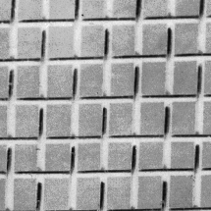
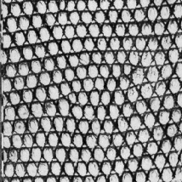
Texture recognition
histogram
Universal texton dictionary

Slide 15
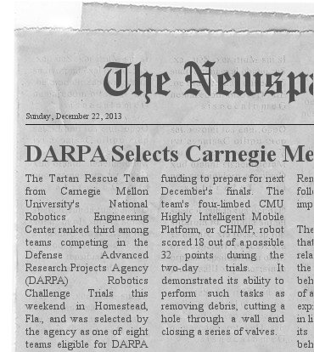
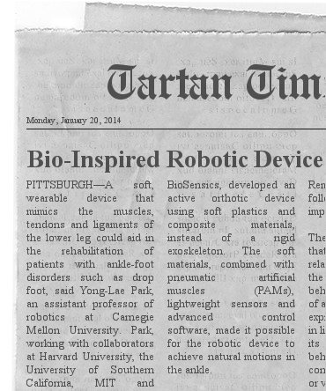
Vector Space Model
G. Salton. ‘Mathematics and Information Retrieval’ Journal of Documentation,1979
1 | 6 | 2 | 1 | 0 | 0 | 0 | 1
Tartan | robot | CHIMP | CMU | bio | soft | ankle | sensor
0 | 4 | 0 | 1 | 4 | 5 | 3 | 2
Tartan | robot | CHIMP | CMU | bio | soft | ankle | sensor
http://www.fodey.com/generators/newspaper/snippet.asp

Slide 16


A document (datapoint) is a vector of counts over each word (feature)
counts the number of occurrences
just a histogram over words
What is the similarity between two documents?

Slide 17

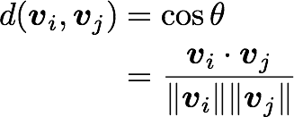
A document (datapoint) is a vector of counts over each word (feature)
counts the number of occurrences
just a histogram over words
What is the similarity between two documents?
Use any distance you want but the cosine distance is fast.

Slide 18
but not all words are created equal

Slide 19

TF-IDF
Term Frequency Inverse Document Frequency
weigh each word by a heuristic
inverse document frequency
term frequency
(down-weights common terms)

Slide 20
Standard BOW pipeline
(for image classification)

Slide 21
Dictionary Learning:
Learn Visual Words using clustering
Encode:
build Bags-of-Words (BOW) vectors
for each image
Classify:
Train and test data using BOWs

Slide 22
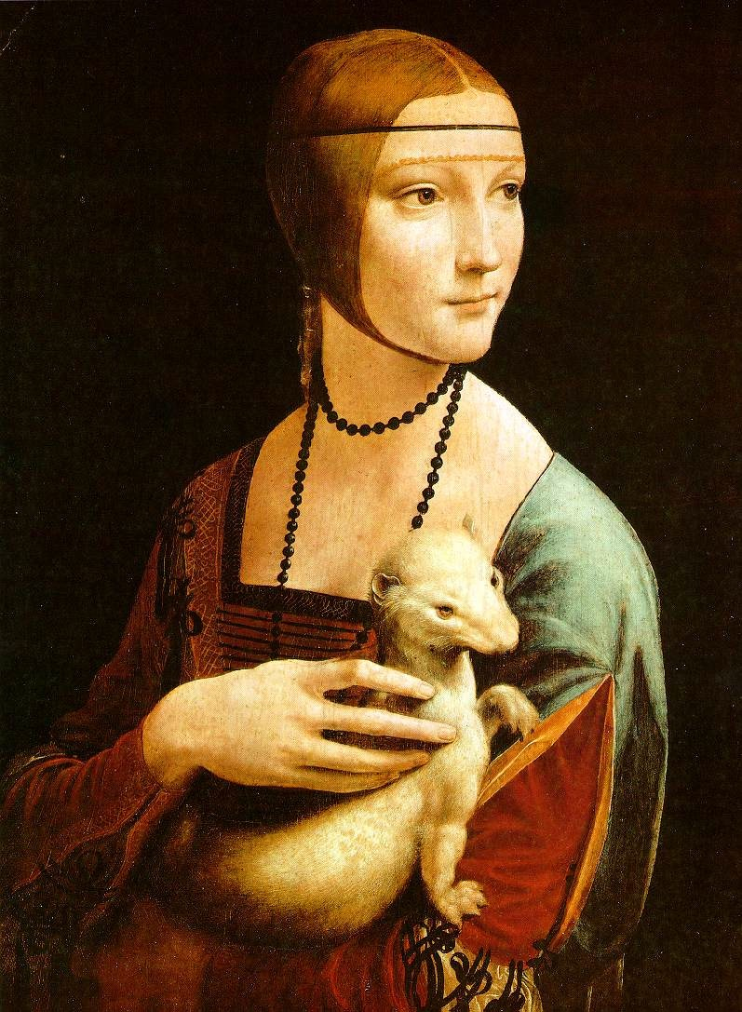
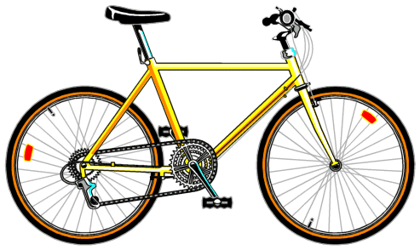
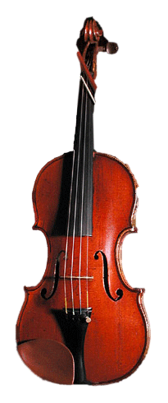
Dictionary Learning:
Learn Visual Words using clustering
1. extract features (e.g., SIFT) from images

Slide 23
Dictionary Learning:
Learn Visual Words using clustering
2. Learn visual dictionary (e.g., K-means clustering)

Slide 24
What kinds of features can we extract?

Slide 25
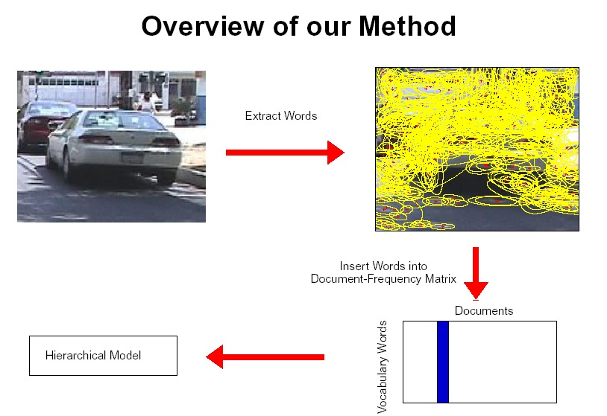
Regular grid
  Vogel & Schiele, 2003
  Fei-Fei & Perona, 2005
Interest point detector
  Csurka et al. 2004
  Fei-Fei & Perona, 2005
  Sivic et al. 2005
Other methods
  Random sampling (Vidal-Naquet & Ullman, 2002)
  Segmentation-based patches (Barnard et al. 2003)

Slide 26
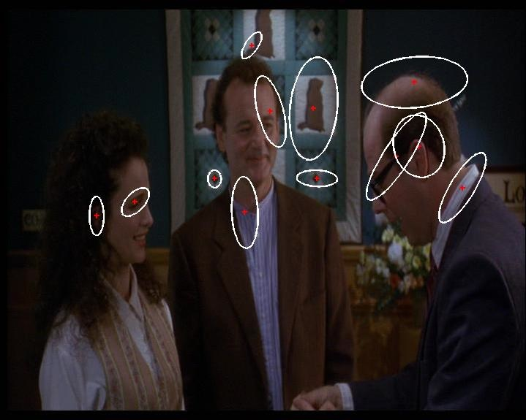
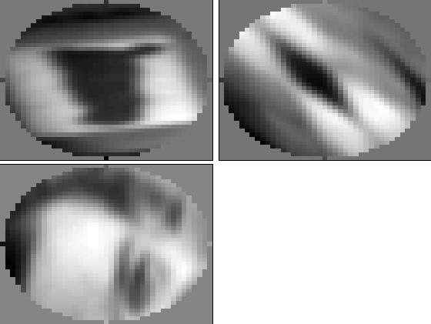
Compute SIFT descriptor
[Lowe’99]
Normalize patch
Detect patches
[Mikojaczyk and Schmid ’02]
[Mata, Chum, Urban & Pajdla, ’02]
[Sivic & Zisserman, ’03]

Slide 27
…

Slide 28
How do we learn the dictionary?

Slide 29
…

Slide 30
…
Clustering

Slide 31
Visual vocabulary
…
Clustering

Slide 32
K-means clustering

Slide 33
1. Select initial centroids at random

Slide 34
1. Select initial centroids at random
2. Assign each object to the cluster with the nearest centroid.

Slide 35
1. Select initial centroids at random
2. Assign each object to the cluster with the nearest centroid.
3. Compute each centroid as the mean of the objects assigned to it (go to 2)

Slide 36
1. Select initial centroids at random
2. Assign each object to the cluster with the nearest centroid.
3. Compute each centroid as the mean of the objects assigned to it (go to 2)
2. Assign each object to the cluster with the nearest centroid.

Slide 37
1. Select initial centroids at random
2. Assign each object to the cluster with the nearest centroid.
3. Compute each centroid as the mean of the objects assigned to it (go to 2)
2. Assign each object to the cluster with the nearest centroid.
Repeat previous 2 steps until no change

Slide 38
K-means Clustering
Given k:
Select initial centroids at random.
Assign each object to the cluster with the nearest centroid.
Compute each centroid as the mean of the objects assigned to it.
Repeat previous 2 steps until no change.

Slide 39
From what data should I learn the dictionary?
  Codebook can be learned on separate training set
  Provided the training set is sufficiently representative, the codebook will be “universal”

Slide 40
From what data should I learn the dictionary?
  Dictionary can be learned on separate training set
  Provided the training set is sufficiently representative, the dictionary will be “universal”

Slide 41
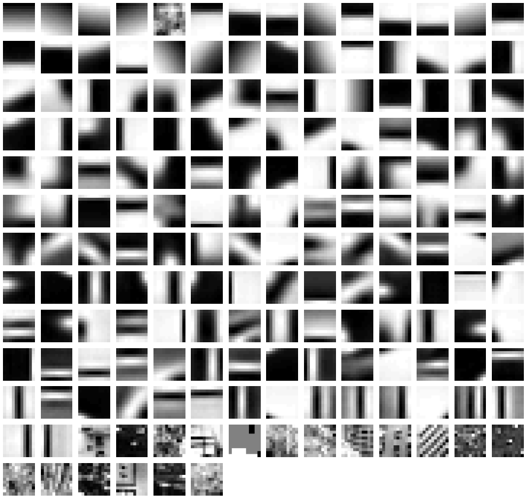
Example visual dictionary

Slide 42
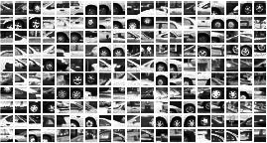
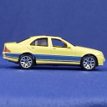
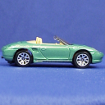
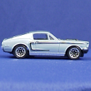
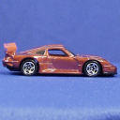
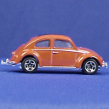
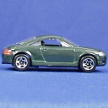
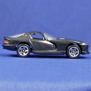
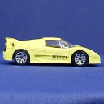
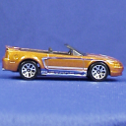
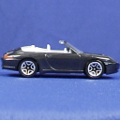






Example dictionary
…
Appearance codebook
Source: B. Leibe

Slide 43
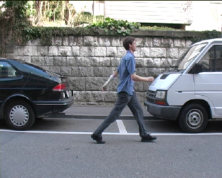
Another dictionary
…
…
…
…
…
Appearance codebook
Source: B. Leibe

Slide 44
Dictionary Learning:
Learn Visual Words using clustering
Encode:
build Bags-of-Words (BOW) vectors
for each image
Classify:
Train and test data using BOWs

Slide 45

1. Quantization: image features gets associated to a visual word (nearest cluster center)
Encode:
build Bags-of-Words (BOW) vectors
for each image

Slide 46
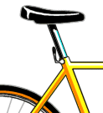
Encode:
build Bags-of-Words (BOW) vectors
for each image
2. Histogram: count the number of visual word occurrences

Slide 47
frequency
…..
codewords

Slide 48
Dictionary Learning:
Learn Visual Words using clustering
Encode:
build Bags-of-Words (BOW) vectors
for each image
Classify:
Train and test data using BOWs

Slide 49
K nearest neighbors
Support Vector Machine
Naïve Bayes

Slide 50
K nearest neighbors

Slide 51
Distribution of data from two classes

Slide 52
Distribution of data from two classes
Which class does q belong too?

Slide 53
Distribution of data from two classes
Look at the neighbors

Slide 54
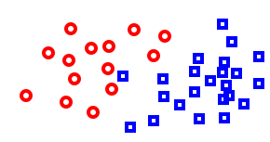
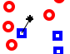
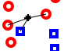
K-Nearest Neighbor (KNN) Classifier
Non-parametric pattern classification approach
Consider a two class problem where each sample consists of two measurements (x,y).
For a given query point q, assign the class of the nearest neighbor
k = 1
Compute the k nearest neighbors and assign the class by majority vote.
k = 3

Slide 55

Nearest Neighbor is competitive
MNIST Digit Recognition
  Handwritten digits
  28x28 pixel images: d = 784
  60,000 training samples
  10,000 test samples
Test Error Rate (%)
Linear classifier (1-layer NN) | 12.0
K-nearest-neighbors, Euclidean | 5.0
K-nearest-neighbors, Euclidean, deskewed | 2.4
K-NN, Tangent Distance, 16x16 | 1.1
K-NN, shape context matching | 0.67
1000 RBF + linear classifier | 3.6
SVM deg 4 polynomial | 1.1
2-layer NN, 300 hidden units | 4.7
2-layer NN, 300 HU, [deskewing] | 1.6
LeNet-5, [distortions] | 0.8
Boosted LeNet-4, [distortions] | 0.7
Yann LeCunn

Slide 56
What is the best distance metric between data points?
  Typically Euclidean distance
  Locality sensitive distance metrics
  Important to normalize.
  Dimensions have different scales
How many K?
  Typically k=1 is good
  Cross-validation (try different k!)

Slide 57


Distance metrics
Euclidean
Cosine
Chi-squared

Slide 58
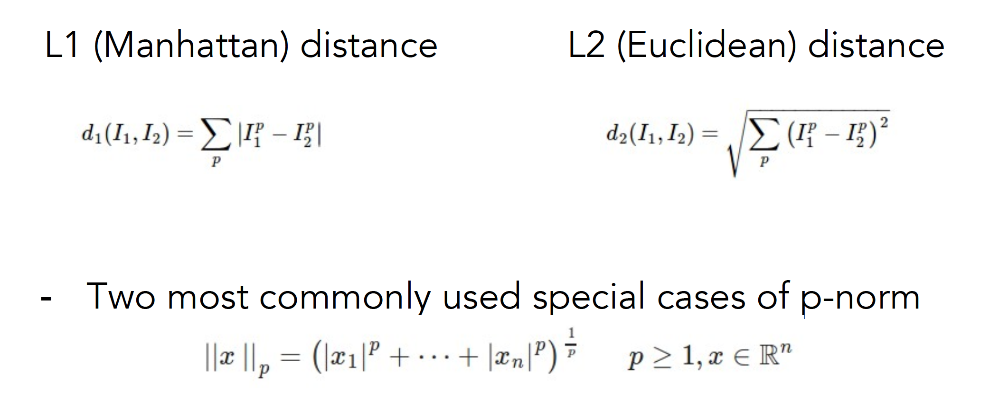
Choice of distance metric
Hyperparameter

Slide 59
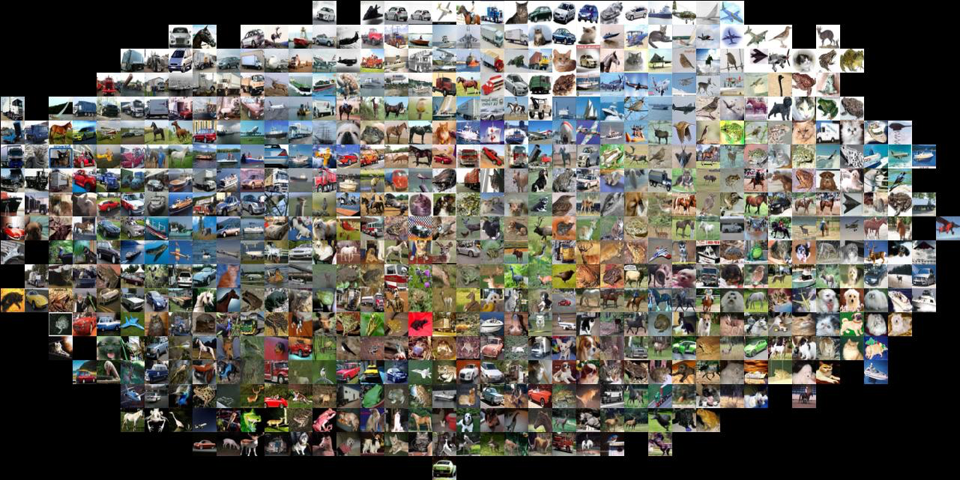
Visualization: L2 distance
Notes:
Background plays an unrealistically large role

Slide 60
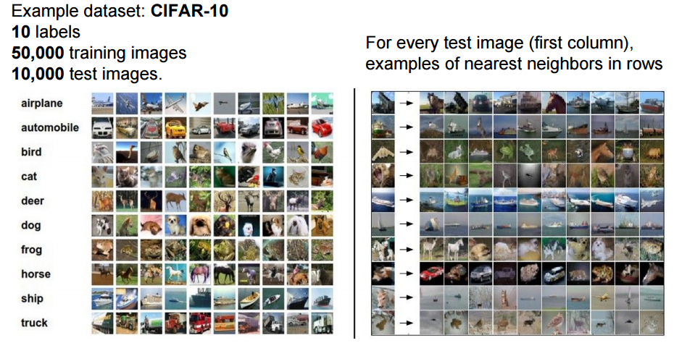
CIFAR-10 and NN results

Slide 61
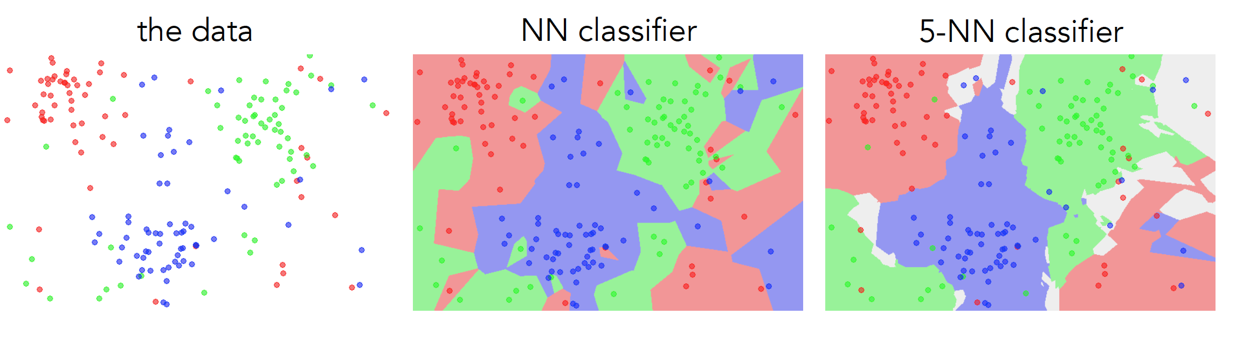
k-nearest neighbor
Find the k closest points from training data
Labels of the k points “vote” to classify

Slide 62
Hyperparameters
What is the best distance to use?
What is the best value of k to use?
i.e., how do we set the hyperparameters?
Very problem-dependent
Must try them all and see what works best

Slide 63


Slide 64


Slide 65

Validation

Slide 66

Cross-validation

Slide 67


Slide 68
How to pick hyperparameters?
Methodology
  Train and test
  Train, validate, test
Train for original model
Validate to find hyperparameters
Test to understand generalizability

Slide 69
Pros
  simple yet effective
Cons
  search is expensive (can be sped-up)
  storage requirements
  difficulties with high-dimensional data

Slide 70
kNN -- Complexity and Storage
N training images, M test images
Training: O(1)
Testing: O(MN)
Hmm…
  Normally need the opposite
  Slow training (ok), fast testing (necessary)

Slide 71


Slide 72
Naïve Bayes

Slide 73
Distribution of data from two classes
Which class does q belong too?

Slide 74
Distribution of data from two classes
Learn parametric model for each class
Compute probability of query

Slide 75

This is called the posterior.
the probability of a class z given the observed features X
For classification, z is a discrete random variable
(e.g., car, person, building)
X is a set of observed features
(e.g., features from a single image)
(it’s a function that returns a single probability value)

Slide 76

This is called the posterior:
the probability of a class z given the observed features X
For classification, z is a discrete random variable
(e.g., car, person, building)
Each x is an observed feature
(e.g., visual words)
(it’s a function that returns a single probability value)

Slide 77


Recall:
The posterior can be decomposed according to Bayes’ Rule
likelihood
prior
posterior
In our context…

Slide 78



The naive Bayes’ classifier is solving this optimization
MAP (maximum a posteriori) estimate
Bayes’ Rule
Remove constants
To optimize this…we need to compute this
Compute the likelihood…

Slide 79



A naive Bayes’ classifier assumes all features are
conditionally independent
Recall:

Slide 80




To compute the MAP estimate
Given (1) a set of known parameters
(2) observations
Compute which z has the largest probability

Slide 81

count | 1 | 6 | 2 | 1 | 0 | 0 | 0 | 1
word | Tartan | robot | CHIMP | CMU | bio | soft | ankle | sensor
p(x|z) | 0.09 | 0.55 | 0.18 | 0.09 | 0.0 | 0.0 | 0.0 | 0.09
Numbers get really small so use log probabilities
* typically add pseudo-counts (0.001)
** this is an example for computing the likelihood, need to multiply times prior to get posterior

Slide 82
count | 1 | 6 | 2 | 1 | 0 | 0 | 0 | 1
word | Tartan | robot | CHIMP | CMU | bio | soft | ankle | sensor
p(x|z) | 0.09 | 0.55 | 0.18 | 0.09 | 0.0 | 0.0 | 0.0 | 0.09
log p(X|z=grand challenge) = - 14.58
log p(X|z=bio inspired) = - 37.48
count | 0 | 4 | 0 | 1 | 4 | 5 | 3 | 2
word | Tartan | robot | CHIMP | CMU | bio | soft | ankle | sensor
p(x|z) | 0.0 | 0.21 | 0.0 | 0.05 | 0.21 | 0.26 | 0.16 | 0.11
http://www.fodey.com/generators/newspaper/snippet.asp
log p(X|z=grand challenge) = - 94.06
log p(X|z=bio inspired) = - 32.41
* typically add pseudo-counts (0.001)
** this is an example for computing the likelihood, need to multiply times prior to get posterior

Slide 83
Support Vector Machine

Slide 84
Image Classification

Slide 85

Score function

Slide 86

Linear Classifier
data (histogram)

Slide 87

Convert image to histogram representation

Slide 88
Distribution of data from two classes
Which class does q belong too?

Slide 89
Distribution of data from two classes
Learn the decision boundary

Slide 90
First we need to understand hyperplanes…

Slide 91



Hyperplanes (lines) in 2D
a line can be written as dot product plus a bias
another version, add a weight 1 and push the bias inside

Slide 92
Hyperplanes (lines) in 2D
(offset/bias outside)
(offset/bias inside)

Slide 93
Hyperplanes (lines) in 2D
(offset/bias outside)
(offset/bias inside)
Important property:
Free to choose any normalization of w
The line
and the line
define the same line

Slide 94

What is the distance to origin?
(hint: use normal form)

Slide 95



distance to origin
scale
by
you get the normal form

Slide 96

What is the distance between two parallel lines?
(hint: use distance to origin)

Slide 97


distance between two parallel lines
Difference of distance to origin

Slide 98
Now we can go to 3D …
Hyperplanes (planes) in 3D
what are the dimensions of this vector?
What happens if you change b?

Slide 99

Hyperplanes (planes) in 3D

Slide 100

Hyperplanes (planes) in 3D
What’s the distance between these parallel planes?

Slide 101

Hyperplanes (planes) in 3D

Slide 102
What’s the best w?

Slide 103
What’s the best w?

Slide 104
What’s the best w?

Slide 105
What’s the best w?

Slide 106
What’s the best w?

Slide 107
What’s the best w?
Intuitively, the line that is the farthest from all interior points

Slide 108
What’s the best w?
Maximum Margin solution:
most stable to perturbations of data

Slide 109



What’s the best w?
support vectors
Want a hyperplane that is far away from ‘inner points’

Slide 110

Find hyperplane w such that …
margin
the gap between parallel hyperplanes
is maximized

Slide 111


Can be formulated as a maximization problem
What does this constraint mean?
label of the data point
Why is it +1 and -1?

Slide 112

Can be formulated as a maximization problem
Equivalently,
Where did the 2 go?
What happened to the labels?

Slide 113
‘Primal formulation’ of a linear SVM
Objective Function
Constraints
This is a convex quadratic programming (QP) problem
(a unique solution exists)

Slide 114
‘soft’ margin

Slide 115
What’s the best w?

Slide 116
What’s the best w?
Very narrow margin

Slide 117
Separating cats and dogs
Very narrow margin

Slide 118
What’s the best w?
Very narrow margin
Intuitively, we should allow for some misclassification if we can get more robust classification

Slide 119
What’s the best w?
Trade-off between the MARGIN and the MISTAKES
(might be a better solution)

Slide 120


Adding slack variables
misclassified point

Slide 121



‘soft’ margin
objective
subject to
for

Slide 122






‘soft’ margin
objective
subject to
for
The slack variable allows for mistakes,
as long as the inverse margin is minimized.

Slide 123
‘soft’ margin
objective
subject to
for
Every constraint can be satisfied if slack is large
C is a regularization parameter
  Small C: ignore constraints (larger margin)
  Big C: constraints (small margin)
Still QP problem (unique solution)

Slide 124


Slide 125


Slide 126
References
Basic reading:
Szeliski, Chapter 14.
Notes:
Ch

