Slide 1
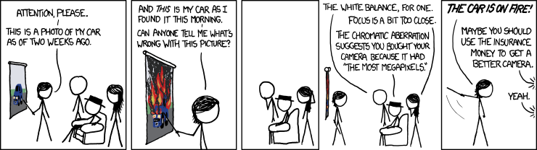
Digital photography
16-385 Computer Vision
Spring 2019, Lecture 16
http://www.cs.cmu.edu/~16385/

Slide 2
Course announcements
Homework 4 is ongoing.
- Due Wednesday March 27th.
- Any questions about the homework?
- How many of you have looked at/started/finished homework 4?
Extra office hours this week by Yannis:
- Tuesday, 3-5 pm.
- Wednesday, 4-8 pm.
- All on graphics lounge/my office.
Talks last week:
- How many of you attended Jun-Yan Zhu’s talk?
- How many of you attended Angjoo Kanazawa’s talk?
Talks this week:
- Abe Davis, “Augmenting Imagination: Capturing, Modeling, and Exploring the World Through Video,”
Monday 2:00 PM GHC 6115.
- Matthias Niessner, “AI-Driven Videos Synthesis and its Implications,” Wednesday, 12:00 PM GHC 6115.
- Angela Dai, “Understanding 3D Scans,” Thursday 12:00 PM GHC 6115.

Slide 3
Overview of today’s lecture
Imaging sensor primer.
Color sensing in cameras.
In-camera image processing pipeline.
Some general thoughts on the image processing pipeline.
Radiometric calibration (a.k.a. HDR imaging).
Take-home message: The values of pixels in a photograph and the output of your camera’s sensor are two very different things.

Slide 4
Slide credits
A lot of inspiration and quite a few examples for these slides were taken directly from:
Kayvon Fatahalian (15-769, Fall 2016).
Michael Brown (CVPR 2016 Tutorial on understanding the image processing pipeline).

Slide 5

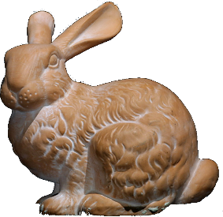
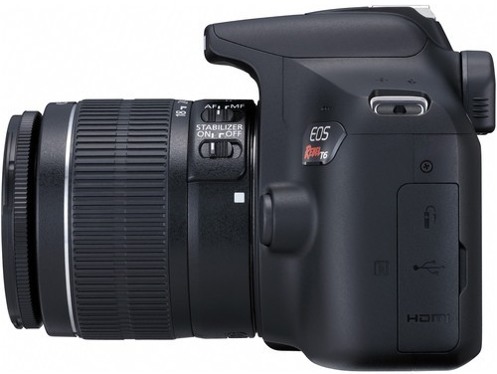
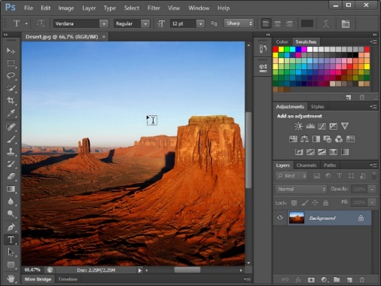
The modern photography pipeline

Slide 6
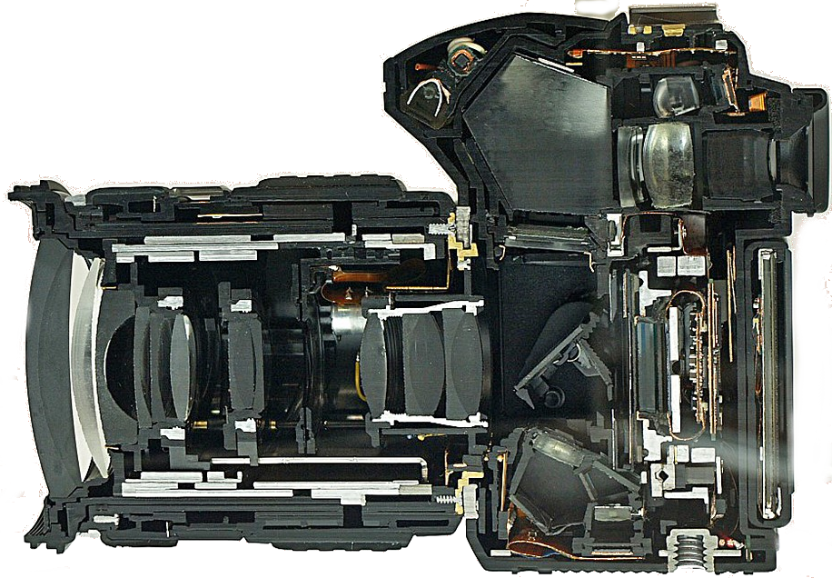
The modern photography pipeline
post-capture processing (16-385, 15-463)
optics and optical controls
sensor, analog front-end, and color filter array
in-camera image processing pipeline
(15-463)
(this lecture)
(this lecture)

Slide 7
Imaging sensor primer

Slide 8
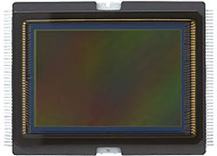
Imaging sensors
Very high-level overview of digital imaging sensors.
We could spend an entire course covering imaging sensors.
Canon 6D sensor
(20.20 MP, full-frame)

Slide 9
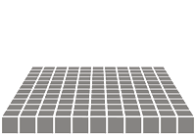
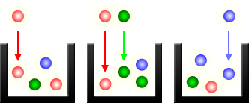
What does an imaging sensor do?
When the camera shutter opens…
photons
… exposure begins…
array of photon buckets
close-up view of photon buckets
… photon buckets begin to store photons...
… until the camera shutter closes. Then, they convert stored photons to intensity values.

Slide 10
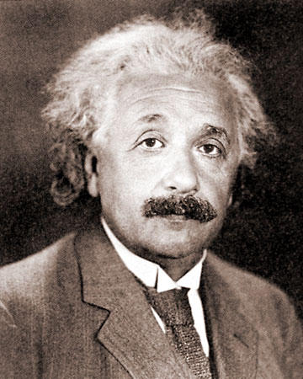
Nobel Prize in Physics
What is this guy known for?

Slide 11
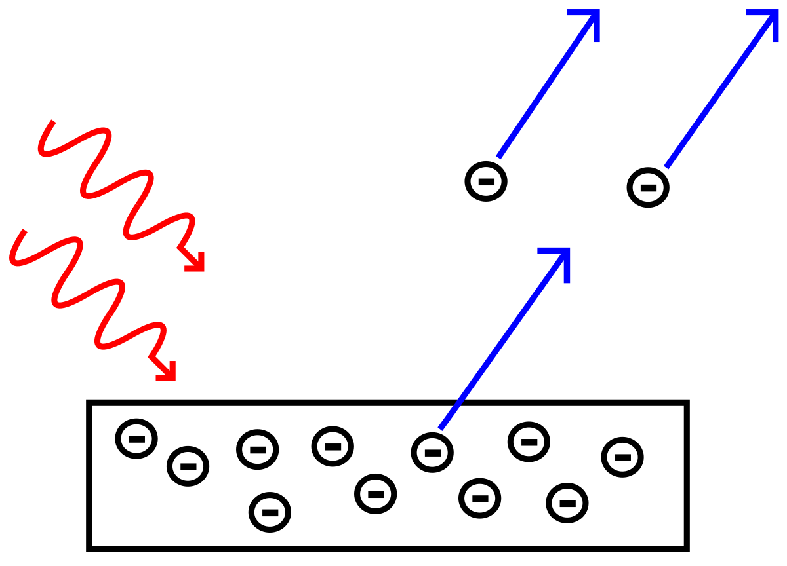
Photoelectric effect
incident photons
emitted electrons
Albert Einstein
Einstein’s Nobel Prize in 1921 “for his services to Theoretical Physics,
and especially for his discovery of the law of the photoelectric effect”

Slide 12
Basic imaging sensor design
Lenslets also filter the image to avoid resolution artifacts.
Lenslets are problematic when working with coherent light.
Many modern cameras do not have lenslet arrays.
We will discuss these issues in more detail at a later lecture.
helps photodiode collect more light (also called lenslet)
microlens
microlens
color filter
color filter
photodiode
photodiode
potential well
potential well
silicon for read-out etc. circuitry
stores emitted electrons
made of silicon, emits electrons from photons
We will see what the color filters are for later in this lecture.

Slide 13
Photodiode quantum efficiency (QE)
How many of the incident photons will the photodiode convert into electrons?
# electrons
QE =
incident photons
emitted electrons
# photons
Fundamental optical performance metric of imaging sensors.
Not the only important optical performance metric!
We will see a few more later in the lecture.

Slide 14
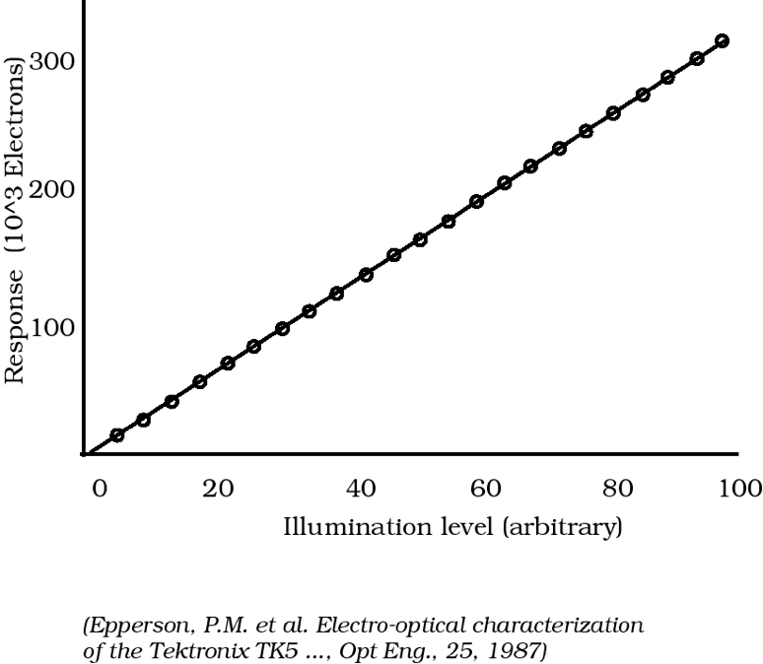
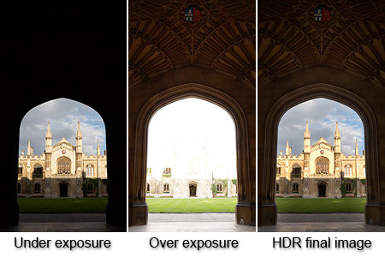
Photodiode response function
For silicon photodiodes, usually linear, but:
non-linear when potential well is saturated (over-exposure)
non-linear near zero (due to noise)
We will see how to deal with these issues in a later lecture (high-dynamic-range imaging).
under-exposure (non-linearity due to sensor noise)
over-exposure
(non-linearity due
to sensor saturation)

Slide 15
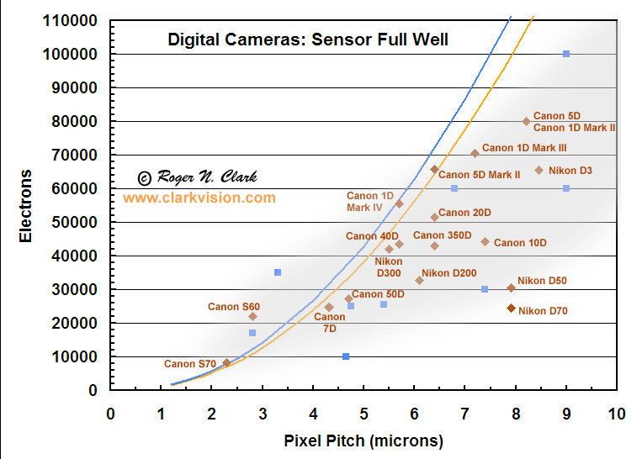
Photodiode full well capacity
How many electrons can photodiode store before saturation?
Another important optical performance metric of imaging sensors.

Slide 16
Two main types of imaging sensors
Do you know them?

Slide 17
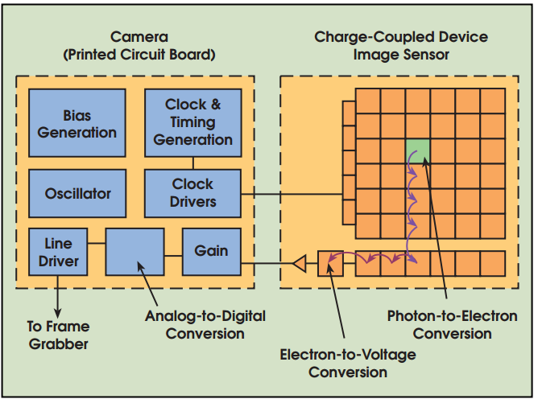
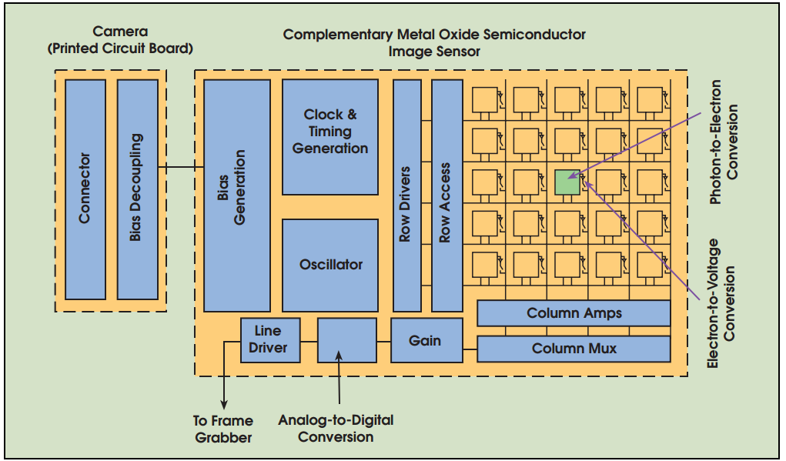
Two main types of imaging sensors
Charged Coupled Device (CCD): converts electrons to voltage using readout circuitry separate from pixel
Complementary Metal Oxide Semiconductor (CMOS): converts electrons to voltage using
per-pixel readout circuitry
Can you think of advantages and disadvantages of each type?

Slide 18
Two main types of imaging sensors
Charged Coupled Device (CCD): converts electrons to voltage using readout circuitry separate from pixel
Complementary Metal Oxide Semiconductor (CMOS): converts electrons to voltage using
per-pixel readout circuitry

higher sensitivity

faster read-out

lower noise

lower cost

Slide 19
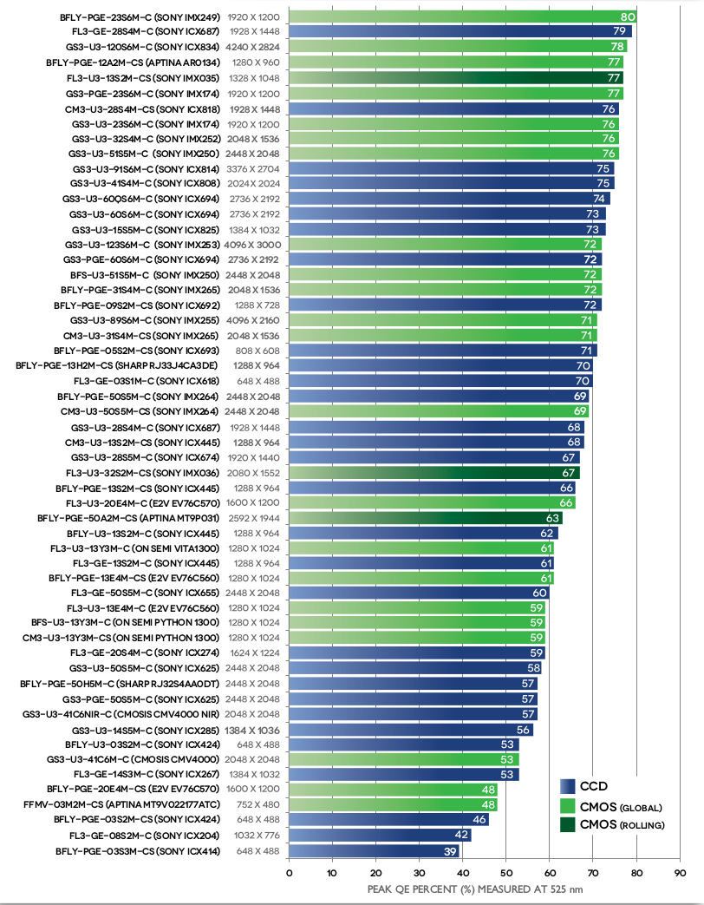
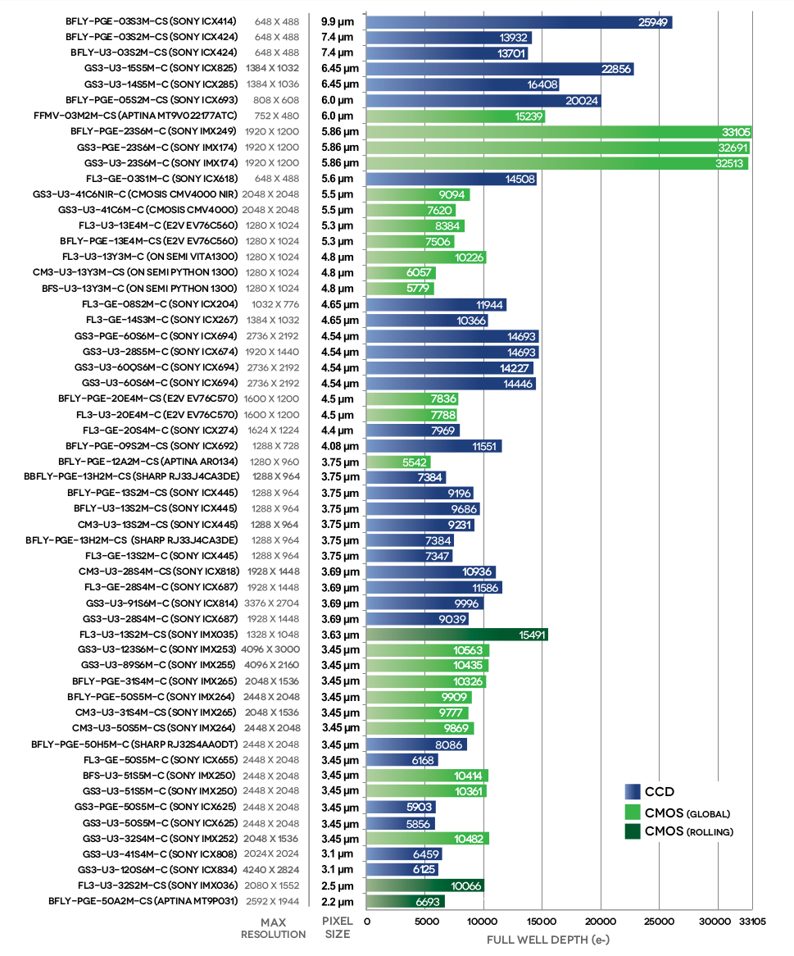
CCD vs CMOS
Modern CMOS sensors have optical performance comparable to CCD sensors.
Most modern commercial and industrial cameras use CMOS sensors.
Can you guess what the QE of the human eye is?

Slide 20
CMOS sensor (very) simplified layout
optically black region (no light gets here)
photodiode (pixel)
row selection register
Can anyone guess why there are pixels in the optically black region?
…
exposed region (light gets here)
active pixel sensor (2D array of pixels)
analog front-end
row buffer
bits

Slide 21
Analog front-end
analog voltage
analog voltage
discrete signal
discrete signal
analog amplifier (gain):
gets voltage in range needed by A/D converter.
accommodates ISO settings.
accounts for vignetting.
analog-to-digital converter (ADC):
depending on sensor, output has 10-16 bits.
most often (?) 12 bits.
look-up table (LUT):
corrects non-linearities in sensor’s response function (within proper exposure).
corrects defective pixels.

Slide 22

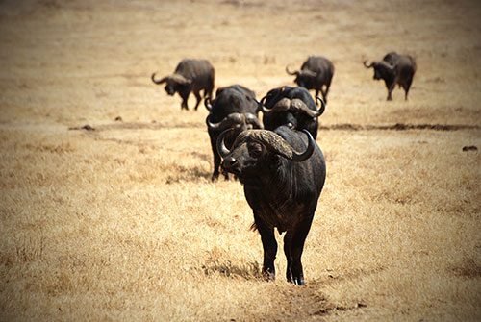
Vignetting
Fancy word for: pixels far off the center receive less light
white wall under uniform light
more interesting example of vignetting

Slide 23
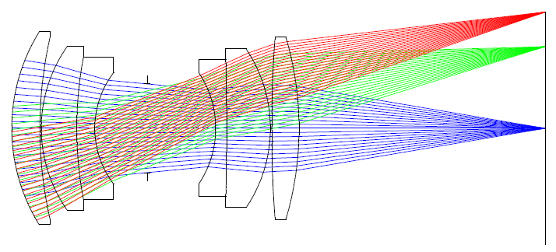
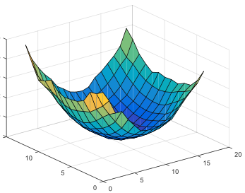
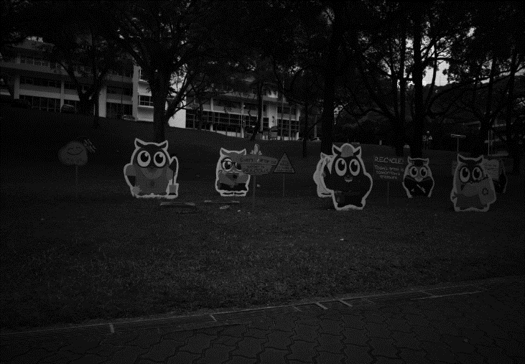
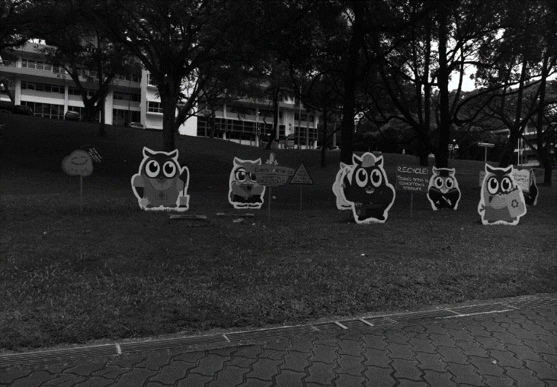
Vignetting
Four types of vignetting:
Mechanical: light rays blocked by hoods, filters, and other objects.
Lens: similar, but light rays blocked by lens elements.
Natural: due to radiometric laws (“cosine fourth falloff”).
Pixel: angle-dependent sensitivity of photodiodes.
non-uniform gain

Slide 24
What does an imaging sensor do?
When the camera shutter opens, the sensor:
at every photodiode, converts incident photons into electrons
stores electrons into the photodiode’s potential well until it is full
… until camera shutter closes. Then, the analog front-end:
reads out photodiodes’ wells, row-by-row, and converts them to analog signals
applies a (possibly non-uniform) gain to these analog signals
converts them to digital signals
corrects non-linearities
… and finally returns an image.

Slide 25
Remember these?
Lenslets also filter the image to avoid resolution artifacts.
Lenslets are problematic when working with coherent light.
Many modern cameras do not have lenslet arrays.
We will discuss these issues in more detail at a later lecture.
helps photodiode collect more light (also called lenslet)
microlens
microlens
color filter
color filter
photodiode
photodiode
potential well
potential well
silicon for read-out etc. circuitry
stores emitted electrons
made of silicon, emits electrons from photons
We will see what the color filters are for later in this lecture.

Slide 26
Color sensing in cameras

Slide 27
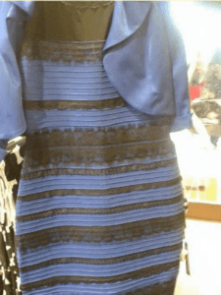
Color
Very high-level discussion of color as it relates to digital photography.
We could spend an entire course covering color.
See 15-463/663/862 for more on color.
color is complicated

Slide 28
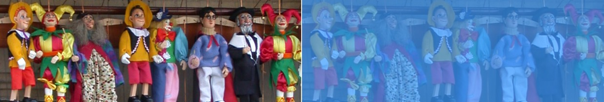
Retinal vs perceived color

Slide 29

Retinal vs perceived color

Slide 30
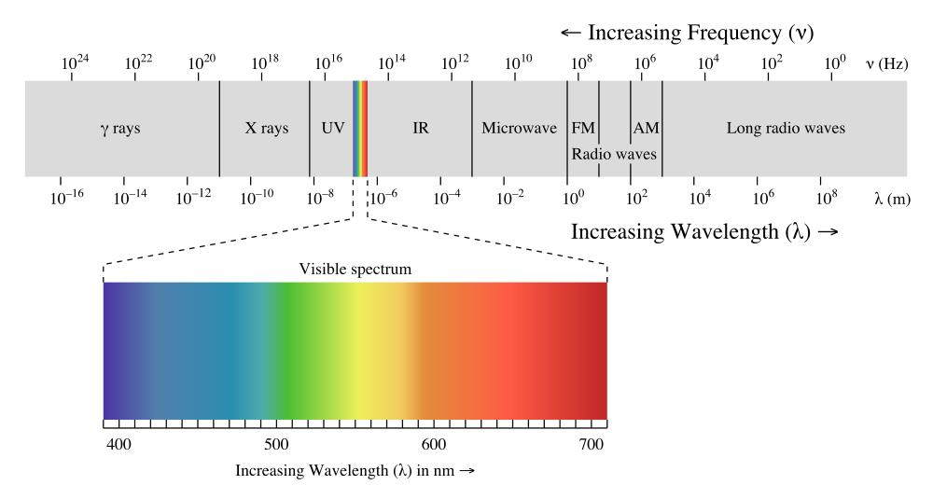
Color is an artifact of human perception
“Color” is not an objective physical property of light (electromagnetic radiation).
Instead, light is characterized by its wavelength.
electromagnetic spectrum
What we call “color” is how we subjectively perceive a very small range of these wavelengths.

Slide 31
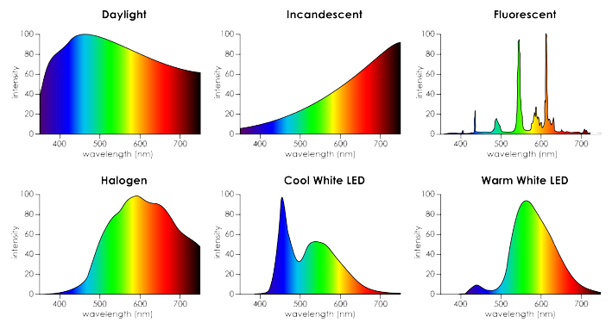
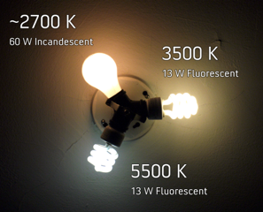
Spectral Power Distribution (SPD)
Most types of light “contain” more than one wavelengths.
We can describe light based on the distribution of power over different wavelengths.
We call our sensation of all of these distributions “white”.

Slide 32


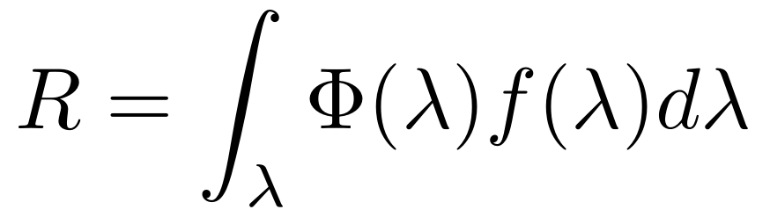
Spectral Sensitivity Function (SSF)
Any light sensor (digital or not) has different sensitivity to different wavelengths.
This is described by the sensor’s spectral sensitivity function .
When measuring light of a some SPD , the sensor produces a scalar response:
light SPD
sensor SSF
sensor response
Weighted combination of light’s SPD: light contributes more at wavelengths where the sensor has higher sensitivity.

Slide 33
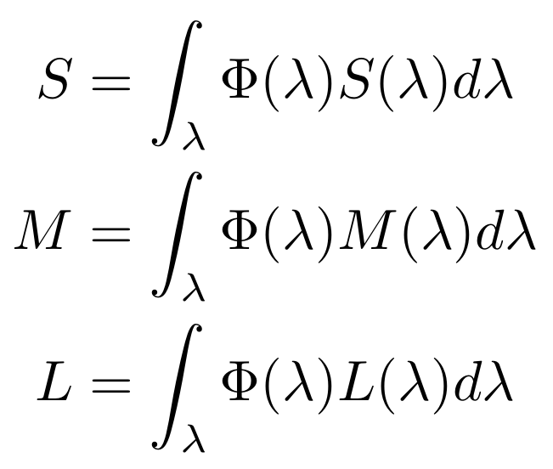
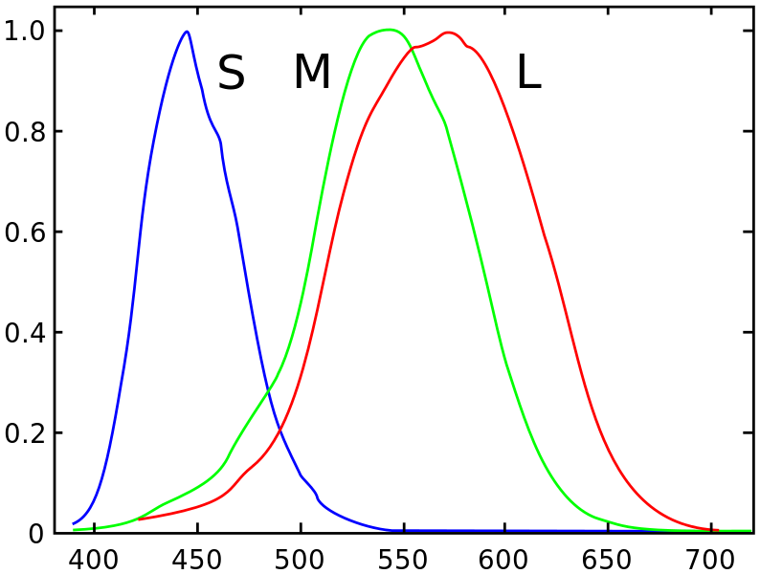
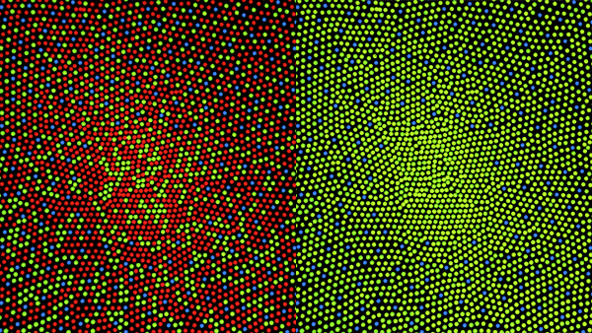
Spectral Sensitivity Function of Human Eye
The human eye is a collection of light sensors called cone cells.
There are three types of cells with different spectral sensitivity functions.
Human color perception is three-dimensional (tristimulus color).
“short”
“medium”
“long”
cone distribution for normal vision (64% L, 32% M)

Slide 34
Color filter arrays (CFA)
To measure color with a digital sensor, mimic cone cells of human vision system.
“Cones” correspond to pixels that are covered by different color filters, each with its own spectral sensitivity function.
microlens
microlens
microlens
color filter
color filter
color filter
photodiode
photodiode
photodiode
potential well
potential well
potential well

Slide 35
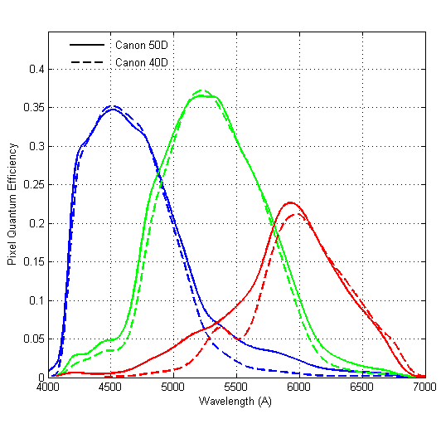
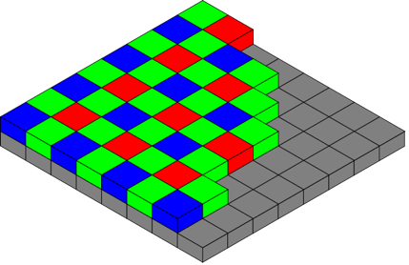
What color filters to use?
Two design choices:
What spectral sensitivity functions to use for each color filter?
How to spatially arrange (“mosaic”) different color filters?
Bayer mosaic
SSF for Canon 50D
Why more green pixels?
Generally do not match human LMS.

Slide 36
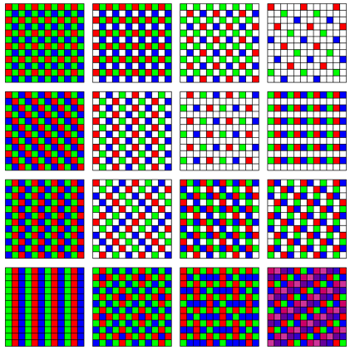
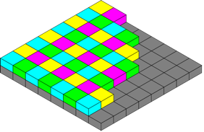
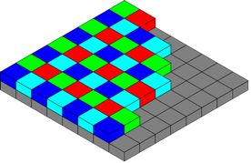
Many different CFAs
Finding the “best” CFA mosaic is an active research area.
CYGM
Canon IXUS, Powershot
RGBE
Sony Cyber-shot
How would you go about designing your own CFA? What criteria would you consider?

Slide 37
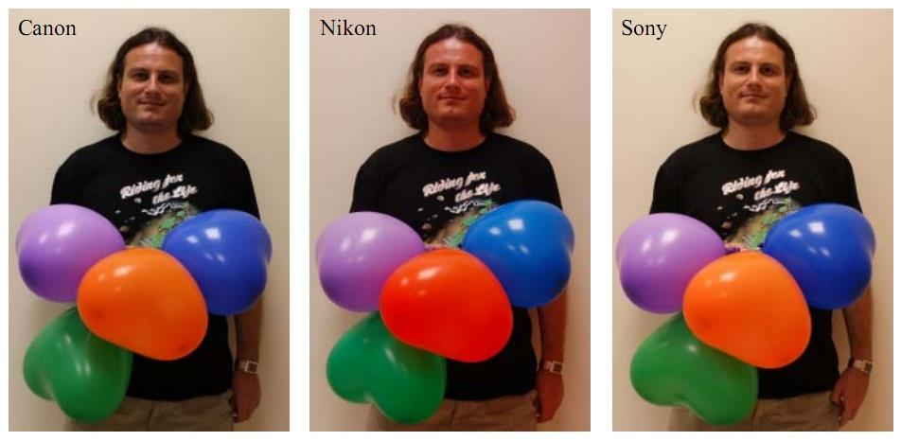
Many different spectral sensitivity functions
Each camera has its more or less unique, and most of the time secret, SSF.
Makes it very difficult to correctly reproduce the color of sensor measurements.
Images of the same scene captured using 3 different cameras with identical sRGB settings.

Slide 38
Aside: can you think of other ways to capture color?

Slide 39
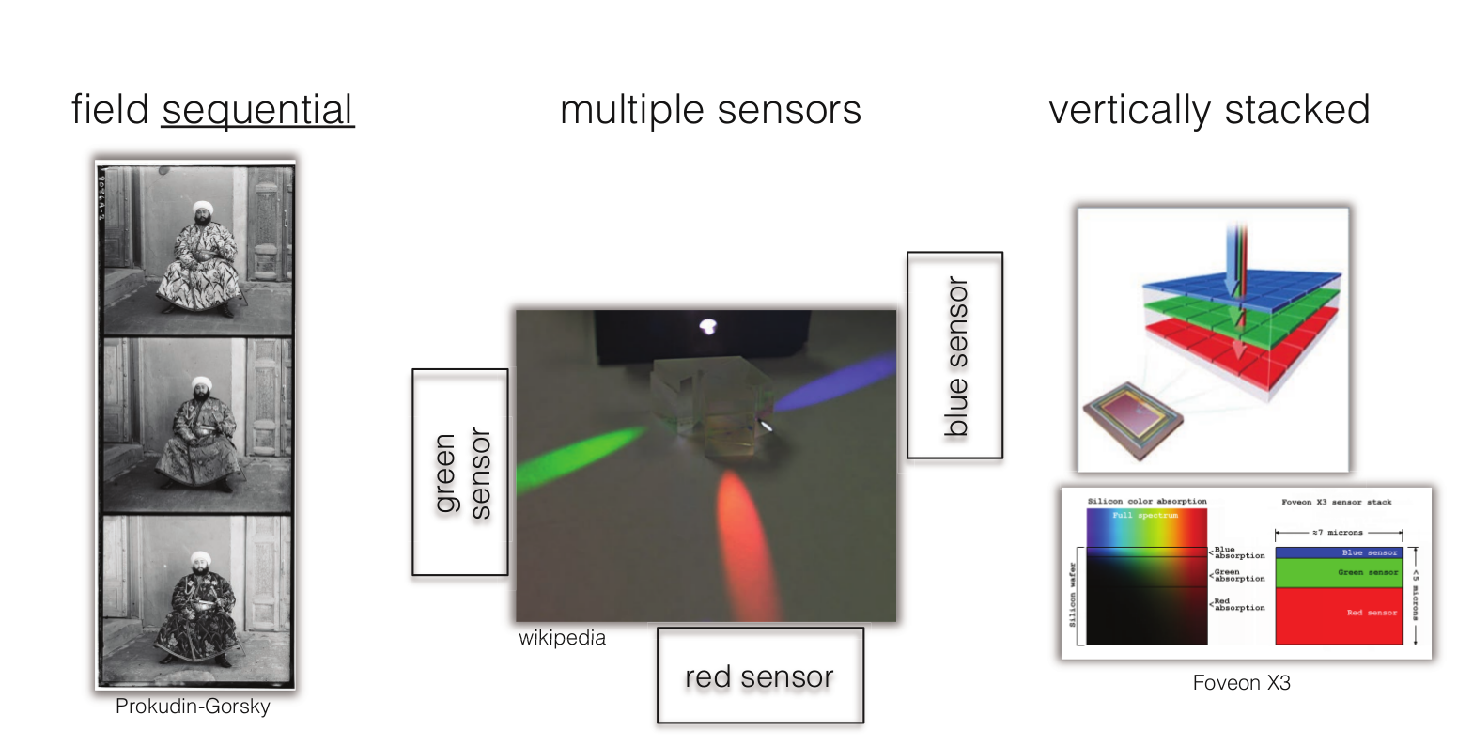
Aside: can you think of other ways to capture color?
[Slide credit: Gordon Wetzstein]

Slide 40
What does an imaging sensor do?
When the camera shutter opens, the sensor:
at every photodiode, converts incident photons into electrons using mosaic’s SSF
stores electrons into the photodiode’s potential well until it is full
… until camera shutter closes. Then, the analog front-end:
reads out photodiodes’ wells, row-by-row, and converts them to analog signals
applies a (possibly non-uniform) gain to these analog signals
converts them to digital signals
corrects non-linearities
… and finally returns an image.

Slide 41
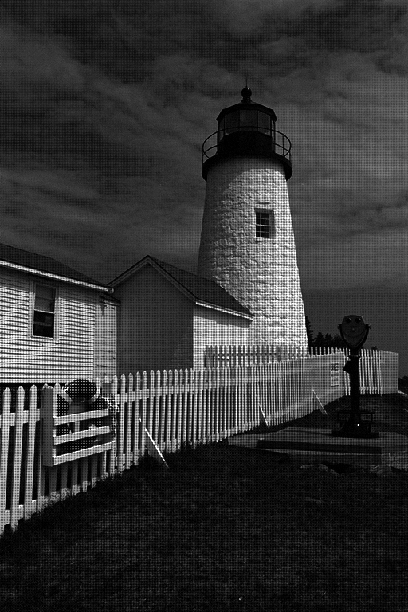
After all of this, what does an image look like?
lots of noise
mosaicking artifacts
Kind of disappointing.
We call this the RAW image.

Slide 42
The modern photography pipeline
post-capture processing (lectures 3-12)
optics and optical controls
sensor, analog front-end, and color filter array
in-camera image processing pipeline
(lectures 13-16)
(this lecture)
(this lecture)

Slide 43
The in-camera image processing pipeline

Slide 44
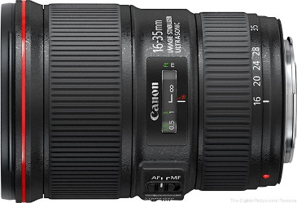

The (in-camera) image processing pipeline
The sequence of image processing operations applied by the camera’s image signal processor (ISP) to convert a RAW image into a “conventional” image.
analog front-end
RAW image (mosaiced, linear, 12-bit)
denoising
CFA demosaicing
white balance
compression
tone reproduction
color transforms
final RGB image (non-linear, 8-bit)

Slide 45
The (in-camera) image processing pipeline
The sequence of image processing operations applied by the camera’s image signal processor (ISP) to convert a RAW image into a “conventional” image.
analog front-end
RAW image (mosaiced, linear, 12-bit)
denoising
CFA demosaicing
white balance
see 15-463
see 18-793
compression
tone reproduction
color transforms
final RGB image (non-linear, 8-bit)

Slide 46
The (in-camera) image processing pipeline
The sequence of image processing operations applied by the camera’s image signal processor (ISP) to convert a RAW image into a “conventional” image.
analog front-end
RAW image (mosaiced, linear, 12-bit)
denoising
CFA demosaicing
white balance
compression
tone reproduction
color transforms
final RGB image (non-linear, 8-bit)

Slide 47
White balancing
Human visual system has chromatic adaptation:
We can perceive white (and other colors) correctly under different light sources.
Retinal vs perceived color.

Slide 48
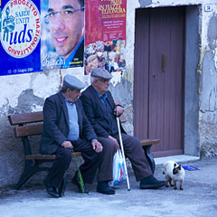
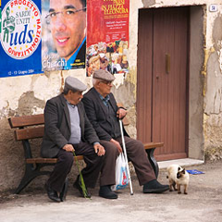
White balancing
Human visual system has chromatic adaptation:
We can perceive white (and other colors) correctly under different light sources.
Cameras cannot do that (there is no “camera perception”).
White balancing: The process of removing color casts so that colors that we would perceive as white are rendered as white in final image.
different whites
image captured under fluorescent
image white-balanced to daylight

Slide 49
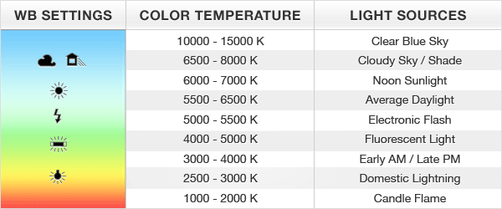
White balancing presets
Cameras nowadays come with a large number of presets: You can select which light you are taking images under, and the appropriate white balancing is applied.

Slide 50
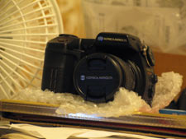
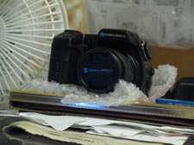
Manual vs automatic white balancing
Manual white balancing:
Manually select object in photograph that is color-neutral and use it to normalize.
Select a camera preset based on lighting.
How can we do automatic white balancing?

Slide 51
Manual vs automatic white balancing
Manual white balancing:
Manually select object in photograph that is color-neutral and use it to normalize.
Select a camera preset based on lighting.
Automatic white balancing:
Grey world assumption: force average color of scene to be grey.
White world assumption: force brightest object in scene to be white.
Sophisticated histogram-based algorithms (what most modern cameras do).

Slide 52
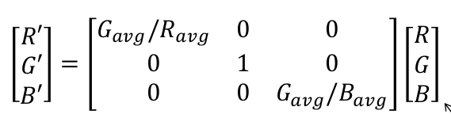
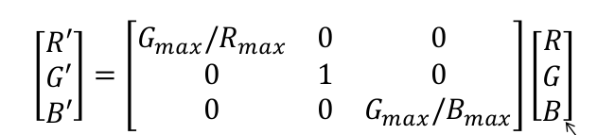
Automatic white balancing
Grey world assumption:
Compute per-channel average.
Normalize each channel by its average.
Normalize by green channel average.
white-balanced RGB
sensor RGB
White world assumption:
Compute per-channel maximum.
Normalize each channel by its maximum.
Normalize by green channel maximum.
white-balanced RGB
sensor RGB

Slide 53
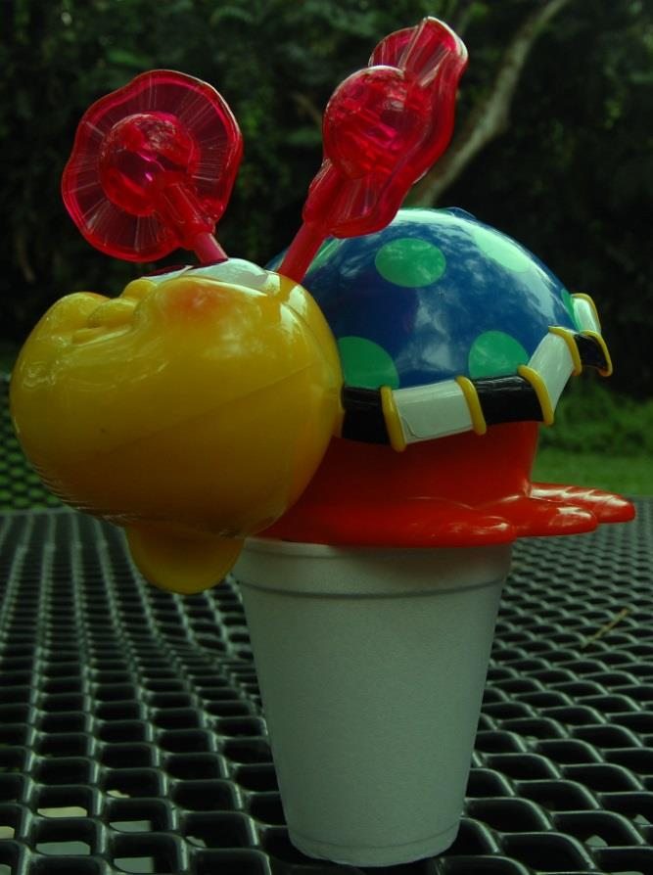
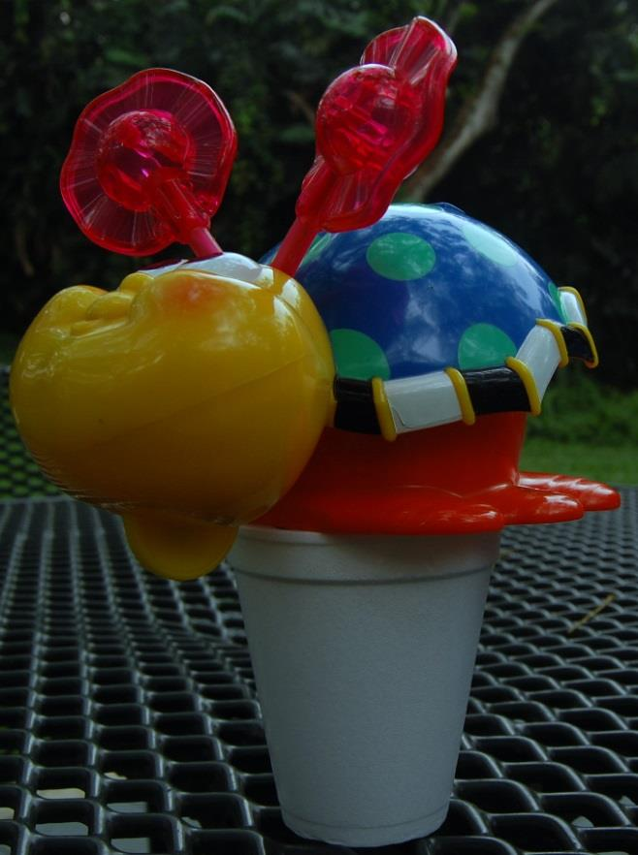
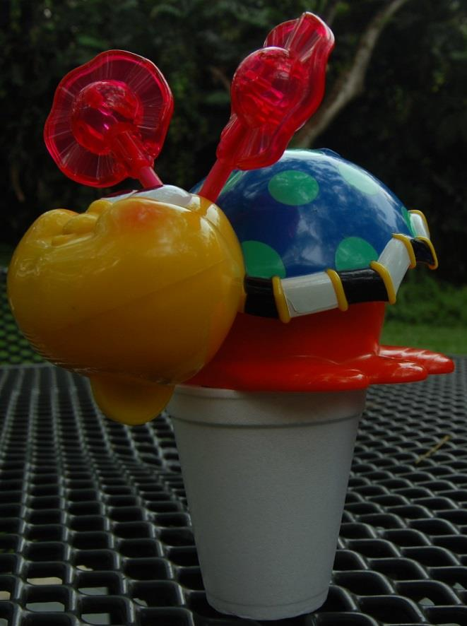
Automatic white balancing example
input image
grey world
white world

Slide 54
The (in-camera) image processing pipeline
The sequence of image processing operations applied by the camera’s image signal processor (ISP) to convert a RAW image into a “conventional” image.
analog front-end
RAW image (mosaiced, linear, 12-bit)
denoising
CFA demosaicing
white balance
compression
tone reproduction
color transforms
final RGB image (non-linear, 8-bit)

Slide 55
CFA demosaicing
Produce full RGB image from mosaiced sensor output.
Any ideas on how to do this?

Slide 56
CFA demosaicing
Produce full RGB image from mosaiced sensor output.
Interpolate from neighbors:
Bilinear interpolation (needs 4 neighbors).
Bicubic interpolation (needs more neighbors, may overblur).
Edge-aware interpolation.
Large area of research.

Slide 57
Demosaicing by bilinear interpolation
Bilinear interpolation: Simply average your 4 neighbors.
G₂
G₁
+
G₂
+
G₃
+
G₄
G₁
G?
G₃
G?
=
4
G₄
Neighborhood changes for different channels:

Slide 58
The (in-camera) image processing pipeline
The sequence of image processing operations applied by the camera’s image signal processor (ISP) to convert a RAW image into a “conventional” image.
analog front-end
RAW image (mosaiced, linear, 12-bit)
denoising
CFA demosaicing
white balance
compression
tone reproduction
color transforms
final RGB image (non-linear, 8-bit)

Slide 59


Noise in images
Can be very pronounced in low-light images.

Slide 60
Three types of sensor noise
1) (Photon) shot noise:
Photon arrival rates are a random process (Poisson distribution).
The brighter the scene, the larger the variance of the distribution.
2) Dark-shot noise:
Emitted electrons due to thermal activity (becomes worse as sensor gets hotter.)
3) Read noise:
Caused by read-out and AFE electronics (e.g., gain, A/D converter).
Bright scene and large pixels: photon shot noise is the main noise source.

Slide 61
How to denoise?

Slide 62
How to denoise?
Simple denoising: look at the neighborhood around you.
I₁
I₂
I₃
I₄
I₅
I₆
I₇
I₈
I₉
Mean filtering (take average):
I₁
+
I₂
+
I₃
+
I₄
+
I₅
+
I₆
+
I₇
+
I₈
+
I₉
I’₅
=
9
Median filtering (take median):
I’₅
=
_{median(}
I₁
,
I₂
,
I₃
,
I₄
,
I₅
,
I₆
,
I₇
,
I₈
,
I₉
₎
Large area of research.

Slide 63
The (in-camera) image processing pipeline
The sequence of image processing operations applied by the camera’s image signal processor (ISP) to convert a RAW image into a “conventional” image.
analog front-end
RAW image (mosaiced, linear, 12-bit)
denoising
CFA demosaicing
white balance
compression
tone reproduction
color transforms
final RGB image (non-linear, 8-bit)

Slide 64

Tone reproduction
Also known as gamma correction.
Without tone reproduction, images look very dark.
Why does this happen?

Slide 65

Perceived vs measured brightness by human eye
We have already seen that sensor response is linear.
Human-eye response (measured brightness) is also linear.
However, human-eye perception (perceived brightness) is non-linear:
More sensitive to dark tones.
Approximately a Gamma function.

Slide 66

What about displays?
We have already seen that sensor response is linear.
Human-eye response (measured brightness) is also linear.
However, human-eye perception (perceived brightness) is non-linear:
More sensitive to dark tones.
Approximately a Gamma function.
Displays have a response opposite to that of human perception.

Slide 67
Tone reproduction
Because of mismatch in displays and human eye perception, images look very dark.
How do we fix this?

Slide 68

Tone reproduction
Because of mismatch in displays and human eye perception, images look very dark.
Pre-emptively cancel-out the display response curve.
Add inverse display transform here.
This transform is the tone reproduction or gamma correction.

Slide 69



Tone reproduction curves
The exact tone reproduction curve depends on the camera.
Often well approximated as L^{γ}, for different values of the power γ (“gamma”).
A good default is γ = 1 / 2.2.
before gamma
after gamma
Warning: Our values are no longer linear relative to scene radiance!

Slide 70
Tone reproduction
Question: Why not just keep measurements linear and do gamma correction right before we display the image?

Slide 71


Tone reproduction
Question: Why not just keep measurements linear and do gamma correction right before we display the image?
Answer: After this stage, we perform compression, which includes change from 12 to 8 bits.
Better to use our available bits to encode the information we are going to need.

Slide 72
The (in-camera) image processing pipeline
The sequence of image processing operations applied by the camera’s image signal processor (ISP) to convert a RAW image into a “conventional” image.
analog front-end
RAW image (mosaiced, linear, 12-bit)
denoising
CFA demosaicing
white balance
compression
tone reproduction
color transforms
final RGB image (non-linear, 8-bit)

Slide 73
Some general thoughts on the image processing pipeline

Slide 74
Do I ever need to use RAW?

Slide 75
Do I ever need to use RAW?
Emphatic yes!
Every time you use a physics-based computer vision algorithm, you need linear measurements of radiance.
Examples: photometric stereo, shape from shading, image-based relighting, illumination estimation, anything to do with light transport and inverse rendering, etc.
Applying the algorithms on non-linear (i.e., not RAW) images will produce completely invalid results.

Slide 76
What if I don’t care about physics-based vision?

Slide 77
What if I don’t care about physics-based vision?
You often still want (rather than need) to use RAW!
If you like re-finishing your photos (e.g., on Photoshop), RAW makes your life much easier and your edits much more flexible.

Slide 78
Are there any downsides to using RAW?

Slide 79
Are there any downsides to using RAW?
Image files are a lot bigger.
You burn through multiple memory cards.
Your camera will buffer more often when shooting in burst mode.
Your computer needs to have sufficient memory to process RAW images.

Slide 80
Is it even possible to get access to RAW images?

Slide 81
Is it even possible to get access to RAW images?
Quite often yes!
Most DSLR cameras provide an option to store RAW image files.
Certain phone cameras allow, directly or indirectly, access to RAW.
Sometimes, it may not be “fully” RAW. The Lightroom app provides images after demosaicking but before tone reproduction.

Slide 82
I forgot to set my camera to RAW, can I still get the RAW file?

Slide 83
I forgot to set my camera to RAW, can I still get the RAW file?
Nope, tough luck.
The image processing pipeline is lossy: After all the steps, information about the original image is lost.
Sometimes we may be able to reverse a camera’s image processing pipeline if we know exactly what it does (e.g., by using information from other similar RAW images).
The conversion of PNG/JPG back to RAW is know as “de-rendering” and is an active research area.

Slide 84

Derendering

Slide 85
Why did you use italics in the previous slide?
What I described today is an “idealized” version of what we think commercial cameras do.
Almost all of the steps in both the sensor and image processing pipeline I described earlier are camera-dependent.
Even if we know the basic steps, the implementation details are proprietary information that companies actively try to keep secret.
I will go back to a few of my slides to show you examples of the above.

Slide 86
The hypothetical image processing pipeline
The sequence of image processing operations applied by the camera’s image signal processor (ISP) to convert a RAW image into a “conventional” image.
analog front-end?
RAW image (mosaiced, linear, 12-bit)
denoising?
CFA demosaicing?
white balance?
compression?
tone reproduction?
color transforms?
final RGB image (non-linear, 8-bit)

Slide 87
The hypothetical analog front-end
analog voltage
analog voltage
discrete signal
discrete signal
analog amplifier (gain):
gets voltage in range needed by A/D converter?
accommodates ISO settings?
accounts for vignetting?
analog-to-digital converter (ADC):
depending on sensor, output has 10-16 bits.
most often (?) 12 bits.
look-up table (LUT):
corrects non-linearities in sensor’s response function (within proper exposure)?
corrects defective pixels?

Slide 88
Various curves
All of these sensitivity curves are different from camera to camera and kept secret.

Slide 89
Serious inhibition for research
Very difficult to get access to ground-truth data at intermediate stages of the pipeline.
Very difficult to evaluate effect of new algorithms for specific pipeline stages.

Slide 90

…but things are getting better

Slide 91


…but things are getting better

Slide 92
How do I open a RAW file in Matlab?
You can’t (not easily at least). You need to use one of the following:
dcraw – tool for parsing camera-dependent RAW files (specification of file formats are also kept secret).
Adobe DNG – recently(-ish) introduced file format that attempts to standardize RAW file handling.
See Homework 0 for more details.

Slide 93
Radiometric calibration
(a.k.a. high dynamic range imaging)
(a.k.a. capturing linear images)

Slide 94
What does it mean to “calibrate a camera”?
Many different ways to calibrate a camera:
Radiometric calibration.
Color calibration.
Geometric calibration.
Noise calibration.
Lens (or aberration) calibration.

Slide 95
The image processing pipeline
Which parts of the image processing pipeline introduce non-linearities?
analog front-end
RAW image
denoising
CFA demosaicing
white balance
compression
tone reproduction
color transforms
final RGB image

Slide 96
The image processing pipeline
Is using RAW images sufficient to get linear images?
analog front-end
RAW image (mosaiced, linear, 12-bit)
denoising
CFA demosaicing
white balance
compression
tone reproduction
color transforms
final RGB image (non-linear, 8-bit)

Slide 97
Photodiode response function
For silicon photodiodes, usually linear, but:
non-linear when potential well is saturated (over-exposure)
non-linear near zero (due to noise)
We will see how to deal with these issues in a later lecture (high-dynamic-range imaging).
under-exposure (non-linearity due to sensor noise)
over-exposure
(non-linearity due
to sensor saturation)

Slide 98


Over/under exposure
in highlights we are limited by clipping
in shadows we are limited by noise

Slide 99


Slide 100


Slide 101


Slide 102


Slide 103

Slide credits

Slide 104
Our devices do not match the world

Slide 105





The world has a high dynamic range
1
1500
25,000
2,000,000,000
400,000

Slide 106
The world has a high dynamic range
10⁻⁶
10⁶
common real-world scenes
adaptation range of our eyes

Slide 107
(Digital) sensors also have a low dynamic range
10⁻⁶
10⁶
sensor
10⁻⁶
10⁶
common real-world scenes
adaptation range of our eyes

Slide 108
(Digital) images have an even lower dynamic range
low exposure
10⁻⁶
10⁶
image
10⁻⁶
10⁶
common real-world scenes
adaptation range of our eyes

Slide 109
(Digital) images have an even lower dynamic range
high exposure
10⁻⁶
10⁶
image
10⁻⁶
10⁶
common real-world scenes
adaptation range of our eyes

Slide 110
Our devices do not match the real world
10:1 photographic print (higher for glossy paper)
20:1 artist's paints
200:1 slide film
500:1 negative film
1000:1 LCD display
2000:1 digital SLR (at 12 bits)
100000:1 real world
Two challenges:
HDR imaging – which parts of the world to include to the 8-12 bits available to our device?
Tonemapping – which parts of the world to display in the 4-10 bits available to our device?

Slide 111


Key idea
Capture multiple LDR images at different exposures
Merge them into a single HDR image

Slide 112
Key idea
Exposure bracketing: Capture multiple LDR images at different exposures
Merging: Combine them into a single HDR image

Slide 113




Ways to vary exposure
Shutter speed
F-stop (aperture, iris)
ISO
Neutral density (ND) filters
Pros and cons of each for HDR?

Slide 114
Ways to vary exposure
Shutter speed
– Range: about 30 sec to 1/4000 sec (6 orders of magnitude)
– Pros: repeatable, linear
– Cons: noise and motion blur for long exposure
F-stop (aperture, iris)
– Range: about f/0.98 to f/22 (3 orders of magnitude)
– Pros: fully optical, no noise
– Cons: changes depth of field
ISO
– Range: about 100 to 1600 (1.5 orders of magnitude)
– Pros: no movement at all
– Cons: noise
Neutral density (ND) filters
– Range: up to 6 densities (6 orders of magnitude)
– Pros: works with strobe/flash
– Cons: not perfectly neutral (color shift), extra glass (interreflections, aberrations),
need to touch camera (shake)

Slide 115
Exposure bracketing with shutter speed
Note: shutter times usually obey a power series – each “stop” is a factor of 2
1/4, 1/8, 1/15, 1/30, 1/60, 1/125, 1/250, 1/500, 1/1000 sec
    usually really is
1/4, 1/8, 1/16, 1/32, 1/64, 1/128, 1/256, 1/512, 1/1024 sec
Questions:
How many exposures?
What exposures?

Slide 116
Exposure bracketing with shutter speed
Note: shutter times usually obey a power series – each “stop” is a factor of 2
1/4, 1/8, 1/15, 1/30, 1/60, 1/125, 1/250, 1/500, 1/1000 sec
    usually really is
1/4, 1/8, 1/16, 1/32, 1/64, 1/128, 1/256, 1/512, 1/1024 sec
Questions:
How many exposures?
What exposures?
Answer: Depends on the scene, but a good default is 5 exposures, the metered exposure and +/- 2 stops around that.

Slide 117
Key idea
Exposure bracketing: Capture multiple LDR images at different exposures
Merging: Combine them into a single HDR image

Slide 118
The image processing pipeline
The sequence of image processing operations applied by the camera’s image signal processor (ISP) to convert a RAW image into a “conventional” image.
analog front-end
RAW image (mosaiced, linear, 12-bit)
denoising
CFA demosaicing
white balance
compression
tone reproduction
color transforms
final RGB image (non-linear, 8-bit)

Slide 119

RAW images have a linear response curve
Colorchecker: Great tool for radiometric and color calibration.
when not over/under exposed
Patches at bottom row have reflectance that increases linearly.

Slide 120
Over/under exposure
in highlights we are limited by clipping
in shadows we are limited by noise

Slide 121





RAW (linear) image formation model
Real scene radiance for image pixel (x,y): L(x, y)
Exposure time:
t₅
t₄
t₃
t₂
t₁
What is an expression for the image I_{linear}(x,y) as a function of L(x,y)?

Slide 122
RAW (linear) image formation model
Real scene radiance for image pixel (x,y): L(x, y)
Exposure time:
t₅
t₄
t₃
t₂
t₁
What is an expression for the image I_{linear}(x,y) as a function of L(x,y)?
I_{linear}(x,y) = clip[ t_{i} ⋅ L(x,y) + noise ]
How would you merge these images into an HDR one?

Slide 123
Merging RAW (linear) exposure stacks
For each pixel:
Find “valid” images
Weight valid pixel values appropriately
Form a new pixel value as the weighted average of valid pixel values
How would you implement steps 1-2?
t₅
t₄
t₃
t₂
t₁

Slide 124
Merging RAW (linear) exposure stacks
For each pixel:
Find “valid” images
Weight valid pixel values appropriately
Form a new pixel value as the weighted average of valid pixel values
(noise) 0.05 < pixel < 0.95 (clipping)
noise
valid
clipped
t₅
t₄
t₃
t₂
t₁

Slide 125
Merging RAW (linear) exposure stacks
For each pixel:
Find “valid” images
Weight valid pixel values appropriately
Form a new pixel value as the weighted average of valid pixel values
(noise) 0.05 < pixel < 0.95 (clipping)
(pixel value) / t_{i}
t₅
t₄
t₃
t₂
t₁

Slide 126

Merging result (after tonemapping)

Slide 127



Relative vs absolute radiance
Final fused HDR image gives radiance only up to a global scale
If we know exact radiance at one point, we can convert relative HDR image to absolute radiance map
HDR image (relative radiance)
spotmeter (absolute radiance at one point)
absolute radiance map

Slide 128
What if I cannot use raw?

Slide 129
The image processing pipeline
Can you foresee any problem when we switch from RAW to rendered images?
analog front-end
RAW image (mosaiced, linear, 12-bit)
denoising
CFA demosaicing
white balance
compression
tone reproduction
color transforms
final RGB image (non-linear, 8-bit)

Slide 130
The image processing pipeline
Can you foresee any problem when we switch from RAW to rendered images?
How do we deal with the nonlinearities?
analog front-end
RAW image (mosaiced, linear, 12-bit)
denoising
CFA demosaicing
white balance
compression
tone reproduction
color transforms
final RGB image (non-linear, 8-bit)

Slide 131
Radiometric calibration
The process of measuring the camera’s response curve. Can be two in three ways:
Take images of scenes with different irradiance while keeping exposure the same.
Takes images under different exposures while keeping irradiance the same.
Takes images of scenes with different irradiance and under different exposures.

Slide 132

Same camera exposure, varying scene irradiance
Colorchecker: Great tool for radiometric and color calibration.
Patches at bottom row have reflectance that increases linearly.
Different values correspond to patches of increasing reflected irradiance.

Slide 133

Same scene irradiance, varying camera exposure
Colorchecker: Great tool for white balancing and radiometric calibration.
known exposure
All points on (the white part of) the target have the same reflectance.
Different values correspond to images taken under increasing camera exposure.

Slide 134

Varying both scene irradiance and camera exposure
You can do this using the LDR exposure stack itself.
Same scene irradiance, different camera exposure
Same scene irradiance, different camera exposure

Slide 135


Non-linear image formation model
Real scene radiance for image pixel (x,y): L(x, y)
Exposure time: t_{i}
I_{linear}(x,y) = clip[ t_{i} ⋅ L(x,y) + noise ]
I_{non-linear}(x,y) = f[ I_{linear}(x,y) ]
How would you merge the non-linear images into an HDR one?

Slide 136

Non-linear image formation model
Real scene radiance for image pixel (x,y): L(x, y)
Exposure time: t_{i}
I_{linear}(x,y) = clip[ t_{i} ⋅ L(x,y) + noise ]
I_{non-linear}(x,y) = f[ I_{linear}(x,y) ]
I_{est}(x,y) = f⁻¹[ I_{non-linear}(x,y) ]
Use inverse transform to estimate linear image, then proceed as before

Slide 137

Linearization
I_{non-linear}(x,y) = f[ I_{linear}(x,y) ]
I_{est}(x,y) = f⁻¹[ I_{non-linear}(x,y) ]

Slide 138
Merging non-linear exposure stacks
Calibrate response curve
Linearize images
For each pixel:
Find “valid” images
Weight valid pixel values appropriately
Form a new pixel value as the weighted average of valid pixel values
(noise) 0.05 < pixel < 0.95 (clipping)
(pixel value) / t_{i}
Same steps as in the RAW case.

Slide 139
Merging non-linear exposure stacks
Calibrate response curve
Linearize images
For each pixel:
Find “valid” images
Weight valid pixel values appropriately
Form a new pixel value as the weighted average of valid pixel values
(noise) 0.05 < pixel < 0.95 (clipping)
(pixel value) / t_{i}
Same steps as in the RAW case.
Note: many possible weighting schemes

Slide 140



Many possible weighting schemes
“Confidence” that pixel is noisy/clipped
We can derive optimal weights by modeling the sensor noise.

Slide 141
What if I cannot measure response curve?

Slide 142
Tone reproduction curves
The exact tone reproduction curve depends on the camera.
Often well approximated as L^{γ}, for different values of the power γ (“gamma”).
A good default is γ = 1 / 2.2.
before gamma
after gamma
If nothing else, take the square of your image to approximately remove effect of tone reproduction curve.

Slide 143

You may find information in the image itself
If you cannot do calibration, take a look at the image’s EXIF data (if available).
Often contains information about tone reproduction curve and color space.

Slide 144
Basic HDR approach
Capture multiple LDR images at different exposures
Merge them into a single HDR image
Any problems with this approach?

Slide 145
Basic HDR approach
Capture multiple LDR images at different exposures
Merge them into a single HDR image
Problem: Very sensitive to movement
Scene must be completely static
Camera must not move
Most modern automatic HDR solutions include an alignment step before merging exposures

Slide 146
How do we store HDR images?
Most standard image formats store integer 8-bit images
Some image formats store integer 12-bit or 16-bit images
HDR images are floating point 32-bit or 64-bit images

Slide 147
How do we store HDR images?
Use specialized image formats for HDR images
32 bits
portable float map (.pfm)
very simple to implement
sign
exponent
mantissa
Radiance format (.hdr)
supported by Matlab
red
green
blue
exponent
OpenEXR format (.exr)
multiple extra features
sign
exponent
mantissa

Slide 148





Another type of HDR images
Light probes: place a chrome sphere in the scene and capture an HDR image
Used to measure real-world illumination environments (“environment maps”)
Application: image-based relighting (later lecture)

Slide 149

Another way to create HDR images
Physics-based renderers simulate radiance maps (relative or absolute)
Their outputs are very often HDR images

Slide 150

A note about HDR today
Most cameras (even phone cameras) have automatic HDR modes/apps
Popular-enough feature that phone manufacturers are actively competing about which one has the best HDR
The technology behind some of those apps (e.g., Google’s HDR+) is published in SIGGRAPH and SIGGRAPH Asia conferences

Slide 151
Take-home messages
The values of pixels in a photograph and the values output by your camera’s sensor are two very different things.
The relationship between the two is complicated and unknown, and we often need to account for it when doing computer vision.

Slide 152
References
Basic reading:
Szeliski textbook, Section 2.3
Michael Brown, “Understanding the In-Camera Image Processing Pipeline for Computer Vision,” CVPR 2016,
very detailed discussion of issues relating to color photography and management, slides available at: http://www.comp.nus.edu.sg/~brown/CVPR2016_Brown.html
Nine Degrees Below, https://ninedegreesbelow.com/
amazing resource for color photography, reproduction, and management.

