Slide 1





Photometric stereo
16-385 Computer Vision
Spring 2019, Lecture 15
http://www.cs.cmu.edu/~16385/

Slide 2
Course announcements
Homework 4 has been posted tonight and is due on March 27th.
- How many of you have looked at/started/finished the homework?
- Any questions?
How many of you attended Jun-Yan Zhu talk?
Another talk tomorrow: Angjoo Kanazawa, “Perceiving Humans in the 3D World,” 10-11 am, GHC 6115

Slide 3
Overview of today’s lecture
Leftover about light sources.
Some notes about radiometry.
Photometric stereo.
Uncalibrated photometric stereo.
Generalized bas-relief ambiguity.
Shape from shading.
Start image processing pipeline.

Slide 4
Slide credits
Many of these slides were adapted from:
Srinivasa Narasimhan (16-385, Spring 2014).
Todd Zickler (Harvard University).
Steven Gortler (Harvard University).
Kayvon Fatahalian (Stanford University; CMU 15-462, Fall 2015).

Slide 5
Some notes about radiometry

Slide 6
What about color?
Notes:
Our work addresses the problem of inferring scene properties from image data.
Specifically, we want to relate observed image intensities to object shape, scene illumination, and material properties, or surface reflectance.
The task is made difficult by the fact that shape, lighting, and reflectance information are all tightly coupled in the image data so that we cannot typically draw conclusions about one of them without making restrictive assumptions about the others.

Slide 7






Spectral radiance
Distribution of radiance as a function of wavelength.
All of the phenomena we described in this lecture can be extended to take into account color, by considering separate radiance and BRDF functions independently for each wavelength.
retinal color
spectral radiance
illuminant spectrum
spectral reflectance

Slide 8
Spectral radiance
Distribution of radiance as a function of wavelength.
All of the phenomena we described in this lecture can be extended to take into account color, by considering separate radiance and BRDF functions independently for each wavelength.
Does this view of color ignore any important phenomena?

Slide 9
Spectral radiance
Distribution of radiance as a function of wavelength.
All of the phenomena we described in this lecture can be extended to take into account color, by considering separate radiance and BRDF functions independently for each wavelength.
Does this view of color ignore any important phenomena?
Things like fluorescence and any other phenomena where light changes color.

Slide 10


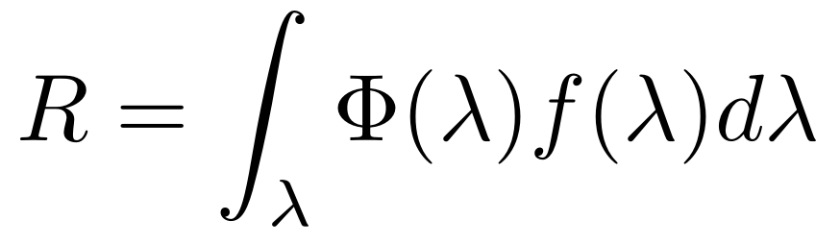
Spectral Sensitivity Function (SSF)
Any light sensor (digital or not) has different sensitivity to different wavelengths.
This is described by the sensor’s spectral sensitivity function .
When measuring light of a some SPD , the sensor produces a scalar response:
light SPD
sensor SSF
sensor response
Weighted combination of light’s SPD: light contributes more at wavelengths where the sensor has higher sensitivity.
The spectral sensitivity function converts radiometric units (radiance, irradiance) defined per wavelength, to radiometric quantities where wavelength has been averaged out.

Slide 11
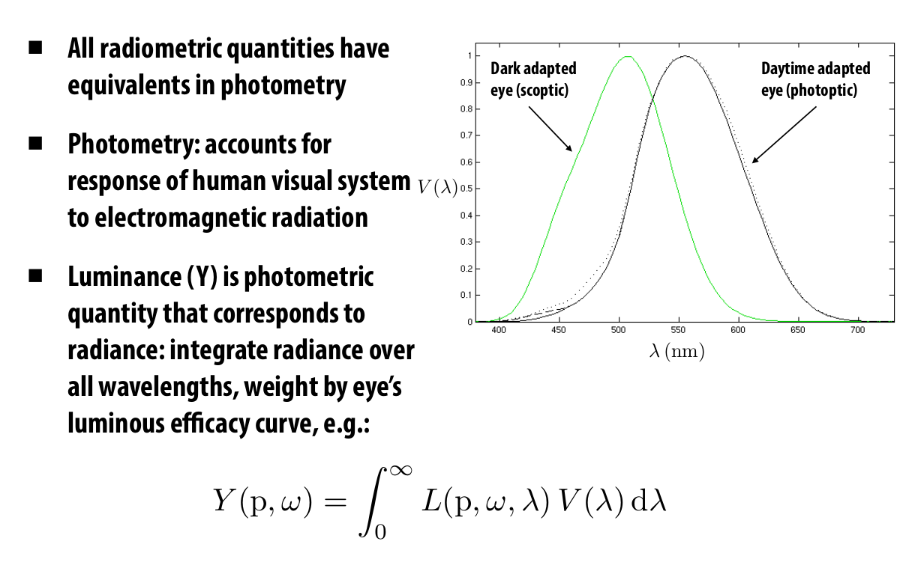
Radiometry versus photometry
Notes:
Our work addresses the problem of inferring scene properties from image data.
Specifically, we want to relate observed image intensities to object shape, scene illumination, and material properties, or surface reflectance.
The task is made difficult by the fact that shape, lighting, and reflectance information are all tightly coupled in the image data so that we cannot typically draw conclusions about one of them without making restrictive assumptions about the others.

Slide 12
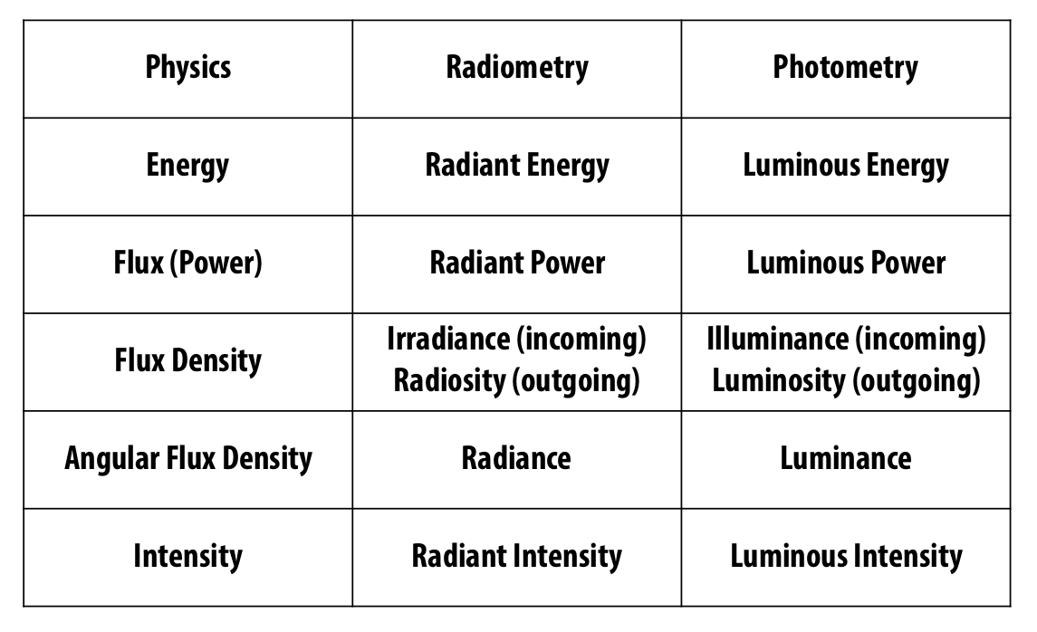
Radiometry versus photometry
Notes:
Our work addresses the problem of inferring scene properties from image data.
Specifically, we want to relate observed image intensities to object shape, scene illumination, and material properties, or surface reflectance.
The task is made difficult by the fact that shape, lighting, and reflectance information are all tightly coupled in the image data so that we cannot typically draw conclusions about one of them without making restrictive assumptions about the others.

Slide 13
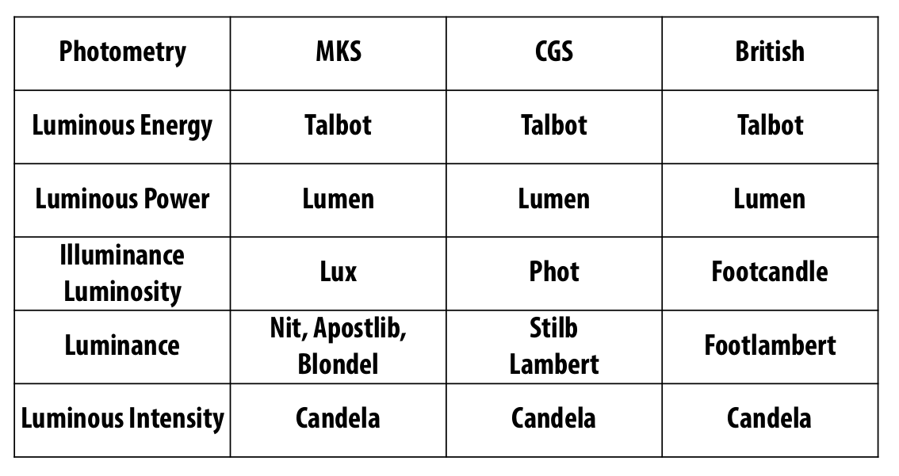
Radiometry versus photometry
Notes:
Our work addresses the problem of inferring scene properties from image data.
Specifically, we want to relate observed image intensities to object shape, scene illumination, and material properties, or surface reflectance.
The task is made difficult by the fact that shape, lighting, and reflectance information are all tightly coupled in the image data so that we cannot typically draw conclusions about one of them without making restrictive assumptions about the others.

Slide 14
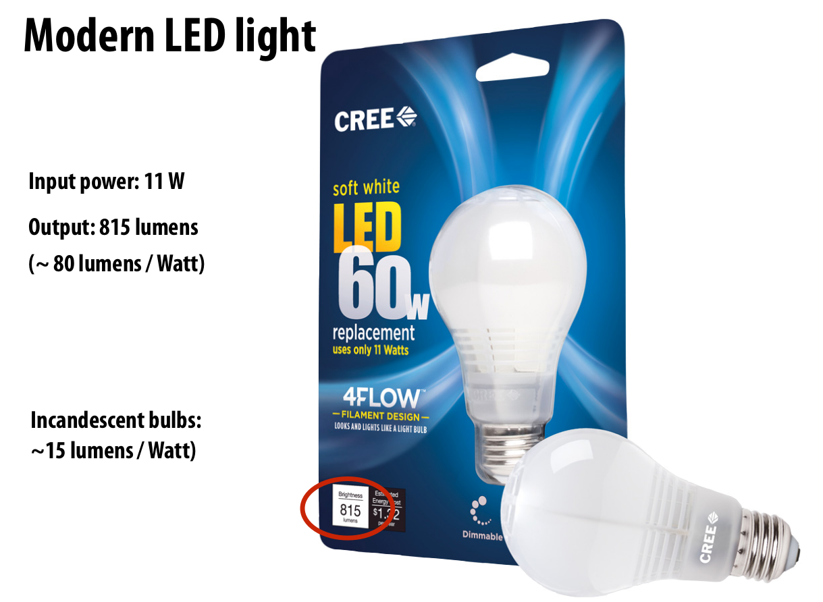
Notes:
Our work addresses the problem of inferring scene properties from image data.
Specifically, we want to relate observed image intensities to object shape, scene illumination, and material properties, or surface reflectance.
The task is made difficult by the fact that shape, lighting, and reflectance information are all tightly coupled in the image data so that we cannot typically draw conclusions about one of them without making restrictive assumptions about the others.

Slide 15
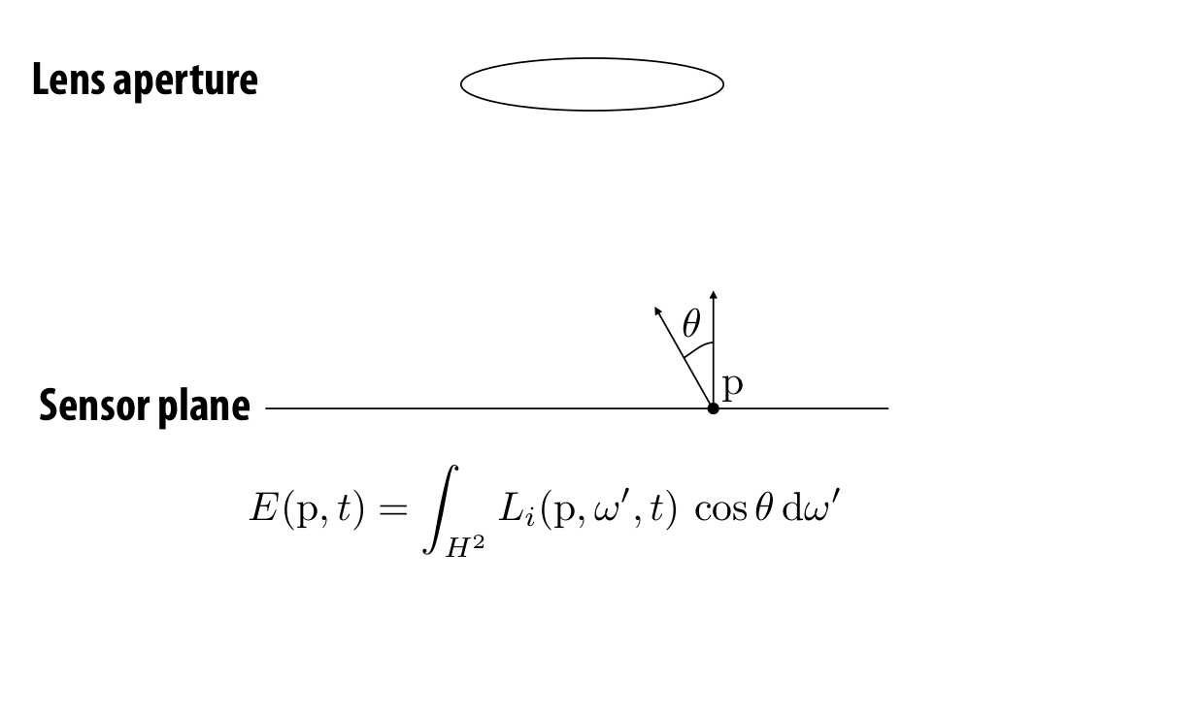
Quiz 1: Measurement of a sensor using a thin lens
What integral should we write for the power measured by infinitesimal pixel p?
Notes:
Our work addresses the problem of inferring scene properties from image data.
Specifically, we want to relate observed image intensities to object shape, scene illumination, and material properties, or surface reflectance.
The task is made difficult by the fact that shape, lighting, and reflectance information are all tightly coupled in the image data so that we cannot typically draw conclusions about one of them without making restrictive assumptions about the others.

Slide 16
Quiz 1: Measurement of a sensor using a thin lens
What integral should we write for the power measured by infinitesimal pixel p?
Can I transform this integral over the hemisphere to an integral over the aperture area?
Notes:
Our work addresses the problem of inferring scene properties from image data.
Specifically, we want to relate observed image intensities to object shape, scene illumination, and material properties, or surface reflectance.
The task is made difficult by the fact that shape, lighting, and reflectance information are all tightly coupled in the image data so that we cannot typically draw conclusions about one of them without making restrictive assumptions about the others.

Slide 17
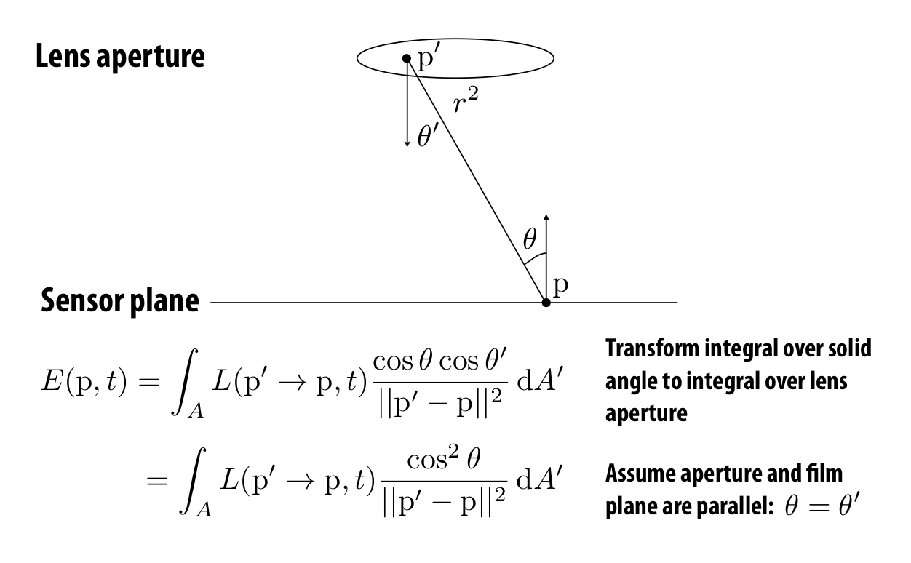
Quiz 1: Measurement of a sensor using a thin lens
What integral should we write for the power measured by infinitesimal pixel p?
Can I transform this integral over the hemisphere to an integral over the aperture area?
Notes:
Our work addresses the problem of inferring scene properties from image data.
Specifically, we want to relate observed image intensities to object shape, scene illumination, and material properties, or surface reflectance.
The task is made difficult by the fact that shape, lighting, and reflectance information are all tightly coupled in the image data so that we cannot typically draw conclusions about one of them without making restrictive assumptions about the others.

Slide 18
Quiz 1: Measurement of a sensor using a thin lens
Can I write the denominator in a more convenient form?
Notes:
Our work addresses the problem of inferring scene properties from image data.
Specifically, we want to relate observed image intensities to object shape, scene illumination, and material properties, or surface reflectance.
The task is made difficult by the fact that shape, lighting, and reflectance information are all tightly coupled in the image data so that we cannot typically draw conclusions about one of them without making restrictive assumptions about the others.

Slide 19
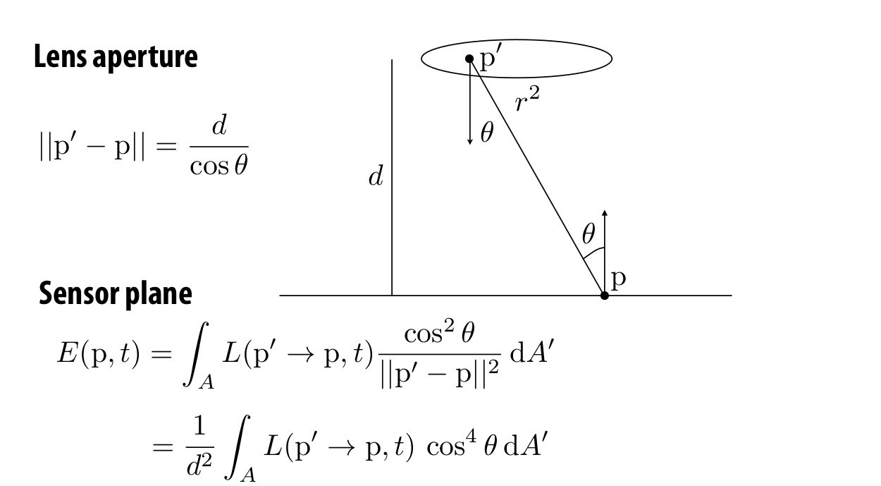
Quiz 1: Measurement of a sensor using a thin lens
What does this say about the image I am capturing?
Notes:
Our work addresses the problem of inferring scene properties from image data.
Specifically, we want to relate observed image intensities to object shape, scene illumination, and material properties, or surface reflectance.
The task is made difficult by the fact that shape, lighting, and reflectance information are all tightly coupled in the image data so that we cannot typically draw conclusions about one of them without making restrictive assumptions about the others.

Slide 20

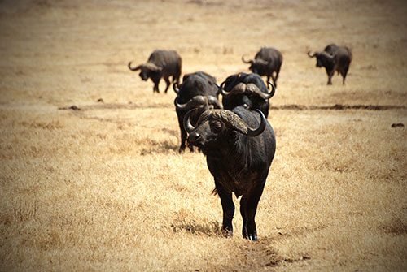
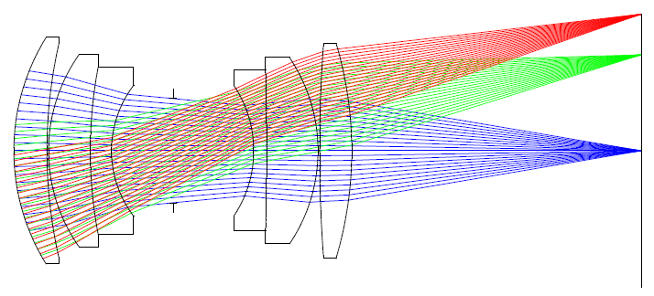
Vignetting
Fancy word for: pixels far off the center receive less light
white wall under uniform light
more interesting example of vignetting
Four types of vignetting:
Mechanical: light rays blocked by hoods, filters, and other objects.
Lens: similar, but light rays blocked by lens elements.
Natural: due to radiometric laws (“cosine fourth falloff”).
Pixel: angle-dependent sensitivity of photodiodes.

Slide 21
Quiz 2: BRDF of the moon
What BRDF does the moon have?
Notes:
Our work addresses the problem of inferring scene properties from image data.
Specifically, we want to relate observed image intensities to object shape, scene illumination, and material properties, or surface reflectance.
The task is made difficult by the fact that shape, lighting, and reflectance information are all tightly coupled in the image data so that we cannot typically draw conclusions about one of them without making restrictive assumptions about the others.

Slide 22
Quiz 2: BRDF of the moon
What BRDF does the moon have?
Can it be diffuse?
Notes:
Our work addresses the problem of inferring scene properties from image data.
Specifically, we want to relate observed image intensities to object shape, scene illumination, and material properties, or surface reflectance.
The task is made difficult by the fact that shape, lighting, and reflectance information are all tightly coupled in the image data so that we cannot typically draw conclusions about one of them without making restrictive assumptions about the others.

Slide 23
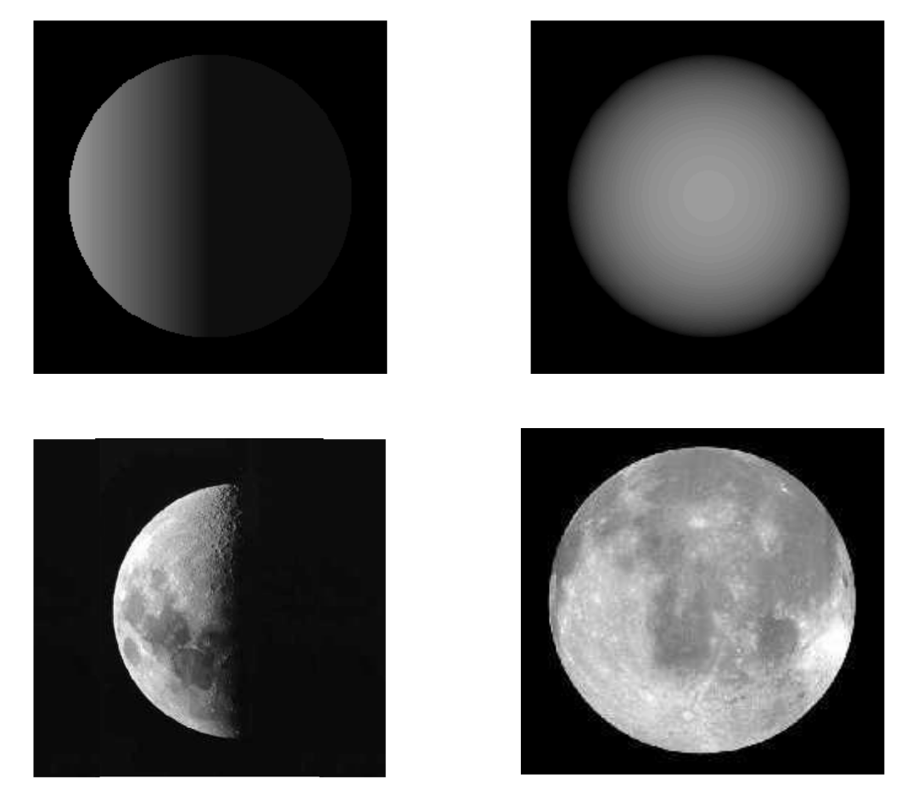
Quiz 2: BRDF of the moon
What BRDF does the moon have?
Can it be diffuse?
Even though the moon appears matte, its edges remain bright.
Notes:
Our work addresses the problem of inferring scene properties from image data.
Specifically, we want to relate observed image intensities to object shape, scene illumination, and material properties, or surface reflectance.
The task is made difficult by the fact that shape, lighting, and reflectance information are all tightly coupled in the image data so that we cannot typically draw conclusions about one of them without making restrictive assumptions about the others.

Slide 24
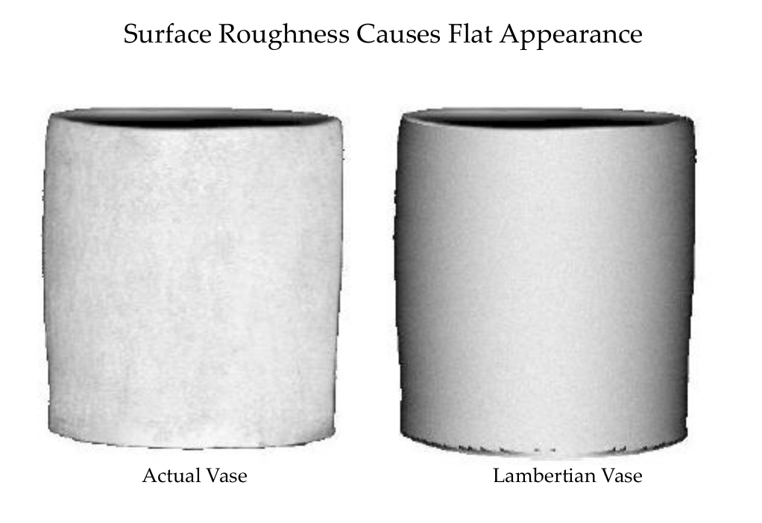
Rough diffuse appearance
Notes:
Our work addresses the problem of inferring scene properties from image data.
Specifically, we want to relate observed image intensities to object shape, scene illumination, and material properties, or surface reflectance.
The task is made difficult by the fact that shape, lighting, and reflectance information are all tightly coupled in the image data so that we cannot typically draw conclusions about one of them without making restrictive assumptions about the others.

Slide 25



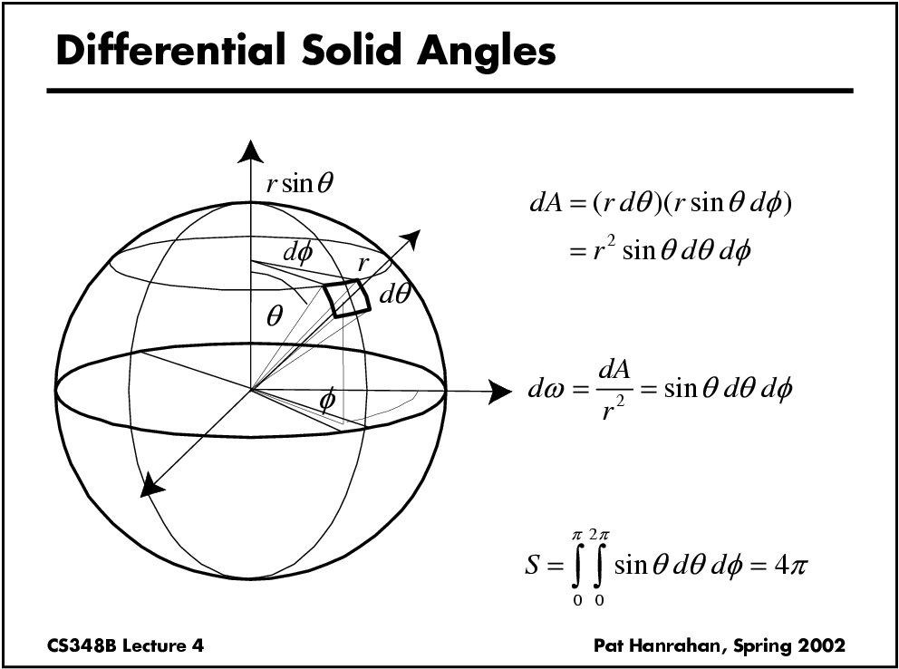
Five important equations/integrals to remember
Flux measured by a sensor of area X and directional receptivity W:
Reflectance equation:
Radiance under directional lighting and Lambertian BRDF (“n-dot-l shading”):
Conversion of a (hemi)-spherical integral to a surface integral:
Computing (hemi)-spherical integrals:
and
Notes:
Our work addresses the problem of inferring scene properties from image data.
Specifically, we want to relate observed image intensities to object shape, scene illumination, and material properties, or surface reflectance.
The task is made difficult by the fact that shape, lighting, and reflectance information are all tightly coupled in the image data so that we cannot typically draw conclusions about one of them without making restrictive assumptions about the others.

Slide 26
Photometric stereo

Slide 27
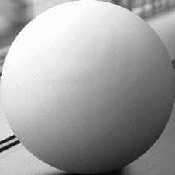
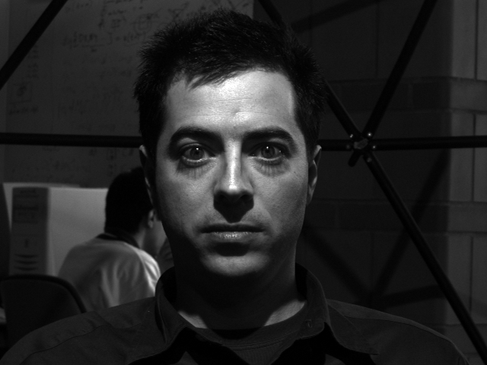
Image Intensity and 3D Geometry
Shading as a cue for shape reconstruction
What is the relation between intensity and shape?

Slide 28
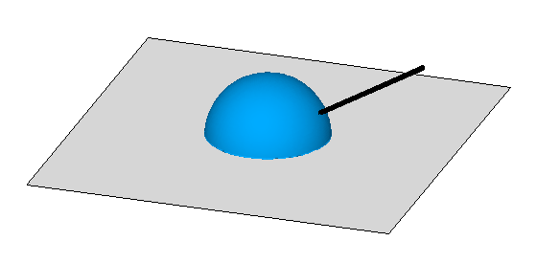

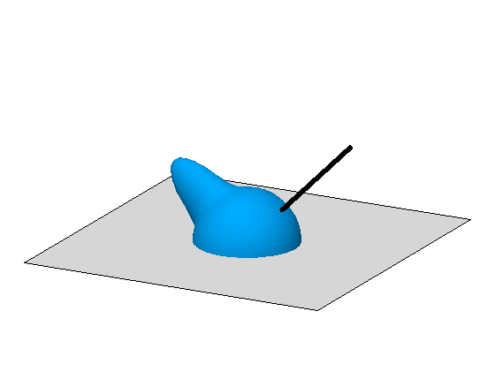
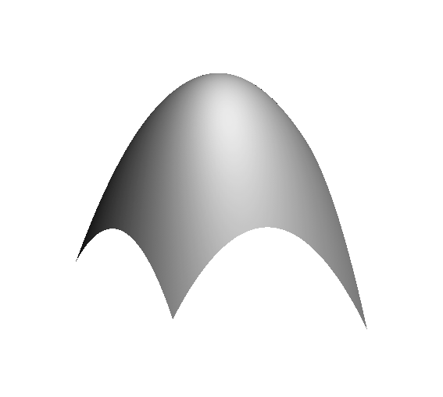
“N-dot-l” shading
ASSUMPTION 1:
LAMBERTIAN
ASSUMPTION 2:
DIRECTIONAL LIGHTING
Why do we call these normal “shape”?
Notes:
I=a\hat{\bf n}^\top\vec{\boldsymbol{\ell}}

Slide 29
Surfaces and normals
z
imaged surface
viewing rays for different pixels
x
what is a camera like this called?
Notes:
I=a\hat{\bf n}^\top\vec{\boldsymbol{\ell}}

Slide 30
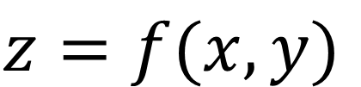
Surfaces and normals
z
imaged surface
Surface representation as a depth field (also known as Monge surface):
$$z=f(x,y)$$
viewing rays for different pixels
pixel coordinates on image place
depth at each pixel
How does surface normal relate to this representation?
x
orthographic camera
Notes:
I=a\hat{\bf n}^\top\vec{\boldsymbol{\ell}}

Slide 31
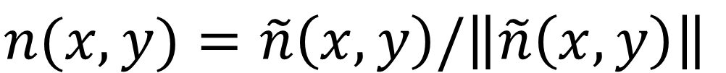
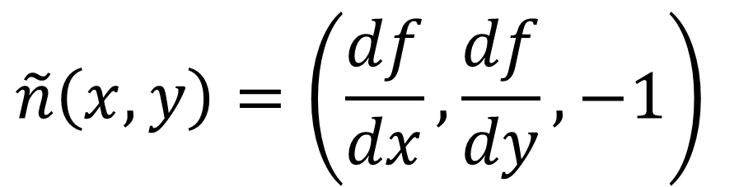
Surfaces and normals
z
imaged surface
Surface representation as a depth image (also known as Monge surface):
$$z=f(x,y)$$
viewing rays for different pixels
pixel coordinates on image place
depth at each pixel
Unnormalized normal:
$$\tilde{n}\left(x,y\right)=\left(\frac{df}{dx},\frac{df}{dy},−1\right)$$
x
orthographic camera
Actual normal:
$$n(x,y)=\tilde{n}\left(x,y\right)/\left\|\tilde{n}\left(x,y\right)\right\|$$
Normals are scaled spatial derivatives of depth image!
Notes:
I=a\hat{\bf n}^\top\vec{\boldsymbol{\ell}}

Slide 32
Shape from a Single Image?
Given a single image of an object with known surface reflectance taken under a known light source, can we recover the shape of the object?

Slide 33
Human Perception

Slide 34
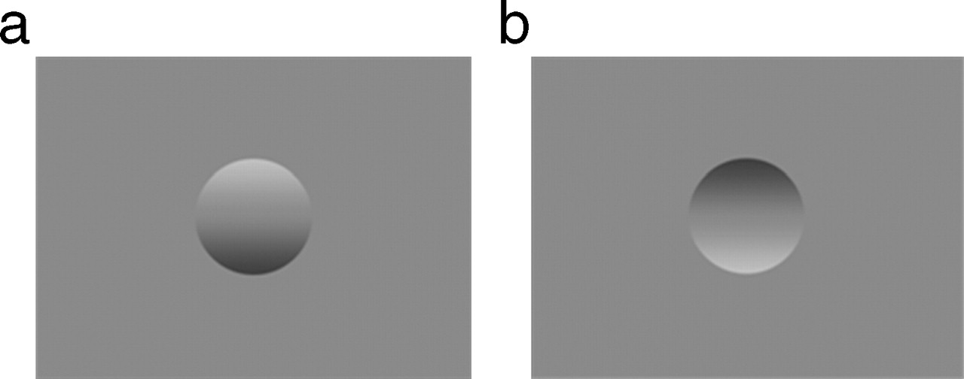

Examples of the classic bump/dent stimuli used to test lighting assumptions when judging shape from shading, with shading orientations (a) 0° and (b) 180° from the vertical.
Thomas R et al. J Vis 2010;10:6
Notes:
Examples of the classic bump/dent stimuli used to test lighting assumptions when judging shape from shading, with shading orientations (a) 0° and (b) 180° from the vertical.

Slide 35
Human Perception
Our brain often perceives shape from shading.
Mostly, it makes many assumptions to do so.
For example:
Light is coming from above (sun).
Biased by occluding contours.
by V. Ramachandran

Slide 36
Single-lighting is ambiguous
ASSUMPTION 1:
LAMBERTIAN
ASSUMPTION 2:
DIRECTIONAL LIGHTING
Notes:
I=a\hat{\bf n}^\top\vec{\boldsymbol{\ell}}

Slide 37




Lambertian photometric stereo
Assumption: We know the lighting directions.
Notes:
%%% latexit
I_1=a\hat{\boldsymbol{n}}^\top\vec{\boldsymbol{\ell}}_1
\vec{\boldsymbol{b}}\triangleq a\hat{\boldsymbol{n}}
\left[\begin{array}{c}
I_1 \\ I_2 \\ \vdots \\ I_N
\end{array}\right]_{N\times 1}\!\!\!\!\!
=\left[\begin{array}{c}
\vec{\boldsymbol{\ell}}_1^\top \\
\vec{\boldsymbol{\ell}}_2^\top \\
\vdots \\
\vec{\boldsymbol{\ell}}_N^\top \\
\end{array}\right]_{N\times 3}\!\!\!\!\!\!\!\!\!
\left[\begin{array}{c}
\vec{\boldsymbol{b}}
\end{array}\right]_{3\times 1}

Slide 38

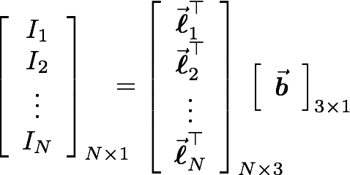
Lambertian photometric stereo
define “pseudo-normal”
solve linear system
for pseudo-normal
What are the dimensions of these matrices?
Notes:
%%% latexit
I_1=a\hat{\boldsymbol{n}}^\top\vec{\boldsymbol{\ell}}_1
\vec{\boldsymbol{b}}\triangleq a\hat{\boldsymbol{n}}
\left[\begin{array}{c}
I_1 \\ I_2 \\ \vdots \\ I_N
\end{array}\right]_{N\times 1}\!\!\!\!\!
=\left[\begin{array}{c}
\vec{\boldsymbol{\ell}}_1^\top \\
\vec{\boldsymbol{\ell}}_2^\top \\
\vdots \\
\vec{\boldsymbol{\ell}}_N^\top \\
\end{array}\right]_{N\times 3}\!\!\!\!\!\!\!\!\!
\left[\begin{array}{c}
\vec{\boldsymbol{b}}
\end{array}\right]_{3\times 1}

Slide 39
Lambertian photometric stereo
define “pseudo-normal”
solve linear system
for pseudo-normal
What are the knowns and unknowns?
Notes:
%%% latexit
I_1=a\hat{\boldsymbol{n}}^\top\vec{\boldsymbol{\ell}}_1
\vec{\boldsymbol{b}}\triangleq a\hat{\boldsymbol{n}}
\left[\begin{array}{c}
I_1 \\ I_2 \\ \vdots \\ I_N
\end{array}\right]_{N\times 1}\!\!\!\!\!
=\left[\begin{array}{c}
\vec{\boldsymbol{\ell}}_1^\top \\
\vec{\boldsymbol{\ell}}_2^\top \\
\vdots \\
\vec{\boldsymbol{\ell}}_N^\top \\
\end{array}\right]_{N\times 3}\!\!\!\!\!\!\!\!\!
\left[\begin{array}{c}
\vec{\boldsymbol{b}}
\end{array}\right]_{3\times 1}

Slide 40
Lambertian photometric stereo
define “pseudo-normal”
solve linear system
for pseudo-normal
How many lights do I need for unique solution?
Notes:
%%% latexit
I_1=a\hat{\boldsymbol{n}}^\top\vec{\boldsymbol{\ell}}_1
\vec{\boldsymbol{b}}\triangleq a\hat{\boldsymbol{n}}
\left[\begin{array}{c}
I_1 \\ I_2 \\ \vdots \\ I_N
\end{array}\right]_{N\times 1}\!\!\!\!\!
=\left[\begin{array}{c}
\vec{\boldsymbol{\ell}}_1^\top \\
\vec{\boldsymbol{\ell}}_2^\top \\
\vdots \\
\vec{\boldsymbol{\ell}}_N^\top \\
\end{array}\right]_{N\times 3}\!\!\!\!\!\!\!\!\!
\left[\begin{array}{c}
\vec{\boldsymbol{b}}
\end{array}\right]_{3\times 1}

Slide 41
Lambertian photometric stereo
define “pseudo-normal”
solve linear system
for pseudo-normal
once system is solved, b gives normal direction and albedo
How do we solve this system?
Notes:
%%% latexit
I_1=a\hat{\boldsymbol{n}}^\top\vec{\boldsymbol{\ell}}_1
\vec{\boldsymbol{b}}\triangleq a\hat{\boldsymbol{n}}
\left[\begin{array}{c}
I_1 \\ I_2 \\ \vdots \\ I_N
\end{array}\right]_{N\times 1}\!\!\!\!\!
=\left[\begin{array}{c}
\vec{\boldsymbol{\ell}}_1^\top \\
\vec{\boldsymbol{\ell}}_2^\top \\
\vdots \\
\vec{\boldsymbol{\ell}}_N^\top \\
\end{array}\right]_{N\times 3}\!\!\!\!\!\!\!\!\!
\left[\begin{array}{c}
\vec{\boldsymbol{b}}
\end{array}\right]_{3\times 1}

Slide 42
Solving the Equation with three lights
inverse
Is there any reason to use more than three lights?

Slide 43
More than Three Light Sources
Get better SNR by using more lights
Least squares solution:
Moore-Penrose pseudo inverse
Solve for as before

Slide 44
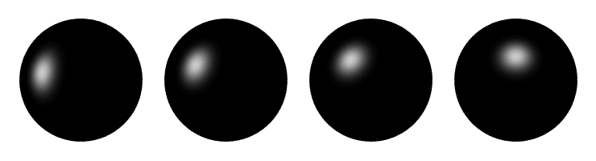
Computing light source directions
Trick: place a chrome sphere in the scene
  the location of the highlight tells you the source direction

Slide 45
Limitations
Big problems
  Doesn’t work for shiny things, semi-translucent things
  Shadows, inter-reflections
Smaller problems
  Camera and lights have to be distant
  Calibration requirements
    measure light source directions, intensities
    camera response function

Slide 46
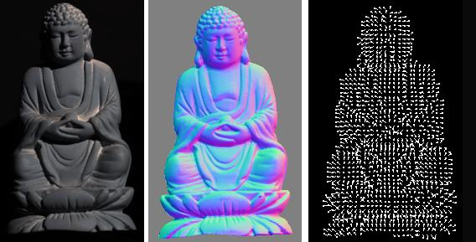
Depth from normals
Solving the linear system per-pixel gives us an estimated surface normal for each pixel
How can we compute depth from normals?
  Normals are like the “derivative” of the true depth
Input photo
Estimated normals
Estimated normals (needle diagram)

Slide 47
Surfaces and normals
z
imaged surface
Surface representation as a depth image (also known as Monge surface):
$$z=f(x,y)$$
viewing rays for different pixels
pixel coordinates in image space
depth at each pixel
Unnormalized normal:
$$\tilde{n}\left(x,y\right)=\left(\frac{df}{dx},\frac{df}{dy},−1\right)$$
x
orthographic camera
Actual normal:
$$n(x,y)=\tilde{n}\left(x,y\right)/\left\|\tilde{n}\left(x,y\right)\right\|$$
Normals are scaled spatial derivatives of depth image!
Notes:
I=a\hat{\bf n}^\top\vec{\boldsymbol{\ell}}

Slide 48
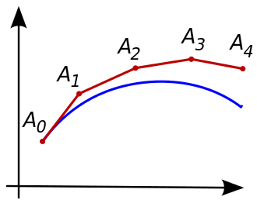
Normal Integration
Integrating a set of derivatives is easy in 1D
  (similar to Euler’s method from diff. eq. class)
Could just integrate normals in each column / row separately
Instead, we formulate as a linear system and solve for depths that best agree with the surface normals

Slide 49

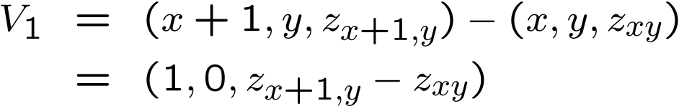


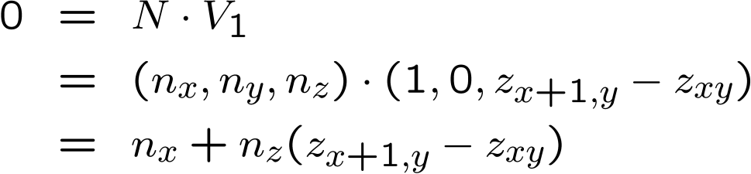

Depth from normals
V₂
V₁
N
Get a similar equation for V₂
  Each normal gives us two linear constraints on z
  compute z values by solving a matrix equation

Slide 50
Results
Estimate light source directions
Compute surface normals
Compute albedo values
Estimate depth from surface normals
Relight the object (with original texture and uniform albedo)

Slide 51
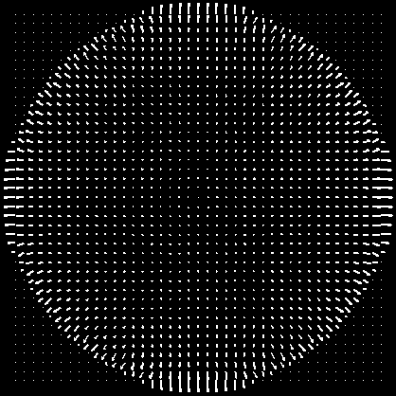

Results: Lambertian Sphere
Input Images
Needles are projections
of surface normals on
image plane
Estimated Surface Normals
Estimated Albedo

Slide 52
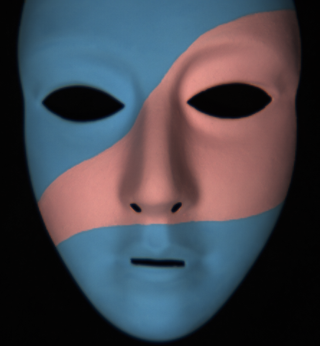
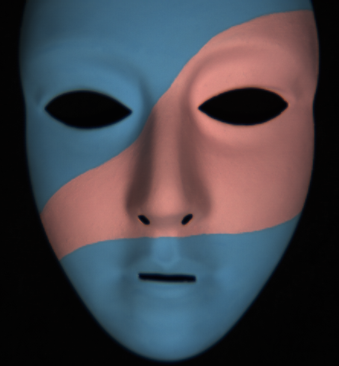
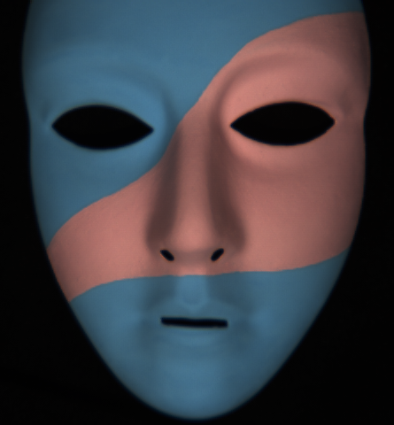
Lambertain Mask

Slide 53
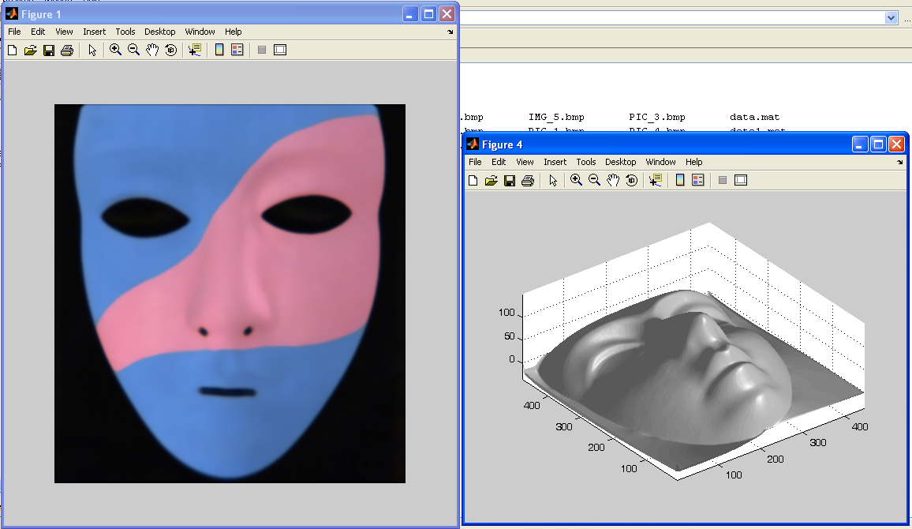
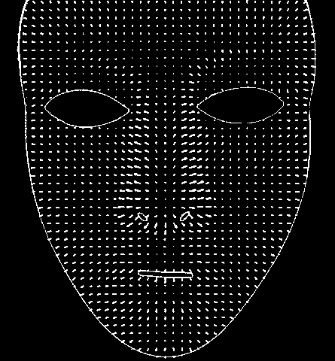
Results – Albedo and Surface Normal

Slide 54
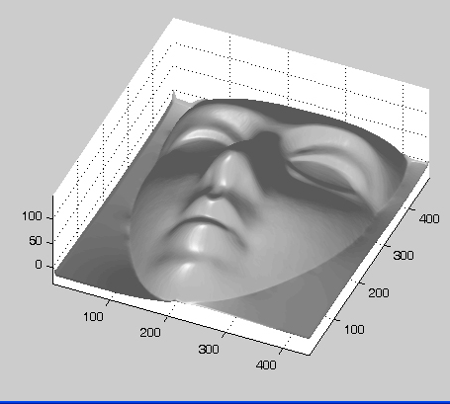
Results – Shape of Mask

Slide 55
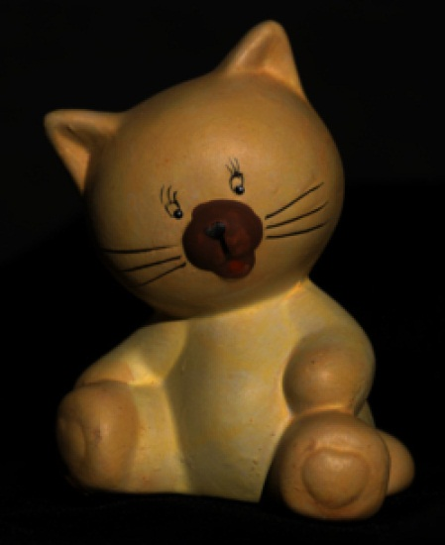
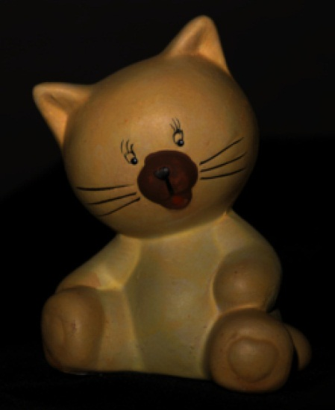
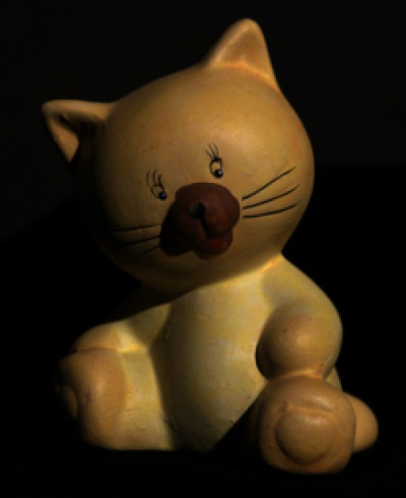
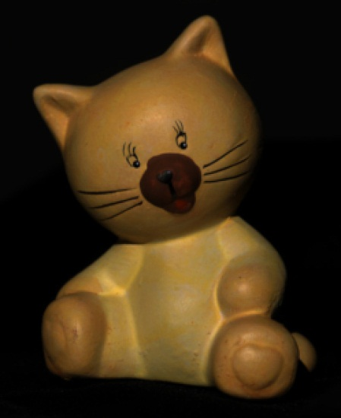
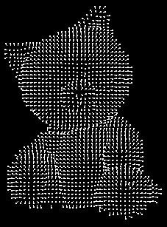
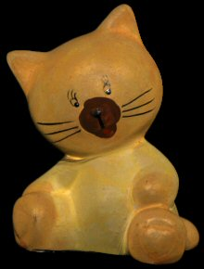
Results: Lambertian Toy
I.2
Input Images
Estimated Surface Normals
Estimated Albedo

Slide 56
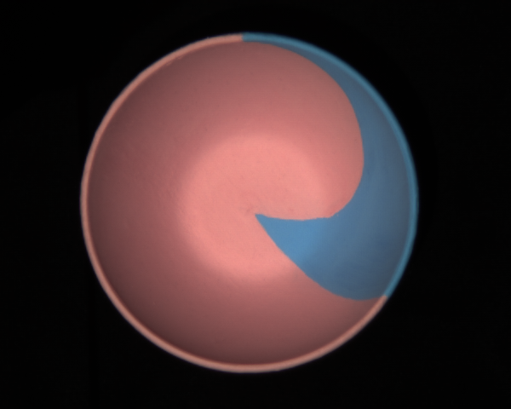
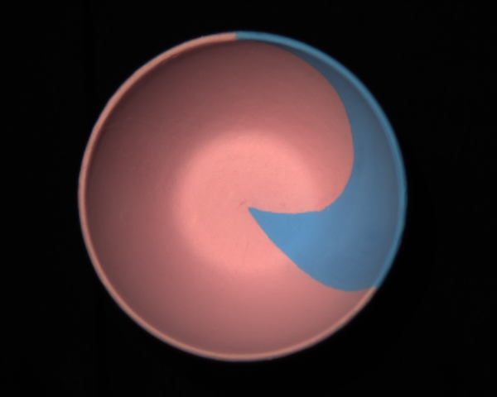
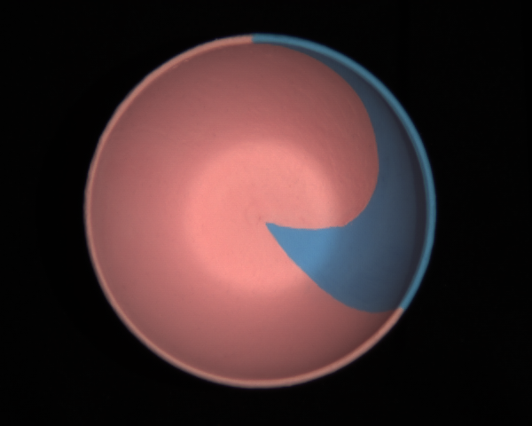
Non-idealities: interreflections

Slide 57
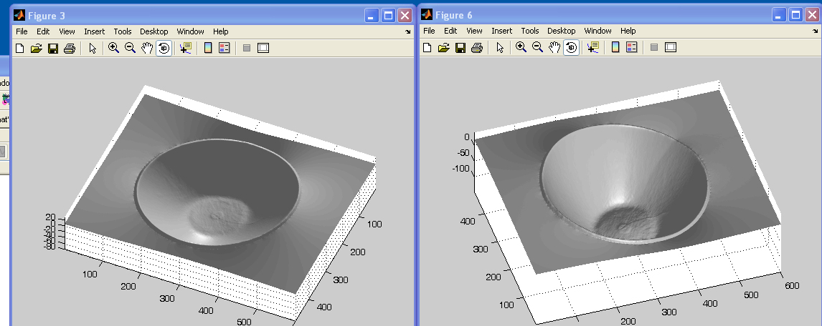
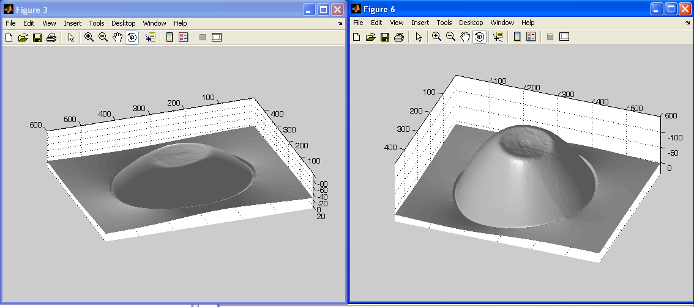
Non-idealities: interreflections
Shallow reconstruction
(effect of interreflections)
Accurate reconstruction
(after removing interreflections)

Slide 58
What if the light directions are unknown?
Notes:
%%% latexit
I_1=a\hat{\boldsymbol{n}}^\top\vec{\boldsymbol{\ell}}_1
\vec{\boldsymbol{b}}\triangleq a\hat{\boldsymbol{n}}
\left[\begin{array}{c}
I_1 \\ I_2 \\ \vdots \\ I_N
\end{array}\right]_{N\times 1}\!\!\!\!\!
=\left[\begin{array}{c}
\vec{\boldsymbol{\ell}}_1^\top \\
\vec{\boldsymbol{\ell}}_2^\top \\
\vdots \\
\vec{\boldsymbol{\ell}}_N^\top \\
\end{array}\right]_{N\times 3}\!\!\!\!\!\!\!\!\!
\left[\begin{array}{c}
\vec{\boldsymbol{b}}
\end{array}\right]_{3\times 1}

Slide 59
Uncalibrated photometric stereo

Slide 60
What if the light directions are unknown?
define “pseudo-normal”
solve linear system
for pseudo-normal
Notes:
%%% latexit
I_1=a\hat{\boldsymbol{n}}^\top\vec{\boldsymbol{\ell}}_1
\vec{\boldsymbol{b}}\triangleq a\hat{\boldsymbol{n}}
\left[\begin{array}{c}
I_1 \\ I_2 \\ \vdots \\ I_N
\end{array}\right]_{N\times 1}\!\!\!\!\!
=\left[\begin{array}{c}
\vec{\boldsymbol{\ell}}_1^\top \\
\vec{\boldsymbol{\ell}}_2^\top \\
\vdots \\
\vec{\boldsymbol{\ell}}_N^\top \\
\end{array}\right]_{N\times 3}\!\!\!\!\!\!\!\!\!
\left[\begin{array}{c}
\vec{\boldsymbol{b}}
\end{array}\right]_{3\times 1}

Slide 61



What if the light directions are unknown?
define “pseudo-normal”
solve linear system
for pseudo-normal at each image pixel
$$B$$
$$M$$
M: number of pixels
$$M$$
Notes:
%%% latexit
I_1=a\hat{\boldsymbol{n}}^\top\vec{\boldsymbol{\ell}}_1
\vec{\boldsymbol{b}}\triangleq a\hat{\boldsymbol{n}}
\left[\begin{array}{c}
I_1 \\ I_2 \\ \vdots \\ I_N
\end{array}\right]_{N\times 1}\!\!\!\!\!
=\left[\begin{array}{c}
\vec{\boldsymbol{\ell}}_1^\top \\
\vec{\boldsymbol{\ell}}_2^\top \\
\vdots \\
\vec{\boldsymbol{\ell}}_N^\top \\
\end{array}\right]_{N\times 3}\!\!\!\!\!\!\!\!\!
\left[\begin{array}{c}
\vec{\boldsymbol{b}}
\end{array}\right]_{3\times 1}

Slide 62
What if the light directions are unknown?
define “pseudo-normal”
solve linear system
for pseudo-normal at each image pixel
How do we solve this system without knowing light matrix L?
$$B$$
$$M$$
$$M$$
Notes:
%%% latexit
I_1=a\hat{\boldsymbol{n}}^\top\vec{\boldsymbol{\ell}}_1
\vec{\boldsymbol{b}}\triangleq a\hat{\boldsymbol{n}}
\left[\begin{array}{c}
I_1 \\ I_2 \\ \vdots \\ I_N
\end{array}\right]_{N\times 1}\!\!\!\!\!
=\left[\begin{array}{c}
\vec{\boldsymbol{\ell}}_1^\top \\
\vec{\boldsymbol{\ell}}_2^\top \\
\vdots \\
\vec{\boldsymbol{\ell}}_N^\top \\
\end{array}\right]_{N\times 3}\!\!\!\!\!\!\!\!\!
\left[\begin{array}{c}
\vec{\boldsymbol{b}}
\end{array}\right]_{3\times 1}

Slide 63
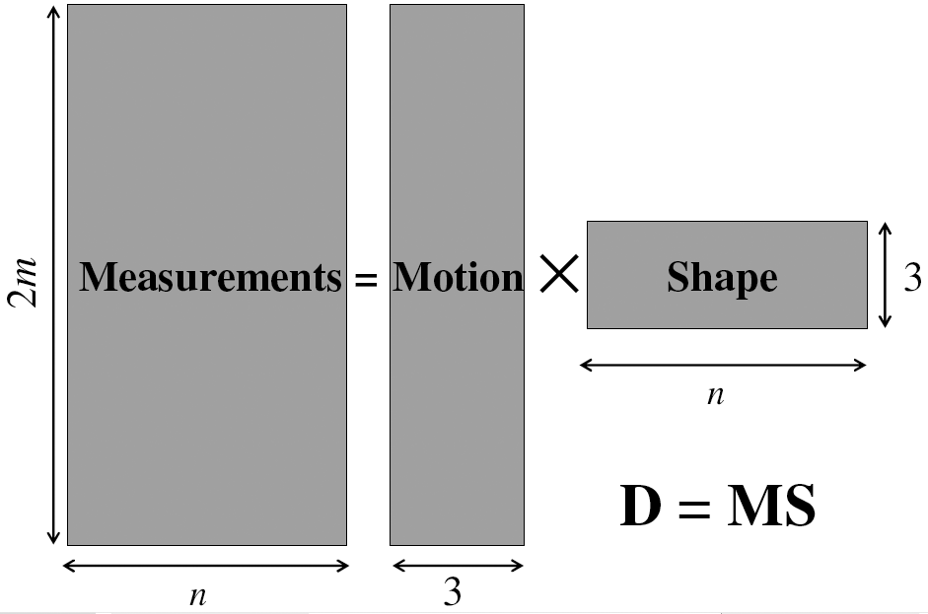
Factorizing the measurement matrix
Lights
Pseudonormals
What are the dimensions?

Slide 64
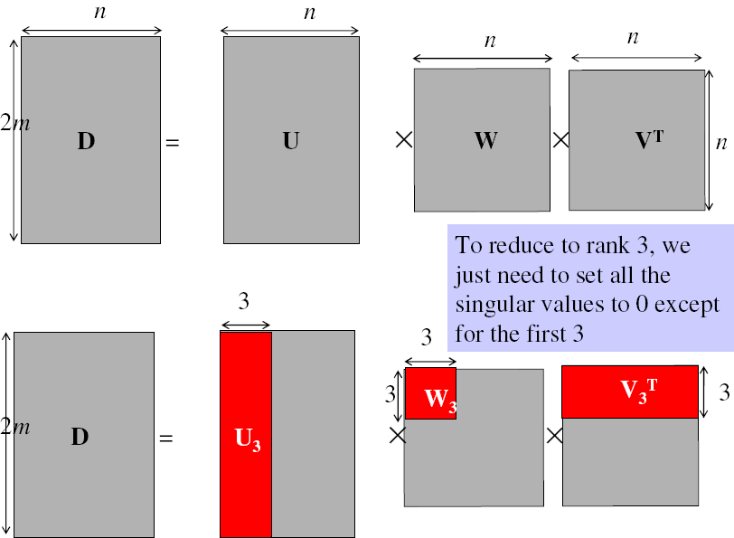
Factorizing the measurement matrix
Singular value decomposition:
This decomposition minimizes
|I-LB|²

Slide 65
Are the results unique?
Notes:
%%% latexit
I_1=a\hat{\boldsymbol{n}}^\top\vec{\boldsymbol{\ell}}_1
\vec{\boldsymbol{b}}\triangleq a\hat{\boldsymbol{n}}
\left[\begin{array}{c}
I_1 \\ I_2 \\ \vdots \\ I_N
\end{array}\right]_{N\times 1}\!\!\!\!\!
=\left[\begin{array}{c}
\vec{\boldsymbol{\ell}}_1^\top \\
\vec{\boldsymbol{\ell}}_2^\top \\
\vdots \\
\vec{\boldsymbol{\ell}}_N^\top \\
\end{array}\right]_{N\times 3}\!\!\!\!\!\!\!\!\!
\left[\begin{array}{c}
\vec{\boldsymbol{b}}
\end{array}\right]_{3\times 1}

Slide 66
Are the results unique?
We can insert any 3x3 matrix Q in the decomposition and get the same images:
I = L B = (L Q⁻¹) (Q B)
Notes:
%%% latexit
I_1=a\hat{\boldsymbol{n}}^\top\vec{\boldsymbol{\ell}}_1
\vec{\boldsymbol{b}}\triangleq a\hat{\boldsymbol{n}}
\left[\begin{array}{c}
I_1 \\ I_2 \\ \vdots \\ I_N
\end{array}\right]_{N\times 1}\!\!\!\!\!
=\left[\begin{array}{c}
\vec{\boldsymbol{\ell}}_1^\top \\
\vec{\boldsymbol{\ell}}_2^\top \\
\vdots \\
\vec{\boldsymbol{\ell}}_N^\top \\
\end{array}\right]_{N\times 3}\!\!\!\!\!\!\!\!\!
\left[\begin{array}{c}
\vec{\boldsymbol{b}}
\end{array}\right]_{3\times 1}

Slide 67
Are the results unique?
We can insert any 3x3 matrix Q in the decomposition and get the same images:
I = L B = (L Q⁻¹) (Q B)
Can we use any assumptions to remove some of these 9 degrees of freedom?
Notes:
%%% latexit
I_1=a\hat{\boldsymbol{n}}^\top\vec{\boldsymbol{\ell}}_1
\vec{\boldsymbol{b}}\triangleq a\hat{\boldsymbol{n}}
\left[\begin{array}{c}
I_1 \\ I_2 \\ \vdots \\ I_N
\end{array}\right]_{N\times 1}\!\!\!\!\!
=\left[\begin{array}{c}
\vec{\boldsymbol{\ell}}_1^\top \\
\vec{\boldsymbol{\ell}}_2^\top \\
\vdots \\
\vec{\boldsymbol{\ell}}_N^\top \\
\end{array}\right]_{N\times 3}\!\!\!\!\!\!\!\!\!
\left[\begin{array}{c}
\vec{\boldsymbol{b}}
\end{array}\right]_{3\times 1}

Slide 68
Generalized bas-relief ambiguity

Slide 69
Enforcing integrability
What does the matrix B correspond to?
Notes:
%%% latexit
I_1=a\hat{\boldsymbol{n}}^\top\vec{\boldsymbol{\ell}}_1
\vec{\boldsymbol{b}}\triangleq a\hat{\boldsymbol{n}}
\left[\begin{array}{c}
I_1 \\ I_2 \\ \vdots \\ I_N
\end{array}\right]_{N\times 1}\!\!\!\!\!
=\left[\begin{array}{c}
\vec{\boldsymbol{\ell}}_1^\top \\
\vec{\boldsymbol{\ell}}_2^\top \\
\vdots \\
\vec{\boldsymbol{\ell}}_N^\top \\
\end{array}\right]_{N\times 3}\!\!\!\!\!\!\!\!\!
\left[\begin{array}{c}
\vec{\boldsymbol{b}}
\end{array}\right]_{3\times 1}

Slide 70
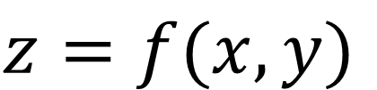
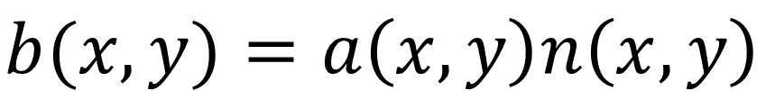


Enforcing integrability
What does the matrix B correspond to?
Surface representation as a depth image (also known as Monge surface):
$$z=f(x,y)$$
depth at each pixel
pixel coordinates in image space
Unnormalized normal:
$$\tilde{n}\left(x,y\right)=\left(\frac{df}{dx},\frac{df}{dy},−1\right)$$
Actual normal:
$$n(x,y)=\tilde{n}\left(x,y\right)/\left\|\tilde{n}\left(x,y\right)\right\|$$
Pseudo-normal:
$$b(x,y)=a\left(x,y\right)n\left(x,y\right)$$
Rearrange into 3xN matrix B.
Notes:
%%% latexit
I_1=a\hat{\boldsymbol{n}}^\top\vec{\boldsymbol{\ell}}_1
\vec{\boldsymbol{b}}\triangleq a\hat{\boldsymbol{n}}
\left[\begin{array}{c}
I_1 \\ I_2 \\ \vdots \\ I_N
\end{array}\right]_{N\times 1}\!\!\!\!\!
=\left[\begin{array}{c}
\vec{\boldsymbol{\ell}}_1^\top \\
\vec{\boldsymbol{\ell}}_2^\top \\
\vdots \\
\vec{\boldsymbol{\ell}}_N^\top \\
\end{array}\right]_{N\times 3}\!\!\!\!\!\!\!\!\!
\left[\begin{array}{c}
\vec{\boldsymbol{b}}
\end{array}\right]_{3\times 1}

Slide 71
Enforcing integrability
What does the integrability constraint correspond to?
Notes:
%%% latexit
I_1=a\hat{\boldsymbol{n}}^\top\vec{\boldsymbol{\ell}}_1
\vec{\boldsymbol{b}}\triangleq a\hat{\boldsymbol{n}}
\left[\begin{array}{c}
I_1 \\ I_2 \\ \vdots \\ I_N
\end{array}\right]_{N\times 1}\!\!\!\!\!
=\left[\begin{array}{c}
\vec{\boldsymbol{\ell}}_1^\top \\
\vec{\boldsymbol{\ell}}_2^\top \\
\vdots \\
\vec{\boldsymbol{\ell}}_N^\top \\
\end{array}\right]_{N\times 3}\!\!\!\!\!\!\!\!\!
\left[\begin{array}{c}
\vec{\boldsymbol{b}}
\end{array}\right]_{3\times 1}

Slide 72

Enforcing integrability
What does the integrability constraint correspond to?
Differentiation order should not matter:
$$\frac{d}{dy}\frac{df(x,y)}{dx}=\frac{d}{dx}\frac{df(x,y)}{dy}$$
Can you think of a way to express the above using pseudo-normals b?
Notes:
%%% latexit
I_1=a\hat{\boldsymbol{n}}^\top\vec{\boldsymbol{\ell}}_1
\vec{\boldsymbol{b}}\triangleq a\hat{\boldsymbol{n}}
\left[\begin{array}{c}
I_1 \\ I_2 \\ \vdots \\ I_N
\end{array}\right]_{N\times 1}\!\!\!\!\!
=\left[\begin{array}{c}
\vec{\boldsymbol{\ell}}_1^\top \\
\vec{\boldsymbol{\ell}}_2^\top \\
\vdots \\
\vec{\boldsymbol{\ell}}_N^\top \\
\end{array}\right]_{N\times 3}\!\!\!\!\!\!\!\!\!
\left[\begin{array}{c}
\vec{\boldsymbol{b}}
\end{array}\right]_{3\times 1}

Slide 73

Enforcing integrability
What does the integrability constraint correspond to?
Differentiation order should not matter:
$$\frac{d}{dy}\frac{df(x,y)}{dx}=\frac{d}{dx}\frac{df(x,y)}{dy}$$
Can you think of a way to express the above using pseudo-normals b?
$$\frac{d}{dy}\frac{b_{1}(x,y)}{b_{3}(x,y)}=\frac{d}{dx}\frac{b_{2}(x,y)}{b_{3}(x,y)}$$
Notes:
%%% latexit
I_1=a\hat{\boldsymbol{n}}^\top\vec{\boldsymbol{\ell}}_1
\vec{\boldsymbol{b}}\triangleq a\hat{\boldsymbol{n}}
\left[\begin{array}{c}
I_1 \\ I_2 \\ \vdots \\ I_N
\end{array}\right]_{N\times 1}\!\!\!\!\!
=\left[\begin{array}{c}
\vec{\boldsymbol{\ell}}_1^\top \\
\vec{\boldsymbol{\ell}}_2^\top \\
\vdots \\
\vec{\boldsymbol{\ell}}_N^\top \\
\end{array}\right]_{N\times 3}\!\!\!\!\!\!\!\!\!
\left[\begin{array}{c}
\vec{\boldsymbol{b}}
\end{array}\right]_{3\times 1}

Slide 74
Enforcing integrability
What does the integrability constraint correspond to?
Differentiation order should not matter:
$$\frac{d}{dy}\frac{df(x,y)}{dx}=\frac{d}{dx}\frac{df(x,y)}{dy}$$
Can you think of a way to express the above using pseudo-normals b?
$$\frac{d}{dy}\frac{b_{1}(x,y)}{b_{3}(x,y)}=\frac{d}{dx}\frac{b_{2}(x,y)}{b_{3}(x,y)}$$
Simplify to:
$$b_{3}\left(x,y\right)\frac{db_{1}\left(x,y\right)}{dy}−b_{1}(x,y)\frac{db_{3}(x,y)}{dy}=b_{2}\left(x,y\right)\frac{db_{1}\left(x,y\right)}{dx}−b_{1}(x,y)\frac{db_{2}(x,y)}{dx}$$
Notes:
%%% latexit
I_1=a\hat{\boldsymbol{n}}^\top\vec{\boldsymbol{\ell}}_1
\vec{\boldsymbol{b}}\triangleq a\hat{\boldsymbol{n}}
\left[\begin{array}{c}
I_1 \\ I_2 \\ \vdots \\ I_N
\end{array}\right]_{N\times 1}\!\!\!\!\!
=\left[\begin{array}{c}
\vec{\boldsymbol{\ell}}_1^\top \\
\vec{\boldsymbol{\ell}}_2^\top \\
\vdots \\
\vec{\boldsymbol{\ell}}_N^\top \\
\end{array}\right]_{N\times 3}\!\!\!\!\!\!\!\!\!
\left[\begin{array}{c}
\vec{\boldsymbol{b}}
\end{array}\right]_{3\times 1}

Slide 75
Enforcing integrability
What does the integrability constraint correspond to?
Differentiation order should not matter:
$$\frac{d}{dy}\frac{df(x,y)}{dx}=\frac{d}{dx}\frac{df(x,y)}{dy}$$
Can you think of a way to express the above using pseudo-normals b?
$$\frac{d}{dy}\frac{b_{1}(x,y)}{b_{3}(x,y)}=\frac{d}{dx}\frac{b_{2}(x,y)}{b_{3}(x,y)}$$
Simplify to:
$$b_{3}\left(x,y\right)\frac{db_{1}\left(x,y\right)}{dy}−b_{1}(x,y)\frac{db_{3}(x,y)}{dy}=b_{2}\left(x,y\right)\frac{db_{1}\left(x,y\right)}{dx}−b_{1}(x,y)\frac{db_{2}(x,y)}{dx}$$
If B_{e} is the pseudo-normal matrix we get from SVD, then find the 3x3 transform D such that B=D⋅B_{e} is the closest to satisfying integrability in the least-squares sense.
Notes:
%%% latexit
I_1=a\hat{\boldsymbol{n}}^\top\vec{\boldsymbol{\ell}}_1
\vec{\boldsymbol{b}}\triangleq a\hat{\boldsymbol{n}}
\left[\begin{array}{c}
I_1 \\ I_2 \\ \vdots \\ I_N
\end{array}\right]_{N\times 1}\!\!\!\!\!
=\left[\begin{array}{c}
\vec{\boldsymbol{\ell}}_1^\top \\
\vec{\boldsymbol{\ell}}_2^\top \\
\vdots \\
\vec{\boldsymbol{\ell}}_N^\top \\
\end{array}\right]_{N\times 3}\!\!\!\!\!\!\!\!\!
\left[\begin{array}{c}
\vec{\boldsymbol{b}}
\end{array}\right]_{3\times 1}

Slide 76
Enforcing integrability
Does enforcing integrability remove all ambiguities?
Notes:
%%% latexit
I_1=a\hat{\boldsymbol{n}}^\top\vec{\boldsymbol{\ell}}_1
\vec{\boldsymbol{b}}\triangleq a\hat{\boldsymbol{n}}
\left[\begin{array}{c}
I_1 \\ I_2 \\ \vdots \\ I_N
\end{array}\right]_{N\times 1}\!\!\!\!\!
=\left[\begin{array}{c}
\vec{\boldsymbol{\ell}}_1^\top \\
\vec{\boldsymbol{\ell}}_2^\top \\
\vdots \\
\vec{\boldsymbol{\ell}}_N^\top \\
\end{array}\right]_{N\times 3}\!\!\!\!\!\!\!\!\!
\left[\begin{array}{c}
\vec{\boldsymbol{b}}
\end{array}\right]_{3\times 1}

Slide 77


Generalized Bas-relief ambiguity
If B is integrable, then:
B’=G^{-T}⋅B is also integrable for all G of the form ($λ$ ≠ 0)
$$G=\left[\begin{matrix}1 & 0 & 0 \\ 0 & 1 & 0 \\ μ & ν & λ\end{matrix}\right]$$
Combined with transformed lights S’=G⋅S, the transformed pseudonormals produce the same images as the original pseudonormals.
This ambiguity cannot be removed using shadows.
This ambiguity can be removed using interreflections or additional assumptions.
This ambiguity is known as the generalized bas-relief ambiguity.
Notes:
%%% latexit
I_1=a\hat{\boldsymbol{n}}^\top\vec{\boldsymbol{\ell}}_1
\vec{\boldsymbol{b}}\triangleq a\hat{\boldsymbol{n}}
\left[\begin{array}{c}
I_1 \\ I_2 \\ \vdots \\ I_N
\end{array}\right]_{N\times 1}\!\!\!\!\!
=\left[\begin{array}{c}
\vec{\boldsymbol{\ell}}_1^\top \\
\vec{\boldsymbol{\ell}}_2^\top \\
\vdots \\
\vec{\boldsymbol{\ell}}_N^\top \\
\end{array}\right]_{N\times 3}\!\!\!\!\!\!\!\!\!
\left[\begin{array}{c}
\vec{\boldsymbol{b}}
\end{array}\right]_{3\times 1}

Slide 78


Generalized Bas-relief ambiguity
When $μ$ = $ν$ = 0, G is equivalent to the transformation employed by relief sculptures.
Otherwise, includes shearing.
When $μ$ = $ν$ = 0 and $λ$ = +-1, top/down ambiguity.
Notes:
%%% latexit
I_1=a\hat{\boldsymbol{n}}^\top\vec{\boldsymbol{\ell}}_1
\vec{\boldsymbol{b}}\triangleq a\hat{\boldsymbol{n}}
\left[\begin{array}{c}
I_1 \\ I_2 \\ \vdots \\ I_N
\end{array}\right]_{N\times 1}\!\!\!\!\!
=\left[\begin{array}{c}
\vec{\boldsymbol{\ell}}_1^\top \\
\vec{\boldsymbol{\ell}}_2^\top \\
\vdots \\
\vec{\boldsymbol{\ell}}_N^\top \\
\end{array}\right]_{N\times 3}\!\!\!\!\!\!\!\!\!
\left[\begin{array}{c}
\vec{\boldsymbol{b}}
\end{array}\right]_{3\times 1}

Slide 79
What assumptions have we made for all this?
Notes:
%%% latexit
I_1=a\hat{\boldsymbol{n}}^\top\vec{\boldsymbol{\ell}}_1
\vec{\boldsymbol{b}}\triangleq a\hat{\boldsymbol{n}}
\left[\begin{array}{c}
I_1 \\ I_2 \\ \vdots \\ I_N
\end{array}\right]_{N\times 1}\!\!\!\!\!
=\left[\begin{array}{c}
\vec{\boldsymbol{\ell}}_1^\top \\
\vec{\boldsymbol{\ell}}_2^\top \\
\vdots \\
\vec{\boldsymbol{\ell}}_N^\top \\
\end{array}\right]_{N\times 3}\!\!\!\!\!\!\!\!\!
\left[\begin{array}{c}
\vec{\boldsymbol{b}}
\end{array}\right]_{3\times 1}

Slide 80
What assumptions have we made for all this?
Lambertian BRDF
Directional lighting
No interreflections or scattering
Notes:
%%% latexit
I_1=a\hat{\boldsymbol{n}}^\top\vec{\boldsymbol{\ell}}_1
\vec{\boldsymbol{b}}\triangleq a\hat{\boldsymbol{n}}
\left[\begin{array}{c}
I_1 \\ I_2 \\ \vdots \\ I_N
\end{array}\right]_{N\times 1}\!\!\!\!\!
=\left[\begin{array}{c}
\vec{\boldsymbol{\ell}}_1^\top \\
\vec{\boldsymbol{\ell}}_2^\top \\
\vdots \\
\vec{\boldsymbol{\ell}}_N^\top \\
\end{array}\right]_{N\times 3}\!\!\!\!\!\!\!\!\!
\left[\begin{array}{c}
\vec{\boldsymbol{b}}
\end{array}\right]_{3\times 1}

Slide 81








Shape independent of BRDF via reciprocity:
“Helmholtz Stereopsis”
[Zickler et al., 2002]

Slide 82
Shape from shading

Slide 83


Single-lighting is ambiguous
ASSUMPTION 1:
LAMBERTIAN
ASSUMPTION 2:
DIRECTIONAL LIGHTING
[Prados, 2004]
Notes:
I=a\hat{\bf n}^\top\vec{\boldsymbol{\ell}}

Slide 84
Stereographic Projection
(p,q)-space (gradient space)
(f,g)-space
Problem
(p,q) can be infinite when
Redefine reflectance map as

Slide 85
Image Irradiance Constraint
Image irradiance should match the reflectance map
Minimize
(minimize errors in image irradiance in the image)

Slide 86
Smoothness Constraint
Used to constrain shape-from-shading
Relates orientations (f,g) of neighboring surface points
Minimize
: surface orientation under stereographic projection
(penalize rapid changes in surface orientation f and g over the image)

Slide 87
Shape-from-Shading
Find surface orientations (f,g) at all image points that minimize
weight
smoothness
constraint
image irradiance
error
Minimize

Slide 88
Numerical Shape-from-Shading
Smoothness error at image point (i,j)
Of course you can consider more neighbors (smoother results)
Image irradiance error at image point (i,j)
Find and that minimize
(Ikeuchi & Horn 89)

Slide 89
Numerical Shape-from-Shading
Find and that minimize
If and minimize , then
where and are 4-neighbors average around image point (k,l)
(Ikeuchi & Horn 89)

Slide 90
Numerical Shape-from-Shading
Update rule
Use known values on the occluding boundary to constrain the solution (boundary conditions)
Compare with for convergence test
As the solution converges, increase to remove the smoothness constraint
(Ikeuchi & Horn 89)

Slide 91

Results

Slide 92

Results

Slide 93

More modern results

Slide 94
References
Basic reading:
Szeliski, Section 2.2.
Gortler, Chapter 21.
This book by Steven Gortler has a great introduction to radiometry, reflectance, and their use for image formation.
Additional reading:
Oren and Nayar, “Generalization of the Lambertian model and implications for machine vision,” IJCV 1995.
The paper introducing the most common model for rough diffuse reflectance.
Debevec, “Rendering Synthetic Objects into Real Scenes,” SIGGRAPH 1998.
The paper that introduced the notion of the environment map, the use of chrome spheres for measuring such maps, and the idea that they can be used for easy rendering.
Lalonde et al., “Estimating the Natural Illumination Conditions from a Single Outdoor Image,” IJCV 2012.
A paper on estimating outdoors environment maps from just one image.
Basri and Jacobs, “Lambertian reflectance and linear subspaces,” ICCV 2001.
Ramamoorthi and Hanrahan, “A signal-processing framework for inverse rendering,” SIGGRAPH 2001.
Sloan et al., “Precomputed radiance transfer for real-time rendering in dynamic, low-frequency lighting environments,” SIGGRAPH 2002.
Three papers describing the use of spherical harmonics to model low-frequency illumination, as well as the low-pass filtering effect of Lambertian reflectance on illumination.
Zhang et al., “Shape-from-shading: a survey,” PAMI 1999.
A review of perceptual and computational aspects of shape from shading.
Woodham, “Photometric method for determining surface orientation from multiple images,” Optical Engineering 1980.
The paper that introduced photometric stereo.
Yuille and Snow, “Shape and albedo from multiple images using integrability,” CVPR 1997.
Belhumeur et al., “The bas-relief ambiguity,” IJCV 1999.
Papadhimitri and Favaro, “A new perspective on uncalibrated photometric stereo,” CVPR 2013.
Three papers discussing uncalibrated photometric stereo. The first paper shows that, when the lighting directions are not known, by assuming integrability, one can reduce unknowns to the bas-relief ambiguity. The second paper discusses the bas-relief ambiguity in a more general context. The third paper shows that, if instead of an orthographic camera one uses a perspective camera, this is further reduced to just a scale ambiguity.
Alldrin et al., “Resolving the generalized bas-relief ambiguity by entropy minimization,” CVPR 2007.
A popular technique for resolving the bas-relief ambiguity in uncalibrated photometric stereo.
Zickler et al., “Helmholtz stereopsis: Exploiting reciprocity for surface reconstruction,” IJCV 2002.
A method for photometric stereo reconstruction under arbitrary BRDF.
Nayar et al., “Shape from interreflections,” IJCV 1991.
Chandraker et al., “Reflections on the generalized bas-relief ambiguity,” CVPR 2005.
Two papers discussing how one can perform photometric stereo (calibrated or otherwise) in the presence of strong interreflections.
Frankot and Chellappa, “A method for enforcing integrability in shape from shading algorithms,” PAMI 1988.
Agrawal et al., “What is the range of surface reconstructions from a gradient field?,” ECCV 2006.
Two papers discussing how one can integrate a normal field to reconstruct a surface.
Notes:
Ch

