Slide 1
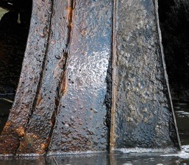
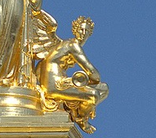

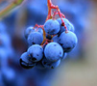
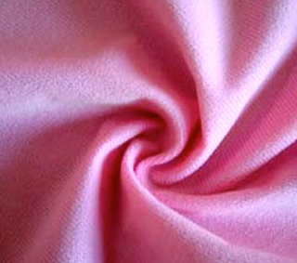
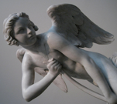
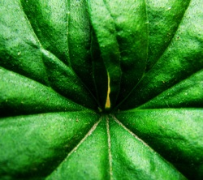
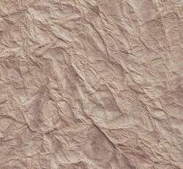
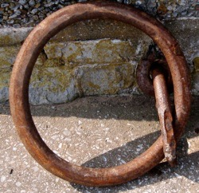
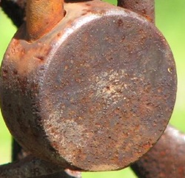
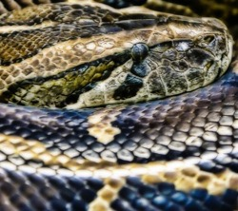
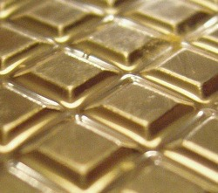
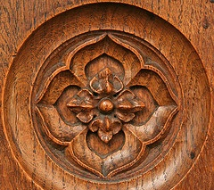
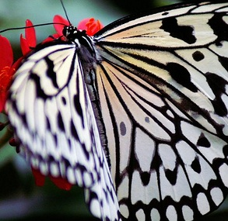
Radiometry and reflectance
16-385 Computer Vision
Spring 2019, Lecture 13
http://www.cs.cmu.edu/~16385/

Slide 2
Course announcements
Homework 3 has been posted and is due on March 10th.
- Any questions about the homework?
- How many of you have looked at/started/finished homework 3?
Extra office hours today: Wednesday 6-8 pm, graphics lounge.

Slide 3
Computer vision talks at CMU
VASC Seminar: https://www.ri.cmu.edu/events/category/vasc-seminar/month/
- VASC stands for Vision and Autonomous Systems Center (no idea).
- One of the longest-running and best-known departmental vision seminars.
Faculty candidate talks: https://www.ri.cmu.edu/events/
- Many vision talks this year.
- Some of the best our field has to offer – the rising stars of computer vision.
Jiajun Wu 3/7 10am NSH 3305
Jun-Yan Zhu 3/19 noon GHC 6115
Angjoo Kanazawa 3/21 10am GHC 6115
Abe Davis 3/25 2pm GHC 6115
Matthias Niessner 3/27 noon GHC 6115
Angela Dai 3/28 noon GHC 6115
Robotics Institute Seminar: https://www.ri.cmu.edu/events/category/robotics-seminar/month/
- Most of the time about robotic, but sometimes about vision.
Talks in other departments (MLD, CSD).

Slide 4

Computer vision talks at CMU
Find all events: https://www.ri.cmu.edu/events/
I will be sending notifications on Piazza about vision talks.
I will also be starting discussion threads on Piazza about vision talks.
Attending and commenting on talks regularly can count towards an extra 5% credit.

Slide 5
Overview of today’s lecture
Appearance phenomena.
Measuring light and radiometry.
Reflectance and BRDF.
Light sources.

Slide 6
Slide credits
Most of these slides were adapted from:
Srinivasa Narasimhan (16-385, Spring 2014).
Todd Zickler (Harvard University).
Steven Gortler (Harvard University).

Slide 7
Appearance

Slide 8
Appearance
Notes:
The problem becomes especially difficult when we allow ourselves to consider the full diversity of the materials that surround us.
Different materials reflect light in different ways, and while these differences in color, sheen, gloss, haze, and so on are what makes many pictures beautiful, they are also what makes them very hard to analyze radiometrically.

Slide 9

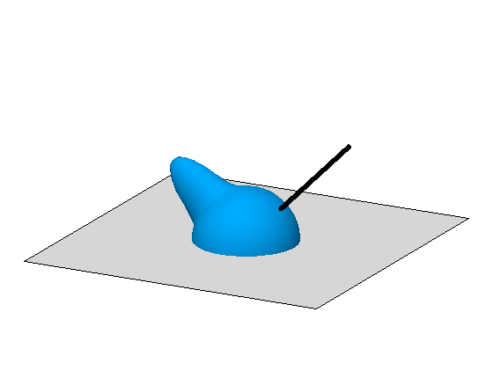

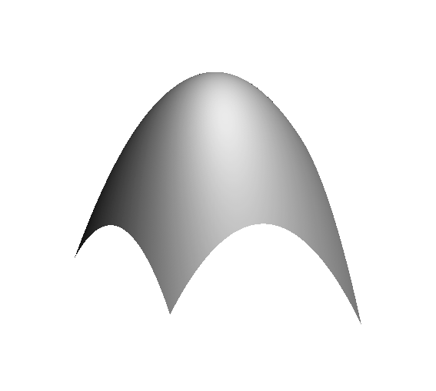
“Physics-based” computer vision
(a.k.a “inverse optics”)
Our challenge: Invent computational representations of shape, lighting, and reflectance that are efficient: simple enough to make inference tractable, yet general enough to capture the world’s most important phenomena
illumination
reflectance
shape
shape
, illumination
, reflectance
Notes:
Our work addresses the problem of inferring scene properties from image data.
Specifically, we want to relate observed image intensities to object shape, scene illumination, and material properties, or surface reflectance.
The task is made difficult by the fact that shape, lighting, and reflectance information are all tightly coupled in the image data so that we cannot typically draw conclusions about one of them without making restrictive assumptions about the others.

Slide 10
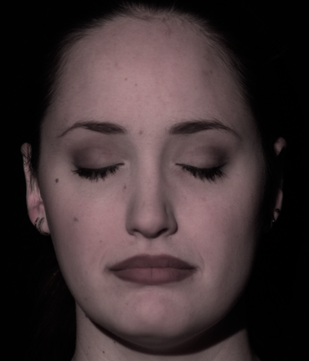
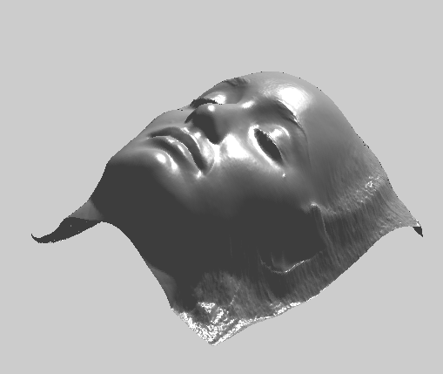
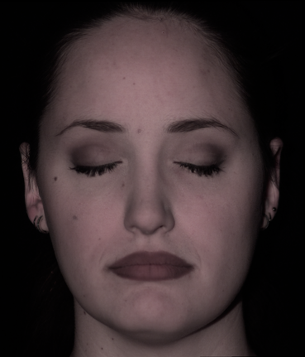
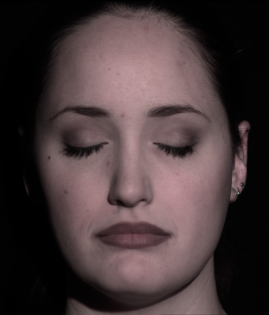
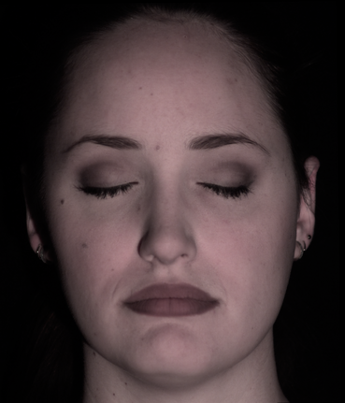
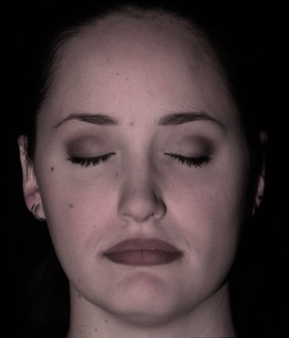
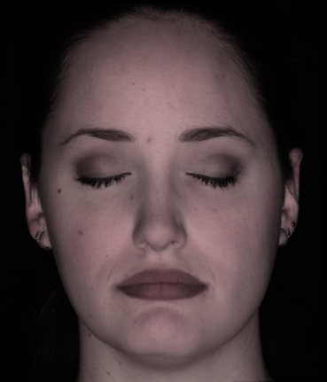
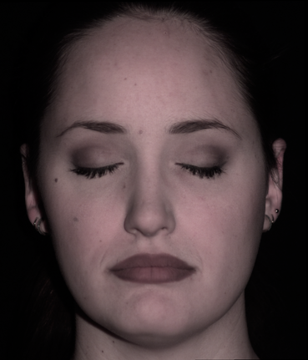
Example application: Photometric Stereo

Slide 11
Why study the physics (optics) of the world?
Lets see some pictures!

Slide 12
Light and Shadows

Slide 13
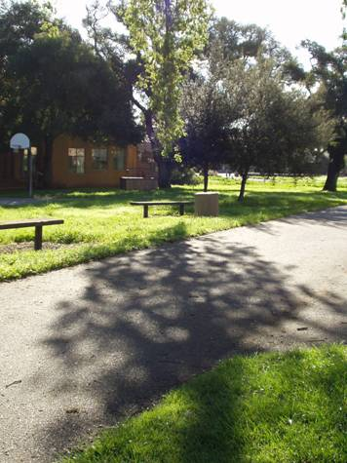

Slide 14
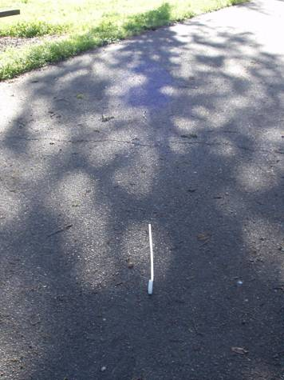
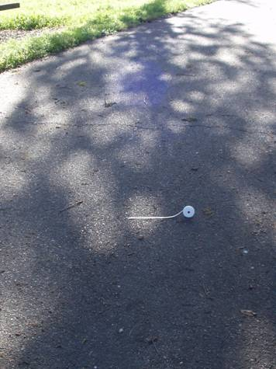

Slide 15
Reflections

Slide 16
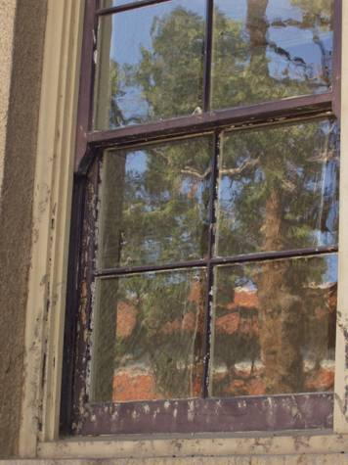
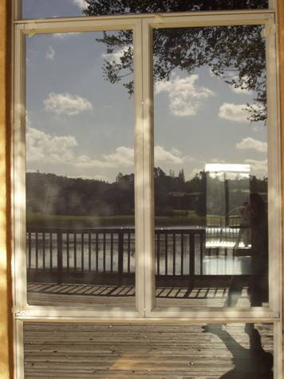

Slide 17
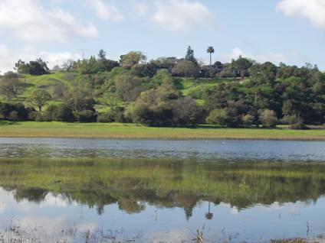

Slide 18
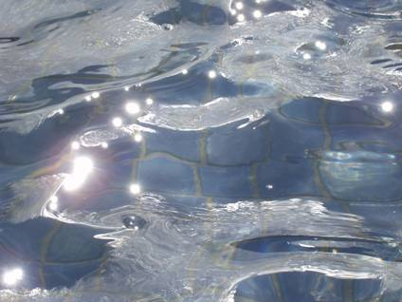
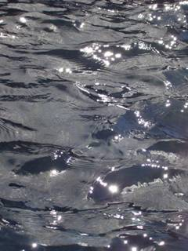

Slide 19
Refractions

Slide 20
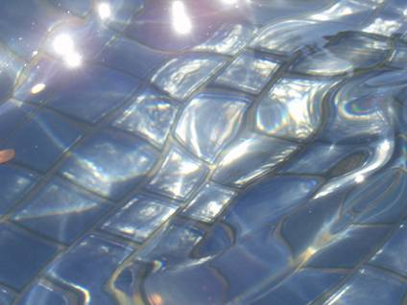

Slide 21
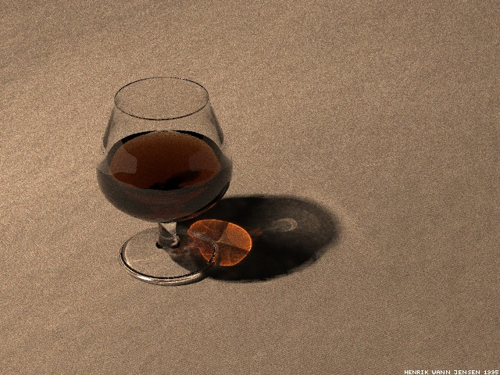
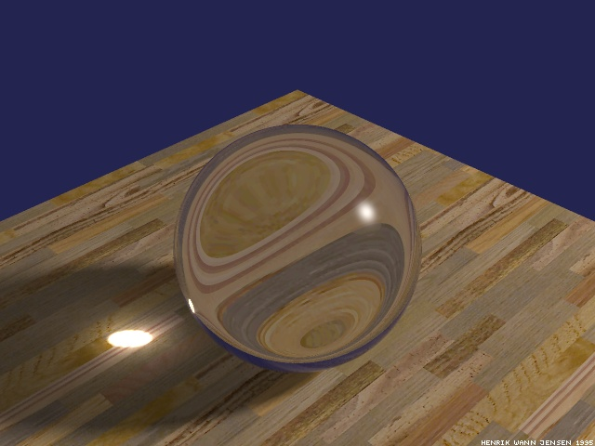

Slide 22
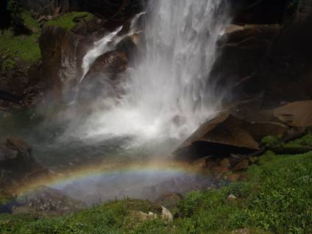

Slide 23
Interreflections

Slide 24
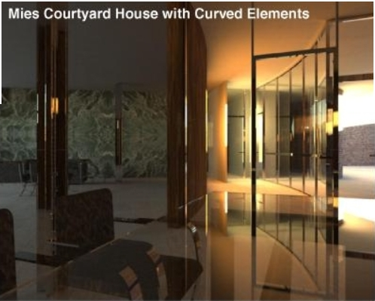

Slide 25
Scattering

Slide 26
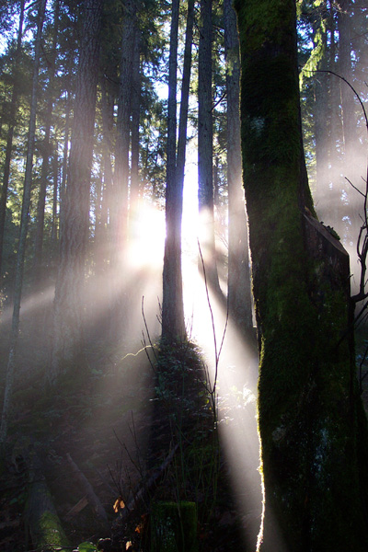
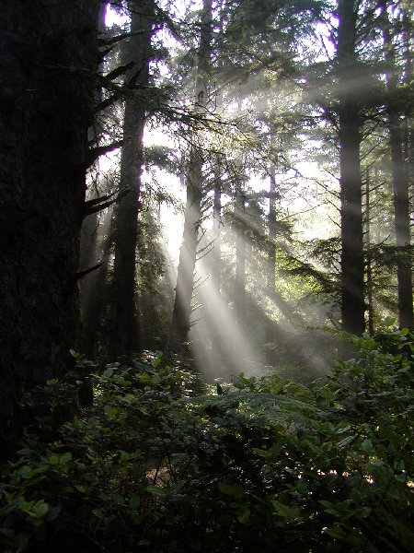

Slide 27
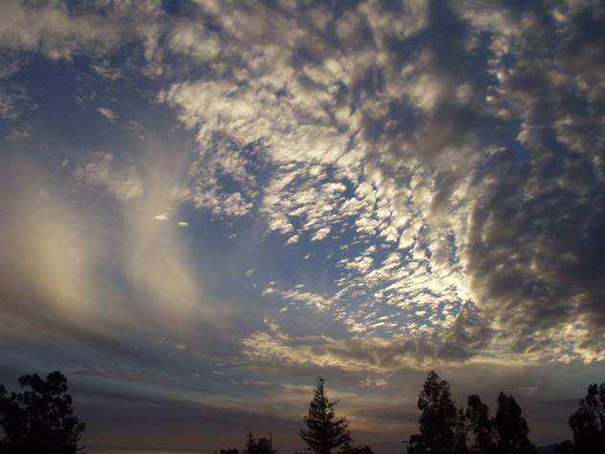

Slide 28
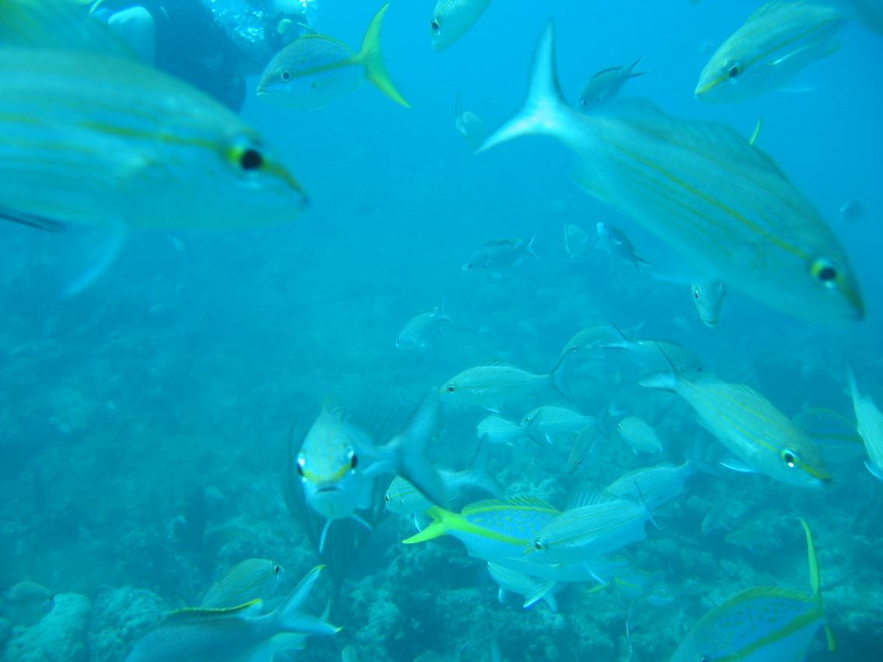

Slide 29
More Complex Appearances

Slide 30

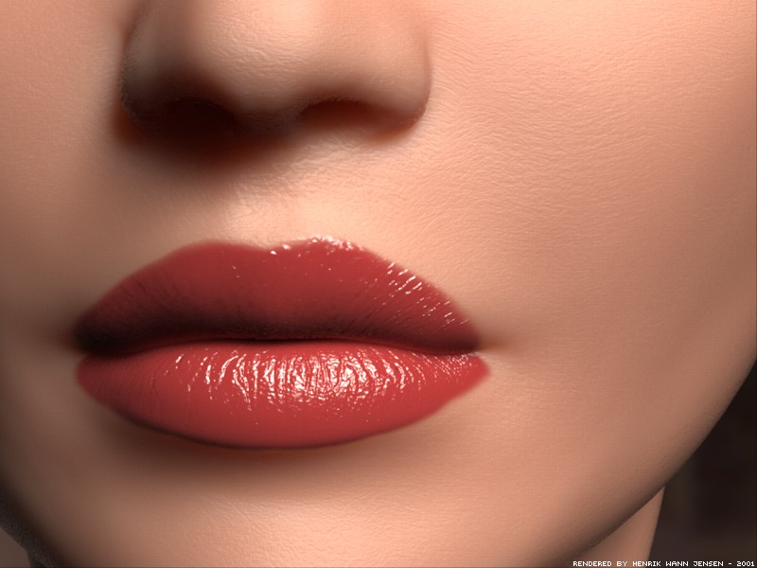

Slide 31
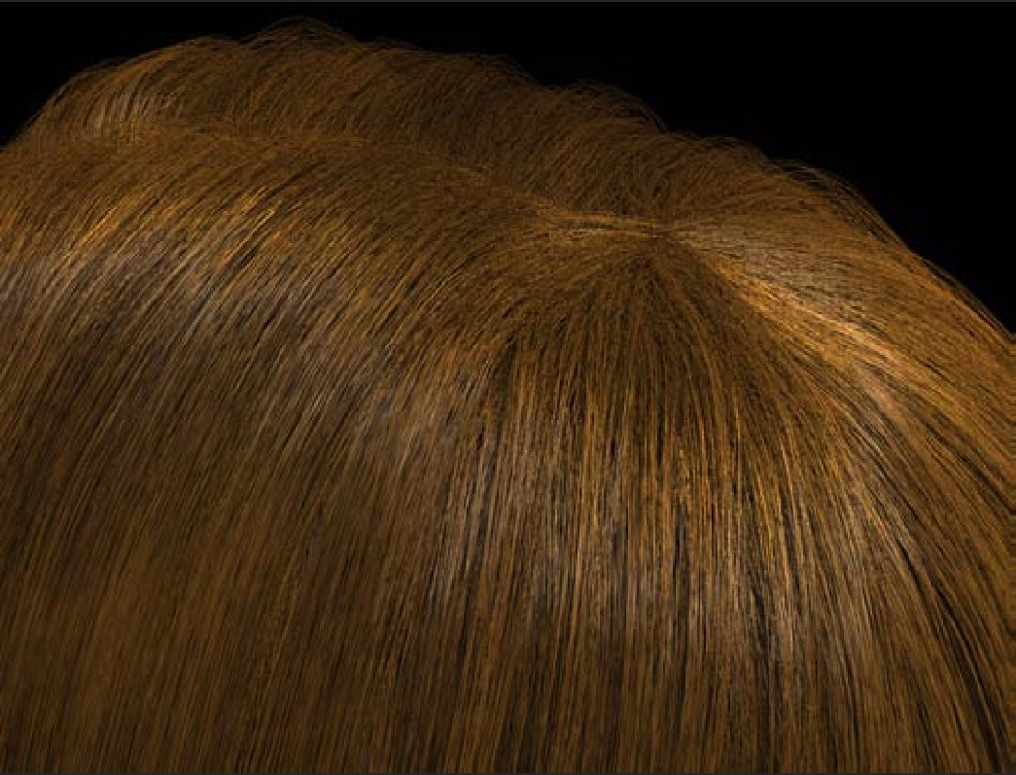

Slide 32
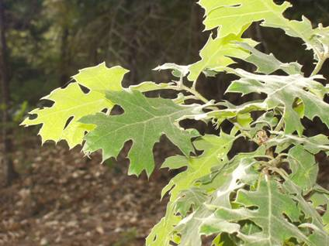
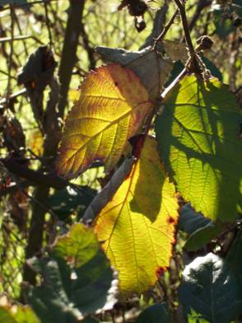
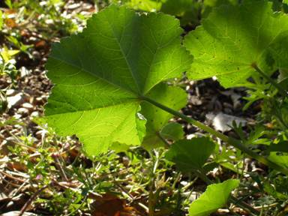

Slide 33
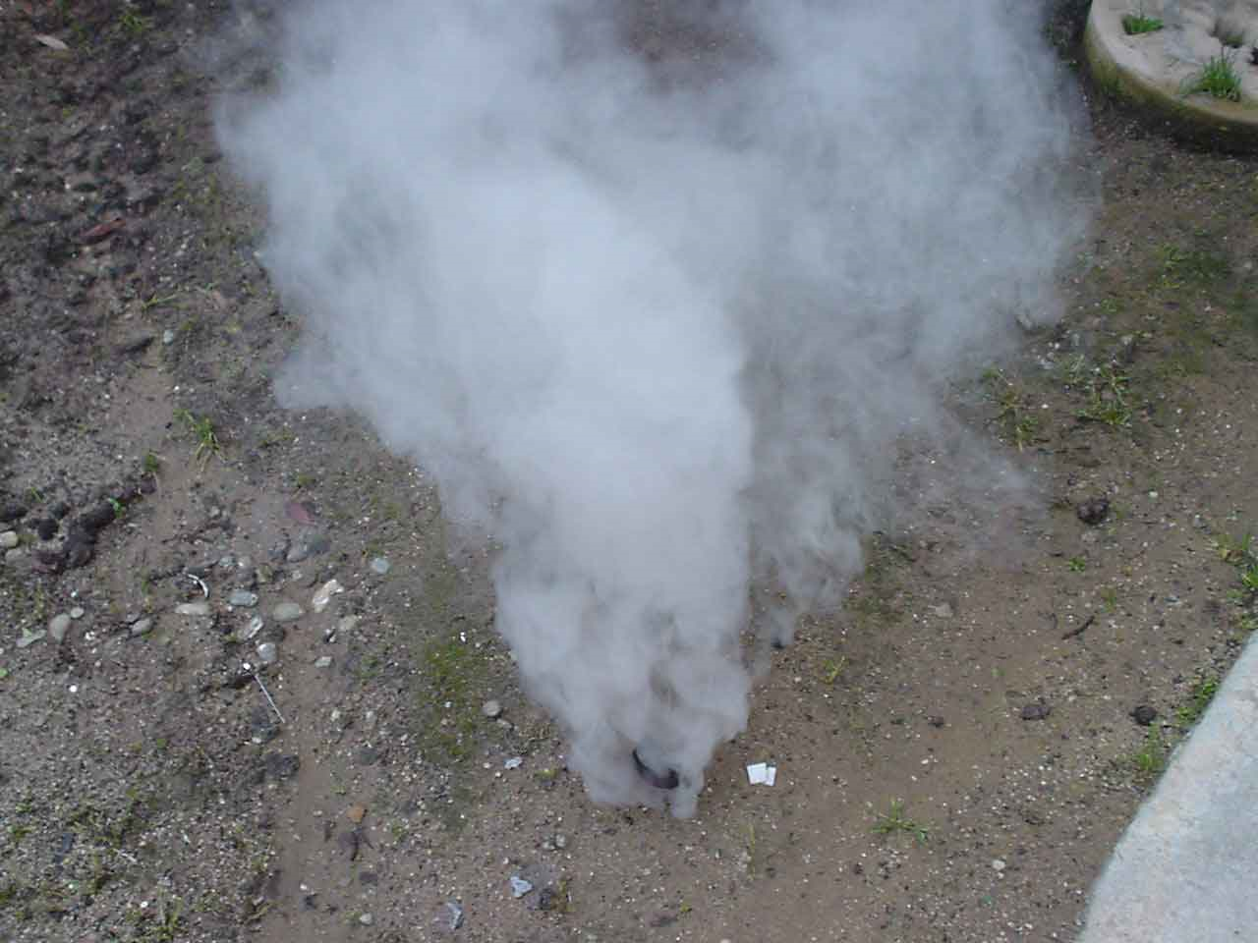

Slide 34
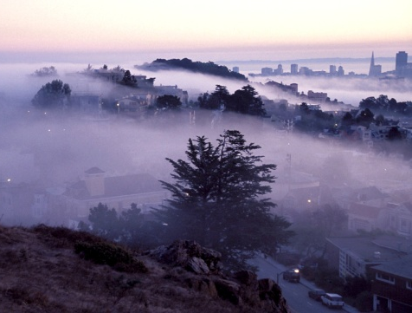
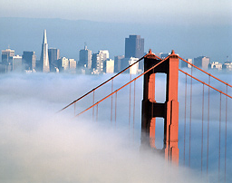
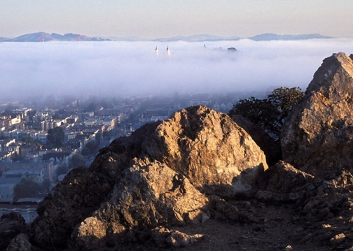
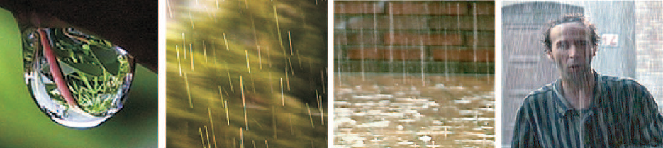


Slide 35
Measuring light and radiometry

Slide 36
Solid angle
The solid angle subtended by a small surface patch with respect to point O is the area of its central projection onto the unit sphere about O
Depends on:
  orientation of patch
  distance of patch

Slide 37

Solid angle
The solid angle subtended by a small surface patch with respect to point O is the area of its central projection onto the unit sphere about O
Depends on:
  orientation of patch
  distance of patch
One can show:
Units: steradians [sr]

Slide 38
Solid angle
The solid angle subtended by a small surface patch with respect to point O is the area of its central projection onto the unit sphere about O
Depends on:
  orientation of patch
  distance of patch
One can show:
“surface foreshortening”
Units: steradians [sr]

Slide 39

Solid angle
To calculate solid angle subtended by a surface S relative to O you must add up (integrate) contributions from all tiny patches (nasty integral)
One can show:
“surface foreshortening”
Units: steradians [sr]

Slide 40
Question
Suppose surface S is a hemisphere centered at O. What is the solid angle it subtends?

Slide 41
Question
Suppose surface S is a hemisphere centered at O. What is the solid angle it subtends?
Answer: 2\pi (area of sphere is 4\pi*r^2; area of unit sphere is 4\pi; half of that is 2\pi)

Slide 42

Quantifying light: flux, irradiance, and radiance
Imagine a sensor that counts photons passing through planar patch X in directions within angular wedge W
It measures radiant flux [watts = joules/sec]: rate of photons hitting sensor area
Measurement depends on sensor area |X|
* shown in 2D for clarity; imagine three dimensions
radiant flux

Slide 43

Quantifying light: flux, irradiance, and radiance
Irradiance:
A measure of incoming light that is independent of sensor area |X|
Units: watts per square meter [W/m²]

Slide 44

Quantifying light: flux, irradiance, and radiance
Irradiance:
A measure of incoming light that is independent of sensor area |X|
Units: watts per square meter [W/m²]

Slide 45

Quantifying light: flux, irradiance, and radiance
Irradiance:
A measure of incoming light that is independent of sensor area |X|
Units: watts per square meter [W/m²]
Depends on sensor direction normal.
We keep track of the normal because a planar sensor with distinct orientation would converge to a different limit
In the literature, notations n and W are often omitted, and values are implied by context

Slide 46



Quantifying light: flux, irradiance, and radiance
Radiance:
A measure of incoming light that is independent of sensor area |X|, orientation n, and wedge size (solid angle) |W|
Units: watts per steradian per square meter [W/(m²∙sr)]
Has correct units, but still depends on sensor orientation
To correct this, convert to measurement that would have been made if sensor was perpendicular to direction ω

Slide 47

Quantifying light: flux, irradiance, and radiance
Radiance:
A measure of incoming light that is independent of sensor area |X|, orientation n, and wedge size (solid angle) |W|
Units: watts per steradian per square meter [W/(m²∙sr)]
“foreshortened area”
Has correct units, but still depends on sensor orientation
To correct this, convert to measurement that would have been made if sensor was perpendicular to direction ω

Slide 48


Quantifying light: flux, irradiance, and radiance
Radiance:
A measure of incoming light that is independent of sensor area |X|, orientation n, and wedge size (solid angle) |W|
Units: watts per steradian per square meter [W/(m²∙sr)]
Has correct units, but still depends on sensor orientation
To correct this, convert to measurement that would have been made if sensor was perpendicular to direction ω

Slide 49
Quantifying light: flux, irradiance, and radiance
Radiance:
A measure of incoming light that is independent of sensor area |X|, orientation n, and wedge size (solid angle) |W|
Units: watts per steradian per square meter [W/(m²∙sr)]
“foreshortened in the
direction of travel”
Has correct units, but still depends on sensor orientation
To correct this, convert to measurement that would have been made if sensor was perpendicular to direction ω

Slide 50
Quantifying light: flux, irradiance, and radiance
Attractive properties of radiance:
  Allows computing the radiant flux measured by any finite sensor
Notes:
\Phi(W,X)=\int_X\int_W L(\hat{\boldsymbol{\omega}},x)d\boldsymbol{\omega}dA

Slide 51

Quantifying light: flux, irradiance, and radiance
Attractive properties of radiance:
  Allows computing the radiant flux measured by any finite sensor
Notes:
\Phi(W,X)=\int_X\int_W L(\hat{\boldsymbol{\omega}},x)d\boldsymbol{\omega}dA

Slide 52

Quantifying light: flux, irradiance, and radiance
Attractive properties of radiance:
  Allows computing the radiant flux measured by any finite sensor
  Constant along a ray in free space

Slide 53
Quantifying light: flux, irradiance, and radiance
Attractive properties of radiance:
  Allows computing the radiant flux measured by any finite sensor
  Constant along a ray in free space
  A camera measures radiance (after a one-time radiometric calibration). So RAW pixel values are proportional to radiance.
  - “Processed” images (like PNG and JPEG) are not linear radiance measurements!!
Notes:
Possible classroom question: A Lambertian planar light source (e.g., a heated metal sheet) is one whose radiant intensity is J(\omega)=J_o<N,\omega>. Show that emitted radiance is independent of \omega (and thus that the sheet looks equally bright from all directions)

Slide 54


Question
Most light sources, like a heated metal sheet, follow Lambert’s Law
radiant intensity [W/sr]
“Lambertian
area source”
What is the radiance of an infinitesimal patch [W/sr･m²]?
Notes:
%%% latexit code
J(\hat{\boldsymbol{\omega}})=J_o\langle\hat{\boldsymbol{\omega}},\hat{\boldsymbol{n}}\rangle=J_o\cos\theta

Slide 55

Question
Most light sources, like a heated metal sheet, follow Lambert’s Law
radiant intensity [W/sr]
“Lambertian
area source”
What is the radiance of an infinitesimal patch [W/sr･m²]?
Answer:
(independent of direction)
Notes:
%%% latexit code
J(\hat{\boldsymbol{\omega}})=J_o\langle\hat{\boldsymbol{\omega}},\hat{\boldsymbol{n}}\rangle=J_o\cos\theta

Slide 56
Question
Most light sources, like a heated metal sheet, follow Lambert’s Law
radiant intensity [W/sr]
“Lambertian
area source”
What is the radiance of an infinitesimal patch [W/sr･m²]?
Answer:
(independent of direction)
“Looks equally bright when viewed from any direction”
Notes:
%%% latexit code
J(\hat{\boldsymbol{\omega}})=J_o\langle\hat{\boldsymbol{\omega}},\hat{\boldsymbol{n}}\rangle=J_o\cos\theta

Slide 57
Radiometric concepts – boring…but, important!
source
(solid angle subtended by )
(foreshortened area)
(surface area)
(1) Solid Angle :
( steradian )
(4) Surface Radiance (tricky) :
What is the solid angle subtended by a hemisphere?
2
(watts / m steradian )
(2) Radiant Intensity of Source :
( watts / steradian )
Flux emitted per unit foreshortened area
per unit solid angle.
L depends on direction
Surface can radiate into whole hemisphere.
L depends on reflectance properties of surface.
Light Flux (power) emitted per unit solid angle
(3) Surface Irradiance :
( watts / m )
Light Flux (power) incident per unit surface area.
Does not depend on where the light is coming from!

Slide 58
Appearance
Notes:
The problem becomes especially difficult when we allow ourselves to consider the full diversity of the materials that surround us.
Different materials reflect light in different ways, and while these differences in color, sheen, gloss, haze, and so on are what makes many pictures beautiful, they are also what makes them very hard to analyze radiometrically.

Slide 59
“Physics-based” computer vision
(a.k.a “inverse optics”)
illumination
reflectance
shape
shape
, illumination
, reflectance
Notes:
Our work addresses the problem of inferring scene properties from image data.
Specifically, we want to relate observed image intensities to object shape, scene illumination, and material properties, or surface reflectance.
The task is made difficult by the fact that shape, lighting, and reflectance information are all tightly coupled in the image data so that we cannot typically draw conclusions about one of them without making restrictive assumptions about the others.

Slide 60
Reflectance and BRDF

Slide 61
Reflectance
Ratio of outgoing energy to incoming energy at a single point
Want to define a ratio such that it:
  converges as we use smaller and smaller incoming and outgoing wedges
  does not depend on the size of the wedges (i.e. is intrinsic to the material)
Notes:
f_{x,\hat{\bf n}}(W_\text{in},\hat{\boldsymbol{\omega}}_\text{out})=\frac{L^\text{out}(x,\hat{\boldsymbol{\omega}}_\text{out})}{E_{\hat{\bf n}}^\text{in}(W_\text{in},x)}
\lim_{W_\text{in}\longrightarrow \hat{\boldsymbol{w}}_\text{in}}
f_{x,\hat{\bf n}}(\hat{\boldsymbol{\omega}}_\text{in},\hat{\boldsymbol{\omega}}_\text{out})

Slide 62





Reflectance
Ratio of outgoing energy to incoming energy at a single point
Want to define a ratio such that it:
  converges as we use smaller and smaller incoming and outgoing wedges
  does not depend on the size of the wedges (i.e. is intrinsic to the material)
Notations x and n often implied by context and omitted; directions \omega are expressed in local coordinate system defined by normal n (and some chosen tangent vector)
Units: sr⁻¹
Called Bidirectional Reflectance Distribution Function (BRDF)
Notes:
f_{x,\hat{\bf n}}(W_\text{in},\hat{\boldsymbol{\omega}}_\text{out})=\frac{L^\text{out}(x,\hat{\boldsymbol{\omega}}_\text{out})}{E_{\hat{\bf n}}^\text{in}(W_\text{in},x)}
\lim_{W_\text{in}\longrightarrow \hat{\boldsymbol{w}}_\text{in}}
f_{x,\hat{\bf n}}(\hat{\boldsymbol{\omega}}_\text{in},\hat{\boldsymbol{\omega}}_\text{out})

Slide 63
BRDF: Bidirectional Reflectance Distribution Function
z
source
incident
direction
viewing
direction
y
normal
surface
element
x
Irradiance at Surface in direction
Radiance of Surface in direction
BRDF :

Slide 64
Reflectance: BRDF
Units: sr⁻¹
Real-valued function defined on the double-hemisphere
Has many useful properties
Notes:
f(\hat{\boldsymbol{\omega}}_\text{in},\hat{\boldsymbol{\omega}}_\text{out})
f(\hat{\boldsymbol{\omega}}_\text{in},\hat{\boldsymbol{\omega}}_\text{out})=f(\hat{\boldsymbol{\omega}}_\text{out},\hat{\boldsymbol{\omega}}_\text{in})
\forall \hat{\boldsymbol{\omega}}_\text{in},\ \ \int_{\Omega_\text{out}} f(\hat{\boldsymbol{\omega}}_\text{in},\hat{\boldsymbol{\omega}}_\text{out})\cos\theta_\text{out}d\hat{\boldsymbol{\omega}}_\text{out}\le 1

Slide 65

Important Properties of BRDFs
z
source
incident
direction
viewing
direction
y
normal
surface
element
x
Conservation of Energy:
Why smaller than or equal?

Slide 66





Property: “Helmholtz reciprocity”
Helmholtz Reciprocity: (follows from 2nd Law of Thermodynamics)
BRDF does not change when source and viewing directions are swapped.
Notes:
For example, a useful property of most opaque materials is that their reflectance function has a symmetry property known as reciprocity.
Reciprocity states that the BRDF is symmetric in terms of its input and output directions, so if we swap these directions, the BRDF value remain unchanged.

Slide 67




Common assumption: Isotropy
BRDF does not change when surface is rotated about the normal.
4D → 3D
[Matusik et al., 2003]
Bi-directional Reflectance Distribution Function (BRDF)
Can be written as a function of 3 variables :
Notes:
An isotropic BRDF is one that is:
- unchanged when the input is spun around the surface normal, and
- symmetric across the incident plane,
These symmetry conditions imply that the domain of an isotropic BRDF is three dimensional instead of four.
<animate> Returning to our problem...

Slide 68

Useful re-parameterization of double-hemisphere
Notes:
An isotropic BRDF is one that is:
- unchanged when the input is spun around the surface normal, and
- symmetric across the incident plane,
These symmetry conditions imply that the domain of an isotropic BRDF is three dimensional instead of four.
<animate> Returning to our problem...

Slide 69

Useful re-parameterization of double-hemisphere
reciprocity
Notes:
An isotropic BRDF is one that is:
- unchanged when the input is spun around the surface normal, and
- symmetric across the incident plane,
These symmetry conditions imply that the domain of an isotropic BRDF is three dimensional instead of four.
<animate> Returning to our problem...

Slide 70
Useful re-parameterization of double-hemisphere
reciprocity
isotropy:
Notes:
An isotropic BRDF is one that is:
- unchanged when the input is spun around the surface normal, and
- symmetric across the incident plane,
These symmetry conditions imply that the domain of an isotropic BRDF is three dimensional instead of four.
<animate> Returning to our problem...

Slide 71

Reflectance: BRDF
Units: sr⁻¹
Real-valued function defined on the double-hemisphere
Has many useful properties
Allows computing output radiance (and thus pixel value) for any configuration of lights and viewpoint
reflectance equation
Why is there a cosine in the reflectance equation?
Notes:
f(\hat{\boldsymbol{\omega}}_\text{in},\hat{\boldsymbol{\omega}}_\text{out})
f(\hat{\boldsymbol{\omega}}_\text{in},\hat{\boldsymbol{\omega}}_\text{out})=f(\hat{\boldsymbol{\omega}}_\text{out},\hat{\boldsymbol{\omega}}_\text{in})
\forall \hat{\boldsymbol{\omega}}_\text{in},\ \ \int_{\Omega_\text{out}} f(\hat{\boldsymbol{\omega}}_\text{in},\hat{\boldsymbol{\omega}}_\text{out})\cos\theta_\text{out}d\hat{\boldsymbol{\omega}}_\text{out}\le 1

Slide 72

Derivation of the Reflectance Equation
From the definition of BRDF:

Slide 73
Derivation of the Scene Radiance Equation
From the definition of BRDF:
Write Surface Irradiance in terms of Source Radiance:
Integrate over entire hemisphere of possible source directions:
Convert from solid angle to theta-phi representation:

Slide 74


Slide 75
BRDF
Bi-directional Reflectance Distribution Function (BRDF)

Slide 76


BRDF
Lambertian (diffuse) BRDF: energy equally distributed in all directions
What does the BRDF equal in this case?
Bi-directional Reflectance Distribution Function (BRDF)
Notes:
At the other end, as I already mentioned is something that is ideally diffuse.

Slide 77
Diffuse Reflection and Lambertian BRDF
source intensity I
incident
direction
normal
viewing
direction
surface
element
Surface appears equally bright from ALL directions! (independent of )
albedo
Lambertian BRDF is simply a constant :
Most commonly used BRDF in Vision and Graphics!

Slide 78


BRDF
Specular BRDF: all energy concentrated in mirror direction
What does the BRDF equal in this case?
Bi-directional Reflectance Distribution Function (BRDF)
Notes:
In the limit, something that is a perfect mirror reflects light in only one direction and the reflectance is a delta function.

Slide 79
Specular Reflection and Mirror BRDF
source intensity I
specular/mirror
direction
incident
direction
normal
viewing
direction
surface
element
Valid for very smooth surfaces.
All incident light energy reflected in a SINGLE direction (only when = ).
Mirror BRDF is simply a double-delta function :
specular albedo

Slide 80





Example Surfaces
Body Reflection:
Diffuse Reflection
Matte Appearance
Non-Homogeneous Medium
Clay, paper, etc
Surface Reflection:
Specular Reflection
Glossy Appearance
Highlights
Dominant for Metals
Many materials exhibit
both Reflections:

Slide 81

BRDF
Glossy BRDF: more energy concentrated in mirror direction than elsewhere
Bi-directional Reflectance Distribution Function (BRDF)
Notes:
something that is more glossy will have a substantially different reflectance function -- one in which more of the energy is concentrated in the mirror direction

Slide 82
Trick for dielectrics (non-metals)
BRDF is a sum of a Lambertian diffuse component and non-Lambertian specular components
The two components differ in terms of color and polarization, and under certain conditions, this can be exploited to separate them.
Notes:
Before we continue, I want to clarify what I mean by separability, or the idea that SV-BRDF can be separated into distinct diffuse and specular components.

Slide 83

Trick for dielectrics (non-metals)
BRDF is a sum of a Lambertian diffuse component and non-Lambertian specular components
The two components differ in terms of color and polarization, and under certain conditions, this can be exploited to separate them.
Often called the dichromatic BRDF:
Diffuse term varies with wavelength, constant with polarization
Specular term constant with wavelength, varies with polarization
Notes:
Before we continue, I want to clarify what I mean by separability, or the idea that SV-BRDF can be separated into distinct diffuse and specular components.

Slide 84




Trick for dielectrics (non-metals)
DIFFUSE
SPECULAR
=
+
In this example, the two components were separated using linear polarizing filters on the camera and light source.

Slide 85



Trick for dielectrics (non-metals)
DIFFUSE
SPECULAR
=
+

Slide 86



Tabulated 4D BRDFs (hard to measure)
Gonioreflectometer
[Ngan et al., 2005]
Notes:
At the other end, as I already mentioned is something that is ideally diffuse.

Slide 87




Low-parameter (non-linear) BRDF models
A small number of parameters define the (2D,3D, or 4D) function
Except for Lambertian, the BRDF is non-linear in these parameters
Examples:
Where do these constants come from?
Lambertian:
Phong:
Blinn:
Lafortune:
Ward:
α is called the albedo

Slide 88
Reflectance Models
Reflection: An Electromagnetic Phenomenon
Two approaches to derive Reflectance Models:
  Physical Optics (Wave Optics)
  Geometrical Optics (Ray Optics)
  Geometrical models are approximations to physical models
  But they are easier to use!

Slide 89


Reflectance that Require Wave Optics

Slide 90
Summary of some useful lighting models
plenoptic function (function on 5D domain)
far-field illumination (function on 2D domain)
low-frequency far-field illumination (nine numbers)
directional lighting (three numbers = direction and strength)
point source (four numbers = location and strength)

Slide 91
References
Basic reading:
Szeliski, Section 2.2.
Gortler, Chapter 21.
This book by Steven Gortler has a great introduction to radiometry, reflectance, and their use for image formation.
Additional reading:
Arvo, “Analytic Methods for Simulated Light Transport,” Yale 1995.
Veach, “Robust Monte Carlo Methods for Light Transport Simulation,” Stanford 1997.
These two thesis are foundational for modern computer graphics. Among other things, they include a thorough derivation (starting from wave optics and measure theory) of all radiometric quantities and associated integro- differential equations. You can also look at them if you are interested in physics-based rendering.
Dutre et al., “Advanced Global Illumination,” 2006.
A book discussing modeling and simulation of other appearance effects beyond single-bounce reflectance.
Weyrich et al., “Principles of Appearance Acquisition and Representation,” FTCGV 2009.
A very thorough review of everything that has to do with modeling and measuring BRDFs.
Walter et al., “Microfacet models for refraction through rough surfaces,” EGSR 2007.
This paper has a great review of physics-based models for reflectance and refraction.
Matusik, “A data-driven reflectance model,” MIT 2003.
This thesis introduced the largest measured dataset of 4D reflectances. It also provides detailed discussion of many topics relating to modelling reflectance.
Rusinkiewicz, “A New Change of Variables for Efficient BRDF Representation,” 1998.
Romeiro and Zickler, “Inferring reflectance under real-world illumination,” Harvard TR 2010.
These two papers discuss the isotropy and other properties of common BRDFs, and how one can take advantage of them using alternative parameterizations.
Shafer, “Using color to separate reflection components,” 1984.
The paper introducing the dichromatic reflectance model.
Stam, “Diffraction Shaders,” SIGGRAPH 1999.
Levin et al., “Fabricating BRDFs at high spatial resolution using wave optics,” SIGGRAPH 2013.
Cuypers et al., “Reflectance model for diffraction,” TOG 2013.
These three papers describe reflectance effects that can only be modeled using wave optics (and in particular diffraction).
Notes:
Ch

