Slide 1
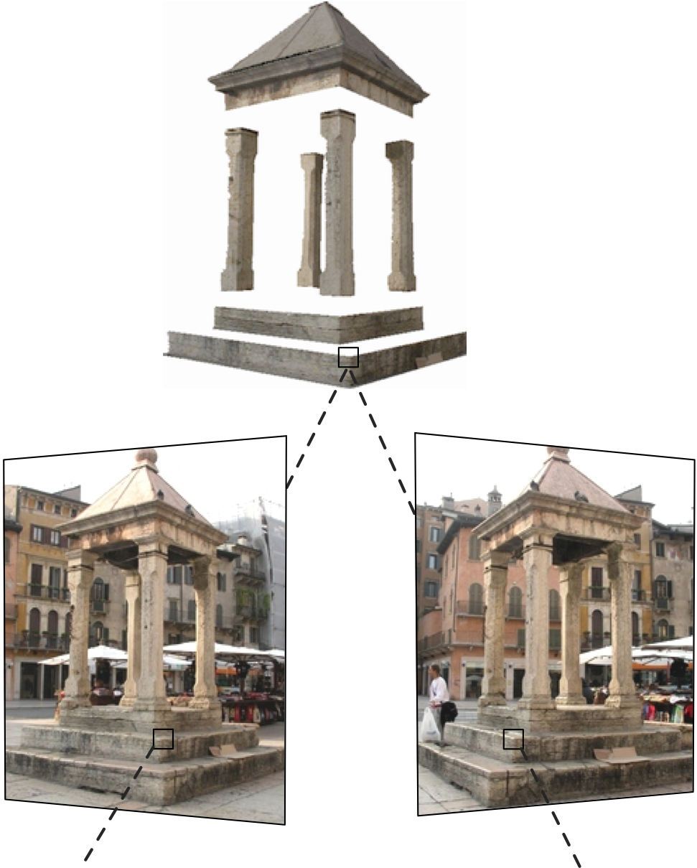
Two-view geometry
16-385 Computer Vision
Spring 2019, Lecture 10
http://www.cs.cmu.edu/~16385/

Slide 2
Course announcements
Homework 2 is due on Wednesday.
- How many of you have looked at/started/finished homework 2?
Homework 3 will be released on Wednesday and will be due Friday, March 8th.
- Do you prefer Sunday, March 10th?
Yannis has extra office hours on Tuesday 3-5pm.
The Hartley-Zisserman book is available online for free from CMU’s library.

Slide 3
Overview of today’s lecture
Leftover from previous lecture: Other types of cameras, calibration.
Triangulation.
Epipolar geometry.
Essential matrix.
Fundamental matrix.
8-point algorithm.

Slide 4
Slide credits
Most of these slides were adapted from:
Kris Kitani (16-385, Spring 2017).

Slide 5
Triangulation

Slide 6
 | Structure (scene geometry) | Motion (camera geometry) | Measurements
Pose Estimation | known | estimate | 3D to 2D correspondences
Triangulation | estimate | known | 2D to 2D coorespondences
Reconstruction | estimate | estimate | 2D to 2D coorespondences

Slide 7



Triangulation
image 1
image 2
Given
camera 1 with matrix
camera 2 with matrix

Slide 8
Triangulation
Which 3D points map to x?
image 1
image 2
camera 1 with matrix
camera 2 with matrix

Slide 9
Triangulation
How can you compute this ray?
image 1
image 2
camera 1 with matrix
camera 2 with matrix

Slide 10
Triangulation
Create two points on the ray:
find the camera center; and
apply the pseudo-inverse of P on x.
Then connect the two points.
+
Why does this point map to x?
image 1
image 2
camera 1 with matrix
camera 2 with matrix

Slide 11
Triangulation
How do we find the exact point on the ray?
+
image 1
image 2
camera 1 with matrix
camera 2 with matrix

Slide 12

Triangulation
Find 3D object point
Will the lines intersect?
image 1
image 2
camera 1 with matrix
camera 2 with matrix

Slide 13
Triangulation
Find 3D object point
(no single solution due to noise)
image 1
image 2
camera 1 with matrix
camera 2 with matrix

Slide 14

Triangulation
Given a set of (noisy) matched points
and camera matrices
Estimate the 3D point

Slide 15
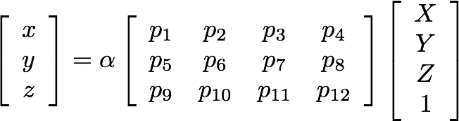
(homogeneous coordinate)
Also, this is a similarity relation because it involves homogeneous coordinates
(homorogeneous coordinate)
Same ray direction but differs by a scale factor
How do we solve for unknowns in a similarity relation?

Slide 16
(homogeneous coordinate)
Also, this is a similarity relation because it involves homogeneous coordinates
(homogeneous coordinate)
Same ray direction but differs by a scale factor
How do we solve for unknowns in a similarity relation?
Remove scale factor, convert to linear system and solve with SVD.

Slide 17
(homogeneous coordinate)
Also, this is a similarity relation because it involves homogeneous coordinates
(homogeneous coordinate)
Same ray direction but differs by a scale factor
How do we solve for unknowns in a similarity relation?
Remove scale factor, convert to linear system and solve with SVD!

Slide 18
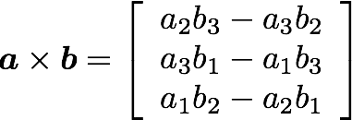
Recall: Cross Product
Vector (cross) product
takes two vectors and returns a vector perpendicular to both
cross product of two vectors in the same direction is zero
remember this!!!

Slide 19
Same direction but differs by a scale factor
Cross product of two vectors of same direction is zero
(this equality removes the scale factor)

Slide 20
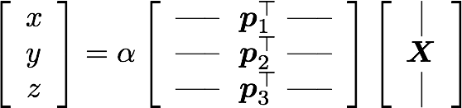
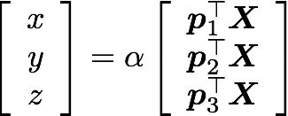

Slide 21
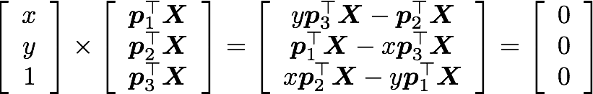

Slide 22
Using the fact that the cross product should be zero
Third line is a linear combination of the first and second lines.
(x times the first line plus y times the second line)
One 2D to 3D point correspondence give you 2 equations

Slide 23
Using the fact that the cross product should be zero
Third line is a linear combination of the first and second lines.
(x times the first line plus y times the second line)
One 2D to 3D point correspondence give you 2 equations

Slide 24



Now we can make a system of linear equations
(two lines for each 2D point correspondence)

Slide 25
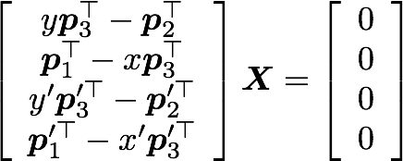
Concatenate the 2D points from both images
sanity check! dimensions?
How do we solve homogeneous linear system?

Slide 26
Concatenate the 2D points from both images
How do we solve homogeneous linear system?
S V D !

Slide 27
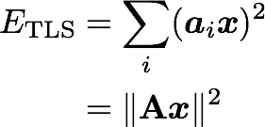




Recall: Total least squares
(Warning: change of notation. x is a vector of parameters!)
(matrix form)
constraint
minimize
minimize
subject to
(Rayleigh quotient)
Solution is the eigenvector
corresponding to smallest eigenvalue of

Slide 28
 | Structure (scene geometry) | Motion (camera geometry) | Measurements
Pose Estimation | known | estimate | 3D to 2D correspondences
Triangulation | estimate | known | 2D to 2D coorespondences
Reconstruction | estimate | estimate | 2D to 2D coorespondences

Slide 29
Epipolar geometry

Slide 30
Epipolar geometry
Image plane

Slide 31
Epipolar geometry
Baseline
Image plane

Slide 32

Epipolar geometry
Baseline
Image plane
Epipole
(projection of o’ on the image plane)

Slide 33
Epipolar geometry
Epipolar plane
Baseline
Baseline
Image plane
Epipole
(projection of o’ on the image plane)

Slide 34

Epipolar geometry
Epipolar line
(intersection of Epipolar plane and image plane)
Epipolar plane
Baseline
Image plane
Epipole
(projection of o’ on the image plane)

Slide 35
Quiz
What is this?

Slide 36
Quiz
Epipolar plane

Slide 37
Quiz
What is this?
Epipolar plane

Slide 38
Quiz
Epipolar line
(intersection of Epipolar plane and image plane)
Epipolar plane

Slide 39
Quiz
Epipolar line
(intersection of Epipolar plane and image plane)
Epipolar plane
What is this?

Slide 40
Quiz
Epipolar line
(intersection of Epipolar plane and image plane)
Epipolar plane
Epipole
(projection of o’ on the image plane)

Slide 41
Quiz
Epipolar line
(intersection of Epipolar plane and image plane)
Epipolar plane
What is this?
Epipole
(projection of o’ on the image plane)

Slide 42
Quiz
Epipolar line
(intersection of Epipolar plane and image plane)
Epipolar plane
Baseline
Epipole
(projection of o’ on the image plane)

Slide 43
Epipolar constraint
Potential matches for
lie on the epipolar line

Slide 44
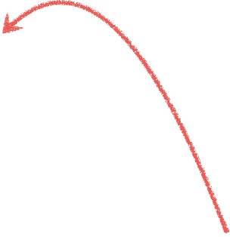

Epipolar constraint
Potential matches for
lie on the epipolar line

Slide 45
The point x (left image) maps to a ___________ in the right image
The baseline connects the ___________ and ____________
An epipolar line (left image) maps to a __________ in the right image
An epipole e is a projection of the ______________ on the image plane
All epipolar lines in an image intersect at the ______________

Slide 46
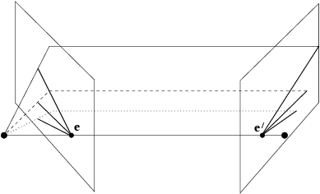
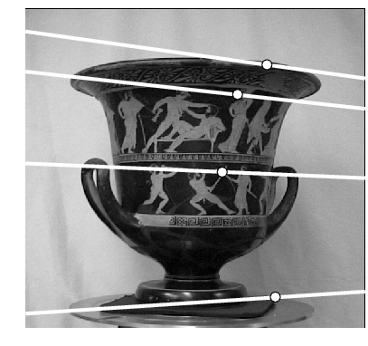
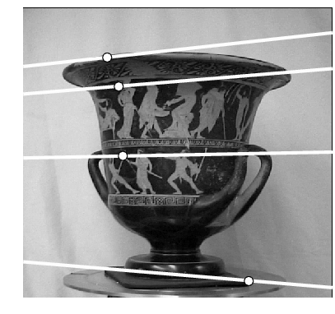

Converging cameras
Where is the epipole in this image?

Slide 47
Converging cameras
here!
Where is the epipole in this image?
It’s not always in the image

Slide 48
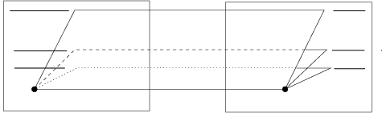
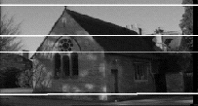
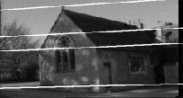
Parallel cameras
Where is the epipole?

Slide 49
Parallel cameras
epipole at infinity

Slide 50
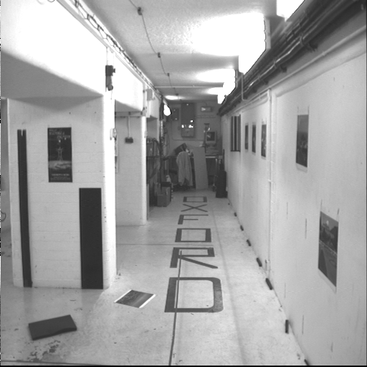
Forward moving camera

Slide 51
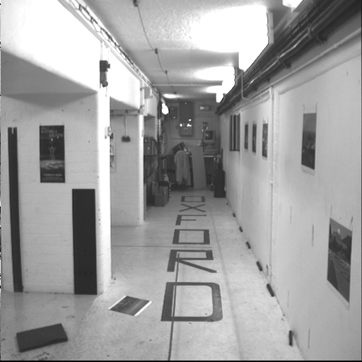
Forward moving camera

Slide 52
Where is the epipole?
What do the epipolar lines look like?

Slide 53
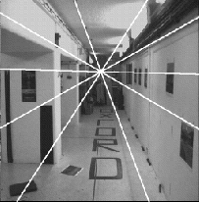
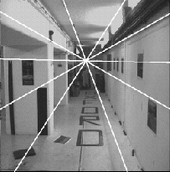
Epipole has same coordinates in both images.
Points move along lines radiating from “Focus of expansion”

Slide 54
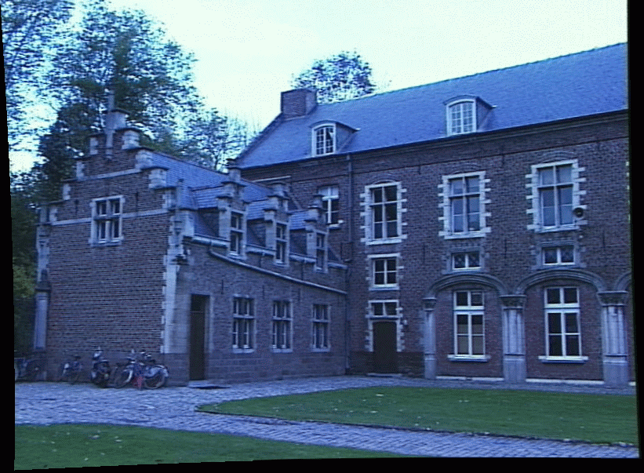
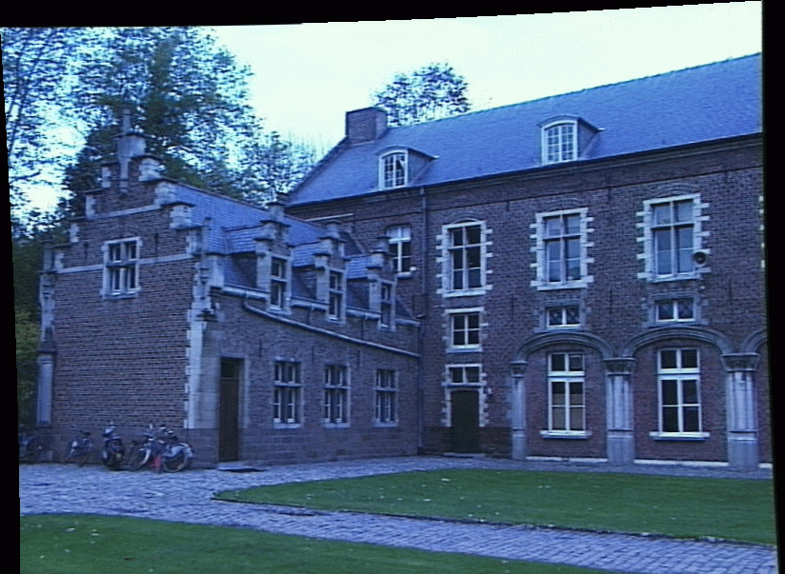

The epipolar constraint is an important concept for stereo vision
Task: Match point in left image to point in right image
Left image
Right image
How would you do it?

Slide 55
Recall:Epipolar constraint
Potential matches for
lie on the epipolar line

Slide 56
The epipolar constraint is an important concept for stereo vision
Task: Match point in left image to point in right image
Left image
Right image
Want to avoid search over entire image
Epipolar constraint reduces search to a single line

Slide 57
The epipolar constraint is an important concept for stereo vision
Task: Match point in left image to point in right image
Left image
Right image
Want to avoid search over entire image
Epipolar constraint reduces search to a single line
How do you compute the epipolar line?

Slide 58
The essential matrix

Slide 59
Recall:Epipolar constraint
Potential matches for
lie on the epipolar line

Slide 60

Given a point in one image,
multiplying by the essential matrix will tell us
the epipolar line in the second view.

Slide 61
Motivation
The Essential Matrix is a 3 x 3 matrix that encodes epipolar geometry
Given a point in one image,
multiplying by the essential matrix will tell us
the epipolar line in the second view.

Slide 62
Recall: Dot Product
dot product of two orthogonal vectors is zero

Slide 63
Recall: Cross Product
Vector (cross) product
takes two vectors and returns a vector perpendicular to both

Slide 64
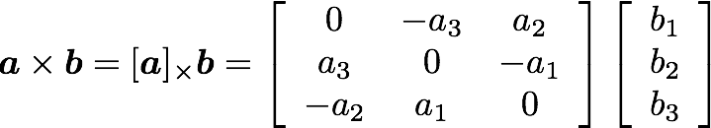
Cross product
Can also be written as a matrix multiplication
Skew symmetric

Slide 65
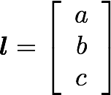


Epipolar Line
Representing the …
in vector form
If the point is on the epipolar line then

Slide 66

Epipolar Line
in vector form
If the point is on the epipolar line then

Slide 67


vector representing the line is normal (orthogonal) to the plane
vector representing the point x is inside the plane
Therefore:

Slide 68

So if and then

Slide 69

So if and then

Slide 70
Essential Matrix vs Homography
What’s the difference between the essential matrix and a homography?

Slide 71

Essential Matrix vs Homography
What’s the difference between the essential matrix and a homography?
They are both 3 x 3 matrices but …
Essential matrix maps a point to a line
Homography maps a point to a point

Slide 72
Where does the Essential matrix come from?

Slide 73




Slide 74
Does this look familiar?

Slide 75
Camera-camera transform just like world-camera transform

Slide 76
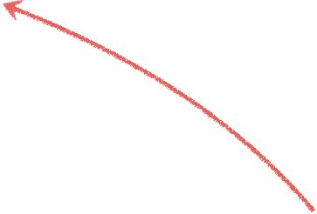
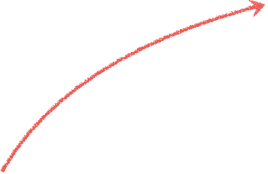


These three vectors are coplanar

Slide 77

If these three vectors are coplanar then

Slide 78

If these three vectors are coplanar then

Slide 79

If these three vectors are coplanar then

Slide 80

If these three vectors are coplanar then

Slide 81

putting it together
rigid motion
coplanarity

Slide 82

putting it together
rigid motion
coplanarity

Slide 83

putting it together
rigid motion
coplanarity

Slide 84
putting it together
rigid motion
coplanarity

Slide 85

putting it together
rigid motion
coplanarity
Essential Matrix
[Longuet-Higgins 1981]

Slide 86
properties of the E matrix
Longuet-Higgins equation
(points in normalized coordinates)

Slide 87


properties of the E matrix
Longuet-Higgins equation
Epipolar lines
(points in normalized coordinates)

Slide 88

properties of the E matrix
Longuet-Higgins equation
Epipolar lines
Epipoles
(points in normalized camera coordinates)

Slide 89
Recall:Epipolar constraint
Potential matches for
lie on the epipolar line

Slide 90
Given a point in one image,
multiplying by the essential matrix will tell us
the epipolar line in the second view.
Assumption:
points aligned to camera coordinate axis (calibrated camera)

Slide 91
How do you generalize to uncalibrated cameras?

Slide 92
The fundamental matrix

Slide 93
The
Fundamental matrix
is a
generalization
of the
Essential matrix,
where the assumption of
calibrated cameras
is removed

Slide 94



The Essential matrix operates on image points expressed in
normalized coordinates
(points have been aligned (normalized) to camera coordinates)
camera point
image point

Slide 95



The Essential matrix operates on image points expressed in
normalized coordinates
(points have been aligned (normalized) to camera coordinates)
camera point
image point
Writing out the epipolar constraint in terms of image coordinates

Slide 96
Same equation works in image coordinates!
it maps pixels to epipolar lines

Slide 97
properties of the E matrix
F
F
Longuet-Higgins equation
Epipolar lines
F
F
F
F
Epipoles
(points in image coordinates)

Slide 98


Breaking down the fundamental matrix
Depends on both intrinsic and extrinsic parameters

Slide 99

Breaking down the fundamental matrix
Depends on both intrinsic and extrinsic parameters
How would you solve for F?

Slide 100
The 8-point algorithm

Slide 101


Assume you have M matched image points
Each correspondence should satisfy
How would you solve for the 3 x 3 F matrix?

Slide 102
Assume you have M matched image points
Each correspondence should satisfy
How would you solve for the 3 x 3 F matrix?
S V D

Slide 103
Assume you have M matched image points
Each correspondence should satisfy
How would you solve for the 3 x 3 F matrix?
Set up a homogeneous linear system with 9 unknowns

Slide 104
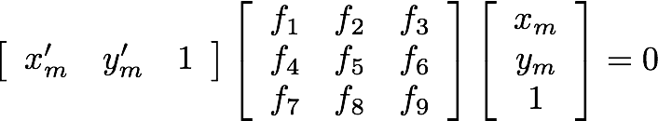
How many equation do you get from one correspondence?

Slide 105
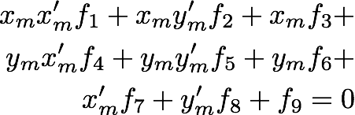
ONE correspondence gives you ONE equation

Slide 106
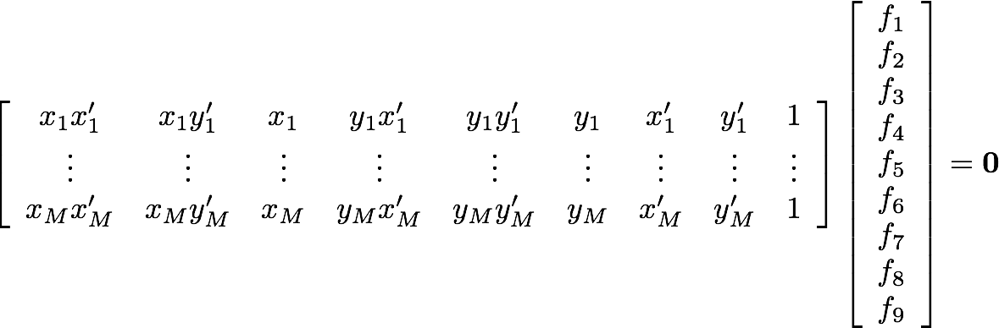
Set up a homogeneous linear system with 9 unknowns
How many equations do you need?

Slide 107
Each point pair (according to epipolar constraint)
contributes only one scalar equation
Note: This is different from the Homography estimation where each point pair contributes 2 equations.
We need at least 8 points
Hence, the 8 point algorithm!

Slide 108
How do you solve a homogeneous linear system?

Slide 109
How do you solve a homogeneous linear system?
Total Least Squares
minimize
subject to

Slide 110
How do you solve a homogeneous linear system?
Total Least Squares
minimize
subject to
S V D !

Slide 111
Eight-Point Algorithm
0. (Normalize points)
Construct the M x 9 matrix A
Find the SVD of A
Entries of F are the elements of column of V corresponding to the least singular value
4. (Enforce rank 2 constraint on F)
5. (Un-normalize F)

Slide 112
Eight-Point Algorithm
0. (Normalize points)
Construct the M x 9 matrix A
Find the SVD of A
Entries of F are the elements of column of V corresponding to the least singular value
4. (Enforce rank 2 constraint on F)
5. (Un-normalize F)
See Hartley-Zisserman for why we do this

Slide 113
Eight-Point Algorithm
0. (Normalize points)
Construct the M x 9 matrix A
Find the SVD of A
Entries of F are the elements of column of V corresponding to the least singular value
4. (Enforce rank 2 constraint on F)
5. (Un-normalize F)
How do we do this?

Slide 114
Eight-Point Algorithm
0. (Normalize points)
Construct the M x 9 matrix A
Find the SVD of A
Entries of F are the elements of column of V corresponding to the least singular value
4. (Enforce rank 2 constraint on F)
5. (Un-normalize F)
How do we do this?
S V D !

Slide 115
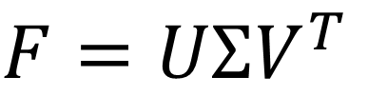
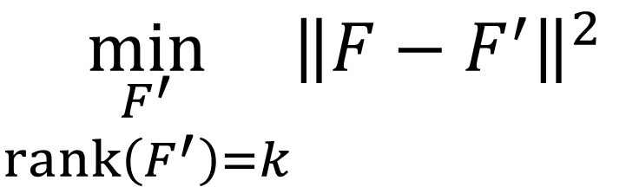
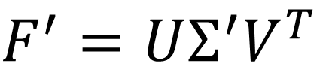
Enforcing rank constraints
Problem: Given a matrix F, find the matrix F’ of rank k that is closest to F,
$$\min_{\begin{aligned}F^{′} \\ rank\left(F^{′}\right)=k\end{aligned}}{{\left\|F−F^{′}\right\|}^{2}}$$
Solution: Compute the singular value decomposition of F,
$$F=UΣV^{T}$$
Form a matrix Σ’ by replacing all but the k largest singular values in Σ with 0.
Then the problem solution is the matrix F’ formed as,
$$F^{′}=UΣ^{′}V^{T}$$

Slide 116
Eight-Point Algorithm
0. (Normalize points)
Construct the M x 9 matrix A
Find the SVD of A
Entries of F are the elements of column of V corresponding to the least singular value
4. (Enforce rank 2 constraint on F)
5. (Un-normalize F)

Slide 117
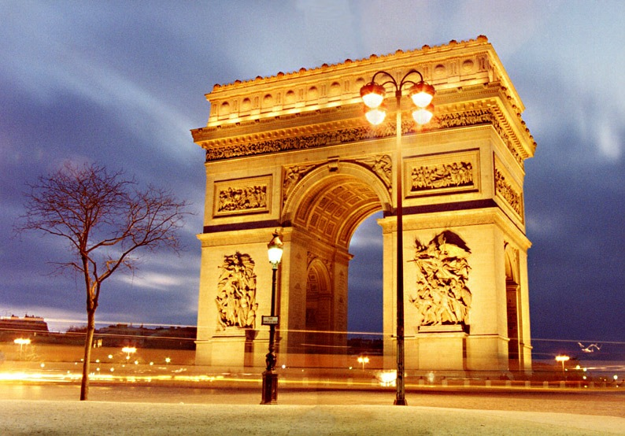
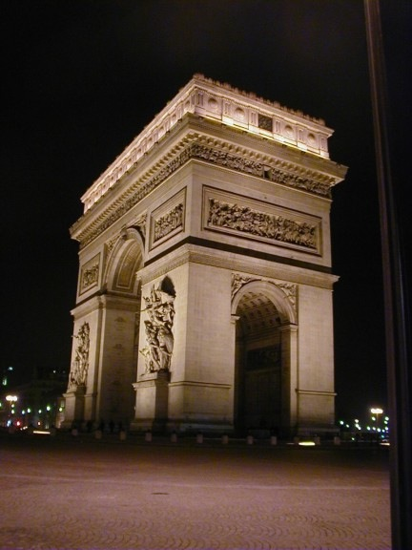
Example

Slide 118
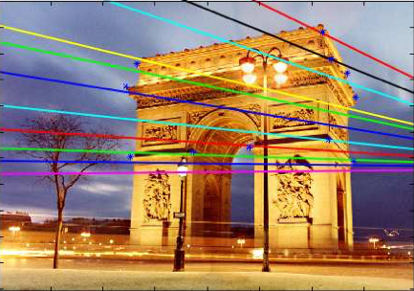
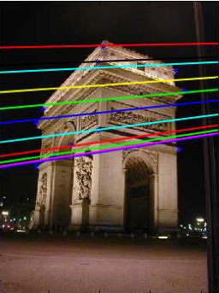
epipolar lines

Slide 119
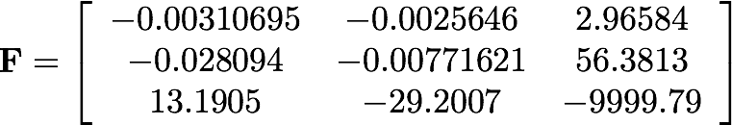
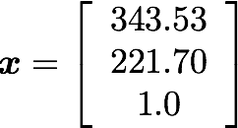
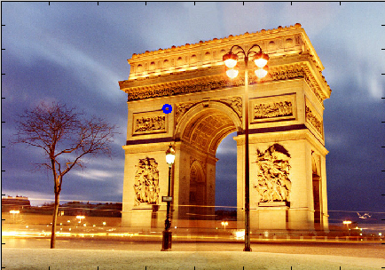

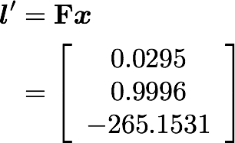

Slide 120
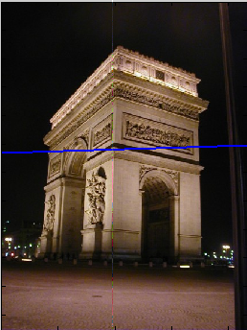


Slide 121
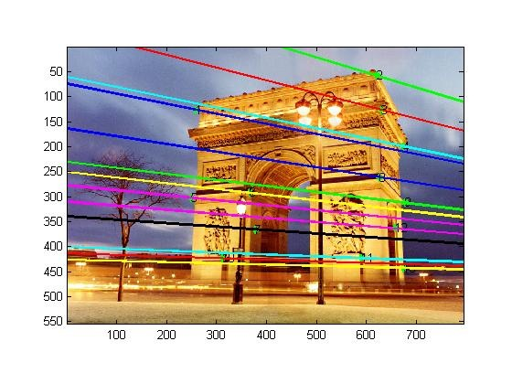
Where is the epipole?
How would you compute it?

Slide 122
The epipole is in the right null space of F
How would you solve for the epipole?
(hint: this is a homogeneous linear system)

Slide 123
The epipole is in the right null space of F
How would you solve for the epipole?
(hint: this is a homogeneous linear system)
S V D !

Slide 124
>> [u,d] = eigs(F’ * F)
u =
-0.0013 0.2586 -0.9660
0.0029 -0.9660 -0.2586
1.0000 0.0032 -0.0005
d = 1.0e8*
-1.0000 0 0
0 -0.0000 0
0 0 -0.0000
eigenvectors
eigenvalue

Slide 125


>> [u,d] = eigs(F’ * F)
u =
-0.0013 0.2586 -0.9660
0.0029 -0.9660 -0.2586
1.0000 0.0032 -0.0005
d = 1.0e8*
-1.0000 0 0
0 -0.0000 0
0 0 -0.0000
eigenvectors
eigenvalue

Slide 126
>> [u,d] = eigs(F’ * F)
u =
-0.0013 0.2586 -0.9660
0.0029 -0.9660 -0.2586
1.0000 0.0032 -0.0005
d = 1.0e8*
-1.0000 0 0
0 -0.0000 0
0 0 -0.0000
eigenvectors
eigenvalue
Eigenvector associated with smallest eigenvalue
>> uu = u(:,3)
( -0.9660 -0.2586 -0.0005)

Slide 127
>> [u,d] = eigs(F’ * F)
u =
-0.0013 0.2586 -0.9660
0.0029 -0.9660 -0.2586
1.0000 0.0032 -0.0005
d = 1.0e8*
-1.0000 0 0
0 -0.0000 0
0 0 -0.0000
eigenvectors
eigenvalue
Eigenvector associated with smallest eigenvalue
>> uu = u(:,3)
( -0.9660 -0.2586 -0.0005)
Epipole projected to image coordinates
>> uu / uu(3)
(1861.02 498.21 1.0)

Slide 128
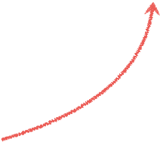
epipole
Epipole projected to image coordinates
>> uu / uu(3)
(1861.02 498.21 1.0)

Slide 129
References
Basic reading:
Szeliski textbook, Sections 7.1, 7.2, 11.1.
Hartley and Zisserman, Chapters 9, 11, 12.
Notes:
Ch

