Slide 1
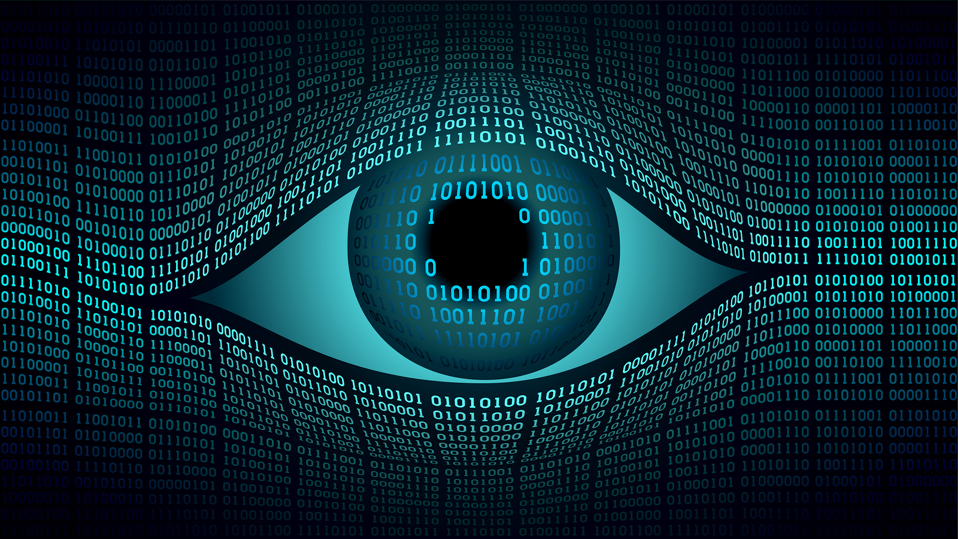
Wrap-up
16-385 Computer Vision
Spring 2020, Lecture 29
http://www.cs.cmu.edu/~16385/

Slide 2
Course announcements
Programming assignment 7 is due on Sunday.
- Any questions about PA 7?
Take-home quiz 11 is due on Sunday.
- Any questions about TQ 11?
You can use all of your remaining late days on either PA7 or TQ11.

Slide 3
Class evaluation*s* – please take them!
CMU’s Faculty Course Evaluations (FCE): https://cmu.smartevals.com/
16-385 end-of-semester survey: https://docs.google.com/forms/d/e/1FAIpQLSeO2CcSkCpi7RB0KXUm0su8s9tMMBaRLcxNaB9t0Fk7CVxwNg/viewform
Please take both, super helpful for developing future offerings of the class.
Thanks in advance!

Slide 4
Today’s lecture
Structure from motion.
Class wrap-up.

Slide 5
Course overview
Lectures 1 – 7
See also 18-793: Image and Video Processing
Image processing.
Geometry-based vision.
Physics-based vision.
Semantic vision.
Dealing with motion.
Lectures 7 – 12
See also 16-822: Geometry-based Methods in Vision
Lectures 13 – 16
See also 16-823: Physics-based Methods in Vision
See also 15-462: Computer Graphics
See also 15-463: Computational Photography
Lectures 17 – 20
See also 16-824: Vision Learning and Recognition
See also 10-703: Deep Reinforcement Learning
Lectures 21 – 24
See also 16-831: Statistical Techniques in Robotics
See also 16-833: Robot Localization and Mapping

Slide 6
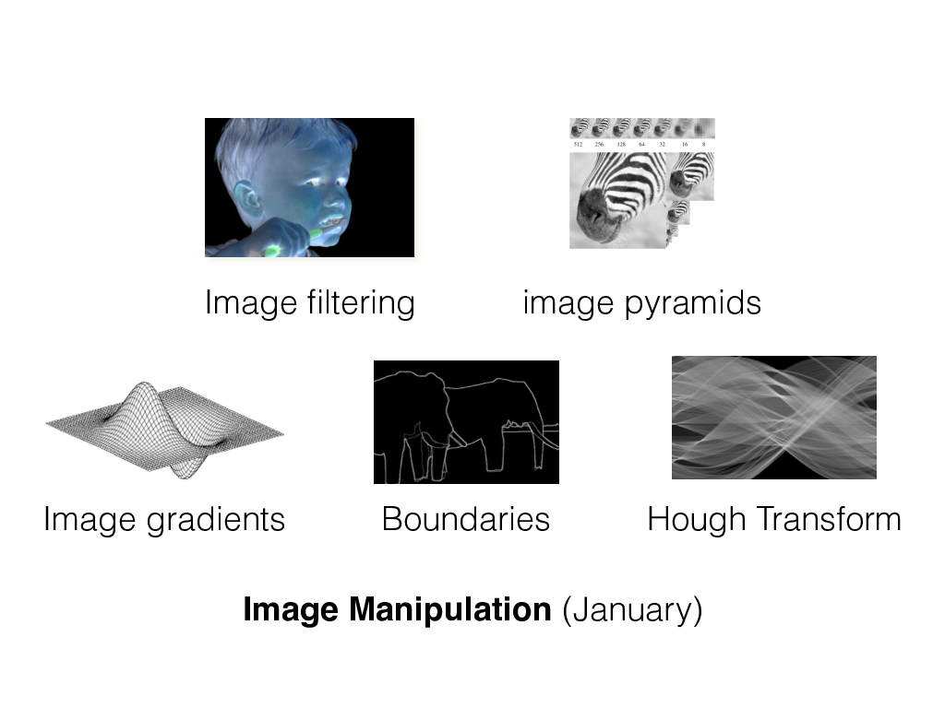
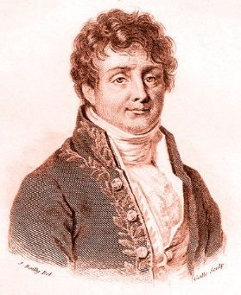
Image processing
Fourier filtering

Slide 7
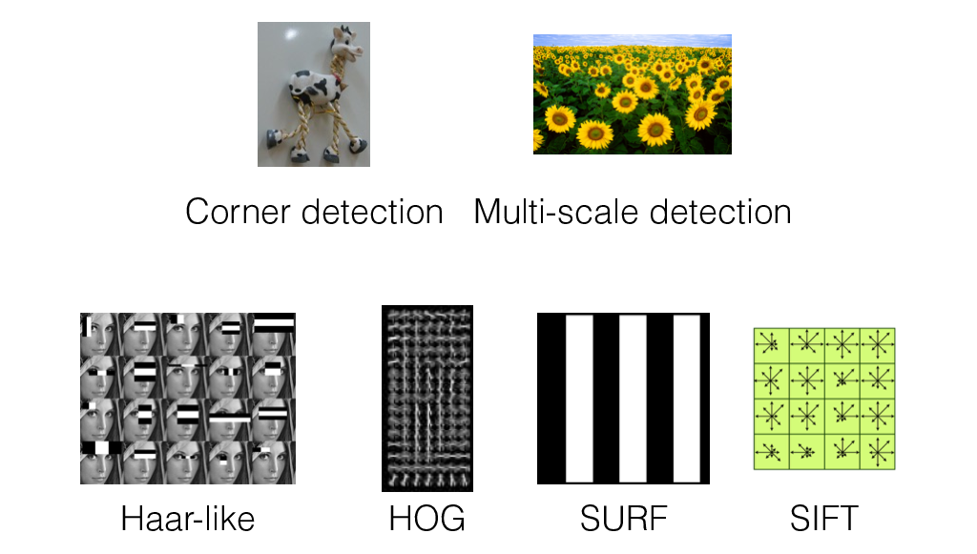
Image features

Slide 8
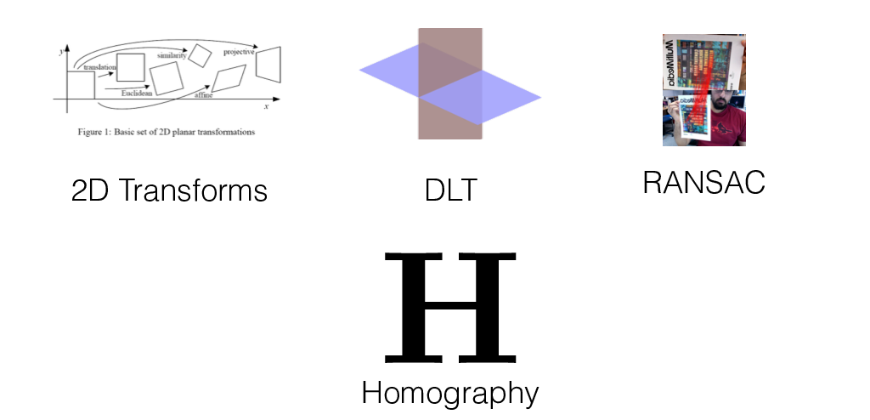
2D alignment

Slide 9
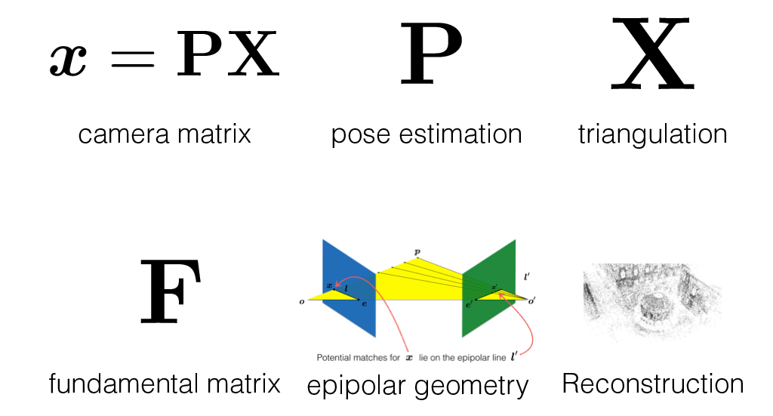
Camera and multi-view geometry

Slide 10
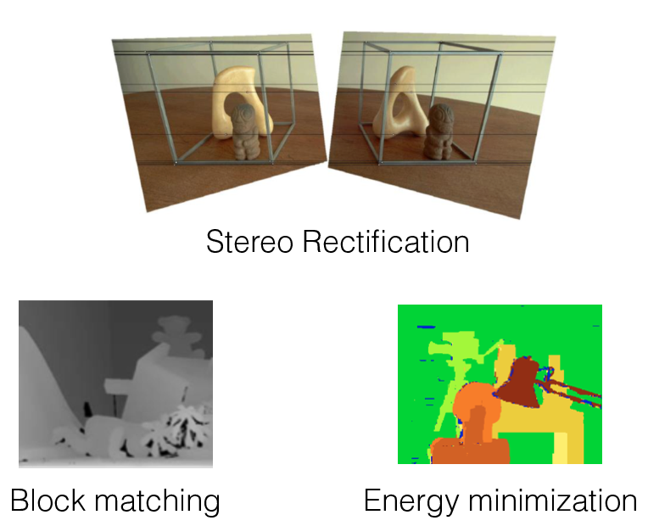
Stereo

Slide 11
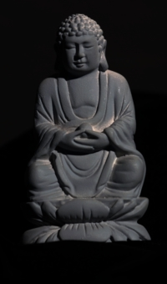

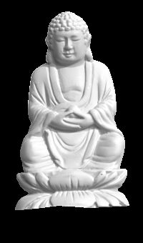

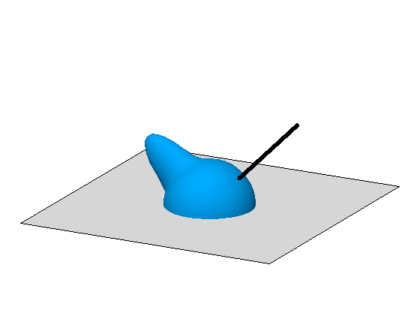

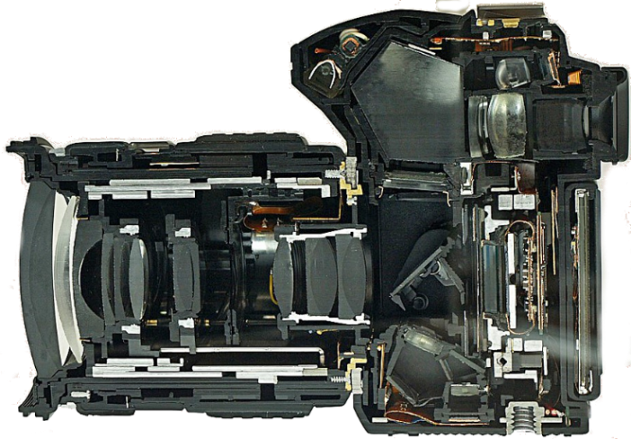
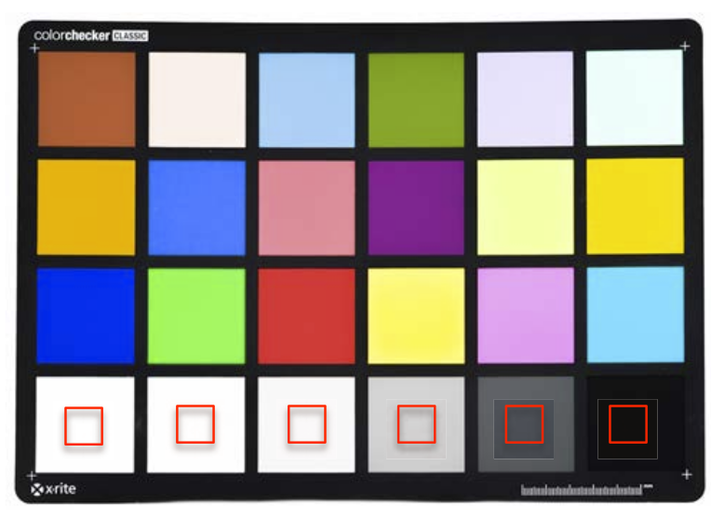
Image formation and physics
illumination
reflectance
shape
Radiometry and image formation
Photometric stereo
Image processing pipeline
Radiometric and color calibration

Slide 12
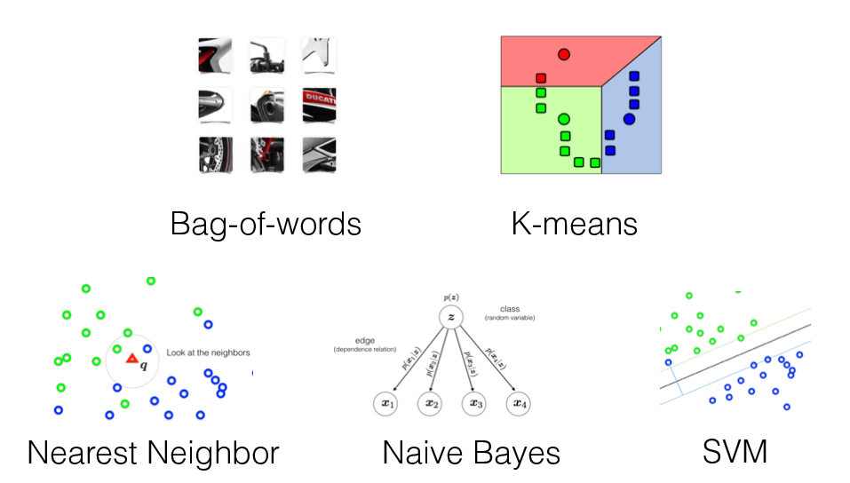
Object recognition

Slide 13
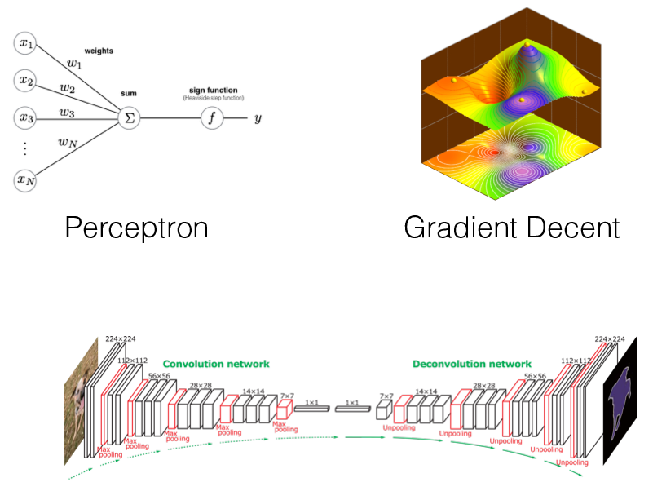
Neural networks
Convolutional Neural Networks

Slide 14
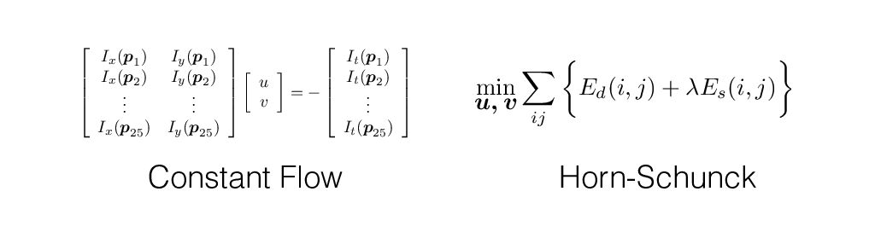
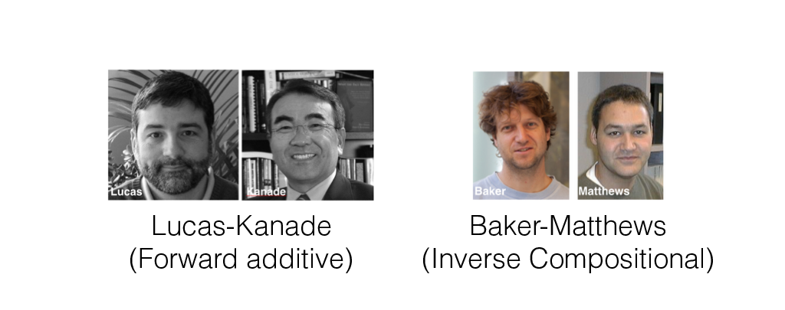
Optical flow and alignment

Slide 15
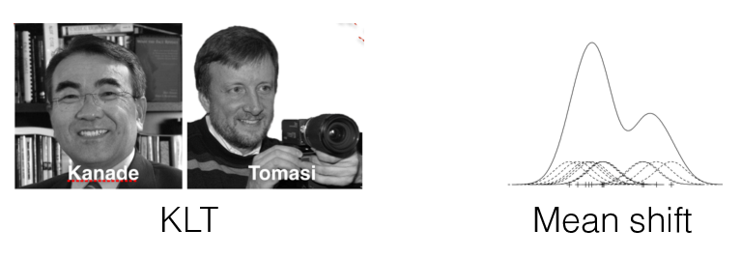
Tracking in videos

Slide 16
Things you should know how to do
Detect lines (circles, shapes) in an image.
Perform automatic image warping and basic AR.
Reconstruct 3D scene structure from two images.
Do photometric stereo and render simple images.
Recognize objects using a bag-of-words model.
Recognize objects using deep CNNs.
Track objects in video.

Slide 17
Questions?

Slide 18
Do you plan on taking any other vision courses?

Slide 19
Which part of the class did you like the most?

Slide 20
Which part of the class did you like the least?

Slide 21
Any topics you wanted to learn more about?

Slide 22
Any topics you wanted to learn less about?

Slide 23
Would the class work better if we did learning first?

Slide 24
Which was your favorite programming assignment?

Slide 25
Which was your least favorite programming assignment?

Slide 26
Would it be better if programming assignments were in Matlab?

Slide 27
Do the take-home quizzes work?

Slide 28
How does course workload compare to other classes?

