Slide 1
Convolutional neural networks
16-385 Computer Vision
Spring 2020, Lecture 22
http://www.cs.cmu.edu/~16385/

Slide 2
Course announcements
Homework 5 is due tonight.
- Any questions about the homework?
- How many of you have looked at/started/finished homework 5?
Homework 6 will be posted tonight and will be due April 22nd.
Take-home quiz 9 has been posted and is due April 12th.

Slide 3
Overview of today’s lecture
Some notes on optimization.
Convolutional neural networks.
Training ConvNets.

Slide 4
Slide credits
Most of these slides were adapted from:
Noah Snavely (Cornell University).
Fei-Fei Li (Stanford University).
Andrej Karpathy (Stanford University).

Slide 5
Some notes on optimization

Slide 6
Summary

Slide 7
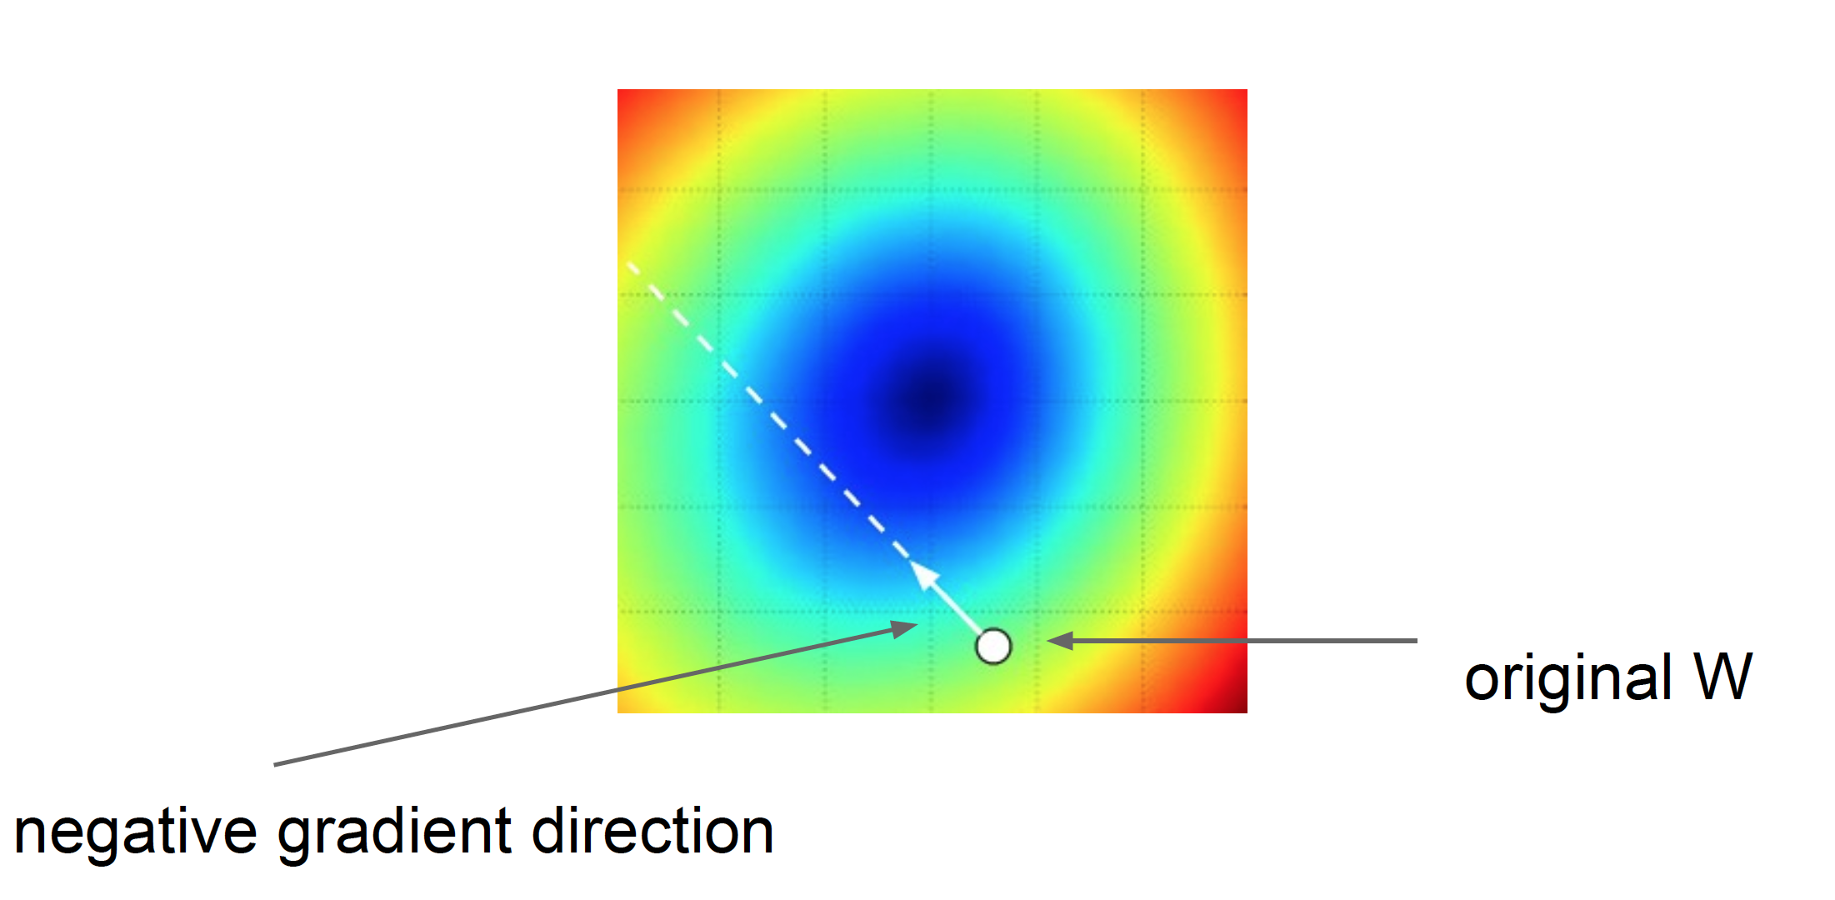
Learning rates
Step size: learning rate
Too big: will miss the minimum
Too small: slow convergence
-

Slide 8
Learning rate scheduling
Use different learning rate at each iteration.
Most common choice:
$$η_{t}=\frac{η_{0}}{\sqrt{t}}$$
Need to select initial learning rate $η_{0}$, important!!!
More modern choice: Adaptive learning rates.
$$η_{t}=G\left({\left\{\frac{∂L}{∂θ}\right\}}_{i=0}^{t}\right)$$
Many choices for G (Adam, Adagrad, Adadelta).

Slide 9
-
$$Δθ←w\frac{∂L}{∂θ}+\left(1−w\right)Δθ$$
Take direction history into account!

Slide 10
No consensus on Adam etc.: Seem to give faster performance to worse local minima.
Notes:
Limited memory Broyden–Fletcher–Goldfarb–Shanno

Slide 11
Derivatives
Given f(x), where x is vector of inputs
Compute gradient of f at x:
How do we do differentiation?

Slide 12
Numerical differentiation
Notes:
What does the derivative say? A step in direction of gradient of size h

Slide 13
Numerical differentiation
Notes:
What does the derivative say? A step in direction of gradient of size h

Slide 14
Numerical differentiation
Numerical differentiation is:
Approximate.
Slow.
Numerically unstable.
Easy to write.
Notes:
What does the derivative say? A step in direction of gradient of size h

Slide 15
Symbolic differentiation
Notes:
What does the derivative say? A step in direction of gradient of size h

Slide 16
Symbolic differentiation
What Mathematica does: Automatically derive analytical expressions for derivative.
Notes:
What does the derivative say? A step in direction of gradient of size h

Slide 17
Symbolic differentiation
What Mathematica does: Automatically derive analytical expressions for derivative.
Often results in very redundant (and expensive to evaluate) expressions.
Often intractable.
Notes:
What does the derivative say? A step in direction of gradient of size h

Slide 18
Automatic differentiation (autodiff)
Notes:
What does the derivative say? A step in direction of gradient of size h

Slide 19
Automatic differentiation (autodiff)
Notes:
What does the derivative say? A step in direction of gradient of size h

Slide 20
In summary
Numerical gradient: easy to implement, bad to use.
Symbolic gradient: sometimes useful, often intractable.
Automatic gradient: exact, fast, error-prone.
In practice: Use symbolic gradient for small/trivial programs. Almost always use analytic gradient, but check correctness of implementation with numerical gradient.
This is called a gradient check.
Notes:
What does the derivative say? A step in direction of gradient of size h

Slide 21
Convolutional Neural Networks

Slide 22
Aside: “CNN” vs “ConvNet”
Note:
•
There are many papers that use either phrase, but
•
“ConvNet” is the preferred term, since “CNN” clashes with other things called CNN

Slide 23
Motivation

Slide 24
Products

Slide 25
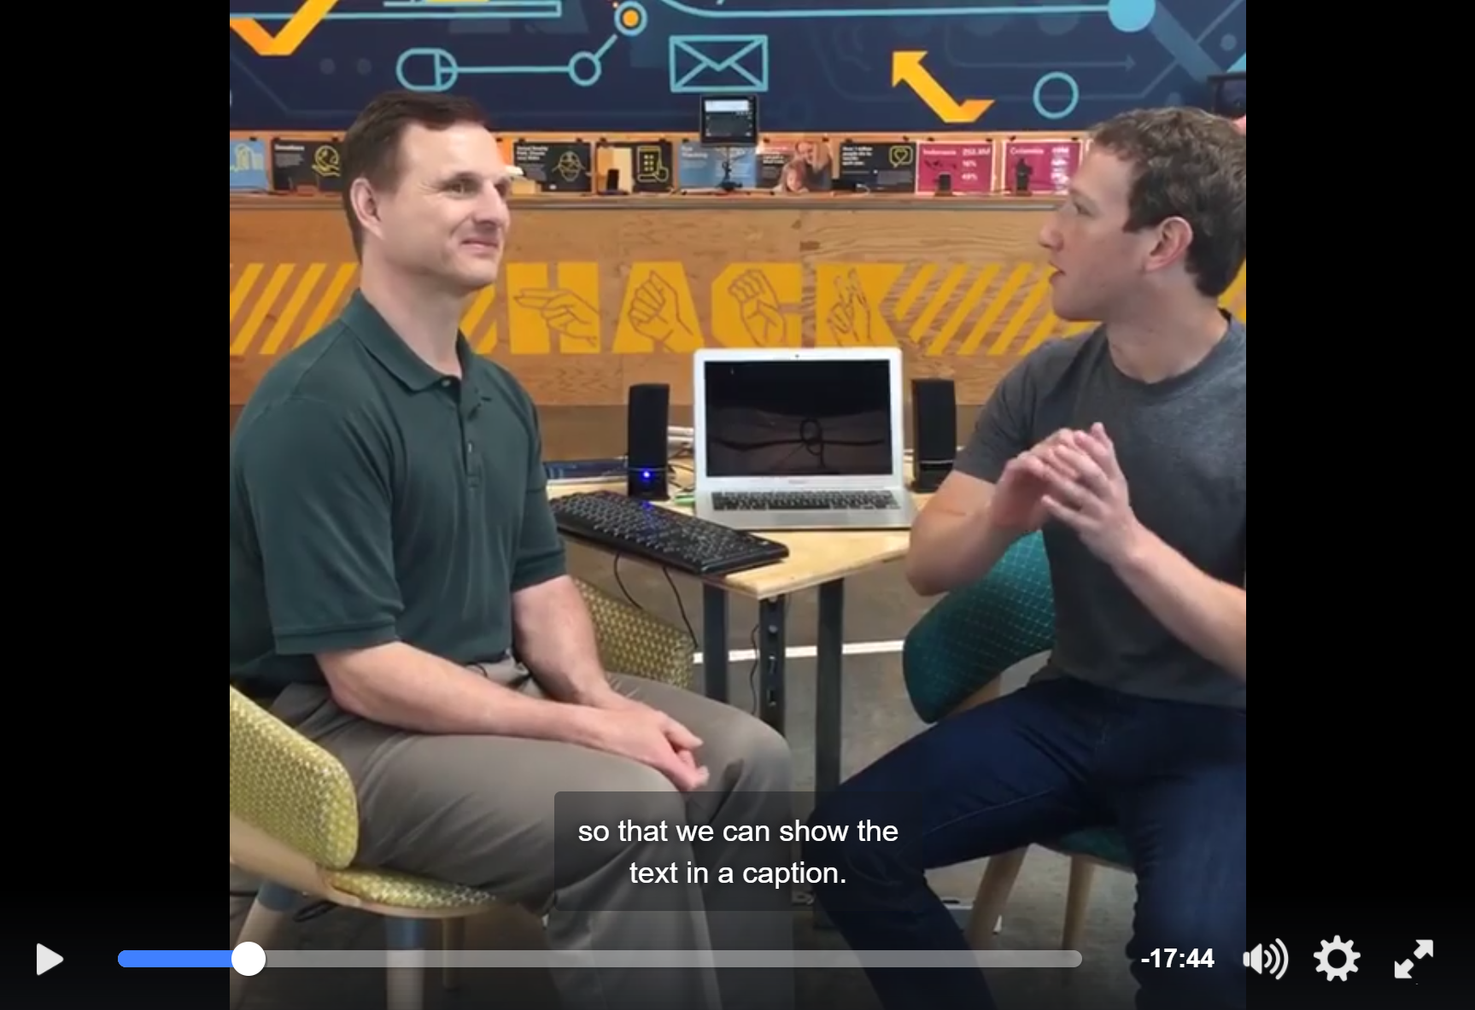
Helping the Blind
https://www.facebook.com/zuck/videos/10102801434799001/

Slide 26
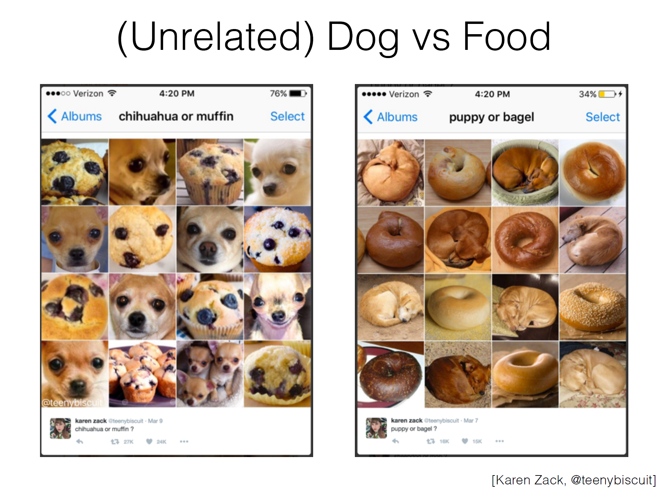

Slide 28
CNNs in 2012: “SuperVision” (aka “AlexNet”)
“AlexNet” — Won the ILSVRC2012 Challenge
Major breakthrough: 15.3% Top-5 error on ILSVRC2012 (Next best: 25.7%)
[Krizhevsky, Sutskever, Hinton. NIPS 2012]

Slide 29
Recap: Before Deep Learning
SVM
Ans
Input Pixels
Extract Features
Concatenate into a vector x
Linear Classifier
Figure: Karpathy 2016

Slide 30
The last layer of (most) CNNs are linear classifiers
This piece is just a linear classifier
Ans
(GoogLeNet)
Input Pixels
Perform everything with a big neural network, trained end-to-end
Key: perform enough processing so that by the time you get to the end of the network, the classes are linearly separable

Slide 35
ConvNets
They’re just neural networks with 3D activations and weight sharing

Slide 70
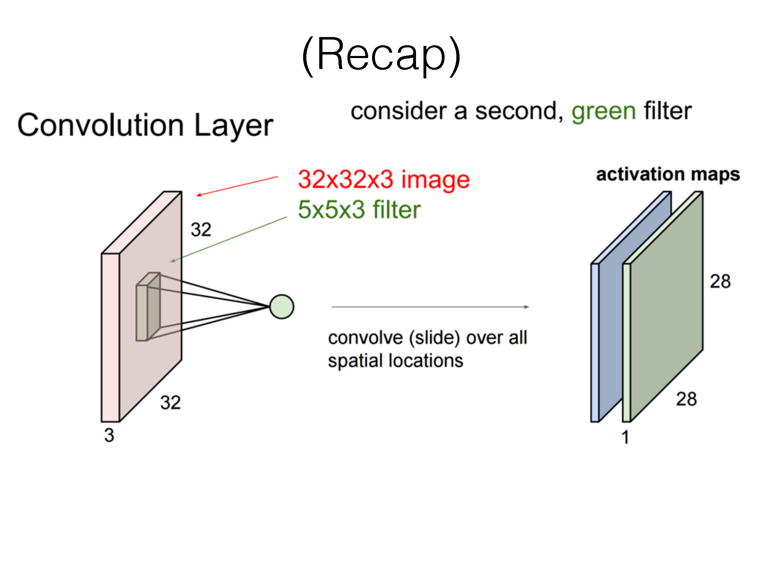

Slide 72
Demos
http://cs231n.stanford.edu/
http://cs.stanford.edu/people/karpathy/convnetjs/demo/mnist.html

Slide 99
Training ConvNets

Slide 140
References
Basic reading: No standard textbooks yet! Some good resources:
https://sites.google.com/site/deeplearningsummerschool/
http://www.deeplearningbook.org/
http://www.cs.toronto.edu/~hinton/absps/NatureDeepReview.pdf
Notes:
Ch

