Slide 1
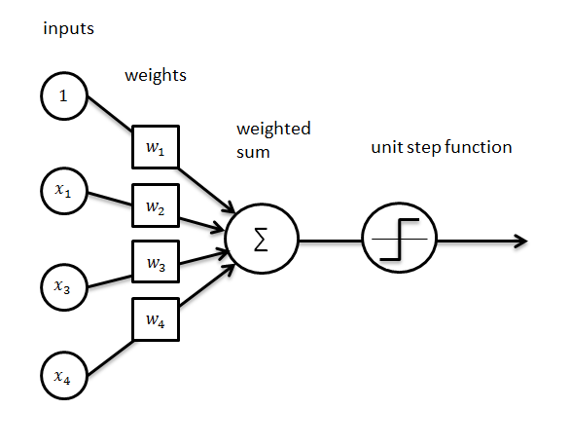
Introduction to neural networks
16-385 Computer Vision
Spring 2020, Lecture 20
http://www.cs.cmu.edu/~16385/

Slide 2
Course announcements
Programming assignment 5 has been posted and is due on April 8th.
- Any questions about the PA5?
Take-home quiz 8 has been late but should be posted tonight and be due on April 5th.
- Will be shorter to make up for the smaller amount of time.

Slide 3
Overview of today’s lecture
Leftover from last lecture: SVM
Perceptron.
Neural networks.
Training perceptrons.
Gradient descent.
Backpropagation.
Stochastic gradient descent.

Slide 4
Slide credits
Most of these slides were adapted from:
Kris Kitani (16-385, Spring 2017).
Noah Snavely (Cornell University).
Fei-Fei Li (Stanford University).
Andrej Karpathy (Stanford University).

Slide 5
Perceptron

Slide 6
1950s Age of the Perceptron
1957 The Perceptron (Rosenblatt)
1969 Perceptrons (Minsky, Papert)
1980s Age of the Neural Network
1986 Back propagation (Hinton)
1990s Age of the Graphical Model
2000s Age of the Support Vector Machine
2010s Age of the Deep Network
deep learning = known algorithms + computing power + big data

Slide 7
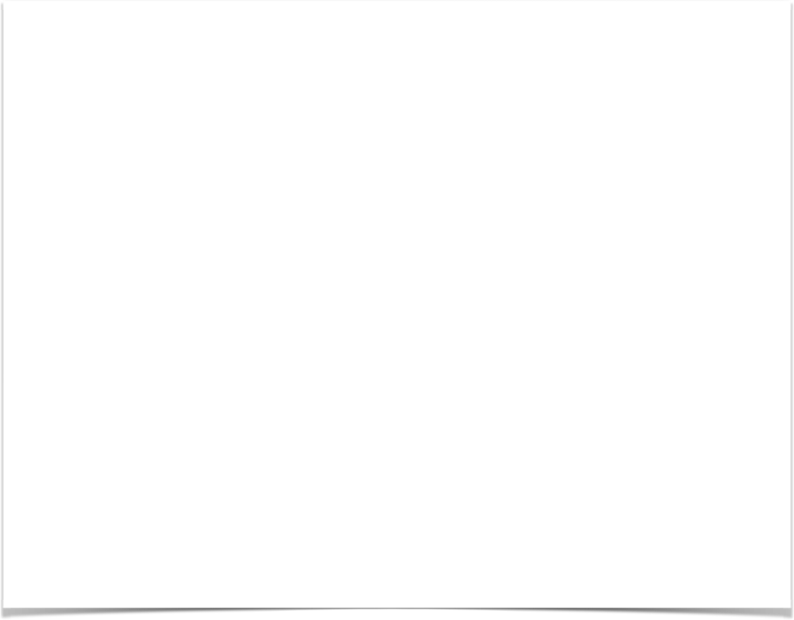
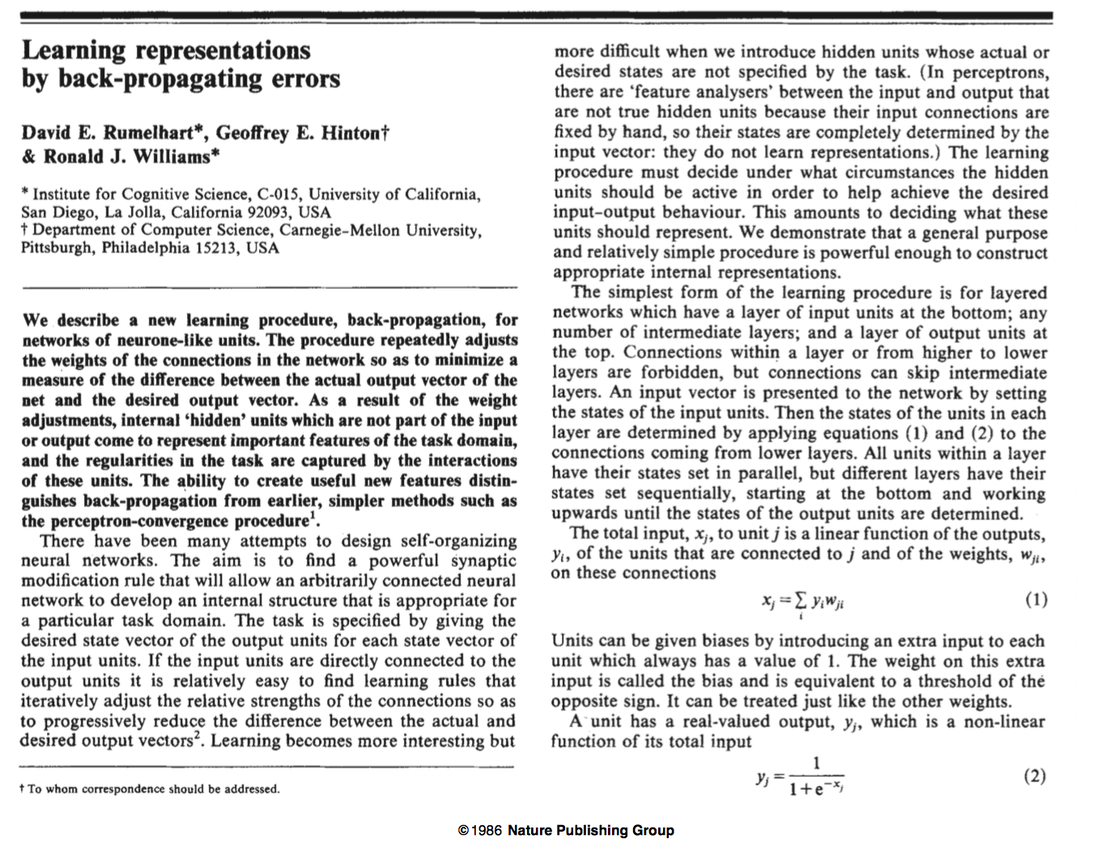

Slide 8
The Perceptron
weights
sum
sign function
(Heaviside step function)
inputs
output

Slide 9
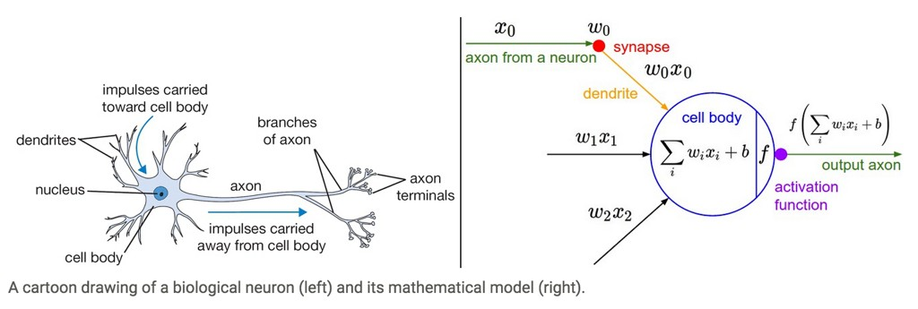
Aside: Inspiration from Biology
Neural nets/perceptrons are loosely inspired by biology.
But they certainly are not a model of how the brain works, or even how neurons work.

Slide 10
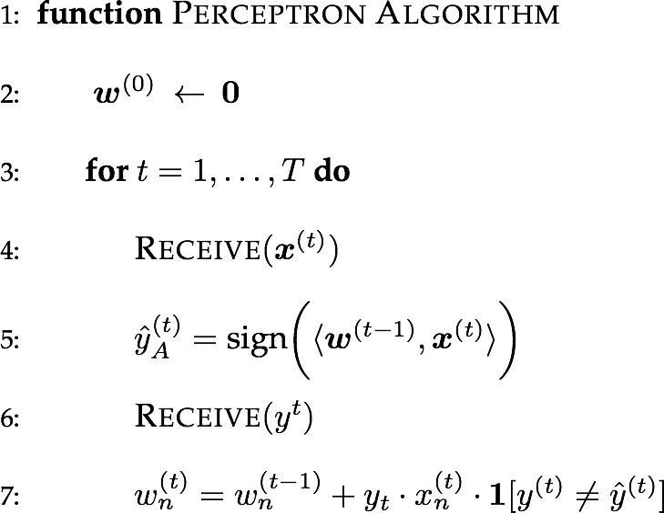


N-d binary vector
perceptron is just one line of code!
sign of zero is +1

Slide 11
initialized to 0

Slide 12

observation (1,-1)
label -1

Slide 13

observation (1,-1)
label -1
= 1

Slide 14

observation (1,-1)
label -1

Slide 15

update w
observation (1,-1)
label -1

Slide 16
update w
no match!
(-1,1)
(0,0)
-1
(1,-1)
1
observation (1,-1)
label -1

Slide 17

(-1,1)
observation (-1,1)
label +1

Slide 18

= 1
(-1,1)
(-1,1)
(-1,1)
observation (-1,1)
label +1

Slide 19

= 1
(-1,1)
(-1,1)
(-1,1)
observation (-1,1)
label +1

Slide 20

update w
match!
(-1,1)
(-1,1)
+1
(-1,1)
0
observation (-1,1)
label +1
update w

Slide 21



Slide 22

update w

Slide 23
update w

Slide 24
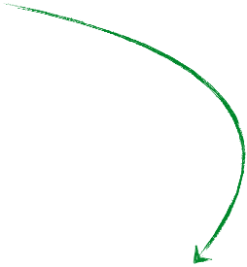

Slide 25
update w

Slide 26
repeat …

Slide 27
The Perceptron
weights
sum
sign function
(e.g., step,sigmoid, Tanh, ReLU)
inputs
output
bias

Slide 28



Another way to draw it…
weights
(1) Combine the sum and activation function
inputs
output
Activation Function
(e.g., Sigmoid function of weighted sum)
(2) suppress the bias term (less clutter)

Slide 29
Programming the 'forward pass'
Activation function (sigmoid, logistic function)
float f(float a)
{
return 1.0 / (1.0+ exp(-a));
}
output
Perceptron function (logistic regression)
float perceptron(vector<float> x, vector<float> w)
{
float a = dot(x,w);
return f(a);
}

Slide 30
Neural networks

Slide 31
Connect a bunch of perceptrons together …

Slide 32
Neural Network
Connect a bunch of perceptrons together …
a collection of connected perceptrons

Slide 33
Neural Network
Connect a bunch of perceptrons together …
a collection of connected perceptrons
How many perceptrons in this neural network?

Slide 34
Neural Network
Connect a bunch of perceptrons together …
a collection of connected perceptrons
‘one perceptron’

Slide 35
Neural Network
Connect a bunch of perceptrons together …
a collection of connected perceptrons
‘two perceptrons’

Slide 36
Neural Network
Connect a bunch of perceptrons together …
a collection of connected perceptrons
‘three perceptrons’

Slide 37
Neural Network
Connect a bunch of perceptrons together …
a collection of connected perceptrons
‘four perceptrons’

Slide 38
Neural Network
Connect a bunch of perceptrons together …
a collection of connected perceptrons
‘five perceptrons’

Slide 39
Neural Network
Connect a bunch of perceptrons together …
a collection of connected perceptrons
‘six perceptrons’

Slide 40

Some terminology…
‘input’ layer
…also called a Multi-layer Perceptron (MLP)

Slide 41

Some terminology…
‘hidden’ layer
‘input’ layer
…also called a Multi-layer Perceptron (MLP)

Slide 42

Some terminology…
‘hidden’ layer
‘input’ layer
‘output’ layer
…also called a Multi-layer Perceptron (MLP)

Slide 43



this layer is a
‘fully connected layer’
all pairwise neurons between layers are connected

Slide 44


so is this
all pairwise neurons between layers are connected

Slide 45
How many neurons (perceptrons)?
How many weights (edges)?
How many learnable parameters total?

Slide 46
How many neurons (perceptrons)?
4 + 2 = 6
How many weights (edges)?
How many learnable parameters total?

Slide 47
How many neurons (perceptrons)?
4 + 2 = 6
How many weights (edges)?
(3 x 4) + (4 x 2) = 20
How many learnable parameters total?

Slide 48
How many neurons (perceptrons)?
4 + 2 = 6
How many weights (edges)?
(3 x 4) + (4 x 2) = 20
How many learnable parameters total?
20 + 4 + 2 = 26
bias terms

Slide 49
performance usually tops out at 2-3 layers,
deeper networks don’t really improve performance...
...with the exception of convolutional networks for images

Slide 50
Training perceptrons

Slide 51
Let’s start easy

Slide 52
world’s smallest perceptron!
What does this look like?

Slide 53
world’s smallest perceptron!
(a.k.a. line equation, linear regression)

Slide 54


Learning a Perceptron
Given a set of samples and a Perceptron
Estimate the parameters of the Perceptron
Notes:
\{ x_i, y_i \}
y = f(x; \theta)
\theta = \{ f,w,b \}
y = f_{\textrm{PER}}(x; w)

Slide 55
Given training data:
10
10.1
2
1.9
3.5
3.4
1
1.1
What do you think the weight parameter is?

Slide 56
Given training data:
10
10.1
2
1.9
3.5
3.4
1
1.1
What do you think the weight parameter is?
not so obvious as the network gets more complicated so we use …

Slide 57

An Incremental Learning Strategy (gradient descent)
Given several examples
and a perceptron
Notes:
\{ (x_1,y_1), (x_2,y_2), \ldots, (x_N,y_N) \}

Slide 58
An Incremental Learning Strategy (gradient descent)
Given several examples
and a perceptron
Modify weight such that
gets ‘closer’ to
Notes:
\{ (x_1,y_1), (x_2,y_2), \ldots, (x_N,y_N) \}

Slide 59

An Incremental Learning Strategy (gradient descent)
Given several examples
and a perceptron
Modify weight such that
gets ‘closer’ to
perceptron parameter
perceptron output
true label
Notes:
\{ (x_1,y_1), (x_2,y_2), \ldots, (x_N,y_N) \}

Slide 60
An Incremental Learning Strategy (gradient descent)
Given several examples
and a perceptron
Modify weight such that
gets ‘closer’ to
perceptron parameter
perceptron output
what does this mean?
true label
Notes:
\{ (x_1,y_1), (x_2,y_2), \ldots, (x_N,y_N) \}

Slide 61
Before diving into gradient descent, we need to understand …
Loss Function
defines what is means to be
close to the true solution
YOU get to chose the loss function!
(some are better than others depending on what you want to do)
Notes:
\ell = (\hat{y}-y)^2
\ell(\hat{y},y) = (\hat{y}-y)^2

Slide 62
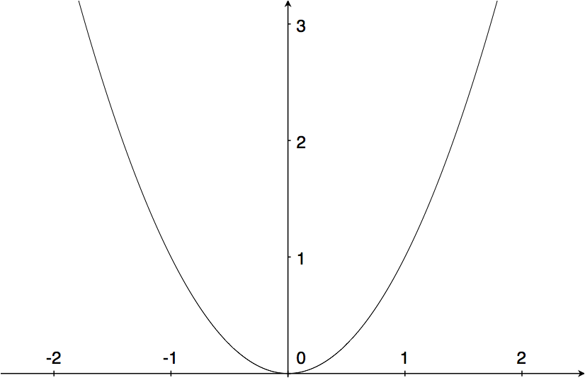


Squared Error (L2)
(a popular loss function) ((why?))

Slide 63

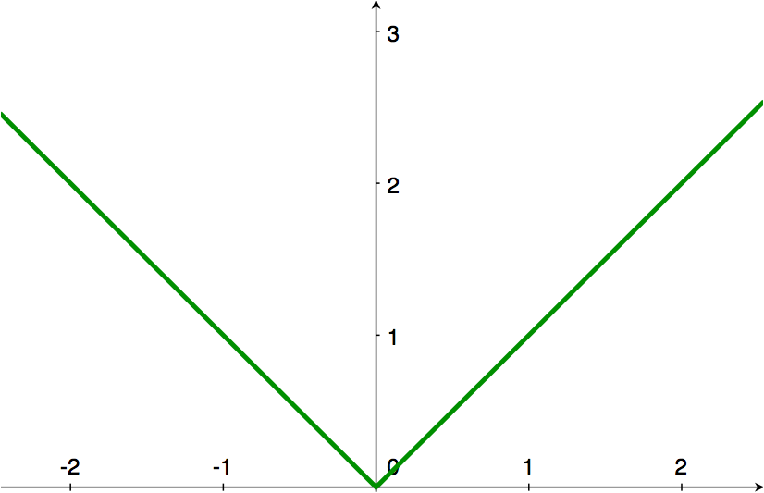
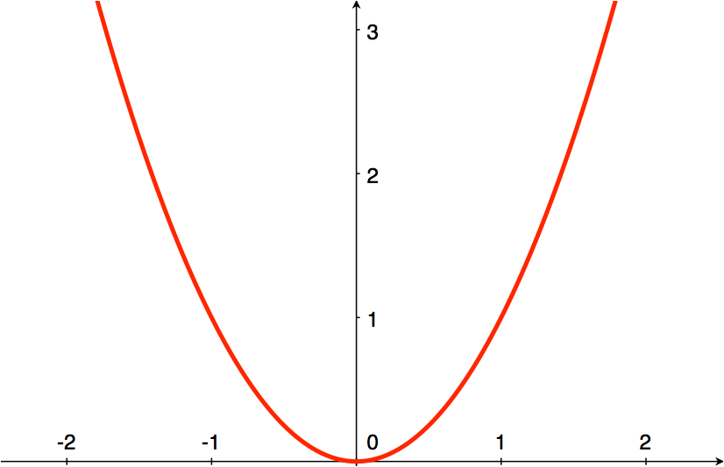

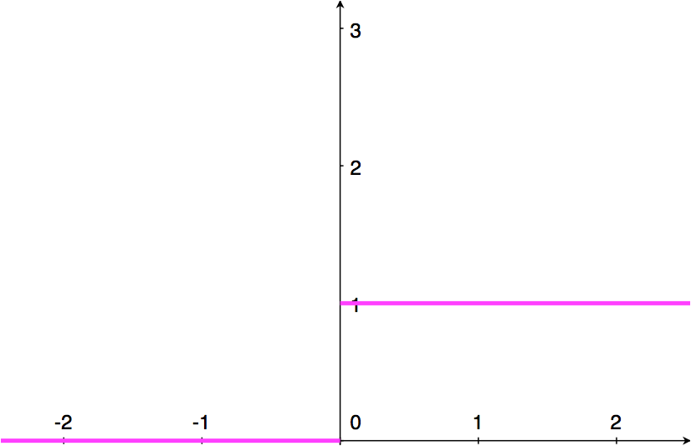
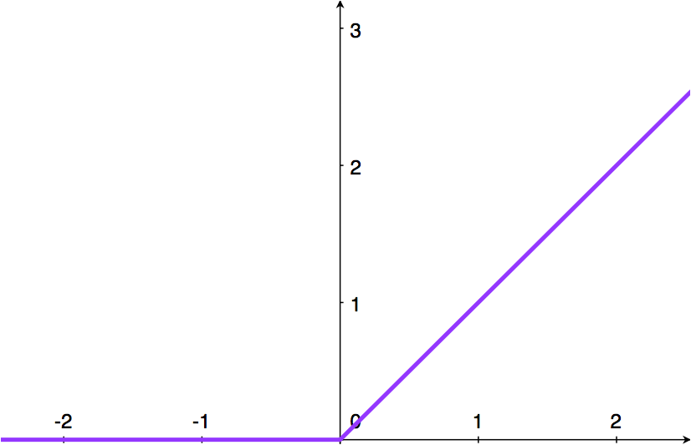
L1 Loss
L2 Loss
Zero-One Loss
Hinge Loss
Notes:
\ell(\hat{y},y) = | \hat{y}-y |
\ell(\hat{y},y) = \vec{1}[\hat{y}=y]
\ell(\hat{y},y) = \max(0, 1-y\cdot\hat{y})

Slide 64
back to the…
World’s Smallest Perceptron!
(a.k.a. line equation, linear regression)
function of ONE parameter!

Slide 65

Learning a Perceptron
Given a set of samples and a Perceptron
what is this activation function?
Estimate the parameter of the Perceptron
Notes:
\{ x_i, y_i \}
y = f(x; \theta)
\theta = \{ f,w,b \}
y = f_{\textrm{PER}}(x; w)

Slide 66

Learning a Perceptron
Given a set of samples and a Perceptron
what is this activation function?
linear function!
Estimate the parameter of the Perceptron
Notes:
\{ x_i, y_i \}
y = f(x; \theta)
\theta = \{ f,w,b \}
y = f_{\textrm{PER}}(x; w)

Slide 67
Learning Strategy (gradient descent)
Given several examples
and a perceptron
Modify weight such that
gets ‘closer’ to
perceptron parameter
perceptron output
true label
Notes:
\{ (x_1,y_1), (x_2,y_2), \ldots, (x_N,y_N) \}

Slide 68
Let’s demystify this process first…
Code to train your perceptron:
Notes:
&\textrm{for} ~~ n = 1 \ldots N \\
&~~~~~ w = w - (y_n - \hat{y}) x_i;

Slide 69

Let’s demystify this process first…
Code to train your perceptron:
just one line of code!
Now where does this come from?
Notes:
&\textrm{for} ~~ n = 1 \ldots N \\
&~~~~~ w = w - (y_n - \hat{y}) x_i;

Slide 70
Gradient descent

Slide 71
(partial) derivatives tell us how much one variable affects another

Slide 72
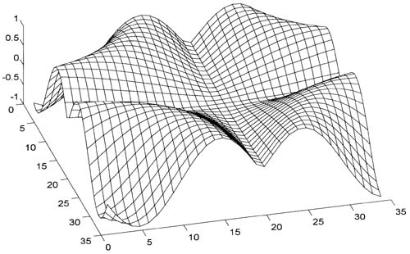
Two ways to think about them:
Slope of a function
Knobs on a machine

Slide 73

1. Slope of a function:
describes the slope around a point
Notes:
\frac{\partial f(\vec{x})}{\partial \vec{x}} =
\bigg [
\frac{\partial f(\vec{x})}{\partial x}, \frac{\partial f(\vec{x})}{\partial y}
\bigg]

Slide 74





2. Knobs on a machine:
input
output
describes how each ‘knob’ affects the output
small change in parameter
output will change by

Slide 75
Gradient descent:
Given a
fixed-point on a function,
move in the direction opposite of the gradient

Slide 76



Gradient descent:
update rule:

Slide 77
Backpropagation

Slide 78
back to the…
World’s Smallest Perceptron!
(a.k.a. line equation, linear regression)
function of ONE parameter!

Slide 79

Training the world’s smallest perceptron
This is just gradient descent, that means…
this should be the gradient of the loss function
Now where does this come from?
Notes:
&\textrm{for} ~~ n = 1 \ldots N \\
&~~~~~ w = w + (y_n - \hat{y}) x_i;

Slide 80





…is the rate at which this will change…
the loss function
… per unit change of this
the weight parameter
Let’s compute the derivative…

Slide 81
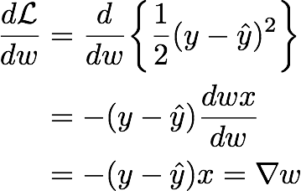
Compute the derivative
just shorthand
That means the weight update for gradient descent is:
move in direction of negative gradient
Notes:
\frac{d \mathcal{L}}{d w}
&=
\frac{d}{d w}
\bigg\{
\frac{1}{2} (y - \hat{y})^2
\bigg\}
\\
&= - (y - \hat{y}) \frac{d w x}{d w}\\
&= - (y - \hat{y}) x = \nabla w
w &= w - \nabla w \\
&= w + (y - \hat{y}) x

Slide 82



Gradient Descent (world’s smallest perceptron)
For each sample
Predict
Forward pass
Compute Loss
Update
Back Propagation
Gradient update
Notes:
\hat{y} = f_{\textrm{MLP}}(x_i; \theta)
\mathcal{L}_i = \frac{1}{2}( y_i - \hat{y})^2
\theta \leftarrow \theta +\eta \frac{\partial \mathcal{L}}{\partial \theta}
\frac{d \mathcal{L}_i}{d w} = - (y_i - \hat{y}) x_i = \nabla w

Slide 83
Training the world’s smallest perceptron

Slide 84
world’s (second) smallest
perceptron!
function of two parameters!

Slide 85


Gradient Descent
For each sample
Predict
Forward pass
Compute Loss
Update
Back Propagation
Gradient update
we just need to compute partial derivatives for this network
Notes:
\hat{y} = f_{\textrm{MLP}}(x_i; \theta)
\mathcal{L}_i = \frac{1}{2}( y_i - \hat{y})^2
\theta \leftarrow \theta +\eta \frac{\partial \mathcal{L}}{\partial \theta}
\frac{d \mathcal{L}_i}{d w} = - (y_i - \hat{y}) x_i = \nabla w

Slide 86
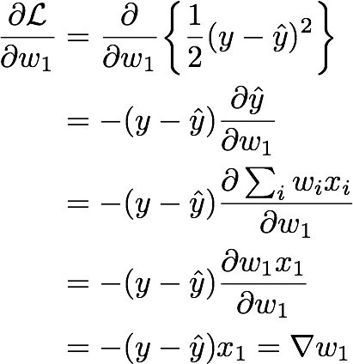
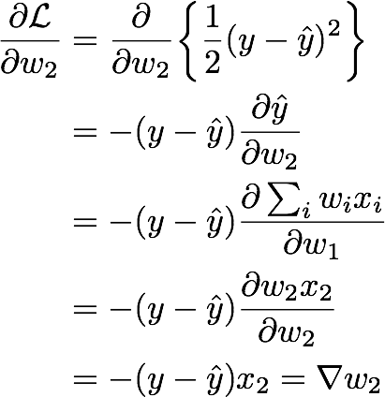
Derivative computation
Why do we have partial derivatives now?
Notes:
\frac{\partial \mathcal{L}}{\partial w_{1}}
&=
\frac{\partial}{\partial w_{1}}
\bigg\{
\frac{1}{2} (y - \hat{y})^2
\bigg\}
\\
&= - (y - \hat{y}) \frac{\partial \hat{y}}{\partial w_{1}}\\
&= - (y - \hat{y}) \frac{\partial \sum_{i} w_i x_i}{\partial w_{1}}\\
&= - (y - \hat{y}) \frac{\partial w_1 x_1}{\partial w_{1}}\\
&= - (y - \hat{y}) x_1 = \nabla w_1
w_1
&= w_1 - \eta \nabla w_1 \\
&= w_1 + \eta (y-\hat{y})x_1

Slide 87


Derivative computation
Gradient Update
Notes:
\frac{\partial \mathcal{L}}{\partial w_{1}}
&=
\frac{\partial}{\partial w_{1}}
\bigg\{
\frac{1}{2} (y - \hat{y})^2
\bigg\}
\\
&= - (y - \hat{y}) \frac{\partial \hat{y}}{\partial w_{1}}\\
&= - (y - \hat{y}) \frac{\partial \sum_{i} w_i x_i}{\partial w_{1}}\\
&= - (y - \hat{y}) \frac{\partial w_1 x_1}{\partial w_{1}}\\
&= - (y - \hat{y}) x_1 = \nabla w_1
w_1
&= w_1 - \eta \nabla w_1 \\
&= w_1 + \eta (y-\hat{y})x_1

Slide 88





Gradient Descent
For each sample
Predict
Forward pass
Compute Loss
Update
Back Propagation
Gradient update
(side computation to track loss. not needed for backprop)
two lines now
(adjustable step size)
Notes:
\hat{y} = f_{\textrm{MLP}}(x_i; \theta)
\mathcal{L}_i = \frac{1}{2}( y_i - \hat{y})
\theta \leftarrow \theta +\eta \frac{\partial \mathcal{L}}{\partial \theta}
w_{1i} = w_{1i} + \eta (y-\hat{y})x_{1i}\\
w_{2i} = w_{2i} + \eta (y-\hat{y})x_{2i}
\nabla w_{1i} = - (y_i-\hat{y})x_{1i}\\
\nabla w_{2i} = - (y_i-\hat{y})x_{2i}

Slide 89
We haven’t seen a lot of ‘propagation’ yet
because our perceptrons only had one layer…

Slide 90

multi-layer perceptron
function of FOUR parameters and FOUR layers!

Slide 91
input
weight
sum
activation
weight
activation
weight
activation
input
layer 1
hidden
layer 2
hidden
layer 3
output
layer 4
Notes:
a_1 &= w_1 \cdot x + b_1\\
a_2 &= w_2 \cdot f_1 (w_1 \cdot x + b_1)\\
a_3 &= w_3 \cdot f_2 ( w_2 \cdot f_1 (w_1 \cdot x + b_1))\\
y &= f_3( w_3 \cdot f_2 ( w_2 \cdot f_1 (w_1 \cdot x + b_1)))
————————————————
\frac{\partial L}{\partial b_1}
=
\frac{\partial L}{\partial f_3}
\frac{\partial f_3}{\partial a_3}
\frac{\partial a_3}{\partial f_2}
\frac{\partial f_2}{\partial a_2}
\frac{\partial a_2}{\partial f_1}
\frac{\partial f_1}{\partial a_1}
\frac{\partial a_1}{\partial b_1}
\\
\frac{\partial L}{\partial w_1}
=
\frac{\partial L}{\partial f_3}
\frac{\partial f_3}{\partial a_3}
\frac{\partial a_3}{\partial f_2}
\frac{\partial f_2}{\partial a_2}
\frac{\partial a_2}{\partial f_1}
\frac{\partial f_1}{\partial a_1}
\frac{\partial a_1}{\partial w_1}

Slide 92

input
weight
sum
activation
weight
activation
weight
activation
input
layer 1
hidden
layer 2
hidden
layer 3
output
layer 4
Notes:
a_1 &= w_1 \cdot x + b_1\\
a_2 &= w_2 \cdot f_1 (w_1 \cdot x + b_1)\\
a_3 &= w_3 \cdot f_2 ( w_2 \cdot f_1 (w_1 \cdot x + b_1))\\
y &= f_3( w_3 \cdot f_2 ( w_2 \cdot f_1 (w_1 \cdot x + b_1)))
————————————————
\frac{\partial L}{\partial b_1}
=
\frac{\partial L}{\partial f_3}
\frac{\partial f_3}{\partial a_3}
\frac{\partial a_3}{\partial f_2}
\frac{\partial f_2}{\partial a_2}
\frac{\partial a_2}{\partial f_1}
\frac{\partial f_1}{\partial a_1}
\frac{\partial a_1}{\partial b_1}
\\
\frac{\partial L}{\partial w_1}
=
\frac{\partial L}{\partial f_3}
\frac{\partial f_3}{\partial a_3}
\frac{\partial a_3}{\partial f_2}
\frac{\partial f_2}{\partial a_2}
\frac{\partial a_2}{\partial f_1}
\frac{\partial f_1}{\partial a_1}
\frac{\partial a_1}{\partial w_1}

Slide 93
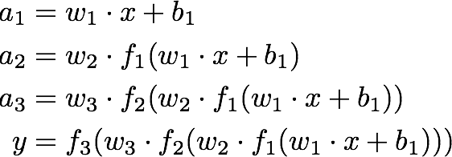
input
weight
sum
activation
weight
activation
weight
activation
input
layer 1
hidden
layer 2
hidden
layer 3
output
layer 4
Notes:
a_1 &= w_1 \cdot x + b_1\\
a_2 &= w_2 \cdot f_1 (w_1 \cdot x + b_1)\\
a_3 &= w_3 \cdot f_2 ( w_2 \cdot f_1 (w_1 \cdot x + b_1))\\
y &= f_3( w_3 \cdot f_2 ( w_2 \cdot f_1 (w_1 \cdot x + b_1)))
————————————————
\frac{\partial L}{\partial b_1}
=
\frac{\partial L}{\partial f_3}
\frac{\partial f_3}{\partial a_3}
\frac{\partial a_3}{\partial f_2}
\frac{\partial f_2}{\partial a_2}
\frac{\partial a_2}{\partial f_1}
\frac{\partial f_1}{\partial a_1}
\frac{\partial a_1}{\partial b_1}
\\
\frac{\partial L}{\partial w_1}
=
\frac{\partial L}{\partial f_3}
\frac{\partial f_3}{\partial a_3}
\frac{\partial a_3}{\partial f_2}
\frac{\partial f_2}{\partial a_2}
\frac{\partial a_2}{\partial f_1}
\frac{\partial f_1}{\partial a_1}
\frac{\partial a_1}{\partial w_1}

Slide 94

input
weight
sum
activation
weight
activation
weight
activation
input
layer 1
hidden
layer 2
hidden
layer 3
output
layer 4
Notes:
a_1 &= w_1 \cdot x + b_1\\
a_2 &= w_2 \cdot f_1 (w_1 \cdot x + b_1)\\
a_3 &= w_3 \cdot f_2 ( w_2 \cdot f_1 (w_1 \cdot x + b_1))\\
y &= f_3( w_3 \cdot f_2 ( w_2 \cdot f_1 (w_1 \cdot x + b_1)))
————————————————
\frac{\partial L}{\partial b_1}
=
\frac{\partial L}{\partial f_3}
\frac{\partial f_3}{\partial a_3}
\frac{\partial a_3}{\partial f_2}
\frac{\partial f_2}{\partial a_2}
\frac{\partial a_2}{\partial f_1}
\frac{\partial f_1}{\partial a_1}
\frac{\partial a_1}{\partial b_1}
\\
\frac{\partial L}{\partial w_1}
=
\frac{\partial L}{\partial f_3}
\frac{\partial f_3}{\partial a_3}
\frac{\partial a_3}{\partial f_2}
\frac{\partial f_2}{\partial a_2}
\frac{\partial a_2}{\partial f_1}
\frac{\partial f_1}{\partial a_1}
\frac{\partial a_1}{\partial w_1}

Slide 95
input
weight
sum
activation
weight
activation
weight
activation
input
layer 1
hidden
layer 2
hidden
layer 3
output
layer 4
Notes:
a_1 &= w_1 \cdot x + b_1\\
a_2 &= w_2 \cdot f_1 (w_1 \cdot x + b_1)\\
a_3 &= w_3 \cdot f_2 ( w_2 \cdot f_1 (w_1 \cdot x + b_1))\\
y &= f_3( w_3 \cdot f_2 ( w_2 \cdot f_1 (w_1 \cdot x + b_1)))
————————————————
\frac{\partial L}{\partial b_1}
=
\frac{\partial L}{\partial f_3}
\frac{\partial f_3}{\partial a_3}
\frac{\partial a_3}{\partial f_2}
\frac{\partial f_2}{\partial a_2}
\frac{\partial a_2}{\partial f_1}
\frac{\partial f_1}{\partial a_1}
\frac{\partial a_1}{\partial b_1}
\\
\frac{\partial L}{\partial w_1}
=
\frac{\partial L}{\partial f_3}
\frac{\partial f_3}{\partial a_3}
\frac{\partial a_3}{\partial f_2}
\frac{\partial f_2}{\partial a_2}
\frac{\partial a_2}{\partial f_1}
\frac{\partial f_1}{\partial a_1}
\frac{\partial a_1}{\partial w_1}

Slide 96

input
weight
sum
activation
weight
activation
weight
activation
input
layer 1
hidden
layer 2
hidden
layer 3
output
layer 4
Notes:
a_1 &= w_1 \cdot x + b_1\\
a_2 &= w_2 \cdot f_1 (w_1 \cdot x + b_1)\\
a_3 &= w_3 \cdot f_2 ( w_2 \cdot f_1 (w_1 \cdot x + b_1))\\
y &= f_3( w_3 \cdot f_2 ( w_2 \cdot f_1 (w_1 \cdot x + b_1)))
————————————————
\frac{\partial L}{\partial b_1}
=
\frac{\partial L}{\partial f_3}
\frac{\partial f_3}{\partial a_3}
\frac{\partial a_3}{\partial f_2}
\frac{\partial f_2}{\partial a_2}
\frac{\partial a_2}{\partial f_1}
\frac{\partial f_1}{\partial a_1}
\frac{\partial a_1}{\partial b_1}
\\
\frac{\partial L}{\partial w_1}
=
\frac{\partial L}{\partial f_3}
\frac{\partial f_3}{\partial a_3}
\frac{\partial a_3}{\partial f_2}
\frac{\partial f_2}{\partial a_2}
\frac{\partial a_2}{\partial f_1}
\frac{\partial f_1}{\partial a_1}
\frac{\partial a_1}{\partial w_1}

Slide 97
input
weight
sum
activation
weight
activation
weight
activation
input
layer 1
hidden
layer 2
hidden
layer 3
output
layer 4
Notes:
a_1 &= w_1 \cdot x + b_1\\
a_2 &= w_2 \cdot f_1 (w_1 \cdot x + b_1)\\
a_3 &= w_3 \cdot f_2 ( w_2 \cdot f_1 (w_1 \cdot x + b_1))\\
y &= f_3( w_3 \cdot f_2 ( w_2 \cdot f_1 (w_1 \cdot x + b_1)))
————————————————
\frac{\partial L}{\partial b_1}
=
\frac{\partial L}{\partial f_3}
\frac{\partial f_3}{\partial a_3}
\frac{\partial a_3}{\partial f_2}
\frac{\partial f_2}{\partial a_2}
\frac{\partial a_2}{\partial f_1}
\frac{\partial f_1}{\partial a_1}
\frac{\partial a_1}{\partial b_1}
\\
\frac{\partial L}{\partial w_1}
=
\frac{\partial L}{\partial f_3}
\frac{\partial f_3}{\partial a_3}
\frac{\partial a_3}{\partial f_2}
\frac{\partial f_2}{\partial a_2}
\frac{\partial a_2}{\partial f_1}
\frac{\partial f_1}{\partial a_1}
\frac{\partial a_1}{\partial w_1}

Slide 98

input
weight
sum
activation
weight
activation
weight
activation
input
layer 1
hidden
layer 2
hidden
layer 3
output
layer 4
Notes:
a_1 &= w_1 \cdot x + b_1\\
a_2 &= w_2 \cdot f_1 (w_1 \cdot x + b_1)\\
a_3 &= w_3 \cdot f_2 ( w_2 \cdot f_1 (w_1 \cdot x + b_1))\\
y &= f_3( w_3 \cdot f_2 ( w_2 \cdot f_1 (w_1 \cdot x + b_1)))
————————————————
\frac{\partial L}{\partial b_1}
=
\frac{\partial L}{\partial f_3}
\frac{\partial f_3}{\partial a_3}
\frac{\partial a_3}{\partial f_2}
\frac{\partial f_2}{\partial a_2}
\frac{\partial a_2}{\partial f_1}
\frac{\partial f_1}{\partial a_1}
\frac{\partial a_1}{\partial b_1}
\\
\frac{\partial L}{\partial w_1}
=
\frac{\partial L}{\partial f_3}
\frac{\partial f_3}{\partial a_3}
\frac{\partial a_3}{\partial f_2}
\frac{\partial f_2}{\partial a_2}
\frac{\partial a_2}{\partial f_1}
\frac{\partial f_1}{\partial a_1}
\frac{\partial a_1}{\partial w_1}

Slide 99
input
weight
sum
activation
weight
activation
weight
activation
input
layer 1
hidden
layer 2
hidden
layer 3
output
layer 4
Notes:
a_1 &= w_1 \cdot x + b_1\\
a_2 &= w_2 \cdot f_1 (w_1 \cdot x + b_1)\\
a_3 &= w_3 \cdot f_2 ( w_2 \cdot f_1 (w_1 \cdot x + b_1))\\
y &= f_3( w_3 \cdot f_2 ( w_2 \cdot f_1 (w_1 \cdot x + b_1)))
————————————————
\frac{\partial L}{\partial b_1}
=
\frac{\partial L}{\partial f_3}
\frac{\partial f_3}{\partial a_3}
\frac{\partial a_3}{\partial f_2}
\frac{\partial f_2}{\partial a_2}
\frac{\partial a_2}{\partial f_1}
\frac{\partial f_1}{\partial a_1}
\frac{\partial a_1}{\partial b_1}
\\
\frac{\partial L}{\partial w_1}
=
\frac{\partial L}{\partial f_3}
\frac{\partial f_3}{\partial a_3}
\frac{\partial a_3}{\partial f_2}
\frac{\partial f_2}{\partial a_2}
\frac{\partial a_2}{\partial f_1}
\frac{\partial f_1}{\partial a_1}
\frac{\partial a_1}{\partial w_1}

Slide 100
Entire network can be written out as one long equation
We need to train the network:
What is known? What is unknown?

Slide 101


Entire network can be written out as a long equation
known
We need to train the network:
What is known? What is unknown?

Slide 102






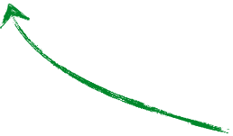
Entire network can be written out as a long equation
activation function sometimes has parameters
unknown
We need to train the network:
What is known? What is unknown?

Slide 103


Learning an MLP
Given a set of samples and a MLP
Estimate the parameters of the MLP
Notes:
\{ x_i, y_i \}
y = f(x; \theta)
\theta = \{ f,w,b \}
y = f_{\textrm{MLP}}(x; \theta)

Slide 104


Gradient Descent
For each random sample
Predict
Forward pass
Compute Loss
Update
Back Propagation
Gradient update
vector of parameter partial derivatives
vector of parameter update equations
Notes:
\hat{y} = f_{\textrm{MLP}}(x_i; \theta)
\mathcal{L}_i = \frac{1}{2}( y_i - \hat{y})
\theta \leftarrow \theta +\eta \frac{\partial \mathcal{L}}{\partial \theta}
\theta \leftarrow \theta -\eta \nabla \theta

Slide 105

So we need to compute the partial derivatives
Notes:
\frac{\partial \mathcal{L}}{\partial \vec{\theta}}
=
\bigg[
\frac{\partial \mathcal{L}}{\partial w_3}
\frac{\partial \mathcal{L}}{\partial w_2}
\frac{\partial \mathcal{L}}{\partial w_1}
\frac{\partial \mathcal{L}}{\partial b}
\bigg]

Slide 106

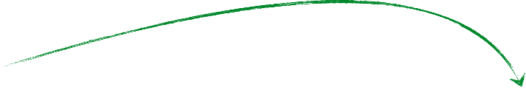
Remember,
Partial derivative
describes…
affect…
this
…this
does
how
(loss layer)
So, how do you compute it?
Notes:
\frac{\partial L}{\partial w_2}
&=
\frac{\partial L}{\partial f_3}
\frac{\partial f_3}{\partial a_3}
\frac{\partial a_3}{\partial f_2}
\frac{\partial f_2}{\partial a_2}
\frac{\partial a_2}{\partial w_2}

Slide 107
The Chain Rule

Slide 108










According to the chain rule…
Intuitively, the effect of weight on loss function :
rest of the network
depends on
depends on
depends on
Notes:
\frac{\partial L}{\partial w_3}
=
\frac{\partial L}{\partial f_3}
\frac{\partial f_3}{\partial a_3}
\frac{\partial a_3}{\partial w_3}

Slide 109
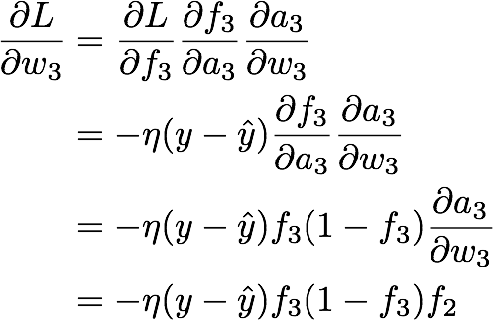
rest of the network
Chain Rule!
Notes:
\frac{\partial L}{\partial w_3}
&=
\frac{\partial L}{\partial f_3}
\frac{\partial f_3}{\partial a_3}
\frac{\partial a_3}{\partial w_3}
\\
&= - \eta (y-\hat{y})
\frac{\partial f_3}{\partial a_3}
\frac{\partial a_3}{\partial w_3}
\\
&= - \eta (y-\hat{y})
f_3 (1-f_3)
\frac{\partial a_3}{\partial w_3}
\\
&= - \eta (y-\hat{y})
f_3 (1-f_3)
f_2

Slide 110

rest of the network
Just the partial derivative of L2 loss
Notes:
\frac{\partial L}{\partial w_3}
&=
\frac{\partial L}{\partial f_3}
\frac{\partial f_3}{\partial a_3}
\frac{\partial a_3}{\partial w_3}
\\
&= - \eta (y-\hat{y})
\frac{\partial f_3}{\partial a_3}
\frac{\partial a_3}{\partial w_3}
\\
&= - \eta (y-\hat{y})
f_3 (1-f_3)
\frac{\partial a_3}{\partial w_3}
\\
&= - \eta (y-\hat{y})
f_3 (1-f_3)
f_2

Slide 111
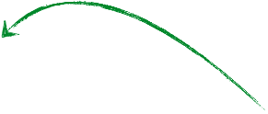

rest of the network
Let’s use a Sigmoid function
Notes:
\frac{\partial L}{\partial w_3}
&=
\frac{\partial L}{\partial f_3}
\frac{\partial f_3}{\partial a_3}
\frac{\partial a_3}{\partial w_3}
\\
&= - \eta (y-\hat{y})
\frac{\partial f_3}{\partial a_3}
\frac{\partial a_3}{\partial w_3}
\\
&= - \eta (y-\hat{y})
f_3 (1-f_3)
\frac{\partial a_3}{\partial w_3}
\\
&= - \eta (y-\hat{y})
f_3 (1-f_3)
f_2

Slide 112
rest of the network
Let’s use a Sigmoid function
Notes:
\frac{\partial L}{\partial w_3}
&=
\frac{\partial L}{\partial f_3}
\frac{\partial f_3}{\partial a_3}
\frac{\partial a_3}{\partial w_3}
\\
&= - \eta (y-\hat{y})
\frac{\partial f_3}{\partial a_3}
\frac{\partial a_3}{\partial w_3}
\\
&= - \eta (y-\hat{y})
f_3 (1-f_3)
\frac{\partial a_3}{\partial w_3}
\\
&= - \eta (y-\hat{y})
f_3 (1-f_3)
f_2
\frac{d s(x)}{dx} = s(x) (1-s(x))

Slide 113
rest of the network
Notes:
\frac{\partial L}{\partial w_3}
&=
\frac{\partial L}{\partial f_3}
\frac{\partial f_3}{\partial a_3}
\frac{\partial a_3}{\partial w_3}
\\
&= - \eta (y-\hat{y})
\frac{\partial f_3}{\partial a_3}
\frac{\partial a_3}{\partial w_3}
\\
&= - \eta (y-\hat{y})
f_3 (1-f_3)
\frac{\partial a_3}{\partial w_3}
\\
&= - \eta (y-\hat{y})
f_3 (1-f_3)
f_2

Slide 114


Notes:
\frac{\partial L}{\partial w_3}
&=
\frac{\partial L}{\partial f_3}
\frac{\partial f_3}{\partial a_3}
\frac{\partial a_3}{\partial f_2}
\frac{\partial f_2}{\partial a_2}
\frac{\partial a_2}{\partial w_2}

Slide 115

already computed.
re-use (propagate)!
Notes:
\frac{\partial L}{\partial w_3}
&=
\frac{\partial L}{\partial f_3}
\frac{\partial f_3}{\partial a_3}
\frac{\partial a_3}{\partial f_2}
\frac{\partial f_2}{\partial a_2}
\frac{\partial a_2}{\partial w_2}

Slide 116
The Chain Rule
a.k.a. backpropagation
Notes:
\frac{\partial L}{\partial w_3}
&=
\frac{\partial L}{\partial f_3}
\frac{\partial f_3}{\partial a_3}
\frac{\partial a_3}{\partial f_2}
\frac{\partial f_2}{\partial a_2}
\frac{\partial a_2}{\partial w_2}

Slide 117



The chain rule says…
depends on
depends on
depends on
depends on
depends on
depends on
depends on
Notes:
\frac{\partial L}{\partial w_1}
&=
\frac{\partial L}{\partial f_3}
\frac{\partial f_3}{\partial a_3}
\frac{\partial a_3}{\partial f_2}
\frac{\partial f_2}{\partial a_2}
\frac{\partial a_2}{\partial f_1}
\frac{\partial f_1}{\partial a_1}
\frac{\partial a_1}{\partial w_1}

Slide 118

The chain rule says…
depends on
depends on
depends on
depends on
depends on
depends on
depends on
already computed.
re-use (propagate)!
Notes:
\frac{\partial L}{\partial w_1}
&=
\frac{\partial L}{\partial f_3}
\frac{\partial f_3}{\partial a_3}
\frac{\partial a_3}{\partial f_2}
\frac{\partial f_2}{\partial a_2}
\frac{\partial a_2}{\partial w_2}
\frac{\partial f_1}{\partial a_1}
\frac{\partial a_1}{\partial w_1}

Slide 119
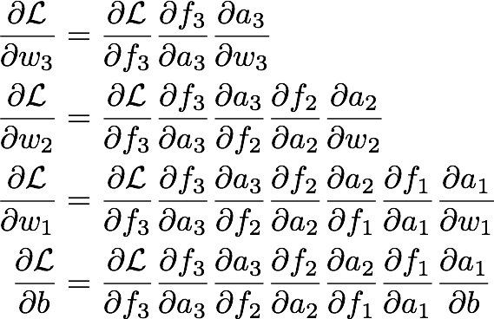
depends on
depends on
depends on
depends on
depends on
depends on
depends on
Notes:
\frac{\partial \mathcal{L}}{\partial w_3}
&=
\frac{\partial \mathcal{L}}{\partial f_3}
\frac{\partial f_3}{\partial a_3}
\frac{\partial a_3}{\partial w_3}
\\
\frac{\partial \mathcal{L}}{\partial w_2}
&=
\frac{\partial \mathcal{L}}{\partial f_3}
\frac{\partial f_3}{\partial a_3}
\frac{\partial a_3}{\partial f_2}
\frac{\partial f_2}{\partial a_2}
\frac{\partial a_2}{\partial w_2}
\\
\frac{\partial \mathcal{L}}{\partial w_1}
&=
\frac{\partial \mathcal{L}}{\partial f_3}
\frac{\partial f_3}{\partial a_3}
\frac{\partial a_3}{\partial f_2}
\frac{\partial f_2}{\partial a_2}
\frac{\partial a_2}{\partial f_1}
\frac{\partial f_1}{\partial a_1}
\frac{\partial a_1}{\partial w_1}
\\
\frac{\partial \mathcal{L}}{\partial b}
&=
\frac{\partial \mathcal{L}}{\partial f_3}
\frac{\partial f_3}{\partial a_3}
\frac{\partial a_3}{\partial f_2}
\frac{\partial f_2}{\partial a_2}
\frac{\partial a_2}{\partial f_1}
\frac{\partial f_1}{\partial a_1}
\frac{\partial a_1}{\partial b}

Slide 120
depends on
depends on
depends on
depends on
depends on
depends on
depends on

Slide 121
depends on
depends on
depends on
depends on
depends on
depends on
depends on

Slide 122

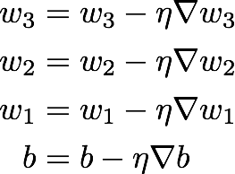
Gradient Descent
For each example sample
Predict
Forward pass
Compute Loss
Update
Back Propagation
Gradient update
Notes:
\hat{y} = f_{\textrm{MLP}}(x_i; \theta)
\mathcal{L}_i = \frac{1}{2}( y_i - \hat{y})
\theta \leftarrow \theta +\eta \frac{\partial \mathcal{L}}{\partial \theta}
\frac{\partial \mathcal{L}}{\partial w_3}
&=
\frac{\partial \mathcal{L}}{\partial f_3}
\frac{\partial f_3}{\partial a_3}
\frac{\partial a_3}{\partial w_3}
\\
\frac{\partial \mathcal{L}}{\partial w_2}
&=
\frac{\partial \mathcal{L}}{\partial f_3}
\frac{\partial f_3}{\partial a_3}
\frac{\partial a_3}{\partial f_2}
\frac{\partial f_2}{\partial a_2}
\frac{\partial a_2}{\partial w_2}
\\
\frac{\partial \mathcal{L}}{\partial w_1}
&=
\frac{\partial \mathcal{L}}{\partial f_3}
\frac{\partial f_3}{\partial a_3}
\frac{\partial a_3}{\partial f_2}
\frac{\partial f_2}{\partial a_2}
\frac{\partial a_2}{\partial w_2}
\frac{\partial f_1}{\partial a_1}
\frac{\partial a_1}{\partial w_1}
\\
\frac{\partial \mathcal{L}}{\partial b}
&=
\frac{\partial \mathcal{L}}{\partial f_3}
\frac{\partial f_3}{\partial a_3}
\frac{\partial a_3}{\partial f_2}
\frac{\partial f_2}{\partial a_2}
\frac{\partial a_2}{\partial w_2}
\frac{\partial f_1}{\partial a_1}
\frac{\partial a_1}{\partial b}
w_3 &= w_3 - \eta \nabla w_3 \\
w_2 &= w_2 - \eta \nabla w_2 \\
w_1 &= w_1 - \eta \nabla w_1 \\
b &= b - \eta \nabla b

Slide 123

Gradient Descent
For each example sample
Predict
Forward pass
Compute Loss
Update
Back Propagation
Gradient update
vector of parameter partial derivatives
vector of parameter update equations
Notes:
\hat{y} = f_{\textrm{MLP}}(x_i; \theta)
\mathcal{L}_i = \frac{1}{2}( y_i - \hat{y})
\theta \leftarrow \theta +\eta \frac{\partial \mathcal{L}}{\partial \theta}

Slide 124
Stochastic gradient descent

Slide 125
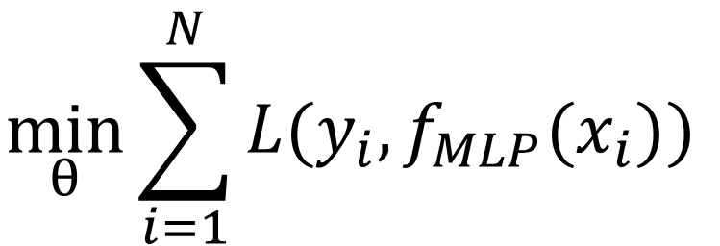
What we are truly minimizing:
$$\min_{θ}{\sum_{i=1}^{N}{L(y_{i},f_{MLP}(x_{i}))}}$$
The gradient is:
Notes:
\{ x_i, y_i \}
y = f(x; \theta)
\theta = \{ f,w,b \}
y = f_{\textrm{PER}}(x; w)

Slide 126
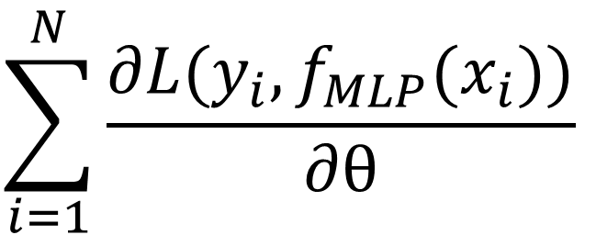
What we are truly minimizing:
$$\min_{θ}{\sum_{i=1}^{N}{L(y_{i},f_{MLP}(x_{i}))}}$$
The gradient is:
$$\sum_{i=1}^{N}{\frac{∂L(y_{i},f_{MLP}(x_{i}))}{∂θ}}$$
What we use for gradient update is:
Notes:
\{ x_i, y_i \}
y = f(x; \theta)
\theta = \{ f,w,b \}
y = f_{\textrm{PER}}(x; w)

Slide 127
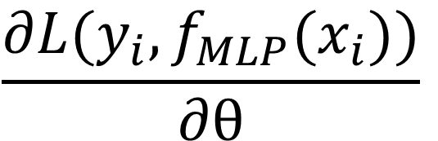
What we are truly minimizing:
$$\min_{θ}{\sum_{i=1}^{N}{L(y_{i},f_{MLP}(x_{i}))}}$$
The gradient is:
$$\sum_{i=1}^{N}{\frac{∂L(y_{i},f_{MLP}(x_{i}))}{∂θ}}$$
What we use for gradient update is:
$$\frac{∂L(y_{i},f_{MLP}(x_{i}))}{∂θ}$$
for some i
Notes:
\{ x_i, y_i \}
y = f(x; \theta)
\theta = \{ f,w,b \}
y = f_{\textrm{PER}}(x; w)

Slide 128
Stochastic Gradient Descent
For each example sample
Predict
Forward pass
Compute Loss
Update
Back Propagation
Gradient update
vector of parameter partial derivatives
vector of parameter update equations
Notes:
\hat{y} = f_{\textrm{MLP}}(x_i; \theta)
\mathcal{L}_i = \frac{1}{2}( y_i - \hat{y})
\theta \leftarrow \theta +\eta \frac{\partial \mathcal{L}}{\partial \theta}

Slide 129
How do we select which sample?
Notes:
\hat{y} = f_{\textrm{MLP}}(x_i; \theta)
\mathcal{L}_i = \frac{1}{2}( y_i - \hat{y})
\theta \leftarrow \theta +\eta \frac{\partial \mathcal{L}}{\partial \theta}

Slide 130
How do we select which sample?
Select randomly!
Do we need to use only one sample?
Notes:
\hat{y} = f_{\textrm{MLP}}(x_i; \theta)
\mathcal{L}_i = \frac{1}{2}( y_i - \hat{y})
\theta \leftarrow \theta +\eta \frac{\partial \mathcal{L}}{\partial \theta}

Slide 131
How do we select which sample?
Select randomly!
Do we need to use only one sample?
You can use a minibatch of size B < N.
Why not do gradient descent with all samples?
Notes:
\hat{y} = f_{\textrm{MLP}}(x_i; \theta)
\mathcal{L}_i = \frac{1}{2}( y_i - \hat{y})
\theta \leftarrow \theta +\eta \frac{\partial \mathcal{L}}{\partial \theta}

Slide 132
How do we select which sample?
Select randomly!
Do we need to use only one sample?
You can use a minibatch of size B < N.
Why not do gradient descent with all samples?
It’s very expensive when N is large (big data).
Do I lose anything by using stochastic GD?
Notes:
\hat{y} = f_{\textrm{MLP}}(x_i; \theta)
\mathcal{L}_i = \frac{1}{2}( y_i - \hat{y})
\theta \leftarrow \theta +\eta \frac{\partial \mathcal{L}}{\partial \theta}

Slide 133
How do we select which sample?
Select randomly!
Do we need to use only one sample?
You can use a minibatch of size B < N.
Why not do gradient descent with all samples?
It’s very expensive when N is large (big data).
Do I lose anything by using stochastic GD?
Same convergence guarantees and complexity!
Better generalization.
Notes:
\hat{y} = f_{\textrm{MLP}}(x_i; \theta)
\mathcal{L}_i = \frac{1}{2}( y_i - \hat{y})
\theta \leftarrow \theta +\eta \frac{\partial \mathcal{L}}{\partial \theta}

Slide 134
References
Basic reading: No standard textbooks yet! Some good resources:
https://sites.google.com/site/deeplearningsummerschool/
http://www.deeplearningbook.org/
http://www.cs.toronto.edu/~hinton/absps/NatureDeepReview.pdf
Notes:
Ch

