Slide 1
Image classification
16-385 Computer Vision
Spring 2020, Lecture 18
http://www.cs.cmu.edu/~16385/

Slide 2
Course announcements
Programming assignment 4 is due tonight at 23:59.
- Please make sure to download the updated version of PA4 (last updated Monday, 10 am ET).
- Due Wednesday March 25th.
- Any questions about the homework?
Programming assignment 5 will be posted tonight and will be due April 8th.
Take-home quiz 7 posted and is due Sunday March 29th.

Slide 3
Overview of today’s lecture
Introduction to learning-based vision.
Image classification.
Bag-of-words.
K-means clustering.
Classification.
K nearest neighbors.
Naïve Bayes.
Support vector machine.

Slide 4
Slide credits
Most of these slides were adapted from:
Kris Kitani (16-385, Spring 2017).
Noah Snavely (Cornell University).
Fei-Fei Li (Stanford University).

Slide 5
Course overview
Lectures 1 – 7
See also 18-793: Image and Video Processing
Image processing.
Geometry-based vision.
Physics-based vision.
Learning-based vision.
Dealing with motion.
Lectures 7 – 13
See also 16-822: Geometry-based Methods in Vision
Lectures 14 – 17
See also 16-823: Physics-based Methods in Vision
See also 15-463: Computational Photography
We are starting this part now

Slide 6
What do we mean by learning-based vision or ‘semantic vision’?

Slide 7
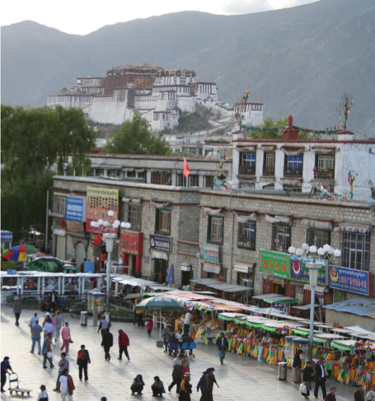
Is this a street light?
(Recognition / classification)

Slide 8
Where are the people?
(Detection)

Slide 9
Is that Potala palace?
(Identification)

Slide 10

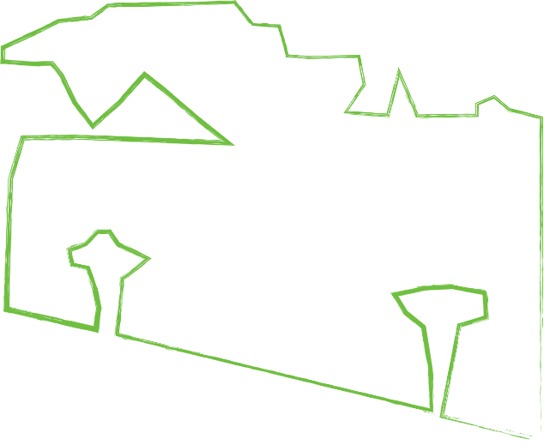
Sky
What’s in the scene?
(semantic segmentation)
Mountain
Trees
Building
Vendors
People
Ground

Slide 11
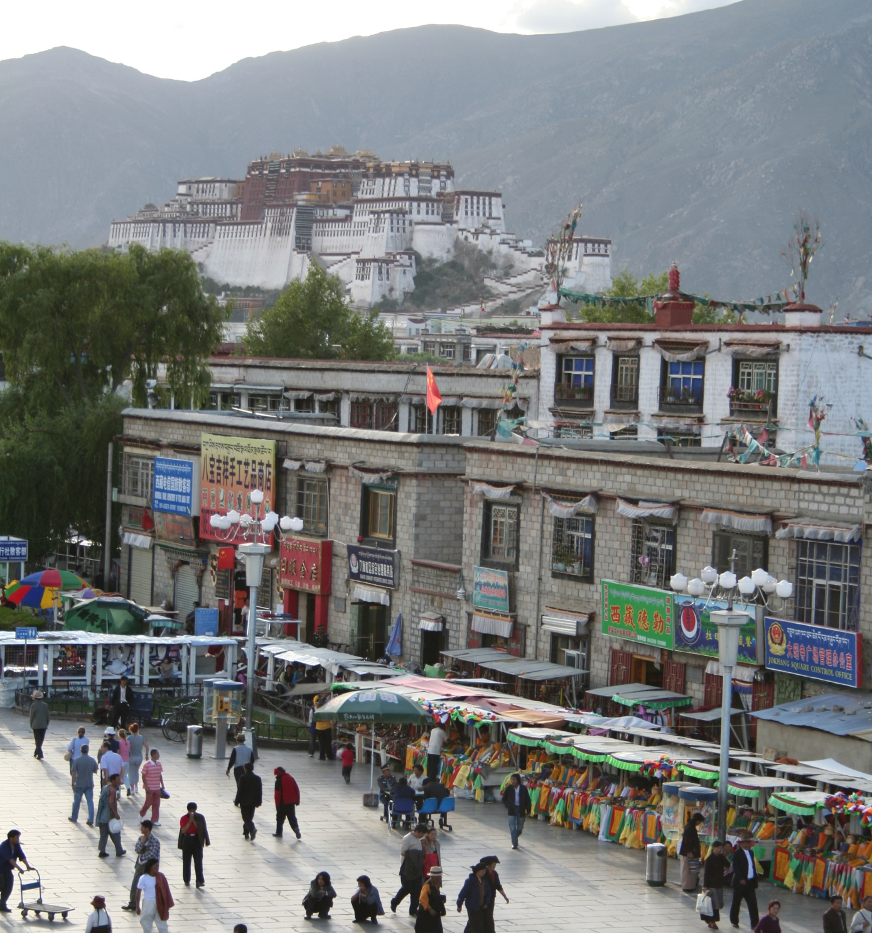
Object categorization
mountain
tree
building
banner
street lamp
vendor
people

Slide 12
What type of scene is it?
(Scene categorization)
Outdoor
Marketplace
City

Slide 13
Activity / Event Recognition
what are these people doing?

Slide 14
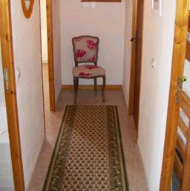

Object recognition Is it really so hard?
Find the chair in this image
Output of normalized correlation
This is a chair

Slide 15
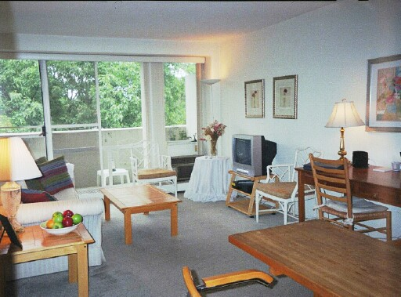
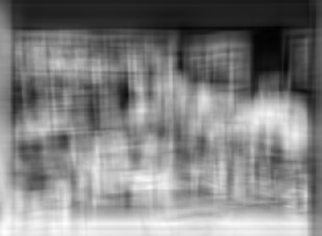
Object recognition Is it really so hard?
Find the chair in this image
Pretty much garbage
Simple template matching is not going to make it
A “popular method is that of template matching, by point to point correlation of a model pattern with the image pattern. These techniques are inadequate for three-dimensional scene analysis for many reasons, such as occlusion, changes in viewing angle, and articulation of parts.” Nivatia & Binford, 1977.

Slide 16
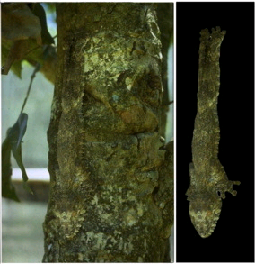
And it can get a lot harder
Brady, M. J., & Kersten, D. (2003). Bootstrapped learning of novel objects. J Vis, 3(6), 413-422

Slide 17
Why is this hard?
Variability:
Camera position
Illumination
Shape parameters
Notes:
One could argue that invariance is the key challenge to computer vision. But is this still true with big data?

Slide 18
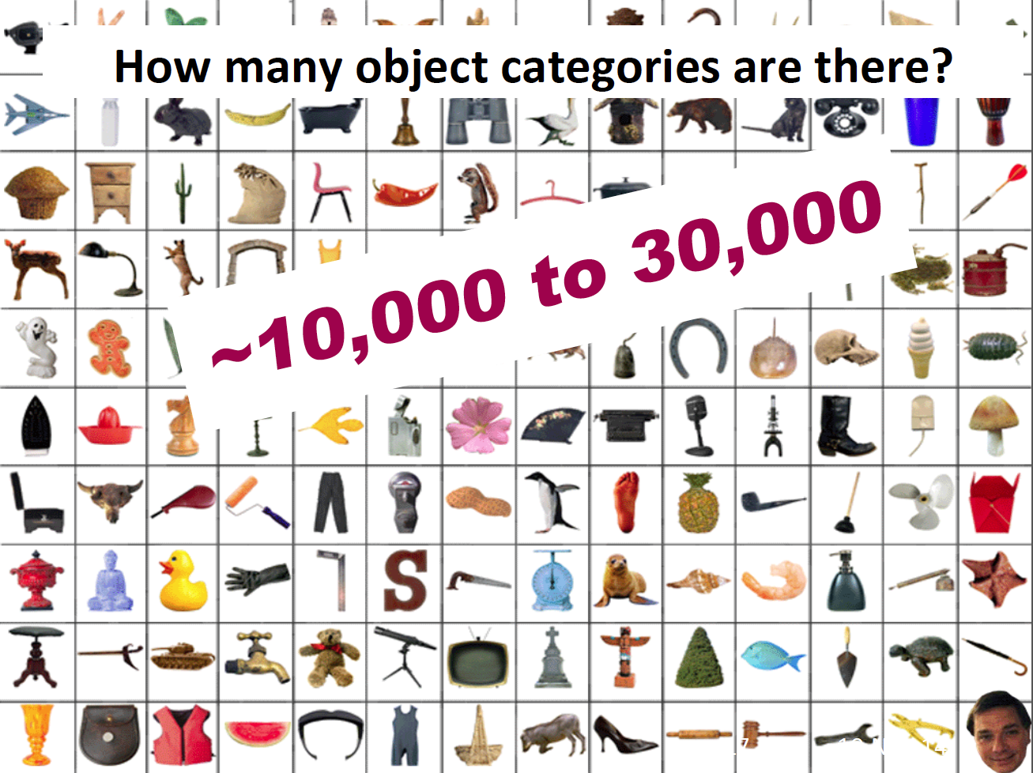

Slide 19
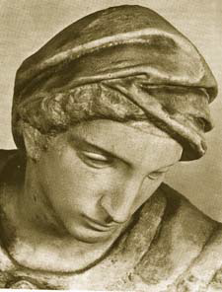
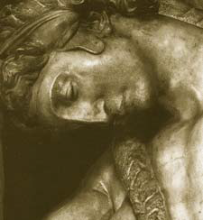
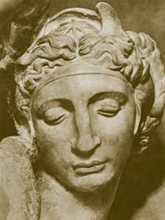
Challenge: variable viewpoint
Michelangelo 1475-1564

Slide 20
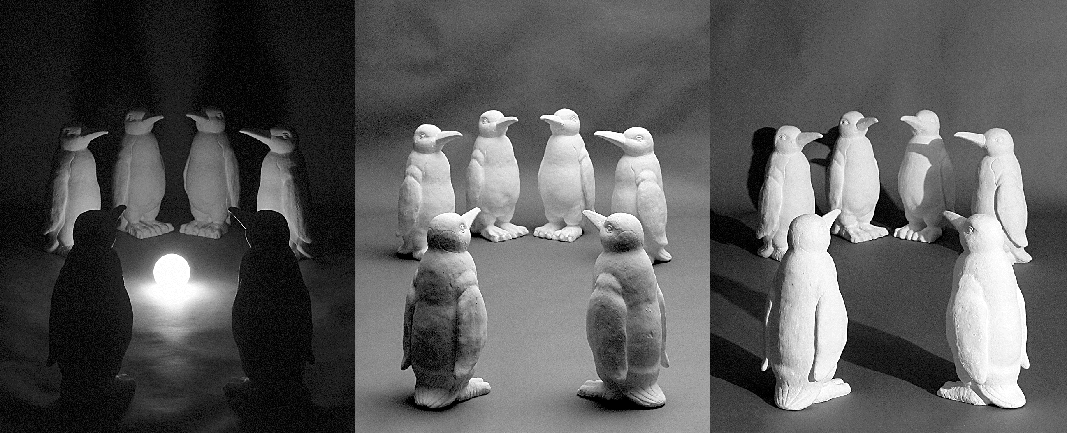
Challenge: variable illumination
image credit: J. Koenderink

Slide 21
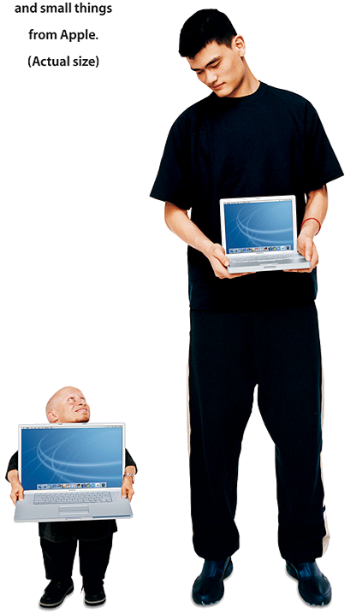
Challenge: scale

Slide 22
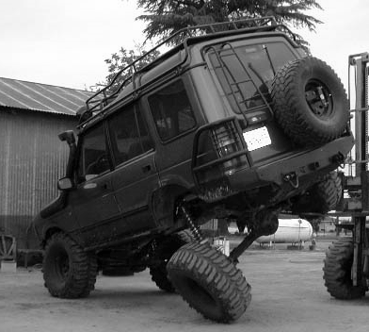
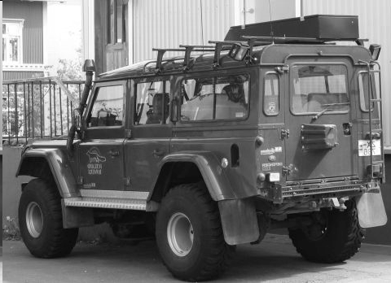
Challenge: deformation

Slide 23
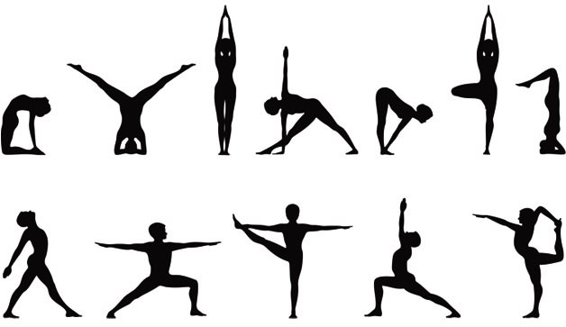
Deformation

Slide 24
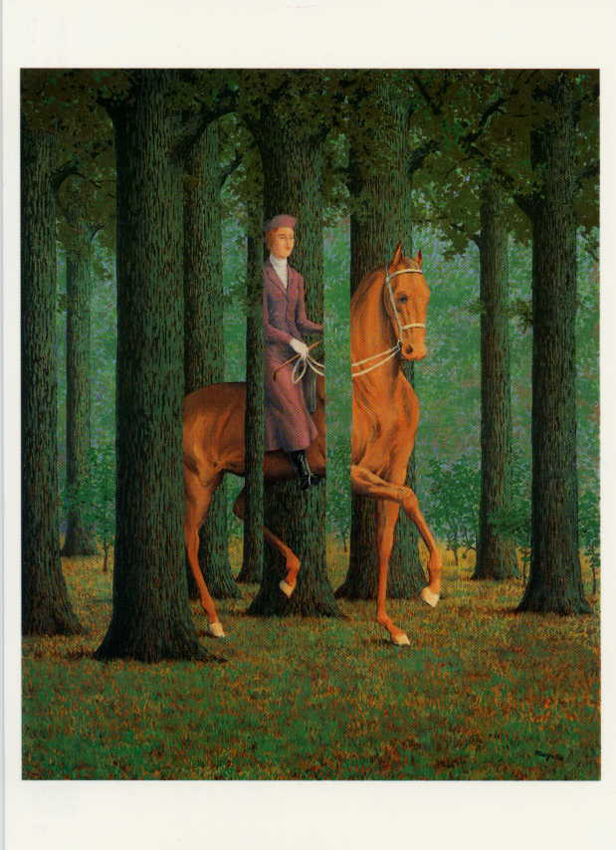
Challenge: Occlusion
Magritte, 1957

Slide 25
Occlusion

Slide 26
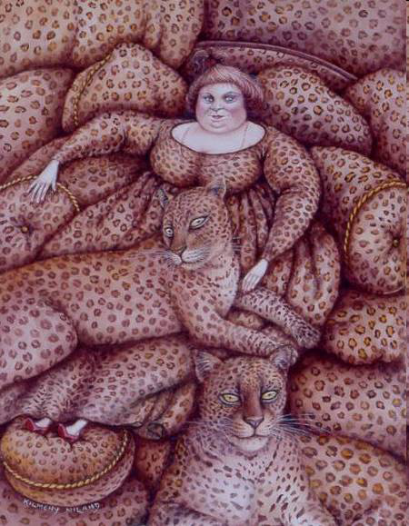
Challenge: background clutter
Kilmeny Niland. 1995

Slide 27
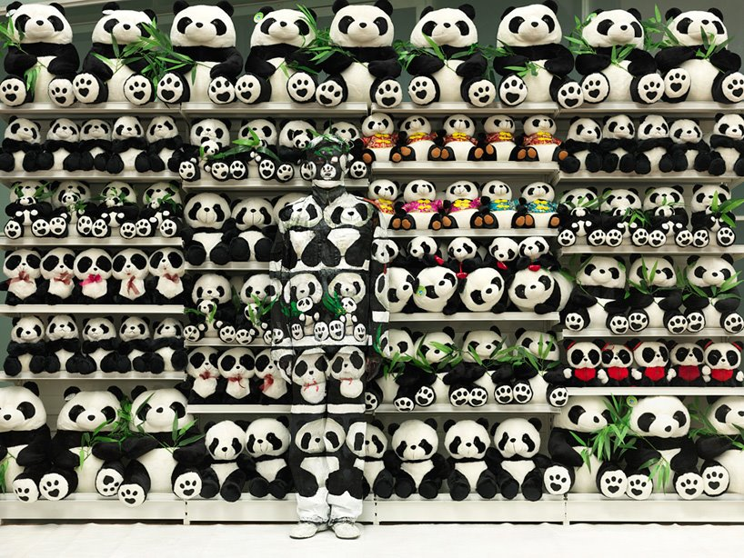
Challenge: Background clutter

Slide 28
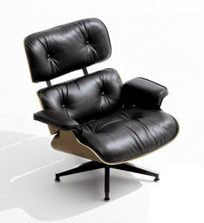
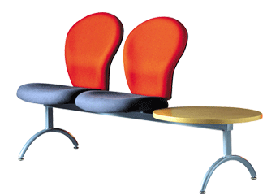
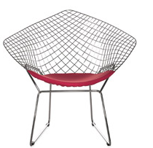
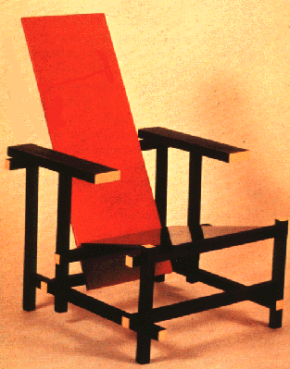
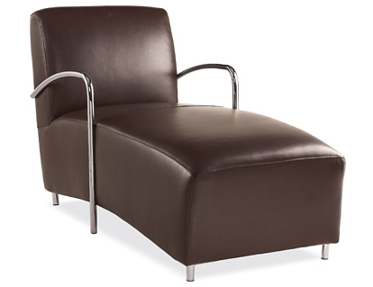
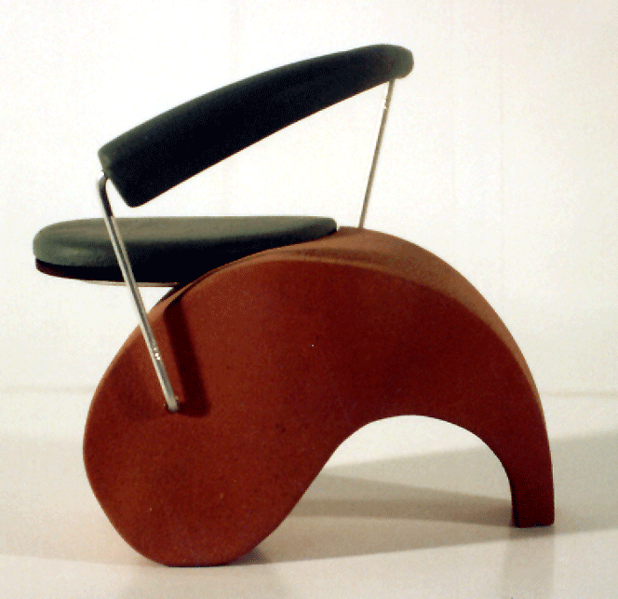
Challenge: intra-class variations
Svetlana Lazebnik
Notes:
Note English language issues. Try to not let language confound things.

Slide 29
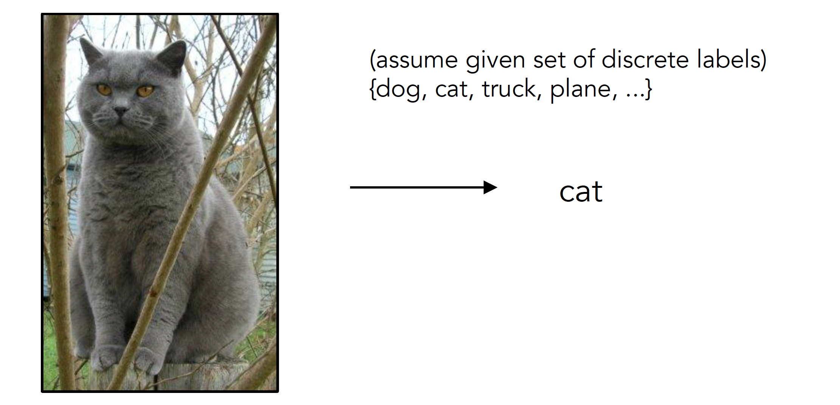
Image Classification

Slide 30
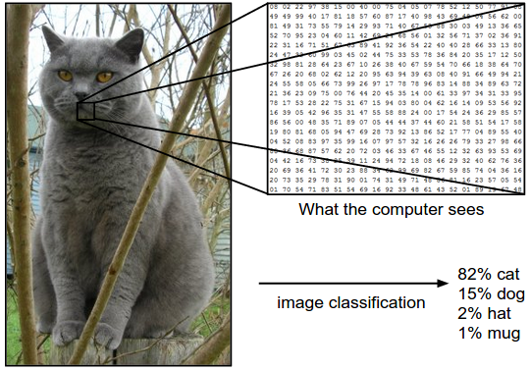
Image Classification: Problem

Slide 31
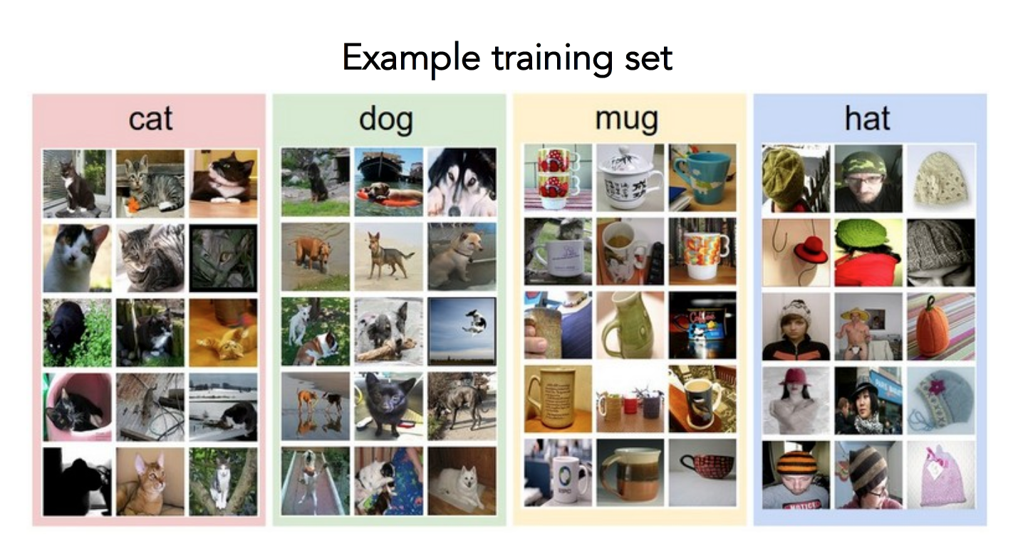
Data-driven approach
Collect a database of images with labels
Use ML to train an image classifier
Evaluate the classifier on test images

Slide 32
Bag of words

Slide 33
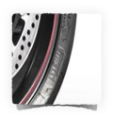
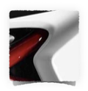
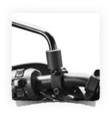
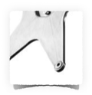
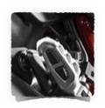
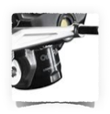
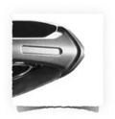
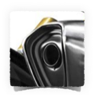

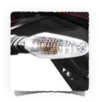
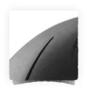
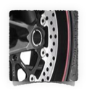
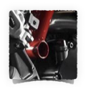
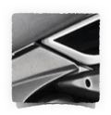
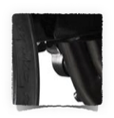
What object do these parts belong to?

Slide 34

Some local feature are very informative
An object as
a collection of local features
(bag-of-features)
deals well with occlusion
scale invariant
rotation invariant

Slide 35
(not so) crazy assumption
spatial information of local features
can be ignored for object recognition (i.e., verification)

Slide 36
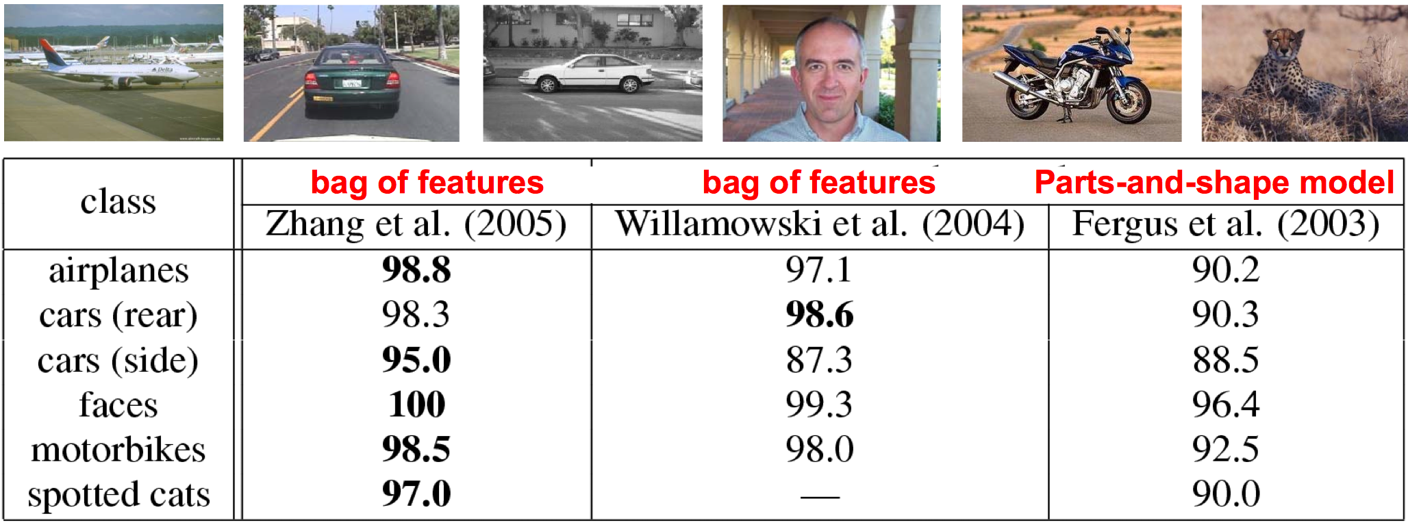
CalTech6 dataset
Works pretty well for image-level classification
Csurka et al. (2004), Willamowski et al. (2005), Grauman & Darrell (2005), Sivic et al. (2003, 2005)

Slide 37
Bag-of-features
represent a data item (document, texture, image)
as a histogram over features
an old idea
(e.g., texture recognition and information retrieval)

Slide 38




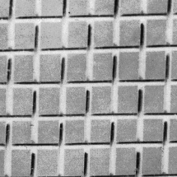
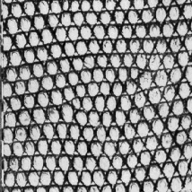
Texture recognition
histogram
Universal texton dictionary

Slide 39
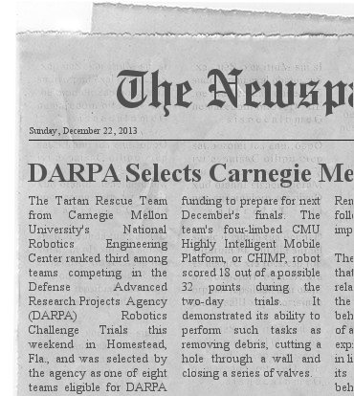
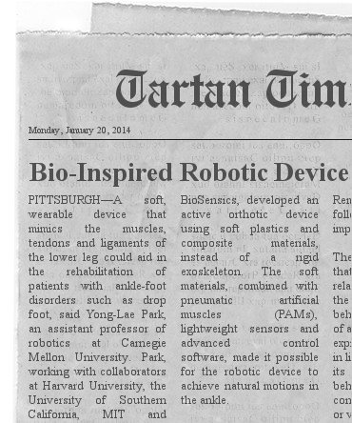
Vector Space Model
G. Salton. ‘Mathematics and Information Retrieval’ Journal of Documentation,1979
1 | 6 | 2 | 1 | 0 | 0 | 0 | 1
Tartan | robot | CHIMP | CMU | bio | soft | ankle | sensor
0 | 4 | 0 | 1 | 4 | 5 | 3 | 2
Tartan | robot | CHIMP | CMU | bio | soft | ankle | sensor
http://www.fodey.com/generators/newspaper/snippet.asp

Slide 40


A document (datapoint) is a vector of counts over each word (feature)
counts the number of occurrences
just a histogram over words
What is the similarity between two documents?

Slide 41

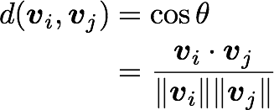
A document (datapoint) is a vector of counts over each word (feature)
counts the number of occurrences
just a histogram over words
What is the similarity between two documents?
Use any distance you want but the cosine distance is fast.

Slide 42
but not all words are created equal

Slide 43

TF-IDF
Term Frequency Inverse Document Frequency
weigh each word by a heuristic
inverse document frequency
term frequency
(down-weights common terms)

Slide 44
Standard BOW pipeline
(for image classification)

Slide 45
Dictionary Learning:
Learn Visual Words using clustering
Encode:
build Bags-of-Words (BOW) vectors
for each image
Classify:
Train and test data using BOWs

Slide 46
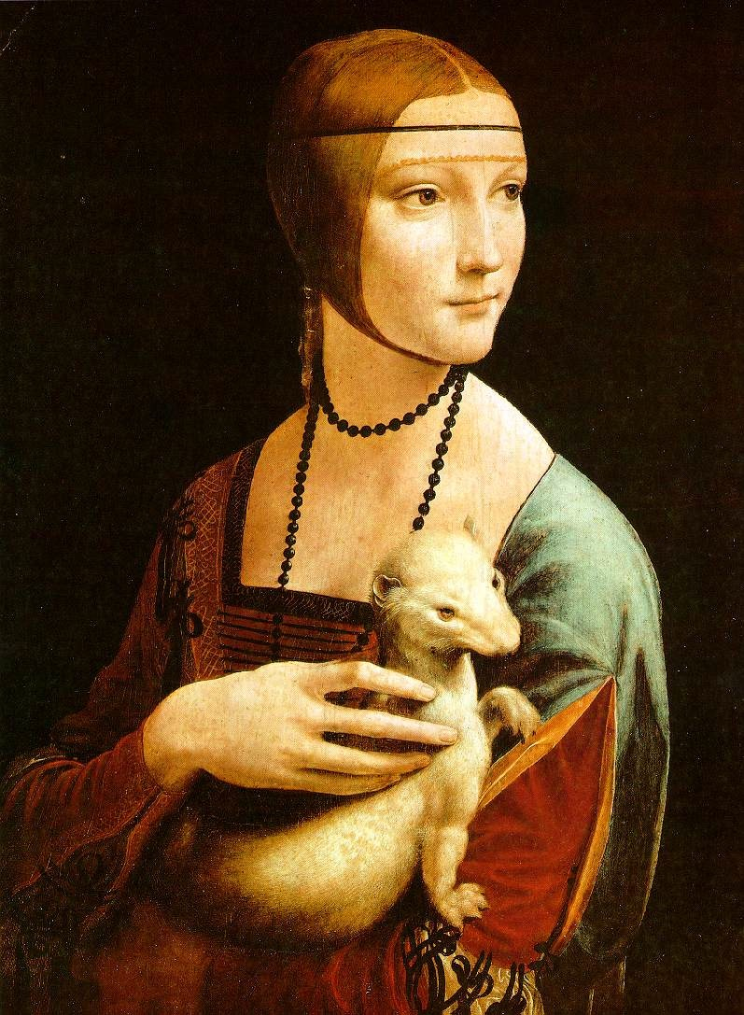
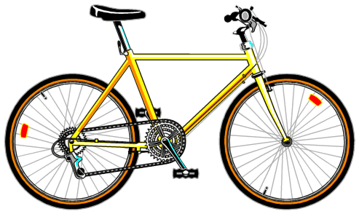

Dictionary Learning:
Learn Visual Words using clustering
1. extract features (e.g., SIFT) from images

Slide 47
Dictionary Learning:
Learn Visual Words using clustering
2. Learn visual dictionary (e.g., K-means clustering)

Slide 48
What kinds of features can we extract?

Slide 49

Regular grid
Vogel & Schiele, 2003
Fei-Fei & Perona, 2005
Interest point detector
Csurka et al. 2004
Fei-Fei & Perona, 2005
Sivic et al. 2005
Other methods
Random sampling (Vidal-Naquet & Ullman, 2002)
Segmentation-based patches (Barnard et al. 2003)

Slide 50


Compute SIFT descriptor
[Lowe’99]
Normalize patch
Detect patches
[Mikojaczyk and Schmid ’02]
[Mata, Chum, Urban & Pajdla, ’02]
[Sivic & Zisserman, ’03]

Slide 51
…

Slide 52
How do we learn the dictionary?

Slide 53
…

Slide 54
…
Clustering

Slide 55
Visual vocabulary
…
Clustering

Slide 56
K-means clustering

Slide 57
1. Select initial centroids at random

Slide 58
1. Select initial centroids at random
2. Assign each object to the cluster with the nearest centroid.

Slide 59
1. Select initial centroids at random
2. Assign each object to the cluster with the nearest centroid.
3. Compute each centroid as the mean of the objects assigned to it (go to 2)

Slide 60
1. Select initial centroids at random
2. Assign each object to the cluster with the nearest centroid.
3. Compute each centroid as the mean of the objects assigned to it (go to 2)
2. Assign each object to the cluster with the nearest centroid.

Slide 61
1. Select initial centroids at random
2. Assign each object to the cluster with the nearest centroid.
3. Compute each centroid as the mean of the objects assigned to it (go to 2)
2. Assign each object to the cluster with the nearest centroid.
Repeat previous 2 steps until no change

Slide 62
K-means Clustering
Given k:
Select initial centroids at random.
Assign each object to the cluster with the nearest centroid.
Compute each centroid as the mean of the objects assigned to it.
Repeat previous 2 steps until no change.

Slide 63
From what data should I learn the dictionary?
Codebook can be learned on separate training set
Provided the training set is sufficiently representative, the codebook will be “universal”

Slide 64
From what data should I learn the dictionary?
Dictionary can be learned on separate training set
Provided the training set is sufficiently representative, the dictionary will be “universal”

Slide 65

Example visual dictionary

Slide 66

















Example dictionary
…
Appearance codebook
Source: B. Leibe

Slide 67

Another dictionary
…
…
…
…
…
Appearance codebook
Source: B. Leibe

Slide 68
Dictionary Learning:
Learn Visual Words using clustering
Encode:
build Bags-of-Words (BOW) vectors
for each image
Classify:
Train and test data using BOWs

Slide 69

1. Quantization: image features gets associated to a visual word (nearest cluster center)
Encode:
build Bags-of-Words (BOW) vectors
for each image

Slide 70

Encode:
build Bags-of-Words (BOW) vectors
for each image
2. Histogram: count the number of visual word occurrences

Slide 71
frequency
…..
codewords

Slide 72
Dictionary Learning:
Learn Visual Words using clustering
Encode:
build Bags-of-Words (BOW) vectors
for each image
Classify:
Train and test data using BOWs

Slide 73
K nearest neighbors
Support Vector Machine
Naïve Bayes

Slide 74
K nearest neighbors

Slide 75
Distribution of data from two classes

Slide 76
Distribution of data from two classes
Which class does q belong too?

Slide 77
Distribution of data from two classes
Look at the neighbors

Slide 78



K-Nearest Neighbor (KNN) Classifier
Non-parametric pattern classification approach
Consider a two class problem where each sample consists of two measurements (x,y).
For a given query point q, assign the class of the nearest neighbor
k = 1
Compute the k nearest neighbors and assign the class by majority vote.
k = 3

Slide 79

Nearest Neighbor is competitive
MNIST Digit Recognition
Handwritten digits
28x28 pixel images: d = 784
60,000 training samples
10,000 test samples
Test Error Rate (%)
Linear classifier (1-layer NN) | 12.0
K-nearest-neighbors, Euclidean | 5.0
K-nearest-neighbors, Euclidean, deskewed | 2.4
K-NN, Tangent Distance, 16x16 | 1.1
K-NN, shape context matching | 0.67
1000 RBF + linear classifier | 3.6
SVM deg 4 polynomial | 1.1
2-layer NN, 300 hidden units | 4.7
2-layer NN, 300 HU, [deskewing] | 1.6
LeNet-5, [distortions] | 0.8
Boosted LeNet-4, [distortions] | 0.7
Yann LeCunn

Slide 80
What is the best distance metric between data points?
Typically Euclidean distance
Locality sensitive distance metrics
Important to normalize. Dimensions have different scales
How many K?
Typically k=1 is good
Cross-validation (try different k!)

Slide 81


Distance metrics
Euclidean
Cosine
Chi-squared

Slide 82

Choice of distance metric
Hyperparameter

Slide 83

Visualization: L2 distance
Notes:
Background plays an unrealistically large role

Slide 84

CIFAR-10 and NN results

Slide 85

k-nearest neighbor
Find the k closest points from training data
Labels of the k points “vote” to classify

Slide 86
Hyperparameters
What is the best distance to use?
What is the best value of k to use?
i.e., how do we set the hyperparameters?
Very problem-dependent
Must try them all and see what works best

Slide 87


Slide 88


Slide 89

Validation

Slide 90

Cross-validation

Slide 91


Slide 92
How to pick hyperparameters?
Methodology
Train and test
Train, validate, test
Train for original model
Validate to find hyperparameters
Test to understand generalizability

Slide 93
Pros
simple yet effective
Cons
search is expensive (can be sped-up)
storage requirements
difficulties with high-dimensional data

Slide 94
kNN -- Complexity and Storage
N training images, M test images
Training: O(1)
Testing: O(MN)
Hmm…
Normally need the opposite
Slow training (ok), fast testing (necessary)

Slide 95


Slide 96
Naïve Bayes

Slide 97
Distribution of data from two classes
Which class does q belong too?

Slide 98
Distribution of data from two classes
Learn parametric model for each class
Compute probability of query

Slide 99

This is called the posterior.
the probability of a class z given the observed features X
For classification, z is a discrete random variable
(e.g., car, person, building)
X is a set of observed features
(e.g., features from a single image)
(it’s a function that returns a single probability value)

Slide 100

This is called the posterior:
the probability of a class z given the observed features X
For classification, z is a discrete random variable
(e.g., car, person, building)
Each x is an observed feature
(e.g., visual words)
(it’s a function that returns a single probability value)

Slide 101


Recall:
The posterior can be decomposed according to Bayes’ Rule
likelihood
prior
posterior
In our context…

Slide 102



The naive Bayes’ classifier is solving this optimization
MAP (maximum a posteriori) estimate
Bayes’ Rule
Remove constants
To optimize this…we need to compute this
Compute the likelihood…

Slide 103



A naive Bayes’ classifier assumes all features are
conditionally independent
Recall:

Slide 104




To compute the MAP estimate
Given (1) a set of known parameters
(2) observations
Compute which z has the largest probability

Slide 105

count | 1 | 6 | 2 | 1 | 0 | 0 | 0 | 1
word | Tartan | robot | CHIMP | CMU | bio | soft | ankle | sensor
p(x|z) | 0.09 | 0.55 | 0.18 | 0.09 | 0.0 | 0.0 | 0.0 | 0.09
Numbers get really small so use log probabilities
* typically add pseudo-counts (0.001)
** this is an example for computing the likelihood, need to multiply times prior to get posterior

Slide 106
count | 1 | 6 | 2 | 1 | 0 | 0 | 0 | 1
word | Tartan | robot | CHIMP | CMU | bio | soft | ankle | sensor
p(x|z) | 0.09 | 0.55 | 0.18 | 0.09 | 0.0 | 0.0 | 0.0 | 0.09
log p(X|z=grand challenge) = - 14.58
log p(X|z=bio inspired) = - 37.48
count | 0 | 4 | 0 | 1 | 4 | 5 | 3 | 2
word | Tartan | robot | CHIMP | CMU | bio | soft | ankle | sensor
p(x|z) | 0.0 | 0.21 | 0.0 | 0.05 | 0.21 | 0.26 | 0.16 | 0.11
http://www.fodey.com/generators/newspaper/snippet.asp
log p(X|z=grand challenge) = - 94.06
log p(X|z=bio inspired) = - 32.41
* typically add pseudo-counts (0.001)
** this is an example for computing the likelihood, need to multiply times prior to get posterior

Slide 107
Support Vector Machine

Slide 108
Image Classification

Slide 109

Score function

Slide 110

Linear Classifier
data (histogram)

Slide 111

Convert image to histogram representation

Slide 112
Distribution of data from two classes
Which class does q belong too?

Slide 113
Distribution of data from two classes
Learn the decision boundary

Slide 114
First we need to understand hyperplanes…

Slide 115



Hyperplanes (lines) in 2D
a line can be written as dot product plus a bias
another version, add a weight 1 and push the bias inside

Slide 116
Hyperplanes (lines) in 2D
(offset/bias outside)
(offset/bias inside)

Slide 117
Hyperplanes (lines) in 2D
(offset/bias outside)
(offset/bias inside)
Important property:
Free to choose any normalization of w
The line
and the line
define the same line

Slide 118

What is the distance to origin?
(hint: use normal form)

Slide 119



distance to origin
scale
by
you get the normal form

Slide 120

What is the distance between two parallel lines?
(hint: use distance to origin)

Slide 121


distance between two parallel lines
Difference of distance to origin

Slide 122
Now we can go to 3D …
Hyperplanes (planes) in 3D
what are the dimensions of this vector?
What happens if you change b?

Slide 123

Hyperplanes (planes) in 3D

Slide 124

Hyperplanes (planes) in 3D
What’s the distance between these parallel planes?

Slide 125

Hyperplanes (planes) in 3D

Slide 126
What’s the best w?

Slide 127
What’s the best w?

Slide 128
What’s the best w?

Slide 129
What’s the best w?

Slide 130
What’s the best w?

Slide 131
What’s the best w?
Intuitively, the line that is the farthest from all interior points

Slide 132
What’s the best w?
Maximum Margin solution:
most stable to perturbations of data

Slide 133



What’s the best w?
support vectors
Want a hyperplane that is far away from ‘inner points’

Slide 134

Find hyperplane w such that …
margin
the gap between parallel hyperplanes
is maximized

Slide 135


Can be formulated as a maximization problem
What does this constraint mean?
label of the data point
Why is it +1 and -1?

Slide 136

Can be formulated as a maximization problem
Equivalently,
Where did the 2 go?
What happened to the labels?

Slide 137
‘Primal formulation’ of a linear SVM
Objective Function
Constraints
This is a convex quadratic programming (QP) problem
(a unique solution exists)

Slide 138
‘soft’ margin

Slide 139
What’s the best w?

Slide 140
What’s the best w?
Very narrow margin

Slide 141
Separating cats and dogs
Very narrow margin

Slide 142
What’s the best w?
Very narrow margin
Intuitively, we should allow for some misclassification if we can get more robust classification

Slide 143
What’s the best w?
Trade-off between the MARGIN and the MISTAKES
(might be a better solution)

Slide 144


Adding slack variables
misclassified point

Slide 145



‘soft’ margin
objective
subject to
for

Slide 146






‘soft’ margin
objective
subject to
for
The slack variable allows for mistakes,
as long as the inverse margin is minimized.

Slide 147
‘soft’ margin
objective
subject to
for
Every constraint can be satisfied if slack is large
C is a regularization parameter
Small C: ignore constraints (larger margin)
Big C: constraints (small margin)
Still QP problem (unique solution)

Slide 148


Slide 149


Slide 150
References
Basic reading:
Szeliski, Chapter 14.
Notes:
Ch

