Slide 1





Photometric stereo
16-385 Computer Vision
Spring 2020, Lecture 16
http://www.cs.cmu.edu/~16385/

Slide 2
Notes about online lectures
Zoom link has been posted on Piazza and is also available on Canvas.
Lectures are recorded, including all discussions. This is to facilitate students that cannot attend the lectures live.
Recorded lectures become available by Zoom a few hours after the lecture.
Please keep cameras closed to try and reduce bandwidth use as much as possible.
Please keep your Zoom window muted throughout the lecture.
If you have questions, either use the “Raise hand” option (preferable), or post in the chat. If I miss you, please repeat. And if I keep missing you, please remove mute and mention that you have a question.
We will post an “online lecture feedback” thread once this lecture is over. This situation is new to all of us, so any thoughts you have on how to make the lectures better will be highly appreciated.

Slide 3
Notes about office hours
Regular office hours on Mondays, Tuesdays, and Fridays continue.
Throughout the semester, there are additional office hours on Thursdays, 4-6 pm.
We will post updated Zoom links for office hours on Piazza.

Slide 4
Notes about homework logistics
Take-home quizzes have been reduced to 11. You can still skip 3 of them.
Take-home quiz 6 is due on Sunday, March 22.
Programming assignment 4 was posted yesterday and is due on Wednesday, March 25.
Programming assignment schedule has been shifted, as shown on the course website.
Last programming assignment will need to be a little shorter, to fit within 1.5 weeks instead of the usual two.

Slide 5
Questions?

Slide 6
Overview of today’s lecture
Some notes about radiometry.
Quick overview of the n-dot-l model.
Photometric stereo.
Uncalibrated photometric stereo.
Generalized bas-relief ambiguity.
Shape from shading.
Start image processing pipeline.

Slide 7
Slide credits
Many of these slides were adapted from:
Srinivasa Narasimhan (16-385, Spring 2014).
Todd Zickler (Harvard University).
Steven Gortler (Harvard University).
Kayvon Fatahalian (Stanford University; CMU 15-462, Fall 2015).

Slide 8
Quick overview of radiometry

Slide 9



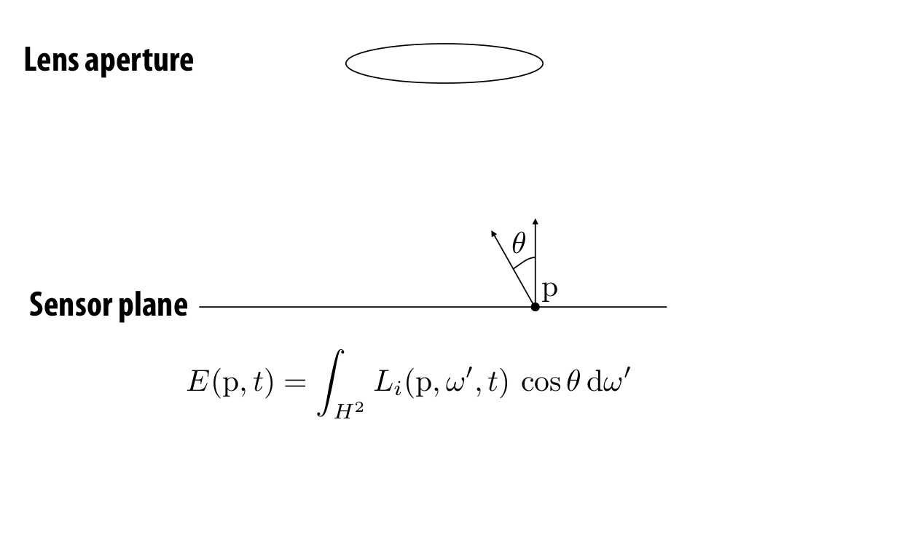
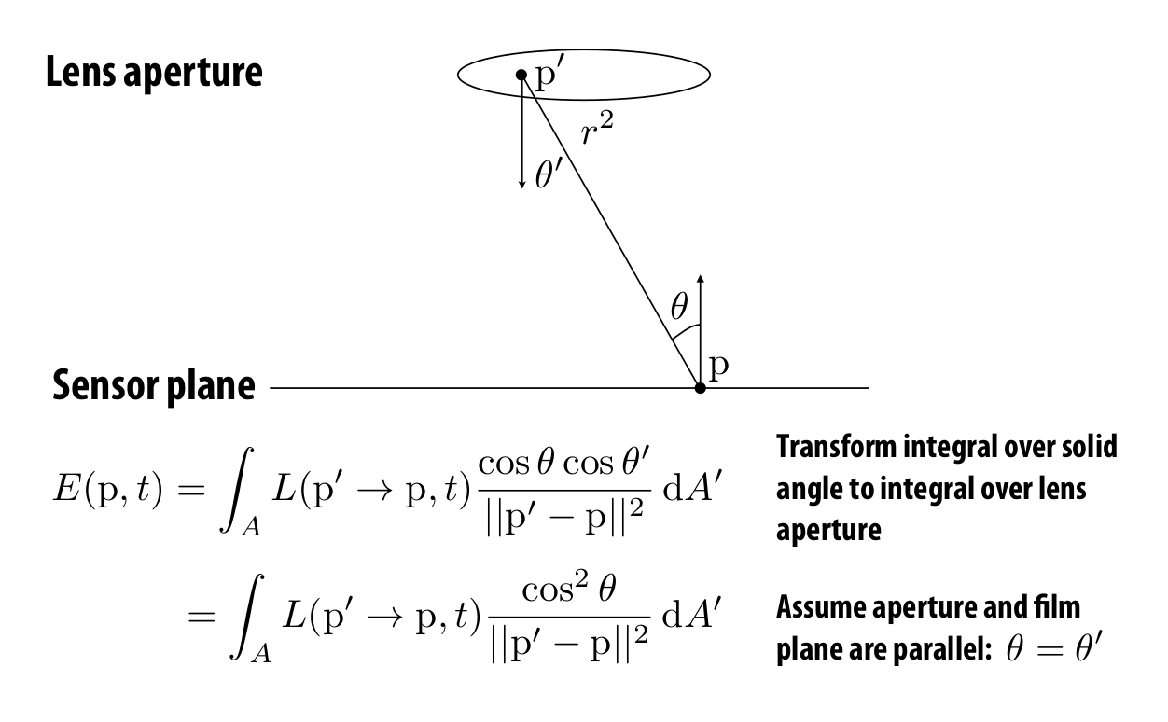
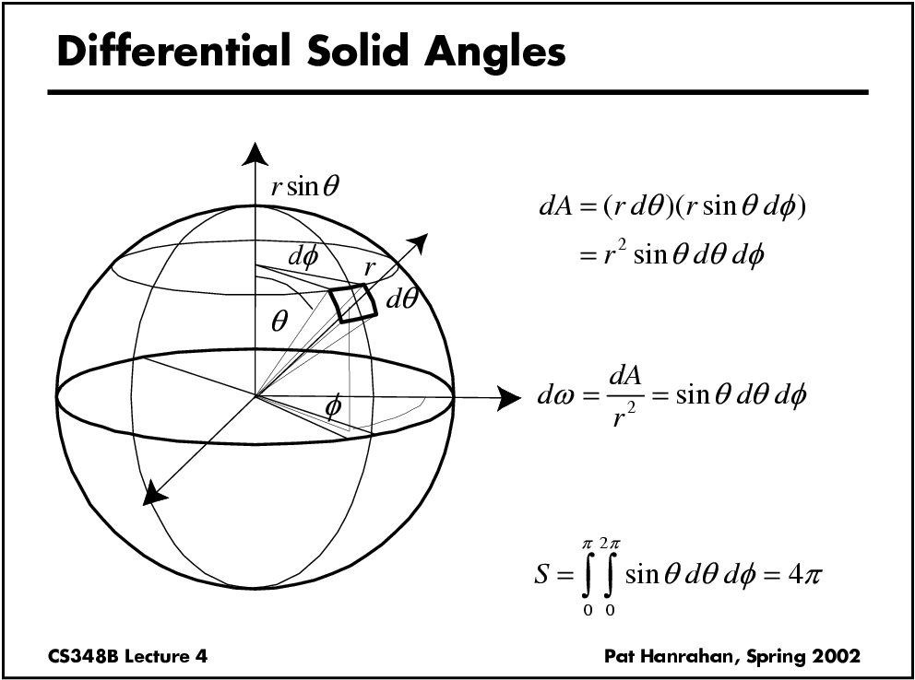
Five important equations/integrals to remember
Flux measured by a sensor of area X and directional receptivity W:
Reflectance equation:
Radiance under directional lighting and Lambertian BRDF (“n-dot-l shading”):
Conversion of a (hemi)-spherical integral to a surface integral:
Computing (hemi)-spherical integrals:
and
Notes:
Our work addresses the problem of inferring scene properties from image data.
Specifically, we want to relate observed image intensities to object shape, scene illumination, and material properties, or surface reflectance.
The task is made difficult by the fact that shape, lighting, and reflectance information are all tightly coupled in the image data so that we cannot typically draw conclusions about one of them without making restrictive assumptions about the others.

Slide 10
Quiz 1: Measurement of a sensor using a thin lens
What integral should we write for the power measured by infinitesimal pixel p?
Notes:
Our work addresses the problem of inferring scene properties from image data.
Specifically, we want to relate observed image intensities to object shape, scene illumination, and material properties, or surface reflectance.
The task is made difficult by the fact that shape, lighting, and reflectance information are all tightly coupled in the image data so that we cannot typically draw conclusions about one of them without making restrictive assumptions about the others.

Slide 11
Quiz 1: Measurement of a sensor using a thin lens
What integral should we write for the power measured by infinitesimal pixel p?
Can I transform this integral over the hemisphere to an integral over the aperture area?
Notes:
Our work addresses the problem of inferring scene properties from image data.
Specifically, we want to relate observed image intensities to object shape, scene illumination, and material properties, or surface reflectance.
The task is made difficult by the fact that shape, lighting, and reflectance information are all tightly coupled in the image data so that we cannot typically draw conclusions about one of them without making restrictive assumptions about the others.

Slide 12
Quiz 1: Measurement of a sensor using a thin lens
What integral should we write for the power measured by infinitesimal pixel p?
Can I transform this integral over the hemisphere to an integral over the aperture area?
Notes:
Our work addresses the problem of inferring scene properties from image data.
Specifically, we want to relate observed image intensities to object shape, scene illumination, and material properties, or surface reflectance.
The task is made difficult by the fact that shape, lighting, and reflectance information are all tightly coupled in the image data so that we cannot typically draw conclusions about one of them without making restrictive assumptions about the others.

Slide 13
Quiz 1: Measurement of a sensor using a thin lens
Can I write the denominator in a more convenient form?
Notes:
Our work addresses the problem of inferring scene properties from image data.
Specifically, we want to relate observed image intensities to object shape, scene illumination, and material properties, or surface reflectance.
The task is made difficult by the fact that shape, lighting, and reflectance information are all tightly coupled in the image data so that we cannot typically draw conclusions about one of them without making restrictive assumptions about the others.

Slide 14
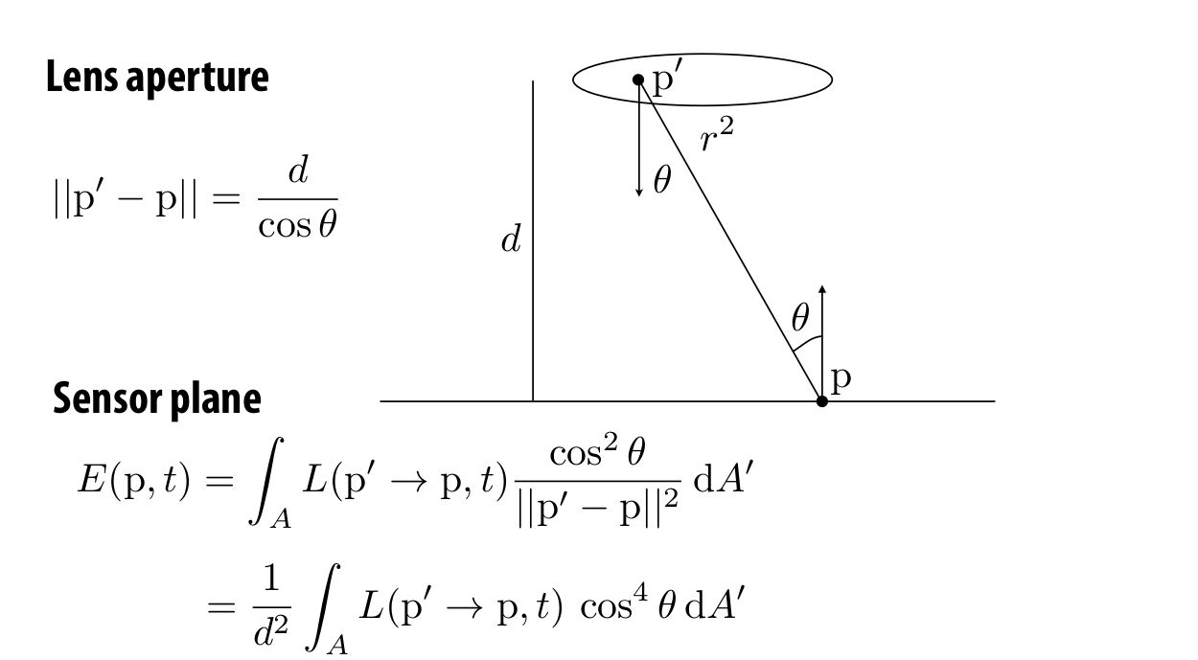
Quiz 1: Measurement of a sensor using a thin lens
What does this say about the image I am capturing?
Notes:
Our work addresses the problem of inferring scene properties from image data.
Specifically, we want to relate observed image intensities to object shape, scene illumination, and material properties, or surface reflectance.
The task is made difficult by the fact that shape, lighting, and reflectance information are all tightly coupled in the image data so that we cannot typically draw conclusions about one of them without making restrictive assumptions about the others.

Slide 15

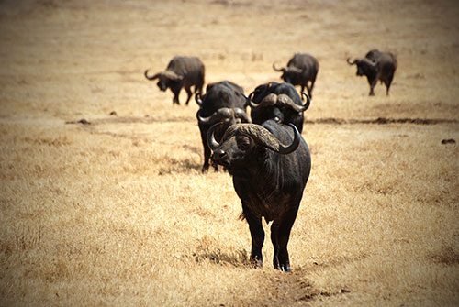
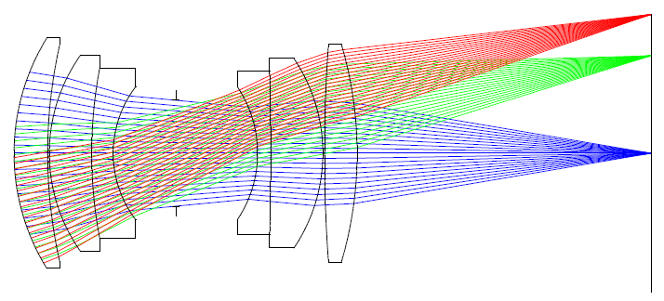
Vignetting
Fancy word for: pixels far off the center receive less light
white wall under uniform light
more interesting example of vignetting
Four types of vignetting:
Mechanical: light rays blocked by hoods, filters, and other objects.
Lens: similar, but light rays blocked by lens elements.
Natural: due to radiometric laws (“cosine fourth falloff”).
Pixel: angle-dependent sensitivity of photodiodes.

Slide 16
Quiz 2: BRDF of the moon
What BRDF does the moon have?
Notes:
Our work addresses the problem of inferring scene properties from image data.
Specifically, we want to relate observed image intensities to object shape, scene illumination, and material properties, or surface reflectance.
The task is made difficult by the fact that shape, lighting, and reflectance information are all tightly coupled in the image data so that we cannot typically draw conclusions about one of them without making restrictive assumptions about the others.

Slide 17
Quiz 2: BRDF of the moon
What BRDF does the moon have?
Can it be diffuse?
Notes:
Our work addresses the problem of inferring scene properties from image data.
Specifically, we want to relate observed image intensities to object shape, scene illumination, and material properties, or surface reflectance.
The task is made difficult by the fact that shape, lighting, and reflectance information are all tightly coupled in the image data so that we cannot typically draw conclusions about one of them without making restrictive assumptions about the others.

Slide 18
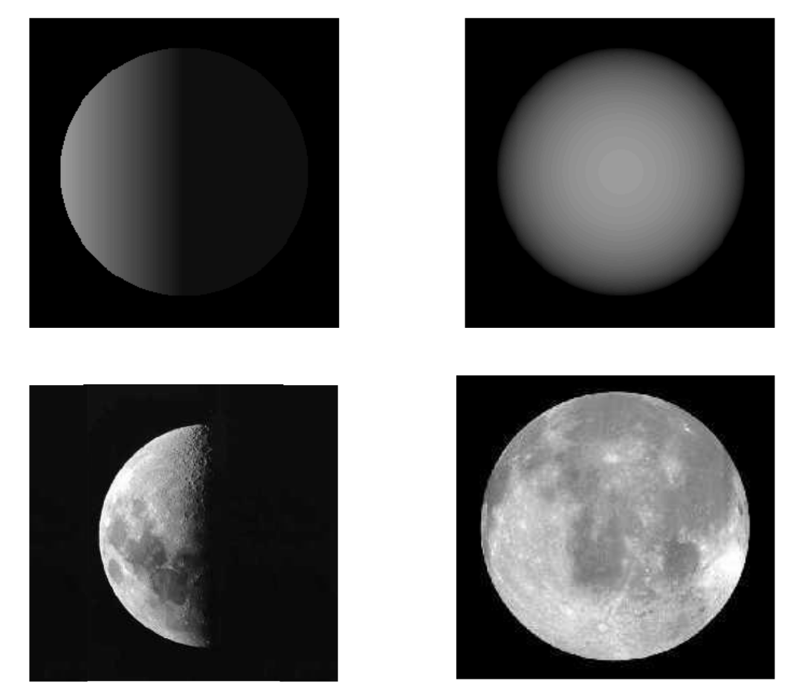
Quiz 2: BRDF of the moon
What BRDF does the moon have?
Can it be diffuse?
Even though the moon appears matte, its edges remain bright.
Notes:
Our work addresses the problem of inferring scene properties from image data.
Specifically, we want to relate observed image intensities to object shape, scene illumination, and material properties, or surface reflectance.
The task is made difficult by the fact that shape, lighting, and reflectance information are all tightly coupled in the image data so that we cannot typically draw conclusions about one of them without making restrictive assumptions about the others.

Slide 19
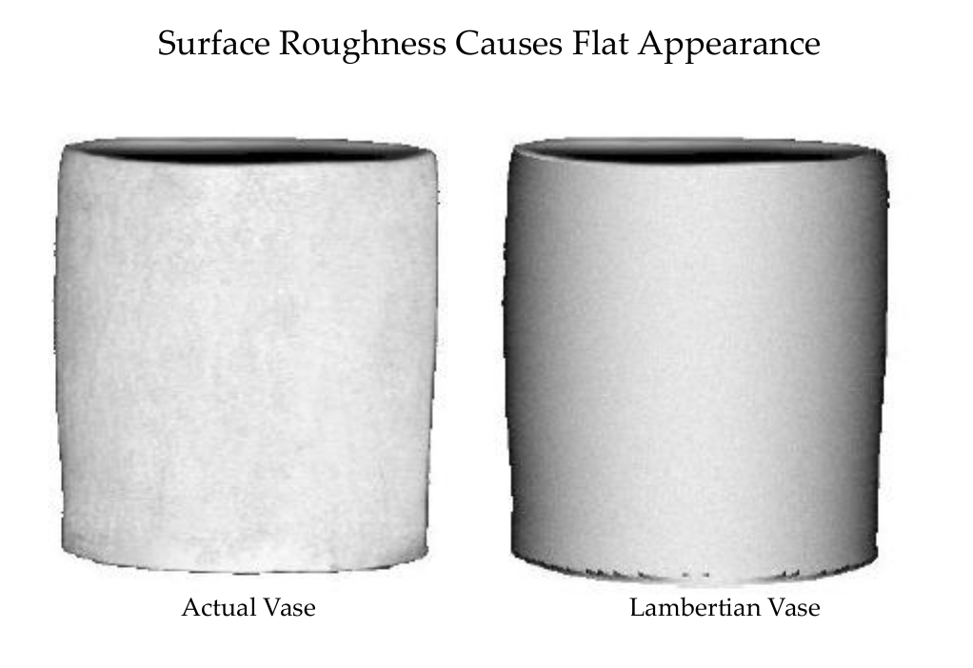
Rough diffuse appearance
Notes:
Our work addresses the problem of inferring scene properties from image data.
Specifically, we want to relate observed image intensities to object shape, scene illumination, and material properties, or surface reflectance.
The task is made difficult by the fact that shape, lighting, and reflectance information are all tightly coupled in the image data so that we cannot typically draw conclusions about one of them without making restrictive assumptions about the others.

Slide 20
Photometric stereo

Slide 21


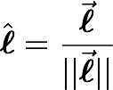

Even simpler:
Directional lighting
Assume that, over the observed region of interest, all source of incoming flux is from one direction
Convenient representation
“light direction”
“light strength”
Notes:
& L(x,\omega,t,\lambda)\longrightarrow L(x,t,\lambda)\longrightarrow s(t,\lambda)\delta(\omega=\omega_o(t))\\
& L(x,\omega)\longrightarrow L(\omega)\longrightarrow s\delta(\omega=\omega_o)
\vec{\boldsymbol{\ell}}=(\ell_x,\ell_y,\ell_z)
\hat{\boldsymbol{\ell}}=\frac{\vec{\boldsymbol{\ell}}}{||\vec{\boldsymbol{\ell}}||}

Slide 22
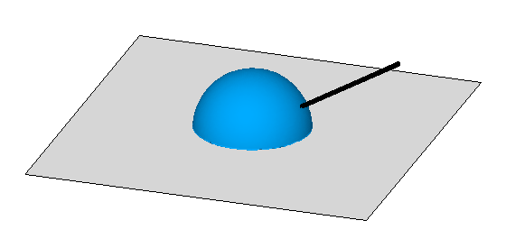

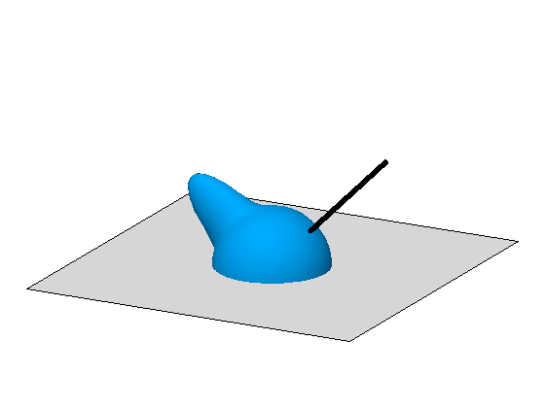
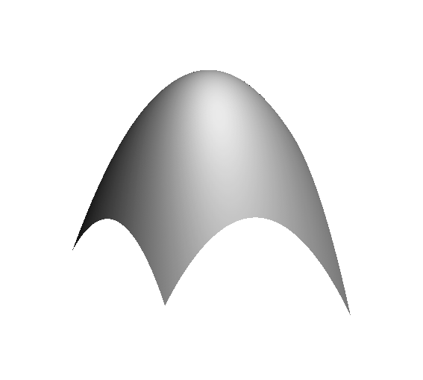
Simple shading
ASSUMPTION 1:
LAMBERTIAN
ASSUMPTION 2:
DIRECTIONAL LIGHTING
Notes:
I=a\hat{\bf n}^\top\vec{\boldsymbol{\ell}}

Slide 23
“N-dot-l” shading
ASSUMPTION 1:
LAMBERTIAN
ASSUMPTION 2:
DIRECTIONAL LIGHTING
Notes:
I=a\hat{\bf n}^\top\vec{\boldsymbol{\ell}}

Slide 24
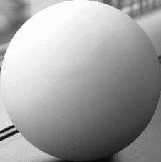
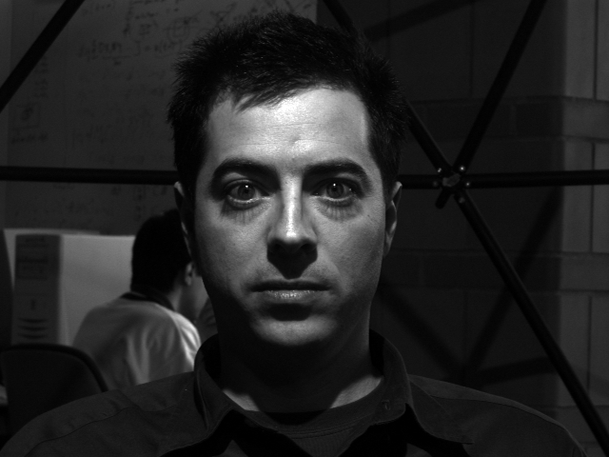
Image Intensity and 3D Geometry
Shading as a cue for shape reconstruction
What is the relation between intensity and shape?

Slide 25
“N-dot-l” shading
ASSUMPTION 1:
LAMBERTIAN
ASSUMPTION 2:
DIRECTIONAL LIGHTING
Why do we call these normal “shape”?
Notes:
I=a\hat{\bf n}^\top\vec{\boldsymbol{\ell}}

Slide 26
Surfaces and normals
z
imaged surface
viewing rays for different pixels
x
what is a camera like this called?
Notes:
I=a\hat{\bf n}^\top\vec{\boldsymbol{\ell}}

Slide 27
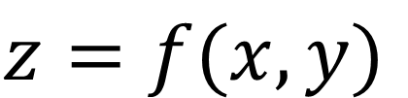
Surfaces and normals
z
imaged surface
Surface representation as a depth field (also known as Monge surface):
$$z=f(x,y)$$
viewing rays for different pixels
pixel coordinates on image place
depth at each pixel
How does surface normal relate to this representation?
x
orthographic camera
Notes:
I=a\hat{\bf n}^\top\vec{\boldsymbol{\ell}}

Slide 28
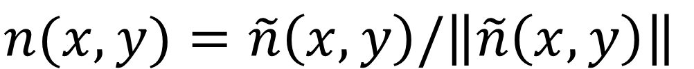
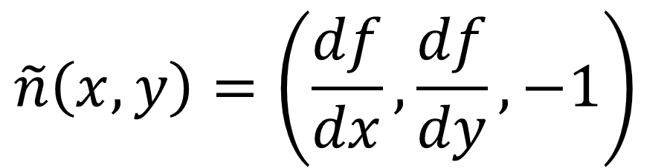
Surfaces and normals
z
imaged surface
Surface representation as a depth image (also known as Monge surface):
$$z=f(x,y)$$
viewing rays for different pixels
pixel coordinates on image place
depth at each pixel
Unnormalized normal:
$$\tilde{n}\left(x,y\right)=\left(\frac{df}{dx},\frac{df}{dy},−1\right)$$
x
orthographic camera
Actual normal:
$$n(x,y)=\tilde{n}\left(x,y\right)/\left\|\tilde{n}\left(x,y\right)\right\|$$
Normals are scaled spatial derivatives of depth image!
Notes:
I=a\hat{\bf n}^\top\vec{\boldsymbol{\ell}}

Slide 29
Shape from a Single Image?
Given a single image of an object with known surface reflectance taken under a known light source, can we recover the shape of the object?

Slide 30
Human Perception

Slide 31
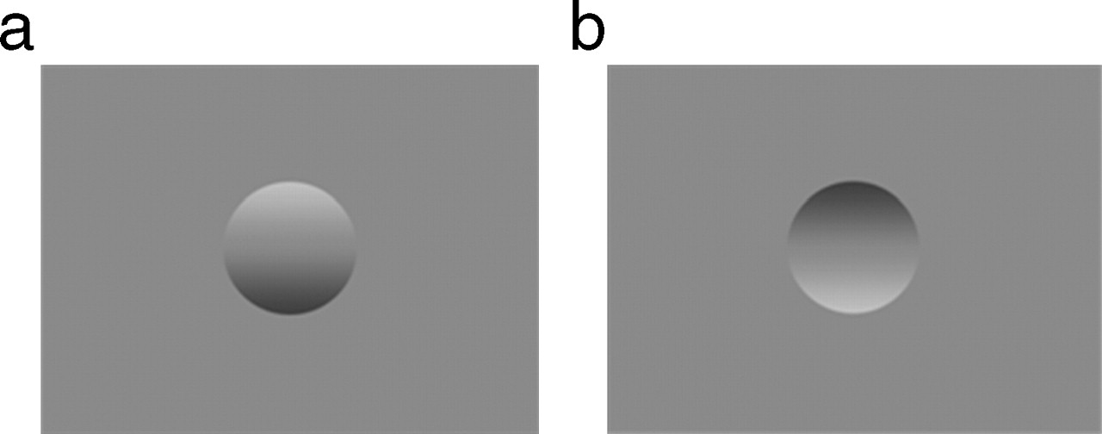

Examples of the classic bump/dent stimuli used to test lighting assumptions when judging shape from shading, with shading orientations (a) 0° and (b) 180° from the vertical.
Thomas R et al. J Vis 2010;10:6
Notes:
Examples of the classic bump/dent stimuli used to test lighting assumptions when judging shape from shading, with shading orientations (a) 0° and (b) 180° from the vertical.

Slide 32
Human Perception
Our brain often perceives shape from shading.
Mostly, it makes many assumptions to do so.
For example:
Light is coming from above (sun).
Biased by occluding contours.
by V. Ramachandran

Slide 33
Single-lighting is ambiguous
ASSUMPTION 1:
LAMBERTIAN
ASSUMPTION 2:
DIRECTIONAL LIGHTING
Notes:
I=a\hat{\bf n}^\top\vec{\boldsymbol{\ell}}

Slide 34




Lambertian photometric stereo
Assumption: We know the lighting directions.
Notes:
%%% latexit
I_1=a\hat{\boldsymbol{n}}^\top\vec{\boldsymbol{\ell}}_1
\vec{\boldsymbol{b}}\triangleq a\hat{\boldsymbol{n}}
\left[\begin{array}{c}
I_1 \\ I_2 \\ \vdots \\ I_N
\end{array}\right]_{N\times 1}\!\!\!\!\!
=\left[\begin{array}{c}
\vec{\boldsymbol{\ell}}_1^\top \\
\vec{\boldsymbol{\ell}}_2^\top \\
\vdots \\
\vec{\boldsymbol{\ell}}_N^\top \\
\end{array}\right]_{N\times 3}\!\!\!\!\!\!\!\!\!
\left[\begin{array}{c}
\vec{\boldsymbol{b}}
\end{array}\right]_{3\times 1}

Slide 35

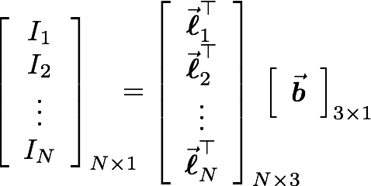
Lambertian photometric stereo
define “pseudo-normal”
solve linear system
for pseudo-normal
What are the dimensions of these matrices?
Notes:
%%% latexit
I_1=a\hat{\boldsymbol{n}}^\top\vec{\boldsymbol{\ell}}_1
\vec{\boldsymbol{b}}\triangleq a\hat{\boldsymbol{n}}
\left[\begin{array}{c}
I_1 \\ I_2 \\ \vdots \\ I_N
\end{array}\right]_{N\times 1}\!\!\!\!\!
=\left[\begin{array}{c}
\vec{\boldsymbol{\ell}}_1^\top \\
\vec{\boldsymbol{\ell}}_2^\top \\
\vdots \\
\vec{\boldsymbol{\ell}}_N^\top \\
\end{array}\right]_{N\times 3}\!\!\!\!\!\!\!\!\!
\left[\begin{array}{c}
\vec{\boldsymbol{b}}
\end{array}\right]_{3\times 1}

Slide 36
Lambertian photometric stereo
define “pseudo-normal”
solve linear system
for pseudo-normal
What are the knowns and unknowns?
Notes:
%%% latexit
I_1=a\hat{\boldsymbol{n}}^\top\vec{\boldsymbol{\ell}}_1
\vec{\boldsymbol{b}}\triangleq a\hat{\boldsymbol{n}}
\left[\begin{array}{c}
I_1 \\ I_2 \\ \vdots \\ I_N
\end{array}\right]_{N\times 1}\!\!\!\!\!
=\left[\begin{array}{c}
\vec{\boldsymbol{\ell}}_1^\top \\
\vec{\boldsymbol{\ell}}_2^\top \\
\vdots \\
\vec{\boldsymbol{\ell}}_N^\top \\
\end{array}\right]_{N\times 3}\!\!\!\!\!\!\!\!\!
\left[\begin{array}{c}
\vec{\boldsymbol{b}}
\end{array}\right]_{3\times 1}

Slide 37
Lambertian photometric stereo
define “pseudo-normal”
solve linear system
for pseudo-normal
How many lights do I need for unique solution?
Notes:
%%% latexit
I_1=a\hat{\boldsymbol{n}}^\top\vec{\boldsymbol{\ell}}_1
\vec{\boldsymbol{b}}\triangleq a\hat{\boldsymbol{n}}
\left[\begin{array}{c}
I_1 \\ I_2 \\ \vdots \\ I_N
\end{array}\right]_{N\times 1}\!\!\!\!\!
=\left[\begin{array}{c}
\vec{\boldsymbol{\ell}}_1^\top \\
\vec{\boldsymbol{\ell}}_2^\top \\
\vdots \\
\vec{\boldsymbol{\ell}}_N^\top \\
\end{array}\right]_{N\times 3}\!\!\!\!\!\!\!\!\!
\left[\begin{array}{c}
\vec{\boldsymbol{b}}
\end{array}\right]_{3\times 1}

Slide 38
Lambertian photometric stereo
define “pseudo-normal”
solve linear system
for pseudo-normal
once system is solved, b gives normal direction and albedo
How do we solve this system?
Notes:
%%% latexit
I_1=a\hat{\boldsymbol{n}}^\top\vec{\boldsymbol{\ell}}_1
\vec{\boldsymbol{b}}\triangleq a\hat{\boldsymbol{n}}
\left[\begin{array}{c}
I_1 \\ I_2 \\ \vdots \\ I_N
\end{array}\right]_{N\times 1}\!\!\!\!\!
=\left[\begin{array}{c}
\vec{\boldsymbol{\ell}}_1^\top \\
\vec{\boldsymbol{\ell}}_2^\top \\
\vdots \\
\vec{\boldsymbol{\ell}}_N^\top \\
\end{array}\right]_{N\times 3}\!\!\!\!\!\!\!\!\!
\left[\begin{array}{c}
\vec{\boldsymbol{b}}
\end{array}\right]_{3\times 1}

Slide 39
Solving the Equation with three lights
inverse
Is there any reason to use more than three lights?

Slide 40
More than Three Light Sources
Get better SNR by using more lights
Least squares solution:
Moore-Penrose pseudo inverse
Solve for as before

Slide 41
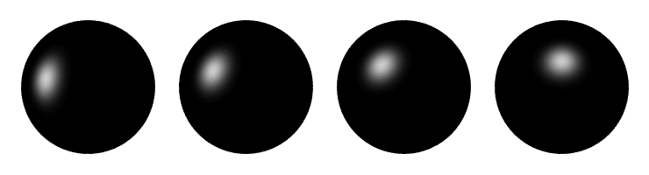
Computing light source directions
Trick: place a chrome sphere in the scene
the location of the highlight tells you the source direction

Slide 42
Limitations
Big problems
Doesn’t work for shiny things, semi-translucent things
Shadows, inter-reflections
Smaller problems
Camera and lights have to be distant
Calibration requirements
measure light source directions, intensities
camera response function

Slide 43
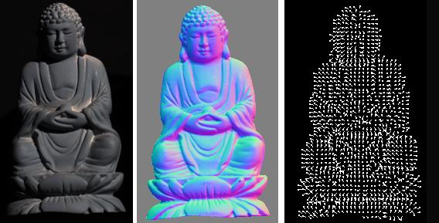
Depth from normals
Solving the linear system per-pixel gives us an estimated surface normal for each pixel
How can we compute depth from normals?
Normals are like the “derivative” of the true depth
Input photo
Estimated normals
Estimated normals (needle diagram)

Slide 44
Surfaces and normals
z
imaged surface
Surface representation as a depth image (also known as Monge surface):
$$z=f(x,y)$$
viewing rays for different pixels
pixel coordinates in image space
depth at each pixel
Unnormalized normal:
$$\tilde{n}\left(x,y\right)=\left(\frac{df}{dx},\frac{df}{dy},−1\right)$$
x
orthographic camera
Actual normal:
$$n(x,y)=\tilde{n}\left(x,y\right)/\left\|\tilde{n}\left(x,y\right)\right\|$$
Normals are scaled spatial derivatives of depth image!
Notes:
I=a\hat{\bf n}^\top\vec{\boldsymbol{\ell}}

Slide 45
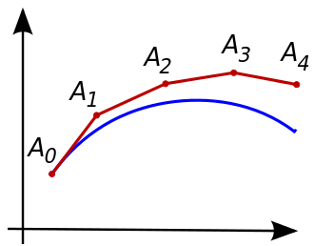
Normal Integration
Integrating a set of derivatives is easy in 1D
(similar to Euler’s method from diff. eq. class)
Could just integrate normals in each column / row separately
Instead, we formulate as a linear system and solve for depths that best agree with the surface normals

Slide 46

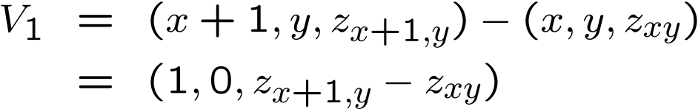


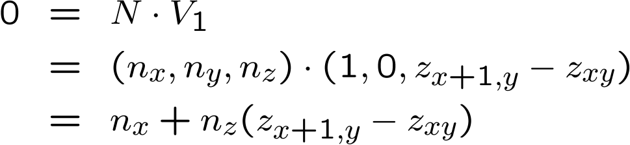

Depth from normals
V₂
V₁
N
Get a similar equation for V₂
Each normal gives us two linear constraints on z
compute z values by solving a matrix equation

Slide 47
Results
Estimate light source directions
Compute surface normals
Compute albedo values
Estimate depth from surface normals
Relight the object (with original texture and uniform albedo)

Slide 48
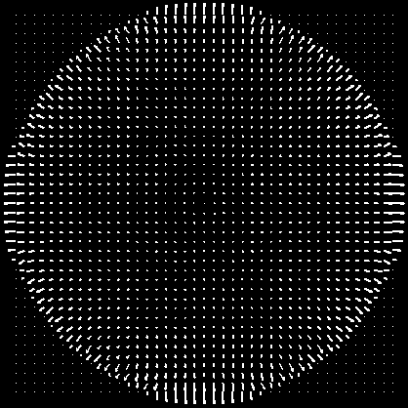

Results: Lambertian Sphere
Input Images
Needles are projections
of surface normals on
image plane
Estimated Surface Normals
Estimated Albedo

Slide 49
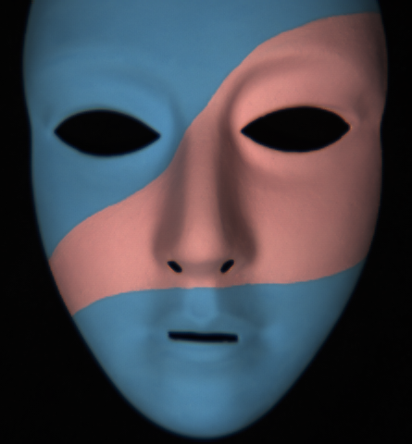
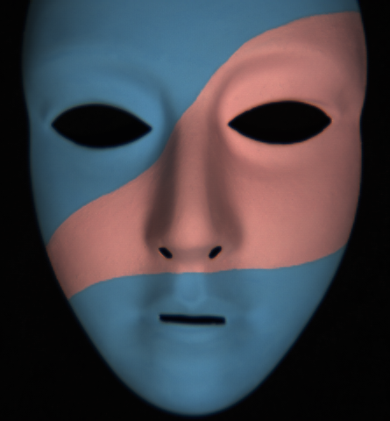
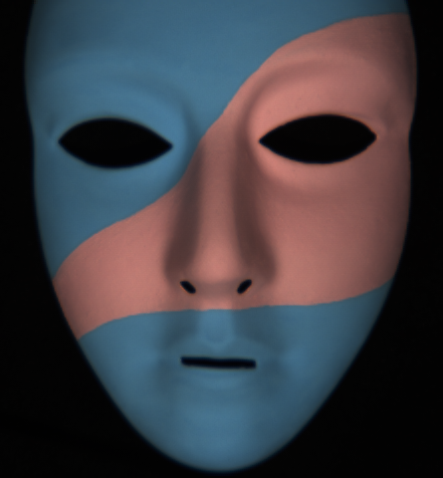
Lambertain Mask

Slide 50
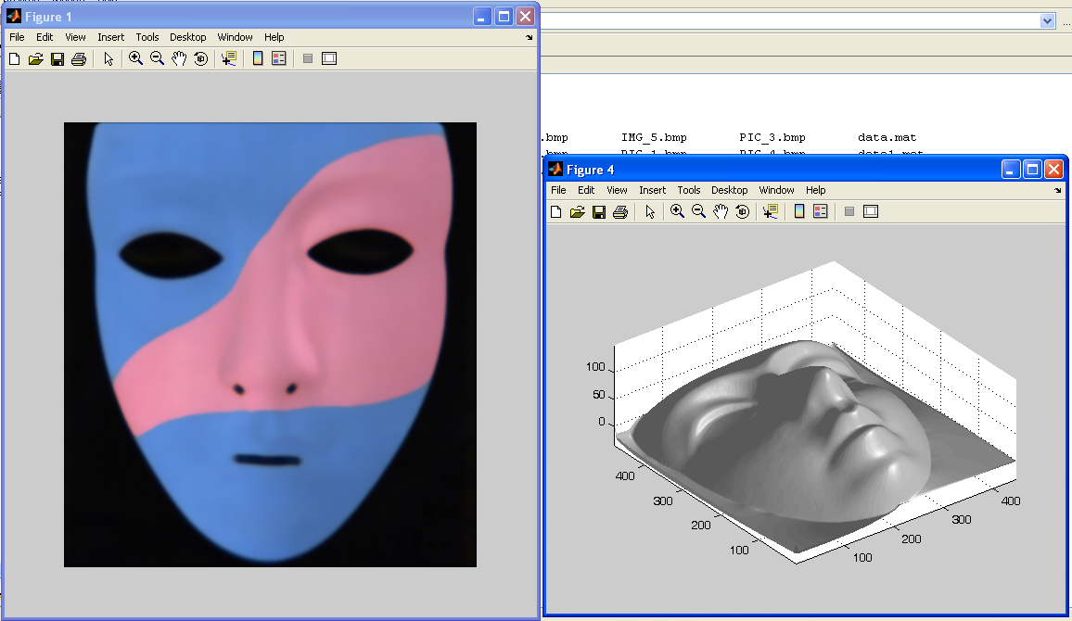
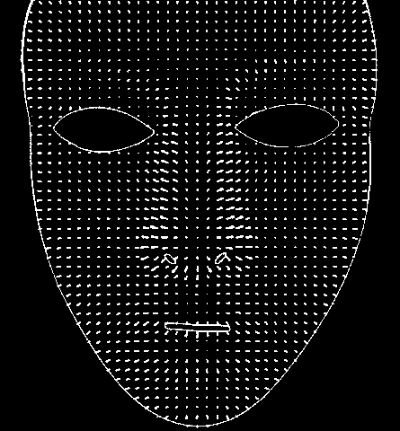
Results – Albedo and Surface Normal

Slide 51
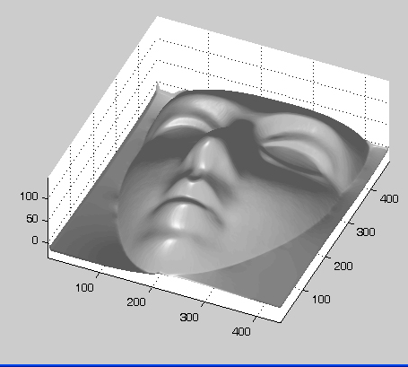
Results – Shape of Mask

Slide 52
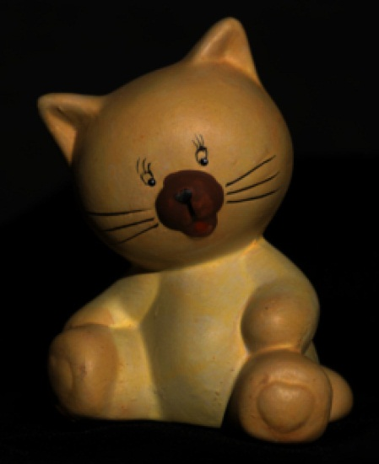
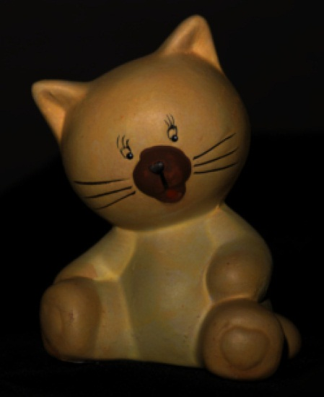
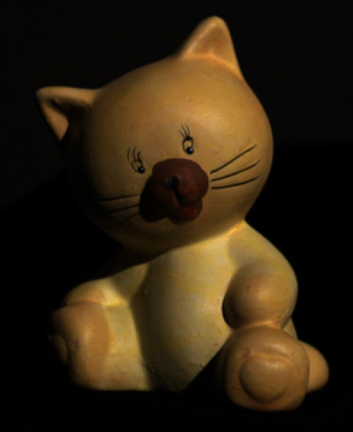
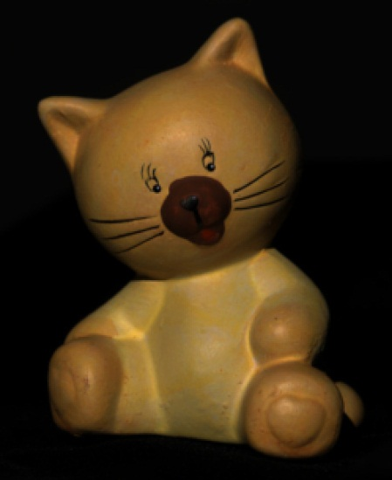
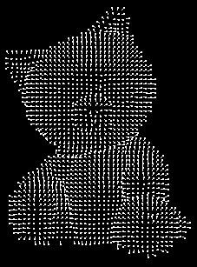
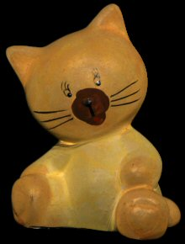
Results: Lambertian Toy
I.2
Input Images
Estimated Surface Normals
Estimated Albedo

Slide 53
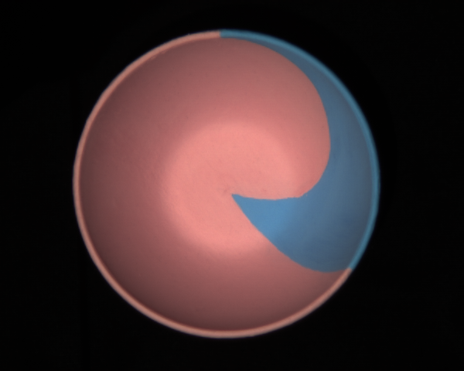
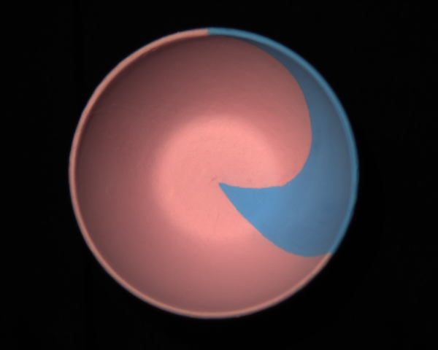
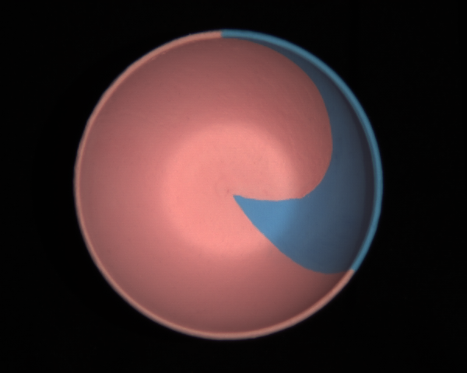
Non-idealities: interreflections

Slide 54
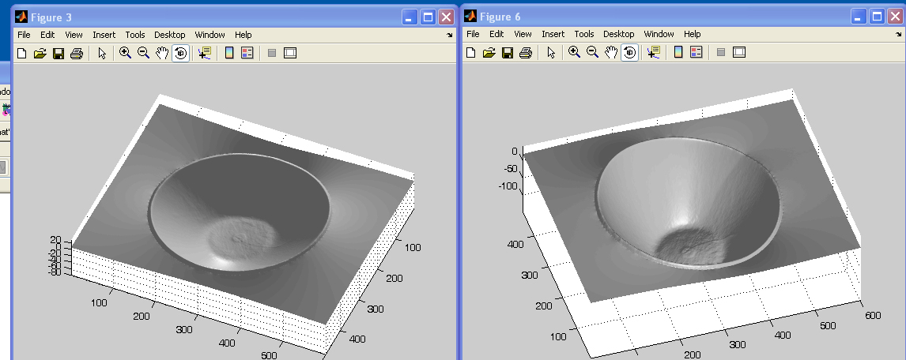
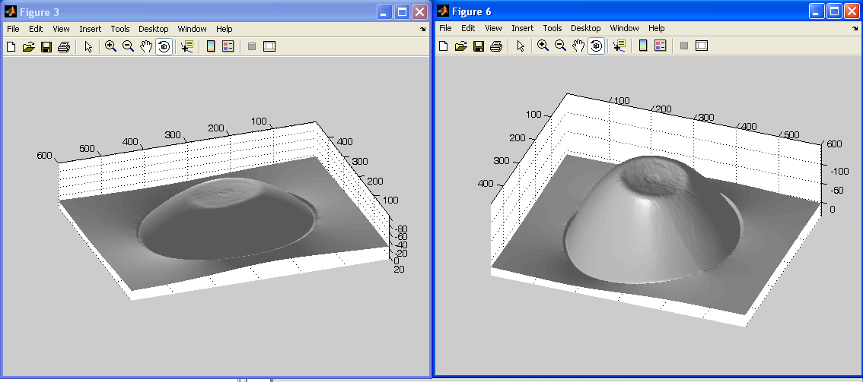
Non-idealities: interreflections
Shallow reconstruction
(effect of interreflections)
Accurate reconstruction
(after removing interreflections)

Slide 55
What if the light directions are unknown?
Notes:
%%% latexit
I_1=a\hat{\boldsymbol{n}}^\top\vec{\boldsymbol{\ell}}_1
\vec{\boldsymbol{b}}\triangleq a\hat{\boldsymbol{n}}
\left[\begin{array}{c}
I_1 \\ I_2 \\ \vdots \\ I_N
\end{array}\right]_{N\times 1}\!\!\!\!\!
=\left[\begin{array}{c}
\vec{\boldsymbol{\ell}}_1^\top \\
\vec{\boldsymbol{\ell}}_2^\top \\
\vdots \\
\vec{\boldsymbol{\ell}}_N^\top \\
\end{array}\right]_{N\times 3}\!\!\!\!\!\!\!\!\!
\left[\begin{array}{c}
\vec{\boldsymbol{b}}
\end{array}\right]_{3\times 1}

Slide 56
Uncalibrated photometric stereo

Slide 57
What if the light directions are unknown?
define “pseudo-normal”
solve linear system
for pseudo-normal
Notes:
%%% latexit
I_1=a\hat{\boldsymbol{n}}^\top\vec{\boldsymbol{\ell}}_1
\vec{\boldsymbol{b}}\triangleq a\hat{\boldsymbol{n}}
\left[\begin{array}{c}
I_1 \\ I_2 \\ \vdots \\ I_N
\end{array}\right]_{N\times 1}\!\!\!\!\!
=\left[\begin{array}{c}
\vec{\boldsymbol{\ell}}_1^\top \\
\vec{\boldsymbol{\ell}}_2^\top \\
\vdots \\
\vec{\boldsymbol{\ell}}_N^\top \\
\end{array}\right]_{N\times 3}\!\!\!\!\!\!\!\!\!
\left[\begin{array}{c}
\vec{\boldsymbol{b}}
\end{array}\right]_{3\times 1}

Slide 58



What if the light directions are unknown?
define “pseudo-normal”
solve linear system
for pseudo-normal at each image pixel
$$B$$
$$M$$
M: number of pixels
$$M$$
Notes:
%%% latexit
I_1=a\hat{\boldsymbol{n}}^\top\vec{\boldsymbol{\ell}}_1
\vec{\boldsymbol{b}}\triangleq a\hat{\boldsymbol{n}}
\left[\begin{array}{c}
I_1 \\ I_2 \\ \vdots \\ I_N
\end{array}\right]_{N\times 1}\!\!\!\!\!
=\left[\begin{array}{c}
\vec{\boldsymbol{\ell}}_1^\top \\
\vec{\boldsymbol{\ell}}_2^\top \\
\vdots \\
\vec{\boldsymbol{\ell}}_N^\top \\
\end{array}\right]_{N\times 3}\!\!\!\!\!\!\!\!\!
\left[\begin{array}{c}
\vec{\boldsymbol{b}}
\end{array}\right]_{3\times 1}

Slide 59
What if the light directions are unknown?
define “pseudo-normal”
solve linear system
for pseudo-normal at each image pixel
How do we solve this system without knowing light matrix L?
$$B$$
$$M$$
$$M$$
Notes:
%%% latexit
I_1=a\hat{\boldsymbol{n}}^\top\vec{\boldsymbol{\ell}}_1
\vec{\boldsymbol{b}}\triangleq a\hat{\boldsymbol{n}}
\left[\begin{array}{c}
I_1 \\ I_2 \\ \vdots \\ I_N
\end{array}\right]_{N\times 1}\!\!\!\!\!
=\left[\begin{array}{c}
\vec{\boldsymbol{\ell}}_1^\top \\
\vec{\boldsymbol{\ell}}_2^\top \\
\vdots \\
\vec{\boldsymbol{\ell}}_N^\top \\
\end{array}\right]_{N\times 3}\!\!\!\!\!\!\!\!\!
\left[\begin{array}{c}
\vec{\boldsymbol{b}}
\end{array}\right]_{3\times 1}

Slide 60
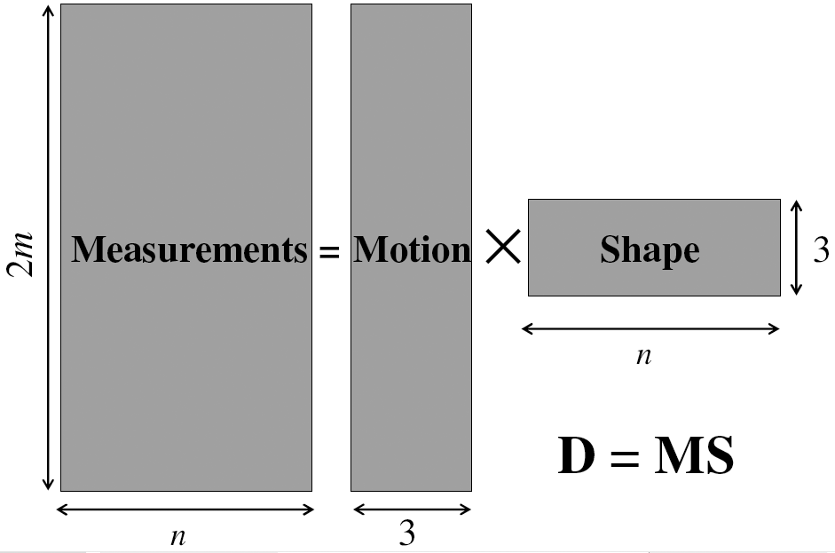
Factorizing the measurement matrix
Lights
Pseudonormals
What are the dimensions?

Slide 61
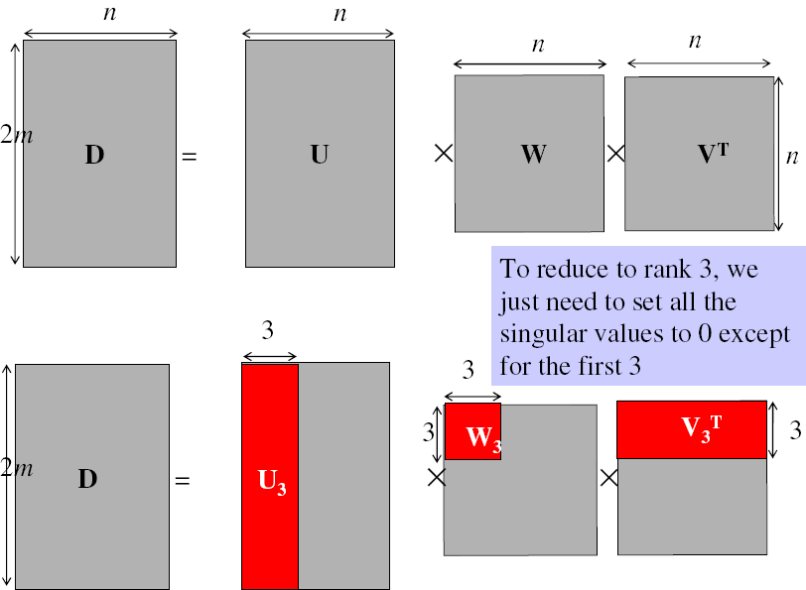
Factorizing the measurement matrix
Singular value decomposition:
This decomposition minimizes |I-LB|²

Slide 62
Are the results unique?
Notes:
%%% latexit
I_1=a\hat{\boldsymbol{n}}^\top\vec{\boldsymbol{\ell}}_1
\vec{\boldsymbol{b}}\triangleq a\hat{\boldsymbol{n}}
\left[\begin{array}{c}
I_1 \\ I_2 \\ \vdots \\ I_N
\end{array}\right]_{N\times 1}\!\!\!\!\!
=\left[\begin{array}{c}
\vec{\boldsymbol{\ell}}_1^\top \\
\vec{\boldsymbol{\ell}}_2^\top \\
\vdots \\
\vec{\boldsymbol{\ell}}_N^\top \\
\end{array}\right]_{N\times 3}\!\!\!\!\!\!\!\!\!
\left[\begin{array}{c}
\vec{\boldsymbol{b}}
\end{array}\right]_{3\times 1}

Slide 63
Are the results unique?
We can insert any 3x3 matrix Q in the decomposition and get the same images:
I = L B = (L Q⁻¹) (Q B)
Notes:
%%% latexit
I_1=a\hat{\boldsymbol{n}}^\top\vec{\boldsymbol{\ell}}_1
\vec{\boldsymbol{b}}\triangleq a\hat{\boldsymbol{n}}
\left[\begin{array}{c}
I_1 \\ I_2 \\ \vdots \\ I_N
\end{array}\right]_{N\times 1}\!\!\!\!\!
=\left[\begin{array}{c}
\vec{\boldsymbol{\ell}}_1^\top \\
\vec{\boldsymbol{\ell}}_2^\top \\
\vdots \\
\vec{\boldsymbol{\ell}}_N^\top \\
\end{array}\right]_{N\times 3}\!\!\!\!\!\!\!\!\!
\left[\begin{array}{c}
\vec{\boldsymbol{b}}
\end{array}\right]_{3\times 1}

Slide 64
Are the results unique?
We can insert any 3x3 matrix Q in the decomposition and get the same images:
I = L B = (L Q⁻¹) (Q B)
Can we use any assumptions to remove some of these 9 degrees of freedom?
Notes:
%%% latexit
I_1=a\hat{\boldsymbol{n}}^\top\vec{\boldsymbol{\ell}}_1
\vec{\boldsymbol{b}}\triangleq a\hat{\boldsymbol{n}}
\left[\begin{array}{c}
I_1 \\ I_2 \\ \vdots \\ I_N
\end{array}\right]_{N\times 1}\!\!\!\!\!
=\left[\begin{array}{c}
\vec{\boldsymbol{\ell}}_1^\top \\
\vec{\boldsymbol{\ell}}_2^\top \\
\vdots \\
\vec{\boldsymbol{\ell}}_N^\top \\
\end{array}\right]_{N\times 3}\!\!\!\!\!\!\!\!\!
\left[\begin{array}{c}
\vec{\boldsymbol{b}}
\end{array}\right]_{3\times 1}

Slide 65
Generalized bas-relief ambiguity

Slide 66
Enforcing integrability
What does the matrix B correspond to?
Notes:
%%% latexit
I_1=a\hat{\boldsymbol{n}}^\top\vec{\boldsymbol{\ell}}_1
\vec{\boldsymbol{b}}\triangleq a\hat{\boldsymbol{n}}
\left[\begin{array}{c}
I_1 \\ I_2 \\ \vdots \\ I_N
\end{array}\right]_{N\times 1}\!\!\!\!\!
=\left[\begin{array}{c}
\vec{\boldsymbol{\ell}}_1^\top \\
\vec{\boldsymbol{\ell}}_2^\top \\
\vdots \\
\vec{\boldsymbol{\ell}}_N^\top \\
\end{array}\right]_{N\times 3}\!\!\!\!\!\!\!\!\!
\left[\begin{array}{c}
\vec{\boldsymbol{b}}
\end{array}\right]_{3\times 1}

Slide 67
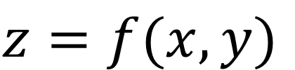
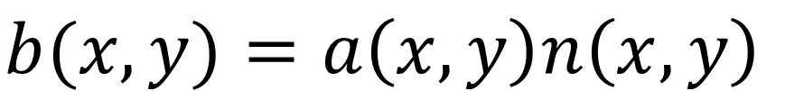
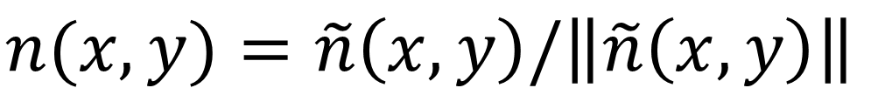
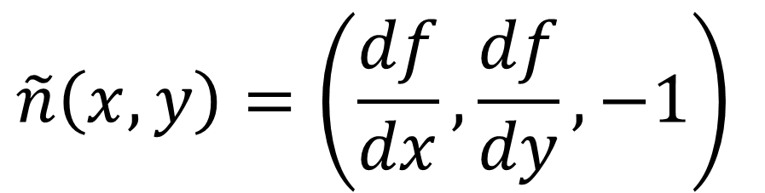
Enforcing integrability
What does the matrix B correspond to?
Surface representation as a depth image (also known as Monge surface):
$$z=f(x,y)$$
depth at each pixel
pixel coordinates in image space
Unnormalized normal:
$$\tilde{n}\left(x,y\right)=\left(\frac{df}{dx},\frac{df}{dy},−1\right)$$
Actual normal:
$$n(x,y)=\tilde{n}\left(x,y\right)/\left\|\tilde{n}\left(x,y\right)\right\|$$
Pseudo-normal:
$$b(x,y)=a\left(x,y\right)n\left(x,y\right)$$
Rearrange into 3xN matrix B.
Notes:
%%% latexit
I_1=a\hat{\boldsymbol{n}}^\top\vec{\boldsymbol{\ell}}_1
\vec{\boldsymbol{b}}\triangleq a\hat{\boldsymbol{n}}
\left[\begin{array}{c}
I_1 \\ I_2 \\ \vdots \\ I_N
\end{array}\right]_{N\times 1}\!\!\!\!\!
=\left[\begin{array}{c}
\vec{\boldsymbol{\ell}}_1^\top \\
\vec{\boldsymbol{\ell}}_2^\top \\
\vdots \\
\vec{\boldsymbol{\ell}}_N^\top \\
\end{array}\right]_{N\times 3}\!\!\!\!\!\!\!\!\!
\left[\begin{array}{c}
\vec{\boldsymbol{b}}
\end{array}\right]_{3\times 1}

Slide 68
Enforcing integrability
What does the integrability constraint correspond to?
Notes:
%%% latexit
I_1=a\hat{\boldsymbol{n}}^\top\vec{\boldsymbol{\ell}}_1
\vec{\boldsymbol{b}}\triangleq a\hat{\boldsymbol{n}}
\left[\begin{array}{c}
I_1 \\ I_2 \\ \vdots \\ I_N
\end{array}\right]_{N\times 1}\!\!\!\!\!
=\left[\begin{array}{c}
\vec{\boldsymbol{\ell}}_1^\top \\
\vec{\boldsymbol{\ell}}_2^\top \\
\vdots \\
\vec{\boldsymbol{\ell}}_N^\top \\
\end{array}\right]_{N\times 3}\!\!\!\!\!\!\!\!\!
\left[\begin{array}{c}
\vec{\boldsymbol{b}}
\end{array}\right]_{3\times 1}

Slide 69
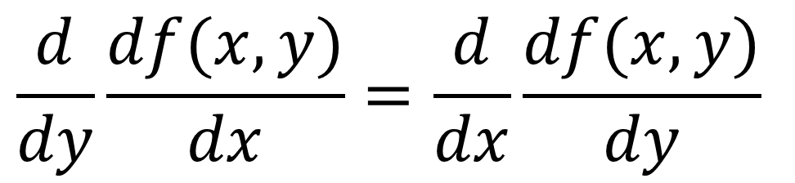
Enforcing integrability
What does the integrability constraint correspond to?
Differentiation order should not matter:
$$\frac{d}{dy}\frac{df(x,y)}{dx}=\frac{d}{dx}\frac{df(x,y)}{dy}$$
Can you think of a way to express the above using pseudo-normals b?
Notes:
%%% latexit
I_1=a\hat{\boldsymbol{n}}^\top\vec{\boldsymbol{\ell}}_1
\vec{\boldsymbol{b}}\triangleq a\hat{\boldsymbol{n}}
\left[\begin{array}{c}
I_1 \\ I_2 \\ \vdots \\ I_N
\end{array}\right]_{N\times 1}\!\!\!\!\!
=\left[\begin{array}{c}
\vec{\boldsymbol{\ell}}_1^\top \\
\vec{\boldsymbol{\ell}}_2^\top \\
\vdots \\
\vec{\boldsymbol{\ell}}_N^\top \\
\end{array}\right]_{N\times 3}\!\!\!\!\!\!\!\!\!
\left[\begin{array}{c}
\vec{\boldsymbol{b}}
\end{array}\right]_{3\times 1}

Slide 70
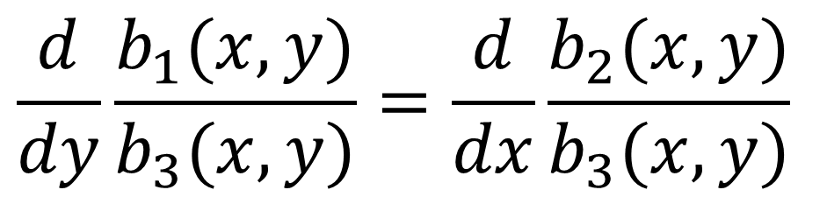
Enforcing integrability
What does the integrability constraint correspond to?
Differentiation order should not matter:
$$\frac{d}{dy}\frac{df(x,y)}{dx}=\frac{d}{dx}\frac{df(x,y)}{dy}$$
Can you think of a way to express the above using pseudo-normals b?
$$\frac{d}{dy}\frac{b_{1}(x,y)}{b_{3}(x,y)}=\frac{d}{dx}\frac{b_{2}(x,y)}{b_{3}(x,y)}$$
Notes:
%%% latexit
I_1=a\hat{\boldsymbol{n}}^\top\vec{\boldsymbol{\ell}}_1
\vec{\boldsymbol{b}}\triangleq a\hat{\boldsymbol{n}}
\left[\begin{array}{c}
I_1 \\ I_2 \\ \vdots \\ I_N
\end{array}\right]_{N\times 1}\!\!\!\!\!
=\left[\begin{array}{c}
\vec{\boldsymbol{\ell}}_1^\top \\
\vec{\boldsymbol{\ell}}_2^\top \\
\vdots \\
\vec{\boldsymbol{\ell}}_N^\top \\
\end{array}\right]_{N\times 3}\!\!\!\!\!\!\!\!\!
\left[\begin{array}{c}
\vec{\boldsymbol{b}}
\end{array}\right]_{3\times 1}

Slide 71
Enforcing integrability
What does the integrability constraint correspond to?
Differentiation order should not matter:
$$\frac{d}{dy}\frac{df(x,y)}{dx}=\frac{d}{dx}\frac{df(x,y)}{dy}$$
Can you think of a way to express the above using pseudo-normals b?
$$\frac{d}{dy}\frac{b_{1}(x,y)}{b_{3}(x,y)}=\frac{d}{dx}\frac{b_{2}(x,y)}{b_{3}(x,y)}$$
Simplify to:
$$b_{3}\left(x,y\right)\frac{db_{1}\left(x,y\right)}{dy}−b_{1}(x,y)\frac{db_{3}(x,y)}{dy}=b_{2}\left(x,y\right)\frac{db_{1}\left(x,y\right)}{dx}−b_{1}(x,y)\frac{db_{2}(x,y)}{dx}$$
Notes:
%%% latexit
I_1=a\hat{\boldsymbol{n}}^\top\vec{\boldsymbol{\ell}}_1
\vec{\boldsymbol{b}}\triangleq a\hat{\boldsymbol{n}}
\left[\begin{array}{c}
I_1 \\ I_2 \\ \vdots \\ I_N
\end{array}\right]_{N\times 1}\!\!\!\!\!
=\left[\begin{array}{c}
\vec{\boldsymbol{\ell}}_1^\top \\
\vec{\boldsymbol{\ell}}_2^\top \\
\vdots \\
\vec{\boldsymbol{\ell}}_N^\top \\
\end{array}\right]_{N\times 3}\!\!\!\!\!\!\!\!\!
\left[\begin{array}{c}
\vec{\boldsymbol{b}}
\end{array}\right]_{3\times 1}

Slide 72
Enforcing integrability
What does the integrability constraint correspond to?
Differentiation order should not matter:
$$\frac{d}{dy}\frac{df(x,y)}{dx}=\frac{d}{dx}\frac{df(x,y)}{dy}$$
Can you think of a way to express the above using pseudo-normals b?
$$\frac{d}{dy}\frac{b_{1}(x,y)}{b_{3}(x,y)}=\frac{d}{dx}\frac{b_{2}(x,y)}{b_{3}(x,y)}$$
Simplify to:
$$b_{3}\left(x,y\right)\frac{db_{1}\left(x,y\right)}{dy}−b_{1}(x,y)\frac{db_{3}(x,y)}{dy}=b_{2}\left(x,y\right)\frac{db_{1}\left(x,y\right)}{dx}−b_{1}(x,y)\frac{db_{2}(x,y)}{dx}$$
If B_{e} is the pseudo-normal matrix we get from SVD, then find the 3x3 transform D such that B=D⋅B_{e} is the closest to satisfying integrability in the least-squares sense.
Notes:
%%% latexit
I_1=a\hat{\boldsymbol{n}}^\top\vec{\boldsymbol{\ell}}_1
\vec{\boldsymbol{b}}\triangleq a\hat{\boldsymbol{n}}
\left[\begin{array}{c}
I_1 \\ I_2 \\ \vdots \\ I_N
\end{array}\right]_{N\times 1}\!\!\!\!\!
=\left[\begin{array}{c}
\vec{\boldsymbol{\ell}}_1^\top \\
\vec{\boldsymbol{\ell}}_2^\top \\
\vdots \\
\vec{\boldsymbol{\ell}}_N^\top \\
\end{array}\right]_{N\times 3}\!\!\!\!\!\!\!\!\!
\left[\begin{array}{c}
\vec{\boldsymbol{b}}
\end{array}\right]_{3\times 1}

Slide 73
Enforcing integrability
Does enforcing integrability remove all ambiguities?
Notes:
%%% latexit
I_1=a\hat{\boldsymbol{n}}^\top\vec{\boldsymbol{\ell}}_1
\vec{\boldsymbol{b}}\triangleq a\hat{\boldsymbol{n}}
\left[\begin{array}{c}
I_1 \\ I_2 \\ \vdots \\ I_N
\end{array}\right]_{N\times 1}\!\!\!\!\!
=\left[\begin{array}{c}
\vec{\boldsymbol{\ell}}_1^\top \\
\vec{\boldsymbol{\ell}}_2^\top \\
\vdots \\
\vec{\boldsymbol{\ell}}_N^\top \\
\end{array}\right]_{N\times 3}\!\!\!\!\!\!\!\!\!
\left[\begin{array}{c}
\vec{\boldsymbol{b}}
\end{array}\right]_{3\times 1}

Slide 74


Generalized Bas-relief ambiguity
If B is integrable, then:
B’=G^{-T}⋅B is also integrable for all G of the form ($λ$ ≠ 0)
$$G=\left[\begin{matrix}1 & 0 & 0 \\ 0 & 1 & 0 \\ μ & ν & λ\end{matrix}\right]$$
Combined with transformed lights S’=G⋅S, the transformed pseudonormals produce the same images as the original pseudonormals.
This ambiguity cannot be removed using shadows.
This ambiguity can be removed using interreflections or additional assumptions.
This ambiguity is known as the generalized bas-relief ambiguity.
Notes:
%%% latexit
I_1=a\hat{\boldsymbol{n}}^\top\vec{\boldsymbol{\ell}}_1
\vec{\boldsymbol{b}}\triangleq a\hat{\boldsymbol{n}}
\left[\begin{array}{c}
I_1 \\ I_2 \\ \vdots \\ I_N
\end{array}\right]_{N\times 1}\!\!\!\!\!
=\left[\begin{array}{c}
\vec{\boldsymbol{\ell}}_1^\top \\
\vec{\boldsymbol{\ell}}_2^\top \\
\vdots \\
\vec{\boldsymbol{\ell}}_N^\top \\
\end{array}\right]_{N\times 3}\!\!\!\!\!\!\!\!\!
\left[\begin{array}{c}
\vec{\boldsymbol{b}}
\end{array}\right]_{3\times 1}

Slide 75


Generalized Bas-relief ambiguity
When $μ$ = $ν$ = 0, G is equivalent to the transformation employed by relief sculptures.
Otherwise, includes shearing.
When $μ$ = $ν$ = 0 and $λ$ = +-1, top/down ambiguity.
Notes:
%%% latexit
I_1=a\hat{\boldsymbol{n}}^\top\vec{\boldsymbol{\ell}}_1
\vec{\boldsymbol{b}}\triangleq a\hat{\boldsymbol{n}}
\left[\begin{array}{c}
I_1 \\ I_2 \\ \vdots \\ I_N
\end{array}\right]_{N\times 1}\!\!\!\!\!
=\left[\begin{array}{c}
\vec{\boldsymbol{\ell}}_1^\top \\
\vec{\boldsymbol{\ell}}_2^\top \\
\vdots \\
\vec{\boldsymbol{\ell}}_N^\top \\
\end{array}\right]_{N\times 3}\!\!\!\!\!\!\!\!\!
\left[\begin{array}{c}
\vec{\boldsymbol{b}}
\end{array}\right]_{3\times 1}

Slide 76
What assumptions have we made for all this?
Notes:
%%% latexit
I_1=a\hat{\boldsymbol{n}}^\top\vec{\boldsymbol{\ell}}_1
\vec{\boldsymbol{b}}\triangleq a\hat{\boldsymbol{n}}
\left[\begin{array}{c}
I_1 \\ I_2 \\ \vdots \\ I_N
\end{array}\right]_{N\times 1}\!\!\!\!\!
=\left[\begin{array}{c}
\vec{\boldsymbol{\ell}}_1^\top \\
\vec{\boldsymbol{\ell}}_2^\top \\
\vdots \\
\vec{\boldsymbol{\ell}}_N^\top \\
\end{array}\right]_{N\times 3}\!\!\!\!\!\!\!\!\!
\left[\begin{array}{c}
\vec{\boldsymbol{b}}
\end{array}\right]_{3\times 1}

Slide 77
What assumptions have we made for all this?
Lambertian BRDF
Directional lighting
Orthographic camera
No interreflections or scattering
Notes:
%%% latexit
I_1=a\hat{\boldsymbol{n}}^\top\vec{\boldsymbol{\ell}}_1
\vec{\boldsymbol{b}}\triangleq a\hat{\boldsymbol{n}}
\left[\begin{array}{c}
I_1 \\ I_2 \\ \vdots \\ I_N
\end{array}\right]_{N\times 1}\!\!\!\!\!
=\left[\begin{array}{c}
\vec{\boldsymbol{\ell}}_1^\top \\
\vec{\boldsymbol{\ell}}_2^\top \\
\vdots \\
\vec{\boldsymbol{\ell}}_N^\top \\
\end{array}\right]_{N\times 3}\!\!\!\!\!\!\!\!\!
\left[\begin{array}{c}
\vec{\boldsymbol{b}}
\end{array}\right]_{3\times 1}

Slide 78








Shape independent of BRDF via reciprocity:
“Helmholtz Stereopsis”
[Zickler et al., 2002]

Slide 79
Shape from shading

Slide 80
Can we reconstruct shape from one image?
Notes:
I=a\hat{\bf n}^\top\vec{\boldsymbol{\ell}}

Slide 81


Single-lighting is ambiguous
ASSUMPTION 1:
LAMBERTIAN
ASSUMPTION 2:
DIRECTIONAL LIGHTING
[Prados, 2004]
Notes:
I=a\hat{\bf n}^\top\vec{\boldsymbol{\ell}}

Slide 82
Stereographic Projection
(p,q)-space (gradient space)
(f,g)-space
Problem
(p,q) can be infinite when
Redefine reflectance map as

Slide 83
Image Irradiance Constraint
Image irradiance should match the reflectance map
Minimize
(minimize errors in image irradiance in the image)

Slide 84
Smoothness Constraint
Used to constrain shape-from-shading
Relates orientations (f,g) of neighboring surface points
Minimize
: surface orientation under stereographic projection
(penalize rapid changes in surface orientation f and g over the image)

Slide 85
Shape-from-Shading
Find surface orientations (f,g) at all image points that minimize
weight
smoothness
constraint
image irradiance
error
Minimize

Slide 86
Numerical Shape-from-Shading
Smoothness error at image point (i,j)
Of course you can consider more neighbors (smoother results)
Image irradiance error at image point (i,j)
Find and that minimize
(Ikeuchi & Horn 89)

Slide 87
Numerical Shape-from-Shading
Find and that minimize
If and minimize , then
where and are 4-neighbors average around image point (k,l)
(Ikeuchi & Horn 89)

Slide 88
Numerical Shape-from-Shading
Update rule
Use known values on the occluding boundary to constrain the solution (boundary conditions)
Compare with for convergence test
As the solution converges, increase to remove the smoothness constraint
(Ikeuchi & Horn 89)

Slide 89

Results

Slide 90

Results

Slide 91

More modern results

Slide 92
References
Basic reading:
Szeliski, Section 2.2.
Gortler, Chapter 21.
This book by Steven Gortler has a great introduction to radiometry, reflectance, and their use for image formation.
Additional reading:
Oren and Nayar, “Generalization of the Lambertian model and implications for machine vision,” IJCV 1995.
The paper introducing the most common model for rough diffuse reflectance.
Debevec, “Rendering Synthetic Objects into Real Scenes,” SIGGRAPH 1998.
The paper that introduced the notion of the environment map, the use of chrome spheres for measuring such maps, and the idea that they can be used for easy rendering.
Lalonde et al., “Estimating the Natural Illumination Conditions from a Single Outdoor Image,” IJCV 2012.
A paper on estimating outdoors environment maps from just one image.
Basri and Jacobs, “Lambertian reflectance and linear subspaces,” ICCV 2001.
Ramamoorthi and Hanrahan, “A signal-processing framework for inverse rendering,” SIGGRAPH 2001.
Sloan et al., “Precomputed radiance transfer for real-time rendering in dynamic, low-frequency lighting environments,” SIGGRAPH 2002.
Three papers describing the use of spherical harmonics to model low-frequency illumination, as well as the low-pass filtering effect of Lambertian reflectance on illumination.
Zhang et al., “Shape-from-shading: a survey,” PAMI 1999.
A review of perceptual and computational aspects of shape from shading.
Woodham, “Photometric method for determining surface orientation from multiple images,” Optical Engineering 1980.
The paper that introduced photometric stereo.
Yuille and Snow, “Shape and albedo from multiple images using integrability,” CVPR 1997.
Belhumeur et al., “The bas-relief ambiguity,” IJCV 1999.
Papadhimitri and Favaro, “A new perspective on uncalibrated photometric stereo,” CVPR 2013.
Three papers discussing uncalibrated photometric stereo. The first paper shows that, when the lighting directions are not known, by assuming integrability, one can reduce unknowns to the bas-relief ambiguity. The second paper discusses the bas-relief ambiguity in a more general context. The third paper shows that, if instead of an orthographic camera one uses a perspective camera, this is further reduced to just a scale ambiguity.
Alldrin et al., “Resolving the generalized bas-relief ambiguity by entropy minimization,” CVPR 2007.
A popular technique for resolving the bas-relief ambiguity in uncalibrated photometric stereo.
Zickler et al., “Helmholtz stereopsis: Exploiting reciprocity for surface reconstruction,” IJCV 2002.
A method for photometric stereo reconstruction under arbitrary BRDF.
Nayar et al., “Shape from interreflections,” IJCV 1991.
Chandraker et al., “Reflections on the generalized bas-relief ambiguity,” CVPR 2005.
Two papers discussing how one can perform photometric stereo (calibrated or otherwise) in the presence of strong interreflections.
Frankot and Chellappa, “A method for enforcing integrability in shape from shading algorithms,” PAMI 1988.
Agrawal et al., “What is the range of surface reconstructions from a gradient field?,” ECCV 2006.
Two papers discussing how one can integrate a normal field to reconstruct a surface.
Notes:
Ch

