Slide 1
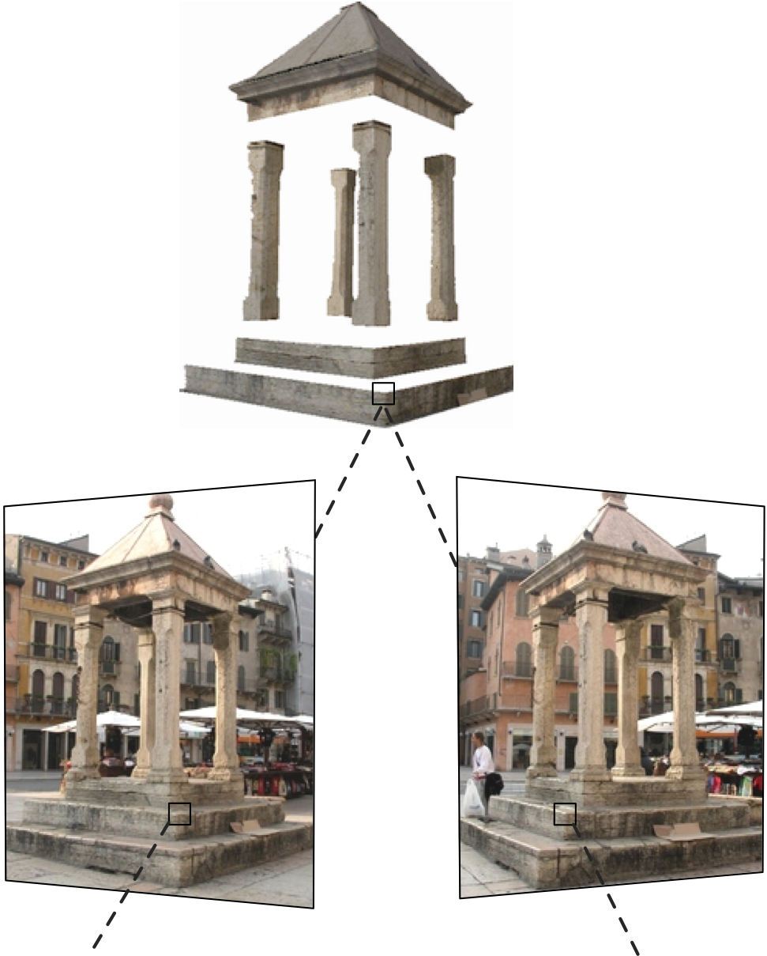
Two-view geometry
16-385 Computer Vision
Spring 2020, Lecture 12
http://www.cs.cmu.edu/~16385/

Slide 2
Course announcements
Homework 3 is available online.
- Due on March 4th at 23:59.
- How many of you have read/started/finished HW2?
Take-home quiz 5 is available online and due Sunday, March 1st at 23:59.
New for quizzes: please only submit PDF files, not ZIP.
How many of you did take-home quiz 4?

Slide 3
Overview of today’s lecture
Triangulation.
Epipolar geometry.
Essential matrix.
Fundamental matrix.
8-point algorithm.

Slide 4
Slide credits
Many of these slides were adapted from:
Kris Kitani (16-385, Spring 2017).
Srinivasa Narasimhan (16-720, Fall 2017).

Slide 5
Triangulation

Slide 6



Triangulation
image 1
image 2
Given
camera 1 with matrix
camera 2 with matrix

Slide 7
Triangulation
Which 3D points map to x?
image 1
image 2
camera 1 with matrix
camera 2 with matrix

Slide 8
Triangulation
How can you compute this ray?
image 1
image 2
camera 1 with matrix
camera 2 with matrix

Slide 9
Triangulation
Create two points on the ray:
find the camera center; and
apply the pseudo-inverse of P on x.
Then connect the two points.
This procedure is called backprojection
+
Why does this point map to x?
image 1
image 2
camera 1 with matrix
camera 2 with matrix

Slide 10
Triangulation
How do we find the exact point on the ray?
+
image 1
image 2
camera 1 with matrix
camera 2 with matrix

Slide 11

Triangulation
Find 3D object point
Will the lines intersect?
image 1
image 2
camera 1 with matrix
camera 2 with matrix

Slide 12
Triangulation
Find 3D object point
(no single solution due to noise)
image 1
image 2
camera 1 with matrix
camera 2 with matrix

Slide 13

Triangulation
Given a set of (noisy) matched points
and camera matrices
Estimate the 3D point

Slide 14
known
known
Can we compute X from a single correspondence x?

Slide 15
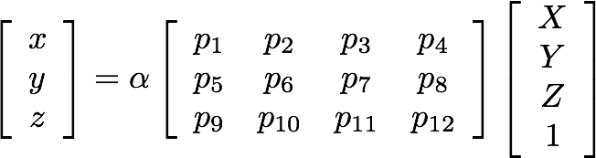
(homogeneous coordinate)
This is a similarity relation because it involves homogeneous coordinates
(homorogeneous coordinate)
Same ray direction but differs by a scale factor
How do we solve for unknowns in a similarity relation?

Slide 16
(homogeneous coordinate)
Also, this is a similarity relation because it involves homogeneous coordinates
(inhomogeneous coordinate)
Same ray direction but differs by a scale factor
How do we solve for unknowns in a similarity relation?

Slide 17
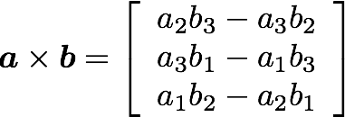
Linear algebra reminder: cross product
Vector (cross) product takes two vectors and returns a vector perpendicular to both
cross product of two vectors in the same direction is zero vector
remember this!!!

Slide 18
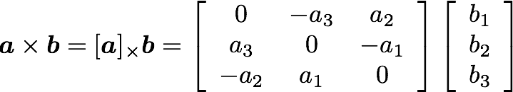
Linear algebra reminder: cross product
Cross product
Can also be written as a matrix multiplication
Skew symmetric

Slide 19
Compare with: dot product
dot product of two orthogonal vectors is (scalar) zero

Slide 20
Back to triangulation
Same direction but differs by a scale factor
How can we rewrite this using vector products?

Slide 21
Same direction but differs by a scale factor
Cross product of two vectors of same direction is zero
(this equality removes the scale factor)

Slide 22
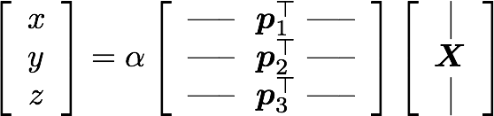
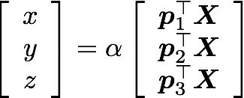
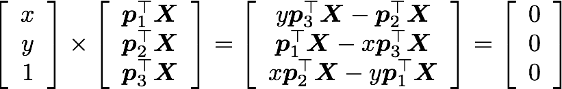
Do the same after first expanding out the camera matrix and points

Slide 23
Using the fact that the cross product should be zero
Third line is a linear combination of the first and second lines.
(x times the first line plus y times the second line)
One 2D to 3D point correspondence give you 2 equations

Slide 24
Using the fact that the cross product should be zero
Third line is a linear combination of the first and second lines.
(x times the first line plus y times the second line)
One 2D to 3D point correspondence give you 2 equations

Slide 25



Remove third row, and rearrange as system on unknowns
Now we can make a system of linear equations
(two lines for each 2D point correspondence)

Slide 26
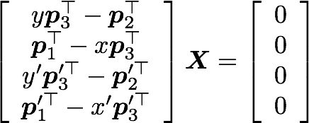
Concatenate the 2D points from both images
Two rows from camera one
Two rows from camera two
sanity check! dimensions?
How do we solve homogeneous linear system?

Slide 27
Concatenate the 2D points from both images
How do we solve homogeneous linear system?
S V D !

Slide 28
Epipolar geometry

Slide 29
Epipolar geometry
Image plane

Slide 30
Epipolar geometry
Baseline
Image plane

Slide 31

Epipolar geometry
Baseline
Image plane
Epipole
(projection of o’ on the image plane)

Slide 32
Epipolar geometry
Epipolar plane
Baseline
Baseline
Image plane
Epipole
(projection of o’ on the image plane)

Slide 33

Epipolar geometry
Epipolar line
(intersection of Epipolar plane and image plane)
Epipolar plane
Baseline
Image plane
Epipole
(projection of o’ on the image plane)

Slide 34
Quiz
What is this?

Slide 35
Quiz
Epipolar plane

Slide 36
Quiz
What is this?
Epipolar plane

Slide 37
Quiz
Epipolar line
(intersection of Epipolar plane and image plane)
Epipolar plane

Slide 38
Quiz
Epipolar line
(intersection of Epipolar plane and image plane)
Epipolar plane
What is this?

Slide 39
Quiz
Epipolar line
(intersection of Epipolar plane and image plane)
Epipolar plane
Epipole
(projection of o’ on the image plane)

Slide 40
Quiz
Epipolar line
(intersection of Epipolar plane and image plane)
Epipolar plane
What is this?
Epipole
(projection of o’ on the image plane)

Slide 41
Quiz
Epipolar line
(intersection of Epipolar plane and image plane)
Epipolar plane
Baseline
Epipole
(projection of o’ on the image plane)

Slide 42
Epipolar constraint
Backproject to a ray in 3D
Epipolar line
(intersection of Epipolar plane and image plane)
Another way to construct the epipolar plane, this time given

Slide 43
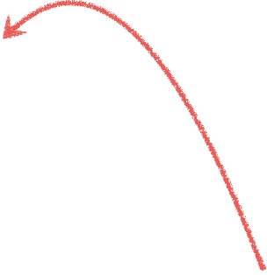

Epipolar constraint
Potential matches for
lie on the epipolar line

Slide 44
The point x (left image) maps to a ___________ in the right image
The baseline connects the ___________ and ____________
An epipolar line (left image) maps to a __________ in the right image
An epipole e is a projection of the ______________ on the image plane
All epipolar lines in an image intersect at the ______________

Slide 45
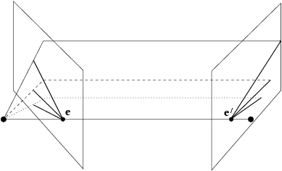
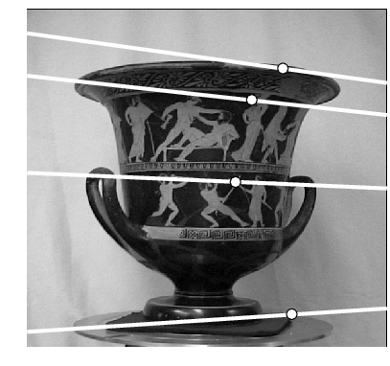
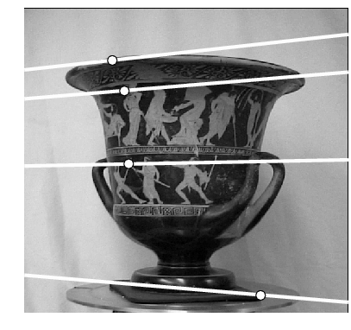

Converging cameras
Where is the epipole in this image?

Slide 46
Converging cameras
here!
Where is the epipole in this image?
It’s not always in the image

Slide 47
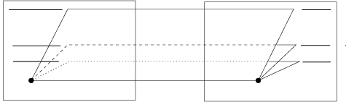
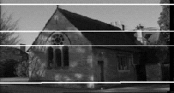
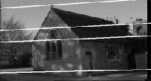
Parallel cameras
Where is the epipole?

Slide 48
Parallel cameras
epipole at infinity

Slide 49
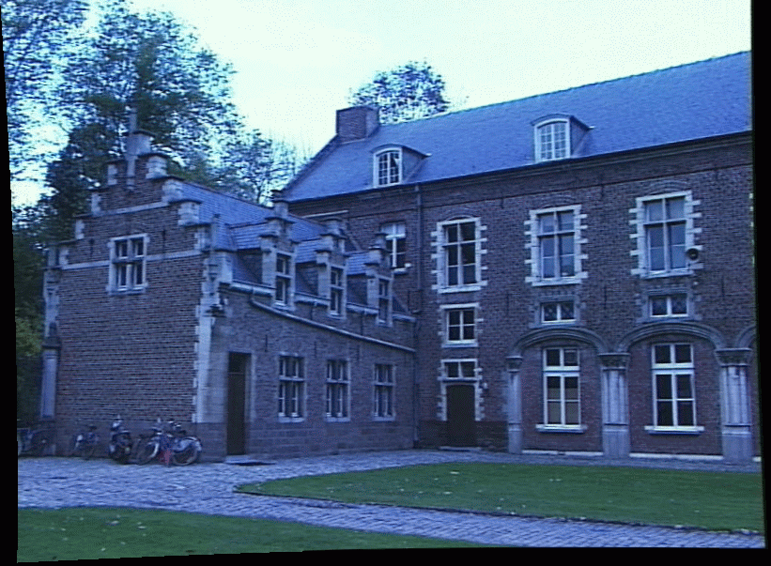
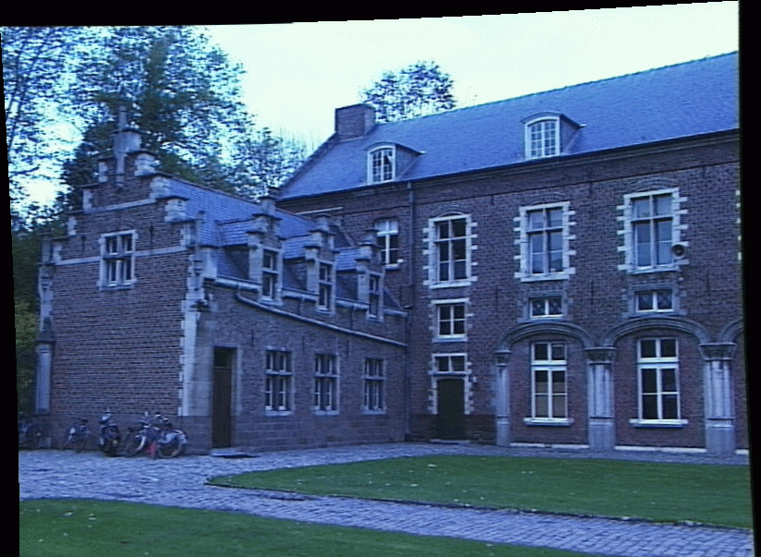

The epipolar constraint is an important concept for stereo vision
Task: Match point in left image to point in right image
Left image
Right image
How would you do it?

Slide 50
Epipolar constraint
Potential matches for
lie on the epipolar line

Slide 51
The epipolar constraint is an important concept for stereo vision
Task: Match point in left image to point in right image
Left image
Right image
Want to avoid search over entire image
Epipolar constraint reduces search to a single line

Slide 52
The epipolar constraint is an important concept for stereo vision
Task: Match point in left image to point in right image
Left image
Right image
Want to avoid search over entire image
Epipolar constraint reduces search to a single line
How do you compute the epipolar line?

Slide 53
The essential matrix

Slide 54
Recall:Epipolar constraint
Potential matches for
lie on the epipolar line

Slide 55

Given a point in one image,
multiplying by the essential matrix will tell us
the epipolar line in the second view.

Slide 56
Motivation
The Essential Matrix is a 3 x 3 matrix that encodes epipolar geometry
Given a point in one image,
multiplying by the essential matrix will tell us
the epipolar line in the second image.

Slide 57
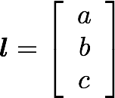


Epipolar Line
Representing the …
in vector form
If the point is on the epipolar line then

Slide 58

Epipolar Line
in vector form
If the point is on the epipolar line then

Slide 59

So if and then

Slide 60

So if and then

Slide 61
Essential Matrix vs Homography
What’s the difference between the essential matrix and a homography?

Slide 62

Essential Matrix vs Homography
What’s the difference between the essential matrix and a homography?
They are both 3 x 3 matrices but …
Essential matrix maps a point to a line
Homography maps a point to a point

Slide 63
Where does the essential matrix come from?

Slide 64




Slide 65
Does this look familiar?

Slide 66
Camera-camera transform just like world-camera transform

Slide 67
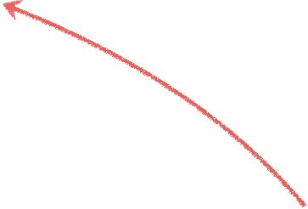



These three vectors are coplanar

Slide 68

If these three vectors are coplanar then

Slide 69

If these three vectors are coplanar then
dot product of orthogonal vectors
cross-product: vector orthogonal to plane

Slide 70

If these three vectors are coplanar then

Slide 71

If these three vectors are coplanar then

Slide 72

putting it together
rigid motion
coplanarity

Slide 73

putting it together
rigid motion
coplanarity
use skew-symmetric matrix to represent cross product

Slide 74

putting it together
rigid motion
coplanarity

Slide 75
putting it together
rigid motion
coplanarity

Slide 76

putting it together
rigid motion
coplanarity
Essential Matrix
[Longuet-Higgins 1981]

Slide 77
properties of the E matrix
Longuet-Higgins equation
(2D points expressed in camera coordinate system)

Slide 78


properties of the E matrix
Longuet-Higgins equation
Epipolar lines
(2D points expressed in camera coordinate system)

Slide 79

properties of the E matrix
Longuet-Higgins equation
Epipolar lines
Epipoles
(2D points expressed in camera coordinate system)

Slide 80
Given a point in one image,
multiplying by the essential matrix will tell us
the epipolar line in the second view.
Assumption:
2D points expressed in camera coordinate system (i.e., intrinsic matrices are identities)

Slide 81
How do you generalize to non-identity intrinsic matrices?

Slide 82
The fundamental matrix

Slide 83
The
fundamental matrix
is a
generalization
of the
essential matrix,
where the assumption of
Identity matrices
is removed

Slide 84




The essential matrix operates on image points expressed in
2D coordinates expressed in the camera coordinate system
camera point
image point

Slide 85


The essential matrix operates on image points expressed in
2D coordinates expressed in the camera coordinate system
camera point
image point
Writing out the epipolar constraint in terms of image coordinates

Slide 86
Same equation works in image coordinates!
it maps pixels to epipolar lines

Slide 87
properties of the E matrix
F
F
Longuet-Higgins equation
Epipolar lines
F
F
F
F
Epipoles
(points in image coordinates)

Slide 88


Breaking down the fundamental matrix
Depends on both intrinsic and extrinsic parameters

Slide 89

Breaking down the fundamental matrix
Depends on both intrinsic and extrinsic parameters
How would you solve for F?

Slide 90
The 8-point algorithm

Slide 91


Assume you have M matched image points
Each correspondence should satisfy
How would you solve for the 3 x 3 F matrix?

Slide 92
Assume you have M matched image points
Each correspondence should satisfy
How would you solve for the 3 x 3 F matrix?
S V D

Slide 93
Assume you have M matched image points
Each correspondence should satisfy
How would you solve for the 3 x 3 F matrix?
Set up a homogeneous linear system with 9 unknowns

Slide 94
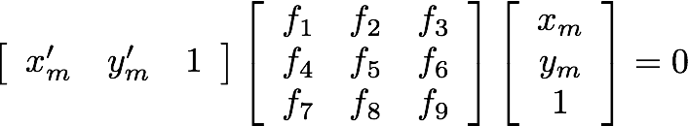
How many equation do you get from one correspondence?

Slide 95
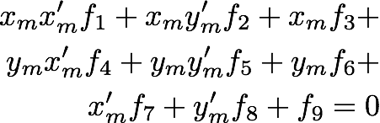
ONE correspondence gives you ONE equation

Slide 96
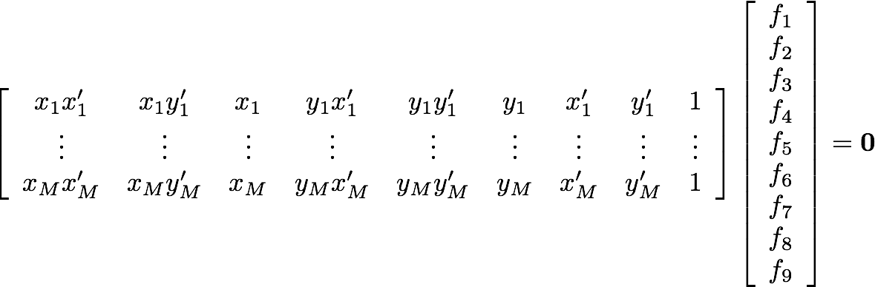
Set up a homogeneous linear system with 9 unknowns
How many equations do you need?

Slide 97
Each point pair (according to epipolar constraint)
contributes only one scalar equation
Note: This is different from the Homography estimation where each point pair contributes 2 equations.
We need at least 8 points
Hence, the 8 point algorithm!

Slide 98
How do you solve a homogeneous linear system?

Slide 99


How do you solve a homogeneous linear system?
Total Least Squares
minimize
subject to

Slide 100
How do you solve a homogeneous linear system?
Total Least Squares
minimize
subject to
S V D !

Slide 101
Eight-Point Algorithm
0. (Normalize points)
Construct the M x 9 matrix A
Find the SVD of A
Entries of F are the elements of column of V corresponding to the least singular value
4. (Enforce rank 2 constraint on F)
5. (Un-normalize F)

Slide 102
Eight-Point Algorithm
0. (Normalize points)
Construct the M x 9 matrix A
Find the SVD of A
Entries of F are the elements of column of V corresponding to the least singular value
4. (Enforce rank 2 constraint on F)
5. (Un-normalize F)
See Hartley-Zisserman for why we do this

Slide 103
Eight-Point Algorithm
0. (Normalize points)
Construct the M x 9 matrix A
Find the SVD of A
Entries of F are the elements of column of V corresponding to the least singular value
4. (Enforce rank 2 constraint on F)
5. (Un-normalize F)
How do we do this?

Slide 104
Eight-Point Algorithm
0. (Normalize points)
Construct the M x 9 matrix A
Find the SVD of A
Entries of F are the elements of column of V corresponding to the least singular value
4. (Enforce rank 2 constraint on F)
5. (Un-normalize F)
How do we do this?
S V D !

Slide 105

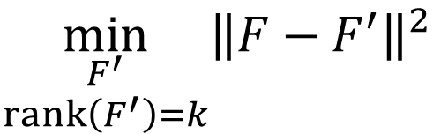

Enforcing rank constraints
Problem: Given a matrix F, find the matrix F’ of rank k that is closest to F,
$$\min_{\begin{aligned}F^{′} \\ rank\left(F^{′}\right)=k\end{aligned}}{{\left\|F−F^{′}\right\|}^{2}}$$
Solution: Compute the singular value decomposition of F,
$$F=UΣV^{T}$$
Form a matrix Σ’ by replacing all but the k largest singular values in Σ with 0.
Then the problem solution is the matrix F’ formed as,
$$F^{′}=UΣ^{′}V^{T}$$

Slide 106
Eight-Point Algorithm
0. (Normalize points)
Construct the M x 9 matrix A
Find the SVD of A
Entries of F are the elements of column of V corresponding to the least singular value
4. (Enforce rank 2 constraint on F)
5. (Un-normalize F)

Slide 107
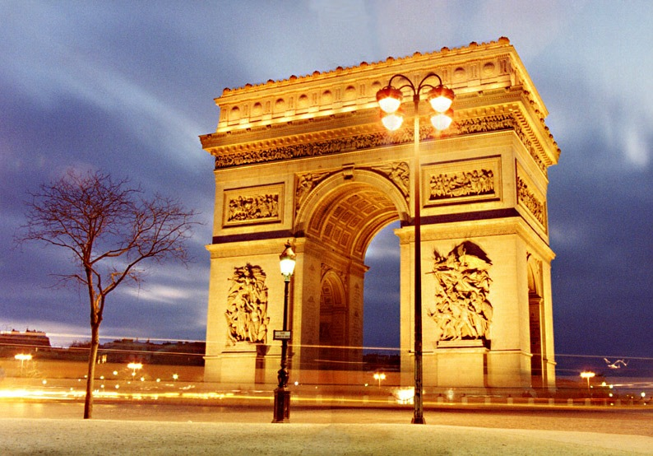
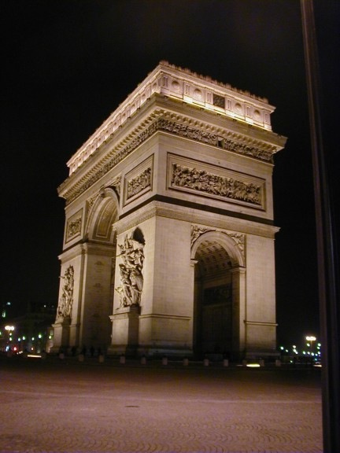
Example

Slide 108
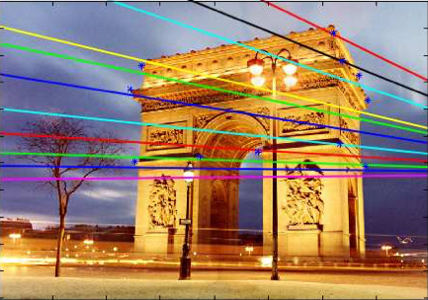
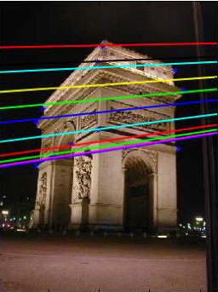
epipolar lines

Slide 109
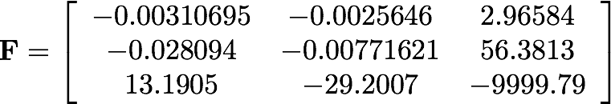
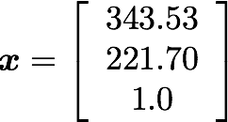
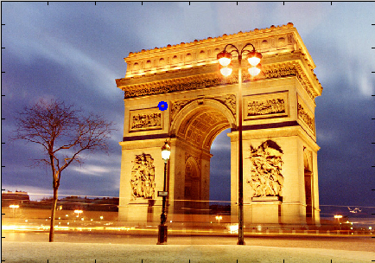

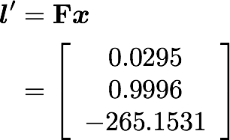

Slide 110
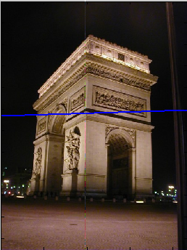


Slide 111
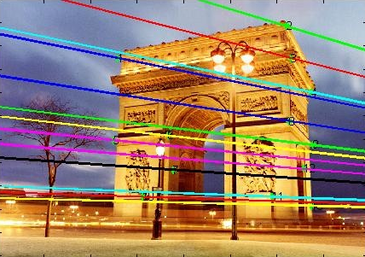
Where is the epipole?
How would you compute it?

Slide 112
The epipole is in the right null space of F
How would you solve for the epipole?

Slide 113
The epipole is in the right null space of F
How would you solve for the epipole?
S V D !

Slide 114
References
Basic reading:
Szeliski textbook, Section 8.1 (not 8.1.1-8.1.3), Chapter 11, Section 12.2.
Hartley and Zisserman, Section 11.12.

