Slide 1
SAT & SMT
With material borrowed from UW CSE 507 by Emina Torlak

Slide 2

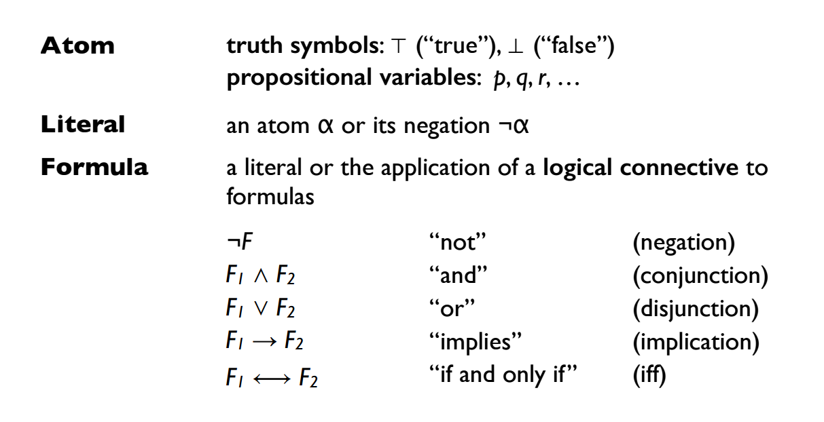
Syntax of propositional logic

Slide 3

Satisfiability & validity of propositional formulas
F is satisfiable iff there exists an assignment for which F is true
F is valid iff F is true for all assignments

Slide 4

Satisfiability & validity of propositional formulas
F is satisfiable iff there exists an assignment for which F is true
F is valid iff F is true for all assignments
Duality of satisfiability and validity:
F is valid iff ¬F is unsatisfiable.

Slide 5

Satisfiability & validity of propositional formulas
F is satisfiable iff there exists an assignment for which F is true
F is valid iff F is true for all assignments
If we have a procedure for checking satisfiability, then we can also check validity of propositional formulas, and vice versa.
Duality of satisfiability and validity:
F is valid iff ¬F is unsatisfiable.

Slide 6
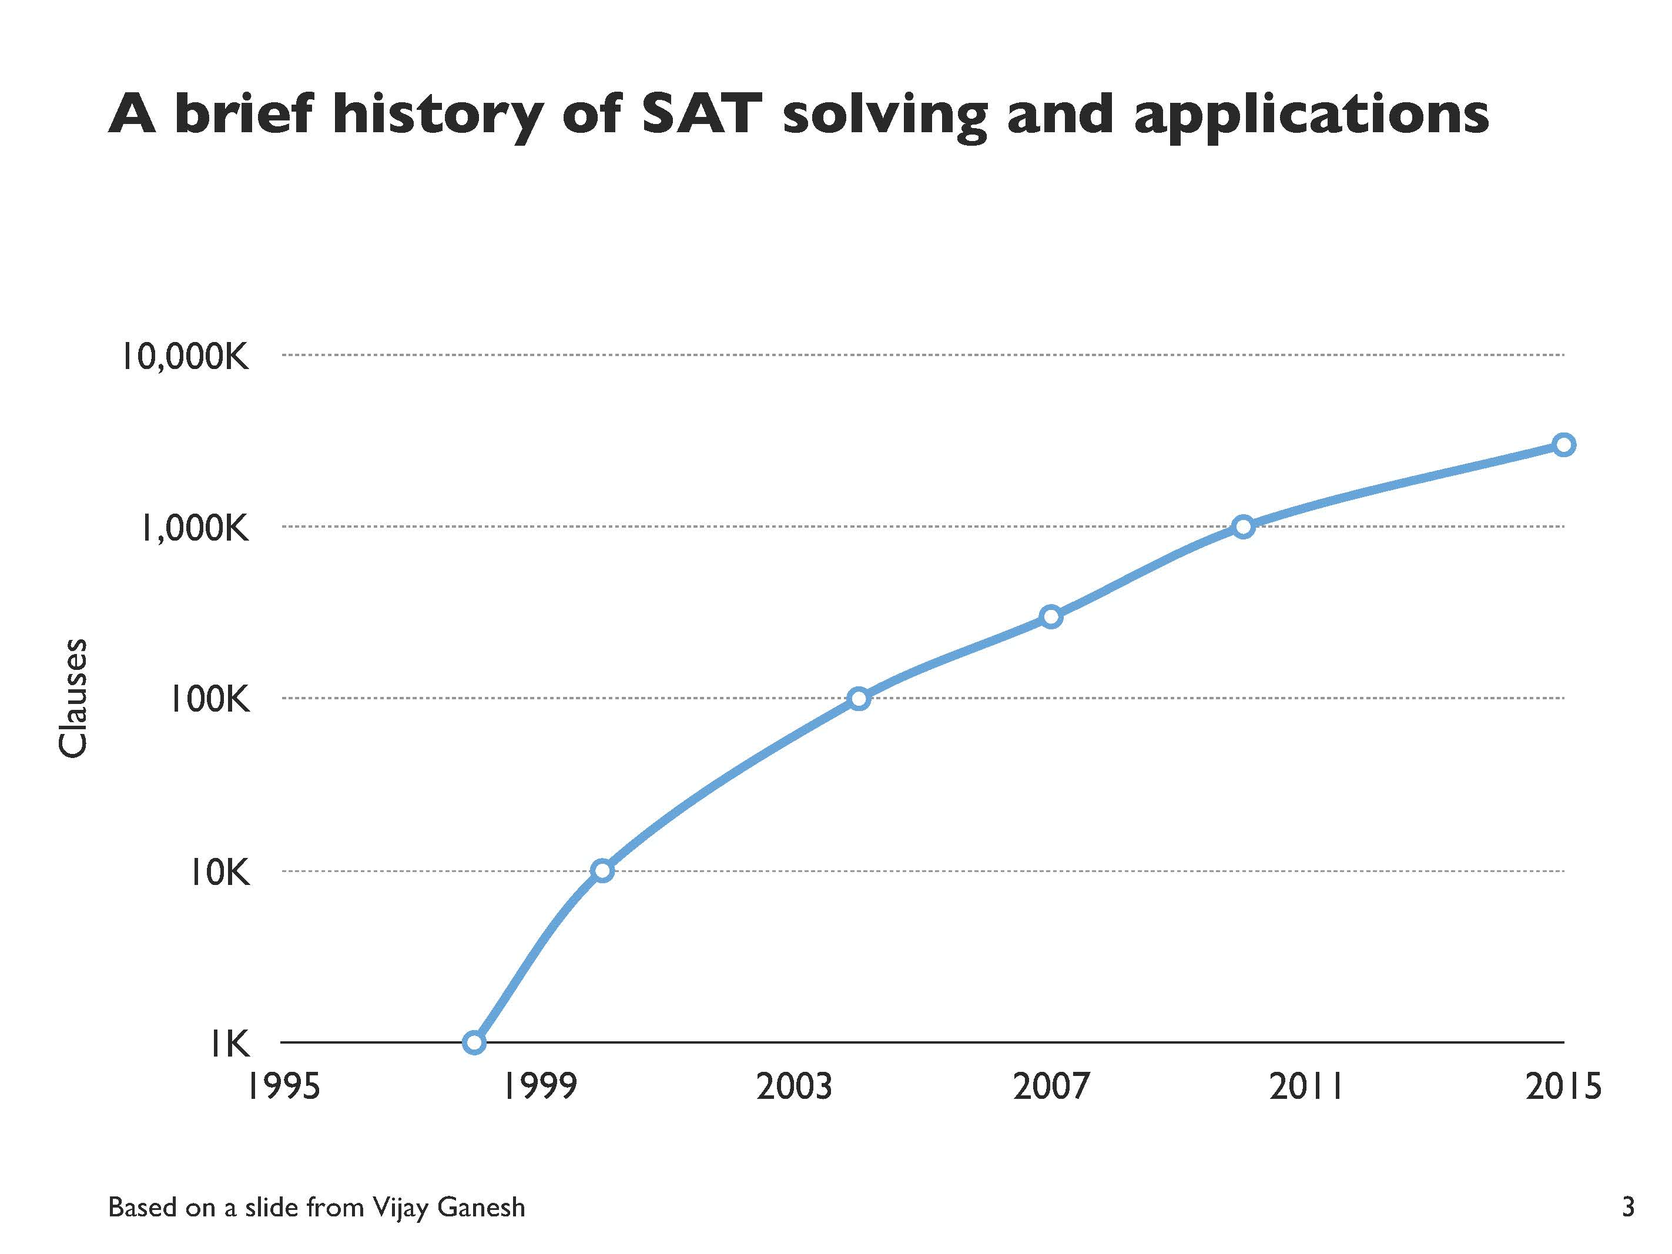
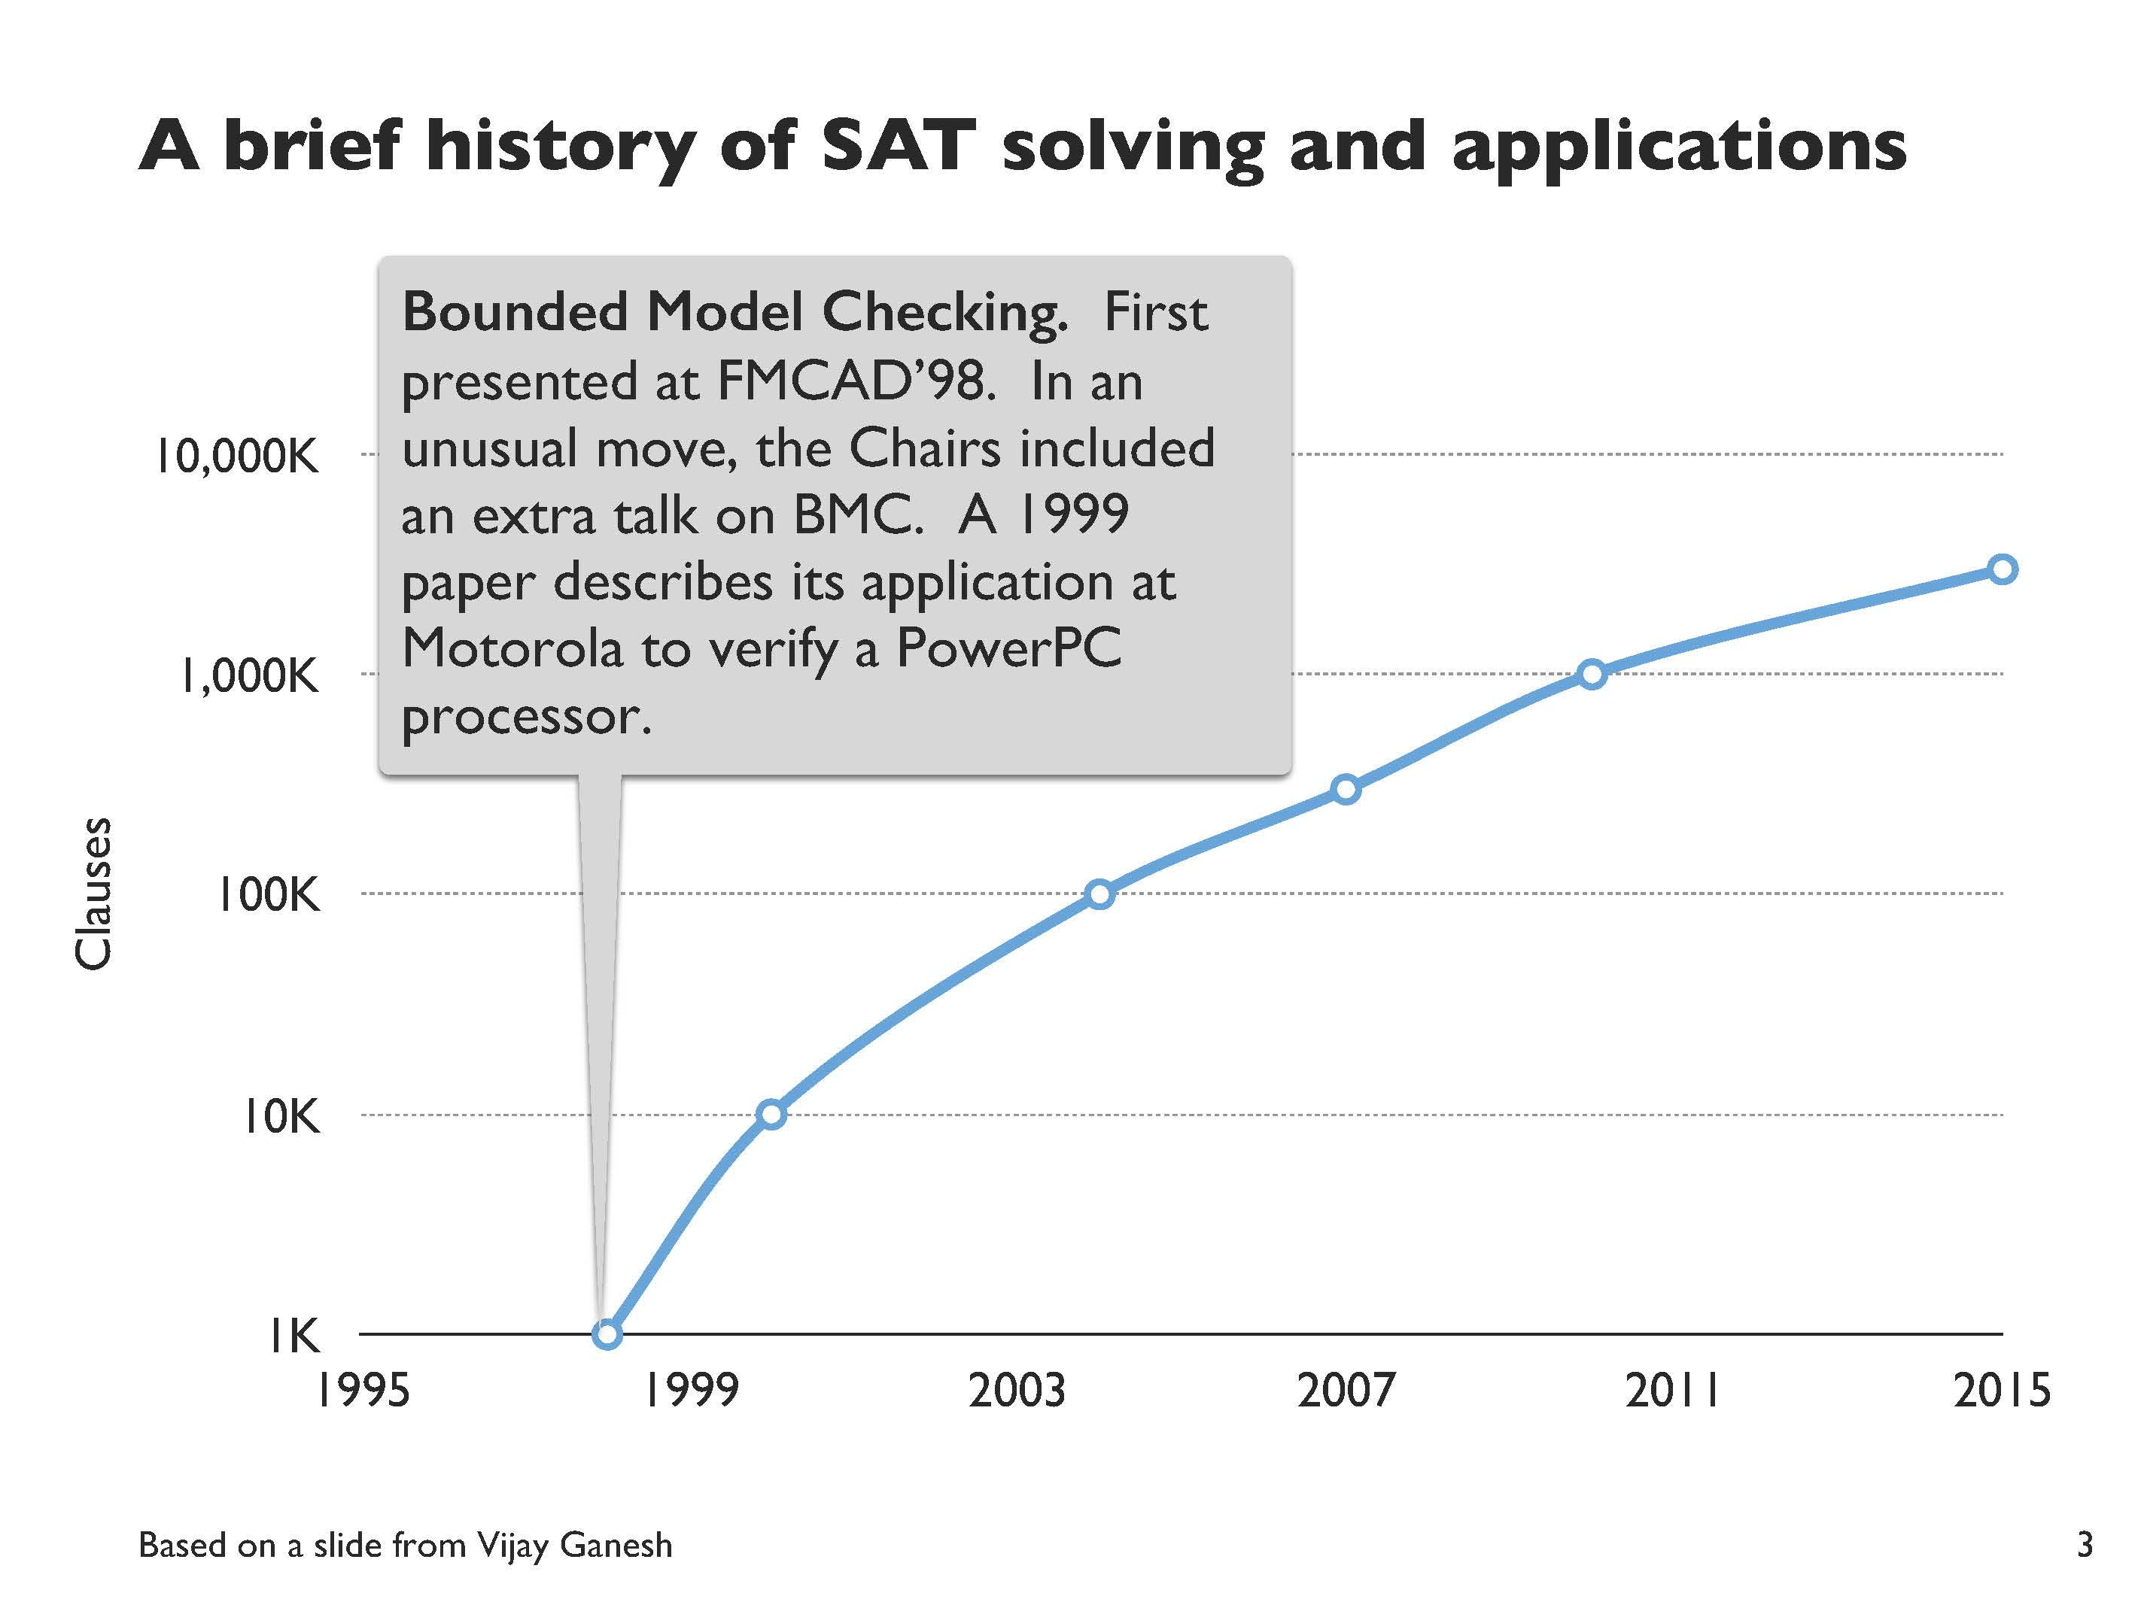
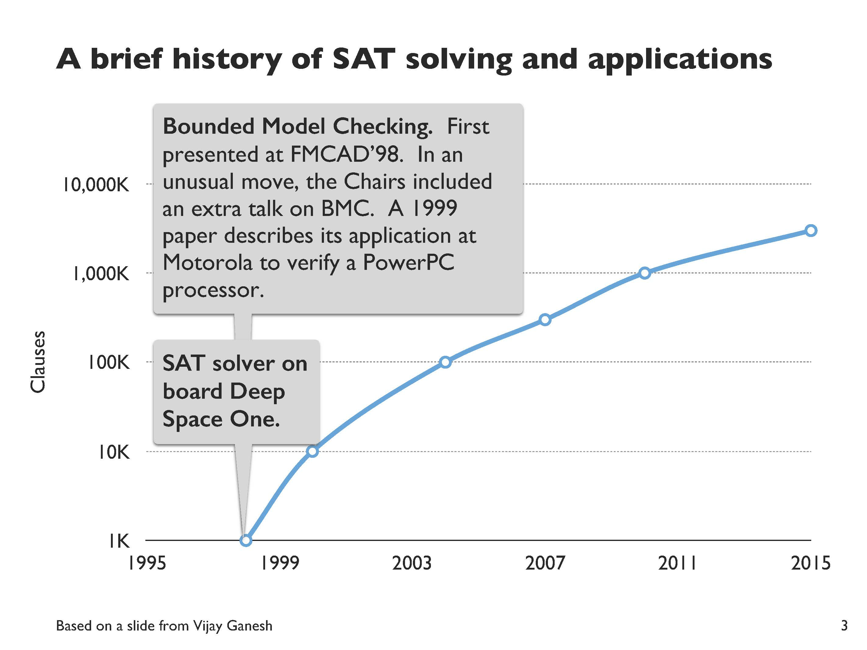
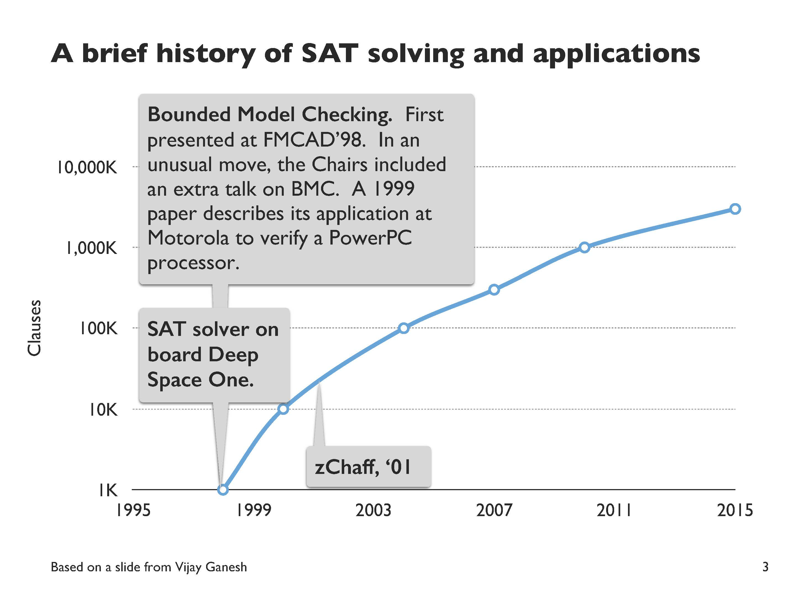
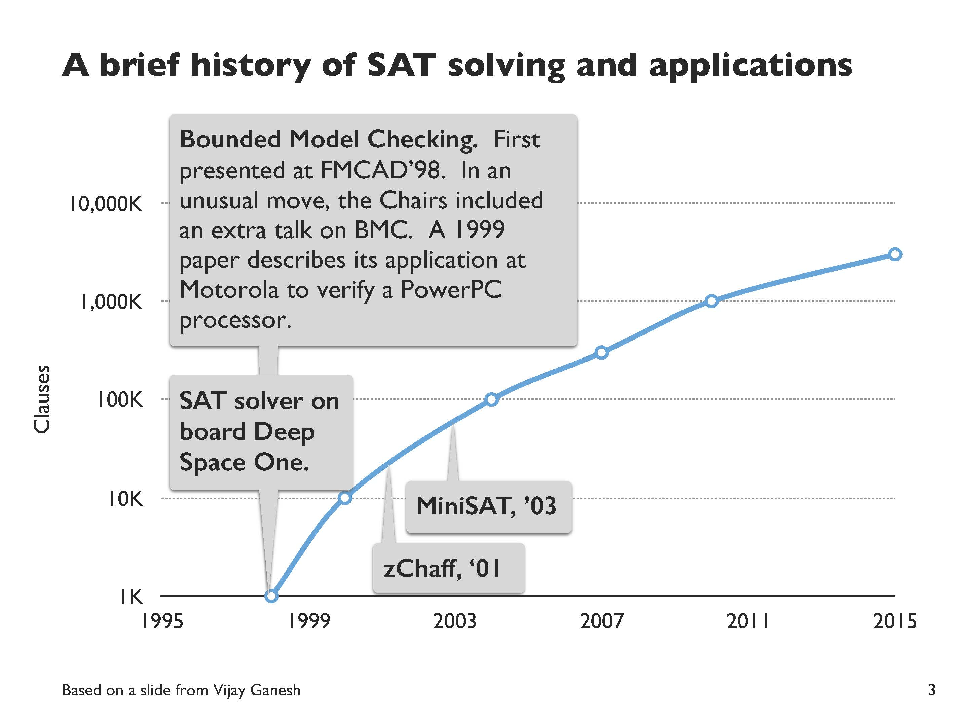
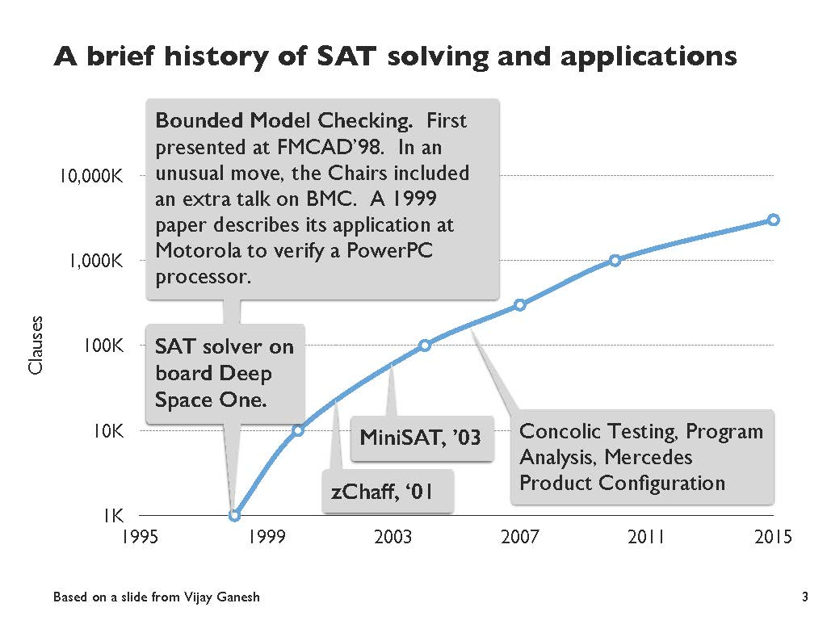
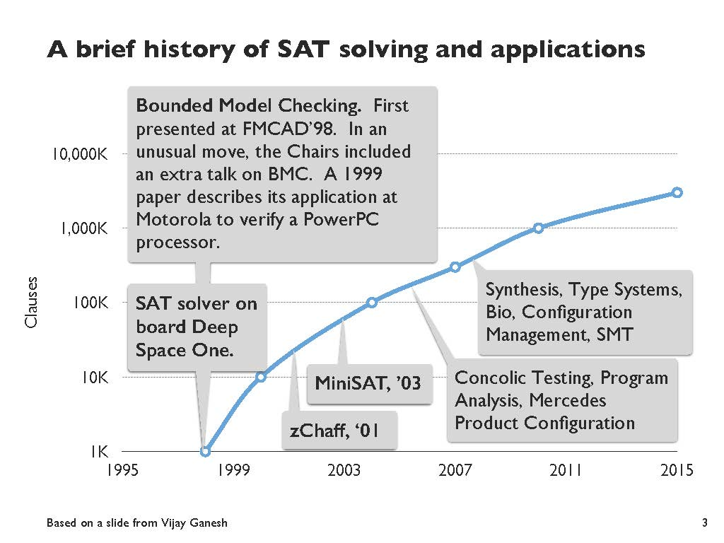

Slide 7
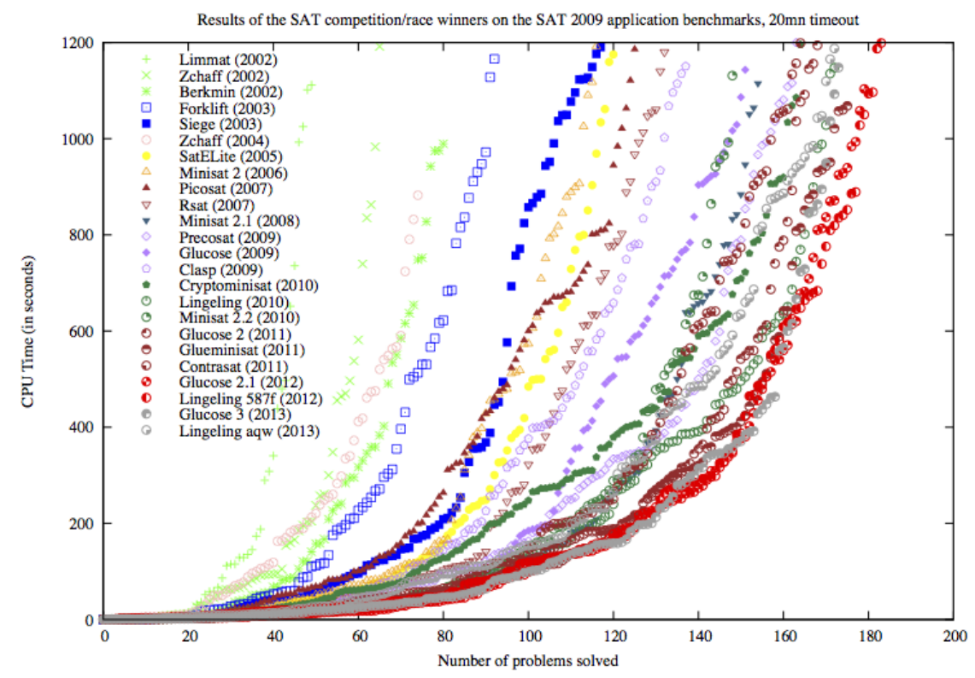
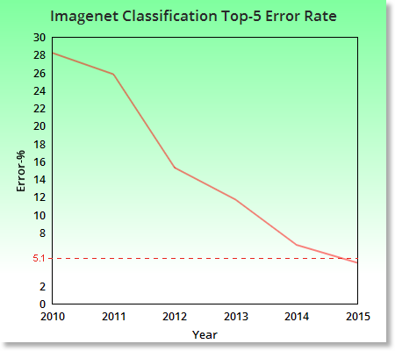
The power of benchmarks
The International SAT Solver Competitions, by Matti Järvisalo, Daniel Le Berre, Olivier Roussel, Laurent Simon

Slide 8

A brief review of DPLL
(DPLL = Davis, Putnam, Logemann, Loveland, 1962)
// Returns true if the CNF formula F is
// satisfiable; otherwise returns false.
DPLL(F)
G ← BCP(F)
if G = ⟙ then return true
if G = ⟘ then return false
p ← choose(vars(G))
return DPLL(G{p ↦ ⟙}) = “SAT” ||
DPLL(G{p ↦ ⟘})
3

Slide 9

A brief review of DPLL
(DPLL = Davis, Putnam, Logemann, Loveland)
Boolean constraint propagation applies unit resolution until fixed point:
lit clause[lit]
⟙
lit clause[¬lit] clause[⟘]
// Returns true if the CNF formula F is
// satisfiable; otherwise returns false.
DPLL(F)
G ← BCP(F)
if G = ⟙ then return true
if G = ⟘ then return false
p ← choose(vars(G))
return DPLL(G{p ↦ ⟙}) = “SAT” ||
DPLL(G{p ↦ ⟘})
3

Slide 10

A brief review of DPLL
(DPLL = Davis, Putnam, Logemann, Loveland)
// Returns true if the CNF formula F is
// satisfiable; otherwise returns false.
DPLL(F)
G ← BCP(F)
if G = ⟙ then return true
if G = ⟘ then return false
p ← choose(vars(G))
return DPLL(G{p ↦ ⟙}) = “SAT” ||
DPLL(G{p ↦ ⟘})
Okay for randomly generated CNFs, but not on practical ones. Why?
3

Slide 11

A brief review of DPLL
(DPLL = Davis, Putnam, Logemann, Loveland)
No learning: throws away all the
work performed to conclude that the current partial assignment (PA) is bad. Revisits bad PAs that lead to conflict due to the same root cause.
// Returns true if the CNF formula F is
// satisfiable; otherwise returns false.
DPLL(F)
G ← BCP(F)
if G = ⟙ then return true
if G = ⟘ then return false
p ← choose(vars(G))
return DPLL(G{p ↦ ⟙}) = “SAT” ||
DPLL(G{p ↦ ⟘})
3

Slide 12

A brief review of DPLL
(DPLL = Davis, Putnam, Logemann, Loveland)
No learning: throws away all the
work performed to conclude that the current partial assignment (PA) is bad. Revisits bad PAs that lead to conflict due to the same root cause.
// Returns true if the CNF formula F is
// satisfiable; otherwise returns false.
DPLL(F)
G ← BCP(F)
if G = ⟙ then return true
if G = ⟘ then return false
p ← choose(vars(G))
return DPLL(G{p ↦ ⟙}) = “SAT” ||
DPLL(G{p ↦ ⟘})
Chronological backtracking: backtracks one level, even if it can be deduced that the current PA became doomed at a lower level.
3

Slide 13

A brief review of DPLL
(DPLL = Davis, Putnam, Logemann, Loveland)
No learning: throws away all the
work performed to conclude that the current partial assignment (PA) is bad. Revisits bad PAs that lead to conflict due to the same root cause.
// Returns true if the CNF formula F is
// satisfiable; otherwise returns false.
DPLL(F)
G ← BCP(F)
if G = ⟙ then return true
if G = ⟘ then return false
p ← choose(vars(G))
return DPLL(G{p ↦ ⟙}) = “SAT” ||
DPLL(G{p ↦ ⟘})
Naive decisions: picks an arbitrary variable and assumes it is true. Fails to consider the state of the search to make heuristically better decisions.
Chronological backtracking: backtracks one level, even if it can be deduced that the current PA became doomed at a lower level.
3

Slide 14
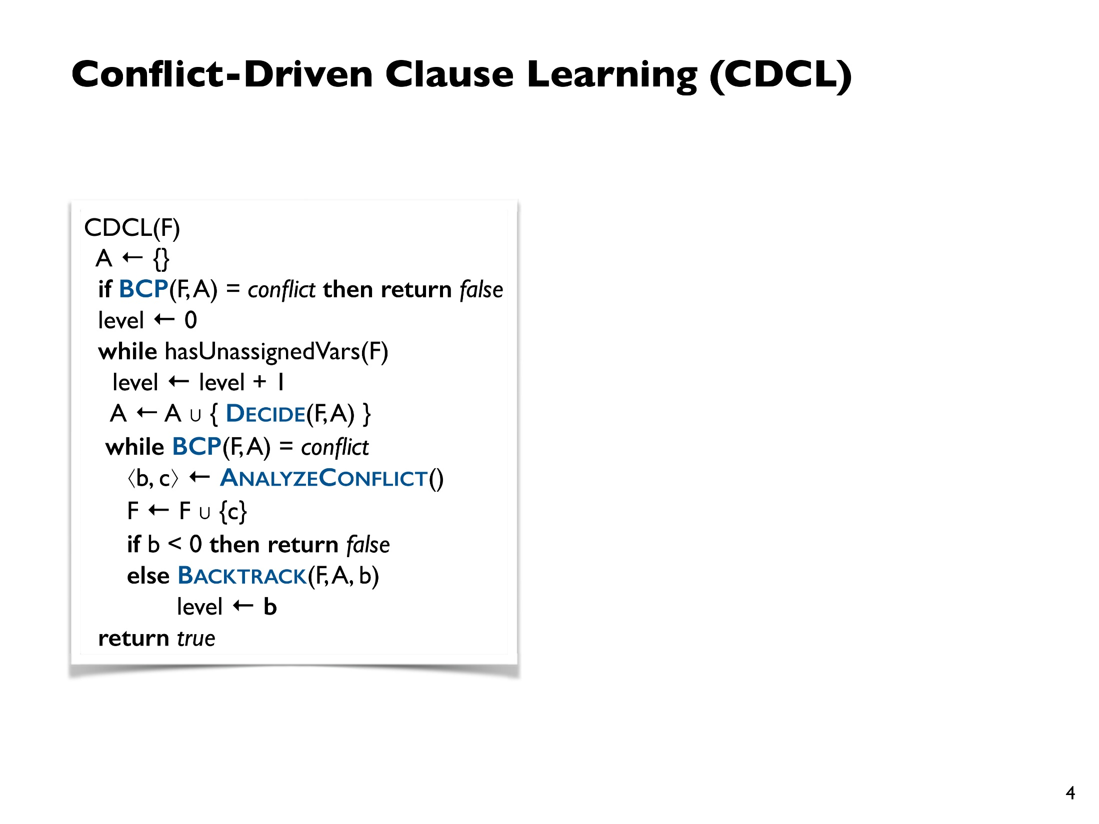
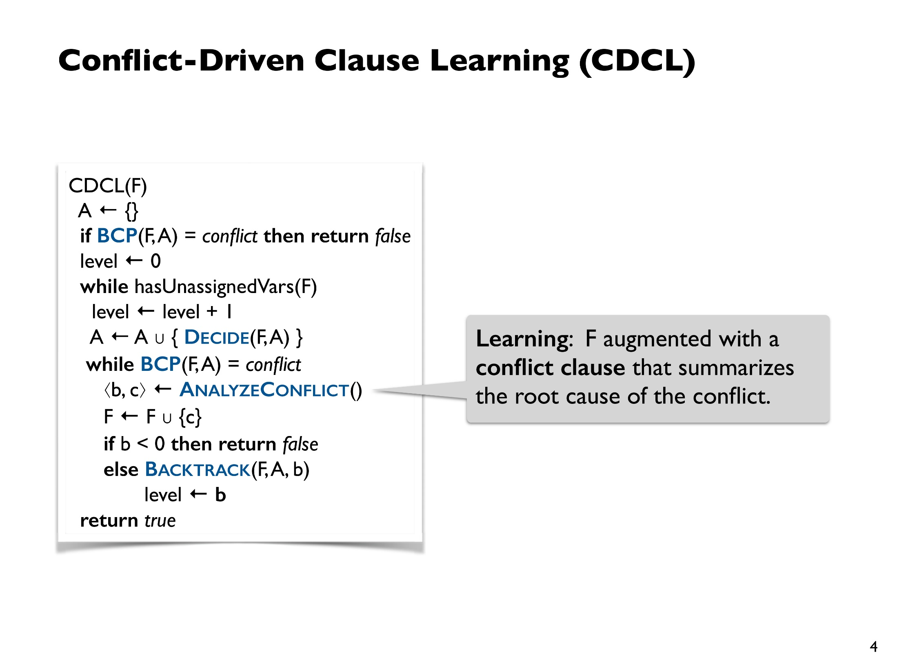
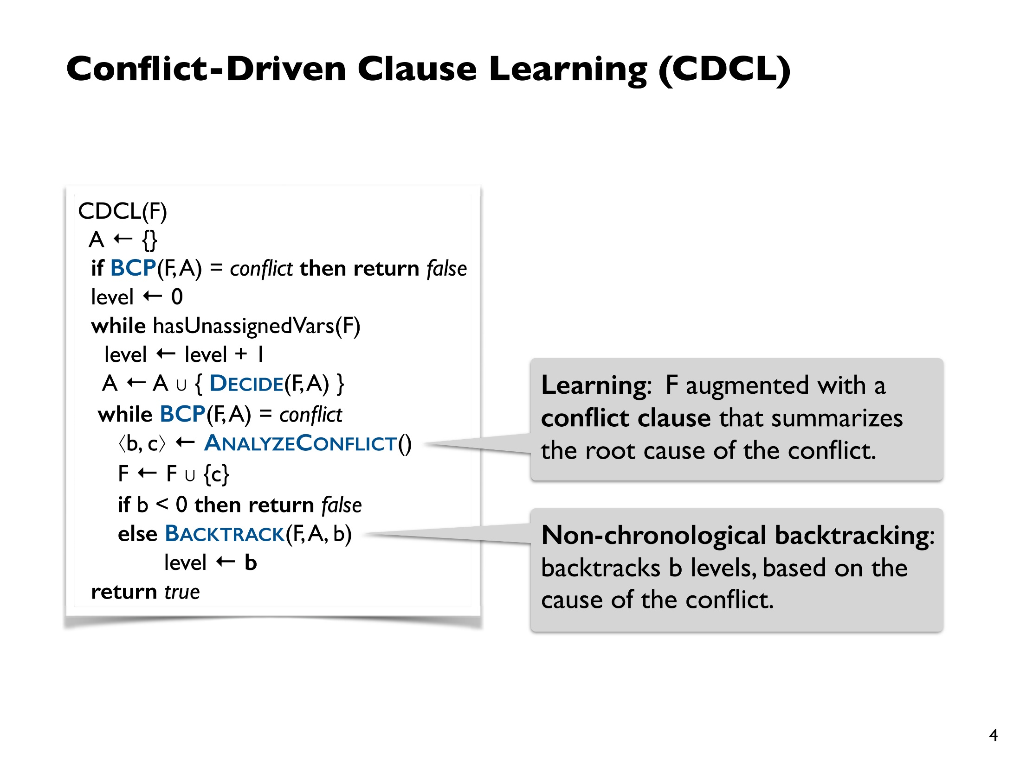
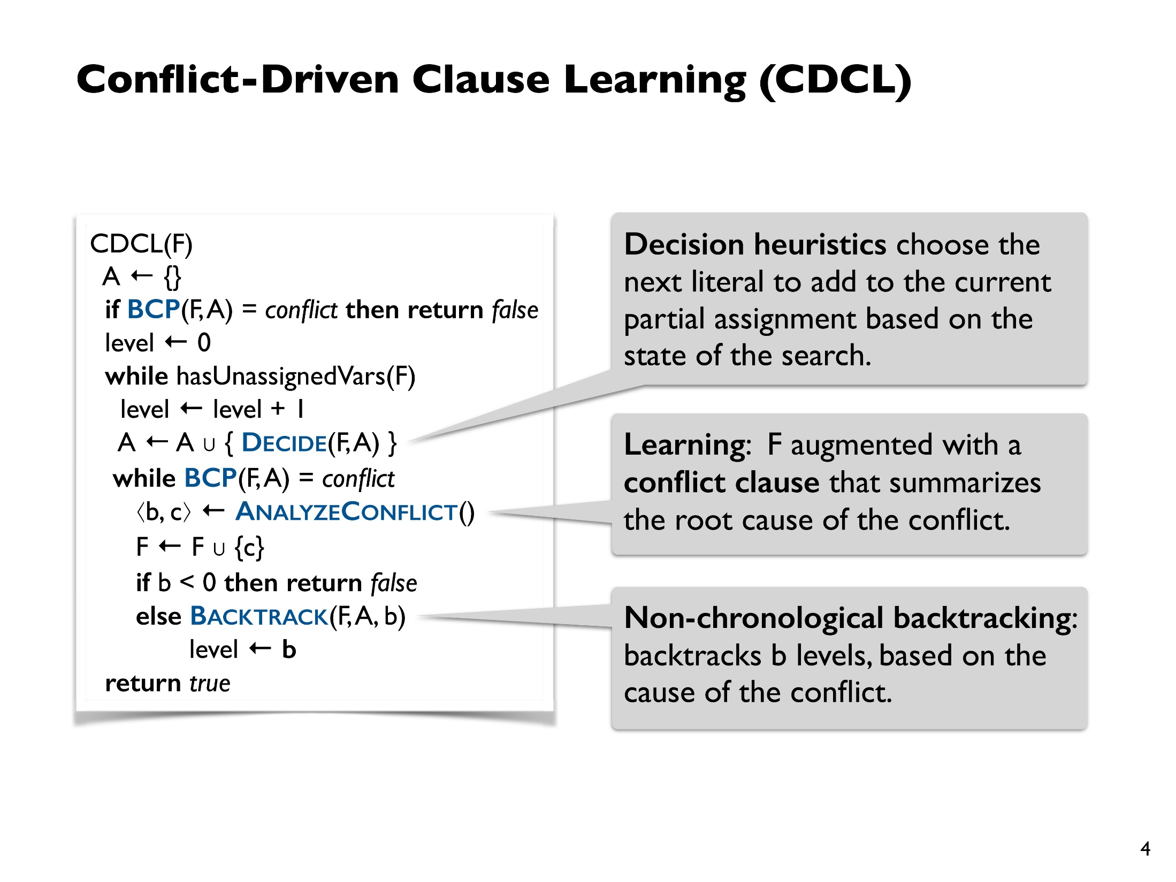
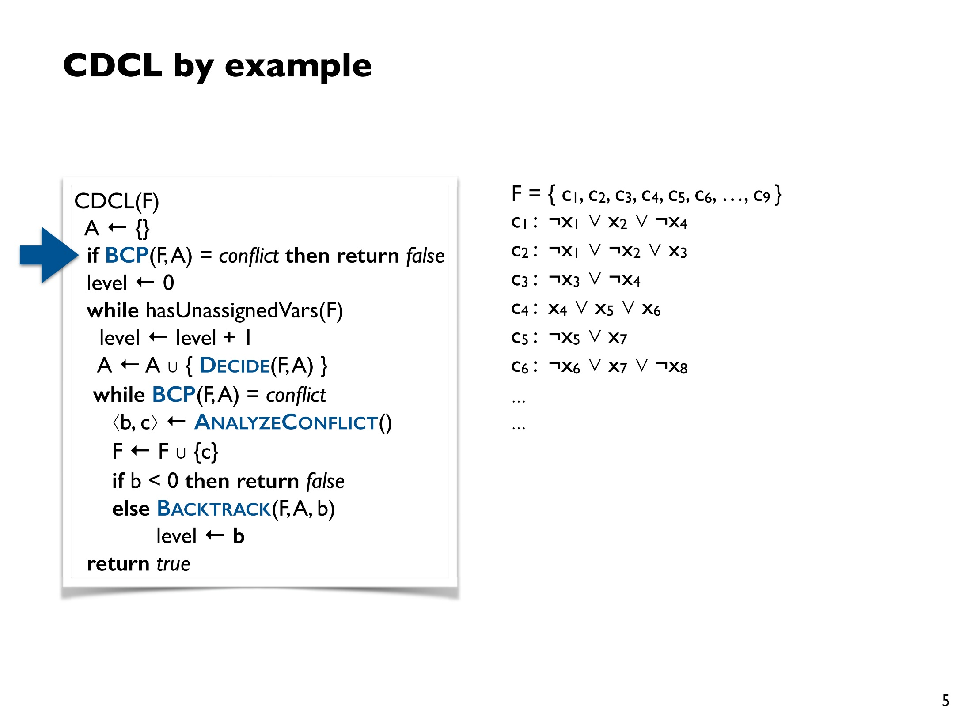
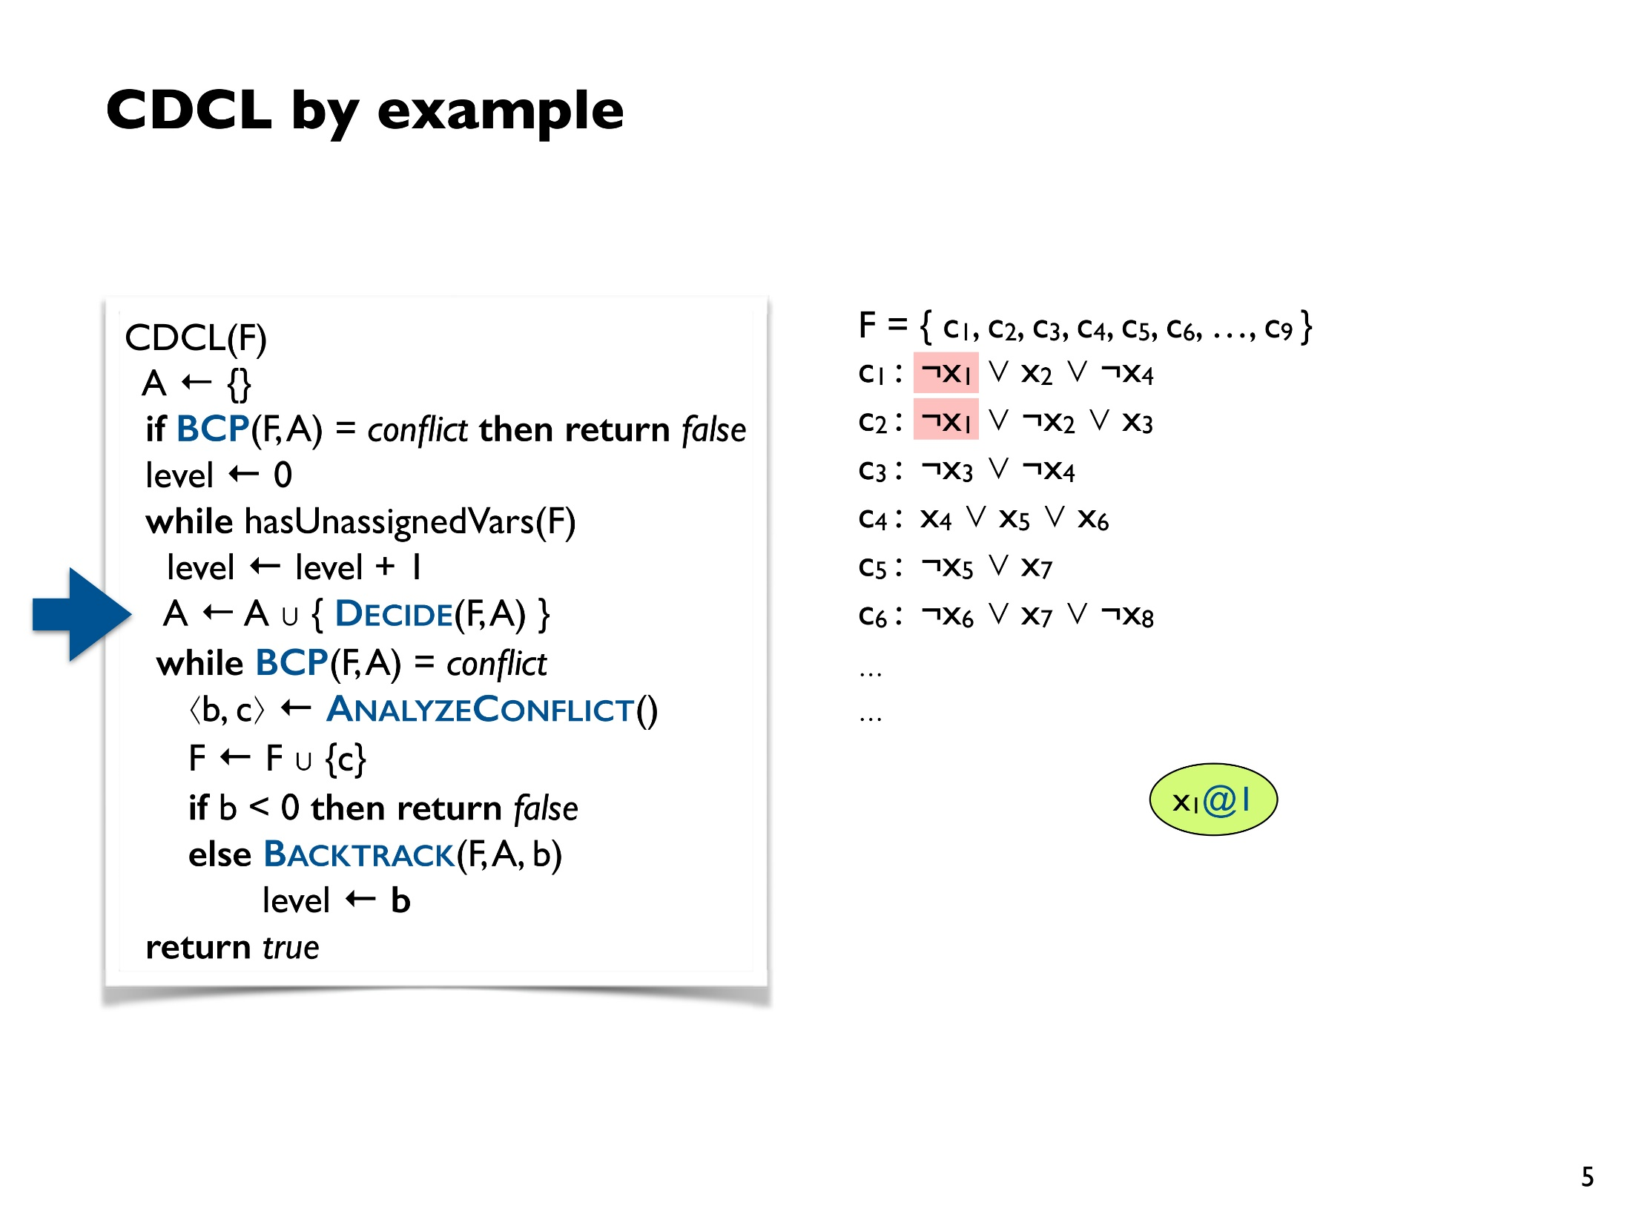
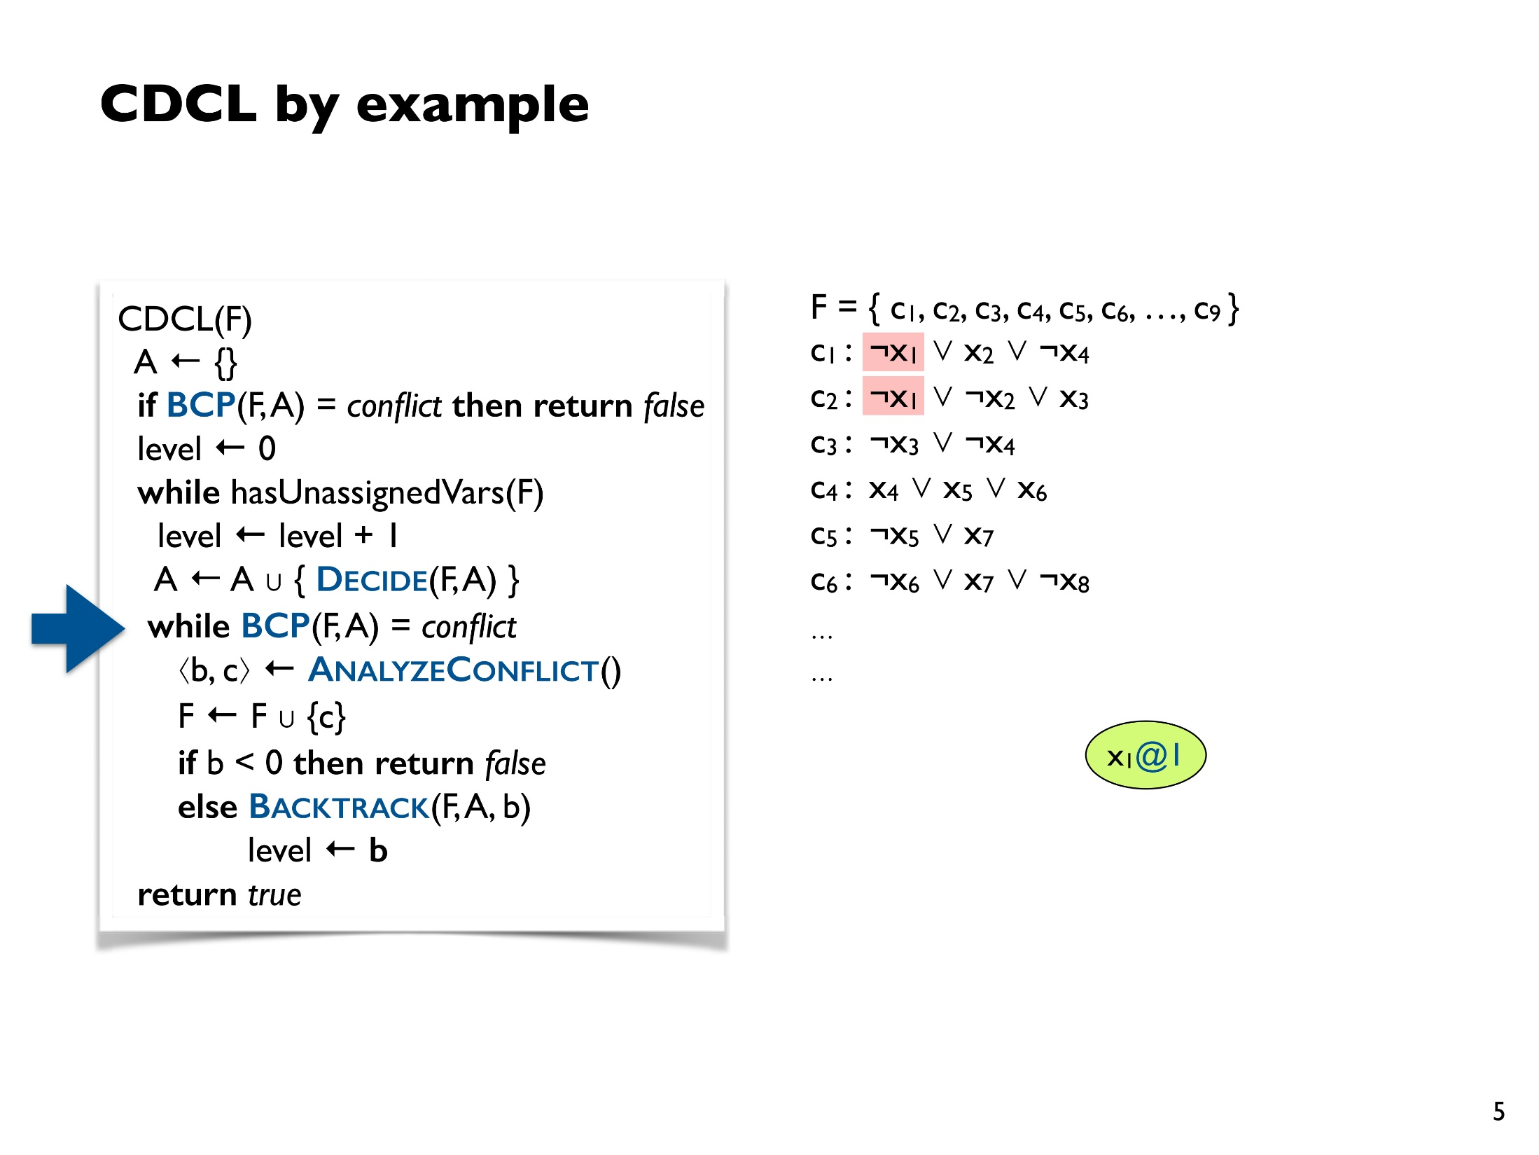
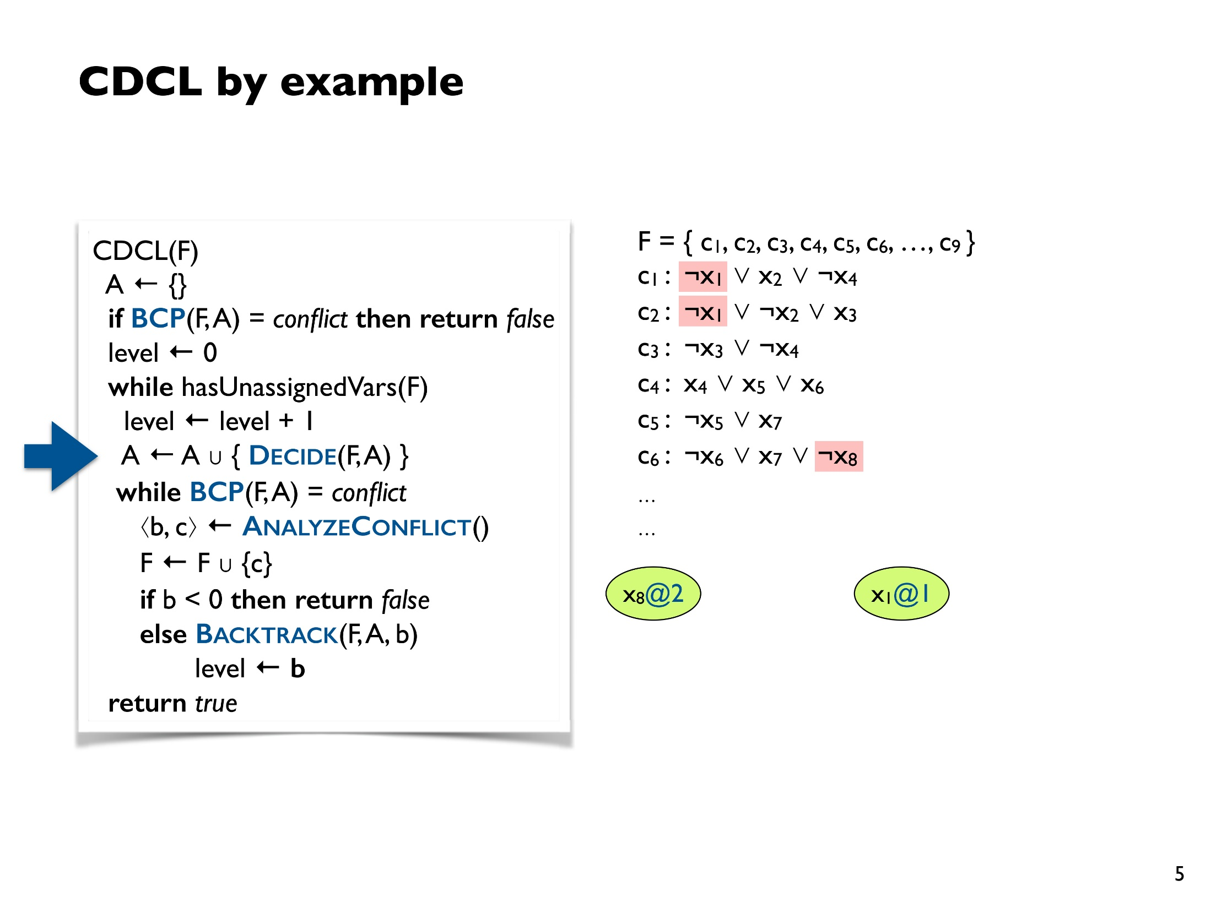
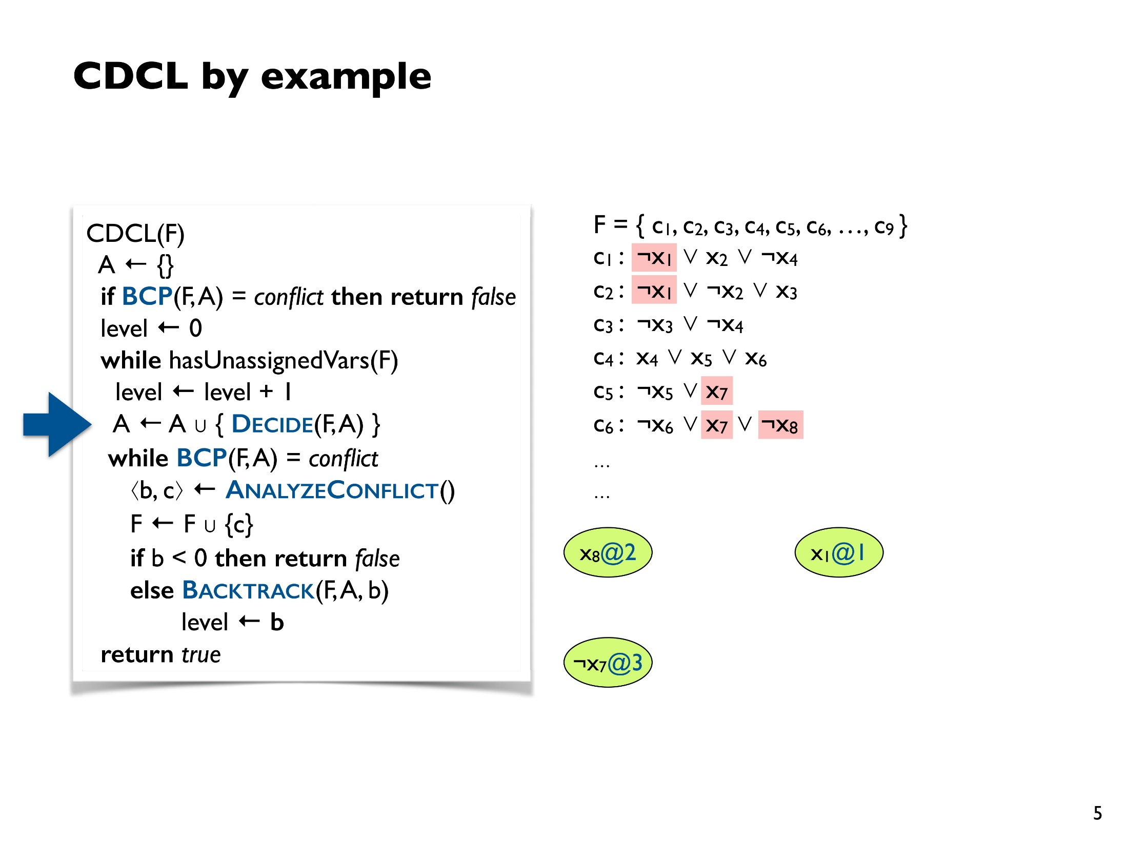
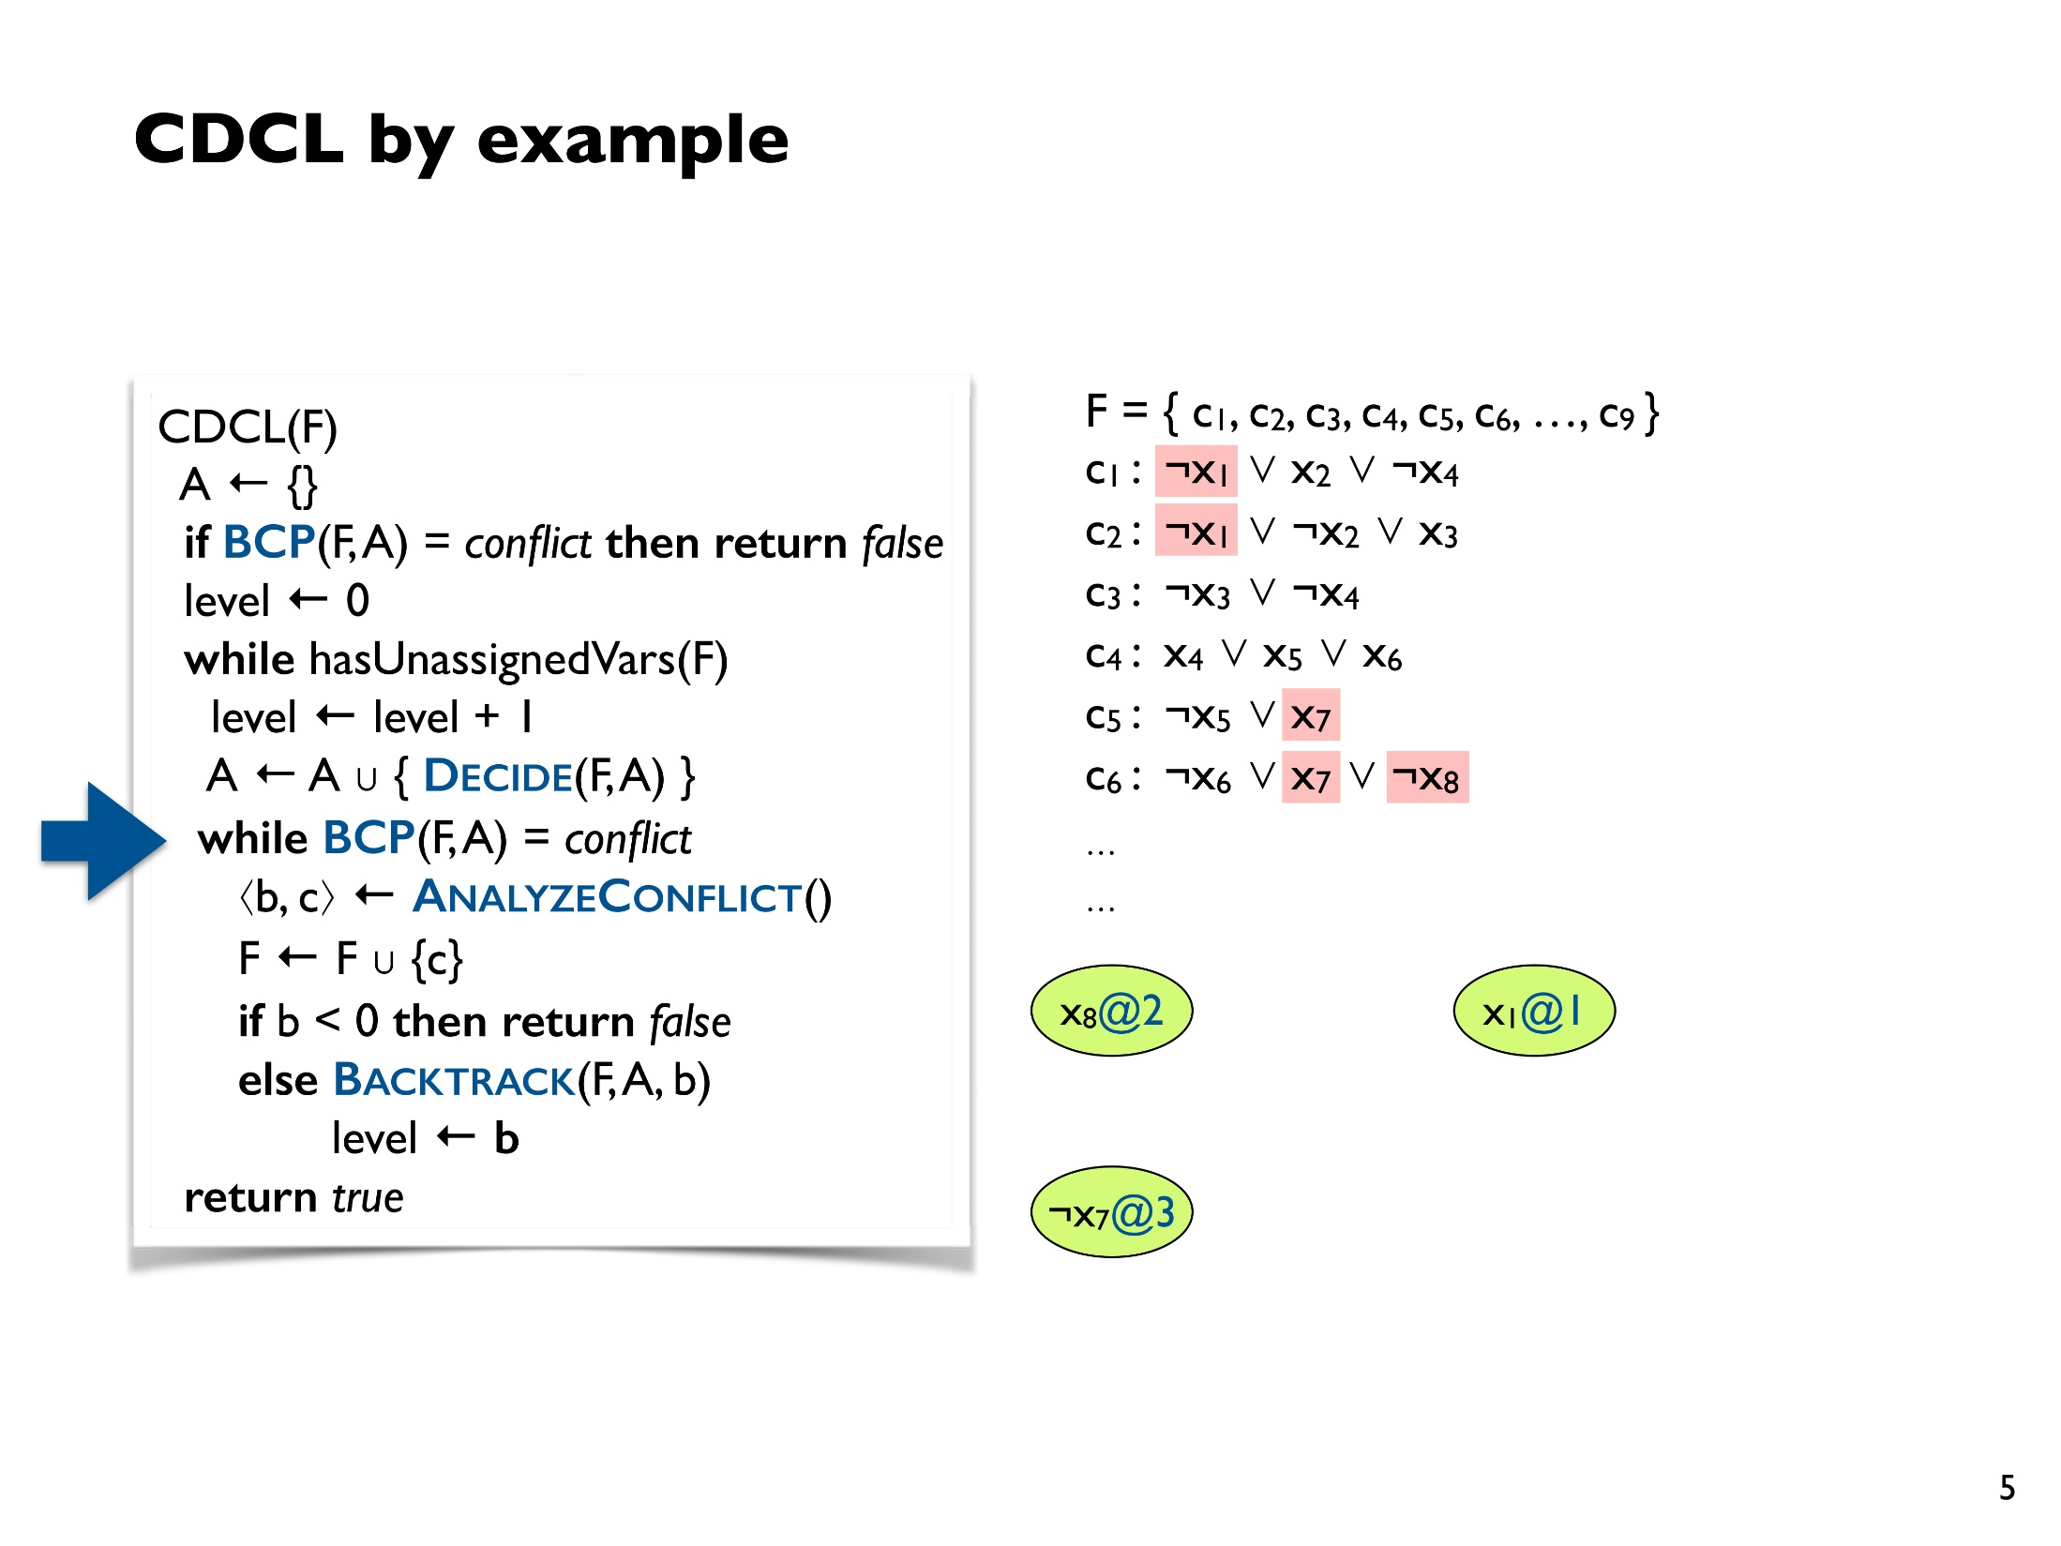
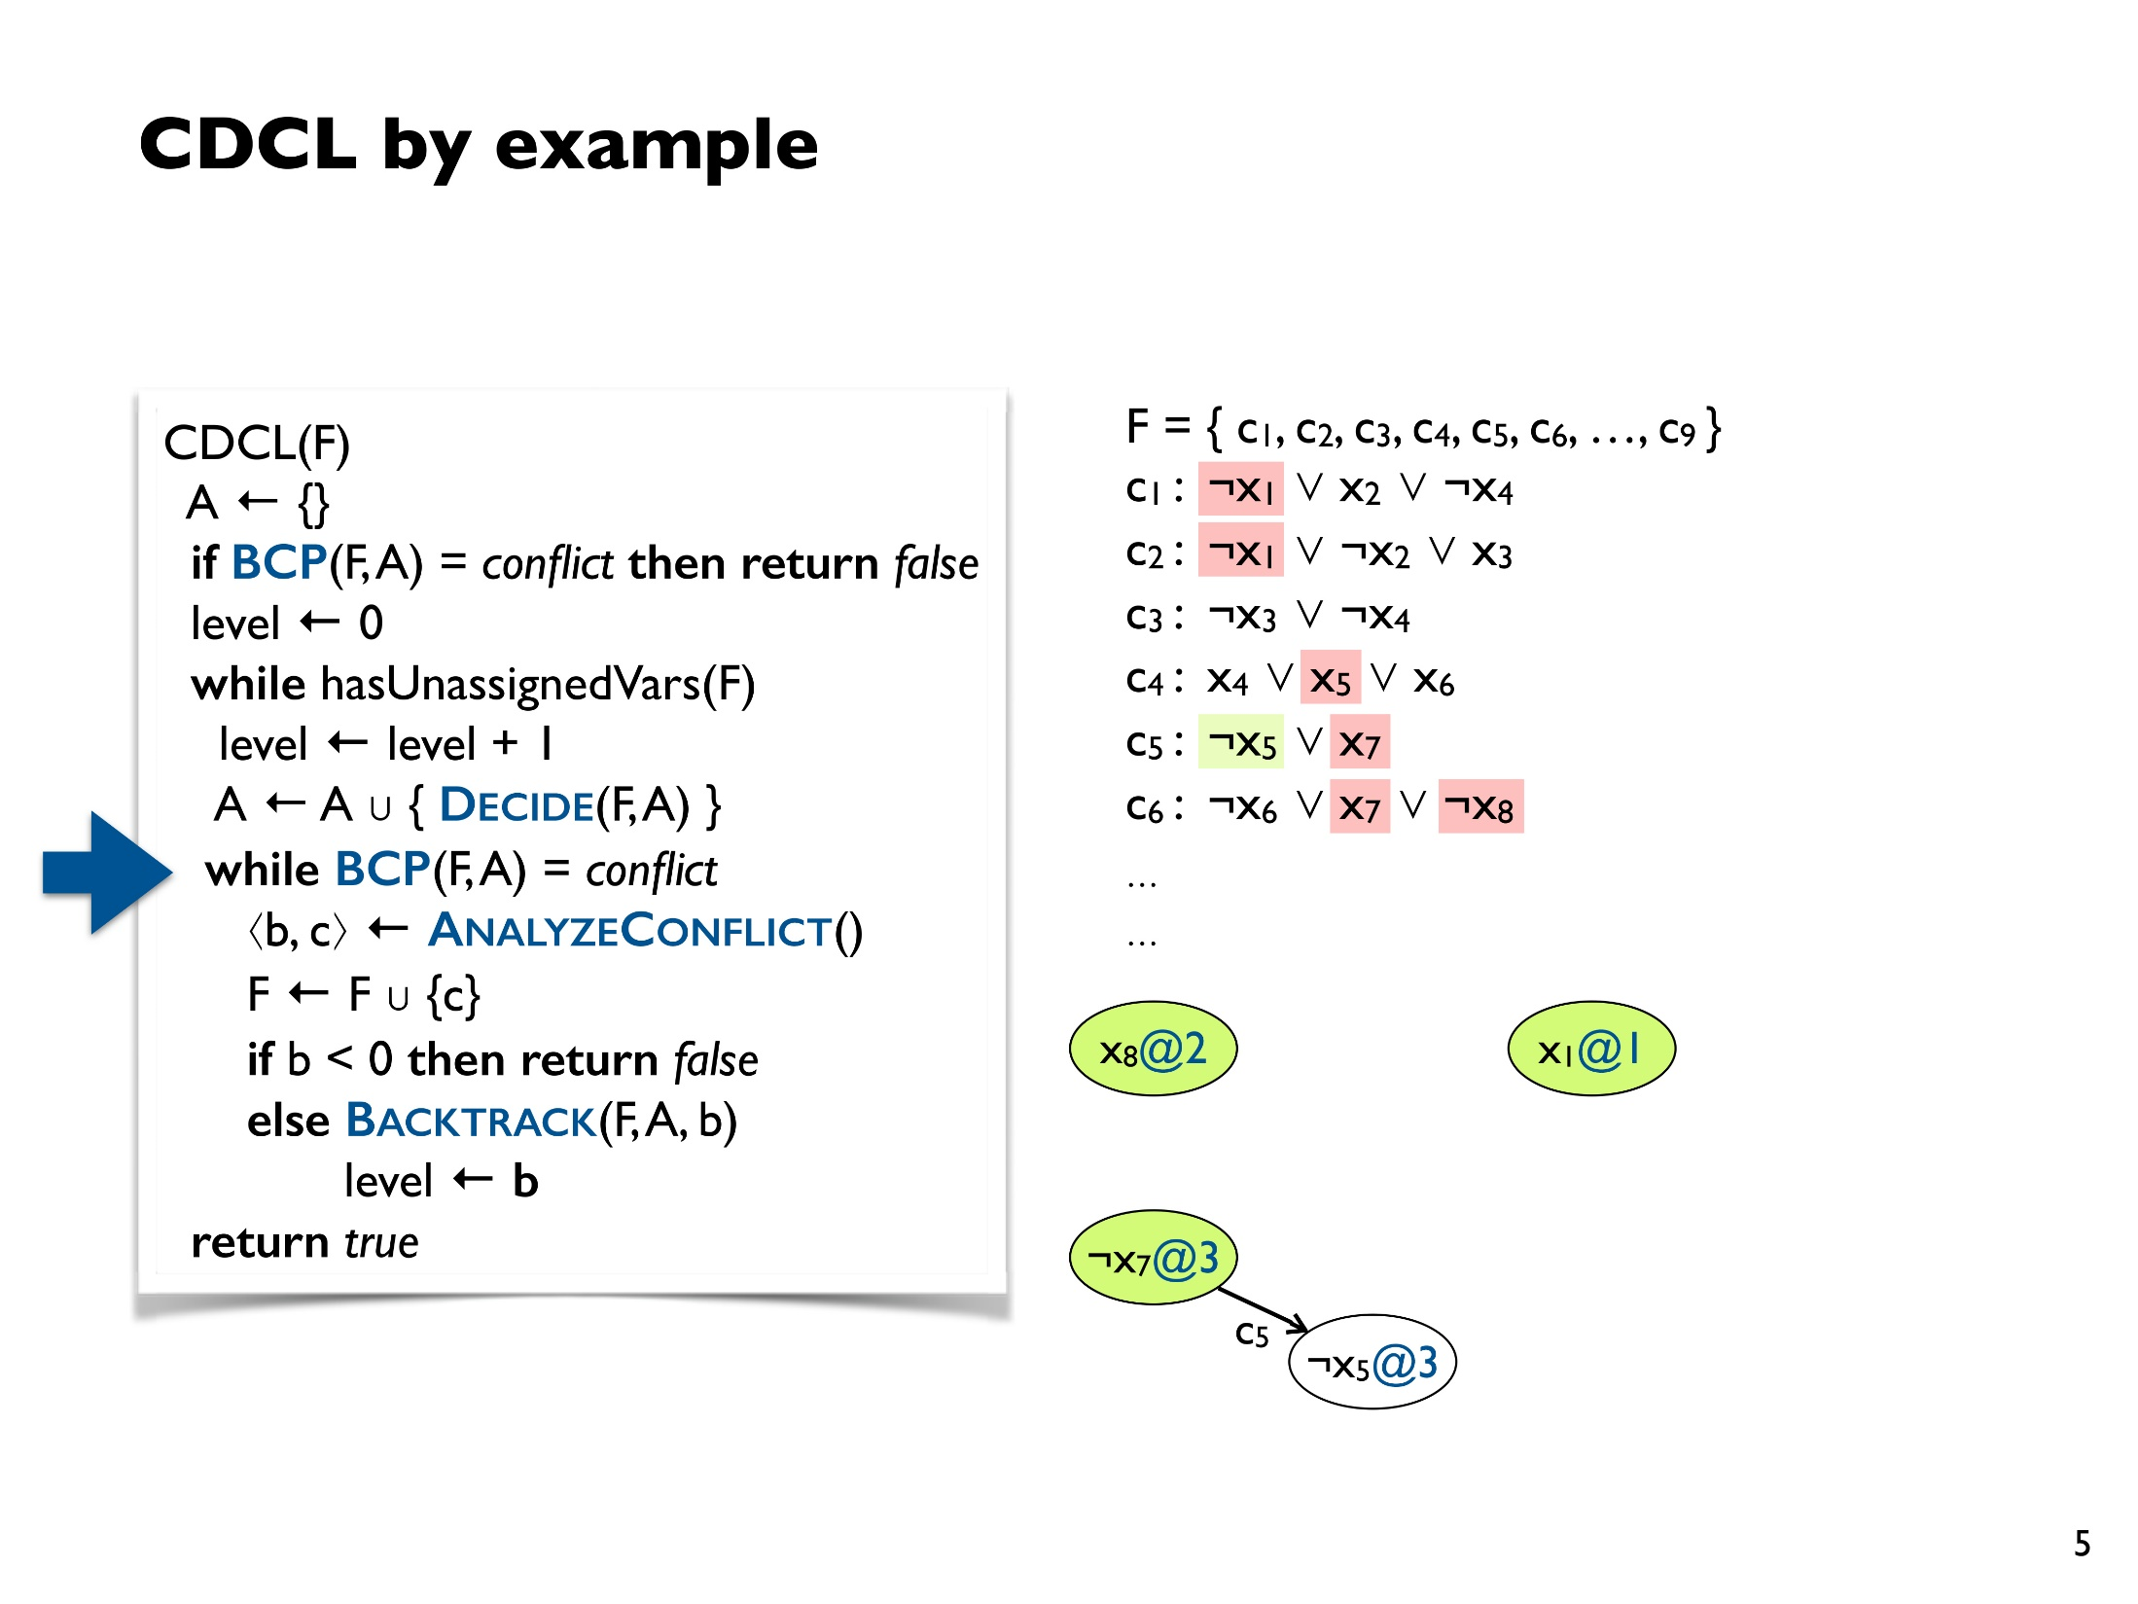
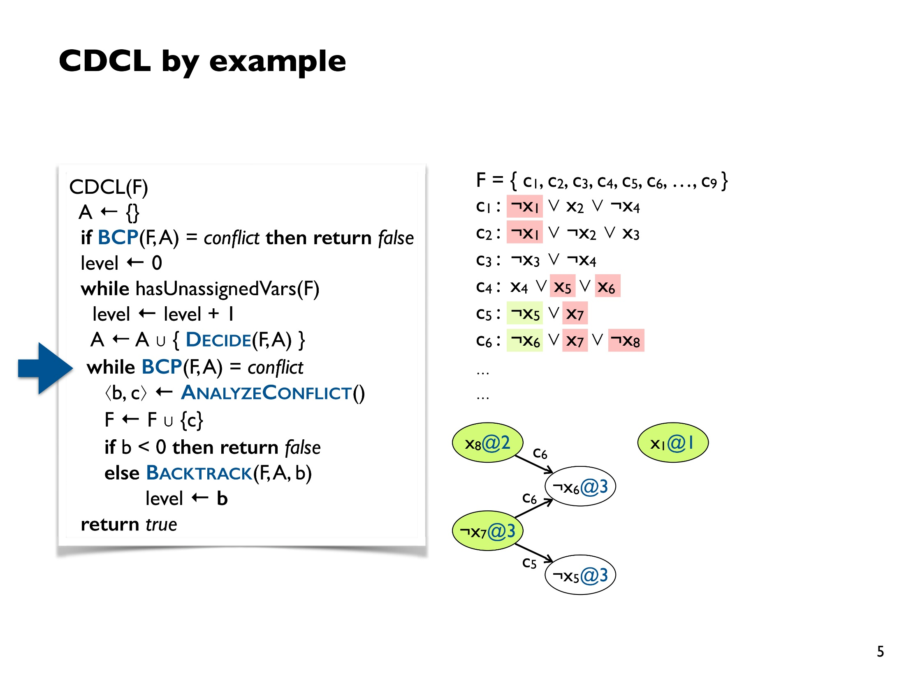
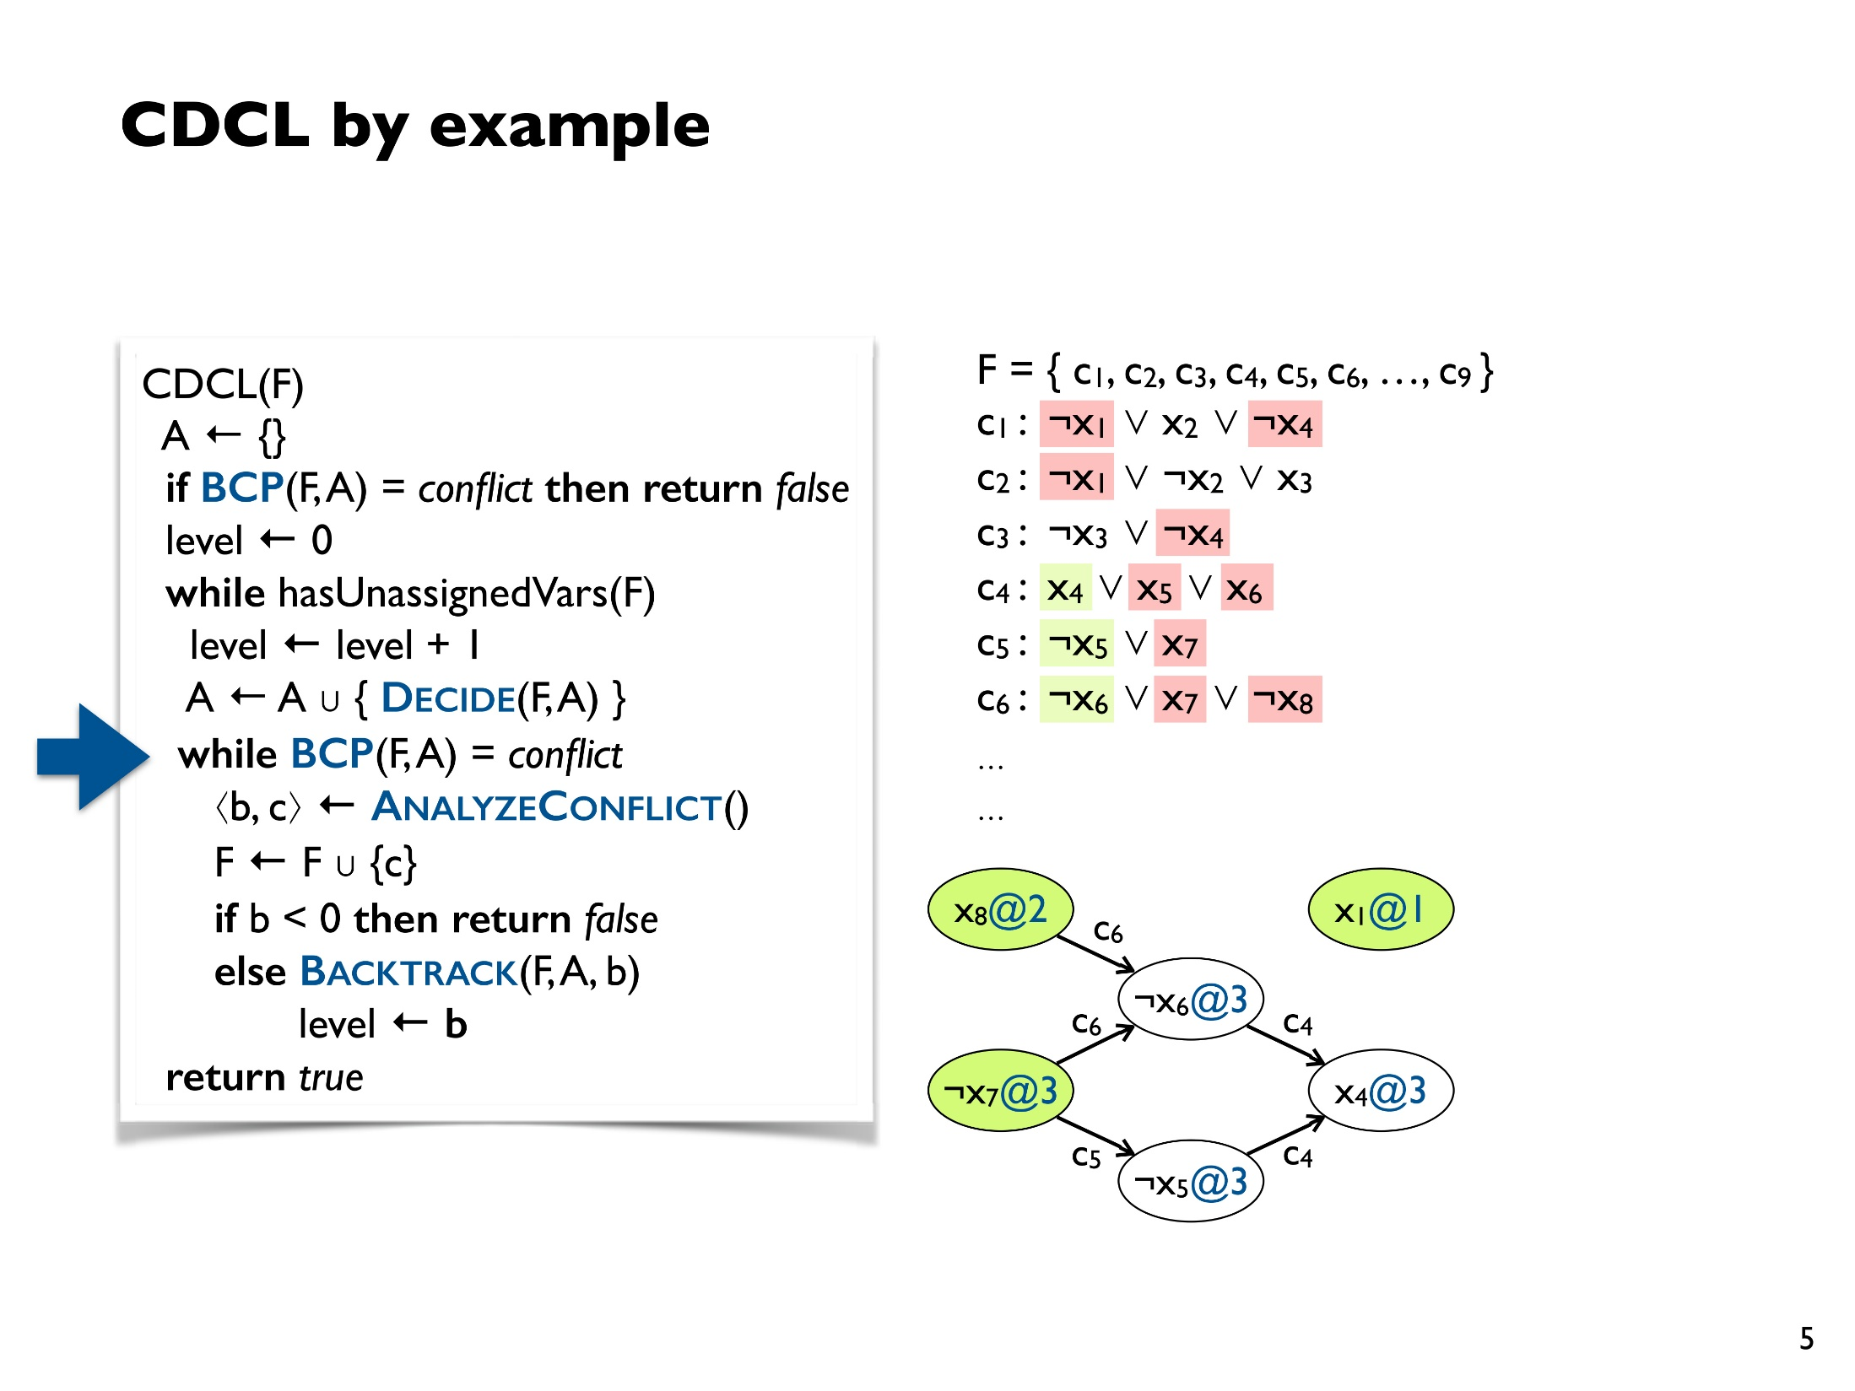
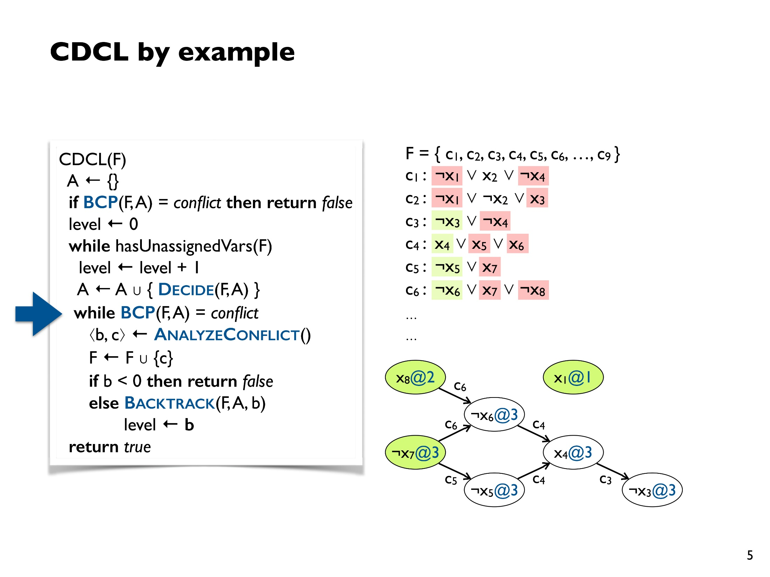
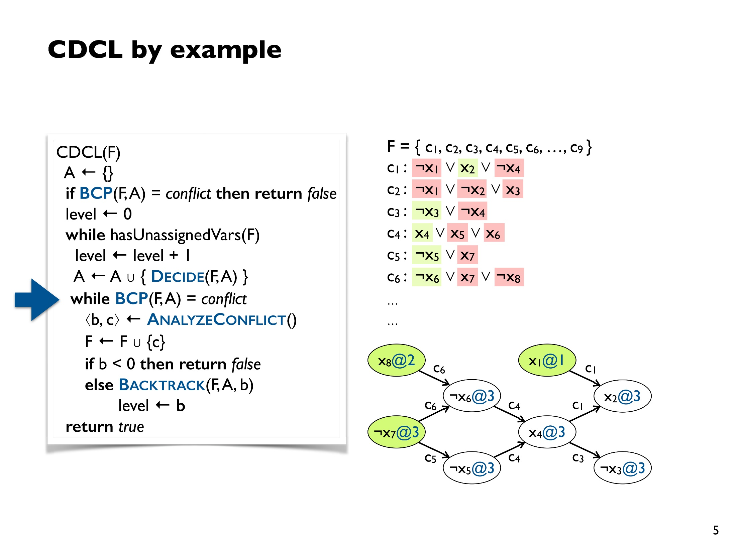
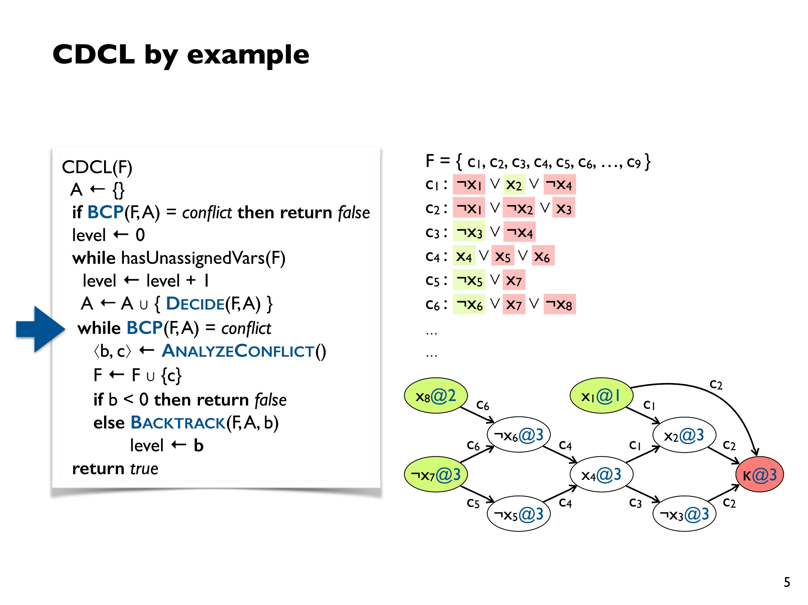
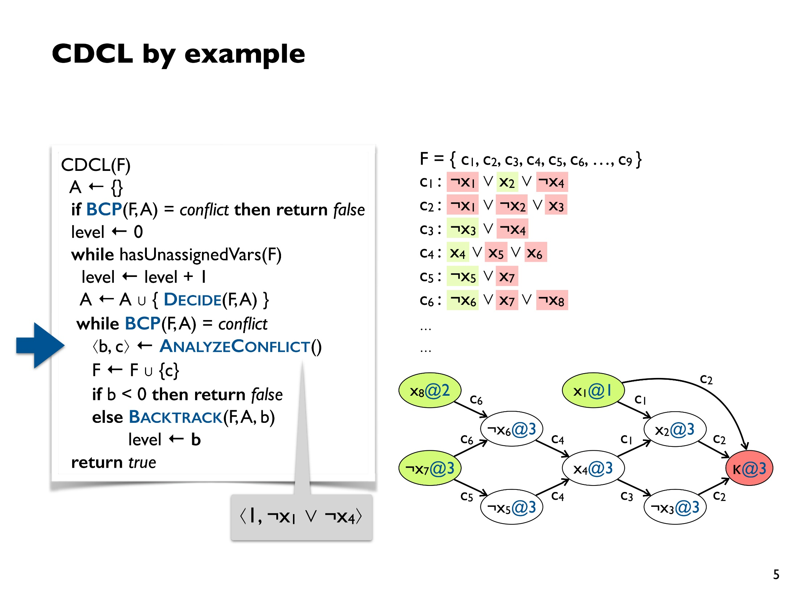
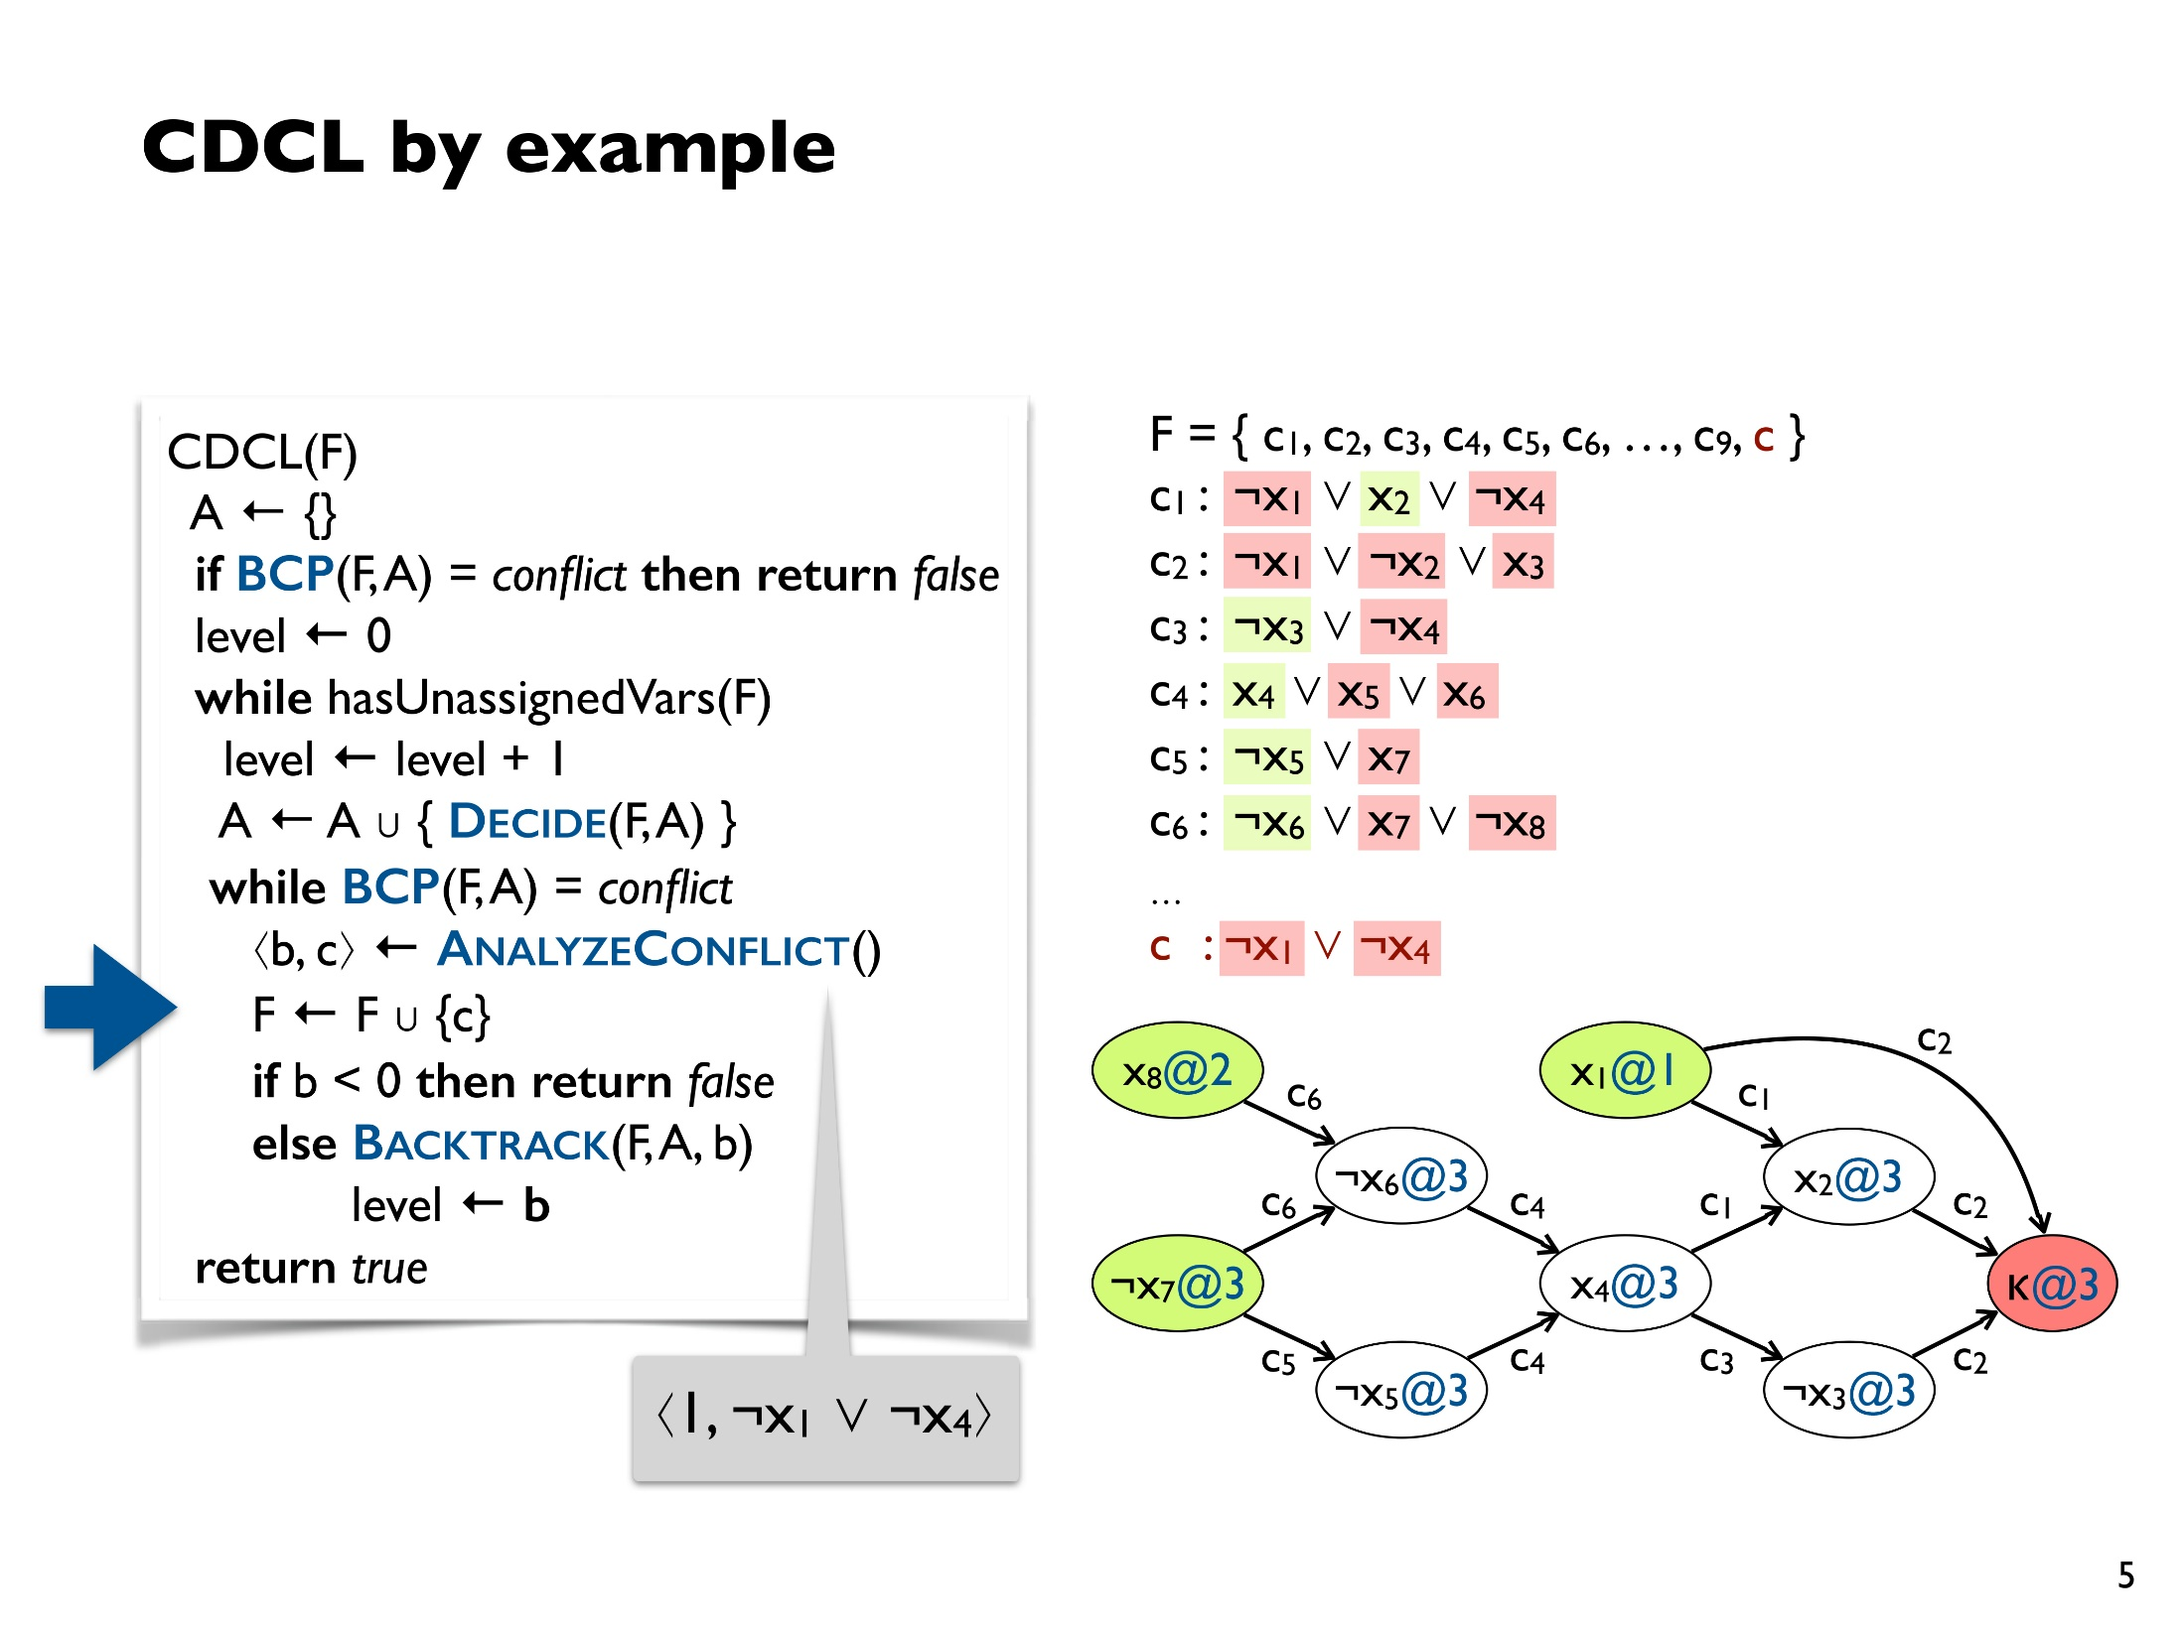
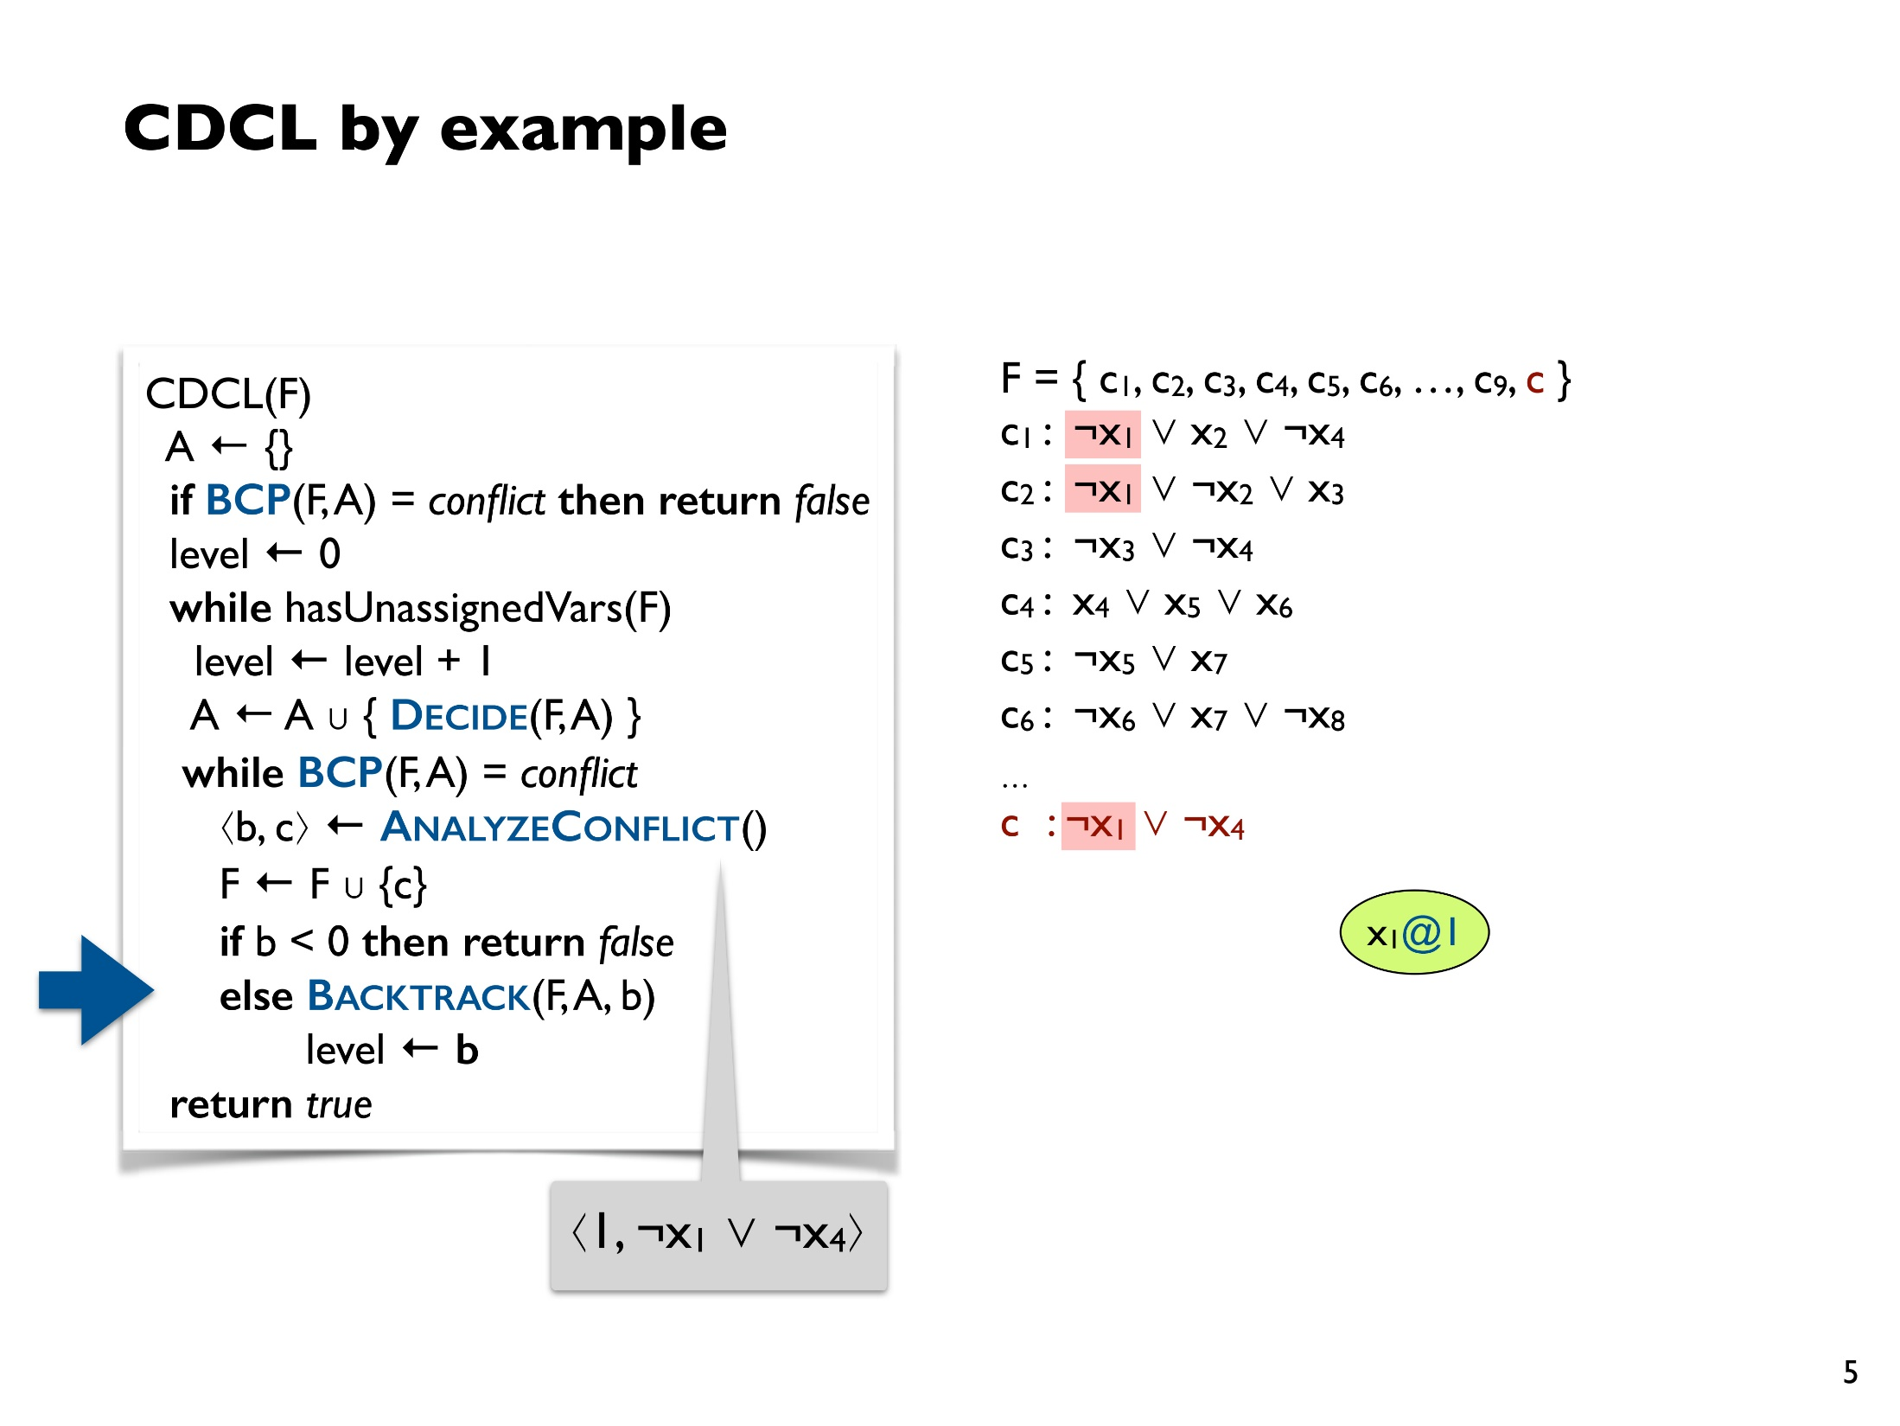
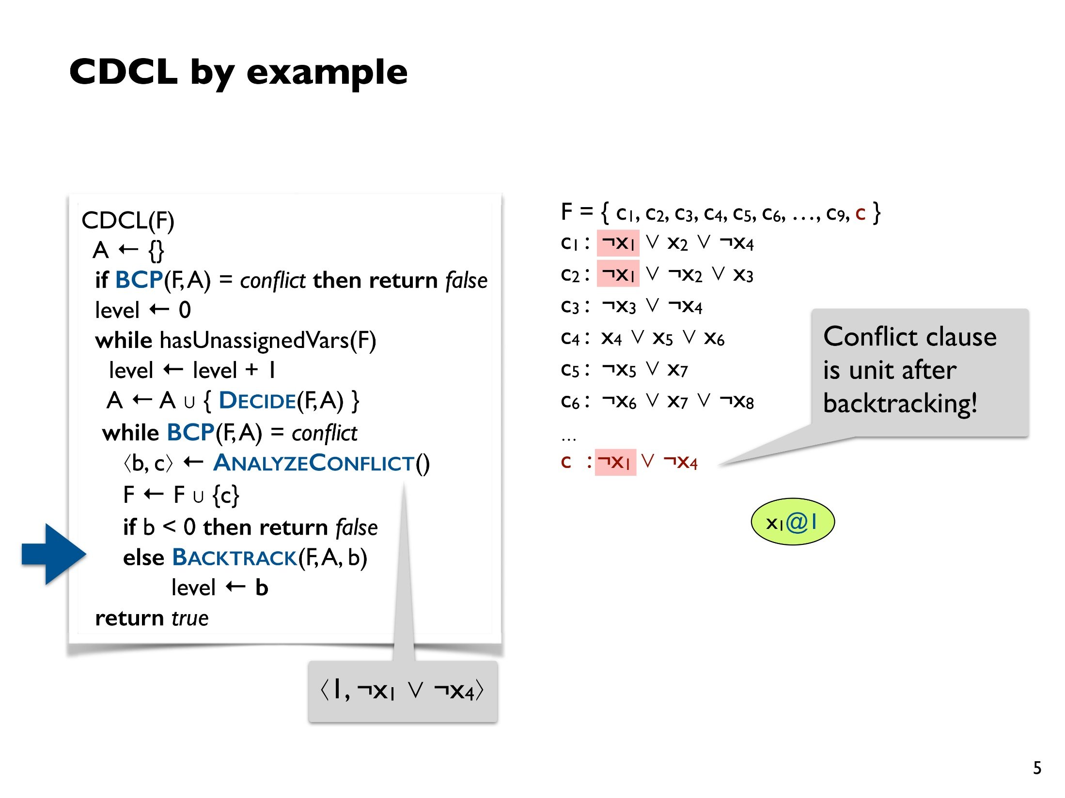
Notes:
Initial pick is to set x_1 to true. Red means false. Setting x_7 to false, means !x_5 must be true…
At the conflict site, notice that the subgraph starting from x_1 and x_4 is enough to lead to the conflict. Therefore, one of the two must be false. Add the clause.
Jump back to earlier level. Notice that we immediately have !x_4, without having to make any arbitrary choices.

Slide 15
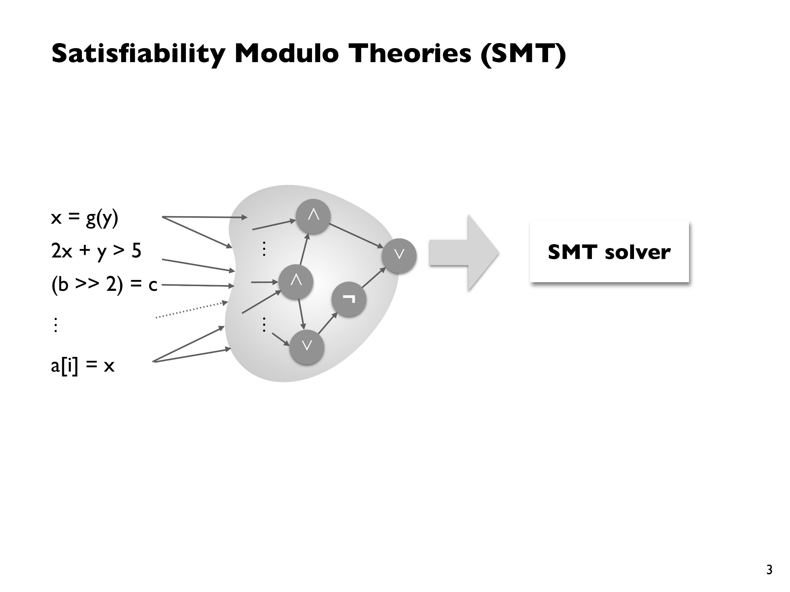
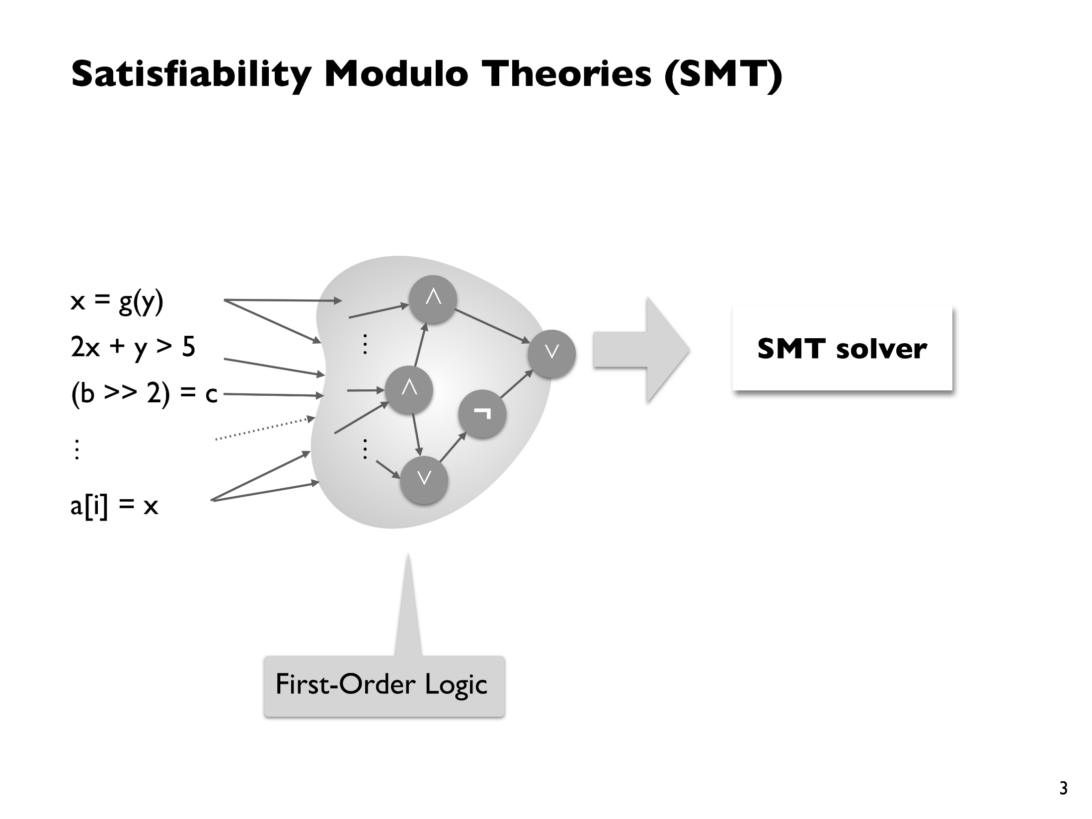
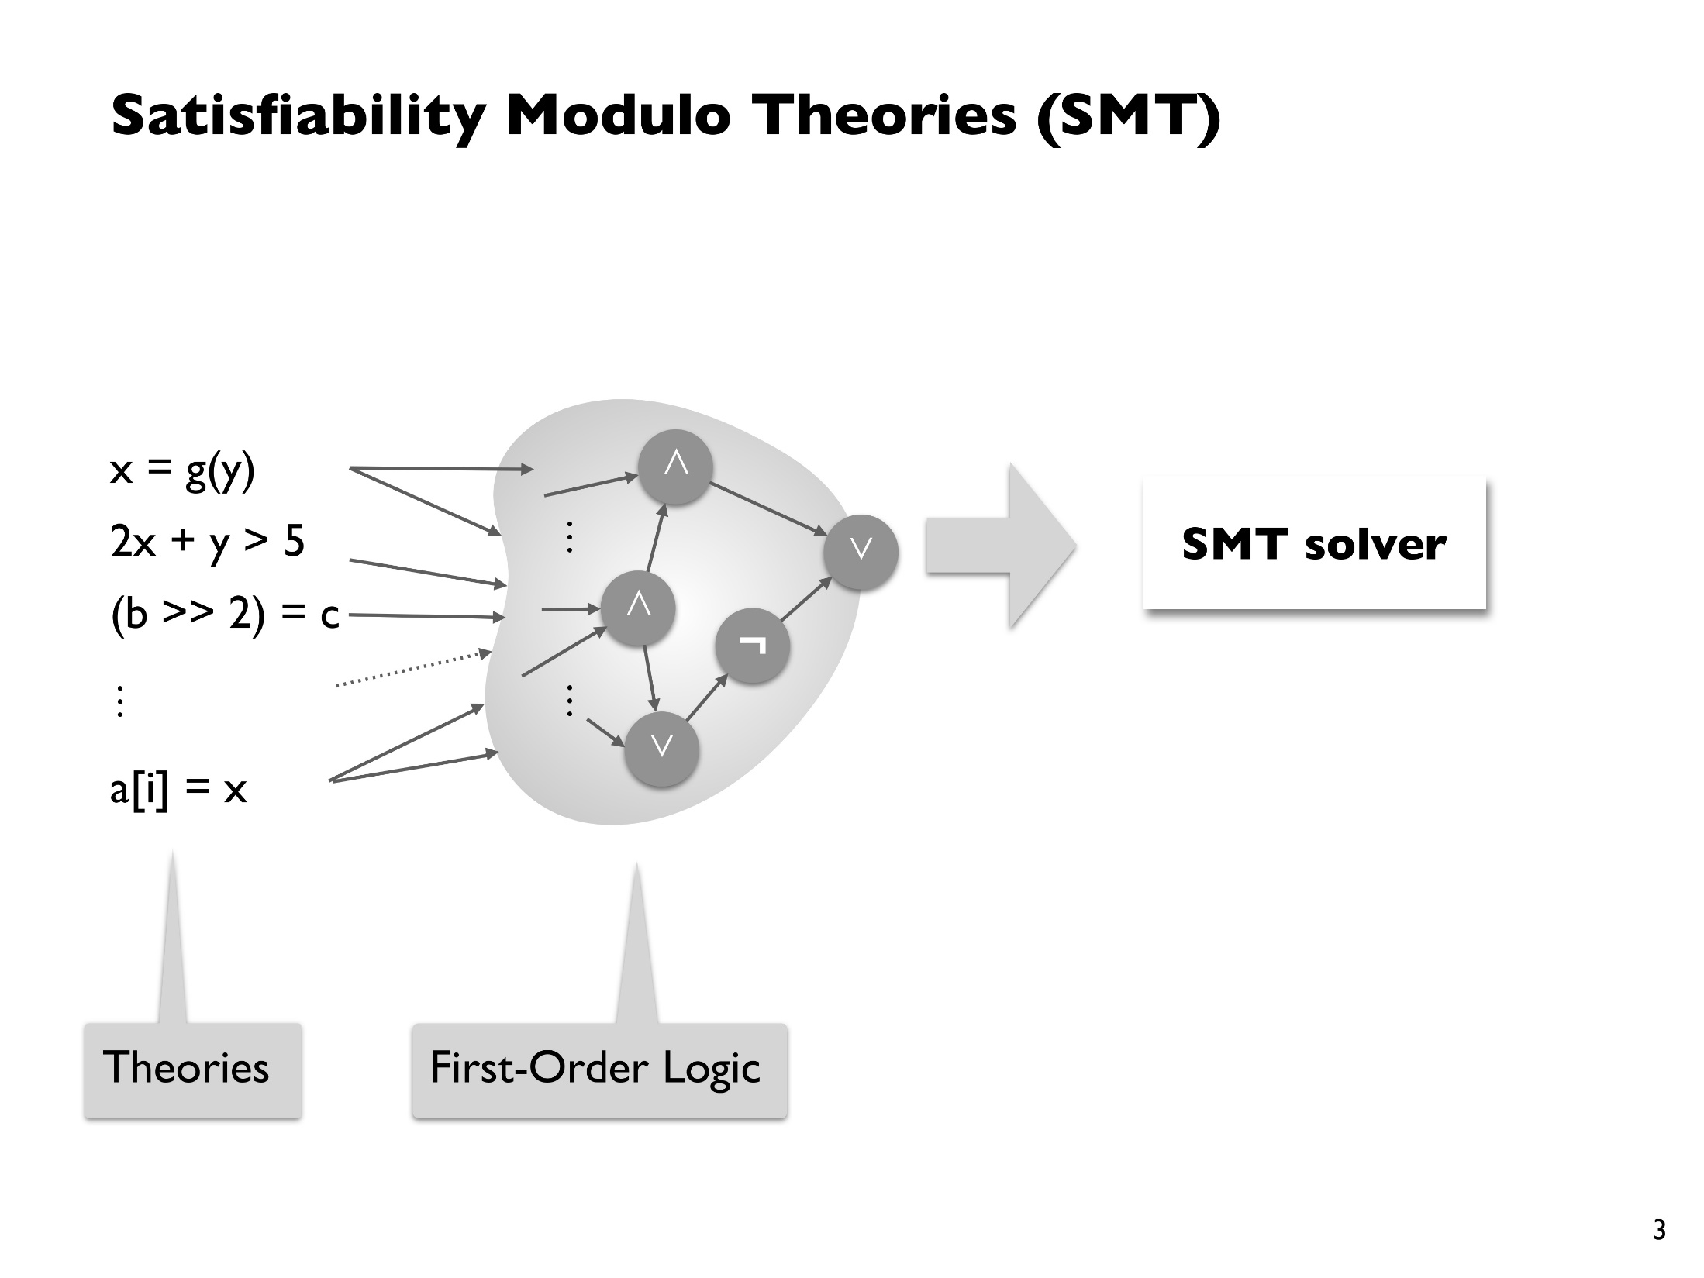
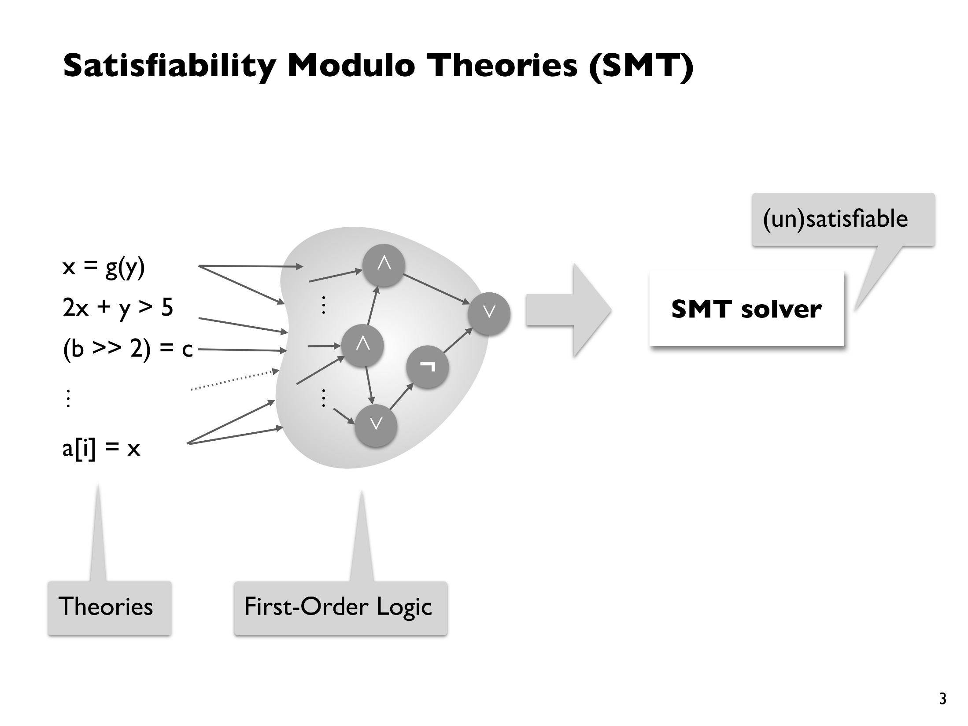
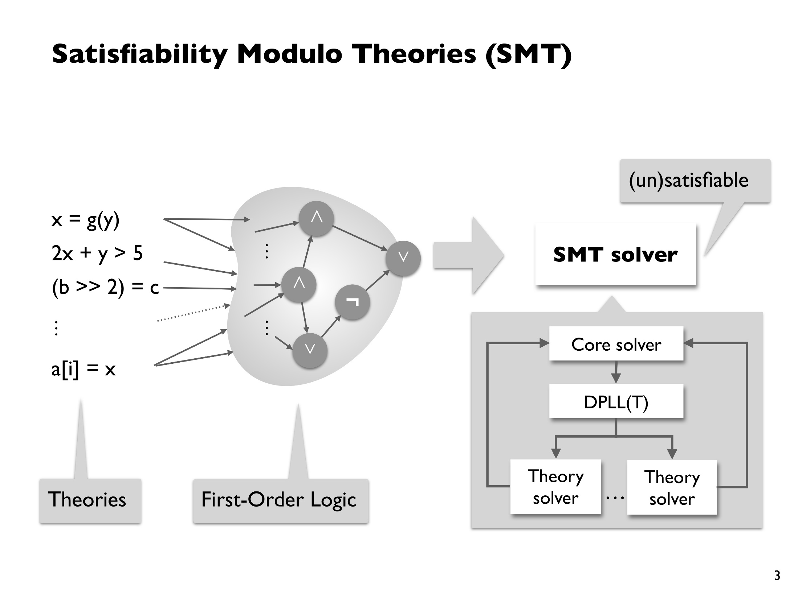

Slide 16
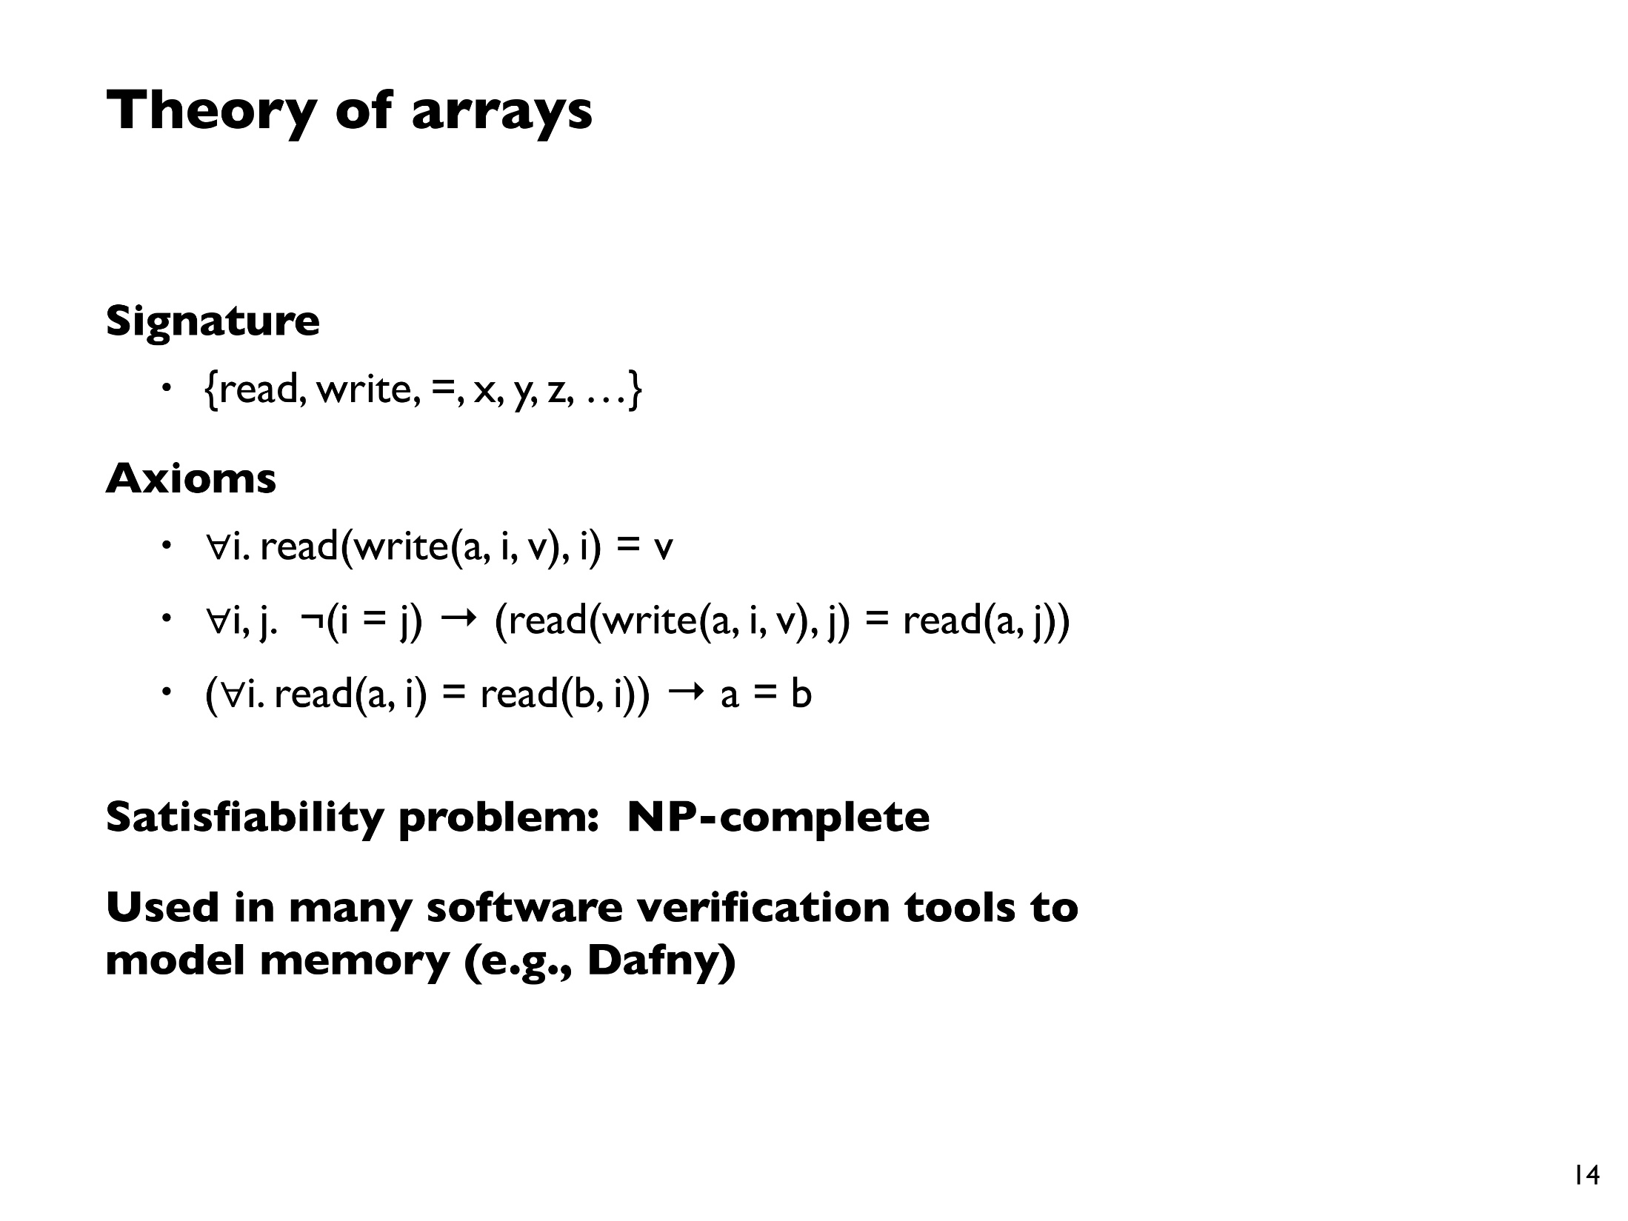
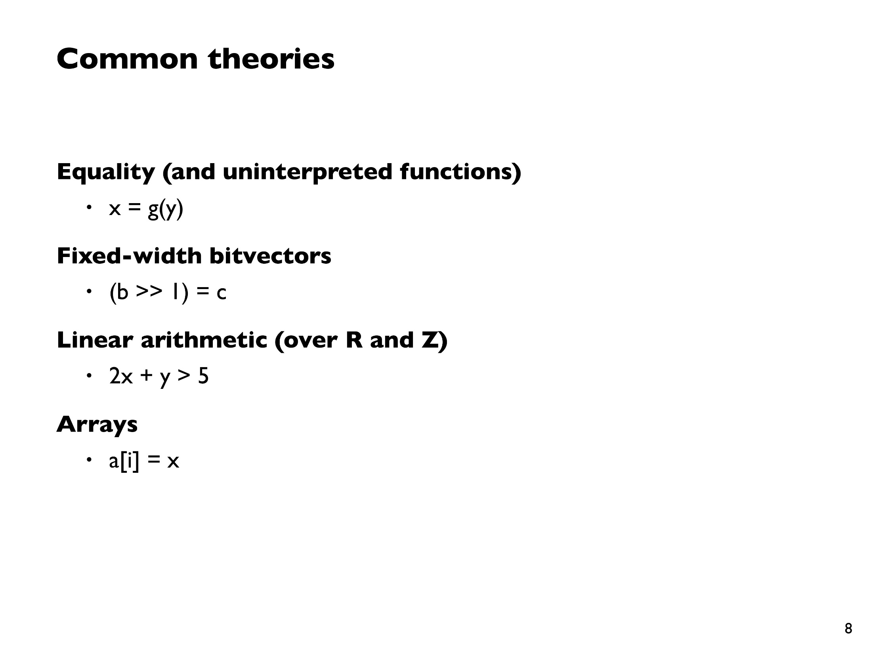
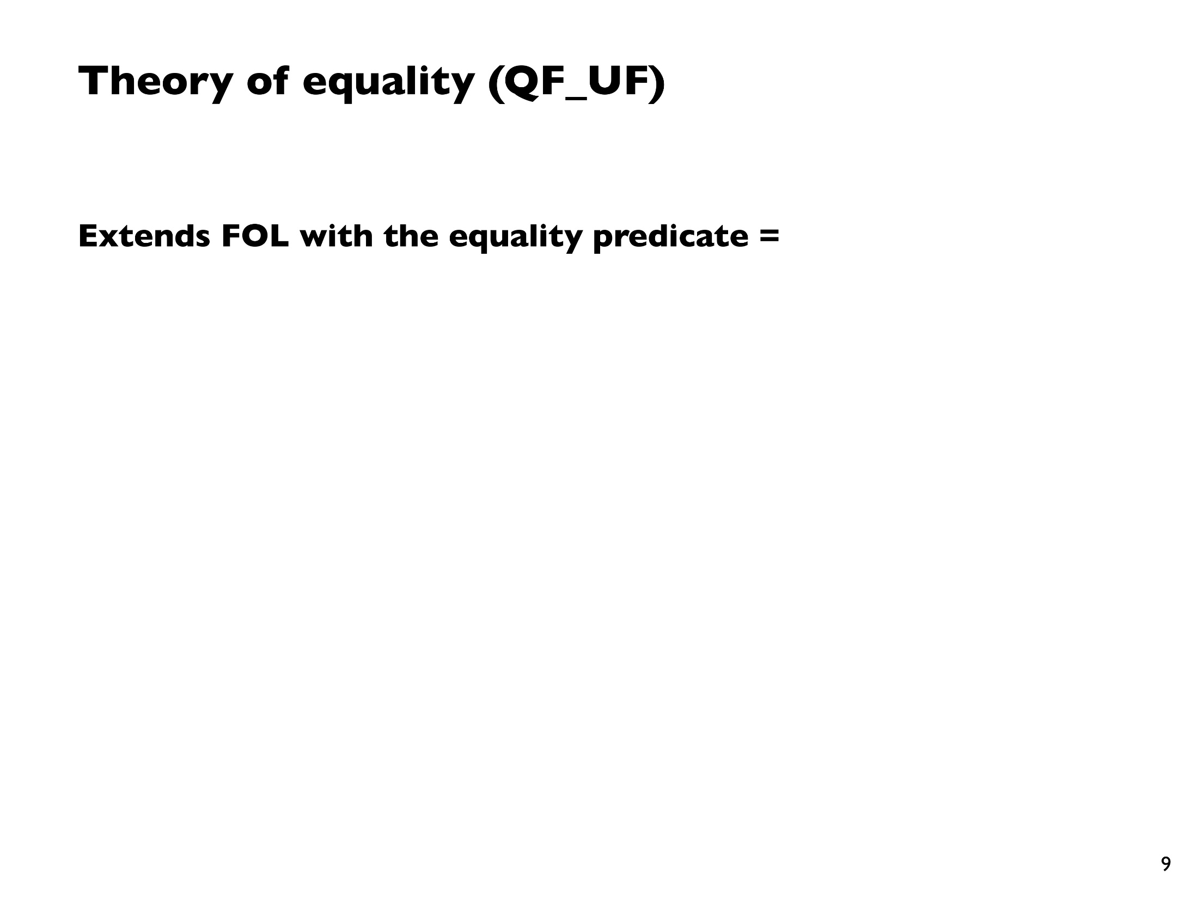
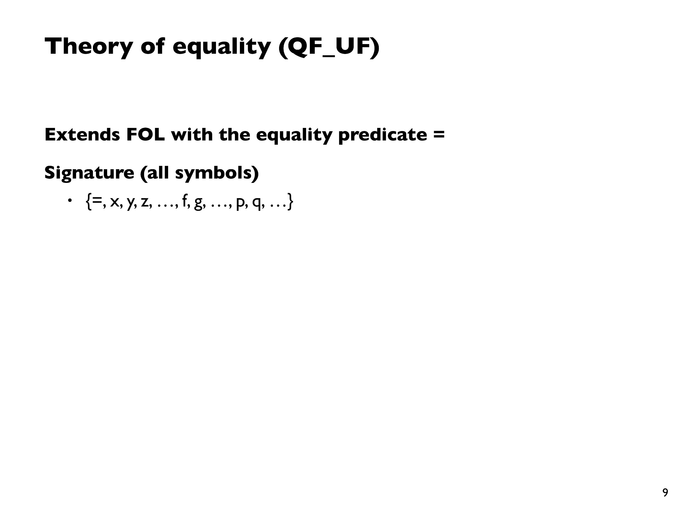
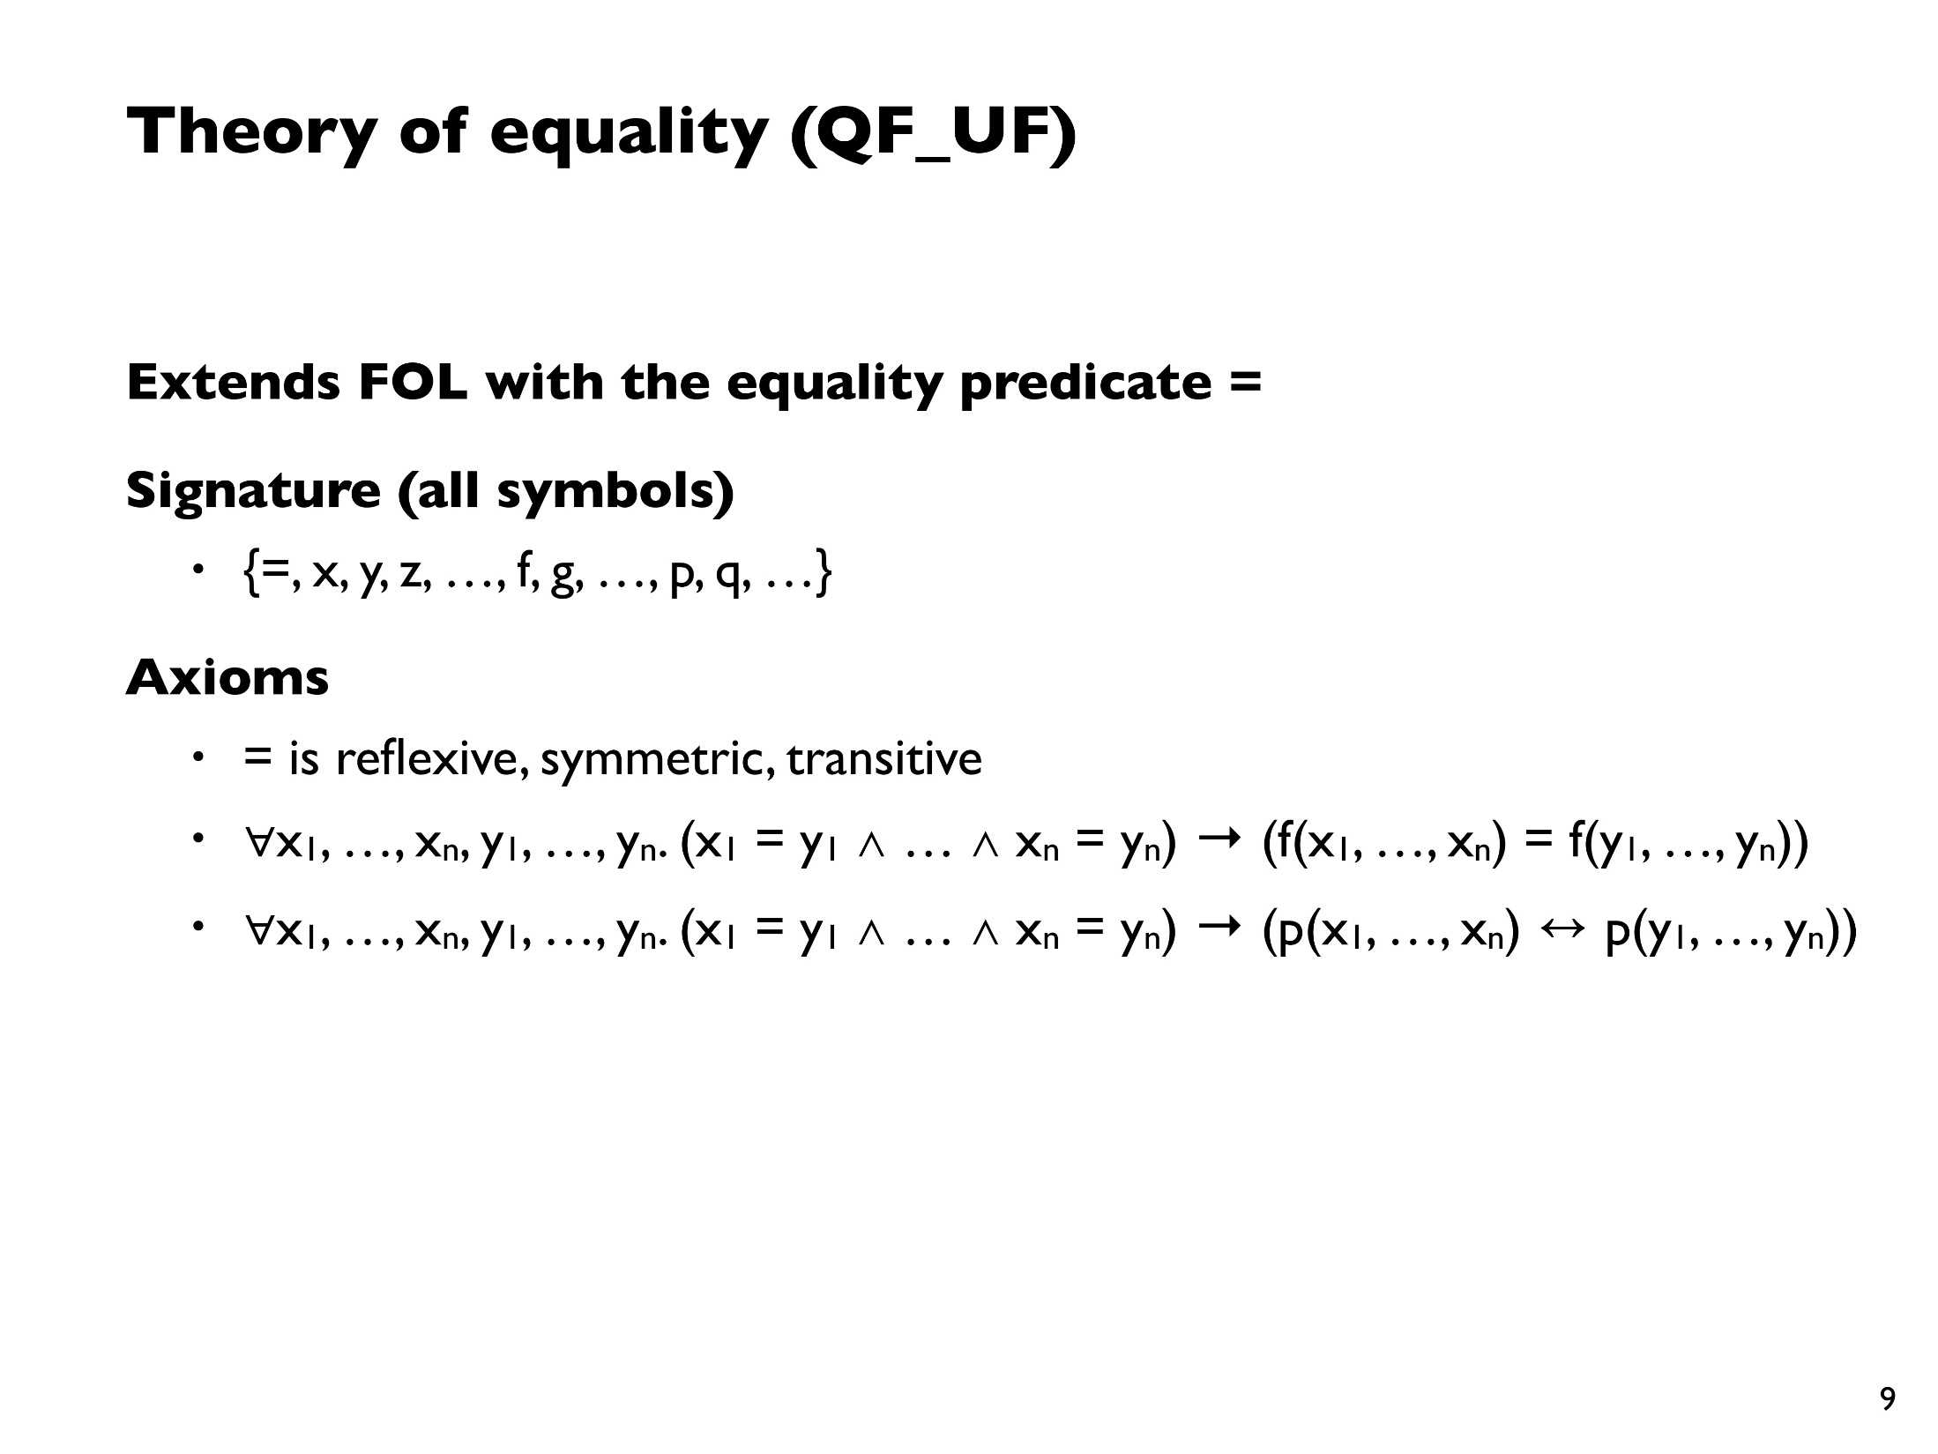
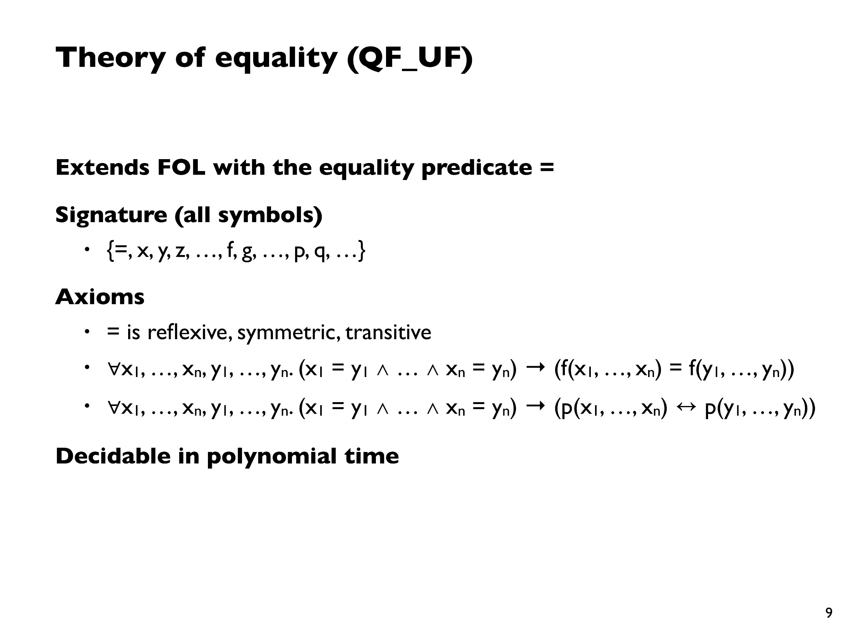
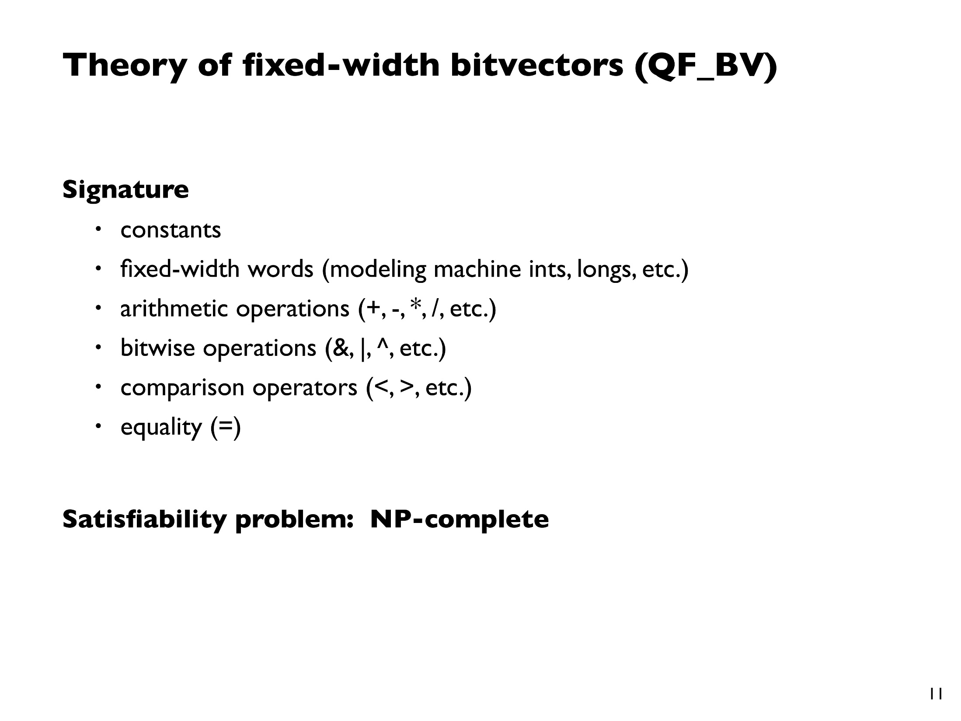
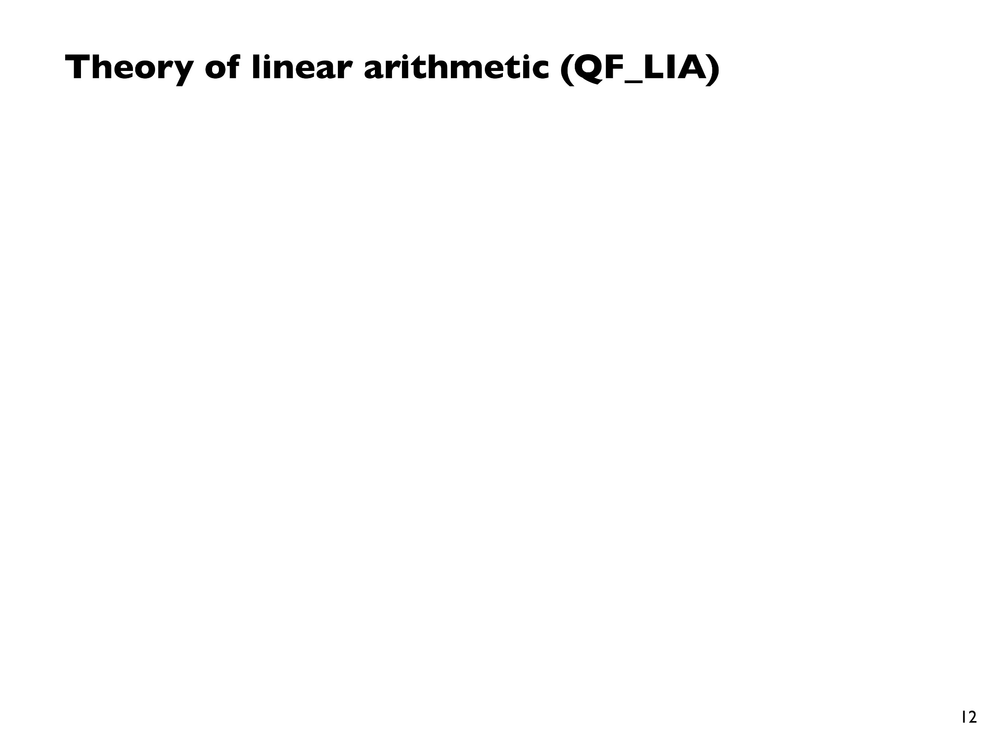
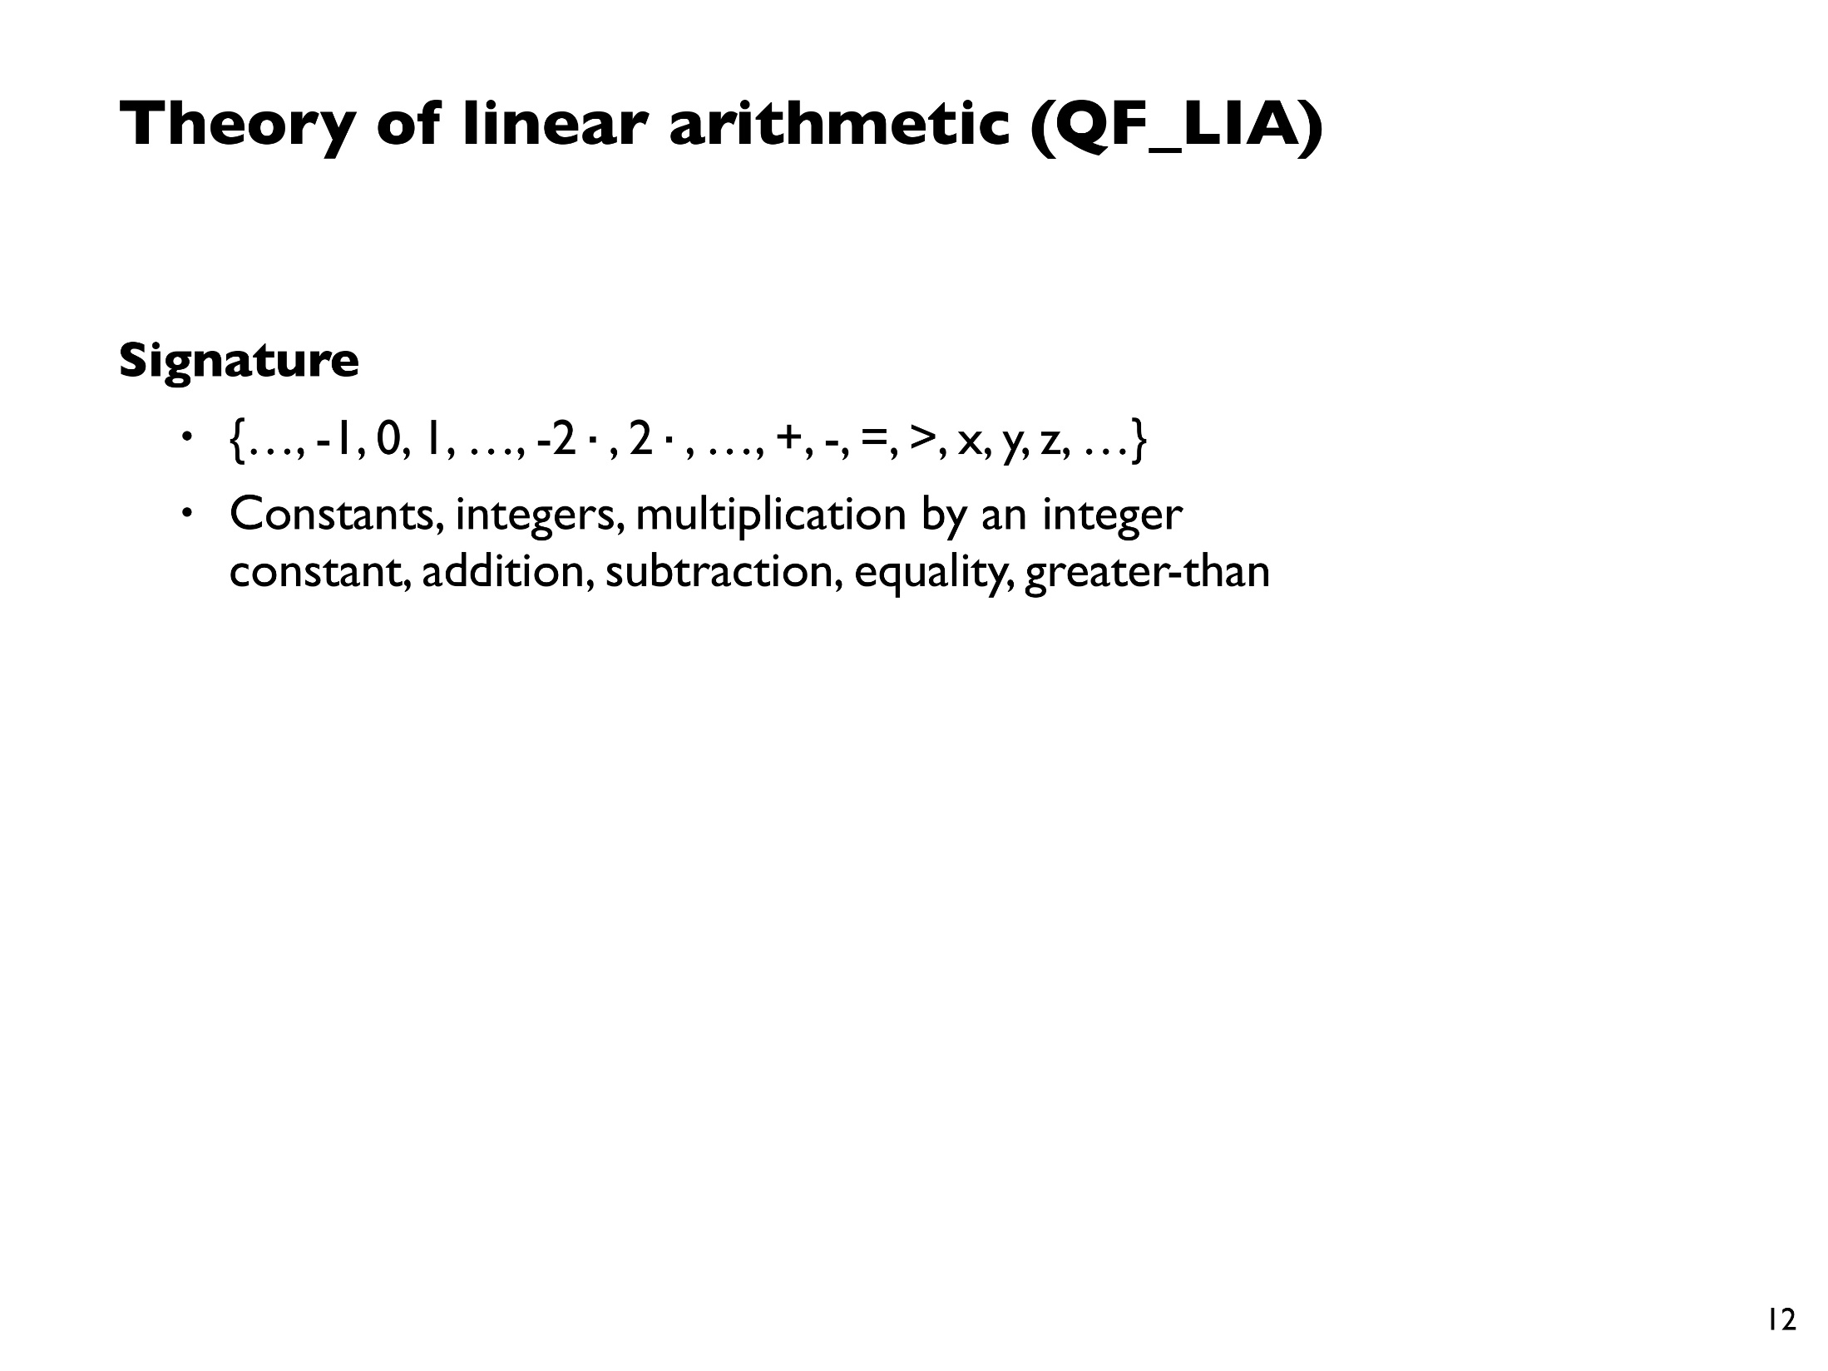
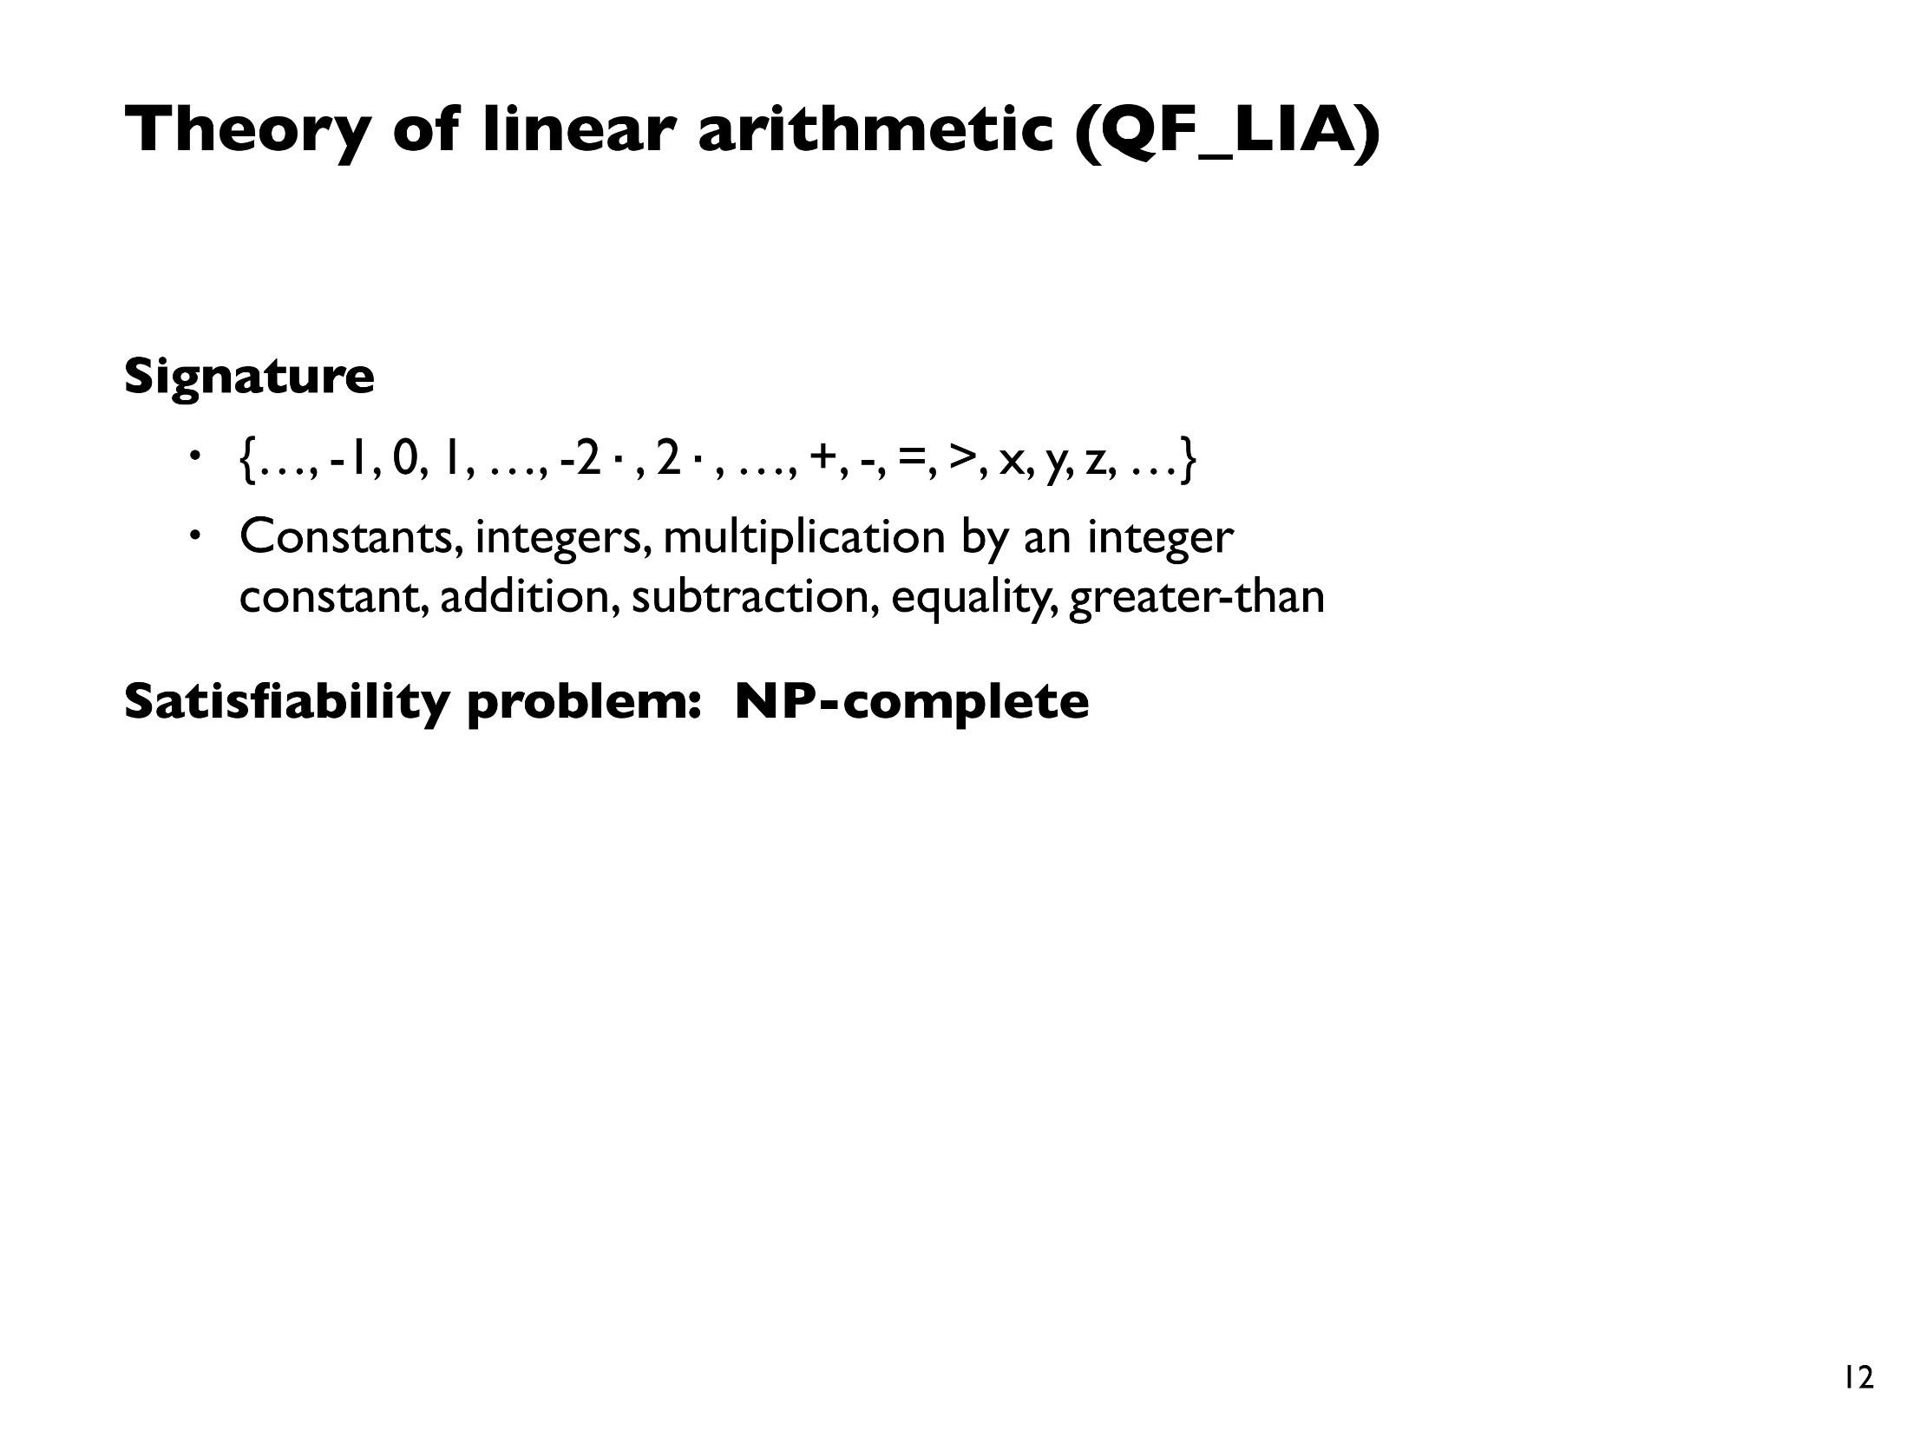
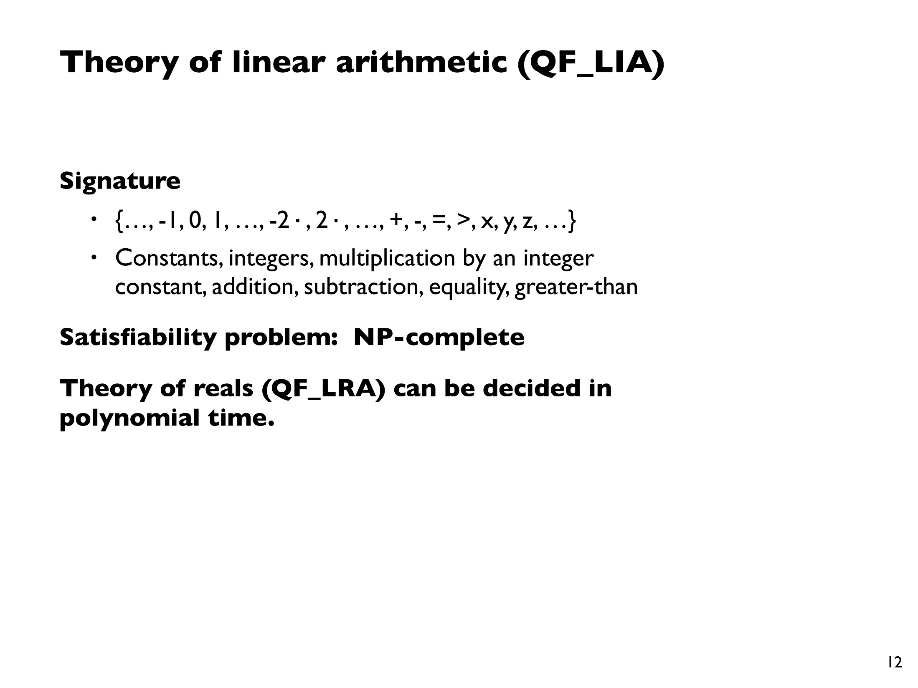
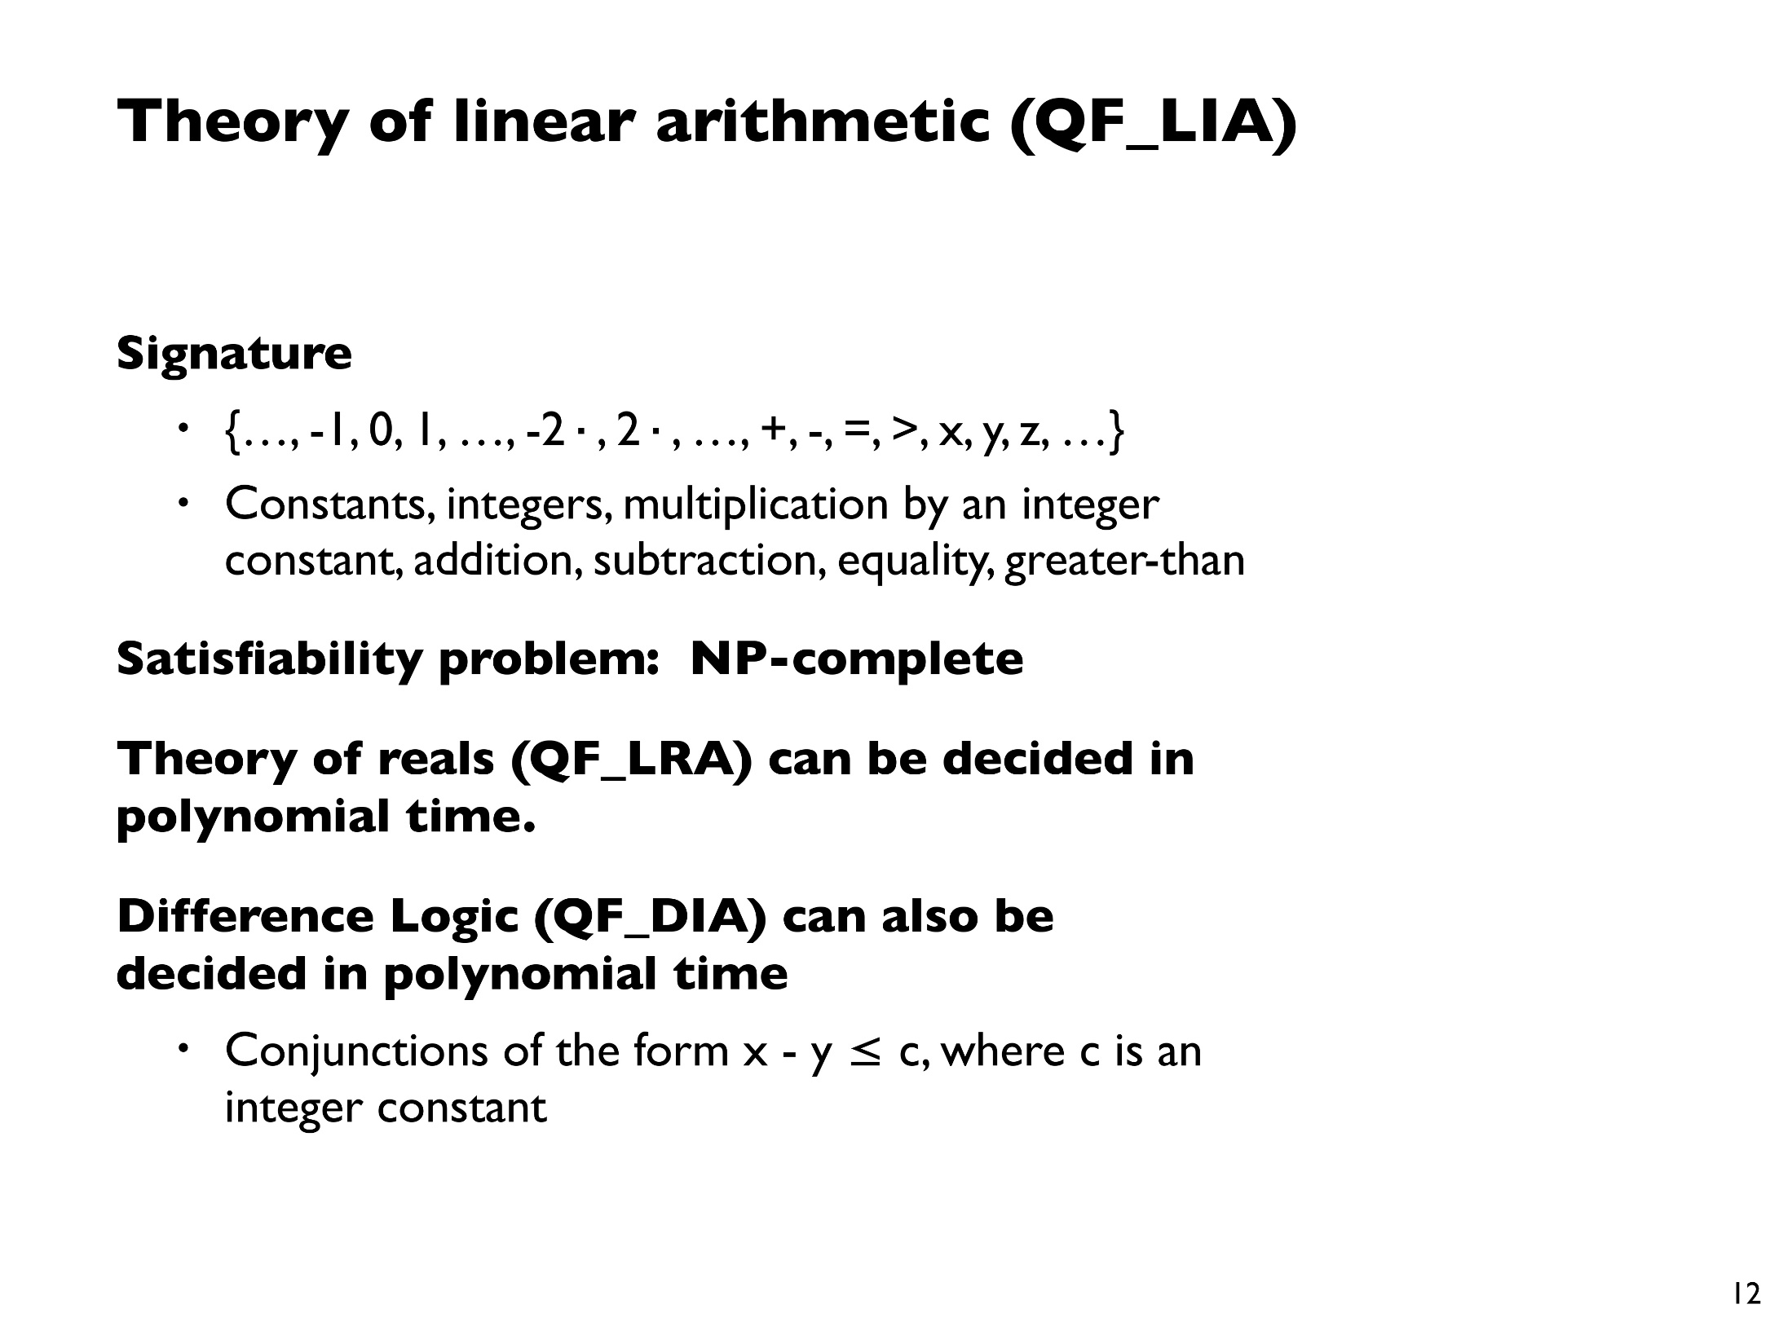
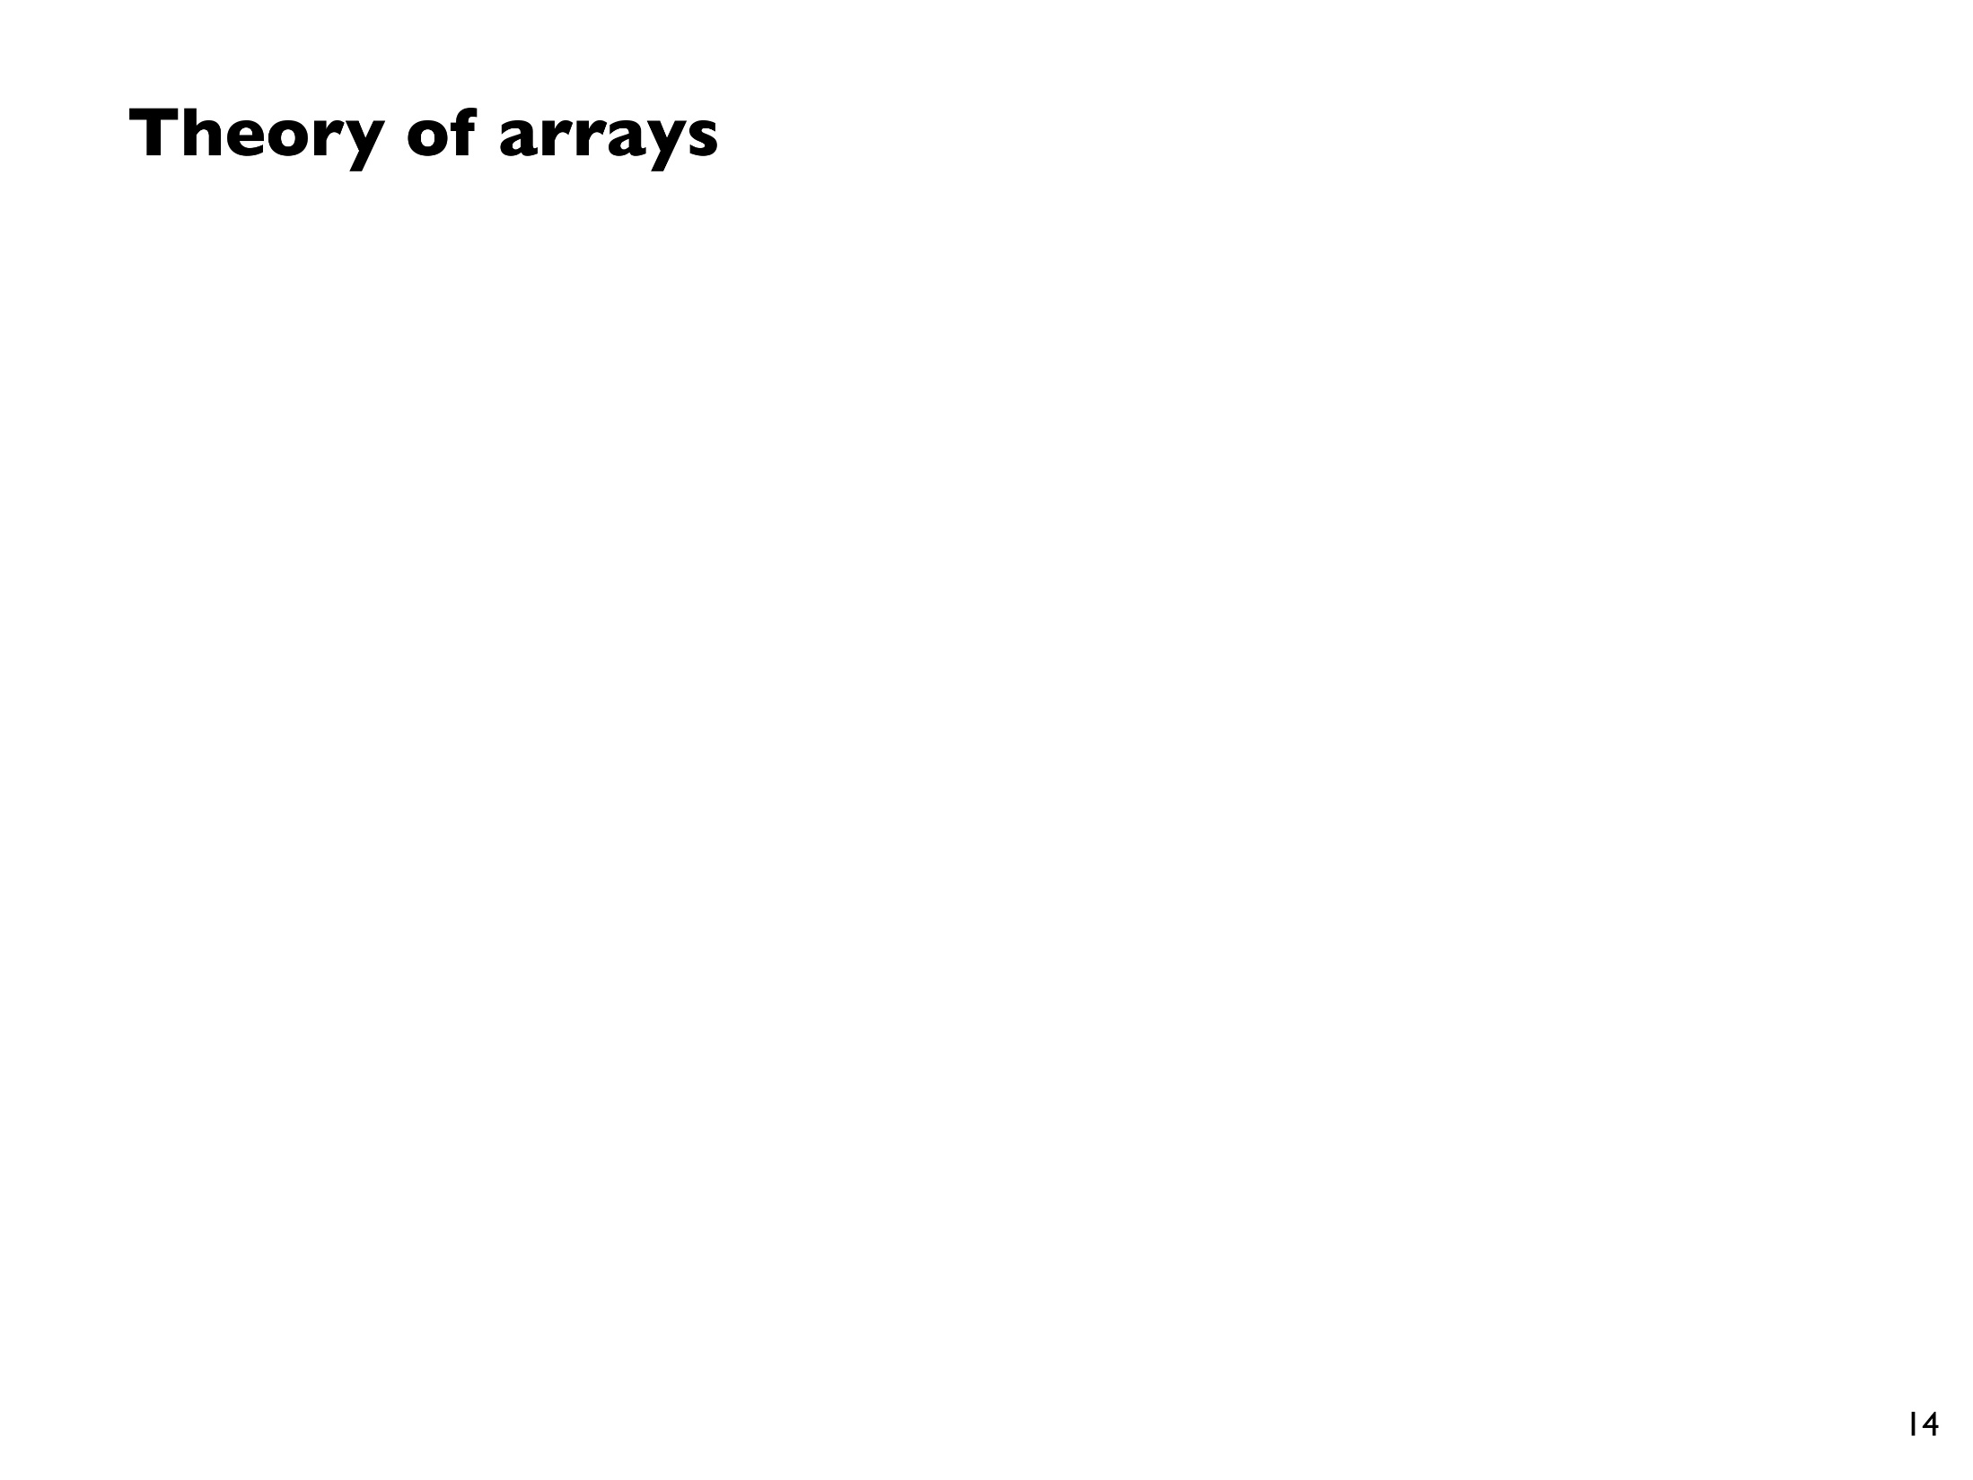
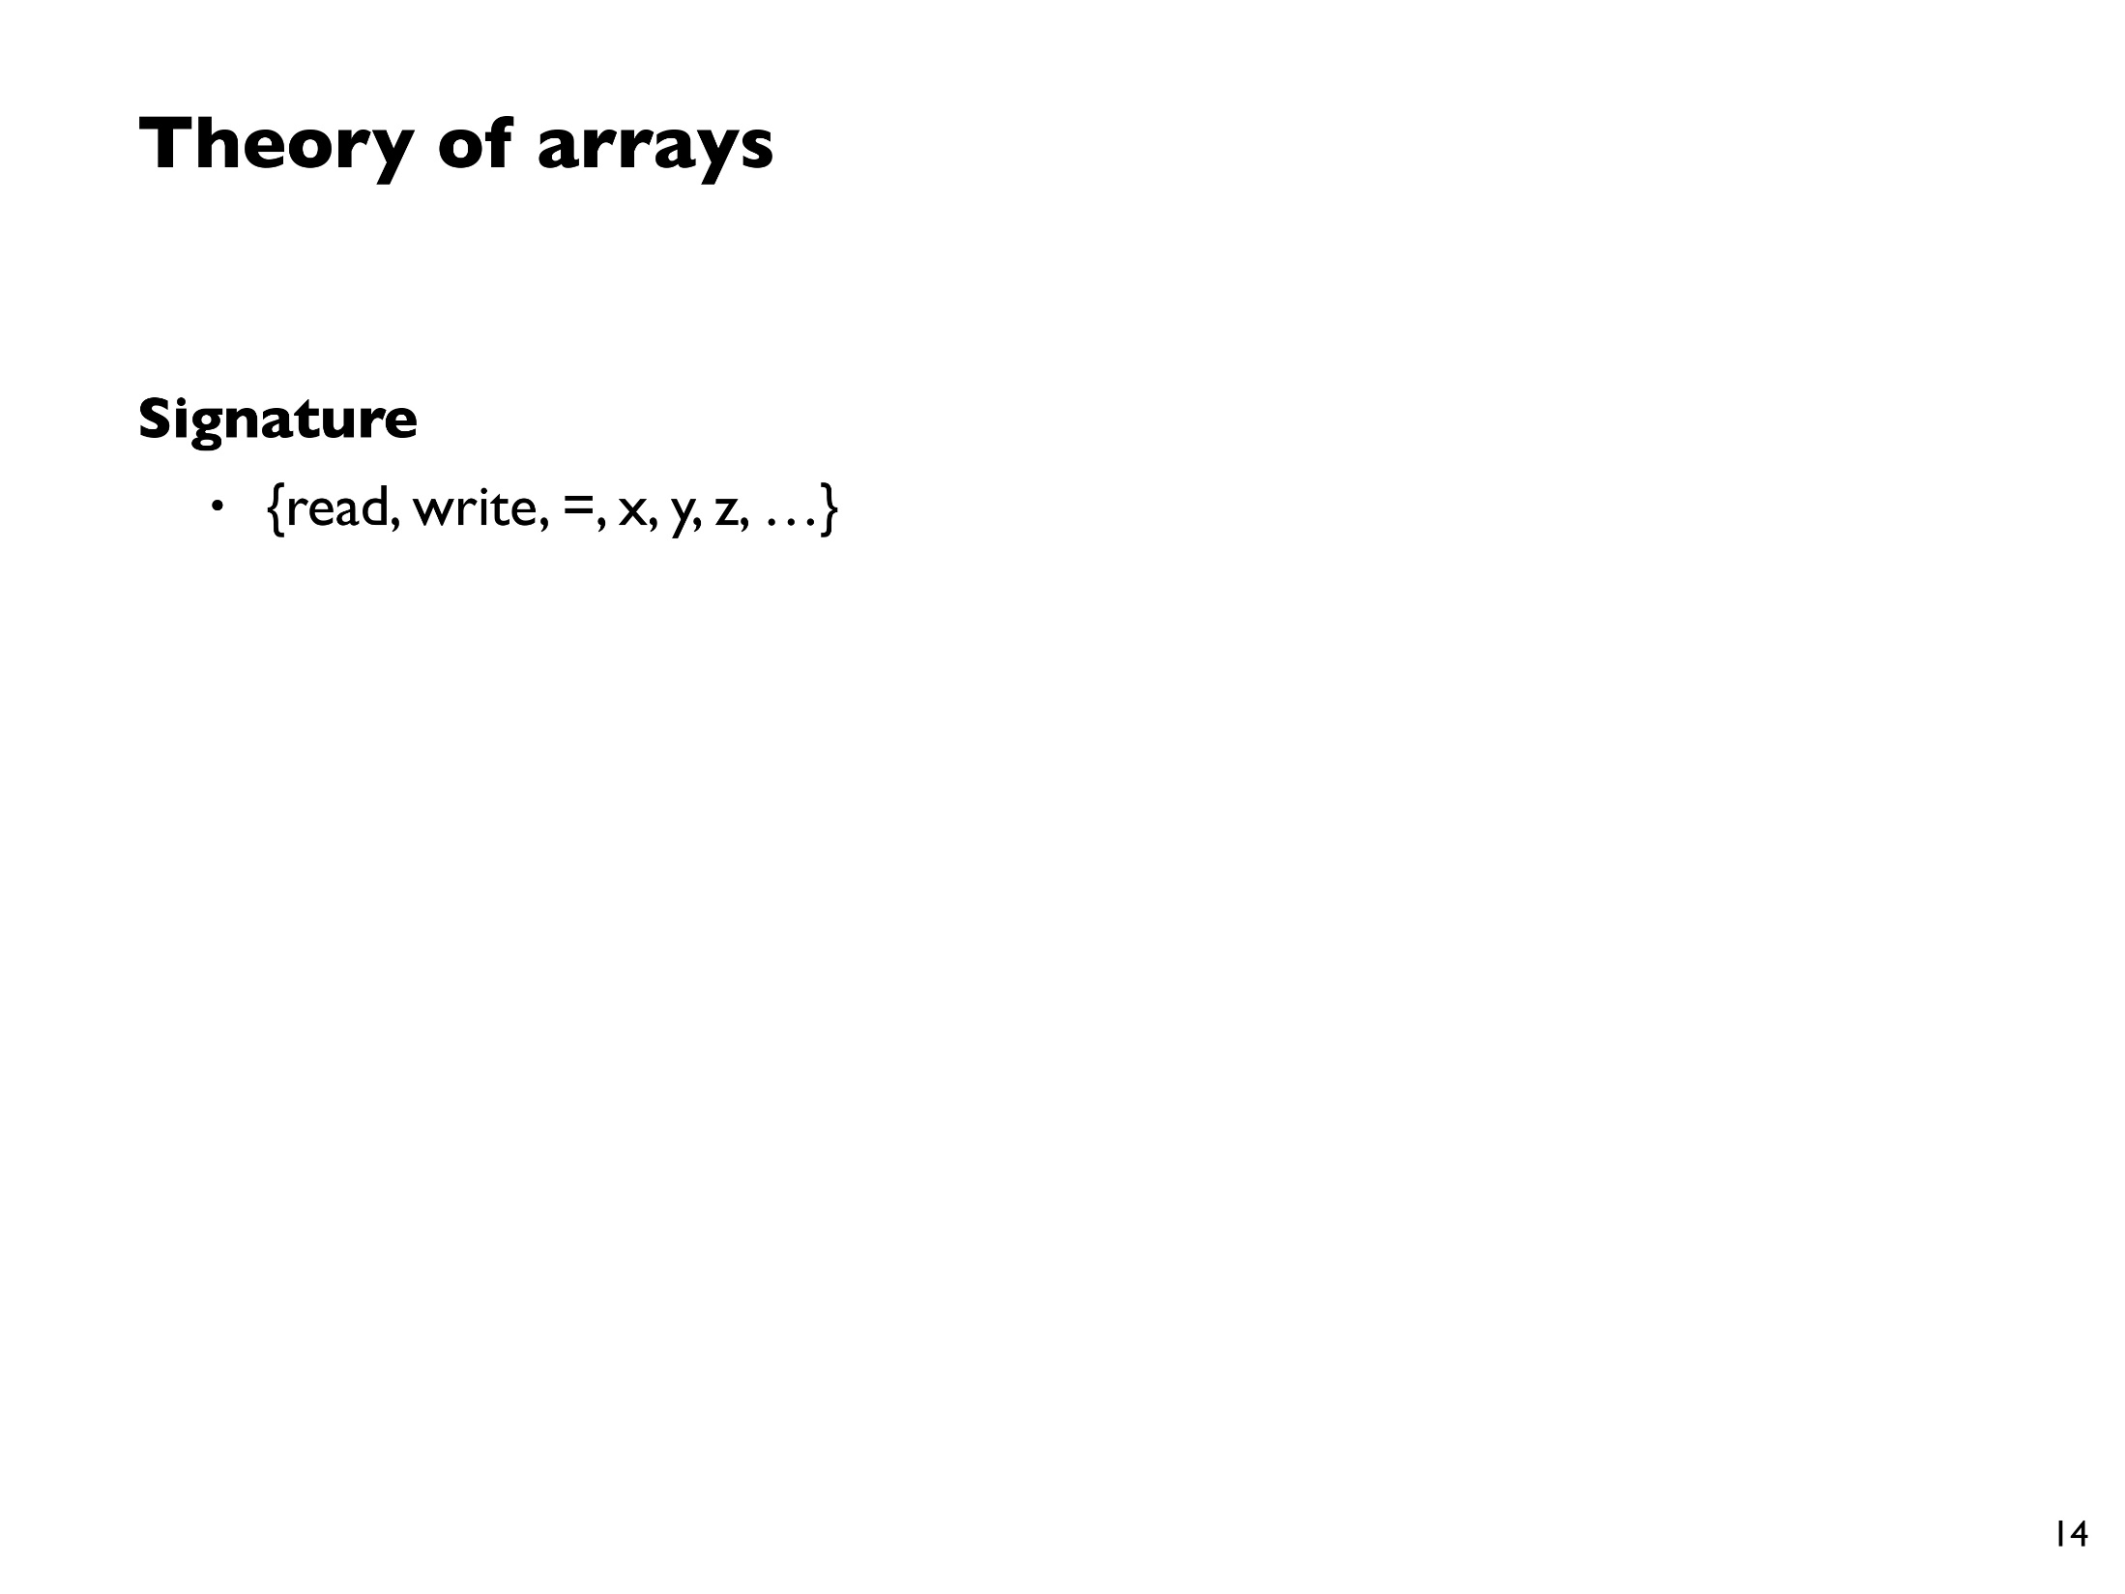
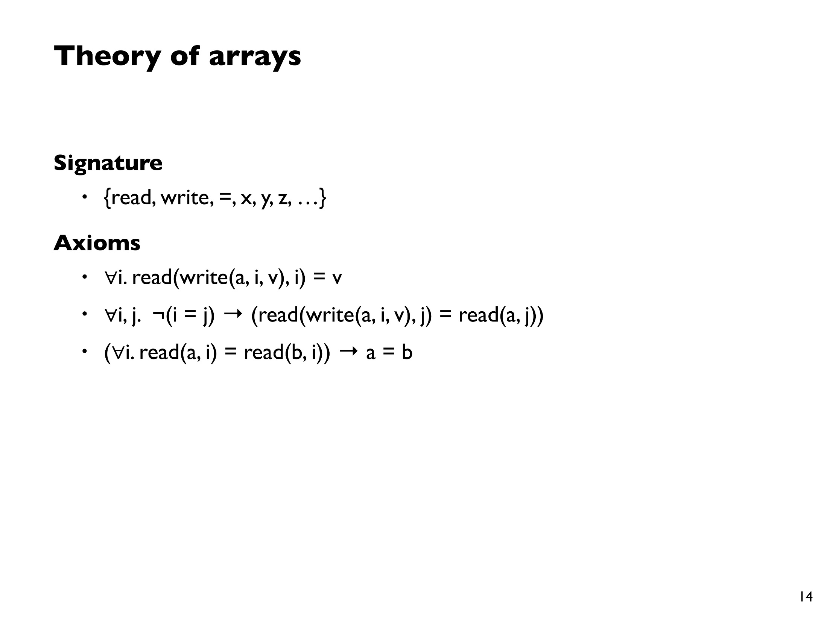


Slide 17
















Slide 18
Z3 SMT prover
DECIDABLE THEORIES
boolean expressions e ::= true | false | !e | e && e | e ==> e | ...
linear integer arithmetic e ::= ... | -2 | -1 | 0 | 1 | 2 | e + e | e – e | e <= e | ...
bit vector arithmetic e ::= ... | e & e | e << e | ...
uninterpreted functions e ::= ... | f(e,…,e)
arrays e ::= ... | e[e] | e[e := e]
MAYBE
sequences e ::= ... | [e,…,e] | e + e | e[e..] | e[..e] | e.Length | …
sets e ::= … | {e,…,e} | e U e | {x | e} | e.Count | …
UNDECIDABLE
quantifiers e ::= ... | forall x :: e | exists x :: e
nonlinear arithmetic e ::= … | e * e | e / e | e % e
inductive definitions f(n) = … f(n – 1) …
Notes:
We use programmer-written quantifiers heavily,
and Dafny uses quantifiers to axiomatize arrays and datatypes.
For our purposes, for any new theory to be a useful addition to the SMT solver, it has to play well with quantifiers

