Slide 1
Regret minimization and applications to solving games
Tuomas Sandholm

Slide 2
Focus of this lecture
We focus on Nash equilibrium in two-player zero-sum games
But, these techniques apply to other problems as well, e.g.:
  Best response computation
  Quantal response equilibrium
  [Farina, Kroer, and Sandholm; “Online Convex Optimization for Sequential Decision Processes and Extensive-Form Games, AAAI’17]
  Near-safe opponent exploitation
  [same as above]
  Coarse-correlated equilibrium in multiplayer games
  Playing better than a given strategy, but like it
  [Jacob, Wu, Farina, Lerer, Hu, Bakhtin, Andreas, Brown; Modeling Strong and Human-Like Gameplay with KL-Regularized Search. ICML’22]

Slide 3
Part One
Nash Equilibria in Normal-Form Games

Slide 4



Recap: Normal-Form Games
🌟 SIMULTANEOUS
(No turns)
0.2
0 | -1 | +1
+1 | 0 | -1
-1 | +1 | 0
0.5
🌟 Strategy for a player is just a probability distribution over actions
0.3

Slide 5
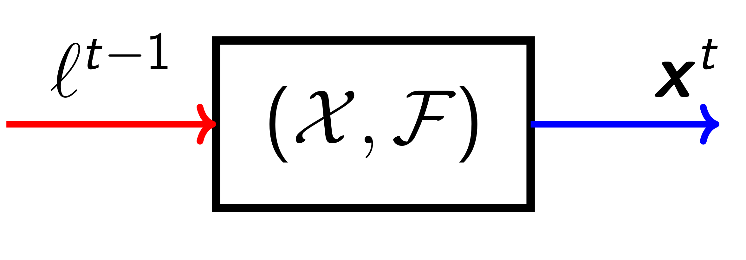
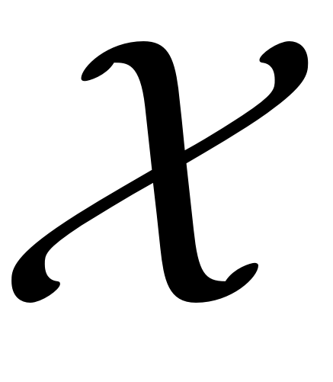



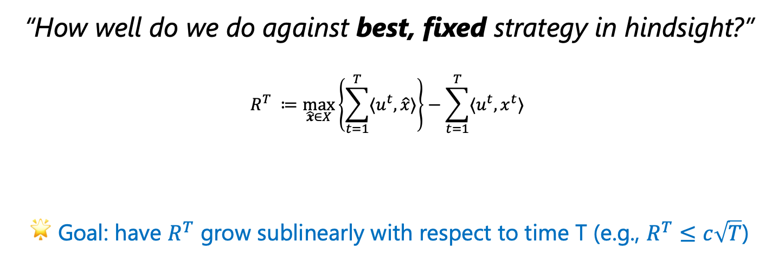
Regret Minimization
Utility vector
(one utility per action)
Regret minimizer
$$u^{t}$$
$$x^{t}$$
Strategy
Set of all possible strategies
(for now, a probability simplex)
“How well do we do against best, fixed strategy in hindsight?”
$$R^{T} ≔\max_{\hat{x}∈X}\left\{\sum_{t=1}^{T}{{〈u}^{t},\hat{x}〉}\right\}−\sum_{t=1}^{T}{{〈u}^{t},x^{t}〉 }$$
🌟 Goal: have $R^{T}$ grow sublinearly with respect to time T (e.g., $R^{T}≤c\sqrt{T}$)
Maximum utility that was
achievable by the best fixed
action in hindsight
Utility that was actually accumulated
  No assumption available on future utilities!
  Must handle adversarial environments

Slide 6
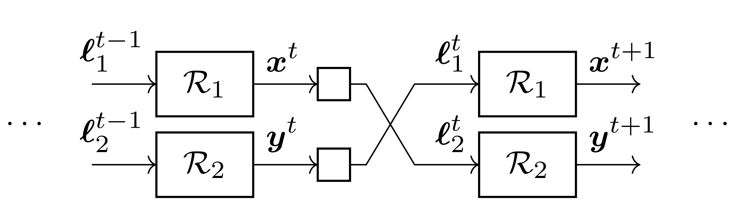

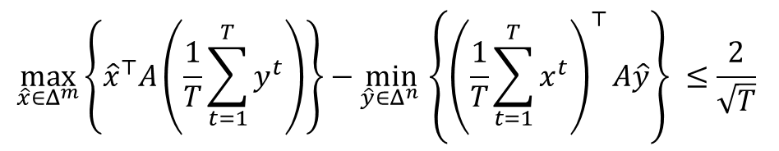




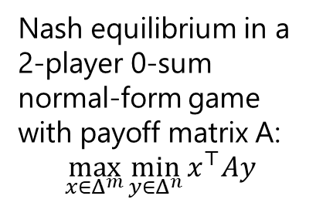
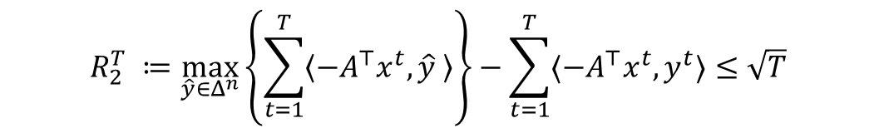
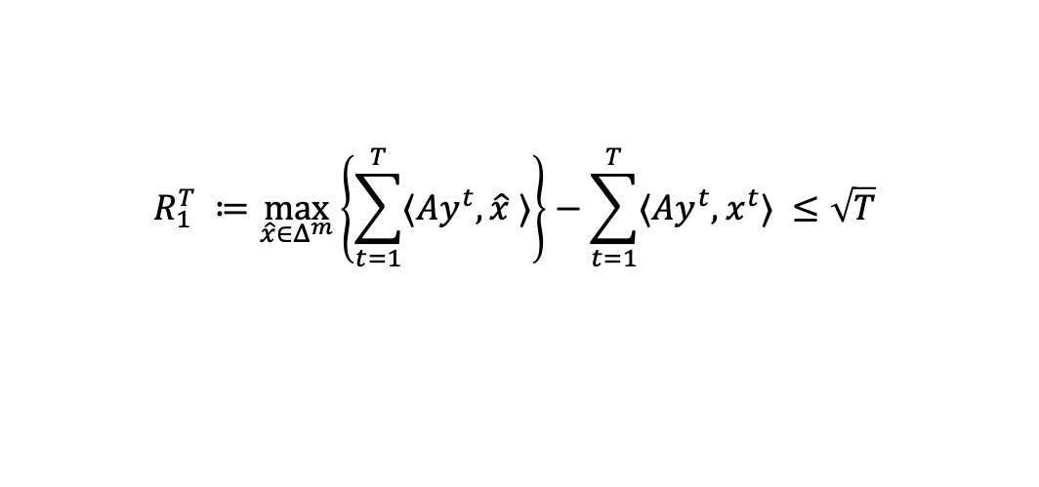

Relationship with Nash Equilibrium
🌟 IDEA: Self-play
Nash equilibrium in a 2-player 0-sum normal-form game with payoff matrix A:
$$\max_{x∈Δ^{m}}\min_{y∈Δ^{n}}{x^{⊤}Ay}$$
$$x^{t}$$
$Ay^{t}$
$$x^{t+1}$$
$$y^{t}$$
${−A}^{⊤}x^{t}$
$$y^{t+1}$$
$$R_{1}^{T} ≔\max_{\hat{x}∈Δ^{m}}\left\{\sum_{t=1}^{T}{〈Ay^{t}, \hat{x} 〉}\right\}−\sum_{t=1}^{T}{〈Ay^{t}, x^{t}〉 }≤\sqrt{T}$$
Add these two lines and
divide by T to get the average
$$R_{2}^{T} ≔\max_{\hat{y}∈Δ^{n}}\left\{\sum_{t=1}^{T}{\left\langle {−A}^{⊤}x^{t}, \hat{y} \right\rangle }\right\}−\sum_{t=1}^{T}{〈{−A}^{⊤}x^{t}, y^{t}〉≤\sqrt{T}}$$
$$\max_{\hat{x}∈Δ^{m}}\left\{{\hat{x}}^{⊤}A\left(\frac{1}{T}\sum_{t=1}^{T}{y^{t}}\right)\right\}−\min_{\hat{y}∈Δ^{n} }\left\{{\left(\frac{1}{T}\sum_{t=1}^{T}{x^{t}}\right)}^{⊤}A\hat{y}\right\} ≤\frac{2}{\sqrt{T}}$$
🌟 TAKEAWAY
The average strategies converge to a Nash equilibrium!

Slide 7
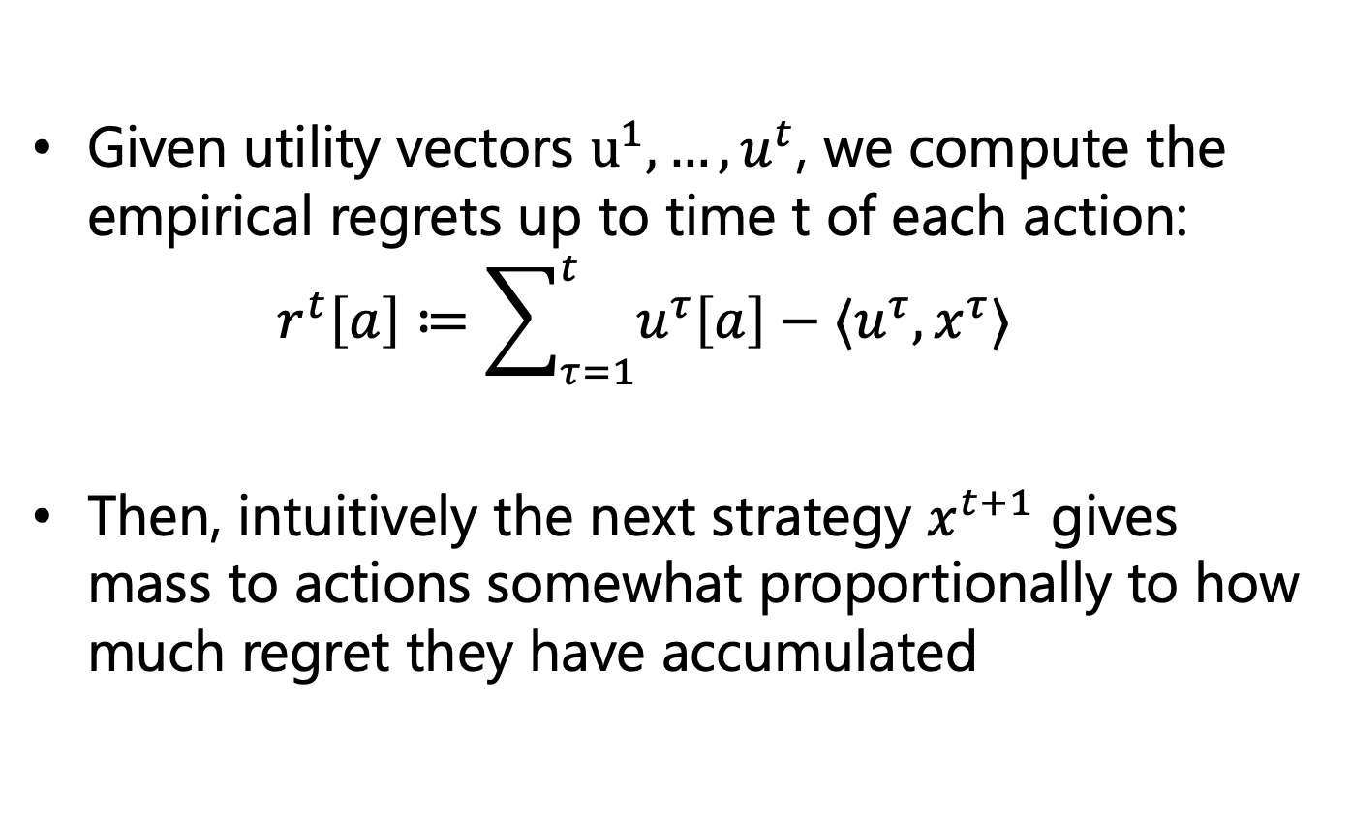
A Common Template for Regret Minimizers
Given utility vectors $u^{1}, …,u^{t}$, we compute the empirical regrets up to time t of each action:
$r^{t}\left[a\right]≔\sum_{τ=1}^{t}{u^{τ}\left[a\right]−⟨u^{τ},x^{τ}⟩}$
Then, intuitively the next strategy $x^{t+1}$ gives mass to actions somewhat proportionally to how much regret they have accumulated

Slide 8
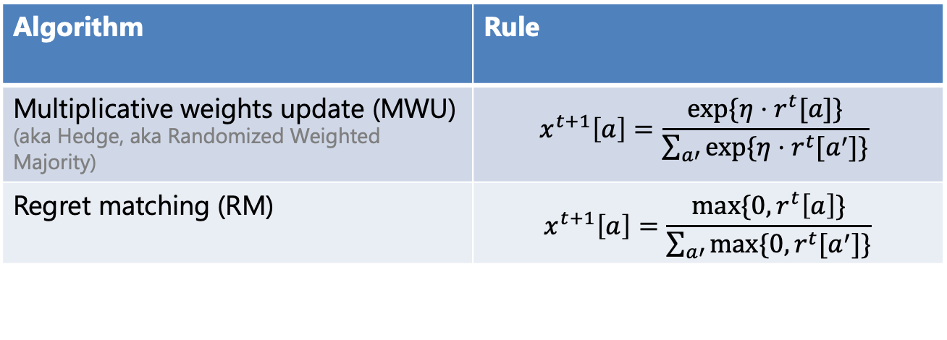
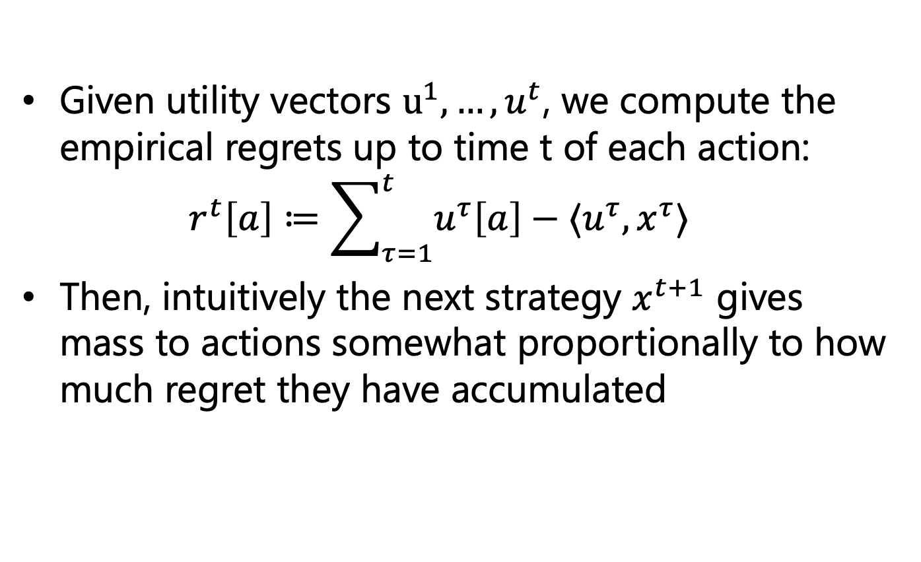
A Common Template for Regret Minimizers
Given utility vectors $u^{1}, …,u^{t}$, we compute the empirical regrets up to time t of each action:
$r^{t}\left[a\right]≔\sum_{τ=1}^{t}{u^{τ}\left[a\right]−⟨u^{τ},x^{τ}⟩}$
Then, intuitively the next strategy $x^{t+1}$ gives mass to actions somewhat proportionally to how much regret they have accumulated
Hyperparameter
(“learning rate”)
Algorithm | Rule
Multiplicative weights update (MWU) (aka Hedge, aka Randomized Weighted Majority) | $$x^{t+1}\left[a\right]=\frac{\exp{{\{η⋅r}^{t}[a]\}}}{\sum_{a′}{\exp{{\{η⋅r}^{t}[a^{′}]\}}}}$$
Regret matching (RM) | $$x^{t+1}\left[a\right]=\frac{\max{\{0,}r^{t}\left[a\right]\}}{\sum_{a′}{\max{{\{0, r}^{t}[a^{′}]\}}}}$$
Note: MWU is a particular instance of a very general algorithm called “Online mirror descent”, which can be applied to all convex strategy sets and guarantees sublinear regret

Slide 9
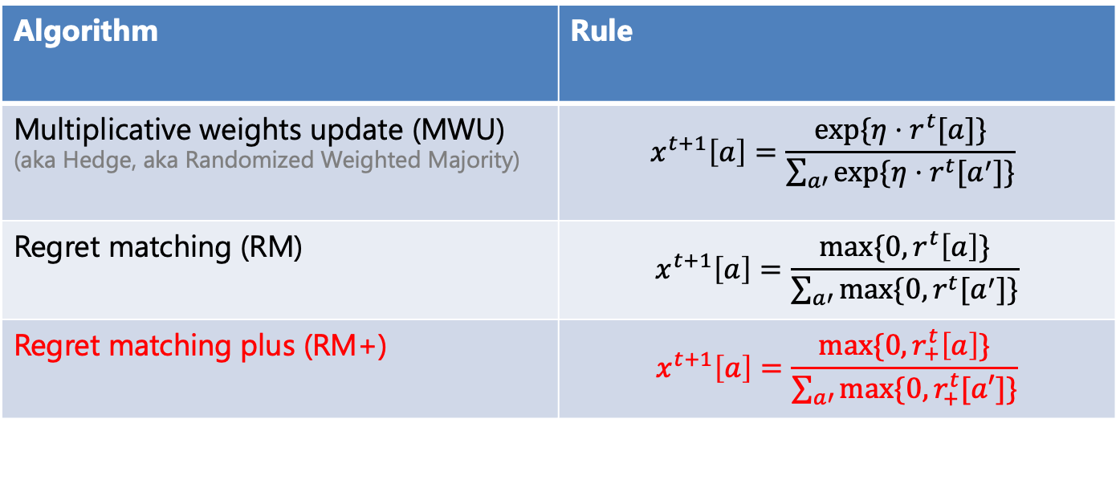
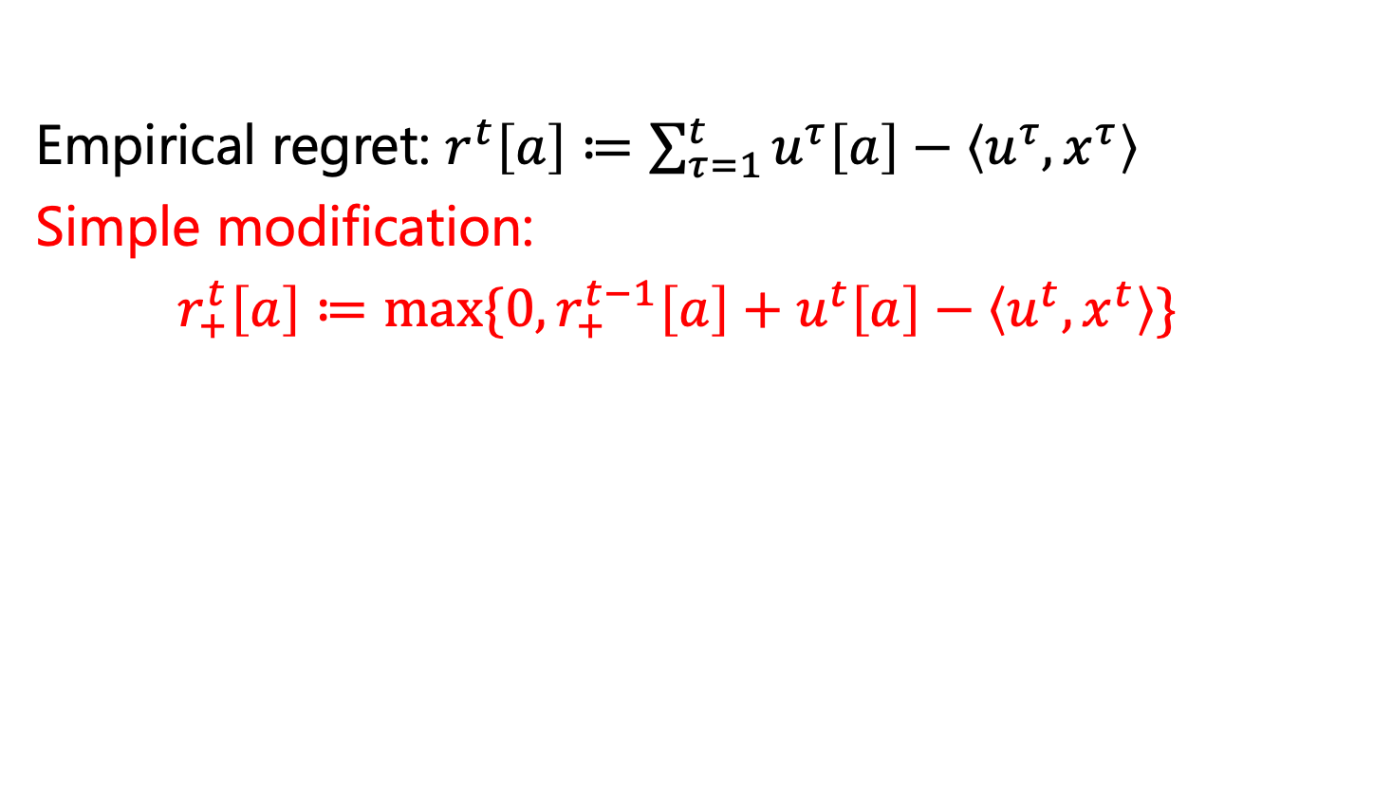
A Common Template for Regret Minimizers
Empirical regret: $r^{t}\left[a\right]≔\sum_{τ=1}^{t}{u^{τ}\left[a\right]−\left\langle u^{τ},x^{τ}\right\rangle }$
Simple modification:
$r_{+}^{t}\left[a\right]≔max⁡\{0, r_{+}^{t−1}\left[a\right]+u^{t}\left[a\right]−\left\langle u^{t},x^{t}\right\rangle \}$
Algorithm | Rule
Multiplicative weights update (MWU) (aka Hedge, aka Randomized Weighted Majority) | $$x^{t+1}\left[a\right]=\frac{\exp{{\{η⋅r}^{t}[a]\}}}{\sum_{a′}{\exp{{\{η⋅r}^{t}[a^{′}]\}}}}$$
Regret matching (RM) | $$x^{t+1}\left[a\right]=\frac{\max{\{0,}r^{t}\left[a\right]\}}{\sum_{a′}{\max{{\{0, r}^{t}[a^{′}]\}}}}$$
Regret matching plus (RM+) | $$x^{t+1}\left[a\right]=\frac{max⁡\{0, r_{+}^{t}\left[a\right]\}}{\sum_{a′}{\max{\{0,r_{+}^{t}[a′]\}}}}$$

Slide 10
State-of-the-art variant in practice: Discounted RM (DRM)
Linear RM (LRM)
  Weight iteration t by t (in regrets and averaging)
  RM+ floors regrets at 0. Can we combine this with linear RM? Theory: Yes. Practice: No! Does very poorly.
But less-aggressive combinations do well: Discounted RM
  On each iteration, multiply positive regrets by 𝑡^{𝛼} / 𝑡^{𝛼}+1
  On each iteration, multiply negative regrets by 𝑡^{𝛽} / 𝑡^{𝛽}+1
  Weight contributions toward average strategy by (𝑡 / (𝑡+1))^{𝛾}
  Worst-case convergence bound only a small constant worse than that of RM
  For 𝛼 = 1.5, 𝛽 = 0, 𝛾 = 2, consistently outperforms RM+ in practice
[Brown & Sandholm, Solving Imperfect-Information Games via Discounted Regret Minimization, AAAI’19]

Slide 11
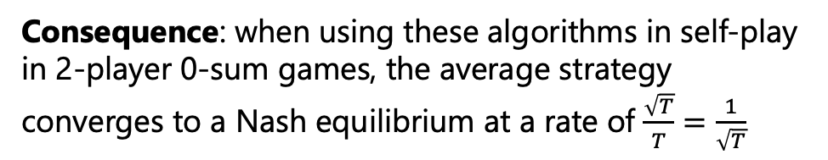
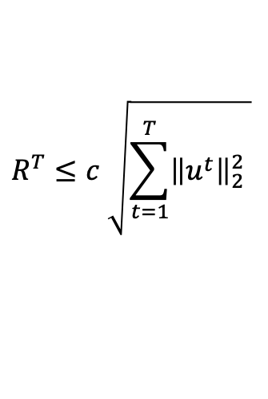
A Common Template for Regret Minimizers
All of these algorithms guarantee that after seeing any number T of utilities $u^{1}, …, u^{T}$, the regret cumulated by the algorithm satisfies
Remember:
This holds without any assumption about the way the utilities are selected by the environment!
$$R^{T}≤c \sqrt{\sum_{t=1}^{T}{{\left\|u^{t}\right\|}_{2}^{2} }}$$
Constant that depends on number of actions
So, assuming that the utility vectors have bounded norms $\left\|u^{t}\right\|≤B$ (this is always the case when playing finite games), then $R^{T}≤cB\sqrt{T}$
Consequence: when using these algorithms in self-play in 2-player 0-sum games, the average strategy converges to a Nash equilibrium at a rate of $\frac{\sqrt{T}}{T}=\frac{1}{\sqrt{T}}$
Reminder: self play

Slide 12
What Regret Minimizers are Used in Practice?
Multiplicative Weights Update (MWU)
Regret Matching (RM)
& Regret Matching+ (RM+)
✔ Special case of OMD, that works for general convex sets
✔ Widely used & understood
❌ Slow in practice for games
❌ Hyperparameters (stepsize)
✔ Can incorporate optimism
about future losses to
converge faster in 2-player 0-sum
games
❌ Only for simplex domains
❌ Not as well studied
✔ Tuned for game solving
✔ No hyperparameters
✔ Incredibly effective
❓ Unknown… Until recently
✔
🌟Modern variants of this, such as DCFR, are the standard in extensive-form game solving!
[Farina et al., Faster Game Solving via Predictive Blackwell Approachability: Connecting Regret Matching and Mirror Descent, AAAI 2021]

Slide 13
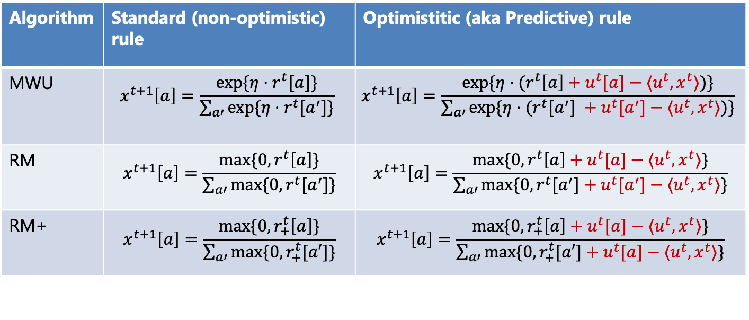
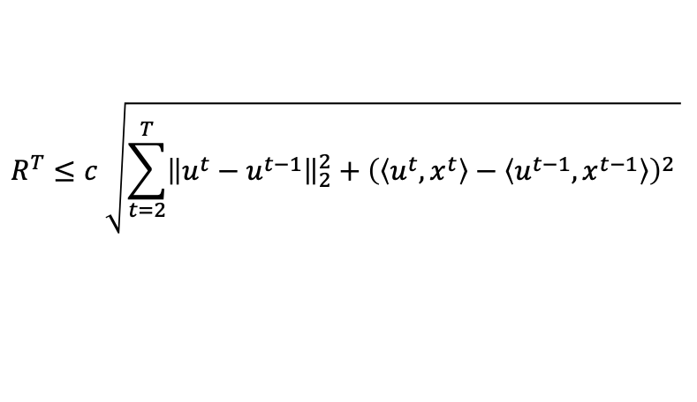
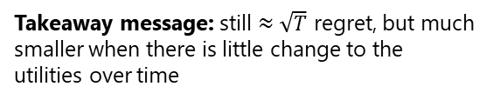
Optimistic regret minimizers
Algorithm | Standard (non-optimistic) rule | Optimistitic (aka Predictive) rule
MWU | $$x^{t+1}\left[a\right]=\frac{\exp{{\{η⋅r}^{t}[a]\}}}{\sum_{a′}{\exp{{\{η⋅r}^{t}[a^{′}]\}}}}$$ | $$x^{t+1}\left[a\right]=\frac{\exp{{\{η⋅(r}^{t}\left[a\right]+u^{t}[a]−⟨u^{t},x^{t}⟩)\}}}{\sum_{a′}{\exp{{\{η⋅(r}^{t}[a^{′}] +u^{t}[a^{′}]−⟨u^{t},x^{t}⟩)\}}}}$$
RM | $$x^{t+1}\left[a\right]=\frac{\max{\{0,}r^{t}\left[a\right]\}}{\sum_{a′}{\max{{\{0, r}^{t}[a^{′}]\}}}}$$ | $$x^{t+1}\left[a\right]=\frac{\max{{\{0,r}^{t}\left[a\right]+u^{t}[a]−⟨u^{t},x^{t}⟩\}}}{\sum_{a′}{\max{{\{0,r}^{t}[a^{′}]+u^{t}[a^{′}]−⟨u^{t},x^{t}⟩\}}}}$$
RM+ | $$x^{t+1}\left[a\right]=\frac{max⁡\{0, r_{+}^{t}\left[a\right]\}}{\sum_{a′}{\max{\{0,r_{+}^{t}[a′]\}}}}$$ | $$x^{t+1}\left[a\right]=\frac{max⁡\{0, r_{+}^{t}\left[a\right]+u^{t}[a]−⟨u^{t},x^{t}⟩\}}{\sum_{a′}{\max{\{0,r_{+}^{t}[a′]+u^{t}[a]−⟨u^{t},x^{t}⟩\}}}}$$
Typically, one-line change in implementation
All of these algorithms guarantee that after seeing any number T of utilities $u^{1}, …, u^{T}$, the regret cumulated by the algorithm satisfies
Remember:
This holds without any assumption about the way the utilities are selected by the environment!
$$R^{T}≤c \sqrt{\sum_{t=2}^{T}{{\left\|u^{t}−u^{t−1}\right\|}_{2}^{2}+{\left(\left\langle u^{t}, x^{t}\right\rangle −\left\langle u^{t−1}, x^{t−1}\right\rangle \right)}^{2} }}$$
Takeaway message: still $≈\sqrt{T}$ regret, but much smaller when there is little change to the utilities over time

Slide 14
A deeper dive into
Regret Matching (RM)

Slide 15

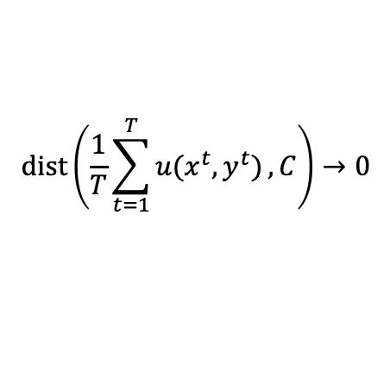



Blackwell Approachability Games
Two-player game with vector payoffs
GOAL: one player wants the average payoff vector to approach a given “target set” C
$$dist\left(\frac{1}{T}\sum_{t=1}^{T}{u(x^{t},y^{t})},C\right)→0$$
$$\frac{1}{t}\sum_{τ=1}^{t}{u(x^{t},y^{t})}$$
🌟 Definition (Forceable halfspace)
Halfspace $H⊇C$ s.t. there exists an action such that no matter what the opponent does, the next payoff vector will be in H.
$$\frac{1}{t+1}\sum_{τ=1}^{t+1}{u(x^{t},y^{t})}$$
$$H$$
C
🌟 Blackwell’s theorem:
C can be approached iff every H is forceable
[Blackwell, An analog of the minmax theorem for vector payoffs, Pacific J. of Math. 1956]
Notes:
In order to understand how regret matching and regret matching plus work, we need to take a step back and introduce Blackwell approachability
A Blackwell approachability game

Slide 16
From Regret Minimization to Blackwell Approachability
🌟 Awesome fact: Constructing a regret minimizer for a simplex domain can be expressed as a Blackwell approachability game!
Spoiler: Using Blackwell’s algorithm we obtain a regret minimization algorithm:
Regret Matching
[Hart & Mas-Colell, A Simple Adaptive Procedure Leading to Correlated Equilibrium, Econometrica 2000]
Notes:
In fact, some people claim that Blackwell was effectively the precursor of online optimization.

Slide 17

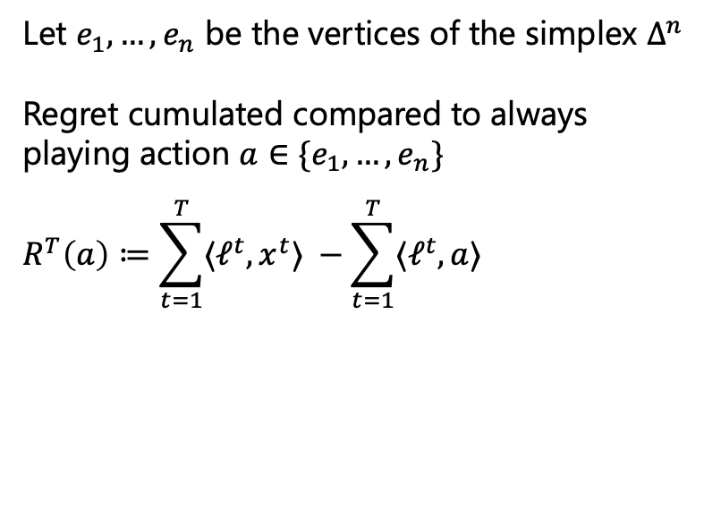
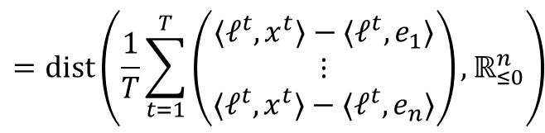

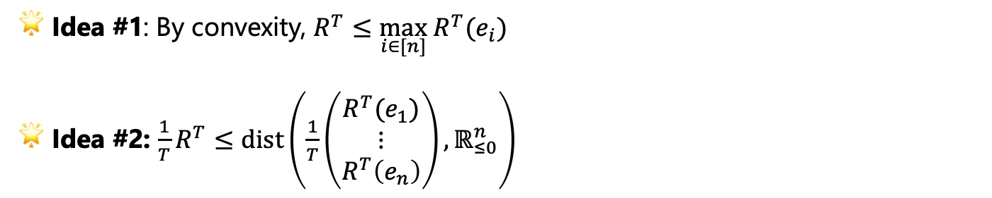
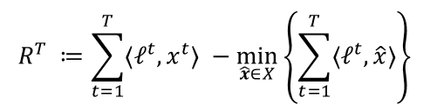
From Regret Minimization to Blackwell Approachability
Let $e_{1},…,e_{n}$ be the vertices of the simplex $Δ^{n}$
Regret cumulated compared to always
playing action $a∈\{e_{1},…, e_{n}\}$
$$R^{T}\left(a\right)≔\sum_{t=1}^{T}{{〈ℓ}^{t},x^{t}〉 }−\sum_{t=1}^{T}{{〈ℓ}^{t},a〉}$$
👀 Reminder: Regret
$$R^{T} ≔\sum_{t=1}^{T}{{〈ℓ}^{t},x^{t}〉 }−\min_{\hat{x}∈X}\left\{\sum_{t=1}^{T}{{〈ℓ}^{t},\hat{x}〉}\right\}$$
🌟 Idea #1: By convexity, $R^{T}≤\max_{i∈[n]} R^{T}(e_{i})$
🌟 Idea #2: $\frac{1}{T}R^{T}≤dist\left(\frac{1}{T}\left(\begin{matrix}R^{T}(e_{1}) \\ ⋮ \\ R^{T}\left(e_{n}\right)\end{matrix}\right), ℝ_{≤0}^{n}\right)$
Target set ${C≔ℝ}_{≤0}^{n}$
$$=dist\left(\frac{1}{T}\sum_{t=1}^{T}{\left(\begin{matrix}{〈ℓ}^{t},x^{t}〉−〈ℓ^{t},e_{1}〉 \\ ⋮ \\ {〈ℓ}^{t},x^{t}〉−〈ℓ^{t},e_{n}〉\end{matrix}\right)},ℝ_{≤0}^{n}\right)$$
$$u\left(x^{t},ℓ^{t}\right):Δ^{n}×ℝ^{n}→ℝ^{n}$$

Slide 18
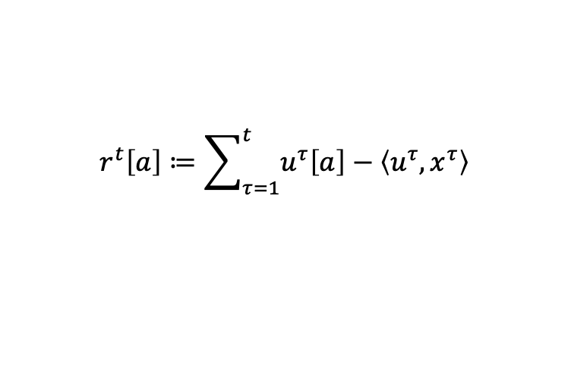
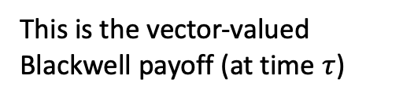
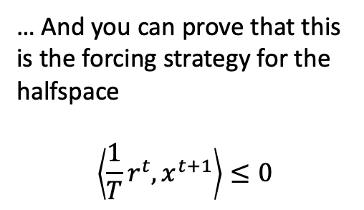
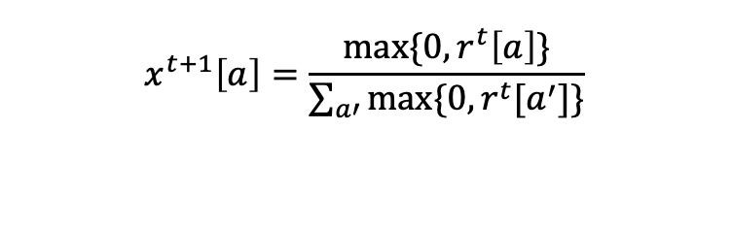
From Regret Minimization to Blackwell Approachability
🌟 As every halfspace that contains C is forceable, using Blackwell’s algorithm we obtain Regret Matching
$$r^{t}\left[a\right]≔\sum_{τ=1}^{t}{u^{τ}\left[a\right]−\left\langle u^{τ},x^{τ}\right\rangle }$$
This is the vector-valued Blackwell payoff (at time $τ$)
… And you can prove that this is the forcing strategy for the halfspace
$$\left\langle {\frac{1}{T}r}^{t}, x^{t+1}\right\rangle ≤0$$
$$x^{t+1}\left[a\right]=\frac{\max{\{0,}r^{t}\left[a\right]\}}{\sum_{a′}{\max{{\{0, r}^{t}[a^{′}]\}}}}$$

Slide 19
A Brief History of Regret Matching+
Discovered 15 years later!
Discovered as a heuristic modification of Regret Matching
Vastly faster numerically than Regret Matching
Set the new standard for solving games for many years
[Tammelin, Solving large imperfect information games using CFR+, ArXiv 2014]
[Bowling et al., Heads-up Limit Hold’em Poker is Solved, Science 2015]

Slide 20
Making the regret minimizers “predictive”

Slide 21
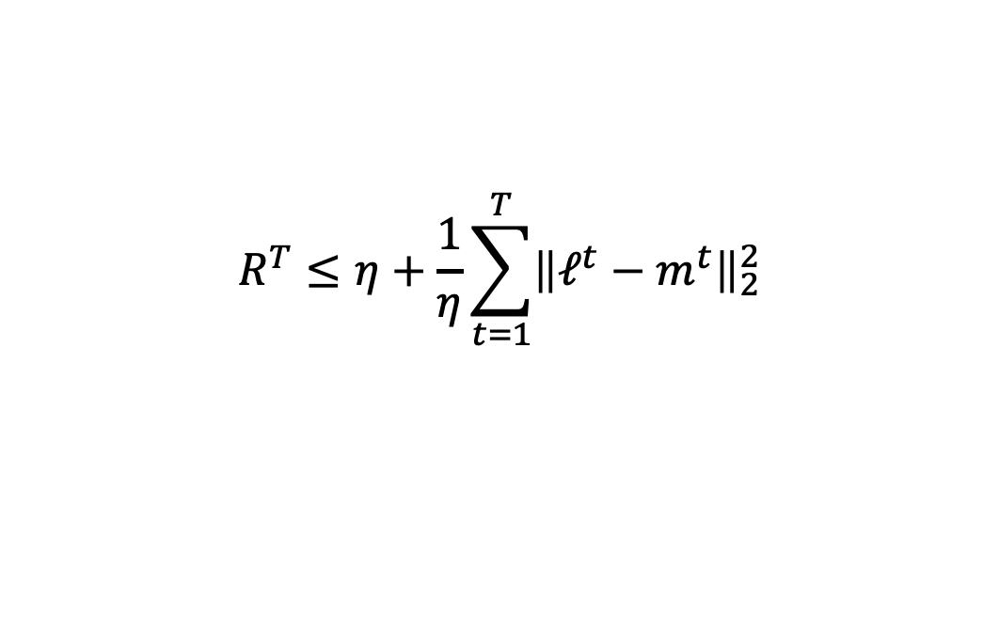
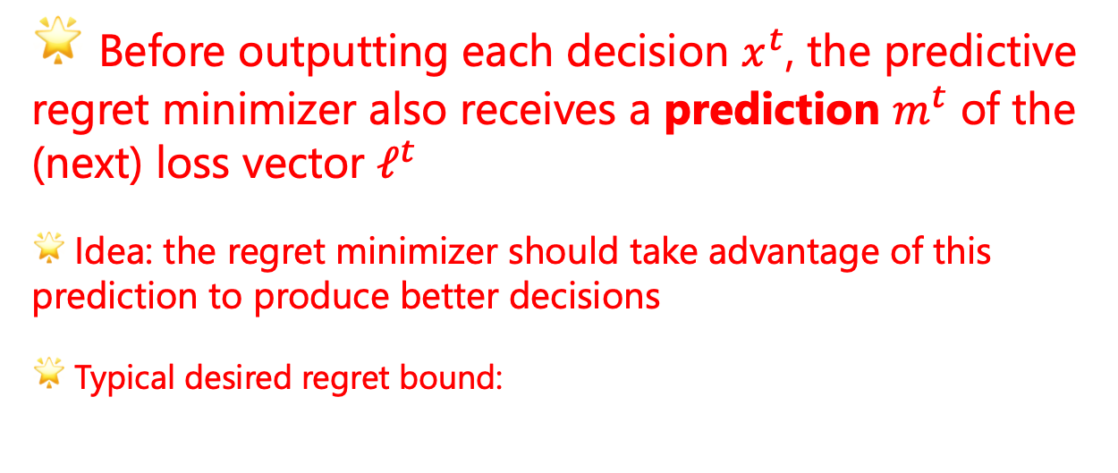
Predictivity
🌟 Before outputting each decision $x^{t}$, the predictive regret minimizer also receives a prediction $m^{t}$ of the (next) loss vector $ℓ^{t}$
🌟 Idea: the regret minimizer should take advantage of this prediction to produce better decisions
🌟 Typical desired regret bound:
$$R^{T}≤η+\frac{1}{η}\sum_{t=1}^{T}{{\left\|ℓ^{t}−m^{t}\right\|}_{2}^{2}}$$
[Chiang et al., Online optimization with gradual variations, COLT 2012]
[Rakhlin & Sridharan, Online Learning with Predictable Sequences, COLT 2013]
Notes:
OK so let me show something cool that you can do with the previous construction. It has to do with predictivity, a recent breakthrough in online learning.
Predictive regret minimization is pretty similar to regular regret minimization. The idea is that in PREDICTIVE regret minimization the regret minimizers also be able to accept a prediction m^t of the next loss vector ell^t
Requirement: a predictive regret minimizer must guarantee that the regret will not grow should the predictions be always correct

Slide 22
Can our Regret Minimizers be Made Predictive?
It is known that online mirror descent can be made predictive, and therefore MWU can be made predictive…
…But in practice RM/RM+ are preferred to solve games…
Q: Can we make RM/RM+ predictive?
A: Yes, by going back to the Blackwell connection

Slide 23
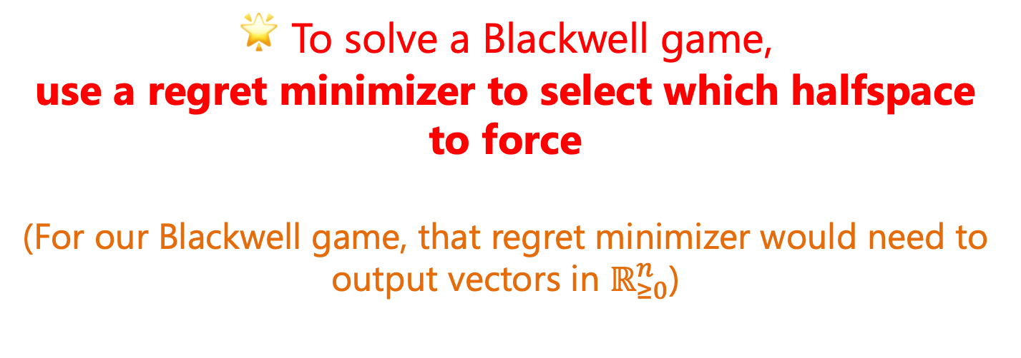
A Construction by Abernethy et al.
🌟 To solve a Blackwell game,
use a regret minimizer to select which halfspace to force
(For our Blackwell game, that regret minimizer would need to output vectors in $ℝ_{≥0}^{n}$)
[Abernethy et al., Blackwell Approachability and No-Regret Learning are Equivalent, COLT 2011]
Notes:
There are a few details missing here that I’m going to fly over. It actually turns out that we had to extend Abernethy et al.’s construction a tiny bit but at any rate, here is the algorithm

Slide 24
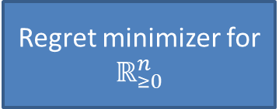
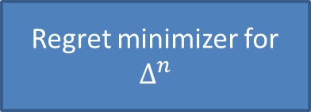
Connection between algorithms
Regret minimizer for
$$ℝ_{≥0}^{n}$$
Strategy for Blackwell game
Regret minimizer for
$$Δ^{n}$$
Follow-the-regularized-leader
(for any stepsize)
🤯
Regret Matching
Online Mirror Descent
(for any stepsize)
🤯🤯
Regret Matching+
Notes:
So, we know that in order to come up with a regret minimizer for the n-dimensional simplex Delta n, it is enough to come up with any approachability strategy for a particular Blackwell game.
And we know that to come up with a strategy for that Blackwell game, one can use any regret using a slightly modified version of the construction by Abernethy et al.
So, at this point one might wonder: what happens if I plug in FTRL as the regret minimizer to the left, what do I get out to the right? Well, it turns out that you get regret matching!
Ok so what happens if you use OMD instead of FTRL? Well, get ready to be amazed, because you recover RM+.

Slide 25
Why is this Surprising?
RM+ was discovered 15 years later than RM, as a heuristic modification.
FTRL/OMD are the two best known algorithms for regret minimization
FTRL and OMD have hyperparameters, but RM and RM+ do not
Notes:
We think that these reductions are incredibly surprising for several reasons, but let me state the two most compelling reasons here.
First, ….
Second, RM/RM+ and FTRL/OMD are pretty different even on the surface: the former do not have hyperparameters, while the latter have stepsize hyperparameters.
It’s important to note that the reduction FTRL -> RM and OMD -> RM+ hold for any stepsize. That means that no matter the stepsize that we use in FTRL and OMD, when plugged in the construction we just talked about the algorithms that you take out do not change. Basically, in the proof the stepsize cancels out.

Slide 26
Predictivity
Regret minimizer for
$$ℝ_{≥0}^{n}$$
Strategy for Blackwell game
Regret minimizer for
$$Δ^{n}$$
Predictive FTRL
Predictive Regret Matching
Predictive OMD
Predictive Regret Matching+

Slide 27
Predictivity
Question: How to set up the prediction?
Typical answer: Use the previous loss!
👍 That is principled! In some cases this actually leads to 1/T convergence to Nash equilibrium
🤔 Though it’s unknown if that’s the case for RM/RM+ (open question)
Notes:
Landmark paper by Syrgkanis 2015
“Fast convergence of regularized learning in games” --- best paper award? I don’t remember

Slide 28
TODO: Add predictive RM / RM+ formulas in the catalogue/table of formulas above
MAYBE compare RM / RM+ with PRM / PRM+ side by side to highlight the differences in the formulas
Remark that PRM* has a regret bound as a function of the variation of the utilities

Slide 29
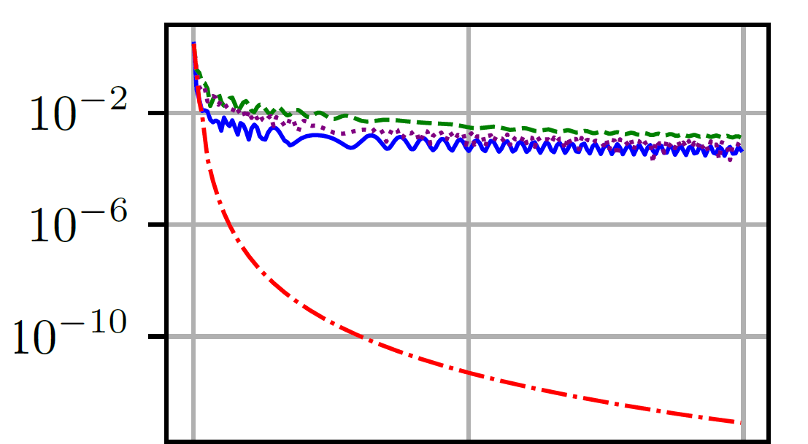
Nash gap / exploitability
Green dashed: Linear RM
Violet dotted: Discounted RM
RM+
Optimistic RM+
Self-play iterations
(RM was omitted as it is typically much slower than RM+)
[Farina, Kroer, and Sandholm; Faster Game Solving via Predictive Blackwell Approachability:
Connecting Regret Matching and Mirror Descent, AAAI’21]

Slide 30
In general, Discounted RM and Optimistic RM+ are the fastest in practice
  For some games, like poker, Discounted RM is empirically consistently faster than Optimistic RM+
  For many other games, Optimistic RM+ is significantly faster
[Farina, Kroer, and Sandholm; Faster Game Solving via Predictive Blackwell Approachability:
Connecting Regret Matching and Mirror Descent, AAAI’21]

Slide 31
Important Takeaways
🌟 Strong connection between FTRL/OMD and RM/RM+
  Surprising for many reasons
  Via Blackwell Approachability
  Advances to FTRL/OMD can be transferred to Blackwell Approachability and ultimately RM/RM+

Slide 32
We Stand on the Shoulders of Giants
Blackwell Approachability:
[Blackwell, An analog of the minmax theorem for vector payoffs, Pacific J. of Math. 1956]
Regret Matching and Regret Matching Plus:
[Hart & Mas-Colell, A Simple Adaptive Procedure Leading to Correlated Equilibrium, Econometrica 2000]
[Tammelin, Solving large imperfect information games using CFR+, ArXiv 2014]
[Bowling et al., Heads-up Limit Hold’em Poker is Solved, Science 2015]
Abernethy’s construction:
[Abernethy et al., Blackwell Approachability and No-Regret Learning are Equivalent, COLT 2011]
Predictivity:
[Chiang et al., Online optimization with gradual variations, COLT 2012]
[Rakhlin & Sridharan, Online Learning with Predictable Sequences, COLT 2013]
Most of the material of the section:
[Farina et al., Faster Game Solving via Predictive Blackwell Approachability: Connecting Regret Matching and Mirror Descent, ArXiv 2020]

Slide 33
Part Two
From Normal-Form to Extensive-Form
(Nash Equilibria in Extensive-Form Games)

Slide 34
From Normal-Form to Extensive-Form
Can capture sequential and simultaneous moves
Private information
We assume perfect recall: no player forgets what the player knew earlier
C
JQ
QJ
KQ
JK
QK
KJ
1
1
1
1
1
1
check
check
check
check
check
check
bet
bet
bet
bet
bet
bet
2
2
2
2
2
2
2
2
2
2
2
2
check
fold
check
fold
check
fold
check
fold
check
fold
check
fold
bet
bet
bet
bet
call
bet
call
bet
call
call
call
call
+2
-2
+1
+2
+1
-2
+1
1
+1
+2
+1
1
+1
-1
1
+1
-2
-1
1
+1
+1
1
-1
1
fold
fold
fold
fold
fold
fold
call
call
call
call
call
call
-1
+2
-1
+2
-1
-2
-1
-2
-1
+2
-1
-2
⚠️ Information sets for red player (Player 2) are not shown

Slide 35
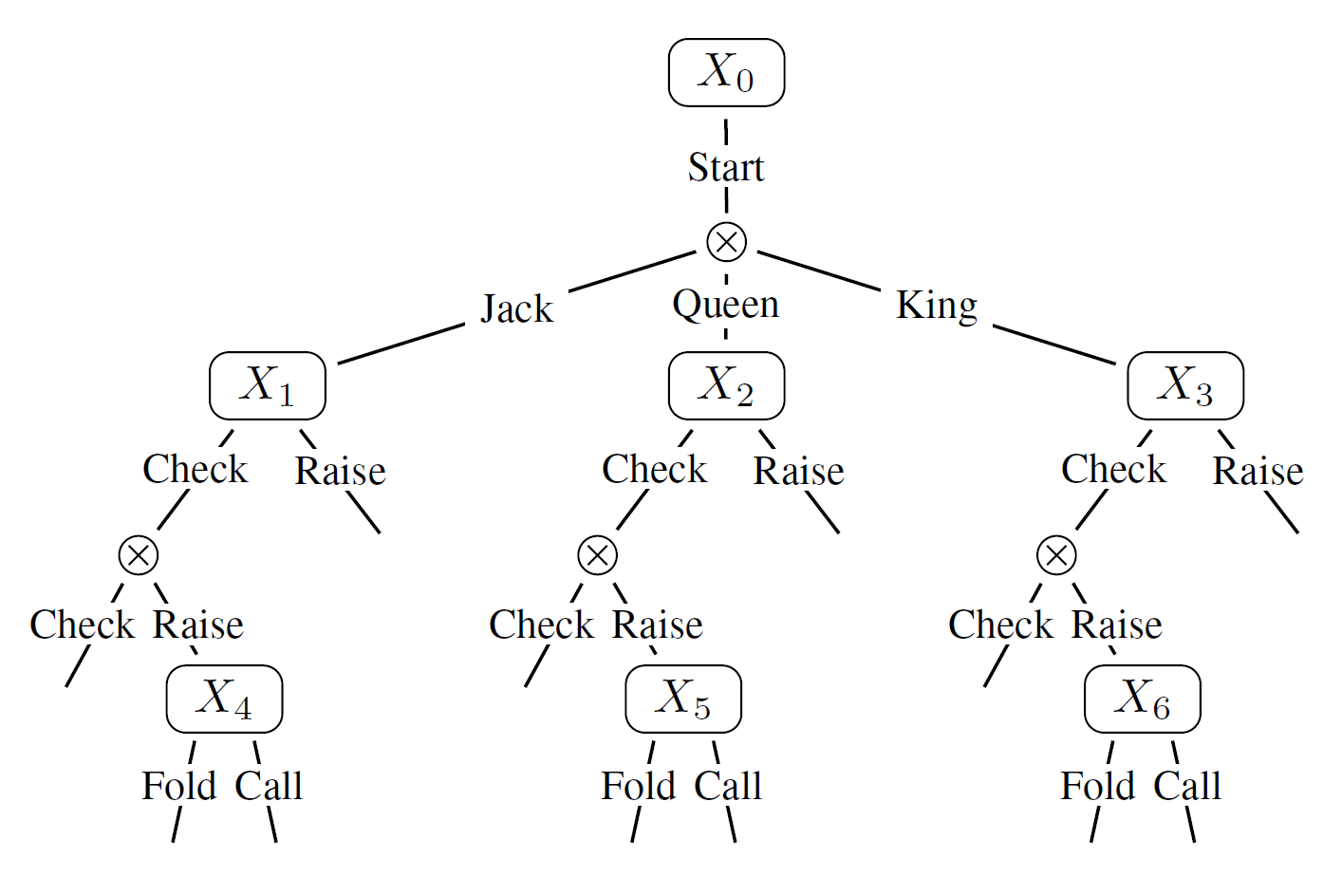
Two Representations
Observation points
C
QJ
KQ
Decision points
QK
KJ
1
1
1
1
1
1
check
check
check
check
check
bet
check
bet
bet
bet
bet
bet
2
2
2
2
2
2
2
2
2
2
2
2
check
check
fold
check
fold
bet
check
check
fold
bet
check
fold
bet
bet
call
fold
bet
fold
call
bet
call
call
call
call
-2
+1
-2
+1
+1
+2
-1
+1
-2
+1
1
+1
+2
+1
1
+1
+2
-1
1
+1
-1
1
1
1
fold
fold
fold
fold
fold
fold
call
call
call
call
call
call
-1
-2
-1
-2
-1
+2
-1
-2
-1
+2
-1
+2
Game tree
Each node belongs to a specific player or chance
Tree-Form (Sequential) Decision Problem
Represents the game from viewpoint of one player
This is the representation in regret minimization

Slide 36
Strategies in Extensive-Form Games
🌟 First attempt:
Assign local probabilities at each decision point
1.0
✔ Set of strategies is convex
❌ Expected utility of game is
not bilinear
Reason: prob. of reaching a
terminal state is product of
variables
0.1
0.9
0.5
0.5
0.75
0.25
0.8
0.2
0.4
0.6
0.1
0.9
``Behavioral strategies’’
Products = non-convexity 😪

Slide 37
Strategies in Extensive-Form Games
🌟 Second attempt:
Store probabilities for whole sequences of actions
1.0
1.0
Parent
0.5
0.75
✔ Set of strategies is convex
✔ Expected utility of game is
bilinear
0.1
0.9
0.5
0.75
0.25
0.1
0.9
0.5
0.5
0.25
0.8
0.2
0.4
0.6
0.1
0.9
0.08
0.02
0.2
0.3
0.075
0.675
Children
🌟 Consistency constraints
Entries all non-negative
Root sequence has probability 1.0
Probability mass conservation
``Sequence-form strategies’’
[Romanovskii, Reduction of a game with complete memory to a matrix game, 1961]
[Koller et al., Fast algorithms for finding randomized strategies in game trees, STOC 1994]

Slide 38







Sequence-Form Strategies
🌟 Consequence: a lot of results carry over from normal form games when using sequence-form strategies!
✔ Nash equilibrium is a bilinear saddle point problem
$$\min_{x∈Q_{1}}\max_{y∈Q_{2}}{x^{⊤}Ay}$$
✔ As long as we can construct regret minimizers for the sets of
sequence-form strategies, we can use them to converge to
Nash equilibrium in self play
$$x^{t}$$
$Ay^{t}$
$$x^{t+1}$$
$$y^{t}$$
${−A}^{⊤}x^{t}$
$$y^{t+1}$$

Slide 39
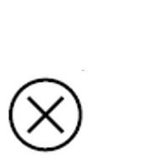





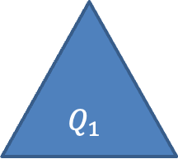
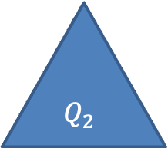

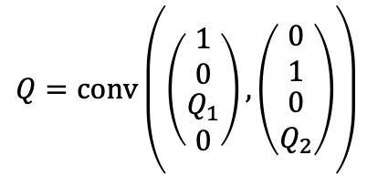
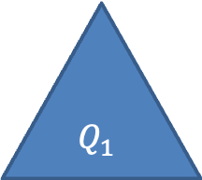
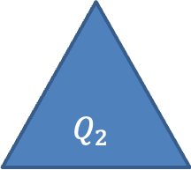

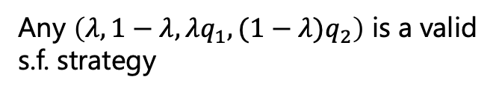
Regret Minimizers for Sequence-Form Strategy Spaces
🌟 IDEA: Sequence-form strategy spaces have a strong combinatorial structure!
Observation node
Action node
$$X$$
$$λ$$
$$1 − λ$$
$$X_{1}$$
$$X_{2}$$
$$Q_{1}$$
$$Q_{2}$$
$$Q_{1}$$
$$Q_{2}$$
Any $\left(q_{1},q_{2}\right)$ is a valid s.f. strategy
Any $\left(λ, 1−λ, λq_{1},(1−λ)q_{2}\right)$ is a valid
s.f. strategy
$$Q=Q_{1}×Q_{2}$$
$$Q=conv\left(\left(\begin{matrix}1 \\ 0 \\ \begin{matrix}Q_{1} \\ 0\end{matrix}\end{matrix}\right),\left(\begin{matrix}0 \\ 1 \\ \begin{matrix}0 \\ Q_{2}\end{matrix}\end{matrix}\right)\right)$$
🌟 Cartesian Products
🌟 Convex Hulls

Slide 40
We can leverage this combinatorial structure to construct compositionally a regret minimizer for a player’s sequence-form strategy set using any regret minimizers for simplices
⭐️
In other words: we can “reduce” regret minimization for extensive-form games to regret minimization for normal-form games
[Farina, Kroer & Sandholm, Regret Circuits: Composability of Regret Minimizers, ICML-19]

Slide 41
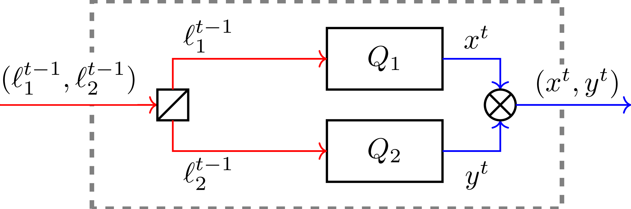



Regret Circuits: Cartesian Product
$$u_{1}^{t−1}$$
$$(u_{1}^{t−1},u_{2}^{t−1})$$
$$u_{2}^{t−1}$$
[Farina, Kroer & Sandholm, Regret Circuits: Composability of Regret Minimizers, ICML-19]

Slide 42
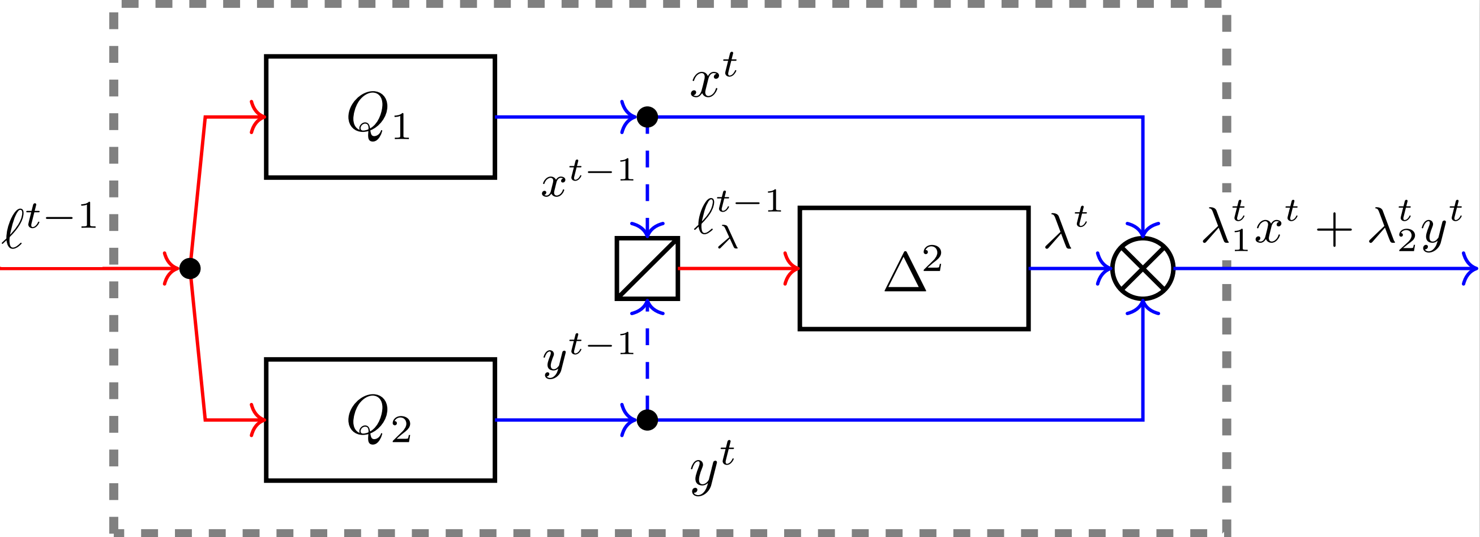


Regret Circuits: Convex Hull
🌟 IDEA
Extra regret minimizer decides how to mix the decisions on X and Y
🌟 Any will work!
RM, RM+, DRM,
Hedge, OMD,
FTRL, ….
$$u^{t−1}$$
$$u_{λ}^{t−1}$$
[Farina, Kroer & Sandholm, Regret Circuits: Composability of Regret Minimizers, ICML-19]

Slide 43
A generalized Counterfactual Regret Minimization (CFR) algorithm
So, by composing the constructions for Cartesian product and convex hull, we obtain a regret minimizer for extensive-form domains
🌟 IDEA: decomposes and bounds regret locally at each decision point in the game
This regret minimizer is called (generalized) CFR
🌟 This, with extensions discussed later, is the practical state-of-the-art in extensive-form game solving
CFR: [Zinkevich et al., Regret minimization in games with incomplete information, NeurIPS-07]
Generalized CFR: [Farina, Kroer & Sandholm, Regret Circuits: Composability of Regret Minimizers, ICML-19]

Slide 44
CFR Viz: Regret Minimization Algorithm
How does CFR end up updating strategies?
Suppose the following local strategies were output by the regret minimizers at each decision point:
1.0
0.1
0.9
0.5
0.5
0.75
0.25
0.8
0.2
0.4
0.6
0.1
0.9

Slide 45

CFR Viz: Regret Minimization Algorithm
An example utility vector $u^{t}$ shown in green is now received by the CFR regret minimizer
  Remember: in regret minimization we make no assumption as to how the environment picked the utility vector. So, the green utilities may not actually be “real” payoffs in Kuhn
  In the special case of playing against an opponent to compute Nash, the green number =
  ∑subsequent game tree leaves in which this player can’t move again because game ends leaf payoff * reach probability of opponent from root to that leaf * reach probability of chance from root to that leaf
Purple: last strategy output by each local regret minimizer
1.0
-0.5
0.1
2.0
0.9
-1.5
0.5
0.0
0.5
-0.4
0.75
1.0
0.25
0.0
0.8
1.2
0.2
-0.6
0.4
-0.5
0.6
1.1
0.1
-2.5
0.9
1.6

Slide 46
CFR Viz: Regret Minimization Algorithm
Step 1: Compute the counterfactual utilities for each action
At leaves:
counterfactual utility = utility at leaf
Elsewhere:
counterfactual utility =
utility at sequence
+
expected utility in the subtree of the decision problem (not game tree) under that sequence, weighting actions according to latest strategy
1.0
-0.5
0.1
2.0
0.9
-1.5
0.5
0.0
0.5
-0.4
0.75
1.0
0.25
0.0
0.8
1.2
0.2
-0.6
0.4
-0.5
0.6
1.1
0.1
-2.5
0.9
1.6
Example:
Counterfactual utility = -0.6
Example:
Counterfactual utility
= 1.0 + (0.1 x -2.5 + 0.9 x 1.6) = 2.19
Purple: last strategy output by each local regret minimizer
Green: utility vector given by environment

Slide 47
CFR Viz: Regret Minimization Algorithm
Step 1: Compute the counterfactual utilities for each action
At leaves:
counterfactual utility = utility at leaf
Elsewhere:
counterfactual utility =
utility at sequence
+
expected utility in the subtree of the decision problem (not game tree) under that sequence, weighting actions according to latest strategy
1.0
-0.5
0.11
0.1
2.0
2.84
0.5
0.0
0.46
0.75
1.0
2.19
0.9
-1.5
-1.5
0.5
-0.4
-0.4
0.25
0.0
0.0
0.8
1.2
1.2
0.2
-0.6
-0.6
0.4
-0.5
-0.5
0.6
1.1
1.1
0.1
-2.5
-2.5
0.9
1.6
1.6
Purple: last strategy output by each local regret minimizer
Green: utility vector given by environment
Orange: counterfactual utilities

Slide 48
CFR Viz: Regret Minimization Algorithm
1.0
-0.5
0.11
Step 2: Feed the counterfactual utilities to the regret minimizers at each decision point
Note: Steps 1 & 2 can be done in a single bottom-up pass
Remember: this will work no matter the choice of regret minimizers (MWU, RM, RM+, Discounted RM, Optimistic RM+, etc). We can also use different regret minimizers at different nodes, unlike the original CFR paper, which used RM
0.1
2.0
2.84
0.5
0.0
0.46
0.75
1.0
2.19
0.9
-1.5
-1.5
0.5
-0.4
-0.4
0.25
0.0
0.0
0.8
1.2
1.2
0.2
-0.6
-0.6
0.4
-0.5
-0.5
0.6
1.1
1.1
0.1
-2.5
-2.5
0.9
1.6
1.6
Example:
Feed utilities (2.84, -1.5) to the regret minimizer that selects the strategy for this decision point
Purple: last strategy output by each local regret minimizer
Green: utility vector given by environment
Orange: counterfactual utilities

Slide 49
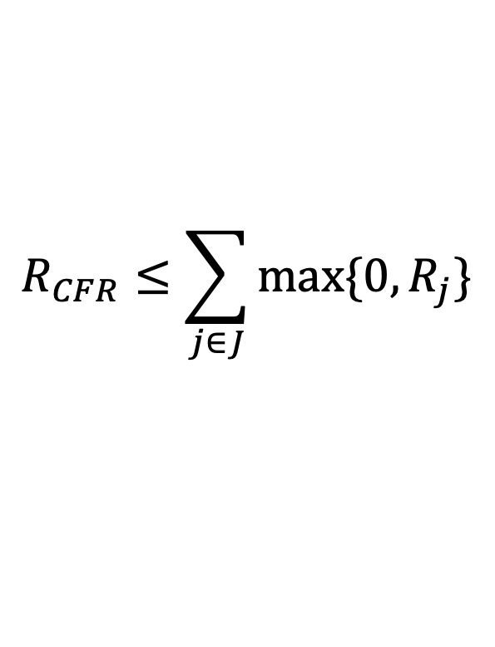
CFR Guarantees
Theorem: the regret cumulated by CFR can be bounded as
Consequence: if the local regret minimizers guarantee sublinear regret, then CFR cumulates sublinear regret
$$R_{CFR}≤\sum_{j∈J}{\max{\{0, R_{j}\}}}$$
Regret cumulated by local regret
minimizer for decision point j
Decision points
[Farina, Kroer & Sandholm, Regret Circuits: Composability of Regret Minimizers, ICML 2019]

Slide 50
CFR in Self-Play on a Game Tree
When putting together all the pieces of the puzzle [*** TODO: CFR in self-play***], this is what an iteration of the CFR algorithm looks like
[*** TODO: VIZ ***]

Slide 51
Why is CFR Superior in Practice?
🌟 … to second-order methods (which can offer convergence rate 1/e^{T} )?
  Does not require solving large linear systems
  Second-order methods (interior point, …) don’t fit in memory for large games
🌟 … to general-purpose regret minimizers (FTRL & OMD)?
  CFR uses an approach local to each decision point (easier to parallelize, warm-start, etc.)
    [Brown & Sandholm, Reduced Space and Faster Convergence in Imperfect-Information Games via Pruning. ICML-17]
    [Brown & Sandholm, Strategy-based warm starting for regret minimization in games, AAAI 2016]
  No need for expensive projections onto feasible strategy polytope (think projected gradient descent)

Slide 52
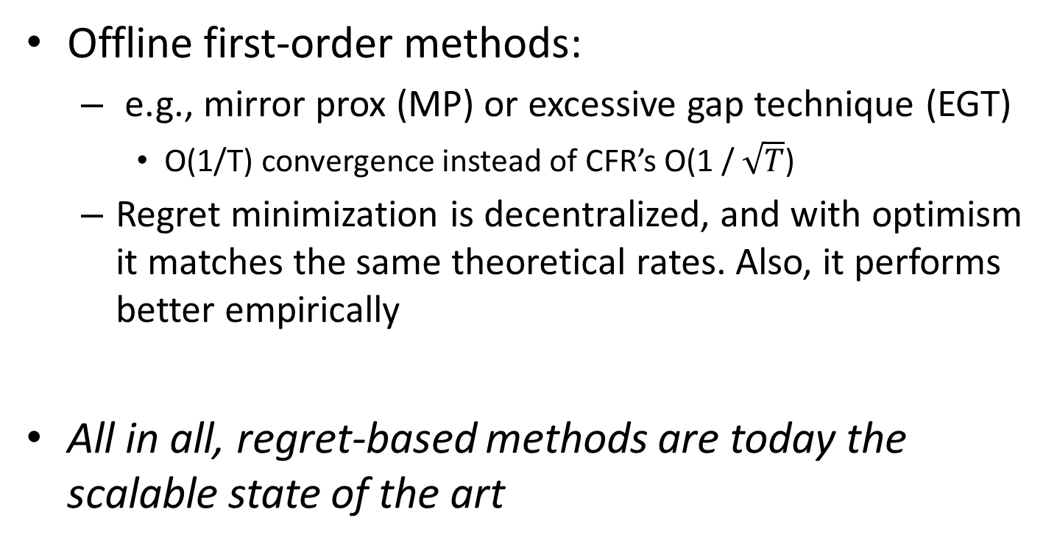
Other approaches
Offline first-order methods:
  e.g., mirror prox (MP) or excessive gap technique (EGT)
    O(1/T) convergence instead of CFR’s O(1 / $\sqrt{T}$)
  Regret minimization is decentralized, and with optimism it matches the same theoretical rates. Also, it performs better empirically
All in all, regret-based methods are today the scalable state of the art

Slide 53
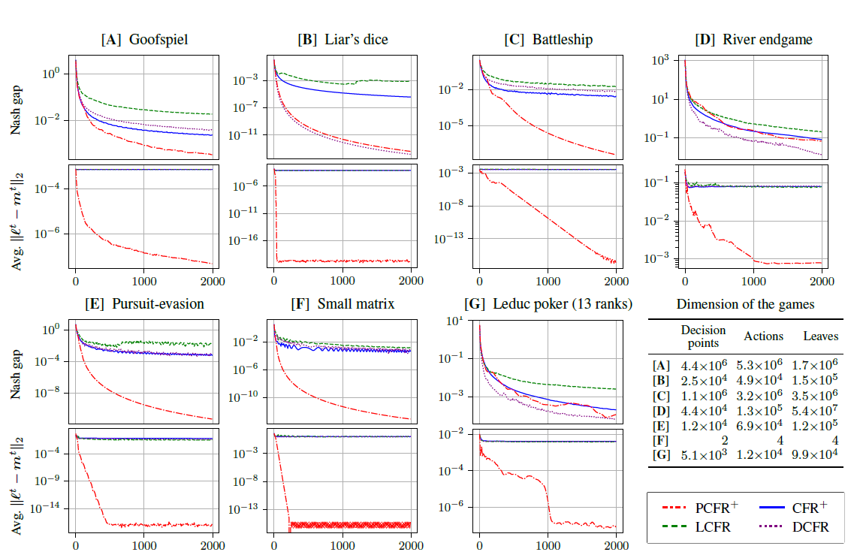
CFR Framework + Predictivity

Slide 54
Important Takeaways
🌟 You can construct a regret minimizer for
sequential decision making problems by
combining regret minimizers for individual
decision points
  Improvements on simplex domains carry over to
  extensive-form domains!
🌟 Predictivity works well in extensive-form
domains

Slide 55
Techniques to Further Increase Scalability of CFR
Using utility estimators
  Similar idea as stochastic gradient descent vs gradient descent
  Instead of exactly computing the green numbers (gradients of the utility function), we use cheap unbiased estimators
  Popular estimator: sample a trajectory in the game tree and use importance sampling
  “Monte Carlo CFR”
[Monte Carlo Sampling for Regret Minimization in Extensive Games; Lanctot, Waugh, Zinkevich, Bowling NIPS 2009]

Slide 56
Techniques to Further Increase Scalability of CFR
Temporary pruning
  Idea: During CFR traversals,
      Prune actions (and their subtrees) that have negative cumulative regret
      Project in how many iterations at the earliest the cumulative regret can turn positive, and catch up that subtree’s iterates then
        Cath up as if we had played a best response throughout the CFR iterations to the opponent’s average strategy in that subtree
        If the regret is still negative, re-project, etc.
  Can be implemented without storing the pruned subtrees => space advantage
  Theorem. In a zero-sum game, if both players choose
  strategies according to CFR with this kind of pruning, conducting T iterations traverses only
  O(|S|T + |H| ln(T)) nodes
All game paths (i.e., information sets)
Game paths that are part of some best response to some equilibrium
[Brown & Sandholm, Reduced Space and Faster Convergence in Imperfect-Information Games via Pruning. ICML-17]

Slide 57
Techniques to Further Increase Scalability of CFR
Sparsification
  Idea: compute a low-rank factorization of the payoff matrix of the game
  For some games, a low-rank factorization is guaranteed to exist, and can dramatically speed up the algorithms
[Zhang & Sandholm, Sparsified linear programming for zero-sum equilibrium finding. ICML 2020]
[Farina & Sandholm, Fast Payoff Matrix Sparsification Techniques for Structured Extensive-Form Games. AAAI 2022]

Slide 58
Bibliographic Remarks
Regret Circuits:
[Farina et al., Online convex optimization for sequential decision processes and extensive-form games, AAAI 2019]
[Farina et al., Regret Circuits: Composability of Regret Minimizers, ICML 2019]
  - Note: we also consider more convexity-preserving operations than just convex hulls & Cartesian products

