Slide 1
Automated Moral Decision Making
Vincent Conitzer

Slide 2
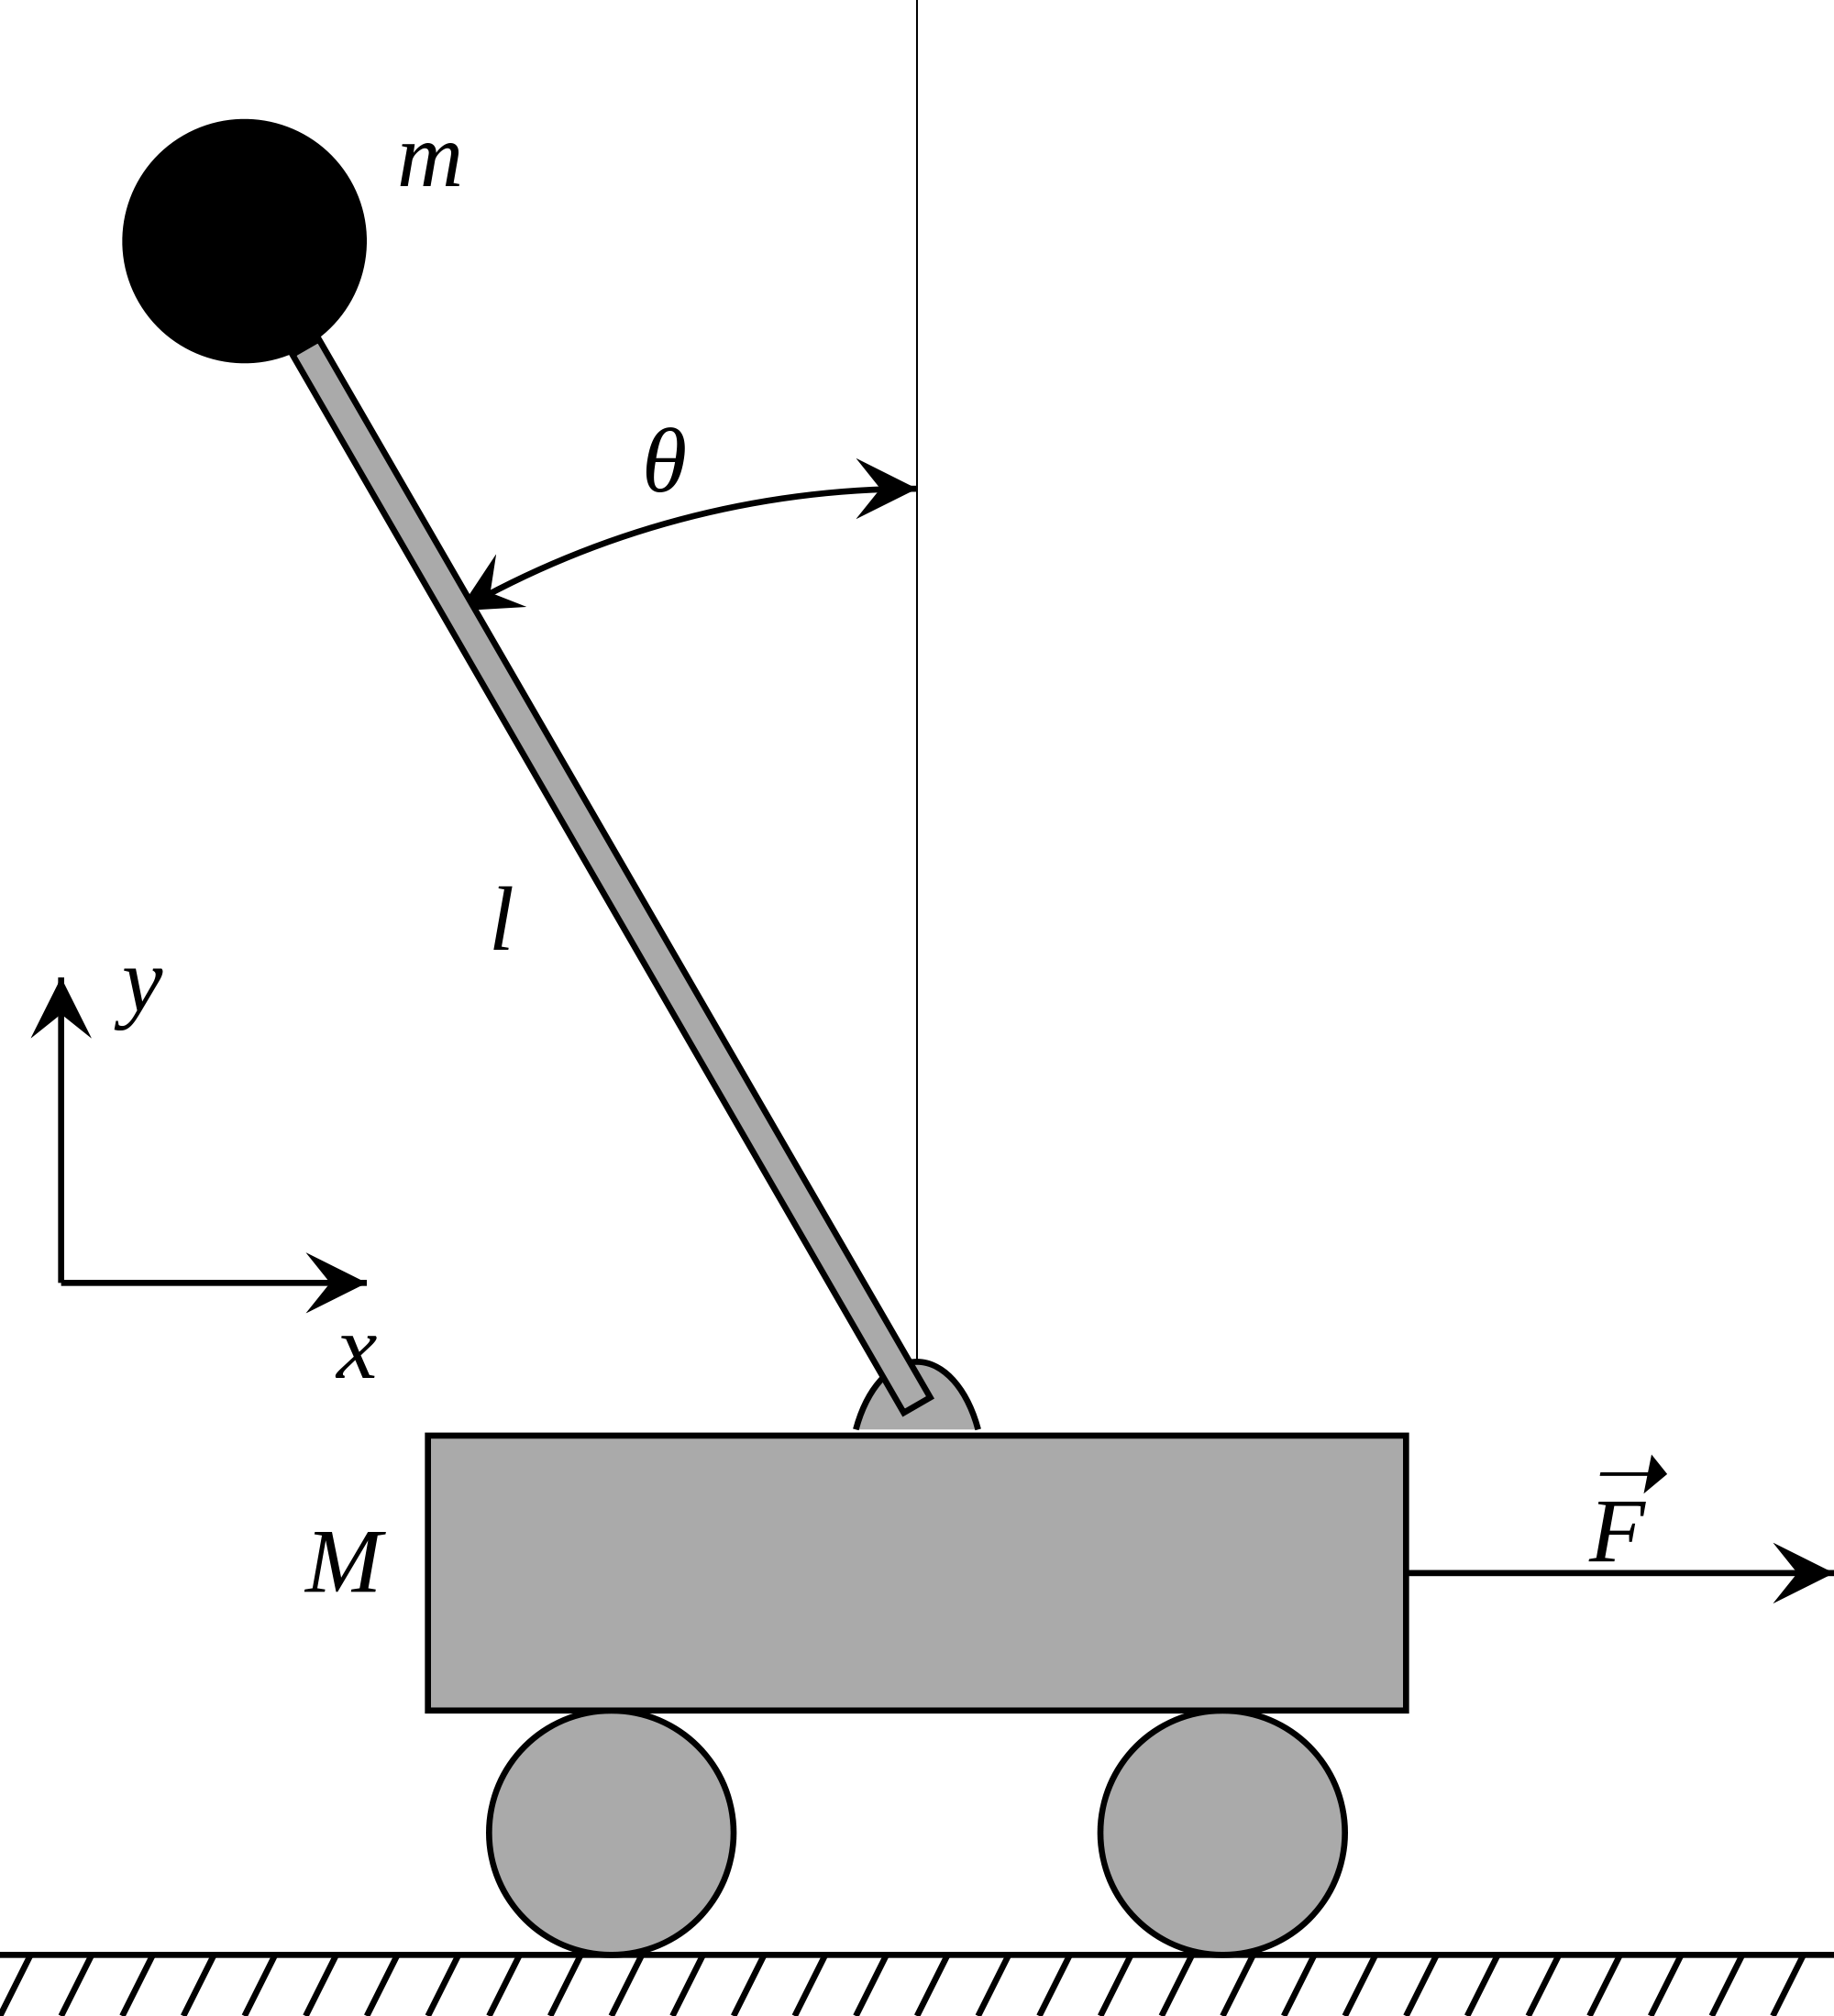
In the lab, simple objectives are good…

Slide 3
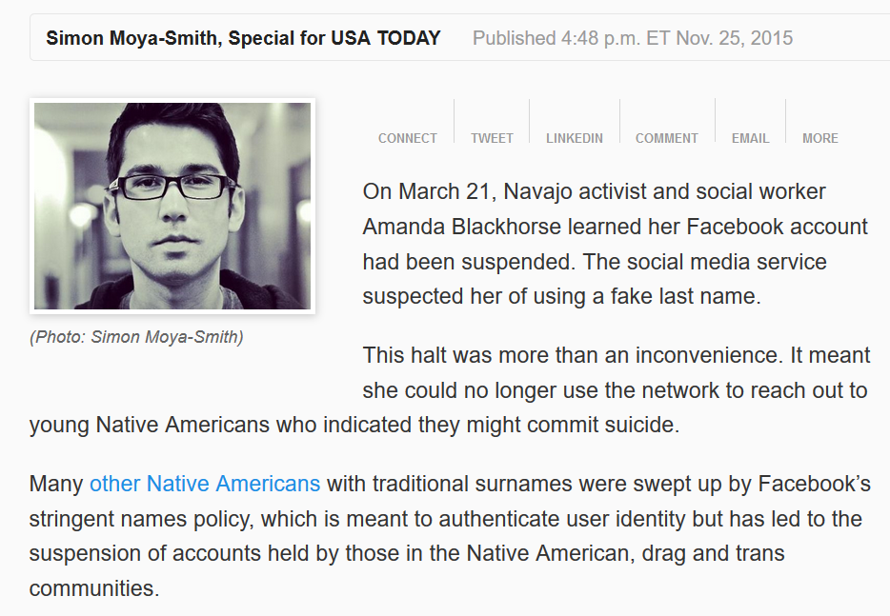
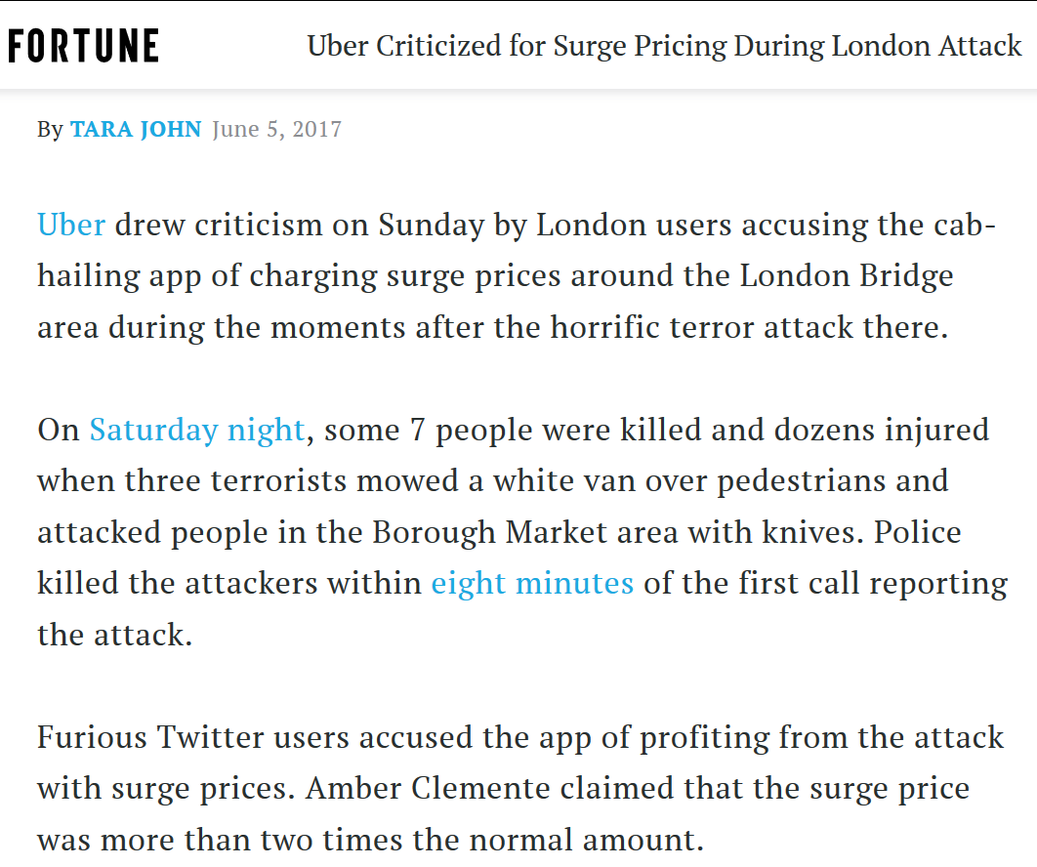
… but in reality, simple objectives have unintended side effects
…

Slide 4
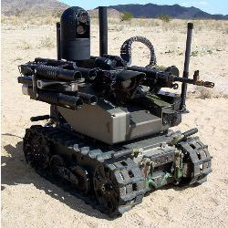

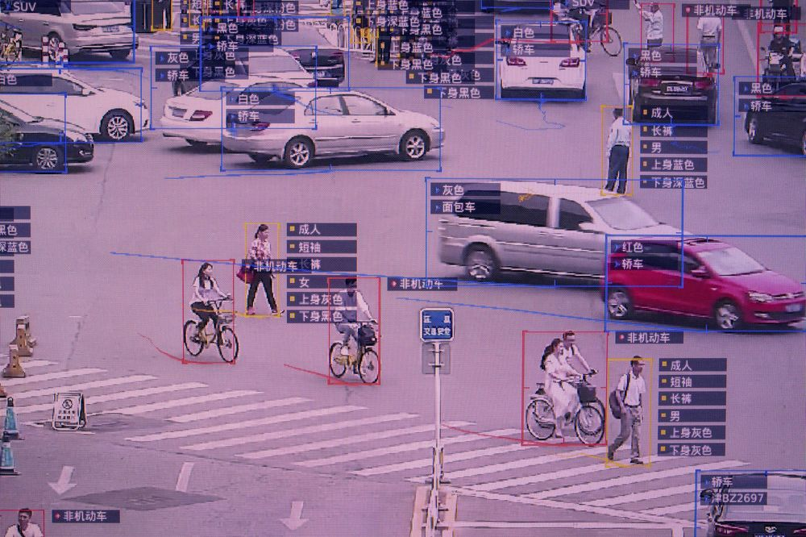
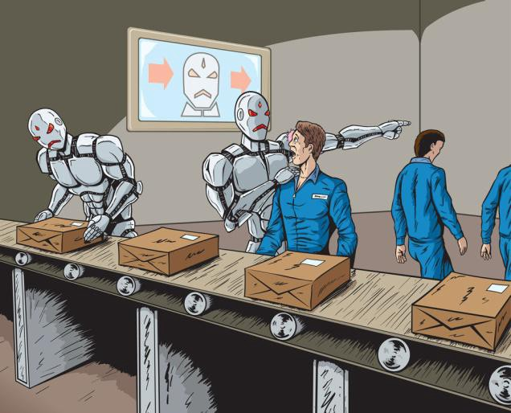
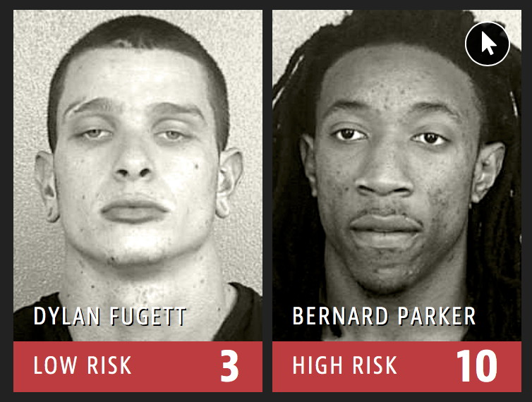
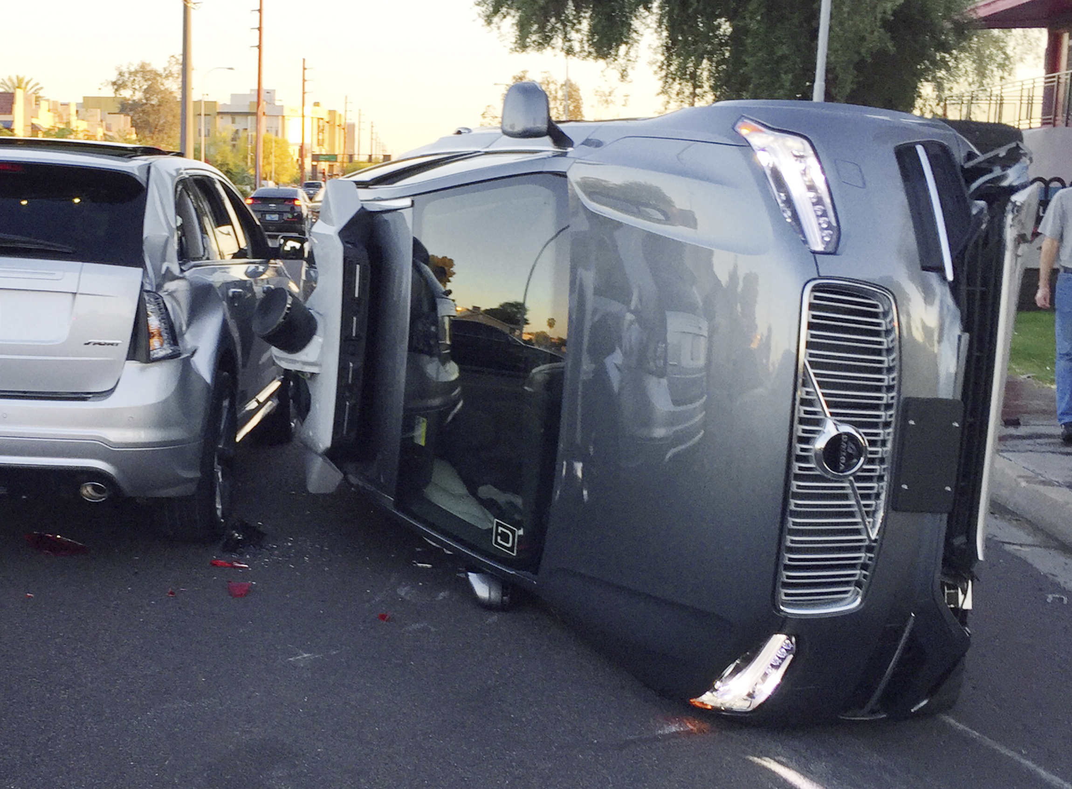
Ethical and Societal Worries about AI
autonomous weapons
AI & cybersecurity, privacy
societal surveillance
media manipulation, polarization
… … …
responsibility and liability
technological unemployment
unfair biases

Slide 5
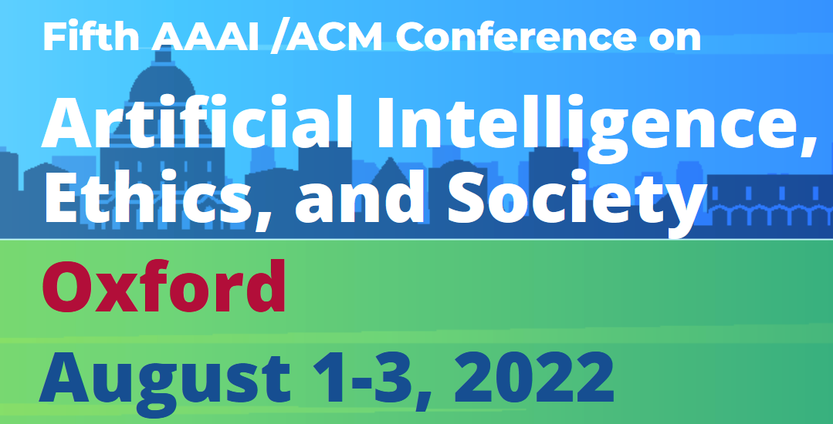

Slide 6




Moral Decision Making Frameworks for Artificial Intelligence
[AAAI’17] with:
Walter Sinnott-Armstrong
Jana Schaich Borg
Yuan Deng
Max Kramer

Slide 7
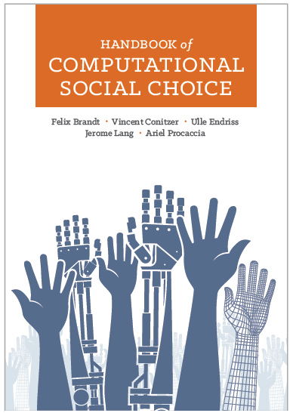
Concerns with learning from people
What if we predict people will disagree?
  New social-choice theoretic questions [C. et al. 2017] – approach also followed by Noothigattu et al. [2018], Kahng et al. [2019]
This will at best result in current human-level moral decision making [raised by, e.g., Chaudhuri and Vardi 2014]
  … though might perform better than any individual person because individual’s errors are voted out
How to generalize appropriately? Representation?

Slide 8
Social-choice-theoretic approaches
C., Sinnott-Armstrong, Schaich Borg, Deng, Kramer [AAAI’17]: “[give] the AI some type of social-choice-theoretic aggregate of the moral values that we have inferred (for example, by letting our models of multiple people’s moral values vote over the relevant alternatives, or using only the moral values that are common to all of them).”
C., Schaich Borg, Sinnott-Armstrong [Trustworthy Algorithmic Decision Making Workshop’17]: “One possible solution is to let the models of multiple subjects vote over the possible choices. But exactly how should this be done? Whose preferences should count and what should be the voting rule used? How do we remove bias, prejudice, and confusion from the subjects’ judgments? These are novel problems in computational social choice.”
Noothigattu, Gaikwad, Awad, Dsouza, Rahwan, Ravikumar, Procaccia [AAAI’18]:
  “I. Data collection: Ask human voters to compare pairs of alternatives (say a few dozen per voter). In the autonomous vehicle domain, an alternative is determined by a vector of features such as the number of victims and their gender, age, health — even species!
  II. Learning: Use the pairwise comparisons to learn a model of the preferences of each voter over all possible alternatives.
  III. Summarization: Combine the individual models into a single model, which approximately captures the collective preferences of all voters over all possible alternatives.
  IV. Aggregation: At runtime, when encountering an ethical dilemma involving a specific subset of alternatives, use the summary model to deduce the preferences of all voters over this particular subset, and apply a voting rule to aggregate these preferences into a collective decision.”
Kahng, Lee, Noothigattu, Procaccia, Psomas [ICML’19]: The idea is that we would ideally like to consult the voters on each decision, but in order to automate those decisions we instead use the models that we have learned as a proxy for the flesh and blood voters. In other words, the models serve as virtual voters, which is why we refer to this paradigm as virtual democracy.

Slide 9
Scenarios
You see a woman throwing a stapler at her colleague who is snoring during her talk. How morally wrong is the action depicted in this scenario?
  Not at all wrong (1)
  Slightly wrong (2)
  Somewhat wrong (3)
  Very wrong (4)
  Extremely wrong (5)
[Clifford, Iyengar, Cabeza, and
Sinnott-Armstrong, “Moral foundations vignettes: A standardized stimulus database of scenarios based on moral foundations theory.” Behavior Research Methods, 2015.]

Slide 10
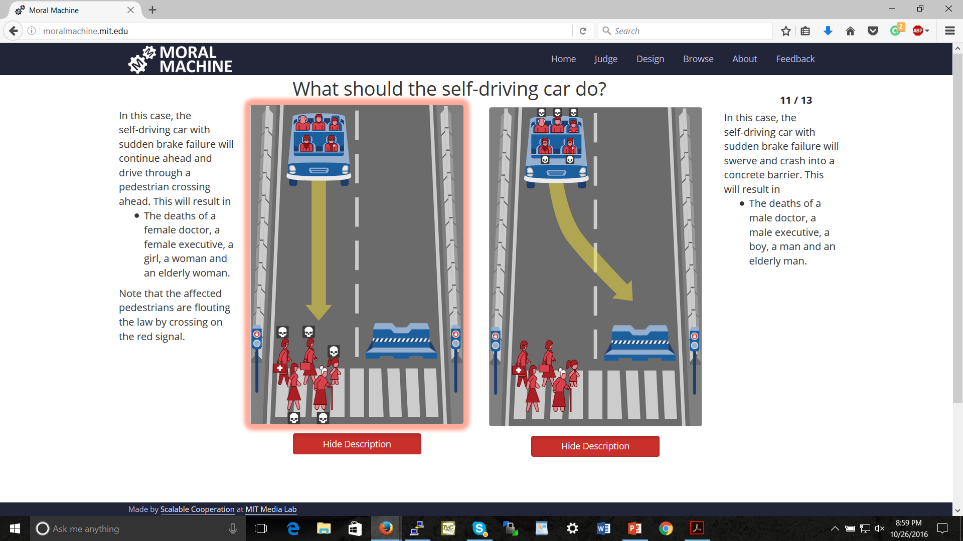
Bonnefon, Shariff, Rahwan, “The social dilemma of autonomous vehicles.” Science 2016
Noothigattu et al., “A Voting-Based System for Ethical Decision Making”, AAAI’18

Slide 11
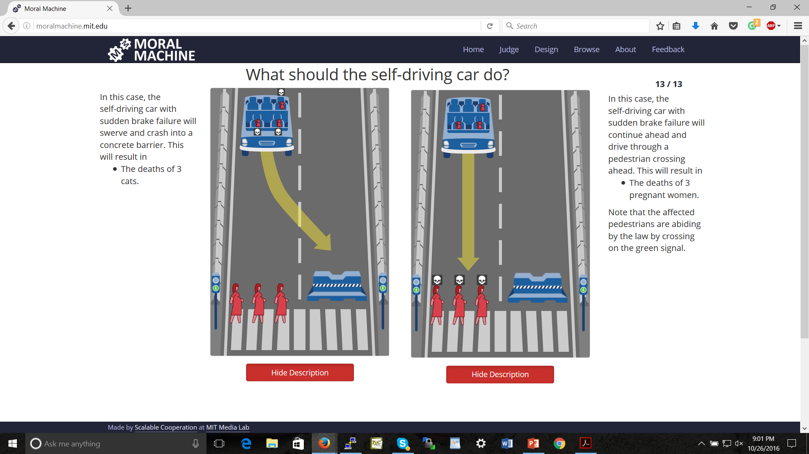

Slide 12
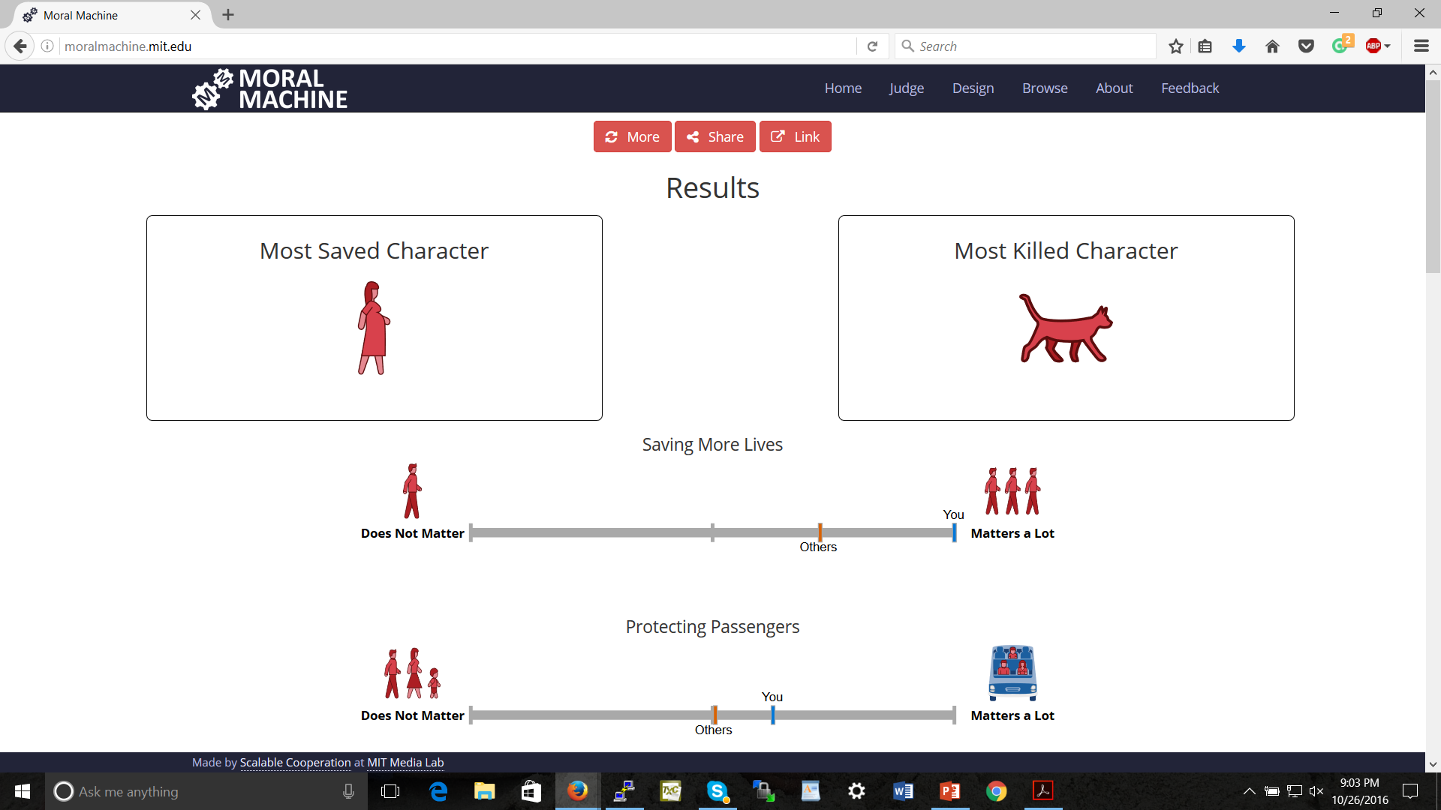

Slide 13
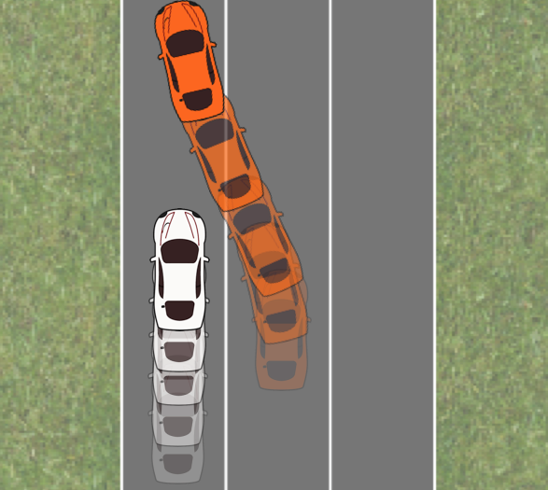
The Merging Problem
[Sadigh, Sastry, Seshia, and Dragan, RSS 2016]
(thanks to Anca Dragan for the image)

Slide 14


Adapting a Kidney Exchange Algorithm to Align with Human Values
[Artificial Intelligence (AIJ) 2020] with:
Rachel Freedman
Jana Schaich Borg
Walter Sinnott-Armstrong
John P. Dickerson

Slide 15


Slide 16
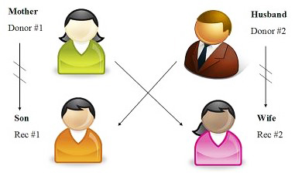
Kidney exchange [Roth, Sönmez, and Ünver 2004]
Kidney exchanges allow patients with willing but incompatible live donors to swap donors

Slide 17
Kidney exchange [Roth, Sönmez, and Ünver 2004]
Kidney exchanges allow patients with willing but incompatible live donors to swap donors
Algorithms developed in the AI community are used to find optimal matchings (starting with Abraham, Blum, Sandholm [2007])

Slide 18
Another example

Slide 19
Eliciting attributes

Slide 20
Different profiles for our study

Slide 21
MTurkers’ judgments

Slide 22
Bradley-Terry model scores

Slide 23
Effect of tiebreaking by profiles

Slide 24
Monotone transformations of the weights make little difference

Slide 25
Classes of pairs of blood types
[Ashlagi and Roth 2014; Toulis and Parkes 2015]
When generating sufficiently large random markets, patient-donor pairs’ situations can be categorized according to their blood types
Underdemanded pairs contain a patient with blood type O, a donor with blood type AB, or both
Overdemanded pairs contain a patient with blood type AB, a donor with blood type O, or both
Self-demanded pairs contain a patient and donor with the same blood type
Reciprocally demanded pairs contain one person with blood type A, and one person with blood type B

Slide 26
Most of the effect is felt by underdemanded pairs

Slide 27

A PAC Learning Framework for Aggregating Agents’ Judgments [AAAI’19]
How many subjects do we need to query?
How many queries do we need to ask each of them?
with:
Hanrui Zhang

Slide 28
Learning from agents’ judgments
features (e.g., is the patient on the left younger?)
label (e.g., should we prefer the patient on the left?)
conjunctions that fit individuals perfectly
conjunction that fits all data best (two mistakes)

Slide 29
Our model
“correct” concept we wish to learn
…
…
individual agents’ noisy versions of the concept
…
…
feature values of individual example shown to agent j
label given to this example by j (according to noisy concept)

Slide 31



Artificial Artificial Intelligence: Measuring Influence of AI "Assessments" on Moral Decision-Making
[AI, Ethics, and Society (AIES) Conference’20] with:
Lok Chan
Kenzie Doyle
Duncan McElfresh
John P. Dickerson
Jana Schaich Borg
Walter Sinnott-Armstrong

Slide 32
“[according to our AI] you care more about the life expectancy of the patients than how many dependents they have”
p = 0.056
p = 0.057

Slide 33
“[according to expert psychologists] you care more about the life expectancy of the patients than how many dependents they have”
p < 0.001
p = 0.15

Slide 34
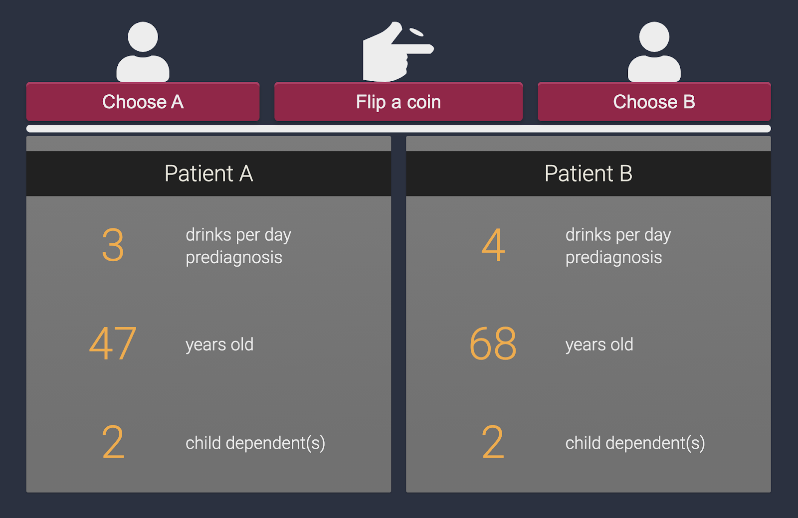
Indecision modeling [AAAI’21]
with:
Duncan McElfresh
Lok Chan
Kenzie Doyle
Walter Sinnott-Armstrong
Jana Schaich Borg
John P. Dickerson

Slide 35
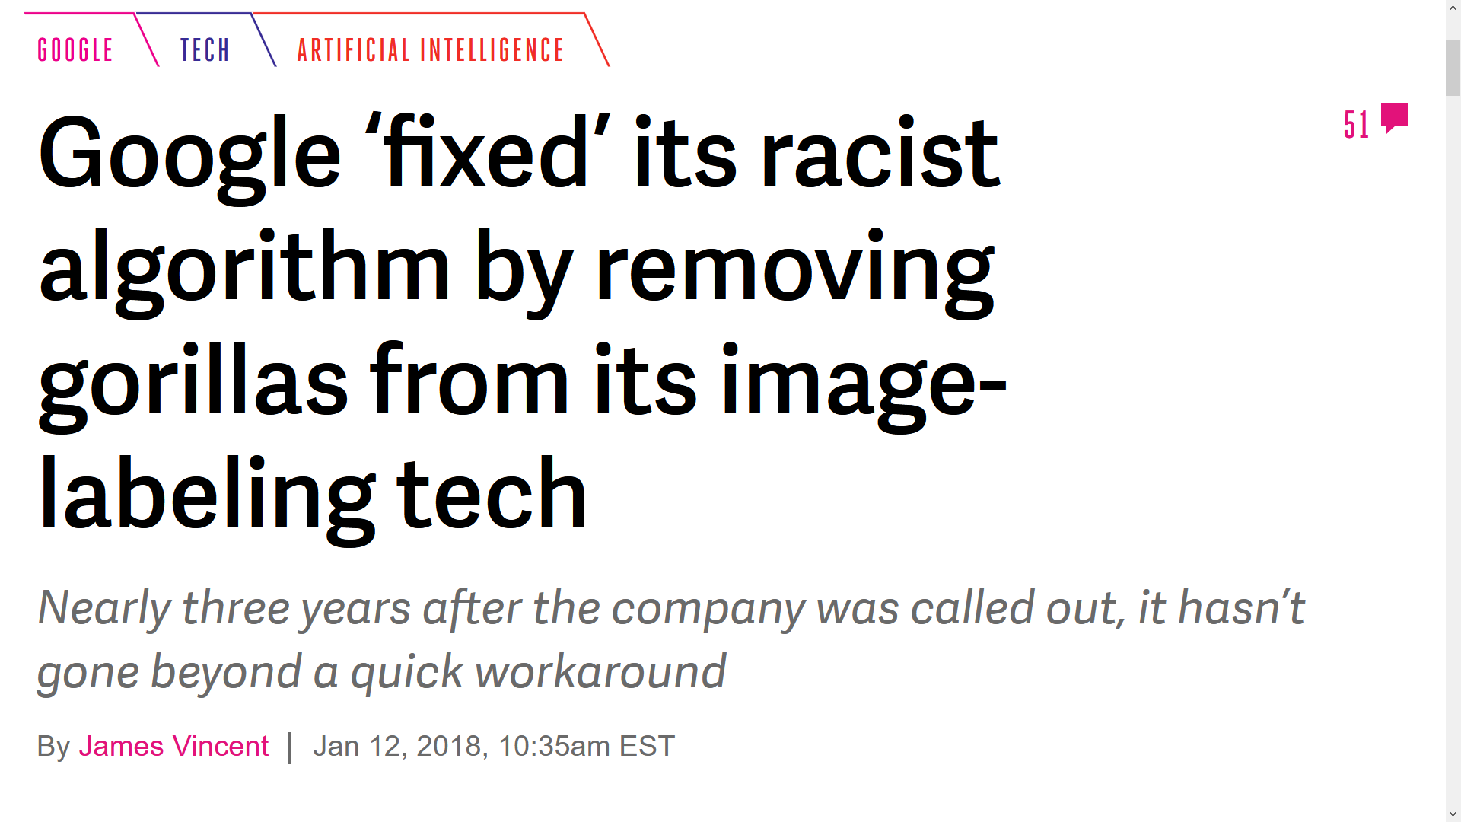
Many open research directions…
Eliciting on global outcomes vs. local outcomes
Can we help people develop better moral reasoning?
Applications involving perception
preference elicitation / ML / statistics
(computational) social choice
ethics and philosophy
behavioral sciences

