Slide 1
Mechanism Design & Automated Mechanism Design
Tuomas Sandholm

Slide 2
Outline
Introduction
Mechanism design basics
Single-item
Multi-item
Automated mechanism design (AMD)
Sample complexity guarantees for automated mechanism design

Slide 3

Mechanism design
Field of game theory with significant real-world impact.
Encompasses areas such as pricing and auction design.
Notes:
Mechanism design is a field of game theory with tremendous real-world impact, encompassing areas such as pricing and auction design.

Slide 4

Amazon’s profit swells to $1.6 billion
[NY Times ‘18]
Bidding in government auction of airwaves reaches $34 billion
[NYTimes ‘14]
Very-large-scale generalized combinatorial multi-attribute auctions: Lessons from conducting $60B of sourcing
[Sandholm, chapter in Handbook of Market Design, 2013]
Notes:
Determining how to design auctions and set prices is a challenging problem with tremendous real-world impact. Amazon has to decide how to price each item it sells.

Slide 5

Amazon’s profit swells to $1.6 billion
[NY Times ‘18]
Bidding in government auction of airwaves reaches $34B
[NYTimes ‘14]
Notes:
Determining how to design auctions and set prices is a challenging problem with tremendous real-world impact. Amazon has to decide how to price each item it sells.

Slide 6

Amazon’s profit swells to $1.6B
[NY Times ‘18]
Notes:
Determining how to design auctions and set prices is a challenging problem with tremendous real-world impact. Amazon has to decide how to price each item it sells.

Slide 7

Amazon’s profit swells to $1.6 billion
[NY Times ‘18]
Bidding in government auction of airwaves reaches $34 billion
[NYTimes ‘14]
Very-large-scale generalized combinatorial multi-attribute auctions: Lessons from conducting $60 billion of sourcing
[Sandholm ‘13]
 | Ad rev. in 2016 | Total rev. in 2016
Google | $79 B | $89.46 B
Facebook | $27 B | $27.64 B
Notes:
As we said at the beginning of this tutorial, large internet companies garner a huge amount of their revenue from ad auctions.

Slide 8

Automated mechanism design [Conitzer and Sandholm, UAI’02; Sandholm CP’03]
Use optimization, ML, & data to design mechanisms
Helps overcome challenges faced by manual approaches:
2 items for sale: Revenue-maximizing mechanism unknown
Notes:
A powerful approach in this field is automated mechanism design, which uses machine learning and optimization to design mechanisms based on data. This automated approach helps overcome challenges faced by traditional, manual approaches to mechanism design, which have been stuck for decades due to inherent computational complexity challenges: the revenue-maximizing mechanism is not known even for just two items for sale! In this tutorial, we cover the rapidly growing area of automated mechanism design for revenue maximization. We’ll give both statistical guarantees and describe real-world success stories.

Slide 9
Automated mechanism design [Conitzer and Sandholm, UAI’02; Sandholm CP’03]
Use optimization, ML, & data to design mechanisms
Helps overcome challenges faced by manual approaches:
2 items for sale: Revenue-maximizing mechanism unknown
In these two lectures, we:
Cover optimization algorithms
Provide statistical guarantees
Techniques of independent interest (we believe) to ML theory
Notes:
A powerful approach in this field is automated mechanism design, which uses machine learning and optimization to design mechanisms based on data. This automated approach helps overcome challenges faced by traditional, manual approaches to mechanism design, which have been stuck for decades due to inherent computational complexity challenges: the revenue-maximizing mechanism is not known even for just two items for sale! In this tutorial, we cover the rapidly growing area of automated mechanism design for revenue maximization. We’ll give both statistical guarantees and describe real-world success stories.

Slide 10
Outline
Introduction
Mechanism design basics
Automated mechanism design (AMD)
Sample complexity guarantees for AMD

Slide 11









Mechanism design for sales settings
There’s a set of items for sale and a set of buyers
At a high level, a mechanism determines:
Which buyers receive which items
What they pay
$v_{i}$ : 2
$v_{i}$ : 2
$v_{i}$ : 3
$v_{i}$ : 2
$v_{i}$ , : 6
$v_{i}$ , : 4
Notes:
In a mechanism, there is a set of items for sale, and a set of buyers. Those buyers have values for the items. For example, this buyer values a coffee for $2, a muffin for $3, and the bundle of both the coffee and the muffin for $6. Notice that his value for the coffee and the muffin is larger than his value for the coffee plus his value for the muffin. So in his mind, the coffee and the muffin are complements. Meanwhile, this other buyer has an additive valuation. At a very high level, a mechanism designer determines 1) which buyers receive which items; and 2) what they pay. I’m going to make this slightly more concrete with a few examples.

Slide 12

Mechanism design example: Posted price mechanisms
Set a price per item
Buyers buy the items maximizing their utility
Value for items minus price
$v_{i}$ : 2
$v_{i}$ : 3
$v_{i}$ , : 6
: 1.50
: 3.50
Notes:
The first example is going to be a pricing example and the next example will be an auctions example. For simplicity to start with, let’s say there’s a single buyer and these two items for sale. We’ll generalize to multiple buyers later on. In a pricing problem, the mechanism designer gets to set a price per item. Let’s say he sets a price of $1.50 for the coffee and a price of $3.50 for the muffin. The buyer is going to choose whatever subset of the items maximizes her utility. Her utility is her value for the bundle of items, minus the price. You can really easily work out that she’ll buy both the coffee and the muffin. Her utility for just the coffee is $2 - $1.50, so that’s 50 cents. Her utility for the muffin is negative fifty cents, and her utility for both the coffee and the muffin is $6 minus $5, so that $1. Therefore, her utility is highest if she buys both the coffee and the muffin.

Slide 13
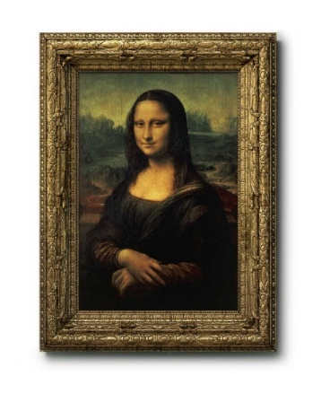

Mechanism design example: First-price auction
Highest bidder wins. Pays his bid.
$9
$7
$6
$5
Notes:
Now I’ll give an example of an auction. In an auction, there’s some set of items for sale, so in this case, there’s this painting for sale. The buyers will each submit a bid for the painting. This guy’s bid is $9, this guy’s bid is $8, and so on. In what is called a first-price auction, the highest bidder wins the item, and he pays his own bid. So in this case, this yellow buyer will win, and he’ll pay his bid, which is $9.

Slide 14
Mechanism design example: Second-price auction
Highest bidder wins. Pays second highest bid.
$9
$7
$6
$5
Notes:
A second-price auction is similar, but it has several desirable properties which we’ll discuss later. In a second price auction, again, the highest bidder will win, but he’ll pay the second-highest bid. So in this case, again, the yellow buyer will win, but this time he’ll pay $8 rather than $9, since $8 is the second-highest bid.

Slide 15
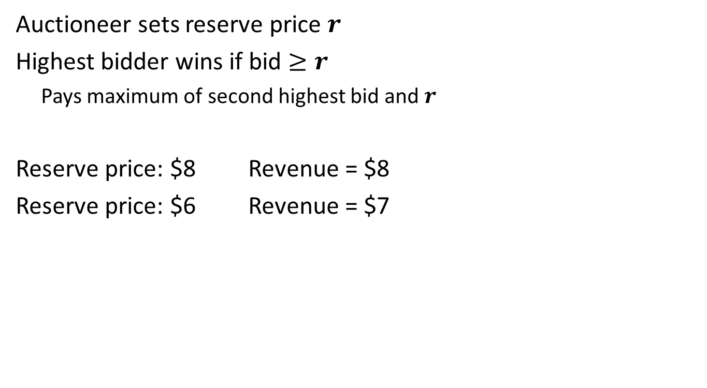
Mechanism design example: Second-price auction with a reserve
Auctioneer sets reserve price $r$
Highest bidder wins if bid $≥r$
Pays maximum of second highest bid and $r$
Reserve price: $8 Revenue = $8
Reserve price: $6 Revenue = $7
$9
$7
$6
$5
Notes:
A second-price auction is similar, but it has several desirable properties which we’ll discuss later. In a second price auction, again, the highest bidder will win, but he’ll pay the second-highest bid. So in this case, again, the yellow buyer will win, but this time he’ll pay $8 rather than $9, since $8 is the second-highest bid.

Slide 16
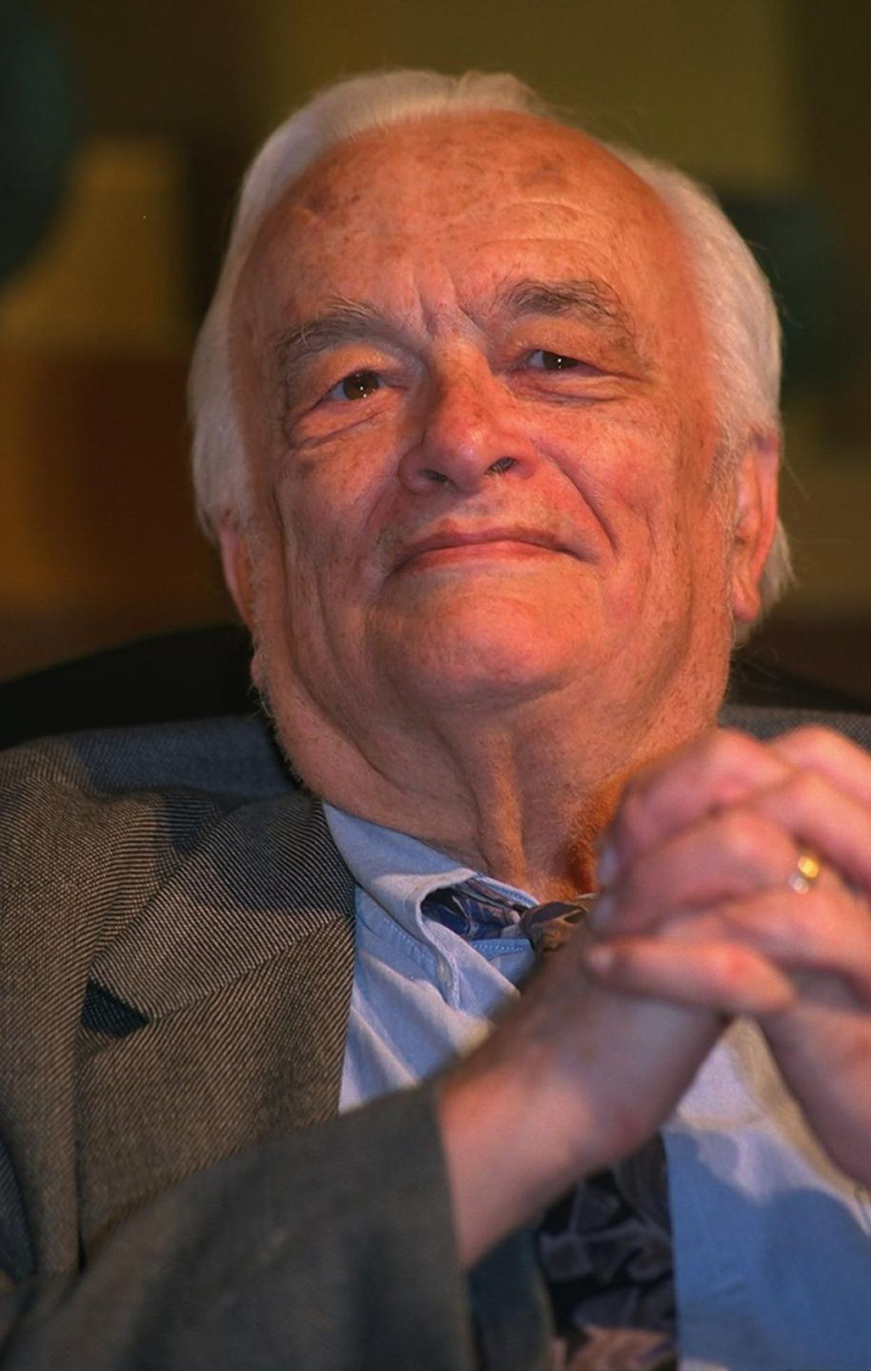
Second-price auction
1961: Introduced by Vickrey
Vickrey, William. "Counterspeculation, auctions, and competitive sealed tenders." The Journal of finance 16.1 (1961): 8-37.
1996: He won Nobel Prize
Studied extensively in CS
[E.g., Sandholm, Intl. J. Electronic Commerce ’00; Cesa-Bianchi, Gentile, and Mansour, IEEE Transactions on Information Theory, ‘15; Daskalakis and Syrgkanis, FOCS’16].
Notes:
As a side-note, the second-price auction is also commonly referred to as the Vickrey auction, named after William Vickrey. He won the Nobel prize in 1996.

Slide 17


Notation
There are $m$ items and $n$ buyers
Each buyer $i$ has value $v_{i}(b)∈ℝ$ for each bundle $b⊆[m]$
Let $v_{i}=\left(v_{i}\left(b_{1}\right),…,v_{i}\left(b_{2^{m}}\right)\right)$ for all $b_{1},…,b_{2^{m}}⊆\left[m\right]$
Buyer $i$’s “type”
Notes:
Now I want to talk about mechanisms slightly more formally. Throughout this talk, we’re going to say that there are m items for sale and n buyers. Each buyer has a value for each bundle of items. A bundle is a subset b of this set of m items. We denote buyer i’s value for a bundle b as vi(b). We’re often going to talk about vectors of valuations. We’ll denote buyer i’s value for all of the bundles, of which there are 2^m, as this vector v_i. To give an example, let’s say again there are these two items, so m = 2. Let’s say buyer i’s value for the empty set is 0, his value for the coffee is 2, his value for the muffin is 3, and his value for the pair is 6. This vector vi is going to have 4 components. In particular, the vector will be 0 2 3 6.

Slide 18










Notation
There are $m$ items and $n$ buyers
Each buyer $i$ has value $v_{i}(b)∈ℝ$ for each bundle $b⊆[m]$
Let $v_{i}=\left(v_{i}\left(b_{1}\right),…,v_{i}\left(b_{2^{m}}\right)\right)$ for all $b_{1},…,b_{2^{m}}⊆\left[m\right]$
Buyer $i$’s “type”
Example
Items = { , }
$v_{i}= v_{i}$ , $v_{i}$ , $v_{i}$ , $v_{i}$ , f
$v_{i}$ = 0
$v_{i}$ = 2
$v_{i}$ = 3
$v_{i}$ , = 6
$$∅$$
$$∅$$
6
0
2
3
Notes:
Now I want to talk about mechanisms slightly more formally. Throughout this talk, we’re going to say that there are m items for sale and n buyers. Each buyer has a value for each bundle of items. A bundle is a subset b of this set of m items. We denote buyer i’s value for a bundle b as vi(b). We’re often going to talk about vectors of valuations. We’ll denote buyer i’s value for all of the bundles, of which there are 2^m, as this vector v_i. To give an example, let’s say again there are these two items, so m = 2. Let’s say buyer i’s value for the empty set is 0, his value for the coffee is 2, his value for the muffin is 3, and his value for the pair is 6. This vector vi is going to have 4 components. In particular, the vector will be 0 2 3 6.

Slide 19

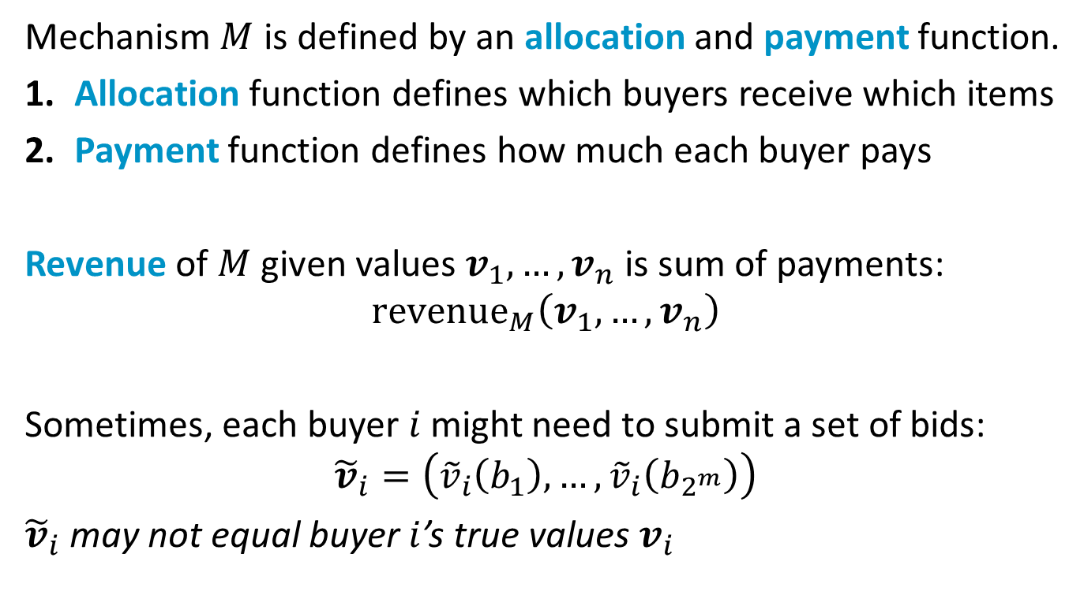
What exactly is a mechanism? (In sale settings)
Mechanism $M$ is defined by an allocation and payment function.
Allocation function defines which buyers receive which items
Payment function defines how much each buyer pays
Revenue of $M$ given values $v_{1},…,v_{n}$ is sum of payments:
$${revenue}_{M}\left(v_{1},…,v_{n}\right)$$
Sometimes, each buyer $i$ might need to submit a set of bids:
$${\tilde{v}}_{i}=\left({\tilde{v}}_{i}\left(b_{1}\right),…,{\tilde{v}}_{i}\left(b_{2^{m}}\right)\right)$$
${\tilde{v}}_{i}$ may not equal buyer $i$’s true values $v_{i}$
Notes:
Now I want to use this notation to say a little more formally what a mechanism is. At its core, a mechanism, which we’ll denote as M, is defined by an allocation function and a payment function. The allocation function takes as input the buyers values and determines which buyers receive which items. The payment function determines how much each buyer pays. In this tutorial, we’re particularly concerned with the revenue of a mechanism. Given all n buyers values v1 up through vn, the revenue of the mechanism M is the sum of their payments, which we denote as revenue_m of v1 up through vn. The mechanism designer can choose these allocation and payment functions however he wants, but we’ll discuss a few constraints we might place on their form in a few slides.
Something I was glossing over is that sometimes these two functions are not going to be a function of the buyers’ values, but rather a function of their bids. In that pricing example, where we set a price for the coffee and the muffin, there were no bids, the buyer just bought their utility maximizing bundle. So then the allocation and payment functions were just functions of the buyer’s true values. But in the first and second price auctions, the allocation and payment functions were functions of the buyers’ bids, which might not necessarily equal the buyers’ values. This distinction between bids and values is something we’ll discuss in the next few slides. I’m going to denote bidder i’s bids as tilde v_i. So, tilde v_i of b is buyer i’s bid for the bundle b. It’s important to note that it might not necessarily be the case that the buyer’s bids equal their values.

Slide 20
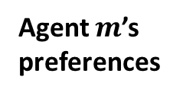
Why can we restrict attention to single-shot IC mechanisms?
Revelation principle (informal): If some allocation and payment fns are implementable by a mechanism, then there’s a single-shot incentive compatible mechanism with same payment and allocation fn
New mechanism
Agent 1’s
preferences
Strategy
formulator
Strategy
.
Original
mechanism
.
Outcome
.
Strategy
Agent $m$’s
preferences
Strategy
formulator
Mechanism lies for the agents!

Slide 21
Mechanism desiderata
We want to design mechanisms that are:
Incentive compatible
Agents’ bids equal their true values
They’re incentivized to bid truthfully
Individually rational
Agents have nothing to lose by participating
Notes:
Once we bring bids into the picture, there are a few standard properties we would like the mechanisms we design to satisfy. I’ll explain these in greater detail in the next few slides. The first property is incentive compatibility. A mechanism is incentive compatible if the agent will maximize his utility by bidding truthfully. The second property is individual rationality. The agent will not obtain negative utility by participating in the mechanism.

Slide 22

Incentive compatibility
The second-price auction is incentive compatible.
Every bidder will maximize their utility by bidding truthfully.
Why not bid above value ?
value - payment • 1 wins item
Notes:
Now I’ll illustrate what it means to be incentive compatible. The second-price auction is incentive compatible. Remember, this is where there’s a single item for sale. All buyers submit bids, the highest bidder wins, and she pays the second highest bid. The claim is that every buyer maximizes her utility by bidding truthfully. Start off by considering the allocation and payment when everyone bids truthfully. We’ll reason about why no bidder has any incentive to raise her bid. If a bidder wins, her utility is her value for the item (let’s say it’s a coffee) minus her payment. If she doesn’t win, she doesn’t pay anything, so her utility is zero. Now let’s see why this auction is incentive compatible. Why shouldn’t she bid something larger than her value for the coffee? Well if she’s the winner, she’ll still be the winner if she raises her bid. She’ll continue paying the second highest bid, so her payment won’t change. Therefore, if she’s the winner, she has no incentive to increase her bid. Meanwhile, if she didn’t win the item, she might become a winner by raising her bid. But if that’s the case, she’ll have to pay more than her value, since now the second highest bid is larger than her value. But this will give her negative utility, whereas if she bids her value, she’ll have zero utility. Therefore, if she loses, she also has no incentive to increase her bid.

Slide 23
Incentive compatibility
The second-price auction is incentive compatible.
Every bidder will maximize their utility by bidding truthfully.
Why not bid above value ?
If winner, will stay winner and price won’t change
value - payment • 1 wins item
Other bidders’ bids
True value
Bid
Notes:
Now I’ll illustrate what it means to be incentive compatible. The second-price auction is incentive compatible. Remember, this is where there’s a single item for sale. All buyers submit bids, the highest bidder wins, and she pays the second highest bid. The claim is that every buyer maximizes her utility by bidding truthfully. Start off by considering the allocation and payment when everyone bids truthfully. We’ll reason about why no bidder has any incentive to raise her bid. If a bidder wins, her utility is her value for the item (let’s say it’s a coffee) minus her payment. If she doesn’t win, she doesn’t pay anything, so her utility is zero. Now let’s see why this auction is incentive compatible. Why shouldn’t she bid something larger than her value for the coffee? Well if she’s the winner, she’ll still be the winner if she raises her bid. She’ll continue paying the second highest bid, so her payment won’t change. Therefore, if she’s the winner, she has no incentive to increase her bid. Meanwhile, if she didn’t win the item, she might become a winner by raising her bid. But if that’s the case, she’ll have to pay more than her value, since now the second highest bid is larger than her value. But this will give her negative utility, whereas if she bids her value, she’ll have zero utility. Therefore, if she loses, she also has no incentive to increase her bid.

Slide 24
Incentive compatibility
The second-price auction is incentive compatible.
Every bidder will maximize their utility by bidding truthfully.
Why not bid above value ?
If winner, will stay winner and price won’t change
If loser, might become winner, but will pay more than value
value - payment • 1 wins item
Other bidder’s bid
True value
Other bidder’s bid
Bid
Notes:
Now I’ll illustrate what it means to be incentive compatible. The second-price auction is incentive compatible. Remember, this is where there’s a single item for sale. All buyers submit bids, the highest bidder wins, and she pays the second highest bid. The claim is that every buyer maximizes her utility by bidding truthfully. Start off by considering the allocation and payment when everyone bids truthfully. We’ll reason about why no bidder has any incentive to raise her bid. If a bidder wins, her utility is her value for the item (let’s say it’s a coffee) minus her payment. If she doesn’t win, she doesn’t pay anything, so her utility is zero. Now let’s see why this auction is incentive compatible. Why shouldn’t she bid something larger than her value for the coffee? Well if she’s the winner, she’ll still be the winner if she raises her bid. She’ll continue paying the second highest bid, so her payment won’t change. Therefore, if she’s the winner, she has no incentive to increase her bid. Meanwhile, if she didn’t win the item, she might become a winner by raising her bid. But if that’s the case, she’ll have to pay more than her value, since now the second highest bid is larger than her value. But this will give her negative utility, whereas if she bids her value, she’ll have zero utility. Therefore, if she loses, she also has no incentive to increase her bid.

Slide 25
Incentive compatibility
The second-price auction is incentive compatible.
Every bidder will maximize their utility by bidding truthfully.
Why not bid below value ?
value - payment • 1 wins item
Notes:
Now I’ll illustrate what it means to be incentive compatible. The second-price auction is incentive compatible. Remember, this is where there’s a single item for sale. All buyers submit bids, the highest bidder wins, and she pays the second highest bid. The claim is that every buyer maximizes her utility by bidding truthfully. Start off by considering the allocation and payment when everyone bids truthfully. We’ll reason about why no bidder has any incentive to raise her bid. If a bidder wins, her utility is her value for the item (let’s say it’s a coffee) minus her payment. If she doesn’t win, she doesn’t pay anything, so her utility is zero. Now let’s see why this auction is incentive compatible. Why shouldn’t she bid something larger than her value for the coffee? Well if she’s the winner, she’ll still be the winner if she raises her bid. She’ll continue paying the second highest bid, so her payment won’t change. Therefore, if she’s the winner, she has no incentive to increase her bid. Meanwhile, if she didn’t win the item, she might become a winner by raising her bid. But if that’s the case, she’ll have to pay more than her value, since now the second highest bid is larger than her value. But this will give her negative utility, whereas if she bids her value, she’ll have zero utility. Therefore, if she loses, she also has no incentive to increase her bid.

Slide 26
Incentive compatibility
The second-price auction is incentive compatible.
Every bidder will maximize their utility by bidding truthfully.
Why not bid below value ?
If winner, might become loser; shift from non-negative to zero utility
value - payment • 1 wins item
Other bidder’s bid
Other bidder’s bid
True value
Bid
Notes:
Now I’ll illustrate what it means to be incentive compatible. The second-price auction is incentive compatible. Remember, this is where there’s a single item for sale. All buyers submit bids, the highest bidder wins, and she pays the second highest bid. The claim is that every buyer maximizes her utility by bidding truthfully. Start off by considering the allocation and payment when everyone bids truthfully. We’ll reason about why no bidder has any incentive to raise her bid. If a bidder wins, her utility is her value for the item (let’s say it’s a coffee) minus her payment. If she doesn’t win, she doesn’t pay anything, so her utility is zero. Now let’s see why this auction is incentive compatible. Why shouldn’t she bid something larger than her value for the coffee? Well if she’s the winner, she’ll still be the winner if she raises her bid. She’ll continue paying the second highest bid, so her payment won’t change. Therefore, if she’s the winner, she has no incentive to increase her bid. Meanwhile, if she didn’t win the item, she might become a winner by raising her bid. But if that’s the case, she’ll have to pay more than her value, since now the second highest bid is larger than her value. But this will give her negative utility, whereas if she bids her value, she’ll have zero utility. Therefore, if she loses, she also has no incentive to increase her bid.

Slide 27
Incentive compatibility
The second-price auction is incentive compatible.
Every bidder will maximize their utility by bidding truthfully.
Why not bid below value ?
If winner, might become loser; shift from non-negative to zero utility
If loser, will still be loser, so utility will still be zero
value - payment • 1 wins item
Other bidder’s bid
True value
Other bidder’s bid
Bid
Notes:
Now I’ll illustrate what it means to be incentive compatible. The second-price auction is incentive compatible. Remember, this is where there’s a single item for sale. All buyers submit bids, the highest bidder wins, and she pays the second highest bid. The claim is that every buyer maximizes her utility by bidding truthfully. Start off by considering the allocation and payment when everyone bids truthfully. We’ll reason about why no bidder has any incentive to raise her bid. If a bidder wins, her utility is her value for the item (let’s say it’s a coffee) minus her payment. If she doesn’t win, she doesn’t pay anything, so her utility is zero. Now let’s see why this auction is incentive compatible. Why shouldn’t she bid something larger than her value for the coffee? Well if she’s the winner, she’ll still be the winner if she raises her bid. She’ll continue paying the second highest bid, so her payment won’t change. Therefore, if she’s the winner, she has no incentive to increase her bid. Meanwhile, if she didn’t win the item, she might become a winner by raising her bid. But if that’s the case, she’ll have to pay more than her value, since now the second highest bid is larger than her value. But this will give her negative utility, whereas if she bids her value, she’ll have zero utility. Therefore, if she loses, she also has no incentive to increase her bid.

Slide 28
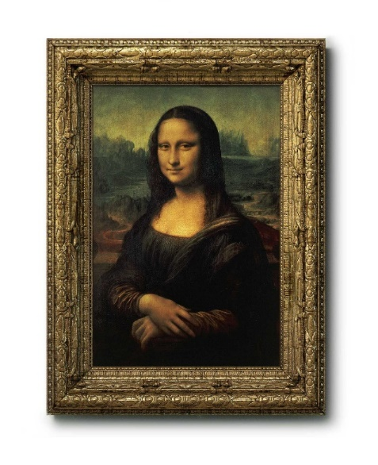


Individual rationality
The second-price auction is individually rational.
Each bidder is no worse off participating than not, when truthful
Bidders pay nothing or their payment is smaller than their value.
$9
$7
$6
$5
Notes:
Remember, the other property we want the mechanisms we design to fulfill is what’s called individual rationality. This means the individual has nothing to lose by participating in the mechanism. The second-price auction is also individually rational so long as the buyers actually bid truthfully. This is because the buyers will either lose and pay nothing, in which case their utility is zero, or they will win and pay the second-highest bid, which is smaller than their value assuming they bid truthfully. So no buyer will obtain negative utility from participating in the auction.

Slide 29


A bit more formally…
Standard assumption
Buyers’ values are drawn from a probability distribution.
Example
$\left(v_{1},…,v_{n}\right)\sim 𝒟$, where $v_{i}= v_{i}\text{ , }v_{i}\text{ , }v_{i}\text{ , }v_{i}\text{ , }$
$$∅$$
Notes:
I want to talk about individual rationality and incentive compatibility a bit more formally, so I’m going to introduce a standard definition, made for decades in economics. This assumption is pretty central to this talk is key to understanding why machine learning is a natural tool for mechanism design. This standard assumption states that the buyers’ values are defined by some probability distribution over all the possible values they might have for all bundles of the items for sale. So again in this example where there are two items for sale, this means there’s some distribution D whose support is in (4n)-dimensional space, from which these valuation vectors are drawn.

Slide 30
Different types of incentive compatibility
Ex ante
Ex interim
Ex post
Each bidder knows:
Distribution
Own values
All bidders’ values
Ex ante IC:
Bidders should be truthful in expectation over all bidders’ values
Ex interim IC:
Bidders should be truthful in expectation over others’ values
Ex post IC:
Given all of the bidders’ values, the bidders should be truthful
Can similarly define ex ante, ex interim, and ex post
individual rationality
Notes:
Once we have this notion of a distribution over buyers’ values, we can discuss incentive compatibility a bit more formally. There are three types of incentive compatibility: ex ante, ex interim, and ex post, corresponding to, essentially, what it means to be incentive compatible at the beginning, middle, and end of the mechanism design procedure. Let’s start with ex ante incentive compatibility. Consider the very beginning of the mechanism, and suppose that every bidder knows the distribution from which all bidders’ values are drawn, but doesn’t know his own value. The bidders’ actual values have yet to be drawn. At this stage, a mechanism is ex ante incentive compatible if for each bidder, in expectation over all bidders’ values, she will maximizer her expected utility by bidding truthfully.
The next type of incentive compatibility I want to discuss is ex interim incentive compatibility, which corresponds, roughly to the middle of the mechanism. This takes ex ante one step further: the buyers know the distribution from which all buyers’ values are drawn, and they know their own value. So the values have actually been drawn at this point, and every bidder knows his own value, but doesn’t know anyone else’s value. A mechanism is ex interim incentive compatible if in expectation over all the other bidders’ values, the bidder will maximize her expected utility by bidding truthfully.
The last type of incentive compatibility we’ll talk about is ex post incentive compatibility. This corresponds to the end of the mechanism. This takes the ex interim setup one step farther, stating that every bidder knows his own value and all other bidders’ values. A mechanism is ex post incentive compatible if for every bidder, no matter his own value and all the other bidders’ values, she will maximize her utility by bidding truthfully.
As you can probably imagine, we can similarly define ex ante, ex interim, and ex post individual rationality, though I won’t go through that here.

Slide 31
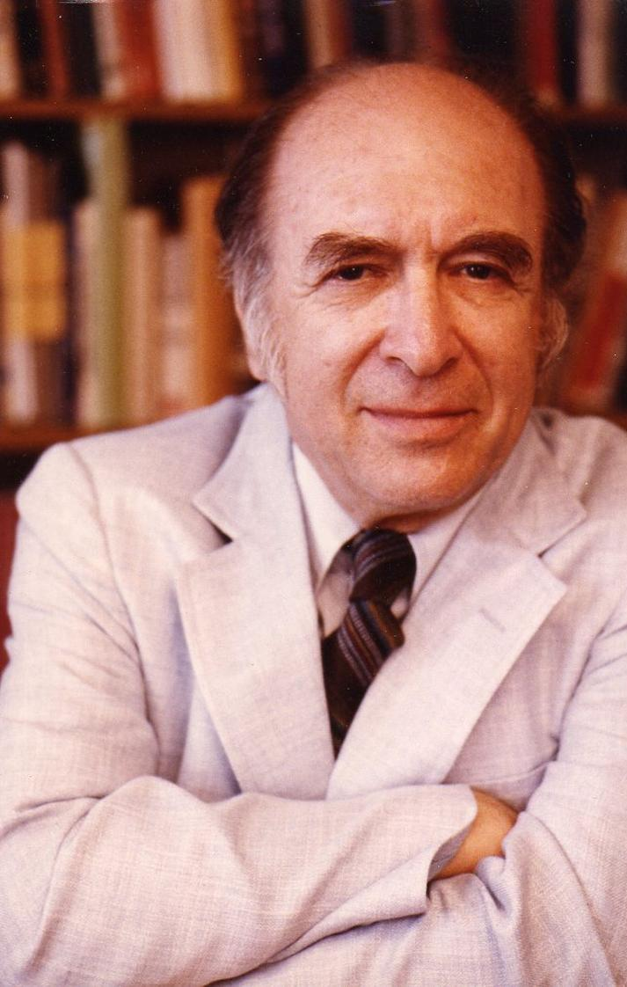
Incentive compatibility
1972: Hurwicz introduced IC
2007: He won Nobel prize
L. Hurwicz. On Informationally Decentralized Systems. Decision and Organization, edited by C.B. McGuire and R. Radner. 1972.
Notes:
On a historical note, it was Leonid Hurwicz who in 1972 introduced the notion of incentive compatibility. He went on to win the 2007 Nobel Prize in Economics for his work on mechanism design.

Slide 32

Optimal single-item sales mechanism
1981: Myerson discovered “optimal” 1-item auction
2007: Won Nobel prize
R. Myerson. Optimal auction design. Mathematics of Operations Research, 6(1):58–73, 1981.
Revenue-maximizing
Notes:
Roger Myerson shared the 2007 Nobel prize with Hurwicz, which brings me to optimal single-item auctions. Myerson discovered the revenue maximizing single-item, multi-bidder auction. In this literature, “optimal” translates to revenue-maximizing.

Slide 33

Optimal single-item auctions
What’s the problem with second-price auction?
Strong bidder typically wins and pays weak bidder’s bid
Leaves revenue on the table!
Weak bidder
Strong bidder
Density
value
Myerson’s optimal auction boosts weak bidders’ bids
Creates extra competition while maintaining IC
Notes:
I’ll go through the definition of Myerson’s optimal auction, but first I want to give a little bit of intuition. What’s the problem with the second-price auction – why wouldn’t that be revenue maximizing? Let’s consider a scenario where there’s a weak bidder whose bids are typically small and a strong bidder whose bids are typically large. Most of the time, the strong bidder is going to win and pay the weak bidder’s bid. We’re losing a lot of revenue. Myerson’s auction boosts these weak bidders’ bids so that they’re competitive with the strong bidders’ bids. In this way, it creates competition for the strong bidder, and the amazing fact is that it remains incentive compatible.

Slide 34


Optimal single-item auctions
Bidder $i$’s value distribution has PDF $f_{i}$, CDF $F_{i}$, support in [0, 1]
Myerson’s optimal auction
Let $φ_{i}\left(t\right)=t−\frac{1−F_{i}(t)}{f_{i}(t)}$. Solicit bids ${\tilde{v}}_{1},…,{\tilde{v}}_{n}$ from buyers
If all virtual values $φ_{1}\left({\tilde{v}}_{1}\right),…,φ_{n}\left({\tilde{v}}_{n}\right)<0$, don’t allocate item
Else allocate item to buyer $i^{∗}$ with highest virtual value $φ_{i}\left({\tilde{v}}_{i}\right)$
Charge bidder $i^{∗}$ her threshold bid (min she could bid and win):
$$φ_{i^{∗}}^{−1}\left(\max\left(0, {\left\{φ_{i^{∗}}\left({\tilde{v}}_{j}\right)\right\}}_{j≠i^{∗}}\right) \right)$$
Notes:
Myerson’s auction specifically applies in the case when the buyers’ values are independently but not identically distributed. So let’s say that bidder i’s value distribution has a probability density function of fi, a CDF of Fi, and support in [0,1]. We’re going to transform the bids using what’s called a virtual value function. Bidder i’s virtual valuation function is defined as phi_i(x) which equals x minus 1 – F_i(x) divided by f_i(x). The auctioneer is going to solicit bids tilde v_1 up through tilde v_n from the buyers. We’re going to transform all of these bids using the virtual valuation functions, so now we have n different virtual values for all the bidders. If all of these virtual values are smaller then zero, then we’re not going to allocate the item. Otherwise, we’re going to allocate the item to the buyer i* who has the highest virtual value. We’ll charge that winning bidder what’s called her “threshold bid.” This is the minimum value she could bid and still win. That specific value is written mathematically here. Myerson’s optimal auction is defined here for a single unit of a single good, but it was later extended to the case where there are multiple units of a single good for sale.

Slide 35
Myerson’s auction: Key proof insights
Auction
Lemma: Allocation function can be paired with payments so resulting mechanism is IC $⇔$ allocation function is monotone (bid more $⇒$ get more).
Payment function is unique: for monotone allocation function $x$, given values $v_{1},…,v_{n}$, bidder $i$ pays $\int_{0}^{v_{i}}{z∙\frac{d}{dz}x_{i}\left(z,v_{−i}\right)dz}$.
Virtual values:
$φ_{i}\left(v_{i}\right)=v_{i}−\frac{1−F_{i}(v_{i})}{f_{i}(v_{i})}$.
No one wins if virtual values < 0. Else winner has max $φ_{i}\left(v_{i}\right)$.
Charge winner her threshold bid.
Claim: $𝔼 \text{[}\text{Revenue}\text{] = }𝔼 \text{[}\text{Virtual} \text{welfare}\text{]}$
How much buyers value allocations, if true values replaced by virtual values.
Notes:
Now I’ll go through some of the key insights from the proof that Myerson’s auction is revenue-maximizing. The key building-block is this lemma by Myerson. Remember, an allocation function says which bidders receive which items based on the bids. Myerson’s lemma says that an allocation function can be paired with a payment function so that the resulting mechanism is incentive compatible if and only if that allocation function is monotone. Monotone means that the more you bid, the more you get. That’s pretty simple characterization of all allocation functions that give rise to an IC mechanism. Additionally, that payment function corresponding to a monotone allocation function is unique. I’ve written it here in case anyone is interested, though it’s not necessary to completely understand this. Given a monotone allocation function x and bids v1 up through vn, bidder i pays the integral from 0 to their bid of z times the derivative of their allocation function, where z is changing and all the other bidders’ bids are fixed.
Given a monotone allocation function, we can use the payment function from Myerson’s lemma to write this formula for the expected revenue. Remarkably, we can deduce that expected revenue of this mechanism equals its expected virtual welfare. By expected virtual welfare, I mean how much the buyers would value their allocation if their true values were replaced by their virtual values.

Slide 36

Myerson’s auction: Key proof insights
Auction
Lemma: Allocation function can be paired with payments so resulting mechanism is IC $⇔$ allocation function is monotone (bid more $⇒$ get more).
Payment function is unique: for monotone allocation function $x$, given values $v_{1},…,v_{n}$, bidder $i$ pays $\int_{0}^{v_{i}}{z∙\frac{d}{dz}x_{i}\left(z,v_{−i}\right)dz}$.
Virtual values:
$φ_{i}\left(v_{i}\right)=v_{i}−\frac{1−F_{i}(v_{i})}{f_{i}(v_{i})}$.
No one wins if virtual values < 0. Else winner has max $φ_{i}\left(v_{i}\right)$.
Charge winner her threshold bid.
Claim: $𝔼 \text{[}\text{Revenue}\text{] = }𝔼 \text{[}\text{Virtual} \text{welfare}\text{]}$
Why? Given monotone allocation function $x\left(v\right)$, with a little calculus, virtual value pops out of revenue:
$𝔼\left[Revenue\right]=𝔼\left[\sum_{i=1}^{n}{\int_{0}^{v_{i}}{z∙\frac{d}{dz}x_{i}\left(z,v_{−i}\right)dz}}\right]=⋯=𝔼\left[\sum_{i=1}^{n}{φ_{i}\left(v_{i}\right)}x_{i}\left(v\right)\right]$.
How much buyers value allocations, if true values replaced by virtual values.
Choose $x$ so virtual welfare is maximized!
(Give item to buyer with highest non-negative virtual value.)
Notes:
Why is this the case? Using little bit of calculus, like changing the order of integration, integration by parts, and so on, the virtual valuation function from the previous slide pops out. This is the sum, over all buyers, of their virtual value, which we defined on the previous slide, multiplied by whether or not they got the good. So like I said, the expected revenue equals the expected virtual welfare.
Now, all we have to do to find the revenue maximizing auction is to find the allocation function so that this virtual welfare is maximized. Then the payment function will fall out of this lemma by Myerson. To maximize virtual welfare, we just give the item to the buyer with the highest non-negative virtual value, or to no one if everyone’s virtual value is negative. The resulting mechanism is Myerson’s optimal auction.

Slide 37
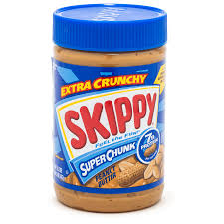

Optimal single-item auctions
When buyers’ values are i.i.d.:
Equivalent to 2nd-price auction with reserve of $φ_{i}^{−1}\left(0\right)$
Extended to selling multiple units of an item [Maskin & Riley, ‘89]
Notes:
Myerson’s auction specifically applies in the case when the buyers’ values are independently but not identically distributed. So let’s say that bidder i’s value distribution has a probability density function of fi, a CDF of Fi, and support in [0,1]. We’re going to transform the bids using what’s called a virtual value function. Bidder i’s virtual valuation function is defined as phi_i(x) which equals x minus 1 – F_i(x) divided by f_i(x). The auctioneer is going to solicit bids tilde v_1 up through tilde v_n from the buyers. We’re going to transform all of these bids using the virtual valuation functions, so now we have n different virtual values for all the bidders. If all of these virtual values are smaller then zero, then we’re not going to allocate the item. Otherwise, we’re going to allocate the item to the buyer i* who has the highest virtual value. We’ll charge that winning bidder what’s called her “threshold bid.” This is the minimum value she could bid and still win. That specific value is written mathematically here. Myerson’s optimal auction is defined here for a single unit of a single good, but it was later extended to the case where there are multiple units of a single good for sale.

Slide 38


Major challenge: Optimal multi-item auctions
Don’t know how to sell two items optimally! Tons of work, e.g.:
Economics
E.g., Rochet, Journal of Mathematical Economics, ‘87; Avery and Hendershott, Review of Economic Studies, ’00; Armstrong, Review of Economic Studies, ’00; Thanassoulis, Journal of Economic Theory, ’04; Manelli and Vincent, Journal of Economic Theory ’06
Computer science
E.g., Conitzer and Sandholm, UAI’02, ICEC’03, EC’04; Likhodedov and Sandholm, AAAI‘04, AAAI’05; Cai and Daskalakis, FOCS’11; Cai, Daskalakis, and Weinberg, STOC’12, FOCS’12; Sandholm and Likhodedov, Operations Research ’15; Yao, SODA’15; Hart and Nisan, Journal of Economic Theory, ‘17
Notes:
Moving from single-item auctions to multi-item auctions poses significantly challenging. Remarkably, we don’t even know how to sell two items while maximizing revenue! I do want to note that several special cases of multi-item mechanism design have been solved, however. One is the case where all buyers are additive and all item values are i.i.d. Another is the case where buyers’ values come from discrete distributions with finite support. This complements a recent line of work that’s gained a lot of traction in the econ-CS community, which studies how close to optimal simple multi-item mechanisms are. This line of work proves guarantees even when you don’t know explicitly what the optimal auction looks like.

Slide 39
Outline
Introduction
Mechanism design basics
Automated mechanism design (AMD)
Sample complexity guarantees for AMD

Slide 40


Automated mechanism design (AMD) [Conitzer and Sandholm, UAI’02; Sandholm CP’03]
Solve mechanism design as a search/optimization problem automatically
Built a system for doing that
Create a mechanism for the specific setting at hand rather than a class of settings
Can lead to greater value of designer’s objective than known mechanisms
Sometimes circumvents economic impossibility results
Always minimizes the pain implied by them
Can be used in new settings & for unusual objectives
Can yield stronger incentive compatibility & participation properties
Shifts the burden of design from human to machine
Often designer has info about agents – silly to ignore
Notes:
The idea in AMD is that we want to solve the mechanism design problem as a search problem automatically, rather than manually. We built a system for doing that. The idea is that we create a mechanism for the specific setting at hand, rather than a class of settings. The advantages are: first of all, it can lead to greater value of designer’s objective than known mechanisms. Secondly, we can sometimes circumvent economic impossibility results and always minimizes the pain implied by them (sometimes they can’t be circumvented). It can be used in new settings that haven’t been analyzed in manual mechanism design to date, and it can be used for traditional settings but for unusual objectives. It can yield stronger incentive compatibility and participation properties: for example, ex post rather than ex interim. And it shifts the burden of design from the human to the machine.

Slide 41
Automated mechanism design ≠ Algorithmic mechanism design
[Conitzer and Sandholm, UAI-02] [Nisan and Ronen`01]

Slide 42
Classical vs. automated mechanism design
Classical
Prove general theorems & publish
Intuitions about
mechanism design
Real-world mechanism
design problem appears
Build mechanism
by hand
Mechanism for setting at hand
Automated
Build software
once
Real-world mechanism
design problem appears
AMD software
Mechanism for setting at hand
Notes:
Here’s the pictorial depiction of what’s going on. Classical mechanism design works like this. You prove theorems and publish, manually. Then some real-world mechanism design problem comes along. You draw intuitions from the theory and then you build a mechanism by hand using those intuitions. That’s your mechanism for the setting. In automated mechanism design, the picture is a little different. We build a software for doing this; we build it once. When the real-world mechanism design instance comes along, we feed it to the software, and the software spits out the mechanism for the setting.

Slide 43
Input
Instance is given by
Set of possible outcomes
Set of agents
For each agent
set of possible types
probability distribution over these types
utility function converting type/outcome pairs to utilities
Objective function
Gives a value for each outcome for each combination of agents’ types
E.g. payment maximization
Restrictions on the mechanism
Are side payments allowed?
Is randomization over outcomes allowed?
What concept of nonmanipulability is used?
What participation constraint notion (if any) is used?

Slide 44
Output
Mechanism
A mechanism maps combinations of agents’ revealed types to outcomes
Randomized mechanism maps to probability distributions over outcomes
Also specifies payments by agents (if payments allowed)
…which
is nonmanipulable (according to the given concept)
satisfies the given participation constraint
maximizes the expectation of the objective function

Slide 45
possible
possible
impossible
possible
type vectors
quasilinear preferences

Slide 46

Complexity of AMD
Theorem [Conitzer and Sandhom, UAI’02, ICEC’03, EC’04]
The following are NP-complete (even for 1 buyer) for designing a deterministic mechanism:
Maximizing social welfare (sum of agents’ values for their allocations) (no payments)
Maximizing designer’s utility over outcomes (no payments)
Maximizing a general (linear) objective that doesn’t regard payments
Expected revenue
Polynomial time for designing a randomized mechanism for constant #agents (LP)
But also there is a blowup in input
Exponential allocation space: (#agents +1)^{#items}
The support of the distribution over values might be doubly exponential: k^(2^{#items})
k is the number of possible values a buyer might have for a bundle

Slide 47
Classes of automated mechanism design
“Flat-representation” de novo design
Search in a parametric mechanism class
Incremental automated mechanism design

Slide 48

Two key ideas to get scalability and avoid the need to discretize type space [Likhodedov & Sandholm AAAI-04, AAAI-05, Operations Research 2015]
Don’t assume valuation distribution is given, only samples from it
AMD as search in a parametric mechanism class

Slide 49




value
~
There’s an unknown distribution over valuations.
Use a set of samples to learn a mechanism that has high expected revenue.
Multi-item
E.g., Likhodedov and Sandholm, AAAI‘04, AAAI’05; Balcan, Blum, Hartline, and Mansour, FOCS’05; Morgenstern and Roughgarden, COLT’16; Syrgkanis, NIPS’17; Cai and Daskalakis, FOCS’17; Gonczarowski and Weinberg, FOCS’18…
Single-item
E.g., Elkind, SODA’07; Dhangwatnotai, Roughgarden, and Yan, EC’10; Mohri and Medina, ICML’14; Cole and Roughgarden STOC’14…
Notes:
For the remainder of this tutorial, we’re not going to assume the mechanism designer knows the distribution over buyers’ values, since it’s not clear how he would know this distribution, and its not clear how he could store this distribution in memory, even if he knew it. Rather, we’ll assume the mechanism designer receives a set of samples from this distribution, which he uses to learn a set of prices, or an auction, which ideally will have high expected revenue on the distribution from which the samples were drawn. There’s been a ton of work in this direction, both from theoretical and applied perspectives.
Huang, Mansour, and Roughgarden, EC’15; Morgenstern and Roughgarden, NIPS’15
[E.g., Morgenstern and Roughgarden, NIPS’15, COLT’16; Roughgarden and Schrijvers, EC’16; Devanur, Huang, and Psomas, STOC’16; Goldner and Karlin, WINE’16; Syrgkanis NIPS’17; Cai and Daskalakis, FOCS’17; Albert, Conitzer, and Stone, AAMAS’17]

Slide 50














Mechanism design as a learning problem
Goal: Given large family of mechanisms and set of buyers’ values sampled from unknown distribution $𝒟$, find mechanism with high expected revenue.
Approach: Find mechanism that’s (nearly) optimal over the set of samples.
Sample 1
Sample $N$
$v_{1}$
$v_{n}$
$v_{1}$
$v_{n}$
$v_{1}$
…
$v_{n}$
…
$v_{1}$
…
$v_{n}$
$v_{1}$
$v_{n}$
$v_{1}$
$v_{n}$

Slide 51



Two key ideas to get scalability and avoid the need to discretize type space [Likhodedov & S., AAAI-04, AAAI-05; S. & Likhodedov, Operations Research-15]
Don’t assume that the distribution over bidders’ valuations is given, only samples from it
Now an active research field in TCS & AI
Automated mechanism design as search in a parametric mechanism class
$$λ\left(b\right)$$
$$w_{i}$$

Slide 52



Vickrey-Clarke-Groves mechanism (VCG)
A fundamental building block for multi-item, multi-bidder automated mechanism design of deterministic mechanisms
Based on a series of papers by Vickrey [Journal of Finance ‘61], Clarke [Public Choice ‘71], and Groves [Econometrica ‘73]
The multi-item, multi-bidder incentive compatible auction that maximizes social welfare
Generalization of the Vickrey auction
Sum of the buyers’ values for the items they’re allocated
Notes:
A fundamental building block for these auctions is the Vickrey-Clarke-Groves mechanism. This is the multi-item, multi-bidder incentive compatible auction that maximizes social welfare, which is the sum of the buyers’ values for the items they’re allocated.

Slide 53

Vickrey-Clarke-Groves mechanism (VCG)
Each buyer $i$ submits a bid $v_{i}(b)$ for each bundle $b$ of items.
The auction is incentive compatible, so we assume the bidders’ bids equal their true values [Clarke, Public Choice ’71; Groves, Econometrica ‘73; Vickrey, Journal of Finance ‘61]
Notes:
How does this auction work? First buyer i submits their bid v_i(b) for each bundle b of items. Again, this auction is incentive compatible, so we can assume their bids equal their true values.

Slide 54


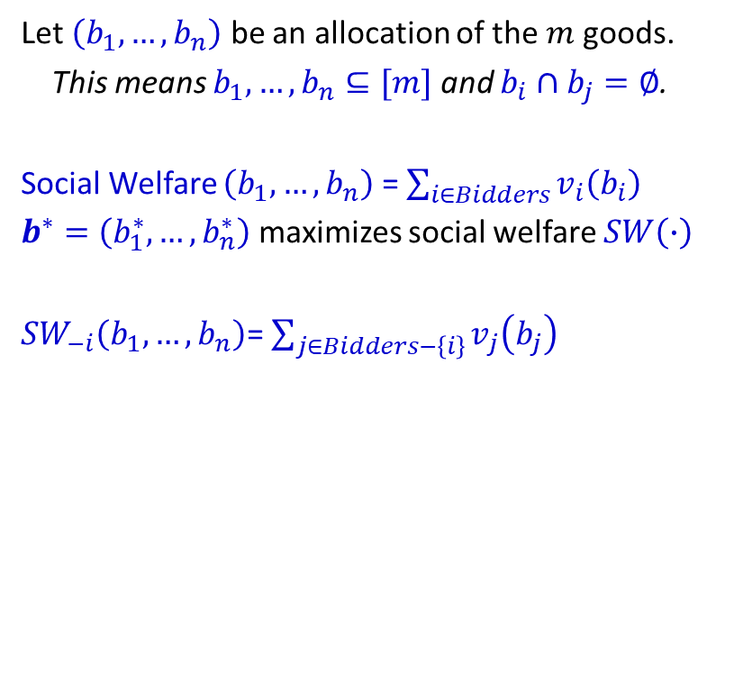
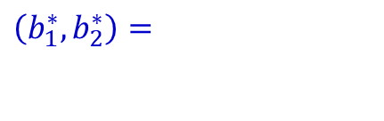
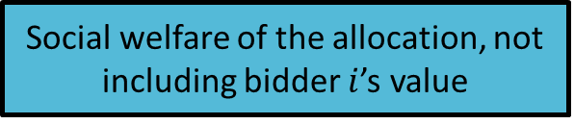


Vickrey-Clarke-Groves mechanism (VCG)
Bidder | 1 | 2
 | 1 | 0
 | 2 | 1
 | 2.5 | 1
Let $\left(b_{1},…,b_{n}\right)$ be an allocation of the $m$ goods.
This means $b_{1},…,b_{n}⊆[m]$ and $b_{i}∩b_{j}=∅$.
Social Welfare $\left(b_{1},…,b_{n}\right)$ = $\sum_{i∈Bidders}{v_{i}\left(b_{i}\right)}$
$b^{∗}=\left(b_{1}^{∗},…,b_{n}^{∗}\right)$ maximizes social welfare $SW\left(∙\right)$
${SW}_{−i}\left(b_{1},…,b_{n}\right)$= $\sum_{j∈Bidders−\left\{i\right\}}{v_{j}\left(b_{j}\right)}$
$\left(b_{1}^{∗},b_{2}^{∗}\right)=$
$$∅$$
$$SW\left(b_{1},…,b_{n}\right)$$
Social welfare of the allocation, not including bidder $i$’s value
Notes:
To describe the whole auction, I’ll have to introduce a little bit of notation. Let b1 up through bn be an allocation of the m goods for sale. This means that these b_i’s are subsets of {1, .., m} and they’re disjoint. Like I said, the social welfare of an allocation is the sum of the buyers’ values for the items they’re allocated. We’ll shorten social welfare to be just SW. Let’s say that b* maximizes social welfare. Let’s look at this example where there are 2 bidders and 2 items. Bidder 1’s value for the coffee is $1, his value for the muffin is $2, and his value for the pair is $2.5. Bidder 2’s value for the coffee is $0, his value for the muffin is $1, and his value for the pair is $1. So the social-welfare-maximizing allocation is the one where bidder 1 gets both items and bidder 2 gets nothing.
Next, let’s say that the social welfare “minus i” of an allocation is the social welfare of the allocation, not including bidder i’s value.

Slide 55
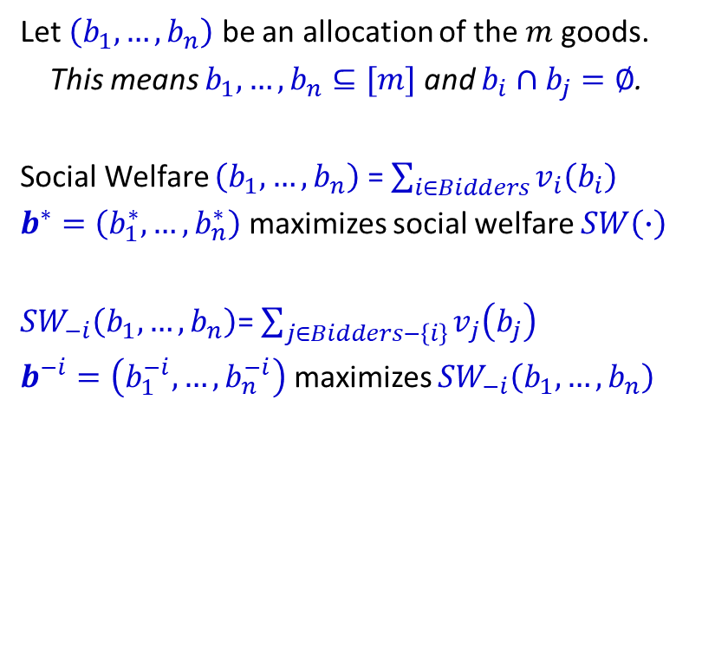
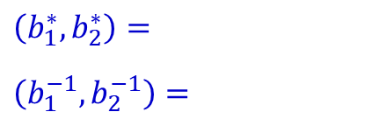
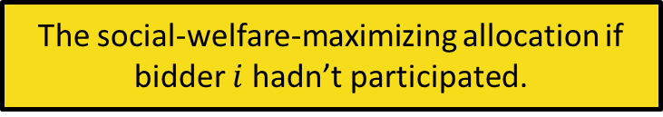

Vickrey-Clarke-Groves mechanism (VCG)
Bidder | 1 | 2
 | 1 | 0
 | 2 | 1
 | 2.5 | 1
Let $\left(b_{1},…,b_{n}\right)$ be an allocation of the $m$ goods.
This means $b_{1},…,b_{n}⊆[m]$ and $b_{i}∩b_{j}=∅$.
Social Welfare $\left(b_{1},…,b_{n}\right)$ = $\sum_{i∈Bidders}{v_{i}\left(b_{i}\right)}$
$b^{∗}=\left(b_{1}^{∗},…,b_{n}^{∗}\right)$ maximizes social welfare $SW\left(∙\right)$
${SW}_{−i}\left(b_{1},…,b_{n}\right)$= $\sum_{j∈Bidders−\left\{i\right\}}{v_{j}\left(b_{j}\right)}$
$b^{−i}=\left(b_{1}^{−i},…,b_{n}^{−i}\right)$ maximizes ${SW}_{−i}\left(b_{1},…,b_{n}\right)$
$\left(b_{1}^{∗},b_{2}^{∗}\right)=$
$\left(b_{1}^{−1},b_{2}^{−1}\right)=$
$$∅$$
$$SW\left(b_{1},…,b_{n}\right)$$
$$∅$$
The social-welfare-maximizing allocation if bidder $i$ hadn’t participated.
Notes:
Let’s say that b^(-i) is the allocation that maximizes social welfare “minus i”, so it’s social-welfare-maximizing allocation if bidder i hadn’t participated in the auction. Back to this example, if bidder 1 didn’t participate in the auction, the social-welfare-maximizing allocation is the one where bidder 2 gets both items.

Slide 56
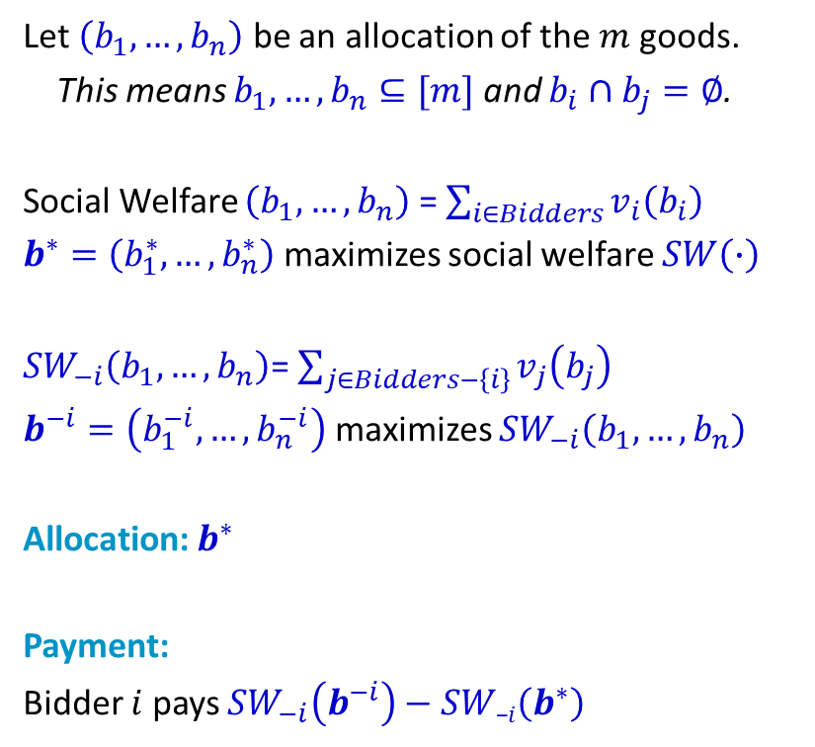
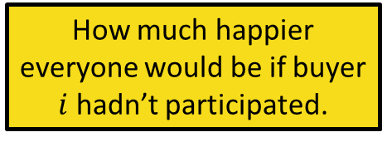
Vickrey-Clarke-Groves mechanism (VCG)
Bidder | 1 | 2
 | 1 | 0
 | 2 | 1
 | 2.5 | 1
Let $\left(b_{1},…,b_{n}\right)$ be an allocation of the $m$ goods.
This means $b_{1},…,b_{n}⊆[m]$ and $b_{i}∩b_{j}=∅$.
Social Welfare $\left(b_{1},…,b_{n}\right)$ = $\sum_{i∈Bidders}{v_{i}\left(b_{i}\right)}$
$b^{∗}=\left(b_{1}^{∗},…,b_{n}^{∗}\right)$ maximizes social welfare $SW\left(∙\right)$
${SW}_{−i}\left(b_{1},…,b_{n}\right)$= $\sum_{j∈Bidders−\left\{i\right\}}{v_{j}\left(b_{j}\right)}$
$b^{−i}=\left(b_{1}^{−i},…,b_{n}^{−i}\right)$ maximizes ${SW}_{−i}\left(b_{1},…,b_{n}\right)$
Allocation: $b^{∗}$
Payment:
Bidder $i$ pays ${SW}_{−i}\left(b^{−i}\right)−SW\text{−}i\left(b^{∗}\right)$
$\left(b_{1}^{∗},b_{2}^{∗}\right)=$
$\left(b_{1}^{−1},b_{2}^{−1}\right)=$
$$∅$$
$$SW\left(b_{1},…,b_{n}\right)$$
$$∅$$
How much happier everyone would be if buyer $i$ hadn’t participated.
The social-welfare-maximizing allocation.
Notes:
The allocation of the VCG mechanism is the one social-welfare-maximizing one. So in this example, bidder 1 will get both items.

Slide 57

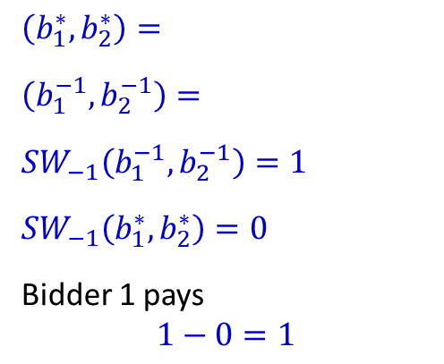
Vickrey-Clarke-Groves mechanism (VCG)
Bidder | 1 | 2
 | 1 | 0
 | 2 | 1
 | 2.5 | 1
Let $\left(b_{1},…,b_{n}\right)$ be an allocation of the $m$ goods.
This means $b_{1},…,b_{n}⊆[m]$ and $b_{i}∩b_{j}=∅$.
Social Welfare $\left(b_{1},…,b_{n}\right)$ = $\sum_{i∈Bidders}{v_{i}\left(b_{i}\right)}$
$b^{∗}=\left(b_{1}^{∗},…,b_{n}^{∗}\right)$ maximizes social welfare $SW\left(∙\right)$
${SW}_{−i}\left(b_{1},…,b_{n}\right)$= $\sum_{j∈Bidders−\left\{i\right\}}{v_{j}\left(b_{j}\right)}$
$b^{−i}=\left(b_{1}^{−i},…,b_{n}^{−i}\right)$ maximizes ${SW}_{−i}\left(b_{1},…,b_{n}\right)$
Allocation: $b^{∗}$
Payment:
Bidder $i$ pays ${SW}_{−i}\left(b^{−i}\right)−SW\text{−}i\left(b^{∗}\right)$
What if we add an additive boost to the social welfare of the allocation $\left(b_{1}^{−1},b_{2}^{−1}\right)$?
$\left(b_{1}^{∗},b_{2}^{∗}\right)=$
$\left(b_{1}^{−1},b_{2}^{−1}\right)=$
$${SW}_{−1}\left(b_{1}^{−1},b_{2}^{−1}\right)=1$$
${SW}_{−1}\left(b_{1}^{∗},b_{2}^{∗}\right)=0$
Bidder 1 pays
$$1−0=1$$
$$∅$$
$$SW\left(b_{1},…,b_{n}\right)$$
$$∅$$
How much happier everyone would be if buyer $i$ hadn’t participated.
Bidder 1 values her allocation for $2.5, but only payed $1. How can we get her to pay more?
Notes:
Bidder i is going to pay the maximum social welfare of the other bidders if he hadn’t participated in the auction, minus the social welfare of the other bidders given that he did participate in the auction. So you can think of this as how much happier everyone would be if bidder i hadn’t participated in the auction. Let’s see what bidder 1 is going to pay in this example. If bidder 1 hadn’t participated in the auction, bidder 2 would have gotten both items, which he values for $1. So the maximum social welfare without bidder 1’s participation is 1. In the actual allocation, bidder 2 doesn’t get anything, so the social welfare without bidder 1 is $0. Therefore, bidder 1 is going to pay 1 minus 0 which equals 1. This is a bit unfortunate because bidder 1 values his allocation for $2.5, but he’s only paying $1. So the question is, how can we get him to pay more? What if we add an additive boost to the social welfare of the allocation without bidder 1’s participation.

Slide 58
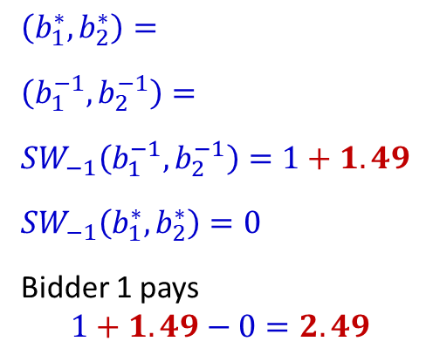
Vickrey-Clarke-Groves mechanism (VCG)
Bidder | 1 | 2
 | 1 | 0
 | 2 | 1
 | 2.5 | 1
Let $\left(b_{1},…,b_{n}\right)$ be an allocation of the $m$ goods.
This means $b_{1},…,b_{n}⊆[m]$ and $b_{i}∩b_{j}=∅$.
Social Welfare $\left(b_{1},…,b_{n}\right)$ = $\sum_{i∈Bidders}{v_{i}\left(b_{i}\right)}$
$b^{∗}=\left(b_{1}^{∗},…,b_{n}^{∗}\right)$ maximizes social welfare $SW\left(∙\right)$
${SW}_{−i}\left(b_{1},…,b_{n}\right)$= $\sum_{j∈Bidders−\left\{i\right\}}{v_{j}\left(b_{j}\right)}$
$b^{−i}=\left(b_{1}^{−i},…,b_{n}^{−i}\right)$ maximizes ${SW}_{−i}\left(b_{1},…,b_{n}\right)$
Allocation: $b^{∗}$
Payment:
Bidder $i$ pays ${SW}_{−i}\left(b^{−i}\right)−SW\text{−}i\left(b^{∗}\right)$
What if we add an additive boost to the social welfare of the allocation $\left(b_{1}^{−1},b_{2}^{−1}\right)$?
$\left(b_{1}^{∗},b_{2}^{∗}\right)=$
$\left(b_{1}^{−1},b_{2}^{−1}\right)=$
$${SW}_{−1}\left(b_{1}^{−1},b_{2}^{−1}\right)=1+1.49$$
${SW}_{−1}\left(b_{1}^{∗},b_{2}^{∗}\right)=0$
Bidder 1 pays
$$1+1.49−0=2.49$$
$$∅$$
$$SW\left(b_{1},…,b_{n}\right)$$
$$∅$$
Notes:
Bidder i is going to pay the maximum social welfare of the other bidders if he hadn’t participated in the auction, minus the social welfare of the other bidders given that he did participate in the auction. So you can think of this as how much happier everyone would be if bidder i hadn’t participated in the auction. Let’s see what bidder 1 is going to pay in this example. If bidder 1 hadn’t participated in the auction, bidder 2 would have gotten both items, which he values for $1. So the maximum social welfare without bidder 1’s participation is 1. In the actual allocation, bidder 2 doesn’t get anything, so the social welfare without bidder 1 is $0. Therefore, bidder 1 is going to pay 1 minus 0 which equals 1. This is a bit unfortunate because bidder 1 values his allocation for $2.5, but he’s only paying $1. So the question is, how can we get him to pay more? What if we add an additive boost to the social welfare of the allocation without bidder 1’s participation.

Slide 59


Affine maximizer auctions
Vickrey-Clarke-Groves mechanism [Vickrey, ‘61; Clarke, ‘71; Groves, ‘73]
Affine maximizer auction [Roberts 1979]
Compute the social-welfare-maximizing allocation:
$b^{∗}= \left(b_{1}^{∗},…,b_{n}^{∗}\right)=argmax\left\{\sum_{j∈Bidders}{w_{j}{ v}_{j}\left(b_{j}\right)}+λ\left(b_{1},…,b_{n}\right)\right\}$
For each bidder $i$, find social-welfare-maximizing allocation w/o his participation:
$b^{−i}=\left(b_{1}^{−i},…,b_{n}^{−i}\right)=argmax\left\{\sum_{j∈Bidders−\{i\}}{w_{j}{ v}_{j}\left(b_{j}\right)+λ\left(b_{1},…,b_{n}\right)}\right\}$
Compute bidder $i$’s payment, for all $i$
(How much happier everyone would be if bidder $i$ hadn’t participated):
$$\frac{1}{w_{i}}\left[\left(\sum_{j∈Bidders−\{i\}}{w_{j} v_{j}\left(b_{j}^{−i}\right)}+λ\left(b^{−i}\right)\right)−\left(\sum_{j∈Bidders−\{i\}}{w_{j} v_{j}\left(b_{j}^{∗}\right)}+λ\left(b^{∗}\right)\right)\right]$$
Boost per allocation $\left(b_{1},…,b_{n}\right)$: $λ\left(b_{1},…,b_{n}\right)$ ; Weight per bidder $i$: $w_{i}$
AMAs are ex-post IC and IR [Roberts 1979]
Every IC multi-item, multi-bidder auction (where each bidder only cares about what she gets and pays) is almost an affine maximizer auction (with some qualifications) [Lavi, Mu'Alem, and Nisan, FOCS’03].
Notes:
Affine maximizer auctions allow us to formalize this intuition. What I’ve got here is the VCG auction, which I’ll transform into an affine maximizer auction. First you compute the social-welfare-maximizing allocation. Then for each bidder, you compute the social-welfare-maximizing allocation without his participation. Then you compute all of the bidders’ payments, which correspond to how much happier everyone would be if bidder i hadn’t participated in the auction.
Affine maximizer auctions were introduced by Roberts. For every allocation, there’s going to be an additive boost. We get to add this boost to the social welfare of all of these allocations. Now when we’re computing the social-welfare-maximizing allocation, we include this additive boost in the maximization term. There’s also a multiplicative boost we give to each bidders’ bids.

Slide 60

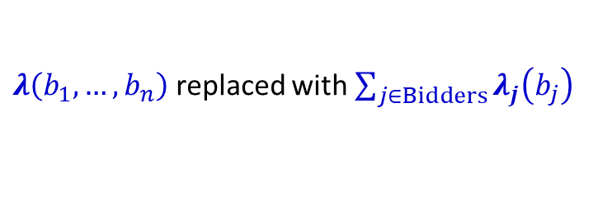

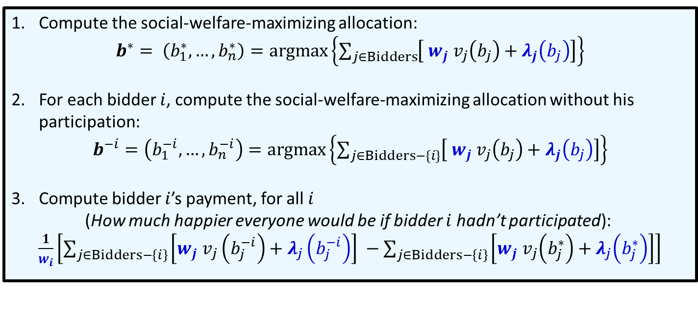
Virtual valuation combinatorial auctions (VVCAs)
Boost per allocation $\left(b_{1},…,b_{n}\right)$: $λ\left(b_{1},…,b_{n}\right)$ ; Weight per bidder $i$: $w_{i}$
Boost per bidder-bundle pair $(j,b)$: $λ_{j}\left(b\right)$;
$λ\left(b_{1},…,b_{n}\right)$ replaced with $\sum_{j∈Bidders}{λ_{j}\left(b_{j}\right)}$
Virtual valuation combinatorial auctions [Likhodedov and Sandholm, AAAI’04, ’05; OR’15]
Compute the social-welfare-maximizing allocation:
$b^{∗}= \left(b_{1}^{∗},…,b_{n}^{∗}\right)=argmax\left\{\sum_{j∈Bidders}{\left[{ w}_{j}{ v}_{j}\left(b_{j}\right)+λ_{j}\left(b_{j}\right)\right]}\right\}$
For each bidder $i$, compute the social-welfare-maximizing allocation without his participation:
$b^{−i}=\left(b_{1}^{−i},…,b_{n}^{−i}\right)=argmax\left\{\sum_{j∈Bidders−\{i\}}{\left[{ w}_{j}{ v}_{j}\left(b_{j}\right)+λ_{j}\left(b_{j}\right)\right]}\right\}$
Compute bidder $i$’s payment, for all $i$
(How much happier everyone would be if bidder $i$ hadn’t participated):
$\frac{1}{w_{i}}\left[\sum_{j∈Bidders−\left\{i\right\}}{\left[{w_{j} v}_{j}\left(b_{j}^{−i}\right)+λ_{j}\left(b_{j}^{−i}\right)\right] }−\sum_{j∈Bidders−\left\{i\right\}}{\left[{w_{j} v}_{j}\left(b_{j}^{∗}\right)+λ_{j}\left(b_{j}^{∗}\right)\right]}\right]$
Notes:
One idea for doing that is learning over virtual valuation combinatorial auctions, where instead of having a boost per allocation, we have a boost per bidder-bundle pair. The boost corresponding to the allocation b1 up through bn is replaced by the sum, over all bidders, of their bidder-specific boost for the bundle they get. The definition of a virtual valuation combinatorial auction is identical to that of an AMA with the boost per allocation replaced with this summation.

Slide 61
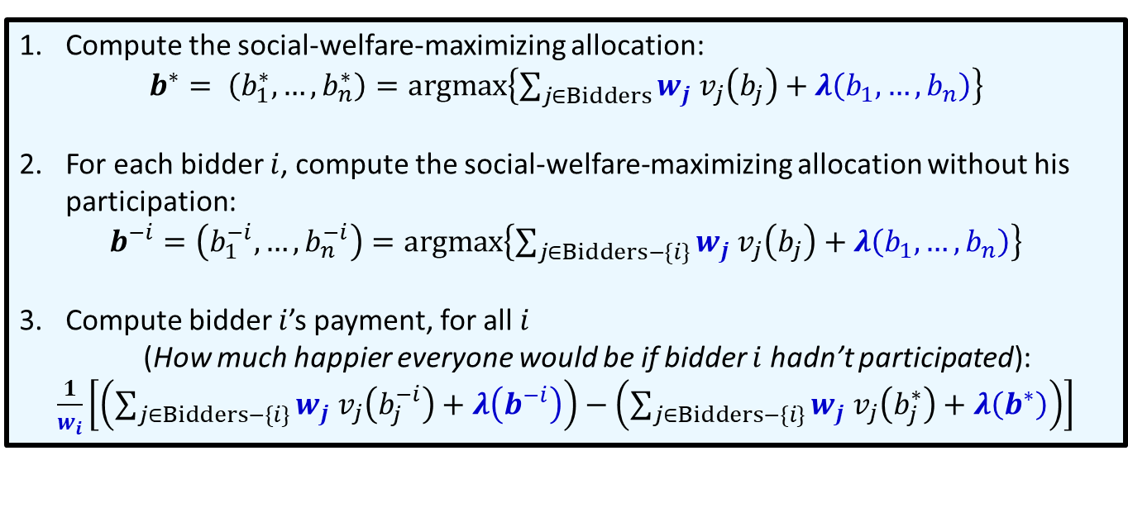
Affine maximizer auctions (AMAs)
Boost per allocation $\left(b_{1},…,b_{n}\right)$: $λ\left(b_{1},…,b_{n}\right)$ ; Weight per bidder $i$: $w_{i}$
Many tunable parameters. How can we simplify the search space?
Affine maximizer auction [Roberts, North-Holland Publishing Company ‘79]
Compute the social-welfare-maximizing allocation:
$b^{∗}= \left(b_{1}^{∗},…,b_{n}^{∗}\right)=argmax\left\{\sum_{j∈Bidders}{w_{j}{ v}_{j}\left(b_{j}\right)}+λ\left(b_{1},…,b_{n}\right)\right\}$
For each bidder $i$, compute the social-welfare-maximizing allocation without his participation:
$b^{−i}=\left(b_{1}^{−i},…,b_{n}^{−i}\right)=argmax\left\{\sum_{j∈Bidders−\{i\}}{w_{j}{ v}_{j}\left(b_{j}\right)+λ\left(b_{1},…,b_{n}\right)}\right\}$
Compute bidder $i$’s payment, for all $i$
(How much happier everyone would be if bidder $i$ hadn’t participated):
$\frac{1}{w_{i}}\left[\left(\sum_{j∈Bidders−\{i\}}{w_{j} v_{j}\left(b_{j}^{−i}\right)}+λ\left(b^{−i}\right)\right)−\left(\sum_{j∈Bidders−\{i\}}{w_{j} v_{j}\left(b_{j}^{∗}\right)}+λ\left(b^{∗}\right)\right)\right]$
Notes:
One complication is that there are many tunable parameters, so we might want to simplify the search space.

Slide 62


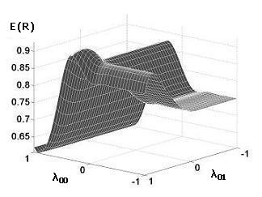
Computational considerations [Sandholm & Likhodedov, OR‘15]
Fact
Theorem
Expected revenue is not convex in the VVCA or AMA parameters.
For any given valuation vector, revenue has only one maximum in any parameter.
Projection of
expected revenue
surface
on a 3D subspace
Theorem
Expected revenue is continuous and almost everywhere differentiable in parameters.
Theorem
Algorithm possibilities:
There is no polynomial-time algorithm capable of determining (for every given set of valuations) whether one parameter vector is better than another (unless P=NP).
Grid search
Hill climbing in parameter space – starting, e.g., from VCG
(In either method, evaluate each step using simulation.)
Notes:
First the bad news about designing AMAs and VVCAs. First, the expected revenue is not convex in the VVCA or AMA parameters. Secondly, there is no polynomial-time algorithm capable of determining (for every given set of valuations) whether one set of parameters is better than another in every instance (unless P=NP). So that means that for at least some inputs, you can’t fix any parameters and search in a subspace.
Next, the good news. For any given vector of valuations, the expected revenue has only one maximum in any one parameter. The expected revenue is continuous and almost everywhere differentiable. So that suggests we’ll do grid search or we’ll do some sort of hill-climbing algorithm for example starting from the VCG and then we boost the revenue from there.

Slide 63
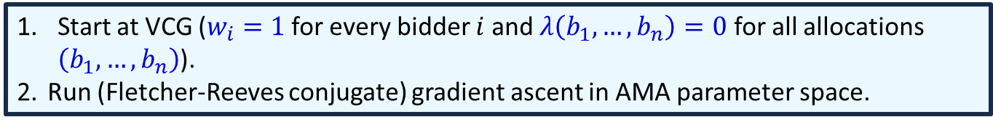
Simple search algorithms in parameter space [Sandholm and Likhodedov, OR’15]
Algorithm AMA*
Iterated grid search of AMA parameter space, with grid tightened and re-centered around best solution from previous iteration.
Algorithm VVCA*
Ditto for VVCA parameter space.
Grid search not scalable to large problems
Overfitting already on 3rd iteration (when using 1,000 samples in the training set) => practical motivation for our learning theory
Algorithm BLAMA (Basic Local AMA search)
Start at VCG ($w_{i}=1$ for every bidder $i$ and $λ\left(b_{1},…,b_{n}\right)=0$ for all allocations $\left(b_{1},…,b_{n}\right)$).
Run (Fletcher-Reeves conjugate) gradient ascent in AMA parameter space.
Notes:
So that’s the simple idea, and these are the algorithms for that. AMA* is grid search over the affine maximizer parameter space. VVCA* is grid search over the virtual valuation combinatorial auction space. Then we have basic local affine maximizer search which starts at the VCG then runs Fletch-Reeves conjugate gradient ascent in the affine maximizer parameter space. So those are the straightforward algorithms. VCG is where the buyer’s weights are all equal to 1 and the allocation boosts are all equal to zero.
We have an improvement idea, which is to reduce the computational complexity of these by selecting the direction of the gradient ascent based on economic insights.

Slide 64

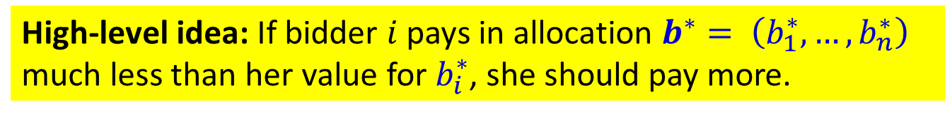
Reduce complexity by selecting gradient ascent direction using economic insights [Sandholm and Likhodedov, OR’15]
High-level idea: If bidder $i$ pays in allocation $b^{∗}= \left(b_{1}^{∗},…,b_{n}^{∗}\right)$ much less than her value for $b_{i}^{∗}$, she should pay more.
Notes:
Here’s what we call allocation boosting of affine maximizer auctions. The key idea is that if bidder i’s payment given an AMA’s allocation is much lower than her value for the bundle she gets, her payment should be larger. Recall bidder i’s payment. Here’s the boosted social welfare of the best allocation without her participation and here’s the social welfare of the other bidders in the true AMA allocation. We can wiggle these parameters to get her to pay more by decreasing the lambda term of the allocation b*, increasing the lambda term of the best allocation without her participation, or modifying the bidder weights w. So the idea behind this algorithm start at the VCG like before, look at the allocations on each of the samples, and run gradient ascent on the parameter subspace corresponding to these special parameters. Sandholm and Likhodedov also introduce a variant on this algorithm specifically for virtual valuation combinatorial auctions.

Slide 65
Allocation boosting of AMA (ABAMA) [Sandholm and Likhodedov, OR’15]
Sample the valuations from the prior distributions
Start at VCG
For every sample point, compute the revenue loss on the winning allocation (ABAMAa) or the second-best allocation (ABAMAb)
The revenue loss from a bidder is the difference between the bidder’s valuation and her payment
The revenue loss is the sum of the bidders’ revenue losses
The revenue loss of an allocation is the sum of the revenue losses of the samples associated with the allocation
Make a list of allocations in decreasing order of revenue loss
Choose the first allocation, a, from the list. If the list is empty, exit.
Run (Fletcher-Reeves conjugate) gradient ascent in the {w, λ(a)} subspace of the AMA parameter space.
If the values of {w, λ(a)} did not change (i.e., we cannot further improve revenue by modifying {w, λ(a)}), remove a from the list and go to 5.
Otherwise go to 3.

Slide 66
Bidder-Bundle Boosting VVCA (BBBVVCA) algorithm [Sandholm and Likhodedov, OR’15]
Similar idea, but optimized for VVCAs

Slide 67
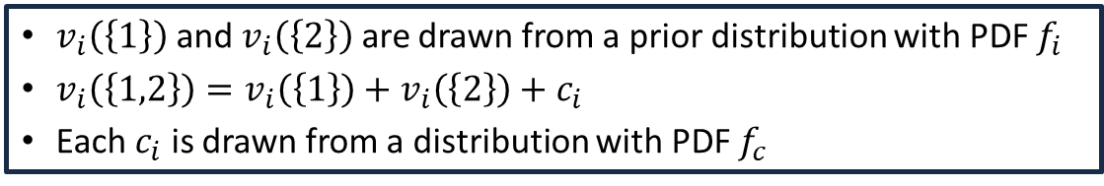
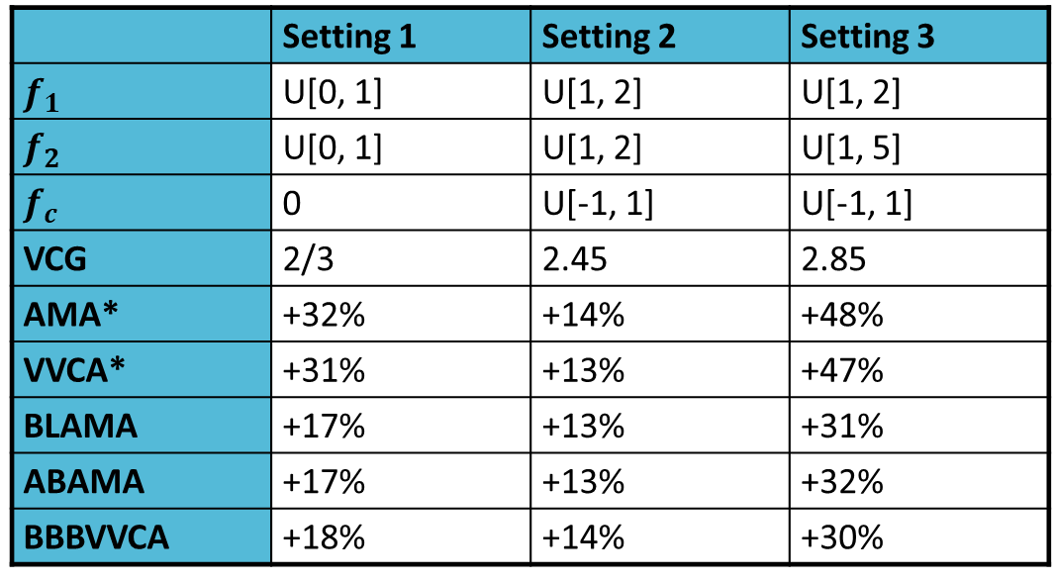
Experiments: 2 items, 2 bidders
Experimental setup
$v_{i}\left(\left\{1\right\}\right)$ and $v_{i}\left(\left\{2\right\}\right)$ are drawn from a prior distribution with PDF $f_{i}$
$v_{i}\left(\left\{1,2\right\}\right)=v_{i}\left(\left\{1\right\}\right)+v_{i}\left(\left\{2\right\}\right)+c_{i}$
Each $c_{i}$ is drawn from a distribution with PDF $f_{c}$
 | Setting 1 | Setting 2 | Setting 3
$$f_{1}$$ | U[0, 1] | U[1, 2] | U[1, 2]
$$f_{2}$$ | U[0, 1] | U[1, 2] | U[1, 5]
$$f_{c}$$ | 0 | U[-1, 1] | U[-1, 1]
VCG | 2/3 | 2.45 | 2.85
AMA* | +32% | +14% | +48%
VVCA* | +31% | +13% | +47%
BLAMA | +17% | +13% | +31%
ABAMA | +17% | +13% | +32%
BBBVVCA | +18% | +14% | +30%
Table shows the revenue lift of various mechanisms over VCG
[Sandholm and Likhodedov, OR‘15]
In Setting I, generalizing the mechanism design from MBARPs to VVCAs doesn’t yield additional revenue, but generalizing further to AMAs does.
Notes:
Here are some small experiments where there are two items and two buyers. Buyer 1’s values for items 1 and 2 are drawn from a distribution with density f1 and buyer 2’s are drawn from a distribution with density f2. Their value for the pair of items is the sum of their values for the two items, plus a random value drawn a distribution with density function f_c. There are three different choices for these functions corresponding to these three columns. So in the first setting, the buyers’ values for the separate items are uniformly drawn for [0,1], and this constant c_i equals 0, so the buyer is additive. The expected revenue of the VCG is 2/3, and you can see that all of these algorithms get a nice revenue boost above the VCG. And in the other settings, we adjust the intervals from which the values are drawn uniformly at random.

Slide 68
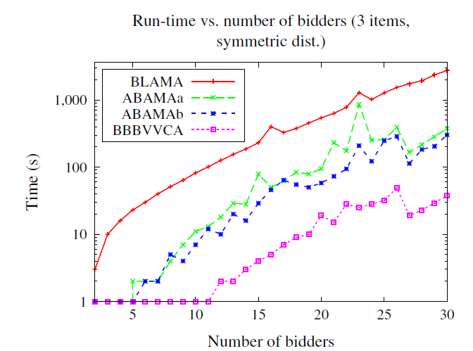
Scalability experiments (3 items, symmetric distribution)
[Sandholm and Likhodedov, OR‘15]
Notes:
Now we look at scalability. Here we have the number of bidders on the x-axis. The grid search algorithms aren’t plotted here because they don’t scale. We see that the basic local affine maximizer algorithm blows up first, then the economically-guided affine maximizer algorithms are almost as bad. And the virtual valuations algorithm boosted by economic insight is by far the most scalable.

Slide 69
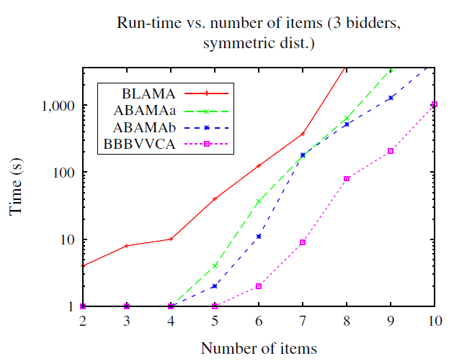
Scalability experiments (3 bidders, symmetric distribution)
[Sandholm and Likhodedov, OR‘15]
Notes:
Then we can also look at scalability in items, and it’s the same story.

Slide 70
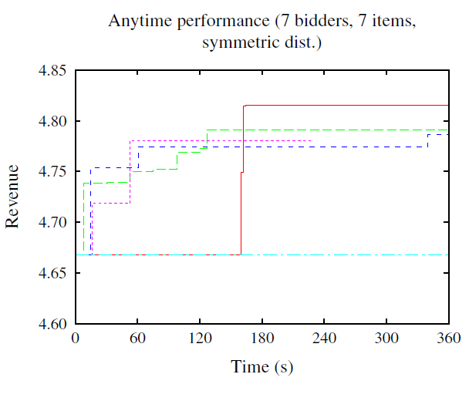
Anytime performance (7 items, 7 bidders, symmetric distribution)
VCG
[Sandholm and Likhodedov, OR‘15]

Slide 71
Classes of automated mechanism design
“Flat-representation” de novo design
Search in a parametric mechanism class
Incremental automated mechanism design

Slide 72
Incremental automated mechanism design [Conitzer and Sandholm IJCAI`07]
Start with some (manipulable) mechanism M
Find some set F of manipulations
Here a manipulation is given by an agent i, a type vector ‹ϑ₁ ,…, ϑ_{n}›, and a better type report ϑ’_{i} for agent i
If possible, change the mechanism M to prevent (many of) these manipulations from being beneficial
make the outcome that M selects for ϑ more desirable for agent i (when he has type ϑ_{i}), or
make the outcome that M selects for ϑ’ less desirable for agent i (when he has type ϑ_{i}), or
a combination of (a) and (b)
Repeat from step 2 until termination

Slide 73
An application of incremental automated mechanism design to a setting with payments [Conitzer and Sandholm IJCAI`07]
Our objective g is to maximize some (say, linear) combination of allocative social welfare (i.e., social welfare not taking payments into account) and revenue
Doesn’t matter what the combination is
The set F of manipulations that we consider is that of all possible misreports (by any single agent at a time)
We try to prevent manipulations according to (a) above (for a type vector from which there is a beneficial manipulation, make its outcome desirable enough to the manipulating agents to prevent the manipulation)
Among outcomes that achieve this, we choose one that maximizes the objective g
Designs the VCG mechanism in a single iteration

Slide 74
An application of incremental automated mechanism design to a setting with ordinal preferences [Conitzer and Sandholm IJCAI`07]
The set F consists of all manipulations in which a voter changes which candidate he ranks first
We try to prevent manipulations as follows: For a type (vote) vector from which there is a beneficial manipulation, consider all the outcomes that may result from such a manipulation (in addition to the current outcome), and choose as the new outcome the one that minimizes #agents that still have an incentive to manipulate from this vote vector
We’ll change the outcome for each vote vector at most once
Designs plurality-with-runoff voting rule
In that voting rule, if no candidate gets more than 50% of the vote, simulate a second election between the 2 candidates with the most votes in the first round

Slide 75
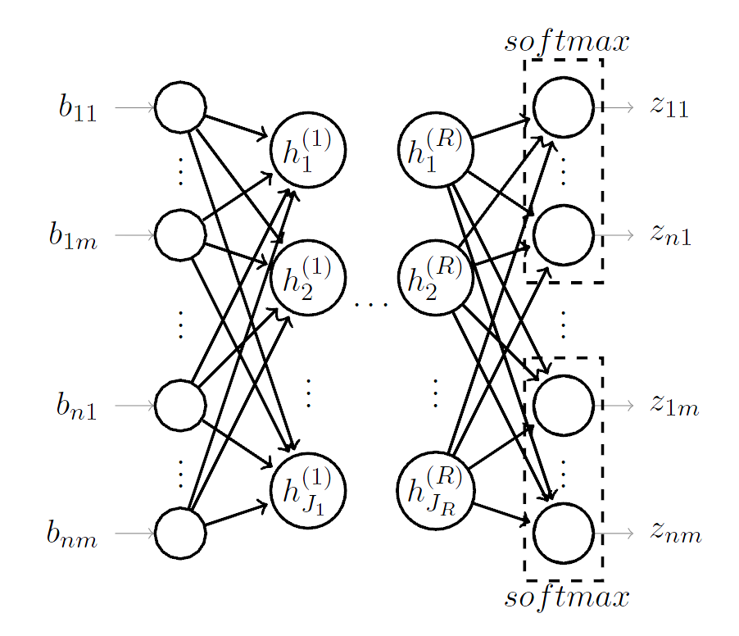
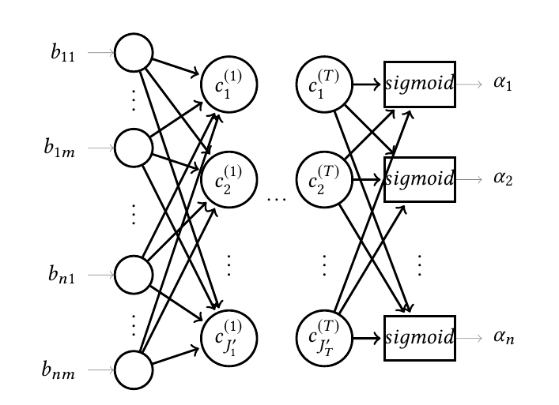
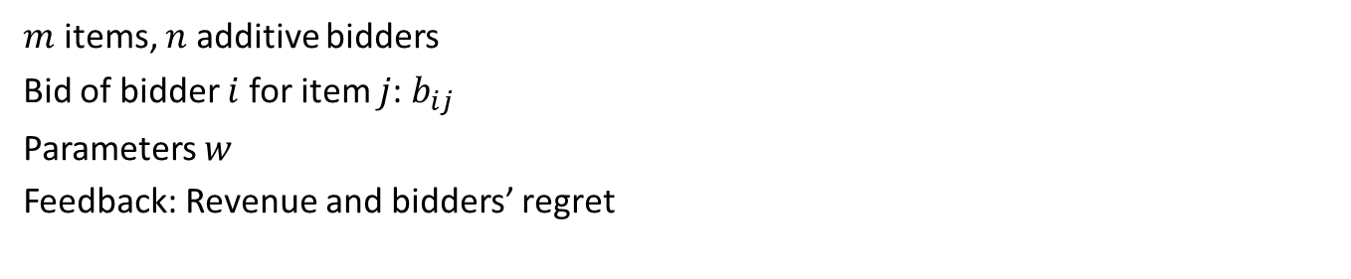
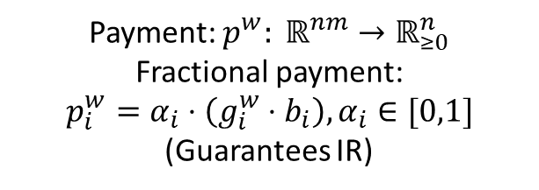
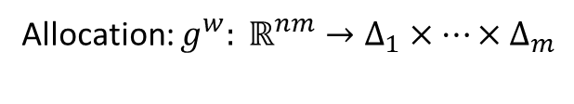
Incremental AMD via deep learning [Dütting, Feng, Narasimhan, Parkes, and Ravindranath, ICML’19]
$m$ items, $n$ additive bidders
Bid of bidder $i$ for item $j$: $b_{ij}$
Parameters $w$
Feedback: Revenue and bidders’ regret
Allocation Net
Payment Net
Allocation: $g^{w}: ℝ^{nm}→Δ_{1}×⋯×Δ_{m}$
Payment: $p^{w}: ℝ^{nm}→ℝ_{≥0}^{n}$
Fractional payment:
$$p_{i}^{w}=α_{i}⋅\left(g_{i}^{w}⋅b_{i}\right), α_{i}∈[0,1]$$
(Guarantees IR)

Slide 76
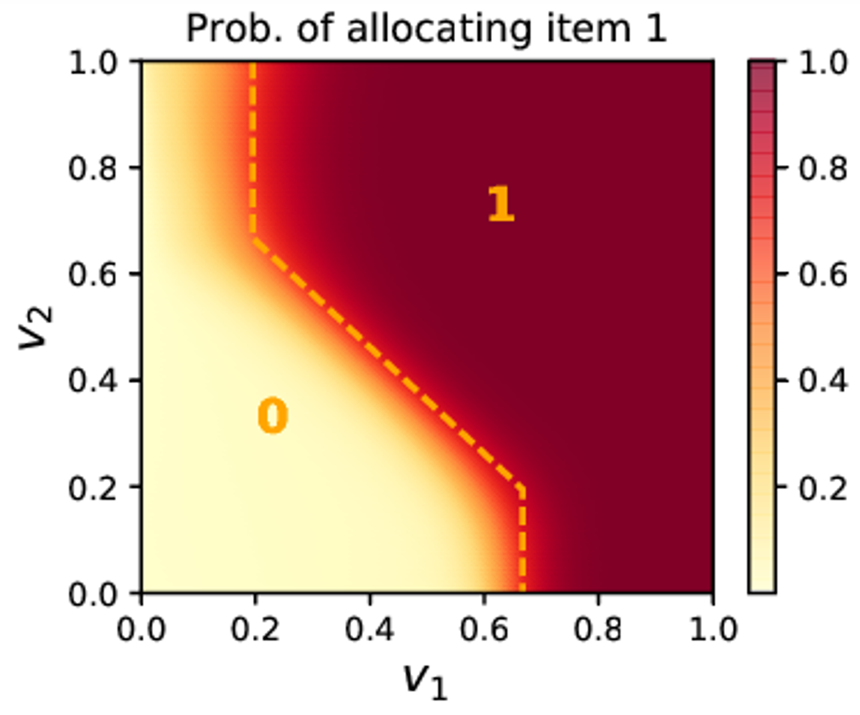
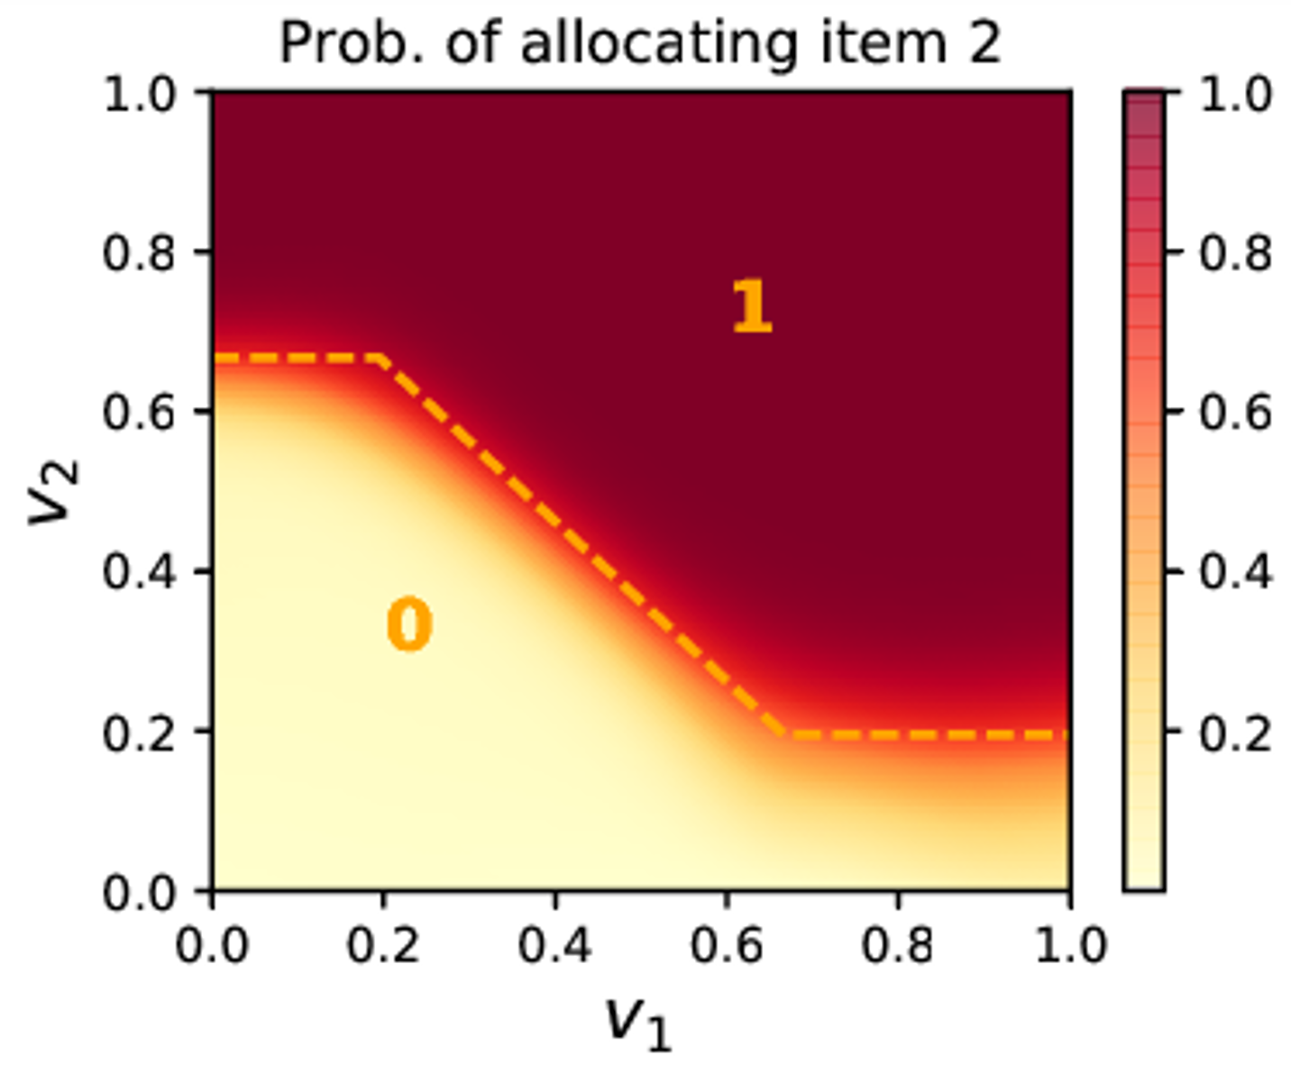
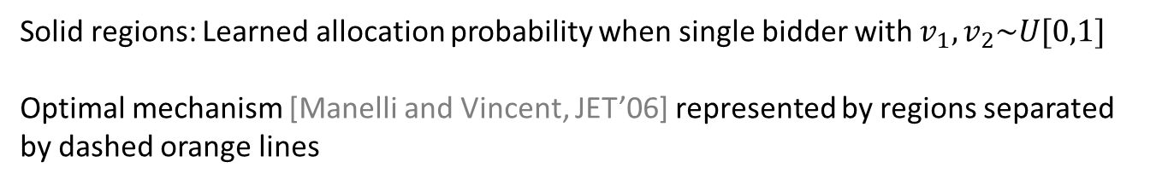
Incremental AMD via deep learning [Dütting, Feng, Narasimhan, Parkes, and Ravindranath, ICML’19]
Solid regions: Learned allocation probability when single bidder with $v_{1},v_{2}\sim U[0,1]$
Optimal mechanism [Manelli and Vincent, JET’06] represented by regions separated by dashed orange lines

Slide 77
Our new architecture: Differentiable economics for randomized affine maximizer auctions [Curry, Sandholm & Dickerson, arXiv-22]
A strategyproof multiagent, multi-item architecture
Modification of affine maximizer auctions
New in our work: learn all parameters, including offered allocations, end-to-end
This additionally allows the offered allocations to be lotteries
Universal
approximator
RegretNet
ALGNet
RochetNet
MenuNet
???
Multiple
Bidders
Always
Strategyproof
Us
Notes:
Intuitive definition: it’s VCG, where welfare is rescaled and shifted by bidder weights and per-allocation boosts

Slide 78
Differentiable end-to-end
AMA procedure describes forward pass at test time
At train time, replace max and argmax operations with soft versions
Compute gradients of learned parameters including the allocations with respect to objective (revenue) and optimize
Contrast with RegretNet: objective is simply revenue (no Lagrangian regret terms)

Slide 79

Diagram: What an AMA does
Allocation determination
Nice Properties
Always strategyproof
Always IR
a₁
a₂
a₃
allocation
a₂
v_{ij}
Boost b₁
Boost b₂
Boost b₃
a₂ maximizes transformed welfare s
Agent bids
Agent i payment determination
a₃ maximizes transformed welfare s_{-i} without agent i
a₁
a₂
a₃
payment p_{i}
Bidder weights w_{i}
p_{i} = (s – s_{-i})/w_{i}
Agent bids without i
Boost b₁
Boost b₂
Boost b₃
Orange: inputs
Blue: Learned parameters

Slide 80
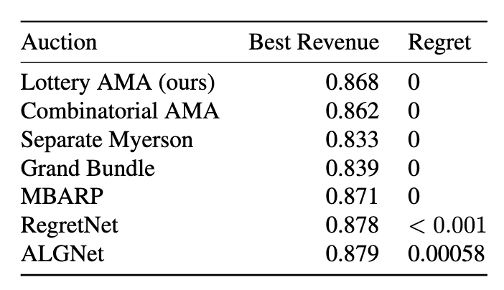
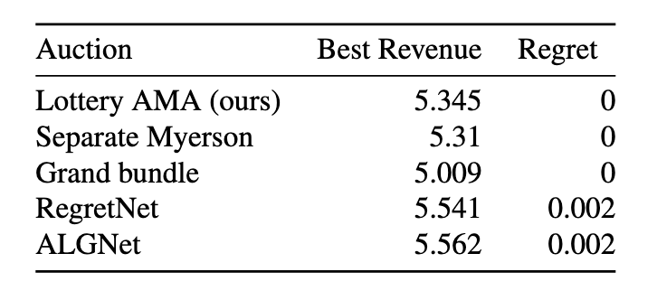
Experimental results
2x2 iid uniform auction:
A larger setting (3x10):
Learned auctions are sparse (2048 allocations allowed, only 10 used at end)
Randomized version yields dramatically better revenue than deterministic version (e.g., 2.158 vs. 1.462)

Slide 81
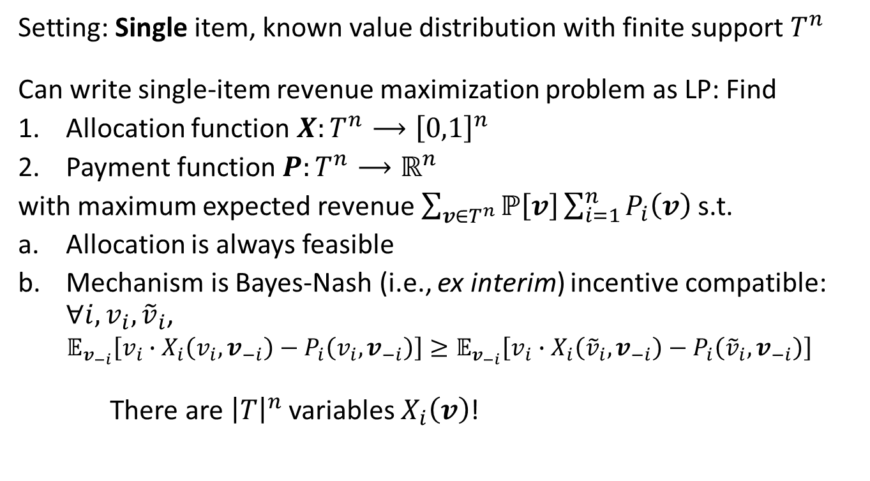
Revenue optimization using interim variables
Setting: Single item, known value distribution with finite support $T^{n}$
Can write single-item revenue maximization problem as LP: Find
Allocation function $X:T^{n}⟶{\left[0,1\right]}^{n}$
Payment function $P:T^{n}⟶ℝ^{n}$
with maximum expected revenue $\sum_{v∈T^{n}}{ℙ\left[v\right]\sum_{i=1}^{n}{P_{i}\left(v\right)}}$ s.t.
Allocation is always feasible
Mechanism is Bayes-Nash (i.e., ex interim) incentive compatible: $∀i,v_{i},{\tilde{v}}_{i}$,
$$𝔼_{v_{−i}}\left[v_{i}∙X_{i}\left(v_{i},v_{−i}\right)−P_{i}\left(v_{i},v_{−i}\right)\right]≥𝔼_{v_{−i}}\left[v_{i}∙X_{i}\left({\tilde{v}}_{i},v_{−i}\right)−P_{i}\left({\tilde{v}}_{i},v_{−i}\right)\right]$$
There are ${\left|T\right|}^{n}$ variables $X_{i}\left(v\right)$!
[Cai, Daskalakis, and Weinberg, ’12]
Notes:
Now I just want to mention a couple of highlights from his literature on understanding the structure of optimal multi-item auctions. This is a really brief high-level overview and doesn’t cover all the results in these papers, nor all of the papers in this field. For intuition, let’s start off by thinking about the case where there’s a single item for sale, and there’s a known value distribution with finite support. There are n buyers, and each buyer’s value is in the set T. In this case, we can actually write the revenue maximization problem as a linear program. The goal is to find an allocation function and payment function defining the revenue maximizing mechanism. So the allocation function maps bidders’ values to probabilities dictating the probability each bidder receives the item. The payment function maps from vales to the payment that each bidder makes. This mechanism should maximize expected revenue, which I’ve written here. The allocation should be feasible with probability 1, and the mechanism should be incentive compatible, in the ex-interim sense. This means that for all agents i, all values that agent might have, and all bids they might report, the expected utility they get from bidding truthfully is at least the expected utility they get from bidding strategically. The problem is that the number of variables equals the size of the entire valuation space, which is exponential in the number of bidders.

Slide 82

Revenue optimization using interim variables…
Instead, optimize over interim variables (single-item case):
$x_{i}\left(v_{i}\right)=𝔼_{v_{−i}}\left[X_{i}\left(v_{i},v_{−i}\right)\right]$
Expected probability bidder $i$ receives item given bid $v_{i}$
$p_{i}\left(v_{i}\right)=𝔼_{v_{−i}}\left[P_{i}\left(v_{i},v_{−i}\right)\right]$
Bidder $i$’s expected payment, given bid $v_{i}$
1-item thm: $n|T|$ interim variables & $n|T|$ constraints suffice
Can be generalized to multi-item for additive bidders
Runtime remains polynomial in #bidders
Polynomial in distribution’s support size: Exponential in #items
[Cai, Daskalakis, and Weinberg, ’12]
Notes:
An idea by Cai, Daskalakis, and Weinberg is to optimize over the interim variables instead. For each value v_i of each bidder I, we define we define their interim allocation probability to be the expected probability they get the item when their bid is v_i, and similarly for the payment function. Cai, Daskalakis, and Weinberg prove that you can write the revenue optimization problem in terms of these interim variables, of which there are just nT, and there will only be nT constrains as well. This can be generalized to multi-settings, remaining polynomial in the number of bidders. This generalization is a bit involved, but you can see their EC’14 tutorial and Costis’s Simons 2015 tutorial for more details.

Slide 83

Revenue optimization and optimal transport
Setting: Single, additive bidder with independent values
Value distribution known
Main result [Daskalakis, Deckelbaum, and Tzamos, EC’13]:
Rev. max. has dual that takes the form of optimal transport problem
(Recall optimal transport problem: Move one mass to another, minimizing cost)
Dual is tight
Consequences:
In that setting, every optimal auction has a certificate in form of transportation flow
Can help verify whether candidate auction is optimal
Can be a tool for characterizing optimal multi-item auctions in restricted settings
They studied conditions under which a take-it-or-leave-it offer for the grand bundle is optimal
Notes:
Here’s one more highlight from this literature. Let’s say there’s a single, additive bidder who has independent values for the items, and her value distribution is known. Daskalkis, Deckelbaum, and Tzamos proved a result connecting revenue maximization to the optimal transport problem. Basically, they show that in this setting, the dual of the revenue maximization problem has the form of an optimal transport problem, and this dual is tight. A few consequences of this result is that every optimal auction is going to have acertificate of optimality in the form of a transportation flow problem. Moreover, this fact can serve as a tool for characterizing optimal multi-item auctions. To learn more, you can look at that EC13 paper, or a survey Costis wrote for SIGecom exchanges, which also talks about the prior results I mentioned.

Slide 84
Automated mechanism design in sponsored search auctions
Generalized second price auction was the basic mechanism used by most companies for sponsored search
But it has many knobs one can tweak
Essentially all sponsored search companies nowadays do some forms of automated mechanism design
Optimizing mechanisms with different expressiveness – “the premium mechanism” [Benisch, Sadeh & Sandholm, Ad Auctions Workshop 2008, IJCAI-09]
First to use computational learning theory tools to characterize expressiveness of a mechanism [Benisch, Sandholm & Sadeh AAAI-08]
Redoing Baidu’s sponsored search auction [Sandholm 2009-13]
Optimizing reserve prices in Yahoo!’s sponsored search auction [Ostrovsky & Schwartz EC-11]
See also reserve price optimization for overstock liquidation (aka “asset recovery”) [Walsh, Parkes, Sandholm & Boutilier AAAI-08]
Reinforcement learning for ad auctions: “reinforcement mechanism design” [Tang IJCAI-17, …]
Boosted second price auction for Google’s display ads [Golrezaei, Lin, Mirrokni, and Nazerzadeh, Management Science R&R]
…

Slide 85



Automated mechanism design beyond sales mechanisms
Combinatorial public goods problems [Conitzer and Sandholm, UAI’03 Bayesian Modeling Applications Workshop]
Real-world industrial sourcing mechanisms
Divorce settlement mechanisms [Conitzer and Sandholm, UAI’03 Bayesian Modeling Applications Workshop]
Reputation/recommendation systems [Jurca and Faltings, EC’06, EC’07]
Facility location problems [Sui, Boutilier, and Sandholm, IJCAI’13]
Assignment mechanisms [Narasimhan and Parkes, UAI’16]
Mechanism design without money [Narasimhan, Agarwal and Parkes, IJCAI’16]
Redistribution mechanisms [Guo and Conitzer, EC’07, AAMAS’08, EC’08, EC’09, AI’10, AIJ’14; Nath and Sandholm, WINE’16, GEB’19…]
…
Notes:
UAI: Aims to answer the question: Given an arbitrary outcome rule, can we automatically design a strategy-proof mechanism that closely approximates the rule? The
particular problem they study is an assignment problem, where there is a set of distinct, indivisible items and the outcome assigns at most one item to each agent. They derive sample complexity bounds using tools from learning theory.
IJCAI: The goal is to find a mechanism that best approximates a given target function subject to a design constraint such as strategy-proofness or stability. The proposed approach involves identifying a rich parametrized class of mechanisms that resemble discriminant-based multiclass classifiers, and relaxing the resulting search problem into an SVM-style surrogate optimization problem. We use this methodology to design strategy-proof mechanisms for social choice problems with single-peaked preferences, and stable mechanisms for two-sided matching problems.

Slide 86
Outline
Introduction
Mechanism design basics
Automated mechanism design (AMD)
Sample complexity guarantees for AMD
Note: There’s been a lot of recent work on batch learning for AMD. We focus on that.

Slide 87
























Mechanism design as a learning problem
Goal: Given family of mechanisms $ℳ$ and set of buyers’ values sampled from unknown distr. $𝒟$, find mechanism with high expected revenue.
Large family of parametrized mechanisms $ℳ$
(E.g., 2nd-price auctions w/ reserves or posted price mechanisms)
reserve
$$p_{2}$$
Set of buyers’ values sampled from unknown distribution $𝓓$
$$p_{1}$$
2nd price auctions with reserves:
Sample 1
Sample $N$
…
$v_{1}$
$v_{2}$
…
$v_{n}$
$v_{1}$
$v_{2}$
…
$v_{n}$
Sample 1
Sample $N$
Posted price mechanisms:
$v_{1}$
$v_{n}$
$v_{1}$
$v_{n}$
$v_{1}$
…
$v_{n}$
…
$v_{1}$
…
$v_{n}$
$v_{1}$
$v_{n}$
$v_{1}$
$v_{n}$

Slide 88















Mechanism design as a learning problem
Goal: Given family of mechanisms $ℳ$ and set of buyers’ values sampled from unknown distr. $𝒟$, find mechanism with high expected revenue.
Approach: Find $\hat{M}$ (nearly) optimal mechanism over the set of samples.
Key question: Will $\hat{M}$ have high expected revenue?
Seen:
$v_{1}$
$v_{2}$
…
$v_{n}$
…
$v_{1}$
$v_{2}$
…
$v_{n}$
?
?
New $v∼D$:
$v_{1}$
$v_{2}$
…
$v_{n}$
…
$v_{1}$
$v_{2}$
…
$v_{n}$
Will $\hat{M}$ have high revenue over $𝒟$?

Slide 89

Mechanism design as a learning problem
Goal: Given family of mechanisms $ℳ$ and set of buyers’ values sampled from unknown distr. $𝒟$, find mechanism with high expected revenue.
Approach: Find $\hat{M}$ (nearly) optimal mechanism over the set of samples.
Will $\hat{M}$ have high expected revenue?
Key technical tool: uniform convergence, for any mechanism in class $ℳ$, average revenue over samples “close” to its expected revenue.

Slide 90

Mechanism design as a learning problem
Goal: Given family of mechanisms $ℳ$ and set of buyers’ values sampled from unknown distr. $𝒟$, find mechanism with high expected revenue.
Approach: Find $\hat{M}$ (nearly) optimal mechanism over the set of samples.
Will $\hat{M}$ have high expected revenue?
Key technical tool: uniform convergence, for any mechanism in class $ℳ$, average revenue over samples “close” to its expected revenue.
Imply that$\hat{M}$ have high expected revenue.

Slide 91
Mechanism design as a learning problem
Goal: Given family of mechanisms $ℳ$ and set of buyers’ values sampled from unknown distr. $𝒟$, find mechanism with high expected revenue.
Approach: Find $\hat{M}$ (nearly) optimal mechanism over the set of samples.
Will $\hat{M}$ have high expected revenue?
Key technical tool: uniform convergence, for any mechanism in class $ℳ$, average revenue over samples “close” to its expected revenue.
Learning theory: $N=O\left(\dim\left(ℳ\right)/ϵ^{2}\right)$ instances suffice for $ε$-close
Imply that$\hat{M}$ have high expected revenue.

Slide 92



Mechanism design as a learning problem
Goal: Given family of mechanisms $ℳ$ and set of buyers’ values sampled from unknown distr. $𝒟$, find mechanism with high expected revenue.
Learning theory: $N=O\left(\dim\left(ℳ\right)/ϵ^{2}\right)$ instances suffice for $ε$-close
Imply that$\hat{M}$ have high expected revenue.
$\dim\left(ℳ\right)$ (e.g. pseudo-dimension): ability of fns in $ℳ$to fit complex patterns

Slide 93

Mechanism design as a learning problem
Goal: Given family of mechanisms $ℳ$ and set of buyers’ values sampled from unknown distr. $𝒟$, find mechanism with high expected revenue.
Learning theory: $N=O\left(\dim\left(ℳ\right)/ϵ^{2}\right)$ instances suffice for $ε$-close
Imply that$\hat{M}$ have high expected revenue.
$\dim\left(ℳ\right)$ (e.g. pseudo-dimension): ability of fns in $ℳ$to fit complex patterns
Challenge: analyze dim($ℳ$) for complex combinatorial, modular mechanisms.

Slide 94
Uniform Convergence of Auctions
Digital goods (unrestricted supply): Balcan, Blum, Hartline, and Mansour [FOCS’05] were first to use learning-theoretic tools to design and analyze auctions.
Mohri and Medina [ICML’14] use a combination of pseudo-dimension and Rademacher complexity to analyze second-price auctions with reserves.
Morgenstern and Roughgarden provide pseudo-dimension bounds for $t$-level auctions [NIPS’15] and “simple” (by design) multi-item mechanisms [COLT’16].
Balcan, Sandholm, and Vitercik [NIPS’16, EC’18] give general theorem for bounding pseudo-dimension of multi-item mechanism classes.
Syrgkanis [NIPS’17] provides a new complexity measure (the “split-sample growth rate” based on Rademacher complexity) to analyze auction classes.
Cai and Daskalakis [FOCS’17] give a new complexity measure implying uniform convergence bounds when the underlying distribution is a product distribution.
Devanur, Huang, and Psomas [STOC’16] and Gonczarowski and Nisan [STOC’17] give covering-style analyses for single-item settings.

Slide 95
Brief tour of VC theory

Slide 96

VC-dimension [Vapnik-Chervonenkis, 1971]
VC-dimension: complexity measure that characterizes the sample complexity of binary-valued function classes.
E.g., H= Linear separators in $R^{d}$
X
O
O
X
X
X
O
X
O
O
X
w
X
X
O
X
O
X
O

Slide 97




VC-dimension [Vapnik-Chervonenkis, 1971]
VC-dimension of a function class H is the cardinality of the largest set S that can be labeled in all possible ways $2^{|S|}$ by H.
[If arbitrarily large finite sets can be shattered by H, then $VCdim(H)=∞$]
$$VCdim(H)=3$$
E.g., H= linear separators in $R^{2}$
$$VCdim\left(H\right)≥3$$
$$VCdim\left(H\right)<4$$

Slide 98

Example: VC-dimension of linear separators
E.g., H= linear separators in $R^{2}$
$$VCdim\left(H\right)≥3$$
Notes:
Make it specific

Slide 99


Example: VC-dimension of linear separators
E.g., H= linear separators in $R^{2}$
$$VCdim\left(H\right)<4$$
Case 1: one point inside the triangle formed by the others. Cannot label inside point as positive and outside points as negative.
Case 2: all points on the boundary (convex hull). Cannot label two diagonally as positive and other two as negative.
Fact: VCdim of linear separators in $R^{d}$ is d+1
Notes:
Make it specific

Slide 100
VC-dimension [Vapnik-Chervonenkis, 1971]
VC-dimension of a function class H is the cardinality of the largest set S that can be labeled in all possible ways $2^{|S|}$ by H.
[If arbitrarily large finite sets can be shattered by H, then $VCdim(H)=∞$]
$$VCdim(H)=3$$
E.g., H= linear separators in $R^{2}$
$$VCdim\left(H\right)≥3$$
$$VCdim\left(H\right)<4$$

Slide 101


Why VC-dimension matters
Why does it matter “how many points we can label in all possible ways with functions from the class”?
Example: H={all 0/1 fns over some domain}, then any set of points can be labelled in all possible ways with fns H, $VCdim\left(H\right)=∞$.
Given training set (pts & labels), there exist fns in H that label training set correctly, but provide complete opposite answers everywhere else.
$$y$$
$$x_{1} x_{2} x_{3} x_{4} x_{5} x_{6} x_{7}$$
Training set
No hope to generalize.

Slide 102



Why VC-dimension matters
Why does it matter “how many points we can label in all possible ways with functions from the class”?
Classes of finite VC-dimension
Sauer’s Lemma: If d = VCdim(H), then any set of points size m>d, can be labelled only in $O\left(m^{d}\right)$ ways with functions from the class.
Not all $2^{m}$ labelings are achievable!
Sample complexity: $N=O\left(\operatorname{VCdim}\left(H\right)/ϵ^{2}\right)$ training instances suffice for generalizability.
Notes:
SHOULD THIS LAST SENTENCE TALK ABOUT DELTA ALSO???

Slide 103





Pseudo-dimension [Pollard 1984]
Pseudo-dimension: complexity measure that characterizes the sample complexity of real-valued function classes.
The pseudo-dimension of a function class $F$ is the cardinality of the largest set $S=\{x_{1},…, x_{N}\}$ and thresholds $y_{1},…, y_{N}$ s.t. all $2^{N}$ above/below patterns can be achieved by functions $f∈F$.
E.g., for $N=2$, there should exist $f_{1}∈F$ s.t. $f_{1}\left(x_{1}\right)<y_{1},f_{1}\left(x_{2}\right)<y_{2}$
$f_{2}∈F$ s.t. $f_{2}\left(x_{1}\right)>y_{1},f_{2}\left(x_{2}\right)<y_{2}$
$f_{3}∈F$ s.t. $f_{3}\left(x_{1}\right)<y_{1},f_{3}\left(x_{2}\right)>y_{2}$
$f_{4}∈F$ s.t. $f_{4}\left(x_{1}\right)>y_{1},f_{4}\left(x_{2}\right)>y_{2}$
Equivalently, the pseudo-dimension of $F$ is the VC dimension of the class of “below-the-graph” indicator functions $\left\{B_{f}\left(x,y\right)=\operatorname{sgn}\left(f\left(x\right)−y\right):f∈F\right\}$

Slide 104









Example: Affine functions on $ℝ$
$$f_{4}$$
$$f_{3}$$
$$y_{2}$$
$$f_{2}$$
$$y_{1}$$
$$f_{1}$$
$$x_{1}$$
$$x_{2}$$
Consider points $x_{1}, x_{2}∈ℝ$ with thresholds $y_{1},y_{2}$. All four above/below patterns can be realized by the class $F$ of affine functions on $ℝ$, $F=\left\{x⟼ax+b :a,b∈ℝ\right\}$.
$f_{1}$ produces (below,below); $f_{2}$ produces (above,below); $f_{3}$ produces (below,above); $f_{4}$ produces (above,above)

Slide 105


Uniform convergence guarantees
Theorem [Pollard‘84; Dudley ‘67]
For any $δ∈(0,1)$ and any distribution $𝒟$ over $𝒳$, with prob. $1−δ$ over the draw $\left\{x_{1},…,x_{N}\right\}\sim 𝒟^{N}$, for all $f∈F$,
$$\left|𝔼_{x\sim 𝒟}\left[f\left(x\right)\right]−\frac{1}{N}\sum_{i=1}^{N}{f\left(x_{i}\right)}\right|=O\left(U\sqrt{\frac{Pdim(𝓕)}{N}}+U\sqrt{\frac{\log{(1/δ)}}{N}}\right),$$
true expectation
Empirical average
Decay rate
Notes:
Pseudo-dimension implies uniform convergence guarantees that are really similar to the VC dimension guarantees from the previous slide. In particular, we know that for any delta in (0,1) and any distribution over this abstract domain X, with probability 1 – delta over the draw of a set of samples from this distribution, for all functions in this class F, the expected value of that function minus the average value of that function over the set of samples is bounded by this. This is a function of U, which is the maximum f(x) for any f in this class and any x in the support of this distribution D, the pseudo-dimension of this class, the number of samples N, and the failure probability delta.

Slide 106



Bounding Pdim of auction classes. $\text{Example}\text{: }\text{Second}\text{−}\text{price} \text{auction} \text{with} \text{a} \text{reserve}$
Setup: single-item, multi-bidder.
Auctioneer sets a reserve price $r$.
Highest bidder wins if bid $≥r$. Pays maximum of the second highest bid and $r$.
Claim: For a fixed set of bids, revenue is a piecewise linear function of the reserve.
Key idea:
Revenue
Revenue = $\max\left\{r, 2nd highest bid\right\}∙1_{\{highest bid≥r\}}$
2nd highest bid
2nd highest bid
Highest bid
Reserve $r$

Slide 107







Bounding Pdim of auction classes. $\text{Example}\text{: }\text{Second}\text{−}\text{price} \text{auction} \text{with} \text{a} \text{reserve}$
Theorem [Mohri and Medina, ICML’14; Morgenstern and Roughgarden, COLT’16; Balcan, Sandholm, and Vitercik, EC’18]
${ℳ=\{rev}_{r}≔$ revenue function of 2nd-price auction w/ reserve $r$}. Pdim$\left(ℳ\right)≤2$.
Key idea:
Consider some example $v^{(i)}$and revenue-threshold $y^{(i)}$.
Scanning $r$ from $0$ to $∞$ there will be (at most) two cutoff values $c_{1}^{(i)}$, $c_{2}^{(i)}$where revenue goes from “below” to “above” to “below”.
With $N$ examples, look at all $2N$ cutoff values.
Revenue on $v^{(i)}$
All $r$ in the same interval between consecutive cutoff values will give the same binary pattern.
So, at most $2N+1$ binary patterns.
$$y^{(i)}$$
$$r$$
$$c_{1}^{(i)}$$
$$c_{2}^{(i)}$$
Pseudo-dimension is max $N$ s.t. all $2^{N}$ binary patterns are achievable. Need $2^{N}≤2N+1$ so $N≤2$.

Slide 108

A general theorem for bounding mechanism classes’ pseudo-dimension
Theorem [Balcan, Sandholm, and Vitercik, EC’18]
Assume:
The mechanism class $ℳ$ is parameterized by vectors $p∈ℝ^{d}$, and
For every set $v$ of buyers’ values, a set of $≤t$ hyperplanes partition $ℝ^{d}$s.t. in every cell of this partition, ${revenue}_{v}(p)$ is linear
Then the pseudo-dimension of $\left\{{revenue}_{M}:M∈ℳ\right\}$ is $O\left(d\log\left(dt\right)\right).$
Notes:
So now I’ll tell you what this general theorem is. Suppose that the mechanism class the designer is going to optimize over is parameterized by d-dimensional vectors. Like I said before, maybe these parameters are prices, but the theorem applies more generally. Now suppose that for every set of buyers’ values, there is a set of t hyperplanes, for some t, partitioning Rd such that in every cell of this partition, profit, for this fixed set of values, is a linear function of the parameters. This is what we saw in this example: there are 5 hyperplanes in R2 partitioning the parameter space into regions where profit is linear.

Slide 109





A general theorem for bounding mechanism classes’ pseudo-dimension
Theorem [Balcan, Sandholm, and Vitercik, EC’18]
Assume:
The mechanism class $ℳ$ is parameterized by vectors $p∈ℝ^{d}$, and
For every set $v$ of buyers’ values, a set of $≤t$ hyperplanes partition $ℝ^{d}$s.t. in every cell of this partition, ${revenue}_{v}(p)$ is linear
Then the pseudo-dimension of $\left\{{revenue}_{M}:M∈ℳ\right\}$ is $O\left(d\log\left(dt\right)\right).$
For example, $p$ = price , price
Price
In this example, $d=2$ and $t=5$.
Price
Notes:
So now I’ll tell you what this general theorem is. Suppose that the mechanism class the designer is going to optimize over is parameterized by d-dimensional vectors. Like I said before, maybe these parameters are prices, but the theorem applies more generally. Now suppose that for every set of buyers’ values, there is a set of t hyperplanes, for some t, partitioning Rd such that in every cell of this partition, profit, for this fixed set of values, is a linear function of the parameters. This is what we saw in this example: there are 5 hyperplanes in R2 partitioning the parameter space into regions where profit is linear.

Slide 110





High level learning theory bit
Theorem [Balcan, Sandholm, and Vitercik, EC’18]
Assume:
The mechanism class $ℳ$ is parameterized by vectors $p∈ℝ^{d}$, and
For every set $v$ of buyers’ values, a set of $≤t$ hyperplanes partition $ℝ^{d}$s.t. in every cell of this partition, ${revenue}_{v}(p)$ is linear
Then the pseudo-dimension of $\left\{{revenue}_{M}:M∈ℳ\right\}$ is $O\left(d\log\left(dt\right)\right).$
Want to prove that for any mechanism parameters $p$:
$\frac{1}{\left|𝒮\right|}\sum_{v∈𝒮}{{revenue}_{p}(v)}$ close to $𝔼\left[{revenue}_{p}\left(v\right)\right]$.
Function class we care about: $\left\{{revenue}_{p}:parameter vectors p\right\}$.
Proof uses structure of dual class $\left\{{revenue}_{v}:buyer values v\right\}$.
$${revenue}_{v}\left(p\right)={revenue}_{p}(v)$$

Slide 111


High level learning theory bit
Theorem [Balcan, Sandholm, and Vitercik, EC’18]
Assume:
The mechanism class $ℳ$ is parameterized by vectors $p∈ℝ^{d}$, and
For every set $v$ of buyers’ values, a set of $≤t$ hyperplanes partition $ℝ^{d}$s.t. in every cell of this partition, ${revenue}_{v}(p)$ is linear
Then the pseudo-dimension of $\left\{{revenue}_{M}:M∈ℳ\right\}$ is $O\left(d\log\left(dt\right)\right).$
Proof uses structure of dual class $\left\{{revenue}_{v}:buyer values v\right\}$.
Usefulness of the dual class also exhibited by [Bartlett, Maiorov, Meir, NIPS’99] and [Moran and Yehudayoff, JACM’15].

Slide 112




An aside: even more general version of our theorem [Balcan, Dick, DeBlasio, Kingsford, Sandholm, Vitercik, arXiv: “How much data is sufficient to learn high-performing algorithms?”]
Want to prove that for all algorithm parameter vectors $α$:
$\frac{1}{\left|𝒮\right|}\sum_{I∈𝒮}{{cost}_{α}(I)}$ close to $𝔼\left[{cost}_{α}\left(I\right)\right]$.
Function class whose complexity want to control: cost as a function of I.
Proof takes advantage of structure of dual class: cost as a function of $α$.
Theorem: Suppose for each ${cost}_{I}(α)$ there are $≤N$ boundary fns $f_{1},f_{2},…∈F$ s.t. within each region defined by them, $∃ g∈G$ s.t. ${cost}_{I}\left(α\right)=g(α)$.
$$Pdim\left(\left\{{cost}_{α}\left(I\right)\right\}\right)=O\left(\left(d_{F^{∗}}+d_{G^{∗}}\right)\log\left(d_{F^{∗}}+d_{G^{∗}}\right)+d_{F^{∗}}\log{N}\right)$$
$d_{F^{∗}}=$VCdim of dual of $F$, $d_{G^{∗}}=$Pdim of dual of $G$.
Notes:
- The order of merges is fixed between any two adjacent interval boundaries

Slide 113






General Sample Complexity via Dual Classes
Thm: Assume ${cost}_{I}(α)$: boundary fns $f_{1},f_{2},…,f_{N}∈F$ s.t. within each region, ${cost}_{I}\left(α\right)=g(α)$ for some $g∈G$.
$$Pdim\left(\left\{{cost}_{α}\left(I\right)\right\}\right)=\tilde{O}\left(\left(d_{F^{∗}}+d_{G^{∗}}\right)+d_{F^{∗}}\log{N}\right)$$
$$g∈G$$
$d_{G^{∗}}=$Pdim($G^{∗}$)
$$f∈F$$
$d_{F^{∗}}=$VCdim ($F^{∗}$)
[Balcan, Dick, DeBlasio, Kingsford, Sandholm, Vitercik, STOC-21: “How much data is sufficient to learn high-performing algorithms?”]

Slide 114
Our main applications of our general theorem
Match or improve over the best-known guarantees for many of the classes previously studied.
Prove bounds for classes not yet studied from a learning perspective.
Mechanism class | Sample complexity studied before?
Randomized mechanisms (lotteries) | NA
Multi-part tariffs and other non-linear pricing mechanisms | NA
Posted price mechanisms | E.g., Morgenstern-Roughgarden COLT’16; Syrgkanis NIPS’17
Affine maximizer auctions | Balcan-Sandholm-Vitercik NIPS ’16
Second price auctions with reserves | E.g., Morgenstern-Roughgarden COLT’16; Devanur et al. STOC‘16

Slide 115
Uniform Convergence of Auctions
Digital goods (unrestricted supply): Balcan, Blum, Hartline, and Mansour [FOCS’05] were first to use learning-theoretic tools to design and analyze auctions.
Mohri and Medina [ICML’14] use a combination of pseudo-dimension and Rademacher complexity to analyze second-price auctions with reserves.
Morgenstern and Roughgarden provide pseudo-dimension bounds for $t$-level auctions [NIPS’15] and “simple” (by design) multi-item mechanisms [COLT’16].
Balcan, Sandholm, and Vitercik [NIPS’16, EC’18] give general theorem for bounding pseudo-dimension of multi-item mechanism classes.
Syrgkanis [NIPS’17] provides a new complexity measure (the “split-sample growth rate” based on Rademacher complexity) to analyze auction classes.
Cai and Daskalakis [FOCS’17] give a new complexity measure implying uniform convergence bounds when the underlying distribution is a product distribution.
Devanur, Huang, and Psomas [STOC’16] and Gonczarowski and Nisan [STOC’17] give covering-style analyses for single-item settings.

Slide 116
Outline
Introduction
Mechanism design basics
Automated mechanism design (AMD)
Sample complexity guarantees for AMD
Formal guarantees
Applications of BSV18 to single-item settings
Applications of BSV18 to multi-item/multi-unit settings

Slide 117



Application: Posted price mechanisms
$ℳ$ = multi-item, multi-buyer posted price mechanisms
Mechanism designer sets price per item
Buyer 1 arrives. Buys bundle maximizing his utility
Buyer 2 arrives. Buys remaining bundle maximizing his utility…
Revenue
Studied extensively in econ-CS
[e.g., Feldman, Gravin, and Lucier, SODA’15; Babaioff, Immorlica, Lucier, and Weinberg, FOCS’14; Cai, Devanur, and Weinberg, STOC’16]
Price
Price
Notes:
Now I’m going to give a few examples of this theorem in action. The first is for posted price mechanisms, which we saw at the beginning of this talk. Here there are multiple items and multiple buyers. The seller gets to choose a price per item. There’s a fixed but arbitrary ordering on the buyers. The first buyer in this ordering arrives and buys the bundle of goods that maximizes his utility. Then, the next buyer arrives and buys the bundle of remaining goods that maximizes his utility, and so on. We prove that pseudo-dimension of this class is the number of items squared. Morgenstern and Roughgarden also studied this class.

Slide 118




Pseudo-dimension of posted price mechanisms
Theorem
Pdim$\left(ℳ\right)=O\left(d\log\left(dt\right)\right)$ w/ $d=\left(\#dimensions\right)=\left(\#items\right)$ and $t=\left(\# hyperplanes\right)=(\# buyers)∙\left(\begin{matrix}2^{(\# items)} \\ 2\end{matrix}\right)$.
Proof sketch. For every buyer and every pair of bundles:
Hyperplane defines where buyer prefers each bundle
$t$ hyperplanes define where buyers’ preference orders fixed
When preference ordering fixed, bundles they buy are fixed
So revenue is linear function of prices of items they buy
Price
Price
Notes:
We assume there’s some fixed but arbitrary ordering on the buyers, known to the mechanism designer. The first buyer in the ordering arrives and buyers the bundle of good that maximizes his utility, then the second buyer arrives and buys the bundle of remaining goods maximizing her utility, and so on. Now we’re thinking about a multi-dimensional parameter space, so to visualize this, let’s say there are two items for sale, a coffee and a muffin. Their prices are on the x and y axes, and profit is on the z axis.

Slide 119

Pseudo-dimension of posted price mechanisms
Theorem
Pdim$\left(ℳ\right)=O\left(d\log\left(dt\right)\right)$ w/ $d=\left(\#dimensions\right)=\left(\#items\right)$ and $t=\left(\# hyperplanes\right)=(\# buyers)∙\left(\begin{matrix}2^{(\# items)} \\ 2\end{matrix}\right)$.
Corollary
Pdim$\left(ℳ\right)= \tilde{O}\left({\left(\#items\right) }^{2}\right)$
Price
Also shown by Morgenstern and Roughgarden [COLT ‘16]
Price
Notes:
We assume there’s some fixed but arbitrary ordering on the buyers, known to the mechanism designer. The first buyer in the ordering arrives and buyers the bundle of good that maximizes his utility, then the second buyer arrives and buys the bundle of remaining goods maximizing her utility, and so on. Now we’re thinking about a multi-dimensional parameter space, so to visualize this, let’s say there are two items for sale, a coffee and a muffin. Their prices are on the x and y axes, and profit is on the z axis.

Slide 120


Application: Posted price mechanisms
$ℳ$ = multi-item, multi-buyer posted price mechanisms
Mechanism designer sets price per item
Buyer 1 arrives. Buys bundle maximizing his utility
Buyer 2 arrives. Buys remaining bundle maximizing his utility…
Claim
Dimension $=d=(\#items)$ and
(#hyperplanes) $=t=(\#bidders)∙2^{2∙(\#items)}$
Corollary
Pseudo-dimension of $ℳ$ is $O\left(d\log\left(dt\right)\right)=\tilde{O}\left({\left(\#items\right) }^{2}\right)$
Also shown by Morgenstern and Roughgarden [COLT ‘17]
Notes:
Now I’m going to give a few examples of this theorem in action. The first is for posted price mechanisms, which we saw at the beginning of this talk. Here there are multiple items and multiple buyers. The seller gets to choose a price per item. There’s a fixed but arbitrary ordering on the buyers. The first buyer in this ordering arrives and buys the bundle of goods that maximizes his utility. Then, the next buyer arrives and buys the bundle of remaining goods that maximizes his utility, and so on. We prove that pseudo-dimension of this class is the number of items squared. Morgenstern and Roughgarden also studied this class.

Slide 121




Two-part tariffs
Application: Single-item, multi-buyer two-part tariffs
Multiple units of item for sale.
Seller sets upfront fee $p_{0}$, fee per unit $p_{1}$.
If buyer buys $k$ units, pays $p_{0}+k∙p_{1}$.
Each buyer buys number of units maximizing utility.
Seller offers “menu” of $L$tariffs.
Buyer chooses tariff and number of units to buy maximizing utility
$$p_{1}$$
Studied for decades in economics
[e.g., Oi, Quarterly Journal of Economics ’71; Feldstein, Quarterly Journal of Economics ’72]
$$p_{0}$$
Notes:
Now I’m going to give a few examples of this theorem in action. The first is for posted price mechanisms, which we saw at the beginning of this talk. Here there are multiple items and multiple buyers. The seller gets to choose a price per item. There’s a fixed but arbitrary ordering on the buyers. The first buyer in this ordering arrives and buys the bundle of goods that maximizes his utility. Then, the next buyer arrives and buys the bundle of remaining goods that maximizes his utility, and so on. We prove that pseudo-dimension of this class is the number of items squared. Morgenstern and Roughgarden also studied this class.

Slide 122

Pseudo-dimension of two-part tariff menus
Theorem
Pdim$\left(ℳ\right)=O\left(d\log\left(dt\right)\right)$ with $d=\left(\#dimensions\right)=2L$ and
$t=\text{(\#}\text{hyperplanes}\text{)}=(\#buyers)\left({L\left(\#units\right) \atop 2}\right)$.
Proof sketch.
For every buyer & every pair of (tariff, #units bought) tuples:
Hyperplane defines where buyer prefers one tuple over other
$t$ hyperplanes define where buyers’ preference orders fixed
When preference ordering fixed, tariff and #units bought fixed
So revenue is linear function of upfront fee and price per unit
Notes:
We assume there’s some fixed but arbitrary ordering on the buyers, known to the mechanism designer. The first buyer in the ordering arrives and buyers the bundle of good that maximizes his utility, then the second buyer arrives and buys the bundle of remaining goods maximizing her utility, and so on. Now we’re thinking about a multi-dimensional parameter space, so to visualize this, let’s say there are two items for sale, a coffee and a muffin. Their prices are on the x and y axes, and profit is on the z axis.

Slide 123

Pseudo-dimension of two-part tariff menus
Theorem
Pdim$\left(ℳ\right)=O\left(d\log\left(dt\right)\right)$ with $d=\left(\#dimensions\right)=2L$ and
$t=\text{(\#}\text{hyperplanes}\text{)}=(\#buyers)\left({L\left(\#units\right) \atop 2}\right)$.
Corollary
$\text{Pdim}\left(ℳ\right)=\tilde{O}\left(L\right)$
Notes:
We assume there’s some fixed but arbitrary ordering on the buyers, known to the mechanism designer. The first buyer in the ordering arrives and buyers the bundle of good that maximizes his utility, then the second buyer arrives and buys the bundle of remaining goods maximizing her utility, and so on. Now we’re thinking about a multi-dimensional parameter space, so to visualize this, let’s say there are two items for sale, a coffee and a muffin. Their prices are on the x and y axes, and profit is on the z axis.

Slide 124
Two-part tariffs
Application: Single-item, multi-buyer two-part tariffs
Multiple units of item for sale.
Seller sets upfront fee $p_{0}$, fee per unit $p_{1}$.
If buyer buys $k$ units, pays $p_{0}+k∙p_{1}$.
Each buyer buys number of units maximizing utility.
Seller offers “menu” of $L$tariffs.
Buyer chooses tariff and number of units to buy maximizing utility
Claim
$d=2L$ and (#hyperplanes) $=t=(\#buyers){\left(L\left(\#units\right)\right)}^{2}$
Corollary
P-dim(class of length-$L$ menus)$=O\left(d\log\left(dt\right)\right)=\tilde{O}\left(L\right)$
Notes:
Now I’m going to give a few examples of this theorem in action. The first is for posted price mechanisms, which we saw at the beginning of this talk. Here there are multiple items and multiple buyers. The seller gets to choose a price per item. There’s a fixed but arbitrary ordering on the buyers. The first buyer in this ordering arrives and buys the bundle of goods that maximizes his utility. Then, the next buyer arrives and buys the bundle of remaining goods that maximizes his utility, and so on. We prove that pseudo-dimension of this class is the number of items squared. Morgenstern and Roughgarden also studied this class.

Slide 125


Randomized mechanisms (lotteries)
Application: Multi-item lotteries for one additive buyer (generalizes easily to multiple unit-demand or additive buyers)
Lottery represented by vector $\left(φ_{1},…,φ_{(\#items)}\right)$ and price $p$
If buyer buys lottery, pays $p$ and receives each item $i$ w.p. $φ_{i}$
Expected utility is $\sum_{i=1}^{(\#items)}{v\left(\left\{i\right\}\right)}∙φ_{i}−p$
Seller offers “menu” of $L$lotteries for buyer to choose from
Buyer chooses expected-utility-maximizing lottery (or buys nothing)
Studied extensively in econ-CS
[e.g., Briest, Chawla, Kleinberg, and Weinberg, SODA’10; Chawla, Malec, and Sivan, EC’10; Babioff, Gonczarowski, and Nisan, STOC’17]
Notes:
Now I’m going to give a few examples of this theorem in action. The first is for posted price mechanisms, which we saw at the beginning of this talk. Here there are multiple items and multiple buyers. The seller gets to choose a price per item. There’s a fixed but arbitrary ordering on the buyers. The first buyer in this ordering arrives and buys the bundle of goods that maximizes his utility. Then, the next buyer arrives and buys the bundle of remaining goods that maximizes his utility, and so on. We prove that pseudo-dimension of this class is the number of items squared. Morgenstern and Roughgarden also studied this class.

Slide 126

Pseudo-dimension of lotteries
Theorem
Pdim$\left(ℳ\right)=O\left(d\log\left(dt\right)\right)$ with $t=\left(\# hyperplanes\right)=L^{2}$
$d=\left(\#dimensions\right)=O\left(\left(\#items\right)∙L\right)$
Proof sketch. Proof similar to previous.
Notes:
We assume there’s some fixed but arbitrary ordering on the buyers, known to the mechanism designer. The first buyer in the ordering arrives and buyers the bundle of good that maximizes his utility, then the second buyer arrives and buys the bundle of remaining goods maximizing her utility, and so on. Now we’re thinking about a multi-dimensional parameter space, so to visualize this, let’s say there are two items for sale, a coffee and a muffin. Their prices are on the x and y axes, and profit is on the z axis.

Slide 127

Pseudo-dimension of lotteries
Theorem
Pdim$\left(ℳ\right)=O\left(d\log\left(dt\right)\right)$ with $t=\left(\# hyperplanes\right)=L^{2}$
$d=\left(\#dimensions\right)=O\left(\left(\#items\right)∙L\right)$
Corollary
$\text{Pdim}\left(ℳ\right)=\tilde{O}\left(L\left(\#items\right)\right)$
Notes:
We assume there’s some fixed but arbitrary ordering on the buyers, known to the mechanism designer. The first buyer in the ordering arrives and buyers the bundle of good that maximizes his utility, then the second buyer arrives and buys the bundle of remaining goods maximizing her utility, and so on. Now we’re thinking about a multi-dimensional parameter space, so to visualize this, let’s say there are two items for sale, a coffee and a muffin. Their prices are on the x and y axes, and profit is on the z axis.

Slide 128


Randomized mechanisms (lotteries)
Application: Multi-item lotteries for one additive buyer
Lottery represented by vector $\left(φ_{1},…,φ_{(\#items)}\right)$ and price $p$
If buyer buys lottery, pays $p$ and receives each item $i$ w.p. $φ_{i}$
Expected utility is $\sum_{i=1}^{(\#items)}{v\left(\left\{i\right\}\right)}∙φ_{i}−p$
Seller offers “menu” of $L$lotteries for buyer to choose from
Buyer chooses expected-utility-maximizing lottery (or buys nothing)
Claim
Dimension $=d=\left(\left(\#items\right)+1\right)∙L$ and
(#hyperplanes) $=t=L^{2}$
Corollary
P-dim(class of length-$L$ menus)$=O\left(d\log\left(dt\right)\right)=\tilde{O}\left(L\left(\#items\right)\right)$
Notes:
Now I’m going to give a few examples of this theorem in action. The first is for posted price mechanisms, which we saw at the beginning of this talk. Here there are multiple items and multiple buyers. The seller gets to choose a price per item. There’s a fixed but arbitrary ordering on the buyers. The first buyer in this ordering arrives and buys the bundle of goods that maximizes his utility. Then, the next buyer arrives and buys the bundle of remaining goods that maximizes his utility, and so on. We prove that pseudo-dimension of this class is the number of items squared. Morgenstern and Roughgarden also studied this class.

Slide 129




Affine maximizer auction pseudo-dimension
Affine maximizer auctions: $\tilde{O}\left({\left(\# bidders\right)}^{\left(\# items\right)+1}(\# items)\right)$
Virtual valuation combinatorial auctions:
$\tilde{O}\left(2^{\left(\# items\right)}(\#items){\left(\# bidders\right)}^{2}\right)$
Mixed bundling auctions with reserves: $\tilde{O}\left({\left(\#items\right) }^{2}\right)$
[Tang and Sandholm, AAMAS’12]
Mixed bundling auctions: $\tilde{O}\left(1\right)$
[Jehiel, Meyer-Ter-Vehn, and Moldovanu, JET‘07]
[Balcan, Sandholm, and Vitercik, EC’18]

Slide 130

Additional applications of our general theorem
Multi-item, multi-unit non-linear pricing mechanisms
[E.g., Wilson, Oxford Press ‘93]
$λ$-auctions
[Jehiel, Meyer-Ter-Vehn, and Moldovanu, J. of Econ. Theory ‘07]

Slide 131

Fine-grained auction hierarchies
Fine-grained hierarchies of AMAs:
$k$-sparse AMAs: $≤k$ allocation boosts
|empirical revenue - expected revenue|$≤\tilde{O}\left(U\sqrt{\frac{\#bidders+k}{|S|}}\right)$
3-sparse AMAs
2-sparse AMAs
1-sparse AMAs

Slide 132

Fine-grained auction hierarchies
Fine-grained hierarchies of AMAs:
$k$-sparse AMAs: $≤k$ allocation boosts
|empirical revenue - expected revenue|$≤\tilde{O}\left(U\sqrt{\frac{\#bidders+k}{|S|}}\right)$
$A$-boosted AMAs: only allocations in $A$ boosted
|empirical revenue - expected revenue|$≤\tilde{O}\left(U\sqrt{\frac{\#bidders+|A|}{|S|}}\right)$

Slide 133

Fine-grained auction hierarchies
Fine-grained hierarchies of AMAs:
$k$-sparse AMAs: $≤k$ allocation boosts
|empirical revenue - expected revenue|$≤\tilde{O}\left(U\sqrt{\frac{\#bidders+k}{|S|}}\right)$
$A$-boosted AMAs: only allocations in $A$ boosted
|empirical revenue - expected revenue|$≤\tilde{O}\left(U\sqrt{\frac{\#bidders+|A|}{|S|}}\right)$
Increasing $k$ and |$A$| means looser bounds,
but greater chance class contains high-revenue auction
Inevitably, there’s a revenue-generalization tradeoff

Slide 134




Optimizing the revenue-generalization tradeoff
We provide guarantees for optimizing this tradeoff
E.g., $k$-sparse AMAs $ℳ_{k}$:
Theorem
Let $\hat{M}={argmax}_{k, M∈ℳ_{k}}\left\{\text{Empirical} \text{revenue} \text{of} M−\tilde{O}\left(U\sqrt{\frac{\#bidders+k}{|S|}}\right)\right\}$
Let $k$* be optimal AMA’s sparsity level.
$\hat{M}$’s revenue is within $\tilde{O}\left(U\sqrt{\frac{\#bidders+k^{∗}}{|S|}}\right)$ of optimal AMA’s revenue.
Increases with $k$
Decreases with $k$

Slide 135




Optimizing the revenue-generalization tradeoff
We provide guarantees for optimizing this tradeoff
E.g., $A$-boosted AMAs $ℳ_{A}$:
Theorem
Let $\hat{M}={argmax}_{A, M∈ℳ_{A}}\left\{\text{Empirical} \text{revenue} \text{of} M−\tilde{O}\left(U\sqrt{\frac{\#bidders+|A|}{|S|}}\right)\right\}$
Let $A$* be the set of boosted allocations under optimal AMA.
$\hat{M}$’s revenue is within $\tilde{O}\left(U\sqrt{\frac{\#bidders+{|A}^{∗}|}{|S|}}\right)$ of optimal AMA’s revenue.
Increases with $|A|$
Decreases with $|A|$

Slide 136
Structural revenue maximization
Structural revenue maximization:
Optimize tradeoff between increasing empirical revenue…
and keeping mechanism class simple
3-sparse AMAs
2-sparse AMAs
1-sparse AMAs

Slide 137
Structural revenue maximization
Structural revenue maximization:
Optimize tradeoff between increasing empirical revenue…
and keeping mechanism class simple
Extensive literature on structural risk minimization research [e.g., Vapnik and Chervonenkis, Theory of Pattern Recognition, ’74; Blumer, Ehrenfeucht, Haussler, and Warmuth, Information Processing Letters ’87; Vapnik, Springer ’95]

