Slide 1
CS 15-784: Cooperative AI
Games of imperfect recall

Slide 2

The Sleeping Beauty problem [Elga’00]
There is a participant in a study (call her Sleeping Beauty)
On Sunday, she is given drugs to fall asleep
A coin is tossed (H or T)
If H, she is awoken on Monday, then made to sleep again
If T, she is awoken Monday, made to sleep again, then again awoken on Tuesday
Due to drugs she cannot remember what day it is or whether she has already been awoken once, but she remembers all the rules
Imagine you are SB and you’ve just been awoken. What is your (subjective) probability that the coin came up H?
Sunday
Monday
Tuesday
H
T

Slide 3
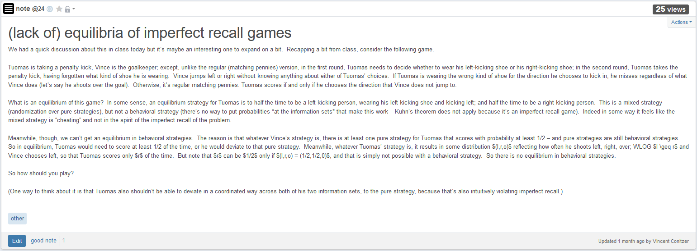

Slide 4
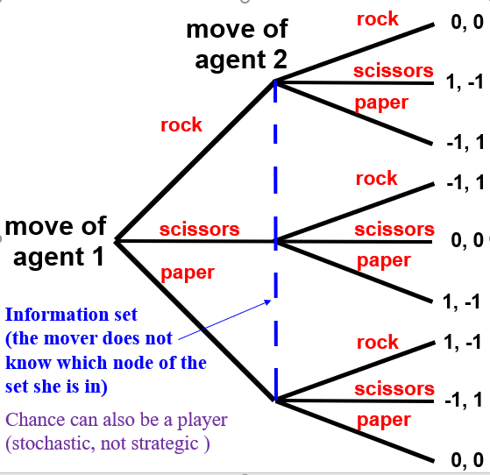
Recall: Extensive-form games
C
QJ
KQ
QK
KJ
1
1
1
1
1
1
check
check
check
check
check
bet
check
bet
bet
bet
bet
bet
2
2
2
2
2
2
2
2
2
2
2
2
check
check
fold
check
fold
bet
check
check
fold
bet
check
fold
bet
bet
fold
bet
fold
call
bet
call
call
call
call
-2
+1
-2
+1
+1
+2
-1
+1
-2
+1
1
+1
+2
+1
1
+1
+2
-1
1
+1
-1
1
1
1
fold
fold
fold
fold
fold
fold
call
call
call
call
call
call
-1
-2
-1
-2
-1
+2
-1
-2
-1
+2
-1
+2

Slide 5
Sleeping Beauty as an extensive-form game
Player 1
Player 1
0
½
Nature
½
0
Player 1

Slide 6
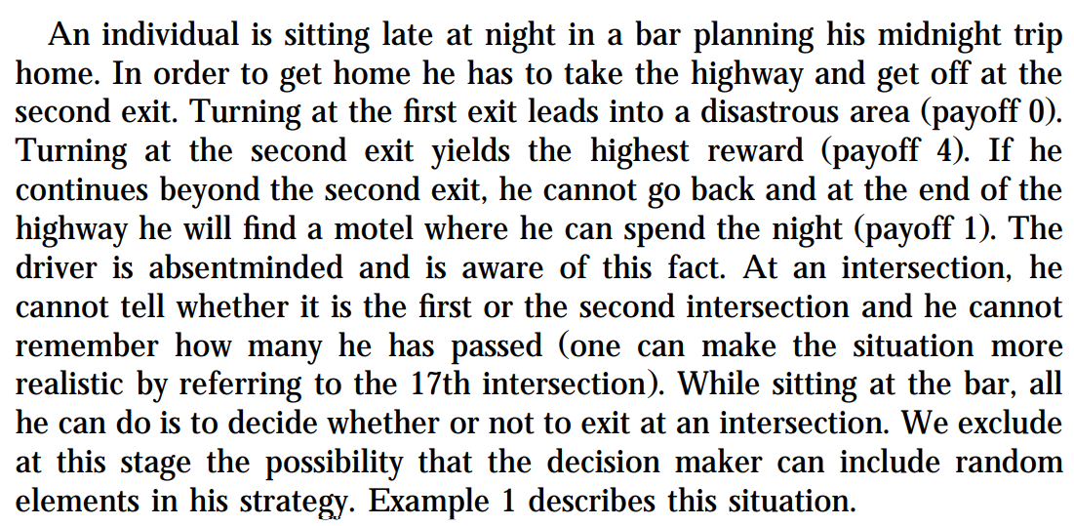
The Absent-Minded Driver
(Piccione and Rubinstein 1997)
continue
1
continue
exit
exit
0
4
(How does this relate to Sleeping Beauty?)

Slide 7
Agenda
Why care
Principles of decision making in games of imperfect recall
Compatibility results

Slide 8
Why care?

Slide 9
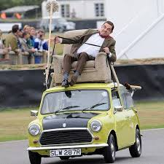
Modern version
Low-level autonomy cars with AI that intervenes when driver makes major error
Does not keep record of such event
Two types of drivers: Good (1 major error), Bad (2 major errors)
Upon intervening, what probability should the AI system assign to the driver being good?
(Similarly: half of households install a given AI system on two devices – with what probability does the AI system think it is alone? And what about simulation case from before?)
Sunday
Monday
Tuesday
H
T

Slide 10
Games of imperfect recall without imperfect recall!
Player 1
Player 1
0
½
Nature
½
0
Player 1

Slide 11

Anthropic arguments
Bostrom’s simulation argument
The Doomsday argument
Fine-tuning arguments
Boltzmann brains
Is the universe large or small?
(Many copies of Earth or just us?)

Slide 12
Simulating our way to cooperation?
Restricted trust game: P1 can give 5 which would be tripled, or 0; after receiving 15, P2 can give back 10, or 0
Twist: P1 can simulate P2 first, at a cost of 1
P1
As (AI system) P2, how likely is it you’re now running as a simulation? → self-locating belief
What happens in equilibrium?
P2
(simulated) P2
5, 0
P2
10, 5
0, 15
4, 0
9, 5
-1, 15

Slide 13
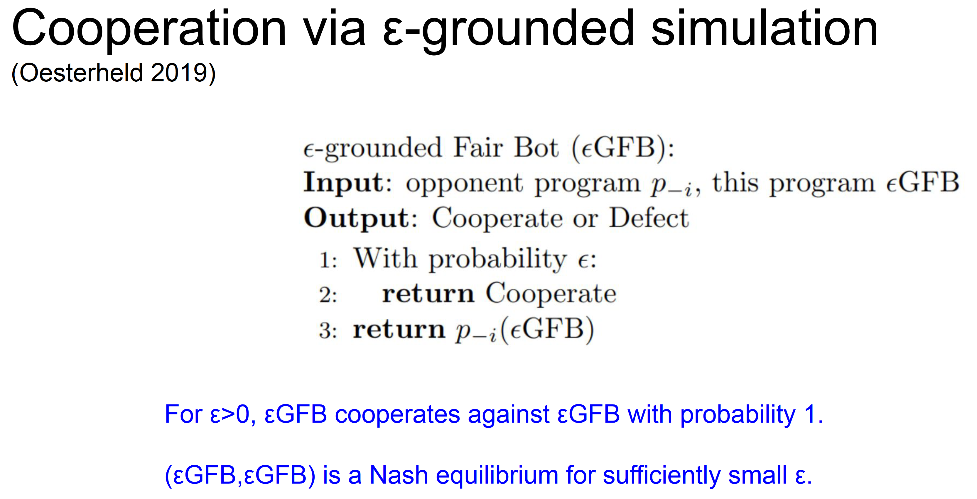

Slide 14
Solution concepts for single-player games of imperfect recall

Slide 15
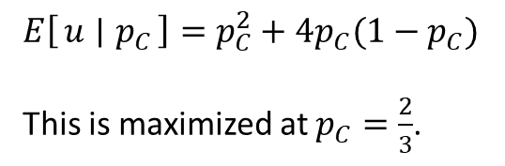
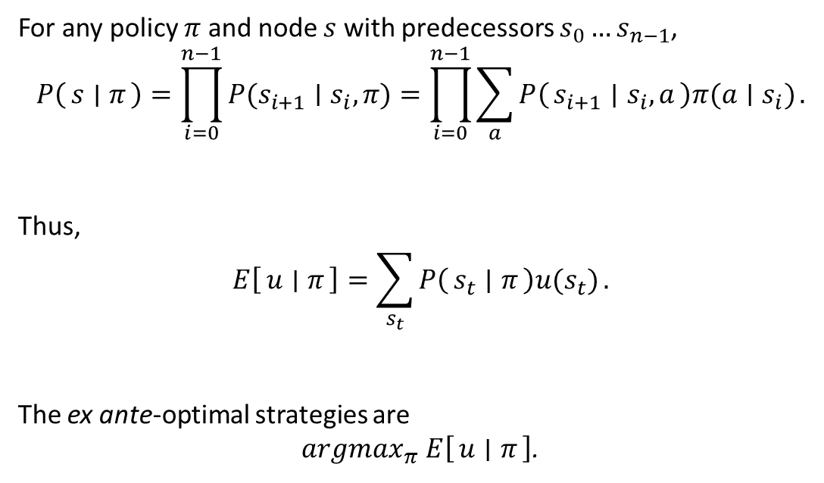



Ex ante-optimal policies for single-player games of imperfect recall
$$s_{1}$$
$$s_{0}$$
…
$$s_{n}=s$$
continue
1
For any policy $π$ and node $s$ with predecessors $s_{0}…s_{n−1}$,
$$P\left(s ∣ π\right)=\prod_{i=0}^{n−1}{P(s_{i+1}∣s_{i},π)}=\prod_{i=0}^{n−1}{\sum_{a}{P\left(s_{i+1} ∣ s_{i},a\right)π(a∣s_{i})}}.$$
Thus,
$$E\left[u ∣ π\right]=\sum_{s_{t}}{P\left(s_{t} ∣ π\right)u(s_{t})}.$$
The ex ante-optimal strategies are
$argmax_{π}$ $E\left[u ∣ π\right]$.
continue
exit
exit
0
4
$$E\left[u ∣ p_{C}\right]=p_{C}^{2}+{4p}_{C}(1−p_{C})$$
This is maximized at $p_{C}=\frac{2}{3}$.

Slide 16
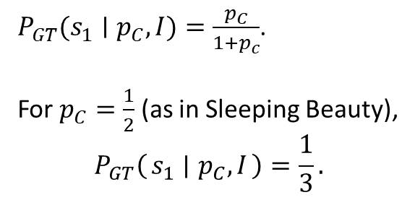
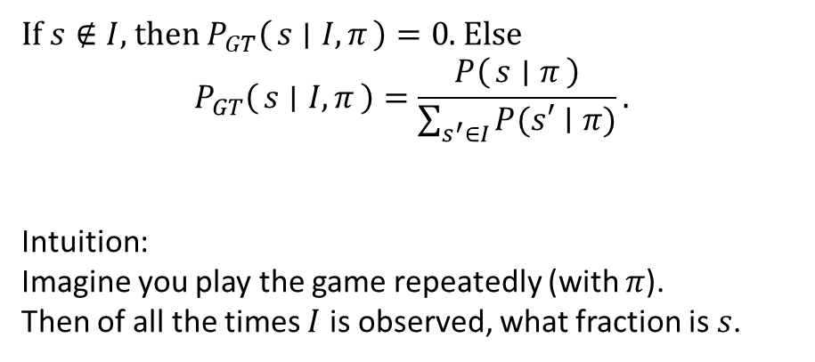


Assigning probabilities a la Sleeping Beauty:
Generalized Thirding (a.k.a. self-indication assumption)
$$s_{0}$$
$$s_{1}$$
1
continue
continue
If $s∉I$, then $P_{GT}\left(s ∣ I,π\right)=0$. Else
$$P_{GT}\left(s ∣ I,π\right)=\frac{P\left(s ∣ π\right)}{\sum_{s^{′}∈I}{P(s′∣π)}}.$$
Intuition:
Imagine you play the game repeatedly (with $π$).
Then of all the times $I$ is observed, what fraction is $s$.
exit
exit
0
4
$P_{GT}(s_{1}∣p_{C},I)=\frac{p_{C}}{1+p_{c}}$.
For $p_{C}=\frac{1}{2}$ (as in Sleeping Beauty),
$$P_{GT}\left(s_{1} ∣ p_{C},I\right)=\frac{1}{3}.$$

Slide 17




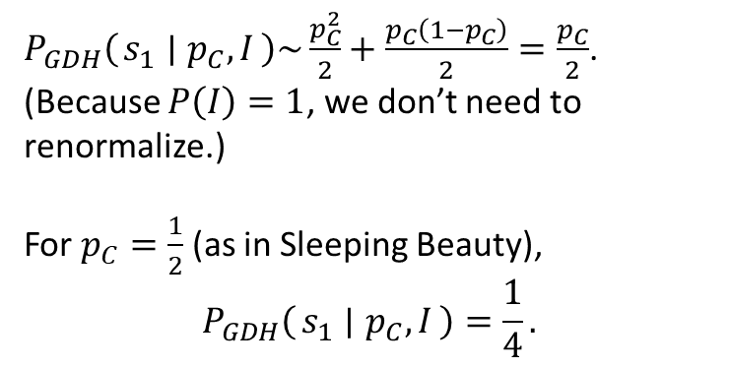
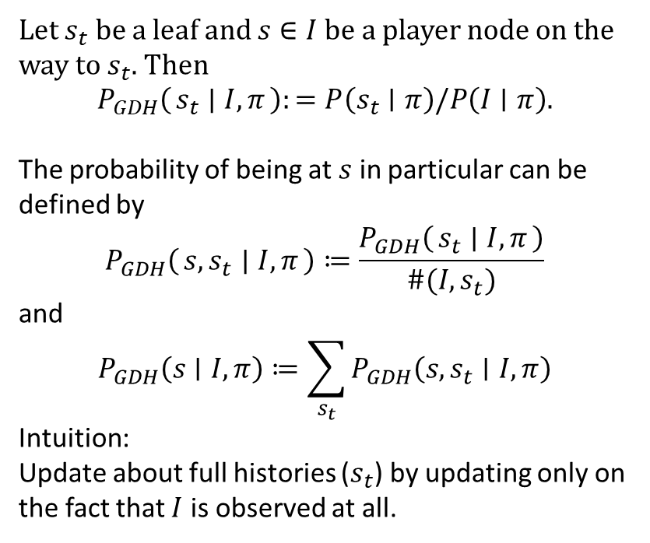
Assigning probabilities – (double-)halfing
(a.k.a. the minimum-reference class self-sampling assumption)
$$s_{t}$$
$$s∈I$$
$$s_{0}$$
$$s_{1}$$
1
Let $s_{t}$ be a leaf and $s∈I$ be a player node on the way to $s_{t}$. Then
$$P_{GDH}\left(s_{t} ∣ I,π\right):=P\left(s_{t}∣π\right)/P\left(I∣π\right).$$
The probability of being at $s$ in particular can be defined by
$$P_{GDH}\left(s,s_{t} ∣ I,π\right)≔\frac{P_{GDH}\left(s_{t} ∣ I,π\right)}{\#(I,s_{t})}$$
and
$$P_{GDH}\left(s∣I,π\right)≔\sum_{s_{t}}{P_{GDH}\left(s,s_{t}∣I,π\right)}$$
Intuition:
Update about full histories ($s_{t}$) by updating only on the fact that $I$ is observed at all.
continue
continue
exit
exit
0
4
$P_{GDH}\left(s_{1} ∣ p_{C},I\right)\sim \frac{p_{C}^{2}}{2}+\frac{p_{C}\left(1−p_{C}\right)}{2}=\frac{p_{C}}{2}$.
(Because $P\left(I\right)=1$, we don’t need to renormalize.)
For $p_{C}=\frac{1}{2}$ (as in Sleeping Beauty),
$$P_{GDH}\left(s_{1} ∣ p_{C},I\right)=\frac{1}{4}.$$

Slide 18
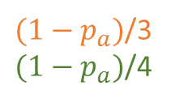
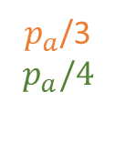
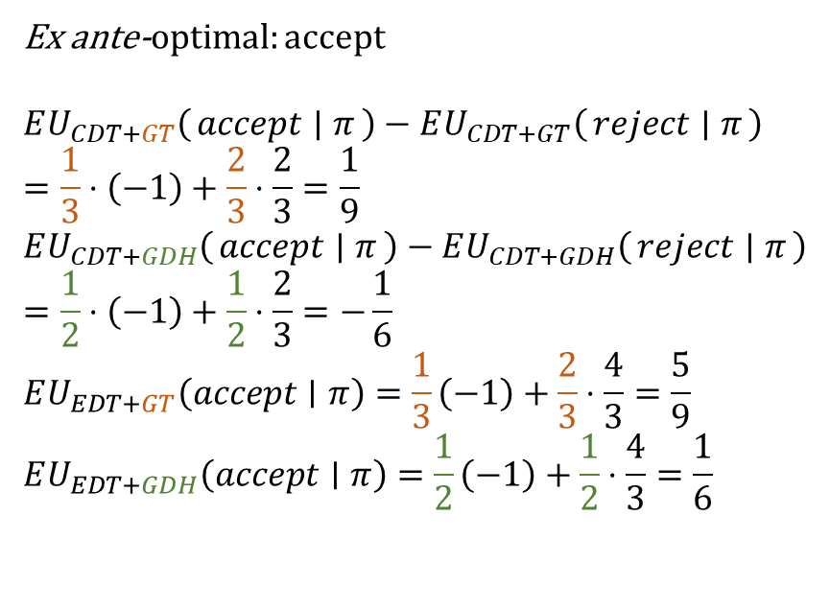
Betting in Sleeping Beauty Problem
Imagine you are in the Sleeping Beauty scenario, but:
Every time you wake up, you are offered a bet that loses $1 if the coin came up Heads and pays $2/3 if the coin came up Tails.
$p_{a}$/3
$$p_{a}/4$$
accept
4/3
Ex ante-optimal: accept
$$EU_{CDT+GT}\left(accept ∣ π\right)−EU_{CDT+GT}\left(reject ∣ π\right)=\frac{1}{3}⋅\left(−1\right)+\frac{2}{3}⋅\frac{2}{3}=\frac{1}{9}$$
$$EU_{CDT+GDH}\left(accept ∣ π\right)−EU_{CDT+GDH}\left(reject ∣ π\right)=\frac{1}{2}⋅\left(−1\right)+\frac{1}{2}⋅\frac{2}{3}=−\frac{1}{6}$$
$$EU_{EDT+GT}\left(accept∣π\right)=\frac{1}{3}\left(−1\right)+\frac{2}{3}⋅\frac{4}{3}=\frac{5}{9}$$
$$EU_{EDT+GDH}\left(accept∣π\right)=\frac{1}{2}\left(−1\right)+\frac{1}{2}⋅\frac{4}{3}=\frac{1}{6}$$
Thirding
Halfing
accept
reject
2/3
1/3
1/4
accept
2/3
½
reject
$({1−p}_{a})$/3
$(1−p_{a})$/4
reject
0
Nature
½
1/3
1/2
accept
-1
reject
0

Slide 19
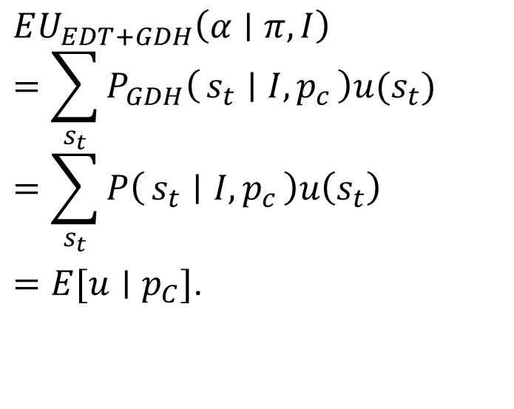
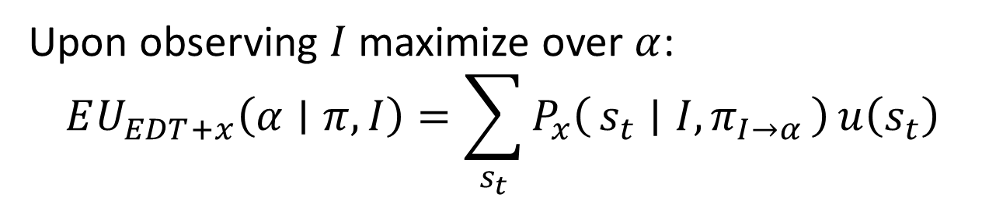
A version of evidential decision theory for games of imperfect recall
Upon observing $I$ maximize over $α$:
$$EU_{EDT+x}\left(α∣π,I\right)=\sum_{s_{t}}{P_{x}\left(s_{t} ∣ I,π_{I→α}\right)}u\left(s_{t}\right)$$
$$EU_{EDT+GDH}\left(α∣π,I\right)$$
$$=\sum_{s_{t}}{P_{GDH}\left(s_{t} ∣ I, p_{c}\right)u(s_{t})}$$
$$=\sum_{s_{t}}{P\left(s_{t} ∣ I, p_{c}\right)u\left(s_{t}\right)}$$
$=E[u∣p_{C}]$.
continue
1
continue
exit
exit
0
4

Slide 20
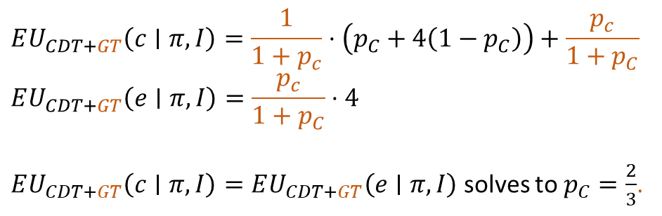
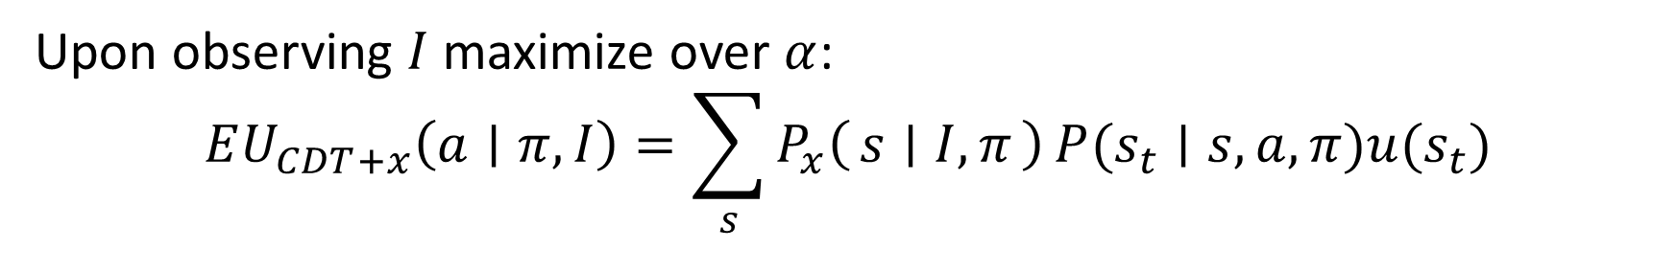
A version of causal decision theory for single-player extensive-form games of imperfect recall
Upon observing $I$ maximize over $α$:
$$EU_{CDT+x}\left(a∣π,I\right)=\sum_{s}{P_{x}\left(s ∣ I,π\right)}P(s_{t}∣s,a,π)u(s_{t})$$
$$EU_{CDT+GT}\left(c∣π,I\right)=\frac{1}{1+p_{c}}⋅\left(p_{C}+4\left(1−p_{C}\right)\right)+\frac{p_{c}}{1+p_{C}}$$
$$EU_{CDT+GT}\left(e∣π,I\right)=\frac{p_{c}}{1+p_{C}}⋅4$$
$EU_{CDT+GT}\left(c∣π,I\right)=EU_{CDT+GT}\left(e∣π,I\right)$ solves to $p_{C}=\frac{2}{3}$.
continue
1
continue
exit
exit
0
4

Slide 21
Compatibility
Theorem (Piccione and Rubinstein 1997): In any single-player extensive-form game, the ex ante-optimal policy is compatible with CDT + GT.
Theorem (Oesterheld and Conitzer 2022): In any single-player extensive-form game, the ex ante-optimal policy is compatible with EDT + GDH.
The other combinations don’t work (e.g., Briggs 2010)!
Even for CDT+GT and EDT+GDH (as defined here) they may be many compatible policies.

Slide 22
References
Piccione and Rubinstein. 1997. On the Interpretation of Decision Problems with Imperfect Recall. In: Games and Economic Behavior 20, pp. 3–24.
Briggs. 2010. Putting a value on Beauty. In: Oxford Studies in Epistemology. Vol. 3. Oxford University Press, pp. 3–24.
Oesterheld. 2019. Robust Program Equilibrium. Theory
and Decision, 86(1): 143–159.
Oesterheld and Conitzer. 2022. Can de se choice be ex ante reasonable in games of imperfect recall? https://www.andrew.cmu.edu/user/coesterh/DeSeVsExAnte.pdf

